Slide 1
Cosmic ray detection in the CESGA quantum computer [Qmio]
H. Álvarez Pol, J.A. Alejo Alonso, F..Y. Ayyad Limonge, M. Caamaño Fresco, C. Cabo Landeira, B. Fernández Domínguez, C. Filgueira Rama, D. González Caamaño
IGFAE Retreat 2025 – 03/07/2025

Slide 2
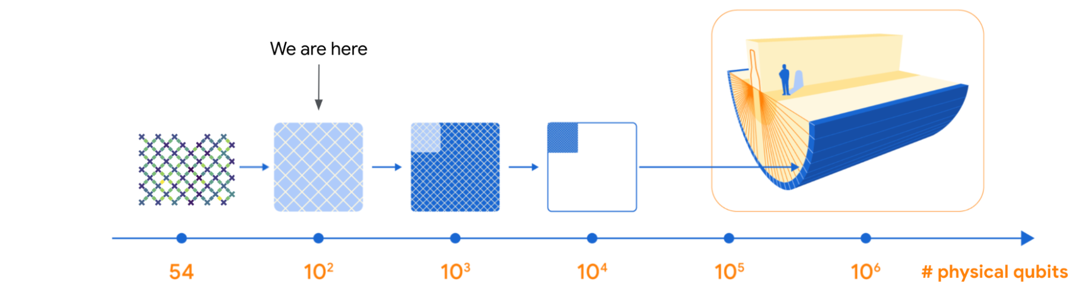
Quantum Computer Errors Correction
Real Quantum Computing requires millions of logic operations.
Intrinsic error correction is possible, but
  Only for a fraction of the qubits (<1% ?).
  Only for random non-correlated errors.
Google Quantum AI Team. “Suppressing quantum errors by scaling a surface code logical qubit”. https://blog.research.google/2023/02/suppressing-quantum-errors-by-scaling.html
Notes:
Os ordenadores cuánticos teñen erros intrínsecos, de forma que os algoritmos poden de forma nativa correr típicamente so da orde de centos a miles de operación lóxicas.
Para poder computar con algoritmos mais poderosos e útiles, que precisan millón ou billóns de portas lóxicas, os erros teñen que reducirse ben por debaixi das partes por millón ou billón.

Slide 3
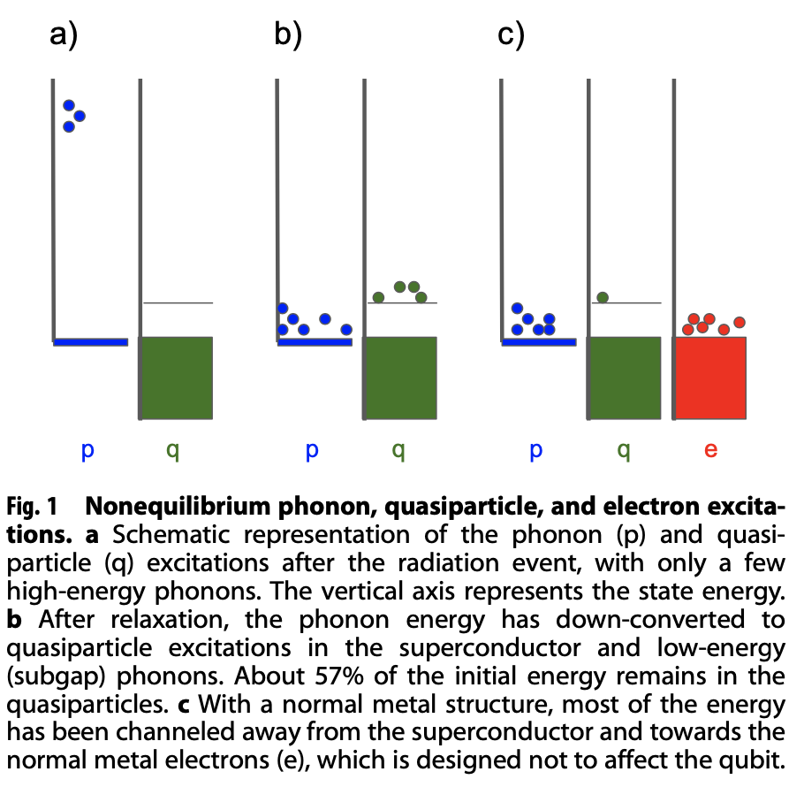
Ionizing radiation effects
Ionizing radiation produces a large number of long-lasting correlated errors:
Ionize the substrate, creating high energy phonons and hole-electron pairs in the medium [10 ns, 1 mm].
Phonons displace and convert 57% of its energy in quasiparticles [300 ns, 3-6 mm]
… they thermalize, radiating low energy phonons and breaking Cooper pairs [1 ms, cm]
Reduce the relaxation time T1 < 1 𝜇s
John M. Martinis. “Saving superconducting quantum processors from decay and correlated errors generated by gamma and cosmic rays”.
Quantum Information 7: 90, xuño 2021 (https://doi.org/10.1038/s41534-021-00431-0). Open Access.

Slide 4
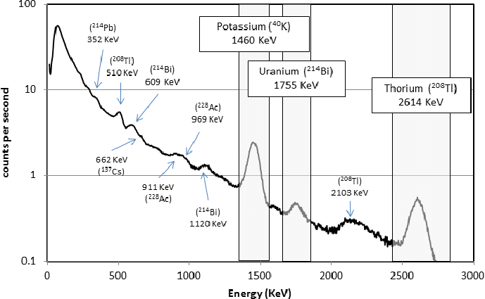
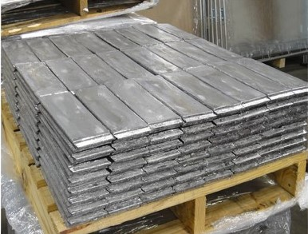
Environmental gamma radiation
Optimized lead shielding

Slide 5
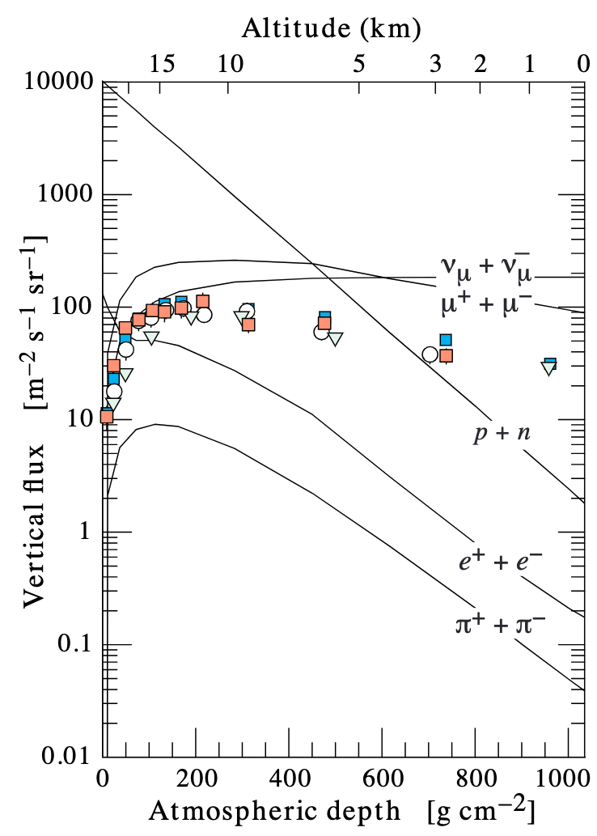
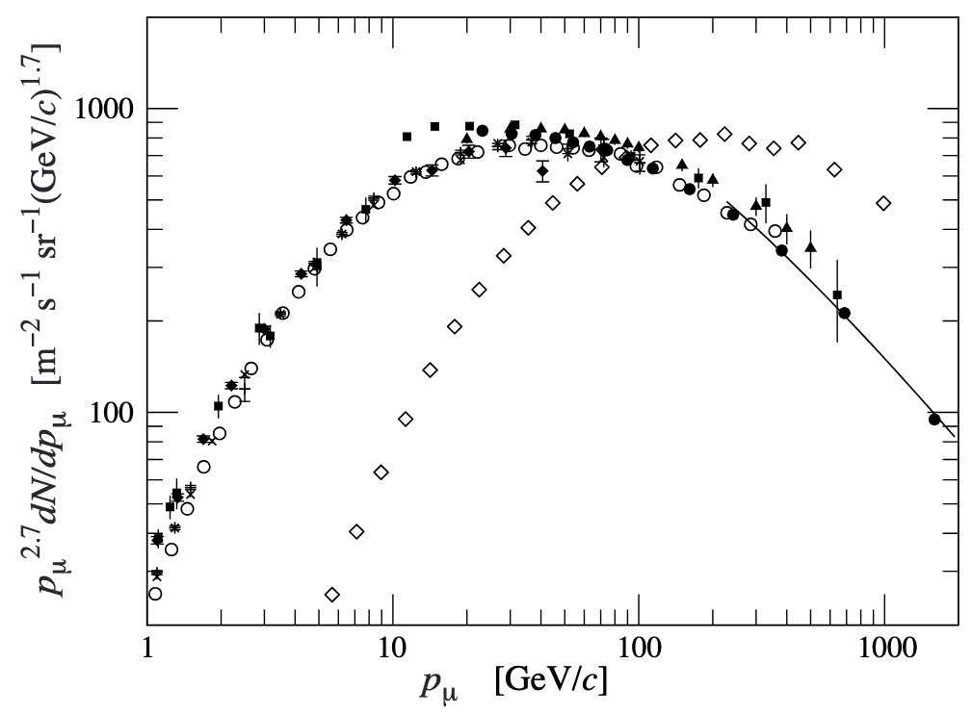
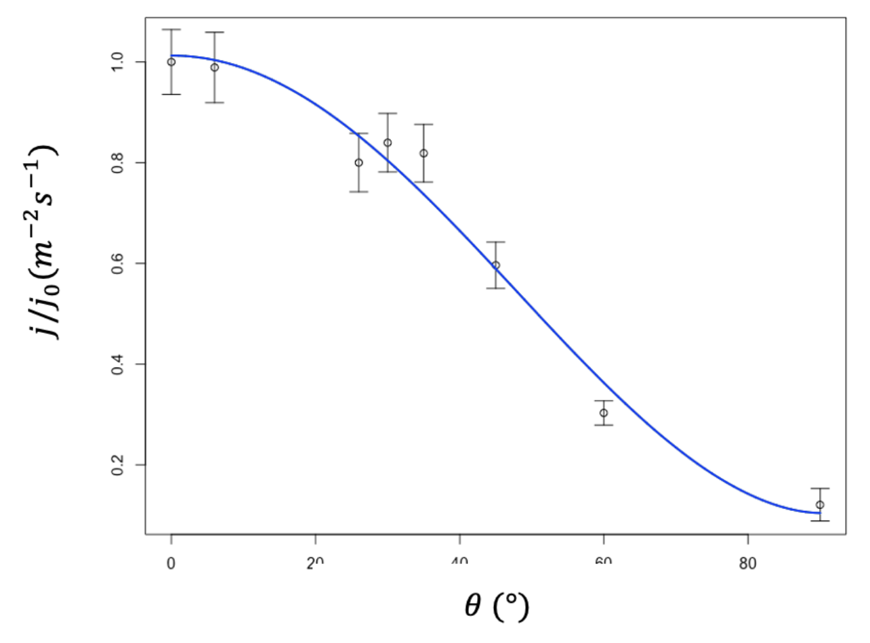
Cosmic radiation (muons)
Flux: ~ 1 muon per cm² and minute
Energy deposited in the substrate: ~ 4 MeV/cm

Slide 6
Cosmic radiation detection in Qmio
Ionizing radiation produces a large number of correlated errors:
Presently identified by the abundance of long-lasting errors, but…
…never confirmed or detected in coincidence, never studied to determine the precise effects on the superconducting processor during the quantum computation.
Proposal: a high-efficiency and resolution cosmic-ray detector coupled to the quantum CESGA-Qmio

Slide 7
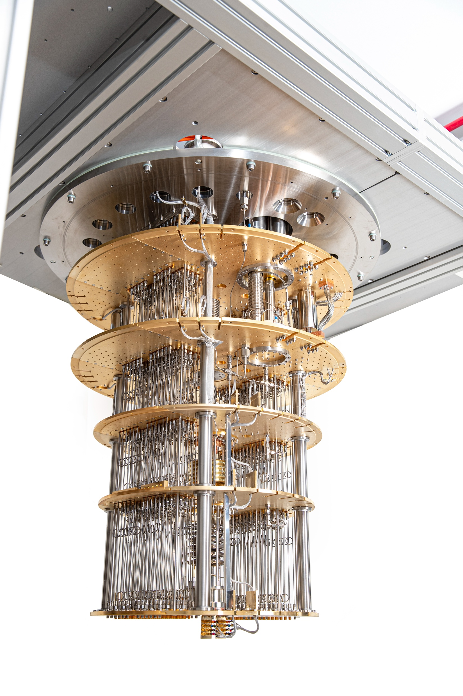
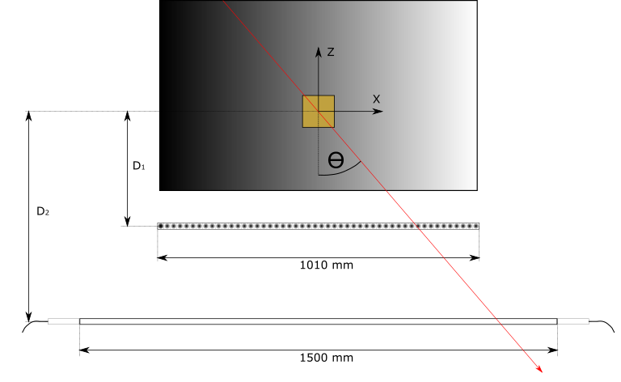
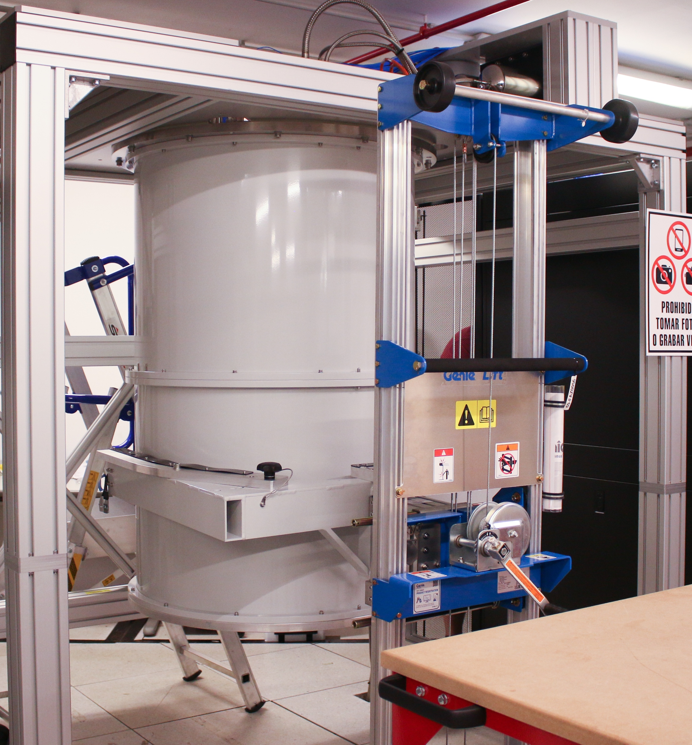
Proposed setup: double wall

Slide 8
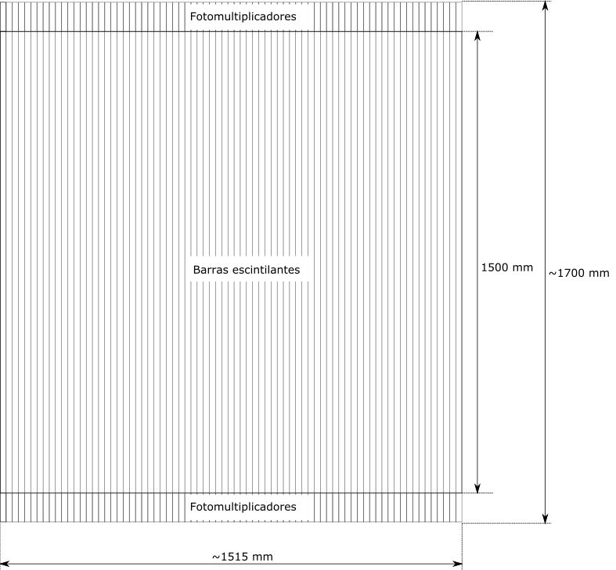
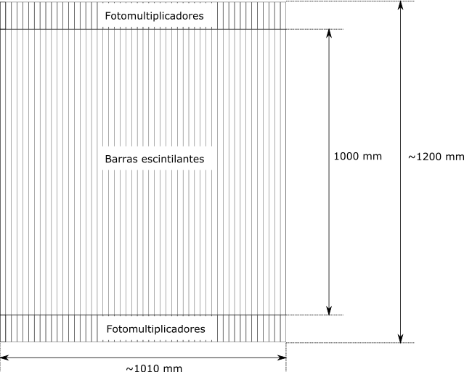
Proposed setup: double wall
50 (75) scintillation bars of 1 (1,5) m length
100 (150) photodetectors + TDC (ADC) + FPGA

Slide 9
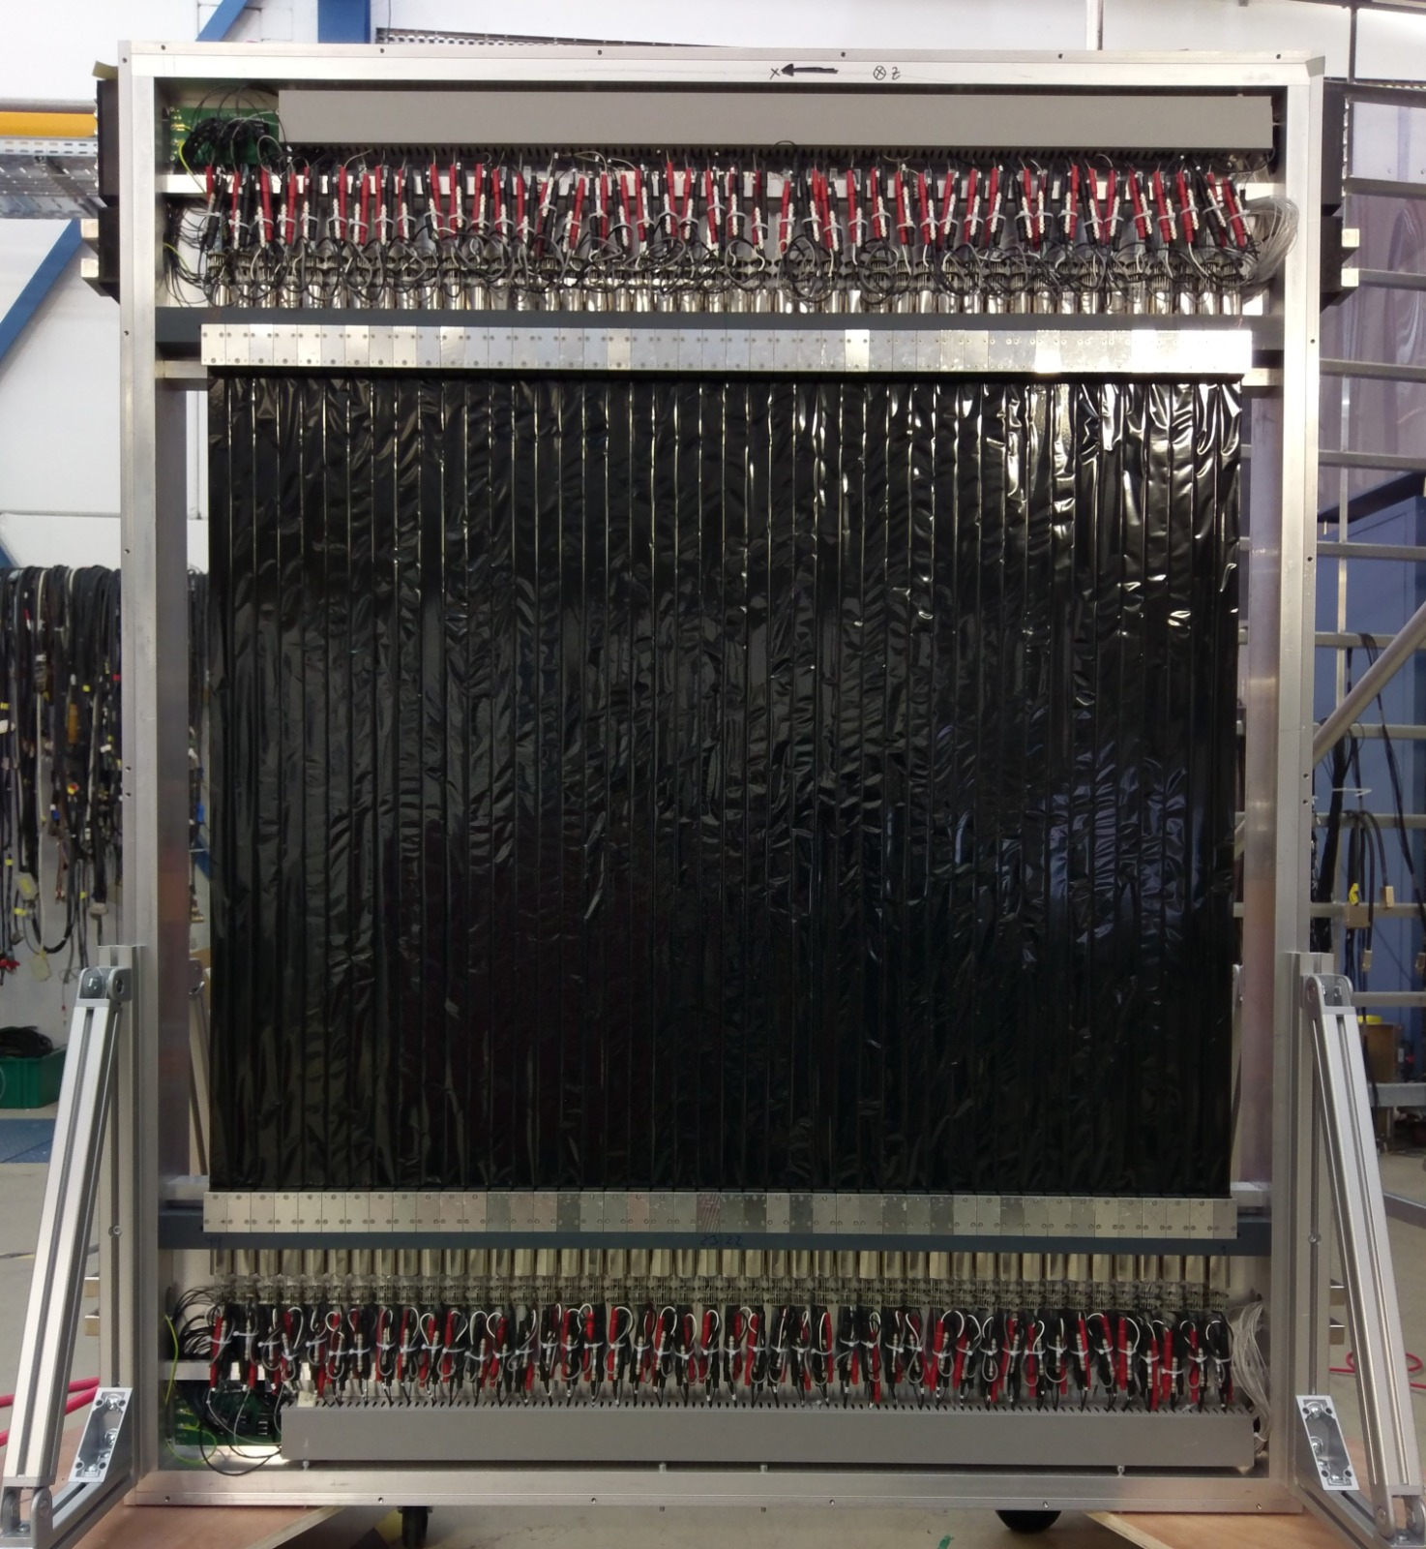
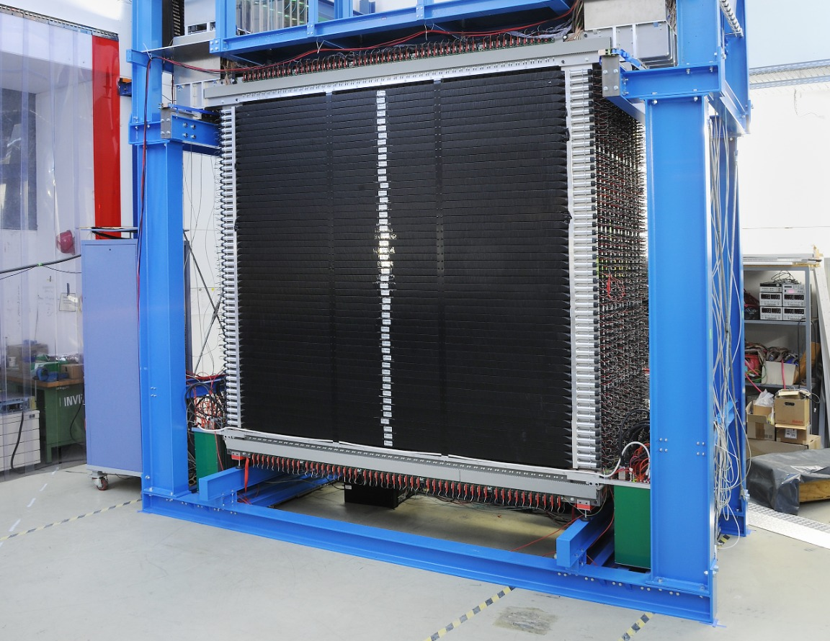
R3B Detectors ToFD and NeuLAND

Slide 10
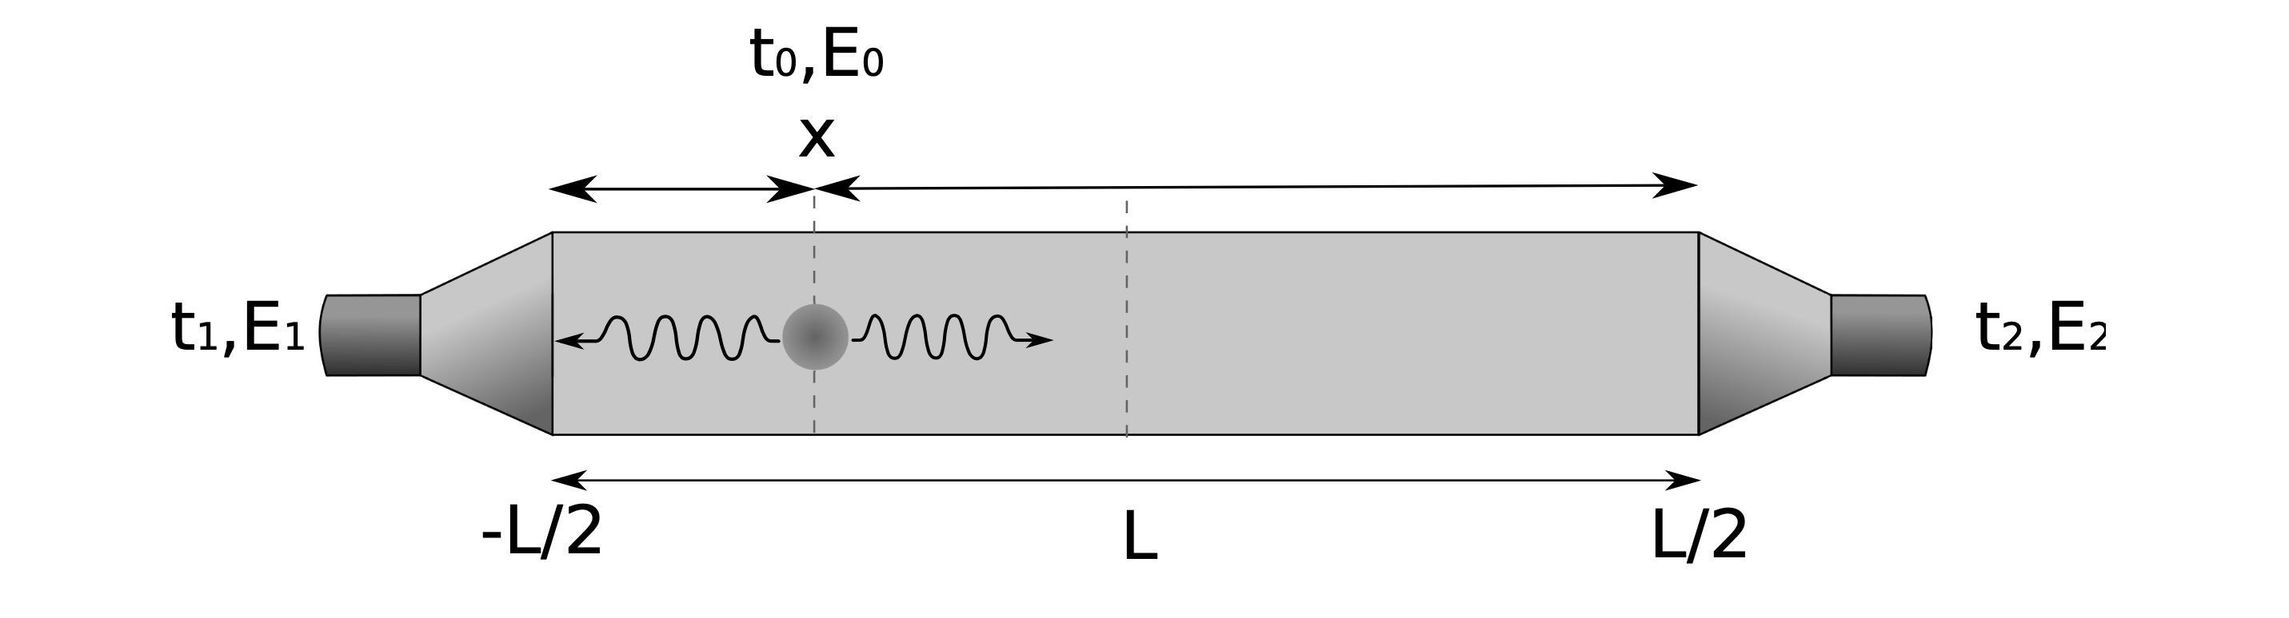
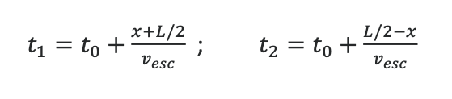
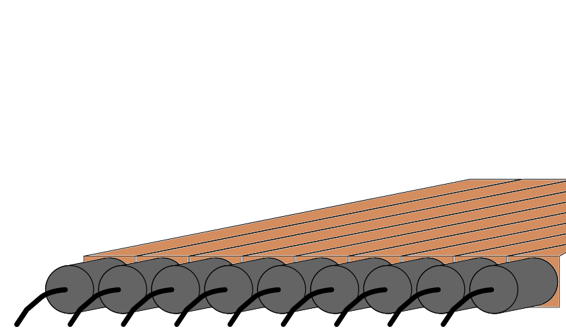
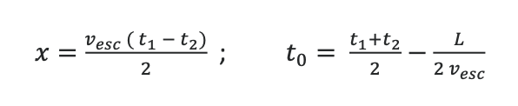
Setup
Geometrical efficiency: > 85%
Intrinsic efficiency: > 99%
Time resolution: < 100 ps
Position resolution (𝜎): < 1 cm

Slide 11
Moving forwards…
… The repetition code results demonstrate that low logical error rates are posible in a superconducting system, but finding and mitigating highly correlated errors such as cosmic ray impacts will be an important area of research moving forwards.
TeamGoogle Quantum AI.
Suppressing quantum errors by scaling a surface code logical qubit.
Nature 614, 676–681 (2023).
https://doi.org/10.1038/s41586-022-05434-1

Slide 12
… many interesting experiments.
The energy pulses from cosmic and gamma rays are clearly an important issue for superconducting qubits, since qubit errors and correlations in time and space will kill error correction by many orders of magnitude… There are many interesting experiments to do soon to demonstrate that an effective solution is possible.
J. Martinis, “Saving superconducting quantum processors from decay and
correlated errors generated by gamma and cosmic rays”
Quantum Information (2021) 7:90;
https://doi.org/10.1038/s41534-021-00431-0

Slide 13
Additional slides

Slide 14
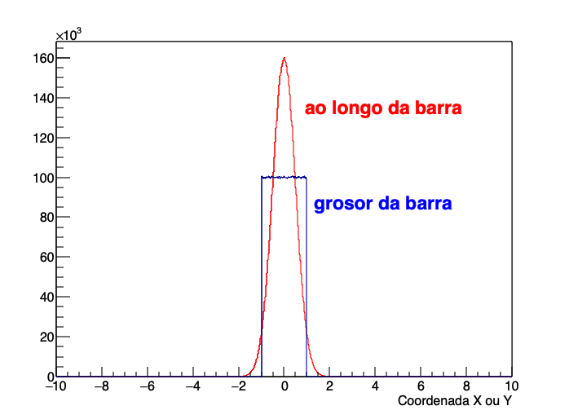
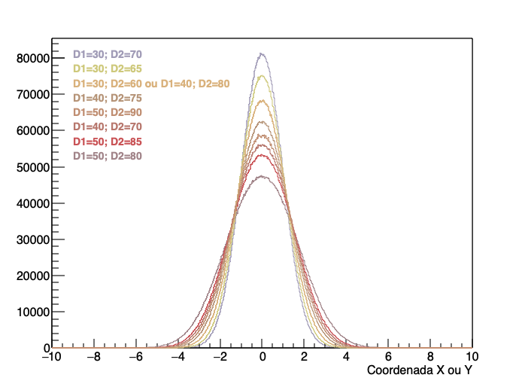
Resolución en posición
Barras de 2 cm de grosor
Resolución no detector
Resolución no procesador
𝜎 = 0,98 cm resolución
no procesador
𝜎 = 0,5 cm resolución

Slide 15
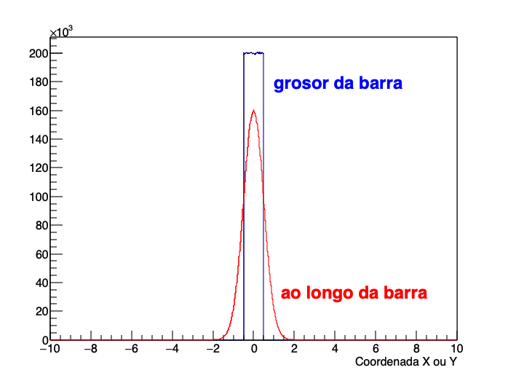
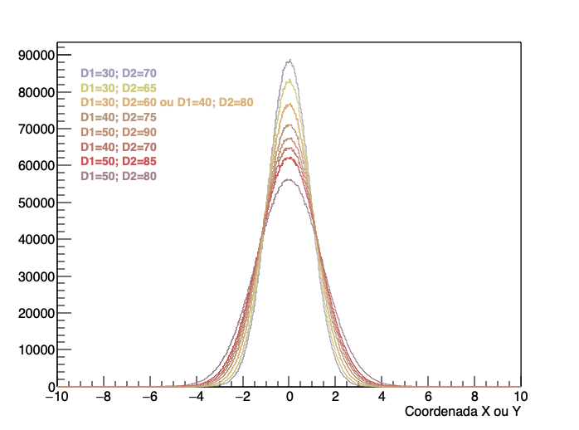
Resolución en posición
Barras de 1 cm de grosor
Resolución no detector
Resolución no procesador
𝜎 = 0,90 cm resolución
no procesador
𝜎 = 0,5 cm resolución

Slide 16
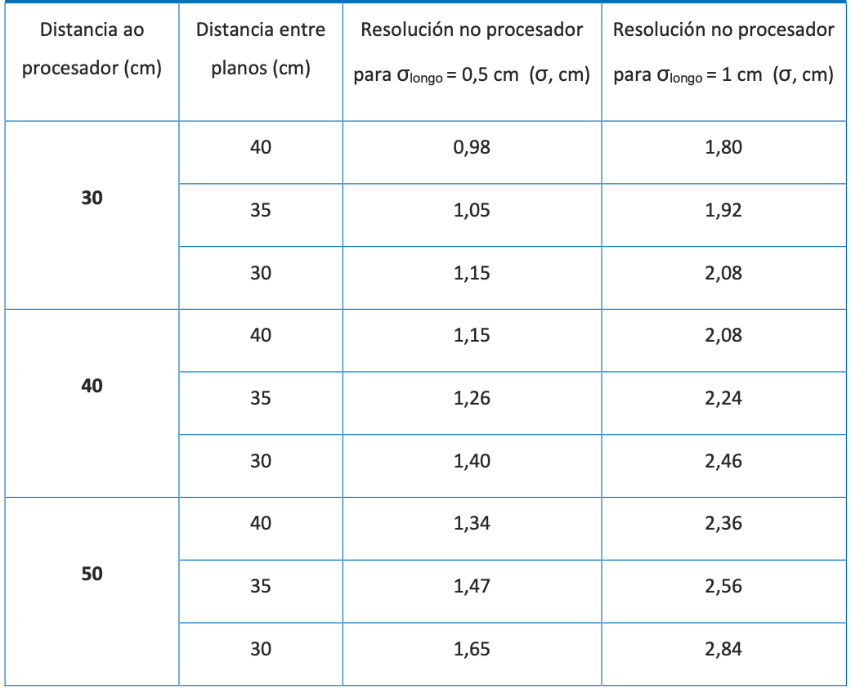
Resolución en posición
Barras de 2 cm de grosor

Slide 17
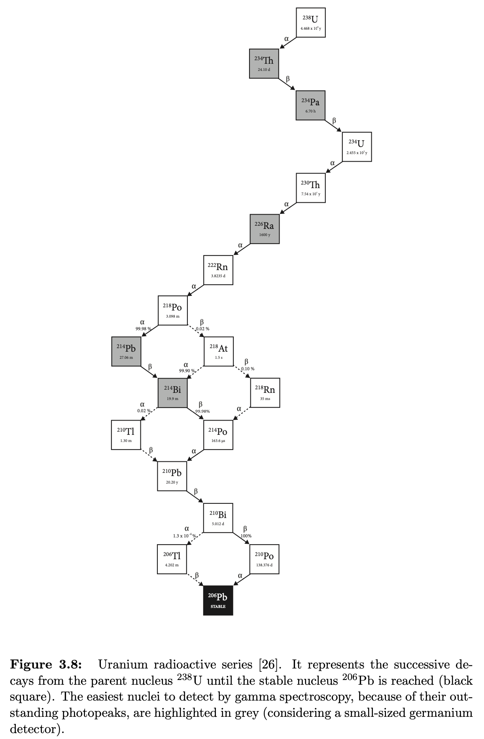
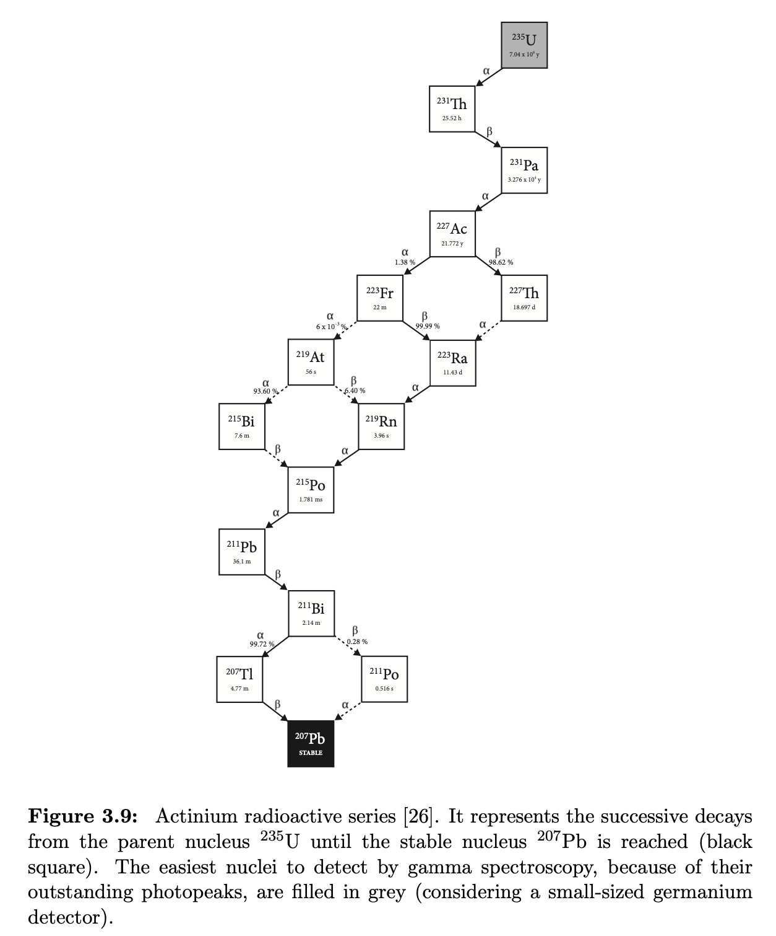
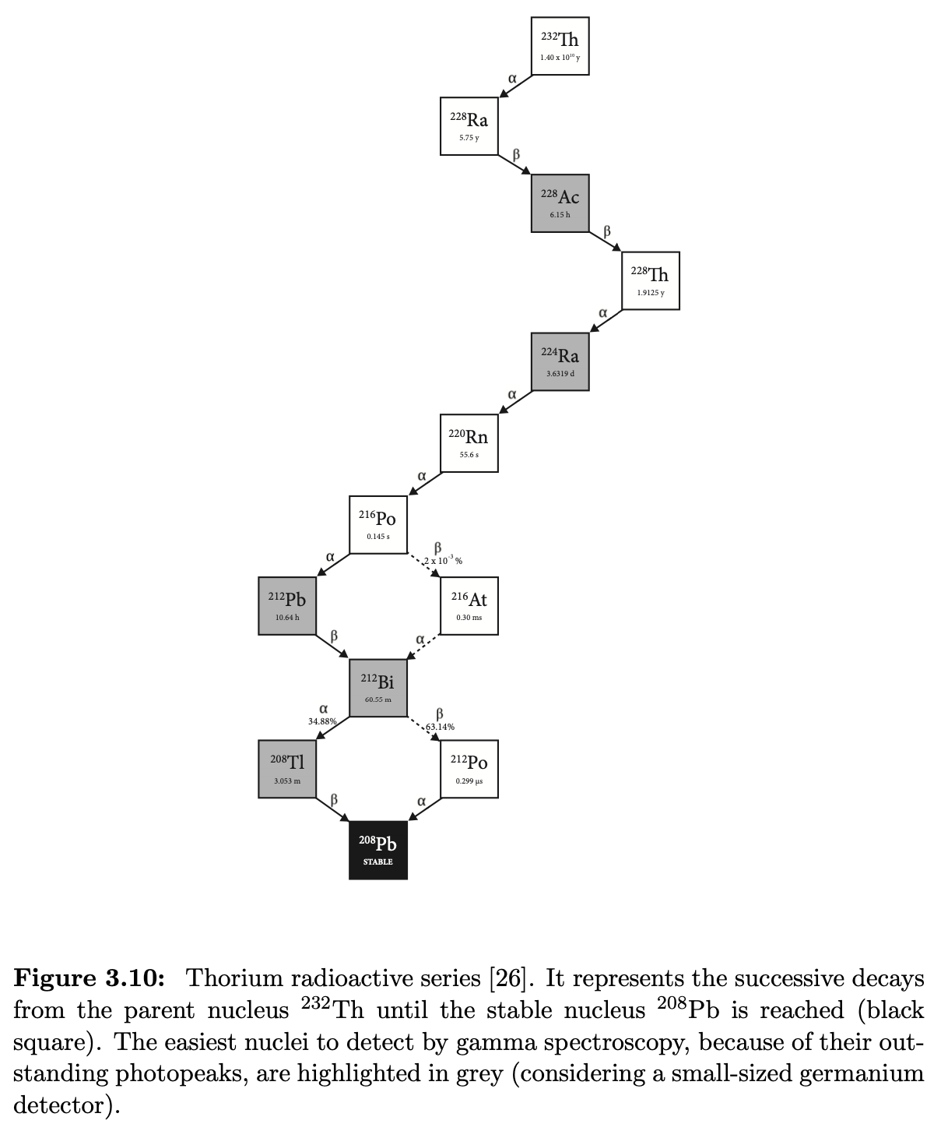

Slide 18
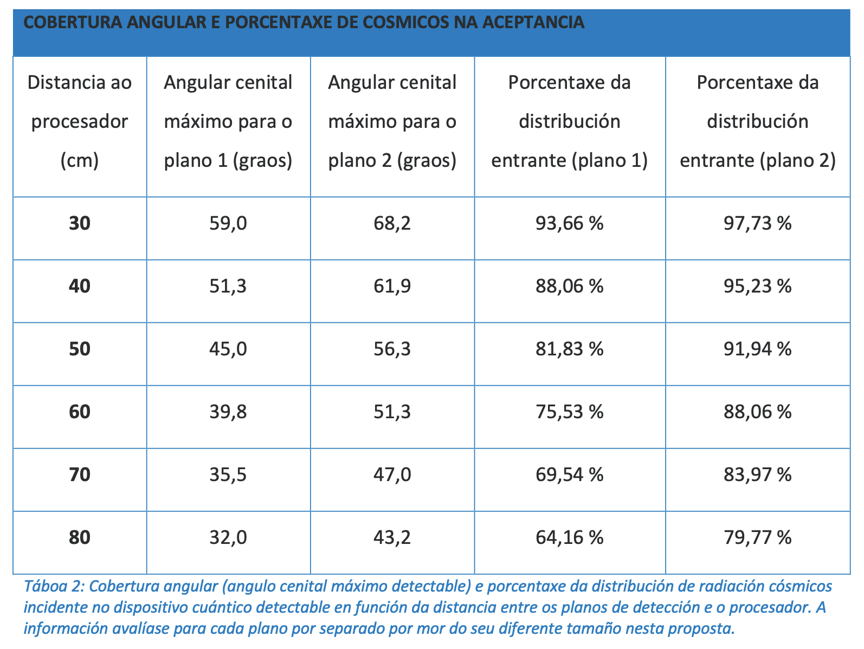

Slide 19
