Slide 1

The structure of the nuclear many-body systems and its astrophysical and cosmological implications
Beatriz Fernández Domínguez, Héctor Alvarez Pol, Manuel Caamaño Fresco, Francesc Yassid Ayyad Limonge
FICA: Corpuscular Physics and Applications
IGFAE Retreat 2025 – 03/07/2025
Notes:
I’m reporting on the Research Line: The structure ...
Basically it corresponds to the activities of the FICA group, excluding Aaron Alejo who is going to report on the activities of the LASER Laboratory in a later report.

Slide 2
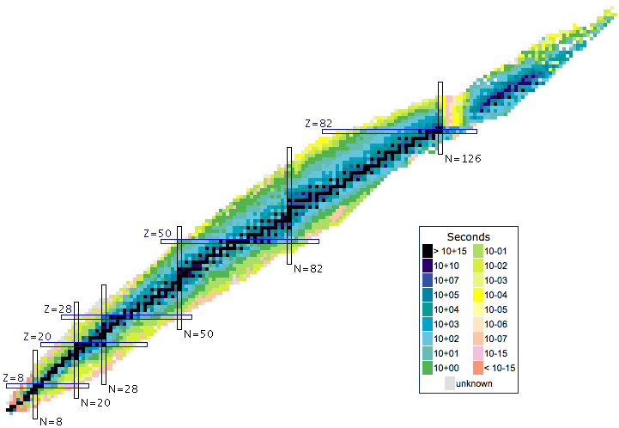



Mapping the FICA activities on the nuclei chart
Experiments on a wide set of fissioning systems allow us to investigate fundamental properties of the fission process.
Fission induced by transfer, proton knock-out or neutron induced reactions at different energies complements our research.
Focus on the light exotic part of the chart where nuclear interactions can be tested against variations in nuclear Isospin.
These systems are a stringent check of fundamental descriptions based on QCD and a benchmark for open quantum systems properties.
Notes:
Our activities can be mapped on top of the nuclear chart and, despite of the variety of experimental setups and different experiments performed in the last years, we converge in two important regions where we have obtained interesting results:
The fission process studied on a wide area of the chart, including actinides, pre-actinides and, recently even up to the lanthanides, where results demonstrate the nuclear structure effects on the fission fragments distribution …
On the other extreme of the chart, we focus on different aspects of the light exotic nuclei structure, where we can explore the isospin dependence of nuclear observables and evaluate the contribution of two and three-body forces …

Slide 3
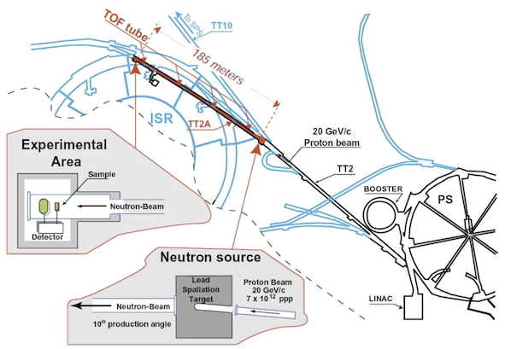
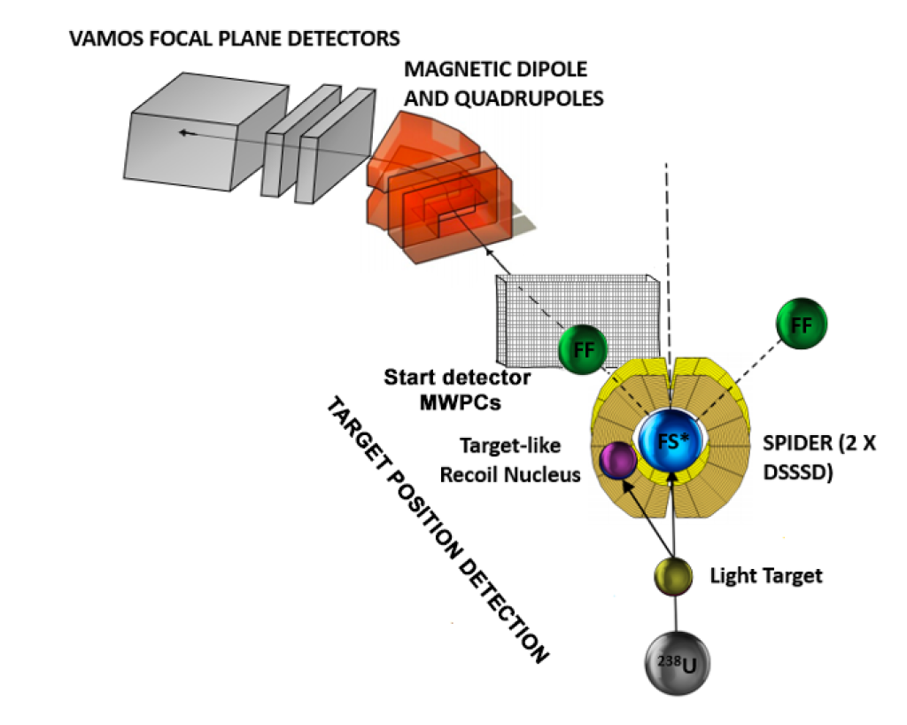
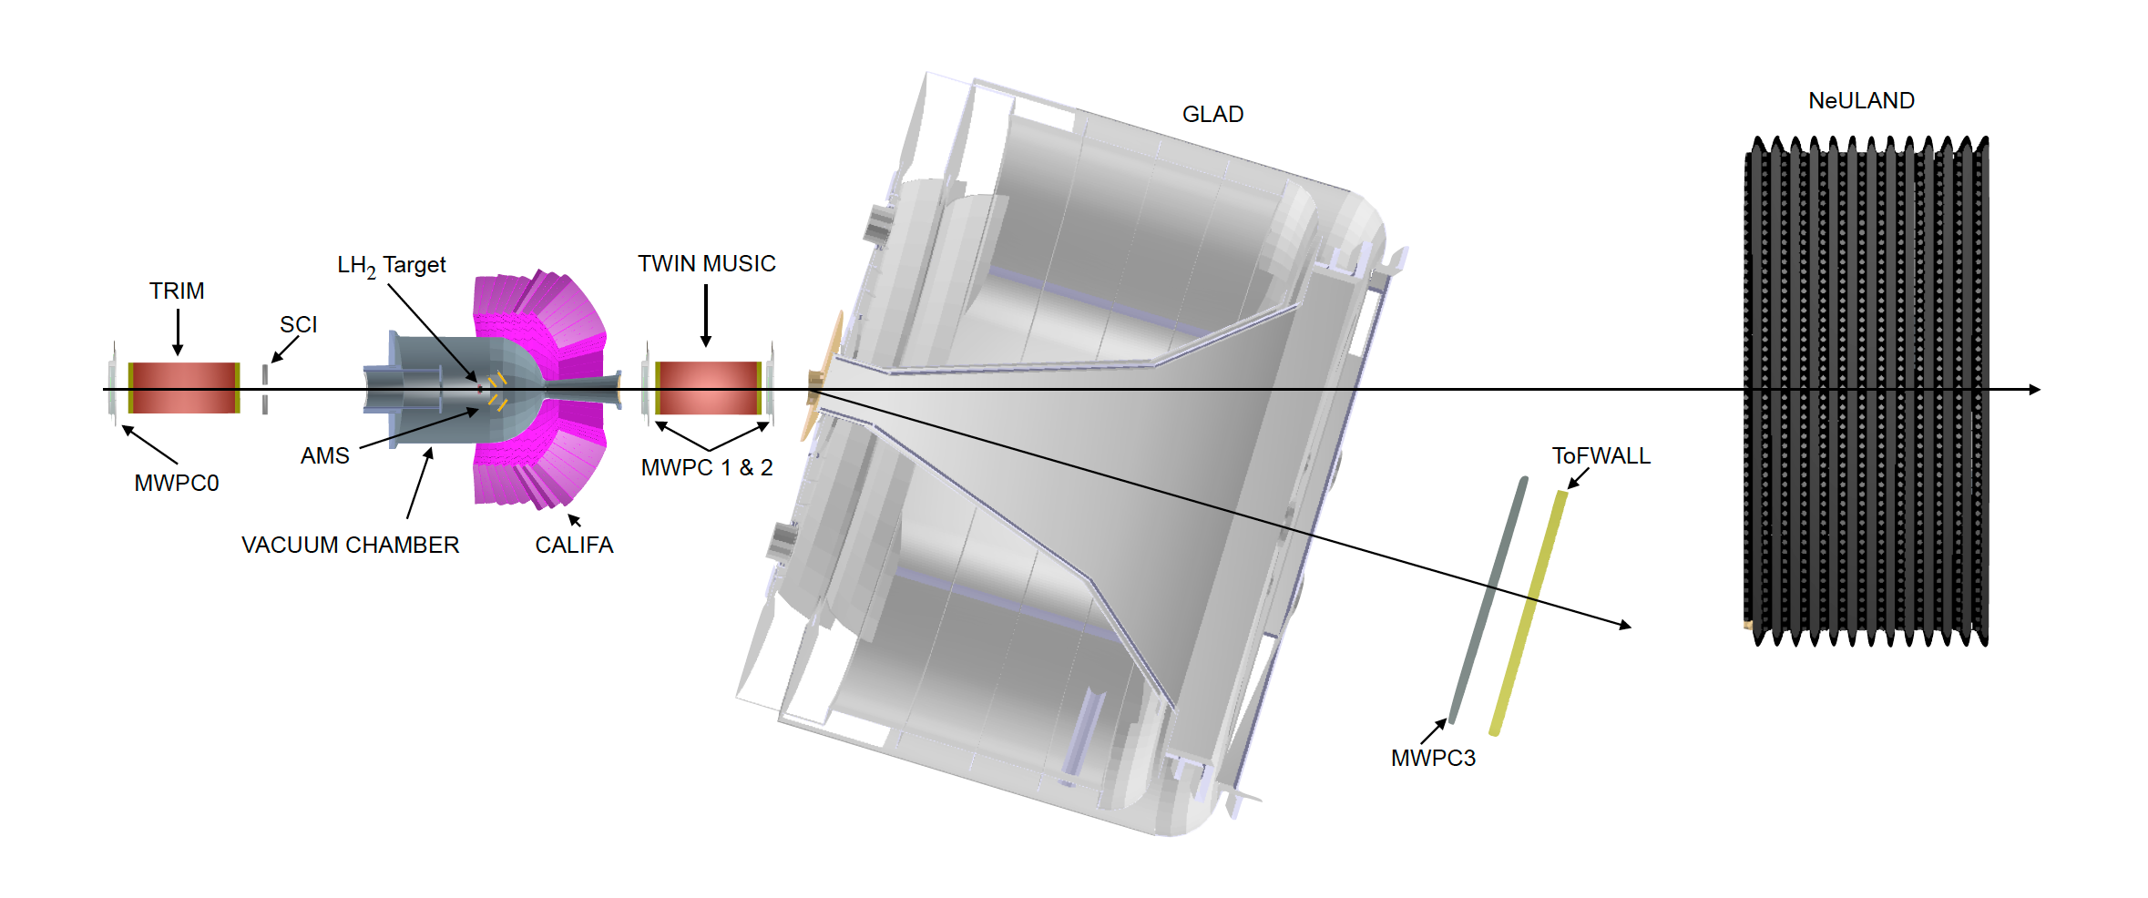
Mapping the FICA activities on the nuclei chart
Experiments on a wide set of fissioning systems allow us to investigate fundamental properties of the fission process.
Fission induced by transfer, proton knock-out or neutron induced reactions at different energies complements our research.
nTOF – CERN
VAMOS – GANIL
R3B – GSI/FAIR
Focus on the light exotic part of the chart where nuclear interactions can be tested against variations in nuclear Isospin.
These systems are a stringent check of fundamental descriptions based on QCD.
Notes:
Let me start with a review of our studies of the fission processes, performed in different installations and following different excitation mechanisms:
nTOF at CERN, using neutron-induced fission over a large energy range, exploring lightest fissioning systems, the low mass lanthanide Cerium
R3B at GSI/FAIR, using proton-induced fission at high incoming energies in inverse kinematics mapping a large variety of fissioning systems
VAMOS at GANIL, using transfer-induced fission at moderate energies to determine new fission modes and the onset of the quasi-fission process.

Slide 4
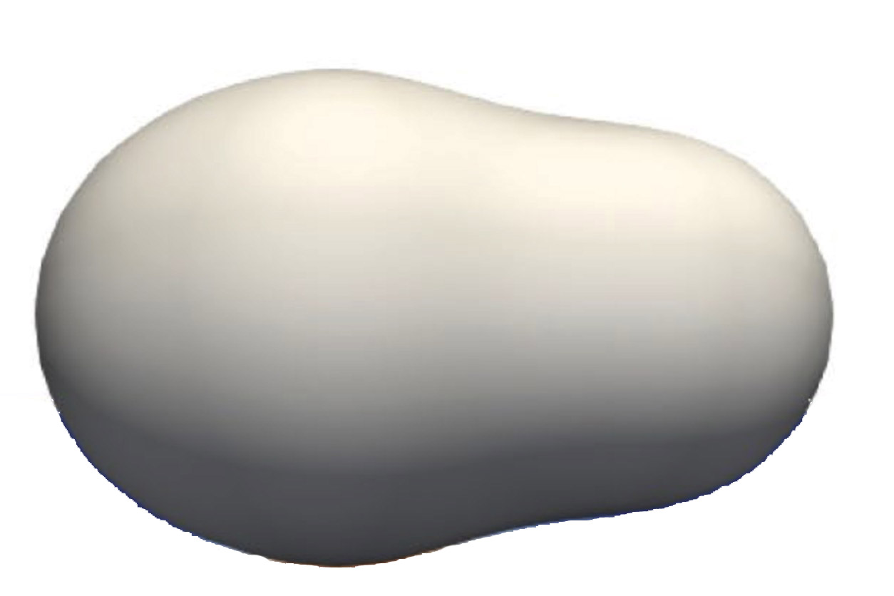
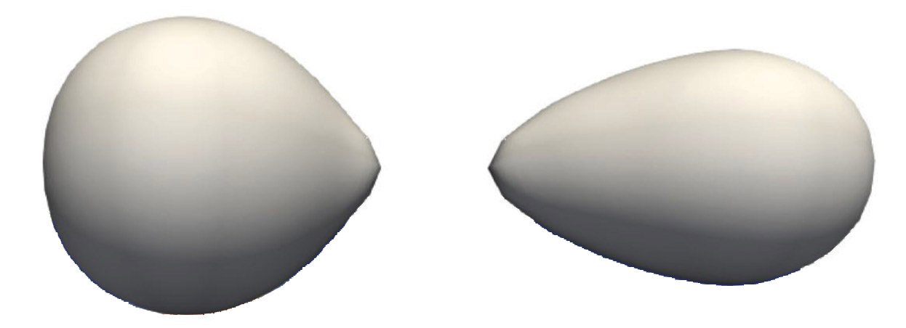
Fission: between microscopic and macroscopic worlds
Fission is a unique process where the competition between microscopic and macroscopic properties of nuclear matter decide the outcome.
Despite its widespread use for energy applications, fundamental properties of the process are still to be understood.
At the barrier: Fissioning system
?
The major challenge is the large number of particles involved: it is not enough to describe it macroscopically, but it is computationally impossible to treat all particles and their interactions.
The main properties are obtained through the combination of as many observables as possible.
At scission: Fission fragments
Notes:
Fission is a 100 years old process which is, still now, far from being completely understood.
Part of the problem comes from the fact that it corresponds to a problem in the limit between a microscopical and a macroscopical statistical description compete in order to determine the properties of the fission fragments.
Many of these properties encode information related with the nuclear structure of the nascent fragments, but it is far from obvious due to the large deformation of the nucleus suffering the fission.
Study of fission in different laboratories, setups and energies which can give access to complementary observables under different mechanism: this view permits a better global understanding of the fission process.

Slide 5
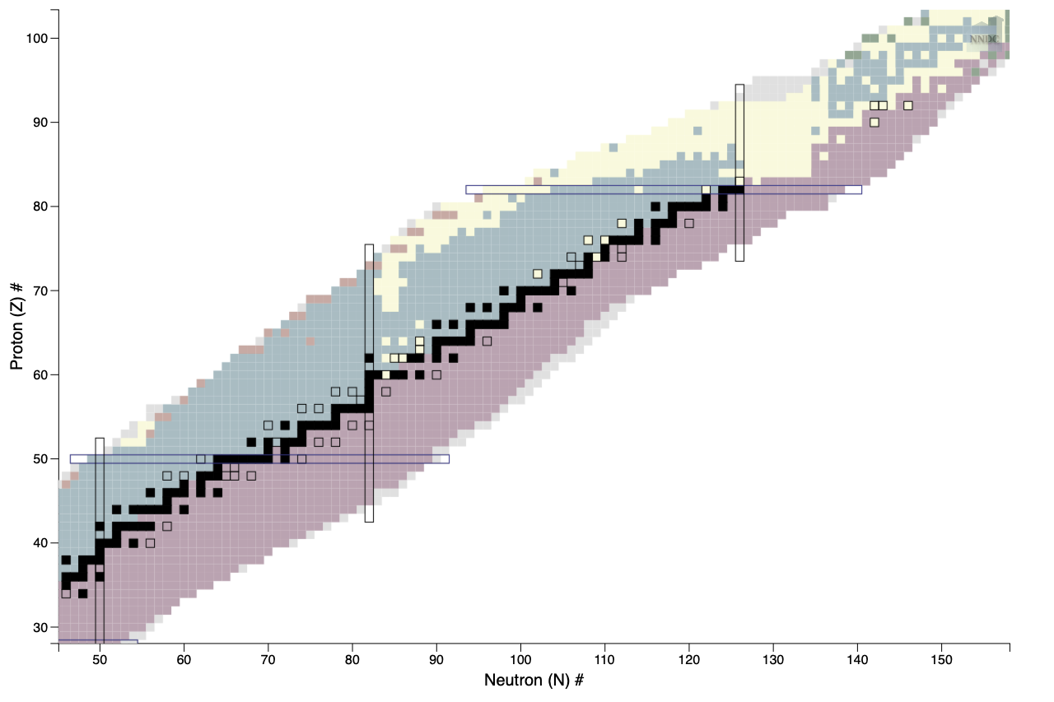
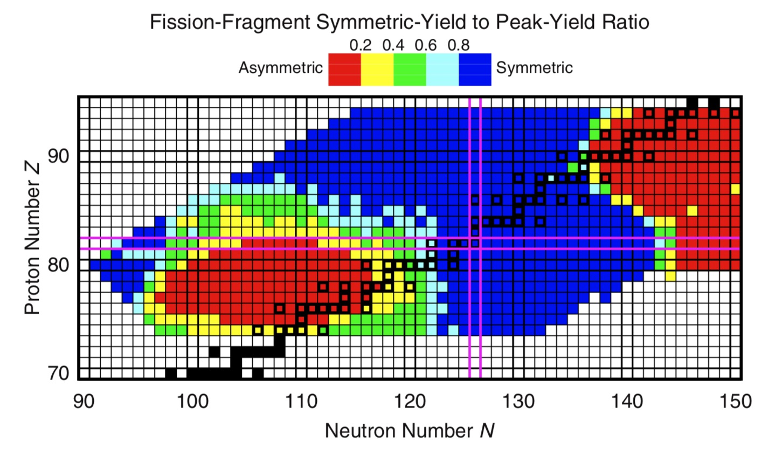
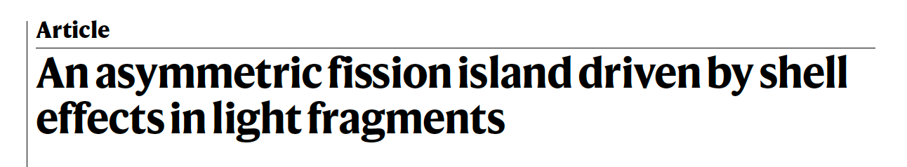

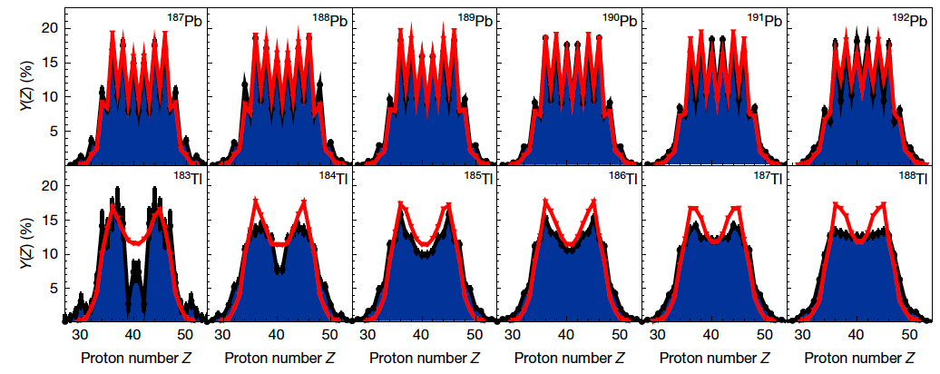
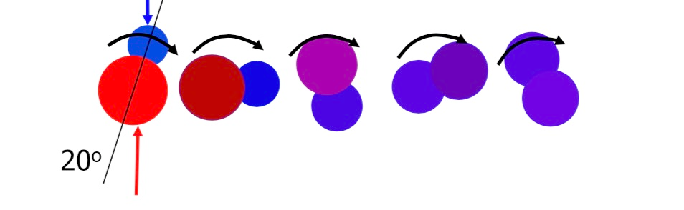
Fission: between microscopic and macroscopic worlds
These past two years were devoted to the preparation and execution of experiments led by our group:
n_TOF/CERN: “Search for new fission modes in light systems around Z=60” (INTC-P-665)
Spokespersons: M. Caamaño, D. Tarrío (U. Uppsala). Performed in 2024.
GANIL: “Complete isotopic fission yields in the thorium region from inverse-kinematics transfer-induced fission” (E849_21) Spokespersons: D. Ramos (GANIL), M. Caamaño. Performed 2024.
GANIL: “Search for structure effects in asymmetric fission of Z≤60 Systems” (E866_22).
Spokespersons: M. Caamaño, D. Ramos (GANIL). Scheduled for September 2025.
GANIL: “Novel insight into quasi-fission for advancing the understanding of reaction dynamics” (E900_24). Spokespersons: C. Schmitt (IPHC Strasbourg), M. Caamaño. Scheduled for 2026.
R3B/GSI-FAIR: “Exploring shell effects in fission yields of neutron-deficient Th, Ac, and Ra isotopes near N=126“. Spokespersons: J.L. Rodriguez, J. Taieb (CEA). Proposed for late 2026.
Exploring unknown
fission regions
  Nature 641, 339-344 (2025)
New observables in quasi-fission
Notes:
In particular the last two years have been very successful in the preparation and realization of new fission experiment at CERN nTOF , GANIL VAMOS and R3B at GSI facilities, led by FICA scientists.
Experiments already performed last year explore new fission modes in light systems and the exploration of the limits of quasi-fission systems where the fusion process is not completed and the subsequent fission reflects it.
A very important achievement corresponds to the publication of a Nature paper presenting the analysis of data taken at GSI with the charge distributions of fission fragments for 100 exotic fissioning systems,
75 of which have never been measured. These new data comprehensively map the asymmetric fission island and provide clear evidence for the role played by the deformed Z = 36 proton shell approaching the proton-rich mercury area.

Slide 6
Fission: between microscopic and macroscopic worlds
… and data analysis.
The bulk of the analysis is being carried out by our students:
Daniel Fernández Fernández: “High Energy Fission and the Onset of Quasi-fission”. (Supervisors: M. Caamaño, D. Ramos (GANIL)). PhD USC (2024).
Antía Graña González: “Fission of 238U investigated using proton-induced knockout collisions in inverse kinematics”. (Supervisors: J.L. Rodriguez, J. Benlliure). PhD USC (2024).
Gabriel García Jiménez: “Proton-induced fission and spallation reactions in inverse kinematics: insights from CALIFA Calorimeter reconstruction”. (Supervisors: H. Alvarez-Pol, D. Cortina). PhD USC (2024).
Filippo Angelini: “Spectroscopic study of nuclei in the region of 78Ni”. (Supervisors: J.J. Valiente (IFIC, Valencia), A. Gottardo (LNL-INFN, Padova), M. Caamaño). PhD U. de Padova, Italia (2025).
Beatriz Errandonea Felix: “Study of the evolution of nuclear structure and fission dynamics with low-energy reactions”. (Supervisors: M. Caamaño, D. Ramos (GANIL)). PhD USC (ongoing).
Nicolas Sánchez Vázquez: “New fission modes in light systems around Z=60”. (supervisors: M. Caamaño, H. Alvarez-Pol). PhD USC (ongoing).
Notes:
As usual, the real analysis is being carried out by our students: three PhD Thesis were granted on fission last year, while three are ongoing or are going to be presented this year.

Slide 7
Mapping the FICA activities on the nuclei chart
Experiments on a wide set of fissioning systems allow us to investigate fundamental properties of the fission process.
Fission induced by transfer, proton knock-out or neutron induced reactions at different energies complements our research.
Focus on the light exotic part of the chart where nuclear interactions can be tested against variations in nuclear Isospin.
These systems are a stringent check of fundamental descriptions based on QCD and a benchmark for open quantum systems properties.
Notes:
Let me now move to the light exotic area: as before, we use several tools to obtain the maximum information from the exploration of the isospin dependence of nuclear observables

Slide 8
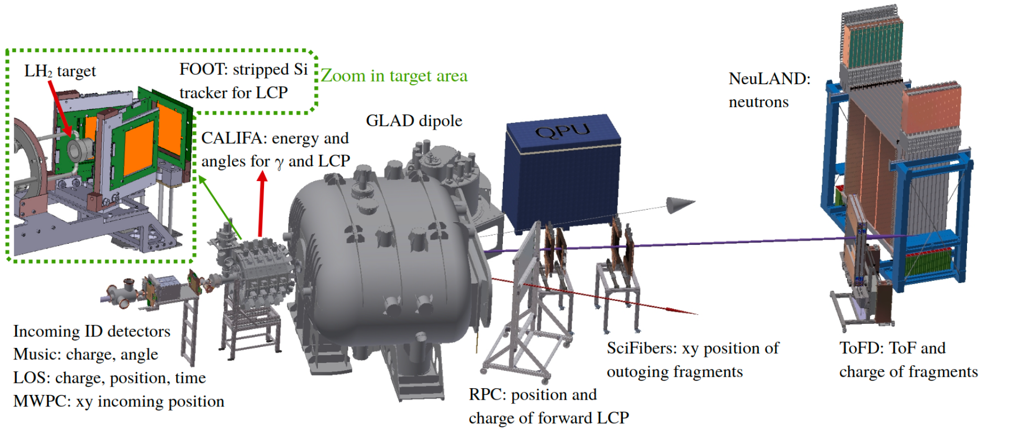
Mapping the FICA activities on the nuclei chart
R3B – GSI/FAIR
Experiments on a wide set of fissioning systems allow us to investigate fundamental properties of the fission process.
Fission induced by transfer, proton knock-out or neutron induced reactions at different energies complements our research.
Martina Feijoo Fontán: “Populating bound and unbound states of 18C via quasi-free (p,2p) reactions”. (Supervisor: JL Rodriguez Sanchez) PhD USC (ongoing).
Pablo González Rusell: “Study of the structure of nucleon-rich isotopes ^{22, 23, 24}O”. (Supervisors: H. Alvarez-Pol, JL Rodriguez-Sanchez) PhD USC (ongoing).
Notes:
At R3B at GSI/FAIR, light fragments cocktail beams selected in the Fragment Separator can collide with protons in a Hli target for a precise determination of the structure of the neutron rich isotopic chain of Carbon, Nitrogen, and Oxigen
resulting in the momentum distribution of the outcome particles, related to the structure of the exotic states. The PhD Thesis…

Slide 9
Mapping the FICA activities on the nuclei chart
Experiments on a wide set of fissioning systems allow us to investigate fundamental properties of the fission process.
Fission induced by transfer, proton knock-out or neutron induced reactions at different energies complements our research.
LOW ENERGY (5-50 AMeV)
ACTIVE TARGETS
Direct reactions (transfer, resonant elastic, etc) measured with the new generation of active targets are specially well suited for the study of these systems.
ACTAR TPC
Cubic geometry, no magnetic field,
V=27 L, Amp: µmegas 128 mm
(France, Spain, Italy, Canada, Japan, Belgium)
AT TPC
Cylindrical geometry and magnetic field,
V= 250 L Amp: µmegas 128 mm,
multilayer thick GEM (1ML, 3 stages)
(USA, Spain, China)
Notes:
To study systems at lower energies, two different but complementary setups profits the excellence of the ACTIVE TARGET approach when dealing with exotic beams
- at GANIL: the ACTAR –TPC, a complex active target without magnetic field but with ancillary detectors for detecting the outgoing particles
At MSU: the ATTPC, where a solenoidal field expand the dinamic range of the detected particles
Both detectors are employed for the analysis of Direct reactions (transfer, resonant elastic, etc) In different laboraties.

Slide 10
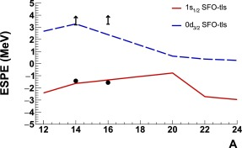
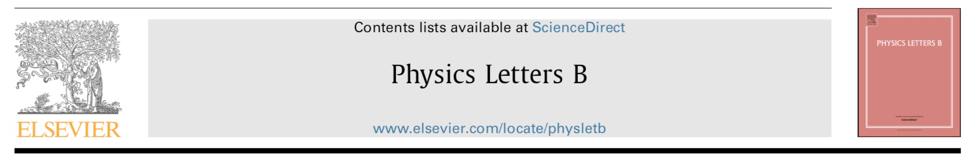
Nuclear structure of light exotic nuclei
ACTAR TPC
Shedding light in the structure of ²²C using its lighter cousin ¹⁷C
Both are ideal laboratories for understanding the nuclear force and testing continuum effects
Study of neutron n0p spin-orbit splitting in ²⁰O
Interplay between tensor and finite-binding effects in the spin-orbit splitting n0p_{1/2}-n0p_{3/2}
“Unbound neutron n0d3/2 strength in ¹⁷C and the N=16 shell gap”, J.L. Fuentes, B. Fernández-Domínguez, M. Caamaño et al., Phys. Lett. B 867, 139600 (2025).
Juan Lois Fuentes: “Complete spectroscopic of ¹⁶C and ²⁰O with solid and AT using transfer reactions”. (Supervisors: B.Fernández, T.Roger). PhD USC (2024).
M. Lozano-González “Study of exotic nuclei with active targets”. (Supervisors: B. Fernández, A. Matta). PhD USC (ongoing)
Notes:
Using ACTAR TPC it has been studied the neutron nuclear shells within the C and O isotopic chain
Among the many light systems that have been studied with our ACTIVE TARGETs, let me stress:
A recent publication by Juan Lois of the neutron unbound states in 17C shed light in the structure of the very exotic 22C, a result that is going to be reviewed in brief at GANIL.
The thesis of Miguel Lozano will help to understand the neutron spin-orbin splitting in the neutron-rich oxygen isotopes.

Slide 11

Exotic nuclei with ACTAR TPC
ACTAR TPC
GANIL Caen (France)
TRIUMF Vancouver (Canada)
TRIUMF (Canada): 2025 campaign
S2008: “Probing single-particle states in ²¹Al”
Spokespersons: B. Fernández-Domínguez, T. Roger
Approved in 2022
S2034: “Detailed structure of ¹²Li with ACTAR TPC ”
Spokespersons: B. Fernández-Domínguez, W.N. Catford, T. Roger
Approved in 2024
Two experiments out of three in the campaign led by IGFAE
Notes:
Note that we are now performing a experimental campaign at TRIUMF where ACTAR TPC is going to run three experiments with two proposals being led by IGFAE FICA group...
These experiments are going to run in August and October 2025.

Slide 12
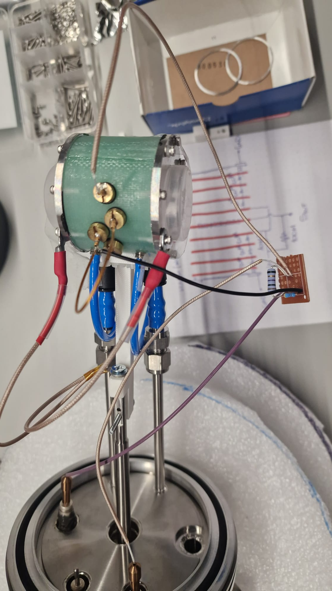
Exotic nuclei with ACTAR TPC
Upgrades ACTAR TPC for TRIUMF (Canada) : 2025 led by IGFAE
New wall of thick silicon detectors
in collab with LHCb team
E. Pérez-Trigo, A. Fdez-Prieto, A. Pazos
C. Cabo , D. Caamaño, I. Blanco-Calviño
Ionisation Chamber (IC)
C. Cabo, Y. Ayyad, J. Peña
Stop high-energy light particles
PID of incomming beam
Notes:
For this purpose several ancillary detectors has been developed within IGFAE, including…

Slide 13
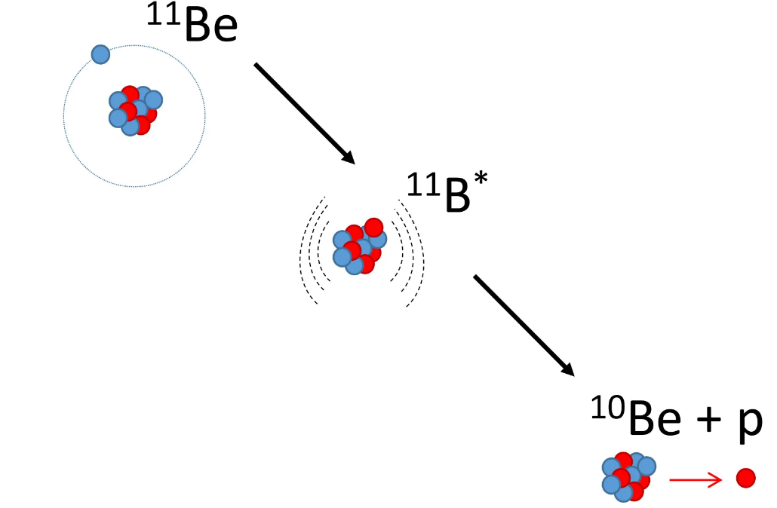
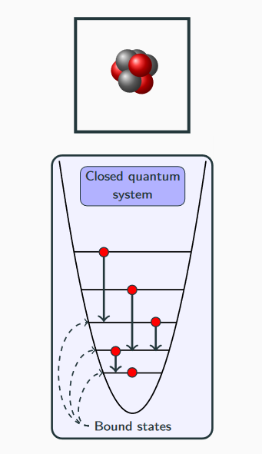
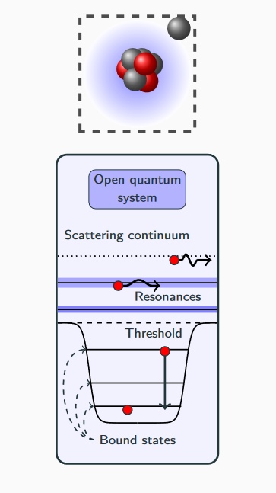
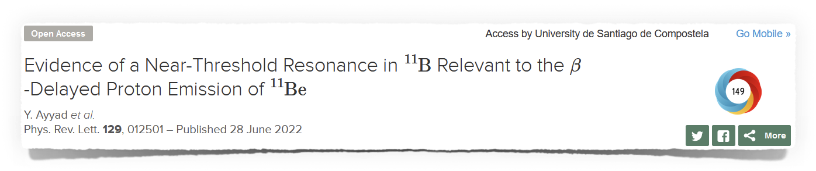
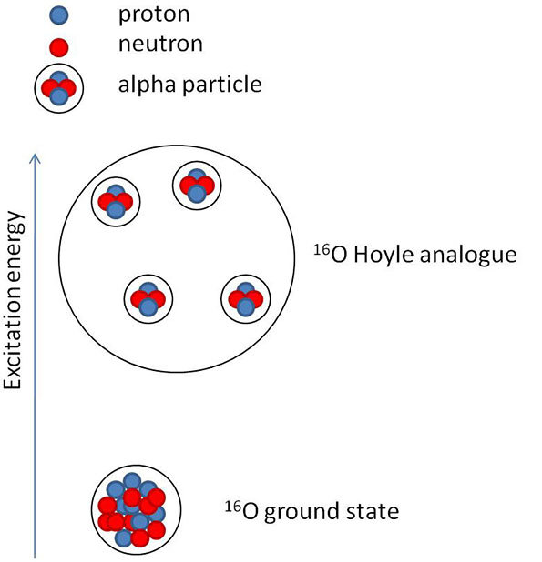
Connection between reaction and structure
Exotic decay modes of halo nuclei
Nuclei as open quantum systems
ß-decay
proton emisión of ¹¹Be
Dilute α-condensate state (Hoyle-like) in ¹⁶O
¹⁶O
Nuclei can capture and emit nucleons or clusters in the open quantum system framework.
Structure and reaction channels influence each other.
α
α
α
α
α
  Daniel Regueira Castro:“Study of 16O dissociation through α-scattering in inverse kinematics with the AT-TPC” FPI (Supervisors: B. Fernández, Y. Ayyad) PhD USC (2025).
  Alicia Muñoz Ramos: “Development of solenoidal spectrometers for studying the structure of exotic nuclei” FPI (Supervisors: Y. Ayyad, H. Alvarez-Pol) PhD USC (ongoing).

Slide 14
FICA members:
Senior
Beatriz Fernández Domínguez (PTU)
Manuel Caamaño Fresco (PTU)
Francesc Yassid Ayyad Limonge (R&C)
Aaron José Alejo Alonso (R&C)
Héctor Álvarez Pol (PTU)
Students
Adrián Bembibre Fernández
Iván Blanco Calviño
Beatriz Errandonea Felix
Martina Feijoo Fontán
Carolina Filgueira Rama
Pablo Gonzalez Rusell
Youssef Khlifi
Jose Manuel López González
Miguel Lozano González
Alicia Muñoz Ramos
David Palacios Suarez-Bustamante
Alicia Reija Vecino
Nicolas Sánchez Vázquez
Georgina Xifra Goya
Post-docs
Cristina Cabo (CESGA PD)
Andrea Lagni (Project PD)
Périne Miriot-Jaubert (from October)
Invited researchers
Jose Luis Rodríguez Sanchez (UDC)
Ad-Honorem researchers
Ignacio Durán Escribano
Juan Antonio Garzón Heydt

Slide 16
Fission: between microscopic and macroscopic worlds
… and data analysis
The bulk of the analysis is being carried out by our students:
D. Fernández: “High Energy Fission and the Onset of Quasi-fission” FPI (supervisors: M. Caamaño, D. Ramos (GANIL)) PhD USC (2024).
B. Errandonea: “Study of the evolution of nuclear structure and fission dynamics with low-energy reactions” FPI (supervisors: M. Caamaño, D. Ramos (GANIL)) PhD USC (ongoing).
N. Sánchez: “New fission modes in light systems around Z=60” (supervisors: M. Caamaño, H. Alvarez-Pol) PhD USC (ongoing).
F. Angelini: “Spectroscopic study of nuclei in the region of 78Ni” (supervisors: J.J. Valiente (IFIC, Valencia), A. Gottardo (LNL-INFN, Padova), M. Caamaño) PhD U. de Padova (Italy) (2025)
Other relevant highlights:
B. Montenegro, M. Caamaño: “Study of the log-third-difference method for the computation of even-odd staggering in fission yields” EPJA 60, 237 (2024). This is a paper summarising the results of a TFG.
M. Caamaño: “Comment on “Fusion-fission dynamics of ^{188,190}Pt through fission fragment mass distribution measurements” PRC 109, 069801 (2024) Comments on published data are particularly difficult to get through.
M. Ballan, S. Bottoni, M. Caamaño et al.: “Nuclear physics midterm plan at Legnaro National Laboratories (LNL)” EPJPlus 138, 179 (2023). The first of a series of papers from an advisory committee for the midterm plan of Nuclear Physics in Italy.
NuPECC Long Range Plan 2024 for European Nuclear Physics. Contribution in ”Open Science and Data” section (H. Alvarez-Pol).

