Slide 1
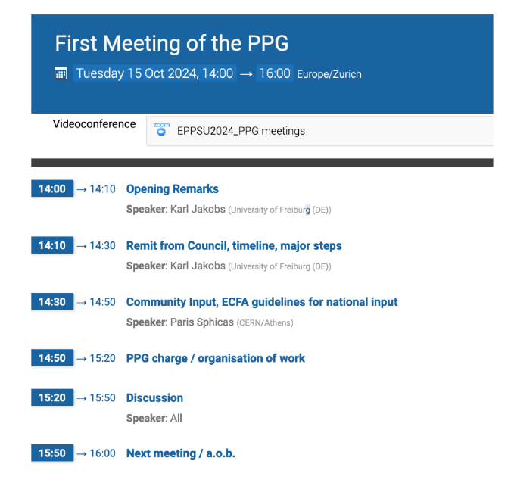
Atividades do Physics Preparatory Group (PPG) do Update da European Strategy for Particle Physics (ESPP)
Atividades do PPG começaram em 15/10/2024
Tasks of the PPG:
collects input from the community
organises the Open Symposium in Venice in June 2025
prepares the Physics Briefing Book based on the input from the community

Slide 2
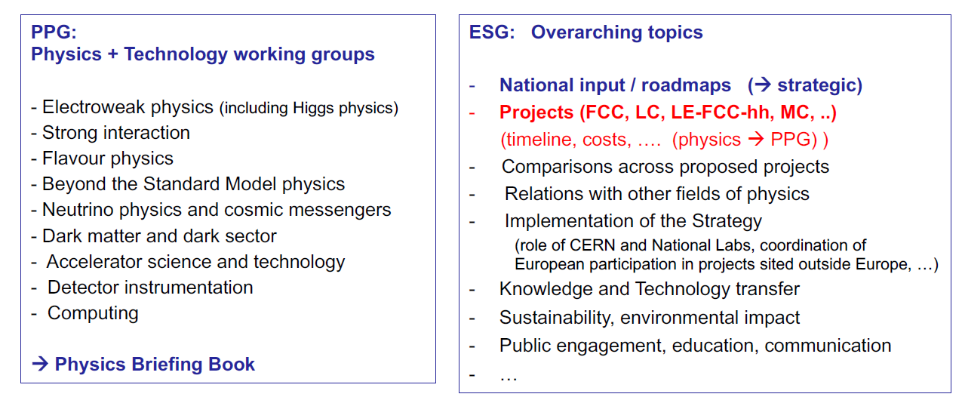

Slide 3
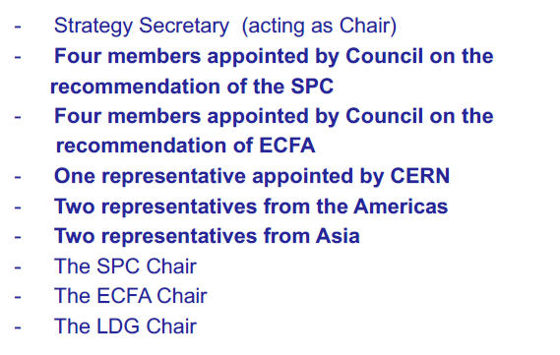
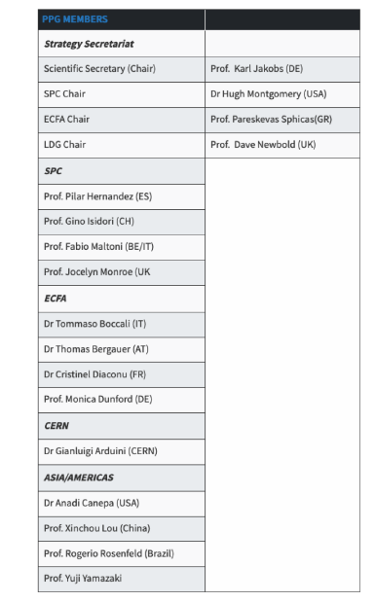
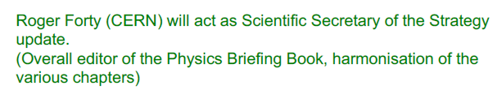

Slide 4
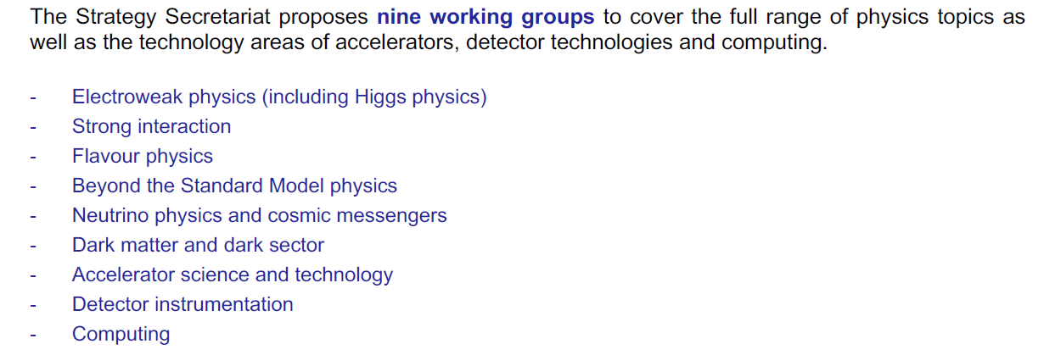
each group have two co-conveners to organise the work.

Slide 5
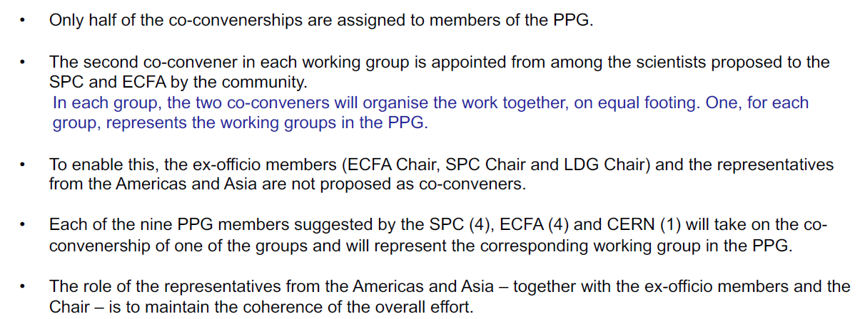

Slide 6
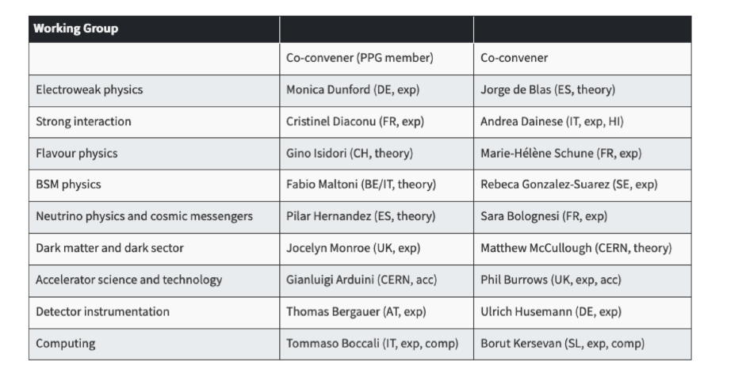

Slide 7
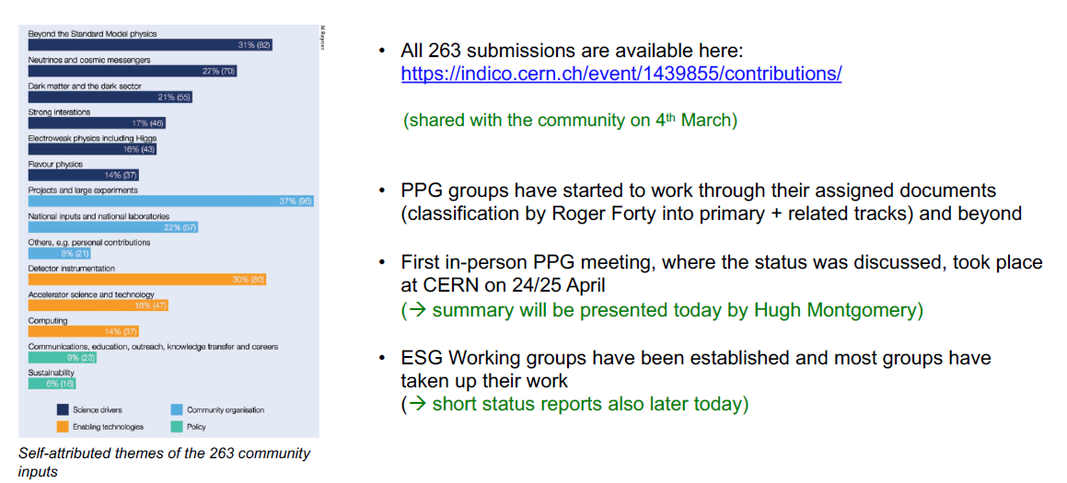

Slide 8
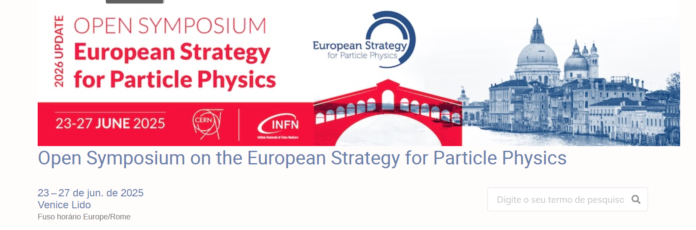

Slide 9
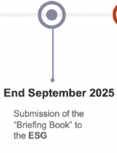
Escrita do Physics Briefing Book
We will receive first draft chapters by 31 July, and a second set by 15
August. We are investigating right now what groups could be ready by
these dates, and we will share the information as soon as it becomes
available.
For reading and sending comments on these chapters, we foresee deadlines
of 15 August (for those that become available on 31 July) and 31 August
(for the chapters we will receive by mid August). This would be in time
for a more in-depth discussion of the major comments at our planned
PPG meeting on 5 September at CERN.

Slide 10
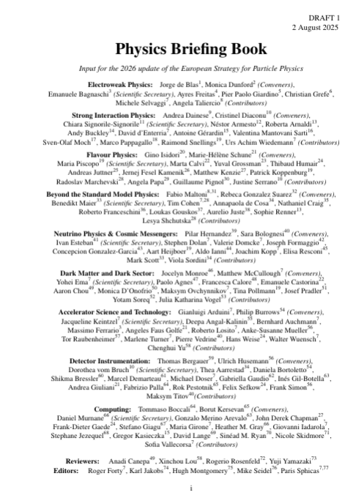
~240 páginas escritas!

Slide 11
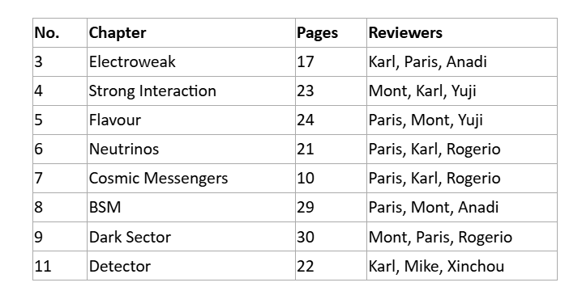
Tenho até dia 15/08 para enviar meus comentários!

Slide 12
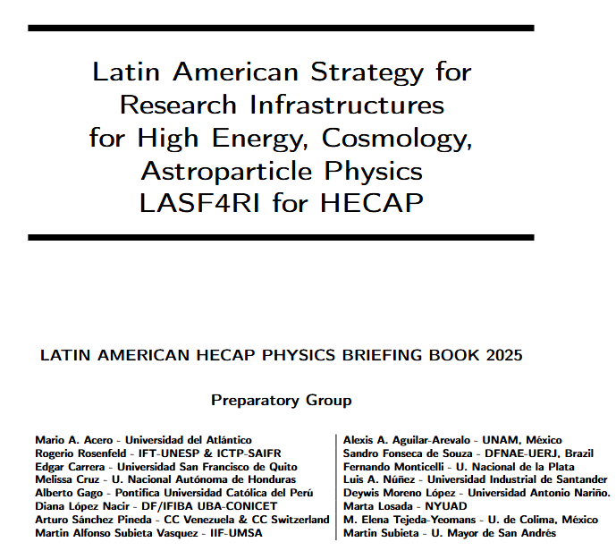

Slide 13
