Slide 1





Probing Conserved Charge Dynamics via HBT Interferometry in Relativistic Heavy-Ion Collisions
Arkadip Mukherjee
In collaboration with:
Dr. Tribhuban Parida
Prof. Sandeep Chatterjee
September 04, 2025

Slide 2

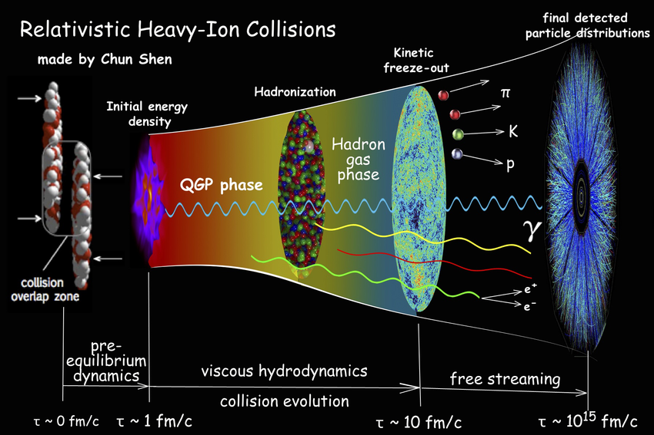



Introduction
1
Under normal conditions, quarks and gluons are confined in hadrons.
Under extreme conditions, quarks and gluons are deconfined to form QGP.
Computer Physics Communications, 199, 61-85

Slide 3
HBT Interferometry (or Femtoscopy)
2

Slide 4
HBT Interferometry (or Femtoscopy)
2
Femtoscopy or HBT interferometry is the study of matter at the femtometer (${10}^{−15}$m) scale, using the interactions and correlations between particles in a pair.

Slide 5
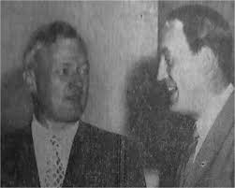
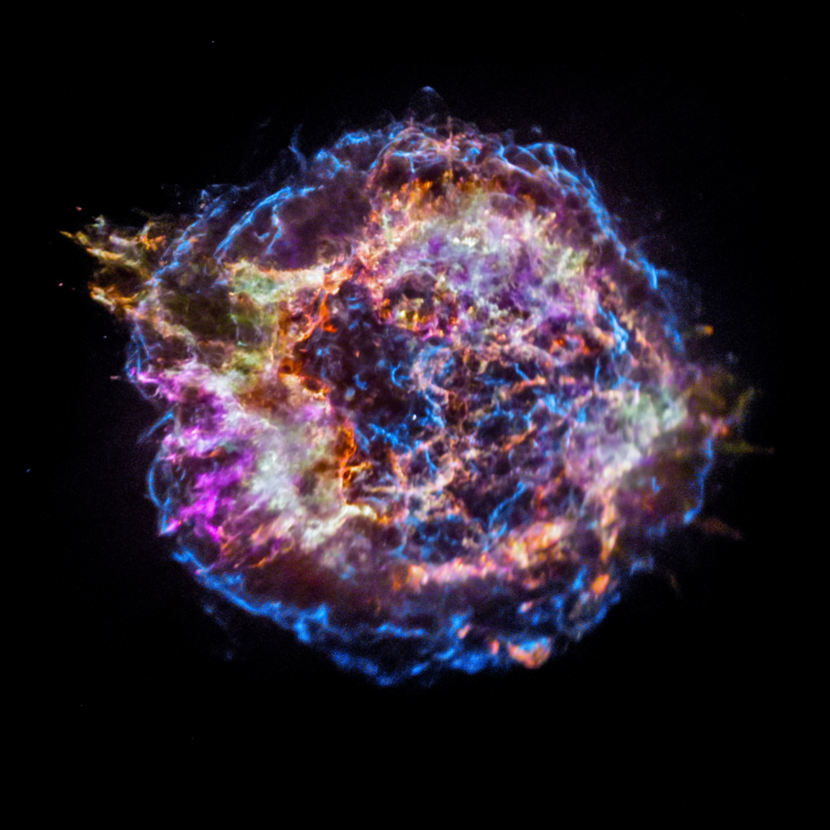
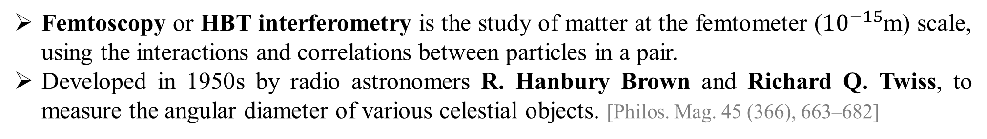
HBT Interferometry (or Femtoscopy)
2
Femtoscopy or HBT interferometry is the study of matter at the femtometer (${10}^{−15}$m) scale, using the interactions and correlations between particles in a pair.
Developed in 1950s by radio astronomers R. Hanbury Brown and Richard Q. Twiss, to measure the angular diameter of various celestial objects. [Philos. Mag. 45 (366), 663–682]
Richard Q. Twiss
R. Hanbury Brown
Lukishova et.al., Quantum Photonics (2019):p.605-619
Cassiopeia A

Slide 6
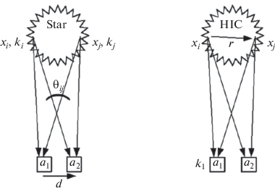
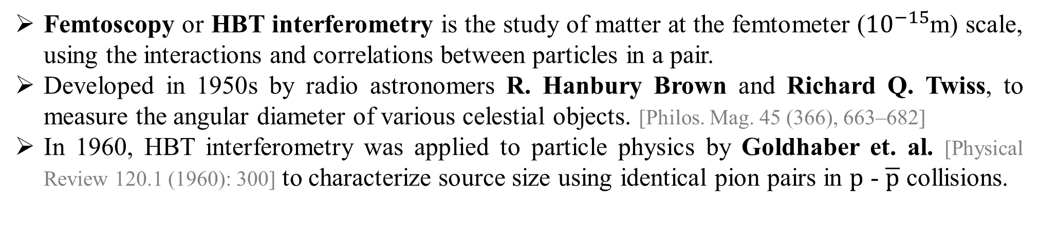
HBT Interferometry (or Femtoscopy)
2
Femtoscopy or HBT interferometry is the study of matter at the femtometer (${10}^{−15}$m) scale, using the interactions and correlations between particles in a pair.
Developed in 1950s by radio astronomers R. Hanbury Brown and Richard Q. Twiss, to measure the angular diameter of various celestial objects. [Philos. Mag. 45 (366), 663–682]
In 1960, HBT interferometry was applied to particle physics by Goldhaber et. al. [Physical Review 120.1 (1960): 300] to characterize source size using identical pion pairs in $p$ - $\overline{p}$ collisions.
Richard Q. Twiss
R. Hanbury Brown
Lukishova et.al., Quantum Photonics (2019):p.605-619
Cassiopeia A
Phys. Part. Nuclei 51, 278–281 (2020)

Slide 7
HBT Interferometry (or Femtoscopy)
3
In high‐energy heavy‐ion collisions, HBT interferometry (or Femtoscopy) provides key insights into the geometry and dynamics of particle‐emitting sources by measuring two‐particle correlations.

Slide 8
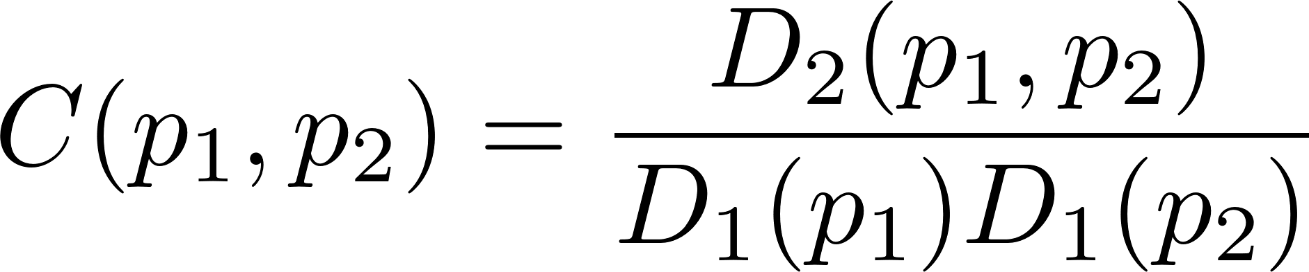
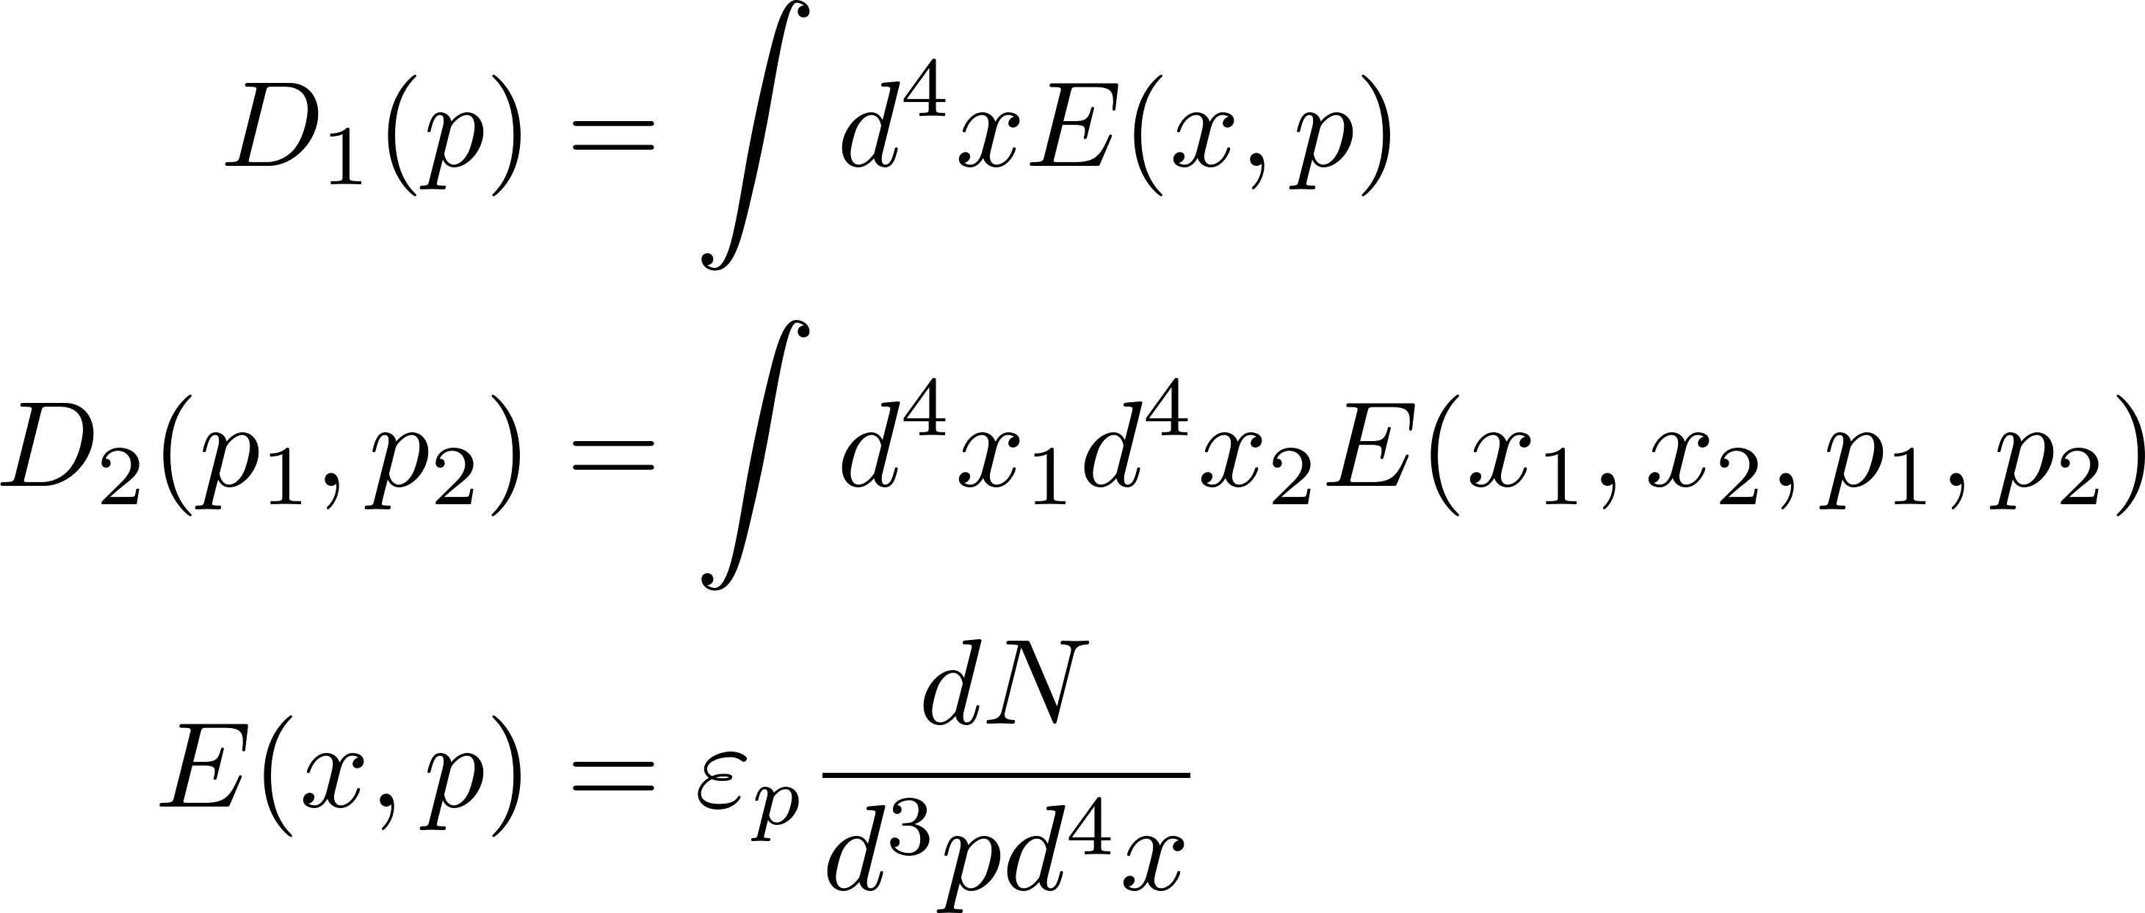
HBT Interferometry (or Femtoscopy)
3
In high‐energy heavy‐ion collisions, HBT interferometry (or Femtoscopy) provides key insights into the geometry and dynamics of particle‐emitting sources by measuring two‐particle correlations.
The two-particle correlation function is defined as:
where,
Physical Review C—Nuclear Physics, 73(6), 064902

Slide 9
HBT Interferometry (or Femtoscopy)
3
In high‐energy heavy‐ion collisions, HBT interferometry (or Femtoscopy) provides key insights into the geometry and dynamics of particle‐emitting sources by measuring two‐particle correlations.
The two-particle correlation function is defined as:
where,
Longitudinally Co-Moving System (LCMS) frame of reference – Net p_{z} = 0.
as
Physical Review C—Nuclear Physics, 73(6), 064902

Slide 10
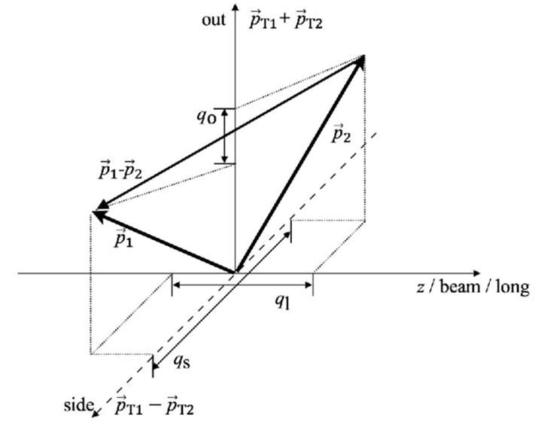
HBT Interferometry (or Femtoscopy)
3
In high‐energy heavy‐ion collisions, HBT interferometry (or Femtoscopy) provides key insights into the geometry and dynamics of particle‐emitting sources by measuring two‐particle correlations.
The two-particle correlation function is defined as:
where,
arXiv:2103.08165
Longitudinally Co-Moving System (LCMS) frame of reference – Net p_{z} = 0.
as
Bertsch-Pratt Parameterization:
out-side-long axes. [Phys. Rev., C37 (1988) 1896-
1900 ; Phys. Rev., D33 (1986) 1314-1327 ]
Physical Review C—Nuclear Physics, 73(6), 064902

Slide 11
Heavy-Ion Collisions
3
GICG
Under normal conditions, quarks and gluons are confined in hadrons.
Under extreme conditions, quarks and gluons are deconfined to form QGP.
MUSIC
iSS
UrQMD
Computer Physics Communications, 199, 61-85

Slide 12
Bulk Observables
4
Hybrid Framework successful in reproducing several bulk observables:

Slide 13
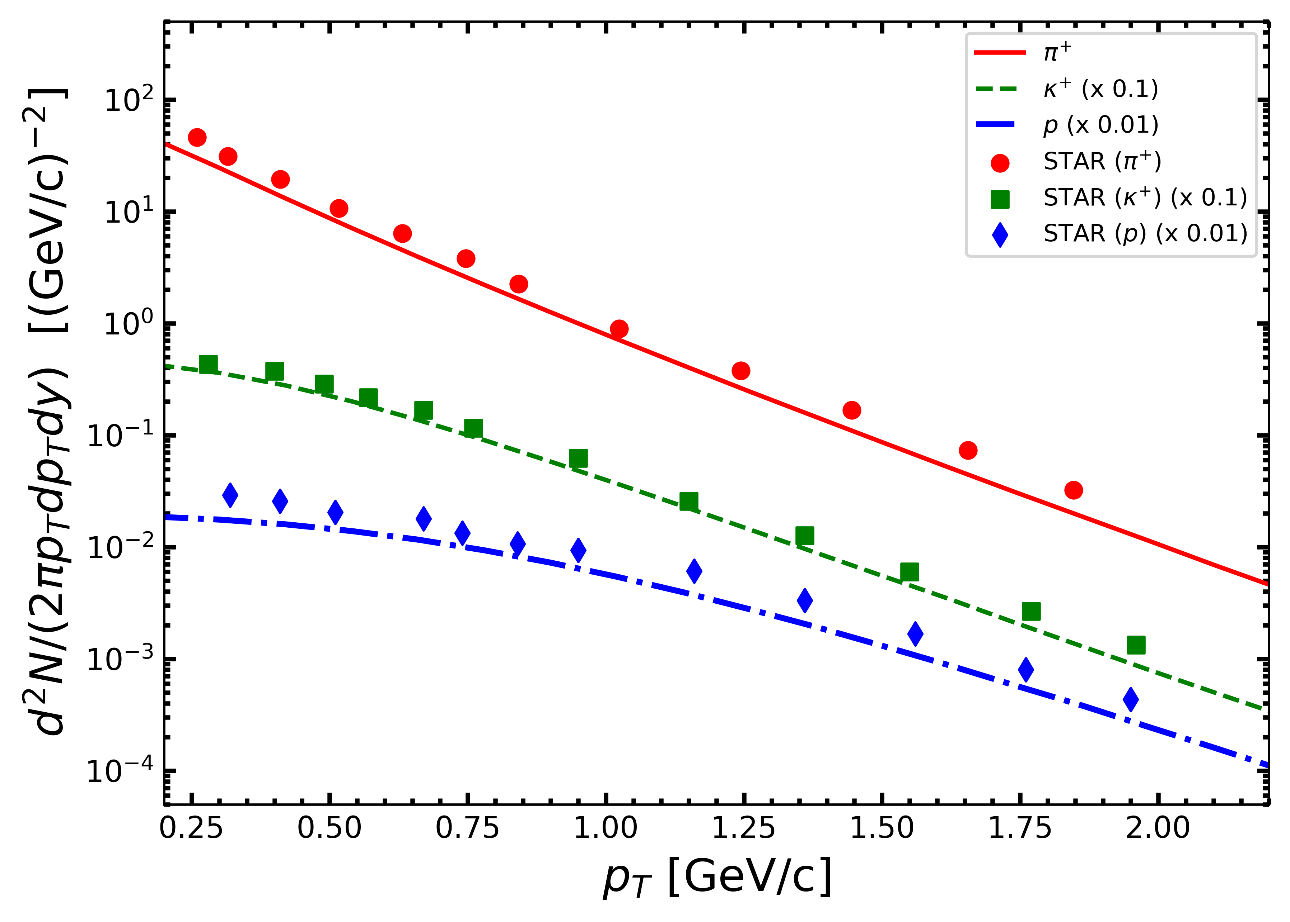
Bulk Observables
4
Hybrid Framework successful in reproducing several bulk observables:
as
Invariant Yield Spectra
Phys.Rev.C 96.4 (2017): 044904.

Slide 14
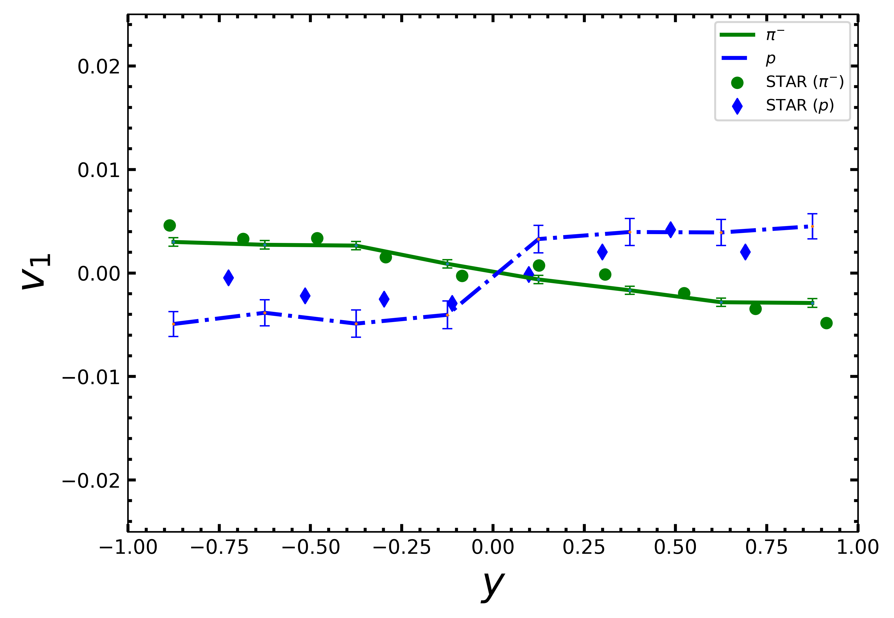
Bulk Observables
4
Hybrid Framework successful in reproducing several bulk observables:
as
Invariant Yield Spectra
Directed Flow (v₁)
Phys.Rev.C 96.4 (2017): 044904.
PRL 112.16 (2014): 162301

Slide 15
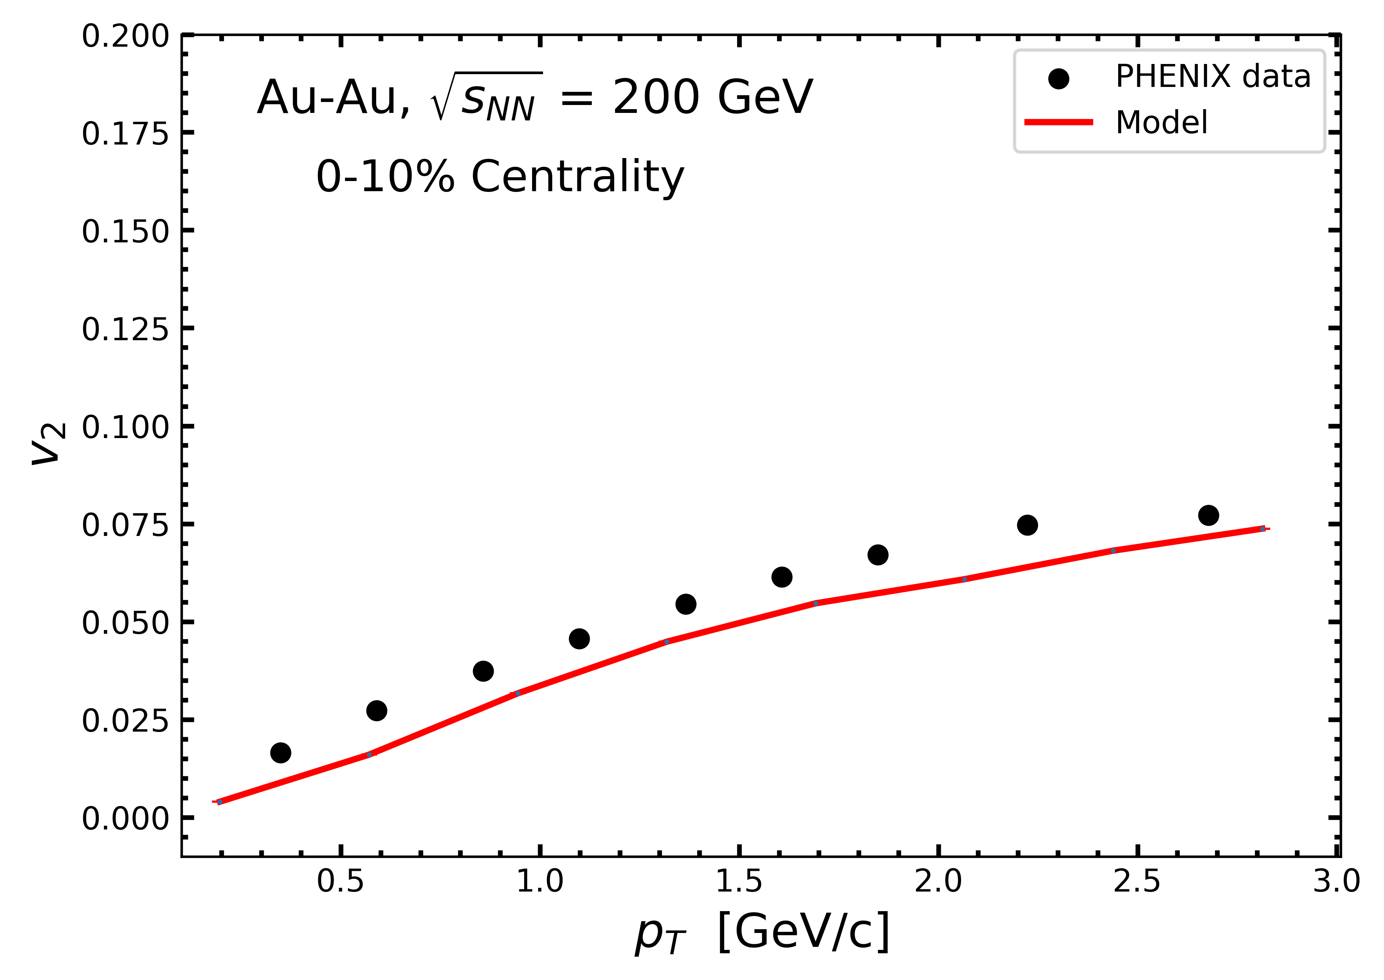
Bulk Observables
4
Hybrid Framework successful in reproducing several bulk observables:
as
Invariant Yield Spectra
Directed Flow (v₁)
Elliptic Flow (v₂)
PRL 112.16 (2014): 162301
PRL 107.25 (2011): 252301
Phys.Rev.C 96.4 (2017): 044904.

Slide 16
Bulk Observables
4
Hybrid Framework successful in reproducing several bulk observables:
as
Invariant Yield Spectra
Directed Flow (v₁)
Elliptic Flow (v₂)
HBT Radii
PRL 112.16 (2014): 162301
PRL 107.25 (2011): 252301
Phys.Rev.C 96.4 (2017): 044904.

Slide 17
Extracting the HBT Radii
5
The three Hanbury Brown‐Twiss radii are represented as : R_{out} , R_{side} & R_{long} along the three out‐side‐long axes.

Slide 18
Extracting the HBT Radii
5
The three Hanbury Brown‐Twiss radii are represented as : R_{out} , R_{side} & R_{long} along the three out‐side‐long axes.
To extract the three HBT radii from the correlation function C(Q, k_{T} ), where Q = (p₁ – p₂ ) & k_{T} = ½ (p_{T,1} + p_{T,2}) , we assume that the single particle emission function E(x, p) is a three-dimensional ellipsoid. Using this form of definition, we obtain the correlation function as:

Slide 19
Extracting the HBT Radii
5
The three Hanbury Brown‐Twiss radii are represented as : R_{out} , R_{side} & R_{long} along the three out‐side‐long axes.
To extract the three HBT radii from the correlation function C(Q, k_{T} ), where Q = (p₁ – p₂ ) & k_{T} = ½ (p_{T,1} + p_{T,2}) , we assume that the single particle emission function E(x, p) is a three-dimensional ellipsoid. Using this form of definition, we obtain the correlation function as:
Physical Review C—Nuclear Physics, 73(6), 064902

Slide 20
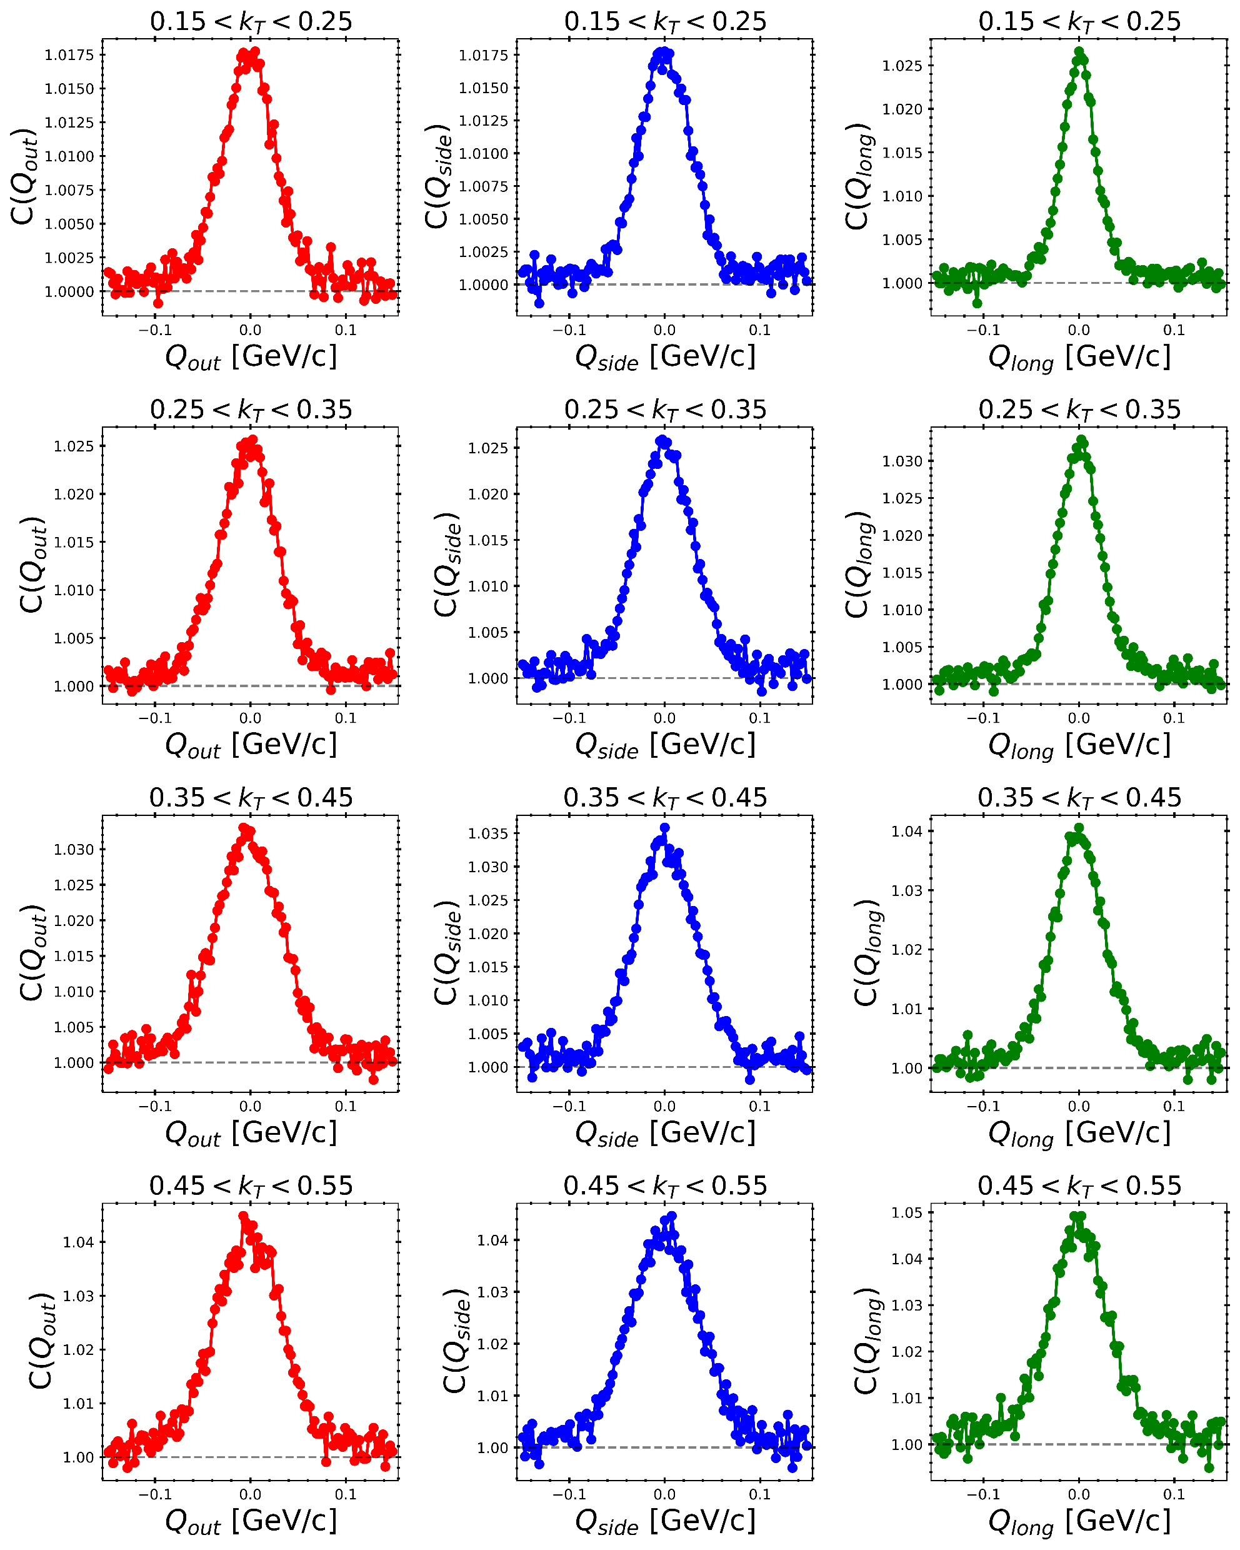
Correlation Function Plots for Pions
6
Fig: The 3-D C(Q) vs Q plots for 0-10% central Au-Au collisions at $\sqrt{s_{NN}}=200 GeV$. |y| < 1.0

Slide 21
Correlation Function Plots for Pions
6
Fig: The 3-D C(Q) vs Q plots for 0-10% central Au-Au collisions at $\sqrt{s_{NN}}=200 GeV$. |y| < 1.0

Slide 22
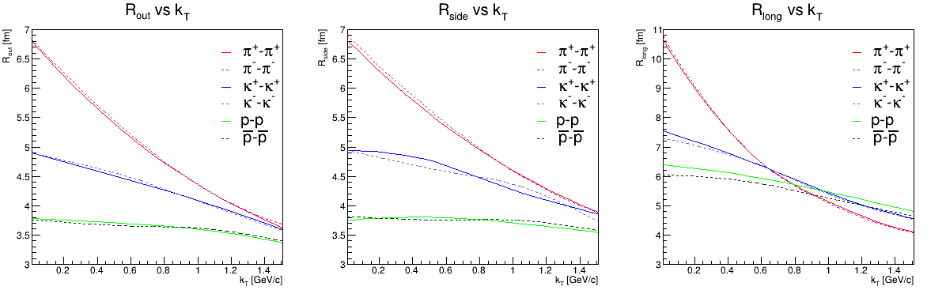
HBT Radii Distributions
7
200 GeV
Fig: The three HBT Radii vs k_{T} plots for 0-10% centrality Au-Au collisions at $\sqrt{s_{NN}}=200 GeV$.

Slide 23
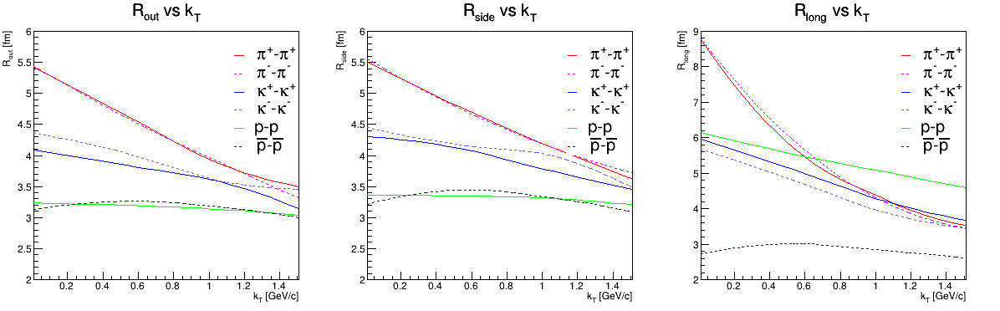
HBT Radii Distributions
8
7.7 GeV
Fig: The three HBT Radii vs k_{T} plots for 0-10% centrality Au-Au collisions at $\sqrt{s_{NN}}=7.7 GeV$.

Slide 24
HBT Radii Distributions
9
$\sqrt{s_{NN}}$ (GeV) = 7.7, 11.5, 19.6, 27, 39, 62.4, 200

Slide 25
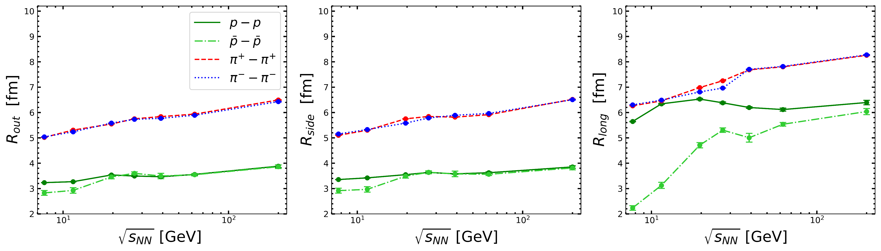
HBT Radii Distributions
9
$\sqrt{s_{NN}}$ (GeV) = 7.7, 11.5, 19.6, 27, 39, 62.4, 200
Fig: The three HBT Radii vs $\sqrt{s_{NN}}$ plots for 0-10% central Au-Au collisions; |y| < 1.0

Slide 26
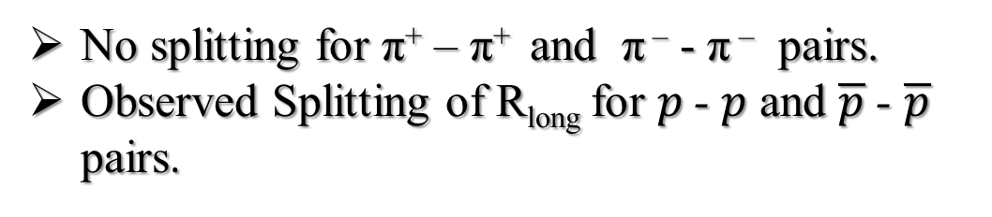
HBT Radii Distributions
9
$\sqrt{s_{NN}}$ (GeV) = 7.7, 11.5, 19.6, 27, 39, 62.4, 200
Fig: The three HBT Radii vs $\sqrt{s_{NN}}$ plots for 0-10% central Au-Au collisions; |y| < 1.0
No splitting for π⁺ – π⁺ and π – - π – pairs.
Observed Splitting of R_{long} for $p$- $p$ and $\overline{p}$ - $\overline{p}$ pairs.

Slide 27
HBT Radii Distributions
9
$\sqrt{s_{NN}}$ (GeV) = 7.7, 11.5, 19.6, 27, 39, 62.4, 200
Fig: The three HBT Radii vs $\sqrt{s_{NN}}$ plots for 0-10% central Au-Au collisions; |y| < 1.0
No splitting for π⁺ – π⁺ and π – - π – pairs.
Observed Splitting of R_{long} for $p$- $p$ and $\overline{p}$ - $\overline{p}$ pairs.
Baryon Stopping

Slide 28
Tilted Emission Source
10

Slide 29
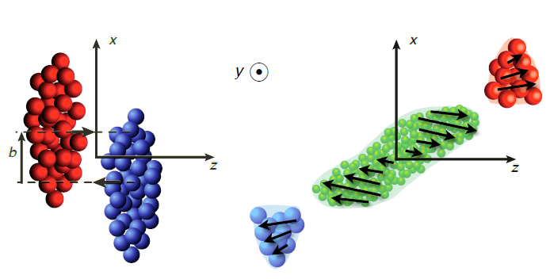
Tilted Emission Source
10
θ
arXiv:2410.15134v1

Slide 30
Tilted Emission Source
10
θ
arXiv:2410.15134v1
Phys. Rev. C 84, 014908 (2011)

Slide 31
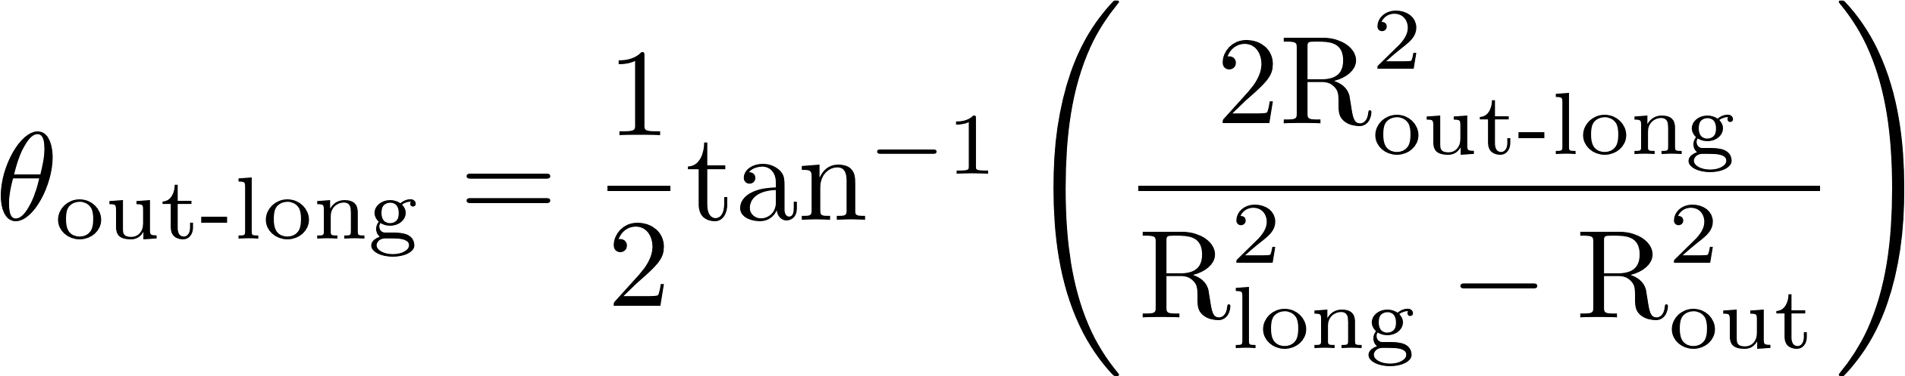

Tilted Emission Source
10
θ
arXiv:2410.15134v1
Phys. Rev. C 84, 014908 (2011)

Slide 32
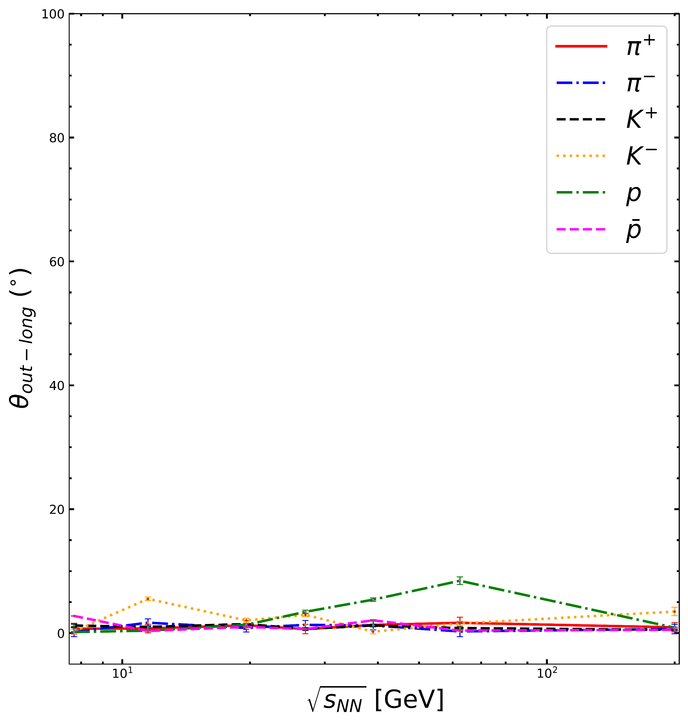
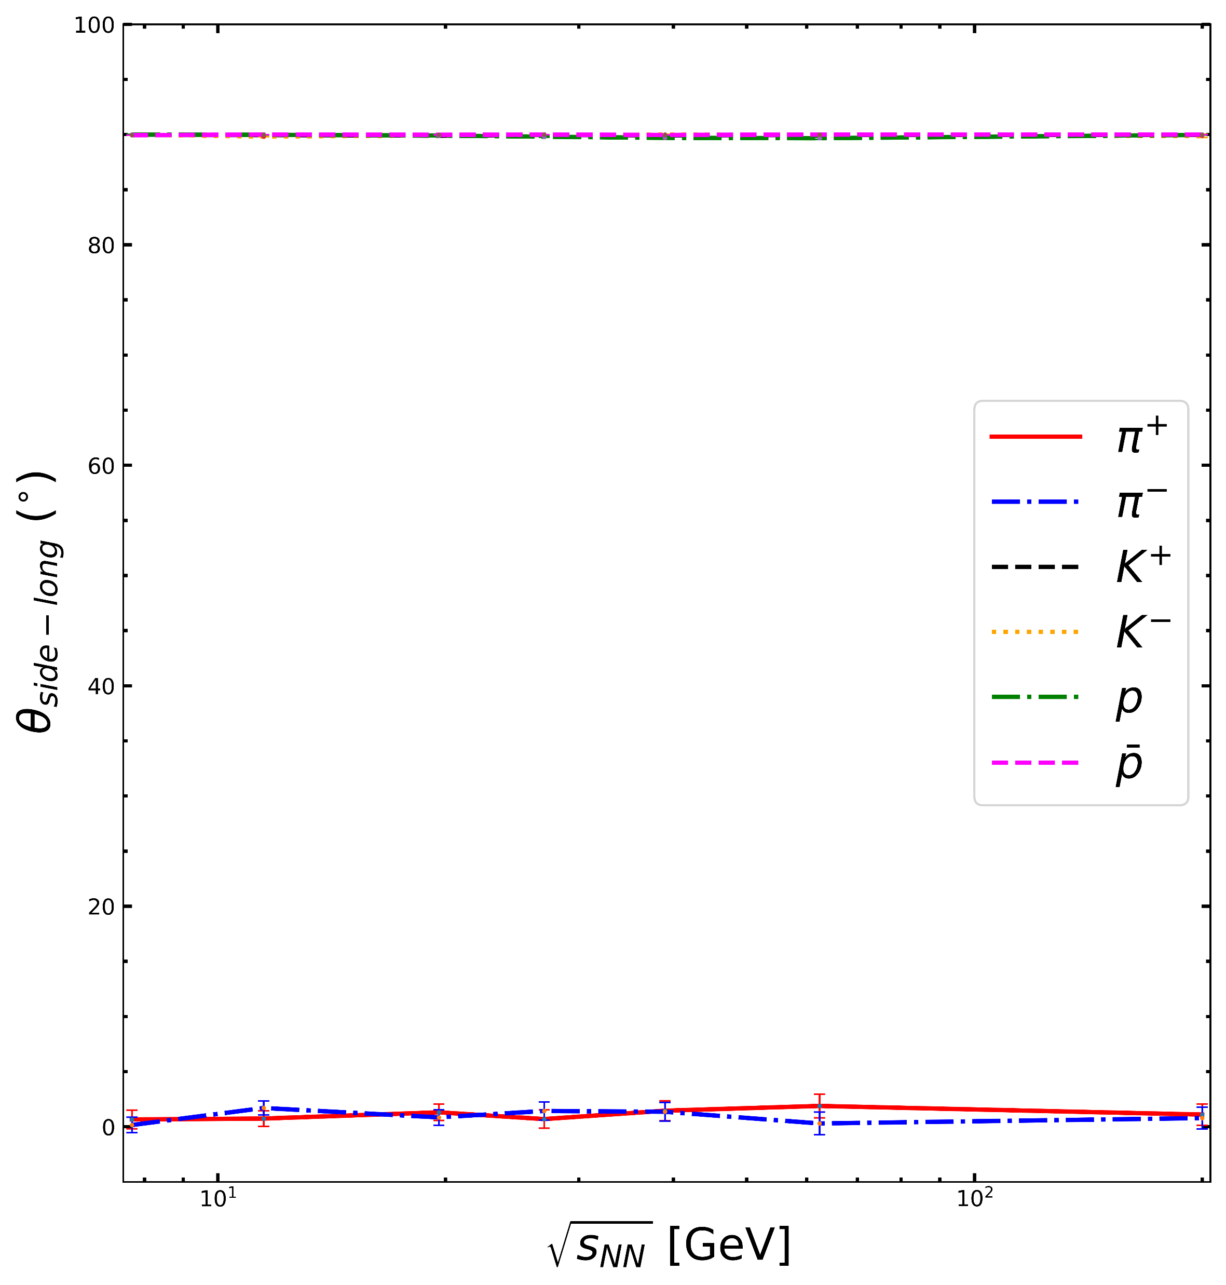
Tilted Emission Source
11
Fig: θ_{ol} & θ_{sl} vs. $\sqrt{s_{NN}}$ for 0-10% central Au-Au collisions; |y| < 1.0

Slide 33
Summary
12

Slide 34
Summary
12
Calculated 3-D correlation functions and extracted three HBT radii.

Slide 35
Summary
12
Calculated 3-D correlation functions and extracted three HBT radii.
Baryon-Antibaryon splitting observed at lower collision energies:
Probable cause include baryon stopping.

Slide 36
Summary
12
Calculated 3-D correlation functions and extracted three HBT radii.
Baryon-Antibaryon splitting observed at lower collision energies:
Probable cause include baryon stopping.
Almost no tilt in out-long and side-long at 0-10% central collisions.

Slide 37
Summary
12
Calculated 3-D correlation functions and extracted three HBT radii.
Baryon-Antibaryon splitting observed at lower collision energies:
Probable cause include baryon stopping.
Almost no tilt in out-long and side-long at 0-10% central collisions.
Upcoming Work:
as
Exact cause of splitting only in R_{long}, and very less or no splitting in R_{out} & R_{side}.
Study centrality dependence of HBT Radii.
Effect of peripheral collisions in θ_{out-long} & θ_{side-long}.

Slide 38

Thank You

