Slide 1



Gain and Ion backflow analysis in a proposed triple GEM geometry
Sachin Rana¹, Md. Kaosor Ali Mondal¹, Poojan Angiras¹, A. Sarkar¹
¹ Indian Institute of Technology Mandi
September 4 , 2025.

Slide 2
Triple
GEM
Studies
1. Motivation
2. Introduction to Micro‑Pattern Gaseous Detectors (MPGDs)
3. Gas Electron Multipliers (GEM)
Table of Content
3.1 Construction of triple GEM using various tools
3.2 Gain and Ion backflow study for newly proposed geometry
4. Results
5. Summary and conclusions
Sachin Rana
2

Slide 3
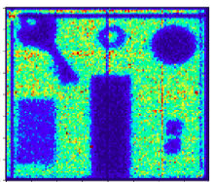
Motivation of the study
Scientific and Technological Need
  LHC and other modern accelerators produce huge number of particles through collisions. Efficient detection of these particles is crucial to extract meaningful Physics insights.
Why MPGDs?
  Higher Gain
  Good spatial resolution better than conventional gas detectors.
  Fast response time for tracking high rate events.
  High Rate Capability
Application Relevance
  High Luminosity LHC experiments.
  Advanced medical imaging techniques.
Ref. JINST 17 (2022) P04002.
Sachin Rana
HOT QCD 3.0 - 2025 (IIT Bhilai)
2

Slide 4
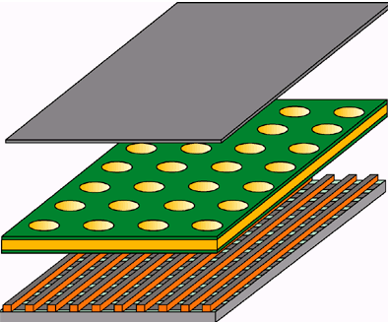
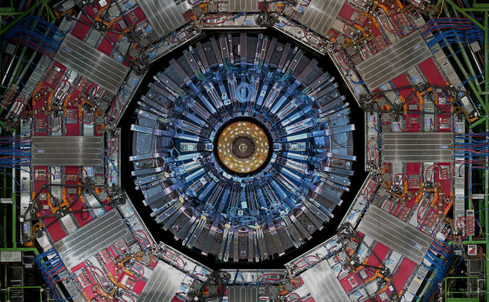
Introduction to MPGD’s
MPGDs are advanced gas ionization detectors featuring fine electrode structures.
MPGDs include:
  Gas Electron Multiplier (GEM)
  Micro MEsh GAseous Structure (MICROMEGAS)
  Resistive Plate Chamber
Focus of this presentation:
  GEM detector
  Construction and Working Principle
  Study using various computational tools
Upgrades
  GEMs in forward muon stations (GE1/1, GE2/1) to boost high-rate muon trigger/tracking.
  New ME0 Station (behind the new endcap calorimeter).
  The Time Projection Chamber (TPC) readout was upgraded with quadruple-GEM stacks to enable continuous high-rate readout
Sachin Rana
HOT QCD 3.0 - 2025 (IIT Bhilai)
3

Slide 5
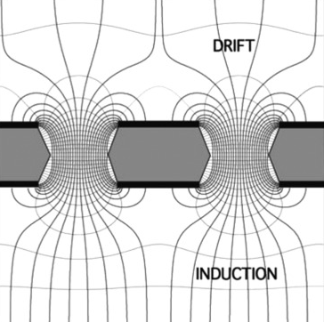
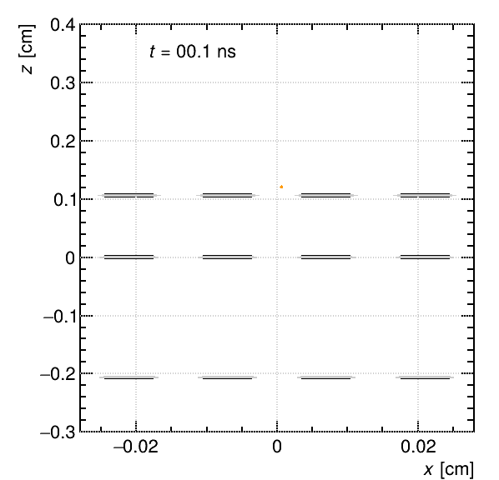
GEM Working Principle
GEM detector is detector is typically divided into three key regions:
Drift region where the incoming charged particle ionizes the gas, producing primary electrons.
GEM foil the core amplification element, consisting of a thin polyimide foil, metalized with copper on both sides and perforated with a high density of microscopic holes
Induction region where the electric field directs electrons toward the readout electrode for signal collection.
Ions drift to cathode, electrons to readout due to E-field.
Some ions hit copper layers; others enter drift region → ion backflow.
Ions move slower than electrons due to low mobility.
Sachin Rana
HOT QCD 3.0 - 2025 (IIT Bhilai)
4

Slide 6
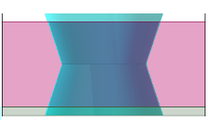
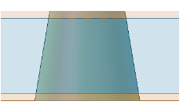
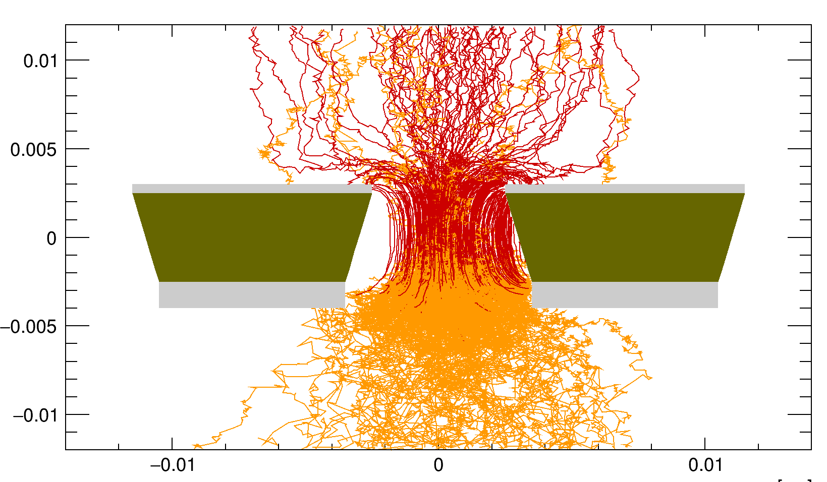
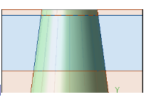
New GEM foil for stability and ion-backflow reduction
Proposed a new GEM foil with a single conical hole replacing the conventional double conical design.
Increased lower copper thickness (5 → 10/15 µm) for improved stability and easier handling.
Thicker copper enhanced ion absorption in the avalanche region, reducing ion backflow.
Single GEM tests showed significant performance gains.
Triple GEM implementation confirmed further improvements.
Large number of backflow ions -> Disturbs field configuration.
Space charge localisation.
Dead time.
Standard GEM biconical hole
Proposed single conical hole
It makes the foil mechanically stable and reduce the ion backflow.
Single conical hole with increased lower copper
Sachin Rana
HOT QCD 3.0 - 2025 (IIT Bhilai)
5

Slide 7
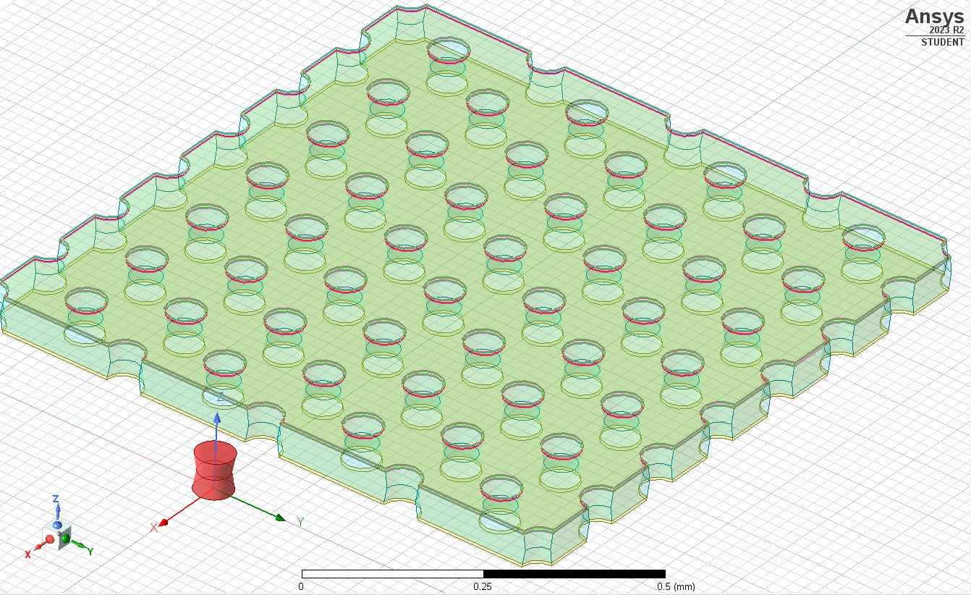
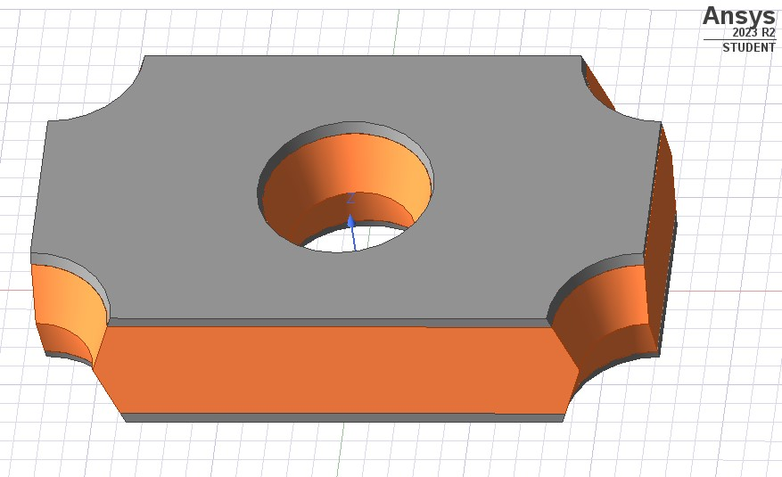
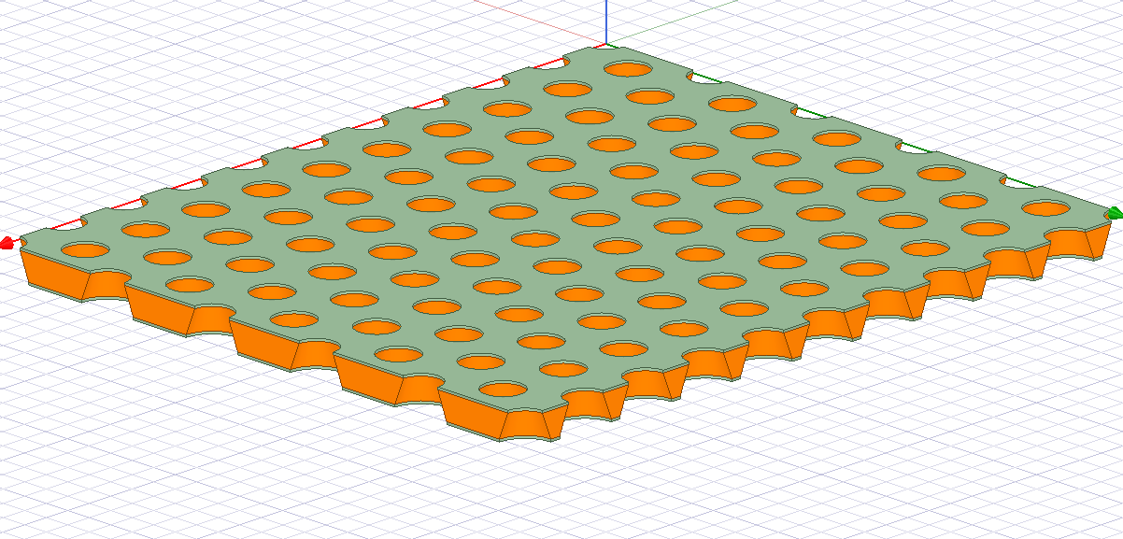
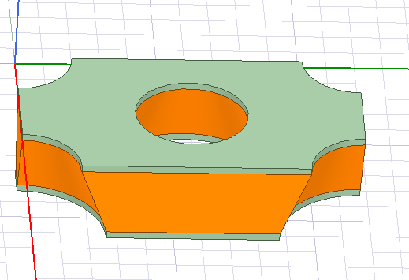
Comparative Study of Standard GEM and Proposed Geometry
Standard GEM foil:
Biconical hole shape
Inner hole diameter 50µm
Outer hole diameter 70µm
Lower and upper copper thickness 5µm
Modified GEM foil:
Single conical hole shape
Upper hole diameter 50µm
Lower hole diameter 70µm
Upper copper thickness 5µm
Lower copper thickness 5µm, 10µm, 15µm
Sachin Rana
HOT QCD 3.0 - 2025 (IIT Bhilai)
6

Slide 8
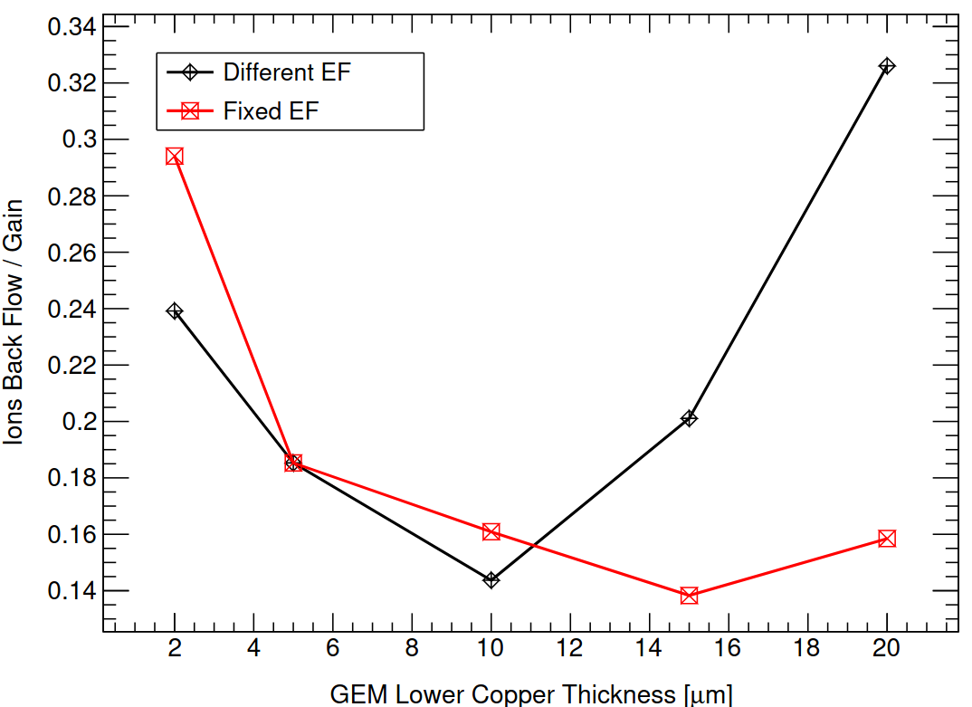
Results from Single GEM
Different Electric field means keeping all voltages same and increasing the lower copper thickness, which disturbs the actual field.
Same Electric Field means playing around voltages to make the field same as in the standard GEM.
Single GEM: hole shape changed from biconical to single conical.
Increased lower Cu thickness to 10 µm and 15 µm (from 5 µm).
IBF/gain ratio reduced ~48% for 15 µm Cu.
Motivated similar study for triple GEM (next slides).
Ref. JINST, 20(04), T04011. IOP Publishing.
Sachin Rana
HOT QCD 3.0 - 2025 (IIT Bhilai)
7

Slide 9
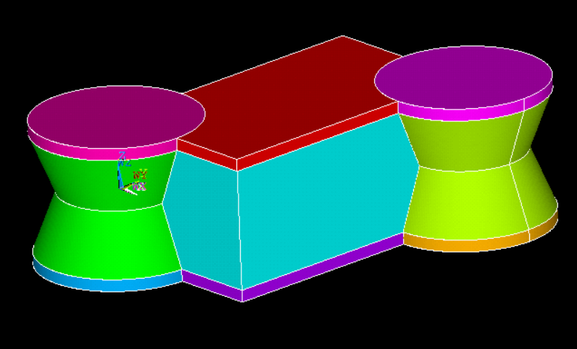
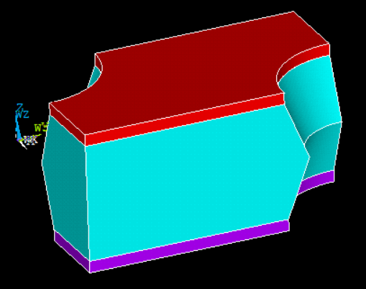
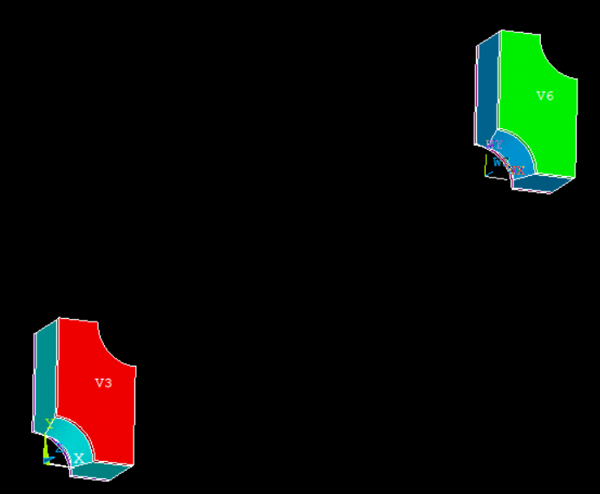
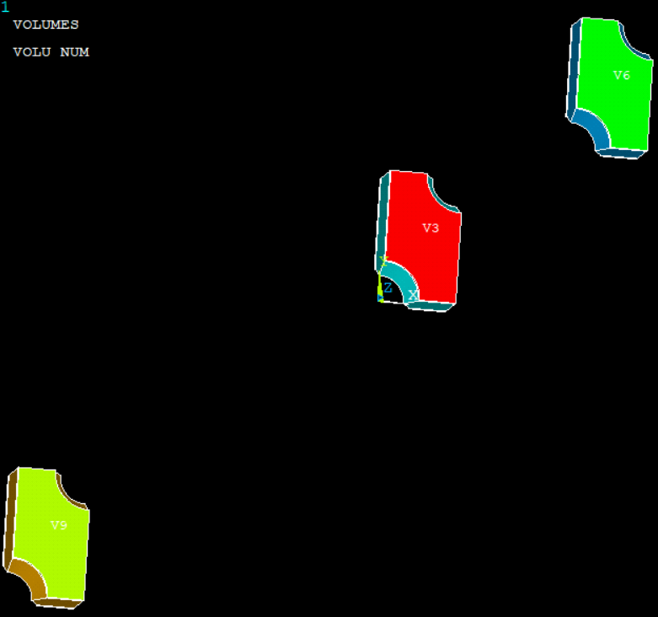
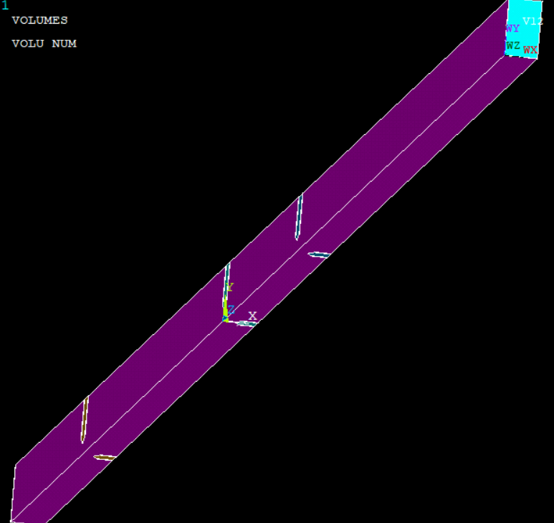
Construction of Triple GEM using APDL
Triple GEM Geometry and Field Map Import:
Triple GEM in 3-1-2-1 configuration.
Drift, transfer, and induction regions defined with set voltages and boundaries.
Import the field maps to Garfield⁺⁺
Sachin Rana
HOT QCD 3.0 - 2025 (IIT Bhilai)
8

Slide 10
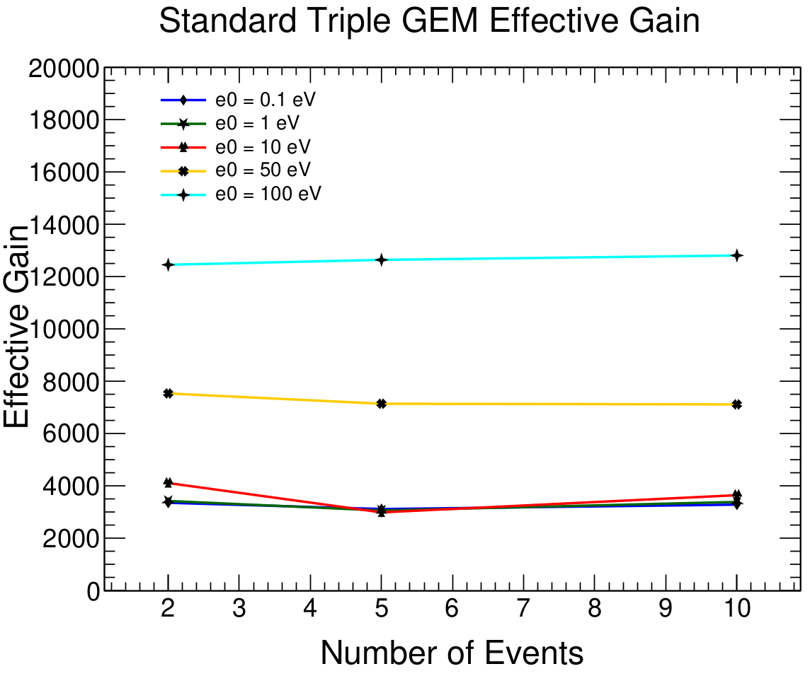
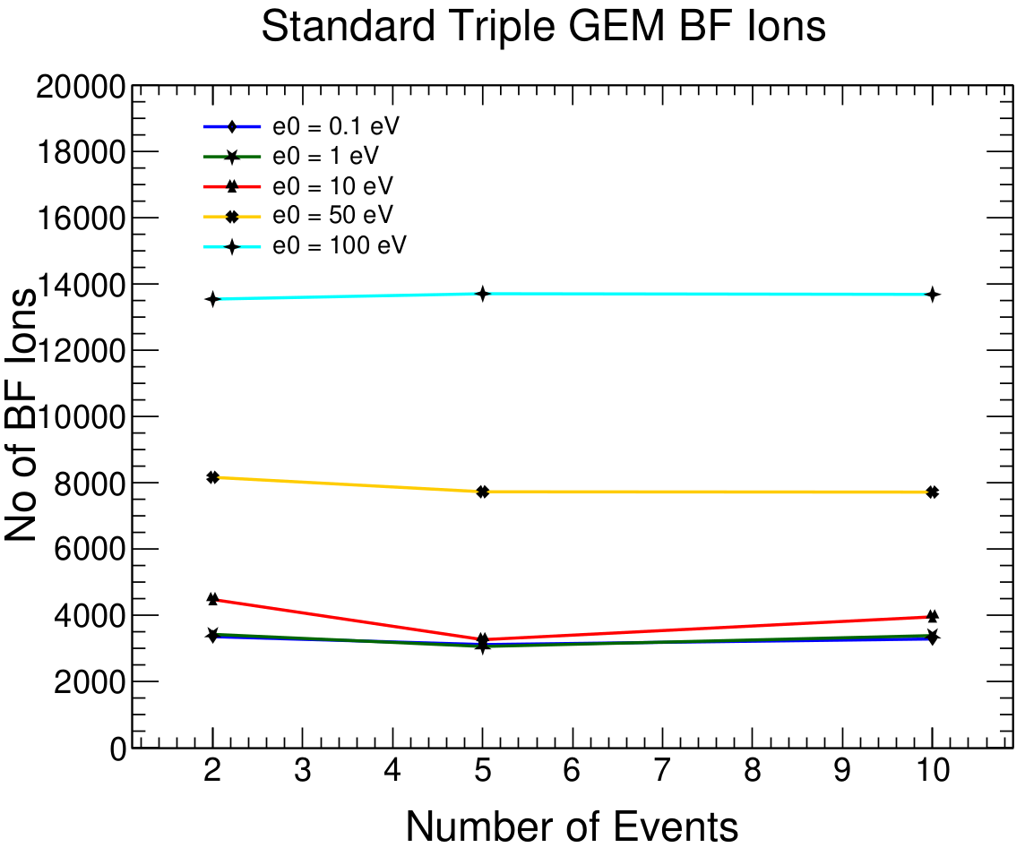
Results: Double Conical Hole: e=0.1eV, 1eV, 10eV, 50eV and 100eV
The ion backflow and effective gain has been evaluated as a function of the number of events.
For the standard GEM, they remains largely independent of the number of events.
With increase in energy, both effective gain and no. of backflow ions are increasing.
Sachin Rana
HOT QCD 3.0 - 2025 (IIT Bhilai)
9

Slide 11
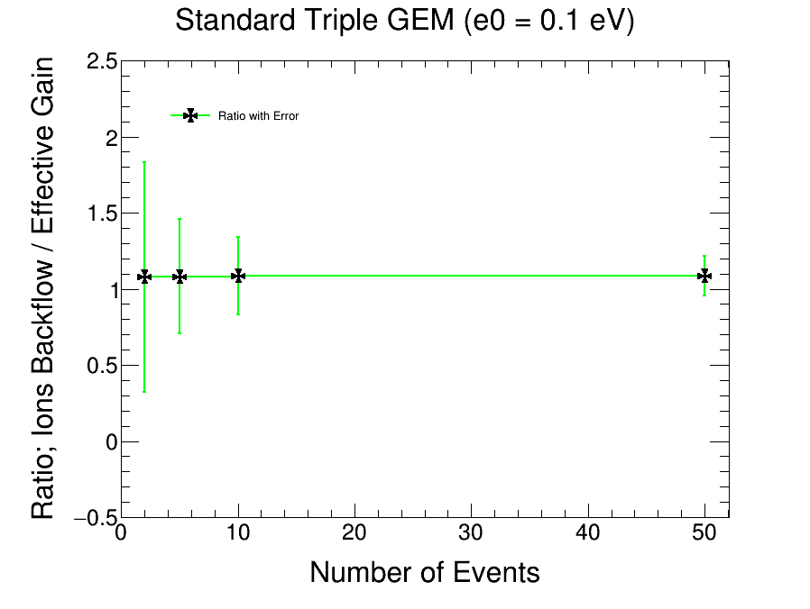
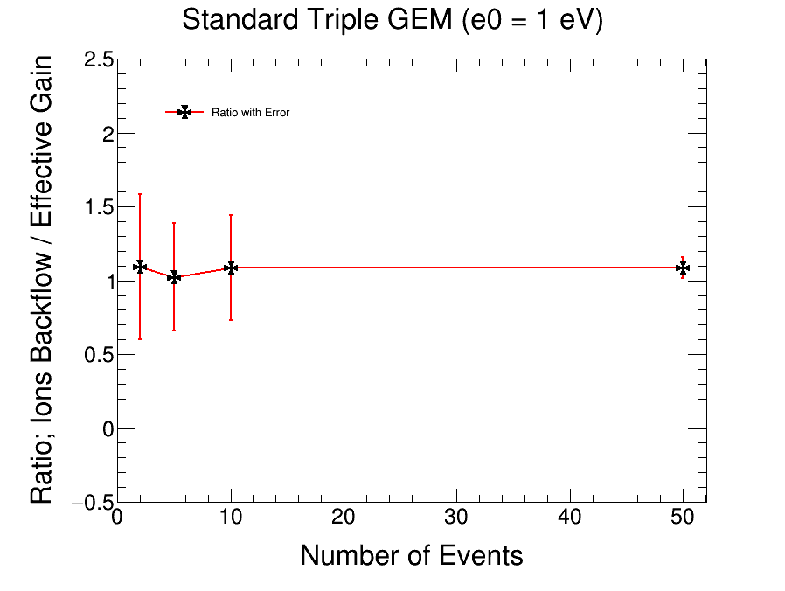
Results: Ratio of ion backflow and effective gain for standard GEM
The ion backflow to effective gain ratio has been evaluated as a function of the number of events.
For the standard GEM, the ratio remains largely independent of the number of events.
Statistical uncertainty is large for small samples but decreases with increasing events.
Sachin Rana
HOT QCD 3.0 - 2025 (IIT Bhilai)
10

Slide 12
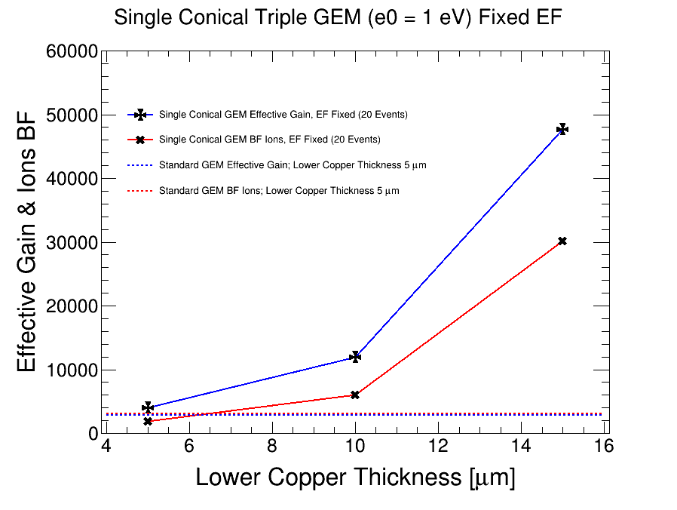
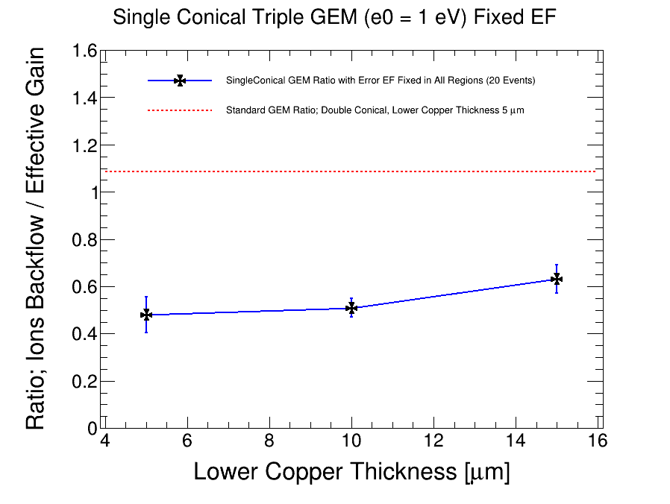
Results: Single Conical Hole E₀ = 1 eV (20 Events)
Both effective gain and ion backflow are increasing with increase in lower copper thickness.
Increase in gain is more compared to that of ion backflow, with increasing copper thickness
The ion backflow/Effective gain ratio reduced to nearly 50%, compared to the standard GEM configuration.
Sachin Rana
HOT QCD 3.0 - 2025 (IIT Bhilai)
11

Slide 13
Summary and Conclusions
Compared standard geometry with a modified geometry.
For the lower energies (e < 15.7eV), the effective gain and ion backflow exhibit overlapping behavior.
With increasing energy, both gain and ion backflow are increasing.
Increase in gain is more compared to that of ion backflow, with increasing copper thickness
Ratio of ion backflow to the effective gain reduced significantly (40-50%) for the newly proposed geometry.
Modified geometry with single cone is highly effective in both reducing ion backflow and increasing gain.
Sachin Rana
HOT QCD 3.0 - 2025 (IIT Bhilai)
12

Slide 14

Thank You!!
Sachin Rana
HOT QCD 3.0 - 2025 (IIT Bhilai)
14

Slide 15
Backup Slides
Sachin Rana
HOT QCD 3.0 - 2025 (IIT Bhilai)
15

Slide 16
Sachin Rana
HOT QCD 3.0 - 2025 (IIT Bhilai)
16

Slide 17
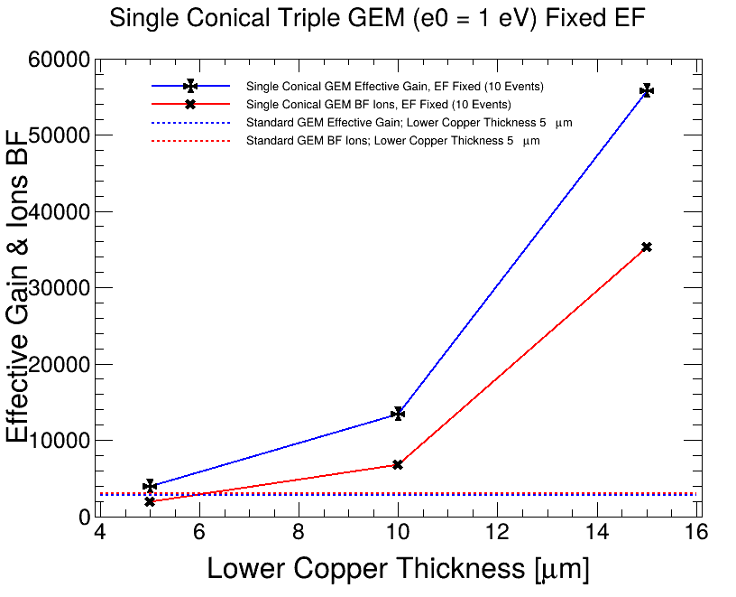

Results: Single Conical Hole E₀ = 1 eV (10 Events)
Both effective gain and ion backflow are increasing with increase in lower copper thickness.
Increase in gain is more compared to that of ion backflow, with increasing copper thickness
The ion backflow/Effective gain ratio reduced to nearly 50%, compared to the standard GEM configuration.
Sachin Rana
HOT QCD 3.0 - 2025 (IIT Bhilai)
11

