Slide 1

Heavy Flavor Jet Quenching in Pb–Pb Collisions Using JETSCAPE Framework
HOT QCD MATTER - 2025
4th September 2025, IIT Bhilai
Manaswini Priyadarshini, A Rathore, J Kalani, M Gupta, P Palni
Email: manaswini.priyadarshini@cern.ch

Slide 2
Outline
Motivation of the study
Nuclear modification Factor
Mass Hierarchy of Jet Quenching
JETSCAPE Framework
  MATTER
  LBT and AdS/CFT
Results and discussions
Conclusions

Slide 3
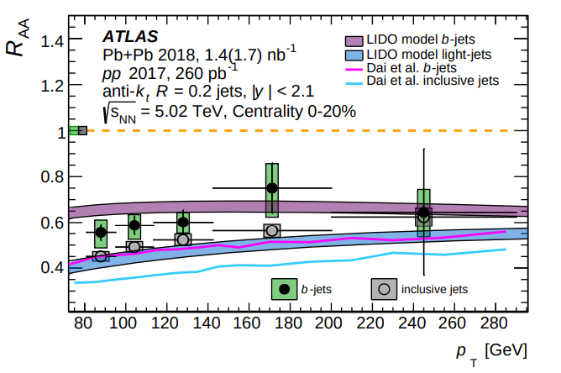
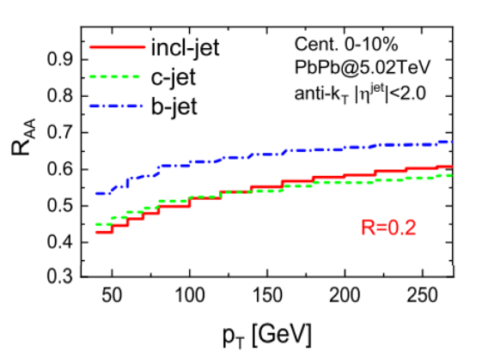

Motivation of The Study
Heavy-flavor jets (b, c) serve as precision probes of the QGP because their large quark masses significantly modify their interactions with the medium, which helps in disentangling the role of quark mass in parton energy loss.
We investigate the mass hierarchy of jet quenching by comparing b- and c-jets to inclusive jets to probe the QCD-predicted energy-loss ordering Δ$E_{b}$ < Δ$E_{c}$ < Δ$E_{light}$ .
[Eur. Phys. J. C (2023) 83, 438]
[Chinese Physics C Vol. 49, No. 6 (2025) 064101]

Slide 4
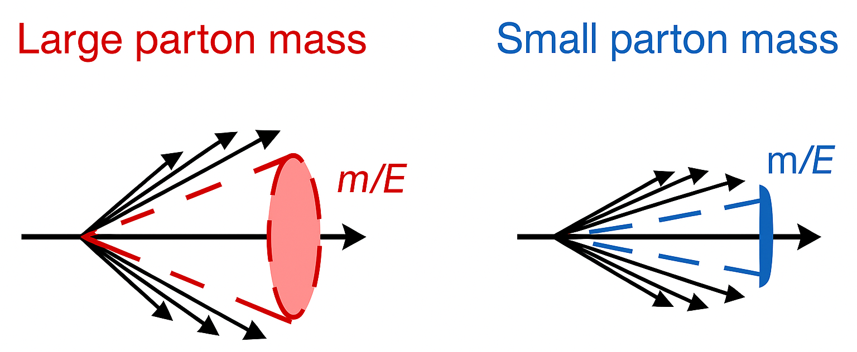


Motivation of The Study
Dead-cone effect as a key signature: Heavy quarks (b, c) radiate less at small angles due to their finite mass, leading to suppressed gluon emission. This modifies internal jet substructure and produces distinct quenching patterns compared to light jets.
  Larger mass ($m_{q})$ → larger dead cone angle
  Higher energy ($E_{q}≫m_{q})$ → smaller dead cone angle
$$θ_{q} \sim \frac{m_{q}}{E_{q}}$$

Slide 5
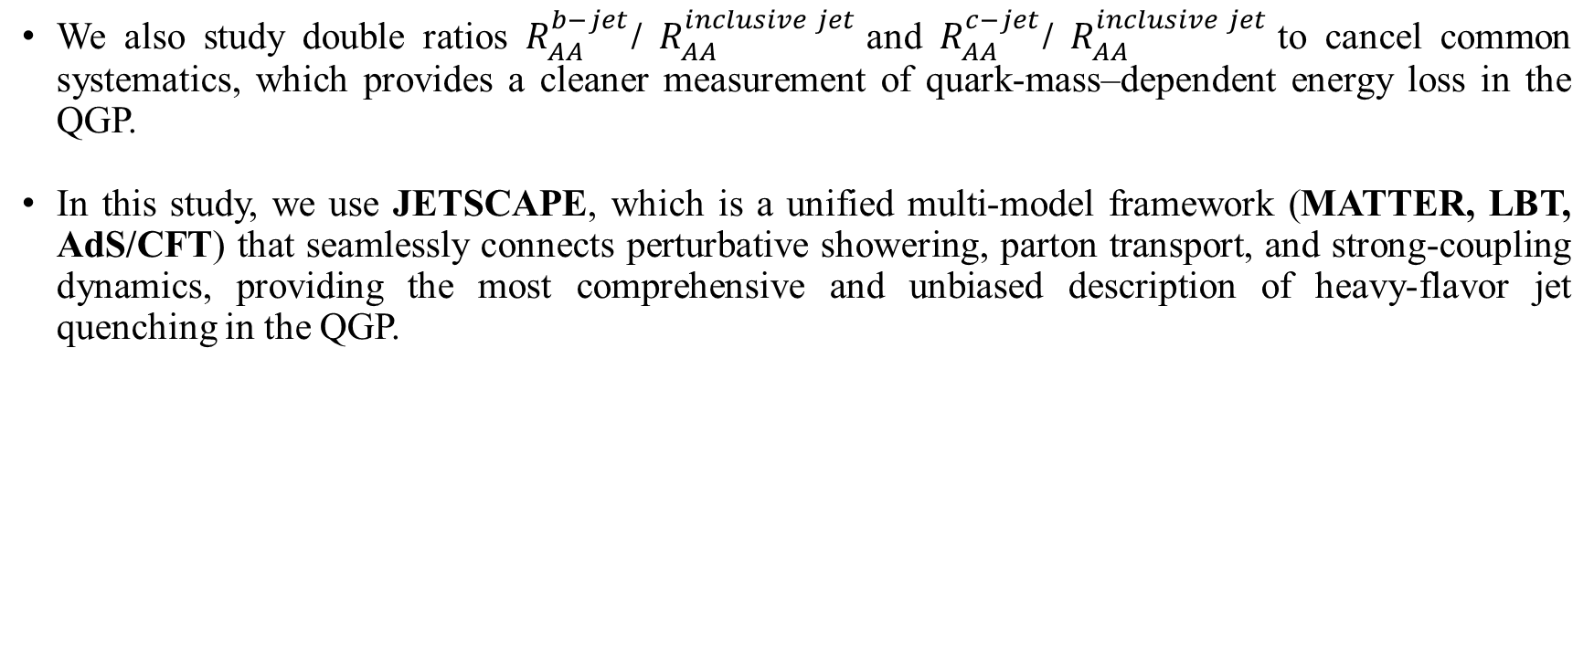
Motivation of The Study
We also study double ratios $R_{AA}^{b−jet}$/ $R_{AA}^{inclusive jet}$and $R_{AA}^{c−jet}$/ $R_{AA}^{inclusive jet}$to cancel common systematics, which provides a cleaner measurement of quark-mass–dependent energy loss in the QGP.
In this study, we use JETSCAPE, which is a unified multi-model framework (MATTER, LBT, AdS/CFT) that seamlessly connects perturbative showering, parton transport, and strong-coupling dynamics, providing the most comprehensive and unbiased description of heavy-flavor jet quenching in the QGP.

Slide 6
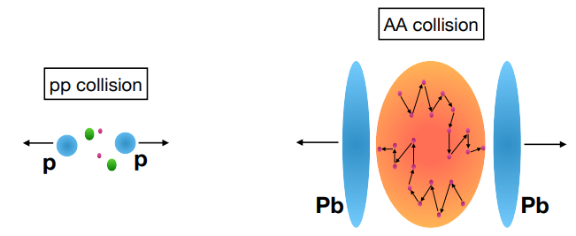
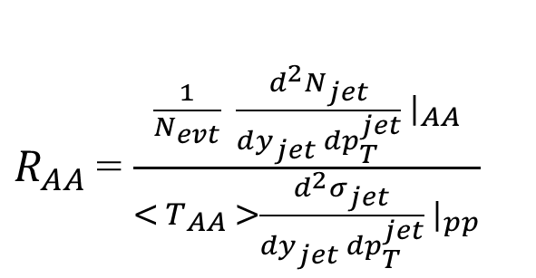
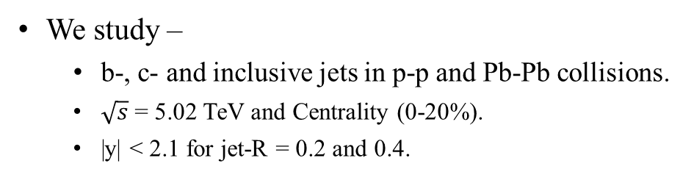
Nuclear Modification Factor
Measures jet suppression in heavy-ion collisions (A+A) compared to proton-proton collisions.
$R_{AA}$ = $\frac{\frac{1}{N_{evt}} \frac{d^{2}N_{jet}}{dy_{jet} dp_{T}^{jet}} {\left.​\right|}_{AA}}{< T_{AA} >\frac{d^{2}σ_{jet}}{dy_{jet} dp_{T}^{jet}} |_{pp}}$
We study –
  b-, c- and inclusive jets in p-p and Pb-Pb collisions.
  $\sqrt{s}$ = 5.02 TeV and Centrality (0-20%).
  |y| < 2.1 for jet-R = 0.2 and 0.4.

Slide 7
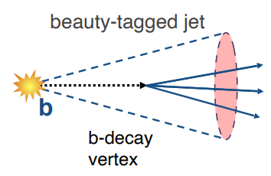
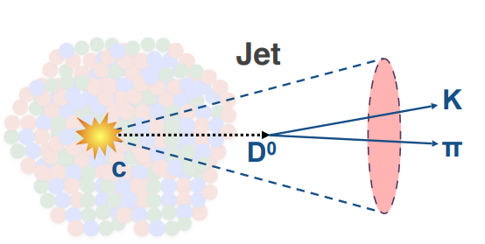
Mass Hierarchy of Jet Quenching
[ JETSCAPE online summer school 2023 ]
Energy loss in the medium depends on parton type: (i) color charge and (ii) mass.
  Gluons & light quarks (u, d, s): Strongest energy loss due to large color charge and no mass suppression.
  Charm quarks (c): Moderate energy loss due to reduced dead cone effect.
  Bottom quarks (b): Least energy loss due to large dead cone effect.
ΔE(g) > ΔE(u, d, s) > ΔE(c) > ΔE(b)
$R_{AA} (inclusive jets)$ < $R_{AA} (c−jets)$ < $R_{AA} (b−jets)$

Slide 8
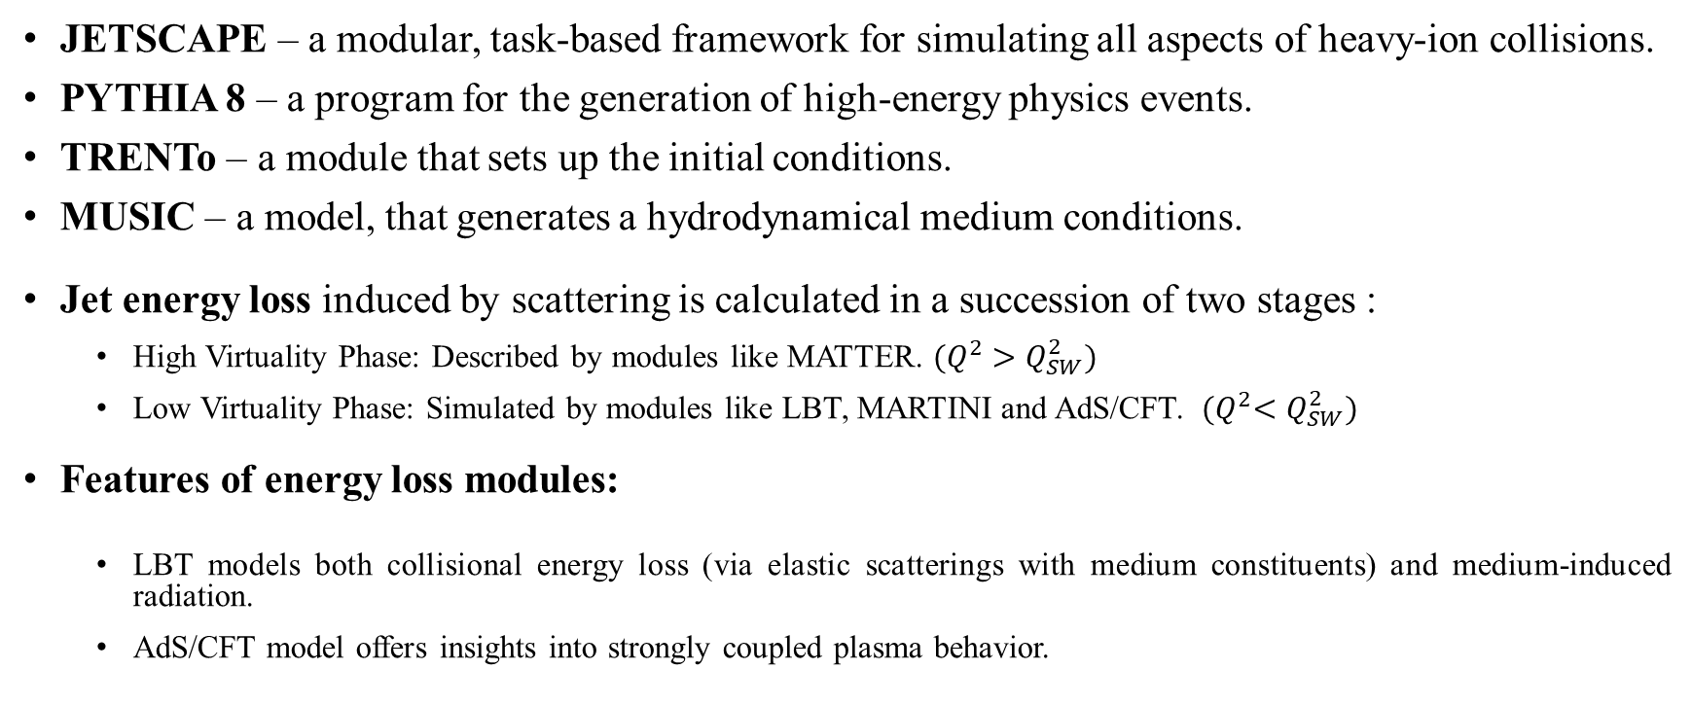
JETSCAPE Framework
JETSCAPE – a modular, task-based framework for simulating all aspects of heavy-ion collisions.
PYTHIA 8 – a program for the generation of high-energy physics events.
TRENTo – a module that sets up the initial conditions.
MUSIC – a model, that generates a hydrodynamical medium conditions.
Jet energy loss induced by scattering is calculated in a succession of two stages :
  High Virtuality Phase: Described by modules like MATTER. ${(Q}^{2} >Q_{SW}^{2})$
  Low Virtuality Phase: Simulated by modules like LBT, MARTINI and AdS/CFT. ${(Q}^{2}<Q_{SW}^{2})$
Features of energy loss modules:
  LBT models both collisional energy loss (via elastic scatterings with medium constituents) and medium-induced radiation.
  AdS/CFT model offers insights into strongly coupled plasma behavior.

Slide 9
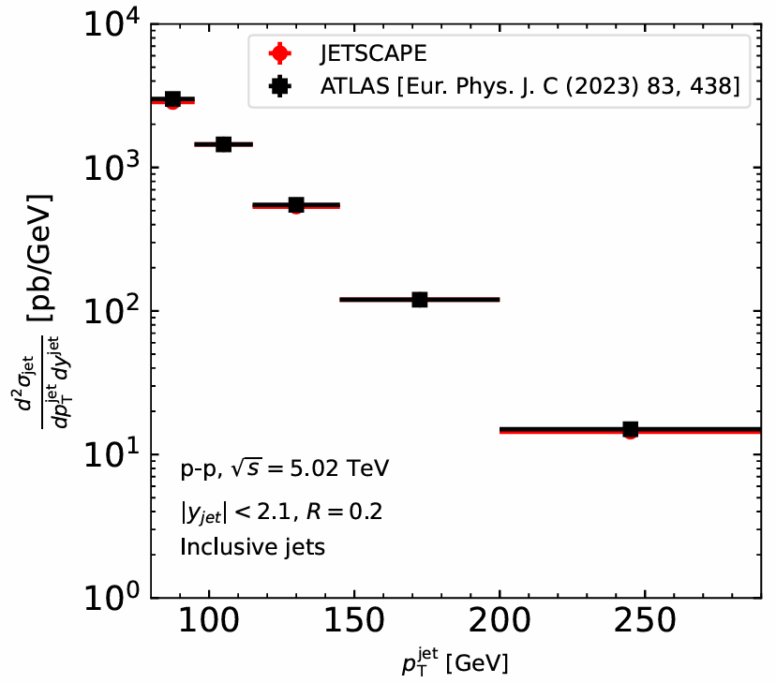
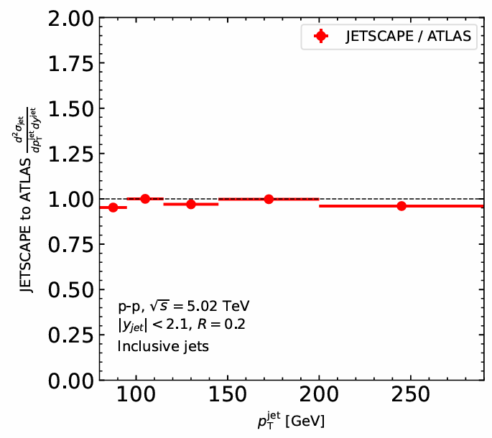
Inclusive Jets in p-p
Fig: Differential cross section of inclusive jets in pp collisions for jet radius 𝑅 = 0.2, obtained from JETSCAPE and compared with ATLAS measurements.
The JETSCAPE simulation shows excellent agreement with ATLAS data for inclusive jet cross sections in p–p, validating the framework for jet production modelling.

Slide 10
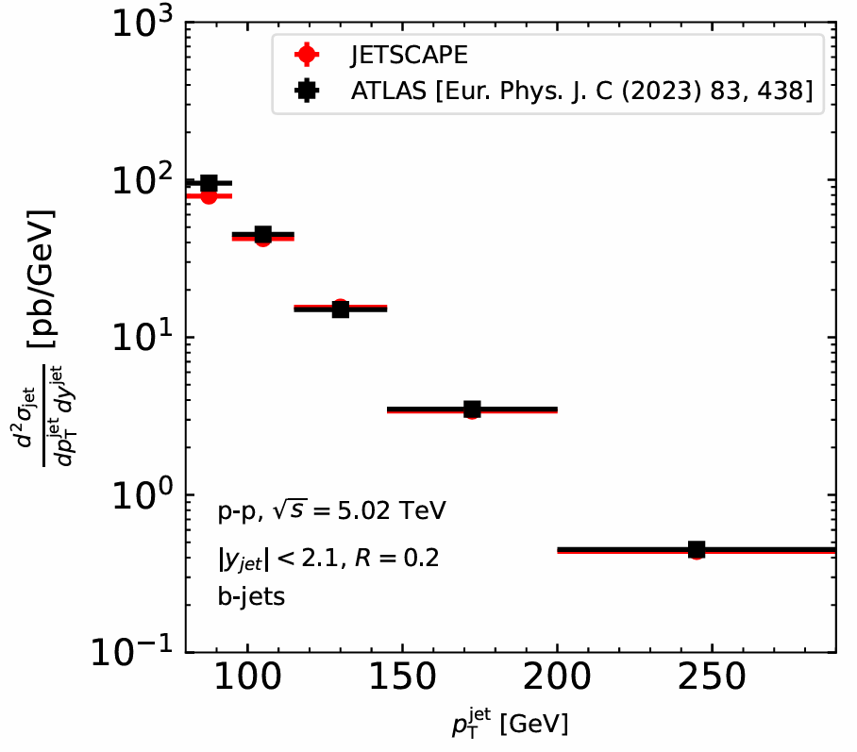
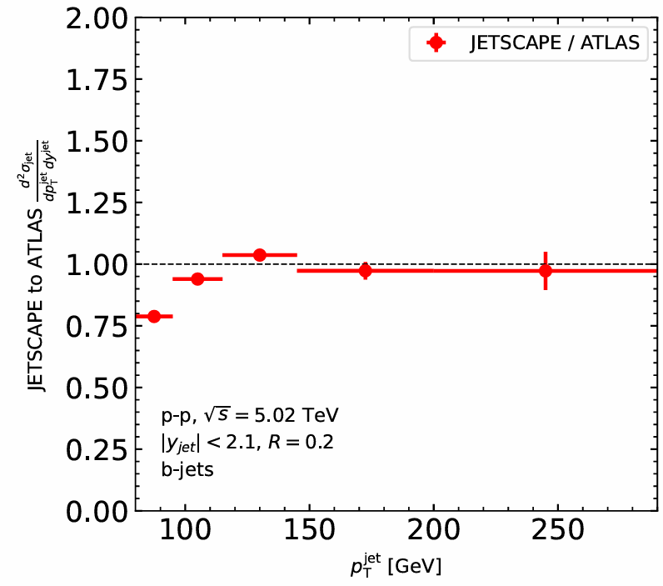
b-jets in p-p
Fig: Differential cross section of b-jets in pp collisions for jet radius 𝑅 = 0.2, obtained from JETSCAPE and compared with ATLAS measurements.
The JETSCAPE framework accurately reproduces the differential cross section of b-jets in p–p collisions, showing good agreement with ATLAS measurements across a wide $p_{T}$ range.

Slide 11
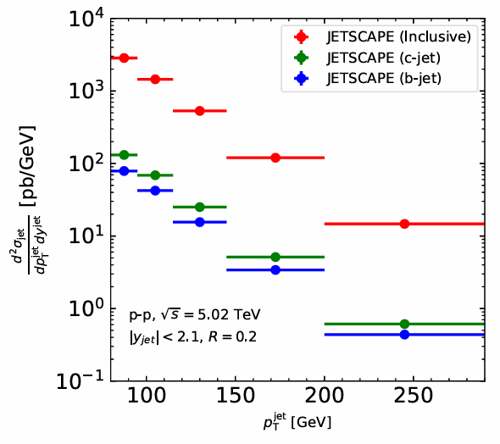
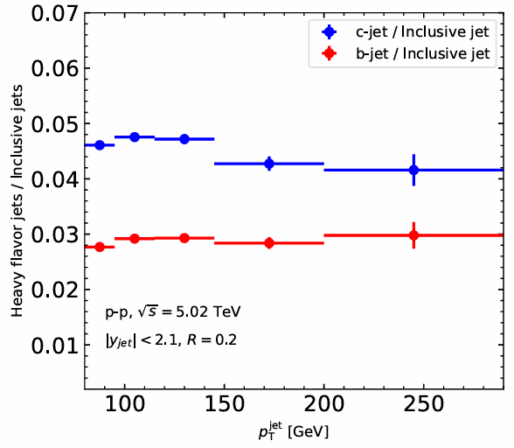
Inclusive, b- and c- jets in p-p
Fig: Differential cross section of heavy flavor (b and c) jets and inclusive jets in pp collision for R = 0.2
The differential cross sections show that inclusive jet production dominates over heavy-flavor jets, with c-jets contributing more than b-jets, as seen from their respective ratios to inclusive jets across the $p_{T}$​ range.

Slide 12
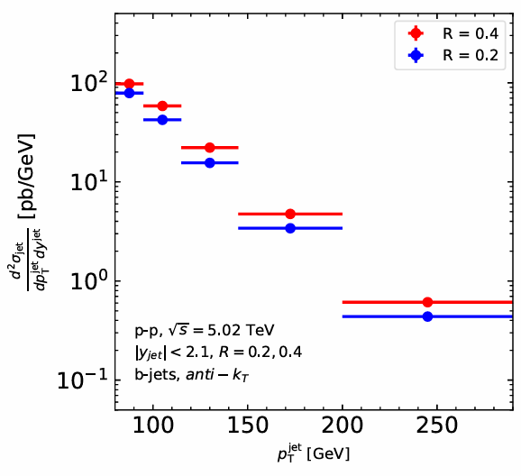
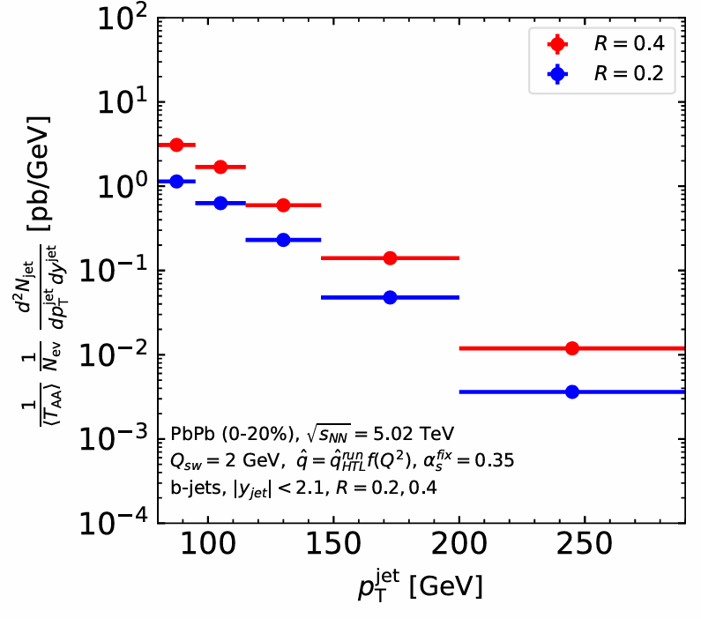
b-jets for Different Jet-R in p-p and Pb-Pb
Fig: b-jet spectra in both p–p and Pb-Pb collisions at √s = 5.02 TeV for jet radii R = 0.2 and 0.4
The b-jet spectra show higher yields for larger jet radii (𝑅 = 0.4) compared to smaller radii (𝑅 = 0.2) in both p–p and Pb–Pb collisions, with a more pronounced suppression in Pb–Pb due to strong jet quenching effects in the QGP medium.

Slide 13
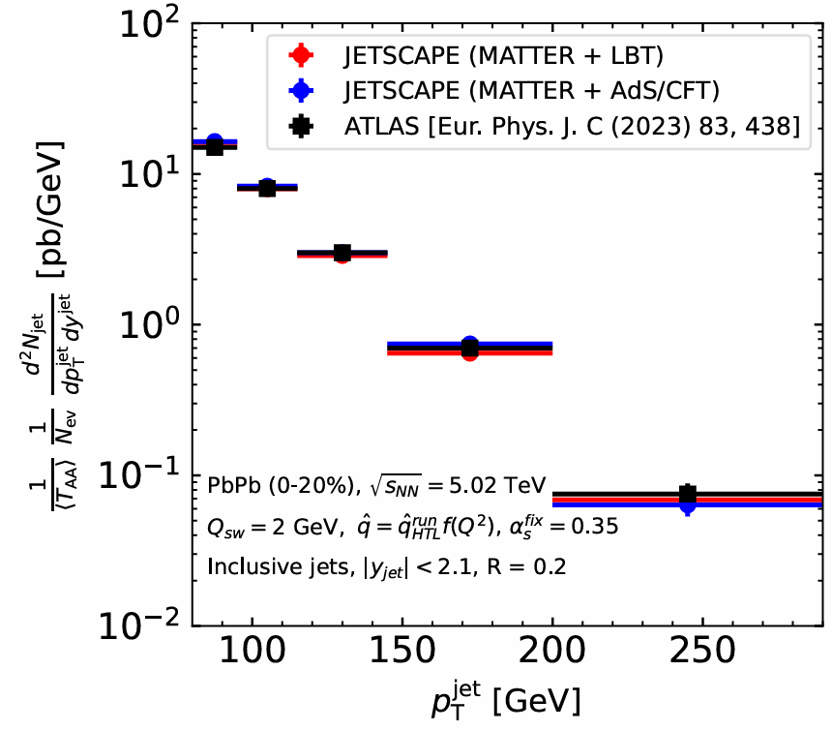
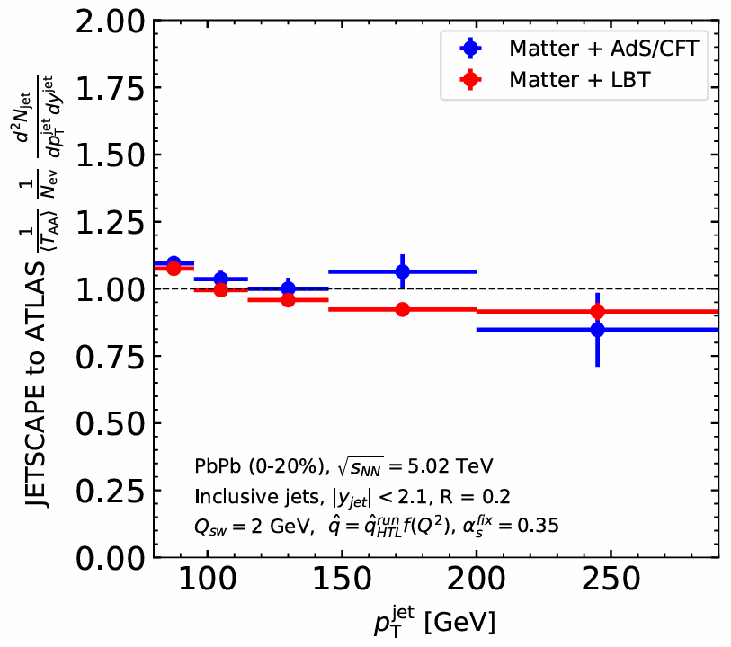
Inclusive Jets in Pb-Pb
Fig: Differential cross section of inclusive jets in Pb-Pb collisions for jet radius 𝑅 = 0.2, obtained from JETSCAPE and compared with ATLAS measurements.
In central Pb–Pb collisions, both MATTER + LBT and MATTER + AdS/CFT models within JETSCAPE successfully reproduce the measured inclusive jet spectra, providing well agreement with ATLAS measurements.

Slide 14
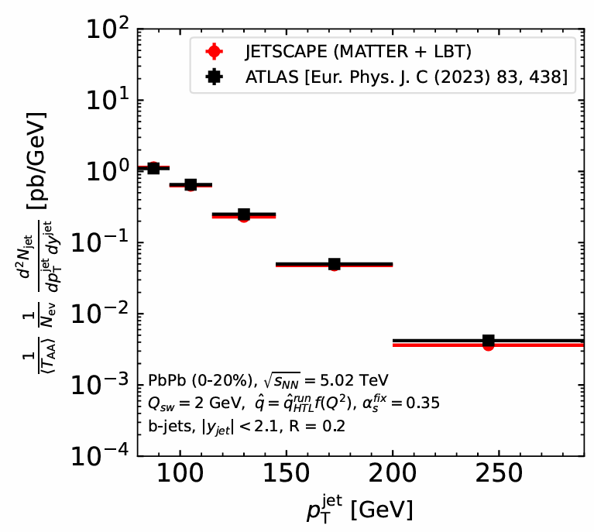
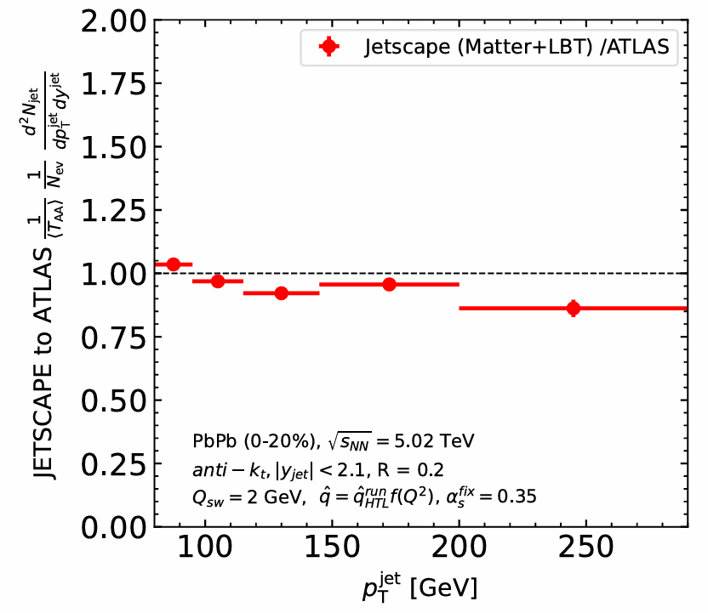
b-jets in Pb-Pb
Fig: Differential cross section of b-jets in Pb-Pb collisions for jet radius 𝑅 = 0.2, obtained from JETSCAPE and compared with ATLAS measurements.
JETSCAPE (MATTER+LBT) successfully captures b-jet spectra in central Pb–Pb collisions, showing excellent agreement with ATLAS data.

Slide 15
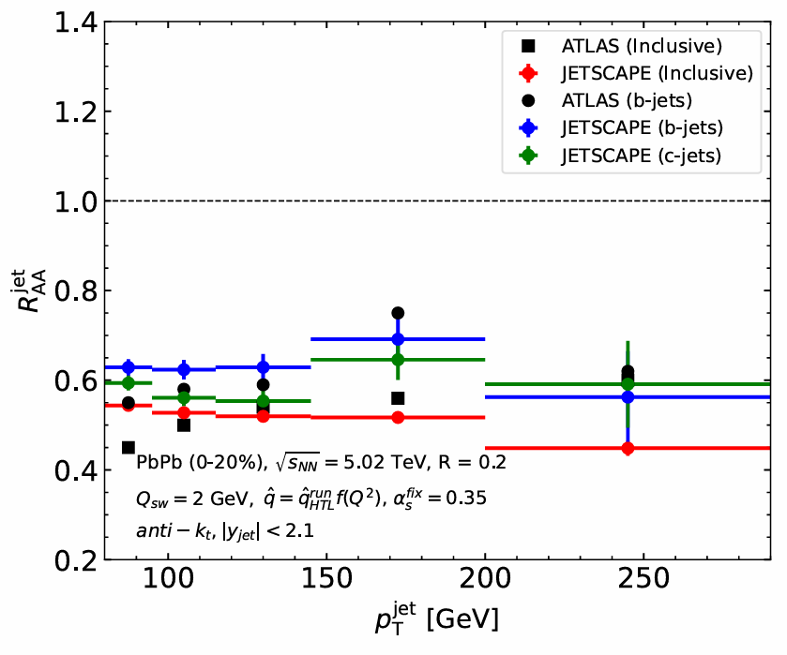

$R_{AA}$ in Pb-Pb Collision (0-20%)
fig: Jet-$R_{AA}$ as a function of jet-$p_{T}$ for the central (0-20%) Pb+Pb collisions at $\sqrt{S_{NN}}$= 5.02 TeV for the b-, c- and inclusive jets.
The $R_{AA}$​ follows the expected energy loss hierarchy: $R_{AA} (inclusive jets)$ < $R_{AA} (c−jets)$ < $R_{AA} (b−jets)$, reflecting the mass-dependent suppression where heavier quarks lose less energy in the QGP.

Slide 16
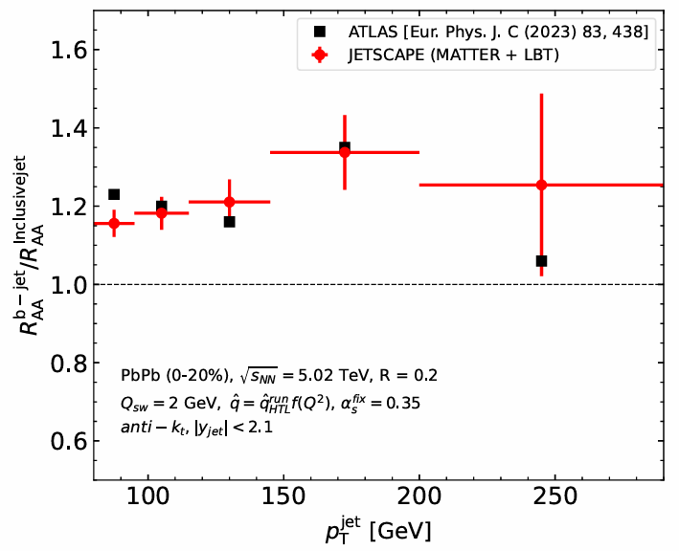
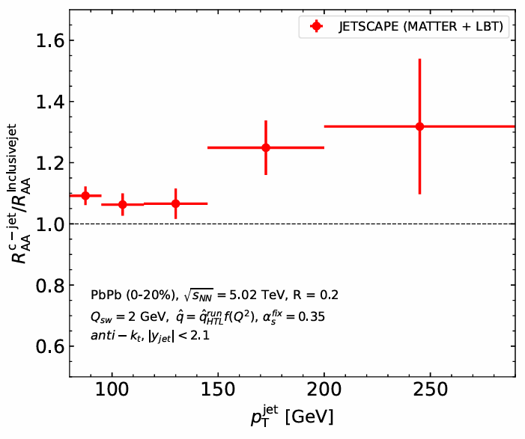
Comparison of $R_{AA}$ of Heavy Jets with Inclusive Jets
fig: Jet-$R_{AA}$ double ratio of b- and c- jets with respect to inclusive jets.
The double ratios obtained using MATTER + LBT within JETSCAPE​ are consistently above unity, showing that heavy-flavor jets (b and c) are less suppressed than inclusive jets, in agreement with the expected mass hierarchy of parton energy loss.

Slide 17
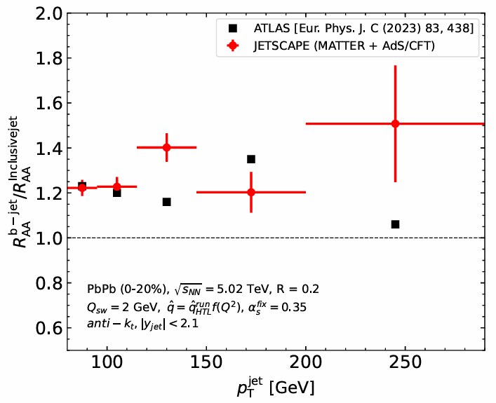
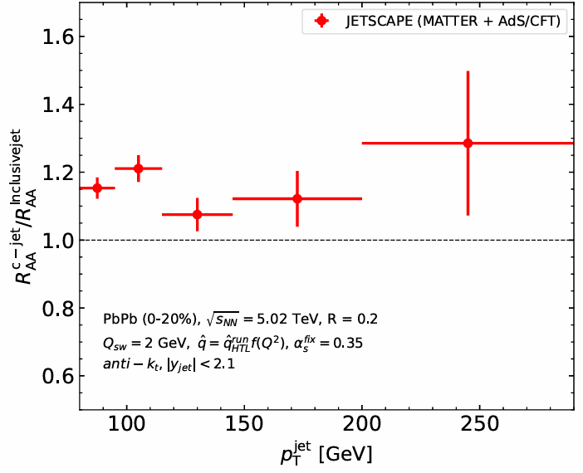
Comparison of $R_{AA}$ of Heavy Jets with Inclusive Jets
fig: Jet-$R_{AA}$ double ratio of b- and c- jets with respect to inclusive jets.
With MATTER + AdS/CFT, the double ratios show a larger enhancement than MATTER+LBT, reflecting the stronger coupling and drag-dominated energy loss in AdS/CFT.

Slide 18
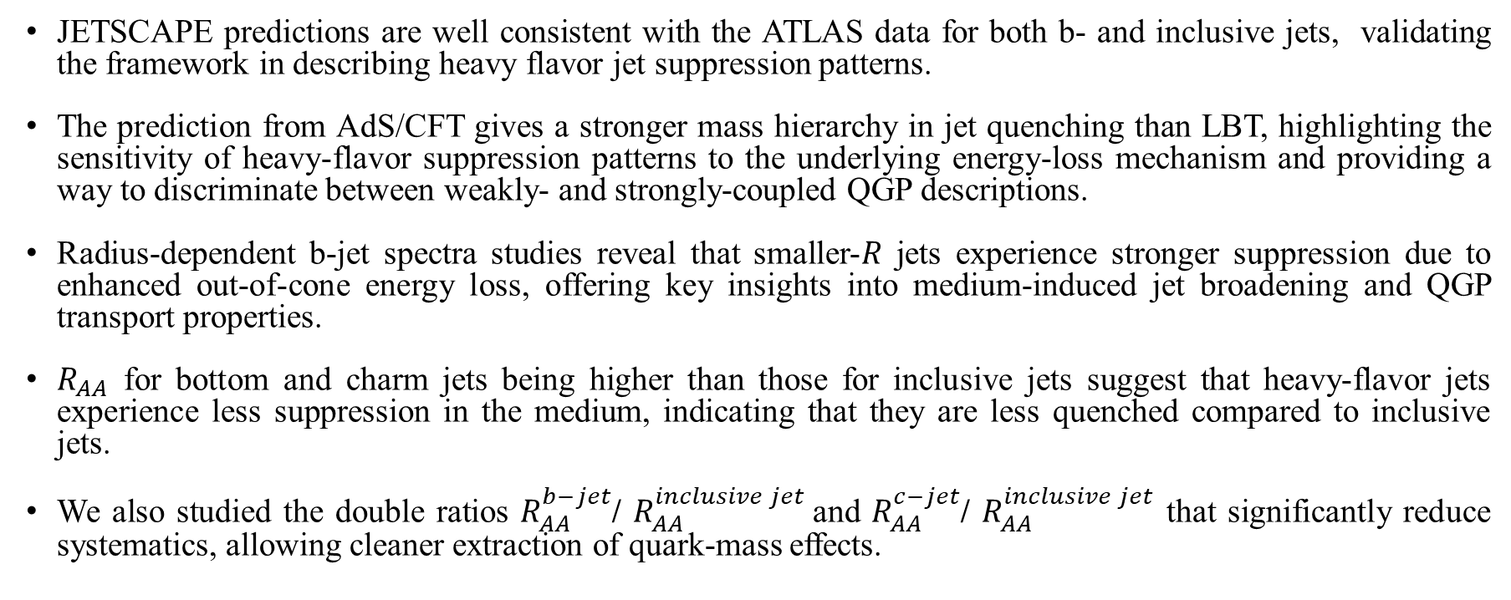
Conclusion
JETSCAPE predictions are well consistent with the ATLAS data for both b- and inclusive jets, validating the framework in describing heavy flavor jet suppression patterns.
The prediction from AdS/CFT gives a stronger mass hierarchy in jet quenching than LBT, highlighting the sensitivity of heavy-flavor suppression patterns to the underlying energy-loss mechanism and providing a way to discriminate between weakly- and strongly-coupled QGP descriptions.
Radius-dependent b-jet spectra studies reveal that smaller-𝑅 jets experience stronger suppression due to enhanced out-of-cone energy loss, offering key insights into medium-induced jet broadening and QGP transport properties.
$R_{AA}$ for bottom and charm jets being higher than those for inclusive jets suggest that heavy-flavor jets experience less suppression in the medium, indicating that they are less quenched compared to inclusive jets.
We also studied the double ratios $R_{AA}^{b−jet}$/ $R_{AA}^{inclusive jet}$and $R_{AA}^{c−jet}$/ $R_{AA}^{inclusive jet}$ that significantly reduce systematics, allowing cleaner extraction of quark-mass effects.
Thank You For Your Attention !!!

Slide 19


Slide 20
Back Up Slides

Slide 21
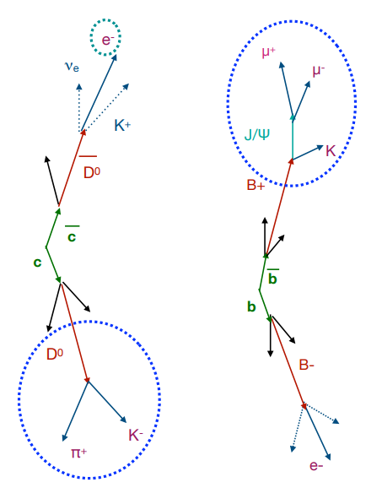
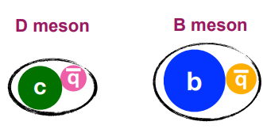
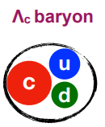
Measurement of Heavy Flavor:
Heavy Flavour:
Heavy quarks (c, b) hadronize with light quarks (q)
Form mesons:
• D mesons (D⁰, D⁺, Dₛ, D*⁺)
• B mesons (B⁰, B⁺, …)
Probe in-medium interactions
• Depend on quark mass and color charge
Study fragmentation & hadronization in presence of medium
ΔE(g) > ΔE(u, d, s) > ΔE(c) > ΔE(b)

Slide 22
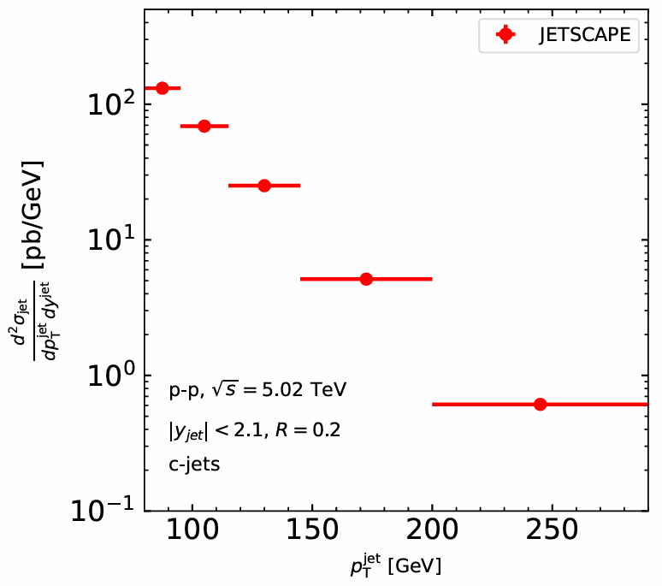
c-jets in p-p:
Fig: Differential cross section of c-jets in pp collisions for jet radius 𝑅 = 0.2, obtained using JETSCAPE framework.

Slide 23
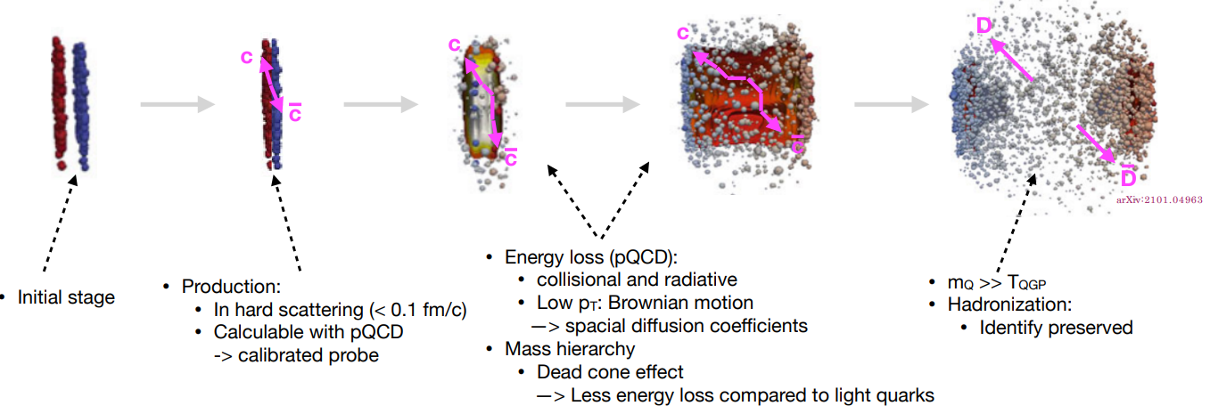
Heavy quarks in HOT QCD medium:
Heavy quarks (c, b) are produced early in hard scatterings, calculable using pQCD, and serve as calibrated probes to study the QGP.
[ JETSCAPE online summer school 2023 ]

Slide 24
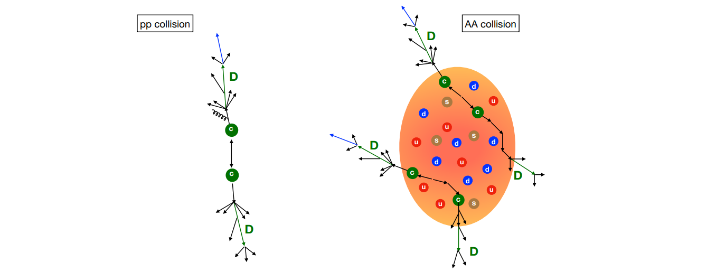
Jet Structure and fragmentation:
In heavy-ion (AA) collisions, the jet shower interacts with the hot QGP medium, leading to modifications in jet structure and fragmentation compared to proton-proton (pp) collisions.
The medium-induced interactions in AA collisions cause additional energy loss and broadening of the jet, altering the distribution of final-state hadrons like 𝐷 mesons.
[ JETSCAPE online summer school 2023 ]

Slide 25
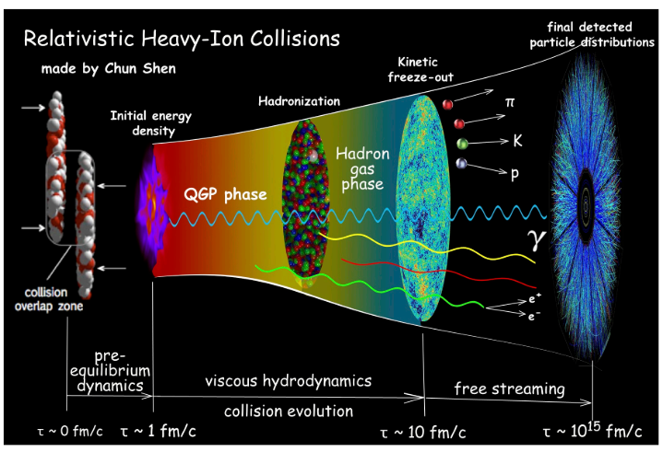
Relativistic Heavy-ion Collision:

Slide 26
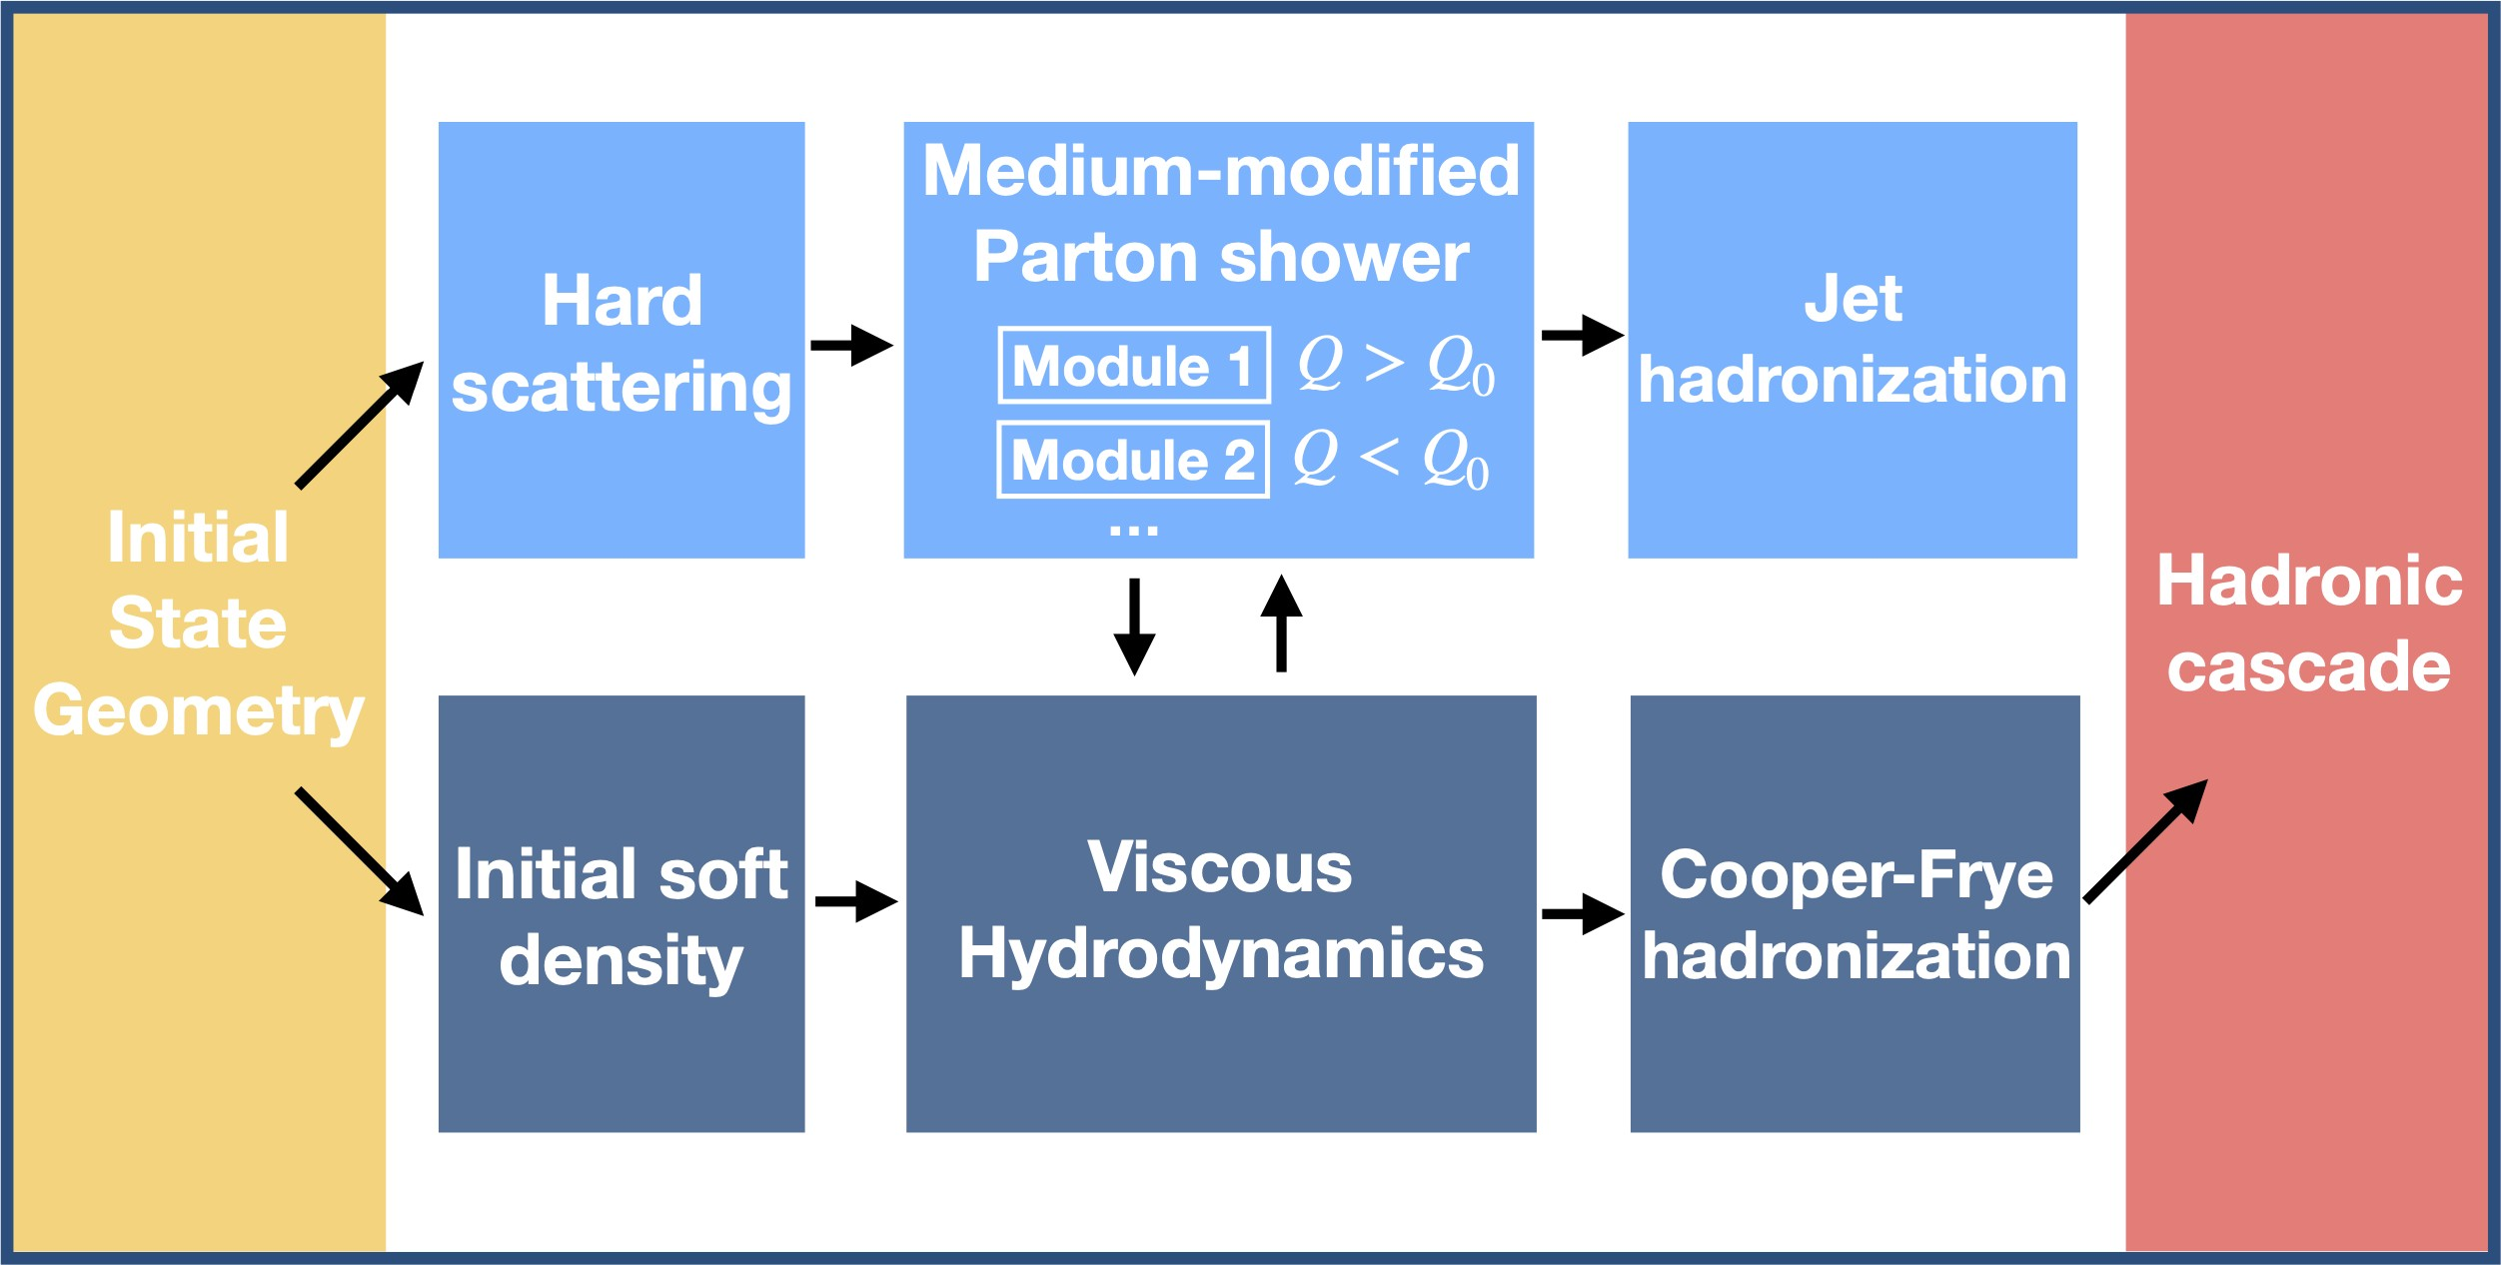
JETSCAPE Framework
[https://github.com/JETSCAPE/JETSCAPE JETSCAPE Manual: arXiv:1903.07706 ]

Slide 27
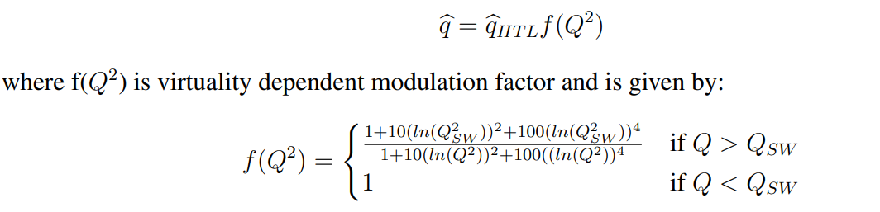

Coherence Effect

