Slide 1

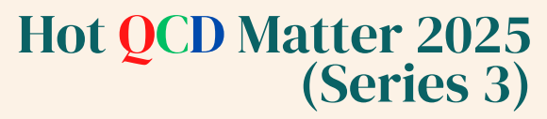
Kinetic Discriminants of DPS in Vector Boson Final States
Anuraag Rathore, M Priyadarshini, J Kalani, P Palni
Sept 4, 2025

Slide 2
Outline
Double Parton Scattering
Why DPS
Vector Bosonic Final States
Results and Discussions
Summary
4 Sept 2025 Anuraag Rathore (IIT Mandi) 2/21

Slide 3
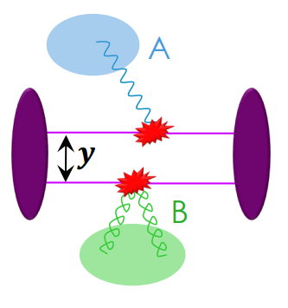
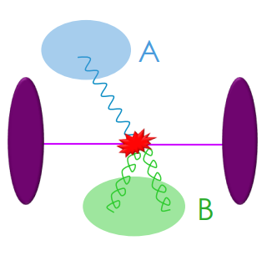
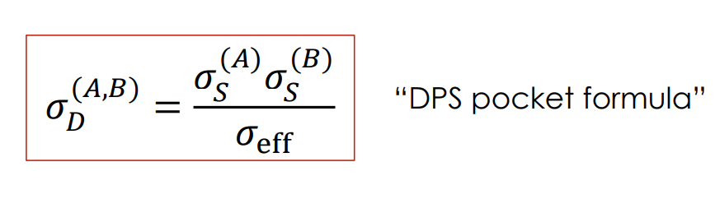
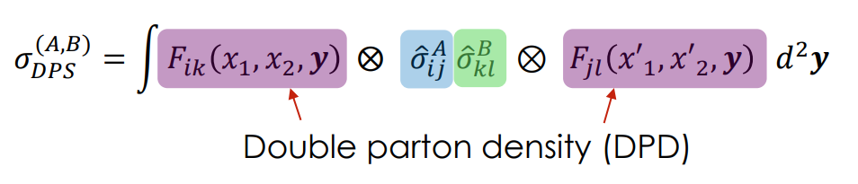

Double Parton Scattering
Two separate hard scattering from a single pp collision
SPS
DPS
DPS Factorization Formula :
4 Sept 2025 Anuraag Rathore (IIT Mandi) 3/21

Slide 4
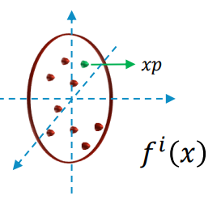
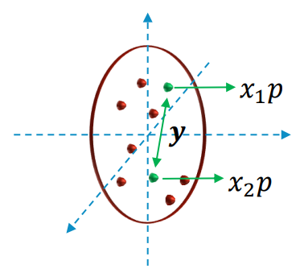


Why DPS ?
Unique window to probe correlation between partons
  So far have lots of information on single parton distributions (PDFs, GPDs, TMDs,..) – only tells us about distribution of a single parton
Clean experimental signature (WW, WZ, ZZ)
Unique feature of MPI.
source: Jonathan Gaunt - DPS WW (LHC-EW Multiboson WG meeting, 30/06/25)
4 Sept 2025 Anuraag Rathore (IIT Mandi) 4/21

Slide 5
Why DPS ?
DPS reveals new information about the structure of the proton – in particular, correlations between partons in the proton.
DPS becomes more important relative to SPS as the collider energy grows, and we probe smaller x values where there is a larger density of partons.
source: Jonathan Gaunt - DPS WW
(LHC-EW Multiboson WG meeting, 30/06/25)
4 Sept 2025 Anuraag Rathore (IIT Mandi) 5/21

Slide 6
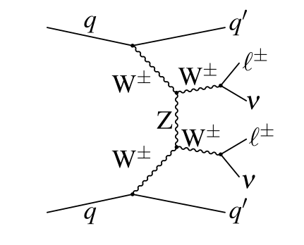
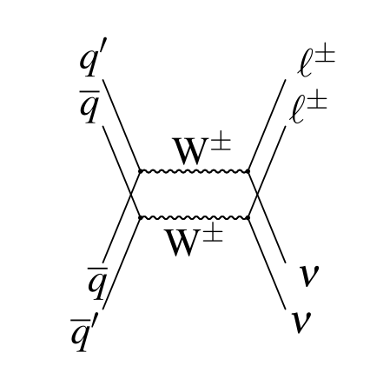
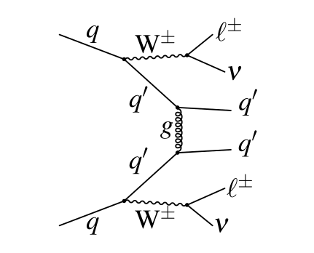
Vector Bosonic Final States: WW
SPS
DPS
4 Sept 2025 Anuraag Rathore (IIT Mandi) 6/21

Slide 7
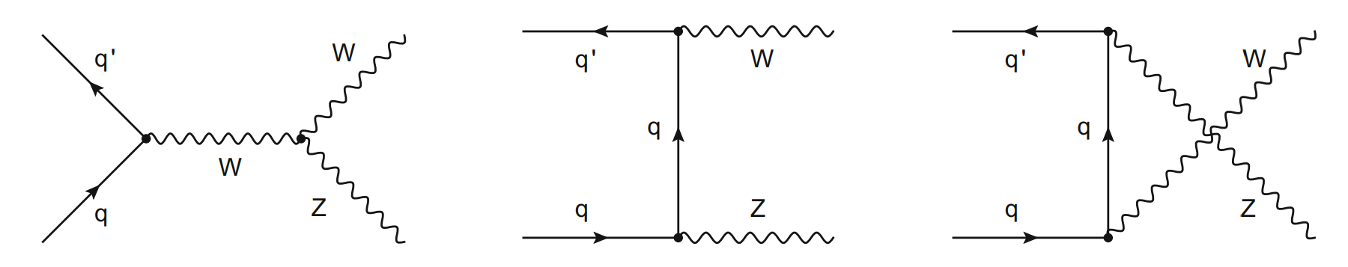
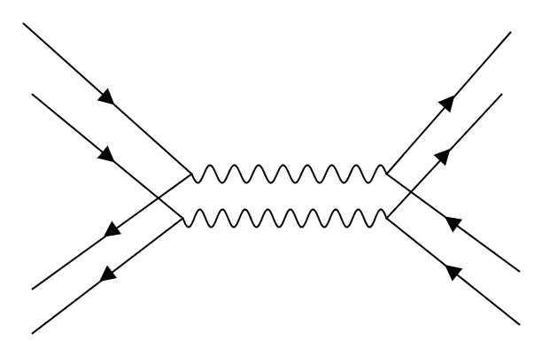
Vector Bosonic Final States: WZ
SPS
q
l⁺
q’
l⁺⁻
Z
DPS
W⁺⁻
qbar
l⁻
qbar
v_{l}
4 Sept 2025 Anuraag Rathore (IIT Mandi) 7/21

Slide 8
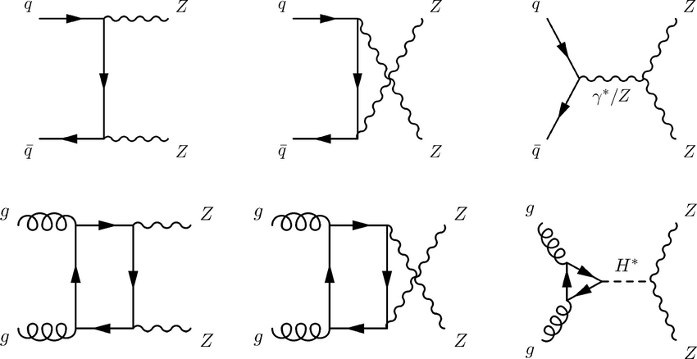
Vector Bosonic Final States: ZZ
DPS
q
l⁺
q
l⁺
Z
SPS
l⁻
Z
qbar
l⁻
qbar
4 Sept 2025 Anuraag Rathore (IIT Mandi) 8/21

Slide 9
Results and Discussion
PYTHIA8 MC generator has been used to simulate both processes SPS as well as DPS for dibosonic (WW, WZ, ZZ) final states at √s = 13 TeV.
4 Sept 2025 Anuraag Rathore (IIT Mandi) 9/21

Slide 10
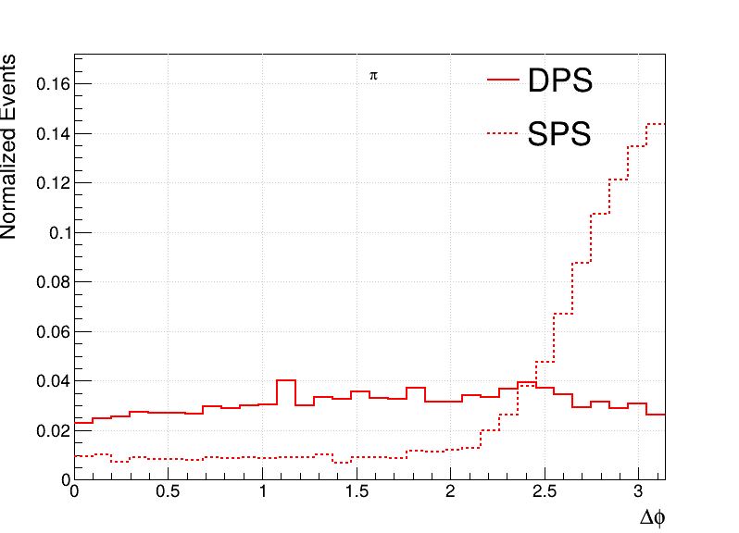
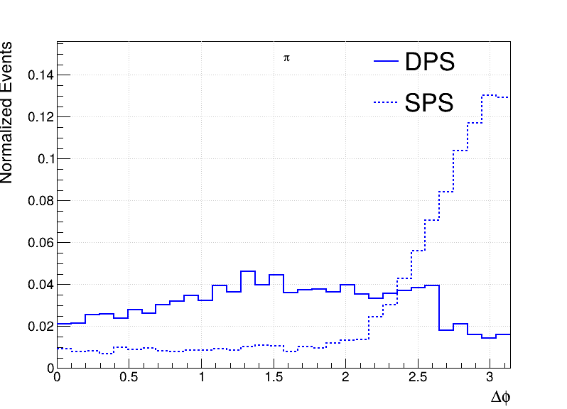
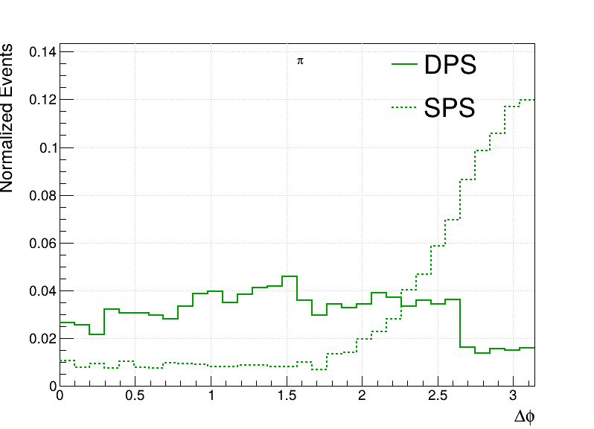
Azimuthal Separation Δ𝛗(V₁,V₂)
Ideally as both the bosons come from different hard scattering, we expect delta_phi to be flat for DPS.
For sps as they are correlated so should peak at pi, meaning back to back.
WW
WZ
ZZ
4 Sept 2025 Anuraag Rathore (IIT Mandi) 10/21

Slide 11
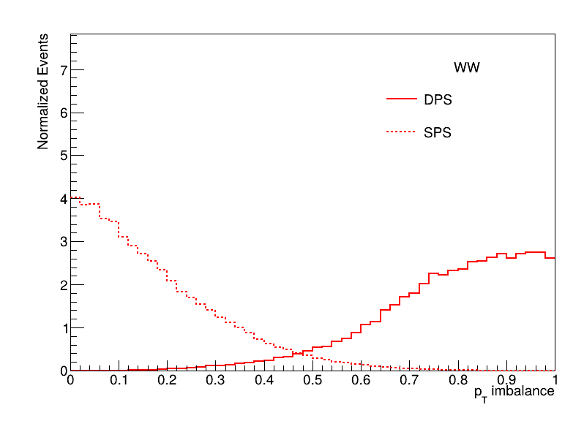
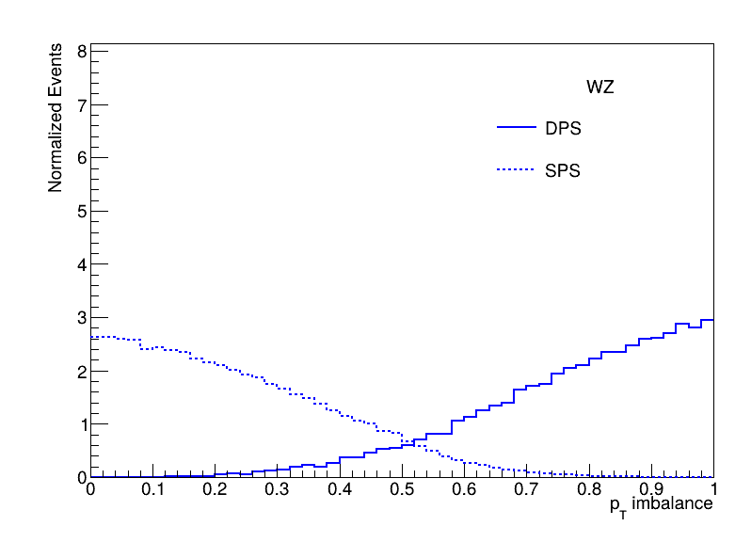
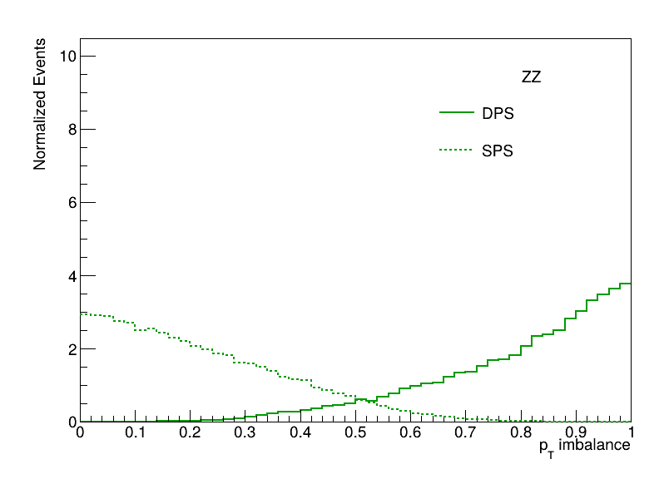
Relative p_{T} imbalance
Δ^{rel} p_{T}= ( |p_{T}^{V1}| - |p_{T}^{V2}| ) / ( |p_{T}^{V1} + p_{T}^{V2}| )
If imbalance→0 maximally correlated (back to back)
Elseif imbalance→1 not correlated.
4 Sept 2025 Anuraag Rathore (IIT Mandi) 11/21

Slide 12
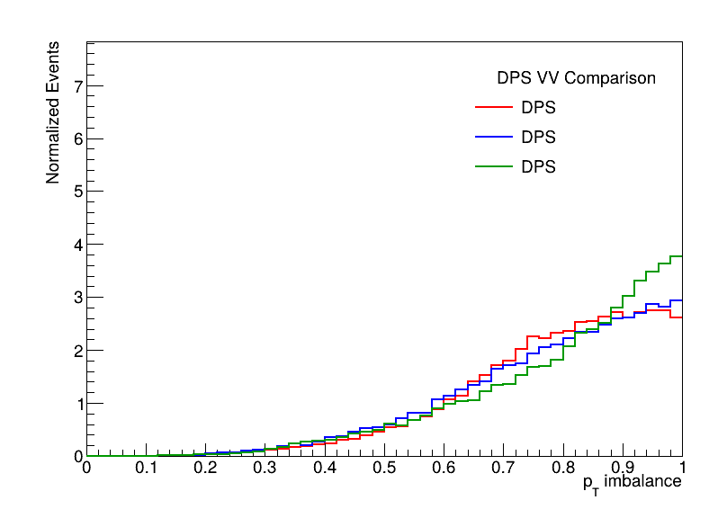
Relative p_{T} imbalance
Δ^{rel} p_{T}= ( |p_{T}^{V1}| - |p_{T}^{V2}| ) / ( |p_{T}^{V1} + p_{T}^{V2}| )
If imbalance→0 maximally correlated (back to back)
Elseif imbalance→1 not correlated.
WW
WZ
ZZ
4 Sept 2025 Anuraag Rathore (IIT Mandi) 12/21

Slide 13
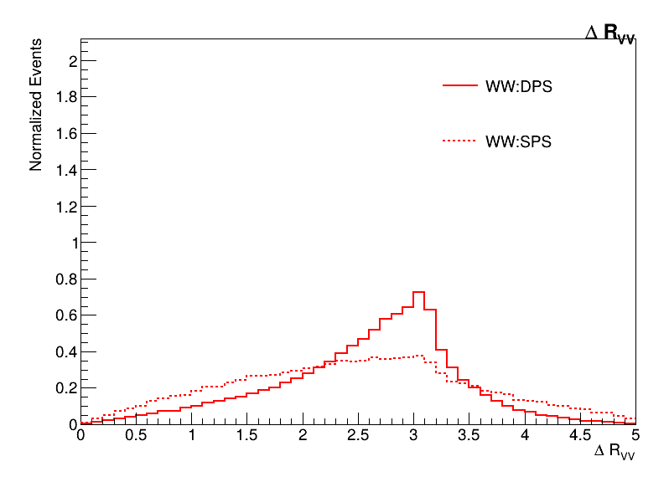
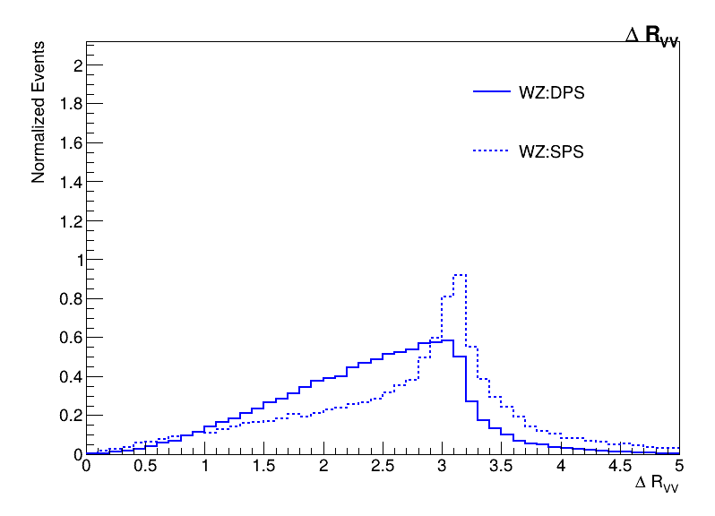
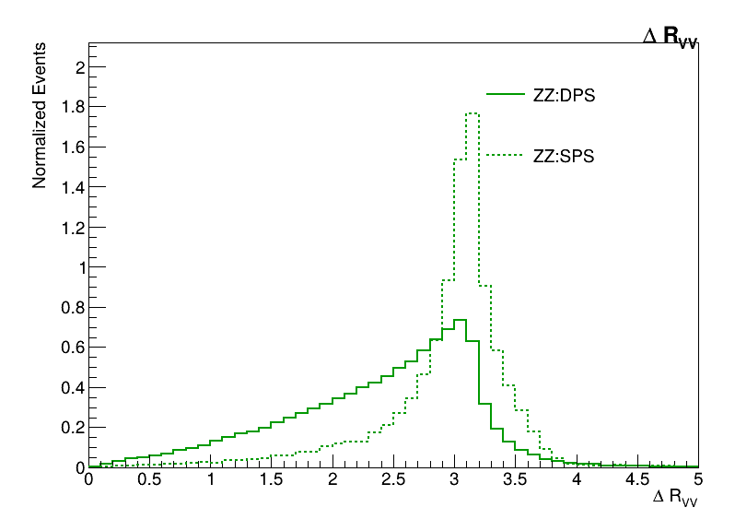
Angular Separation ΔR(V₁,V₂)
Measures the angular separation of the two bosons in the detector.
Small ΔR: bosons are produced close together (like in SPS).
Large ΔR: bosons are widely separated, more likely in DPS where the scatterings are uncorrelated in direction.
ΔR_{VV}= √(Δη_{VV})² + (Δ𝛗_{VV})²
4 Sept 2025 Anuraag Rathore (IIT Mandi) 13/21

Slide 14
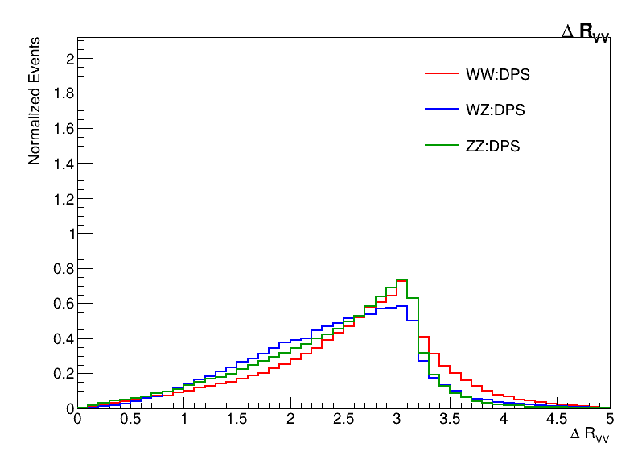
Angular Separation ΔR(V₁,V₂)
Measures the angular separation of the two bosons in the detector.
Small ΔR: bosons are produced close together (like in SPS).
Large ΔR: bosons are widely separated, more likely in DPS where the scatterings are uncorrelated in direction.
ΔR_{VV}= √(Δη_{VV})² + (Δ𝛗_{VV})²
4 Sept 2025 Anuraag Rathore (IIT Mandi) 14/21

Slide 15
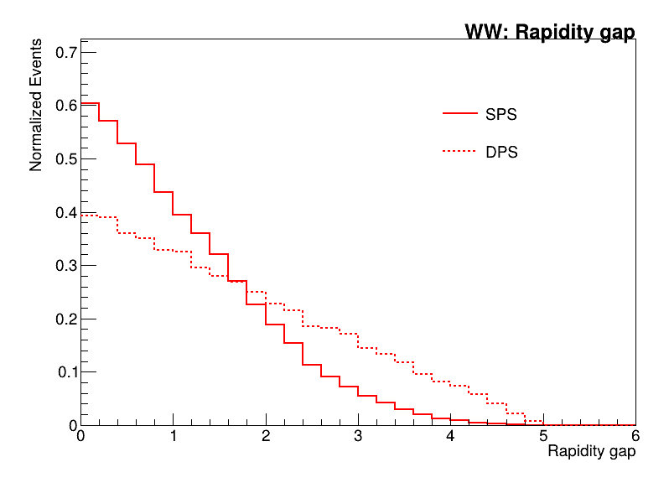
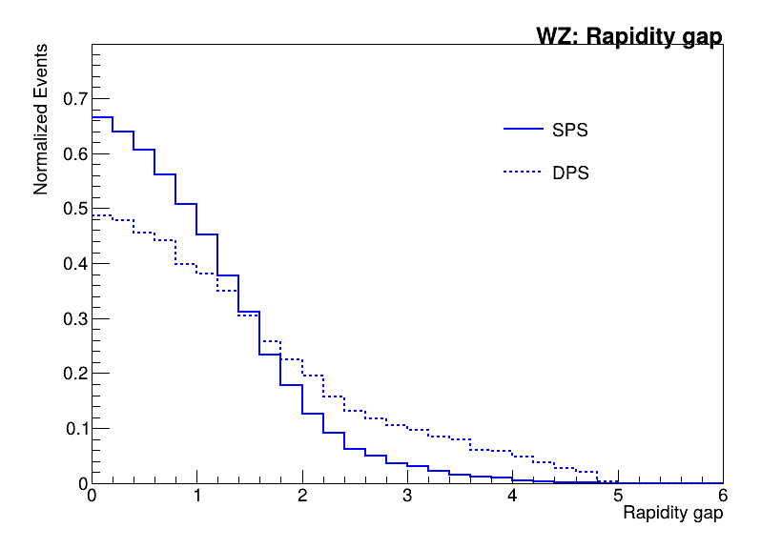
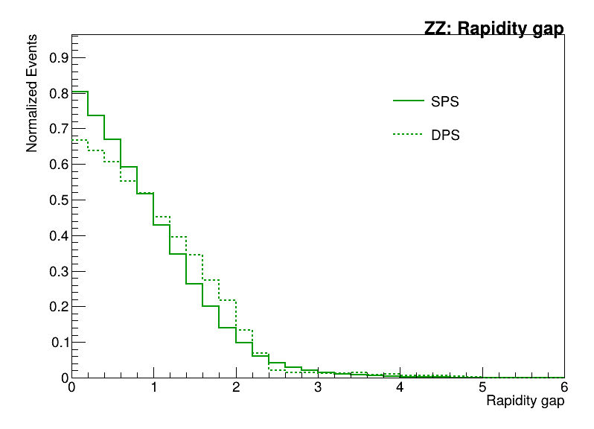
Rapidity Gap
Probes how far apart the two bosons are
Small Δy: bosons produced centrally and close in rapidity, usually in SPS.
Large Δy: bosons are widely separated in rapidity, a typical feature of DPS because each boson originates independently and can go in very different rapidity regions.
Δy_{VV}=|y_{V1}- y_{V2}|
4 Sept 2025 Anuraag Rathore (IIT Mandi) 15/21

Slide 16
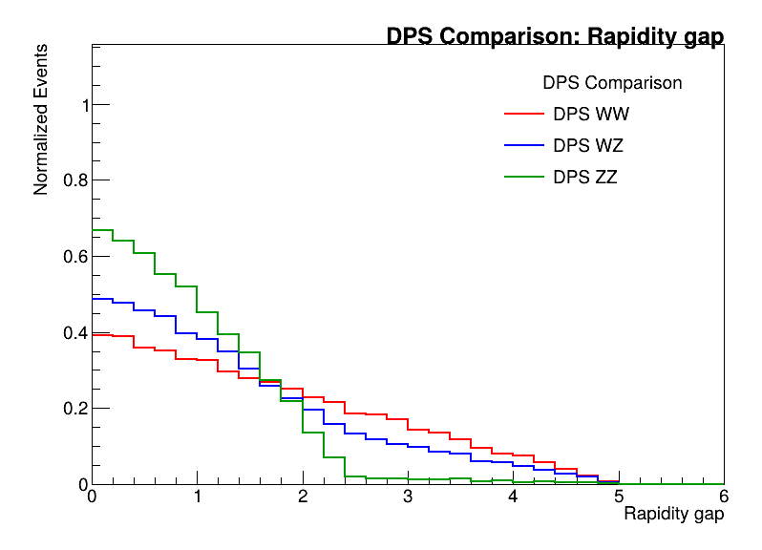
Rapidity Gap
Probes how far apart the two bosons are
Small Δy: bosons produced centrally and close in rapidity, usually in SPS.
Large Δy: bosons are widely separated in rapidity, a typical feature of DPS because each boson originates independently and can go in very different rapidity regions.
Δy_{VV}=|y_{V1}- y_{V2}|
4 Sept 2025 Anuraag Rathore (IIT Mandi) 16/21

Slide 17
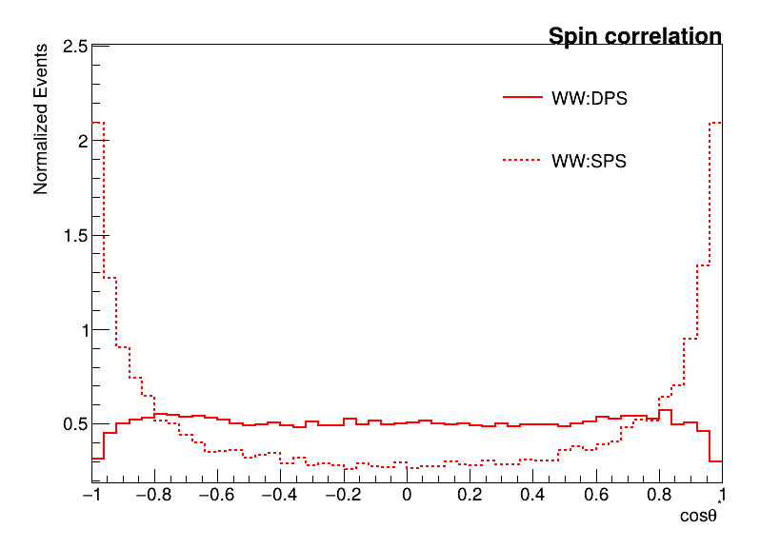
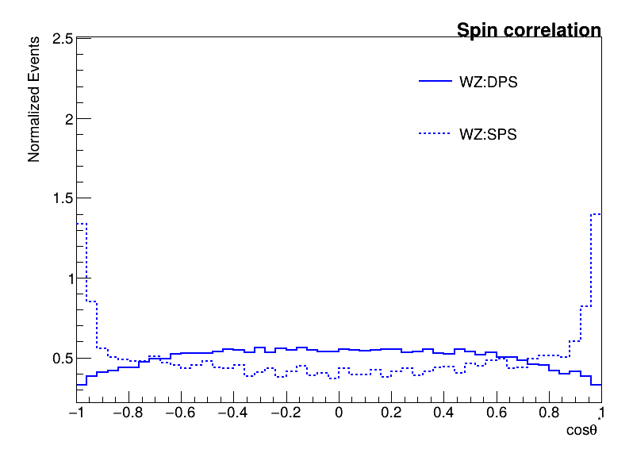
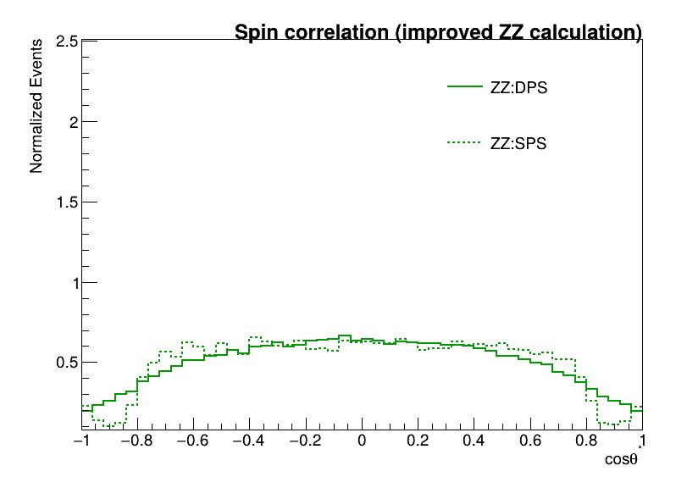
Spin correlation
DPS Distributions are more flat and smooth this reflects that in double parton scattering, the bosons originate from the separate hard scatter, so correlation is weaker after averaging over all kinematics.
SPS: peaked at cosθ* ≈ ±1 indicates strong alignment or anti-alignment of the final-state particles.
4 Sept 2025 Anuraag Rathore (IIT Mandi) 17/21

Slide 18
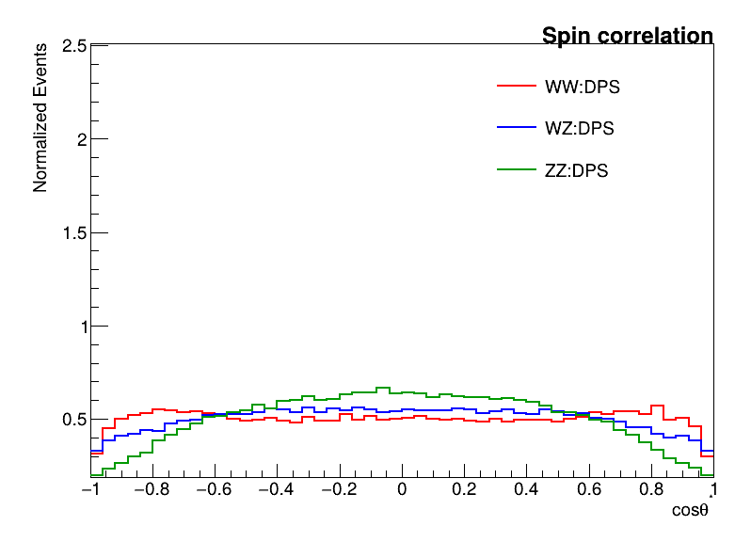
Spin correlation
DPS Distributions are more flat and smooth this reflects that in double parton scattering, the bosons originate from the separate hard scatter, so correlation is weaker after averaging over all kinematics.
SPS: peaked at cosθ* ≈ ±1 indicates strong alignment or anti-alignment of the final-state particles.
4 Sept 2025 Anuraag Rathore (IIT Mandi) 18/21

Slide 19
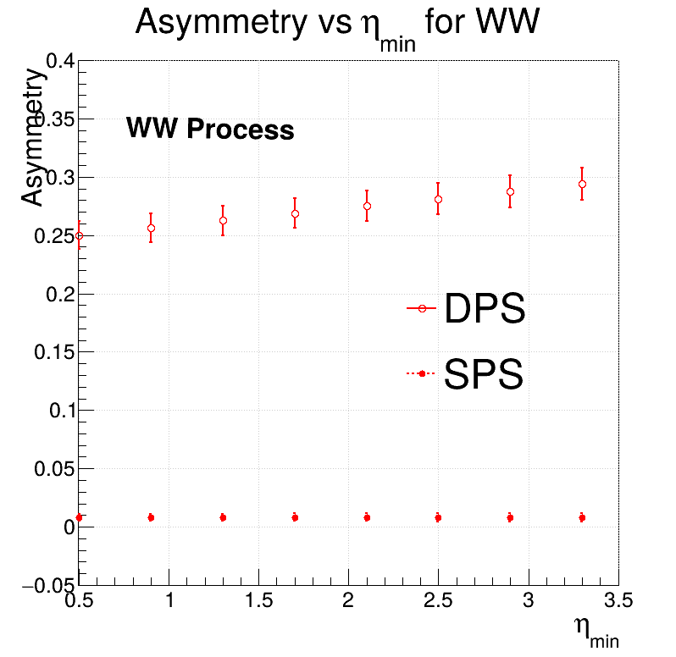
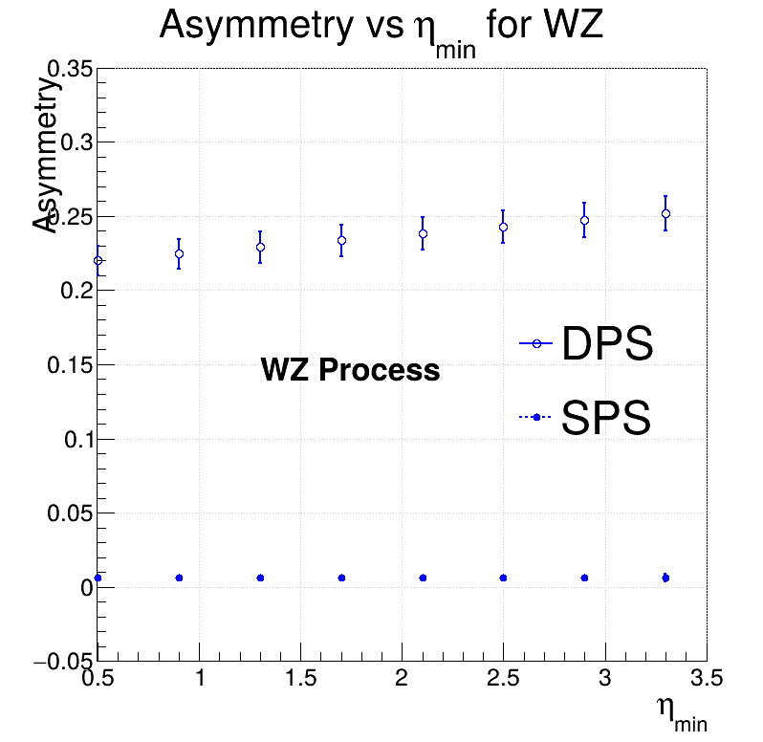
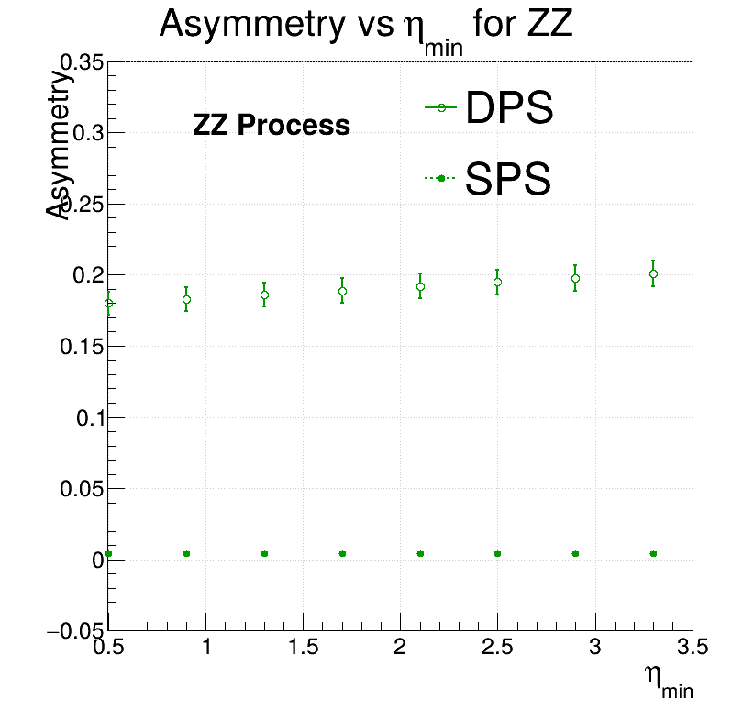
Lepton Pseudorapidity Asymmetry
SPS stays closer to zero, since a single hard scatter with balanced kinematics is more symmetric.
DPS deviates more due to independent scatterings, bosons can emerge in more forward/backward regions, leading to asymmetry.
A(η)=(N⁺(η) - N⁻(η)) / (N⁺(η) + N⁻(η))
4 Sept 2025 Anuraag Rathore (IIT Mandi) 19/21

Slide 20
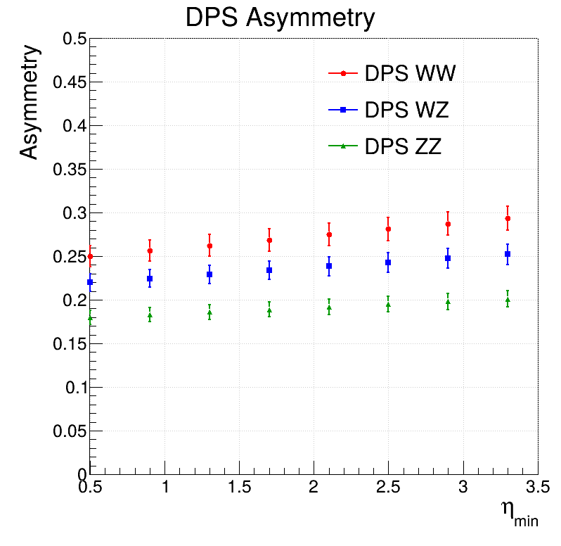
Lepton Pseudorapidity Asymmetry
SPS stays closer to zero, since a single hard scatter with balanced kinematics is more symmetric.
DPS deviates more due to independent scatterings, bosons can emerge in more forward/backward regions, leading to asymmetry.
A(η)=(N⁺(η) - N⁻(η)) / (N⁺(η) + N⁻(η))
4 Sept 2025 Anuraag Rathore (IIT Mandi) 20/21

Slide 21
Summary
DPS provides new insights into parton correlations beyond PDFs.
Vector boson final states (WW, WZ, ZZ) are clean channels for studying DPS.
Angular and kinematic variables (Δφ, ΔR, Δy, imbalance) show clear separation between SPS and DPS.
Spin correlation is a particularly powerful discriminator: DPS shows stronger alignment.
Combining multiple observables strengthens the case for identifying DPS in experiments.
4 Sept 2025 Anuraag Rathore (IIT Mandi) 21/21

Slide 22
Summary
DPS provides new insights into parton correlations beyond PDFs.
Vector boson final states (WW, WZ, ZZ) are clean channels for studying DPS.
Angular and kinematic variables (Δφ, ΔR, Δy, imbalance) show clear separation between SPS and DPS.
Spin correlation is a particularly powerful discriminator: DPS shows stronger alignment.
Combining multiple observables strengthens the case for identifying DPS in experiments.
Thankyou !!
4 Sept 2025 Anuraag Rathore (IIT Mandi) 21/21

