Slide 1

Investigation of Breakdown and Timing Performance in Post-Irradiated JTE-Guarded 4H-SiC LGADs Using TCAD
Jaideep Kalani¹*, Arnav Chauhan¹, Ridham Mahajan¹, Prabhakar Palni¹
¹ School of Physical Sciences, Indian Institute of Technology, Mandi, Himachal Pradesh, India
September 04 , 2025

Slide 2
Outline
Motivation
4D Tracking for High-Resolution Detection
Introduction to LGADs
Challenge at High Voltages
Results and Discussions
  Detector geometry
  Gain vs Bias
  Time Resolution
  Post-Irradiation studies
Conclusions

Slide 3
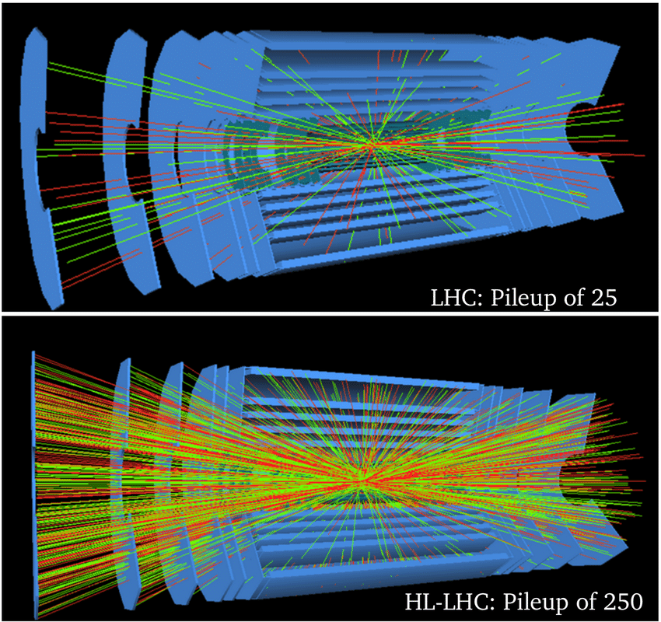
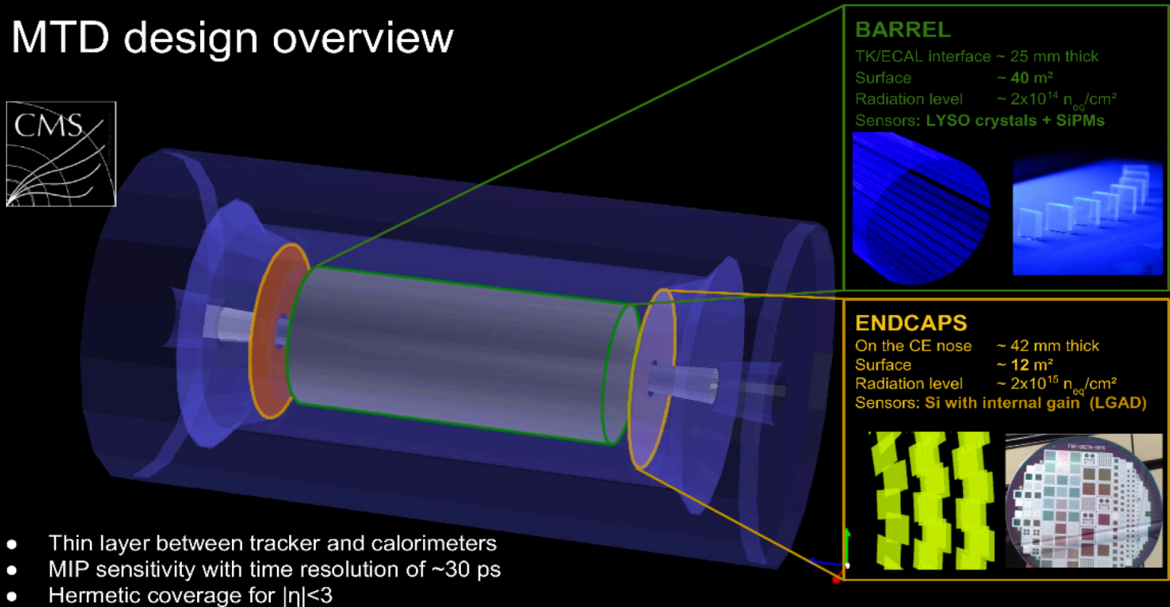
Motivation
Development of large area silicon detectors,” Tech. Rep. ATL-UPGRADE-PROC-2012-003, CERN, 2012. arXiv:1201.5469.
Why Upgrading Tracking Detectors Matter?
The LHC will be upgraded to HL-LHC
The luminosity of HL-LHC would be 7 times of nominal instantaneous luminosity (10³⁴ cm⁻² s⁻¹ )
Simulated pile-up in LHC vs HL-LHC
Markovic, Lazar. (2023). Progress on characterization of LGAD sensors for the CMS ETL. 095. 10.22323/1.427.0095.
This increase will lead to a large number of collision pile-up.
A major task is disentangling primary interactions from pile-up.
MTD placement in CMS detector

Slide 4
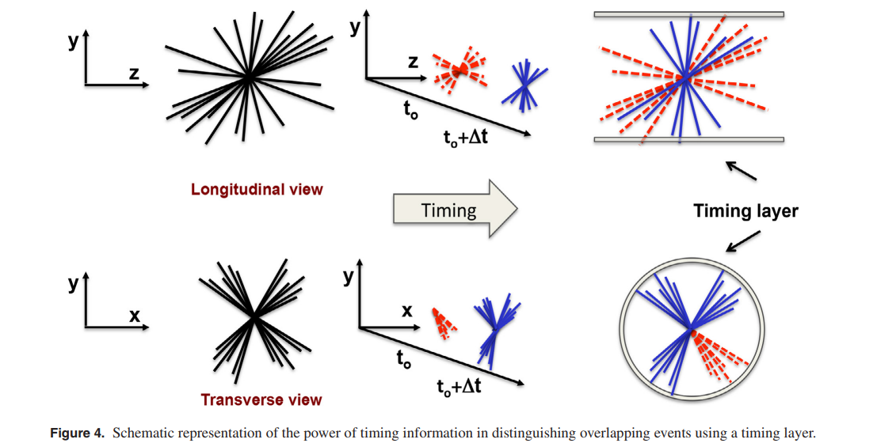
4D Tracking for High-Resolution Detection
N. Cartiglia et al., 4D tracking: present status and perspectives, Nucl. Instrum. Meth. A 1040 (2022) 167228.
Using time information to resolve signal.

Slide 5
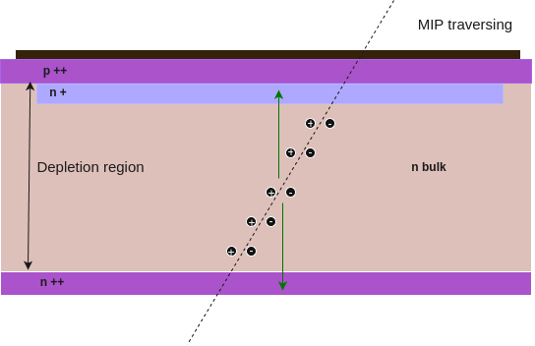
Introduction to Low Gain Avalanche Diodes (LGAD)
LGAD: Silicon or similar semiconductor based detectors modeled on PiN diode structure with a doped multiplication layer.
Reverse Biasing: Widens depletion region, creating a strong electric field.
Impact Ionisation: Incident particles generate electron-hole pairs in the bulk.
Avalanche Multiplication: Electrons create more electron-hole pairs in the multiplication layer (E ≃ 300 kV/cm)
Electric Field
Fast Response: High electric field (E ≃ 30 kV/cm) ensures rapid collection of charge carriers.
Schematic structure of a typical p-in-n LGAD
Simulation software: Silvaco TCAD

Slide 6
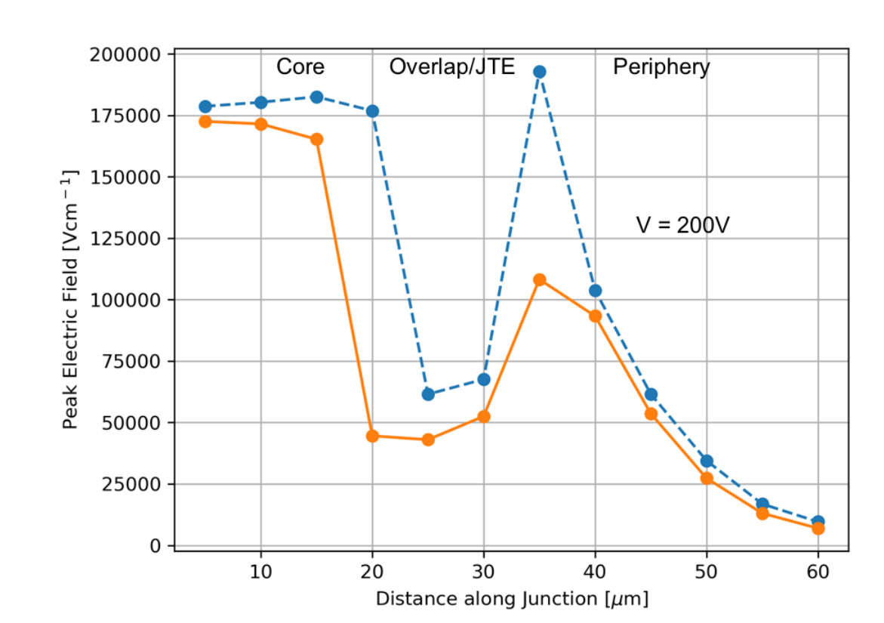
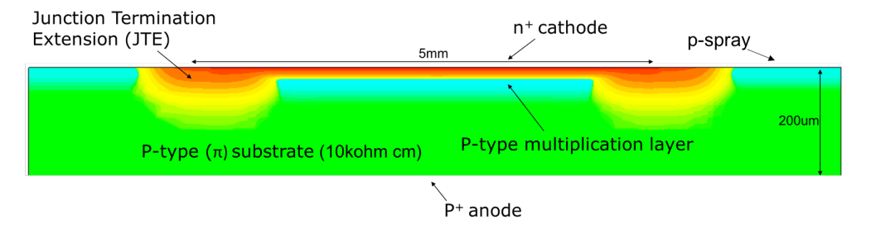
Challenge at High Voltage
SC detectors requires very high bias voltage for full detector depletion for a high doping
Strong electric field crowds at device edges and sharp corners
Solution is Junction Termination Extension (JTE) to laterally spread depletion region
Smooth redistribution of electric field lines at periphery
Improves detector reliability and extended operational lifetime
N. Moffat et al., JINST 13 (2018) C03014
Without JTE
With JTE
Image of a JTE implanted LGAD
Electric Field variation along x-axis

Slide 7
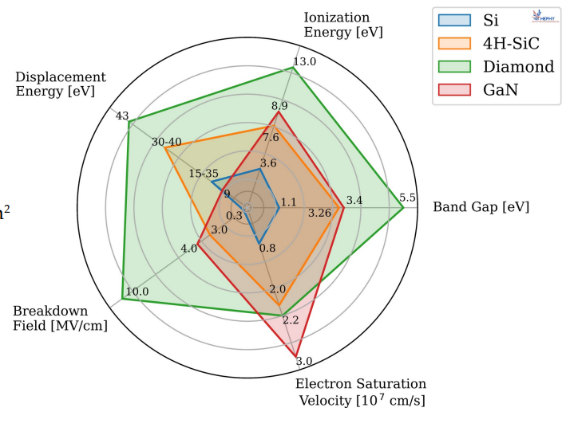
4H-SiC as LGAD Bulk
https://indico.cern.ch/event/1439336/contributions/6242447/attachments/2980364/5248275
Comparison of different parameters of different materials

Slide 8
Results and Discussions

Slide 9
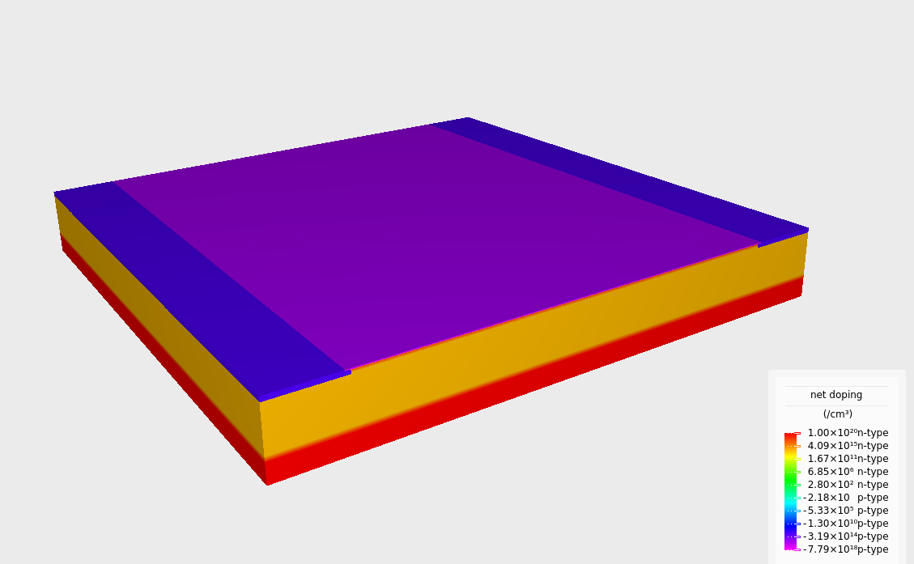
TCAD Simulated LGAD (3D)
Visualization of LGAD geometry used in this work.

Slide 10
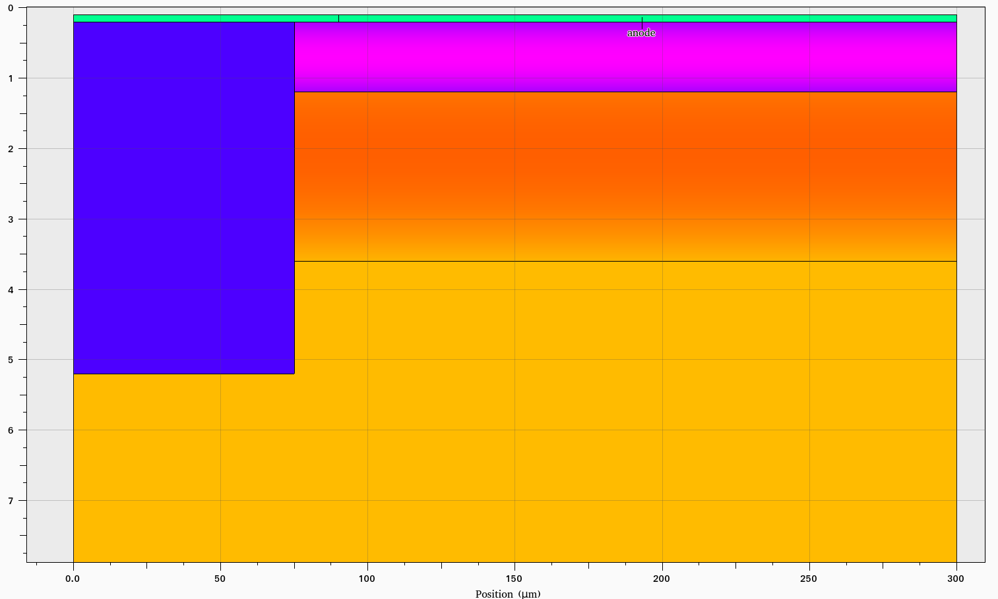
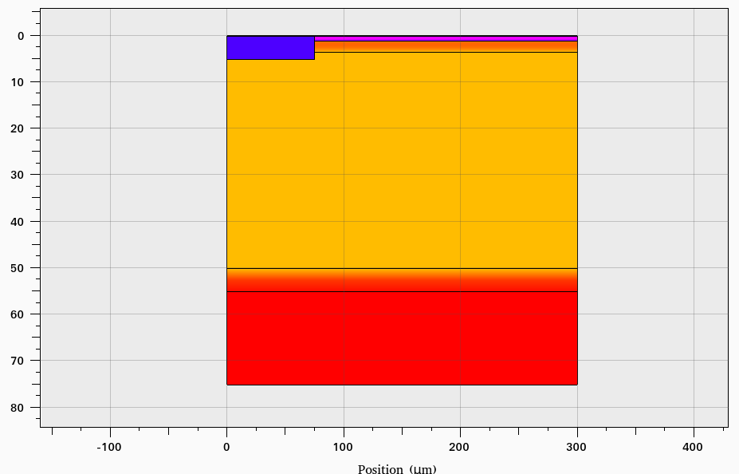
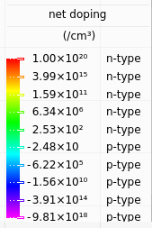
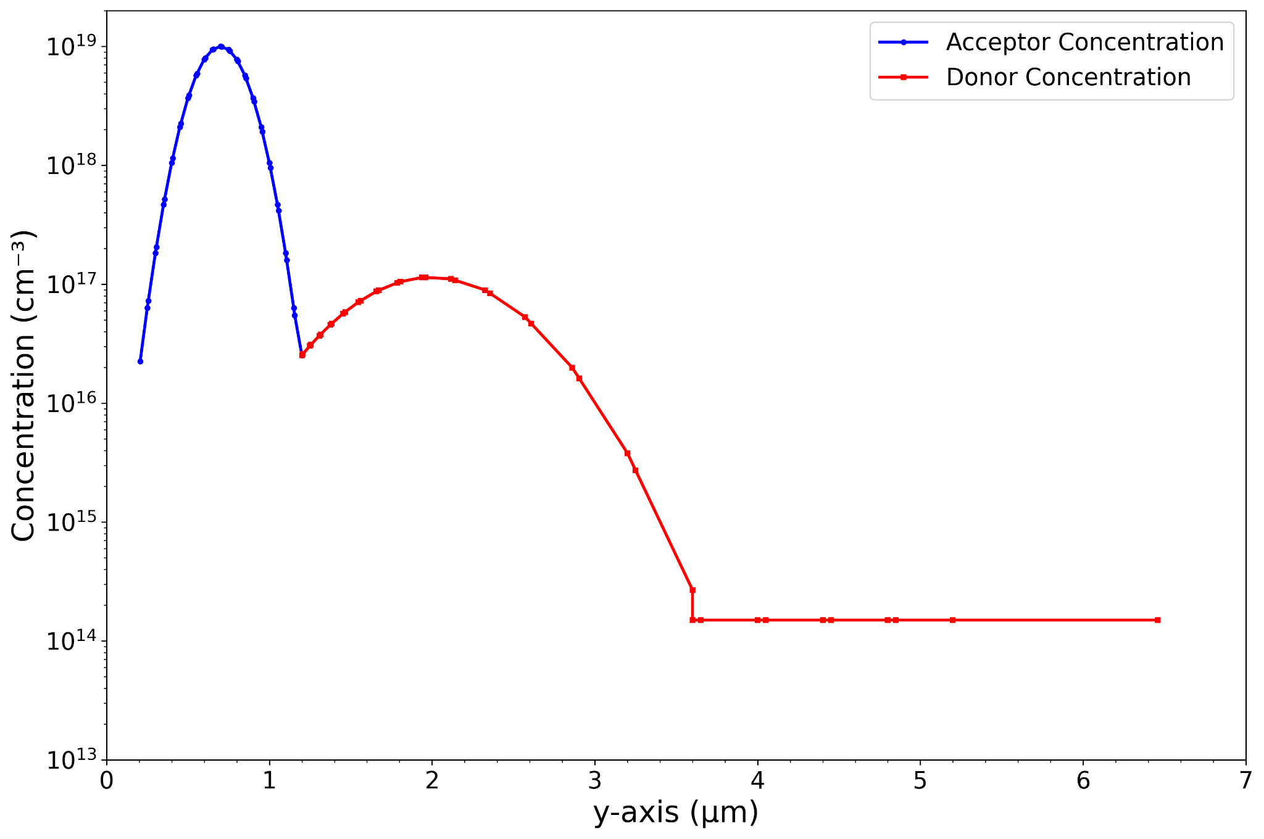
2D Geometry and Doping Profile
Simulated 2D mirrored half of device.
Gaussian doping profile in implanted layers and uniform in grown layers.
Shallow implant gain layer achieves smooth transition to epi.
Buffer between epi and subtraction to avoid junction effects.
(a)
(b)
(c)
LGAD structure simulated in TCAD (a), the doping concentration (c), at the multiplication region (b).

Slide 11
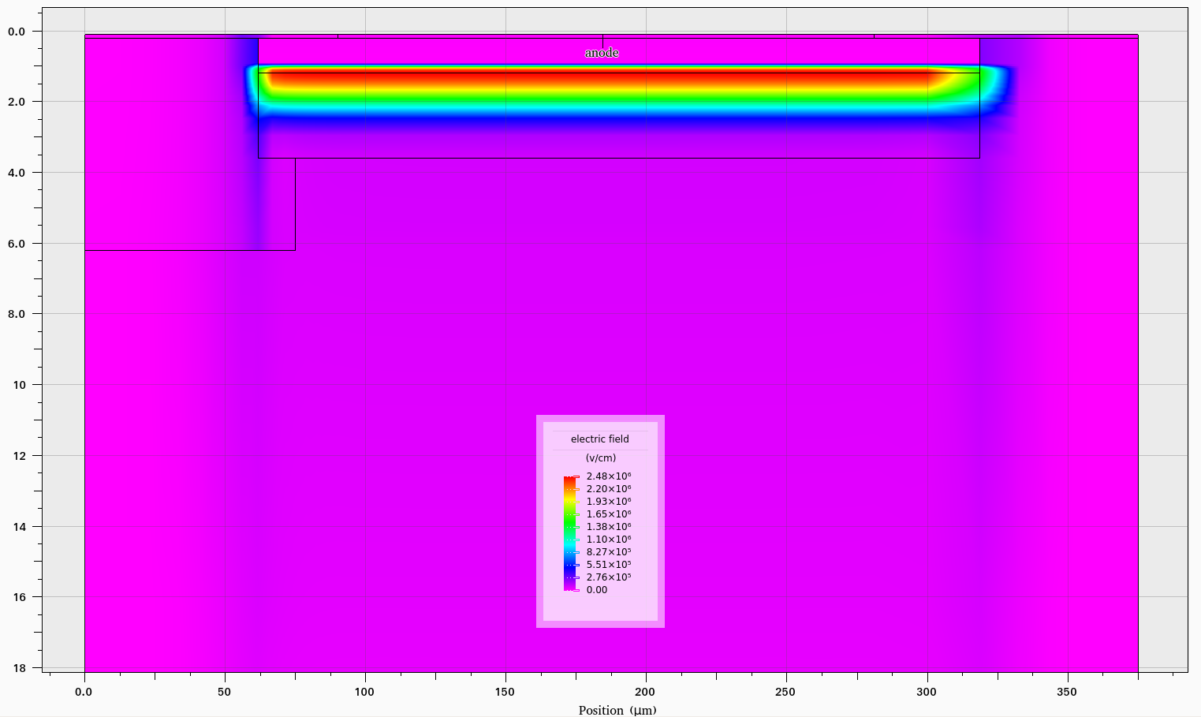
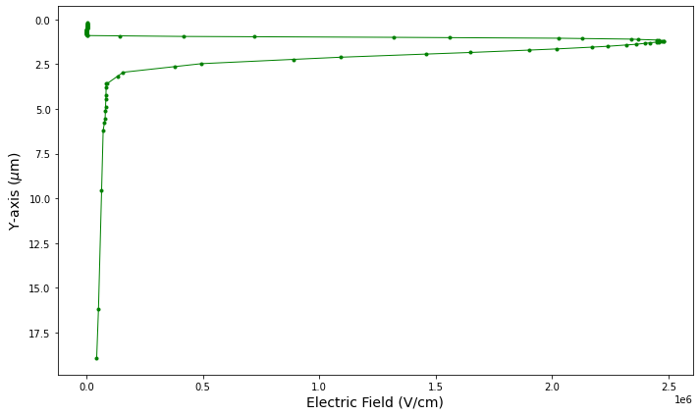
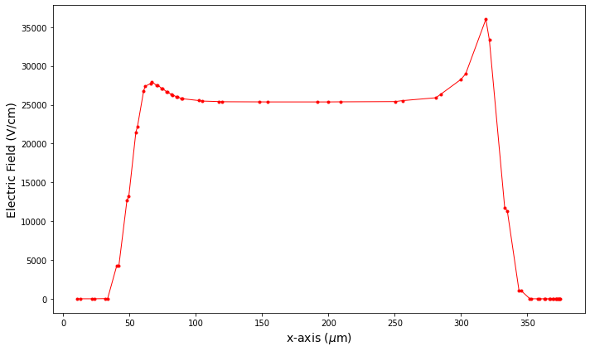
Electric Field Profile in LGAD
JTE
No JTE
Electric Field peaks at the junction of p++ and gain layer.
The peak intensity is ~ 2.5 x 10⁶ V/cm.
Epitaxial layer has a low magnitude steadily decreasing field.
In this LGAD, adding a JTE helps slowly dissipate the electric field near the junction edges.
Electric Field inside the LGAD along the x and y directions

Slide 12
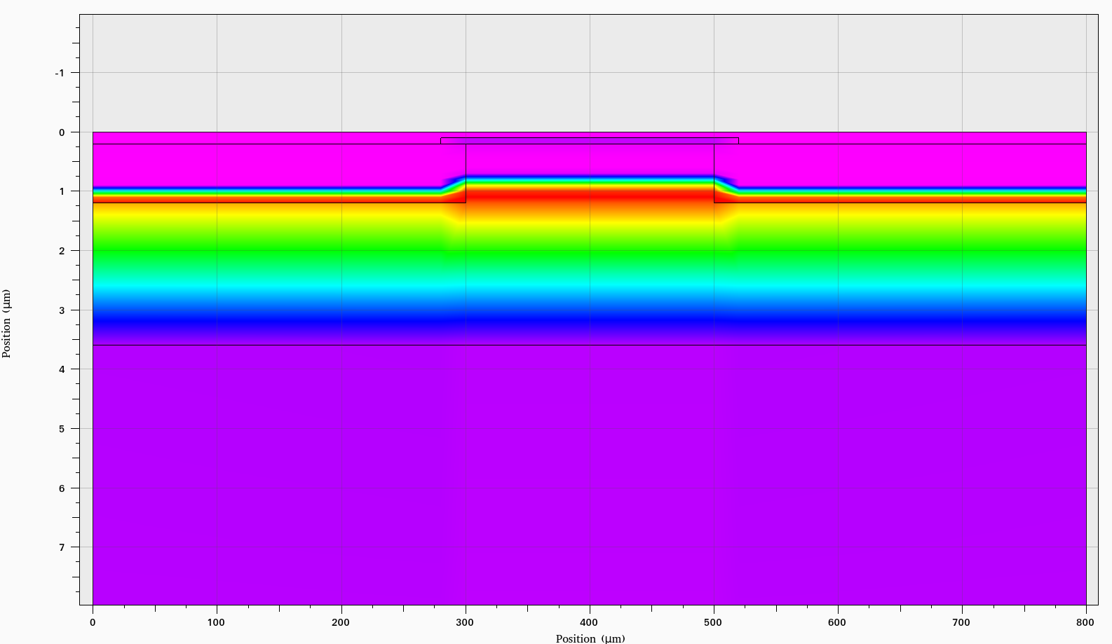
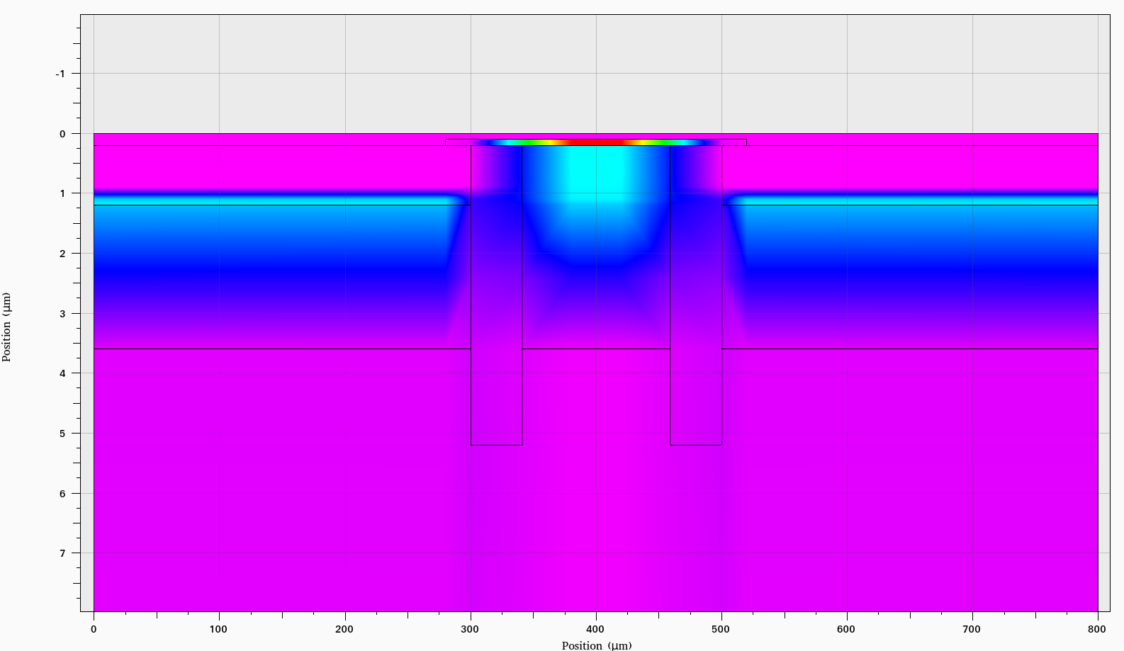
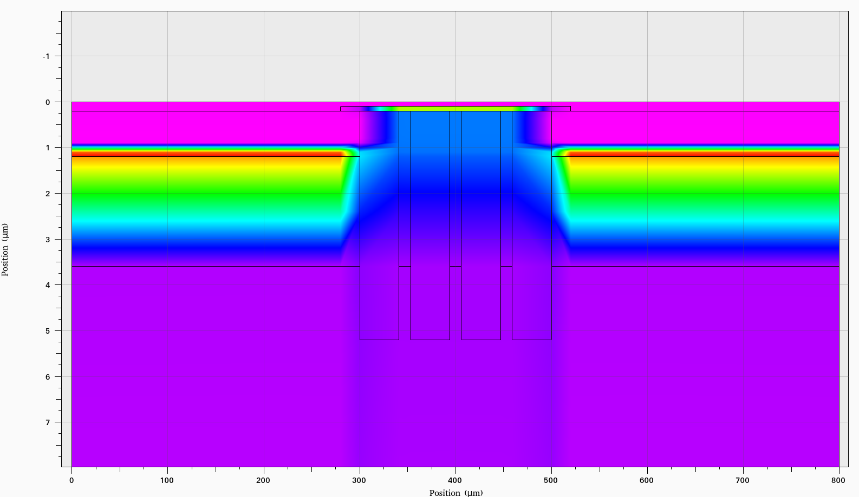
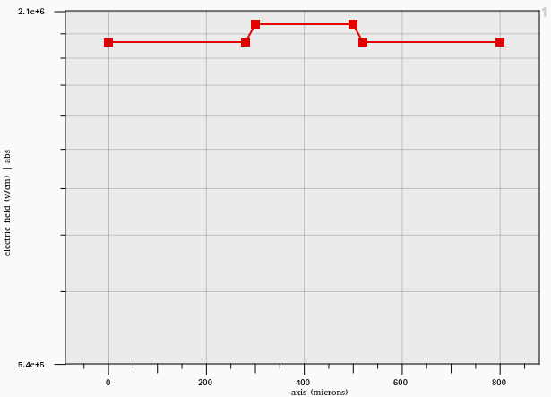
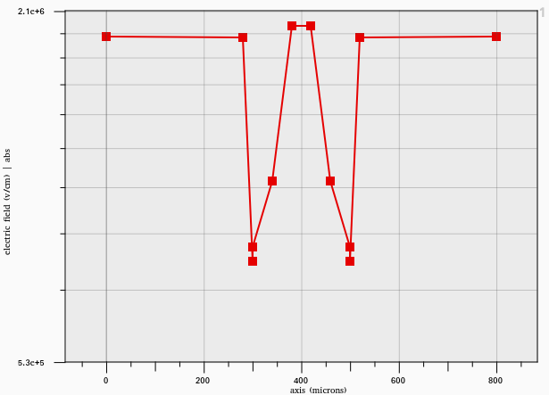
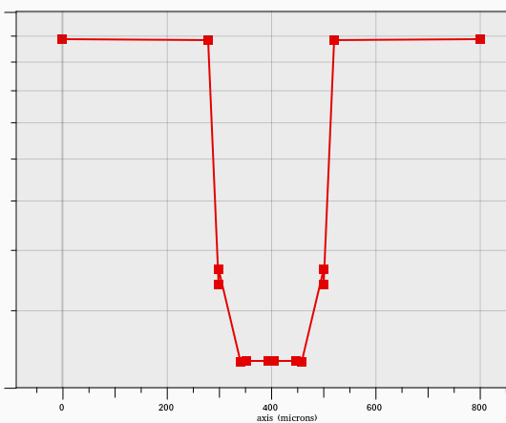
Role of the JTE
(a)
(b)
(c)
(a)
(b)
(c)
Electric Field Profile in LGAD at the multiplication junction.
The effect of adding (a) no JTE, (b) 2 JTEs, (c) 4 JTEs
Adding multiple JTEs help slowly dissipate the electric field.

Slide 13
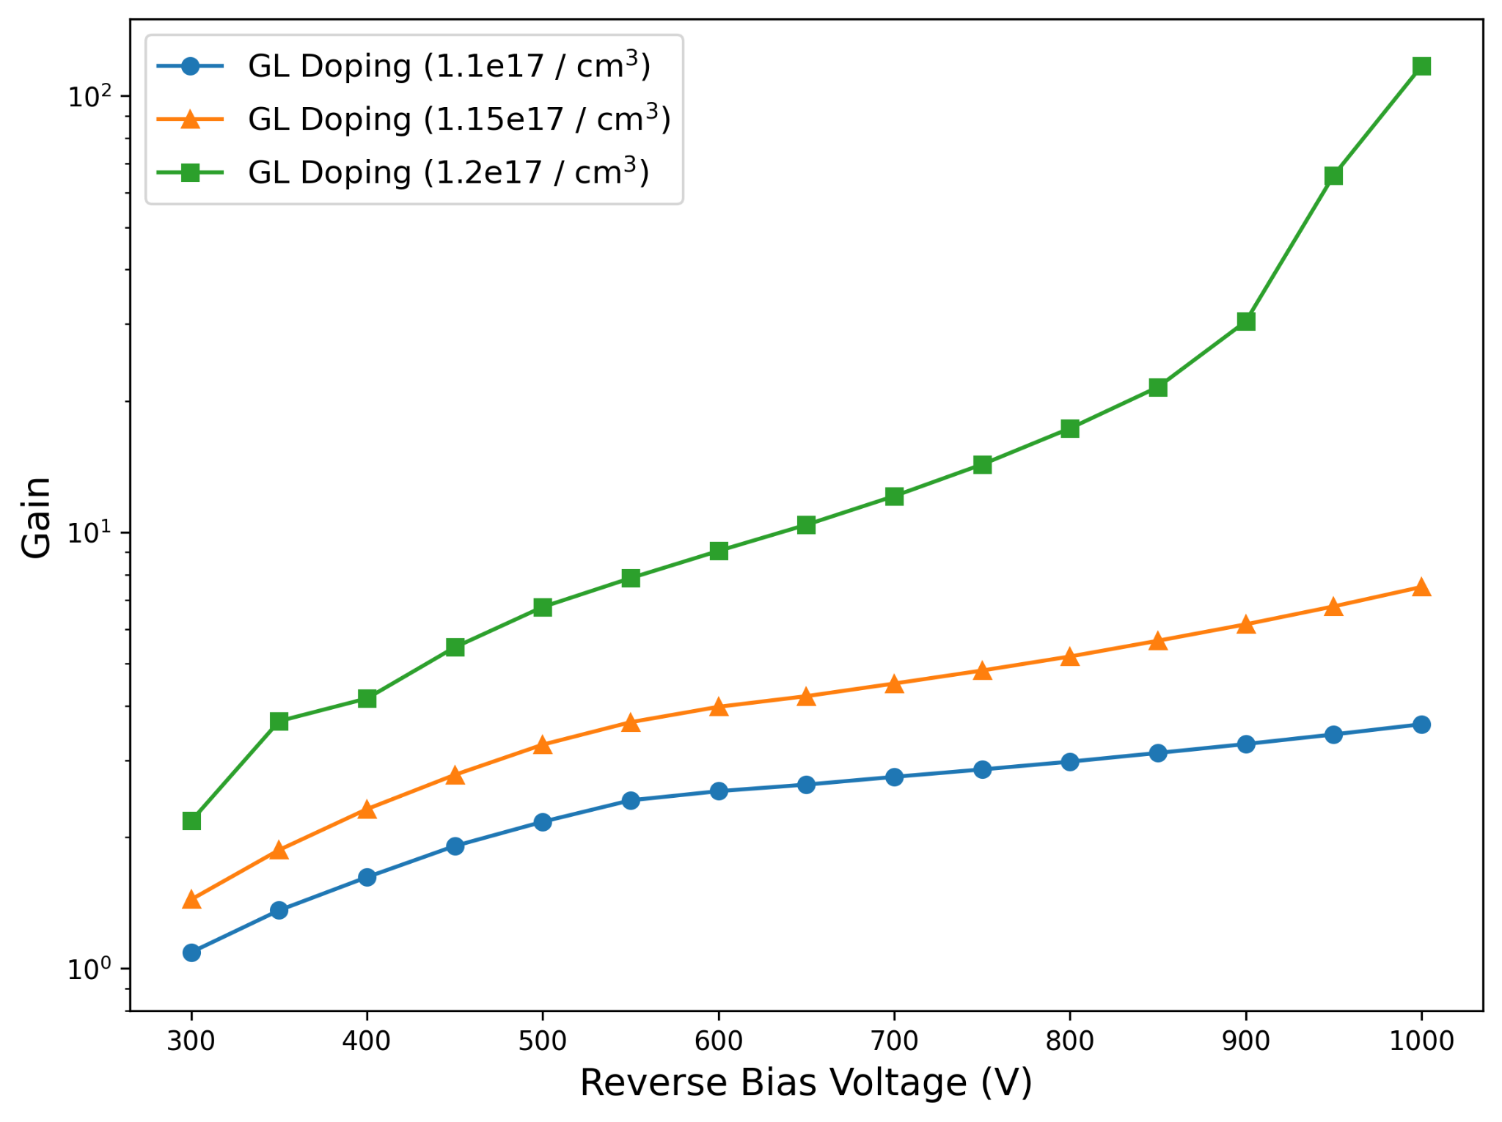
Pre-irradiated Sensor Study
Gain of the detector with increasing Reverse Bias.
Gain = Q_{LGAD} / Q_{PiN}
The study is done for three doping concentrations of the gain layer
The temperature is fixed at 300 K.
The epitaxial thickness is kept 50 μm.
Gain increases with the increase in doping and bias.
Gain vs Bias Voltage for different gain layer doping concentration

Slide 14
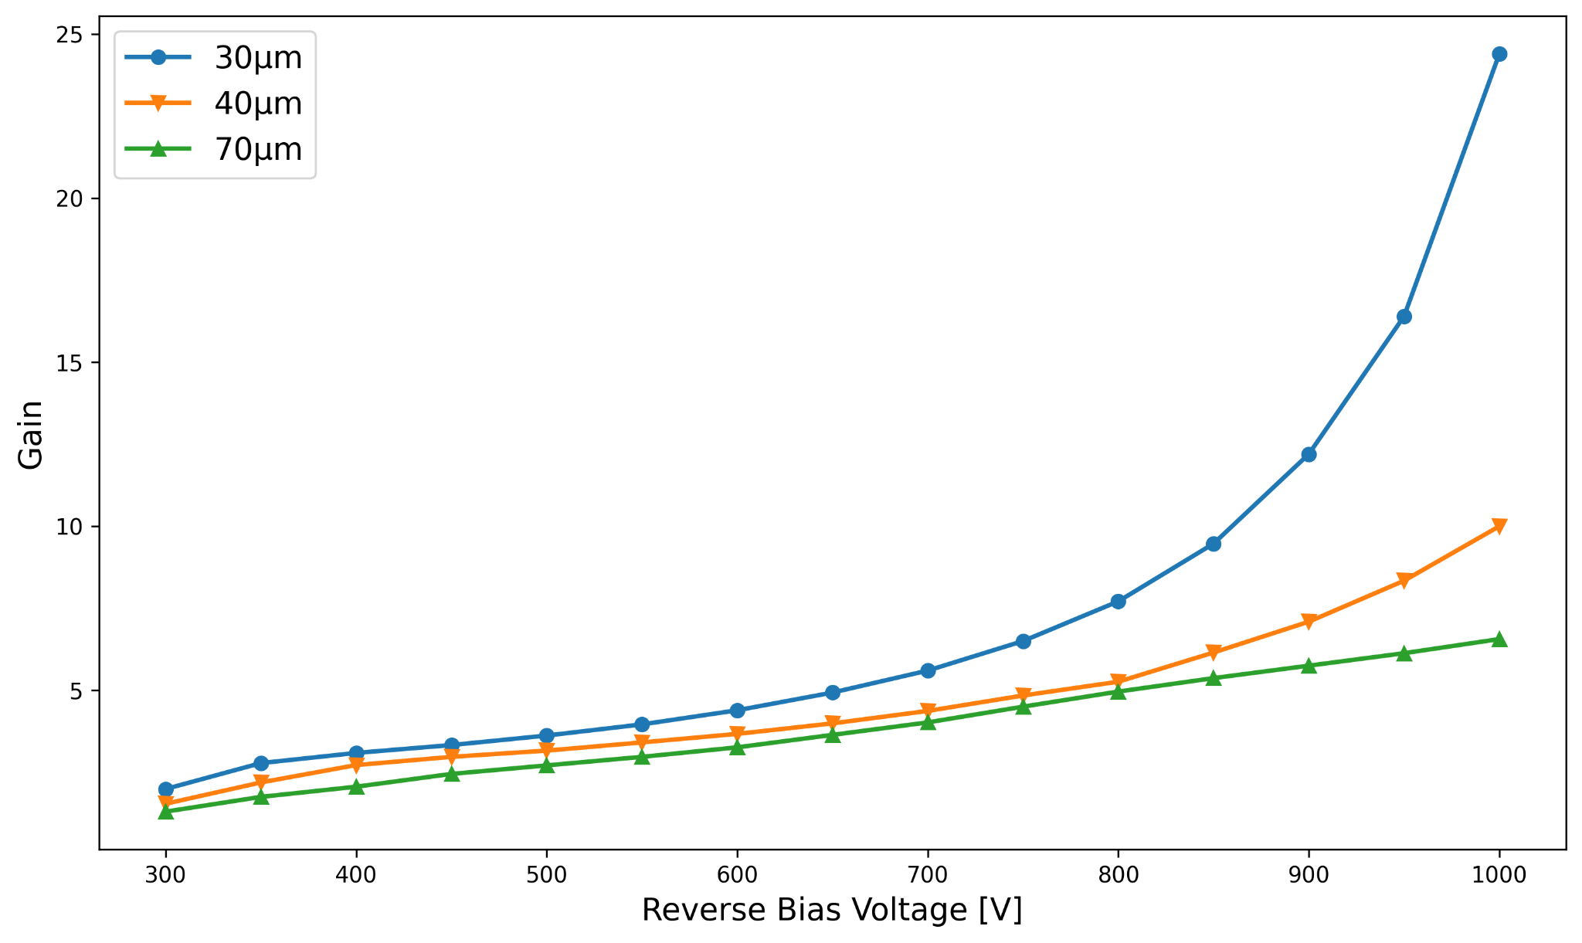
Effect of Epitaxial Layer Thickness
Gain for various detector thickness.
The study is done for four different thicknesses.
The temperature is fixed at 300K.
The gain layer doping is kept at 1.15e17 / cm³.
Gain increases with the decrease in epitaxial thickness.
Gain vs Bias Voltage for varying epitaxial layer thickness.

Slide 15
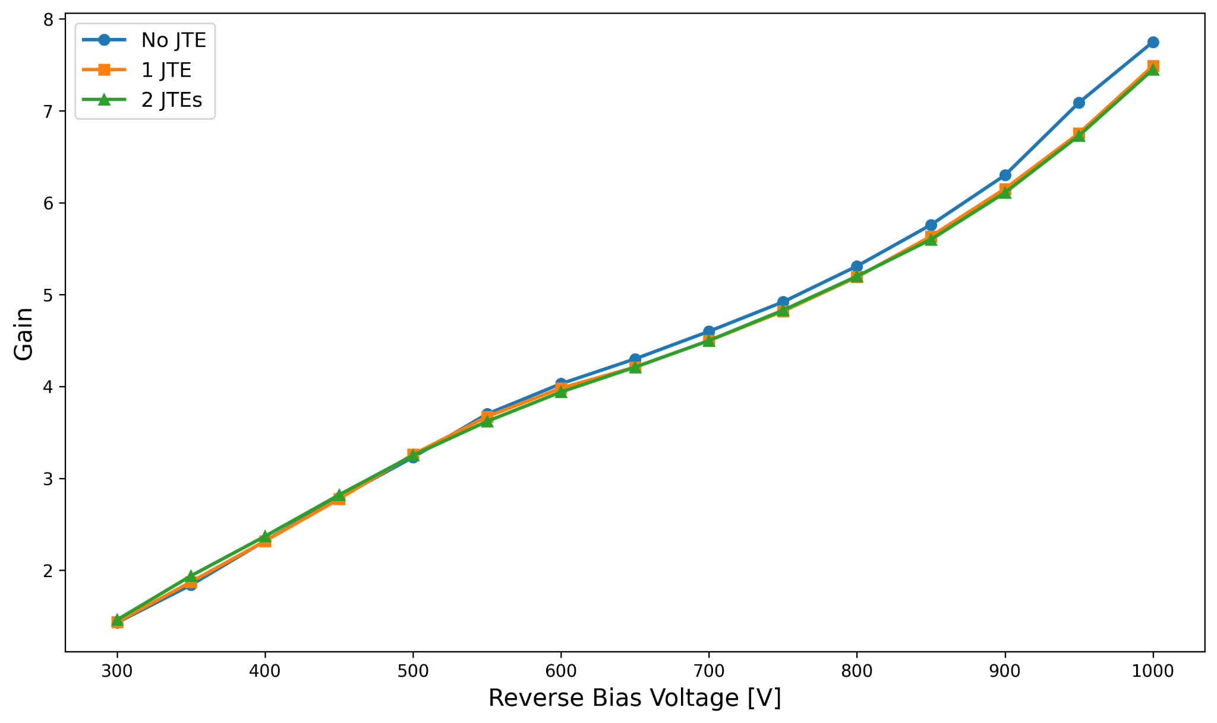
Effect on Gain by JTE
The study is done for a 50 μm epi layer at a gain layer doping of 1.15e17 / cm³
The data shows no major gain change for introducing multiple JTE
Gain vs Bias Voltage for the LGAD with and without JTE

Slide 16
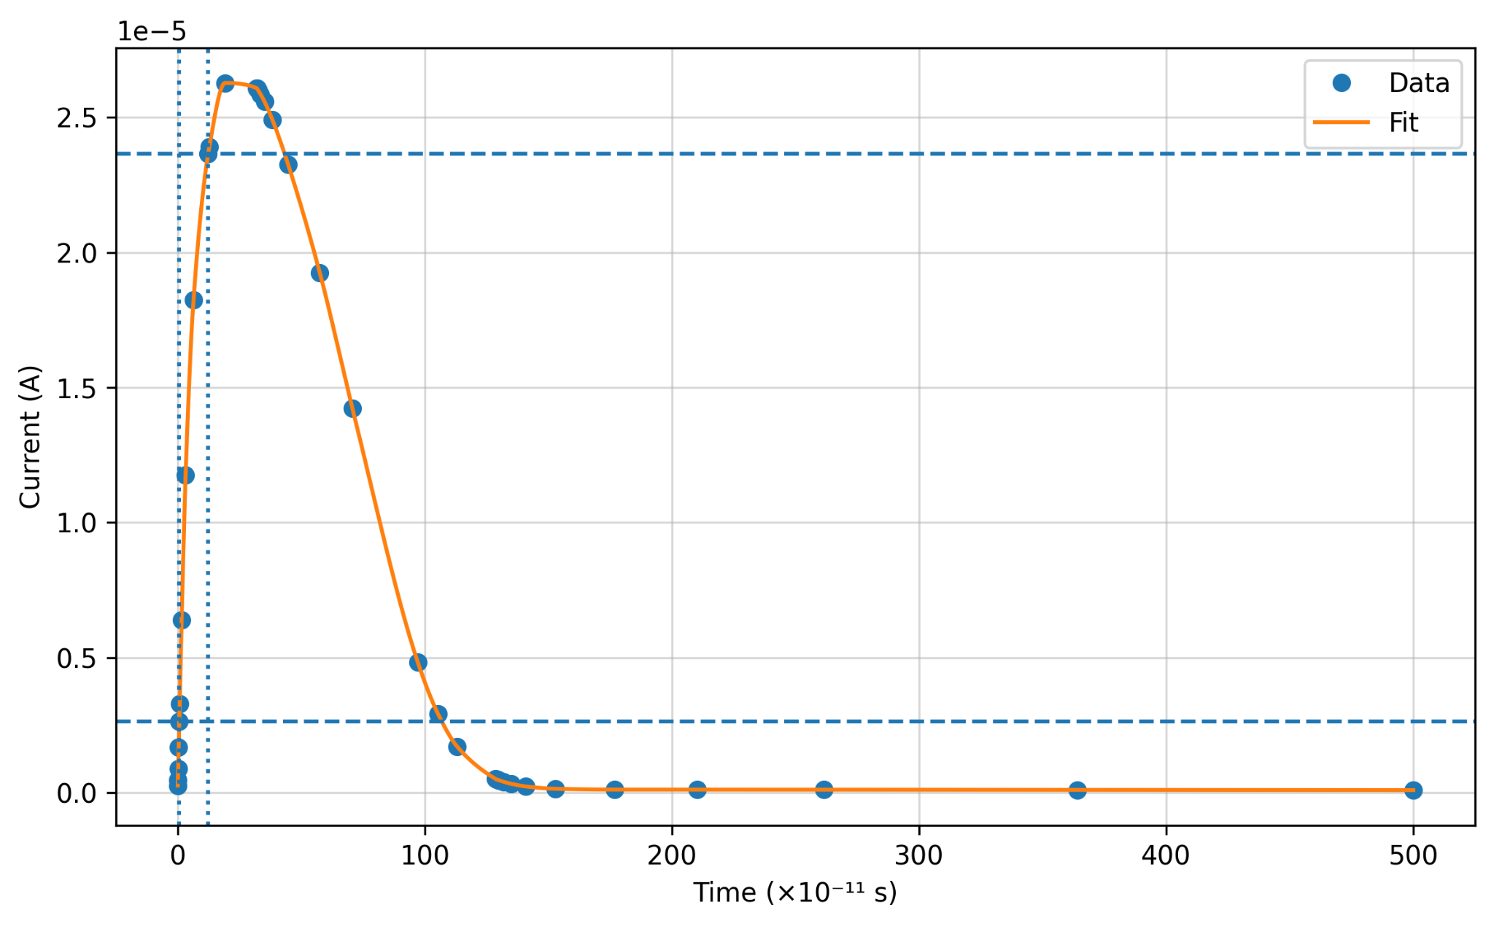
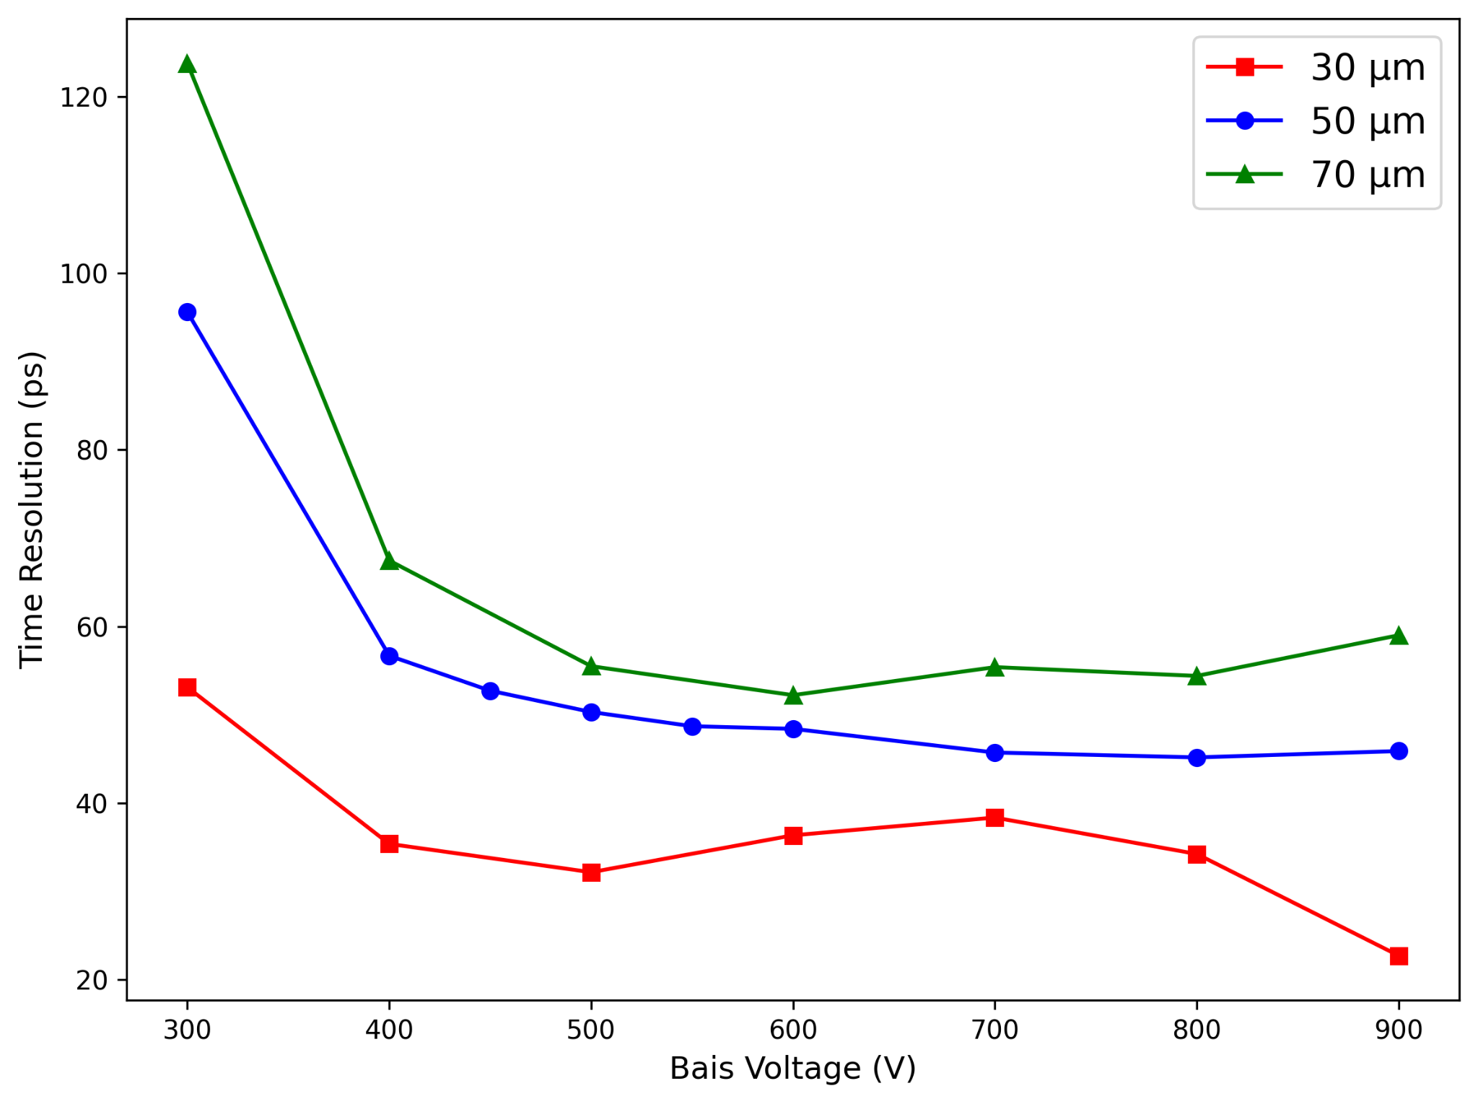
Current Pulse and Time Resolution
The current pulse here is shown for gain layer doping 1.15e17 / cm³ at 600 V .
The temperature is fixed at 300 K.
The epitaxial thickness is kept 50 μm.
Time resolution for different thickness of epi layer is shown.
Current pulse generated
Time Resolution vs Reverse Bias

Slide 17
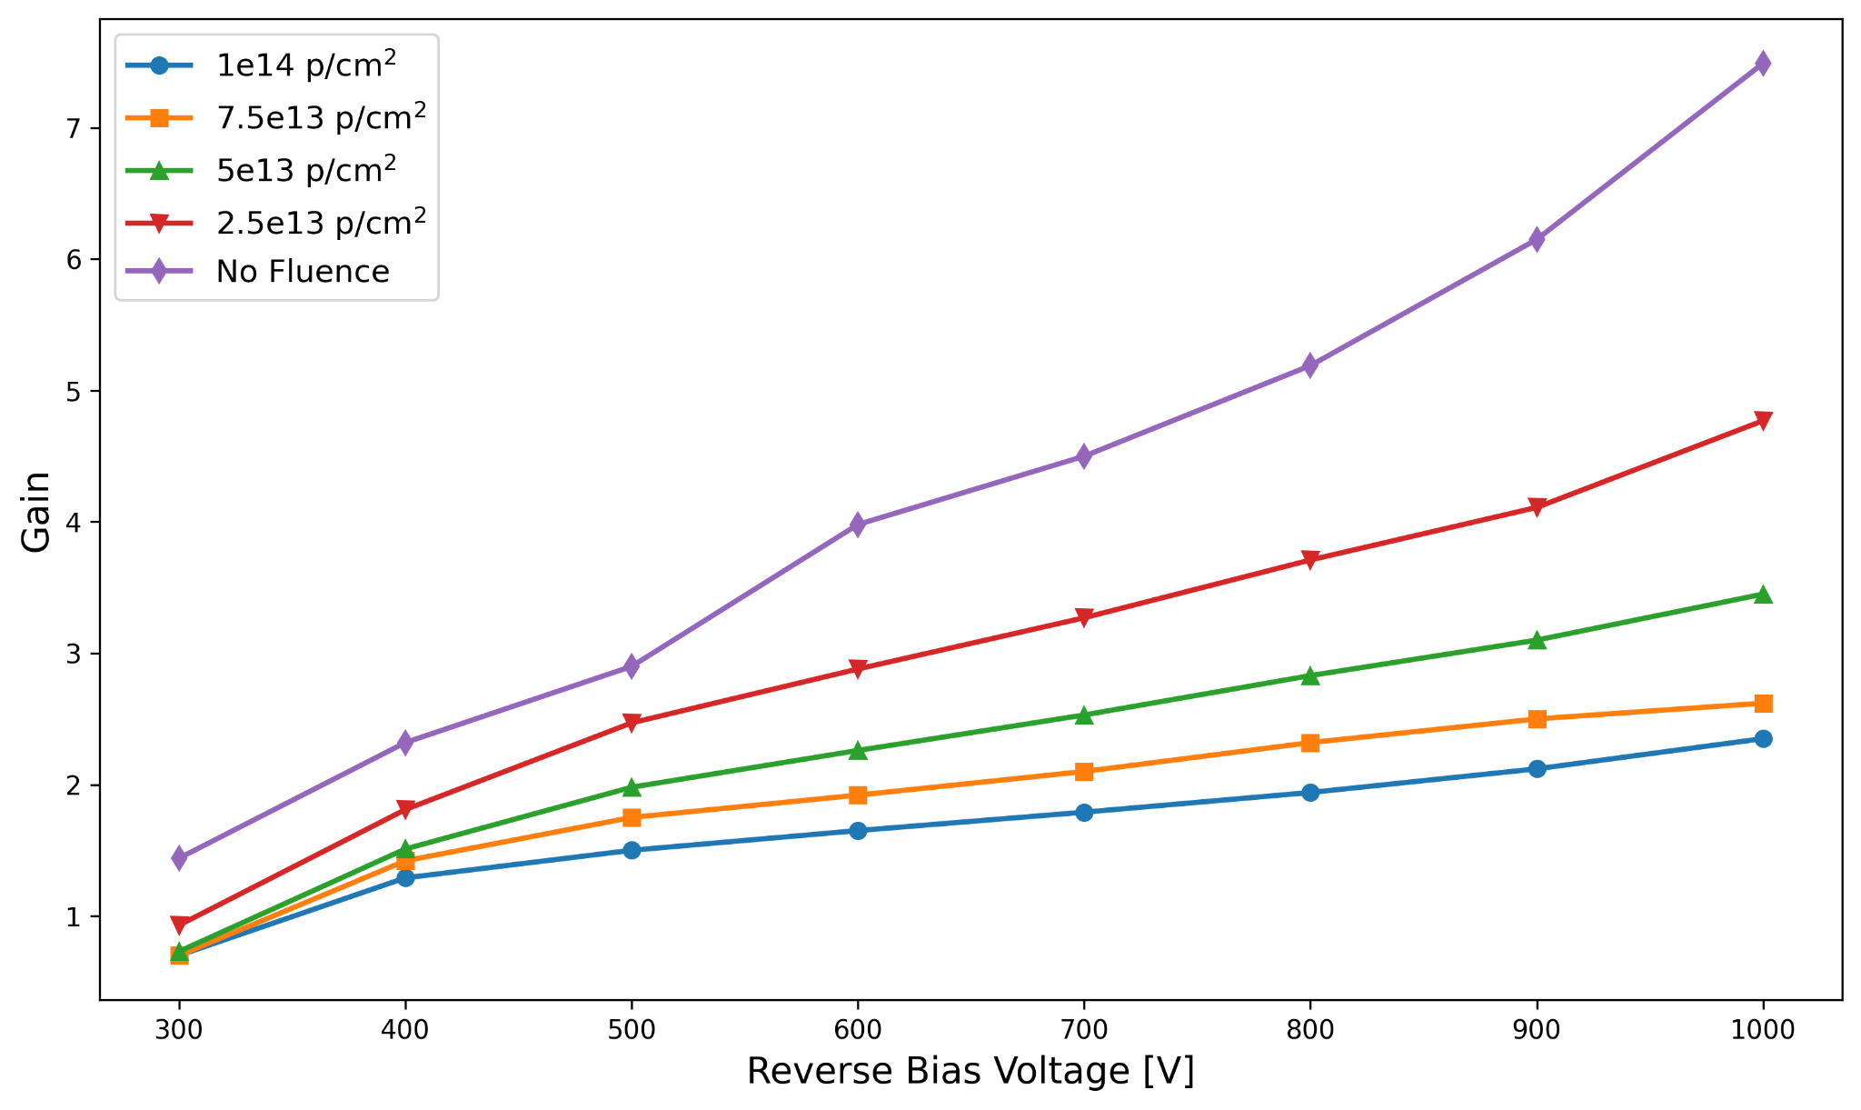
Radiation Hardness Study
Gain of the detector with increasing Fluence.
The study shows gain of the detector at various proton fluence levels.
The study is done for a 50 μm epi layer at a gain layer doping of 1.15e17 / cm³
The data shows a clear gain quenching with the rise in the fluence level.
Gain vs Bias Voltage for different fluences

Slide 18
Conclusions
Silvaco TCAD simulations reveal 4H-SiC LGAD behavior across doping, bias, thickness, and radiation fluence.
JTE at the junction termination smooths edge electric fields, enabling more stable operation at higher bias
Gain rises exponentially with increase in gain-layer doping and decrease in thickness.
Thicker epitaxial layers degrade detector performance and timing unless fully depleted at operating bias, i.e. they require higher voltages.
Radiation fluence quenches the gain, but operating at higher bias partially recovers detector response.
SiC-LGADs exhibit excellent radiation tolerance with stable operation at high bias voltages.

Slide 19
Thank You

Slide 20
Back Up

Slide 21
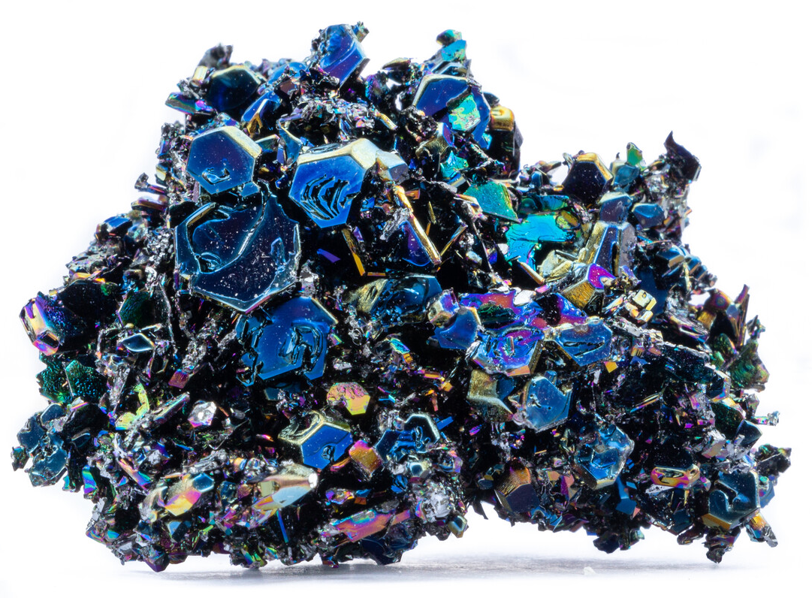
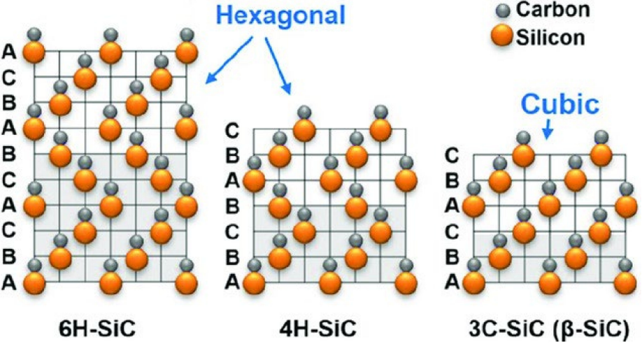
SiC structures
4H-SiC crystal (left) and Lattice Structure (right)

Slide 22
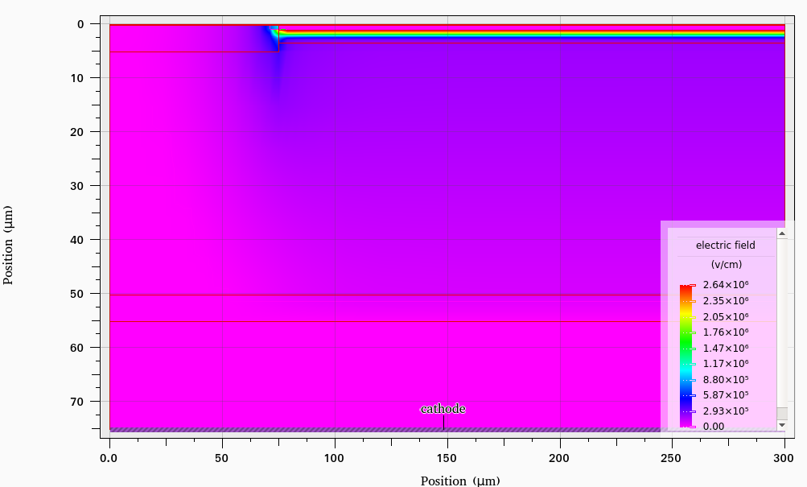
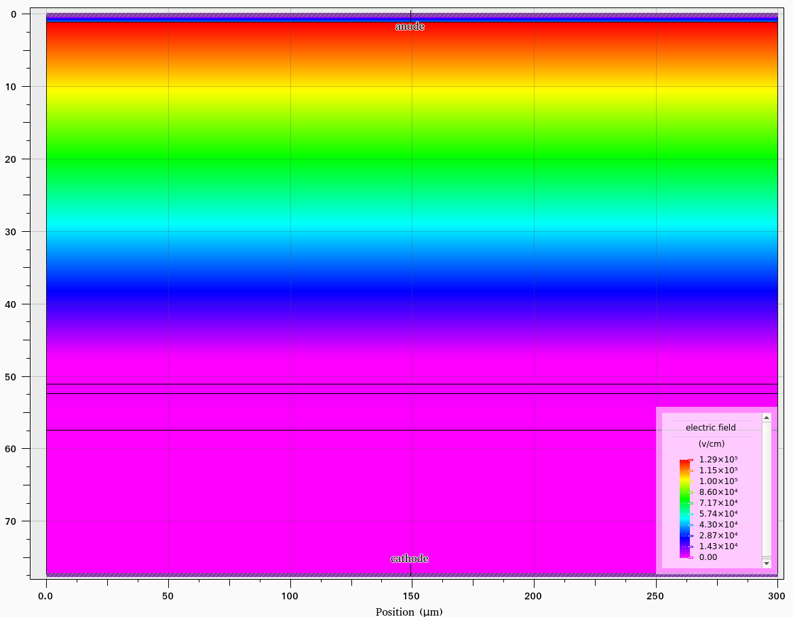
Electric Field Profile of PiN vs LGAD
Electric field profile in an LGAD (left) and PIN diode (right) at 400V

Slide 23
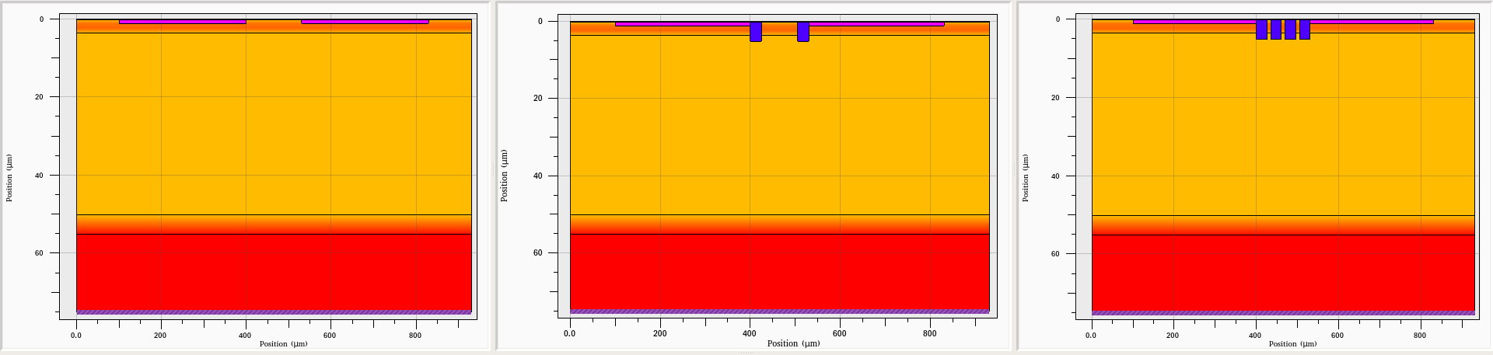
Breakdown study (Doping)
LGAD geometry where pixels are separated using No JTE (left), 1 JTE (middle) and 2 JTE (right).

Slide 24
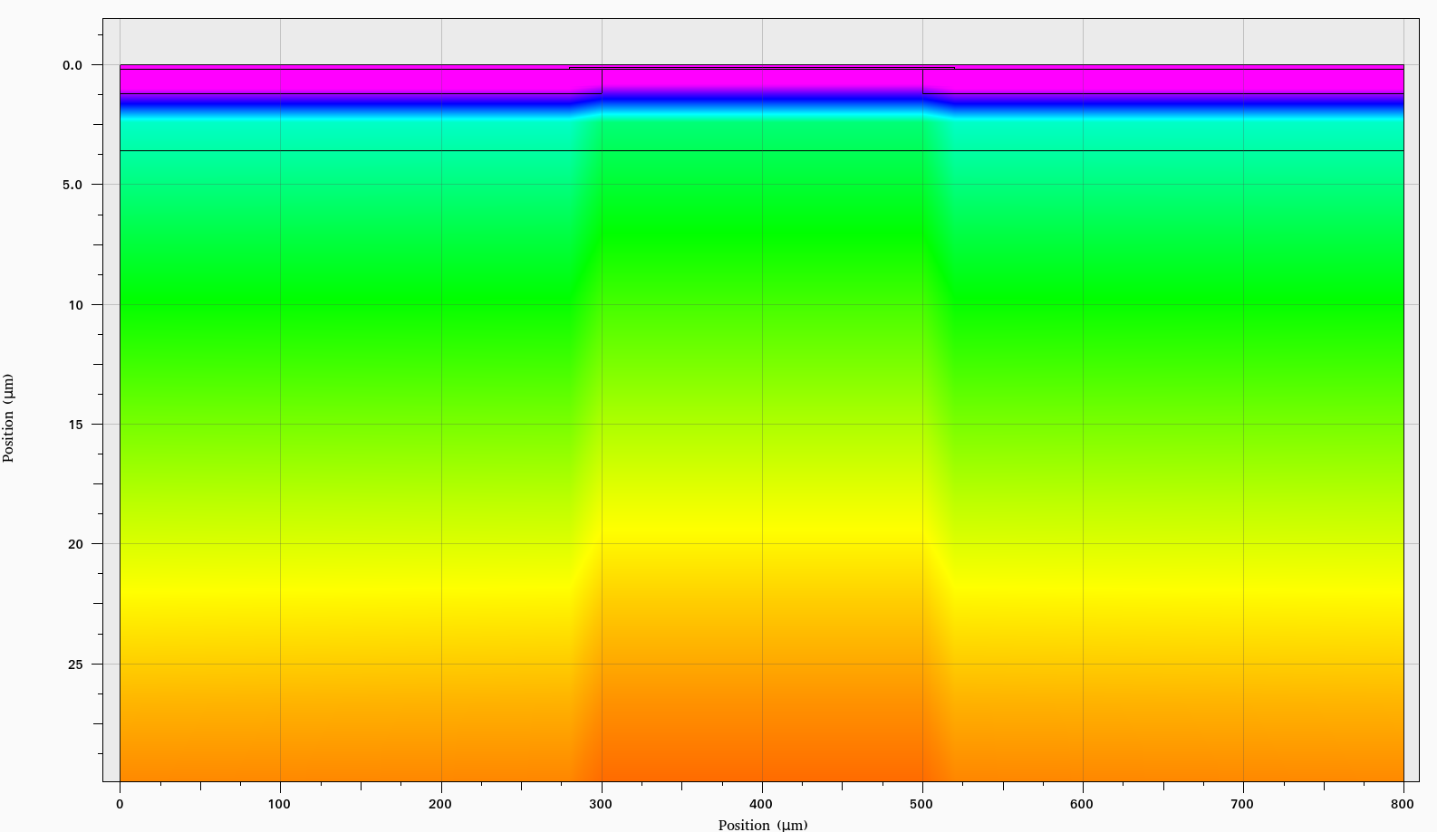
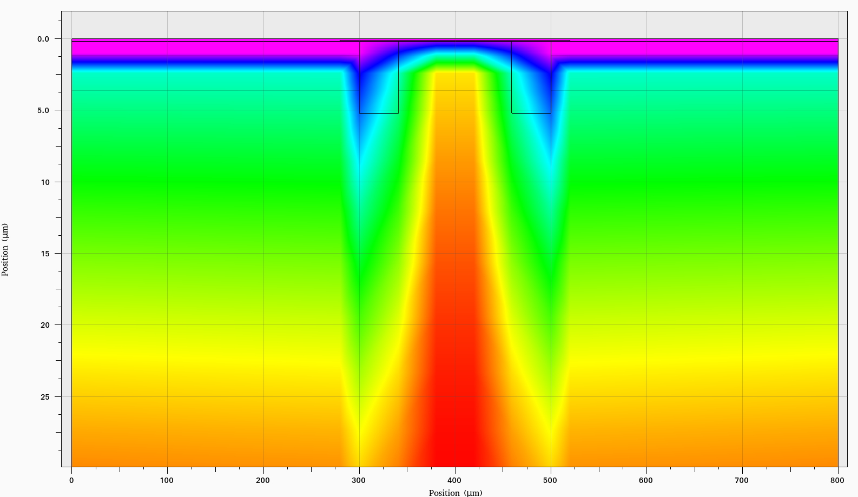
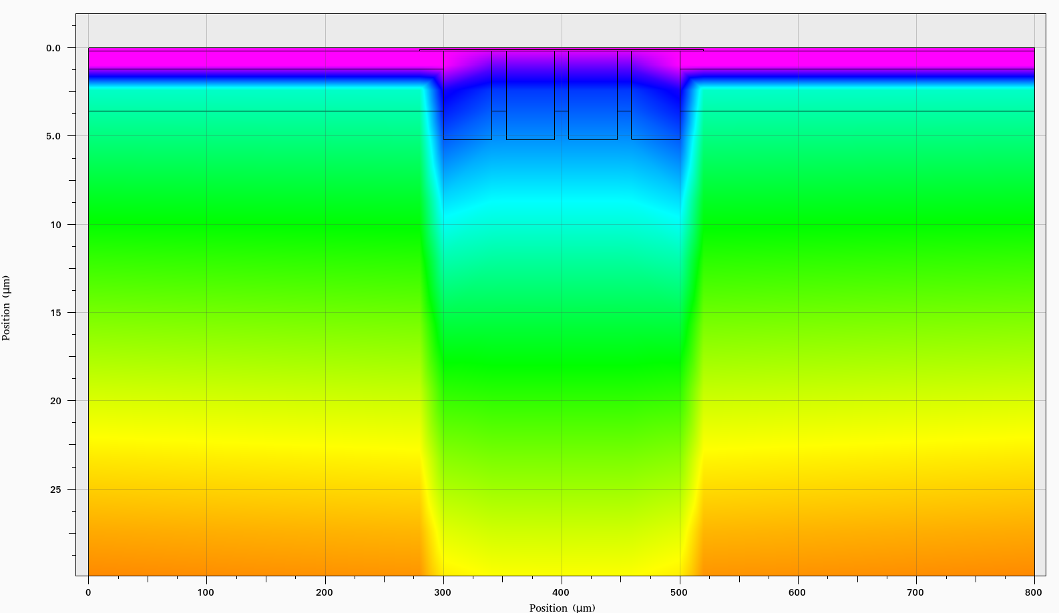
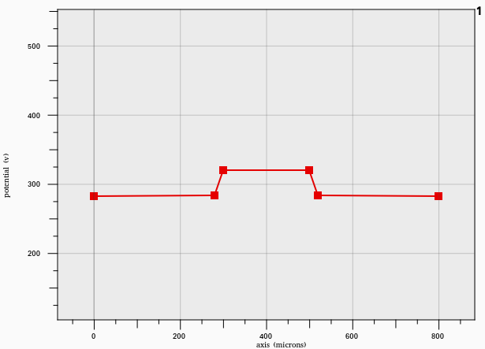
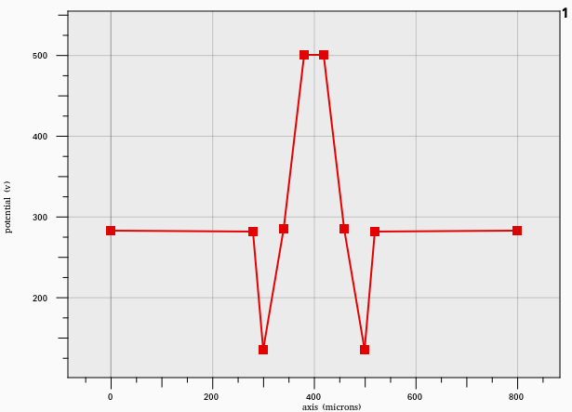
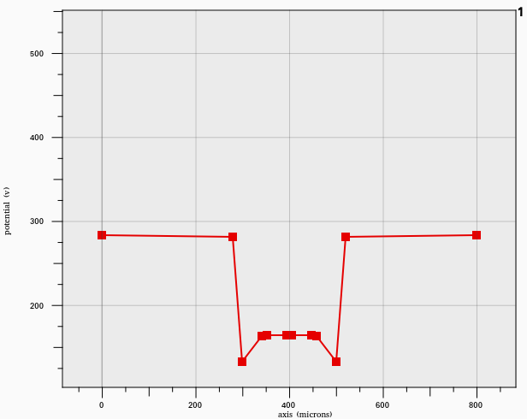
Breakdown study (Potential)
(a)
(b)
(c)
(a)
(b)
(c)
Fig 21: Potential Profile in LGAD with (a) no JTE, (b) 1 JTE, (c) 2 JTE

Slide 25
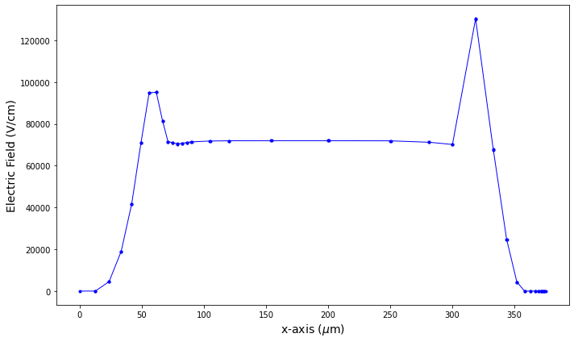
Breakdown study (Electric Field)
(a)
The variation of Electric field in x- axis is plotted
Adding a JTE helps slowly dissipate the electric field near the edges.
The early breakdown due to junction effects can be resolved
(b)
(c)
Fig 22 : Asymmetric LGAD structure with JTE on one side (a) with electric field profiles at 400V taken near Junction Boundary (b) and at the middle of epitaxial layer (c).

