Slide 1
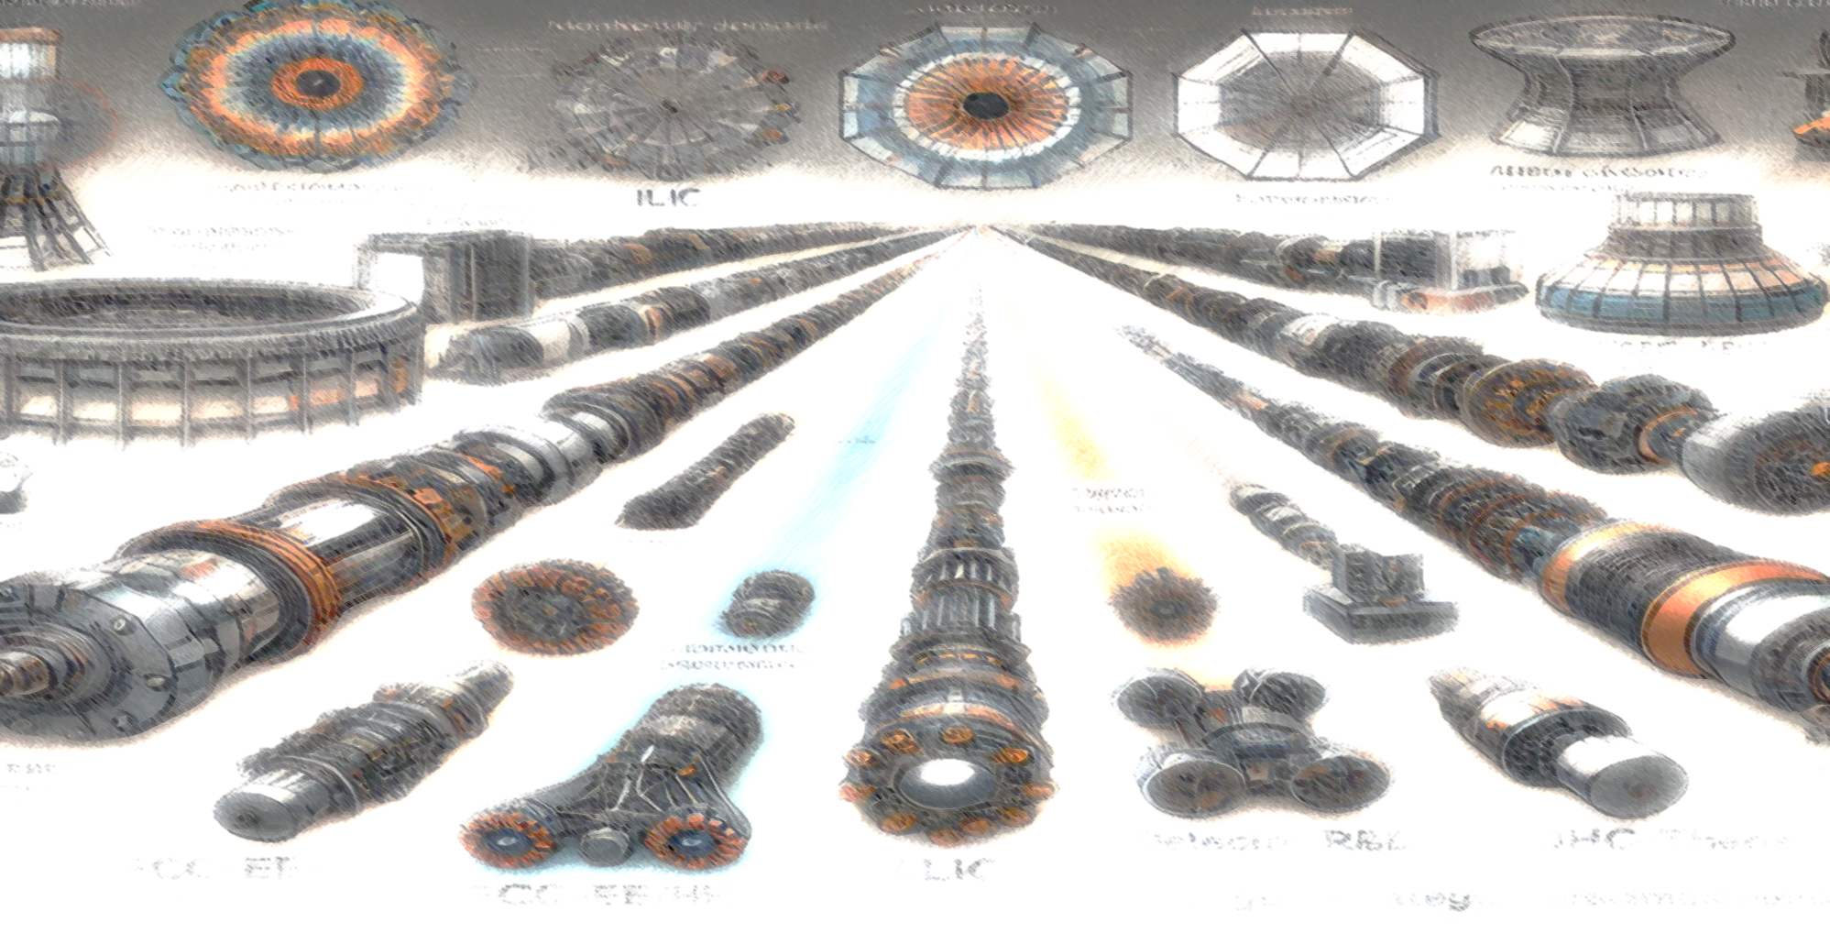

Overview of Activities of the Elementary Particle Physics & Instrumentation group
IFCA Strategy Workshop
June 17th 2025
I. Vila Álvarez
IFCA (CSIC-UC)

Slide 2
Captatio benevolentiae
Too many and too broad topics to be covered in a single talk in detail
Do not expect detailed nor comprehensive explanations.
I will try to show you the forest without paying much attention to the trees

Slide 3
Outline
Elementary Particle Physics Group introduction
Frontier Collider Physics:
  Compact Muon Solenoid at the Large Hadron Collider
Direct detection of low mass Dark Matter
  DAMIC-M
  CADEx
Instrumentation R&D:
  Future colliders and DM direct detection
KT transfer activities: Muon Tomography & medical physics
Final Remarks

Slide 4
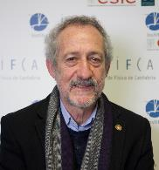
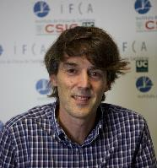
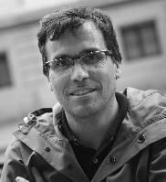
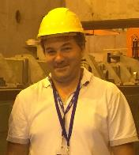
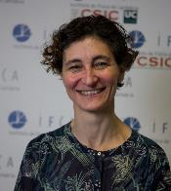
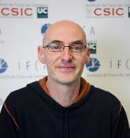
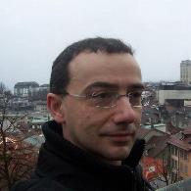
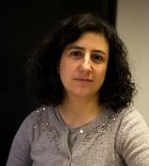
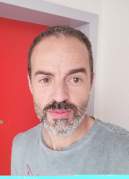
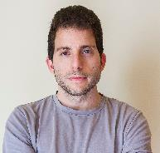
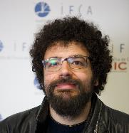
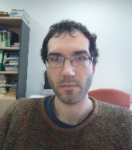
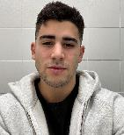
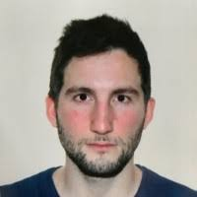
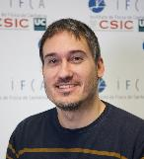
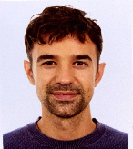
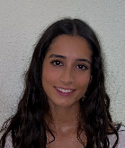
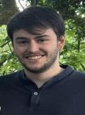
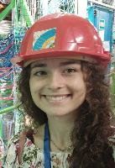
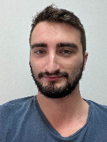
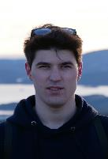
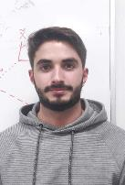
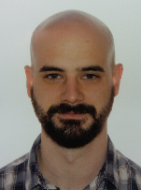
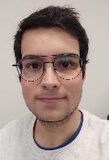
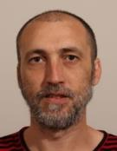
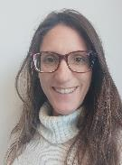
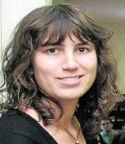
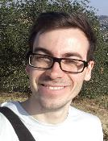

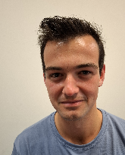
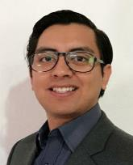
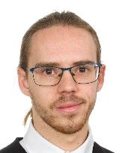
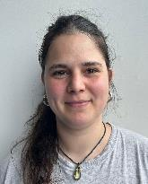
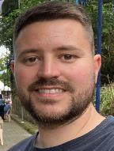
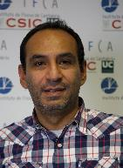
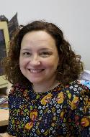
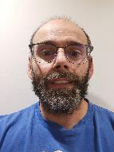
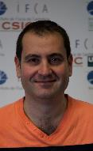
The EPP Group in a Nutshell – Group Composition
TENURED
HIRED STAFF
TENURE TRACK
SYNERGY COMPUTING
SYNERGY COSMO
STUDENTS
STRUCTURAL STAFF

Slide 5
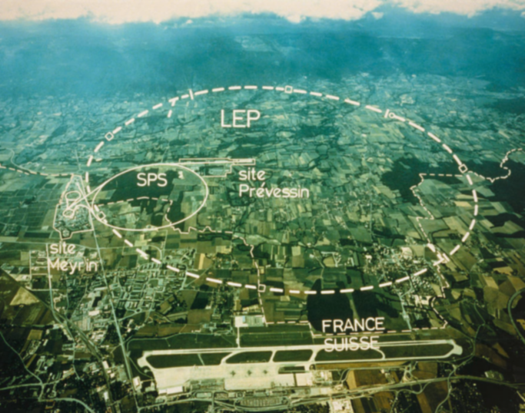
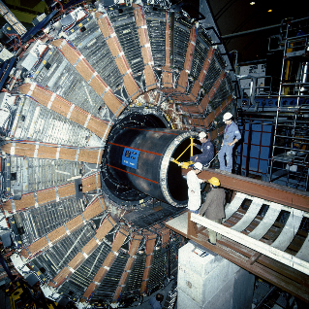


The EPP group in a nutshell – Scientific Background
Long, long time ago (in the early seventies), in a city far, far away, within the newly born University of Santander, the EPP Research Group was created… later becoming a founding group of IFCA.
After Spain rejoined CERN in 1983, the group was consolidated, joining the major league of EPP experiments:
  The DELPHI experiment at the Large Electron-Positron Collider (LEP) at CERN, which ran from 1989 to 2000.
  For about two decades, activities focused on electroweak physics, Higgs searches, and contributions to calorimetry and time-of-flight detectors.

Slide 6







The EPP group in a nutshell – Scientific Background (2)
In 1993, the group opened a new research line in hadronic collider physics, becoming a founding member of the Compact Muon Solenoid (CMS) experiment at the Large Hadron Collider (LHC) at CERN:
  First phase (1994 to 2007): Detector building, including the hardware alignment system connecting the muon and tracker detectors, pioneer development of grid computing.
  Second phase (since 2008 until now): Physics exploitation of CMS.
  Third phase (since 2010 until now): High-Luminosity Upgrade of CMS.
In 1999, the group formally joined the CDF experiment at the Tevatron, the energy-frontier collider at Fermilab (Run II: 2001–2011), becoming the first Spanish group to join the Tevatron:
  Group activities included flavour (B_s) and top physics, serving as an excellent training ground in preparation for LHC physics, and a contribution to the Muon trigger and ToF detector (a stepping stone toward integrating fast timing in general-purpose hadronic detectors).
In 2007, the group started a dedicated detector R&D lines on semiconductor tracking sensor for the future International Linear Collider and vertex detector for Belle-2 (2007-2018).
In 2010, related with the high-luminosity upgrade of CMS, the group joined the RD50 collaboration(Radiation hard semiconductor devices for very high luminosity colliders ) at CERN (2002-2023)

Slide 7

Compact Muon Solenoid Experiment

Slide 8


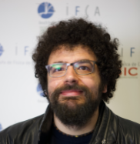


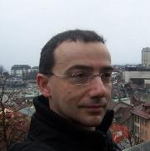
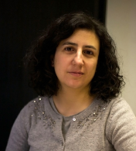
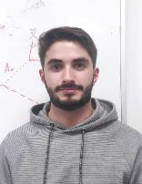
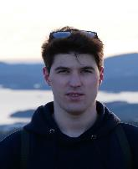
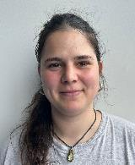
Hadron collider physics at CMS: Analysis action line (Run 3)
The LHC Run 3 has a duration of 4 years. It started in July 2022 and it will finish in May 2026.
The center-of-mas energy is 13.6 TeV and we will get around 300 fb-1 of accumulated luminosity.
Broad scientific program:
  precision Higgs physics, Dark matter searches, Heavy resonances, LLP, top quark physics, electroweak,
IFCA one of two major Spanish groups in the collaboration
  In the current funding period (projects -PID2023-146983NB-I00 + PCI2024-155030-2)
P. Martínez
J. Piedra
J. Vizán
F. Matorras
L. Scodelaro
STUDENTS
Alicia Calderón
Project Co-IP
Celso Martínez
Project Co-IP
Victor
S. Blanco
R. López
Mayra

Slide 9
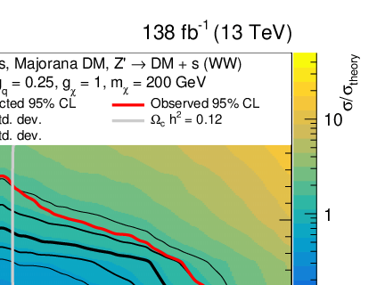
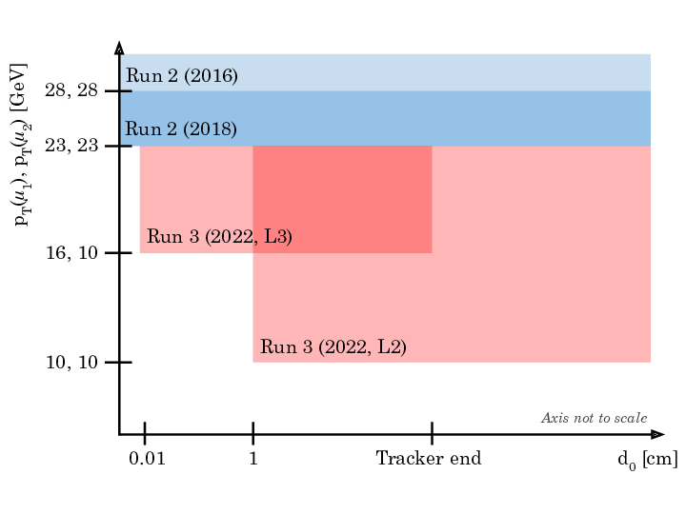
Hadron collider physics at CMS: Run 3 analysis highlights
      In Run 3, we are analysing, among other things, at 13.6 TeV: the inclusive W⁺W⁻ production cross section, long-lived particle decays involving a pair of muons, and searching for dark matter particles produced in association with a Higgs boson (the latter was studied in Run 2).
We have been principal analysers of dark matter
particles produced with a Higgs boson at 13 TeV
JHEP 03 (2024) 134
One of the first analysis at Run 3 at 13.6 TeV (inclusive W+W− production cross section of 125.7 ± 5.6 pb)
CMS-PAS-SMP-24
Search for long-lived particles decaying to final states with a pair of muons in proton-proton collisions at √s = 13.6 TeV
JHEP 05 (2024) 047
Normalized cross section measurement
Change of different triggers in Run 2 and Run 3
Both Sergio Blanco and Rubén López are L3 conveners of Muon Calibration and Muon Reconstruction in the CMS Physics Object Group

Slide 10
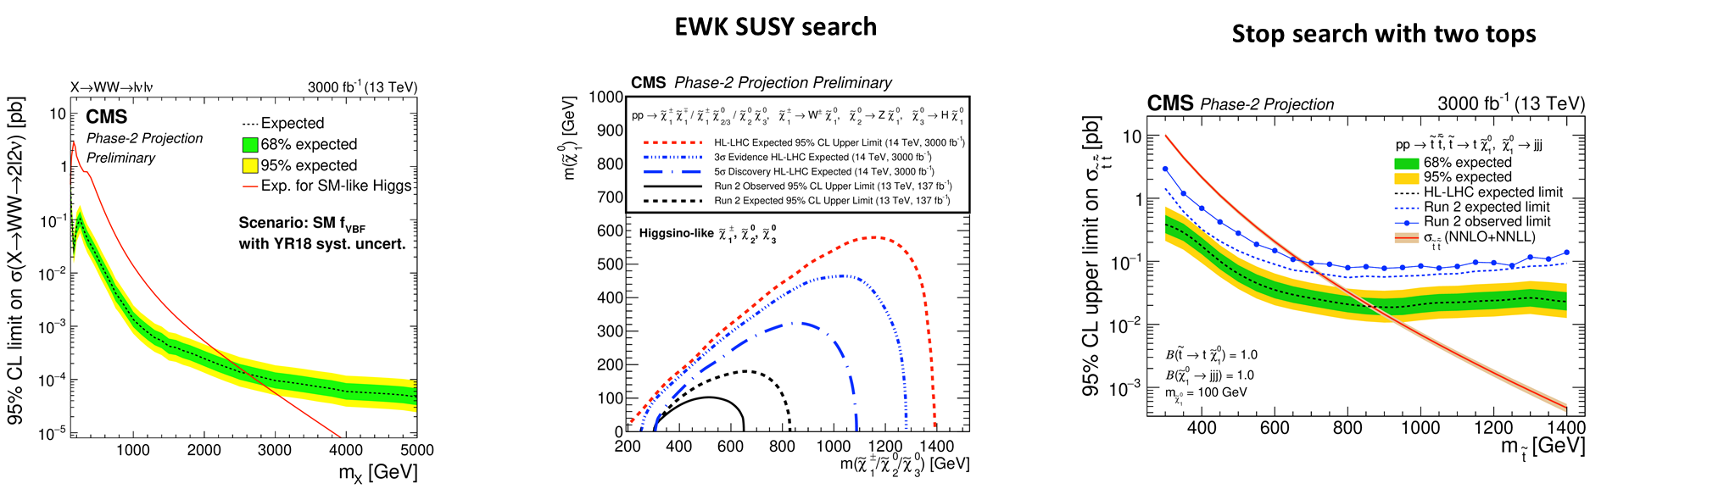
Hadron Collider Physics at CMS: Preparing for the Run 4.
In August 2030 the High-Luminosity-LHC will start after the upgrade of CMS subdetectors (Run 4).
We will have a integrate a luminosity of 3000 fb-1 (x10 run3) with data at the same energy 13.6 TeV
Will participate in some special analysis, aligned with the high-luminosity upgrade activities of the Inner Tracker and Endcap Timing Layer subdetectors where the group is currently involved (see next slides).
Heavy Higgs to W+W- with dileptons

Slide 11
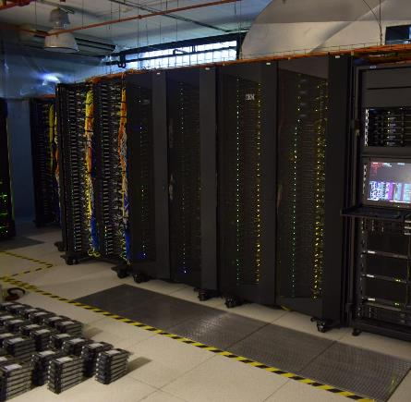





Hadron Collider Physics at CMS: Computing
P. Izquierdo
L. Lloret
Synergy Computing
I. Cabrillo
Spanish T2 data processing centre for CMS (about 5000 cores, cloud):
  handling around 2 PB of data in 2024, with approximately 100,000 processing hours and 50,000 analysis jobs each month.
Funding:
  PID2022-139519OB-C21 CMS-T2
  PID2019-104974RB-I00 CMS-T2
  UCAN15-EE-3271 (high perf storage system)
Advanced statistical techniques and machine learning:
F. Matorras
Project IP

Slide 12

Hadron Collider Physics at CMS: High-Luminosity upgrade
The high-luminosity phase of the LHC (2030-41) will increase up to a factor of eight the original peak luminosity of the LHC and will multiply by ten the integrated luminosity at the end of run 3.
Radiation tolerance (2x10¹⁶ n/cm2 and 1 GRad) requires the installation of a new vertex detector (IT)
Disentangling the multiple collisions (about 200) within a LHC bunch crossing requires precise time stamping of MIP particles (around 30 ps). A dedicated timing detector to be built (MTD)

Slide 13
















Hadron Collider Physics at CMS: High-Luminosity upgrade
Strong involvement in the upgrades of CMS for both the Inner Tracker and the Endcap Timing Layer
  Sensor (3D pixels for IT + LGAD for ETL) testing and characterization
  Sensor Module assembly at IFCA
  Software development and physics studies
Gervasio Gómez
(Faculty CSIC)
Project CO-IP
Pablo Martínez
(Faculty UC)
Project CO-IP
Efrén Navarrete
(PhD CSIC)
Javier González
(Hired Ing. CSIC)
Iván Vila
(Faculty CSIC)
Cristian Quintana
(PhD CSIC)
PROJECTS IN THE LAST YEARS
PID2020-113705RB-C31 (CMS upgrade and R&D ) 2021-2025
  Coordinated with ITAINNOVA and CNM
PID2023-148418NB-C41 (CMS upgrade and R&D) 2024-2027
  Coordinated with ITAINNOVA, CNM and CNA
Core cost CMS upgrade:
2024AEP019: (“bridge” between PIDs) 2024-2024
Marcos Fernández
(Faculty CSIC)
Richard Jaramillo
(Staff Dr. Ing. CSIC)
Clara Lasaosa
(PhD CSIC)
Jordi Duarte
(RyC researcher
CSIC)
David Moya
(Staff Ing. CSIC)
Rubén López
(PhD UC)
Antonio Gómez
(PhD CSIC)
Pedro Rodríguez
(Hired Technician CSIC)

Slide 14



Hadron Collider Physics at CMS: High-Luminosity upgrade highlights
Characterization of 3D sensor radiation tolerance in TB campaigns
IT TBPX L1 to be implemented with 3D 25x100 μm pixel sensors
Efficiency at normal incidence a after maximal irradiation fluence: higher than 97% for all the modules

Slide 15

Hadron Collider Physics at CMS: High-Luminosity - Module production

Slide 16
Hadron Collider Physics at CMS: Leadership positions
Alberto Ruíz
CMS Thesis Awards committee
Alicia Calderón
Section and WG1 in LHC cross-section WG
Celso Martínez
Spanish CMS link person
Francisco Matorras
CMS statistics committee chair and member of publication committee
Gervasio Gómez
L2 Convener high-luminosity upgrade of Inner Tracker sensors
Jonatan Piedra
MUO contact in Higgs PAG
Luca Scodellaro
SUSY MC, L3 SUSY TBT, DQM contact for Higgs.
Pablo Martínez Ruiz del Arbol
L2 convenor MIP Timing Detector (MTD)
L3 Physics coordinator in MTD
Ruben López
L3 convener of Muon reconstruction POG
Sergio Blanco
L3 convener of Muon Calibration and Commissioning. L3 de Muon HLT

Slide 17

Dark Matter With CCDs

Slide 18












Direct Dark Matter searches: DAMIC-M
This focuses on the search for light DM candidates, between eV up to a few GeV
Underground experiments based on CCDs with single electron resolution, that will improve by orders of magnitude the existing limits on DM for a range of different models.
Bradley Kavanagh
(Faculty CSIC)
Project CO-IP
Rocío Vilar
(Faculty UC)
Project CO-IP
Synergy
Observational Cosmology
María Pérez
Hired CSIC)
Carlos Centeno
PhD student
Iker Martinez
Hired Ing.
Michelangelo Traina
Hired postdoc
Design, development, implementation and maintenance of the Data Quality Monitoring (DQM) to improve the data taken, and the collaboration data analysis framework (WADERS). Lead by Nuria Castello
Data Analysis and Simulations. Nuria Castello convener of the analysis and simulation group
Phenomenology, models and signals . Bradley Kavanagh lead this initiative
Low Background tasks (specially related to the Copper material). RV convener of the low background group.
Modane clean room and CCDs testing infrastructures:
  Contact persons with LSM (Michelangelo Traina) and LSC (RV)
Funding:
PID2022 Search for light Dark Matter: From phenomenology to underground lab searches. 04/11/2023- 01/09/2026
PID2019-109829GB-I00, 01/01/2020-31/12/2022.
N. Castello
(Tenure track CSIC)
J. Duarte
(Tenure track CSIC)
A. López
(Staff Physicist UC)
D. Moya
(Staff Engineer CSIC)

Slide 19


Direct Dark Matter searches: DAMIC-M / LBC prototype results

Slide 20

Direct Dark Matter searches: DAMIC-M Schedule

Slide 21

Canfranc Axion Detection Experiment

Slide 22










Canfranc Axion Detection Experiment: Original proposal
Overview
Proposed (JCAP 11 (2022) 044) axion haloscope experiment to search for QCD axion Dark Matter (DM) in the W-band (80-110 GHz) - well-motivated but so far unexplored region of parameter space (m_{a} = 330-460 μeV)
Spanish collaboration with experiment to eventually be hosted at Canfranc Underground Lab (LSC)
IFCA Contribution
Synergetic activity within IFCA - participation from both Particle Physics and Cosmology groups
IFCA leads the Science Working Group (Coordinator: Bradley Kavanagh)
EPP group
Cosmology group

Slide 23





Canfranc Axion Detection Experiment: Current status
Haloscope cavity (Cartagena) and Kinetic inductance detectors (CAB, Madrid) currently under development
Aiming to operate CADEx pathfinder at IFCA Cryolab and have first science results in 2027/2028
Existing EoI (EOI-31-2021) with LSC through 2026, with eventual goal of operating the full-scale CADEx experiment at LSC
Partially funded by:
Plan Complementario de I+D+i en Astrofísica y Física de Partículas, 2022-2025, PIs: Ivan Vila
Quantum sensors for direct detection of light dark matter (QTP2021-03-014 ), 04/2021- 30/09/2025; PI: Ivan Vila
Novel detection system:
- Haloscope + Kinetic Inductance Detectors (KIDs)
- haloscope array in high static magnetic field
New cryogenic laboratory under construction at IFCA to host a CADEX technology pathfinder (civil work to be complete this week)
Installation of dilution refrigerator now.
Test bed of quantum sensors technologies.
Thermometry for LiteBird experiment (COSMO)
Haloscope cavity
Kinetic Inductance Detector

Slide 24



Detector R&D for future collider experiments:
Implementing the detector R&D Roadmap of the European Future Collider Accelerator Commitee.

Slide 25




Detector R&D for future collider experiments: 4D tracking
Carried out in the context of the RD50 (Radiation hard semiconductor devices for very high luminosity colliders (2002-2023) and its successor DRD3 (Solid State Detectors, 2024-) and the infrastructure projects saga (EUDET- AIDA - AIDA2020 – AIDAInnova, 2007-2024) of the EU framework program.
The ECFA detector R&D roadmap stablish as high priority the development of TPSD (Time and Position Sensitive Detectors) with time resolution < 10 picoseconds and position resolution < 10 microns.
The IFCA group is pioneering several proposed enabling sensor technologies: TI-LGAD; I-LGADs and 3D pixels (all these new architecture are advancements of the design used for the CMS High-Luminosity upgrade)
Funding: AIDA, EU H2020, Grant agreement, 2021-2025, PIs: I. Vila ; Tracking-4D para detectores de partículas, CSN2024-154303, 2024-26, PI: J. Duarte .
Efrén Navarrete
(PhD CSIC)
Javier González
(Hired Ing. CSIC)
Iván Vila
(Faculty CSIC)
Project IP
Cristian Quintana
(PhD CSIC)
Richard Jaramillo
(Staff Dr. Ing. CSIC)
Marcos Fernández
(Faculty CSIC)
Clara Lasaosa
(PhD CSIC)
David Moya
(Staff Ing. CSIC)
Jordi Duarte
(RyC researcher
CSIC)
Project IP
Trench-isolated Low Gain Avalanche detectors (TI-LGAD)
3D Columnar pixels
(fast timing with maximal radiation hard)
Pedro Rodríguez
(Hired Technician CSIC)
Antonio Gómez
(PhD CSIC)

Slide 26



Detector R&D for future collider experiments: SiC semiconductor
Carried out in the context of the RD50 (Radiation hard semiconductor devices for very high luminosity colliders (2002-2023) and its successor DRD3 (Solid State Detectors, 2024-)
The ECFA detector R&D roadmap stablish as high priority the development of radiation semiconductor detector for extremely hostile environments, in particular manufactured with Wideband Semiconductors.
SiC is the most promising semiconductor material, strong industrial boost revolutionizing power electronics world wide.
Strong synergy with medical physics applications and KT transfer activities (partially common R&Ds, see next slides).
SiC Diode characterization using
a multiphoton absorption process (first time in world)

Slide 27

Non-Accelerator oriented R&D activities : Beyond DAMIC-M

Slide 28

Knowledge and Technology Transfer - Showcase: Semiconductor Industry
Signature of Explotation and IP right agreement between IFCA, CERN, UPV-EHU and US on the TPA-TCT method.
Royalties on technology transfer discussion with interested companies in progress at CERN

Slide 29




Knowledge and Technology Transfer - Showcase: Muon Tomography
Integración y validación experimental de un demostrador tecnológico de un tomógrafo de muones con resolución temporal, PDC2021-121718-C31 (2022-2024), PIs: Gervasio, Iván
Pablo Martinez
(Faculty UC)
Iván Vila
(Faculty CSIC)
Jordi Duarte
(RyC CSIC)
Gervasio Gómez
(Faculty CSIC)

Slide 30



Knowledge and Technology Transfer - Showcase: Medical Physics
Alberte Arteche
(HIred researcher
CSIC)
Iván Vila
(Faculty CSIC)
Project IP
Pablo Martinez
(Faculty
CSIC)
Jordi Duarte
(RyC researcher
CSIC)
Diego Rosich
(Phd Student)
Nuria Castellon
(RyC researcher
CSIC)
PDC2023-145925-C31 (POC, proton tomography + timing) 2024-2025
  Coordinated with ITAINNOVA and CNM
  85.462,30 €
Development of silicon carbide based instrumentation for ultra-fast monitoring of the dose deposited under flash mode in proton therapy machines, 2023-2026, PIs: Iván, 73.500 €

Slide 31



Knowledge and Technology Transfer - Showcase: Scientific sector
Skipper CCDs Radiopurity mEasurEmeNt sERvice (SCREENER)
The main goal of the CCD setup at LCS is to characterize radiogenic and cosmogenic backgrounds
For DAMIC-M Experiments but as installation of radiopurity for LSC: highly sensitive to certain radioisotopes as: ³²Si, ²³⁸U,²³²Th and ²¹⁰ Pb using coincidence analysis and Energy spectrum
  Upper limit is orders of magnitude better than the sensitivity obtained by direct assay techniques
Do science with the system too.
  Test different models that profits from being not so deep as Modane
SUBVTC-2022-0033, USO DE CCDs CIENTIFICAS CON RESOLUCION SUBELECTRONICA PARA MEDIDAS DE RADIOPUREZA (RP-CCD). CONSEJERIA DE UNIVERSIDADES, IGUALDAD, CULTURA Y DEPORTE; GOBIERNO DE CANTABRIA. Rocio Vilar Cortabitarte. (Instituto de Física de Cantabria (IFCA)). 09/11/2022- 08/11/2023. 20.000 €.

Slide 32
Final Remarks
Since the last review, nearly four years ago, the group has made significant progress in advancing its world-class research program, fully aligned with the strategic roadmaps of the field.
It has fulfilled its commitments to the experiments in which it participates, despite the considerable delays affecting activities both in CMS and DAMIC-M.
There has been a very notable increase in tenured and tenure-track personnel; regarding PhD students, we are currently at our historical maximum.
Several major milestones have been achieved or are nearing completion:
– Completion of the Run 3 data-taking period.
– Start of the detector production phase in CMS for the High-Luminosity upgrade.
– DAMIC-M: detector construction to be completed this year, with the physics run starting in 2026.
– The cryolab facility represents another key milestone, expected to strengthen collaboration between particle physics and cosmology.
Several challenges are emerging on the horizon :
  It is unclear whether we will be able to maintain the current level of funding. A very significant portion of the previously listed activities (over €2M) was supported by the European Recovery Funds (NEXT GENERATION program). As of today, it remains uncertain whether such funding will continue that was critical for cross-group collaboration.
  The funding related with the transfer activities is brittle, we have not achieve yet a consolidated funding line.
The path ahead is certainly challenging, but also extremely exciting and fun.

Slide 33
Back-up

Slide 34
International and national collaboration network
CMS Run3:
CMS Computing
High-luminosy IT and ETL upgrade:
  National groups: Instituto de Microelectrónica de Barcelona (IMB-CNM); Instituto Tecnológico de Aragón (ITAInnova); Centro Nacional de Aceleradores (CNA)
  International groups: Paul Scherrer Institute, Hamburg University, Swiss Federal Institute of Technology (ETHZ), Helsinki University, Fermilab, LIP.
DAMIC-M:
CADEX + QTP
  Nacionales: IMB-CNM, INMA, CAB.
DRDs
  National groups: Instituto de Microelectrónica de Barcelona (IMB-CNM); Instituto Tecnológico de Aragón (ITAInnova); Centro Nacional de Aceleradores (CNA), Instituto de Física Corpuscular (IFIC).
  International Groups: CERN, University of Zurich (UZH), Joseph Stephan Institute (JSI), IHEP (Beijing), UCSC, Vienna (HEPHY).

