Slide 1

Report on Medical Physics Activities
Alberto Arteche
on behalf of D. Rosich, J. Duarte-Camperros, N. Castello-Mor, A. Ruiz, P. Martínez Ruiz del Árbol, I. Vila
Marina Gutiérrez, Rosa Fabregat, Samuel Ruiz-Arrebola, Pedro Prada
June 18th, 2025

Slide 2
Outline
Proton Therapy Activities:
  Why Proton Therapy?
  Radiological Safety report and Bunshi applied to the future HUMV Proton Therapy Facility
  Future plans & data-taking campaigns
  Proton CT: PROTECT
Brachytherapy activities:
  What is Brachytherapy
  Setup & Monte Carlo Simulations
  Results
Teaching & Outreach

Slide 3
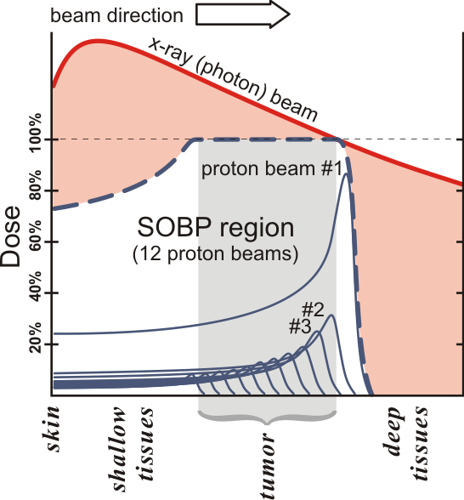
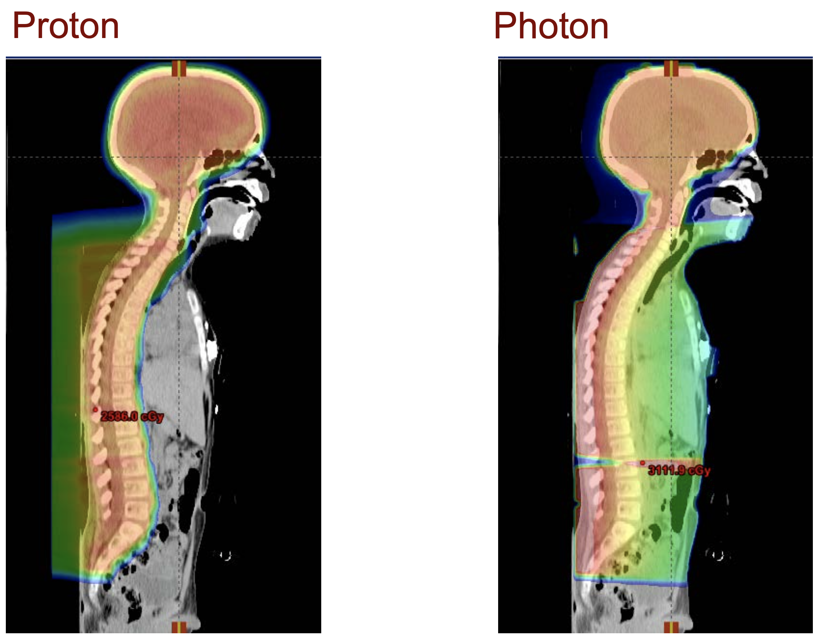
Why proton therapy? Rationale
  Proton radiation allows for dose deposition in a much more confined manner:
    It minimizes radiation to healthy tissue by 3 to 5 times.
    This is especially relevant for cancers near radiosensitive organs.
    The technique was first proposed by Robert R. Wilson in 1946.
https://en.wikipedia.org/wiki/Proton_therapy

Slide 4
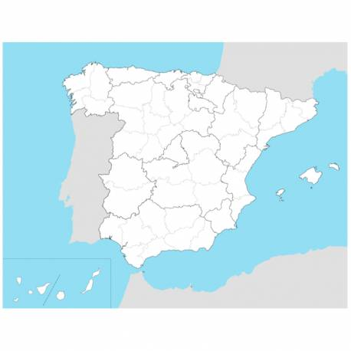
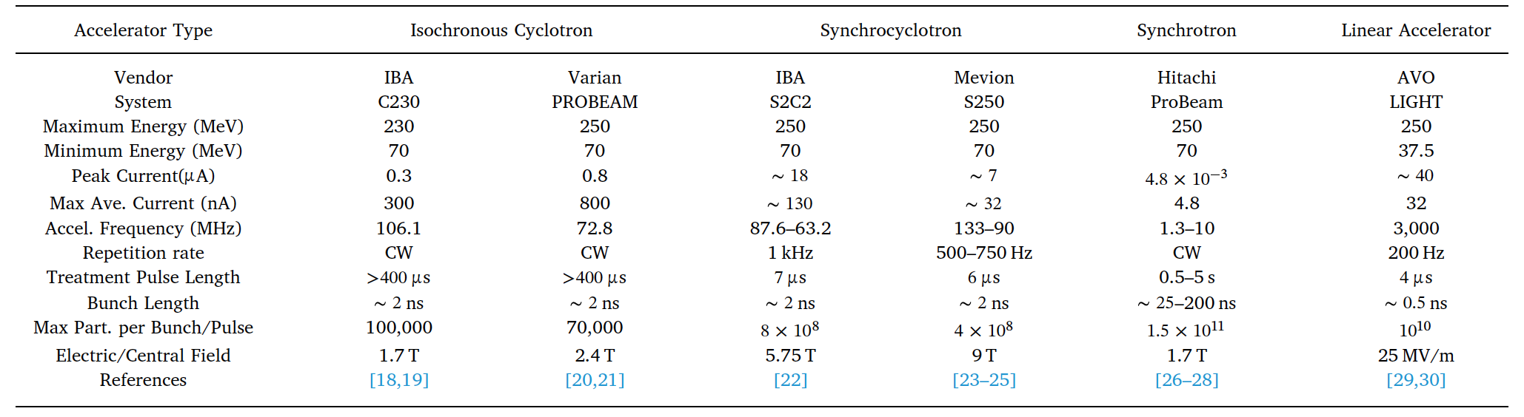
Proton Therapy in Spain
Hospital universitario Marqués de Valdecilla (HUMV) in Santander
Technical challenges for FLASH proton therapy, Simon Jolly, Hywel Owen, Marco Schippers, Carsten Welsch,, Physica Medica, https://doi.org/10.1016/j.ejmp.2020.08.005.
FAO
HUMV
Quirón
CUN

Slide 5

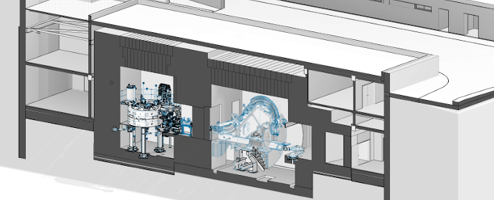
Radiological Protection Study for the HUMV PT Facility
VARIAN PROBEAM 360 AT HUMV
"Business Case": The Nuclear Safety Council (CSN) required the preparation of a Radiological Protection (RP) report by an independent third-party entity for the commissioning of the BEAMPRO250 cyclotron at Valdecilla Hospital.
Radioprotection Report for the Future Proton Therapy Installation at Valdecilla Hospital (Contracted by SCS, 2022–2024) (19k EUR)
Development of a dedicated software tool (BUNker SHIelding simulation tool – BUNSHI) for the evaluation of key radioprotection parameters:
CYCLOTRON
GANTRY (360°)
ESS
ISOCENTER
(patient)
HD concrete
MAZE

Slide 6
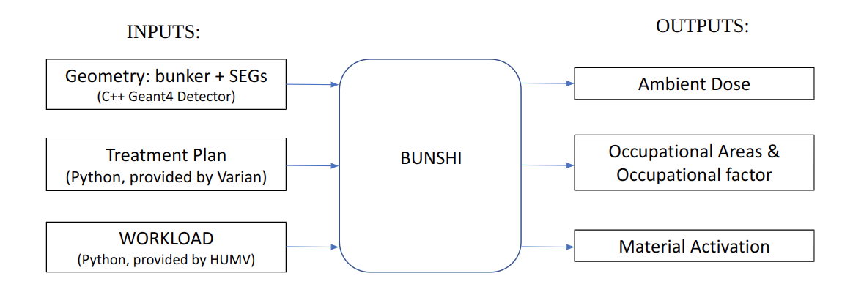
Radiological Protection Study for the HUMV PT Facility
VARIAN PROBEAM 360 AT HUMV
State of the art for similar problems: FLUKA, MCNP, Geant4
In-house Selection Based on IFCA’s Extensive Experience: Geant4
Decoupled approach:

Slide 7
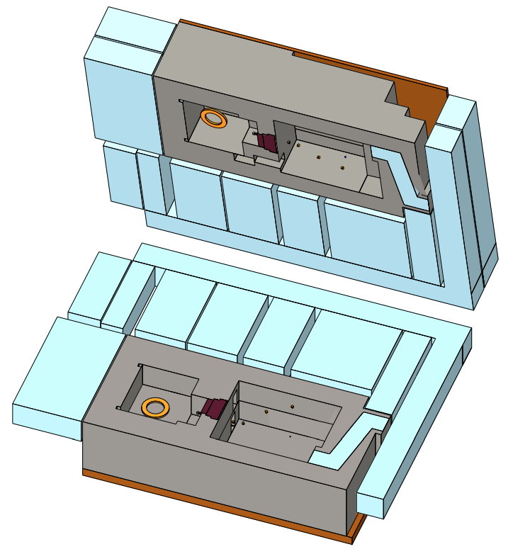
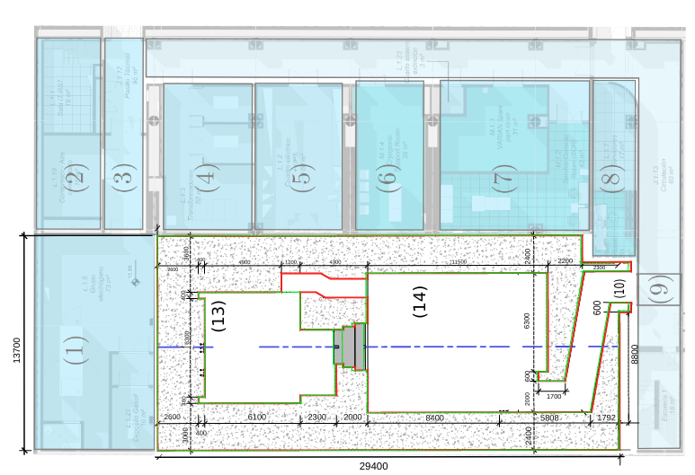
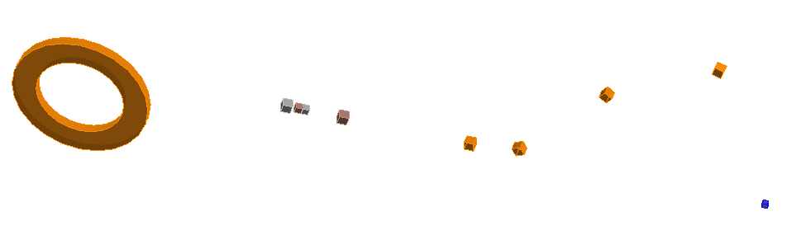
Radiological Protection Study for the HUMV PT Facility
GEOMETRY
10 EGSRs identify by VARIAN

Slide 8
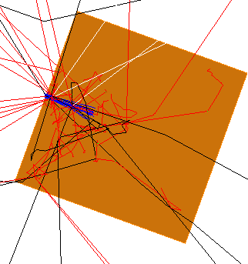
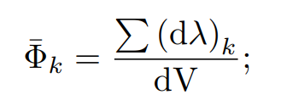

Radiological Protection Study for the HUMV PT Facility
GEOMETRY
The proton beam interacts with the EGRSs, whose positions are provided by Varian. These are modeled as 40 cm cubes of the corresponding material, producing neutrons, gammas, electrons:
A beam of 10⁸ protons is simulated to strike each of the 10 EGRSs.
Kellerer’s law¹ is applied during the voxelization (26 cm × 26.5 cm × 26 cm) of the GEANT geometry to generate a normalized equivalent dose template H* per EGRS, based on the fluence of secondary particles:
10 EGSRs identify by VARIAN
(1) Kellerer, A.M.: Considerations on the random traversal of convex bodies and solutions for general cylinders. Radiation Research 47, 359–376 (1971)

Slide 9
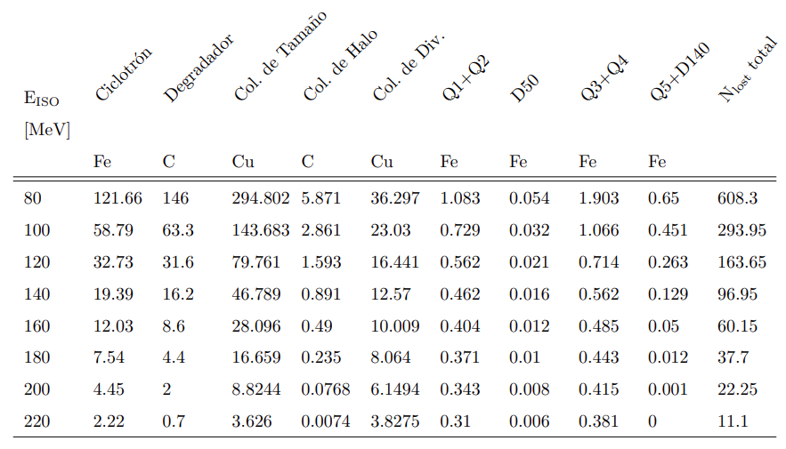
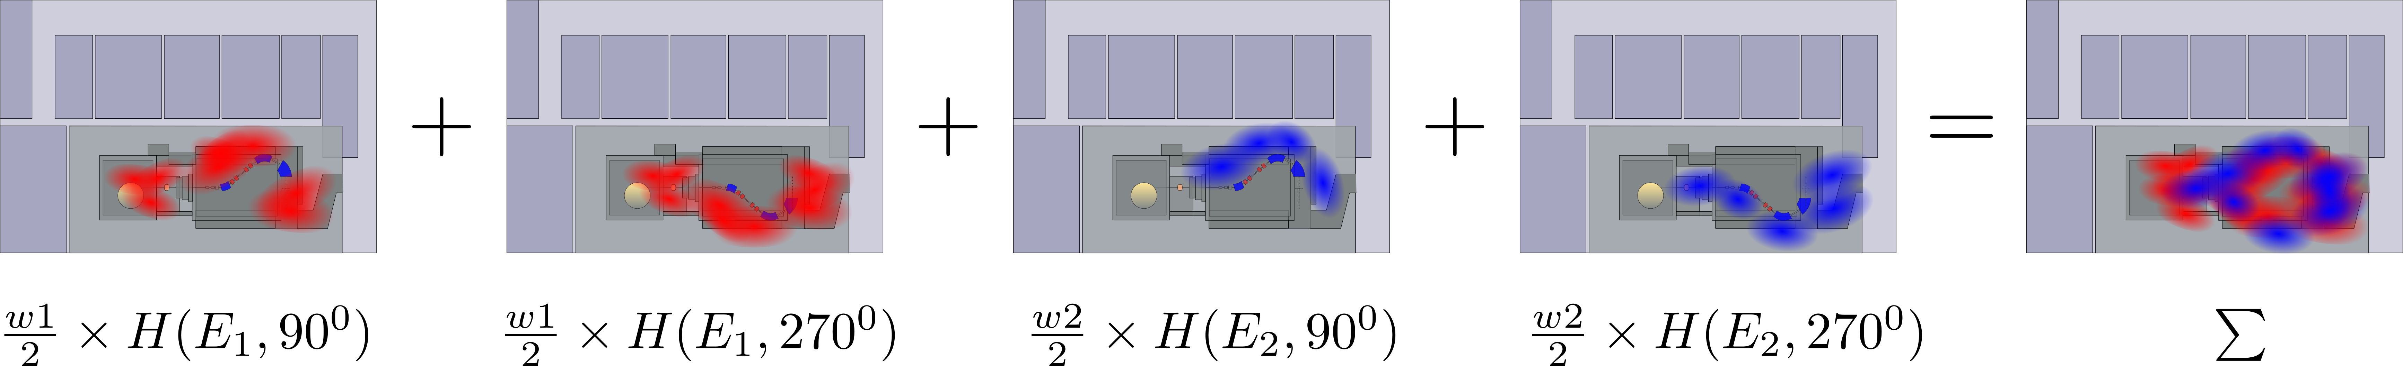
Radiological Protection Study for the HUMV PT Facility
TREATMENT PLAN

Slide 10
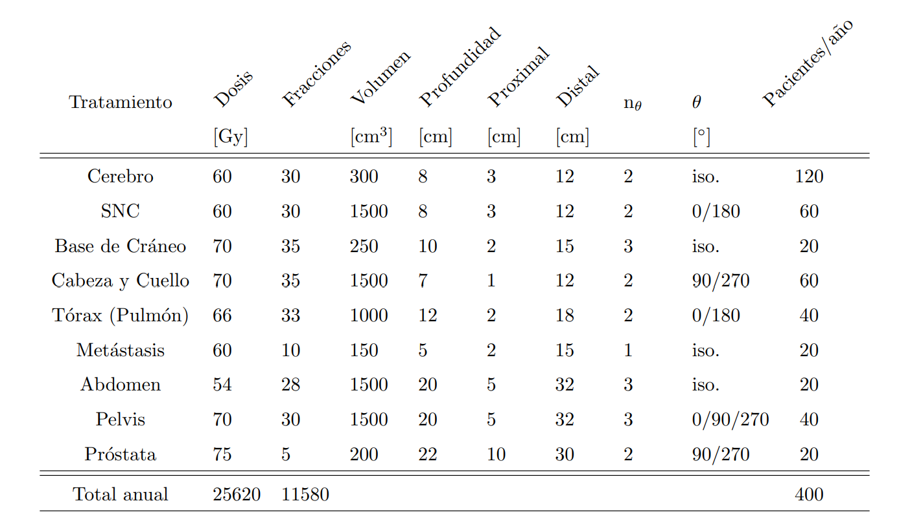
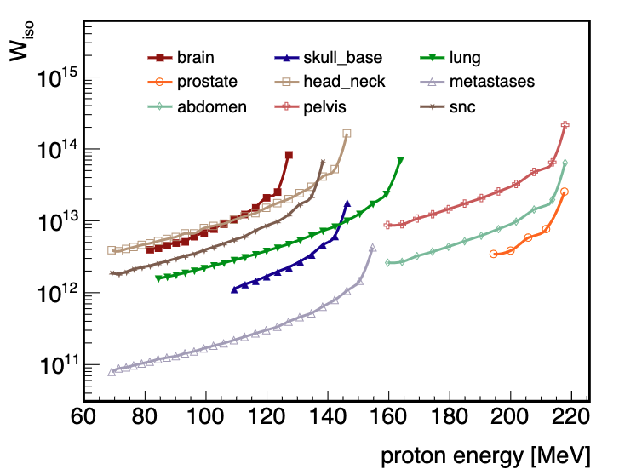
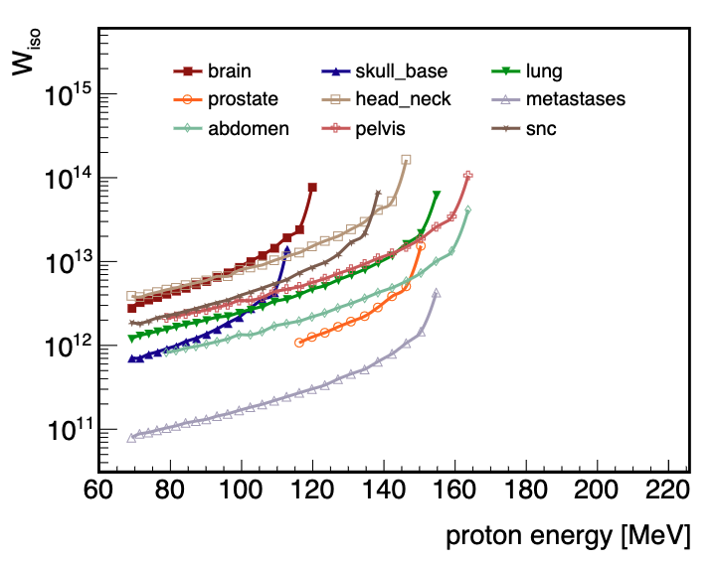
Radiological Protection Study for the HUMV PT Facility
WORKLOAD
Total number of protons reaching the isocenter in one year of treatments for 400 patients at the HUMV facility:

Slide 11
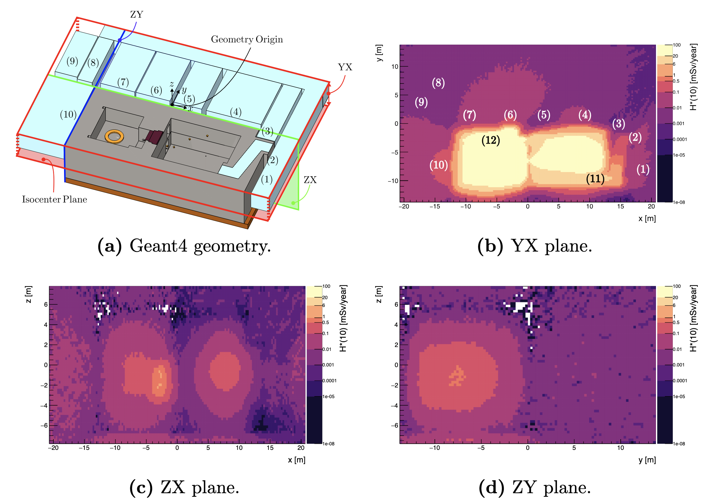
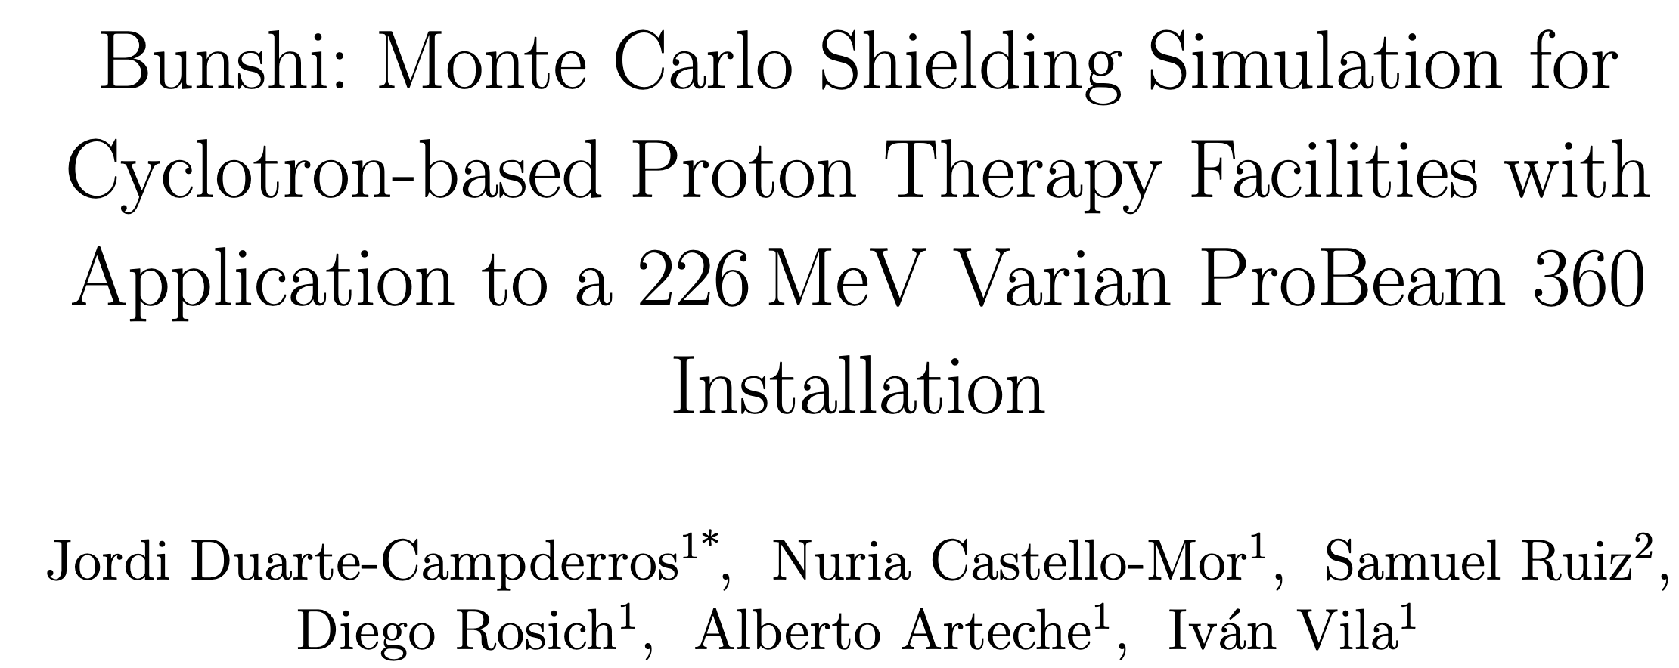
Radiological Protection Study for the HUMV PT Facility
CONCLUSIONS
No accessible area exceeds the legal limit to be classified as a controlled or restricted zone.
Bunshi enables the study of both dose rate and activity.
Bunshi has been validated with experimental results and MCNP simulations.
A publication is in preparation with the detailed radiological characterization study of the Valdecilla facility.
The decoupled approach is easily applicable to other facilities.

Slide 12
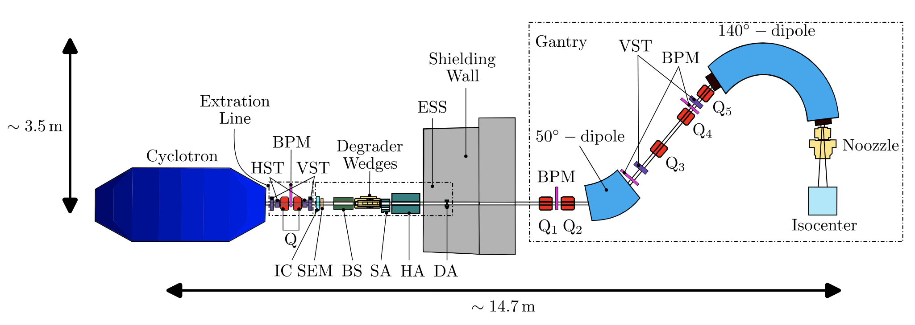
Time Scale & Plans for the Future HUMV PT Facility
VARIAN PROBEAM 360 AT HUMV
May, 2025
June, 2026
June, 2027
Bunker Construction Period
Cyclotron Tunning
Clinical Operation
At least ~20 Saturdays during the first year of operation dedicated to research beamtime coordinated by IFCA

Slide 13
Time Scale & Plans for the Future HUMV PT Facility
VARIAN PROBEAM 360 AT HUMV
EURADOS: European Radiation Dosimetry Group
  WP9: Beamtime at the Danish Centre for Particle Therapy (DCPT) in October 2025 for a LET characterization data-taking campaign.
  DCPT is also a Varian ProBeam 360 model
Future Studies :
  Proton CT: both at DCPT and HUMV
  FLASH: Irradiations with ultra high dose rate pulsed radiation reduce adverse effect in healthy tissue
https://en.wikipedia.org/wiki/Proton_therapy

Slide 14
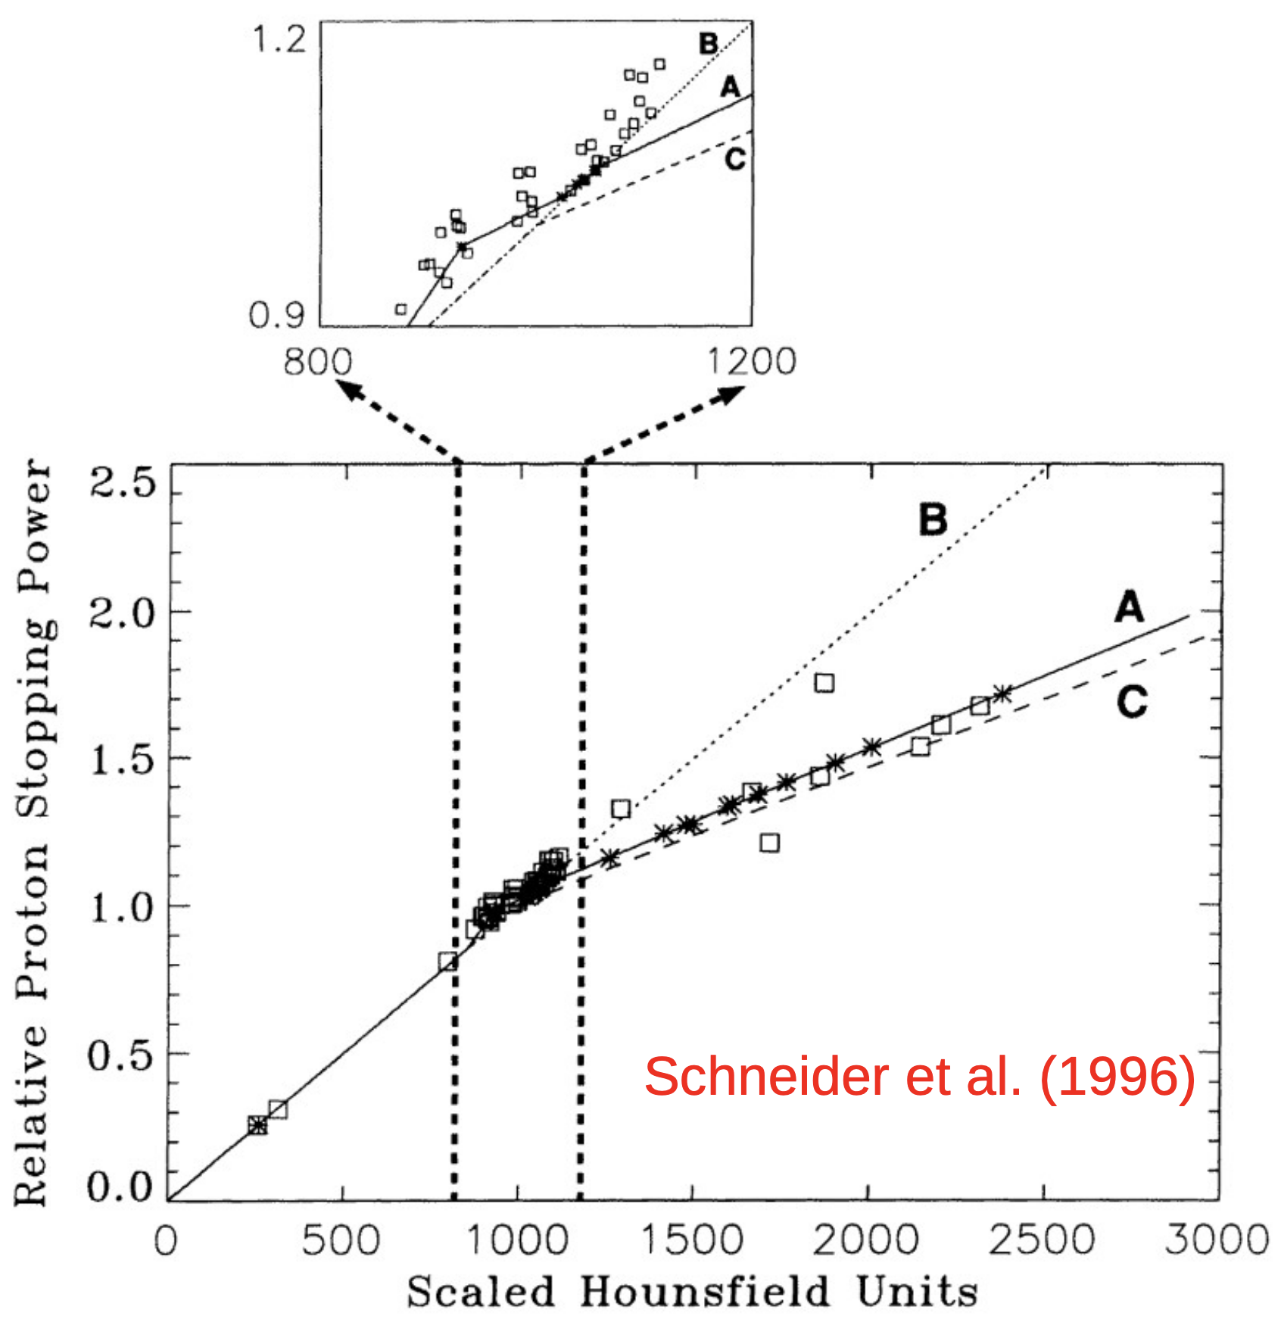
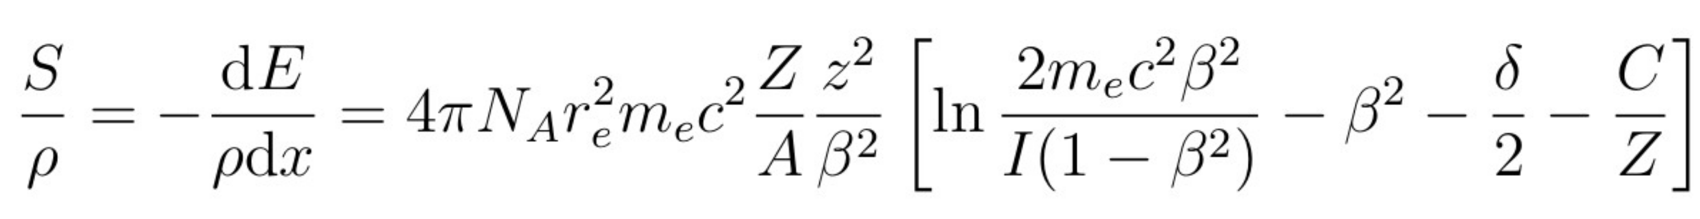
Time-of-Flight Proton Imaging: Protect
WHY PROTON CT?
Proton imaging is rapidly emerging as a tool to refine the treatment planning in proton therapy:
Photon-based imaging diagnostics introduce a 1%–3% uncertainty in the stopping power estimation, which translates into approximately 3 mm of range uncertainty in proton therapy (*)
Obvious (?) Solution to use protons from the same treatment machine at high-energies and then simply apply the Stopping Power equation to translate to treatment energies:
(*) Physics in Medicine and Biology 43(6), 1579–1592

Slide 15
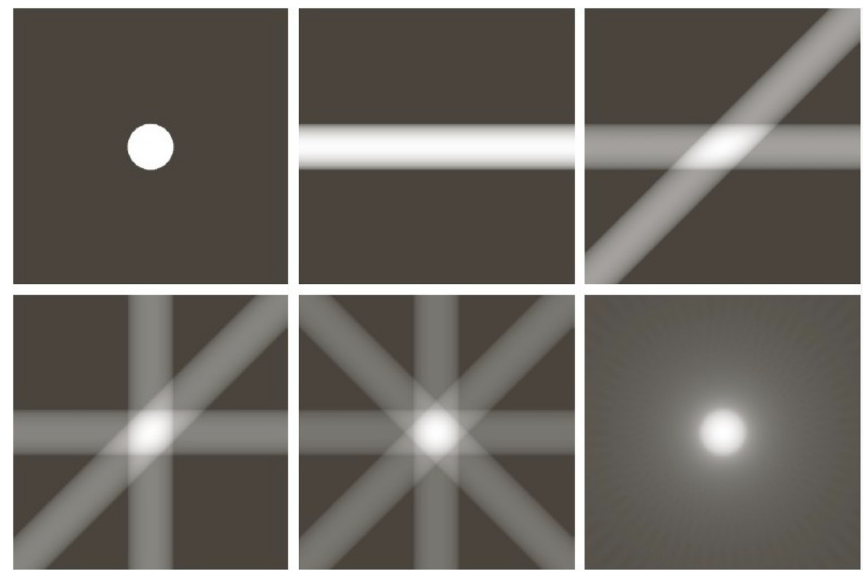
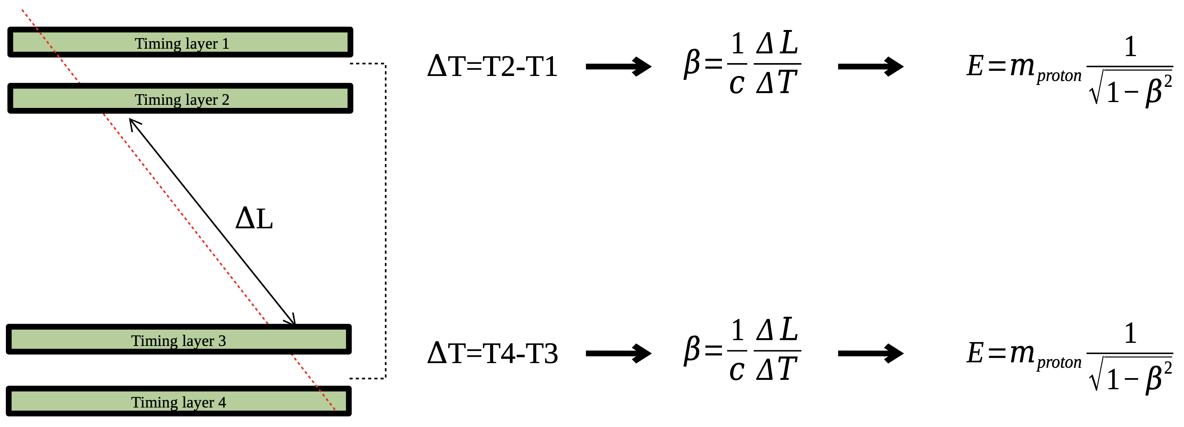
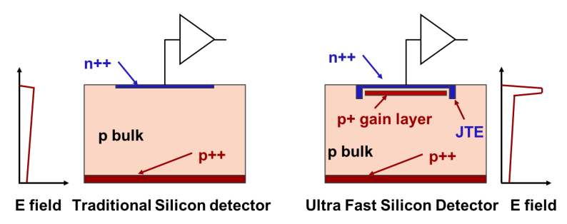
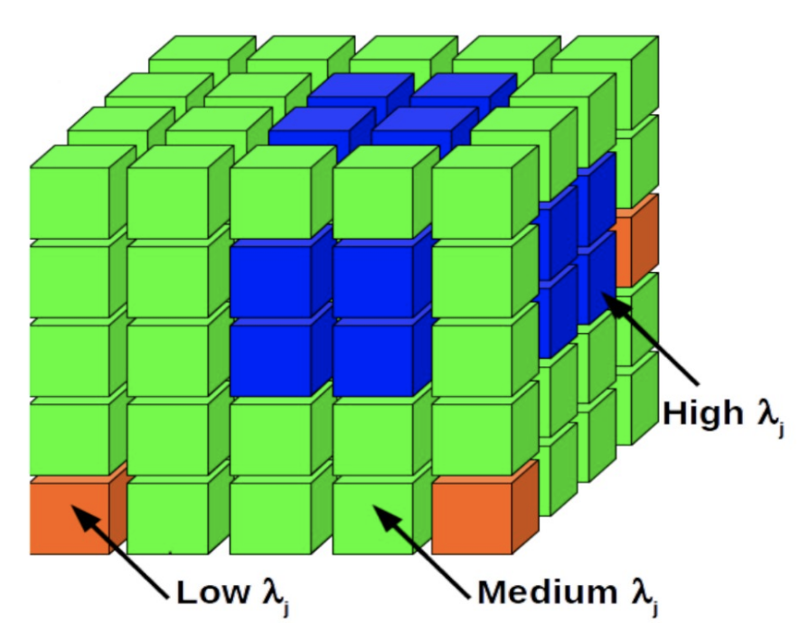
Time-of-Flight Proton Imaging: Protect
PROTON CT BASED IN ENERGY LOSS AND LGADS
Time resolution ~ 30ps and ΔL~ 1m + 5 planes → momentum resolution < 1% at proton therapy energies
Inverse Problem: From energy loss to stopping power via back filtered projection algorithms
and taking assumptions to produce trustworthy stopping-power maps
Pablo Martínez Ruiz del Árbol

Slide 16
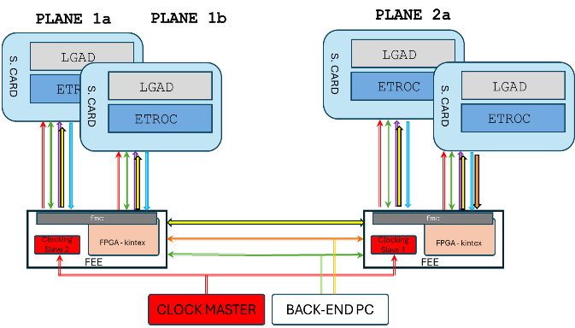
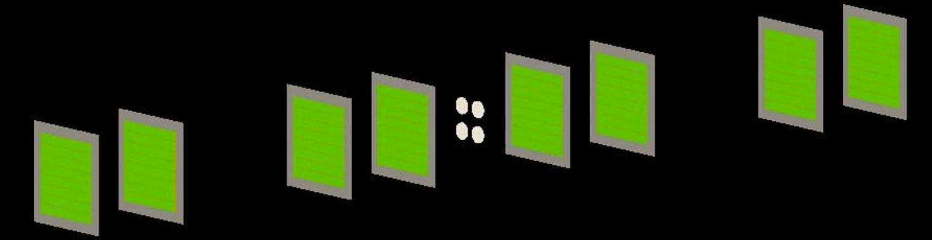
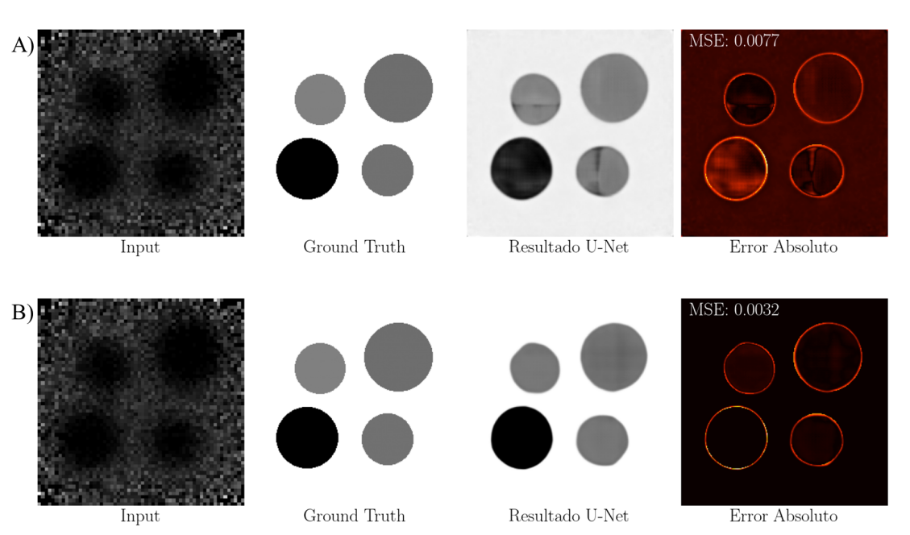
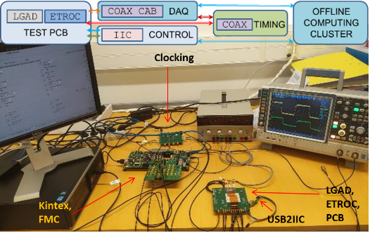
Time-of-Flight Proton Imaging: Protect
SIMULATION VALIDATION
Project in collaboration with CNM (LGAD sensors) and ITAINNOVA (clock distribution)
Plane sync using White Rabbit technology (self-calibrating distributed clock based on ethernet)
Simulation and reconstruction chain is fully operative
Several Imaging algorithms are under development
GEANT4 simulation with 4 tissue phantoms
U-NET based dennoising

Slide 17
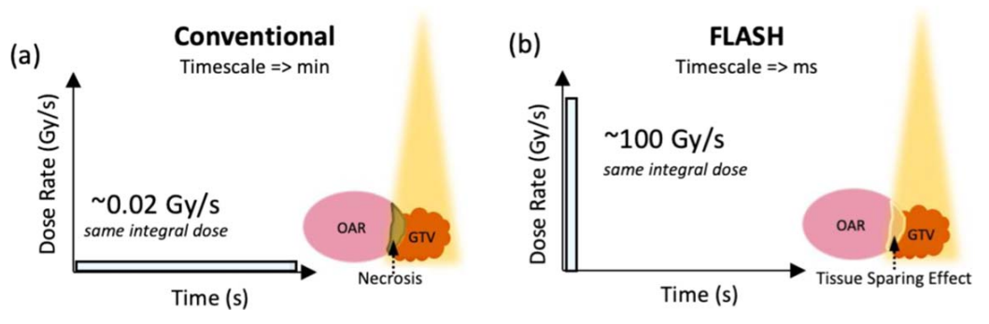
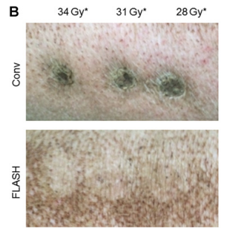
Time Scale & Plans for the Future HUMV PT Facility
VARIAN PROBEAM 360 AT HUMV
FLASH: Irradiations with ultra high dose rate pulsed radiation reduce adverse effect in healthy tissue
  Both DCPT and HUMV are Varian ProBeam 360 with FLASH capability
  FLASH radiotherapy: > 40 Gy/s
  Conventional radiotherapy: < 0.5 Gy/s
Conventional dosimeters saturate
There is a need for real-time, precise and hard dosimeters
Wide bandgap semiconductor detectors
  Diamond is the current standard for FLASH dosimetry
  SiC could be a great alternative
R Hachadorian et al 2023 Phys. Med. Biol. 68 15NT01
High-Dose Rate Brachytherapy Studies while we manage
to have access to PT-FLASH facilities
Vozenin MC, et al. Clin Cancer Res. 2019;25(1):35-42.

Slide 18


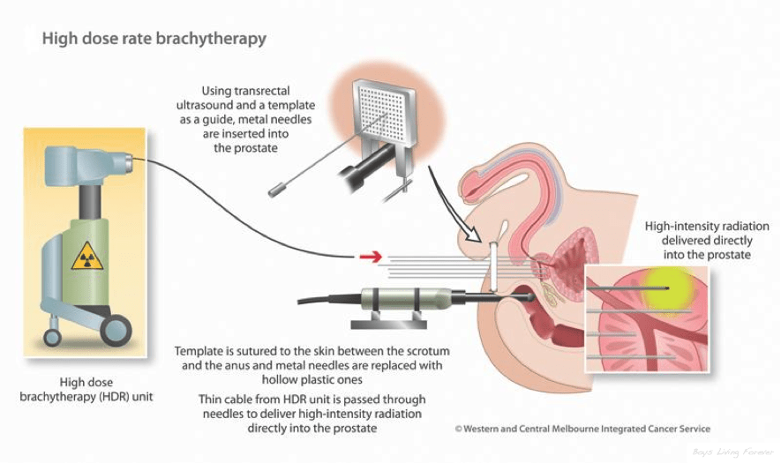
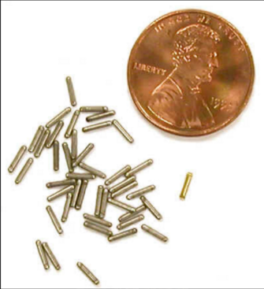
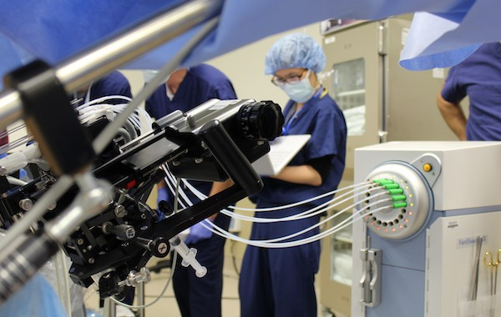
Brachytherapy Dosimetry Activities
WHAT IS HIGH-DOSE RATE BRACHYTHERAPY?
High-Dose Rate Brachytherapy (HDRB) delivers precise, high-intensity radiation directly to the tumor site through temporarily inserted applicators, in short sessions, minimizing exposure to surrounding healthy tissue.
HDR brachytherapy is commonly used for cancers such as prostate, gynecological, breast, and skin, offering high local control with reduced side effects.
Necessity of an In Vivo and Real-Time Dosimetry System
¹⁹²Ir seeds → ɣ: 355KeV, >300GBq

Slide 19
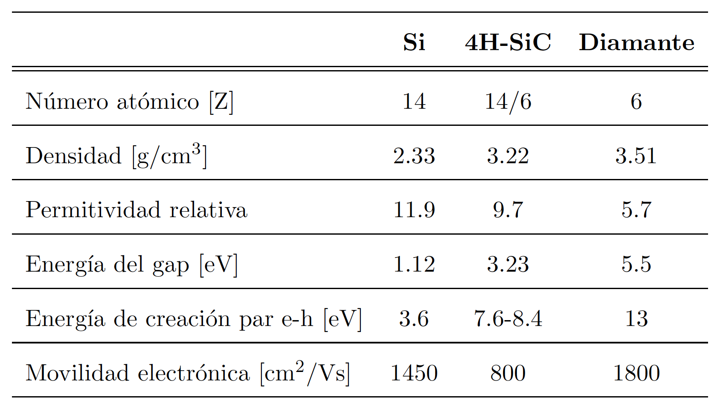
Brachytherapy Dosimetry Activities
SILICON CARBIDE FOR BRACHYTHERAPY DOSIMETRY
Why Silicon Carbide?
  Radiation hardness (?)
  Low temperature dependence
  Low noise
  Easier and cheaper to manufacture compared to Diamond
Main current research activity:
  Funded by the AECC through Diego Rosich’s stipend
  Objective: develop SiC-based tailored detectors for real-time & IVD for HDRBT (INNVAL: 20k EUR. )
  We maintain a very close and strong collaboration with HUMV, which allows frequent access to the HDRB bunker and independent operation (A. Arteche is a CSN-approved operator of the facility).
  TG43 Characterisation Measurements with CNM detectors
(1) M. SiC detectors: A review on the use of silicon carbide as radiation detection material, De Napoli, Front. Phys. 2022, 10, 898833.
(2) First Characterization of Novel Silicon Carbide Detectors with Ultra-High Dose Rate Electron Beams for FLASH Radiotherapy, Romano, F et al (2023), Applied Sciences, 13(5), 2986.

Slide 20

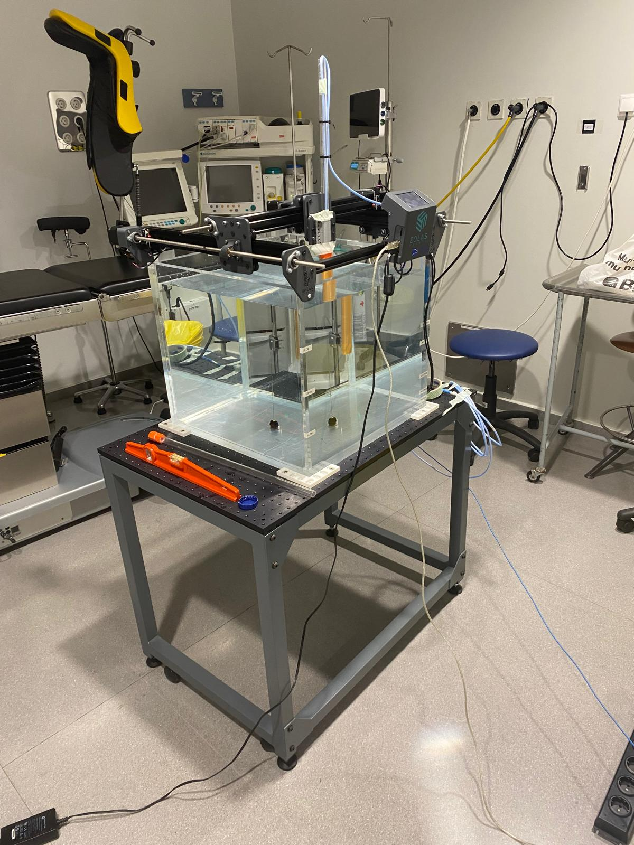
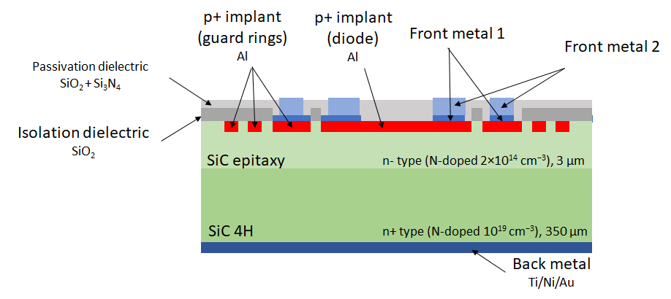
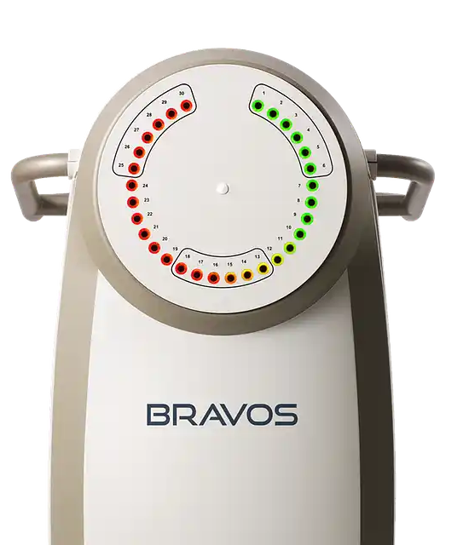
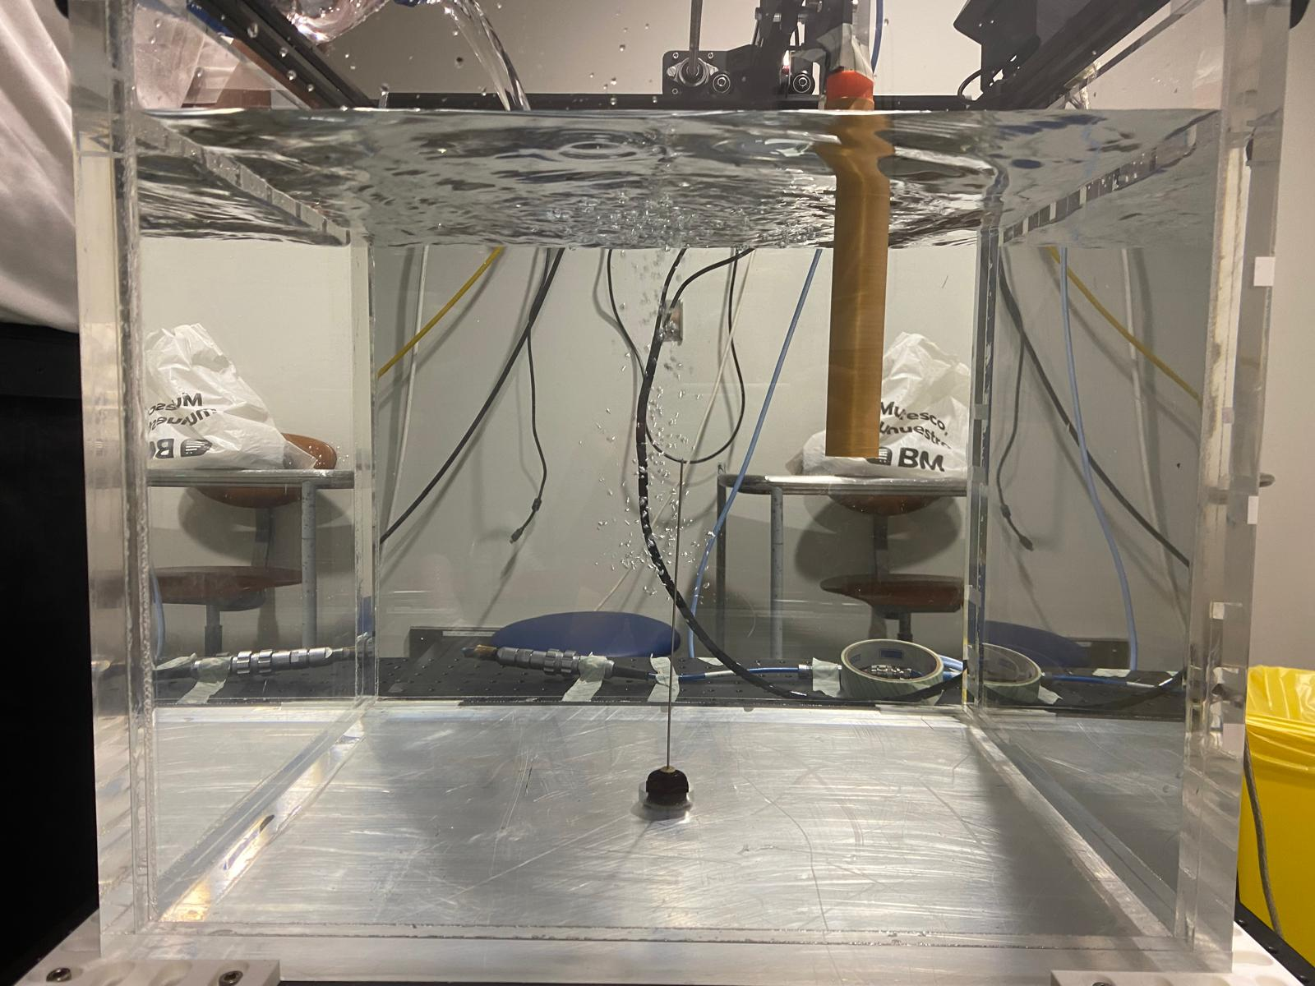
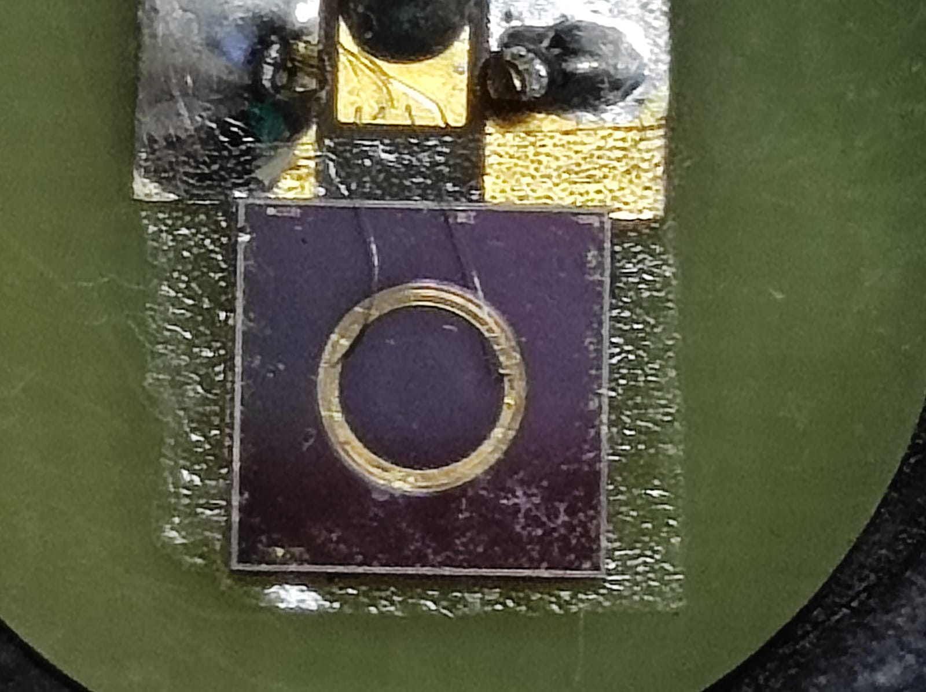
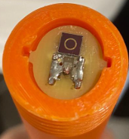
Brachytherapy Dosimetry Activities
CHARACTERISATION CAMPAIGN AT HUMV
Fleta C, et al.. Phys Med Biol. 2024;69(9):10.1088/1361-6560/ad37eb
2.2mm

Slide 21

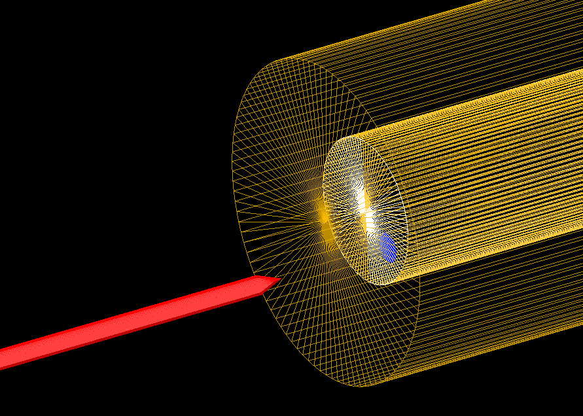
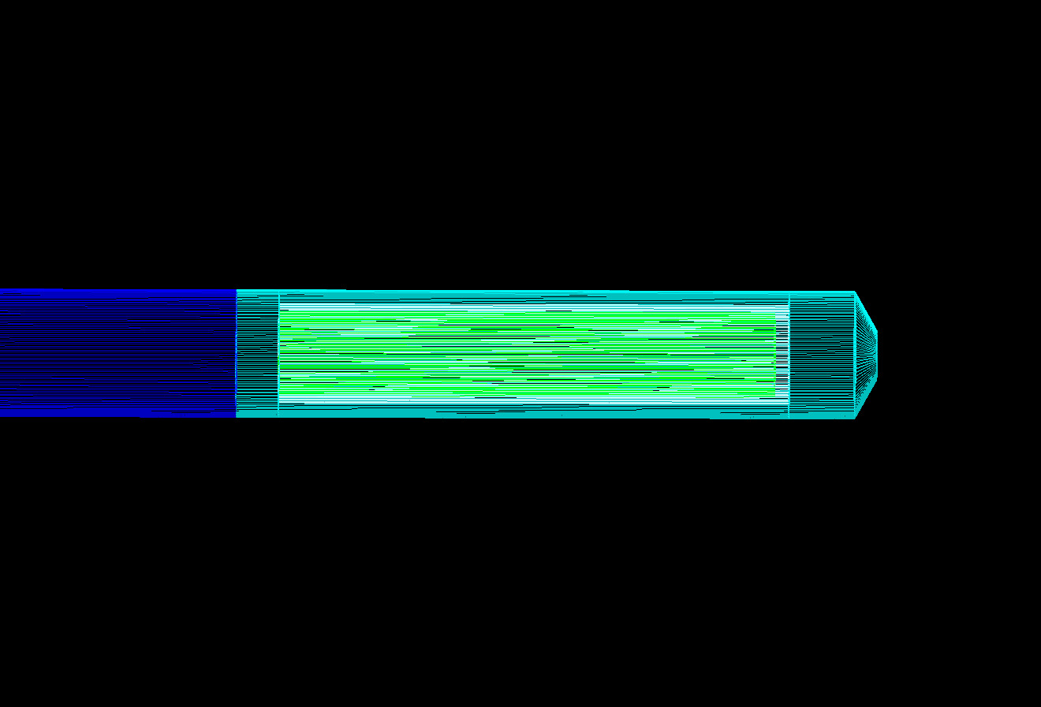
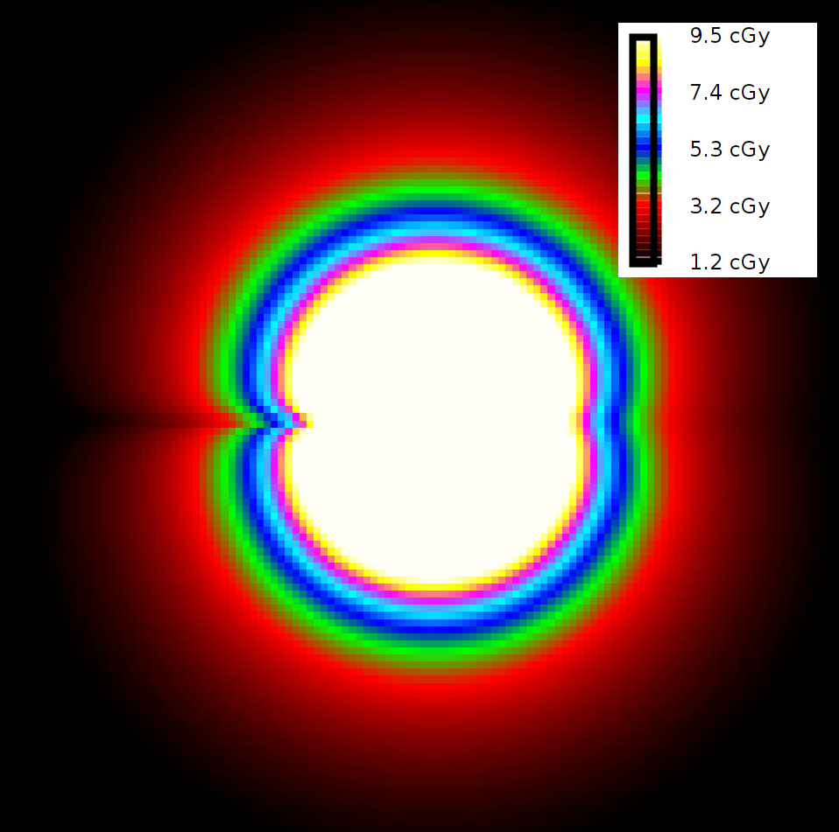
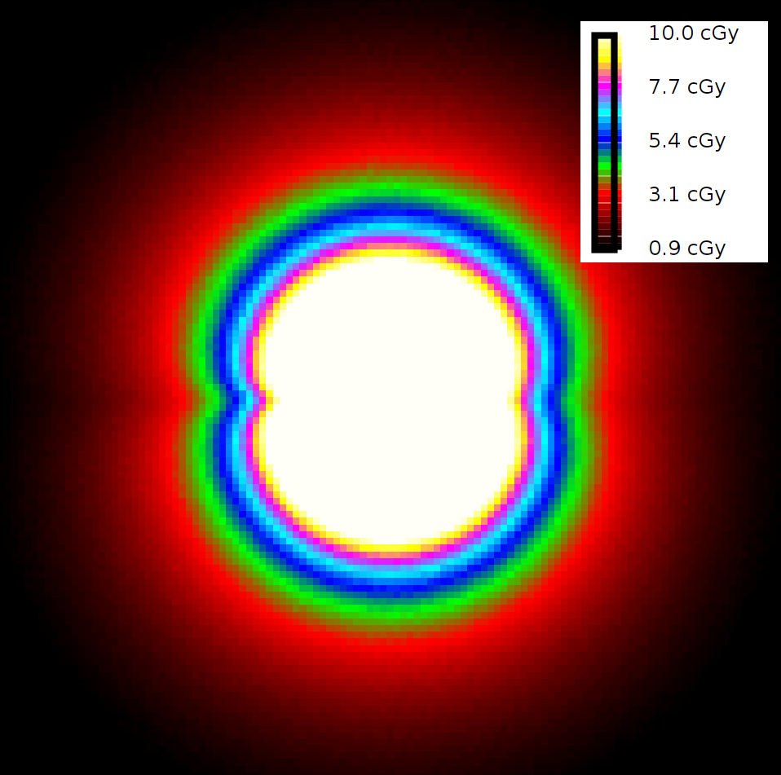
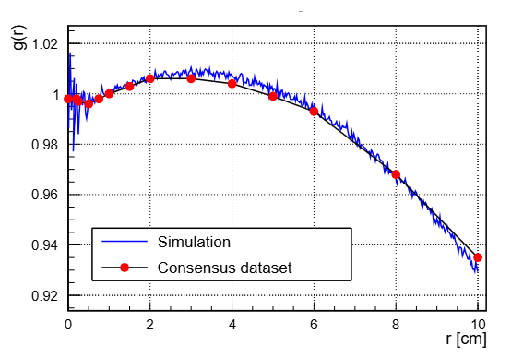
Brachytherapy Dosimetry Activities
CHARACTERISATION CAMPAIGN AT HUMV
Dose imparted to the detector’s volume and the dwell times are calculated through Geant4 MC simulations
Physics list validated through comparison against consensus datasets of TG-43 dosimetry parameters and treatment planning system data
Detailed modelling of the experimental layout of the detector, needle and clinical phantom
TPS
Simulation
GammaMed HDR Plus
Detector
Titanium needle
PLA tube
Diego Rosich

Slide 22
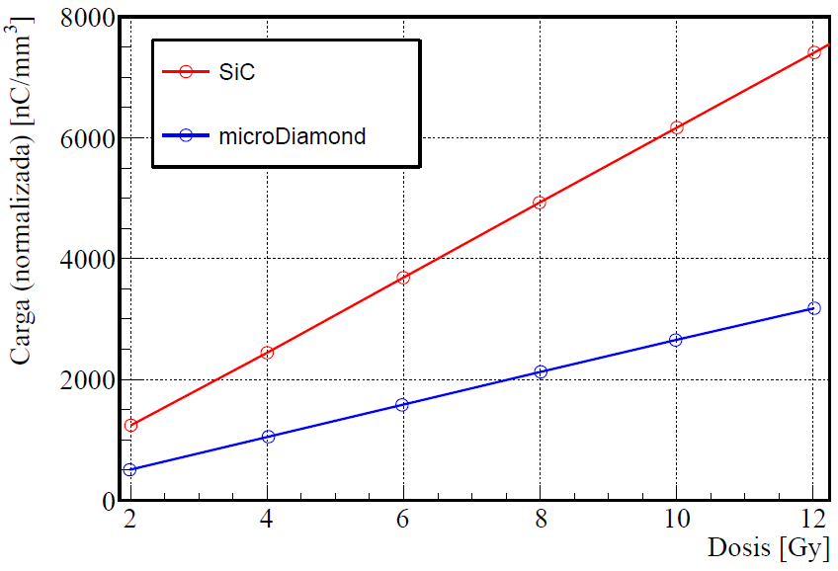
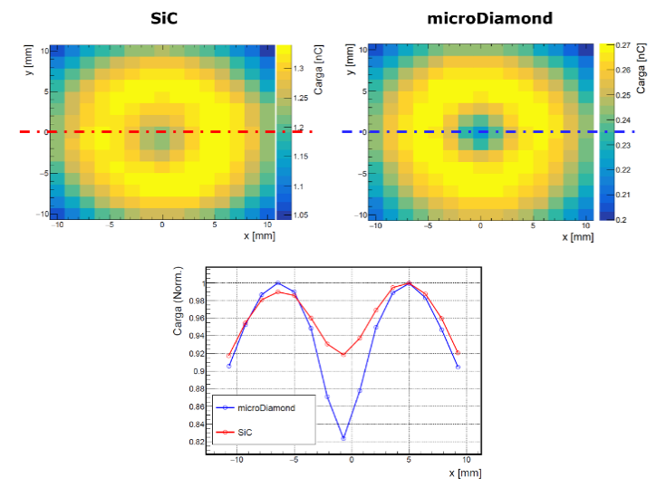
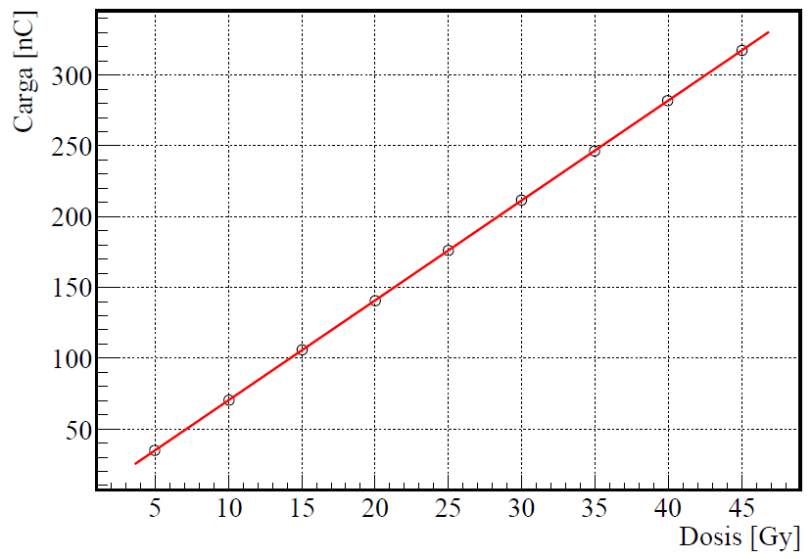
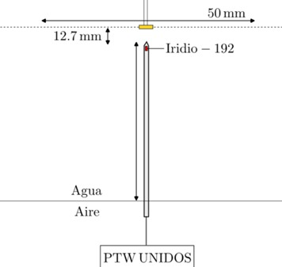

Brachytherapy Dosimetry Activities
CHARACTERISATION CAMPAIGN AT HUMV
S ~ 7.47 nC/Gy
S(SiC) ~ 3×S (microDiamond)
Non sensitive to temperature
Missing figures: Response vs distance at isodose
Deviations below 0.15%

Slide 23

Brachytherapy Dosimetry Device
CONCLUSION
Future Measurements and detectors:
  Dosimetry based on Pulse counting with the CNM PIN detectors, but also Silicon and Silicon Carbide LGADs.
  TG43 missing Figures of Merit to submit a paper.
  Detector Miniaturization
EUROPRACTICE membership and TCAD license purchased
Access to the brachytherapy facility

Slide 24


Brachytherapy Dosimetry Activities
ENTREPREUNDERSHIP COMPETITIONS
SiCk detectors Identified as a market product due to strong recommendations from international bodies on the need for in vivo dosimetry in HDR brachytherapy (HDRBT):
2nd Position at the European EUNICE Competition (March, 2025)
UCem Competition (June, 2025)
https://eunice-university.eu//
https://web.unican.es/noticias/Paginas/2025/03/El-doctorando-del-IFCA-Diego-Rosich-representar%C3%A1-a-la-UC-en-la-competici%C3%B3n-de-emprendimiento-de-EUNICE.aspx

Slide 25

Teaching & Outreach in Medical Physics
Brachytherapy 3 TFGs
IOR: 1 Research Project, 1 TFM & TFG
Microcredencial in Proton therapy in collaboration with HUMV supported by Santander Bank (27 students so far):
Future Plans:
  Microcreds Program (September 2025, funded by the European Commission): training sessions to technical staff in PT
  Final objective: CSN-certified training center for future supervisor & operators of PT centers
Outreach: 8 talks about PT and medical physics given at High Schools in Cantabria.

Slide 26
That’s all - Thank you!

Slide 27
BACKUP

Slide 28


Slide 29



Slide 30



Cryogenic support Room
Disponible North
Transformers
Electrical Panel Room + UPS
Varian + IT
Service Console Room
Disponible
South
Treatment Control Room
Maze
Power Generator
SEGs

Slide 31
(1) M. SiC detectors: A review on the use of silicon carbide as radiation detection material, De Napoli, Front. Phys. 2022, 10, 898833.
(2) First Characterization of Novel Silicon Carbide Detectors with Ultra-High Dose Rate Electron Beams for FLASH Radiotherapy, Romano, F et al (2023), Applied Sciences, 13(5), 2986.

