Slide 1
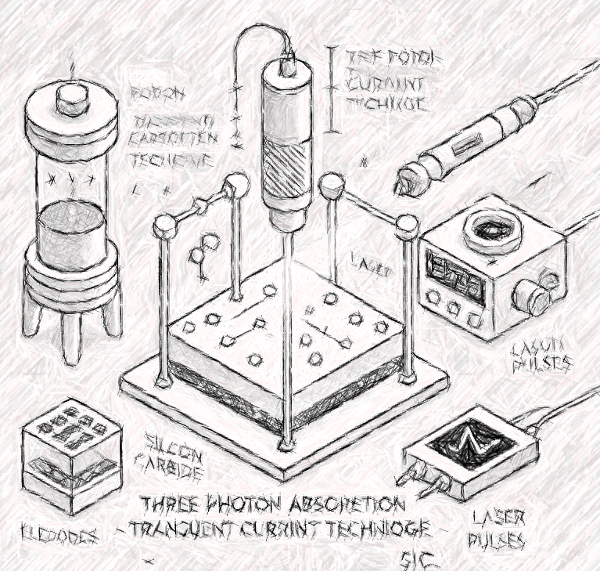

Overview of R&D activities for future collider experiments
IFCA Strategy Workshop
June 17th 2025
I. Vila Álvarez
IFCA (CSIC-UC)

Slide 2
Outline
Motivation and Scope
Selected activity lines:
  Radiation tolerant vertex and timing sensing technologies for the High-Luminosity LHC experiment upgrade
  4D tracking for vertexing and tracking beyond the HL-LHC.
  TPA-TCT on Silicon Carbide
Final Remarks

Slide 3
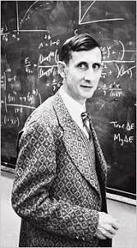
(The) Motivation: Technology as Science Revolution enabler
“New directions in science are launched by new tools much more often than by new concepts. The effect of a concept-driven revolution is to explain old things in new ways. The effect of a tool-driven revolution is to discover new things that have to be explained”
Freeman Dyson

Slide 4
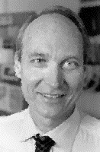
(The) Motivation: Technology in the tool belt of a physicists ?
“No one does it better than physicists when it come to innovation for instrumentation, and thus the future of all scientific fields rests on our hands”
Michael S. Turner

Slide 5
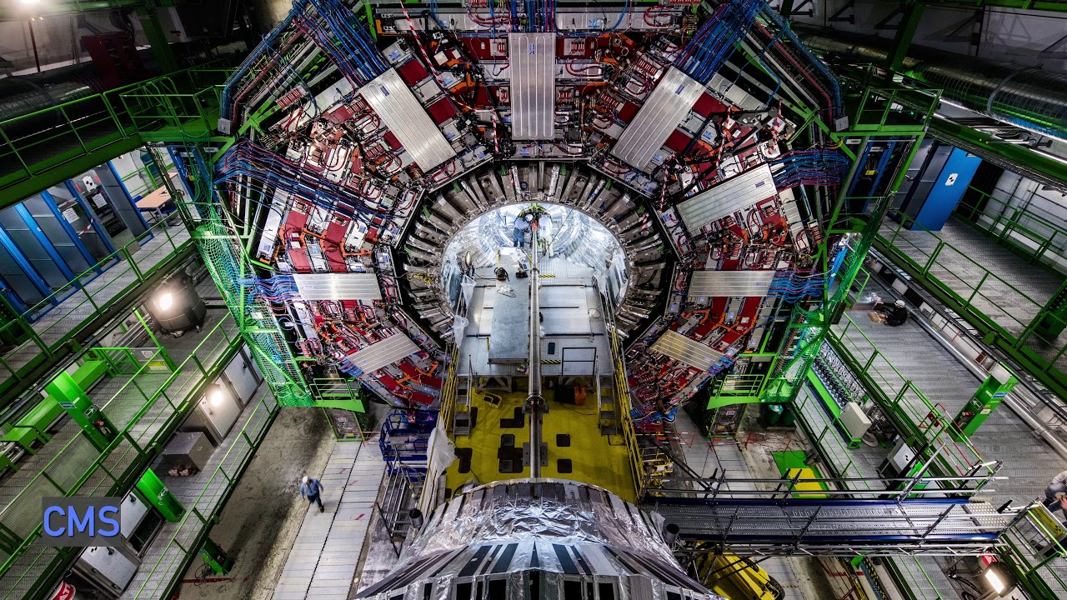
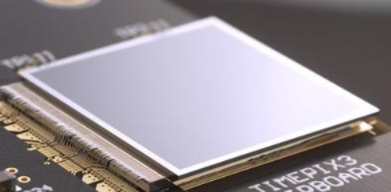
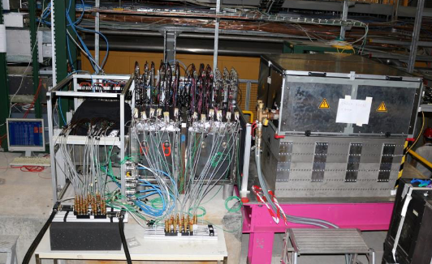
Scope: The two detector development perspectives
Experiment building
Detector technology R&D
Established detector technologies
Targeting reliability, affordability and deadlines.
Challenge: system integration
Competitive collaborations (Atlas, CMS, LHCb, etc.)
Proof-of-concept technologies
Targeting optimal performance
Challenge: exceed the state of the art
collaborative projects (CERN RDs, EU programs,…)
In same cases, there is no clear division between the two perspectives.

Slide 6









A long trajectory in detector R&D Project and collaborations
2006-2009
2011-2014
2015-2020
2021-2025
2010-2023
2024

Slide 7
Selected (and more recent) R&D topics
Radiation tolerance:
  3D pixel sensors for the HL-LHC vertex detectors
High-precision timing:
  Low Gain Avalanche Detectors for the MIP timing detector of the HL-LHC experiments
Beyond the HL-LHC:
  Large area 4D tracking, large fill-factor LGADs.
  Radiation tolerant 4D vertexing, 3D pixel detectors.

Slide 8
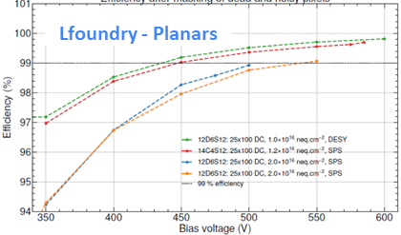
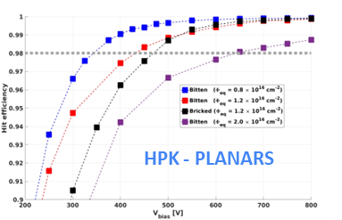
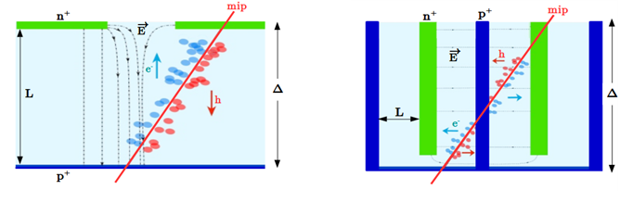
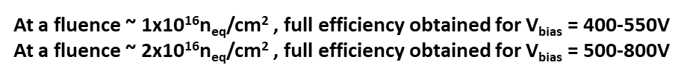
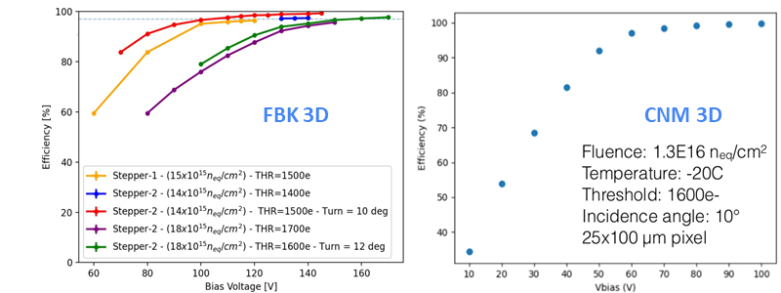
Radiation tolerance: Innermost sensing technology for HL-LHC vertex detectors
R&D motivation: to decide between planar and 3D pixelated sensor technology for the intermost layer of the vertex detector.
Thin planar pixel:
  Drawback: longer distance between electrodes (high bias voltage for achieving a large electric field in the diode).
  Advantage: Standard and well stablished manufacturing process.
3D pixel:
  Drawback: Non-standard complex manufacturing process
  Advantage: smaller distance between electrodes (low bias voltage for achieving a large electric field in the diode).
At a fluence ~ 1x10¹⁶n_{eq}/cm² , full efficiency obtained for V_{bias} = 80-130 V
At a fluence ~ 2x10¹⁶n_{eq}/cm² , full efficiency obtained for V_{bias} = 170 V

Slide 9
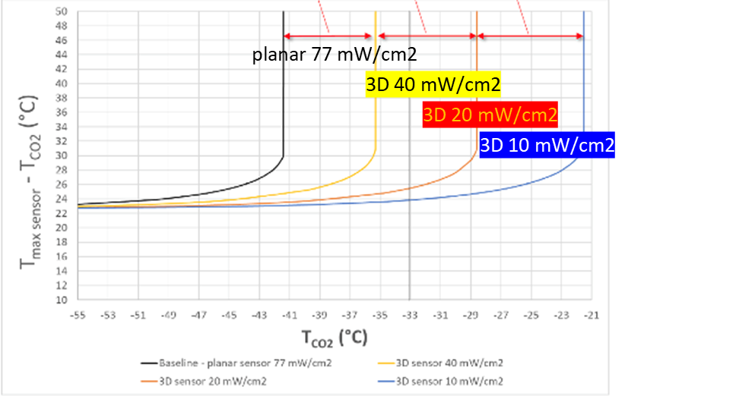
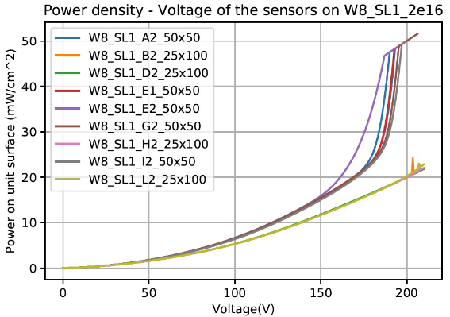
Radiation tolerance: Innermost sensing technology for HL-LHC vertex detectors (2)
From detailed and realistic FEA thermal simulation:
  The CMS IT innermost layer cannot sustain Runs 4+5 fluences with planar sensors
  No thermal runaway for 3D sensors after Runs 4 +5
3D Pixels
Cooling pipe
temperature
Operating
range
Lesson learned: Just because a technology works in the lab doesn’t mean it’ll survive real-world use — remember, It’s the power dissipation, idiot!

Slide 10
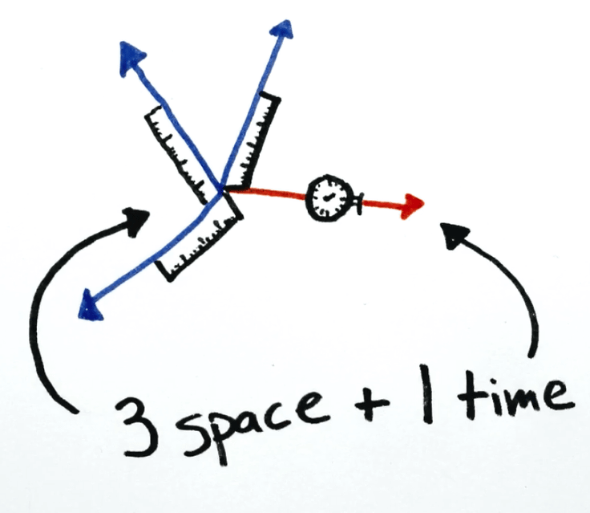
High-precision timing: ( the other) dominant R&D topic of this decade.

Slide 11

Early Historical developments :The first appearance on scene of the LGAD
Why LGADs became such a hot topic in the last decade? My recall of how the whole thing started
Status of the RD50 funding request for "detectors with enhanced multiplication”
November 2012

Slide 12
Who requested the LGAD? A few months before in Bari…
Great vision!
June 2012

Slide 13
Actually, no such a novelty...
Sep 1953
Low Gain Avalanche Detectors
are
Reach-through Avalanche Diodes
proposed by W. Heinz in 1967
May 1967

Slide 14
… then, what is the reason behind the recent coolness of RAPDs (aka LGADs)?
A precise Position Sensitive Detector (PSD) requires small signal collecting electrodes with a high Signal-to-Noise ratio.
A precise Time Stamping detector requires a high Slope-to-Noise ratio.
The ultimate time resolution (negligible jitter) depends on:
Signal amplitude (dominated by sensor)
Noise (dominated by the front-end electronics noise)
Rise time ( dominated by front-end electronics risetime)
Conclusion: Of the three requirements for effective time-stamping detectors, two are related to the front-end electronics.

Slide 15
The double-Low answer
A favorably fact and two inconvenient truths:
  A low in-sensor amplified MIP signal, when read out with a low-noise, fast rise-time amplifier, achieves tens of picoseconds time stamping resolution.
  Low noise amplifiers demand higher power consumption.
  Amplifiers with fast rise-times also require more power.
The catalytic idea behind the LGAD concept is that a LOW SENSOR GAIN enables the use of relatively LOW POWER FRONT-END electronics.
  A low gain results in a narrower signal dynamic range, which can be managed by low-power amplifiers.
  A low gain enables preamplifiers with smaller electronic gain, reducing again the power consumptions.
  One may say that low-gain in the sensor is environmentally friendly and efficient energetically compared with having the gain in the front-end.

Slide 16
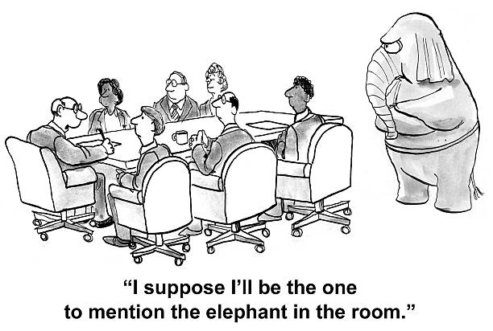
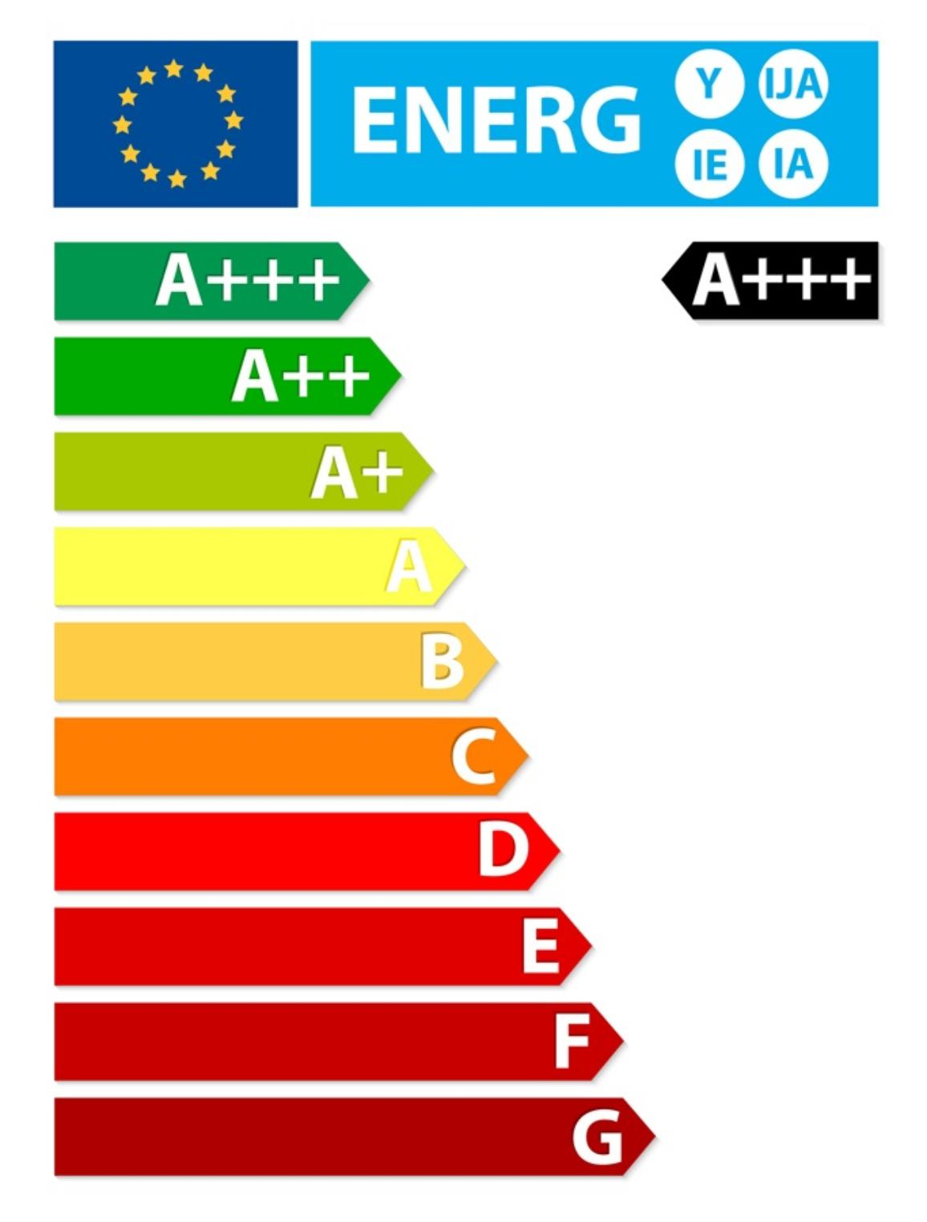
Corollary and the main past and future RD challenge
Precise time stamping is a matter of two: sensor and front-end electronics
During this decade the front-end design evolved towards low-power.
The elephant in the room: the primary optimization factor for a practical 4D tracking system (millions of readout channels) is power consumption (scales with # of channels not with the detector area).
The main challenge for the future of LGAD-based 4D trackers remains the front-end power consumption.

Slide 17
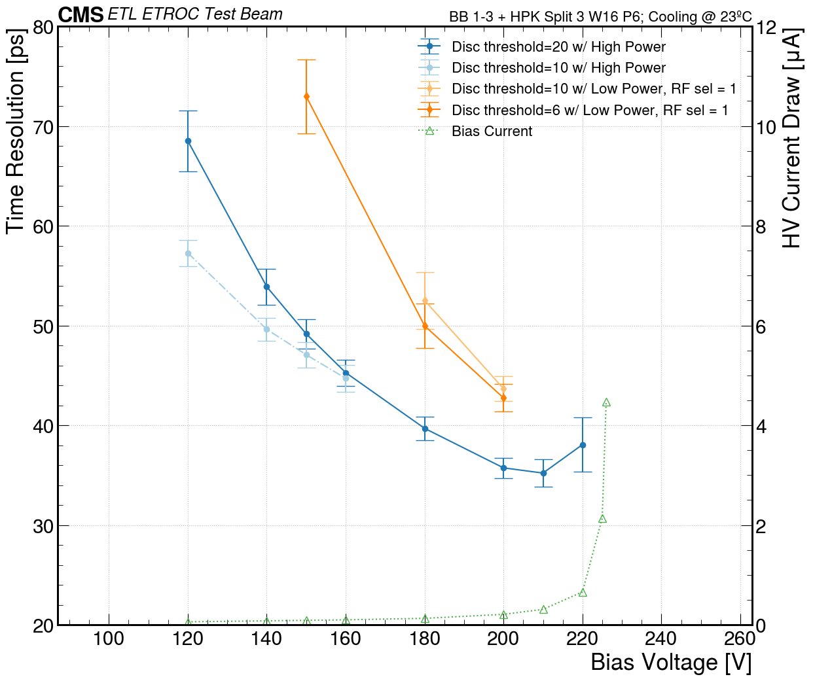
Timing for the HL-LHC: current status
First results with a full (HPK) sensors bond bonded to the ETROC2 readout ASIC
Well within the CMS requirements (before irradiation).

Slide 18
Towards a LGAD-based 4D tracking enabling sensor
Several technologies for improving the spatial resolution and increased fill factor:
  Resistive AC-Coupled LGADs (AC-LGADs), more recently Resistive DC-Coupled
    (Initially from FBK; new foundries joining IHEP, BNL, HPK, etc.)
  Trench-isolated LGADs (TI-LGAD)
    (first manufacturing run from FBK)
  Deep Junction Low Gain Avalanche detectors (DJ-LGAD)
    (first manufacturing from BNL)
  Thin Inverse Low Gain Avalanche detectors (iLGAD)
    (first production just completed at IMB-CNM)

Slide 19
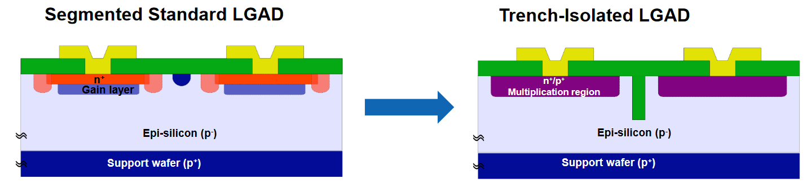
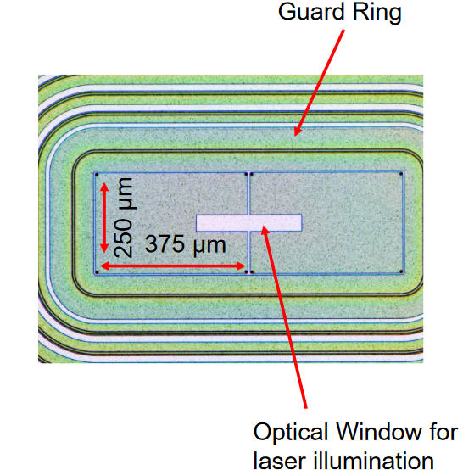
4-D tracking at IFCA: Trench-isolated Low Gain Avalanche detectors
Pixel border region hosts structures to control E field (JTE, p-stop, etc..)
Trench isolation could drastically reduce inter-pixel border region down to few μm
  Typical trench width < 1 μm (max aspect ratio: 1:20)
  Trench filling with: SiO2, Si3N4, Polysilicon
See A. Gomez Carrera talk in this workshop

Slide 20
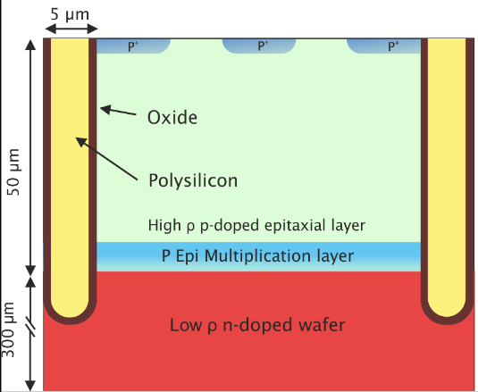
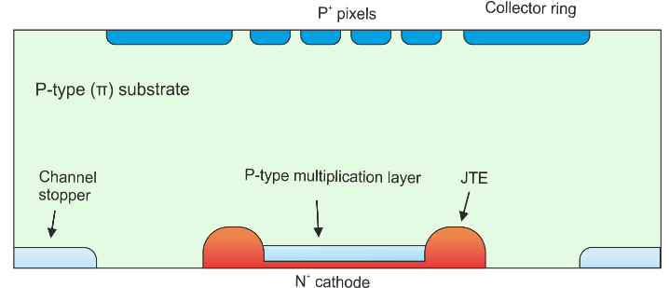
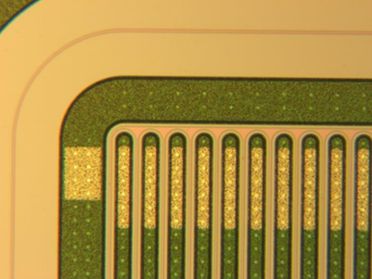
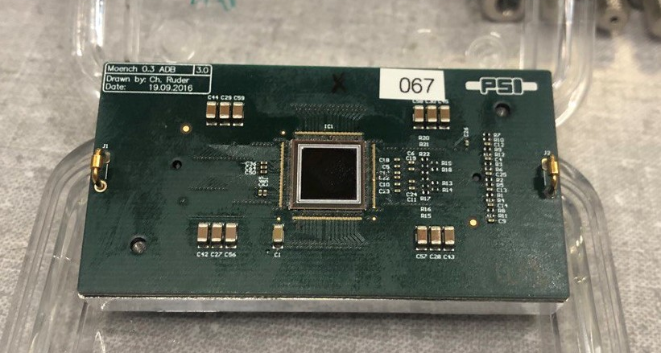
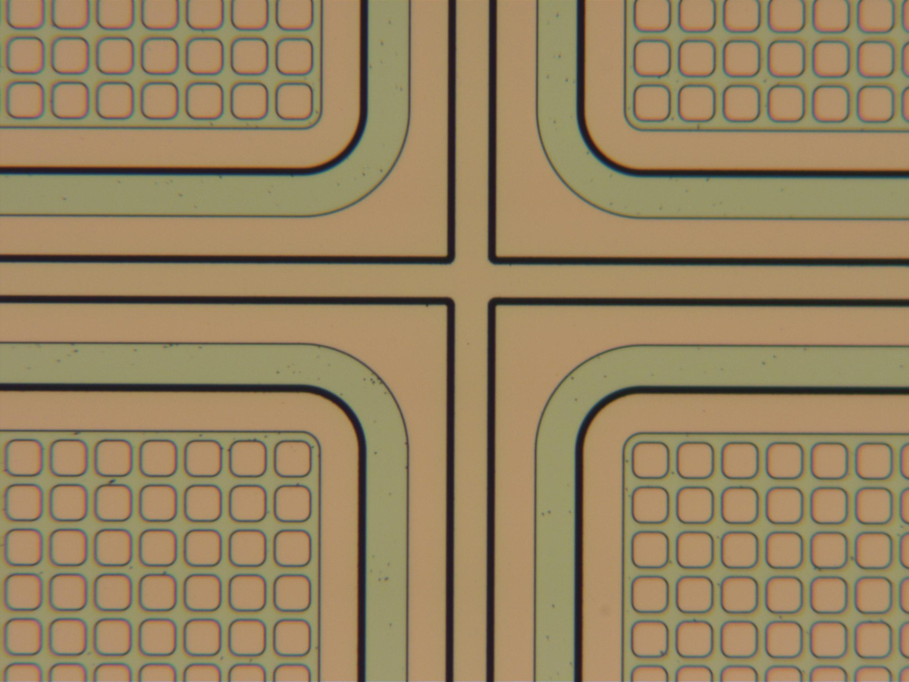
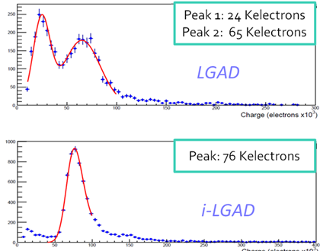
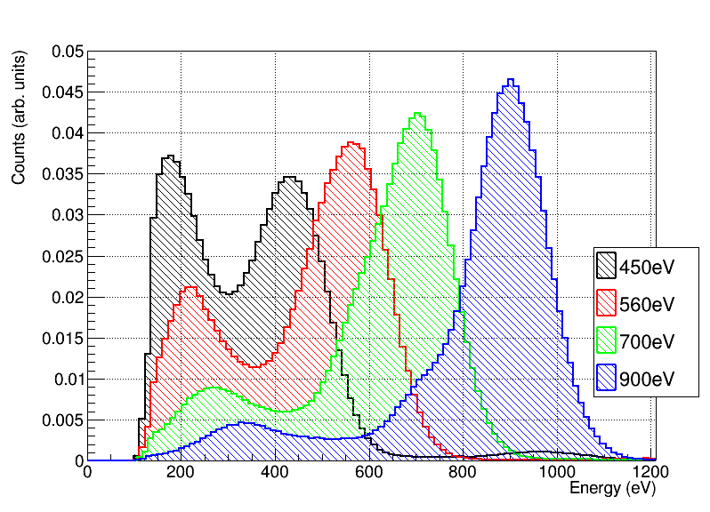
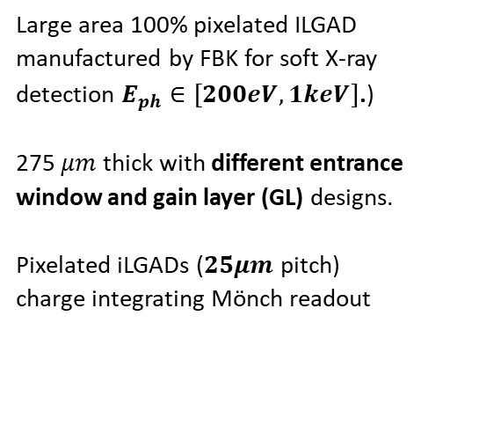
4-D tracking at IFCA: (Thin) Inverse LGAD (iLGAD)
Large area 100% pixelated ILGAD manufactured by FBK for soft X-ray detection $E_{ph}∈[200eV,1keV]$.)
275 $μm$ thick with different entrance window and gain layer (GL) designs.
Pixelated iLGADs (𝟐𝟓𝝁𝒎 pitch)
charge integrating Mönch readout
Continuous multiplication layer, segmented hole readout.
Strip iLGADs from CNM
80𝝁𝒎 pitch
SPS test beam
I. Vila,
13th Trento Workshop,
A Liguori
18th Trento Workshop
Thin Single-sided design for 4D tracking manufactured at IMB-CNM
Notes:
Stress the fact that it is the same technology the difference is that in this case the ohmic contact is the segmented structure.

Slide 21
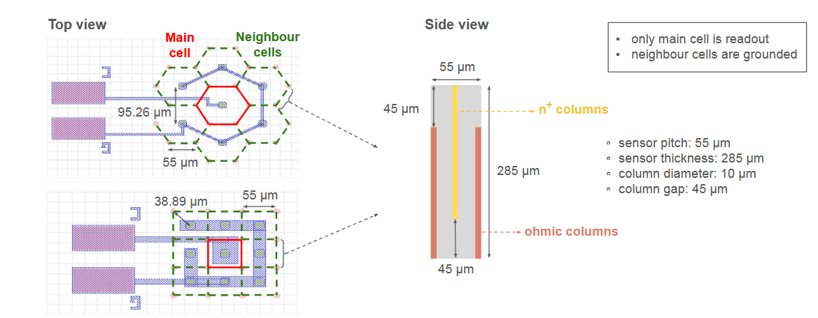
4D – tracking at IFCA: 3D pixels for timing
Can we benefic from the intrinsic high-electric field of 3D sensors to implimente a a radiation-tolerant 4D vertexing?
C. Lasaosa talk in Tredi 2025
https://zenodo.org/records/15089244

Slide 22
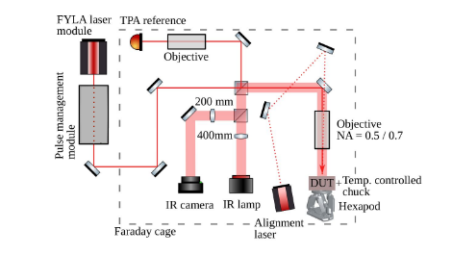
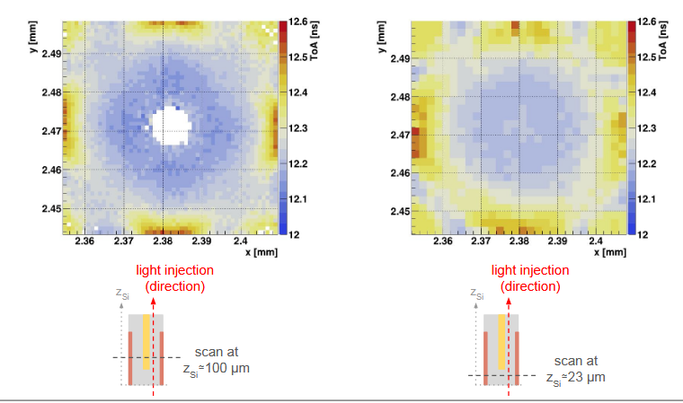
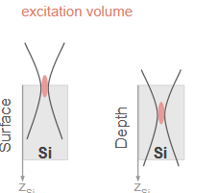
4D – tracking at IFCA: 3D pixels for timing(2)

Slide 23
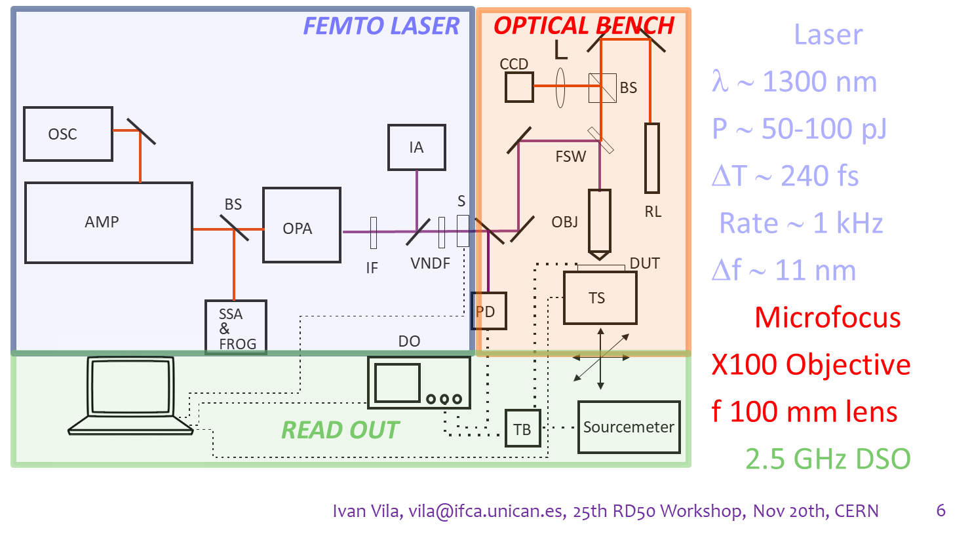
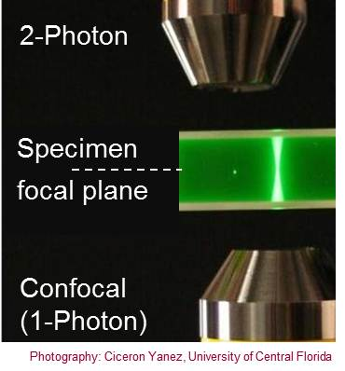
R&D spin-off: invention of new characterization techniques (TPA-TCT)

Slide 24
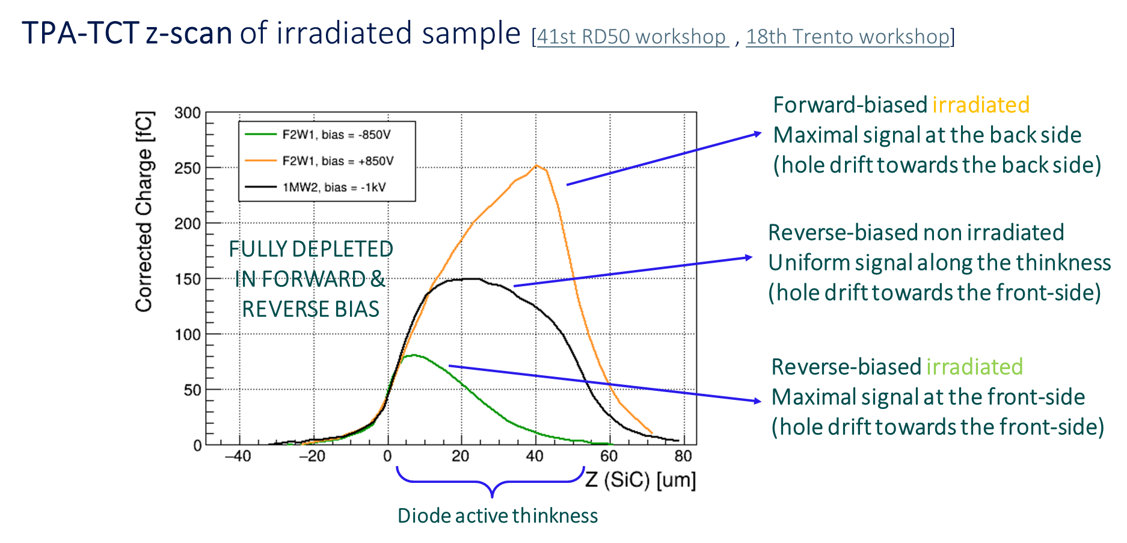
… enabling new discoveries: observation of signal multiplication in irradiated SiC diodes under direct bias
See talk from C. Quitana and D. Rosich
In this workshop

Slide 25
Take home messages
Even a small, foundational activity in generic instrumentation is essential to support experiment-driven developments.
To state it explicitly, teaming up with groups that offer complementary and unique skill sets has proven extremely beneficial: including IMB-CNM, ITAinnova, UPV-EHU, and, more recently, CAN
Our group's broad scope facilitates access to, and meaningful contributions within, world-class experiments.
The group is well aligned with the main R&D priorities defined in the ECFA Detector R&D Roadmap, which sets the direction for the remainder of the decade.
Unexpected opportunities and challenges are always just around the corner.

Slide 26
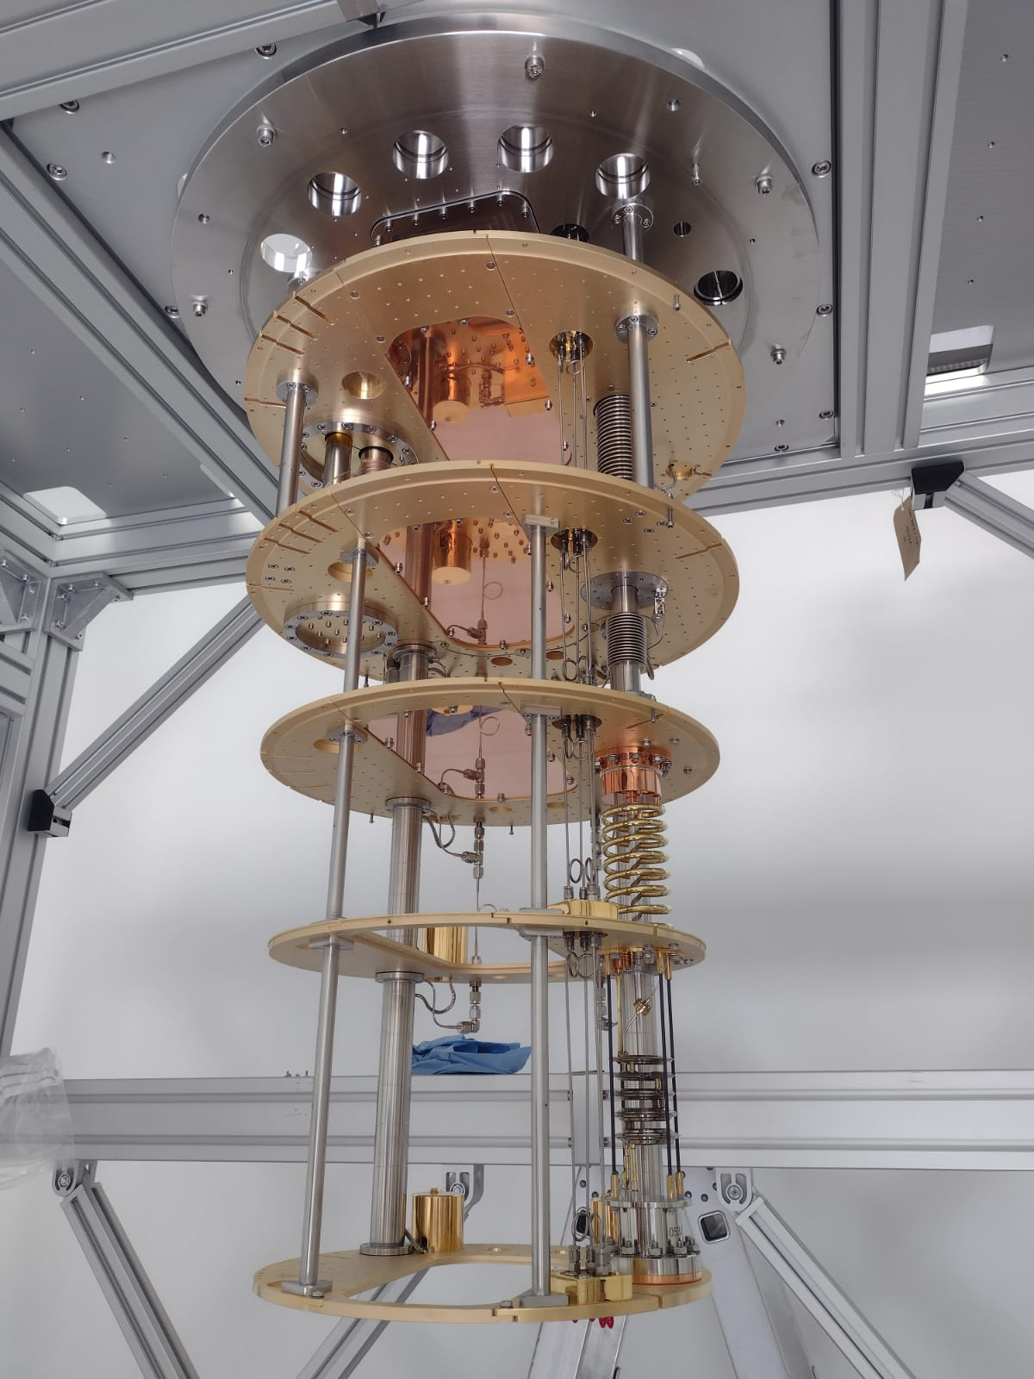
Thank you for your attention
Yesterday 18:00 @ IFCA Cryolab

