Slide 1
CMS Analysis
Run 2, Run 3 and Run 4

Slide 2
LHC Run 2 and Run 3 analysis projects
      The LHC Run 2 took place from 2016 to 2018. The proton-proton center-of-mass energy was 13 TeV, with a total luminosity of 139 fb⁻¹
      Run 3 has a duration of 4 years. It started in July 2022 and it will finish in May 2026. The energy is 13.6 TeV and we will get around 300 fb⁻¹
      CMS analysis at IFCA has been granted several national projects since 1995, being one of the main Spanish groups in the CMS collaboration. Since 2017 we have had these projects:
        FPA2017-85155-C4-4-R. Funding 415,000 € with IP’s Luca and Celso
        PID2020-113304RB-I00. Funding 950,000 € with IP’s Alicia and Celso
        PID2023-146983NB-I00. Funding 334,300 € with IP’s Alicia and Celso (+ PCI2024-155030-2 for M&O with funding 656,000 €)
      In the ongoing project PID2023-146983NB-I00 (Participación del IFCA en el experimento CMS (Run3) del LHC) + PCI2024-155030-2 (Participation in the CMS experiment of the LHC-IFCA) we have
        5 seniors (Alicia, Celso, Luca, Jónatan and Jesús)
        4 predoc students
        Several master students

Slide 3
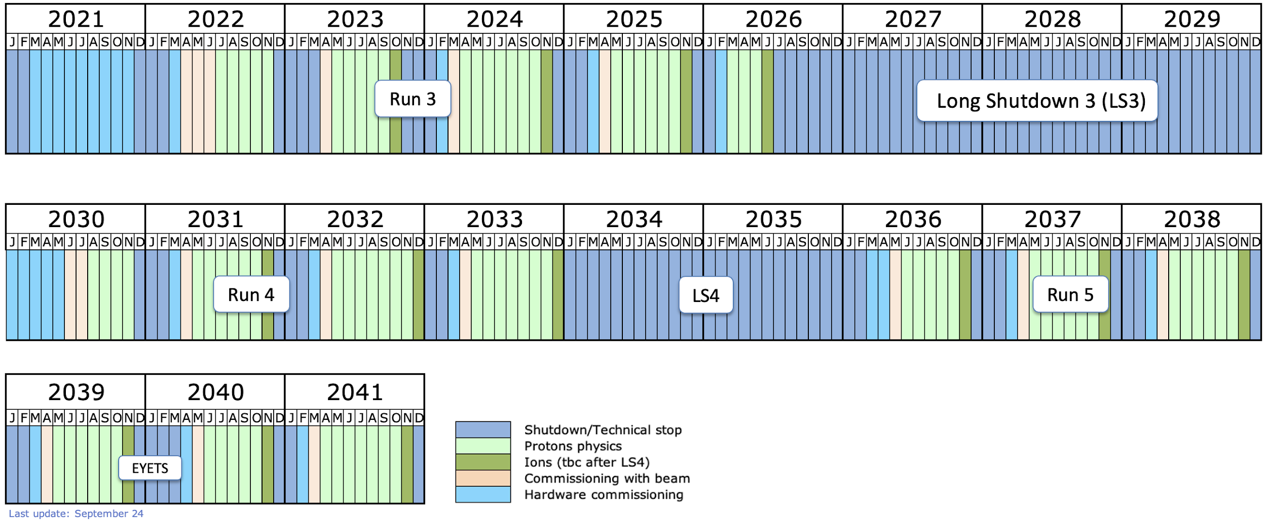
LHC Run 3 and Run 4
Last update: September 2024

Slide 4
Been active in creating new researchers
      Since 2022 we have tutored 4 PhD’s
          2022: Pedro Fernández (grant UC) ➛ Fellow at CERN
          2022: Cédric Prieels (FPI) ➛ Private firm
          2023: Celia Fernández (FPU) ➛ Postdoc at Boston University
          2025: Pablo Matorras (FPI) ➛ Has recently read the PhD. Looking for his next steps
      Our current students are Sergio (FPI), Rubén (FPU), Víctor (FPI) and Mayra (European grant from another project)
      All our students have a national / international contract
          FPU
          FPI
          Research grant from University of Cantabria
          European projects
          …

Slide 5
LHC Run 2 Supersymmetry and Higgs Physics
Combined search for electroweak production of winos, binos, higgsinos, and sleptons in pp collisions at 13 TeV
Phys. Rev. D 109, 112001
Combination and interpretation of differential Higgs boson production cross sections in pp collisions at 13 TeV
CMS-HIG-23-013

Slide 6
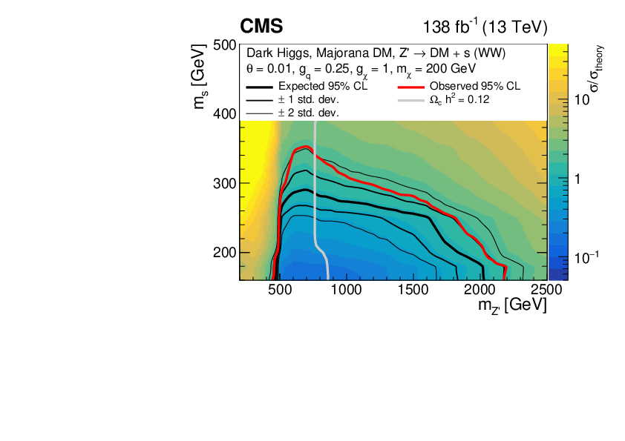
LHC Run 2 dark matter search (with a Higgs boson)
      Search for dark matter particles in WW events with transverse momentum imbalance in pp collisions at 13 TeV
We are main analysers of a search for dark matter
particles produced with a Higgs boson at 13 TeV
JHEP 03 (2024) 134

Slide 7
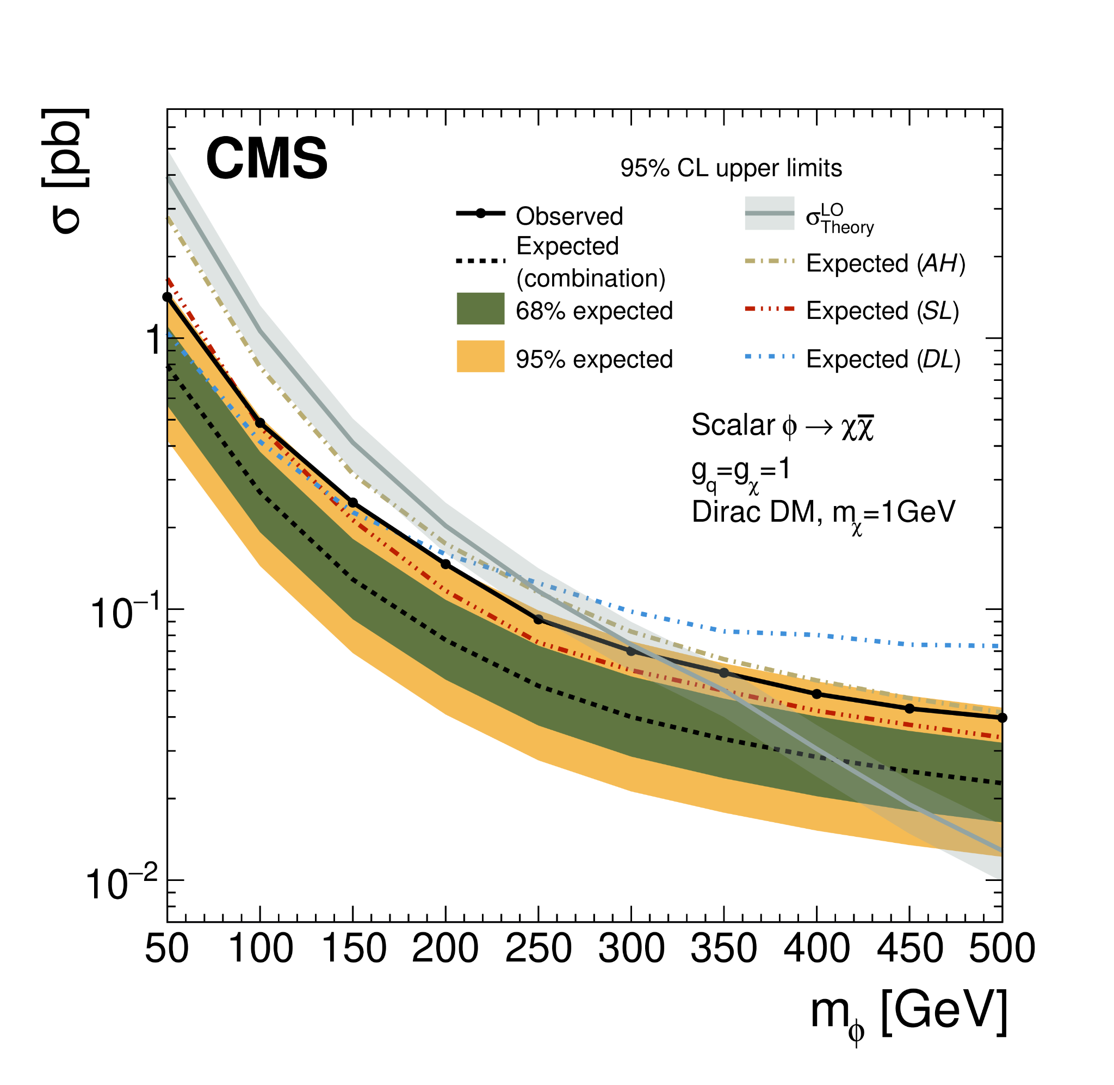
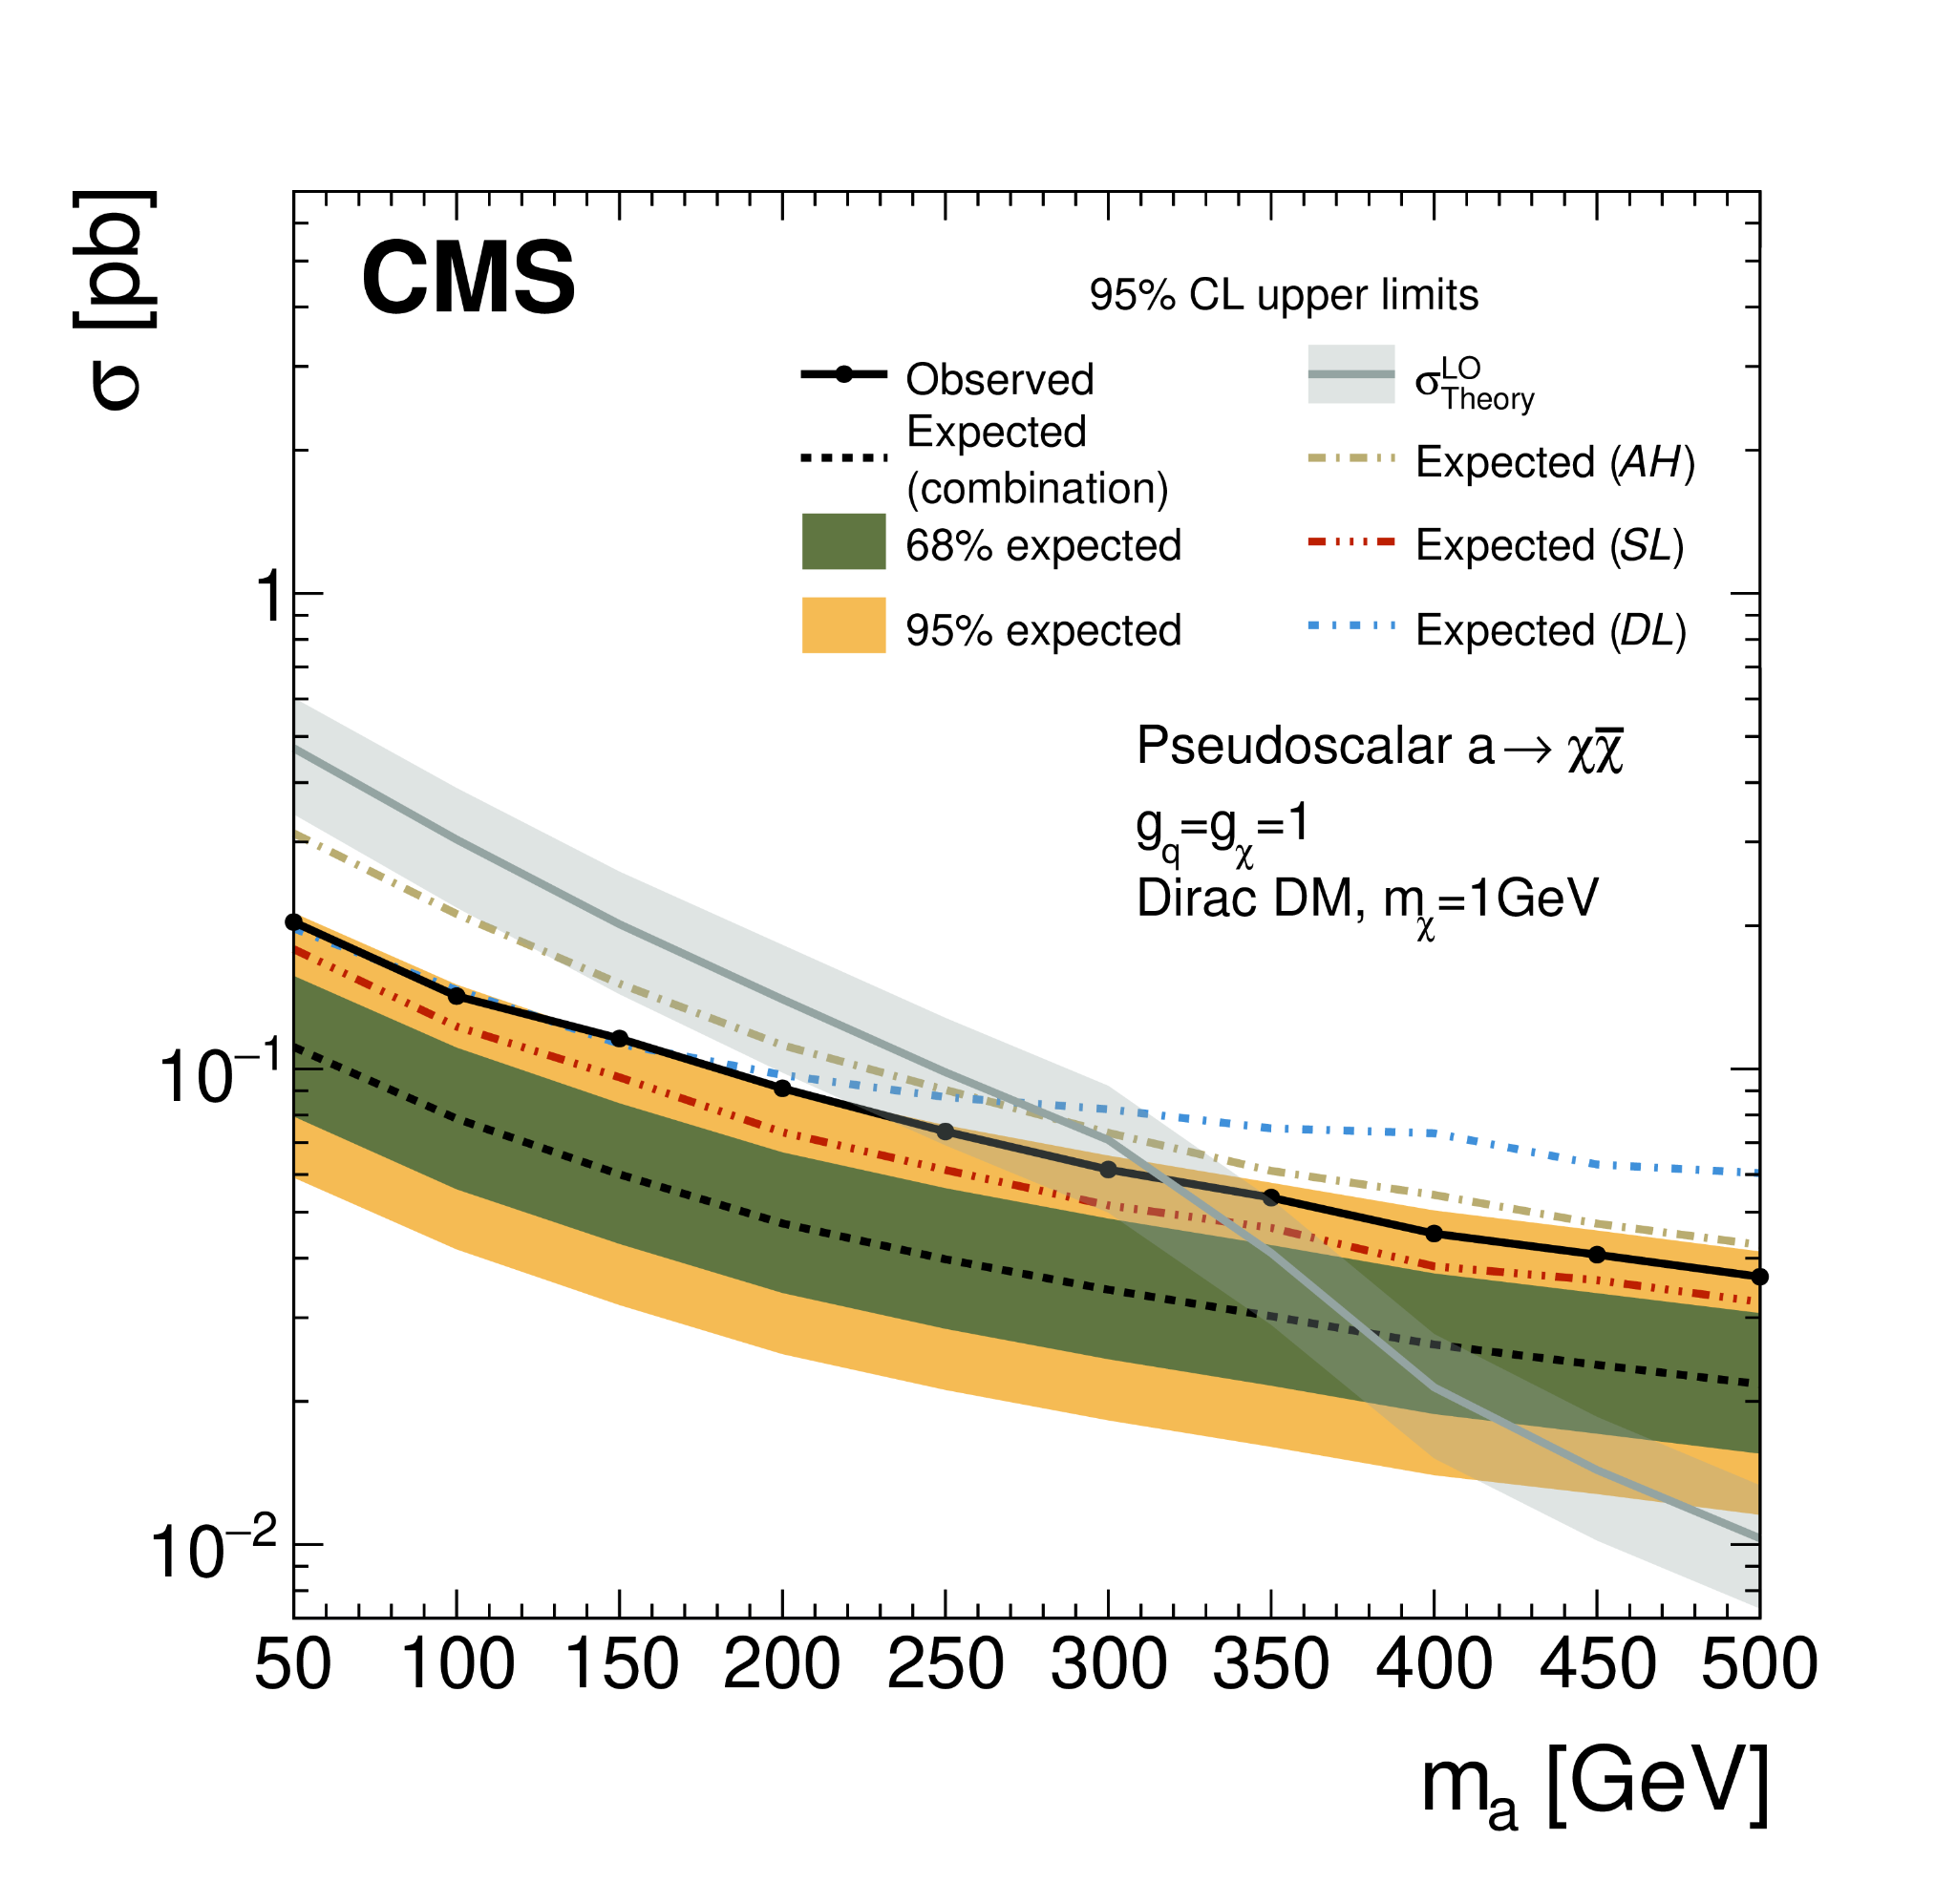
LHC Run 2 dark matter search (with top quarks)
      Search for dark matter produced in association with one or two top quarks in proton-proton collisions at 13 TeV
We are main analysers in the dilepton channel
arXiv:2505.05300 [hep-ex] submitted to JHEP

Slide 8
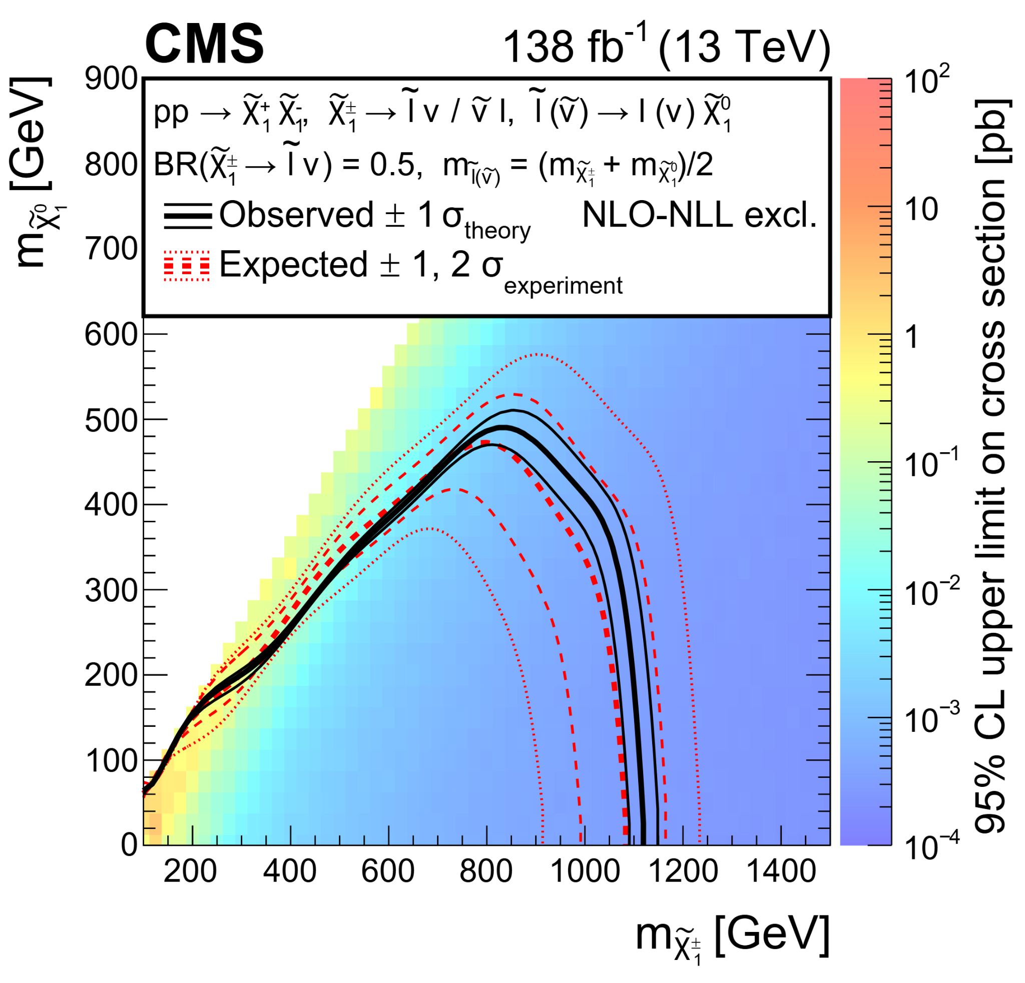
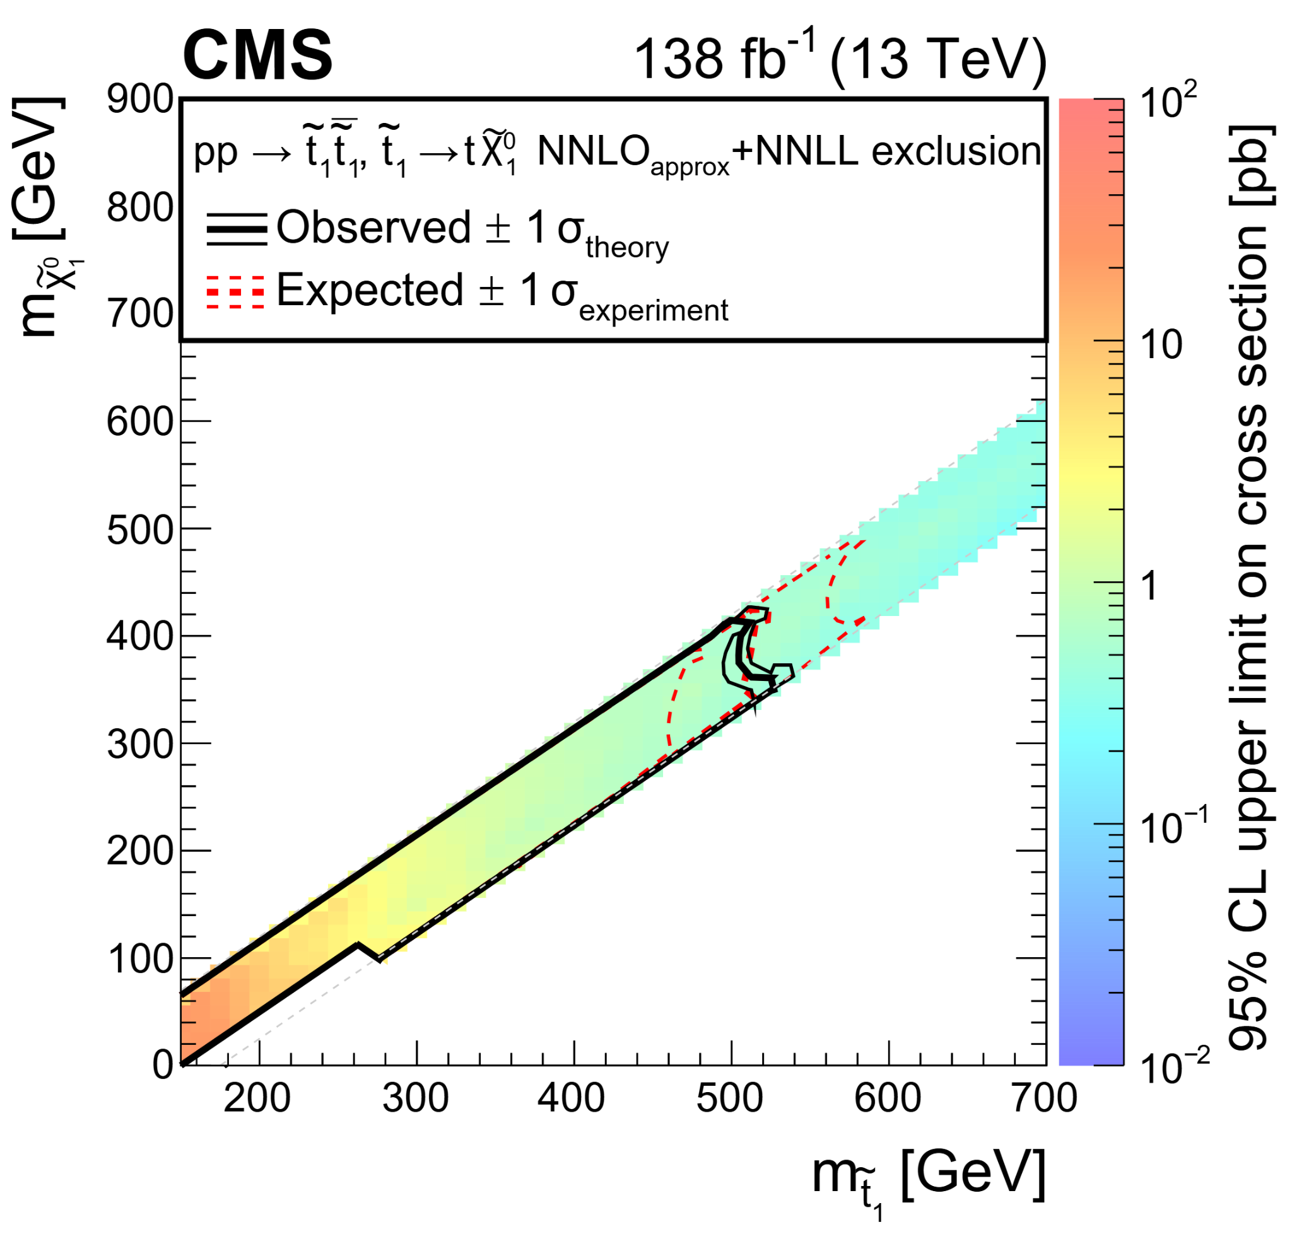
LHC Run 2 Supersymmetry
      Search for beyond SM physics in events with 2 oppositely-charged leptons and large missing momentum
Very general phase space, sensitive to a large spectra of new physics signature
Results interpreted in the context of the minimal supersymmetric SM in Run2 analysis
Can be extended and integrated with other analysis activities
CMS-PAS-SUS-23-002 CWR-Ended

Slide 9
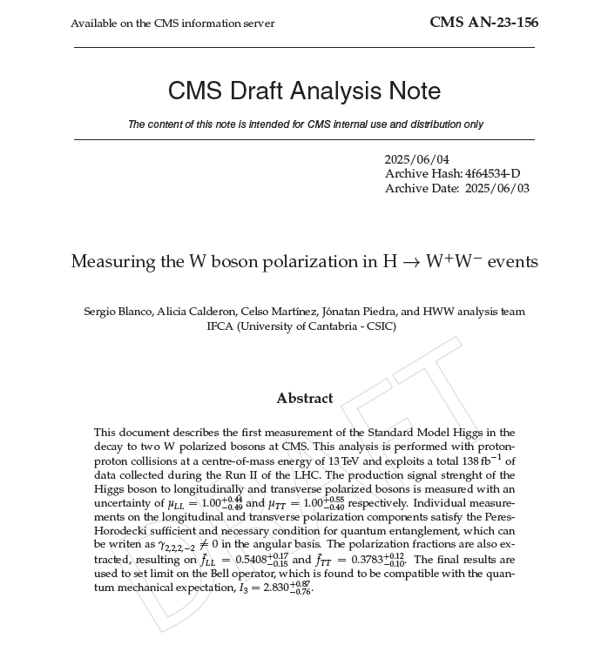
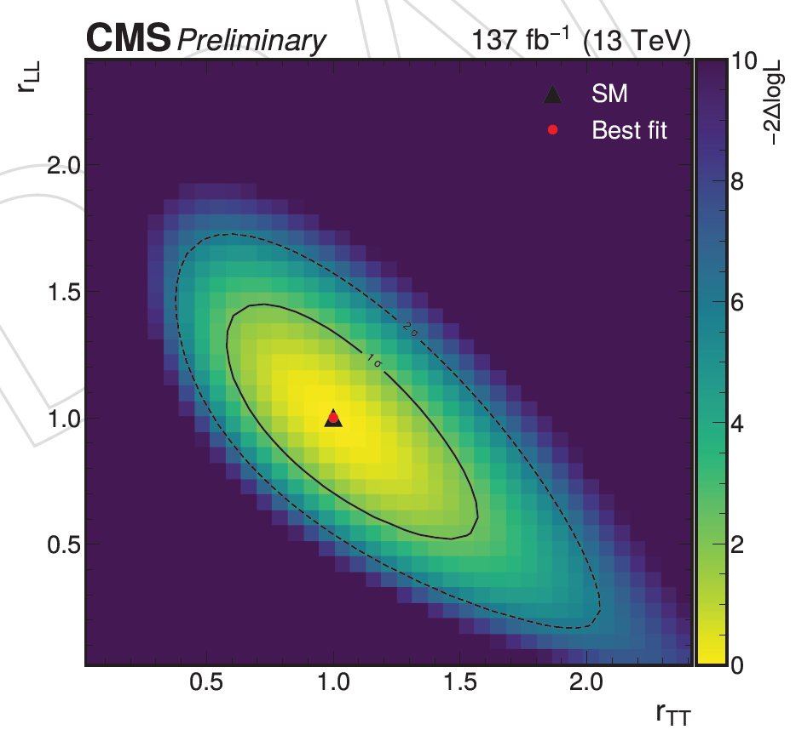
LHC Run 2 Higgs Physics
      Measuring the W boson polarization in HWW events
The intrinsic relationship between polarization observables and angular coefficients permits to interpret the results in terms of quantum entanglement and Bell inequalities
(Results to be updated) See Sergio Blanco’s thesis project slides
HIG-24-005 (AN-23-156)

Slide 10
LHC Run 2 and Run 3 muons
Rubén is the L3 convener of Muon reconstruction POG
Sergio is the L3 convener of Muon Calibration and Commissioning
Sergio is the L3 of Muon HLT
Muon ID and Isolation efficiencies with muons in proton-proton collisions at 13.6 TeV
CERN-CMS-DP-2024-067

Slide 11
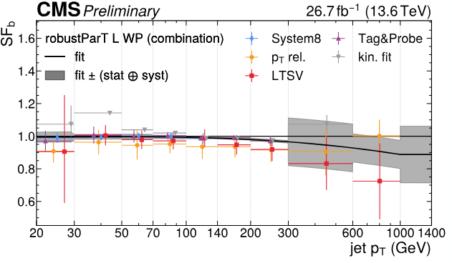
LHC Run 2 and Run 3 b-tagging
      IFCA very active on calibration performance group during Run 2
      Luca responsible of delivery of pTrel method SF’s and combination of AK4 SF’s from different methods
      Jesús responsible of delivery of System8 method SF
      Víctor responsible of MC (new task for Run 3) and starting commissioning work (similar task as Pablo Matorras in the past)
Selected publications and DP notes
      Identification of heavy-flavour jets with the CMS detector in pp collisions at 13 TeV
      2018 JINST 8 P04013 [1211.4462]
      Performance summary of AK4 jet b tagging with data from 2022 pp collisions at 13.6 TeV with the CMS detector
      CMS-DP-2024-025
      A unified approach for jet tagging in Run 3 at 13.6 TeV in CMS
      CMS DP-2024/066
      Run 3 commissioning results of heavy-flavor jet tagging at 13.6 TeV with CMS data using a modern framework for data processing
      CMS-DP-2024-024
Example of first Run 3 combination results
Efforts lately on converging to a common POG-wide framework starting with imminent 2024 campaign

Slide 12
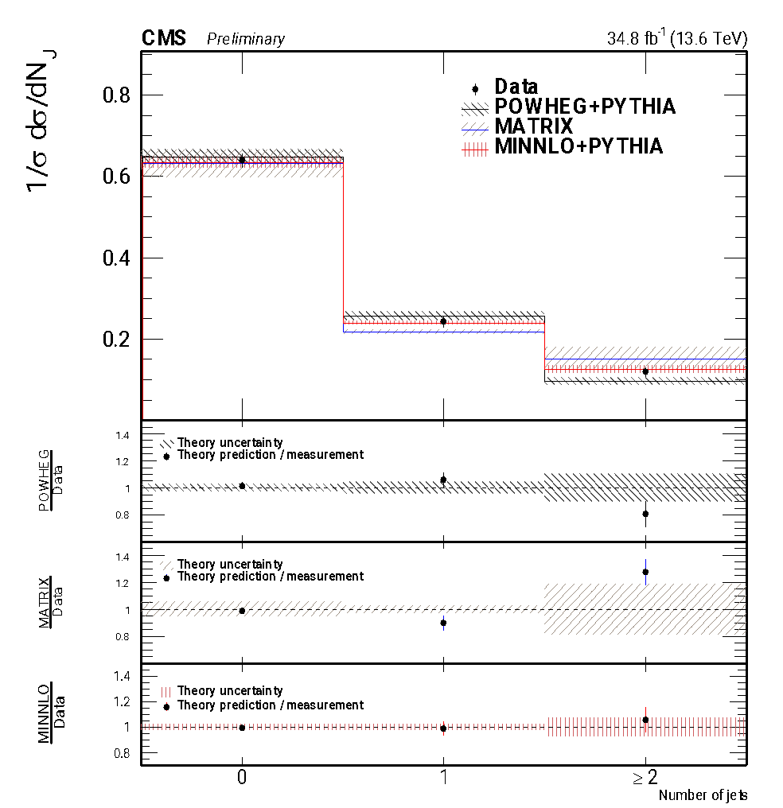
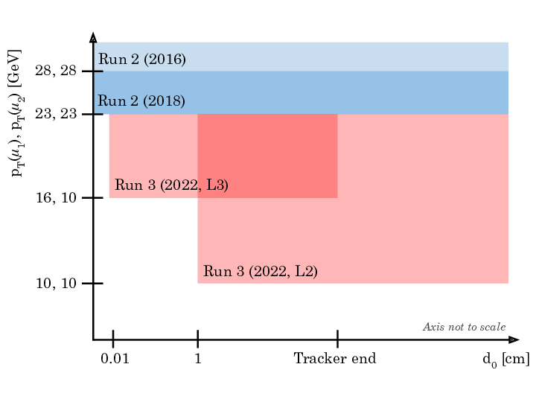
LHC Run 3 Electroweak and New Physics
      In Run 3 we are analysing, amongst other things
The inclusive W+W- production cross section
Long-lived particle decays with a pair of muons
One of the first analysis at Run 3 at 13.6 TeV (inclusive W+W− production cross section of 125.7 ± 5.6 pb)
Phys. Lett. B 861 (2025) 139231
Search for long-lived particles decaying to final states with a pair of muons in proton-proton collisions at 13.6 TeV
JHEP 05 (2024) 047
Normalized cross section measurement
Change of different triggers in Run 2 and Run 3

Slide 13
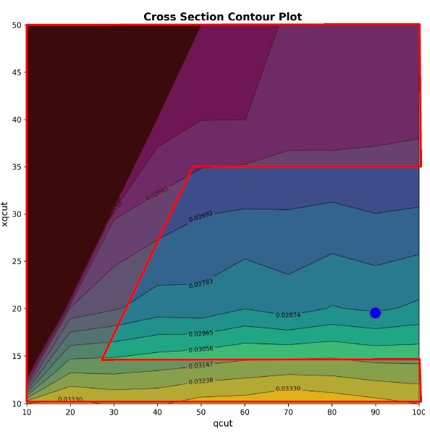
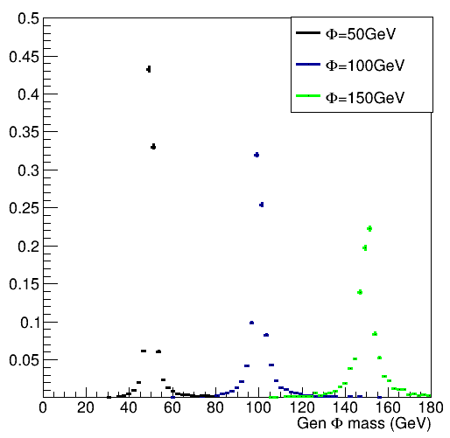
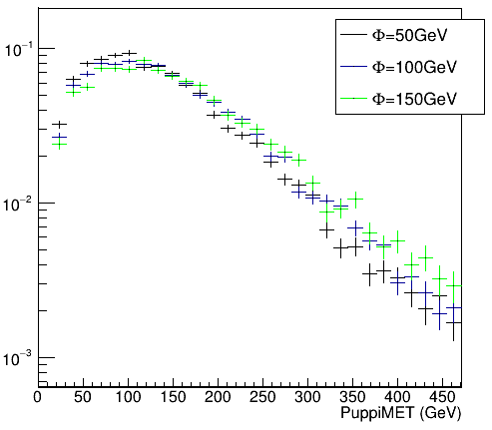
LHC Run 3 dark matter with top quarks
Starting analysis: gridpacks ready for Run 2 models. Available small production of private samples
We will consider new signals H2DM, specially relevant for single top tW signal (enhanced process)
Strategy: consider semileptonic channel and more boosted categories
GEN and RECO level plots from our Latino framework ntuple
Run 3 gridpack validation matching parameters

Slide 14
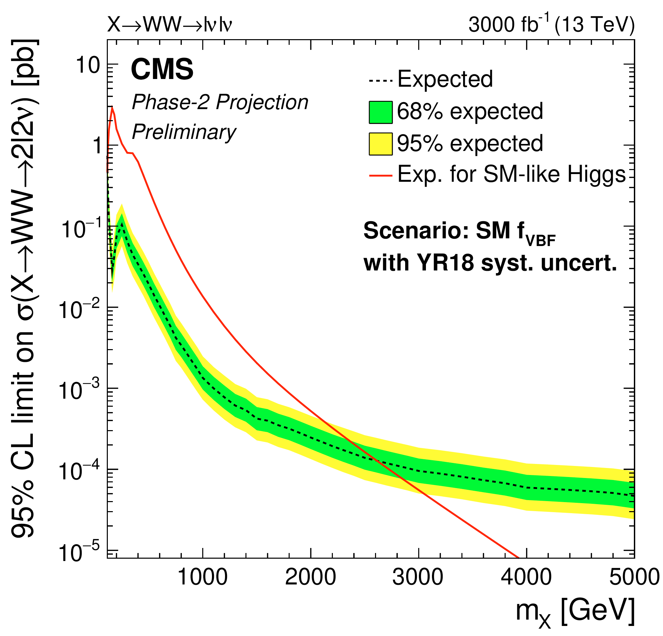
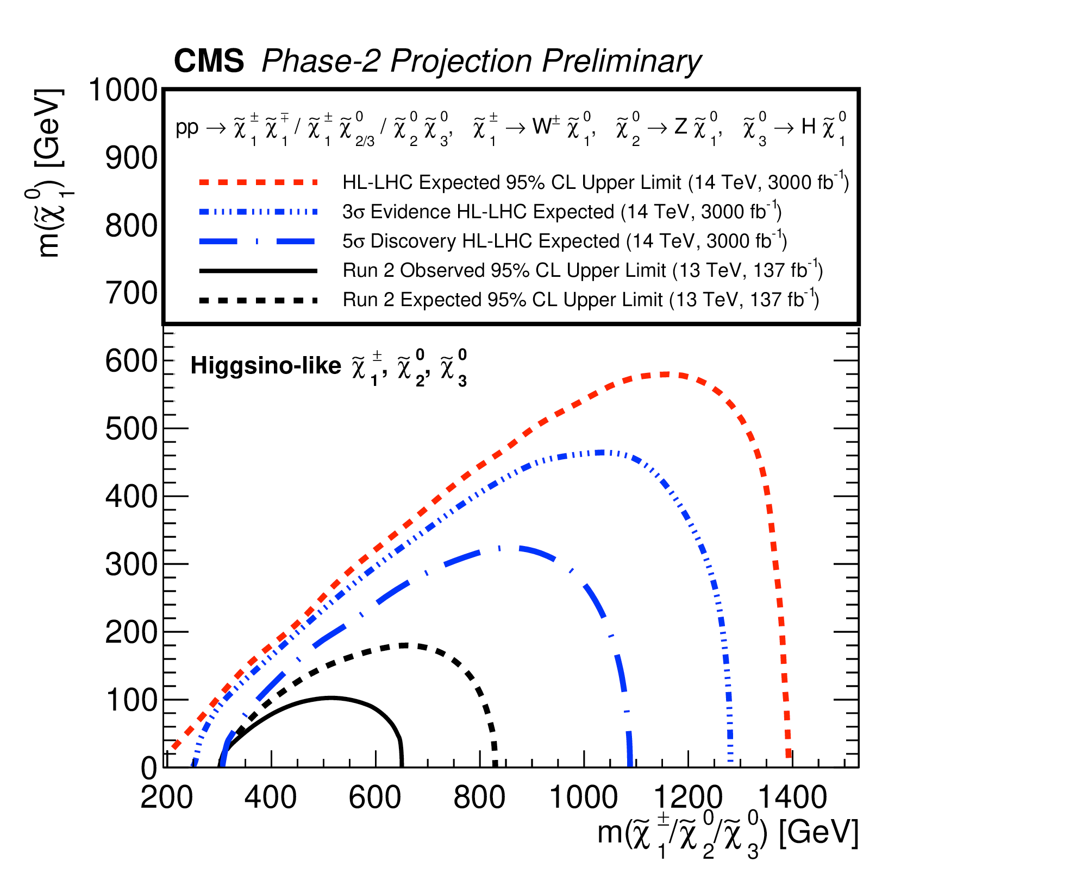
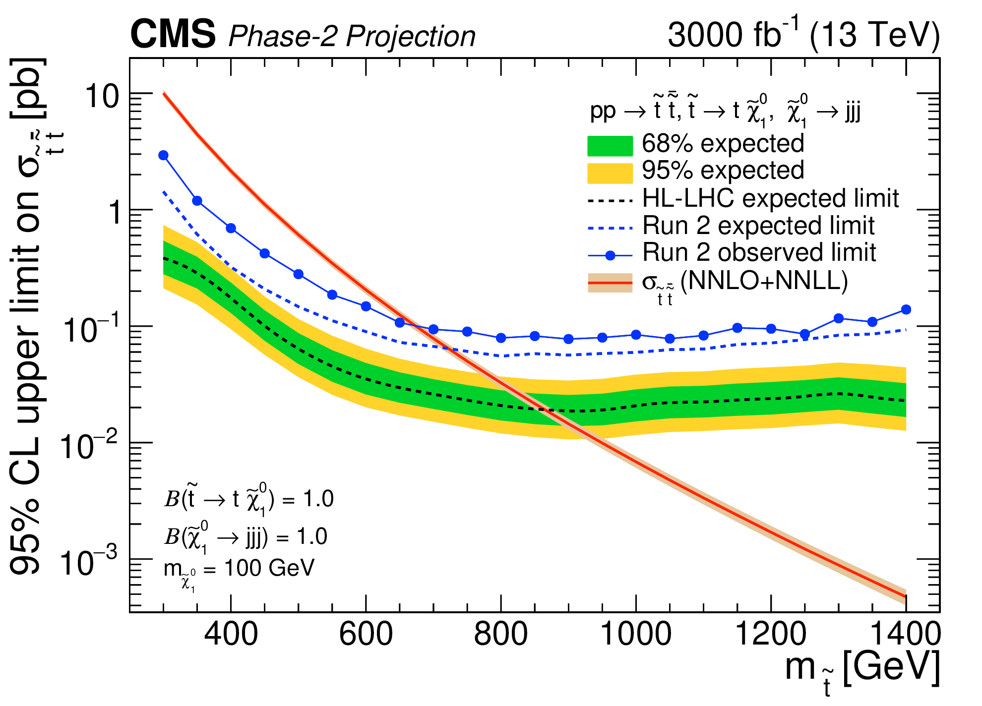
High Luminosity LHC: Run 4
In August 2030 the HL-LHC will start after several years of upgrade of subdetectors in Phase 2
We will have a luminosity of 3000 fb⁻¹ with data at 13.6 TeV
We will participate in new analyses, since we have been active in the Tracker and ETL in MTD upgrades
Heavy Higgs to W⁺W⁻ with dileptons
EWK SUSY search
Stop search with two tops

Slide 15
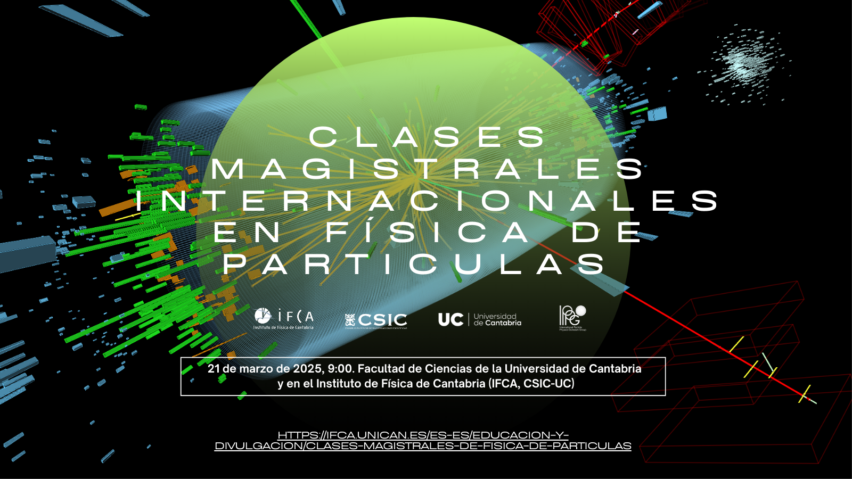
Outreach
We were one of the first groups in HEP in Europe involved in Masterclasses in 2005
Since then we have been involved in all Masterclasses
Many more outreach activities done in our group
Talks at schools, Café Científico, Ciencia en el Ateneo, European Researchers’ Night, Semana de la Ciencia, Pint of Science, etc

