Slide 1
Reconstruction

Slide 2
>> Event reconstruction <<
The process of interpreting the electronic signals produced in a high-energy physics (HEP) experiment's detector to determine what original particles passed through the detector and their characteristics.

Slide 3
>> Event reconstruction <<
Tracking and Vertexing
  Hit Point
  Track Finding
  Track Fitting
  Vertex Fitting
Particle ID
  Electron and Photon
  Muon
Jet Identification
  Identification of b-jets

Slide 4
Track Reconstruction
(Slides are reused from https://indico.tlabs.ac.za/event/112/contributions/3196/attachments/1062/1453/MM_Tracking_TIPP_2023.pdf)

Slide 5
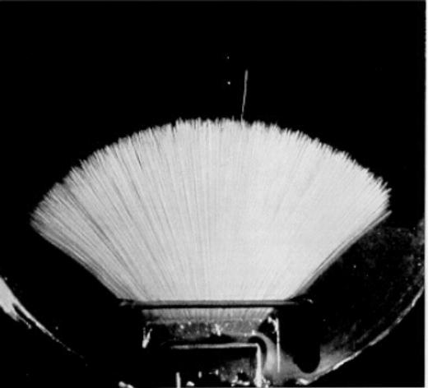
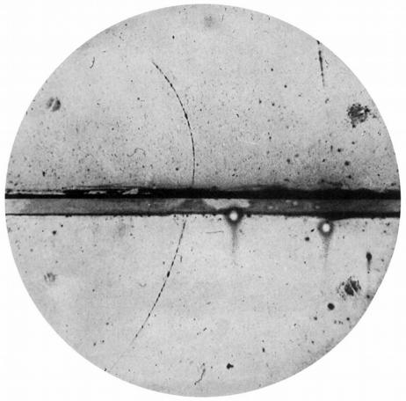
Tracking Systems in 'Old Days'
At the beginning of particle physics, the techniques for observing particles
were developed together with the physical ideas about them.
Most techniques were based on optically observing their paths and
recording them by photographs.
A first tracking detector was the cloud chamber invented by Wilson in 1910:
Particles traverse supersaturated water/alcohol vapor. The e–/ion pairs in
the track act as condensation nuclei.

Slide 6
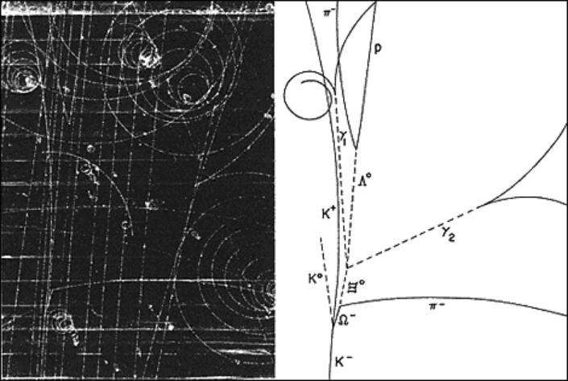
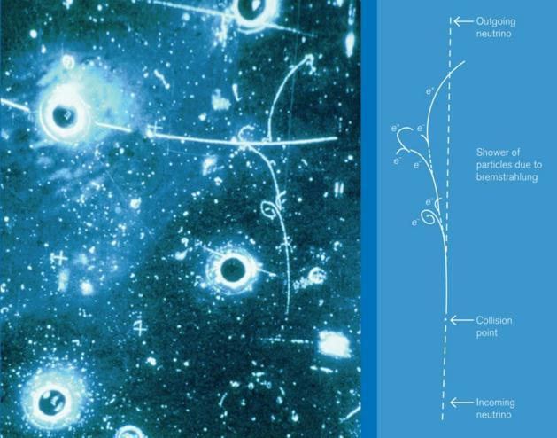
Bubble Chambers
The bubble chamber was invented by D. Glaser in 1952 (NP 1960).
Particles traverse a superheated liquid and the deposited energy creates
bubbles → Photos are made.
Discovery of the  in 1964
Discovery of Neutral Currents

Slide 7
General Requirements for a
Tracking System
Some general statements can be made on general requirements of a
tracking system:
●
Detect charged particles with high efficiency
●
Precise measurement of particle track (direction, origin, etc)
●
Momentum measurement
●
Determining the sign of the charge, possibly also the charge itself
●
Particle identification for example by dE/dx
●
Study impact parameter, that is the distance of the track to the expected
point of collision
●
Robust measurements in environments with many tracks
●
Operation for a long time, in particular also able to stand a lot of radiation
without aging
●
Cheap
Experiment specific requirements will often surpass these.

Slide 8
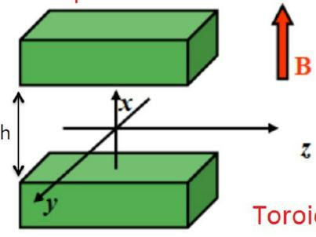
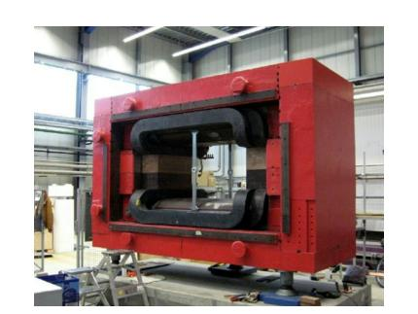

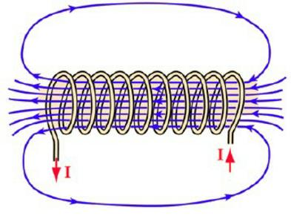
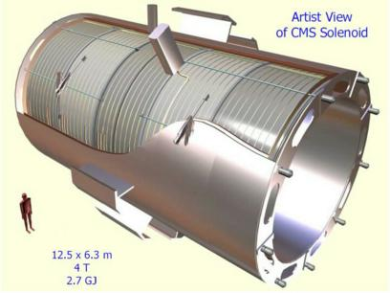
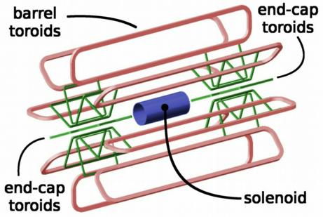
Magnet Field Configurations
In HEP experiments three field configurations are used:
1) Dipole fields
(for fixed target
experiments)
2) Solenoidal fields
(for collider experiments)
3) Toroidal fields
(for muon system of
collider experiment)

Slide 9

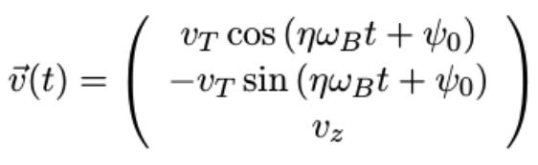
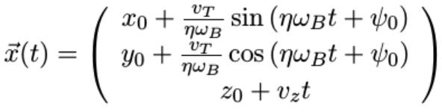
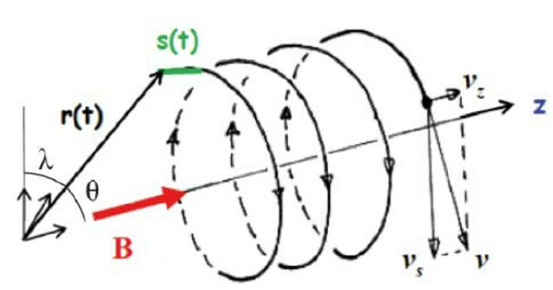
Track Parameters in B-fields (I)
In magnetic fields, the particle path can be derived starting from the Lorentz
force:
Assuming a homogenous B field, which can be directed along the z axis
allows to solve for v:
with  =|q|B/ m, =q/|q|, and v =√v ²+v ²
B
T
x
y
Integration gives
=> Helix trajectory
with 6 parameters x , y , v , ,  , 
0
0
T
B
0

Slide 10
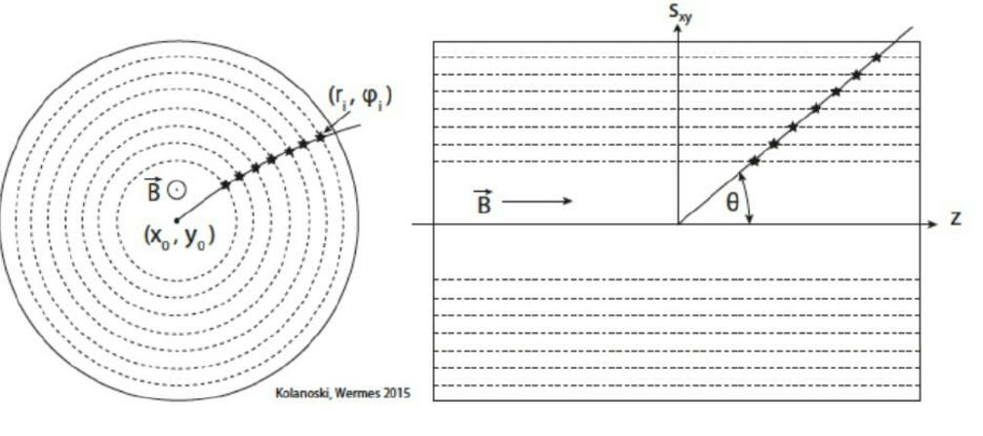
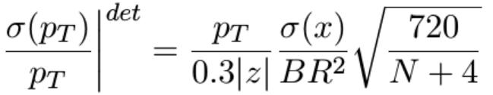
Solenoidal Setup
The calculation for
dp/p is completely
analog to the sagitta
method
1) Momentum resolution improves quadratically with radius
2) Momentum resolution improves linearly with the B-field
3) Detectors with better spatial resolution helps
4) Number of track points also improves the result
5) (p)/p increases with p → more difficult to measure high energetic tracks

Slide 11
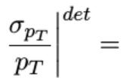

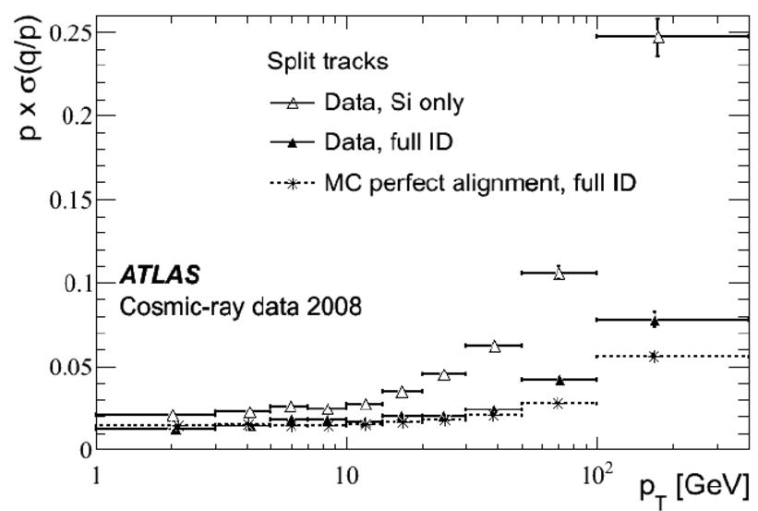
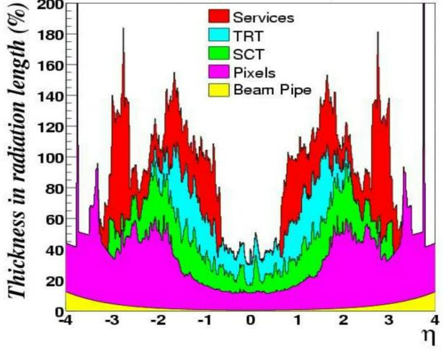
Example ATLAS TrackingPerformance
The estimate of
fits well with the official detector
requirement of  /p = 0.05% p (GeV/c) + 1%
pT
T
T
The additional 1% is given because of the material budget of the inner
detectors:
arXiv:1004.5293v2
PoS(ACAT)046

Slide 12
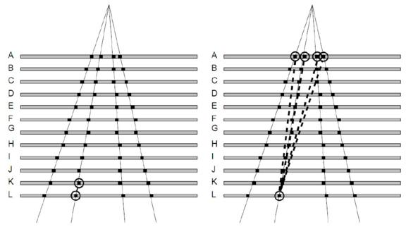
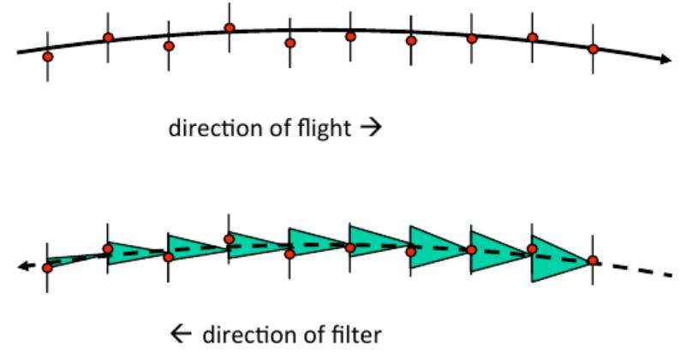
KF for Track Finding
1) Find a seed track: This is often a combina-
torial approach using the 2-3 outermost
layers and an inner layers of measurement.
The outside is chosen, because tracks are
separated and possible combinations are
reduced.
2) Make a track estimate: Based on the currently available track points and
their errors, a prediction is made for hits in the next detector layer.
3) Looking for hit: If hit is found, add it to track and update the track
prediction for the next layer.

Slide 13
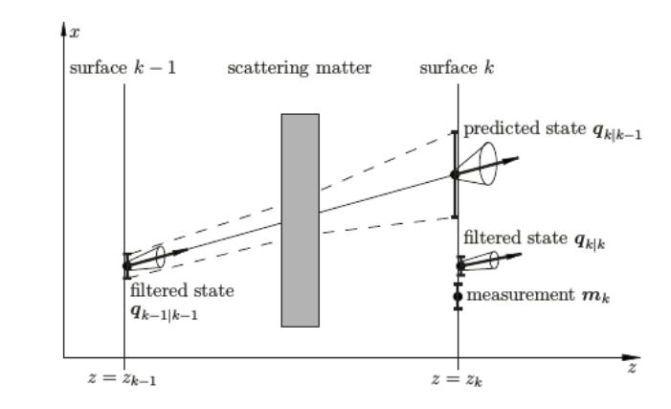
Advantages of the KF
It is easy to take detector effects into
account
●
Energy loss
●
Multiple Scattering
●
Bremsstrahlung
can be accommodated by recognizing
the effect and correcting for it in the
next step.
A filter can be built, that stores the intermediate results of the filter
→ outliers such as noise or hits from close tracks can be identified and
removed afterward.
The best parameter estimate can be given at any point.
Because of the flexibility, the algorithm is widely used for tracking objects in
real time:
Radar tracking, sonar ranging, satellite orbit computation, automated driving

Slide 14
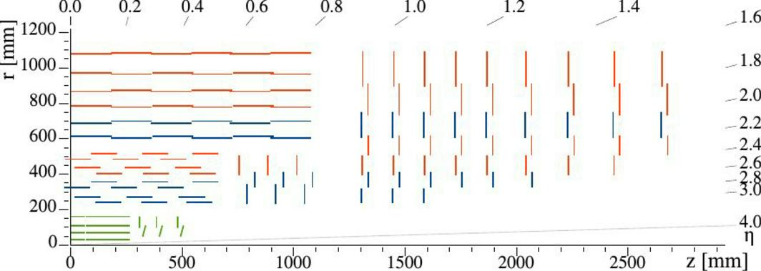


CMS Silicon Tracker
● All-silicon design:
○ Allows for high-precision charged particle tracking up to |η|<3;
○ Essential in particle identification, heavy-flavour tagging, trigger decisions,
vertex reconstruction;
○ Largest Si tracker in the world: ~200 m² area, ~135M electronic channels
● Comprised of the Pixel (innermost parts)
○ 4 layers in the barrel (BPix) and 3 disk (FPix) in the forward regions:
■ 1,856 Pixel modules.
● and the Strips sub-detectors (outer parts)
○ 10 layers in the barrel (TIB, TOB) and 12 forward disks (TID, TEC):
■ 15,148 Strips modules.
● Micro-strip sensors
● Stereo modules
(two components
TOB
with a 100 mrad
stereo angle)
● Analog readout
TIB
TID
TEC
BPix FPix
● pixel sensors
● ~124M channels
● digital readout

Slide 15
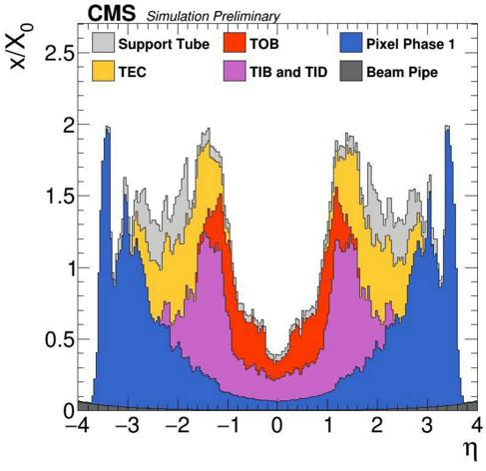
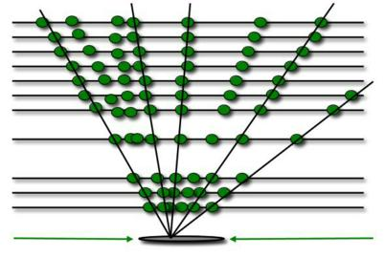
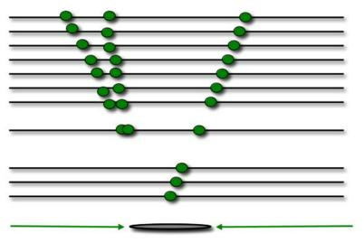
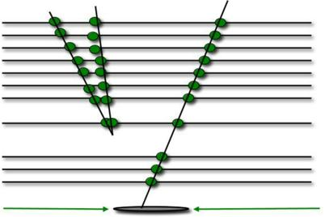

Track reconstruction in CMS
● Few, but precise measurements;
● Dead material inside the tracker volume
● Main tracking algorithm: Combinatorial Track Finder
used in iterative steps:
○ limits the number of combinatorics in pattern recognition
○ tracking reach guaranteed, w/o degrading computing performance
Reconstruct
Clean
Reconstruct

Slide 16
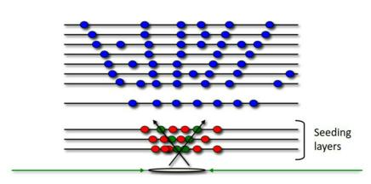
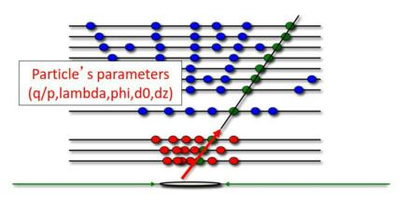
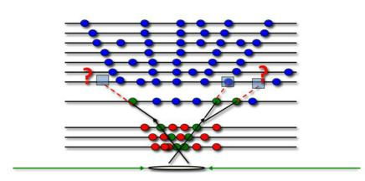
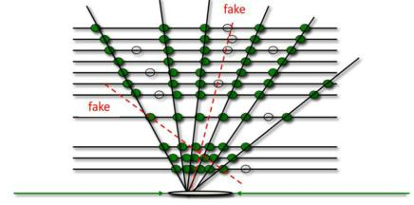
Track reconstruction in CMS
In each iteration, tracks are reconstructed in four steps:
1. Seeding:
○ provides track candidates, with an initial estimate of the trajectory parameters and their
uncertainties (use combination of pixel, strip or mixed hits);
2. Pattern recognition:
○ hits compatible with the predicted track position are added (Kalman update) to the
trajectory and track parameters are updated;
3. Final fit:
○ taking into account the B-field non uniformity and a detailed description of the material
budget;
○ provides the best estimate of the parameters of each smooth trajectory after combining all
associated hits (outlier hits are rejected);
4. Selection:
○ sets quality flags based on a ML-based MVA with more than 20 inputs;
○ aims to reject fake tracks; tracks sharing too many hits are also cleaned as duplicates;
1
3
2
4

Slide 17
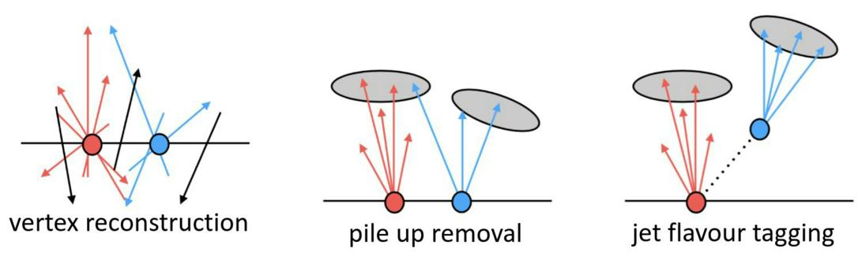
The tracking challenge at LHC
● The tracking challenge at the LHC:
○ typically 30 charged particles within the tracking volume acceptance
per proton-proton collision
○ and 50-60 collisions per event: O(1500) charged particles per event;
● These need to be reconstructed:
○ with very high efficiency (>90% for ~GeVꢂ pions)
○ precise track parameters
○ very low fake rate: O(~ few %)
○ quickly (stringent CPU limits)
● Very strong requirements on track reconstruction algorithms
● Track reconstruction is not just about reconstructing charged particles:
○ used in almost every element of reconstruction

Slide 18
Summary for Tracking
● Tracking algorithms need to provide high-quality tracks efficiently andwith an efficient usage of resources:
○ high tracking and vertexing performance is a must (despite
challenging conditions at the LHC);
● To provide more precise and accurate track reconstruction
sophisticated algorithms, techniques and calibrations have been
developed.

Slide 19
Vertex Reconstruction

Slide 20
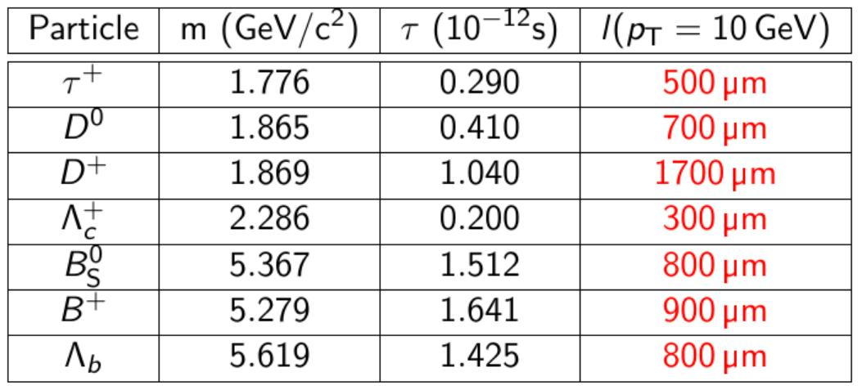
Vertex Reconstruction
Particles produced in the collision decay fast, but they can fly a certain
distance before decaying:
l =  c 

Slide 21
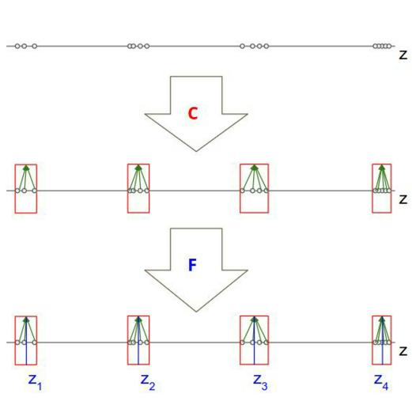

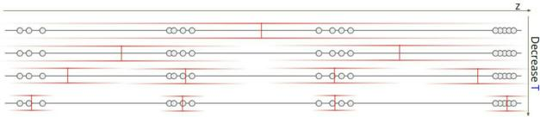
Vertexing
● Vertexing starts from a set of tracks.
● Then proceeds into two steps:
○ Clustering: group together close-by tracks
in cluster candidates. The algorithm used is
deterministic annealing;
○ Fitting: fit vertex properties of those clusters
from those of the tracks. The algorithm used
is Adaptive vertex fitting algorithm;
Clustering
Fitting
● Vertexing is based on
optimizing an energy (assignment)
function with a penalization entropy term:
○ Starting at very high temperature (T)
all tracks are assigned to one single
cluster;
○ As we lower T, splitting the cluster
into several becomes beneficial;
○ Iteratively update assignment
probabilities P while lowering T
ik
provides a final robust estimation of
the clusters.

Slide 22
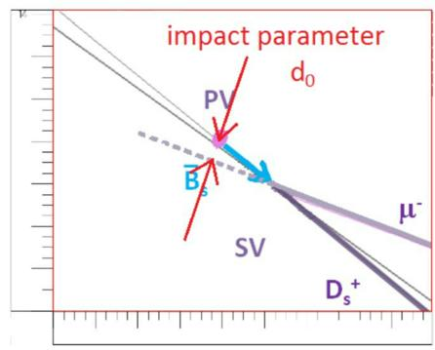
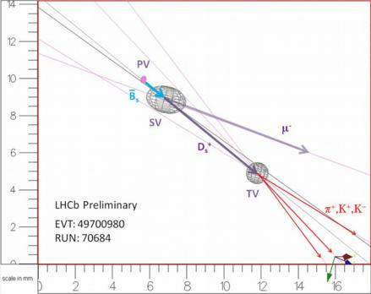
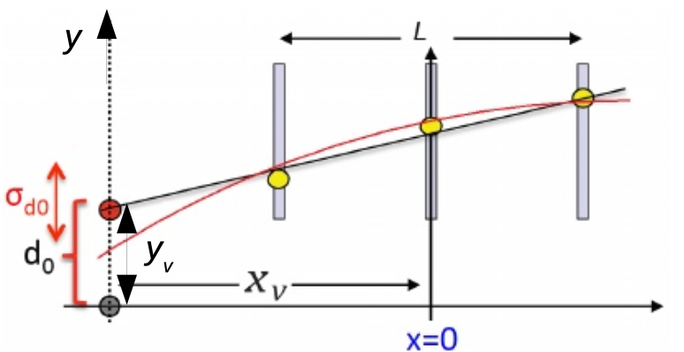

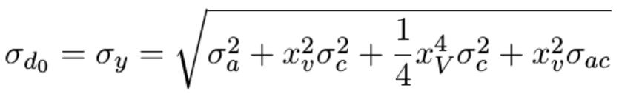
Impact Parameter
Impact parameter d quantifies the mismatch to the
0
primary vertex (PV)
The impact parameter significance S = d /
d0
0
d0
serves as selection criterion to distinguish tracks
from primary or secondary vertices.
The track as measured by the tracking detectors has to be extrapolated to the
vertices. This can be done with
●
Linear extrapolation y = a + bx
(no magnetic field)
●
Quadratic extrapolation y = a + bx + cx² (good approximation for helix in B)
Errors on the vertex position y is given
v
for linear
approx. by
or for quadratic approx. by

Slide 23
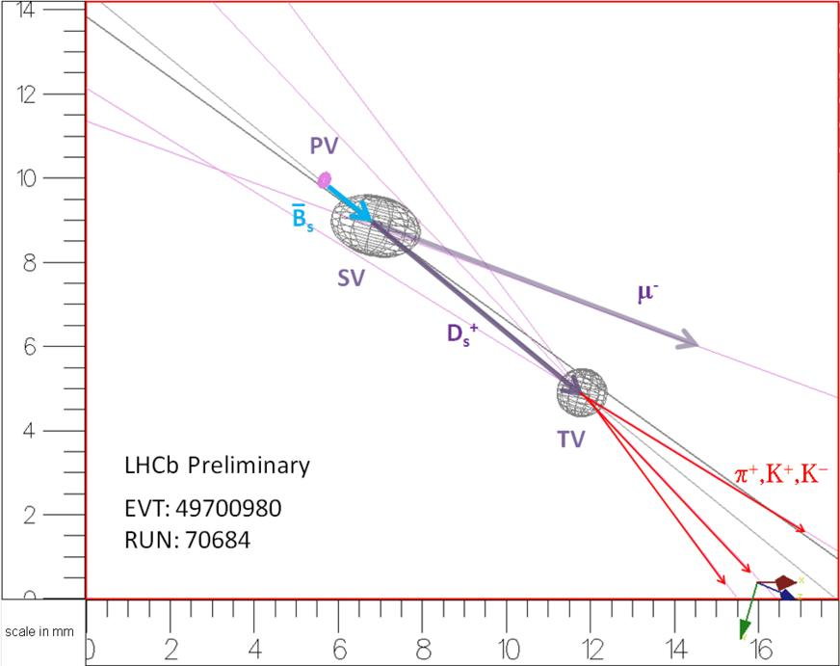
Example of Decay Chain
Identifying the primary vertex (PV), secondary vertex (SV) and tertiary vertex
(TV) is important to understand the decay chain of the particle and to
reconstruct its mass and life time completely.

Slide 24
Muon Reconstruction
(Slides are reused from https://indico.cern.ch/event/242419/contributions/520665/attachments/412163/572720/LHCFrance_MuonReco_NVranjes.pdf)

Slide 25
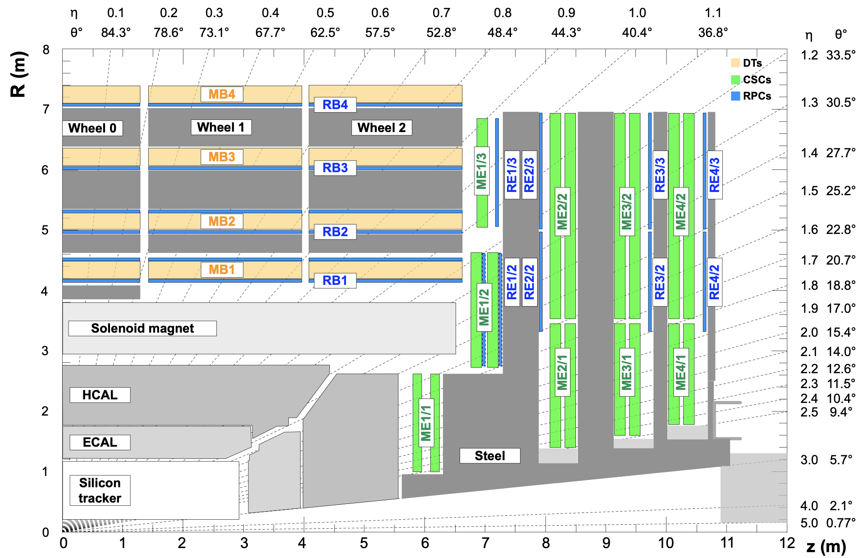
Muon detectors
DT
RPC
(Drift Tubes)
(Resistive
Plate Chambers)
long drift time (380ns) – low rate reg.,
wire pitch 4.2cm
Fast gaseous det. (~2ns), dedicated for L1
Efficiency >95% @ 1KHz
resolution (per chmber) rφ:100 µm, rθ:150 µm
8φ+4θ layers in station (only φ in MB4)
Low noise (<5Hz/cm2),
meas. Φ (strip Pitch 0.5-4cm)
CSC
(Cathode
Strip Chambers)
fast response,
high rate
close wire spacing (res. R75-150 µm)
strips 6.7-16mm (res. Φ 150 µm)

Slide 26
Algorithms in Muon Detectors
Local Reconstruction: Find Track Segments which held information about position and direction of muon crossing one chamber. Track Segments are formed by straight line fit using multi-hit measurements in stations.
DT: hit position w.r.t. wire computed from drift time; r-φ (8meas.) and r-θ (4meas.); direction reconstructed independently and combined into segment
CSC: 2D points from wire and strips measurements in plane. Build segment using hits from up to 6 planes
RPC: secondary importance in track reconstruction (measure 3d hit only)
Stand-Alone Muon Reconstruction
Based on the Kalman Filter Technique
Propagation with energy losses, in non-constant magnetic field.
Seeding – definition of initial trajectory state.
Online: input (position, momentum) from L1 trigger
Offline: global analysis of segments. Seed kinematics is estimated by simple parametrisation of bending in/between segments.
Forward Pattern Recognition (pre-filtering) goes from most inner to outer muon station. Segments compatible with trajectory (χ² based) are collected constraining trajectory state.
Backward Pattern Recognition: Trajectory Fitting: propagating outside-in update trajectory with individual hits from segments (χ² based). Optionally update fit with vertex constraint

Slide 27
Algorithms in Tracker
Global Muon:
Define Region of Interest (ROI) which describes supposed track parameters at vertex (based on Stand-Alone Muon reconstruciton and assumed tolerances).
Offline: reuse tracks from standard tracker reconstruction
Combinatorial Track Finder (CTF) - Kalman Filter based algorithm consisting of global hit based seeding, inside-out pattern recognition, final cleaning, fitting and smoothing (backward fitting).) Select tracks compatible with ROI.
Online: run regional tracker track reconstruction in ROI (find pixel hit pairs or triplets which are compatible with ROI). Standard tracker CTF, customized cleaning.
Match tracker tracks to Stand-Alone Muon (check trajectory compatibility on intermediate surface). Refit track using hits from Tracker Track and Stand-Alone Muon.
Tracker Muon
(offline only, alternative to start with Stand-Alone Muon)
Reuse tracks from standard tracker reconstruction
For each track combine muon signatures (energy in calorimeters, segment crossed by extrapolation, discance from chamber edges)
Flag track as Tracker Muon if track has MIP signal in calorimeter or at least one
matched muon segment

Slide 28
Alignment
The structure of the CMS detector is not rigid:
1-3 cm deformation due to magnetic field
5-15 mm due to gravity (weight)
500 µm due to changes in temperature and humidity
Reconstruction requires a precise knowledge of the location of the detector components
(ex. In order not to degrade momentum measurements in muon system: 200 µm in the r-φ).
Alignment scenarios:
•Ideal: assumes a perfectly placed detector
•Startup: our best estimate of
alignment at day one
• Long-term: our expectation of
improved knowledge with data
CMS strategy for alignment is based on:
•Optical system
•Tracking (from collisions, cosmics, halo)

Slide 29
Electron & Photon Reconstruction
(Slides are reused from L. Finco, LPC Physics Forum 2021)

Slide 30
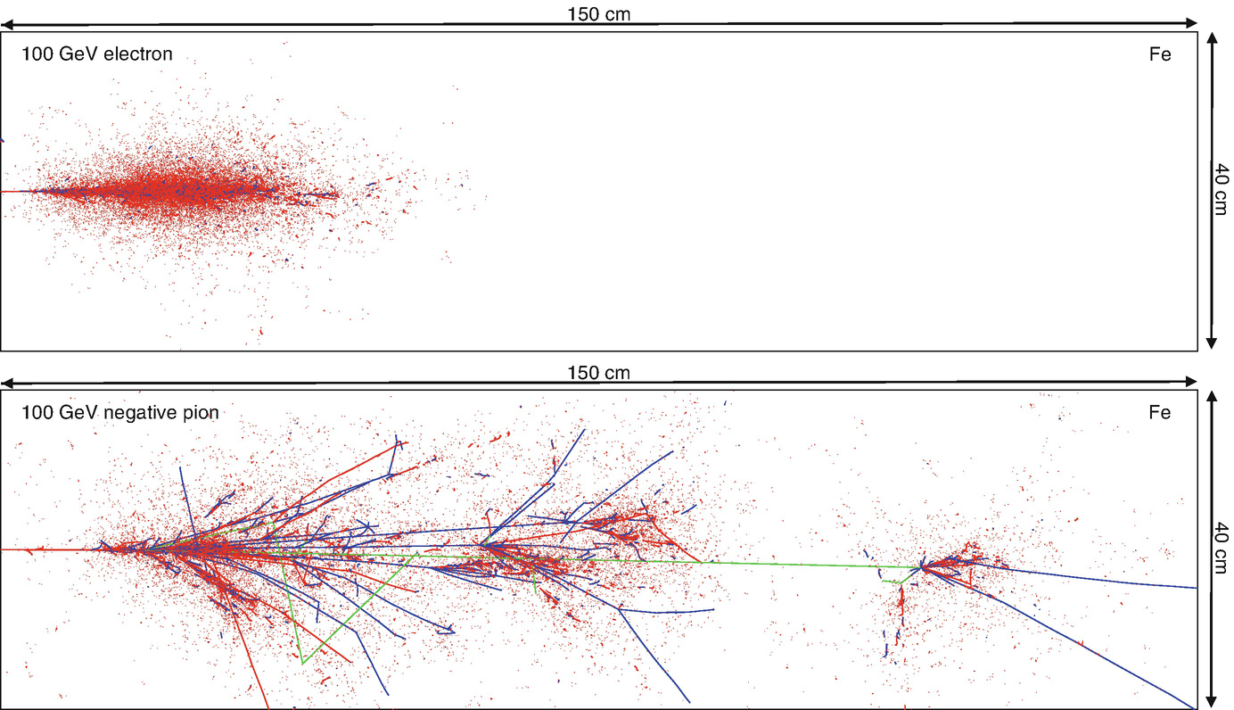
Definition of Calorimeter
• In particle physics a calorimeter is a detector measuring the energy carried by
an incoming particle
• Instrumented blocks of matter in which the particle interacts and deposits
all its energy in the form of a cascade of particles
• The particle energy is measured in
eV (MeV-GeV-TeV 10⁶, 10^{9,} 10¹² eV)
• 1 eV = energy acquired by one
electron accelerated by 1 V
• The temperature effect of a 100
GeV particle in 1 litre of water
(at 20 °C) is ΔT = 3.8×10⁻¹² K
https://doi.org/10.1007/978-3-319-47999-6_53-1

Slide 31
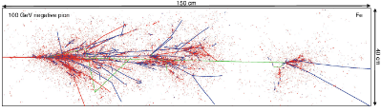
General Features of Caloremeters
• Calorimetry is a “destructive” method
• The energy is measured by total absorption of the particle
• A calorimeter converts the energy of an incident particle to a detectable signal,
proportional to the incoming energy
• Calorimeters can measure the energy of electromagnetic radiation (electrons,
photons) or hadronic particles (charged pions, protons, neutrons)
• The charged component of the particles' cascade deposits energy in the active
part of the calorimeter and it is detected in the form of charge or light
• This talk is mainly focused on electromagnetic calorimeters
https://doi.org/10.1007/978-3-319-47999-6_53-1

Slide 32
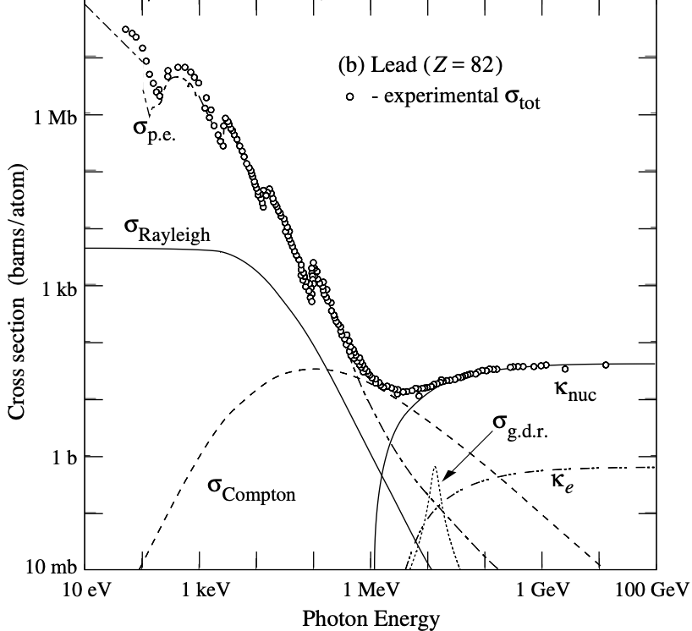
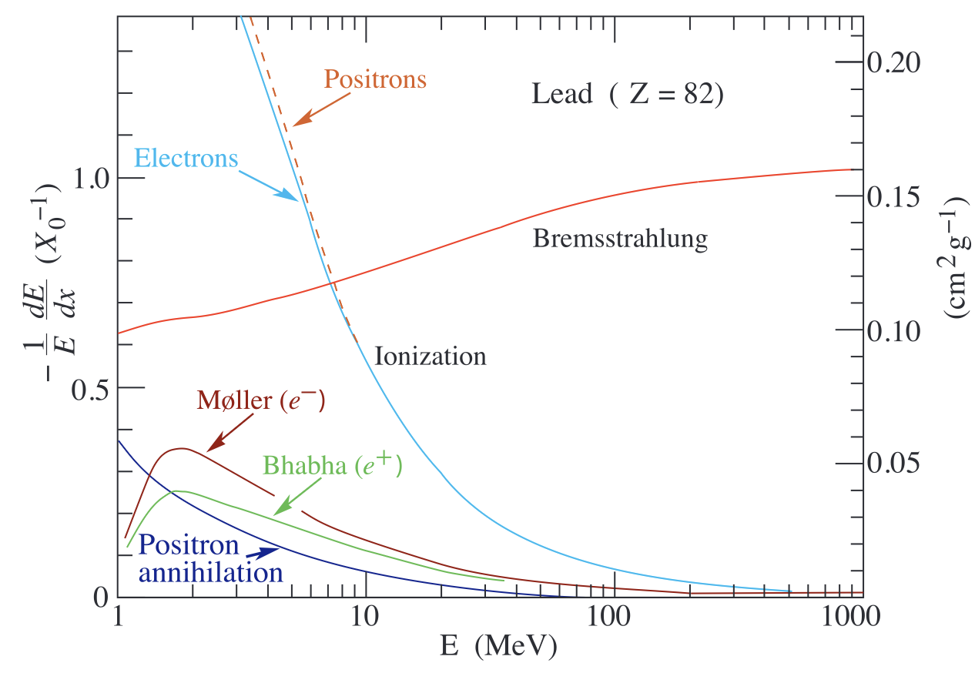
Particle-Matter Interactions
• In matter electrons and photons loose energy
interacting with nuclei and atomic electrons
• Main photon interactions with matter:
• Photoelectric effect
• Compton scattering
• Pair production
• Main electron interactions with matter:
• Ionization
• Bremsstrahlung
• Čerenkov radiation
• Multiple scattering

Slide 33
Particle-Matter Interactions
• In matter electrons and photons loose energy
interacting with nuclei and atomic electrons
Pair production
• Main photon interactions with matter:
• Photoelectric effect
• Compton scattering
• Pair production
• Main electron interactions with matter:
• Ionization
• Bremsstrahlung
• Čerenkov radiation
• Multiple scattering
Bremsstrahlung
At colliders interesting electrons and
photons have usually E > 1 GeV

Slide 34
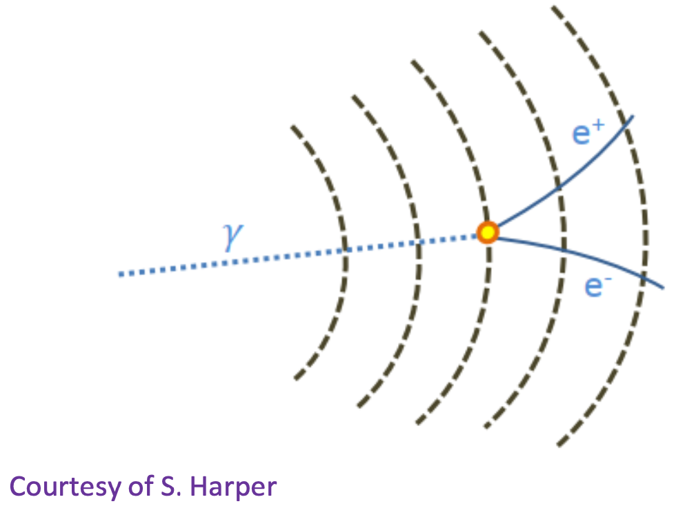
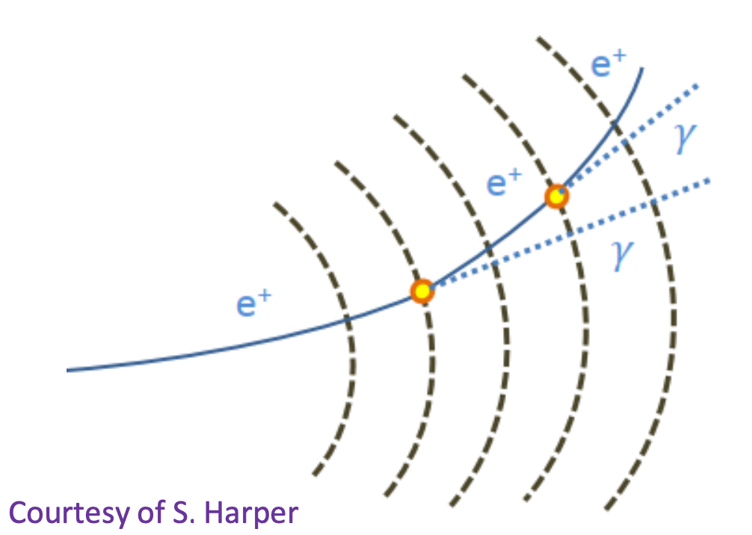
Particle-Matter Interactions
Pair production
• In matter electrons and photons loose energy
interacting with nuclei and atomic electrons
• Main photon interactions with matter:
• Photoelectric effect
• Compton scattering
• Pair production
• Main electron interactions with matter:
• Ionization
• Bremsstrahlung
• Čerenkov radiation
• Multiple scattering
Bremsstrahlung
These processes are the basis of the
electromagnetic shower

Slide 35
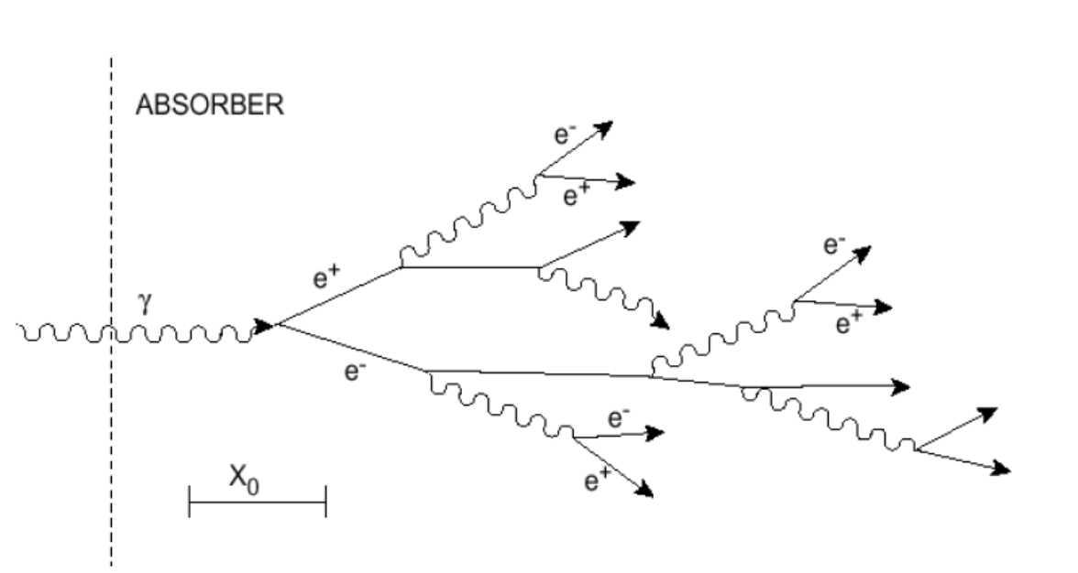
Electromagnetic Shower
• Electrons and photons create a cascade (shower) of particles
• Number of particles N
• Is proportional to the energy of the incoming particle
• Increases until the energy of the electron component falls below E_{c}
(critical energy ~ 5-10 MeV)
• With E < E a slow decrease in number of particles occurs as electrons are
c
stopped and photons absorbed
• Longitudinal extension of the shower is proportional to ln(E/ E_{c})

Slide 36
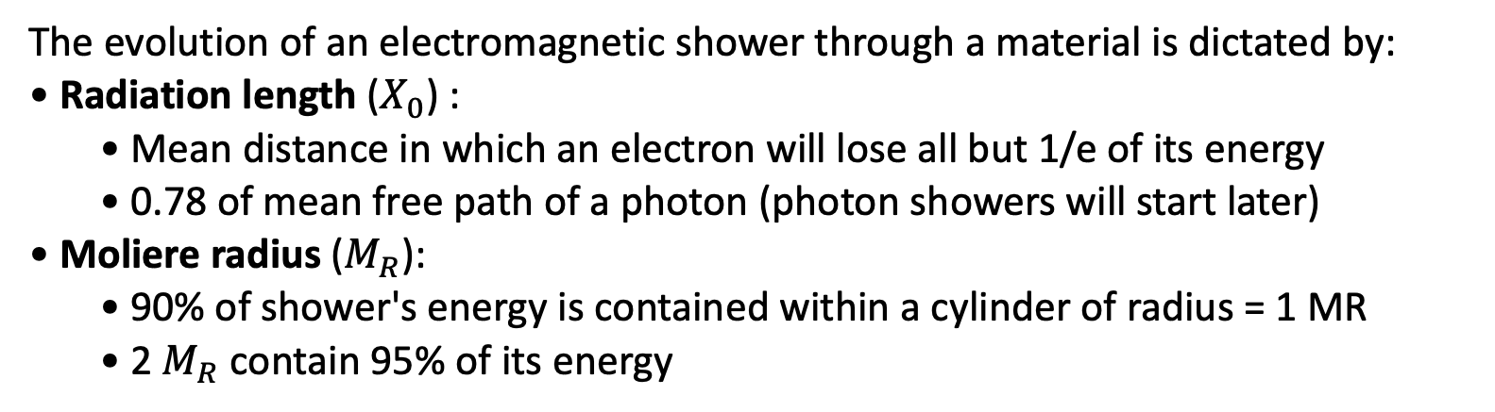
Electromagnetic Shower
Related to radiation length
Related to Moliere radius
The evolution of an electromagnetic shower through a material is dictated by:
• Radiation length ($X_{0}$) :
  • Mean distance in which an electron will lose all but 1/e of its energy
  • 0.78 of mean free path of a photon (photon showers will start later)
• Moliere radius ($M_{R}$):
  • 90% of shower's energy is contained within a cylinder of radius = 1 MR
  • 2 $M_{R}$ contain 95% of its energy

Slide 37
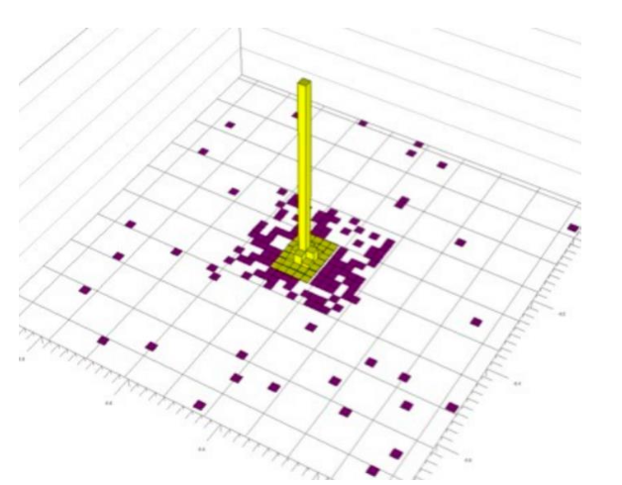
Calorimeter’s Design Characteristics
• Size of the detector: the longitudinal depth of the detector is dictated by
X and is driven by the required resolution
0
• Small X₀ allows to reduce calorimeter size (compactness)
• Cell size: typically chosen such that 70-80% of energy of a centrally
incoming particle is deposited in the cell, while having energy in the
neighbouring cells large enough to measure the centre of gravity
coordinates
• Related to M_{R}
• Granularity: size of detector elements
in the transverse and longitudinal
direction, which determines the ability
to resolve two showers induced by
nearby particles as distinct. It depends
on the shower size, distance from the
interaction point and transverse size of
detector elements/cells

Slide 38
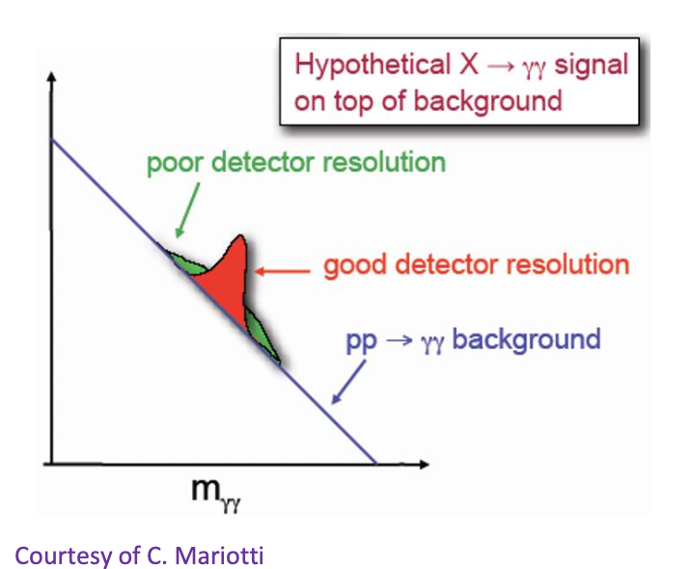
LHC Requirements for Calorimeters
• Fast response (25 ns or faster) and high granularity, to reduce pile-up
induced noise
• Radiation-hard detectors and electronics
• Hermetic and cover the full azimuthal angle and rapidity range, to tag
very forward jets and well measure the missing energy
• Excellent electromagnetic energy
resolution
• To detect the two photon decay of
an intermediate mass Higgs (golden
channel together with H→ZZ →4l)

Slide 39
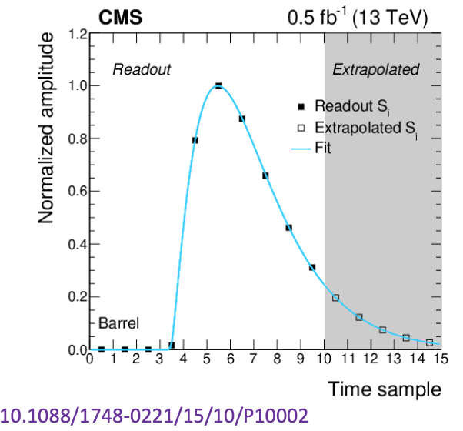

ECAL Energy Reconstruction
• Energy in the ECAL observed as a pulse
as the photons from the shower arrive
over time
• This pulse shape is converted to an
energy (E ∝ A, signal channel
amplitude)
• In case of out-of-time pile-up events,
multiple pulses from different bunch
crossings are generated
• They lead to an apparent increased
amplitude measurement
• The amplitudes of different pulses are
resolved by fitting the multiple pulse
shapes simultaneously

Slide 40

Electron and Photon Reconstruction
• First step is to construct individual particles from the reconstructed energy
deposits (clustering)
• The clustering procedure looks for local maxima above a given threshold (1 GeV)
• Energies between overlapping adjacent clusters are shared

Slide 41

Clustering of Crystals Energy
• Found 5 clusters in this region of the ECAL
• Each one represents the energy deposits of a particle (electron/photon)
• In practice not this clean: often clusters have a very large number of crystals with
small energy fraction

Slide 42

Superclusters
• An electron or photon when it arrives to ECAL, may be accompanied by multiple
secondary particles created through interactions with matter on the way to ECAL
• Superclustering (clustering on clusters) aims to combine the individual electrons
and photons into a single object, corresponding to the original electron/photon
• It starts by taking the highest energy cluster (in this case the light blue one) and
looks for compatible clusters

Slide 43


Electron Track Reconstruction
• Electrons leave a signal in both tracker and calorimeter
• Electron tracks have changing curvature because of radiative energy loss due to
bremsstrahlung
• A dedicated tracking algorithm known as GSF tracking is used to take into
account these changes in the curvature
• Used to associate additional bremsstrahlung radiation and photon conversion
tracks to the supercluster
Bremsstrahlung
Pair production
Notes:
GSF: Gaussian Sum Filter

Slide 44

Refined Superclusters
Recover of a very soft bremsstrahlung
photon into the refined supercluster
• Refined superclusters use the information from the tracker, to be able to link
bremsstrahlung emissions to missed ECAL deposits and reject some clusters which
are highly incompatible with its matched tracks

Slide 45

Energy Corrections
• Energy deposited by electrons and
photons in the ECAL and collected
in superclusters is subject to losses
• Energy lost in gaps
• Large amount of material
upstream of the calorimeter
• Calorimeter measurements
more sensitive to pileup than
tracking.
• To calibrate the reconstructed
energy back to generated energy a
correction procedure is needed
• Based on simulation
• Uses machine learning
techniques
• Applied on data and MC

Slide 46

Reconstruction Performance
Electron reconstruction
efficiency is higher than 95%
for E > 20 GeV and is
T
compatible between data and
simulation within 2%

Slide 47

Electron and Photon Identification
• Several variables are developed to separate electrons/photons from
background (jets, photon conversions, particles from secondary vertices)
• They exploit that electrons/photons are single objects which are almost fully
contained in the ECAL
• Many different types:
• Shower-shape variables
• Track matching variables
• Conversion ID variables
• Isolation variables

Slide 48
Electron and Photon Identification
• Several variables are developed to separate electrons/photons from
background (jets, photon conversion, particles from secondary vertices)
• They exploit that electrons/photons are single objects which are almost fully
contained in the ECAL
Are the energy deposits in
• Many different types:
• Shower-shape variables
• Track matching variables
• Conversion ID variables
• Isolation variables
the calorimeters compatible
with coming from a single
electron/photon?
Does the ECAL deposit
have a compatible track?
Is there a large amount
of other particles
nearby the
Are the tracks compatible with coming
from the collision point? Or do they
appear later on in the tracker?
electron/photon?

Slide 49

Shower Shape Variables: σ_{iηiη}
• σ_{iηiη} is one of the most important electron/photon ID variables in CMS
• It measures the spread of an electromagnetic shower along ieta direction
• A 5x5 array of crystals is the area where an electron/photon is almost fully contained

Slide 50

Shower Shape Variables: H/E
• H/E is the ratio of the hadronic energy to the electromagnetic energy
• Excellent ID variable used in electron and photon identification
• Very well modelled in simulation

Slide 51

Conversion ID Variables: R₉
• 5x5 matrix contains 96.5% (97.5%) of unconverted photon energy in EB (EE)
• R is the energy sum of the 3×3 crystals centred on the most energetic
9
crystal in the supercluster divided by the energy of the supercluster
• R helps in conversions identiﬁcation and to distinguish real photons from
9
π₀

Slide 52
Jet Reconstruction
(Slides are resused from https://indico.cern.ch/event/975141/)

Slide 53

Event Reconstruction
1. Build muon candidates (not shown), tracks, and calorimetry clusters
2. Link tracks and the calorimetry clusters based on spatial proximity
3. Identify 'charged hadron candidates' among the links by associating calorimetric energy to track momenta, when tracks are close
4. 'photon' and 'neutral hadron' candidates from excess energy

Slide 54



Particle Flow Event Reconstruction
• Reconstruct charged/neutral hadrons, $γ,e^{±}$ ${,μ}^{±}$
• fully exploit tracking resolution and fine ECAL granularity
• optimal combination of track and calorimetry resolution

Slide 55

Particle Flow Event Reconstruction

Slide 56

Jet Clustering
Event reconstruction provides list of particle candidates
• Need to correlate 'sprays' of particles from hadronization (jets) with the initial partons of the hard scatter event
• This is done by "sequential" jet clustering algorithms:
  • Identify seeds and devise a recursive procedure to associate other particles until the whole event is clustered
  • Controlled by an angular distance measure e.g. AR=0.4 ('slim' jets) or 0.8/1.0/1.2 ('fat' jets) that defines the angular size of the jets

Slide 57


Jet Clustering

Slide 58

Jet Algorithms

Slide 59

Jet Substructure

Slide 60

Tagged Jets

Slide 61

Pile-Up Cleanup

Slide 62
Summary
Event reconstruction is a very rich topic. It combines particle interactions, detector knowledge, computing, algorithms, machine learning etc.
Event reconstruction is based on identification and reconstruction of individual objects such as tracks, vertices, electrons, photons, jets.
Data analysis is possible thanks to these objects.

