Slide 1
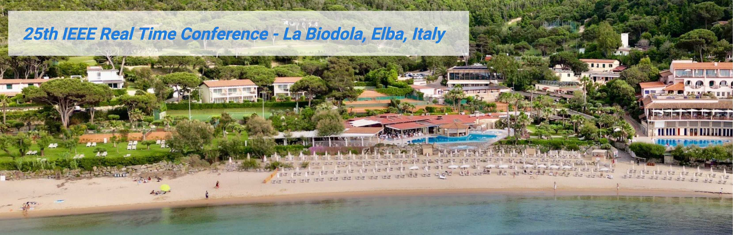
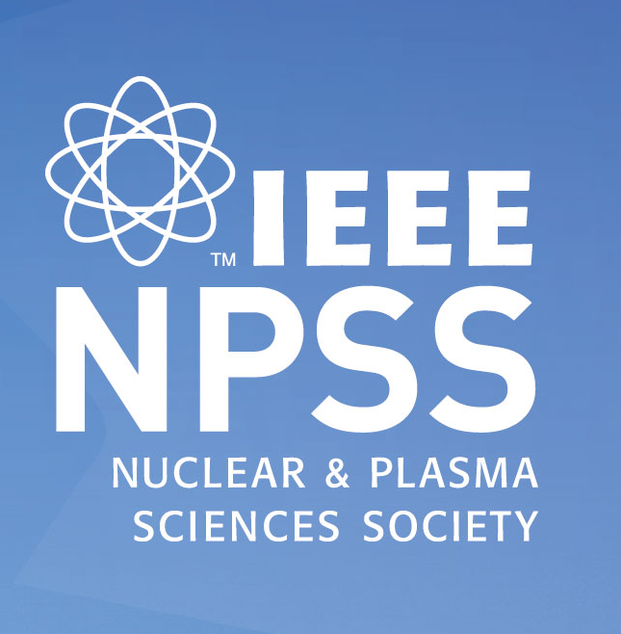
Welcome
Vesna Sossi, PhD
IEEE Fellow
NPSS Past President,
Div IV Director-Elect

Slide 2
NPSS - Division IV - IEEE
IEEE
Why should I be an IEEE NPSS member?
DIV IV
NPSS

Slide 3

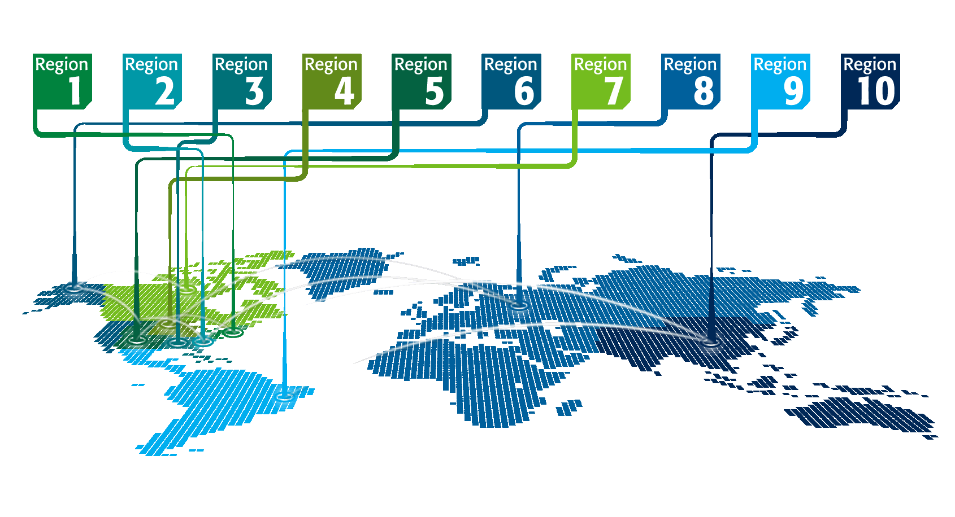

IEEE at a Glance
IEEE has…
Over 500,000 members
in more than 190 countries,
more than 67 percent of whom are
from outside the United States
More than 189,000 Student members
347 Sections in ten geographic
Regions worldwide
2,815 Chapters that unite local members with similar technical interests
3,613 Student Branches at colleges and universities in over 100 countries
4,240 Student Branch Chapters of IEEE technical Societies
670 affinity groups and growing
All figures stated above are current as of 12/31/2024.

Slide 4
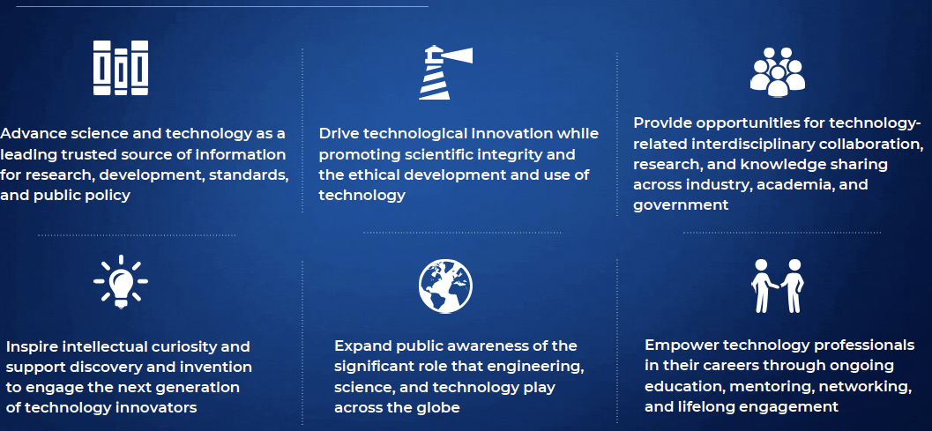
6 IEEE Strategic Goals (2025-2030)
ADVANCING SCIENCE
DRIVING ETHICAL INNOVATION
INTERDISCIPLINARY COLLABORATIONS AND IMPACT
FOSTER THE NEXT GENERATION
PUBLIC OUTREACH
EMPOWER PROFESSIONALS

Slide 5
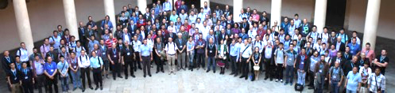

IEEE Organization
M E M B E R S
Board of Directors (BoD)
Assembly
MGA
TAB
PSPB
EAB
SA
IEEE-USA
ED
Member and Geographic Activities
Board
Technical Activities Board
Publication Services and Products Board
Educational Activities Board
Standards Association
IEEE USA
Executive Director
10 Regions
10 Divisions
Staff &
Society Executive Directors/
Administrators
Sections & Geographic Councils
Societies & Technical Councils
This is where we are
(39 Societies and 7 Councils)
Chapters
ta.ieee.org

Slide 6
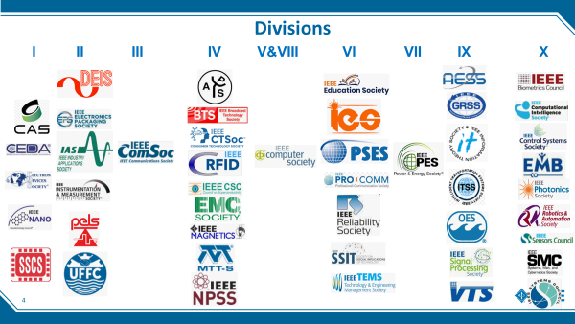
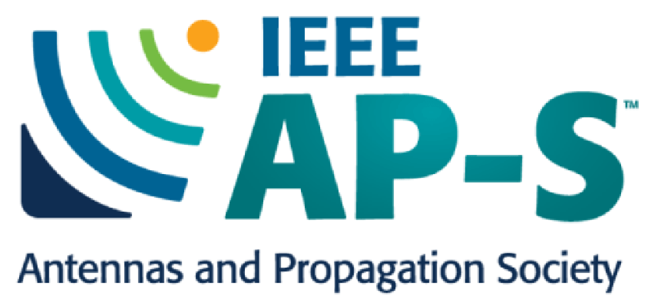


COMMON THEME: ELECTROMAGETISM

Slide 7

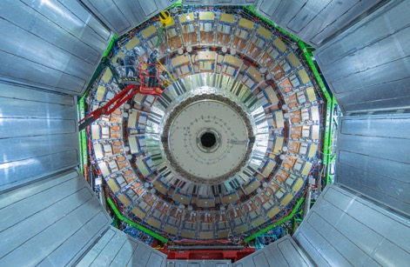
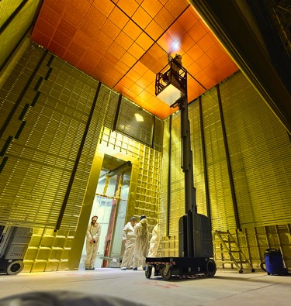
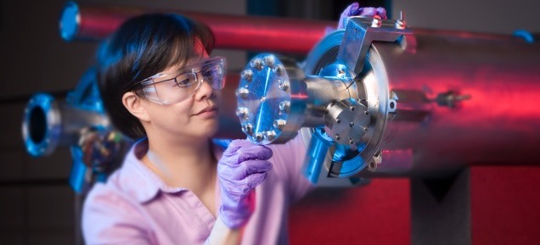
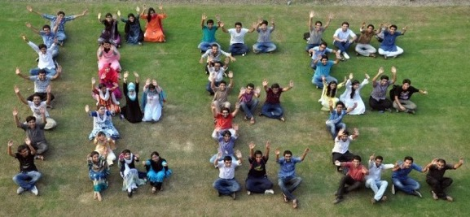
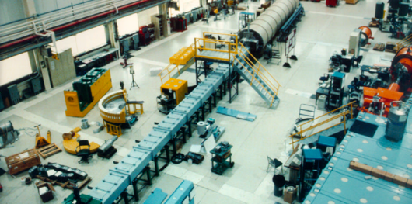

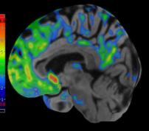

IEEE and IEEE Nuclear and Plasma Sciences Society

Slide 8
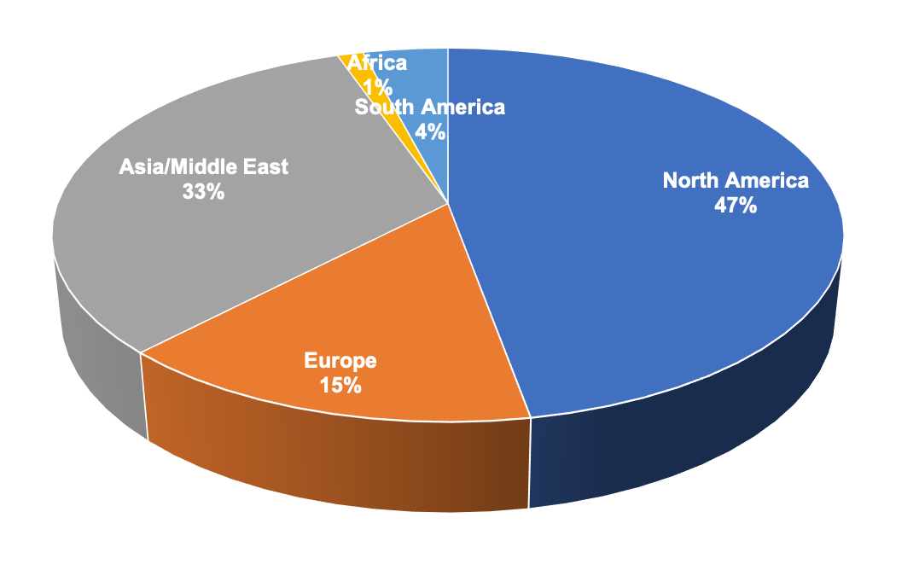
NPSS at a Glance
~3,250 members in 80 countries

Slide 9
What can the society do for you?
Why should I be an IEEE NPSS member?
What other opportunities do you have within IEEE?

Slide 10
What does NPSS do for you at this conference (and beyond) ?
Organizes and financially sponsors this conference
Sponsors additional events at the conference (example WIE)
Provides grants
Gives awards at all career levels

Slide 11
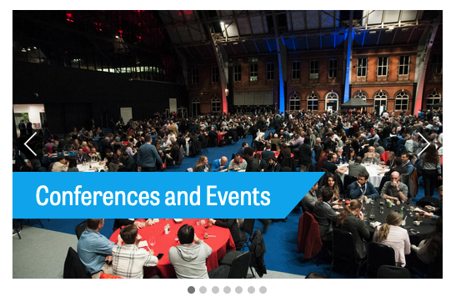
Networking Opportunities
Make friends and collaborations
Expand your professional network
Learn more about NPSS/IEEE

Slide 12
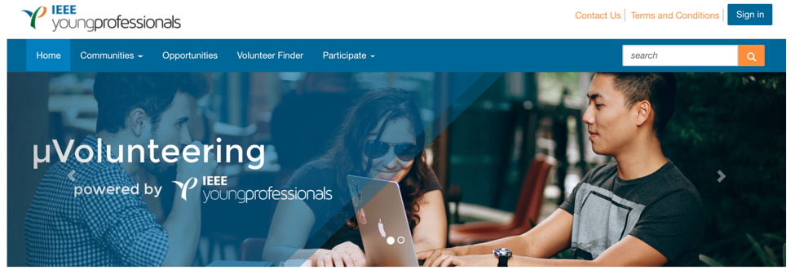
Volunteering Opportunities (two-way street)
Conference abstract reviewing
Conference organisation roles
Journal article reviewing
Membership desk (Membership to leadership – M2L)
Committee roles (CANPS, NPSS AdCom)
http://uv.ieee.org

Slide 13
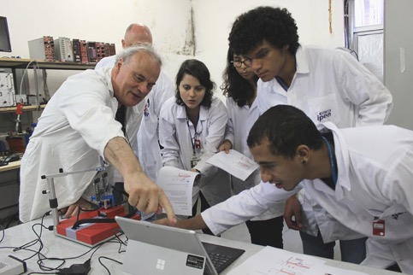
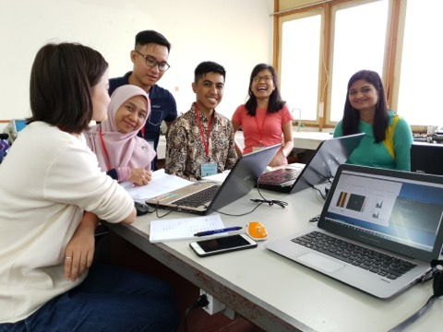
Develop your Leadership & Teaching Skills
Nominate for a committee role on CANPS or NPSS AdCom
Organise and teach a short course or a regional workshop

Slide 14
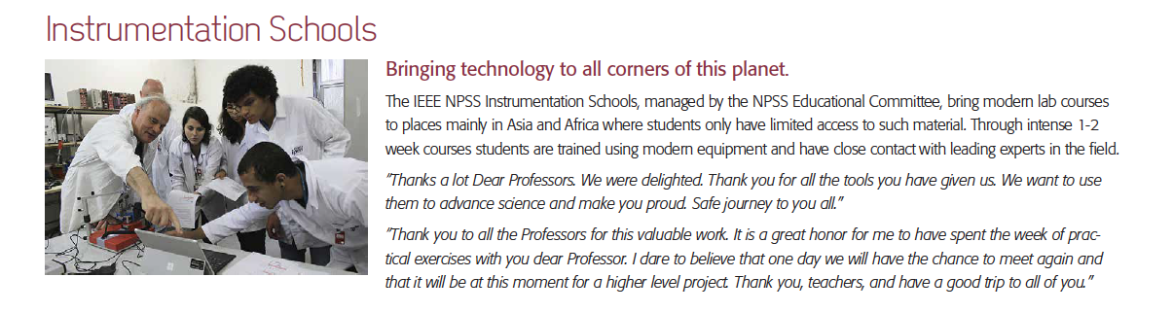
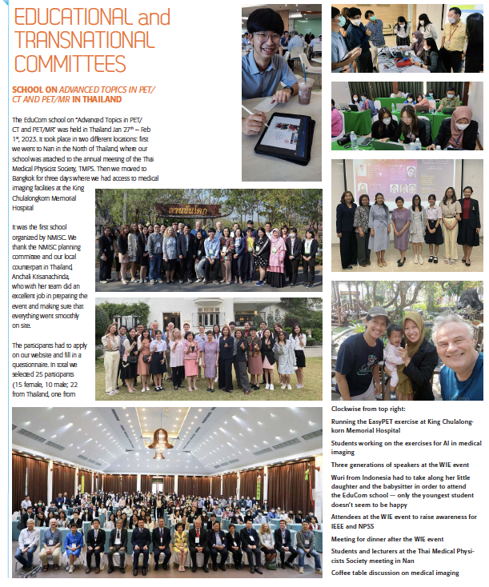
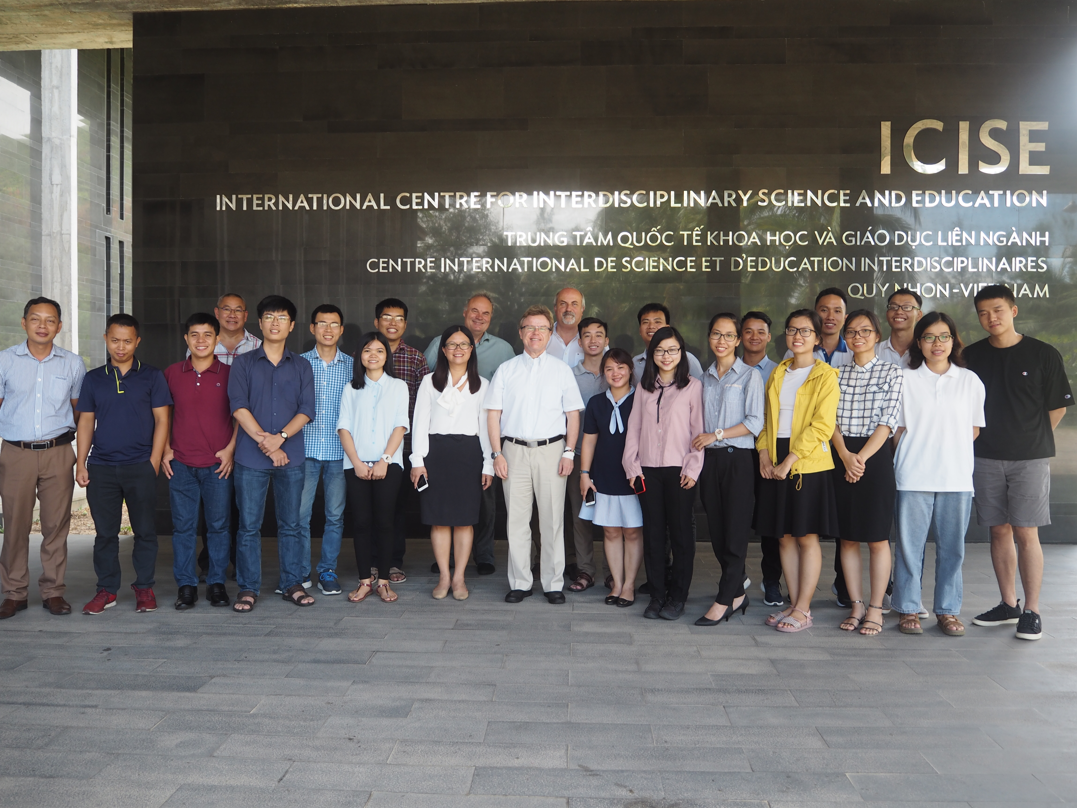
Schools

Slide 15
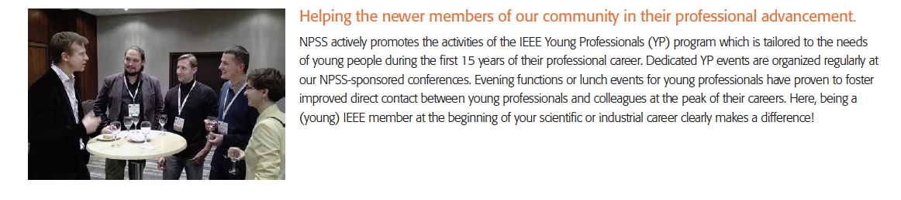
Affinity groups: Young Professionals and Women in Engineering
YP and WiE events are held at most of our conferences supported by IEEE YP

Slide 16
NPSS Administrative Committee
Functional Committees
Liaisons
Awards
Chapters
Chapters Co-Chair
Communications
Communications Co-Chair
Conferences
Conferences Co-Chair
Distinguished Lecturers
Fellow Candidate Evaluation Committee
Fellow Search Committee
Finance Chair
Finance Co-Chair
NPSS Foundation
Membership
Nominations
Publications
Transnational
Young Professionals
EduCom
Broadening Participation Committee (BP)
Coalition for Plasma Science
IEEE Education Activities Board (EAB)
Fusion Energy Sciences Advisory Committee (FESAC) (US DoE)
ICALEPCS
IEEE Fellows Evaluation Committee
IEEE Social Implications of Technology
ISV Governing Board rep
IEEE-USA R&D Policy Comm
IEEE-USA AI & Comms Policy Comm
IEEE-USA Energy Policy Comm
IEEE NanoTechnoly Council
NCRP (National Council on Radiation Protection and Measurements)
PAC Oversight Committee and APS-DPB
RADECS
IEEE Transactions on Medical Imaging (Steering Committee)
Social Media
Women in Engineering
Climate change
IEEE Brain
IEEE AI Coalition
IEEE Standards Association
These are all volunteer roles!

Slide 17
Division and IEEE opportunities

Slide 18










2025 IEEE Future Directions Current Coverage
Transition under way
Industry Advisory Board
New Initiatives 2025
Alternative Energy Generation and Storage
Smart Agri-Food Systems
AI Coalition
IEEE’s ‘Think tank’
New Initiatives under consideration:
AgeTech
HART (Hardware for AI, Research, & Talent-building)
Both approved in Dec 2025
New Ad Hocs in 2026
Data for AI
YP Connect
Global Semiconductors
Ad Hoc
Emphasis on inter-society collaborations
18
21-22 November 2025

Slide 19
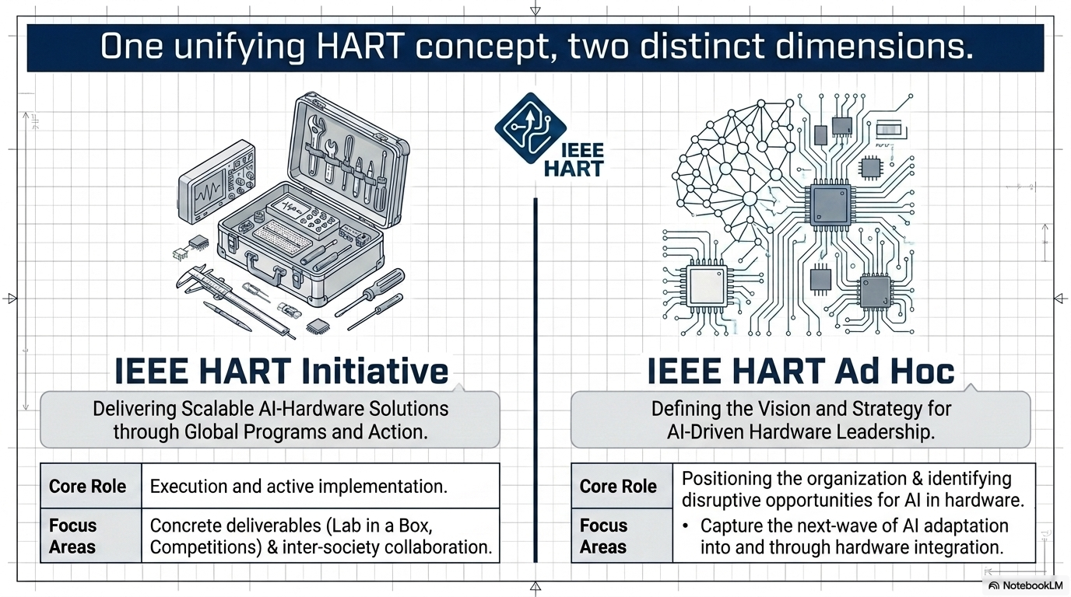



Slide 20
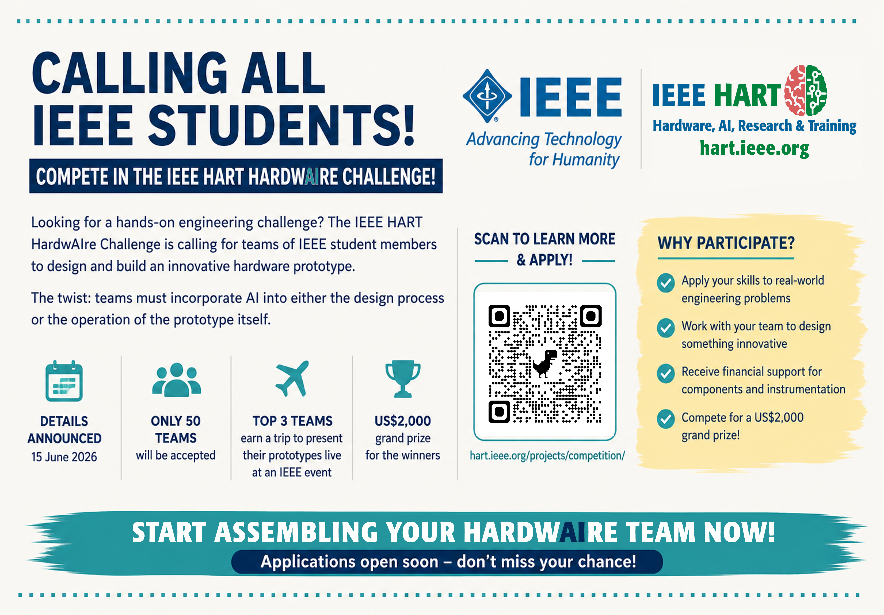

HOT OFF THE PRESS!!

Slide 21
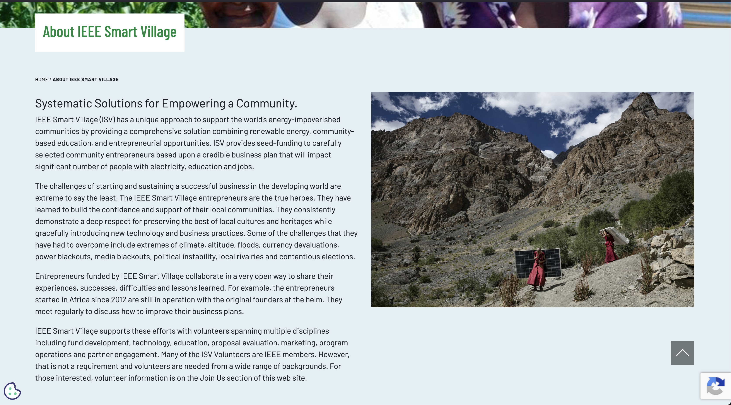
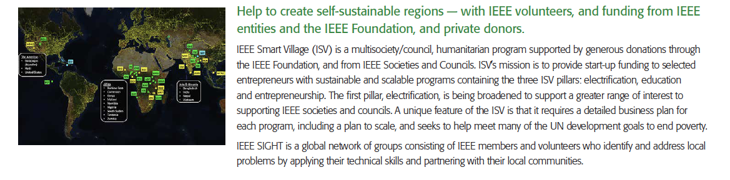
Humanitarian Outreach
Example
IEEE Smart Village
USD 119 million—109 solar mini‑grids—231,000 Nigerian homes and businesses to be connected in underserved communities.
Rajan Kapur, President, IEEE Smart Village
01-May-2026

Slide 22
Project Funding
Do you have an idea for a project that aligns with the IEEE/NPSS strategic goals? (https://ieee-npss.org)
There is funding available
Examples
  Development of virtual labs
  From membership to leadership
  Many educational and humanitarian efforts
NEW this year: YP_travel grant - To enable 2-3 YPs/year to attend IEEE-wide events which emphasize YP engagement. Please see:
https://newsletter.ieee-npss.org/yp-travel-grant-mar-2026/

Slide 23
Why am I part of (and volunteer for) IEEE NPSS?
I believe in the values promoted by IEEE/NPSS
I have the opportunity and privilege to work with people that I respect and admire
How did I get here?
Started attending conference as a student
Started volunteering
…..
What am I getting out of it?
Opportunity for continuous learning – depth and breath – stepping stone to broader IEEE activities
Learning of transferable leadership and organizational skills
Meet people that influenced my career (and life)
Some wonderful friends

Slide 24
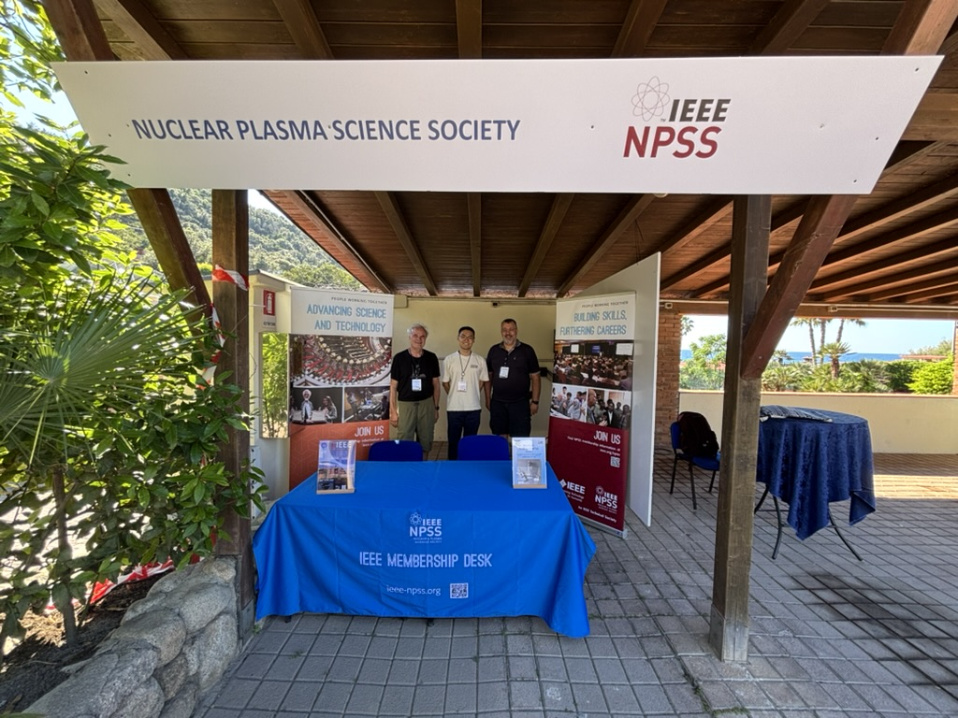
Where do I get more information:
  Membership desk!
  on involvement opportunities
  on IEEE and NPSS activities
  etc…

Slide 25
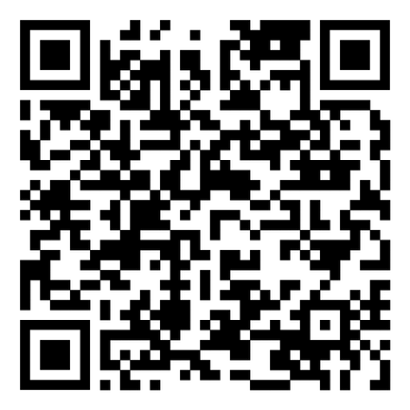

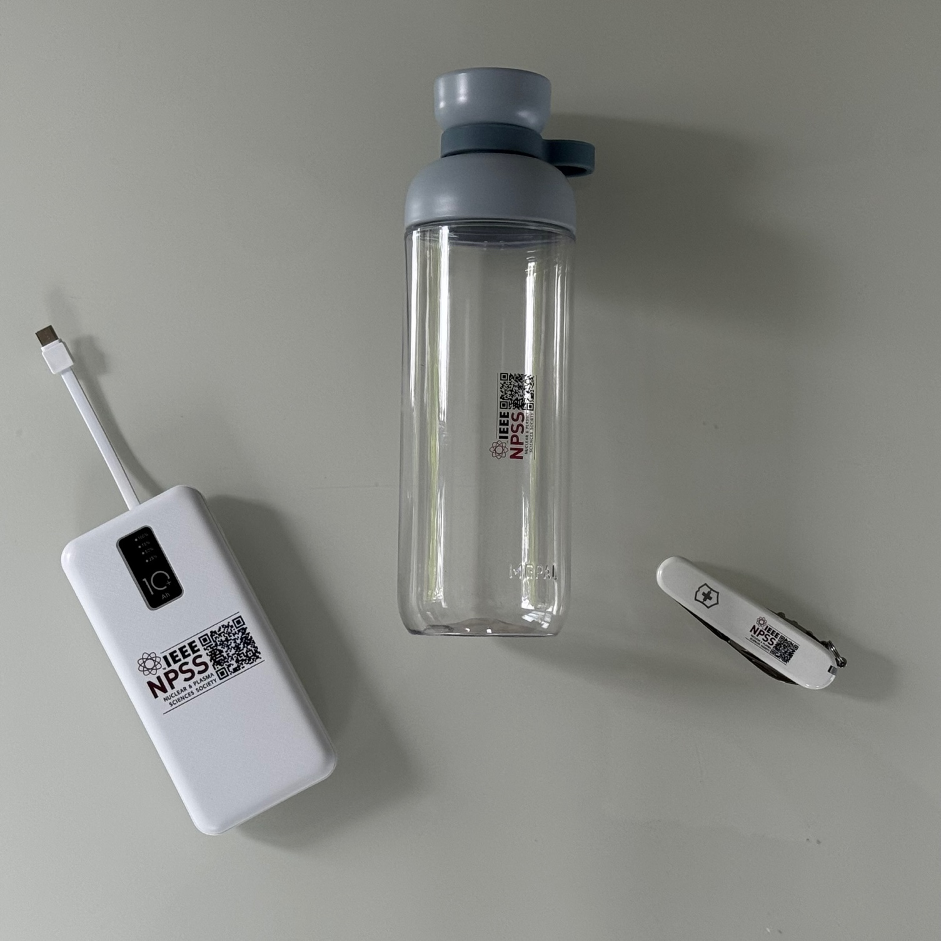
Become a new
IEEE and NPSS
Member!
If you sign up to become a new IEEE and NPSS member via this QR code, you qualify for a valuable gift at this table.
Special gift for first time members!
Water Bottle
Swiss
Army Knife
10,000 mAh
Power Bank

