Slide 1

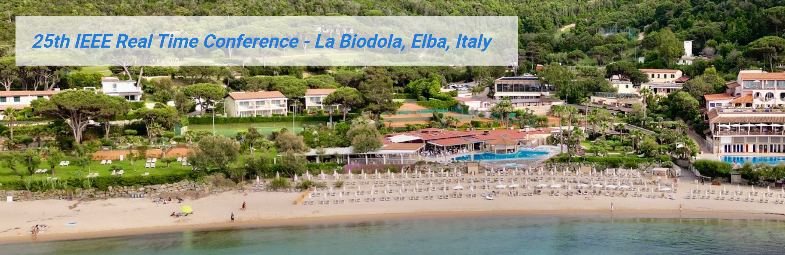
Real-time Monitoring of Virgo Super-Attenuators
Alberto Gennai

Slide 2
Summary
VIRGO Gravitational Waves Detector
  Gravitational Waves
  Detector
Seismic Isolation
  Super Attenuator
Control System
  System in use
  Running upgrade
  Future upgrades

Slide 3
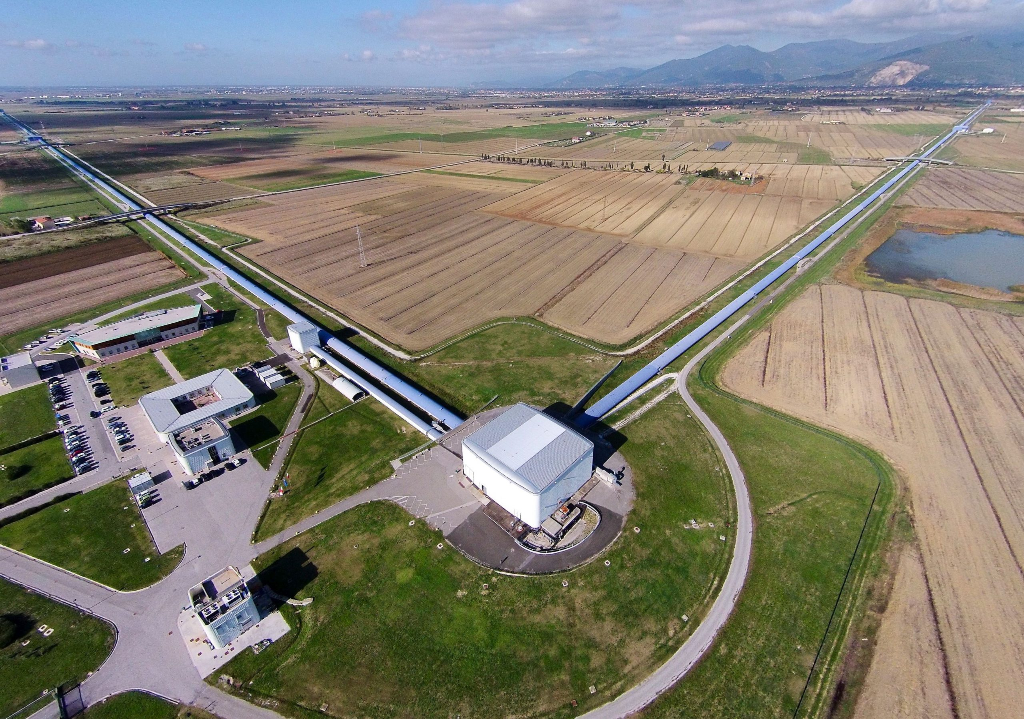

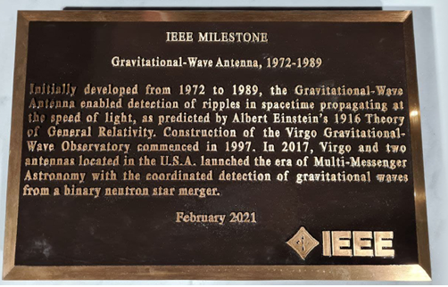
https://www.ego-gw.it/

Slide 4
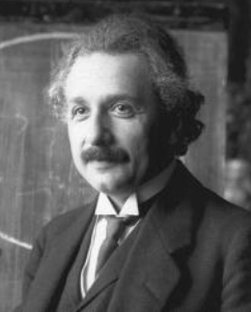
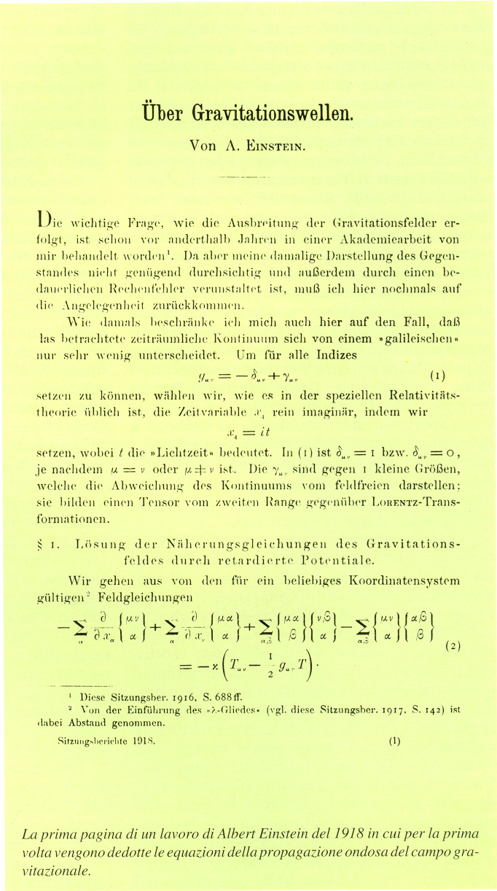
Gravitational Waves
Einstein describes gravity as a property of space-time that is deformed by masses.
Acceleration of large masses on the ‘fabric’ of space-time produce tiny ripples, Gravitational Waves, that propagates at the speed of light alternately stretching and squeezing the fabric.

Slide 5
Gravitational Waves (II)
How Small?
To detect a gravitational wave, we must measure displacements in the order of 10⁻¹⁸ m over a length of 3 km
Such displacement is so small that it is extremely difficult to figure out what does it mean. To give some hint, it is like:
  Detecting a variation in the order of one atom diameter in the Earth-Sun distance.
  Detecting a variation in the order of one human hair in the distance of Proxima Centauri (about 4 ly).
  Detecting the variation in the oceans level pouring in a glass of water.

Slide 6

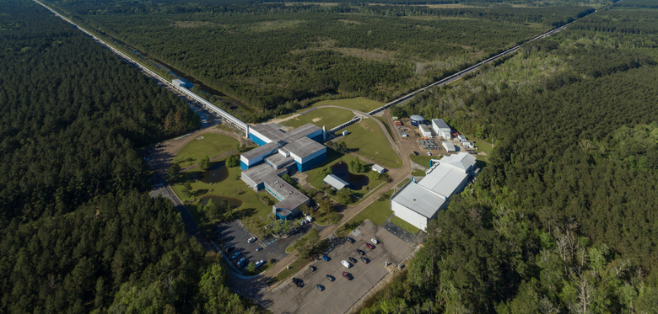
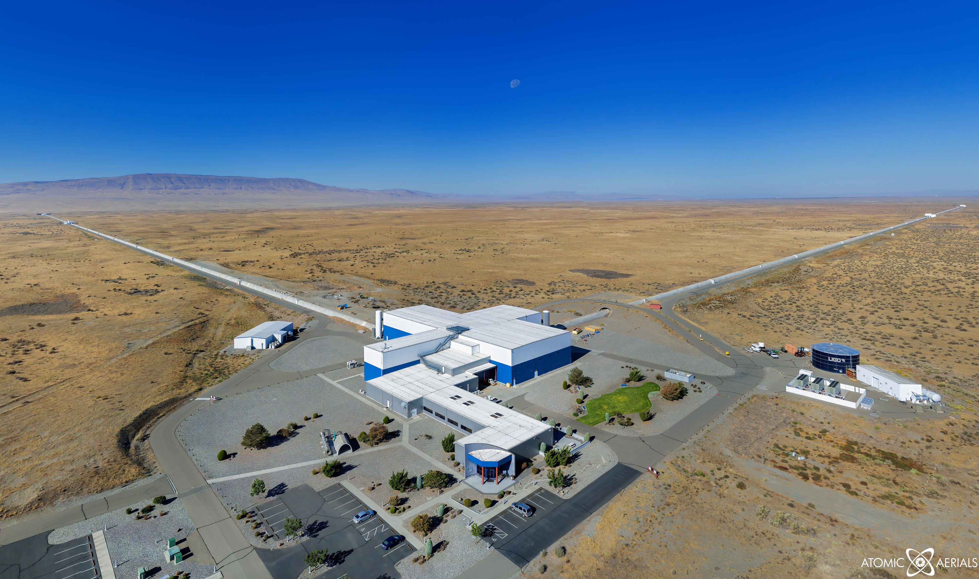

GW170814: 3 Detectors
Livingston (LA) & Hanford (WA) Detectors

Slide 7
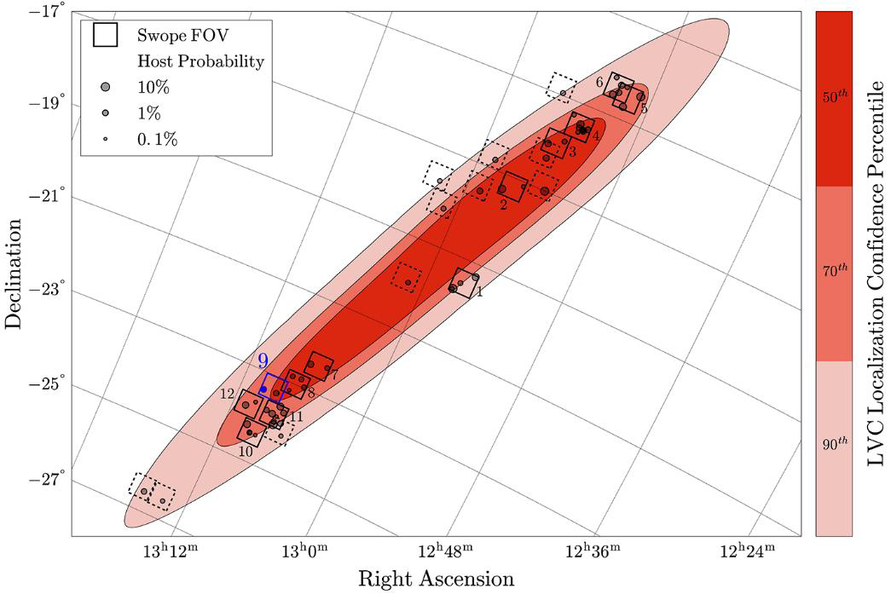
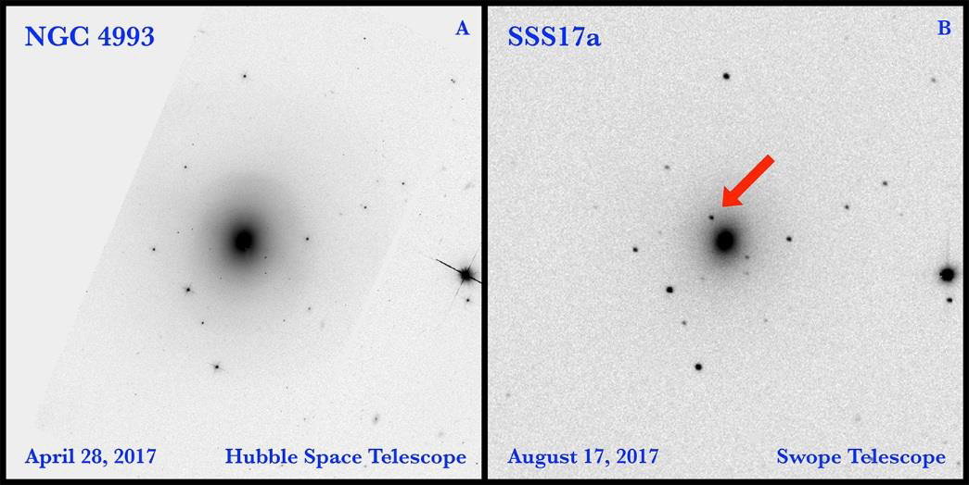
Dawn of multi-messanger era
Astronomical Observatories were triggered with the coordinates of the event
Starting from search area and using the additional information about event distance, astronomers could select a small set of galaxies to look at
About 80 observatories all over the world followed the birth a new star, a kilonova at ~130–140 million light-years from us

Slide 8
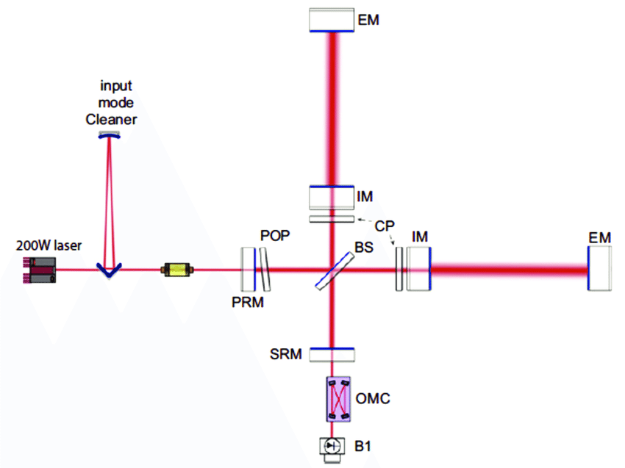
Optical Layout
VIRGO interferometer is more complex than basic Michelson.
The two arms are Fabry Perot cavities 3km long
Makes use of Power Recycling technique to increase the total circulating power
Signal Recycling

Slide 9
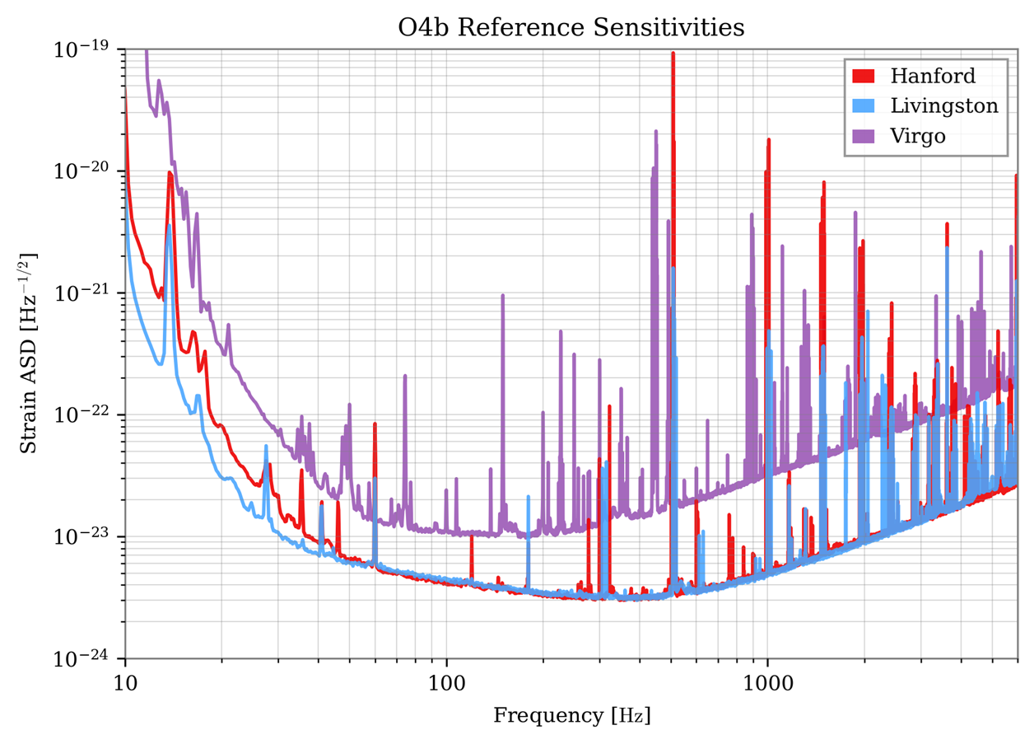


Source:
LIGO-T2500390-v1
Francesco Di Renzo

Slide 10
Seismic Noise
Different sources:
  Tidal strain (about 200 µm peak-to-peak between input and end mirrors)
  Earthquakes
  Seismic noise
    Microseism: dominant between 0.1 and 1 Hz mainly due to sea waves
    Anthopogenic:
      between 1 and 5-10 Hz, due to heavy vehicles traveling along near roads and bridges
      Between 10 and 40 Hz, due to onsite ‘traffic’.

Slide 11
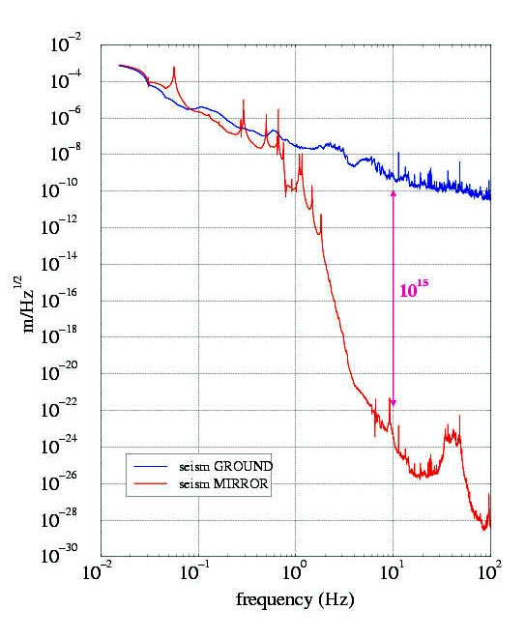
Seismic Noise Reduction
Seismic noise limits sensitivity of ground-based detectors at low frequencies - “seismic wall”
Typical seismic noise at Virgo site at 10 Hz is ~ few x 10⁻¹⁰ m/√Hz
- many orders of magnitude above target noise level
Solution: isolation system with a multistage pendulum: the Super-Attenuator
Isolation required in vertical direction as well as horizontal due to cross-coupling

Slide 12
Super-Attenuator

Slide 13
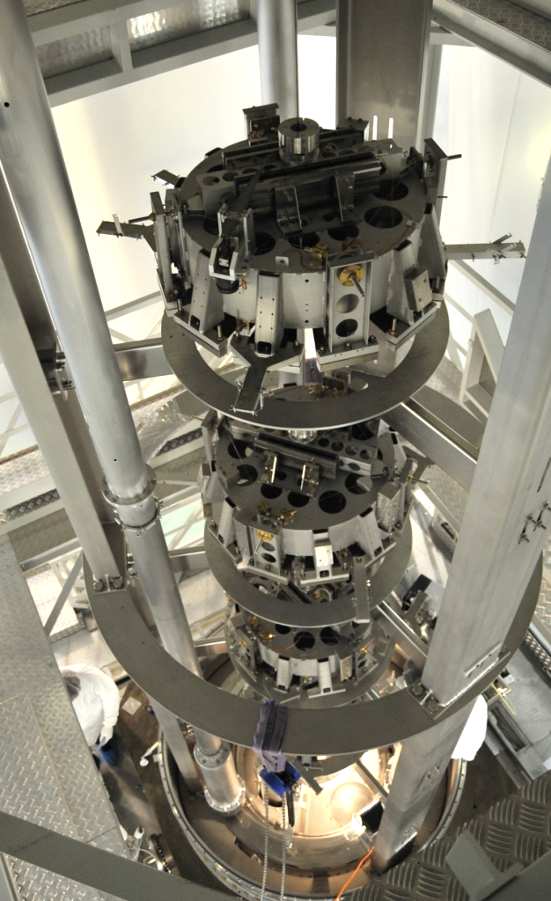
Seismic Filters
The Super-Attenuator is a chain of mechanical stages acting as filters for seismic noise
At the end of the chain of filters there is the Payload: Marionette and Mirror

Slide 14
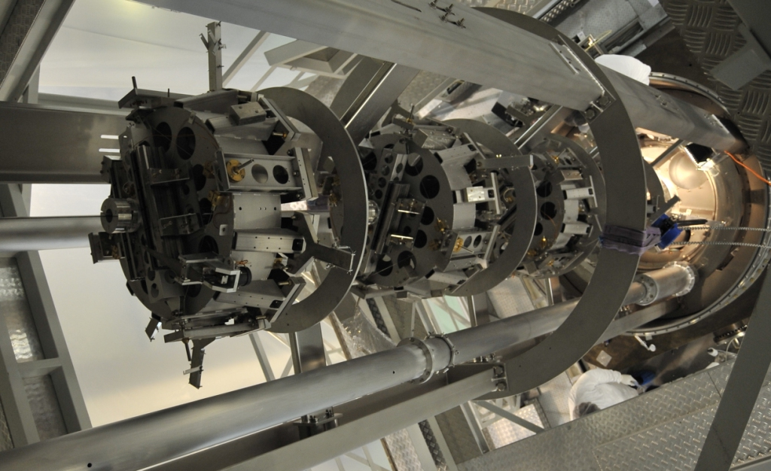
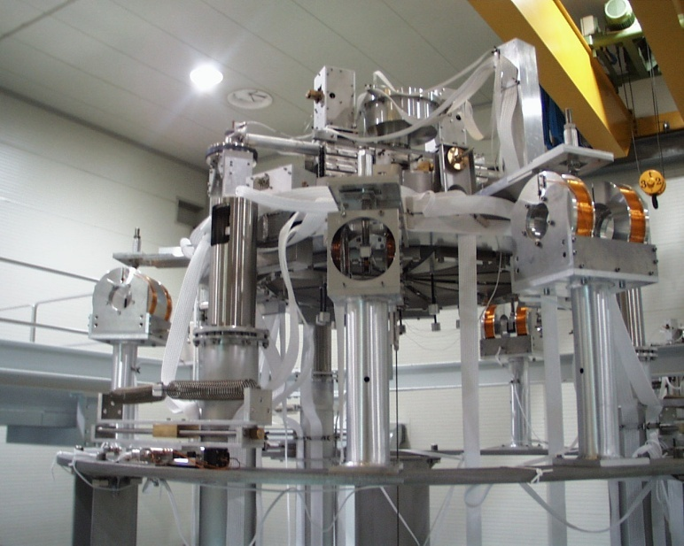
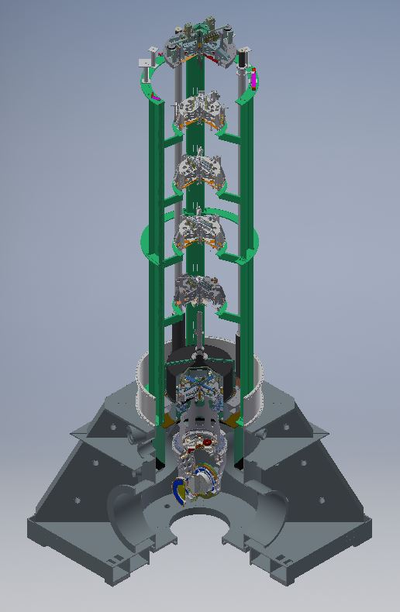
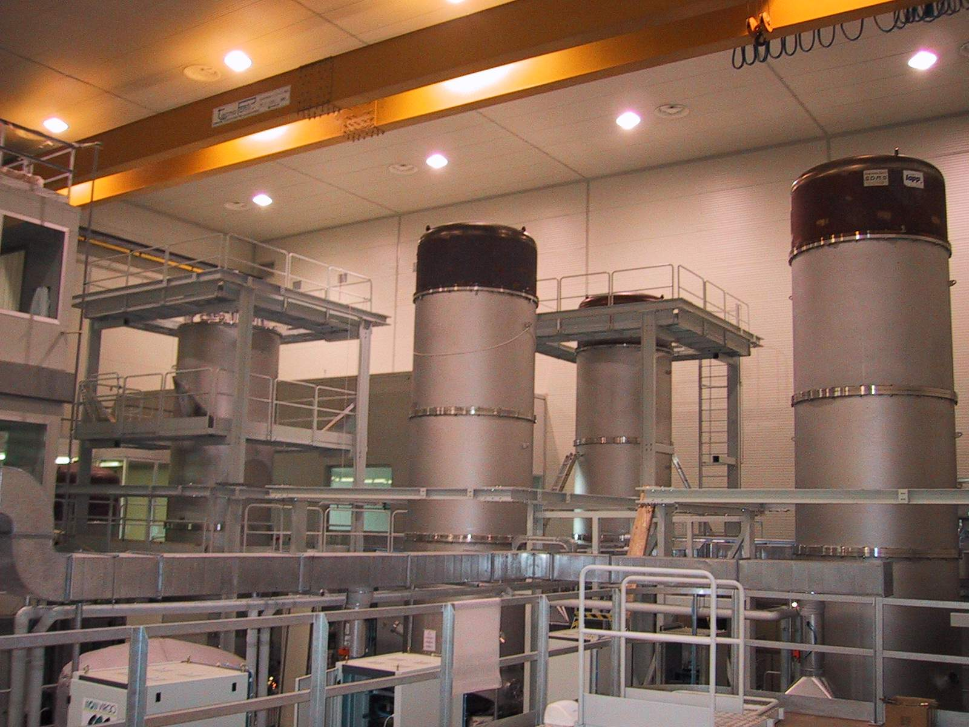
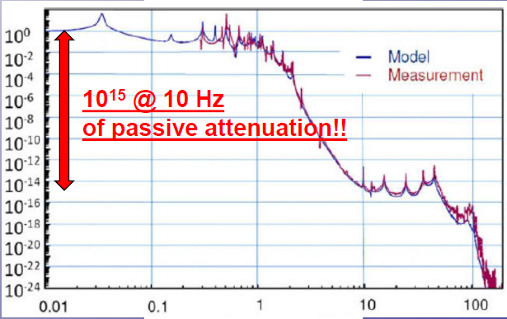
Super-Attenuator

Slide 15
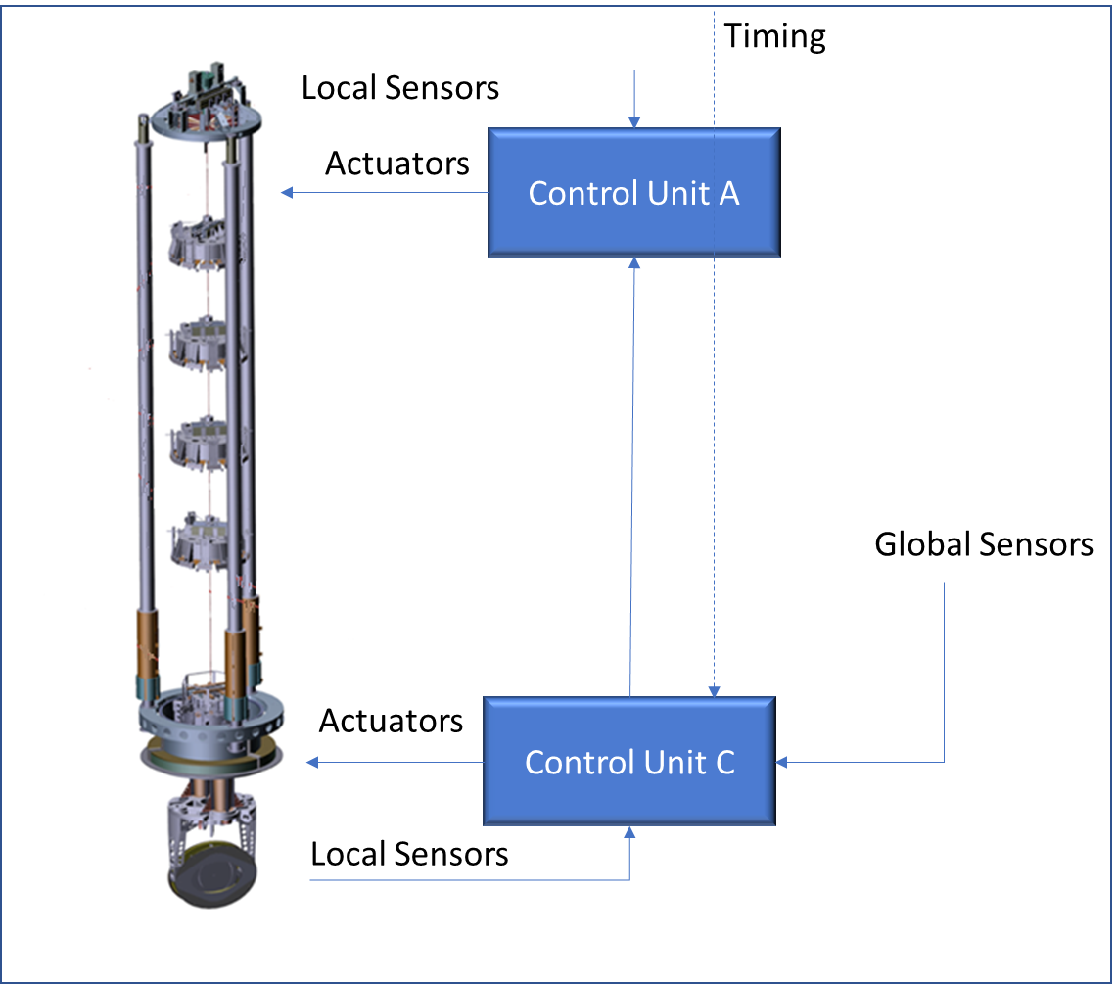
Virgo Control
Seismic Isolation System
Interferometer

Slide 16
Feedback Control
Environmental Disturbances
Seismic Noise
Tidal Displacement
...
Opto-Mechanical System
Sensors
Global Sensors
  Photodiodes
Local Sensors
  Rel. Displacement
  Inertial
Control System
Actuation Noise
Measurement Noise
~400 signals
~600 signals

Slide 17
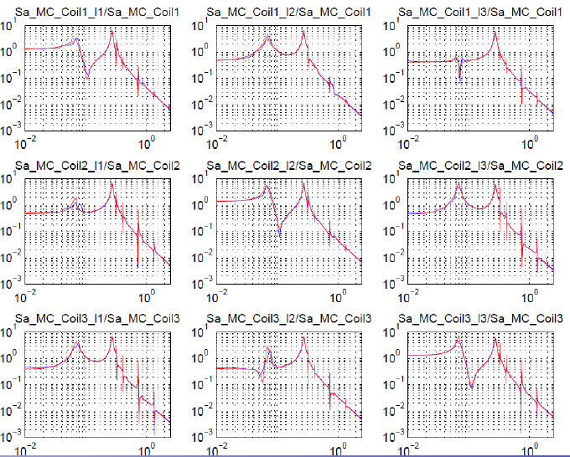
Mechanical transfer functions between force applied on Super-Attenuator top stage.
High complexity and high dynamics

Slide 18
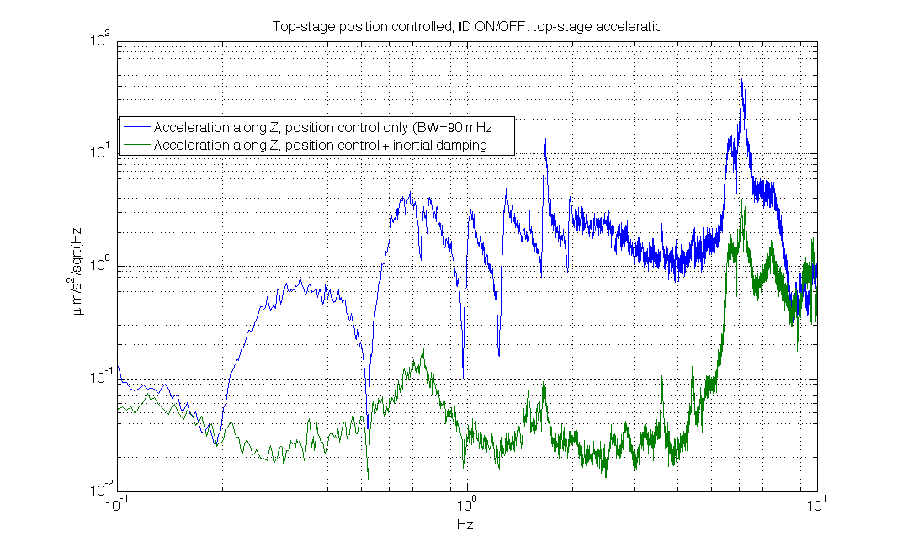
Open loop (blue) vs closed loop (green) top stage acceleration spectra
Without local control of the normal modes of the Super-Attenuator, residual motion of suspended mirrors would be too large

Slide 19
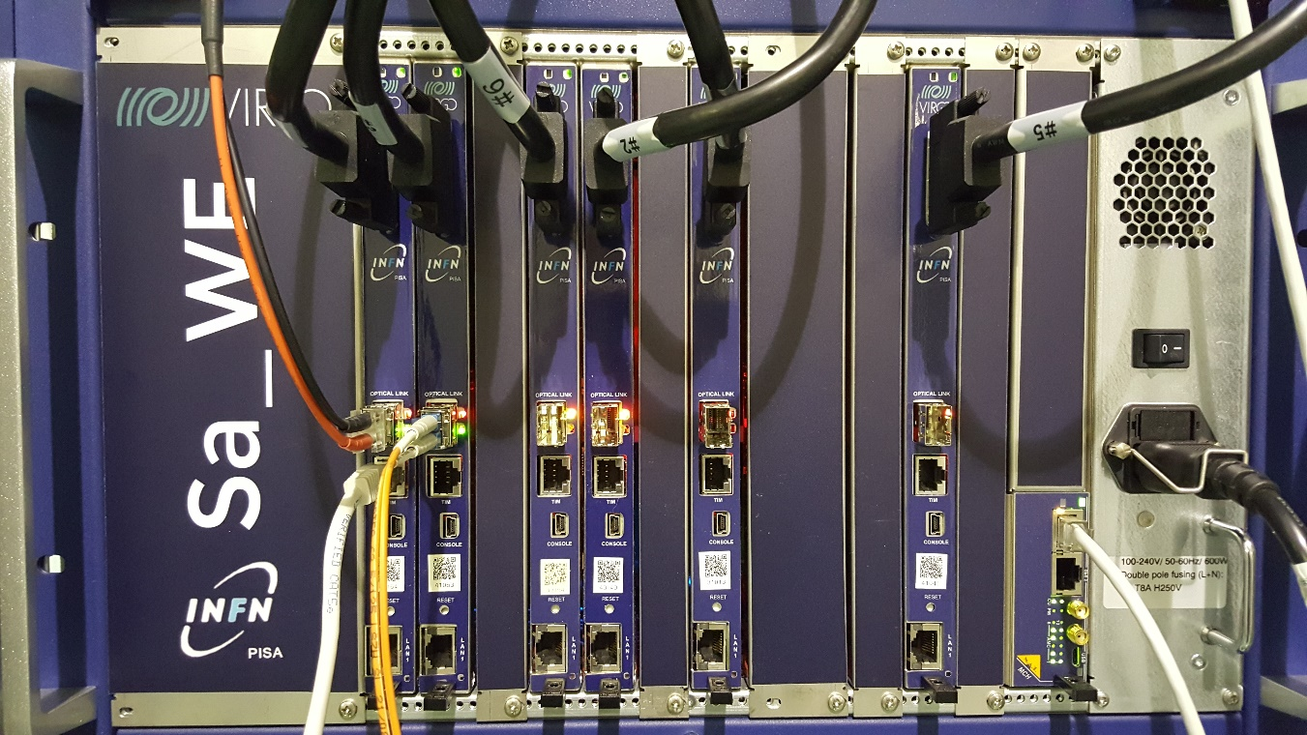
Control Hardware Evolution
10 Super Attenuators: 20 Local Control Units
2009-2014: VME Crate
2x Multi ADSP21160
2x PowerPC
60x Analog IO
NIM Cratefor FE Electronics
2015-2026: MTCA Crate (20 units)
Up to 12x TMS320C6678 DSPs
Up to 72x Analog IO including FE electronics
1999-2009: VME Crate (10 Units)
2x Motorola DSP96002
2x PowerPC
60x Analog IO (16bit ADC – 20bit DAC)
NIM Crate for FE Electronics

Slide 20
Local Control Unit
MicroTCA (customized)
20 Control Units
130 UDSPT boards
Each board equipped with:
6ch ADC (24bit, 3.84MSPS)
6ch DAC (24bit 320 kSPS)
8 core DSP TMS3206678
Analog electronics
Up to 60 GFLOPS per board

Slide 21
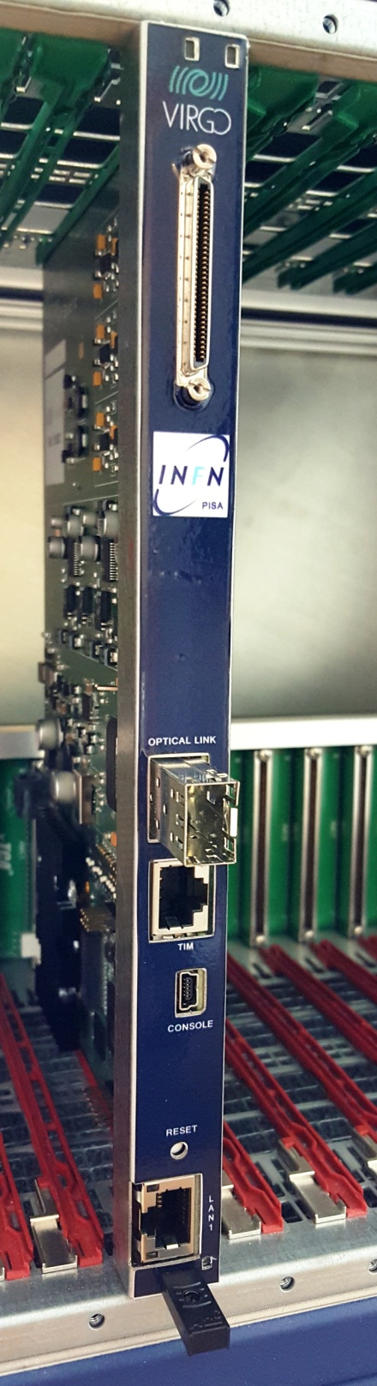
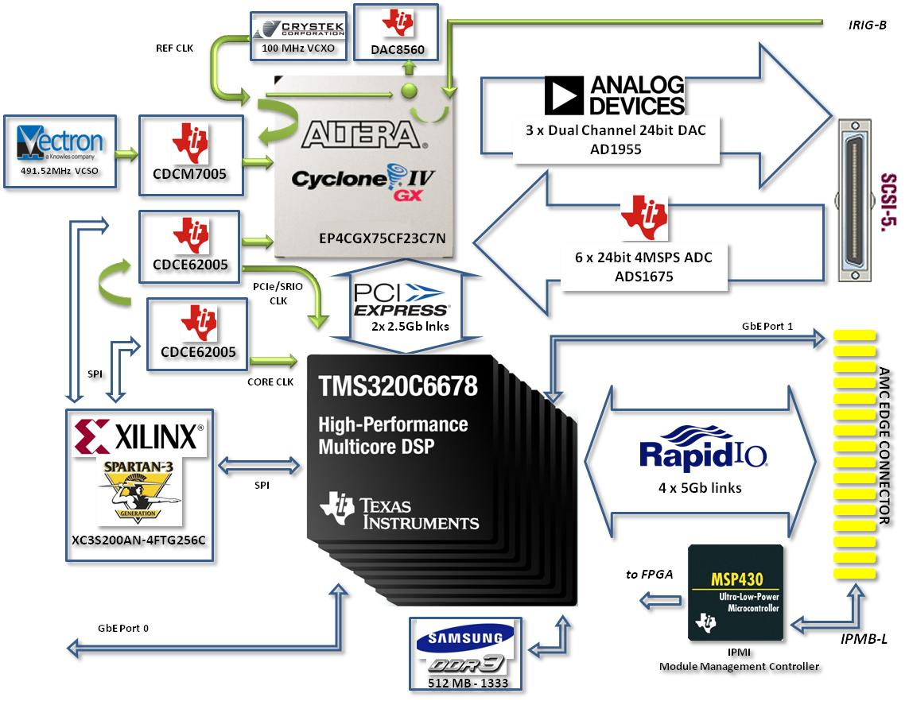
UDSPT Module
Customized (taller) MicroTCA
DSP <-> AD/DA PCIe
DSP <-> DSP SRIO

Slide 22
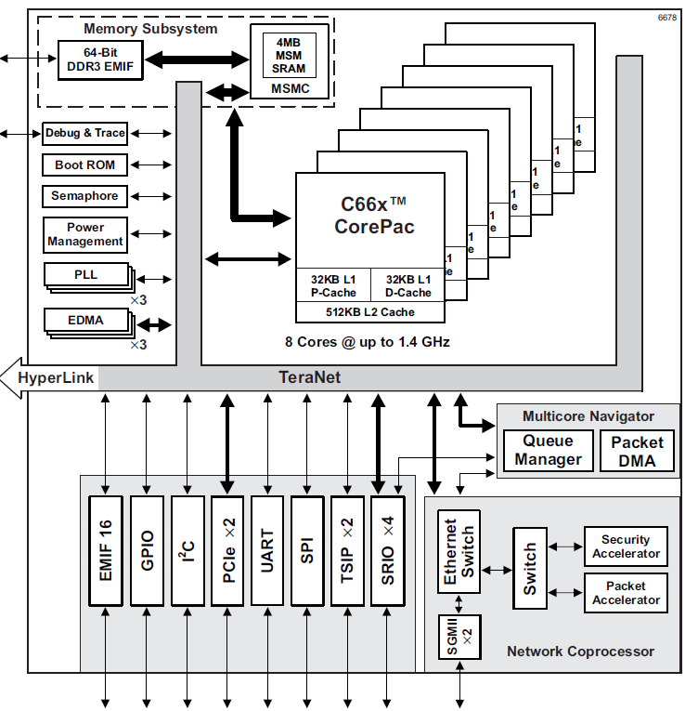
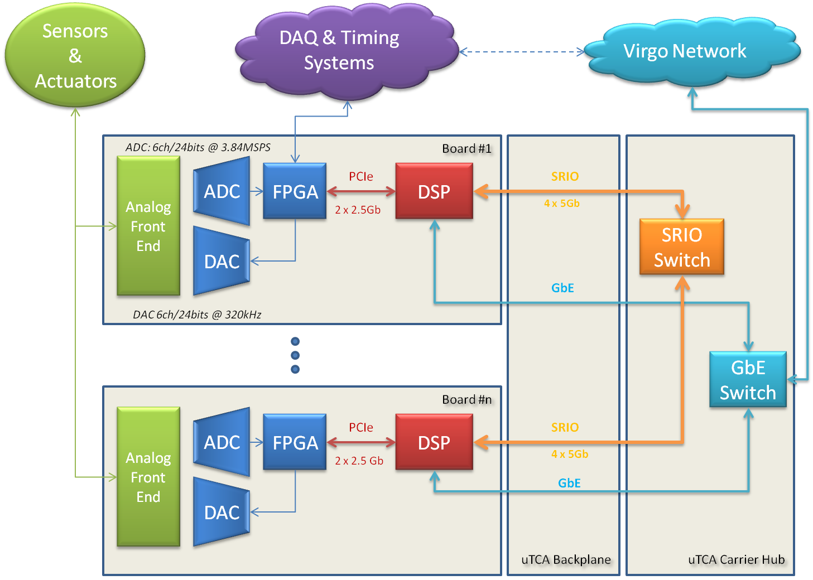
Interconnections

Slide 23
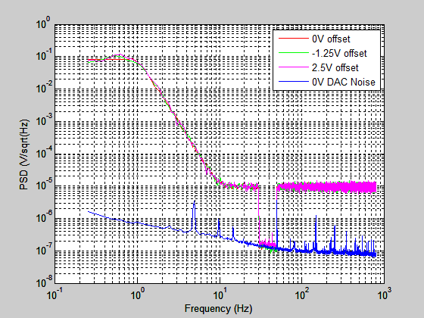
Digital To Analog Converters
AD1955 stereo digital audio converter 24bit operated at 320kSPS
Benchmark for linearity check (no up-conversion of low frequency components)
Due to high dynamics of mechanical systems, we need double precision

Slide 24
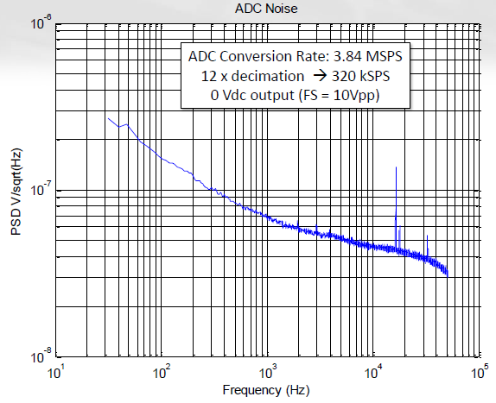
Analog to Digital Converters
TI ADS1675, delta-sigma converter, 24bit 4MSPS
Local sensors that monitor the Super Attenuator movements are typically inductive (ironless LVDT) operating at 50 kHz

Slide 25
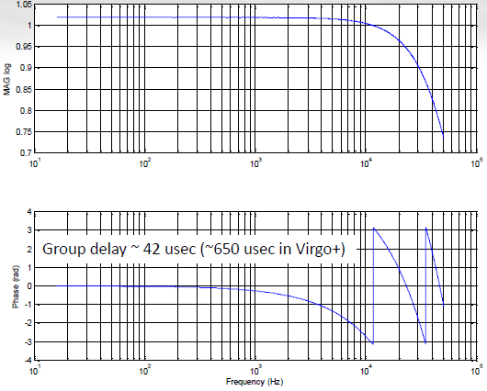
AD → Processing → DA
Since we are dealing with feedback loops, delay must be kept low.
The minimum delay we can achieve is 42 us
50 us delay produce a 18deg phase shift at 1 kHz, therefore limiting the unity gain frequencies in the kHz range.

Slide 26

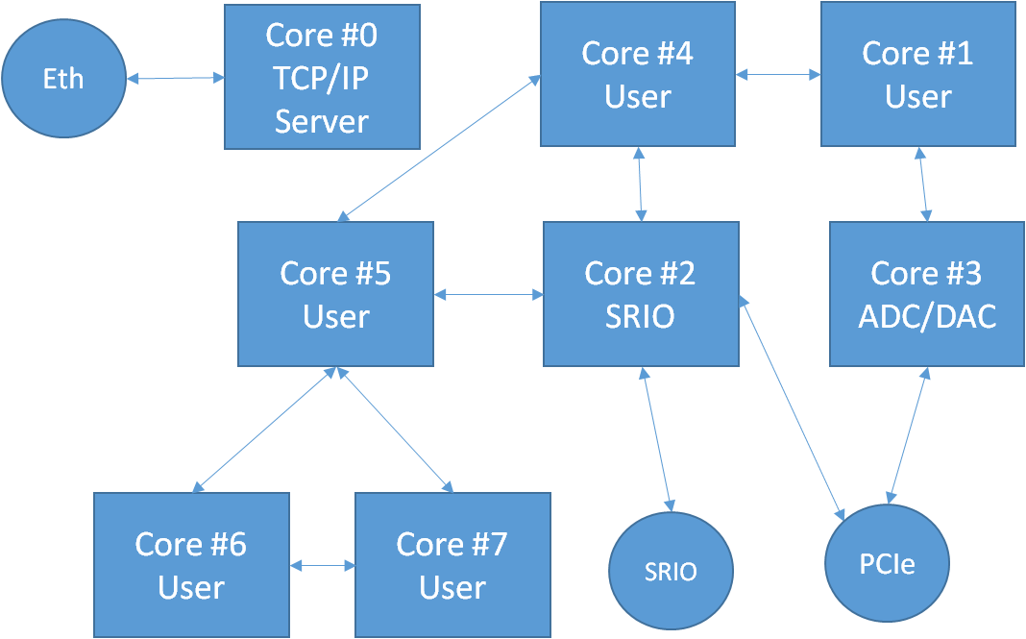
Data Fluxes
AD
FPGA
DSP
DA
10 Super-Attenuators, 20 LCU, ~130 boards
~600 input channels 24b 3.84MSPS
~600 output channels 24b 320kSPS
All conversions are synchronous triggered by the Virgo timing system

Slide 27
Software Architecture
Users act only on application layer
The hard real-time part of user's code run on two parallel task whose activation frequency is selectable between 10 and 320 kHz. Compiler checks if there are timing issues
Native programming language using a library of optimized functions

Slide 28
Example: ScNE LCU Tasks List
9 user tasks are running. Activation frequency is 40 kHz for all of them except for the last one activated 320’000 times per second. Execution is parallel: each tusk runs on a dedicated DSP core.
24 system task are running simultaneously to user tasks (ADC decimation, DAC inputs interpolation, Data Acquisition signals pre-processing, communication, …)
Task Name | Activation Period (us) | Exec Time (us) | Digital IO | MFLOPS
NE_LN.hrd | 25 | 3.2 | 56 | 43
NE_Mar_LN.hrd | 25 | 5.2 | 50 | 64
NE_PSDf.hrd | 25 | 3.7 | 167 | 119
NE_PSDi.hrd | 25 | 3.3 | 40 | 46
NE_PSDm.hrd | 25 | 0.6 | 10 | 26
NE_PSDt.hrd | 25 | 0.6 | 104 | 26
NE_F7_CD.hrd | 25 | 1.9 | 32 | 34
NE_F7_LVDT | 25 | 0.7 | 20 | 25
NE_F7_LVDT_Demod | 3.125 | 1.9 | 0 | 134
 |  |  | Total | 516

Slide 29
Example: Vertical Control
Four DSPs involved
Users develop only control algorithms using a simple text interface
Communication and synchronization transparent to users

Slide 30
Data Flows
Each of the 20 LCU could handle continuously:
  More than 5000 high quality audio streams (320kbps)
  250 HD movies (3GB/hr)
  100 4K Ultra HD movies
Slot | kPkts/s RX | kPkts/s TX | MB/s RX | MB/s TX
AMC_1/8-11 | 160 | 120 | 44 | 33
AMC_2/8-11 | 0 | 80 | 0 | 22
AMC_3/8-11 | 0 | 80 | 0 | 22
AMC_4/8-11 | 0 | 160 | 0 | 44
AMC_6/8-11 | 120 | 120 | 33 | 33
InterSwitch_1 | 200 | 120 | 54 | 33
InterSwitch_3 | 240 | 40 | 65 | 11
AMC_7/8-11 | 200 | 80 | 54 | 22
AMC_11/8-11 | 120 | 80 | 33 | 22
AMC_12/8-11 | 160 | 40 | 44 | 11
 |  | Total | 207 | 207

Slide 31
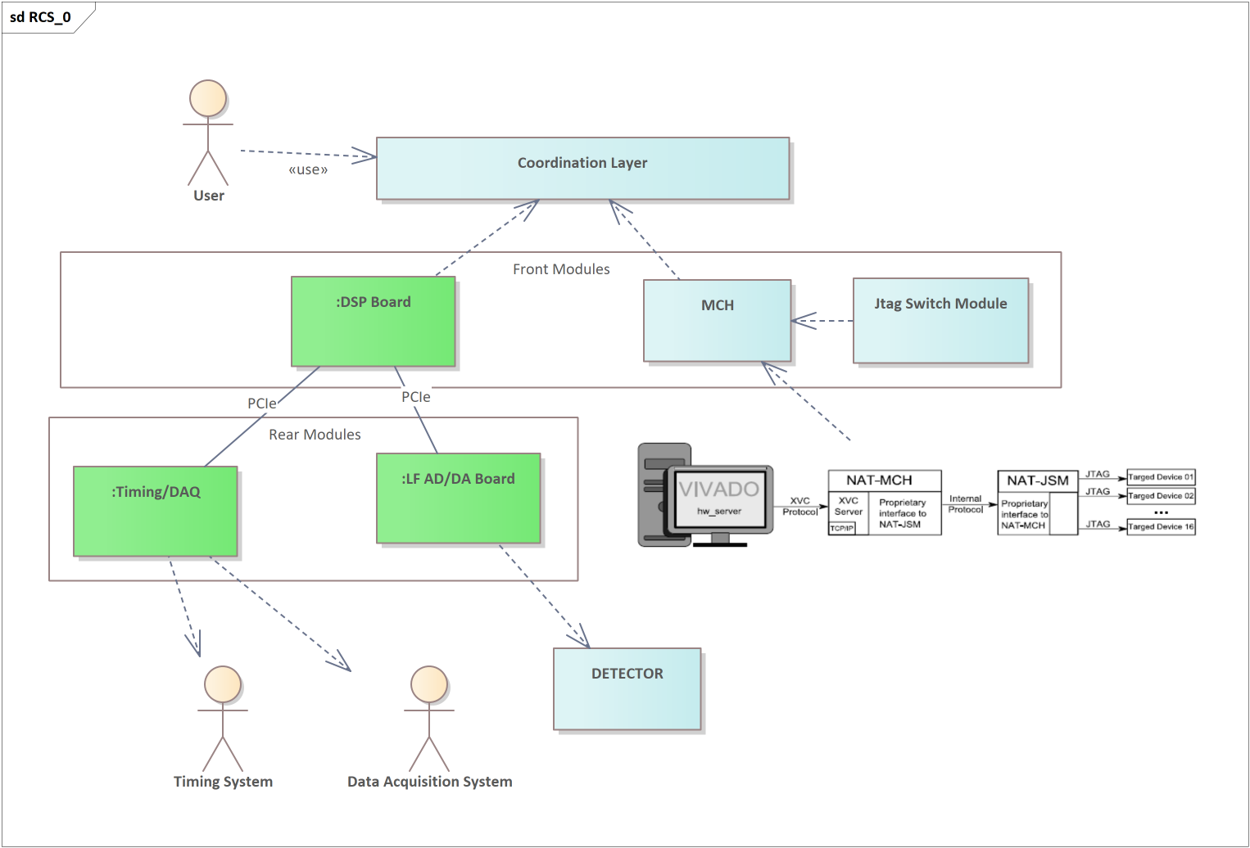
Upgrade running (prototypes ready soon)
The upgrade of existing system has been recently funded by the Virgo Collaboration for complete replacement of control electronics.
Virgo Subsystem Mirror Position Control
Main differences
  Fully compliant with MTCA.4
  Replace DSPs with TI 66AK2H14 Multicore DSP+ARM® KeyStone™ II System-on-Chip (SoC)
  Added flexibility with different rear modules
  In collaboration with INFN Bologna (Timing/DAQ Module)

Slide 32
MicroTCA.4 (MTCA.4)
Functionalities that in old system are merged into a single board have been split into three different modules:
  DSP Front Module
  AD/DA Rear Module
  TimingDAQ Rear Module

Slide 33
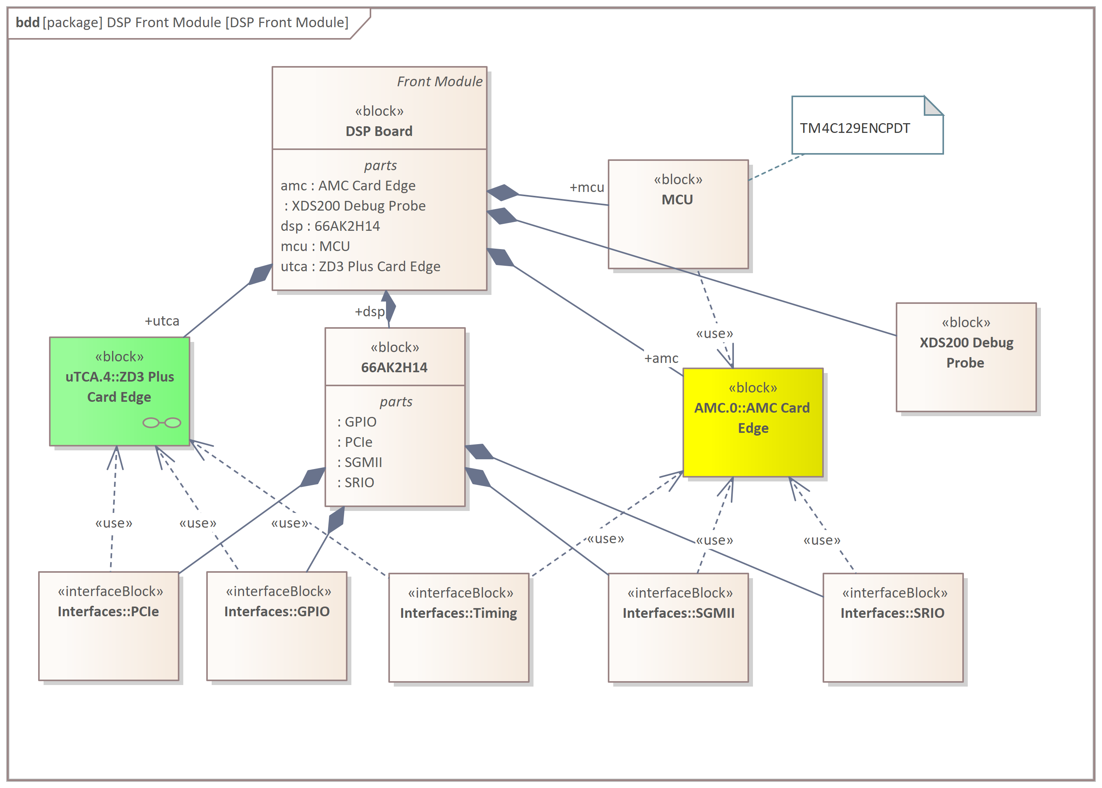
DSP Front Module

Slide 34
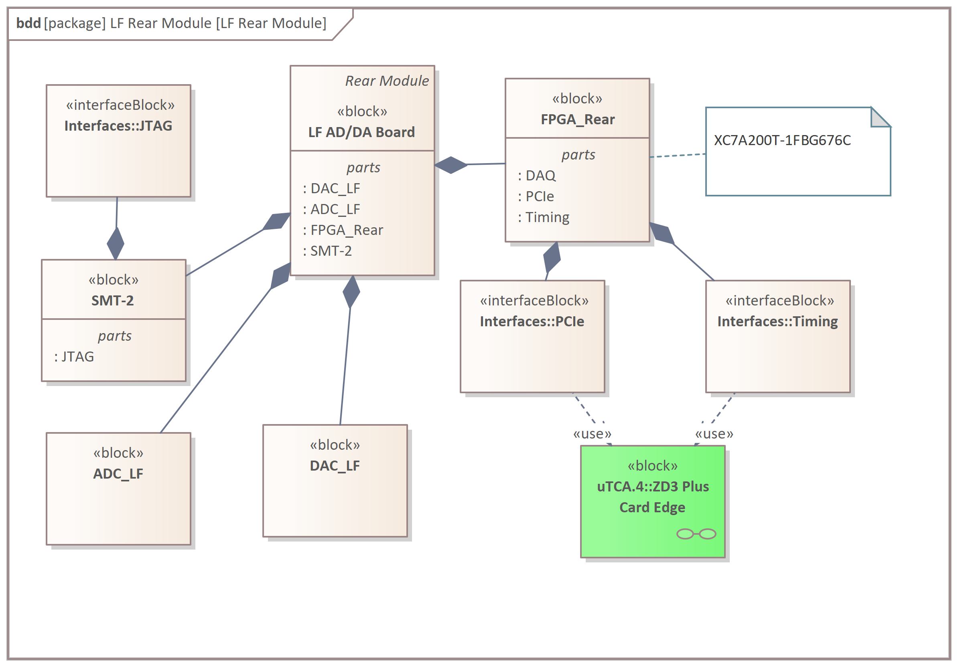
AD/DA Rear Module
To speed up replacement, we keep same front end and data converters of system today in use
Any further improvement postponed.

Slide 35
Future Upgrades
We are starting from existing VIRGO system and evolve gradually towards future architecture where presumably A.I. will play a key role.
Progress in Ethernet latency reduction will probably allow replacement of RapidIO.
DSP+FPGA architecture would presumably evolve in GPU+FPGA architecture but total latency cannot be larger than the 40 us we have today (minimum delay).
Key focusing is in high resolution converters and in lower low-frequency noise in general.
Improving total latency down to 3-4 us with solutions based on fast data converters and FPGA will allow extending feedback loops unity gain frequencies and therefore possible applications range.

Slide 36

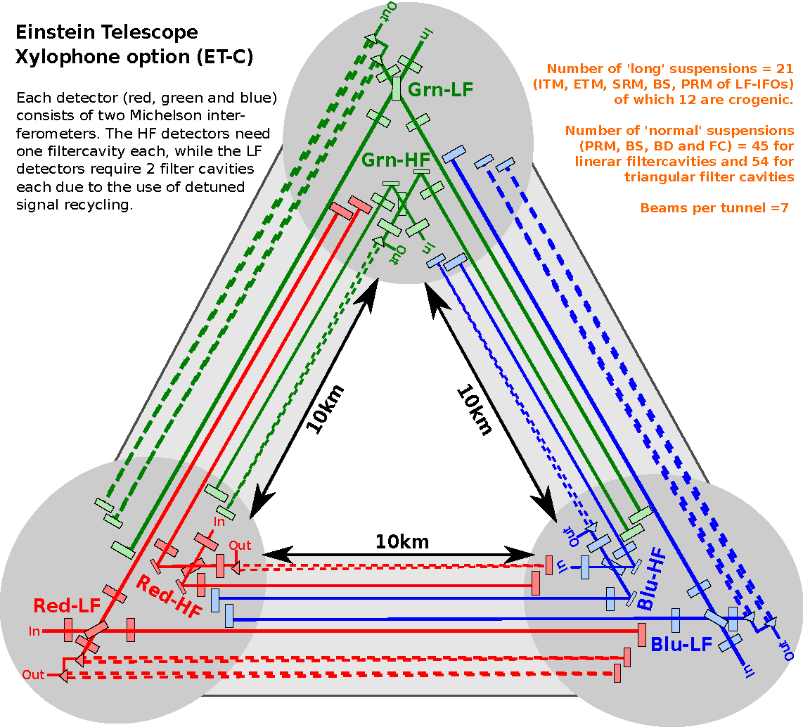
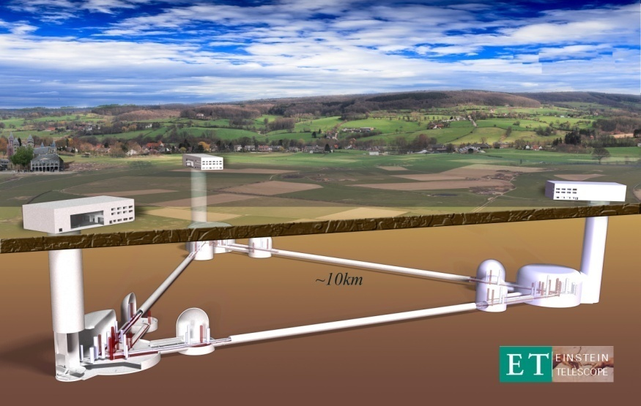
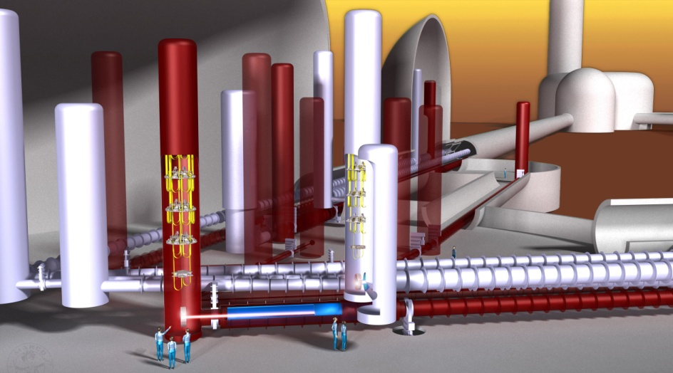
Einstein Telescope

Slide 37
Real Time Systems Design
Control Theory
Signal Processing
Computers Architecture
Real Time Systems
Programming Languages
Algorithms
High Resolution Data Converters
Operating Systems
Low Noise Analog Electronics

