Slide 1
Award Talk
25th IEEE Real Time conference, Elba, Italy
May 29, 2026
Stefan Ritt, IEEE Fellow
Head, Muon Physics Group, PSI

Slide 2

ChatGTP-5.5

Slide 3

ChatGTP-5.5

Slide 4
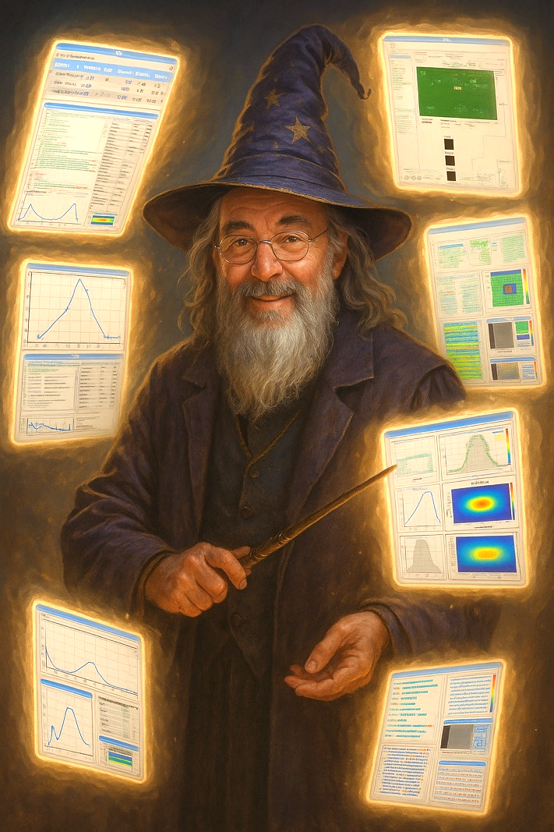
The Art of writing
Open Source Software
Conclusions from 45+ years of programming experience
General Aspects
Technical Aspects
Social Aspects
ChatGTP-5.5

Slide 5
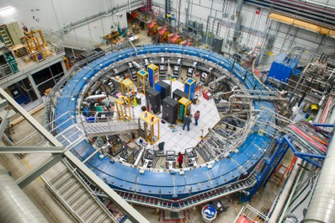
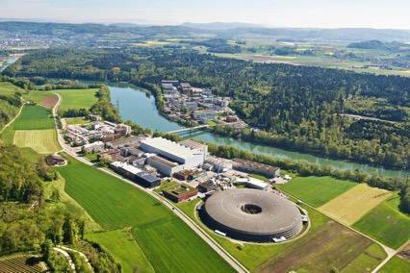
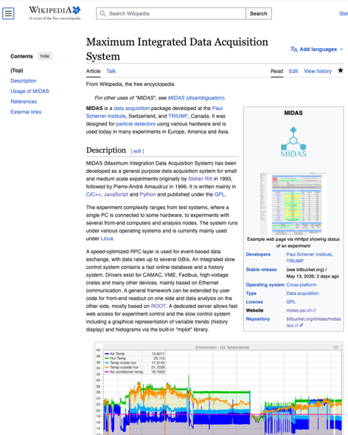
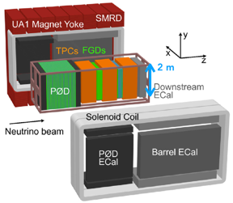
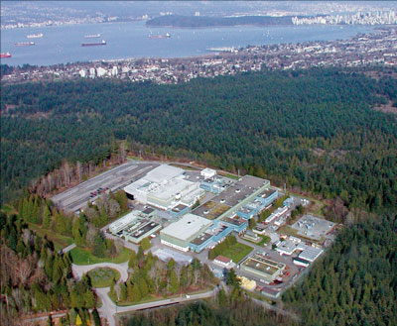
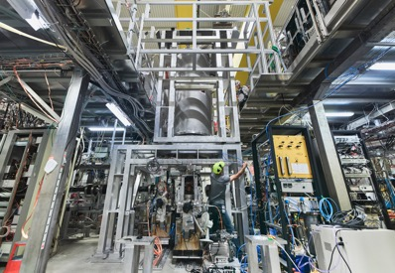
Maximum Integrated Data Acquisition System MIDAS
g-2 Fermilab
PSI, Switzerland
https://en.wikipedia.org/wiki/Maximum_Integrated_Data_Acquisition_System
T2K ND240, J-PARC
TRIUMF, Canada
Alpha-g, CERN
. . .

Slide 6
General Aspects
Where to start?

Slide 7
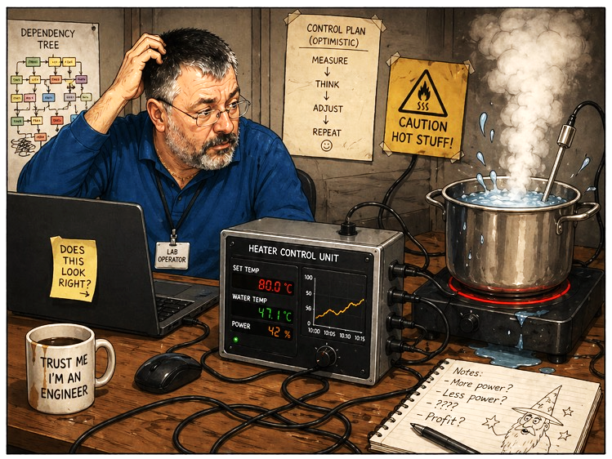
Specific Solutions vs. General Solutions
“Write a temperature controller for our lab heater”
main() {
float lab_temp, heater_power;
do {
lab_temp = read_adc(0)/10 * 100;
heater_power = pid(lab_temp);
set_dac(1, heater_power/100 * 10);
} while (1);
}
ChatGTP-5.5

Slide 8
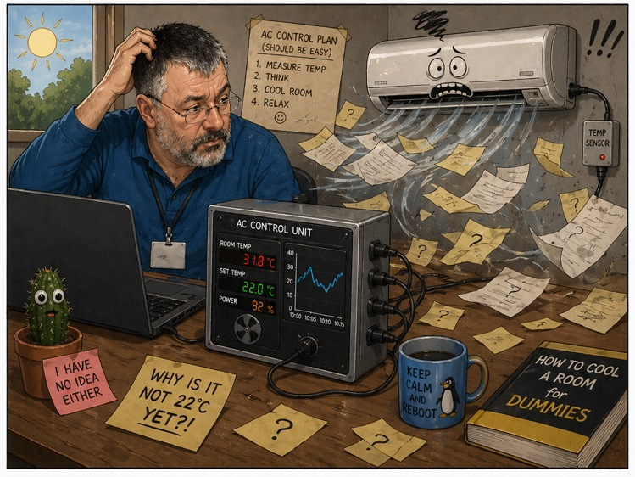
Specific Solutions vs. General Solutions
“Write a temperature controller for our air conditioner”
main() {
float air_temp, ac_power;
do {
air_temp = read_adc(2)/20 * 50;
ac_power = pid(air_temp);
set_dac(2, ac_power/100 * 20);
} while (1);
}
ChatGTP-5.5

Slide 9
Specific Solutions vs. General Solutions
“Write a temperature controller for our lab heater”
“Write a temperature controller for our air conditioner”
main() {
float lab_temp, heater_power;
do {
lab_temp = read_adc(0)/10 * 100;
heater_power = pid(lab_temp);
set_dac(1, heater_power/100 * 10);
} while (1);
}
main() {
float air_temp, ac_power;
do {
air_temp = read_adc(2)/20 * 50;
ac_power = pid(air_temp);
set_dac(2, ac_power/100 * 20);
} while (1);
}

Slide 10
Specific Solutions vs. General Solutions
“Write a temperature controller for our lab heater”
“Write a temperature controller for our air conditioner”
struct o {
temp = NaN;
temp_adc = 0;
temp_calib = 10;
power = NaN;
power_dac = 1;
power_calib = 10;
};
main() {
do {
o.temp = read_adc(o.temp_adc)*o.temp_calib;
o.power = pid(o.temp);
set_dac(o.power_dac, o.power*o.power_calib);
} while (1);
}
struct o {
temp = NaN;
temp_adc = 2;
temp_calib = 2.5;
power = NaN;
power_dac = 2;
power_calib = 0.2;
};
main() {
do {
o.temp = read_adc(o.temp_adc)*o.temp_calib;
o.power = pid(o.temp);
set_dac(o.power_dac, o.power*o.power_calib);
} while (1);
}

Slide 11
Specific Solutions vs. General Solutions
“Write a temperature controller for our lab heater”
“Write a temperature controller for our air conditioner”
{
"temp": null,
"temp_adc": 0,
"temp_calib": 10,
"power": null,
"power_dac": 1,
"power_calib": 10
}
{
"temp": null,
"temp_adc": 2,
"temp_calib": 2.5,
"power": null,
"power_dac": 2,
"power_calib": 0.2
}
#include ”config.json”
main() {
do {
j.temp = read_adc(j.temp_adc)*j.temp_calib;
j.power = pid(j.temp);
set_dac(j.power_dac, j.power*j.power_calib);
} while (1);
}

Slide 12
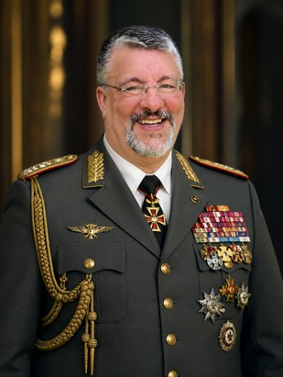
MIDAS as a framework keeps 99.9% of code general
MIDAS Framework
461.387 Lines Total
146k C, 275k C++,
30k JavaScript, 10k Python
A General Solution
Online
Database
(ODB)
Hardware
Specific
Readout
~ few 100 lines
Experiment
Specific
Visualization
~ few 100 lines
Event
Buffers
ChatGTP-5.5

Slide 13
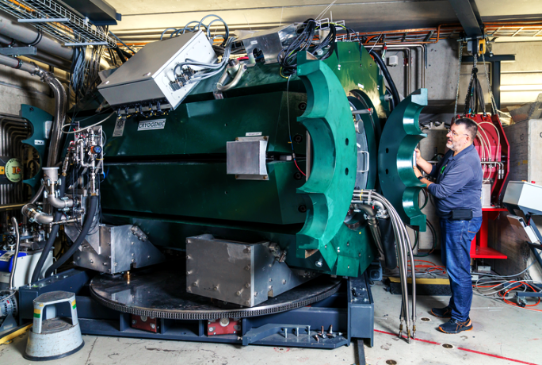
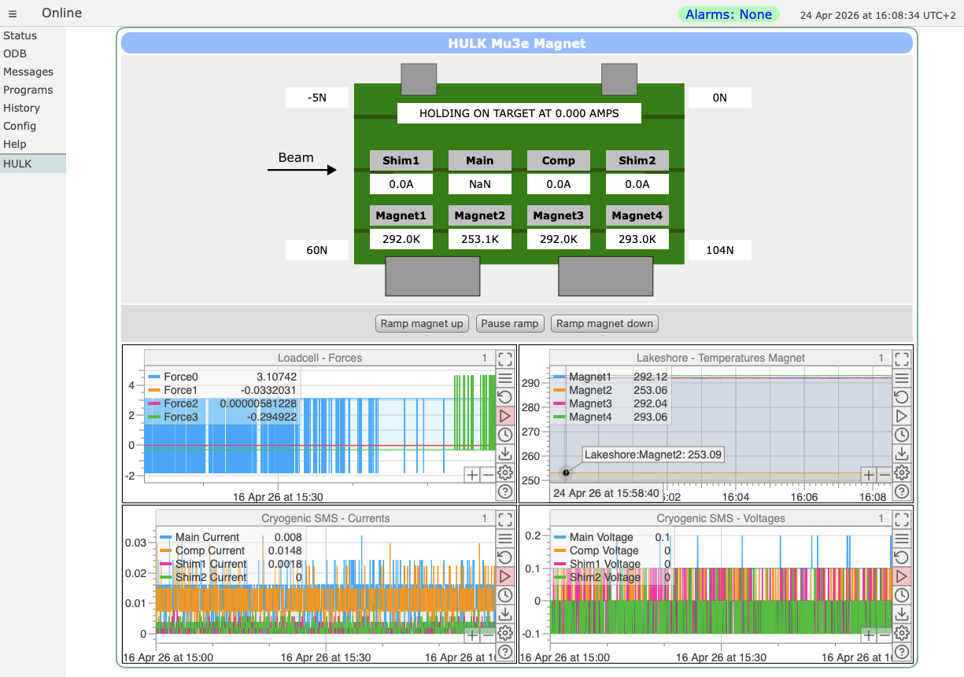
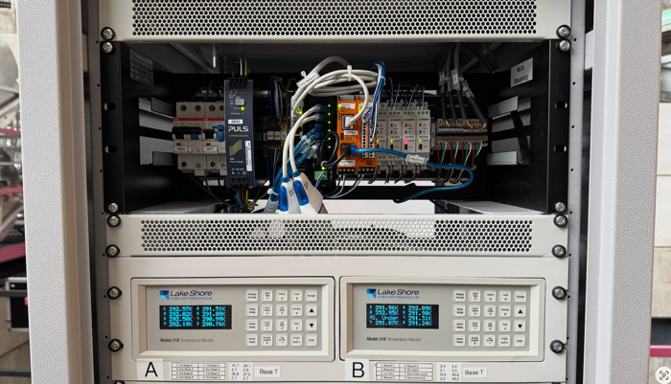
Mu3e Magnet Control Example
Raspberry Pi 5 on DIN Rail with attached IO modules

Slide 14
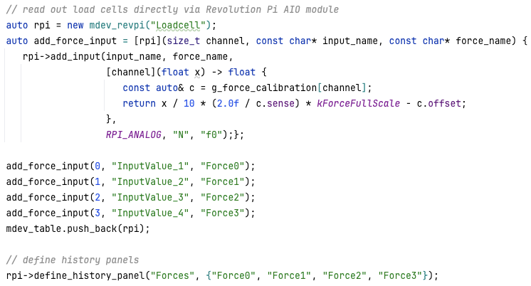
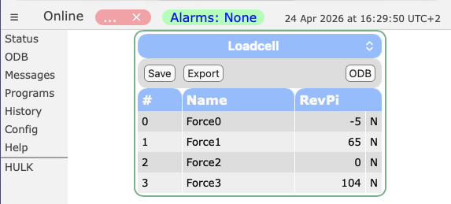
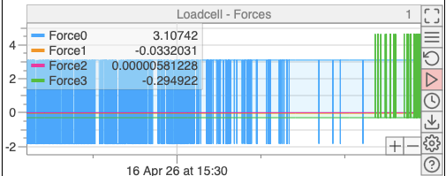
Mu3e Magnet Control Frontend Program

Slide 15
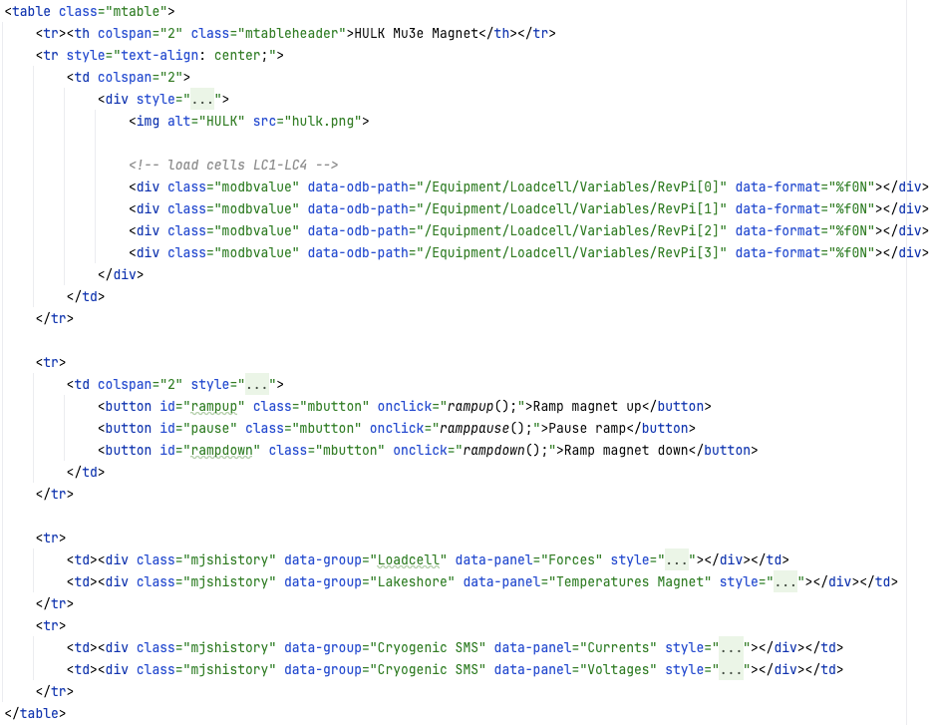
MIDAS custom pages
slightly simplified, total 168 lines

Slide 16

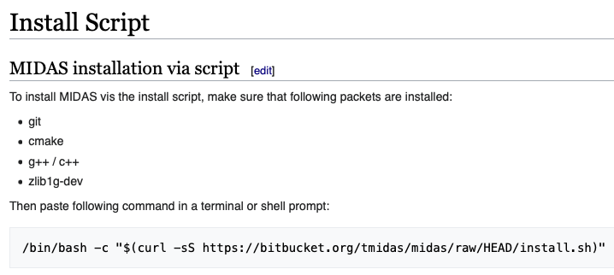
Write open-source software as general as possible
Should not depend on specific
OS / Library Versions / Software Environments
If your software does not compile / run
→ change your software rather than the environment
CMake is your friend!
Test often in all possible environments (use Docker, use your colleagues, …)
The more general you write your software, the higher are the chances of its acceptance
Easy installation is very important
https://cmake.org

Slide 17
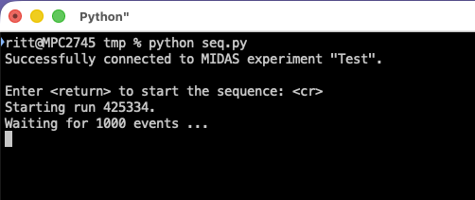
Sequence Scripts
Most experiments need special “sequences”
→ Start a run, take 1000 events, modify a setting, start next run, repeat
People used Tcl/Tk, bash scripts, python programs
(MIDAS has a Python binding)
Problem: Only the person in front of the terminal can control the program and monitor the progress (tmux/screen needs ssh tunnel)
No easy web access

Slide 18
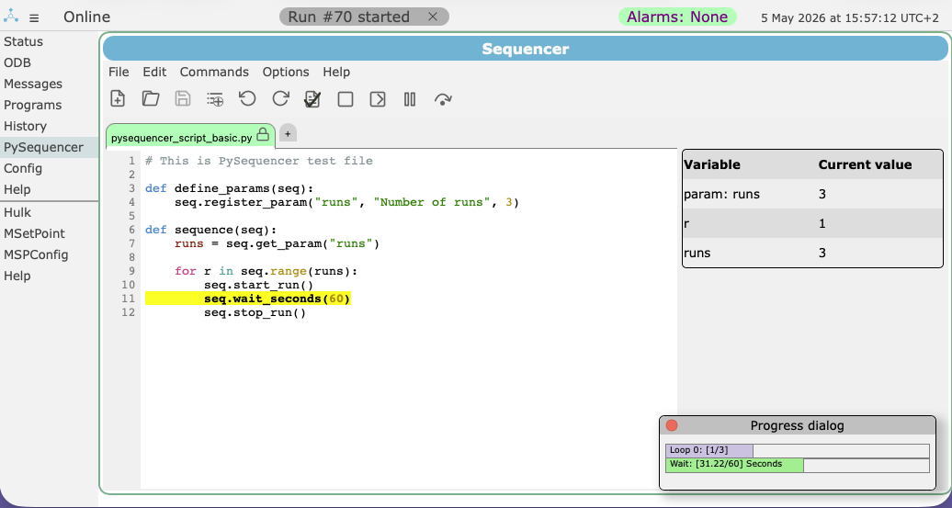
Solution: MIDAS Python Sequencer
Start, Stop, Pause, Debug
Web-based editor
Live variables
Current progress
Progress

Slide 19
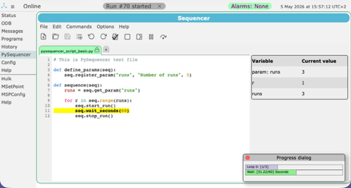


Python Sequencer usage around the globe

Slide 20
Technical Aspects
From Architecture to Engineering

Slide 21
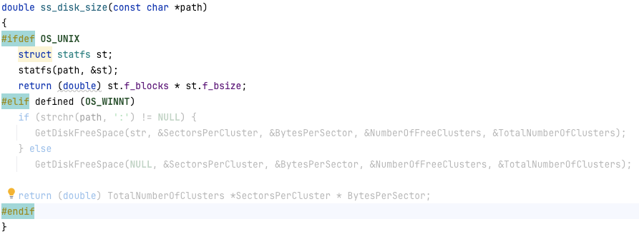
Operating System Dependencies can be covered by conditional compilation
MIDAS System
Avoid OS or library lock-in by
conditional compilation
MIDAS uses ~3% of conditional code to run on
  Windows NT
  MS-DOS
  VMS
  Ultix
  Solaris
  Linux
  MacOSX
ss_disk_size
ss_file_exists
UNIX
UNIX
Standard Functions
Windows
Windows
printf
exit
3% of MIDAS code

Slide 22
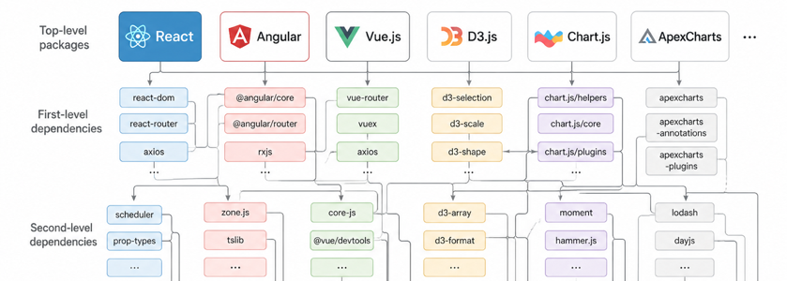
Check your external dependencies
Easy to develop code based on existing open-source packages
Packages often have multi-level dependencies
Ask yourself
  Which package will still be maintained in 10 years?
  Which package will still be open-source in 10 years?
  Will the API still be the same in 10 years?
My philosophy: Use external libraries carefully, but
write the code parts critical for long-term stability
  More work initially, but long-term benefits
  E.g. MIDAS ODB developed back in 1996 still current
  You can hand-optimize functions if needed

Slide 23
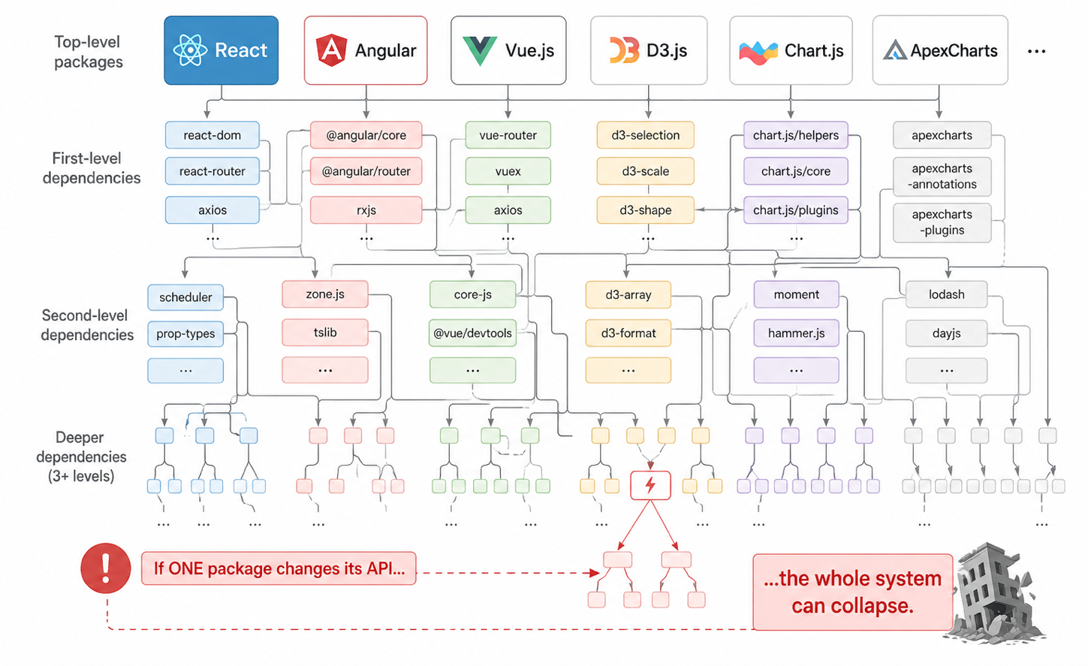
Problem of too many External Dependencies

Slide 24
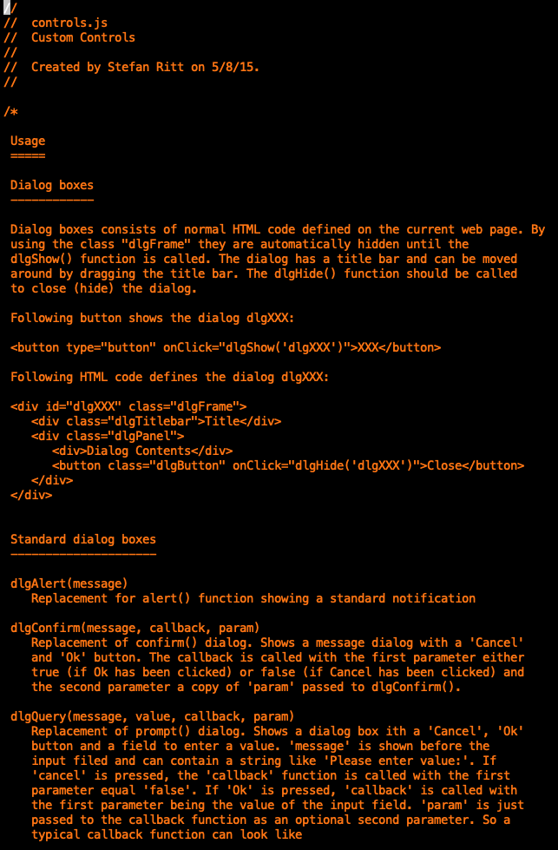
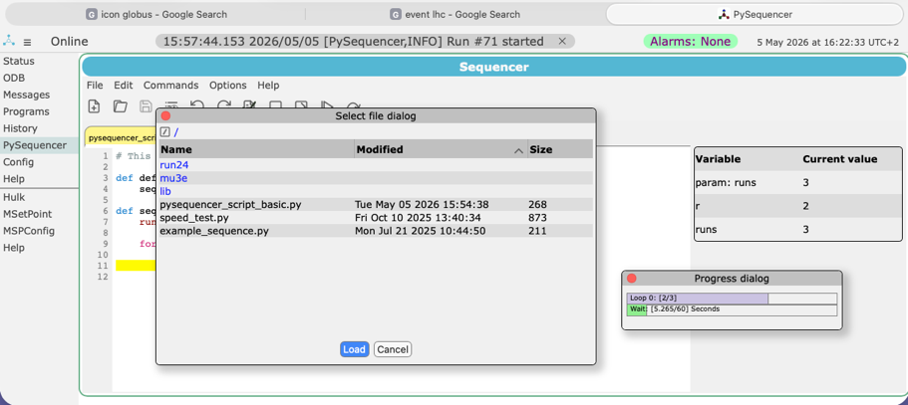
MIDAS dialog box “library” can be very compact
HTML5 misses standard dialog boxes
Many libraries are available
MIDAS uses its own “controls.js”
  dlgAlert, dlgConfirm, dlgQuery
  Sliders
  Progress bars
  Icon buttons
Only 1300 lines
of CSS / JS code
Custom Controls

Slide 25
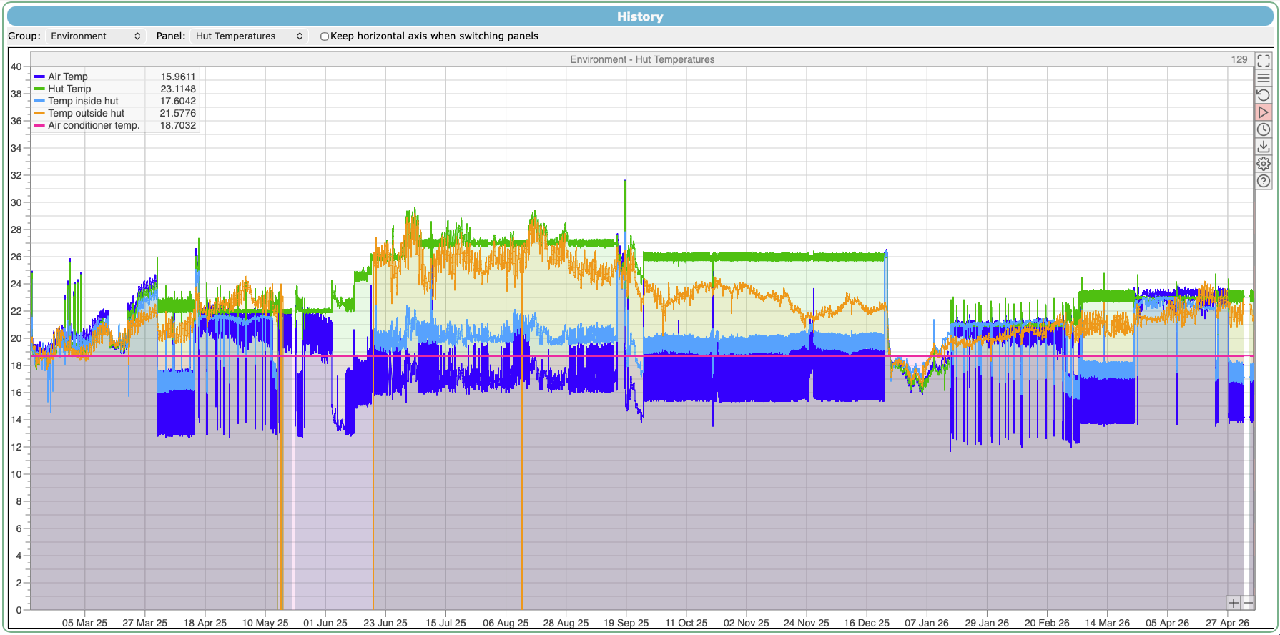
MIDAS History Plots
History of slow control variables is typically written ~once per second
→ 30 M data points per year
I don’t know any graphics library which can draw millions of points reasonably
One can plot only every 10th point (decimation), but how to preserve spikes?
1 year: 5 x 30M data points

Slide 26
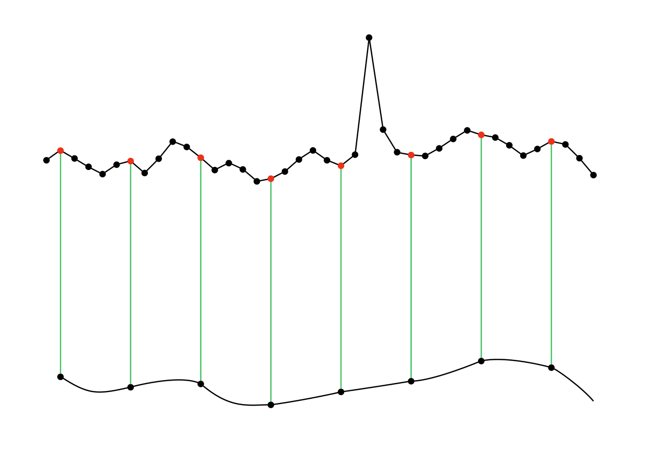
Decimation: Plot for example every 5th point
Spike is lost!

Slide 27
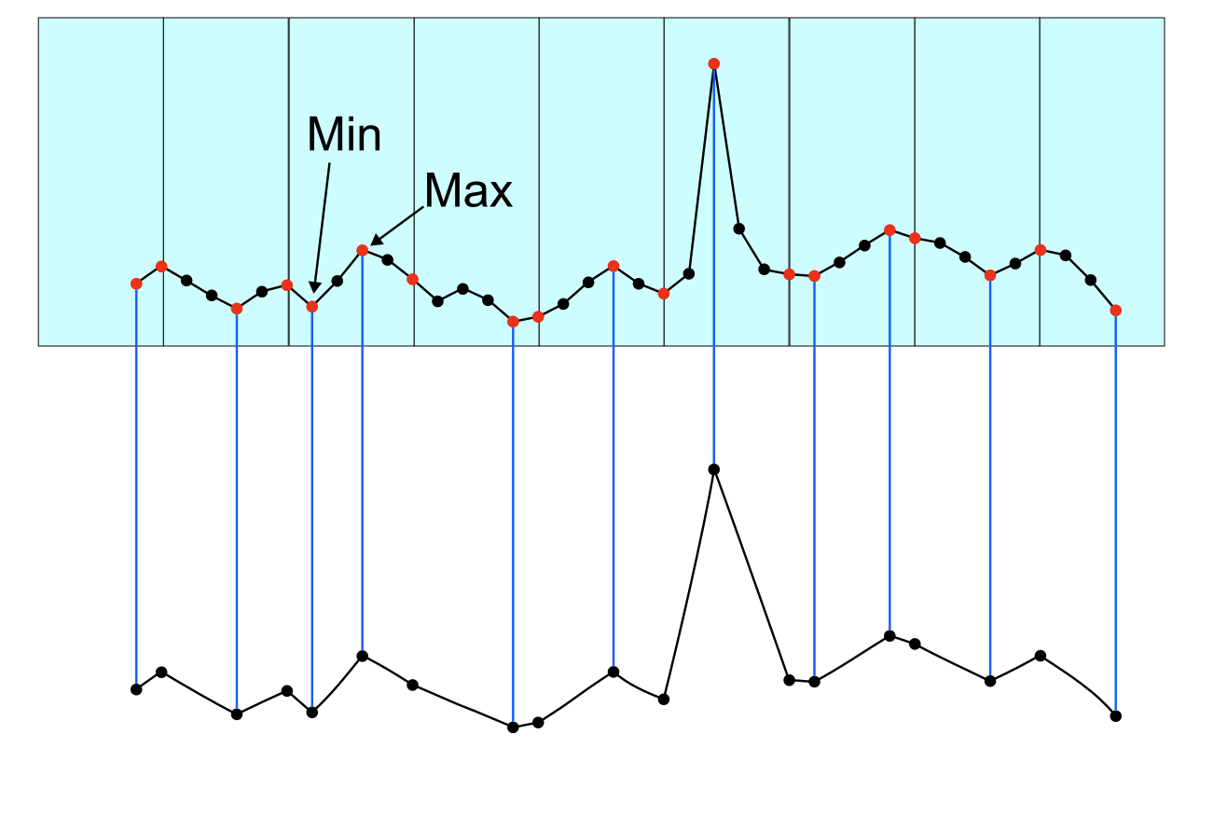
MIDAS History Decimation: Add Min/Max points
Spike is conserved!

Slide 28
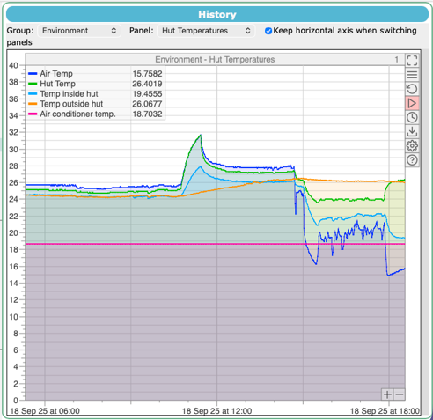
Identifying rare issues via min/max decimation
Spike still visible
MIDAS “min/max decimation” in plot library or on server-side history database (hand-written)
A/C failure
MIDAS custom plotting library allows easy implementation of “special” features

Slide 29
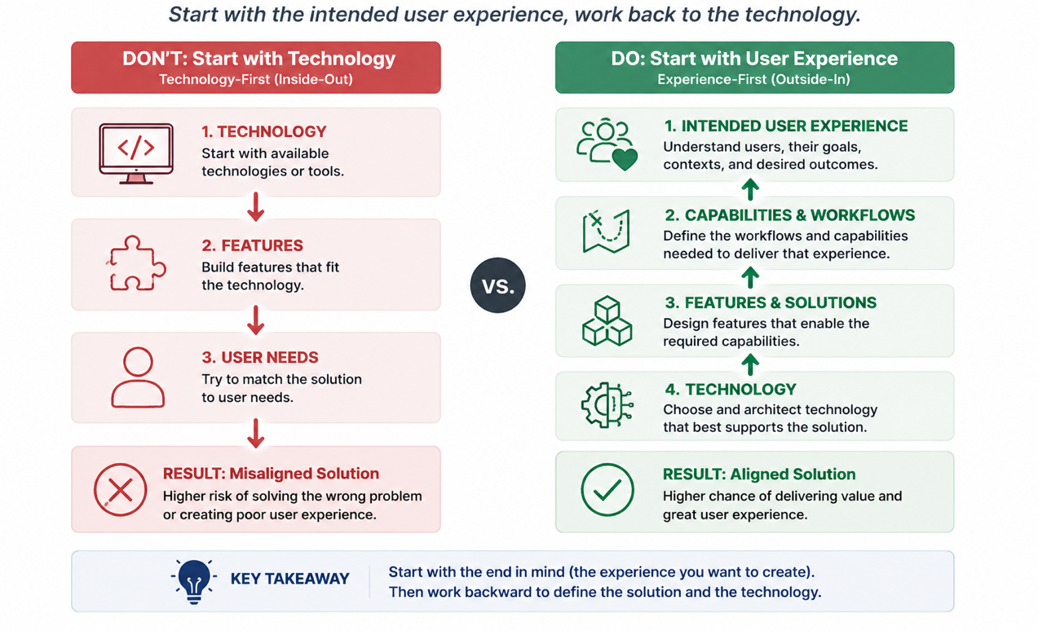

Start your design from the intended user experience
Don’t try to fit your technology to the user
Start with what the user wants and work your way back
Inspired by Steve Jobs*
*https://www.youtube.com/shorts/_GUsYU2DcJM

Slide 30
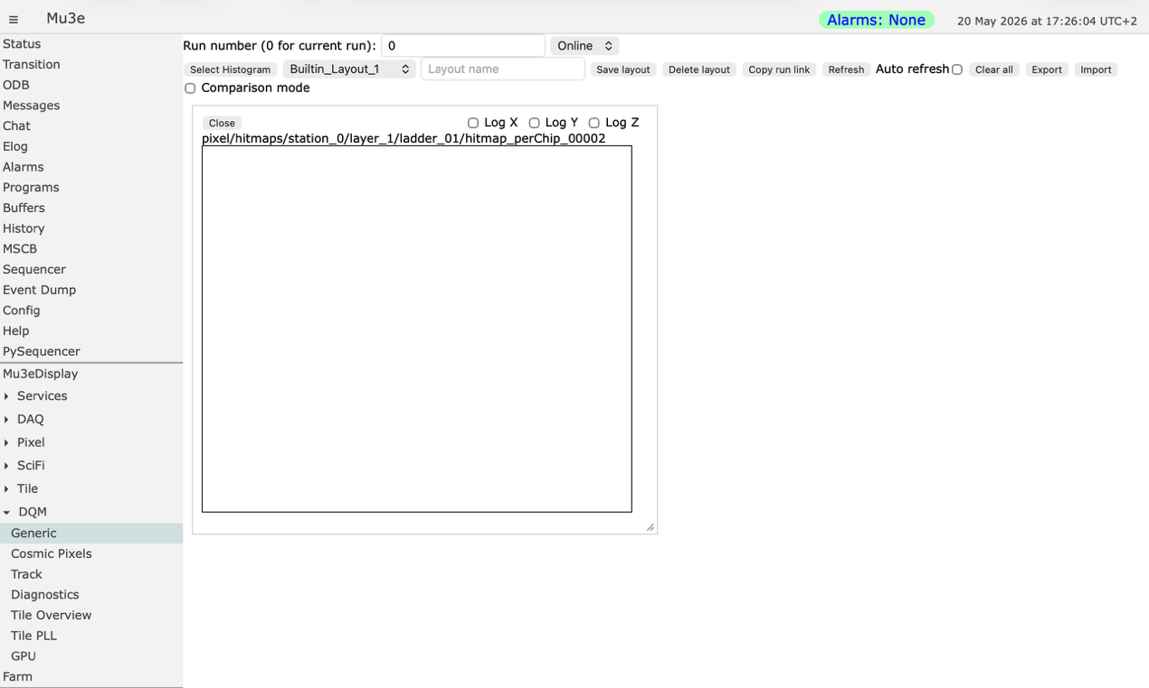
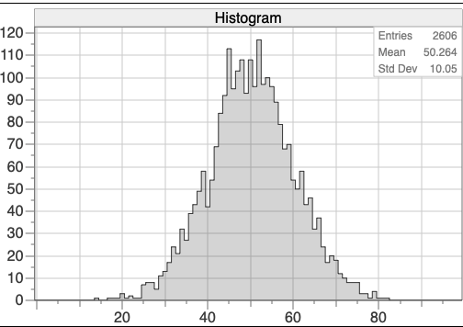
Design Example A

Slide 31
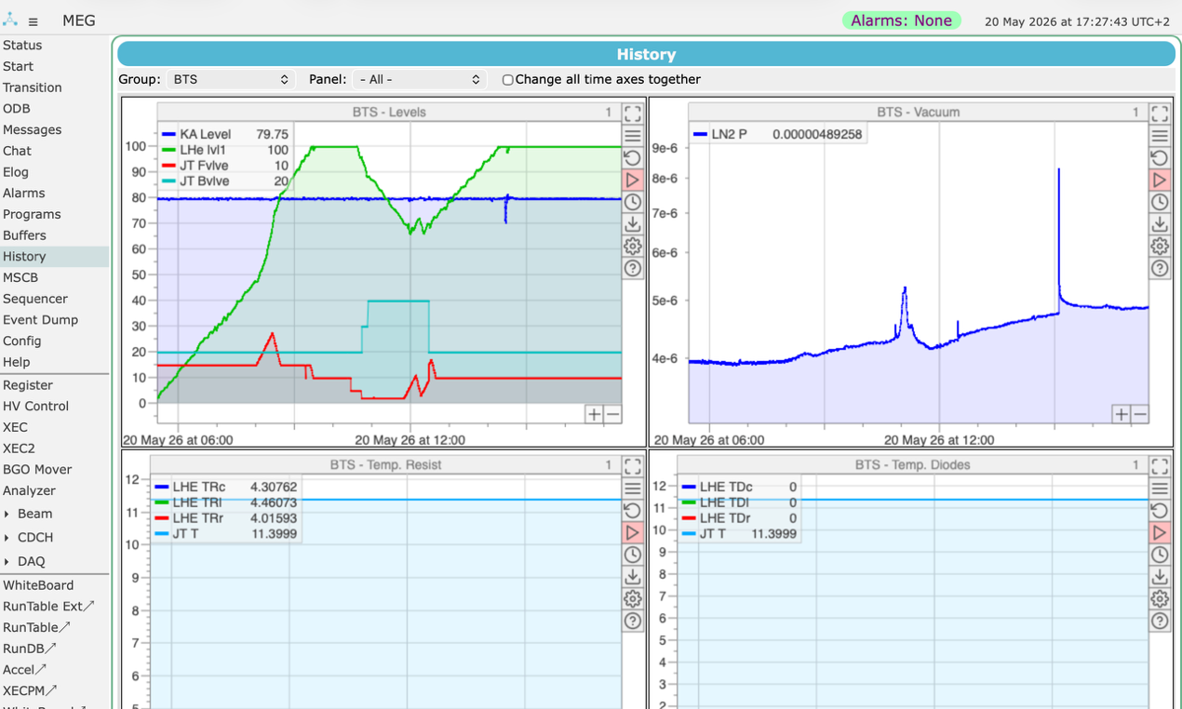
Design Example B

Slide 32
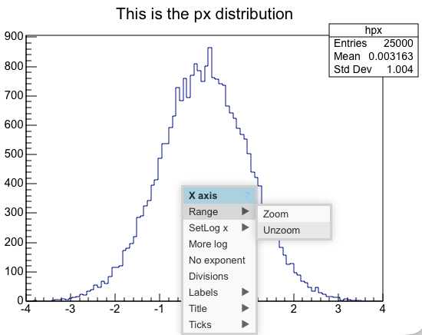
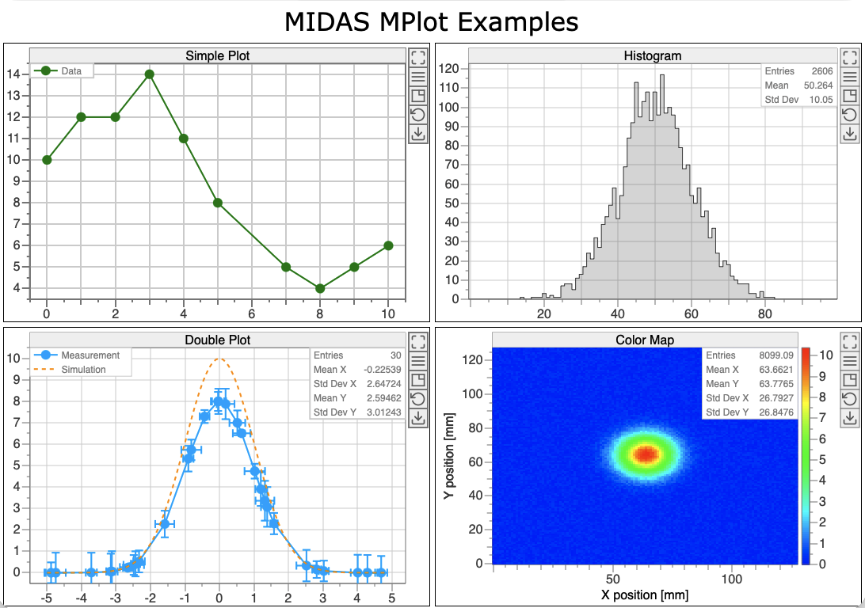
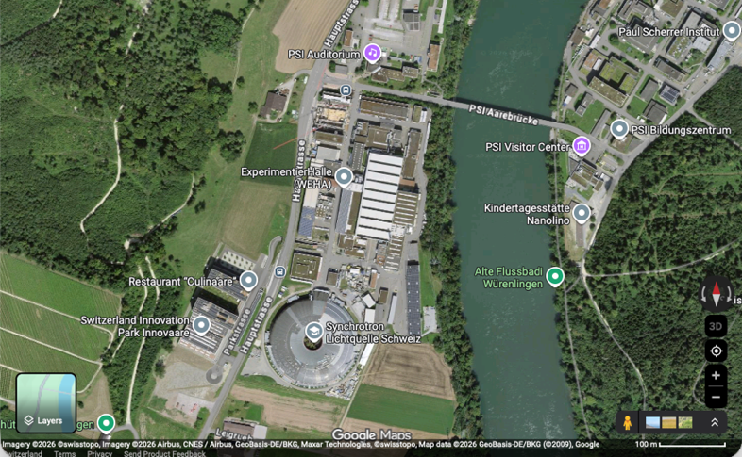


MPlot Library for plotting graphs
JSRoot
Unzoom
Pan and Zoom inspired by Google Maps
Zoom reset button
Try it: https://elog.psi.ch/mplot/

Slide 33
Social Aspects
The Human Side of Open Source

Slide 34
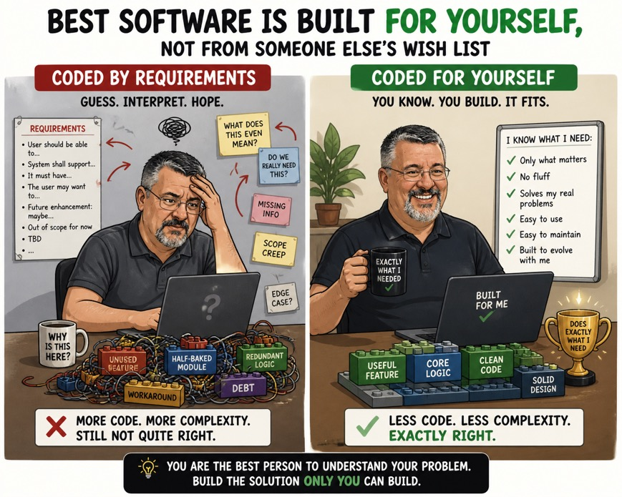
How to “steer” the development?
Programming by “requirement specifications”
→ Incomplete or unnecessary functionality
My personal approach:
  Write software for yourself, since you know best what is needed and what not
  Adapt frequently, drop unnecessary parts,
  add new features if needed
  Listen to your users
  (Forum, Issue tracker, ELOG, …)
  Don’t hesitate to integrate new features from others
  (avoid “not invented here” syndrome)
  → might help you later
  Do “sprints” (I visit TRIUMF every 2 years for a MIDAS development session)
ChatGTP-5.5

Slide 35
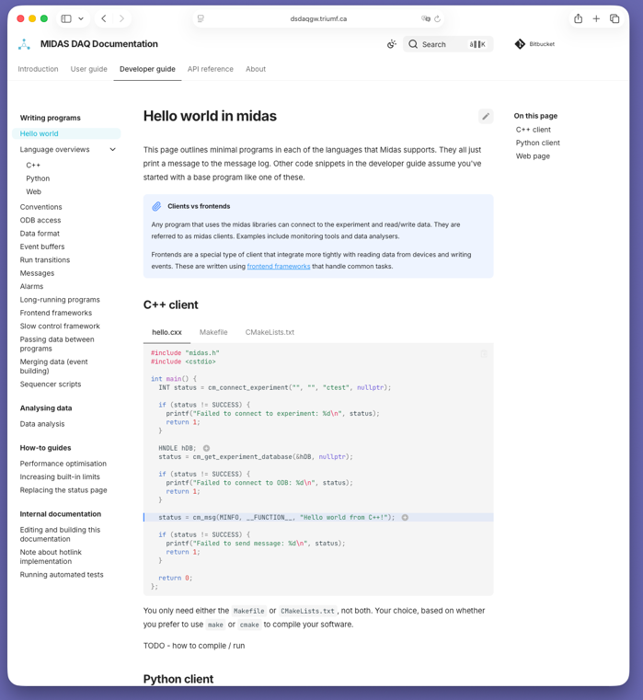

How to write a good documentation?
A good documentation is essential
What is a “good” documentation?
My lesson:
  A developer is not good in documenting their own code
  Ask a user who painfully went through installation/configuring/development to write the documentation
  Review the documentation every ~10 years,
  don’t be afraid to rewrite it
  AI is excellent in writing documentation from code
With MIDAS, we went
HTML (1996) → Doxygen (2003)
→ Wiki (2013) → MkDocs (2026)
https://www.mkdocs.org

Slide 36

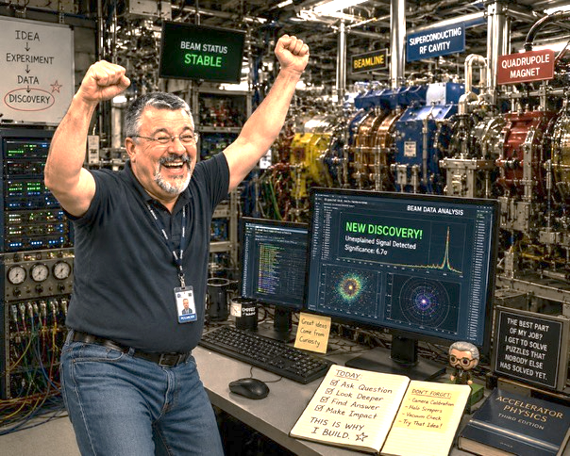
How to get your motivation?
Staying motivated for 30+ years on a single project is not easy
Don’t expect compliments for your users:
“The absence of complaints is praise enough”
You will lack publications (scientifically proven):
Developers prefers to invest resources in
improving/extending code than publishing
My motivation:
  I want to do good physics!
  I have seen other experiments wasting precious beam time because of DAQ problems
  Developing MIDAS and maintaining it enables me to avoid this
  Even if a DAQ system has 10% more uptime than another, that can result in years of recovered beam time over the last 30 years (Pibeta, MEG, MEG II, Mu3e, g-2, …)
ChatGTP-5.5
ChatGTP-5.5

Slide 37
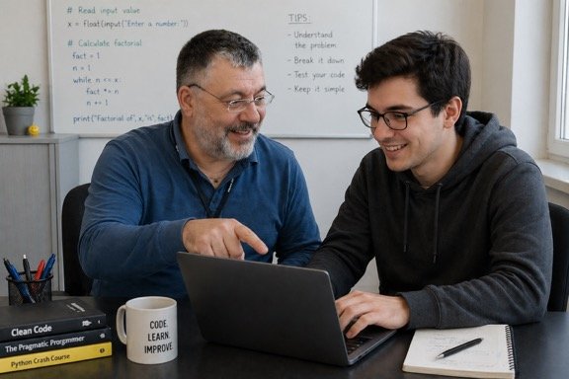
Motivate your co-developers
Co-workers often come from other labs, you’re not their boss!
They often have their “normal work”
How to keep them motivated to contribute?
My ”game”:
  Identify a task for them which solves a problem
  Mention this problem to them and ask for a solution
  Iterate until they find your solution without telling them
  Make them believe that this was their idea
  → They will be motivated to implement “their” solution
If colleagues come up with a nice request/solution, encourage them to commit to the repository, write documentation etc.
ChatGTP-5.5

Slide 38
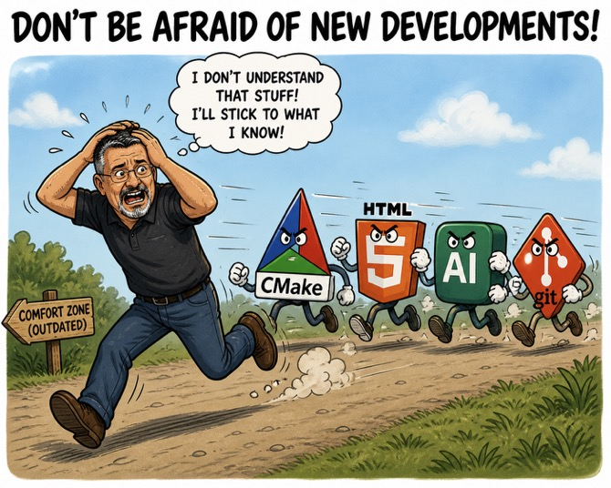
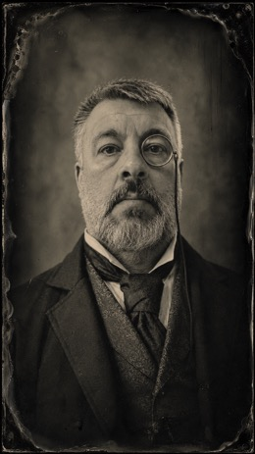

Don’t be afraid of new developments
Terminal control (1993) → WWW control
C → C++ with STL
OS evolution: Windows NT → Ultrix → Linux → MacOSX
Subversion → git
batch scripts → Makefile → CMake
Static HTML → HTML5, JavaScript
Python
Touchscreen (Smartphones, Tablets)
CI/CD and Automatic Testing (hard for a real-time system)
Generative AI (Large Language Models)
Don’t jump on every new development,
only on those which will last long and have potential
ChatGTP-5.5
ChatGTP-5.5
ChatGTP-5.5

Slide 39
The AI Revolution
How Large Language Models Change the Game

Slide 40
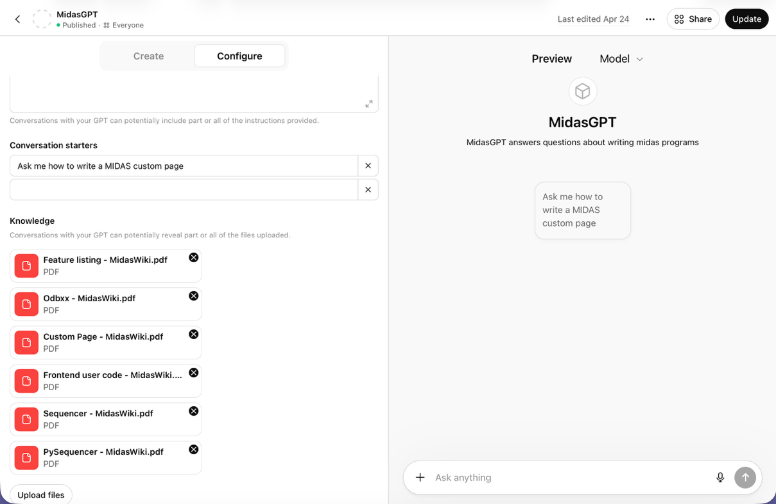


MidasGPT
OpenAI lets you define “GPTs”
= basis model + ~100MB files
Files can be documentation and source code
GenAI answers are based on documents and very good
You can ask for references to documents and code files
ChatGTP-5.5
https://chatgpt.com/g/g-68b1cce155a48191bb5df1b2919bdaf4-midasgpt

Slide 41
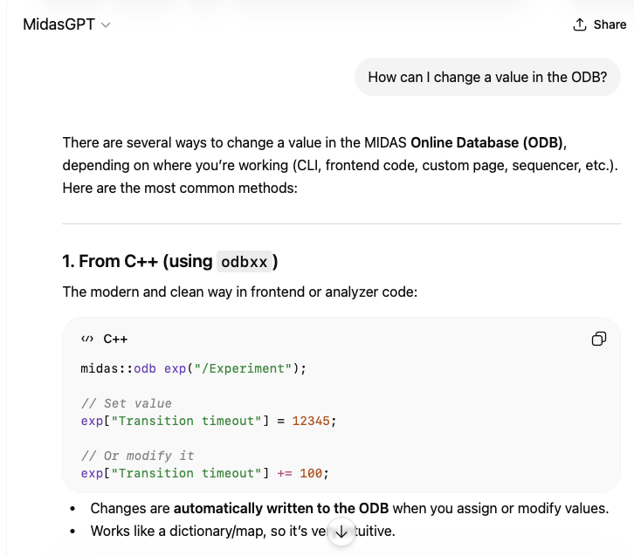
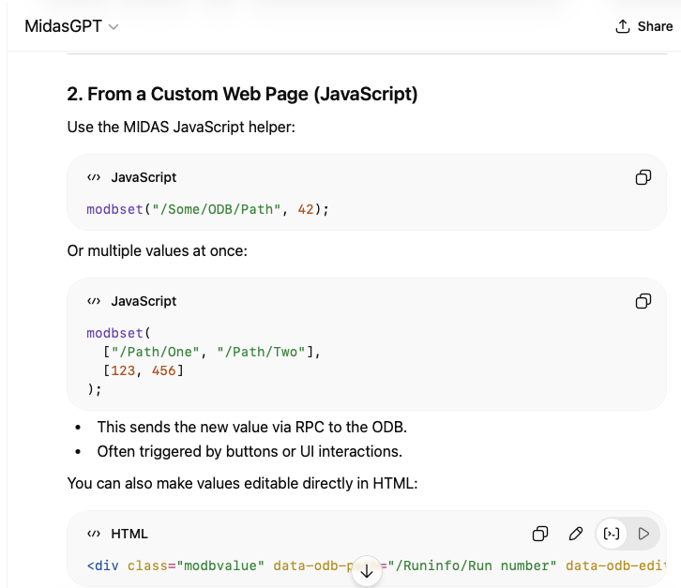
How can I change a value in the ODB?

Slide 42
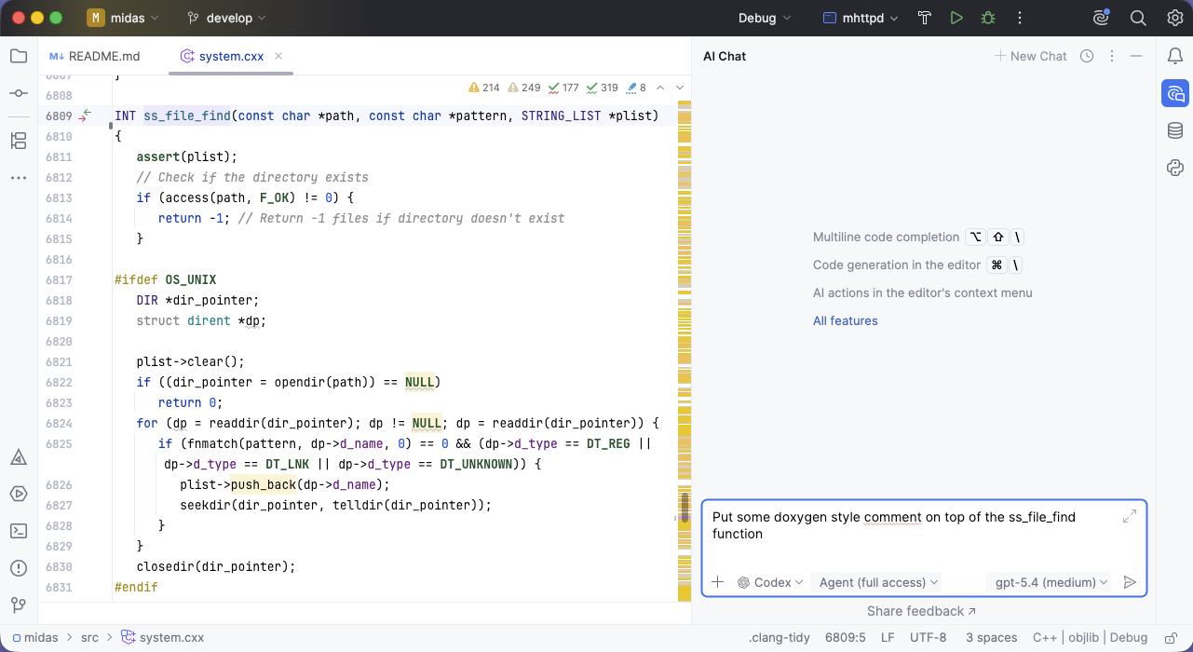
Let GenAI write your documentation

Slide 43
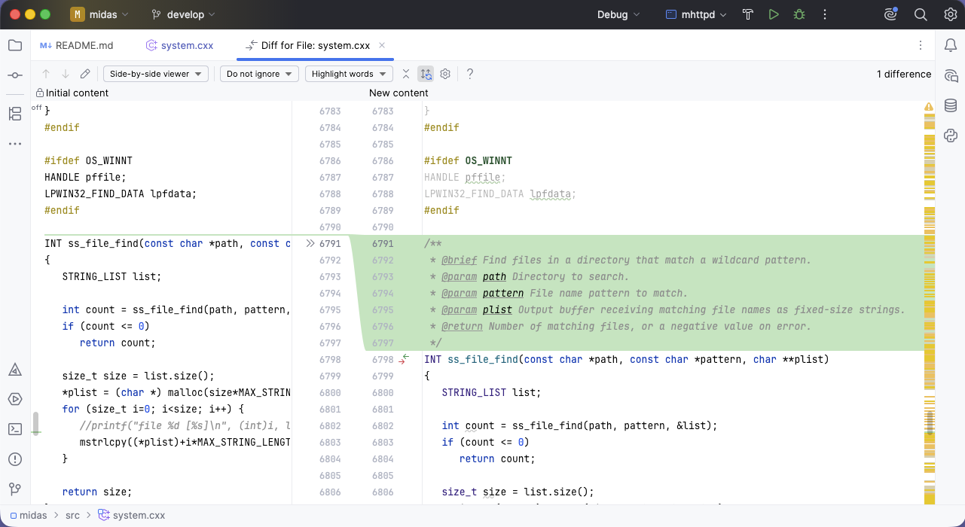
Let GenAI write your documentation

Slide 44
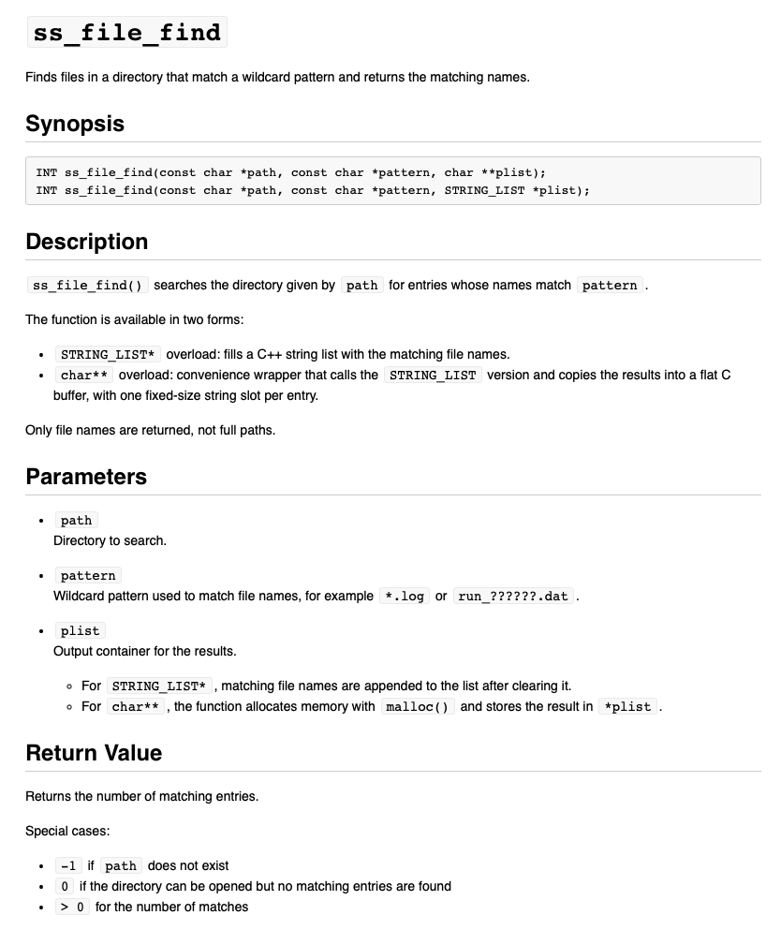
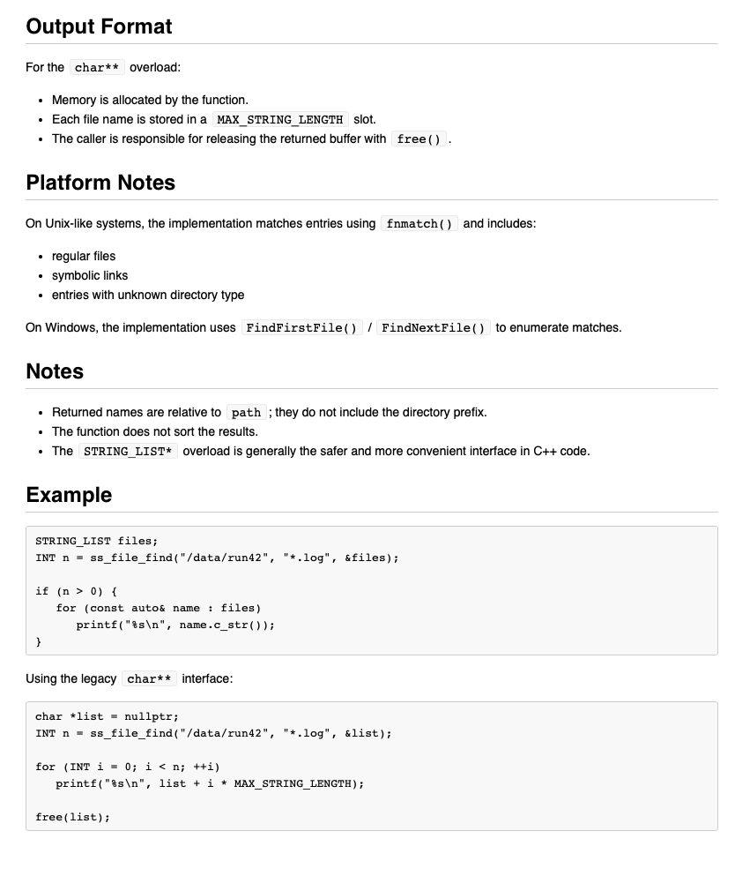
‘Write a description of this function in Markdown”
Codex gpt-5.4 (medium)

Slide 45


My recommendation how to use GenAI
Never blindly trust GenAI
Great for documenting and checking
your code (memory leaks, refactoring, …)
Too big chunks of GenAI code can become a “black box”
If you program with GenAI, do it one small
snippet at a time (10-20 lines of code)
If done correctly, GenAI can save you
50% of your time (it does for me!)
Never blindly trust GenAI
ChatGTP-5.5
ChatGTP-5.5

Slide 46


Find somebody who believes in you
PSI, ca. 1988
16th Real Time Conferecne 2009, Beijing, China

Slide 47


Slide 48

ChatGTP-5.5

