Slide 1
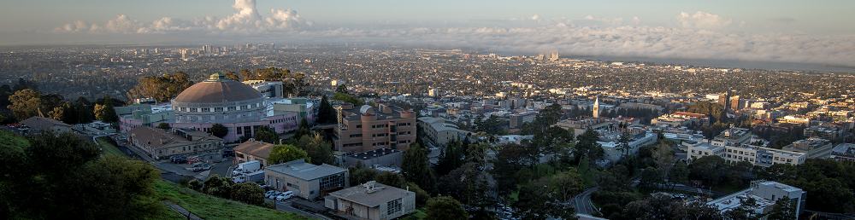
A High-Bandwidth, High-Framerate Integrated Ionizing Particle Detection System
IEEE Real Time Conference, Elba, Italy 05/26/2026
Carl Grace, on behalf of the Advanced Accelerator Diagnostics Collaboration
Lawrence Berkeley National Laboratory

Slide 2





Advanced Accelerator Diagnostics Collaboration
Three University of California campuses and three US National Labs
  UC Santa Cruz (Santa Cruz Institute for Particle Physics), UC Davis, UC Santa Barbara
  Lawrence Berkeley National Lab, Los Alamos National Lab, SLAC National Accelerator Lab
Originally funded by the University of California, Office of the President. Current funding from the the US Department of Energy
Developing diagnostic systems for XFEL, synchrotron, and proton beams and performing basic diamond sensor R&D (transport properties, radiation tolerance). Focus of this talk is on beam position monitors for future XFELs.

Slide 3
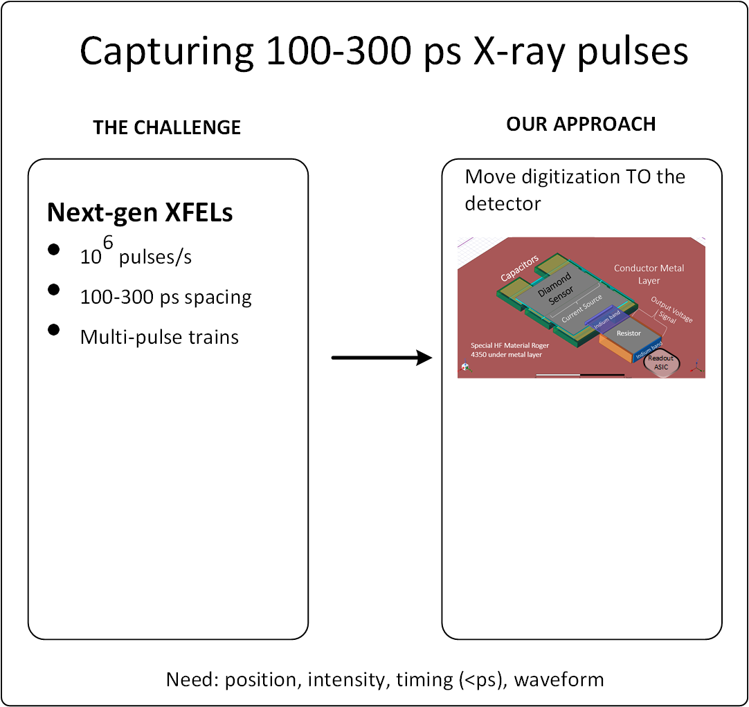
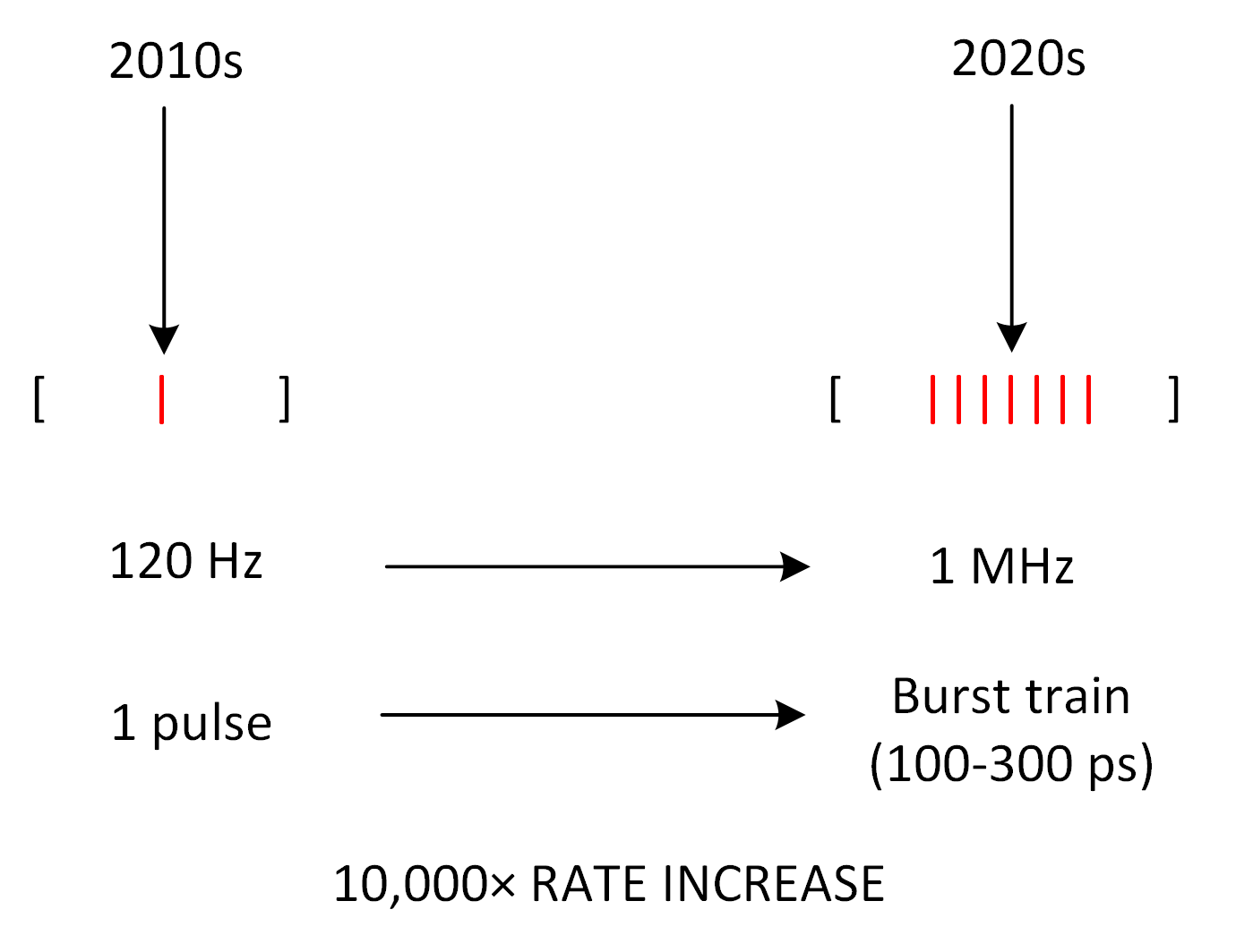
Per‑pulse XFEL beam diagnostics in the sub‑ns regime
Evolution
Current 50 MHz electronics too slow and cannot resolve individual pulses
Remote digitizers smear signals
36 GS/s
< 250 fs Jitter
Minimal cables
Diamond + ASIC integration
Tarun Prakash, IEEE NSS, 2025

Slide 4
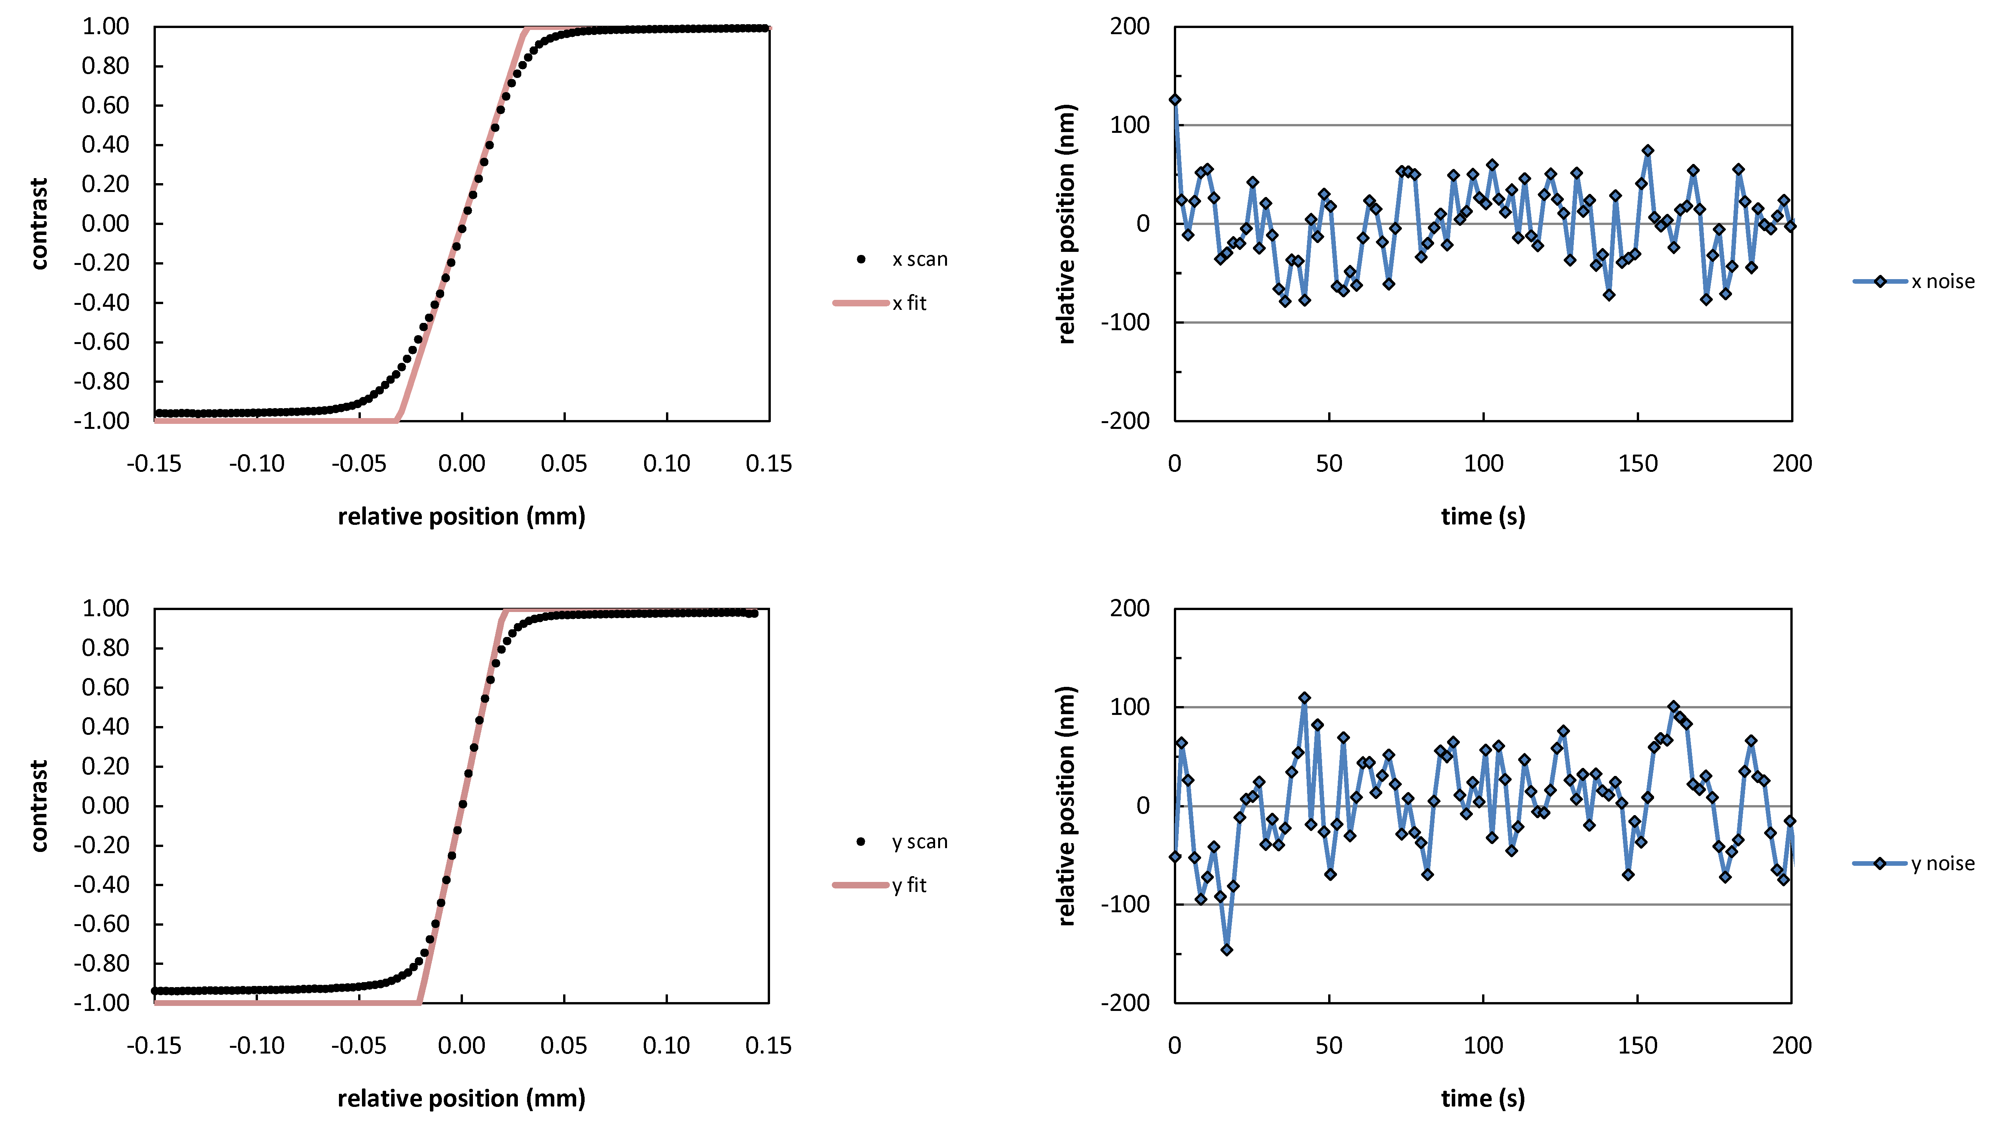
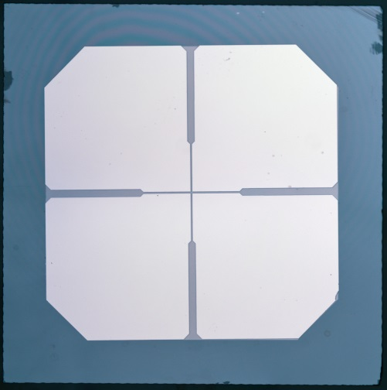
Beam Position Monitors
30-50 µm thick
Metallization: 25 nm Pt
20µm
Diamond Sensors
Low X-ray Absorption (can be used in beam path)
High Thermal Conductivity
Radiation Hardness
Large, indirect bandgap 5.5 eV → 13.3 eV/eh-pair (~4X silicon)
High mobility (~2X e⁻ and 4X holes compared to Si)
Fabricated at LANL
A
B
C
D
3.1mm
4.0mm

Slide 5
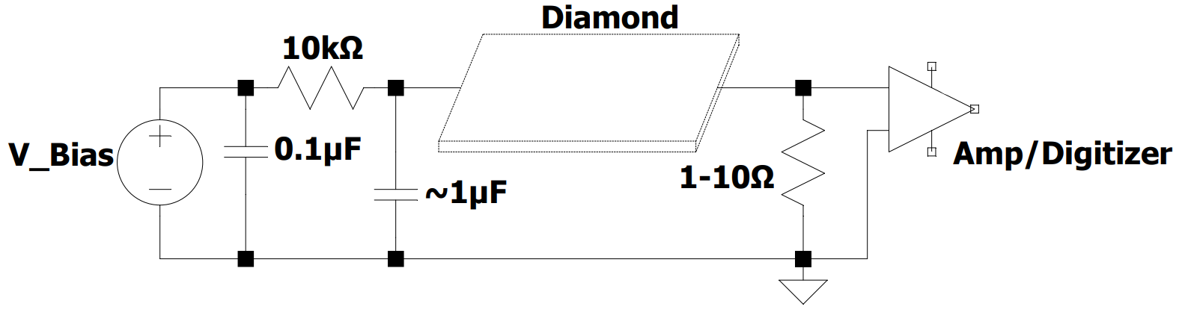
Fast Diamond Sensor System Concept
Rene Padilla, Ulitima 2023
  Charge Collection (LANL, SLAC)
    Diamond fast and efficient up to ~10¹⁶ charges/cm³
  Signal Path (UCSC, UCSB)
    How fast the signal can return to ground without ringing?
  Signal processing / amplification / buffering / digitization (LBNL and UC Davis)
    High speed electronics development
  Interfacing of signal path with signal processing features (LBNL)
    RF Engineering

Slide 6
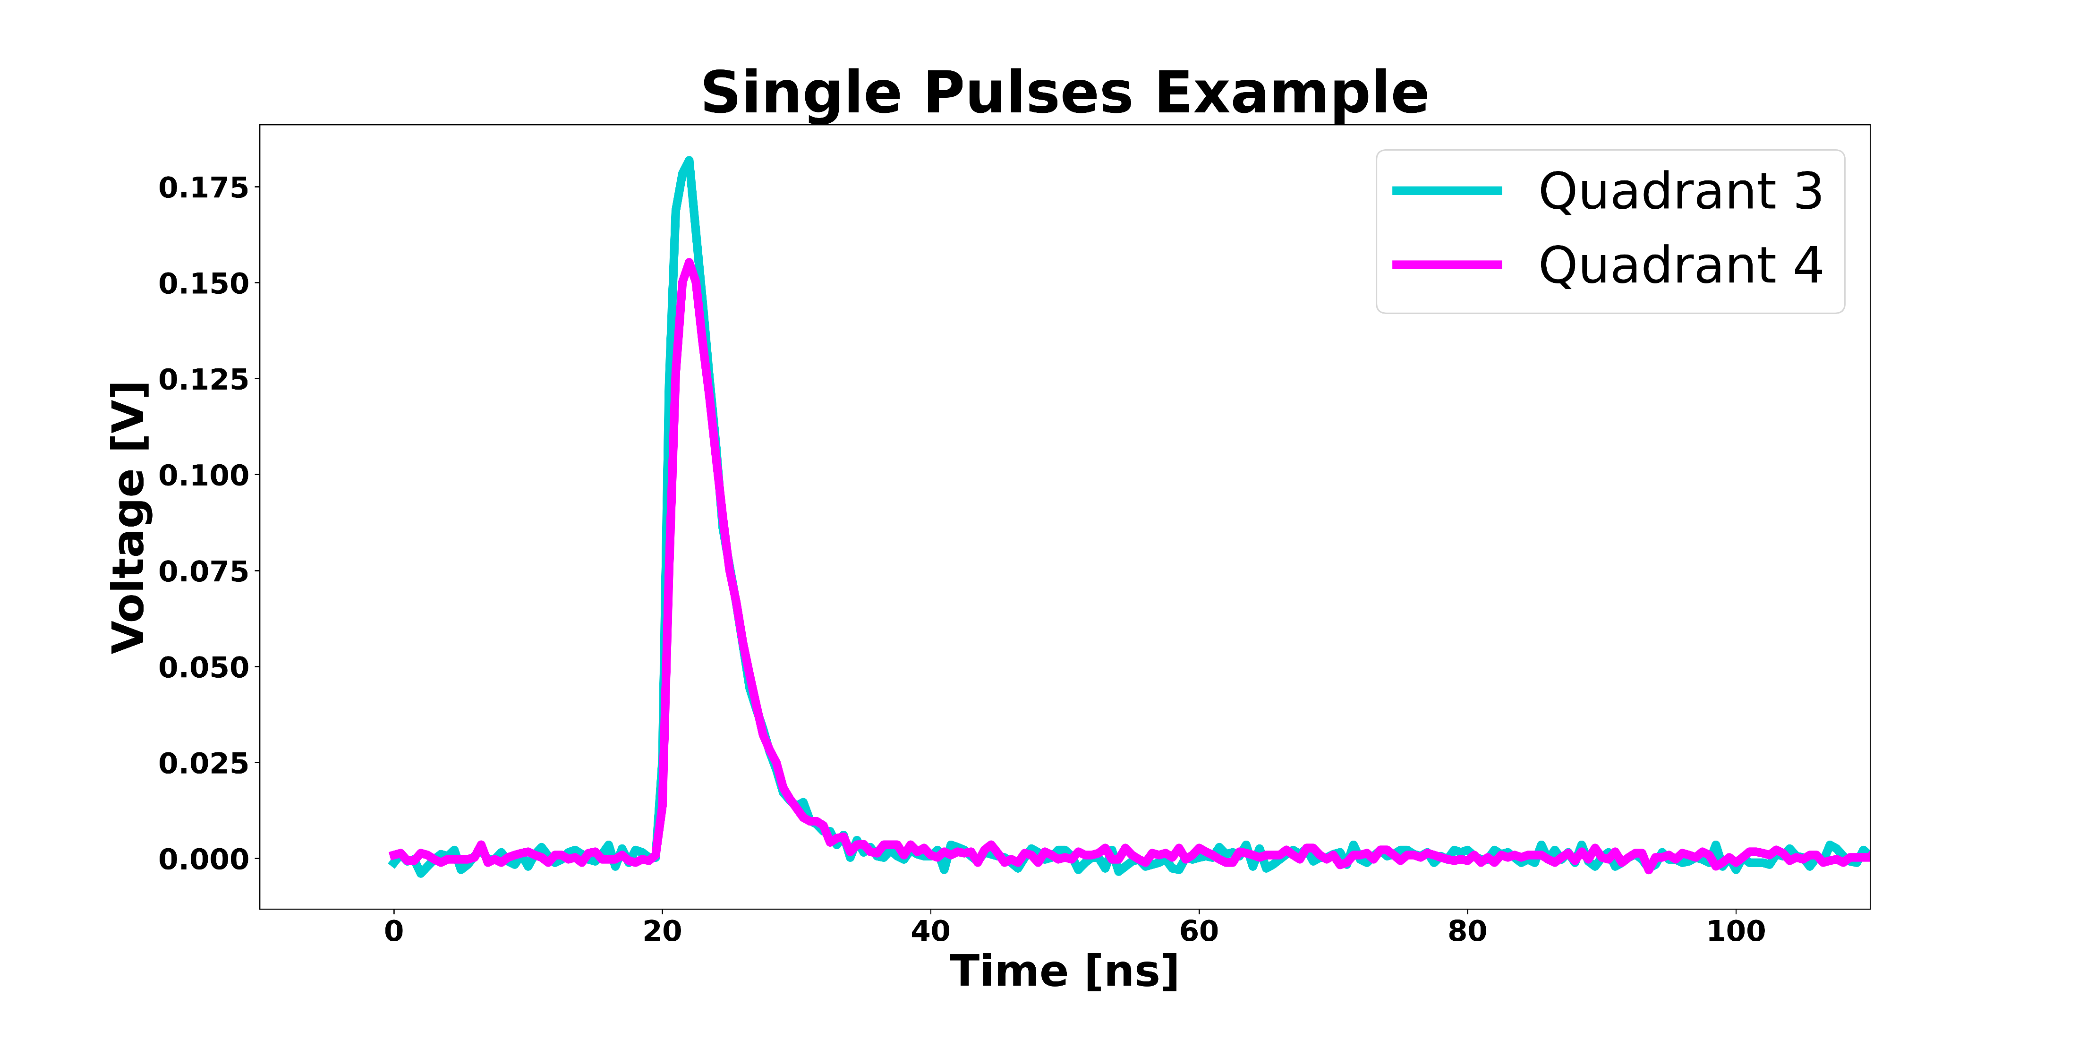
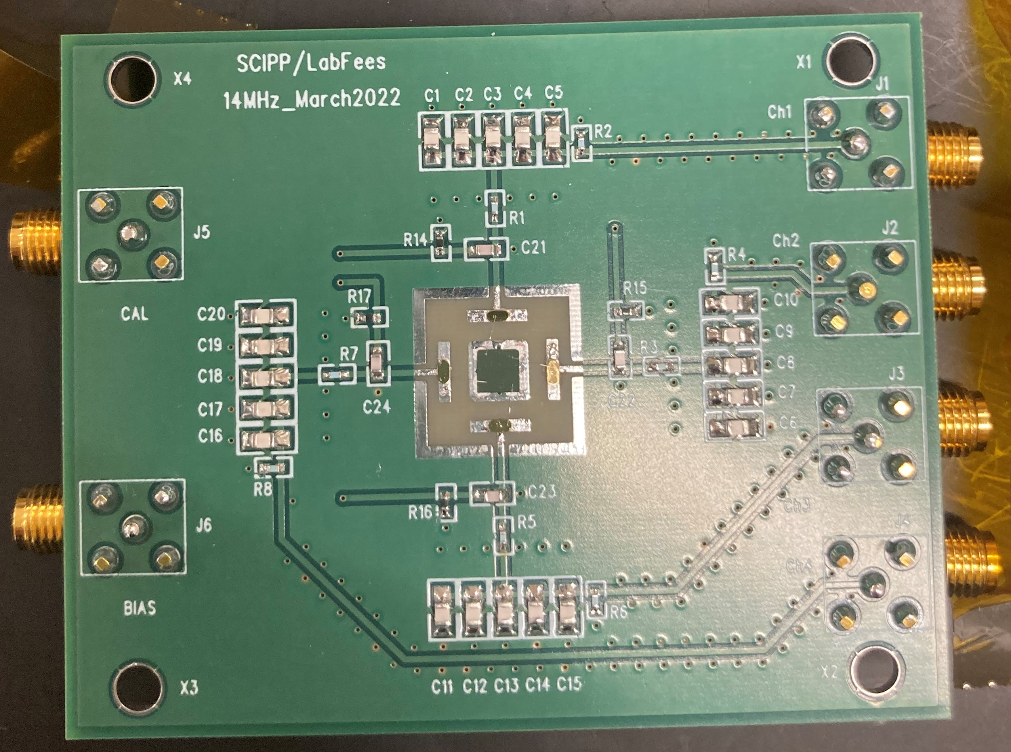
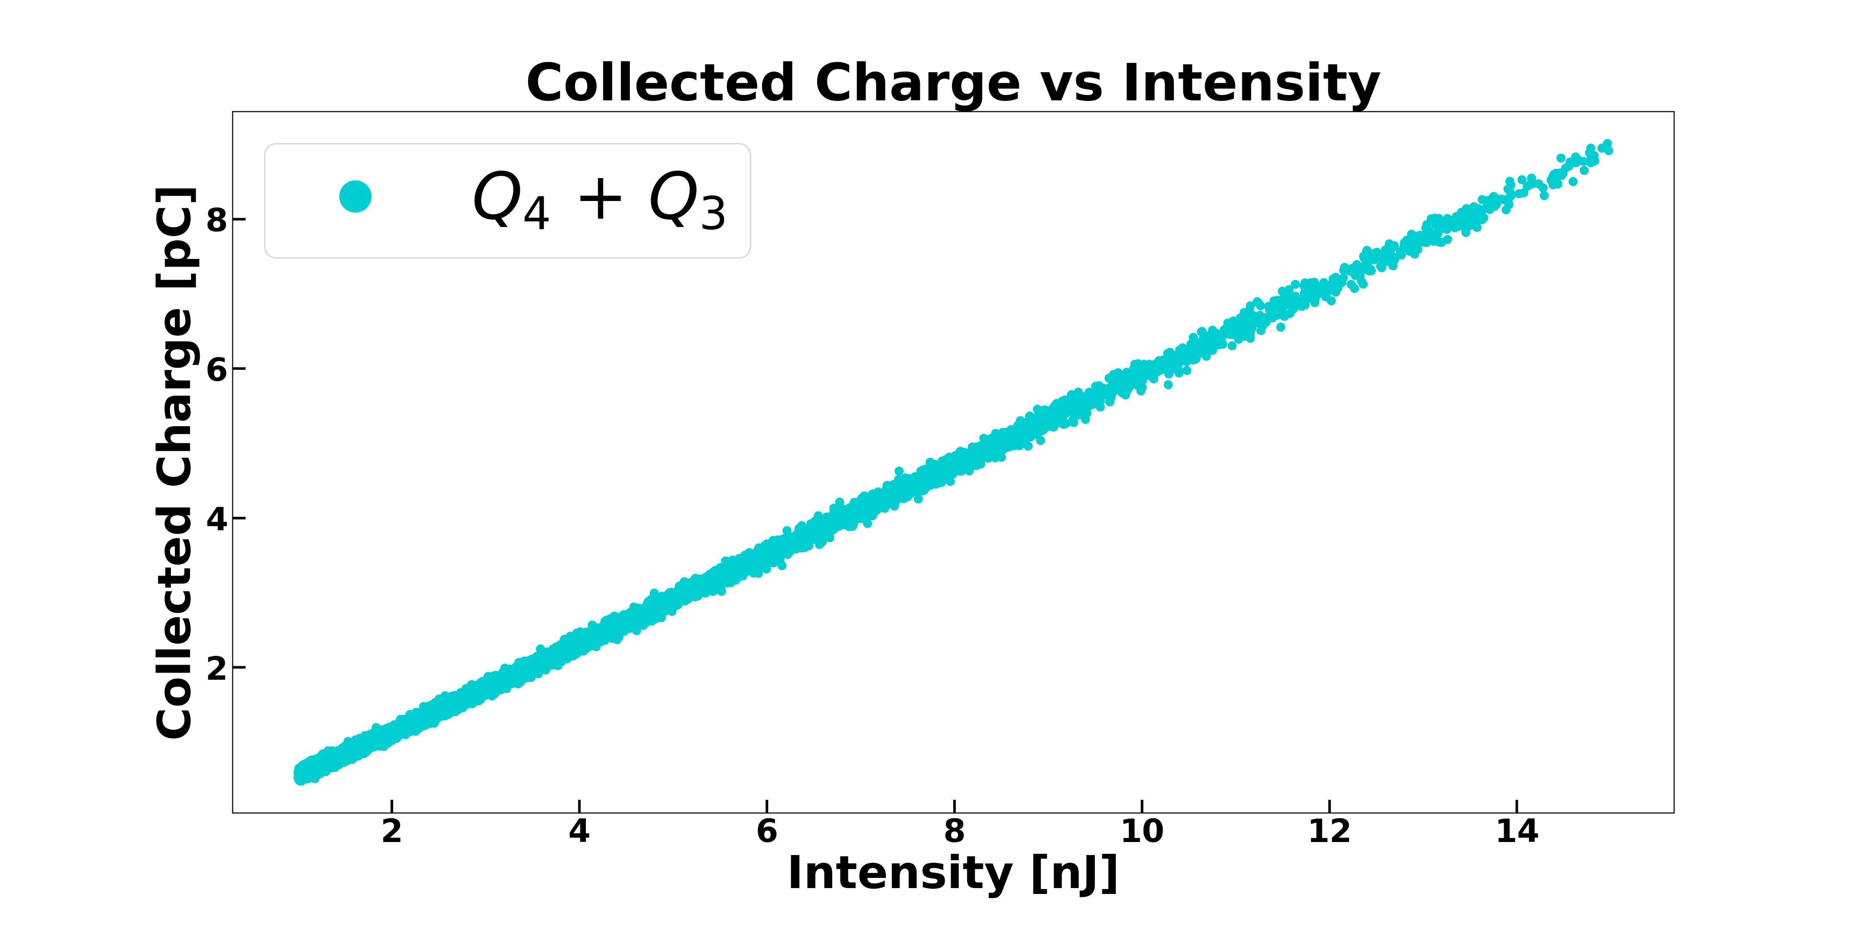
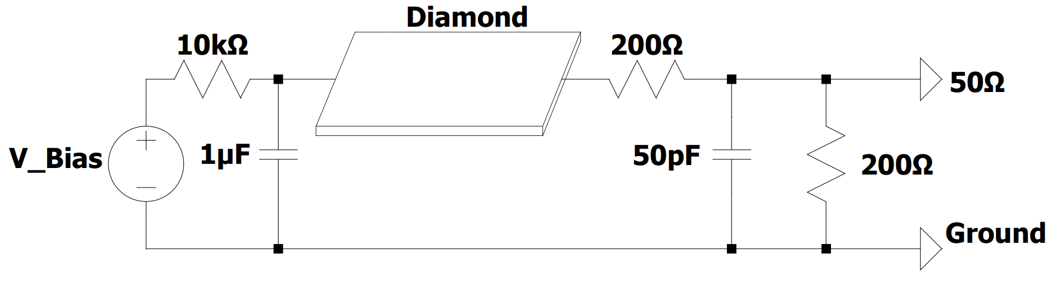
50 MHz Position-Sensitive Diagnostic (proof of concept)
4 quadrant diamond sensor
∼ 20 ns pulse time
Sweep across 2 quadrants
Charge resolution ∼ 0.025 pC
~ 10 ns shaping network

Slide 7
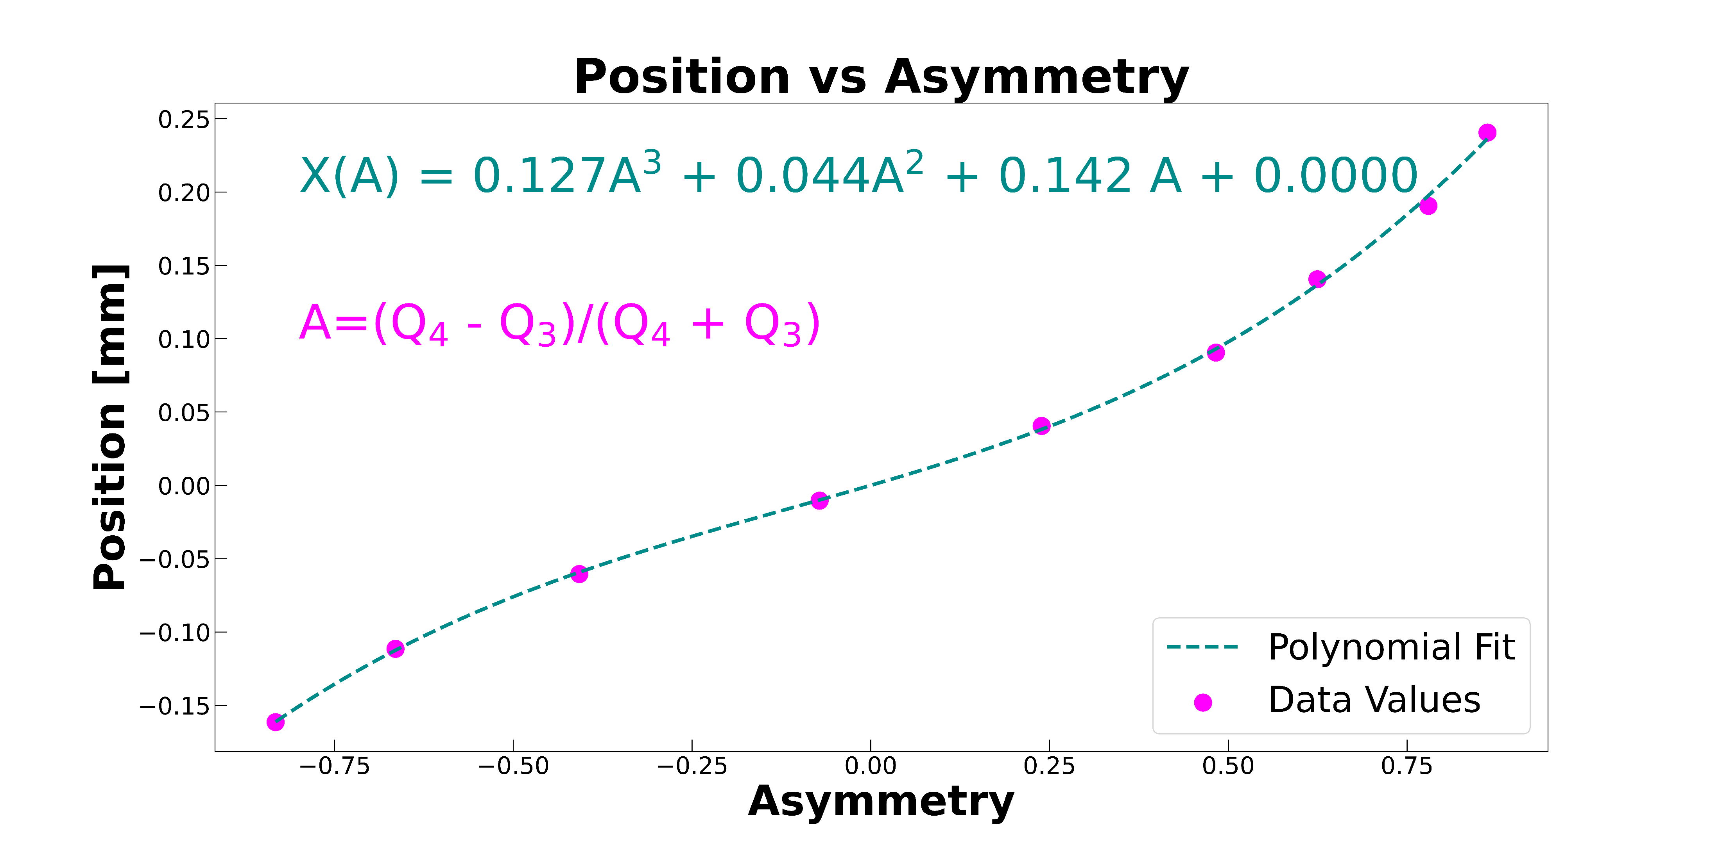
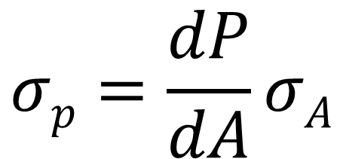
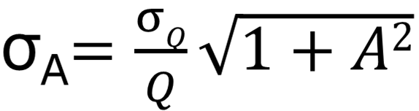
50 MHz Position-Sensitive Diagnostic (proof of concept)
P
→ Position Resolution
Asymmetry ranges only between -1 to 1
For 4 nJ pulse ~ σ_{Q} of 0.025 pC yields to 2 μm centroid position resolution (pulse-by-pulse)
ASIC needed to extend speed by 20X +

Slide 8
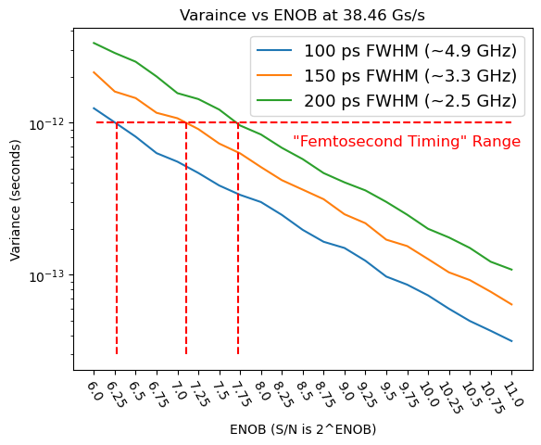
ASIC Specification
Timing Accuracy vs ENOB and analog BW (sampling at ~40 GS/s)
James McDaniel, UC Santa Cruz 2023

Slide 9
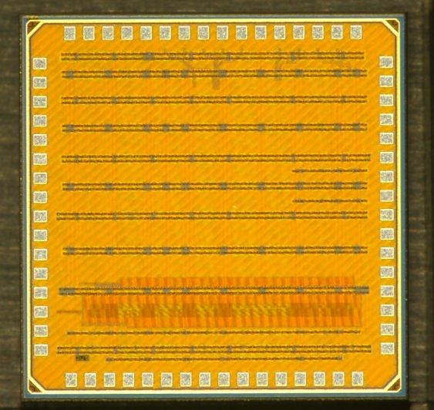
First ASIC – FPS-0 (was LABFEES)
Intended to explore front end architectures
Designed for 11 GHz bandwidth
3 transimpedance (current mode input) amplifiers
3 voltage sensitive inputs
Included ring oscillator and internal bias network
Measured BW of 3.5 GHz. Limitation was use of active inductors in the front end to reduce silicon area
Implemented in 65nm CMOS
First ASIC submitted 04/2022

Slide 10
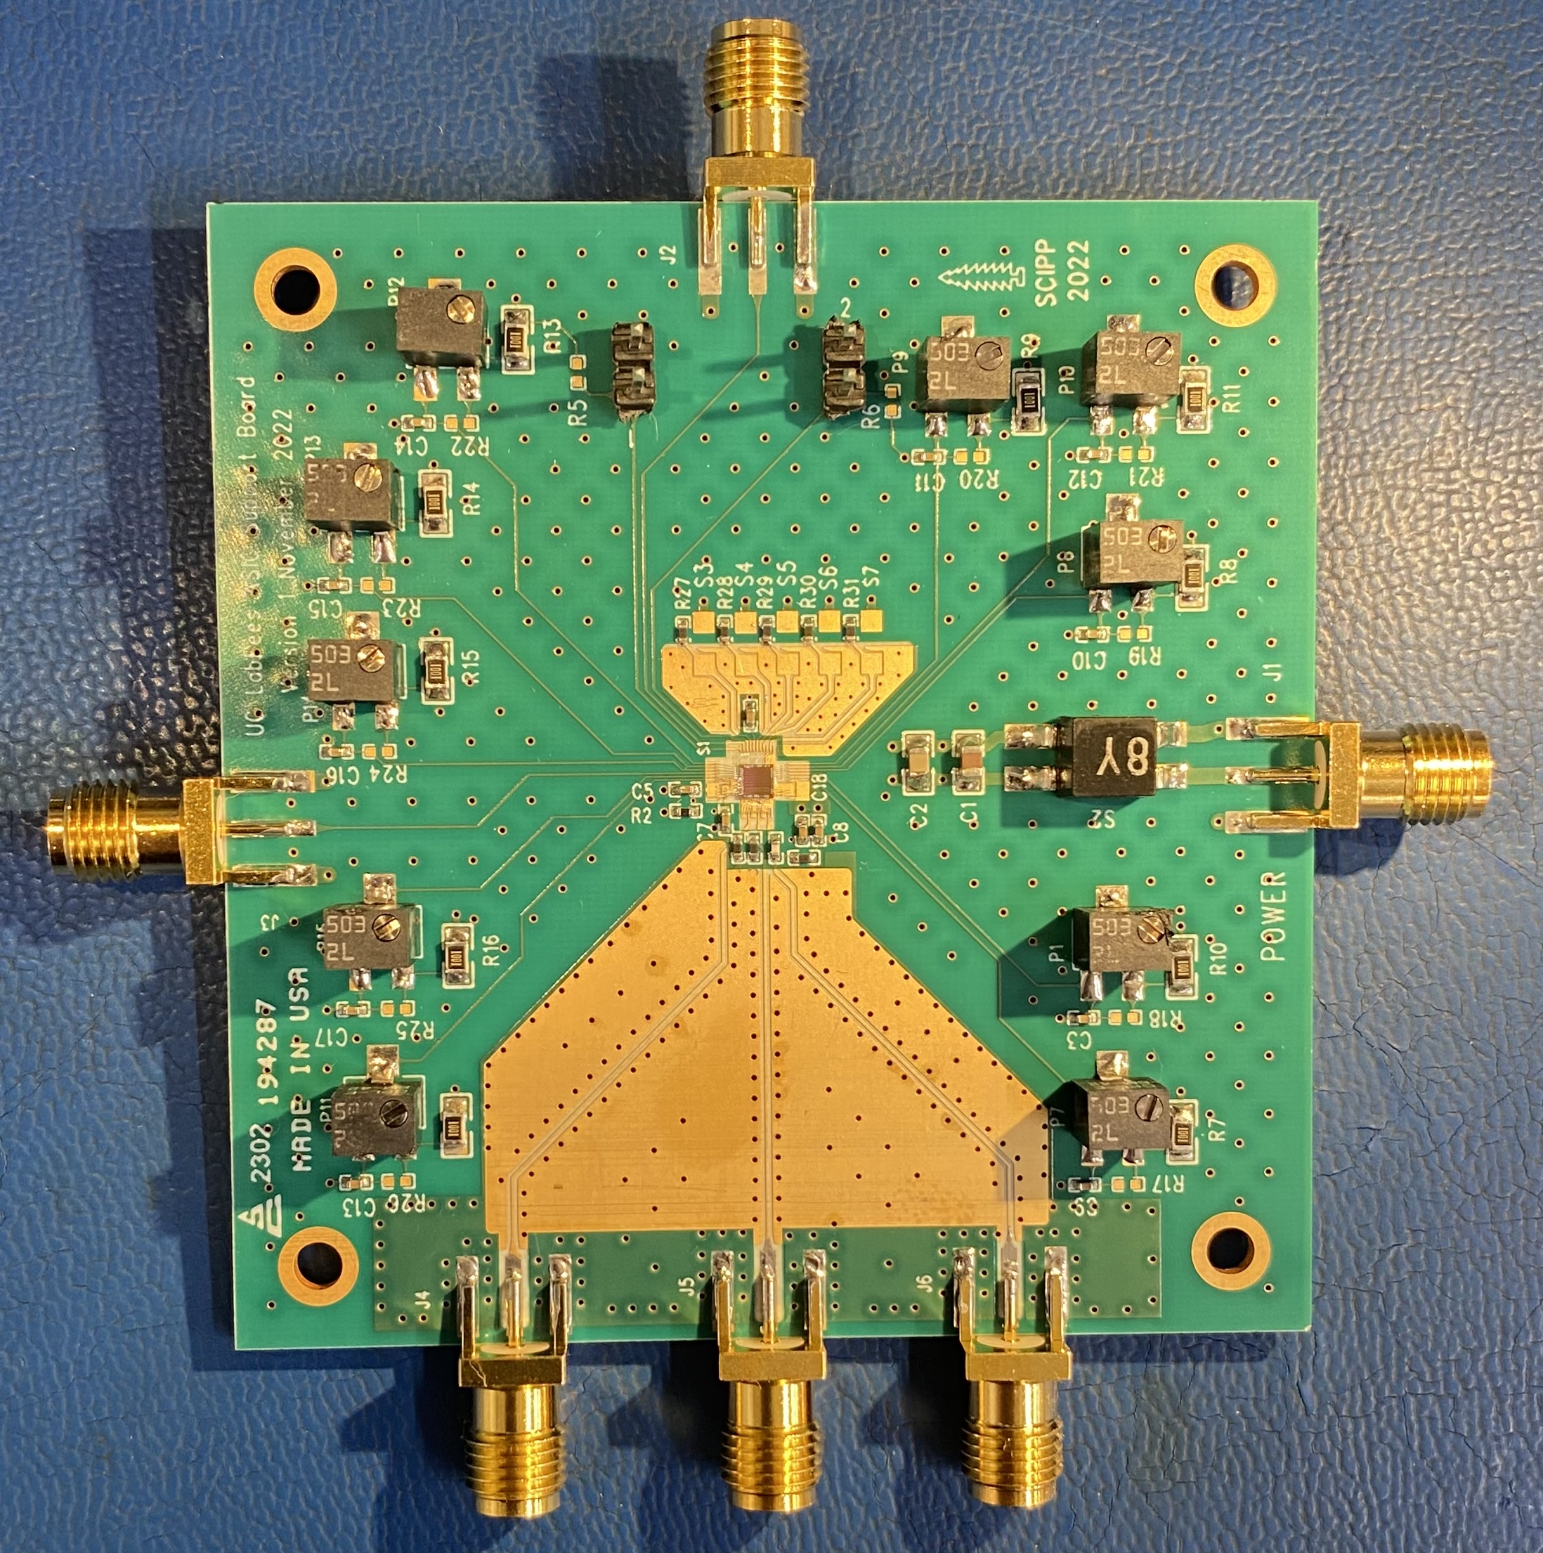
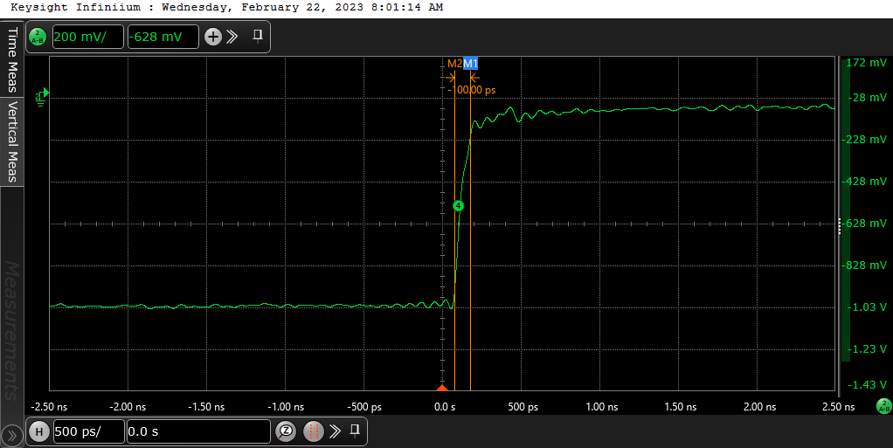
First ASIC (FPS-0) performance
Pulse input
Probed Signal
Fast pulse input (∼ 40 ps rise time)
Observed 100 ps rise time with Probe
Signals preserved to at least 3.5 GHz bandwidth
Preliminary HyperLynx (RF solver) simulation of PCB suggests > 5 GHz preserved at input to chip
ASIC
Rene Padilla, Ulitima 2023

Slide 11
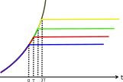
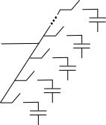

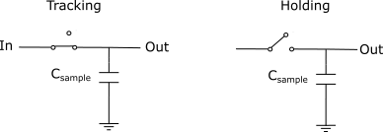
Second ASIC – FastPulse Precision Sampler (FPS-1)
Input pulse
Switched-Capacitor array
Conrad Rowling, UC Davis MS Thesis
Concept: use array of capacitors to store fast pulse in “analog memory” and digitize slowly
Useful because sampling is a faster process than quantization

Slide 12
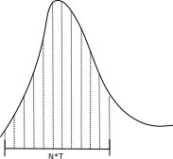
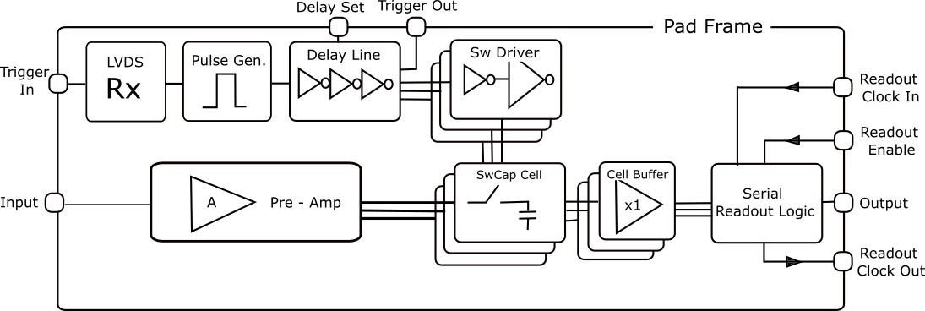
Second ASIC – FastPulse Precision Sampler (FPS-1)
FPGA
(ADC)
Second ASIC submitted 03/2023
Specification | Value | Unit
Sample Rate | 50 | Gs/s
Capture Window | 1 | ns
Readout Rate | 500 | MHz
Resolution | 10 | bits
Four-channel waveform digitizer with analog output
Externally-triggered sampling
Improved current-mode input amplifier
Implemented in 65 nm CMOS

Slide 13
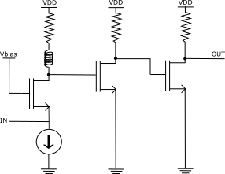
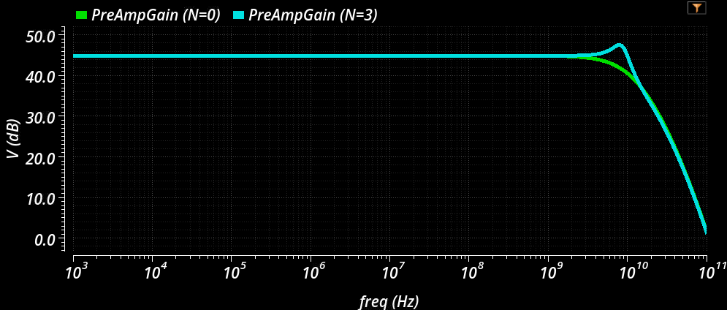
Second ASIC - FastPulse Precision Sampler (FPS-1)
Tunable pseudo-resistors
Key changes to address UCFEES ASIC shortcomings:
Common-gate input with inductive peaking ← key
Multi-stage, open-loop design
Dedicated low-gain output stage
Peaking for BW extension
Physical inductor
Gain Stage
Transimpedance State
Output Stage

Slide 14
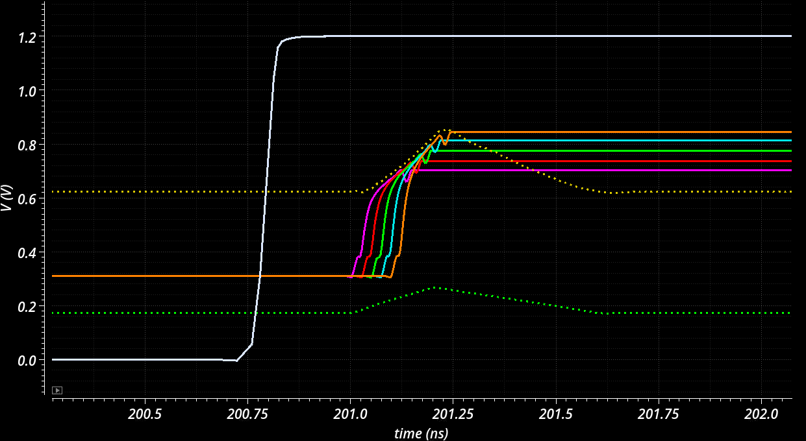
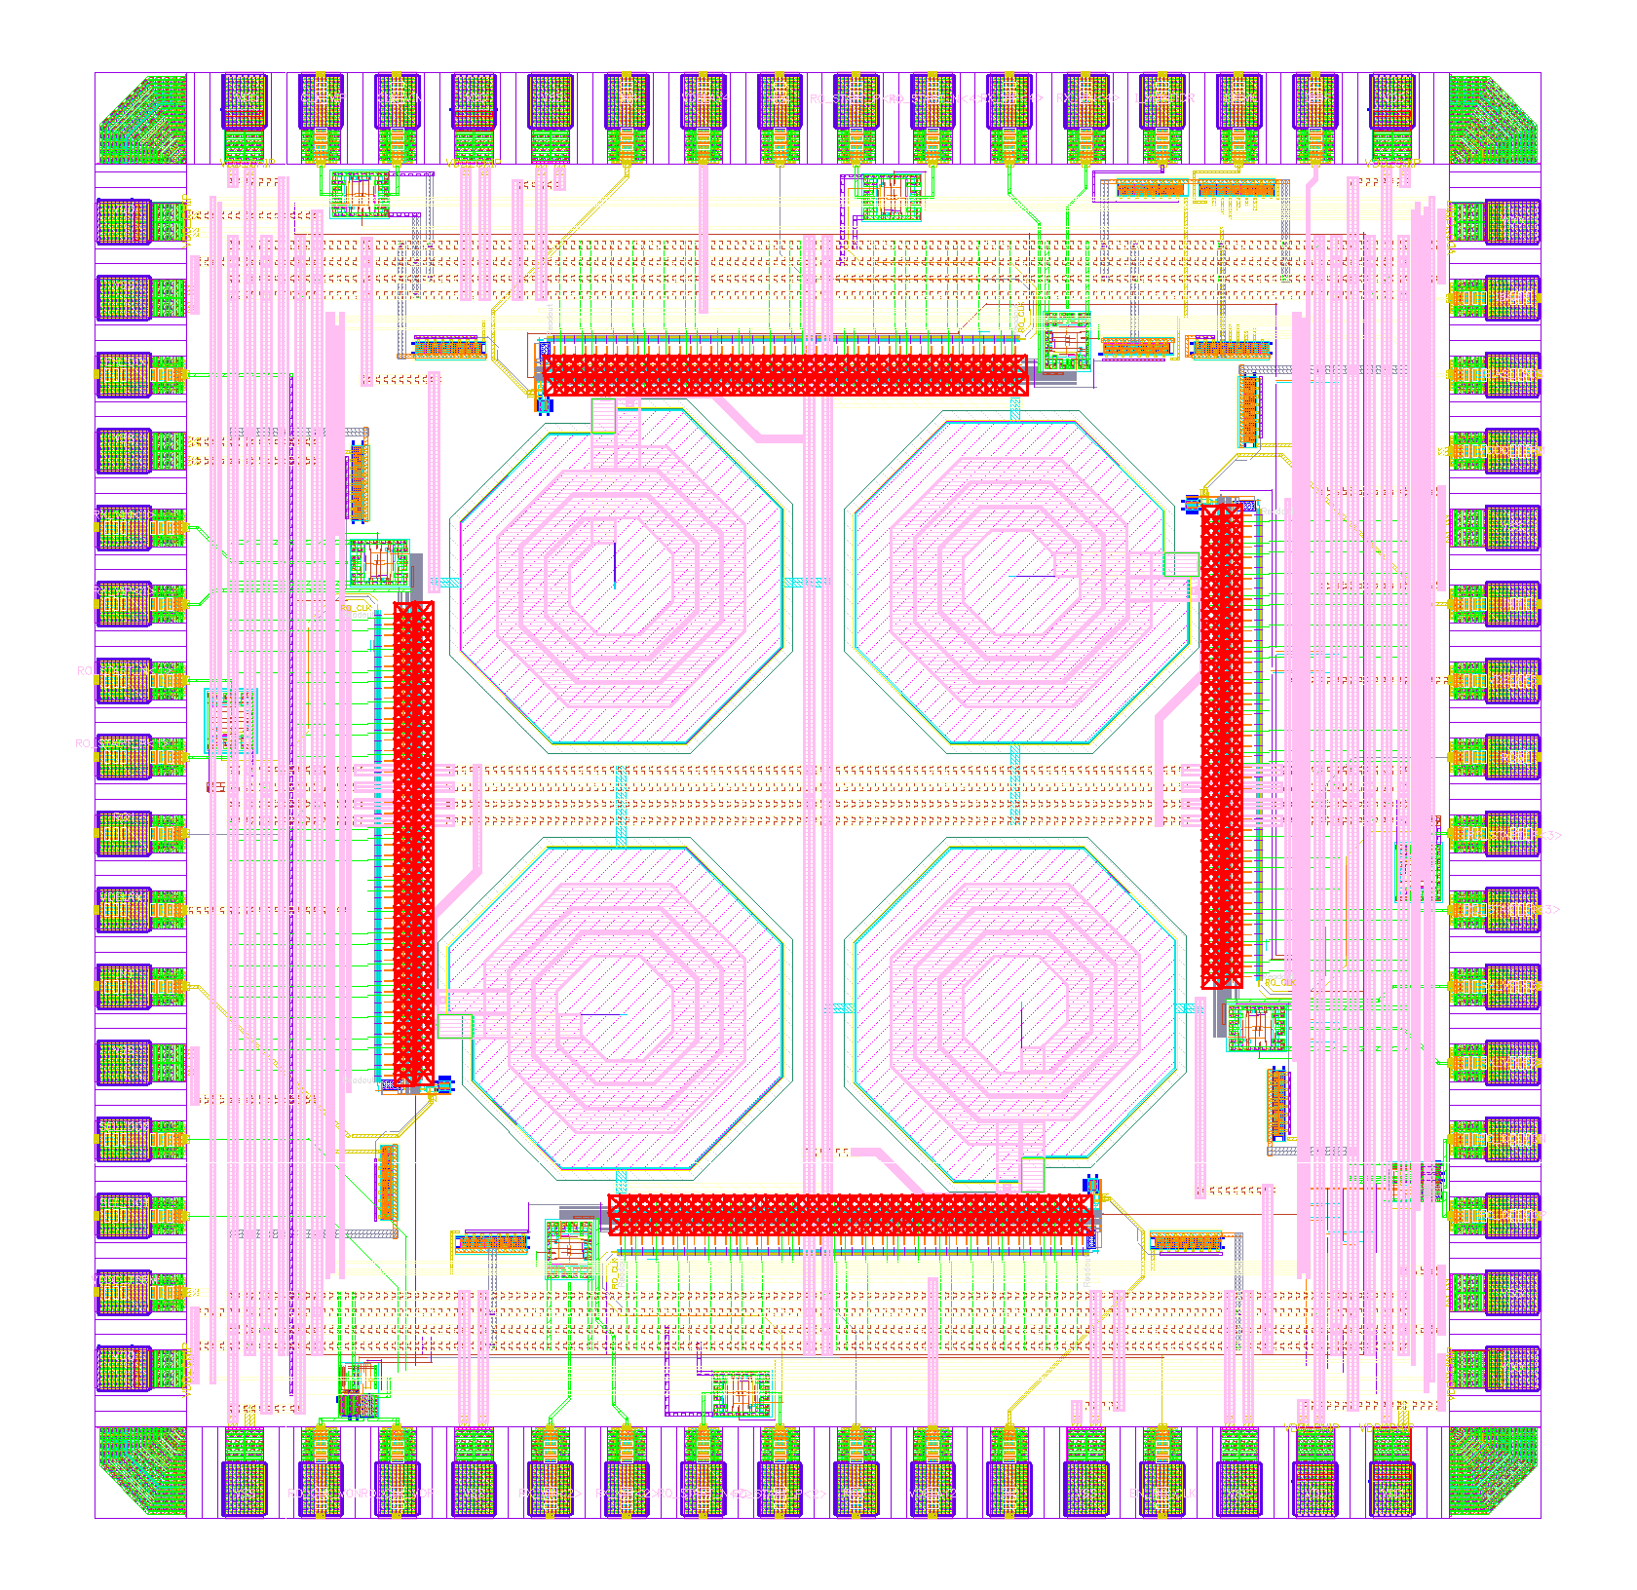
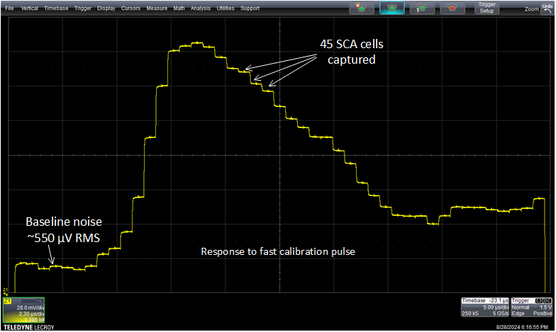
Second ASIC - FastPulse Precision Sampler (FPS-1)
LVDS
trigger
Amplified
Input pulse
FPS Simulation Result
Measured Performance
Inductors for gain peaking

Slide 15
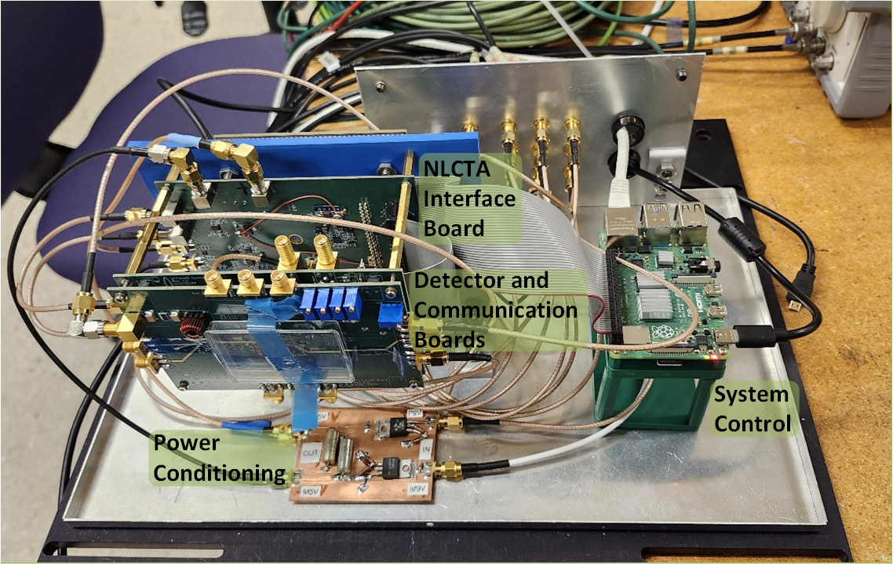
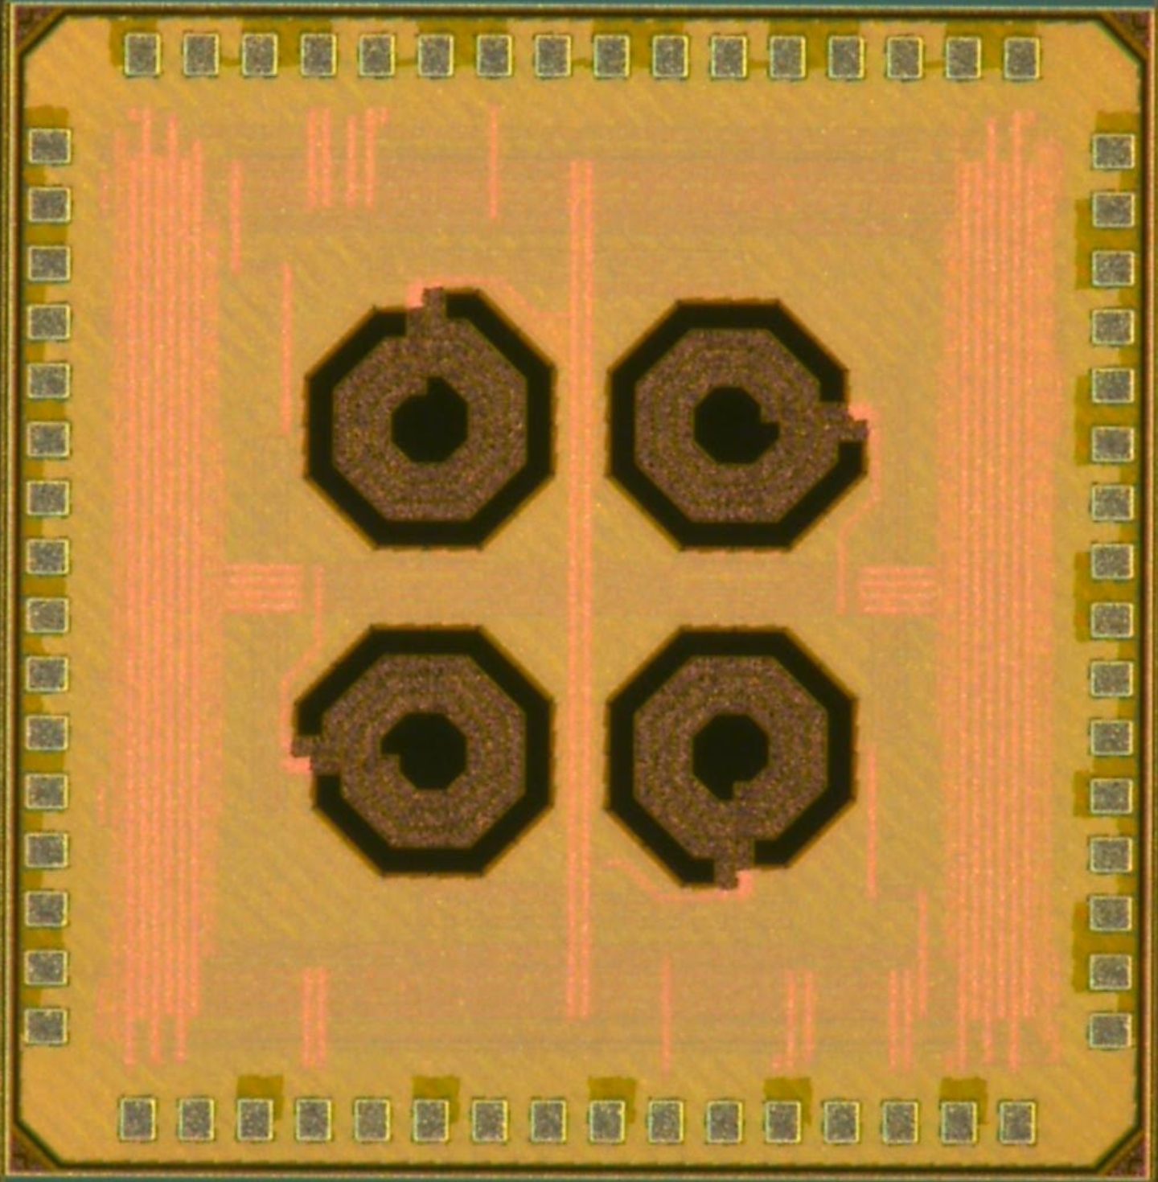
System Test at NLCTA at SLAC
2 mm
2 mm
FPS-1 – 65 nm CMOS
NLCTA = Next Generation Linear Collider Test Accelerator

Slide 16
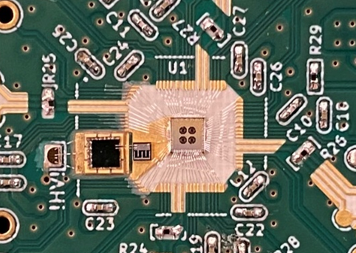
Zoom in on readout board
Readout Board
16

Slide 17
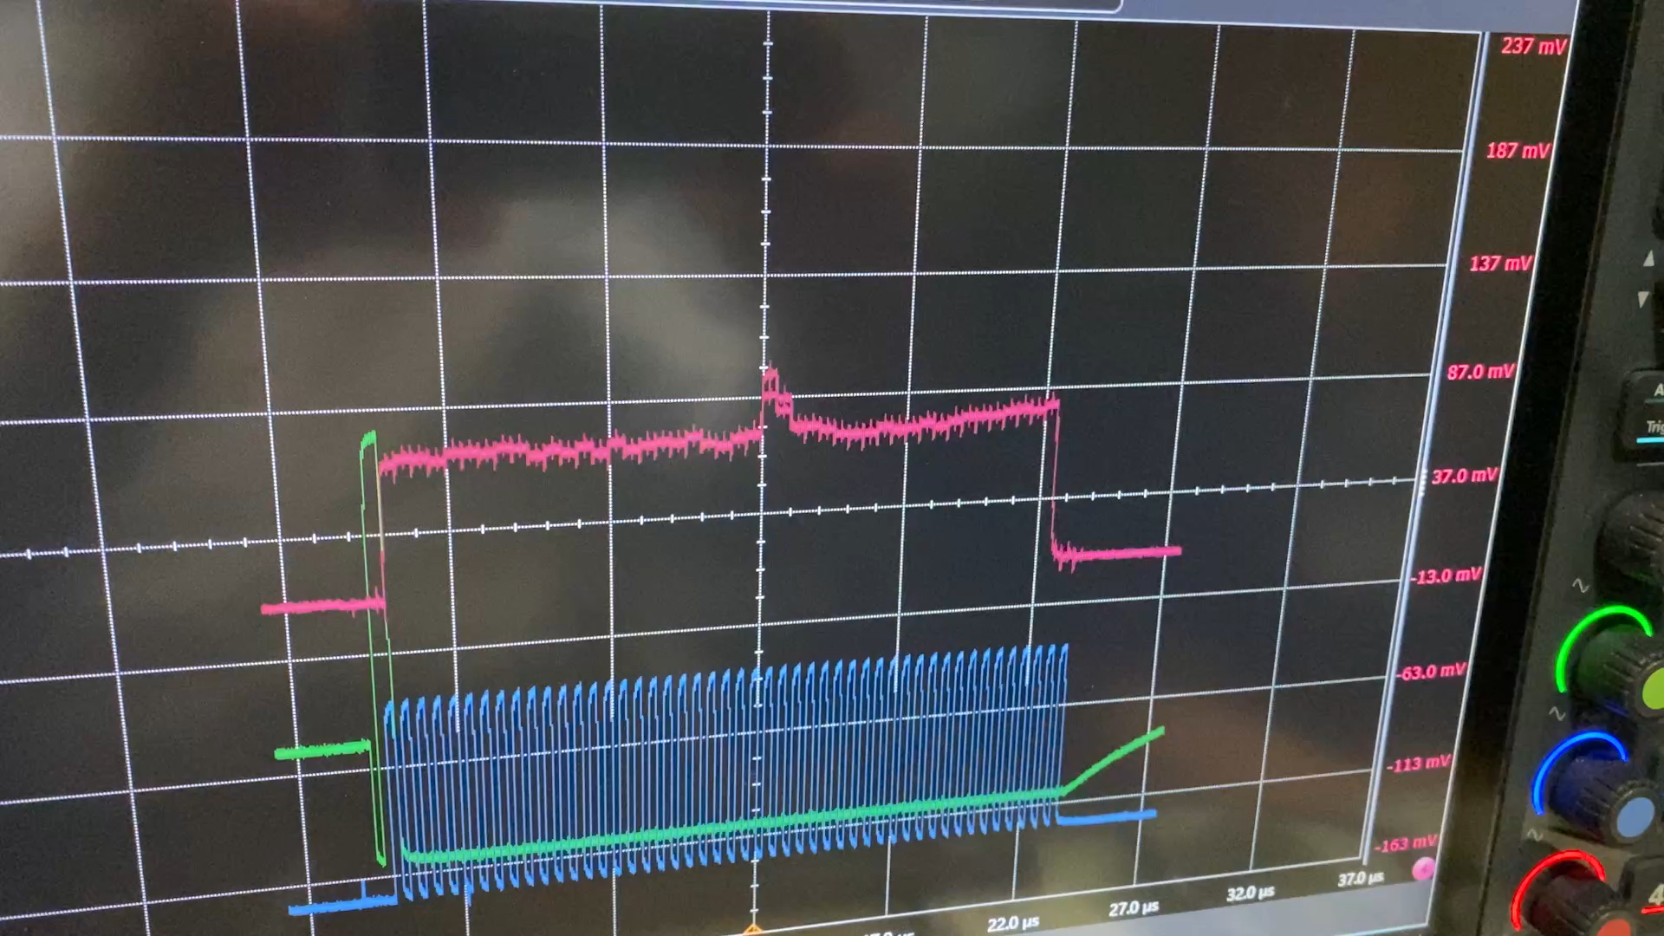
July 16, 2025: Beam delivered to the system
Search for beam with slowest sampling rate (~18 GS/s)
Capture window ~2.5 ns
Courtesy: B. A. Schumm, UCSC/SCIPP
Notes:
On July 16th, 2025, beam was first delivered to our system - this was a really exciting moment. We initially searched at 18 gigasamples per second with a 2.5 nanosecond window and successfully found the beam.

Slide 18
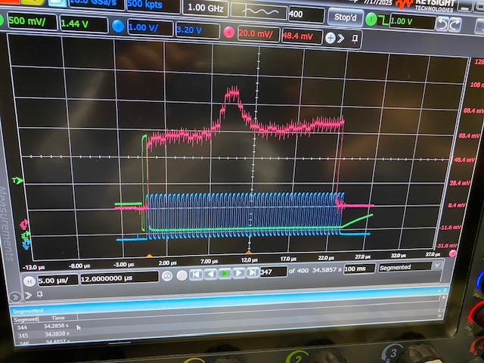
July 16, 2025: Beam delivered to the system
With beam found, switch to fastest sampling rate (~36 GS/s)
Capture window ~1.25 ns
Read out SCA at 2 MHz (500 ns per capacitor)
Courtesy: B. A. Schumm, UCSC/SCIPP

Slide 19
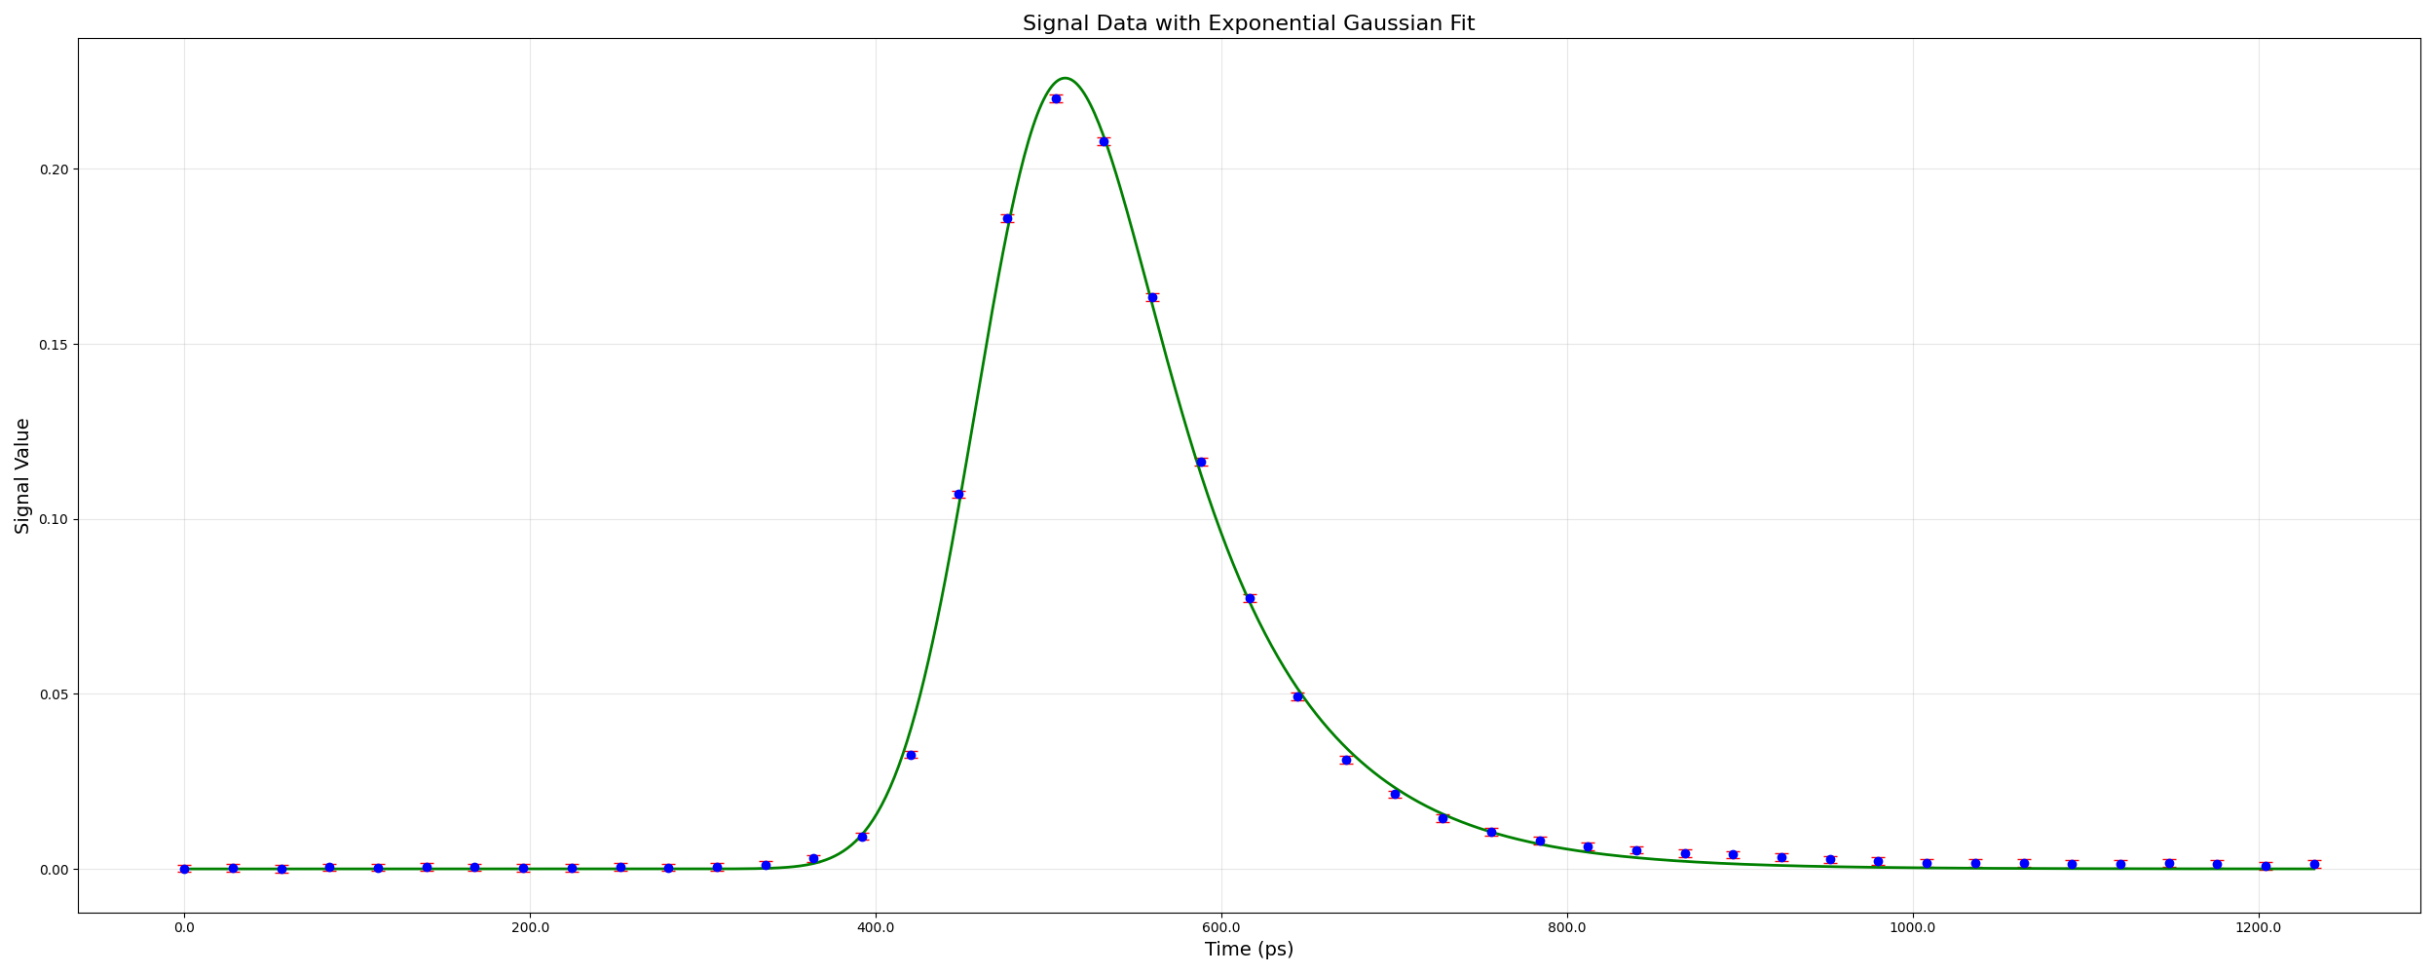
Measured beam pulse after averaging and fit
Cleanup: subtract pedestal, remove clock spikes, average ~1000 points → one value per cap
Align: use Δt calibration to map cells to time; reconstruct on 28 ps grid (~1.25 ns window)
Fit: Exponentially modified Gaussian fit to the samples; example pulse near top of linear range

Slide 20
Third / Fourth ASIC (FPS2 / FPS3)
Key additions:
Delay Locked Loop to stabilize delays
Internal trigger capability
On-chip ADC to simplify interface (FPS3)

Slide 21
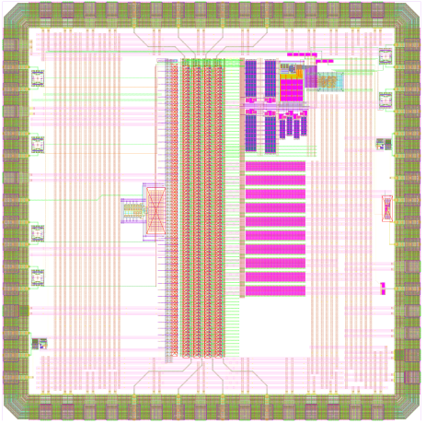
FPS2 fabricated; characterization underway
2 mm
Co-designed with compact signal path load (Spice level for now)
Preamp change: regulated common gate amplifier for predictable 8+ GHz BW
DLL from 1 GHz ref; low‑jitter multiphase sampling; replica path for pulse conditioning
90 cells → 2.25 ns window at 25 ps spacing
Improved routing/buffers to cut crosstalk;
ADC will be added for FPS3
2 mm

Slide 22
Comparison of FPS ASICs
ASIC | BW [GHz] | Max Sampling Rate [GS/s] | Memory locations | Noise [µV-rms] | Resolution (ENOB) | Process [nm] | Fab Date
UCFEES (FPS-0) | 3.5 | N/A | N/A | 750 | N/A | 65 | 2022
FPS-1 | 5 | 36 | 45 | 550 | ~ 8 | 65 | 2023
FPS-2 | 8 | 50 | 90 | TBD | ~ 9 | 65 | 2025 (under test)
FPS-3 | TBD | TBD | TBD | TBD | 10 (goal) | 65 | 2028 (expected)

Slide 23
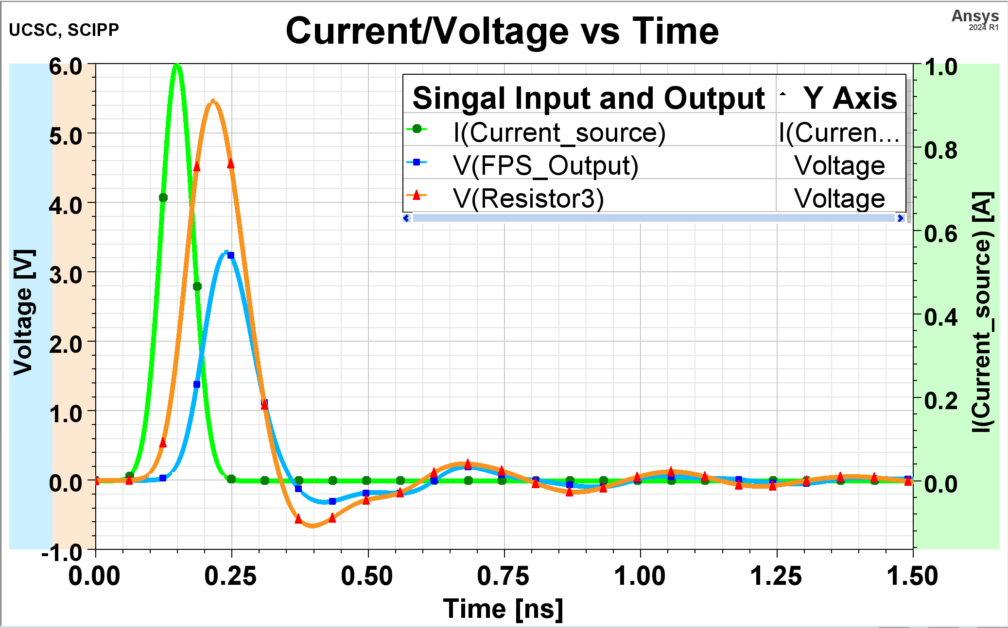
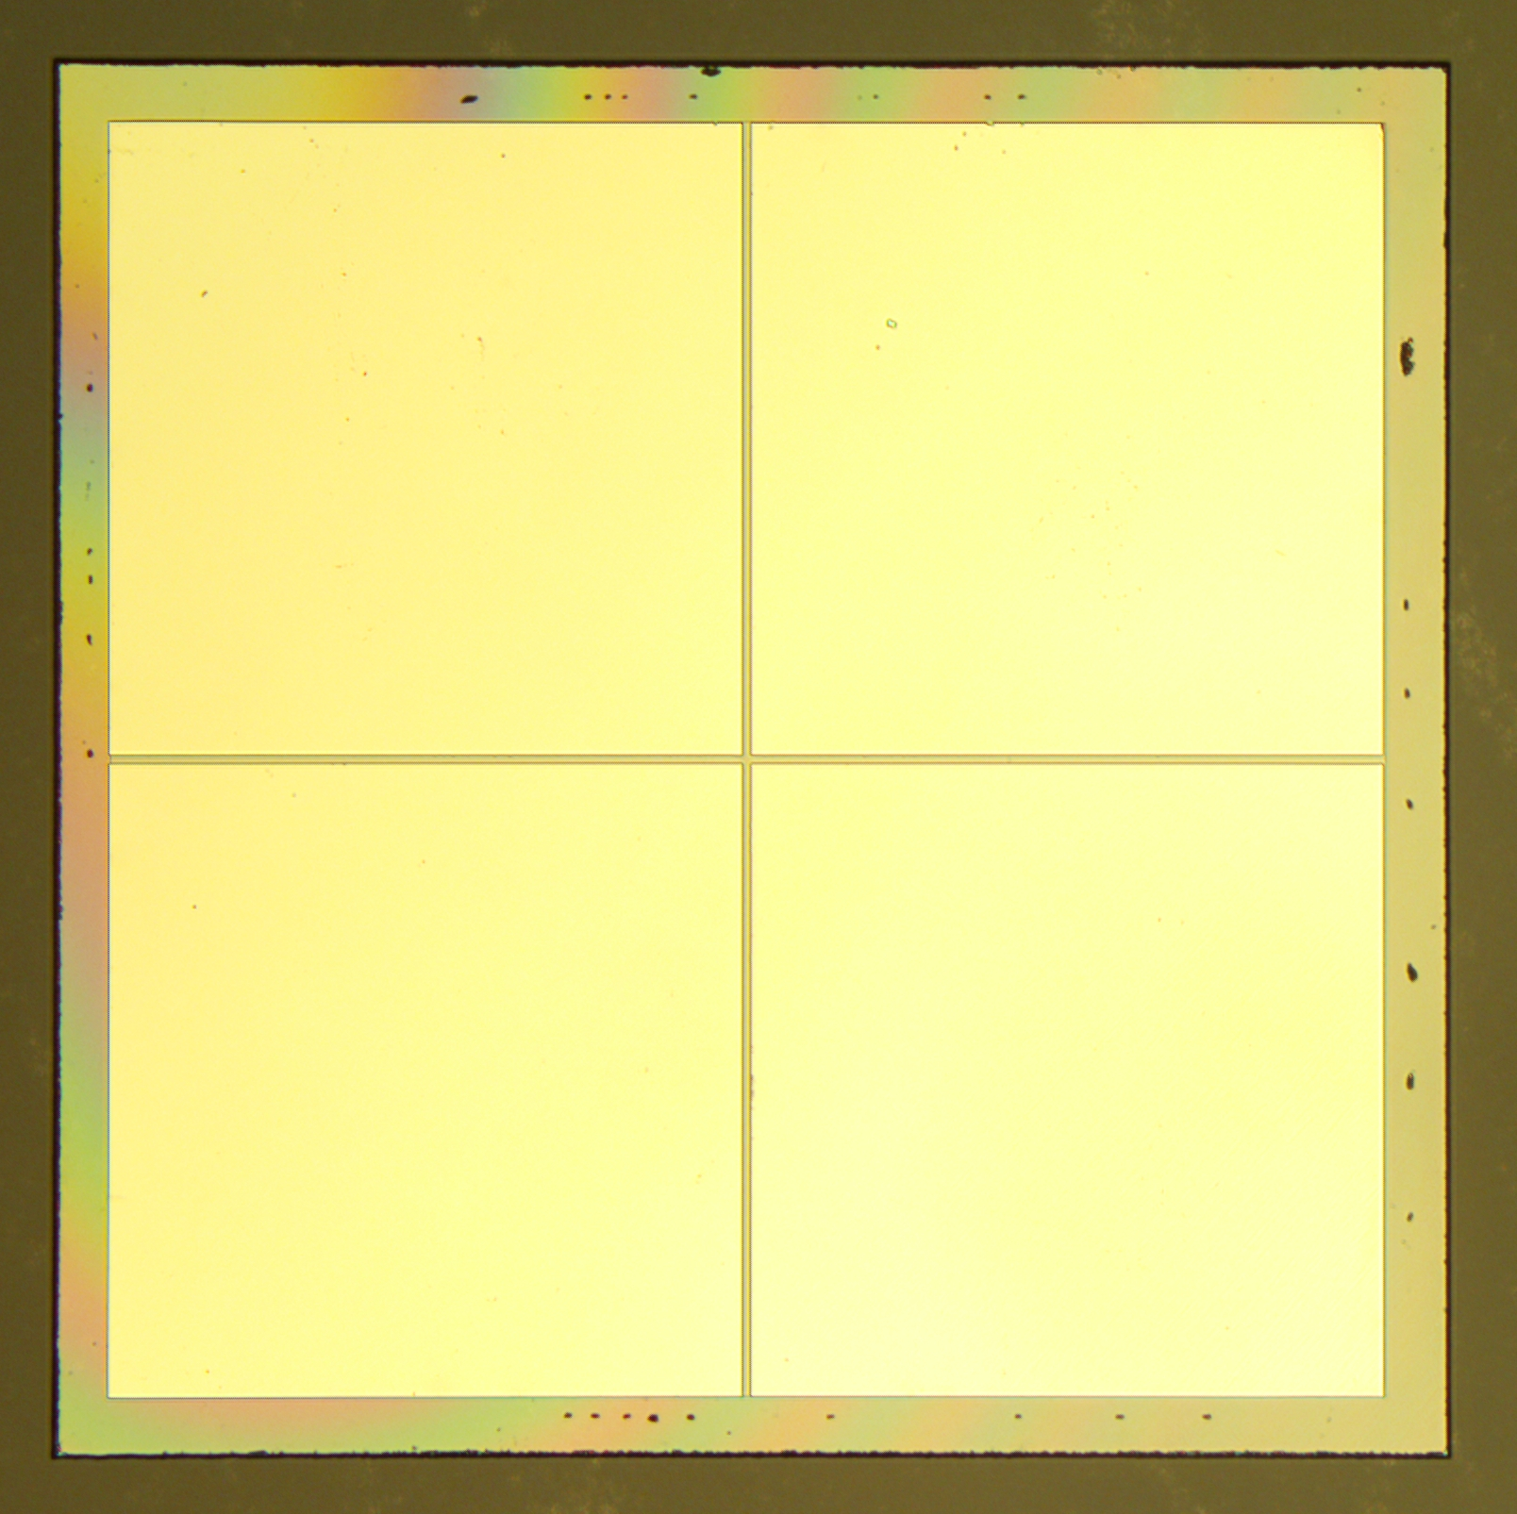
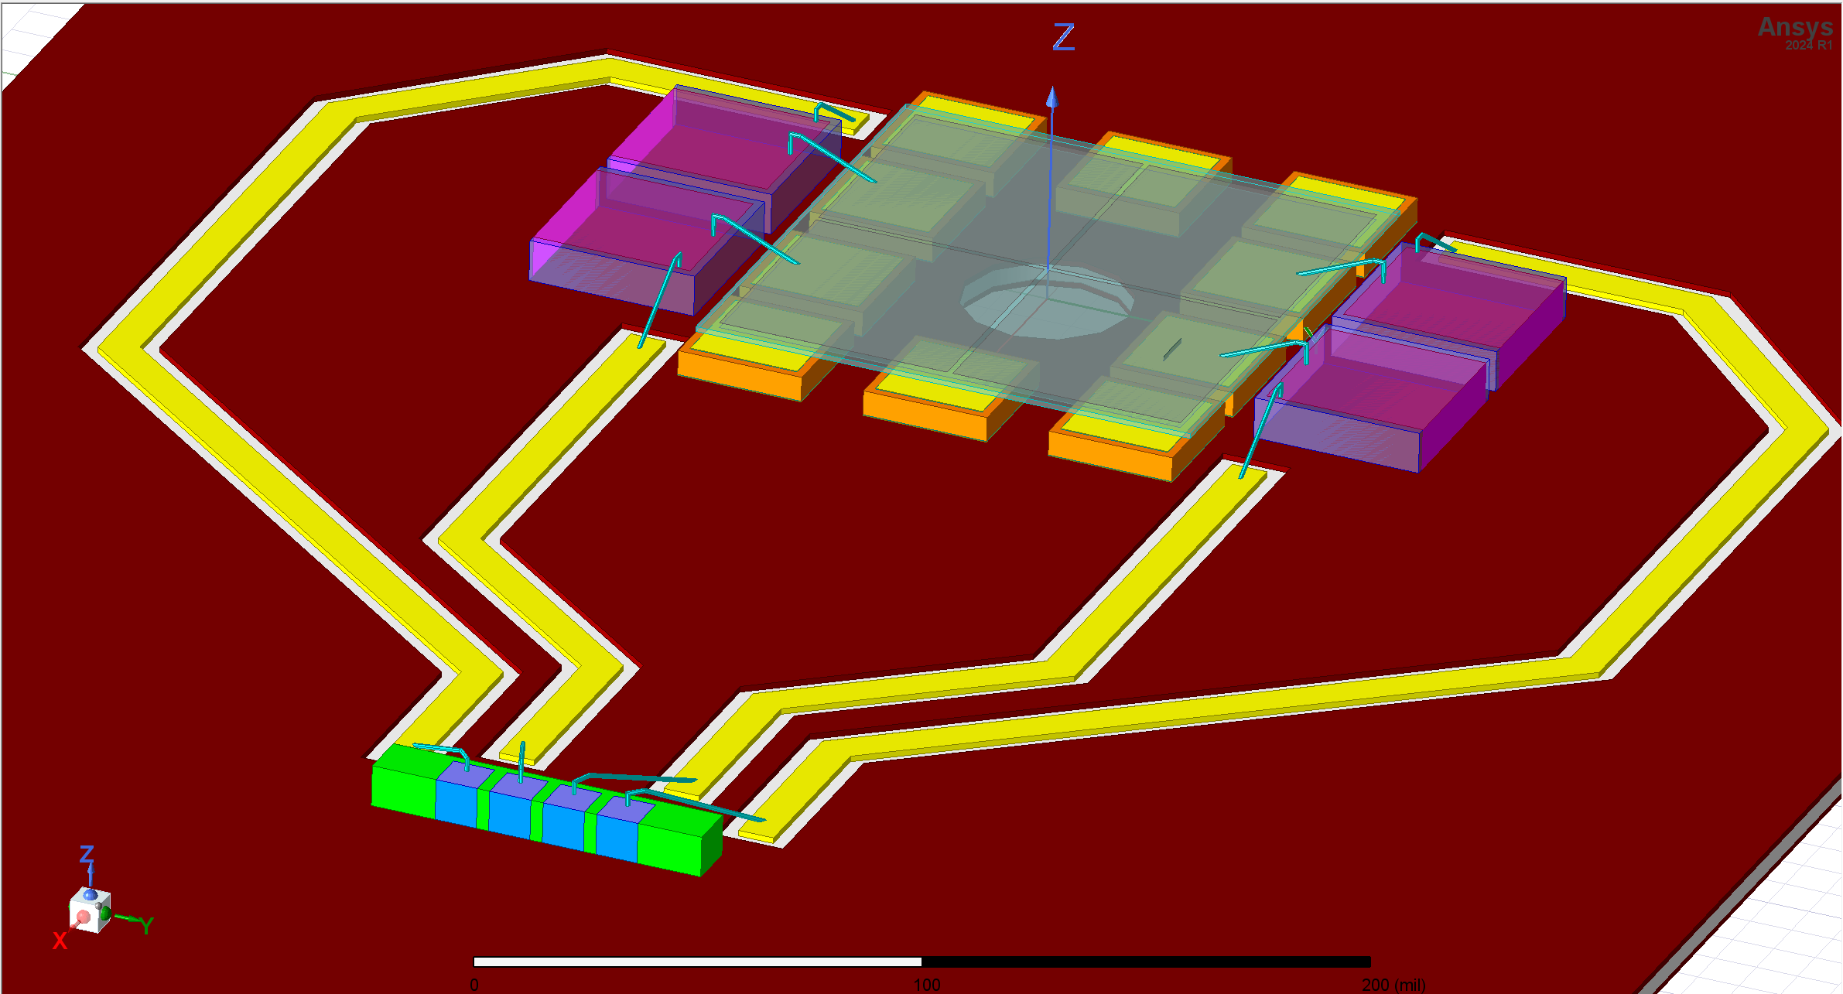
Future: Multi-GHz Position Sensing System
3 mm
Diamond Sensor (LANL)
Input current pulse
HFSS Simulation
10 Ohm back-contact sense resistor
50Ω traces on Rogers Material
FPS is 50Ω resistive load

Slide 24
Conclusion
Developing high-speed diagnostics for next generation accelerators. End-goal is ease of use as well as performance
Successfully demonstrated in-situ beam position monitoring
Multi-GHz (5 – 10+ GHz) analog BW, 50+ GS/s, 10b+ readout generally useful
Have made progress on diamond sensor, readout ASIC, and signal path

Slide 25
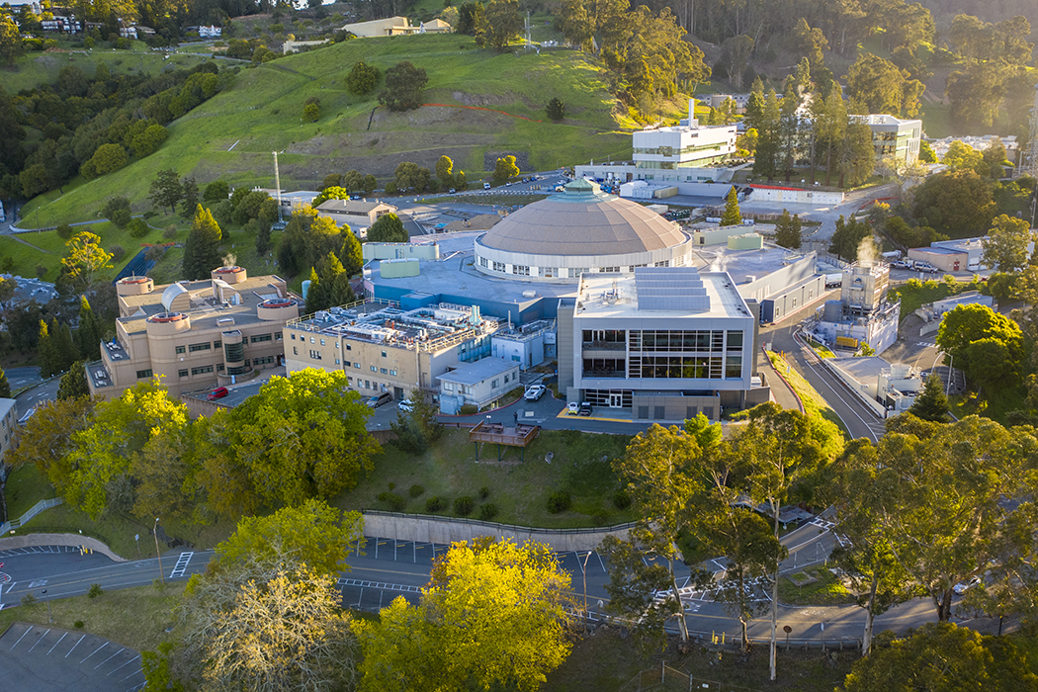


Thank You
This work was supported in part by the U.S. Department of Energy under Contract No. DE-AC02-05CH11231

