Slide 1

Data Acquisition Architecture in TELE-NEURART project
25th IEEE Real Time Conference
Donato Romano
INFN Sezione di Bari

Slide 2

TELE-NEURART PROJECT
The TELE-NEURART project represents the first European-scale virtual pediatric network dedicated to the advanced management of childhood neurological disorders.
It focuses on four main categories of disability: brain injuries (congenital or acquired), intellectual disability, autism spectrum disorder and neuromuscular diseases.
The aim of this project is to build an advanced digital pediatric network for the diagnosis, monitoring, and rehabilitation of neurodevelopmental disorders.

Slide 3
Objective
The TELE-NEURART project aims to:
🧠 Integrate clinical and digital data
Collect and harmonize data from hospitals, medical devices, sensors, and telemedicine platforms.
📡 Enable tele-monitoring and tele-rehabilitation
Support patients directly within their everyday living environment, reducing hospital visits and travel needs.
🤖 Leverage AI and digital biomarkers
Use Artificial Intelligence models to identify biomarkers supporting personalized diagnosis and treatment pathways.
🏥 Standardize clinical protocols
Share methodologies and rehabilitation workflows across the national healthcare network.
📊 Create an AI-ready data platform
Ensure interoperability, data quality, security, and scalability for pediatric clinical data.

Slide 4









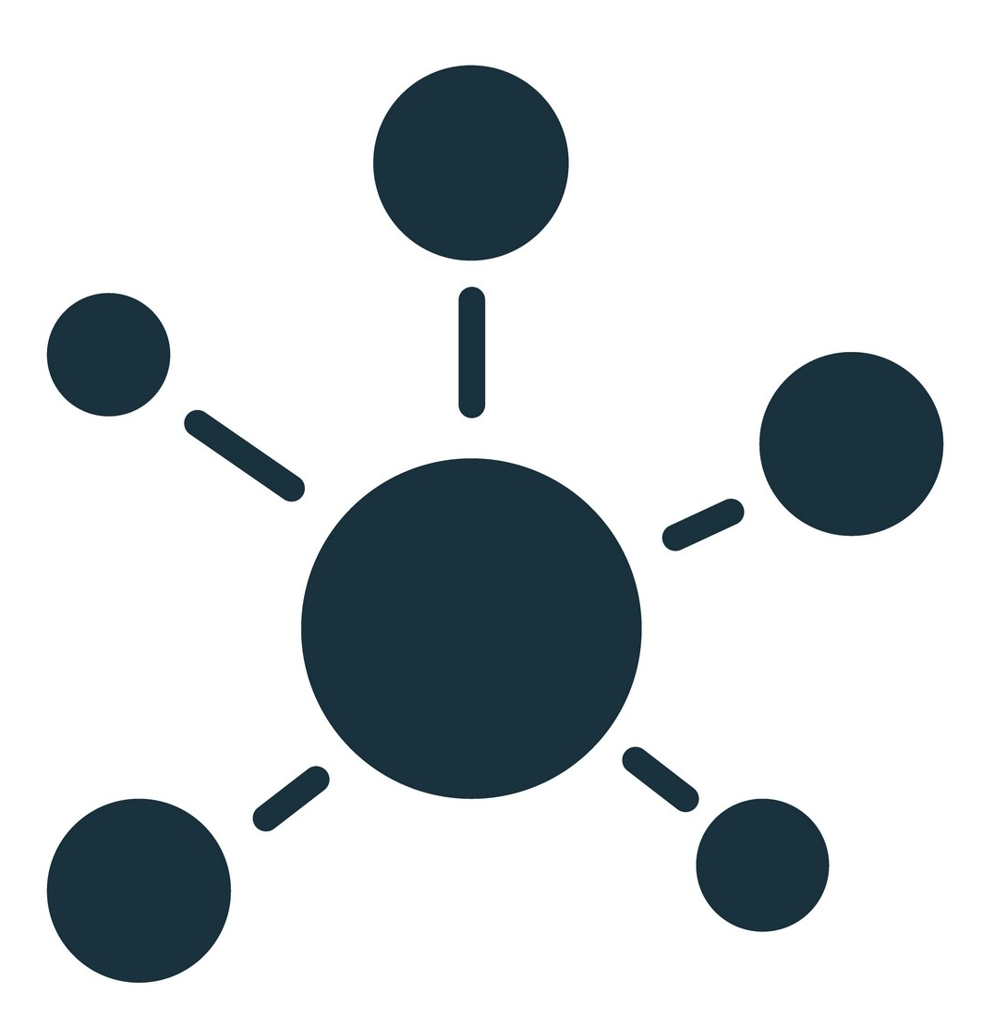
Operational context
Clinic 1
Clinic 2
Several partners contribute to data collection, each with specific objectives and tools.
Key points:
Complete interoperability between data collected in different centers
Multiple data storage (textual, numerical, spatial, temporal, multimedia)
Distributed and synchronized data collection via HM-MM interface.
Device
Devices
Web form
Clinic 3
A.I.
DataBase
Neural Network Clustering
Web form
Notes:
There are several project partners that contribute to the data collection, each with specific objectives and tools. It is necessary to prepare a tool capable of guaranteeing (1) complete interoperability between the data collected in the different hospital centers (shared syntax and semantics) (2) the storage of useful data, whether textual, numerical, spatial, temporal or multimedia (3) the collection distributed via MAN-MACHINE and MACHINE-TO-MACHINE interfaces.

Slide 5


End-to-End Data Flow
Patient / Devices
Hospital Acquisition
Middleware
INFN Cloud
Database / Data Lake
AI Analysis
Clinical Insights

Slide 6
Key Technical Challenges
🔒 Security & Governance:
- GDPR-compliant pediatric data management
- Anonymization and pseudonymization
- Role-based access control
- Secure cloud storage and transmission
🤖 AI-Ready Infrastructure:
- Feature extraction pipelines
- Scalable storage and processing
- Metadata-driven dataset organization
- Support for AI and digital biomarker analysis
🔄 Interoperability:
Heterogeneous clinical, imaging, and sensor data
Different formats, semantics, and acquisition protocols
Cross-center data harmonization
🌐 Distributed Acquisition:
- Multi-center synchronized collection
- Real-time and longitudinal monitoring
✅ Data Quality:
- Missing or incomplete data handling
Signal validation and preprocessing
Traceability and reproducibility of datasets

Slide 7



Operational tools
Web-based system designed for distributed, domain-independent data collection
Create complex data entry forms
Manage data security
Use an Relational Database Management System (RDBMS) for improved data consistency
WebForm
Requires limited HW/SW resources
Installable on-premise (on the INFN cloud) ensuring data localization
Deployment
Implements M2M interface for data retrieval and dissemination
It allows the automation of data collection processes from equipment
API

Slide 8


Process proposal
Output
Pre-collection
Functional requirements specification
Functional requirements analysis
Interface design
Software development
Requirements Specification Document
Interface Mockup and E-R Scheme
System Design with RedCap and Server Configuration
Software Delivery to Production
Collection
  Implementation of the clinical protocol
Analysis
  Use of AI approaches on the collected data

Slide 9
Example of operational scenario
An 8-year-old patient is evaluated for Cerebral Palsy (CP) and congenital brain injury.
Clinical objectives:
Detailed classification of the condition,
Analysis of cognitive and motor functions,
Verification of any associated genetic syndromes

Slide 10
Specification of functional requirements
Define the data collection protocol:
  What data do we collect?
  What type of data and through what tools? E.g., web forms, machines, etc.
  What are the current data collection processes?
  Do patients undergo tests at different clinics or just one?
  Is the study longitudinal?
  Where are the data collected by the clinics stored?
  Must they be anonymized before being shared?
  Are there any data storage restrictions (e.g., unencrypted/unclear)
  …

Slide 11
Example of functional requirements
Diagnosis according to SCPE (Surveillance of Cerebral Palsy in Europe):
Identifies the forms of Cerebral Palsy (CP) and describes the characteristics of the condition (e.g., spastic, dyskinetic, etc.).
Functional classifications (MACS, GMFCS):
MACS (Manual Ability Classification System) describes the level of manual dexterity needed to perform daily activities.
GMFCS (Gross Motor Function Classification System) assesses gross motor skills, such as walking and mobility.
Cognitive assessments (WISC-III, Rey Copia, etc.):
WISC-III (Wechsler Intelligence Scale for Children) is a tool for assessing cognitive level in children.
Rey Copia measures visuo-motor integration and visual memory skills through the drawing of a complex figure.
Diagnostic imaging
Magnetic resonance imaging
Computed tomography
Real-time tracking of parameters of interest
Motion sensors and accelerometers
Neurofeedback and Brain-Computer Interface (BCI)

Slide 12


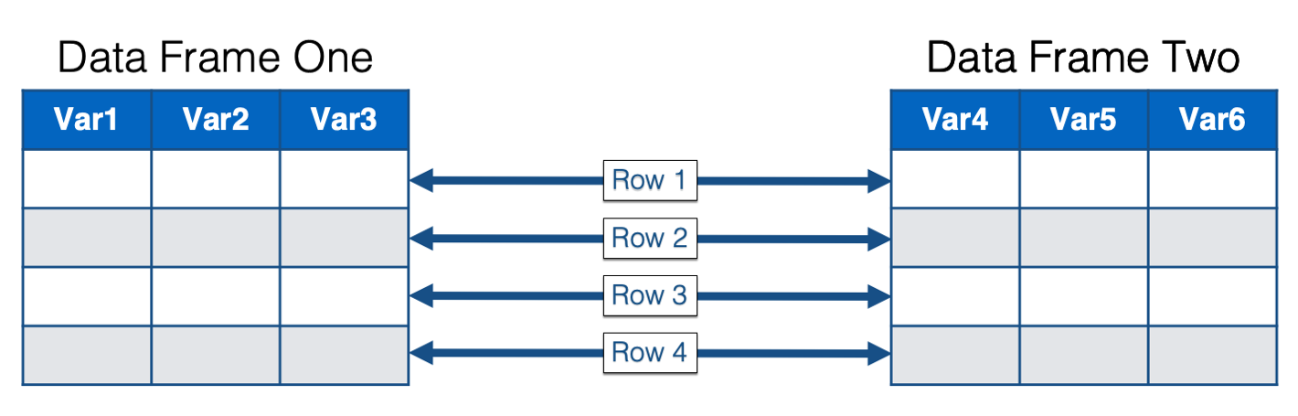



Data collection system architecture
Hospital tools
INFN Cloud
Clinic
Middleware
File system
Real time sensors
DataBase
Data Frame
Web form

Slide 13
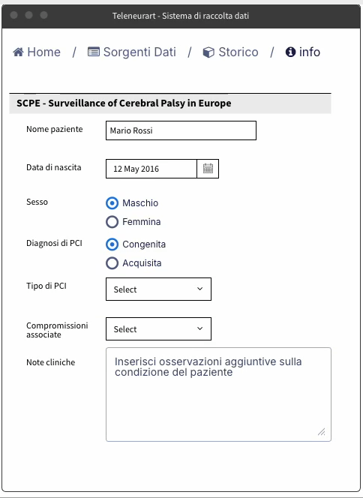
Interface mockups
Diagnosis according to SCPE (Surveillance of Cerebral Palsy in Europe)
Field | Description
Patient name
Date of birth
Sex
Diagnosis of CP (congenital/acquired)
ICP type | Choice between unilateral spastic, bilateral spastic, dyskinetic, ataxic
Associated Compromises | Please indicate if any and specify epilepsy, visual, hearing, intellectual disorders, etc.
Clinical notes | Additional observations on the patient's condition

Slide 14
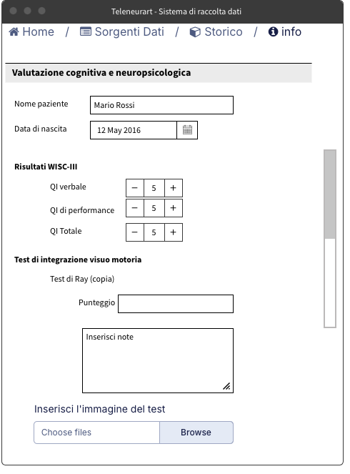
Interface mockups
Cognitive and neuropsychological assessment
Patient name
Date of birth
WISC-III results
Verbal QI
Performance QI
Total QI
Visual-motor integration test
Rey's Test (copy) | Score and notes on the ability to copy a complex figure
VMI | VMI Scale Score
Memory
Rey test (memory) | Selective Verbal Memory Test Score
Attentional functions
Visual attention BVN | Score and observations
Auditory attention BVN | Score and observations
Executive functions
Tower of London Test (TOL) | Score and performance level
BRIEF | Global and specific score for each executive function assessed
Neuropsychological notes | Additional observations on observed performance and behaviors
Domain control
Computed data
Dynamic
and conditional forms
File uploads

Slide 15
Next steps
Define the data collection protocol:
What data do we collect?
What are the current data collection processes?
Do patients undergo tests at different clinics or just one?
Is the study longitudinal?
Must they be anonymized before being shared?
Are there any data storage constraints (e.g., clear/encrypted)
Do data from different pathologies need to be communicated? Will analyses be performed across different pathologies?
Do the hospital's Data Protection Officer and the INFN need to communicate (what requirements are there for data retention? Certification?
We propose to proceed with a pilot project, defining the pathology and starting with a single hospital before extending the collection to the rest of the clinics.
Start collections on datasets to be converged in the overall architectural design.

Slide 16
Partners
IRCCS Fondazione Stella Maris
IRCCS Fondazione Mondino
Associazione la Nuova Famiglia
Ospedale Pediatrico Bambino Gesù
IRCCS Don Gnocchi
AORN Santobono Pausilipon
IRCCS Associazione OASI Maria SS Onlus
SSSUP Sant’Anna

