Slide 1

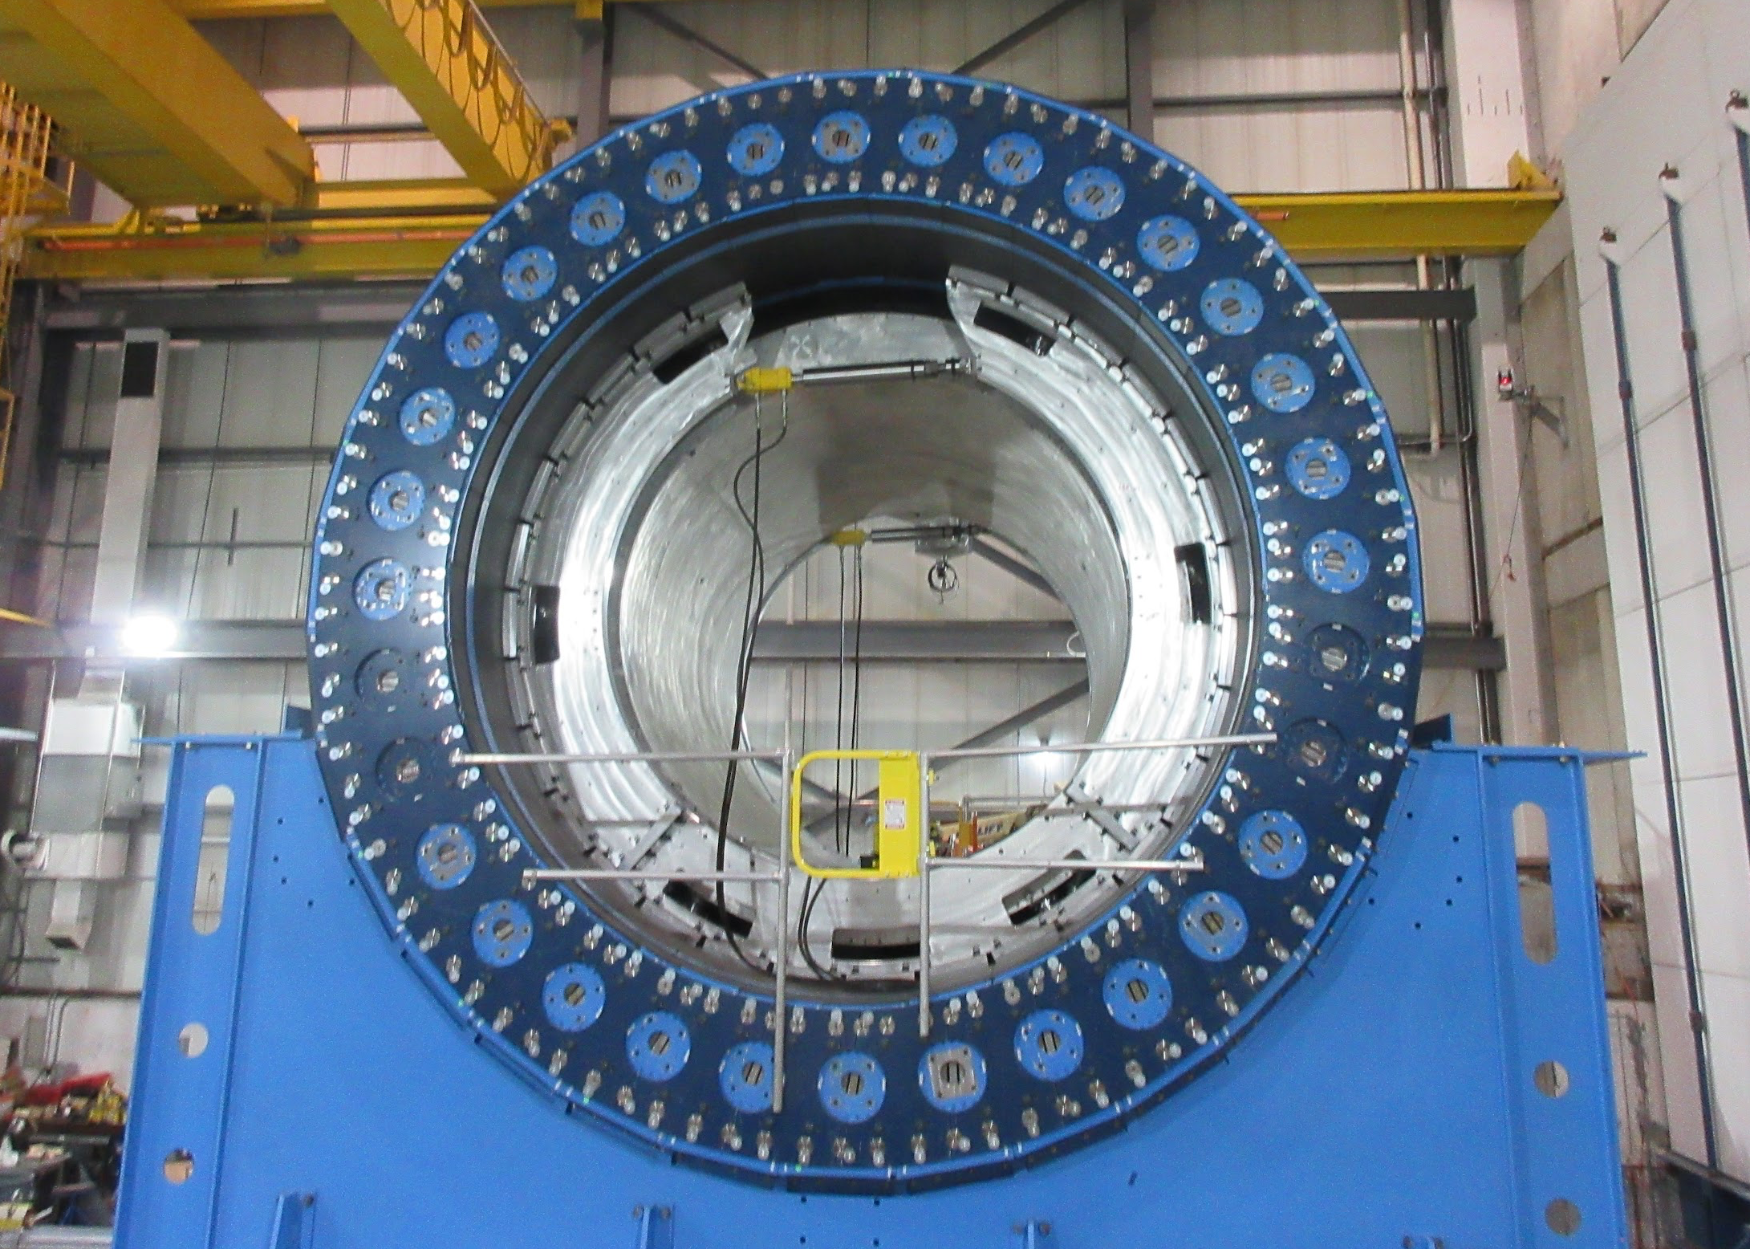


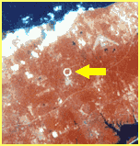
The Final Run of sPHENIX
Martin L. Purschke
Manhattan
Long Island, NY
RHIC from space

Slide 2
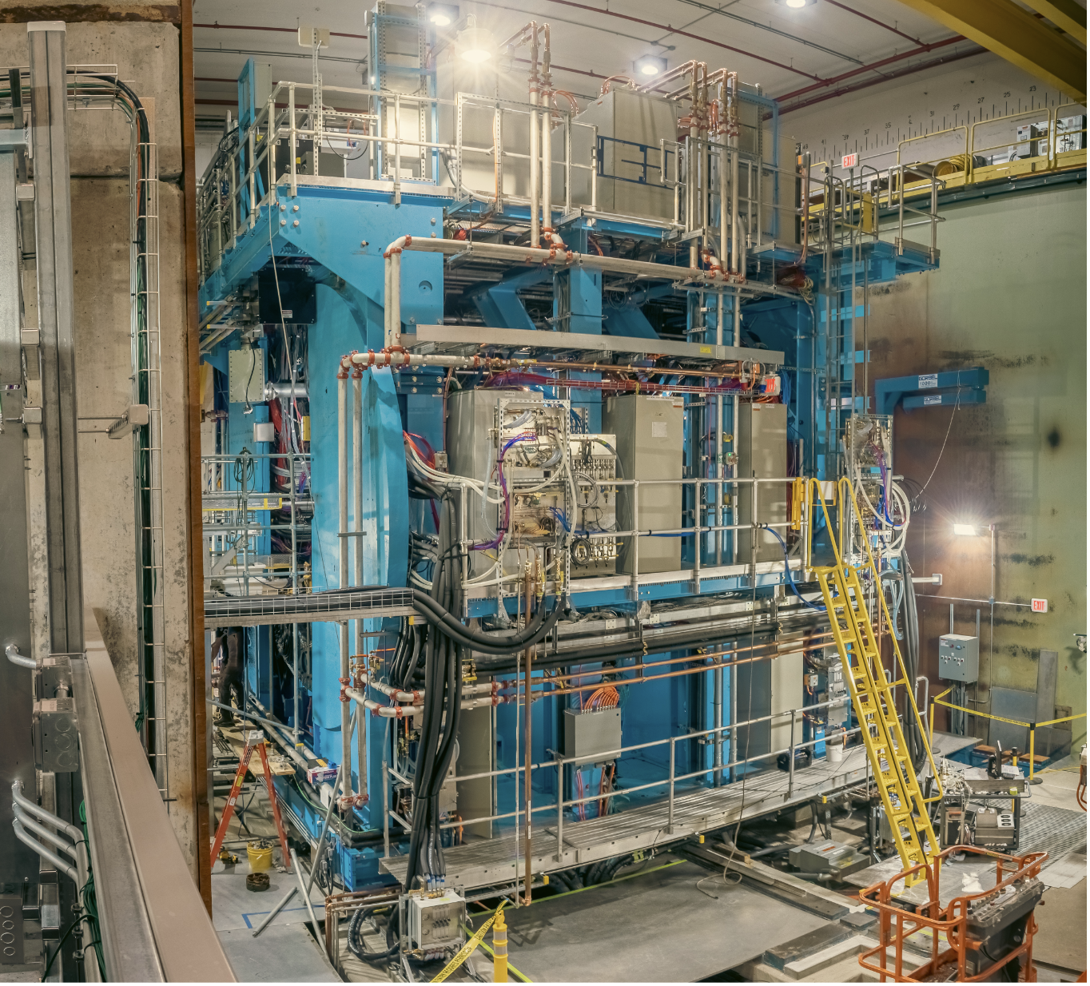
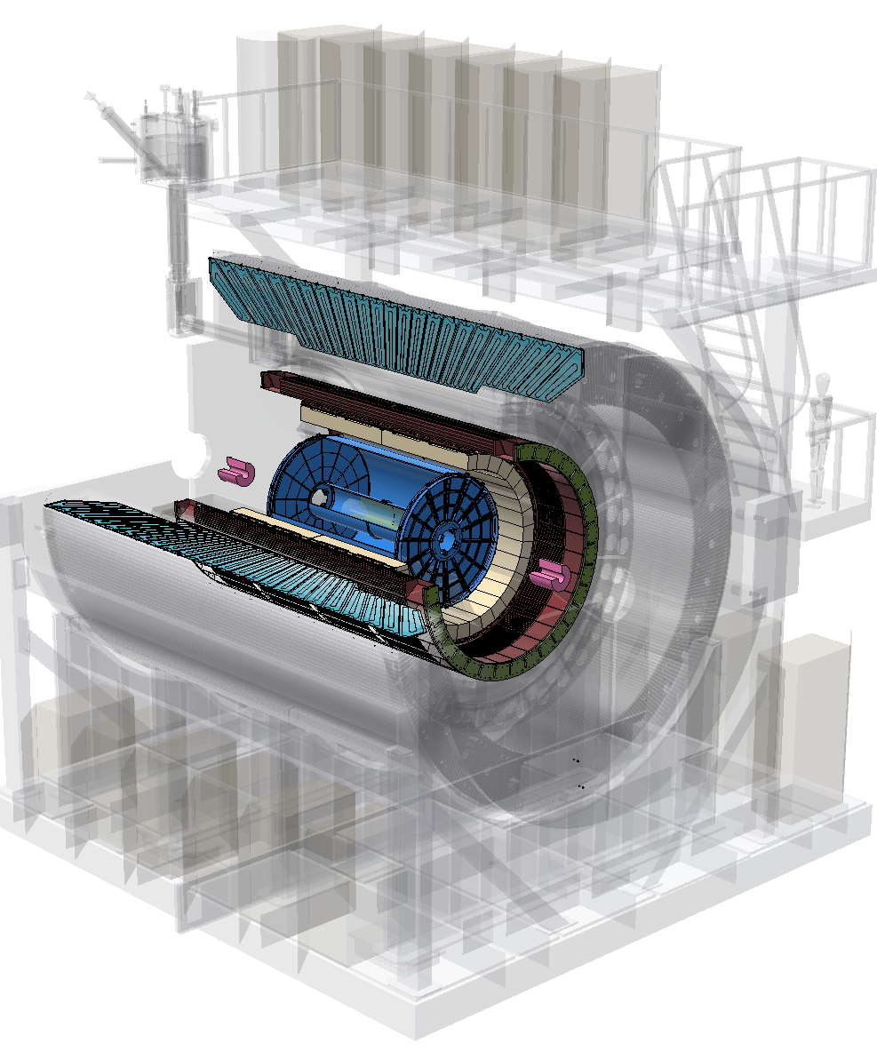
The sPHENIX Detector
Hadronic Calorimeters
Electromagnetic Calorimeter
Time Projection Chamber (TPC)
Minimum Bias Detector (MBD)
Intermediate Tracker (INTT)
Vertex Detector (MVTX)
Not shown: an event plane detector and a small timing detector

Slide 3
sPHENIX Runs
The plan had been for 3 years of running (2023, 2024, 2025)
During the 2023 RHIC Run, on August 1, the accelerator developed a Helium leak that ended the 2023 run prematurely before we ever got to “physics” running
2024 was the polarized p-p run (with 3 weeks of Au+Au at the end, mostly commissioning)
2025/26 has been the long Au+Au run, p+p, and a few days of O+O
Both 2024 and 2025 runs have been a great success, despite some challenges
Our Streaming Readout played an outsized role in achieving our luminosity goals.

Slide 4
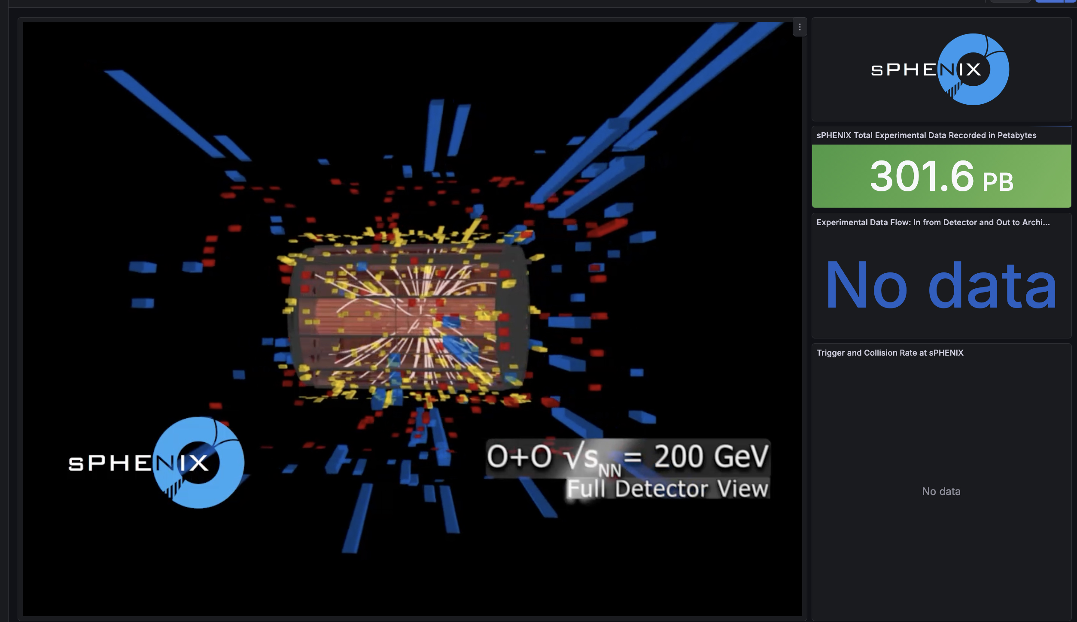
To jump right into it…
This is how we ended sPHENIX… Beam operations ended with ~297PB
We crossed the 300PB threshold with the post-beam calibration runs

Slide 5
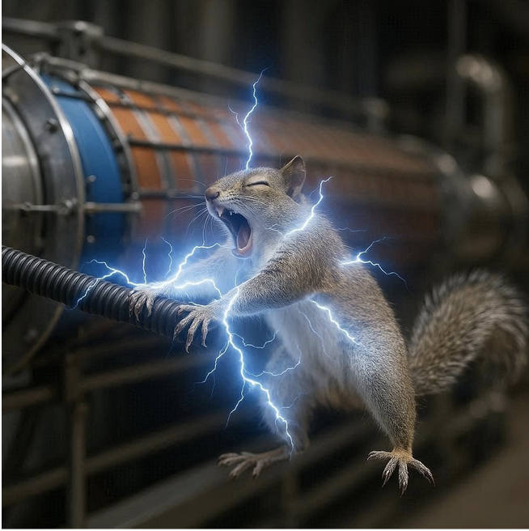
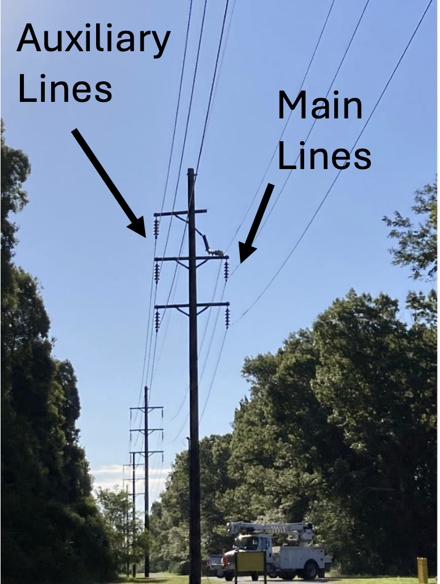
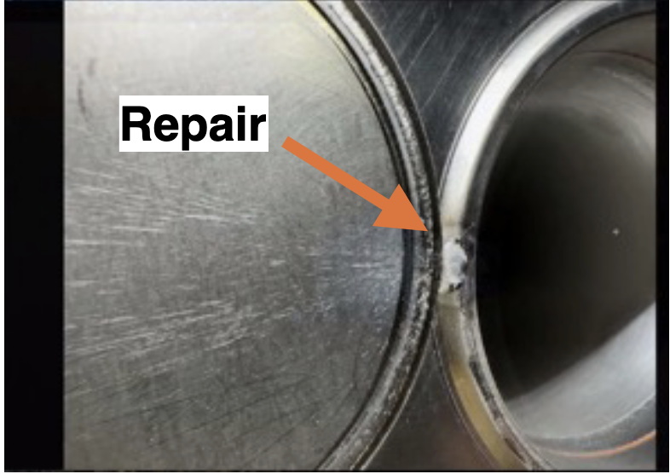
2025 challenges (many smaller ones, too)
We had a few tense moments
A squirrel “visiting” a power bus
The main RHIC power feed broke an arm
An abort kicker pre-fire sent the beam to the vacuum pipe wall and drilled a hole, exposed to air

Slide 6
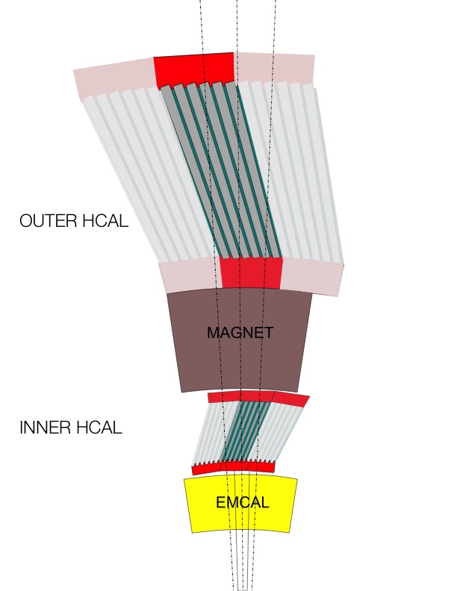
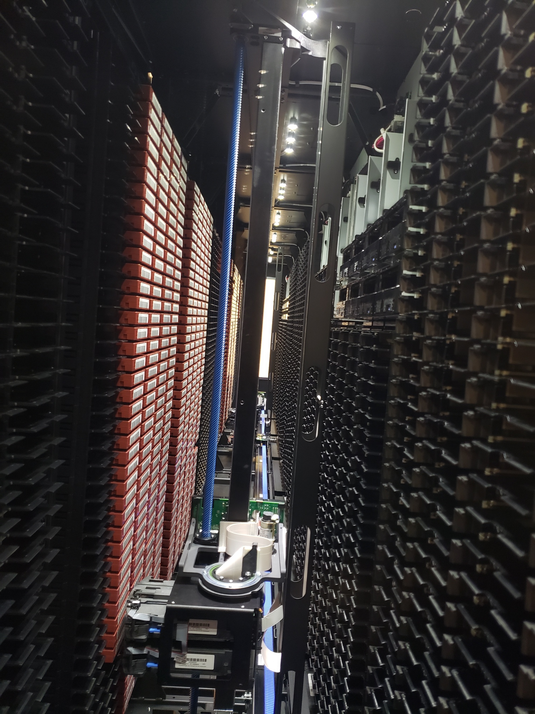
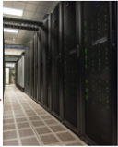
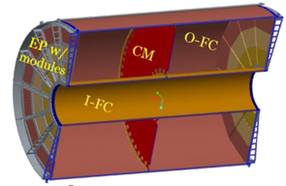
sPHENIX DAQ Birds-Eye View (2025)
FEE
100+ Gigabit
Crossbar
Switch
Buffer Box
To HPSS
DCM
DCM2
DCM
DCM
DCM
DCM
Buffer Box
FEE
DCM
SEB
~65 25Gbs links
DCM
Buffer Box
DCM
DCM2
DCM
DCM
DCM
Buffer Box
FEE
DCM
SEB
DCM
DCM
Buffer Box
2 400Gbs links
DCM
DCM2
DCM
SEB
DCM
Buffer Box
DCM
Not to scale – 20 SEBs + 40 EBDCs in reality
Buffer Box
FEE
DCM
DCM
FELIX
EBDC
Buffer Box
DCM
FEE
12 50Gbs links
Buffer Box
DCM
DCM
FELIX
EBDC
DCM
Buffer Box
FEE
Buffer Box
DCM
FELIX
EBDC
DCM
To the Farm
DCM
Buffer Box
Data Concentration
On Detector
Rack Room
Rack Room
SCDF Computing Center
Rack Room
For the Au+Au run, we upgraded from 6 to 12 bufferboxes to more than double our DAQ bandwidth
DCM-2 receives data from digitizer, zero-suppresses and packages
SEB collects data from a DCM group (~20)
EBDC (FELIX) Event Buffer and Data Compressor (~40)
Buffer Box data interim storage before sending to the computing center (6)

Slide 7
RCDAQ – our core DAQ system
RCDAQ has been around for about 13 years
It has been the workhorse DAQ system for many, many R&D efforts (sPHENIX ones, and also EIC-themed ones, also Medical Imaging, lots more)
I’m aware of about 30 test beam campaigns and countless lab setups using it
Support for the sPHENIX hardware (digitizers, but notably 3 different flavors of the ATLAS FELIX card)
All knowledge how to read out a particular hardware is contained in RCDAQ plugins
We are using many (84) concurrent RCDAQ instances (”cohort”), each reading out a particular part of the sPHENIX detector in a synchronized way
This “cohort” of RCDAQs is controlled by a super-process called “Run Control”, gives consistent and coherent operations

Slide 8
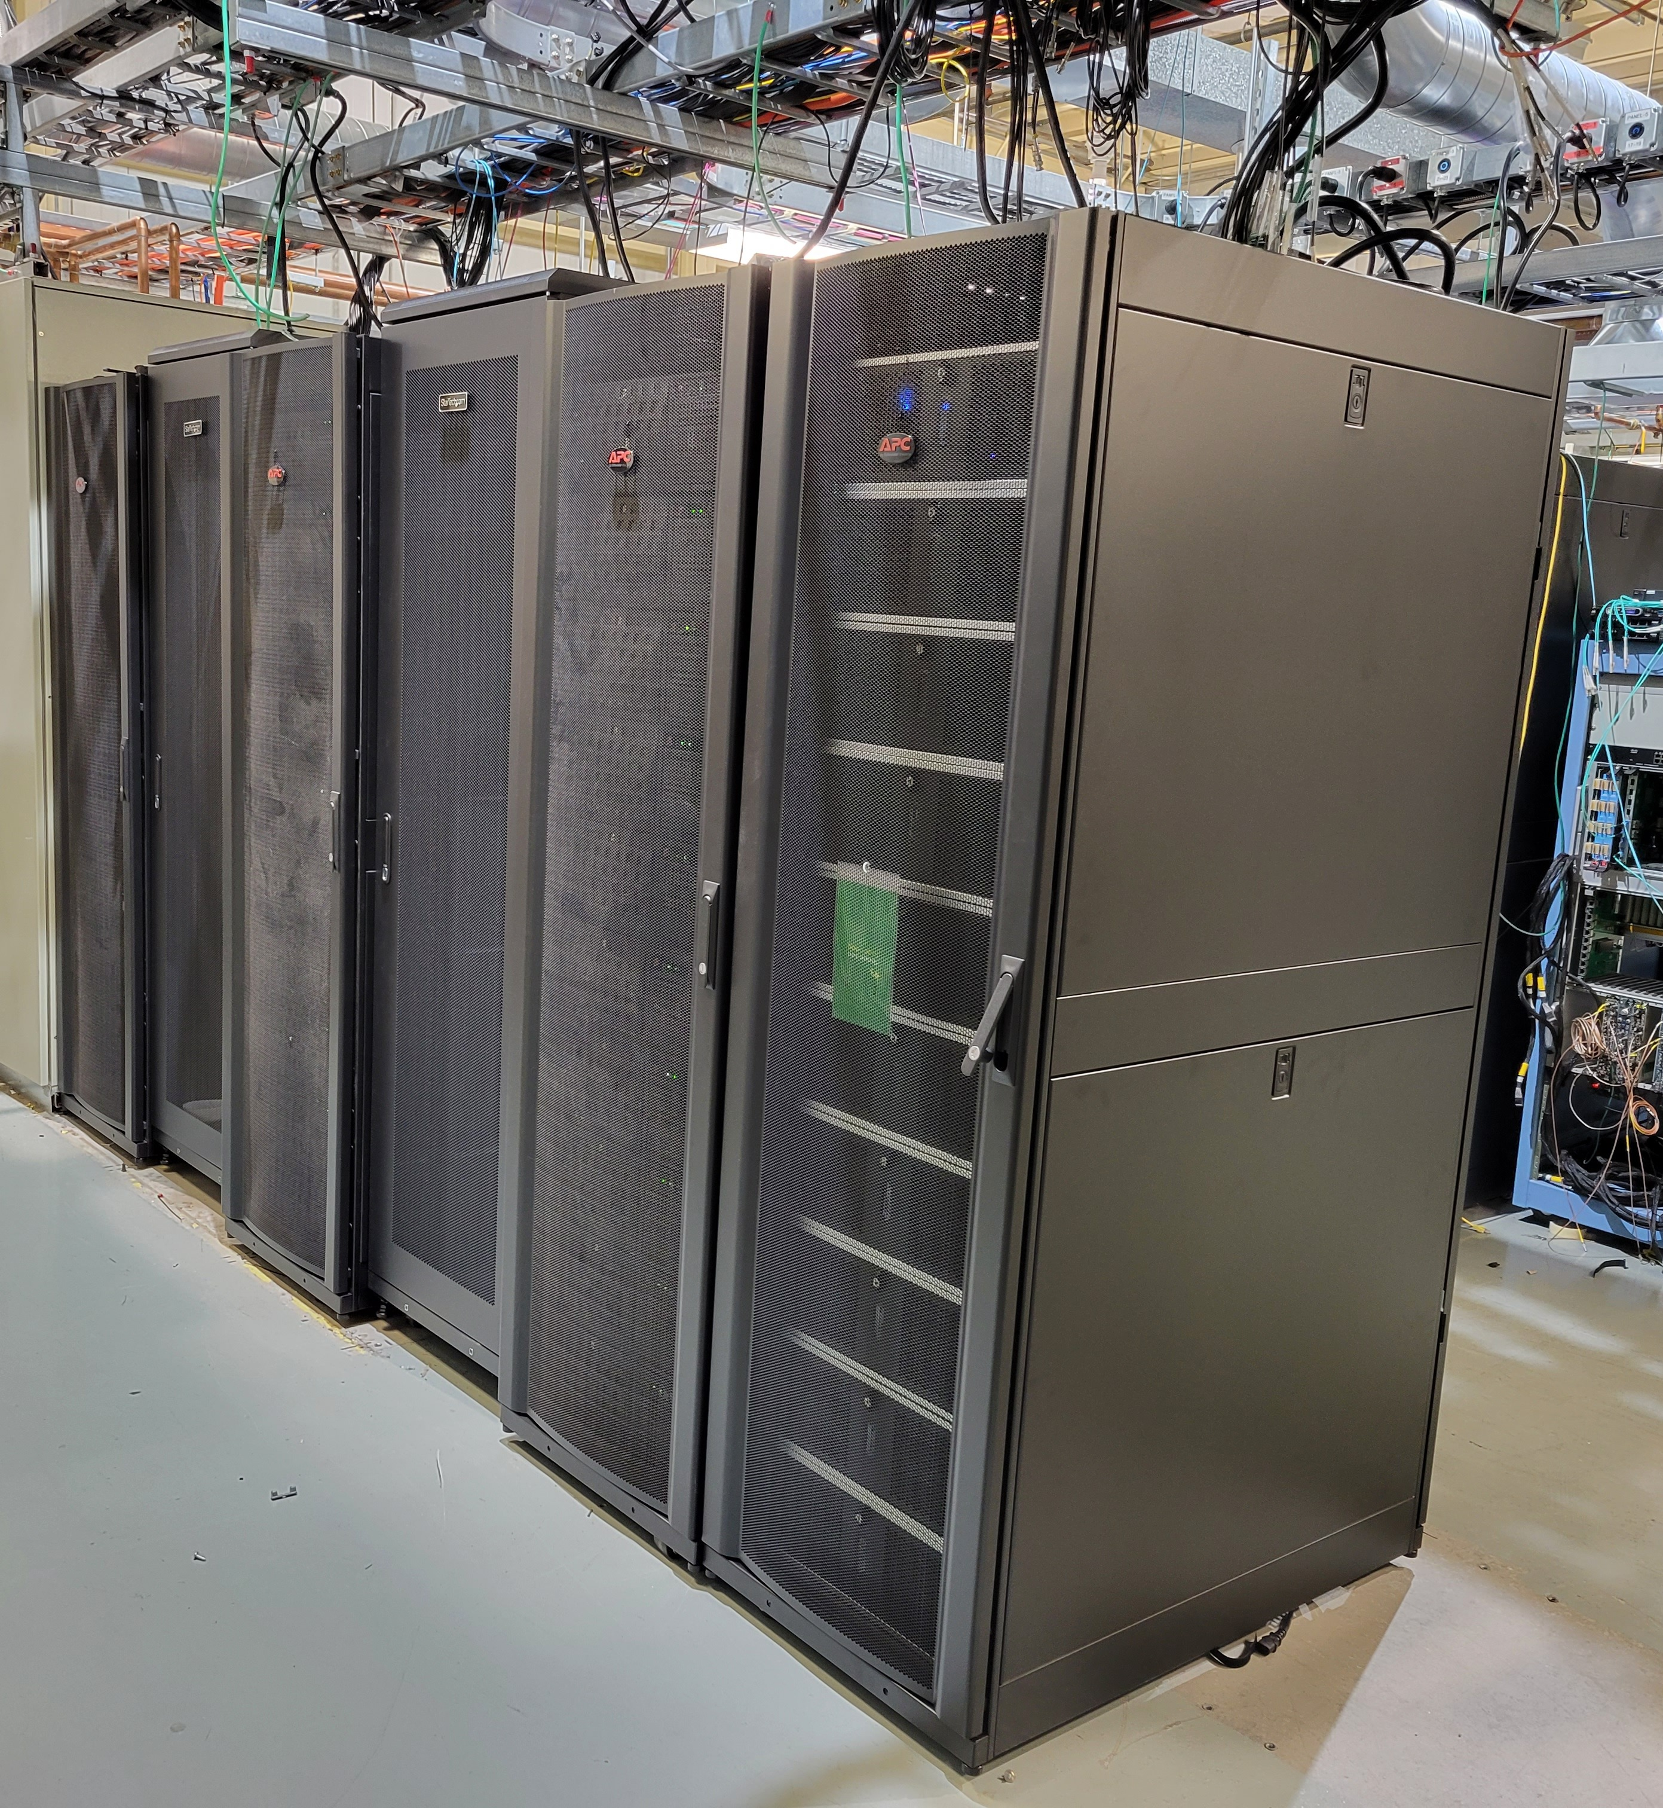
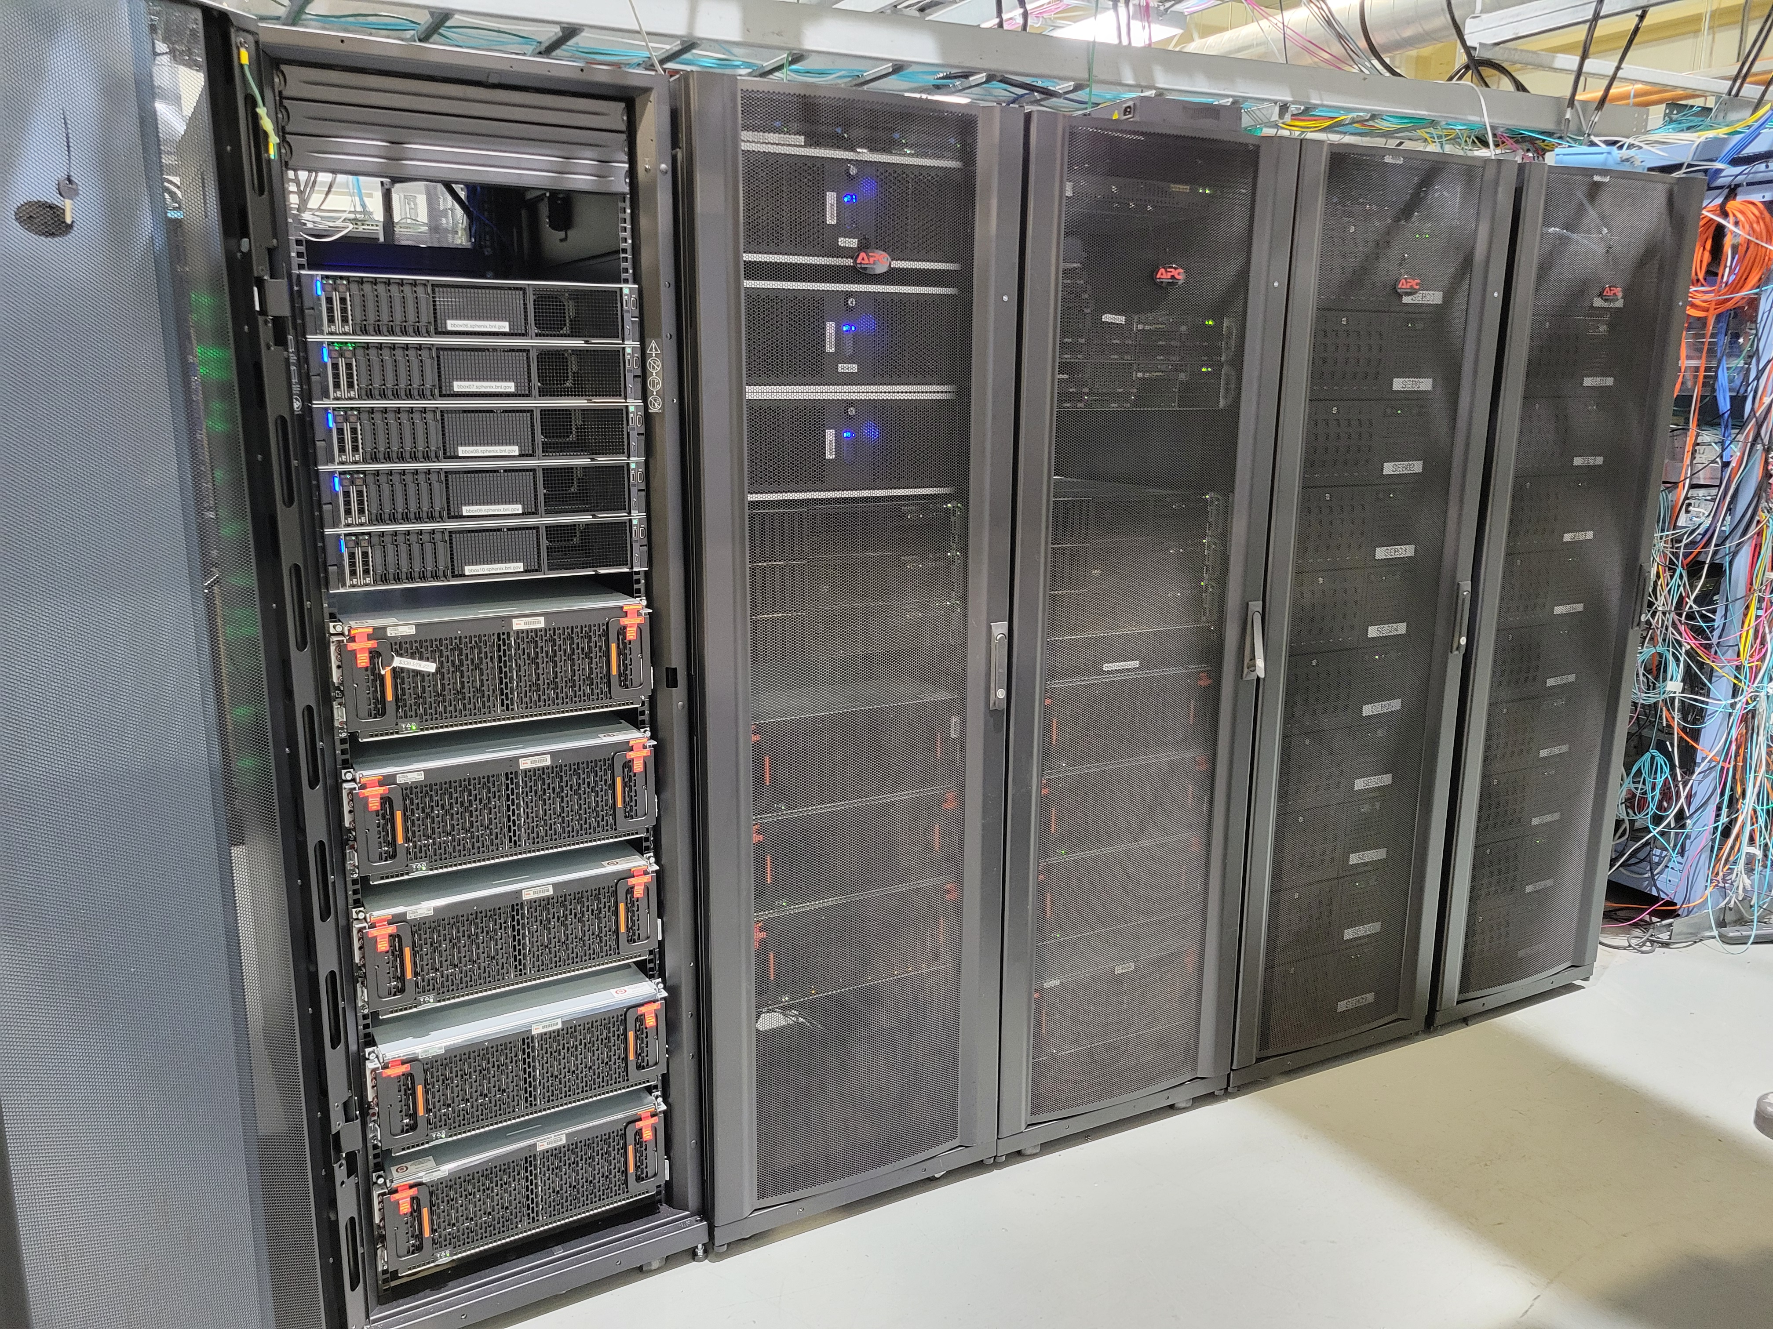
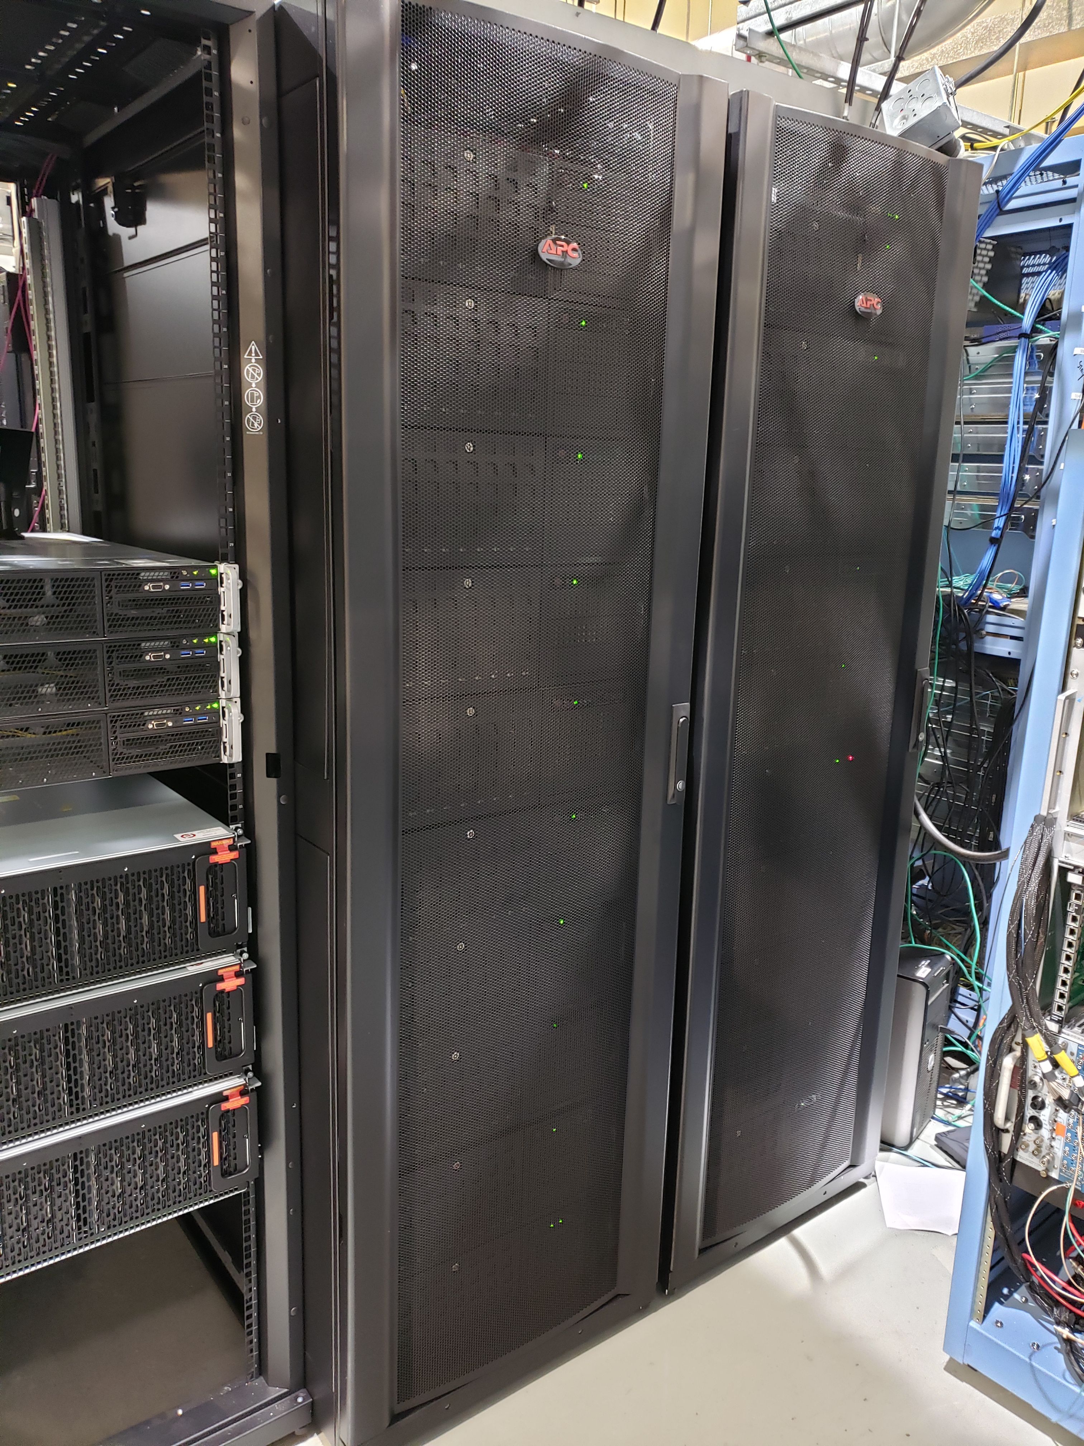
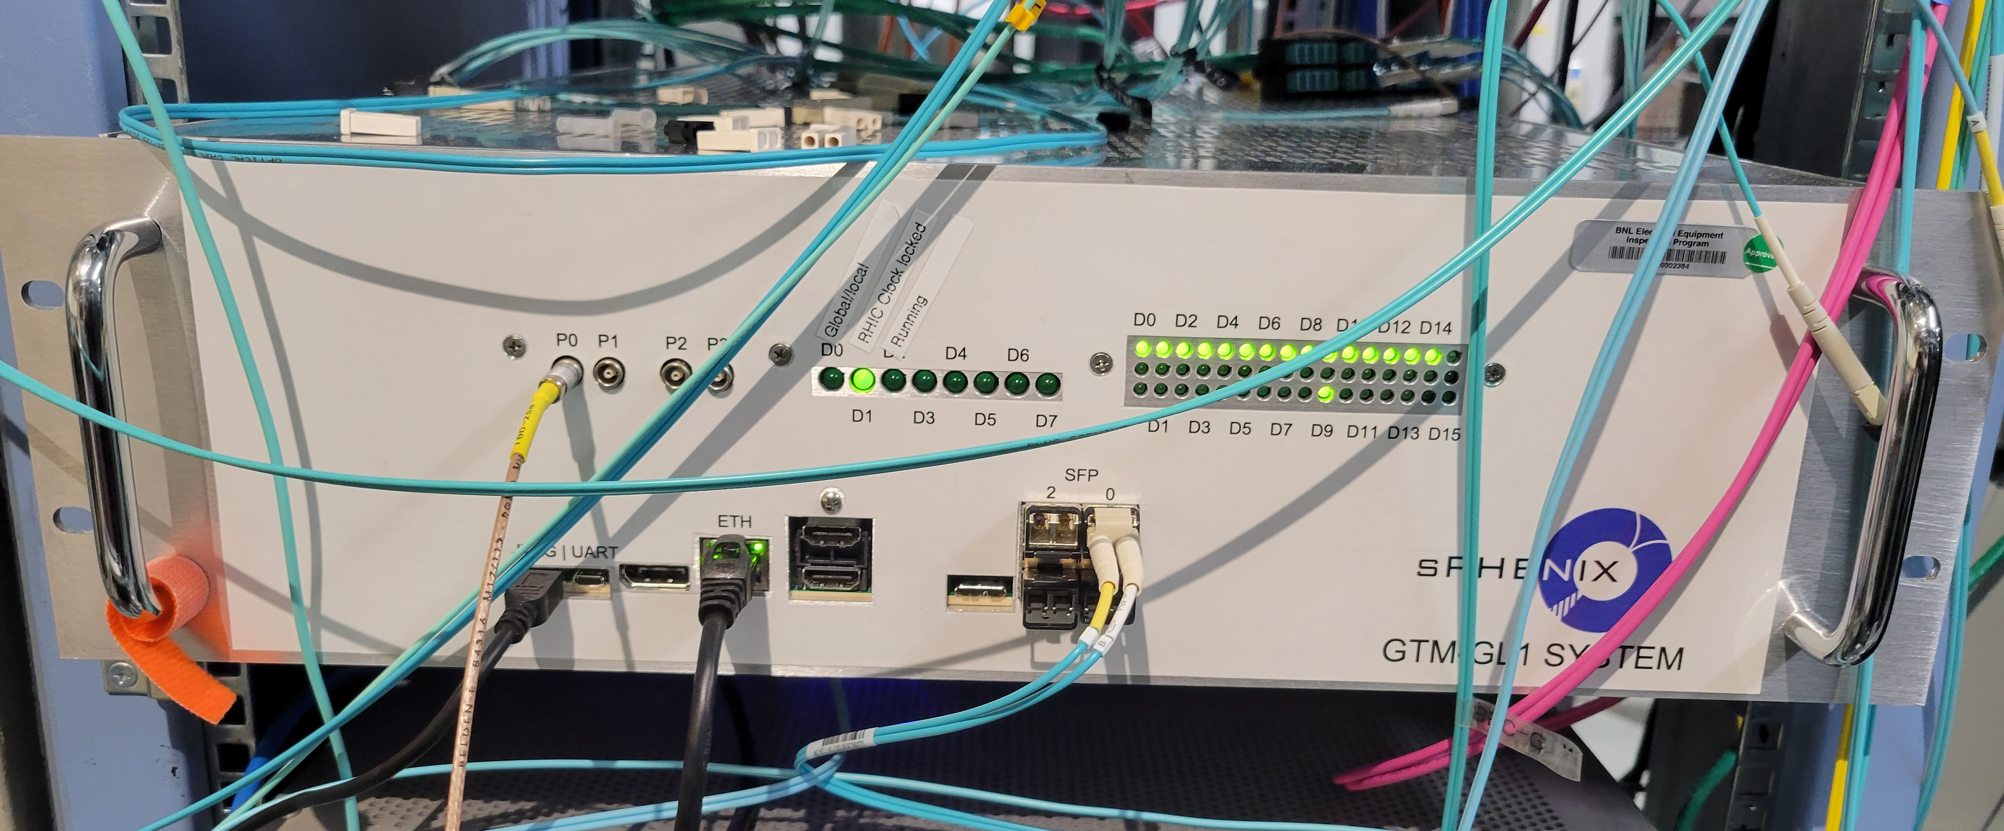
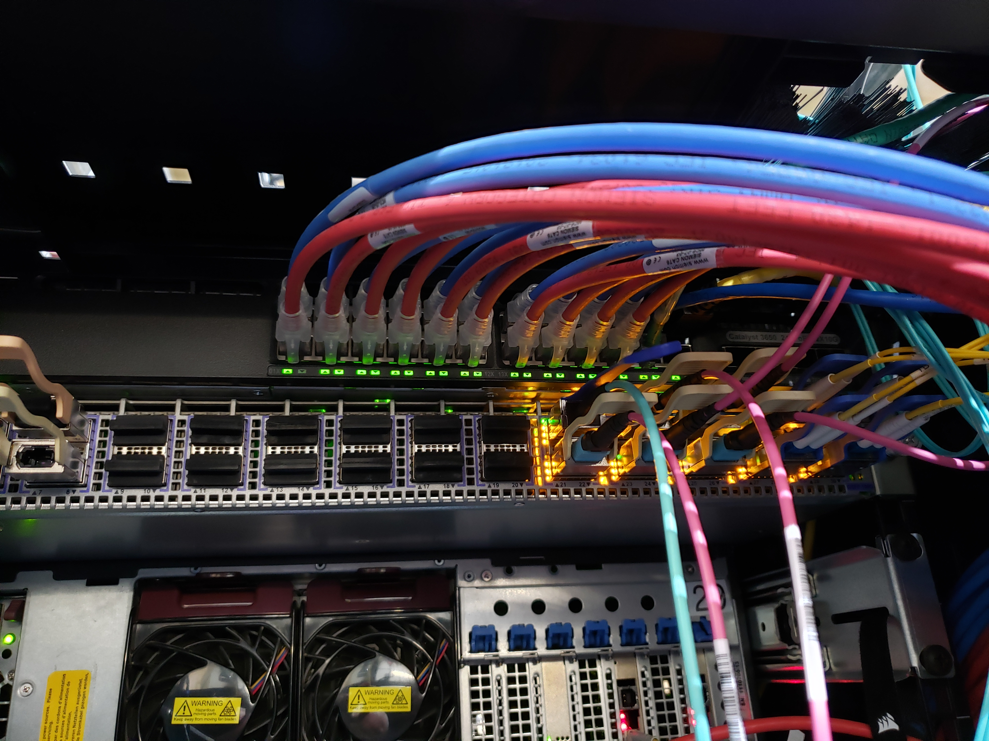
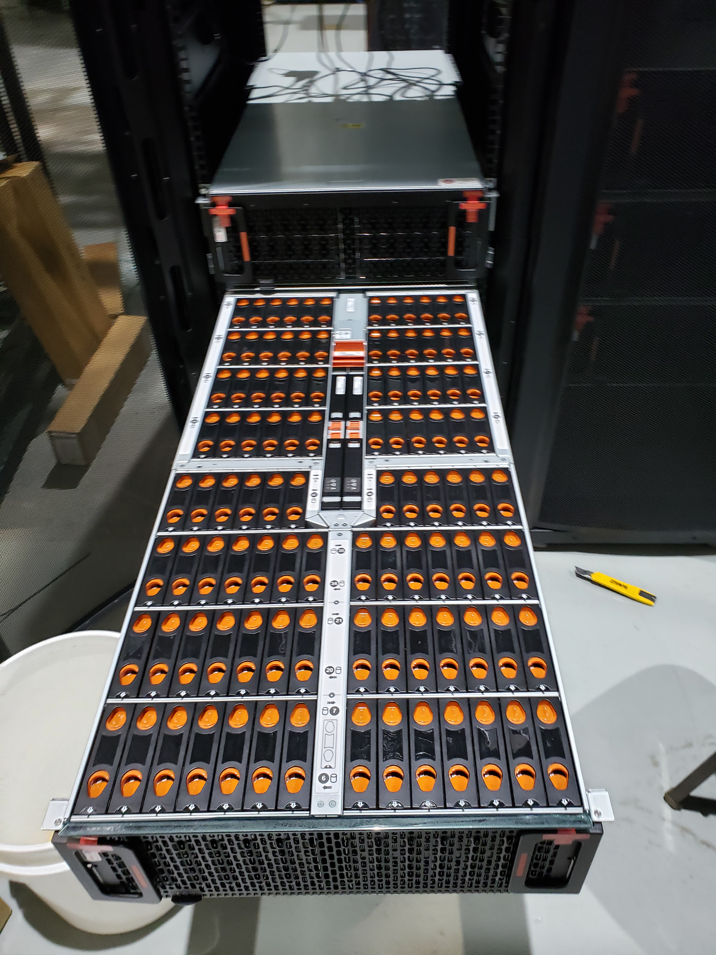
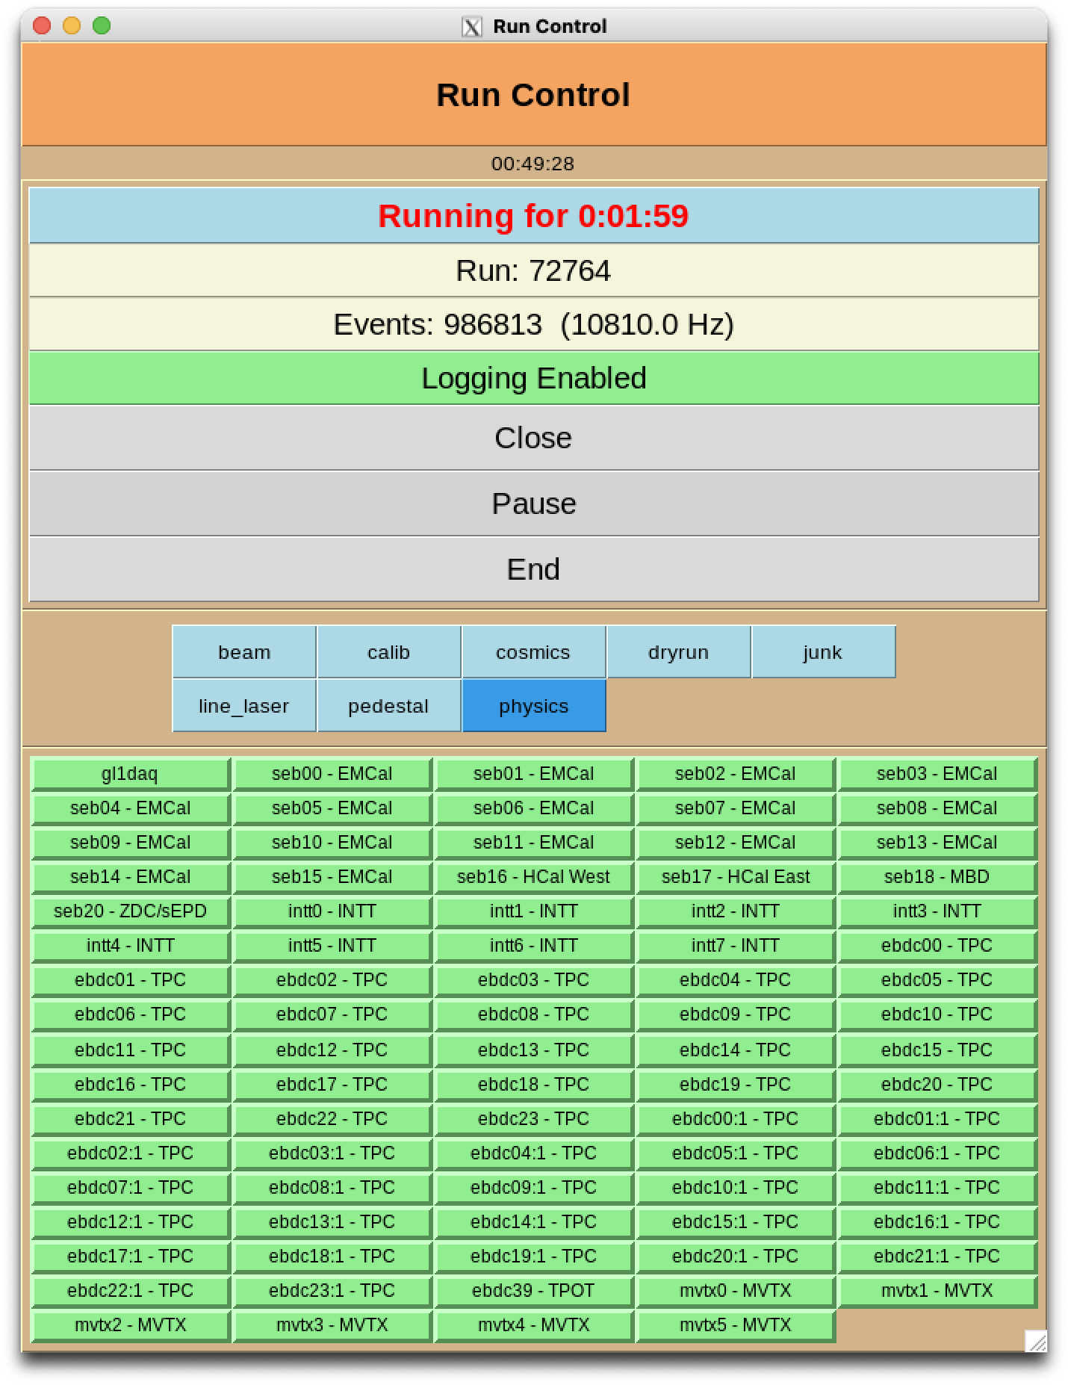
Some of our DAQ gear at the experiment
FEM
FEE
FEE
DCM
DCM2
DCM
DCM
DCM
DCM
DCM
FELIX
EBDC
DCM
DCM
DCM
DCM
DCM
FELIX
EBDC
FEM
DCM
SEB
FEE
FEE
DCM
DCM
DCM
DCM
DCM2
DCM
FELIX
EBDC
DCM
FELIX
EBDC
DCM
DCM
DCM
DCM
DCM
FEM
DCM
SEB
FEE
DCM
DCM
FEE
DCM
DCM
FELIX
EBDC
DCM
DCM
DCM2
DCM
DCM
FELIX
EBDC
DCM
SEB
DCM
DCM
DCM
FEE
FEE
DCM
DCM
DCM
FELIX
EBDC
DCM
FEM
DCM
DCM
FELIX
EBDC
DCM
DCM2
DCM
DCM
FEE
FEE
DCM
DCM
DCM
DCM
DCM
SEB
DCM
FELIX
EBDC
DCM
FELIX
EBDC
FEM
DCM
DCM
DCM
DCM
DCM2
FEE
DCM
DCM
DCM
FEE
DCM
DCM
FELIX
EBDC
DCM
FEM
DCM
SEB
DCM
DCM
FELIX
EBDC
DCM
DCM
DCM
DCM
DCM2
FEE
FEE
DCM
SEB
DCM
DCM
DCM
DCM
FELIX
EBDC
DCM
DCM
DCM
FELIX
EBDC
FEE
DCM
FEM
DCM
FEE
DCM
DCM
FELIX
EBDC
DCM
DCM
DCM2
DCM
DCM
FELIX
EBDC
DCM
DCM
DCM
DCM
DAQ machines
DCM
SEB
FEE
FEE
FEM
DCM
FELIX
EBDC
DCM
DCM
DCM
DCM
FELIX
EBDC
DCM
DCM2
DCM
DCM
DAQ Machines
DCM
DCM
DCM
FEM
DCM
SEB
FEE
FEE
DCM
DCM
DCM
DCM
DCM
FELIX
EBDC
DCM
DCM
DCM2
DCM
DCM
FELIX
EBDC
DCM
SEB
DCM
DCM
FEE
FEE
DCM
DCM
DCM
FELIX
EBDC
DCM
FELIX
EBDC
FEM
DCM
DCM
BufferBoxes
~14PB
DCM
DCM2
FEE
FEE
DCM
DCM
DCM
DCM
DCM
DCM
DCM
FELIX
EBDC
DCM
FELIX
EBDC
FEM
DCM
SEB
DCM
DCM
DCM
DCM
DCM2
FEE
DCM
DCM
DCM
FEE
DCM
DCM
FELIX
EBDC
DCM
FEM
DCM
SEB
DCM
DCM
FELIX
EBDC
DCM
DCM
DCM
FEE
DCM
DCM2
DCM
FEE
DCM
SEB
DCM
FELIX
EBDC
DCM
DCM
DCM
DCM
FELIX
EBDC
DCM
FEE
DCM
DCM
FEE
FEM
DCM
FELIX
EBDC
DCM
FELIX
EBDC
DCM
DCM
DCM
DCM
DCM2
DCM
DCM
DCM
DCM
DCM
SEB
FEE
FEE
FEM
DCM
DCM
DCM
DCM
FELIX
EBDC
DCM
Trigger/Timing system
DCM
DCM2
DCM
DCM
FELIX
EBDC
DCM
DCM
DCM
FEE
FEM
DCM
SEB
DCM
FEE
DCM
DCM
FELIX
EBDC
DCM
DCM
DCM
DCM
FELIX
EBDC
DCM
DCM2
DCM
DCM
SEB
FEE
Disk Enclosure (102 16TB disks)
DCM
DCM
FEE
DCM
DCM
FELIX
EBDC
DCM
FELIX
EBDC
DCM
DCM
FEM
FEE
DCM
Network switch
DCM
DCM2
DCM
FEE
DCM
DCM
DCM
DCM
DCM
DCM
DCM
FELIX
EBDC
DCM
FELIX
EBDC
FEM
DCM
SEB
DCM
DCM
FEE
DCM
DCM2
DCM
FEE
DCM
DCM
DCM
FELIX
EBDC
DCM
DCM
DCM
DCM
FELIX
EBDC
FEM
DCM
SEB
DCM
DCM
FEE
DCM
DCM
FEE
DCM
DCM2
DCM
FELIX
EBDC
DCM
FELIX
EBDC
DCM
DCM
DCM
DCM
SEB
DCM
DCM
FEE
FEE
DCM
DCM
DCM
FELIX
EBDC
DCM
FEM
DCM
DCM
FELIX
EBDC
DCM
DCM2
DCM
DCM
DCM
DCM
FEE
FEE
DCM
SEB
DCM
DCM
FEM
DCM
FELIX
EBDC
DCM
FELIX
EBDC
DCM
DCM
DCM
DCM
DCM2
DCM
DCM
FEE
DCM
DCM
FEE
FEM
DCM
SEB
DCM
FELIX
EBDC
DCM
FELIX
EBDC
DCM
DCM
DCM
DCM
DCM
DCM
DCM2
DCM
SEB
DCM
DCM
It uses a synchronized “cohort” of 84 individual RCDAQ instances, each reading a particular part of the detector
Held together by “Run Control”, like a conductor keeping everyone in line
The Timing System keeps it all synchronized
And here is what our investment of $339,278.22 got us
84 RCDAQs

Slide 9
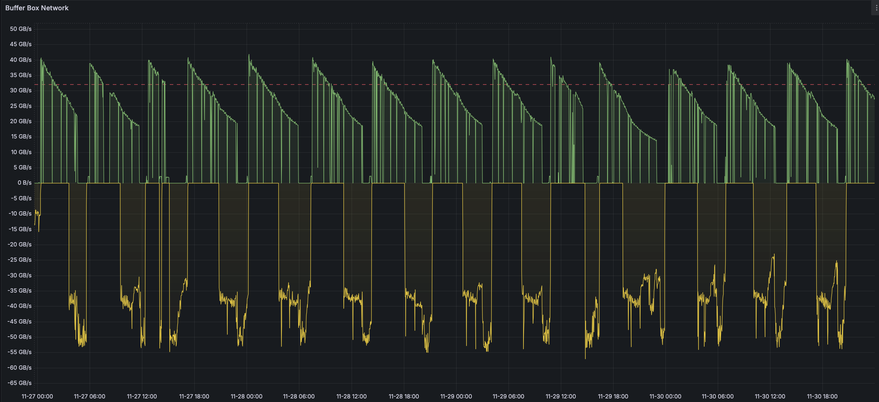
sPHENIX Data Taking
For Au+Au, 12PB in a week (~ 1.7PB/day) is a good yield, although not every week was like that
In Au+Au (different from p+p), we pretty much take all collisions we get
As the luminosity decays, there aren’t more collisions to be had, so the data rate goes down
We turned the transfers off during the highest-lumi periods
Au+Au
Incoming from the DAQ
Data sent to the SDCC/HPSS

Slide 10
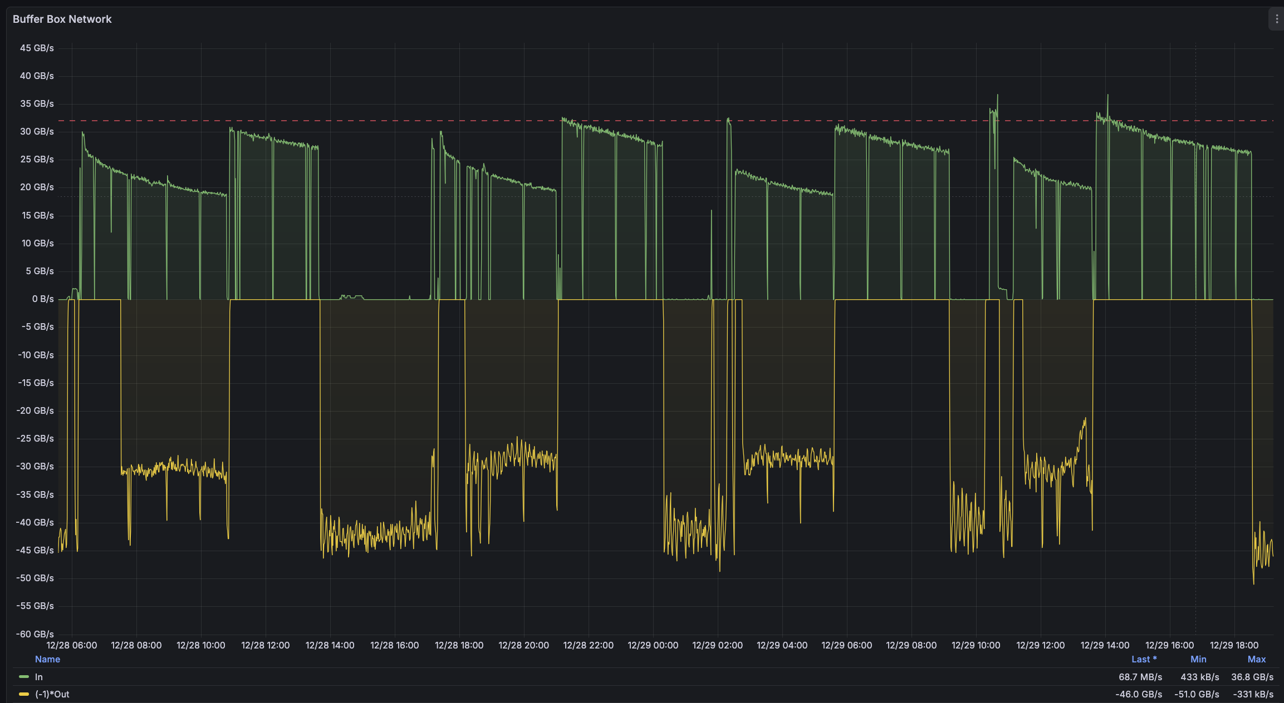
p+p is different
Here we get MHz worth of collisions and can always fill the bandwidth
We run the most selective triggers at high luminosity, and then increase the streaming fraction
Compromise to get data to the computing center fast for near-line monitoring

Slide 11
Streaming Readout in sPHENIX
Let me say this up front:
It is hard to overstate just how much easier everything is with streaming readout!
You don’t need to worry as much about event alignment
It just runs…
The Beam Crossing number (“BCO”) is what replaces an “event number”
In a distributed system as everyone has now, not as much concern about “missing a beat”

Slide 12
Streaming Readout in general
I have come to regard a particular feature of SRO as the defining property, even if you ultimately trigger your front-end:
There is no synchronized end to a given event!
While collision n is streaming in some places, in other places, data from collision n-1 (or -2, -3…) isn’t finished yet
Data are interleaved in this way. No need to wait for an event stream to be finished – do it offline. Just stream!
Bottom line: Streaming Readout is independent of how the front-end arrives at its decision to send up the data. Can be triggered, can be self-determined from the data… it’s still streaming data.

Slide 13
How does RCDAQ support “Streaming Readout”?
RCDAQ itself is pretty much unaware of what kind of data it reads
It has a concept of “read the data that is offered and don’t care what it is”
It doesn’t really care (or even know) how the front-ends arrived at the decision to send data up
Triggered or streaming, no matter - when data arrive, they are getting stored
All the magic lies in the RCDAQ plugins that teach RCDAQ how to read out a given kind of front-end electronics
We use about 10 different plugins to read the different sPHENIX detectors
(There are many more to support readout hardware that you will find in your typical test beam – while I‘m here, I remotely support two test beam setups, one at CERN, one at Jlab)

Slide 14
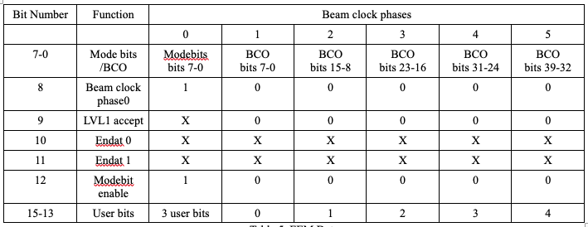
The Timing System holds it all together
Trigger/Timing system
We picked a convenient multiple of the beam crossing frequency (x6)
We have a global 64 bit master beam-crossing (BCO) counter, lasts > 60,000 years
We transmit 40 of the 64 bits to the front-ends, those 40 bits go into the data stream
Some front-ends again pass 20 bits on to the FEEs for “micro-alignment” between FEEs
This data block (96 bits) is sent out for each RHIC beam crossing (every ~106 ns):
One beam crossing
40 bits BCO

Slide 15
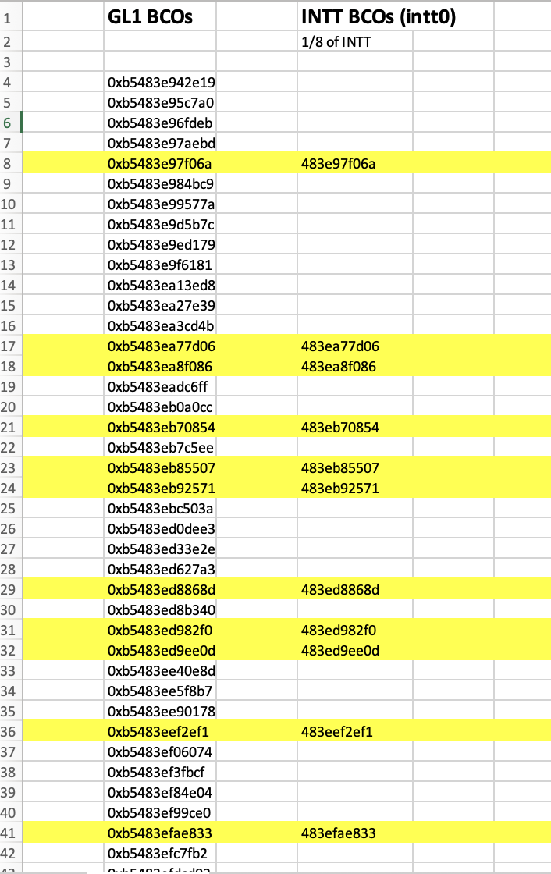
Example – INTT (Intermediate Tracker)
The left column are BCO’s that were triggered on
The right column shows the SRO data from (1/8th) of the INTT (not all triggers have data in every portion)
You can see the matching BCO numbers
40 bits

Slide 16
What’s in it for us?
Our calorimeter systems are triggered. Full stop. Can’t be changed.
But: There’s a lot of physics just with the tracking system! Get whatever we can get...
When we trigger the calorimeters, we need to make sure that the tracking systems covers that triggered-on crossing.
Our TPC, for example, has a drift time of about 13 μs, call it 120 RHIC beam crossings
If you read out just those 120 crossings, then you have covered exactly that trigger crossing.
But add just one more (121), then you have also covered the one after the trigger
Add 2, cover 2 more crossings… you get the picture
We were able to stream 1000 crossings after a trigger – cover ~880 more crossings
If a new trigger arrives during that period, reset the count and start the 1000 again
With high luminosity and a high rate of collisions, you get to continuous streaming.
Adjust the coverage window to what your bandwidth allows.

Slide 17
Multi-threaded Data compression
After all data reduction methods are applied, the data are still compressible (try gzip on your data file… you will be surprised…)
Our raw data format supports a late-stage data compression that works on an I/O buffer:
Our DAQ readout machines all have 96 CPU cores
We run a multi-threaded compression on the output buffers before writing
4 different compression levels to choose from - 3 LZO algorithms, and ”bz2”
We achieve compression yields around 60% - meaning 100GB become 60GB.
Better use of disk storage and also network throughput.
buffer
buffer
buffer
buffer
buffer
buffer
compression
algorithm
Add new
buffer hdr
New buffer with the compressed one as payload, header says so
This is what a file then looks like
On readback:
Un-compress
Original uncompressed buffer restored

Slide 18
Compression Yields
For everything but the TPC, we have the CPU muscle to run the “bz2” compression, sort of the Holy Grail of compression
The original size of the buffer is in the header, to allocate enough memory at uncompression time… that makes it easy to see the compression yields:
The TPC has too much data to keep up; we can “only” run “LZO” here. It is also denser to begin with:
Overall we get a reduction to about 60% of the original size.
$ prdfcheck physics_seb10-00068999-0000.prdf | more
buffer 1 at record 0 length = 32575780 3977 marker = ffffbefa BZ2 Marker Or.length: 67058744 48.578%
buffer 2 at record 3977 length = 32606651 3981 marker = ffffbefa BZ2 Marker Or.length: 67066472 48.6184%
buffer 3 at record 7958 length = 32602595 3980 marker = ffffbefa BZ2 Marker Or.length: 67066084 48.6126%
buffer 4 at record 11938 length = 32591621 3979 marker = ffffbefa BZ2 Marker Or.length: 67065432 48.5968%
buffer 5 at record 15917 length = 32596554 3980 marker = ffffbefa BZ2 Marker Or.length: 67063228 48.6057%
buffer 6 at record 19897 length = 32603688 3980 marker = ffffbefa BZ2 Marker Or.length: 67070792 48.6109%
$ prdfcheck TPC_ebdc16_0_physics-00077980-0000.evt | more
buffer 1 at record 0 length = 7997 1 marker = ffffbcfe LZO Marker Or.length: 17640 45.3345%
buffer 2 at record 1 length = 361533375 44133 marker = ffffbcfe LZO Marker Or.length: 520119368 69.5097%
buffer 3 at record 44134 length = 363089288 44323 marker = ffffbcfe LZO Marker Or.length: 520112984 69.8097%
buffer 4 at record 88457 length = 363165726 44332 marker = ffffbcfe LZO Marker Or.length: 520110952 69.8247%
buffer 5 at record 132789 length = 362751108 44282 marker = ffffbcfe LZO Marker Or.length: 520100040 69.7464%
buffer 6 at record 177071 length = 362783445 44286 marker = ffffbcfe LZO Marker Or.length: 520112680 69.7509%

Slide 19
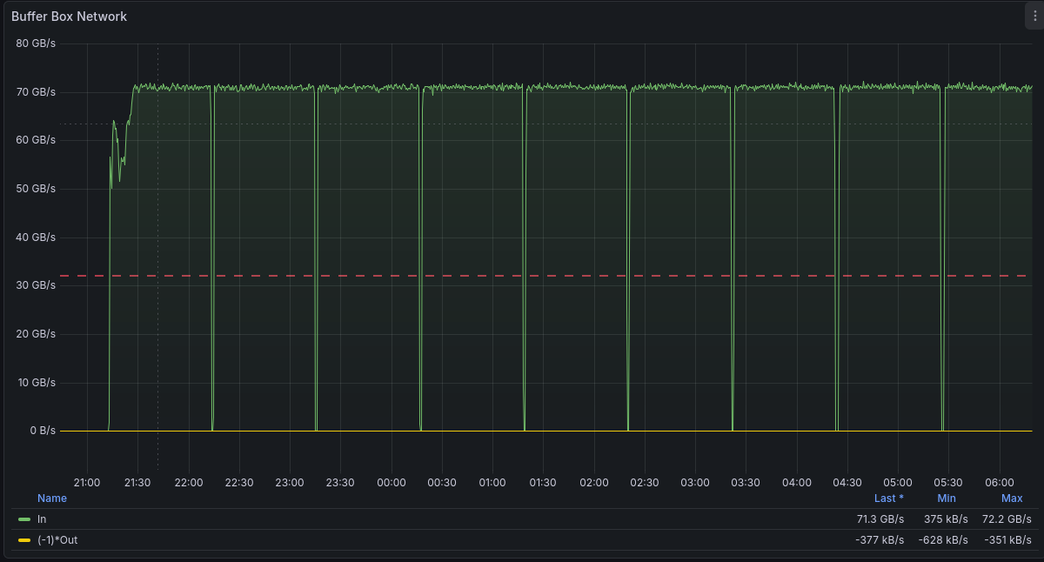
But what can the DAQ really do?
The numbers I showed so far are constrained what the accelerator and the front-ends deliver
I wanted to know what the DAQ can really do without those constraints…
Post-beam, with all detectors in top shape, I took some “break-the-DAQ” type runs
Switched off or turned down zero-suppression and generated the highest data rate the front-end can deliver (DAQ goes 100% busy, but we don’t care here)
70 Gbyte/s
72GB/s or ~580Gbs average over a day or so
Remember, that’s to disk
That gives almost 6PB/day
No issues, it kept running and running…
1-Hour runs

Slide 20
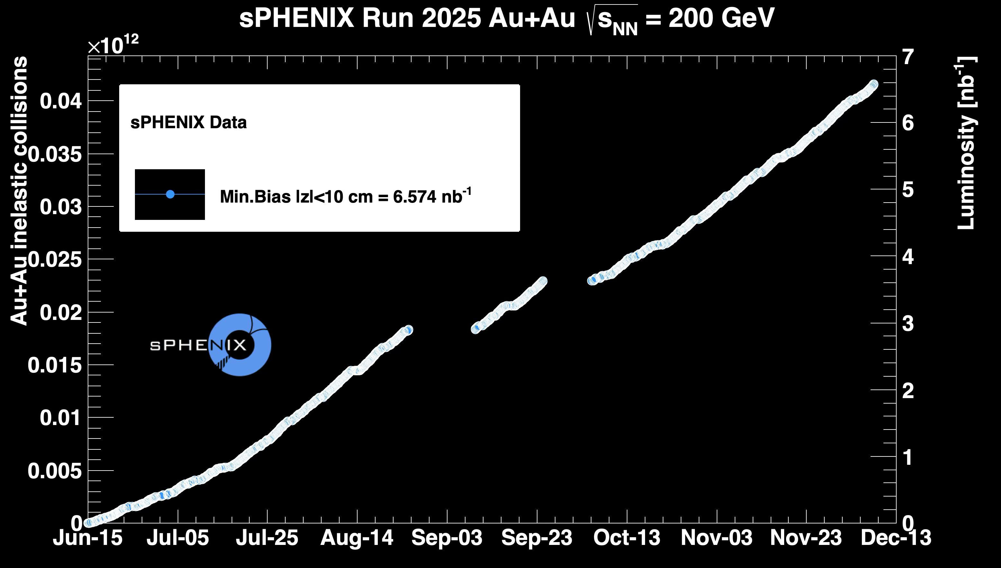
How we did in terms of our goals
182 days of Au+Au, 6.6/nb, 94% of goal
41 days of p+p, 16.7/pb, 130% of goal
5.3 days of O+O, 23.6/nb, 182% of goal
Pre-Fire incident
Squirrel Incident and 69KV Line repair

Slide 21
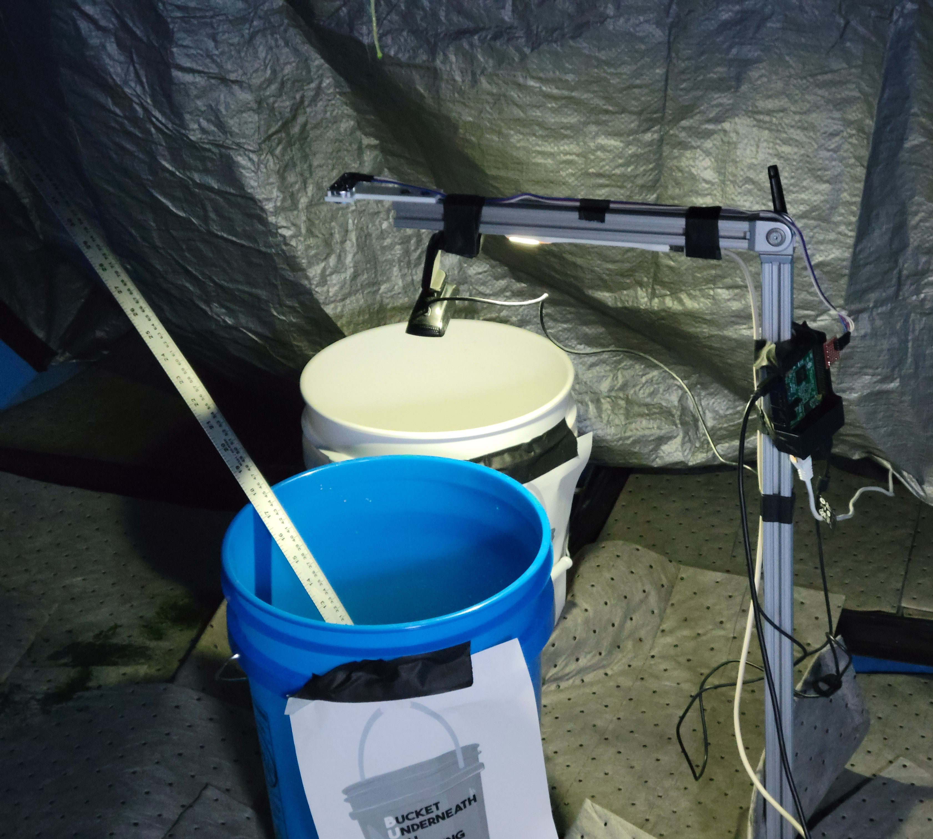
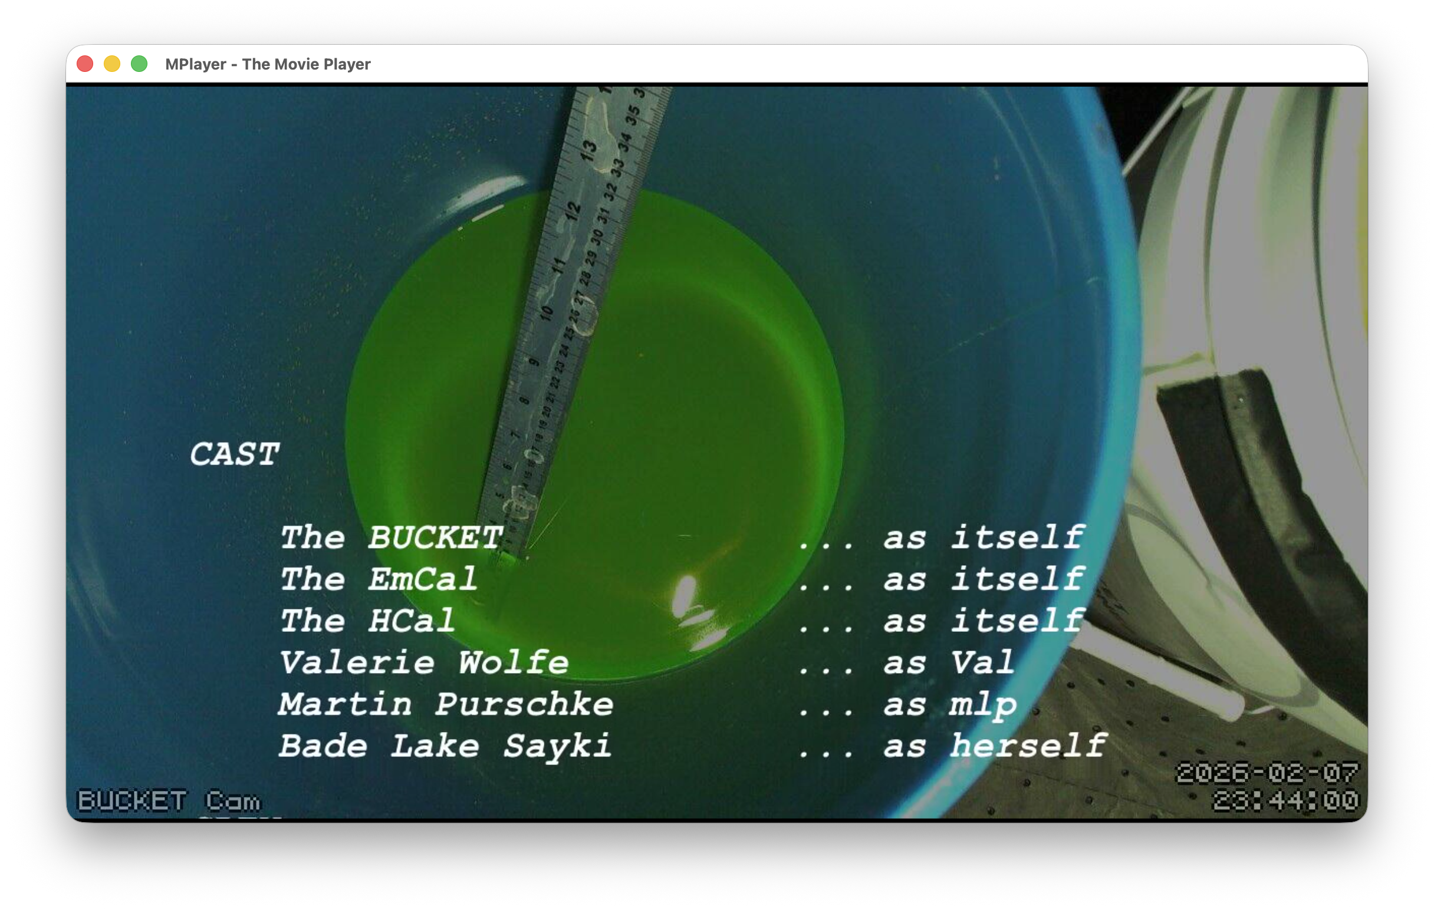
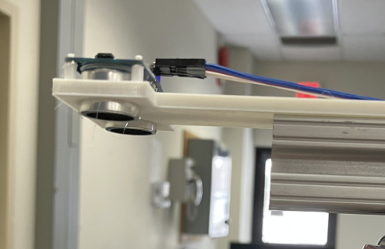
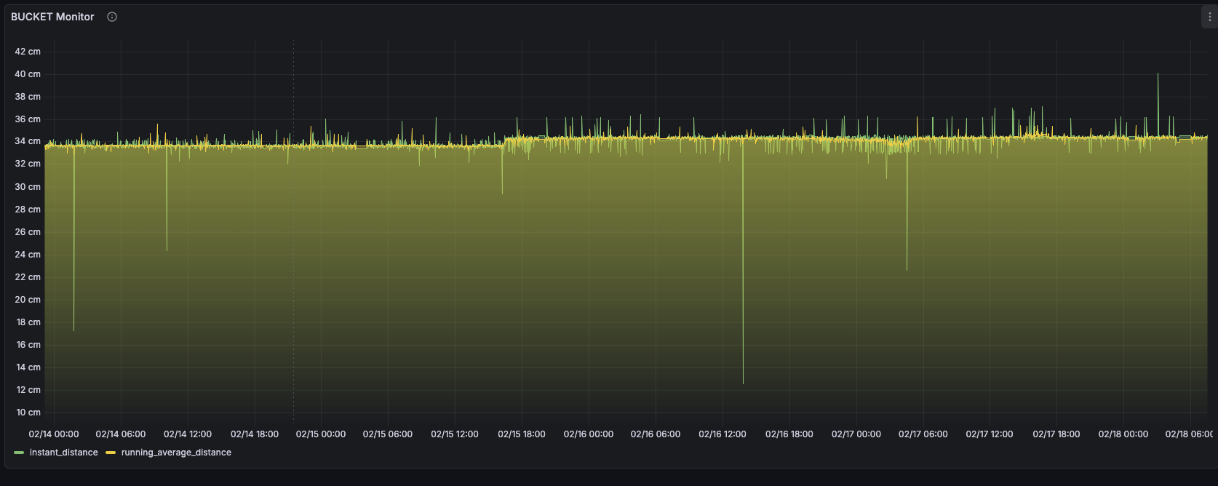
A bit of sPHENIX fun (with a serious background…)
My personal metrics of when an experiment has reached maturity: The experts have a bit of time on their hands for some playfulness…
In the last weeks of the run, the EMCal glycol cooling loop developed a small leak, inaccessible…
We used a rather low-tech bucket to capture the glycol seeping out from the low point of the HCal barrel
Rather than making a daily access to check on the level (leak might get worse), we promoted the BUCKET to the “13th sPHENIX subsystem”
I devised an ultrasound system to continuously monitor the glycol level in the bucket, also a camera
Someone found the time to make a movie of the periodic still images
We made a Grafana page…
… that allowed us to skip the level-check accesses

Slide 22
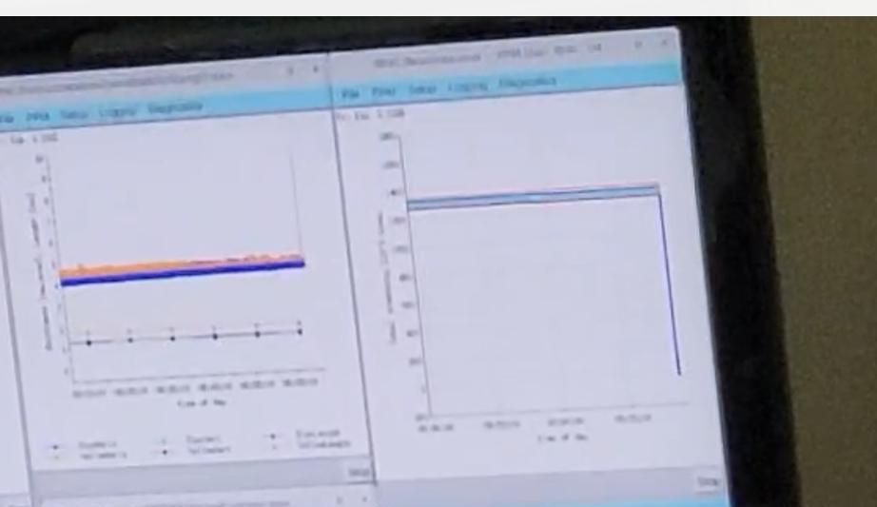
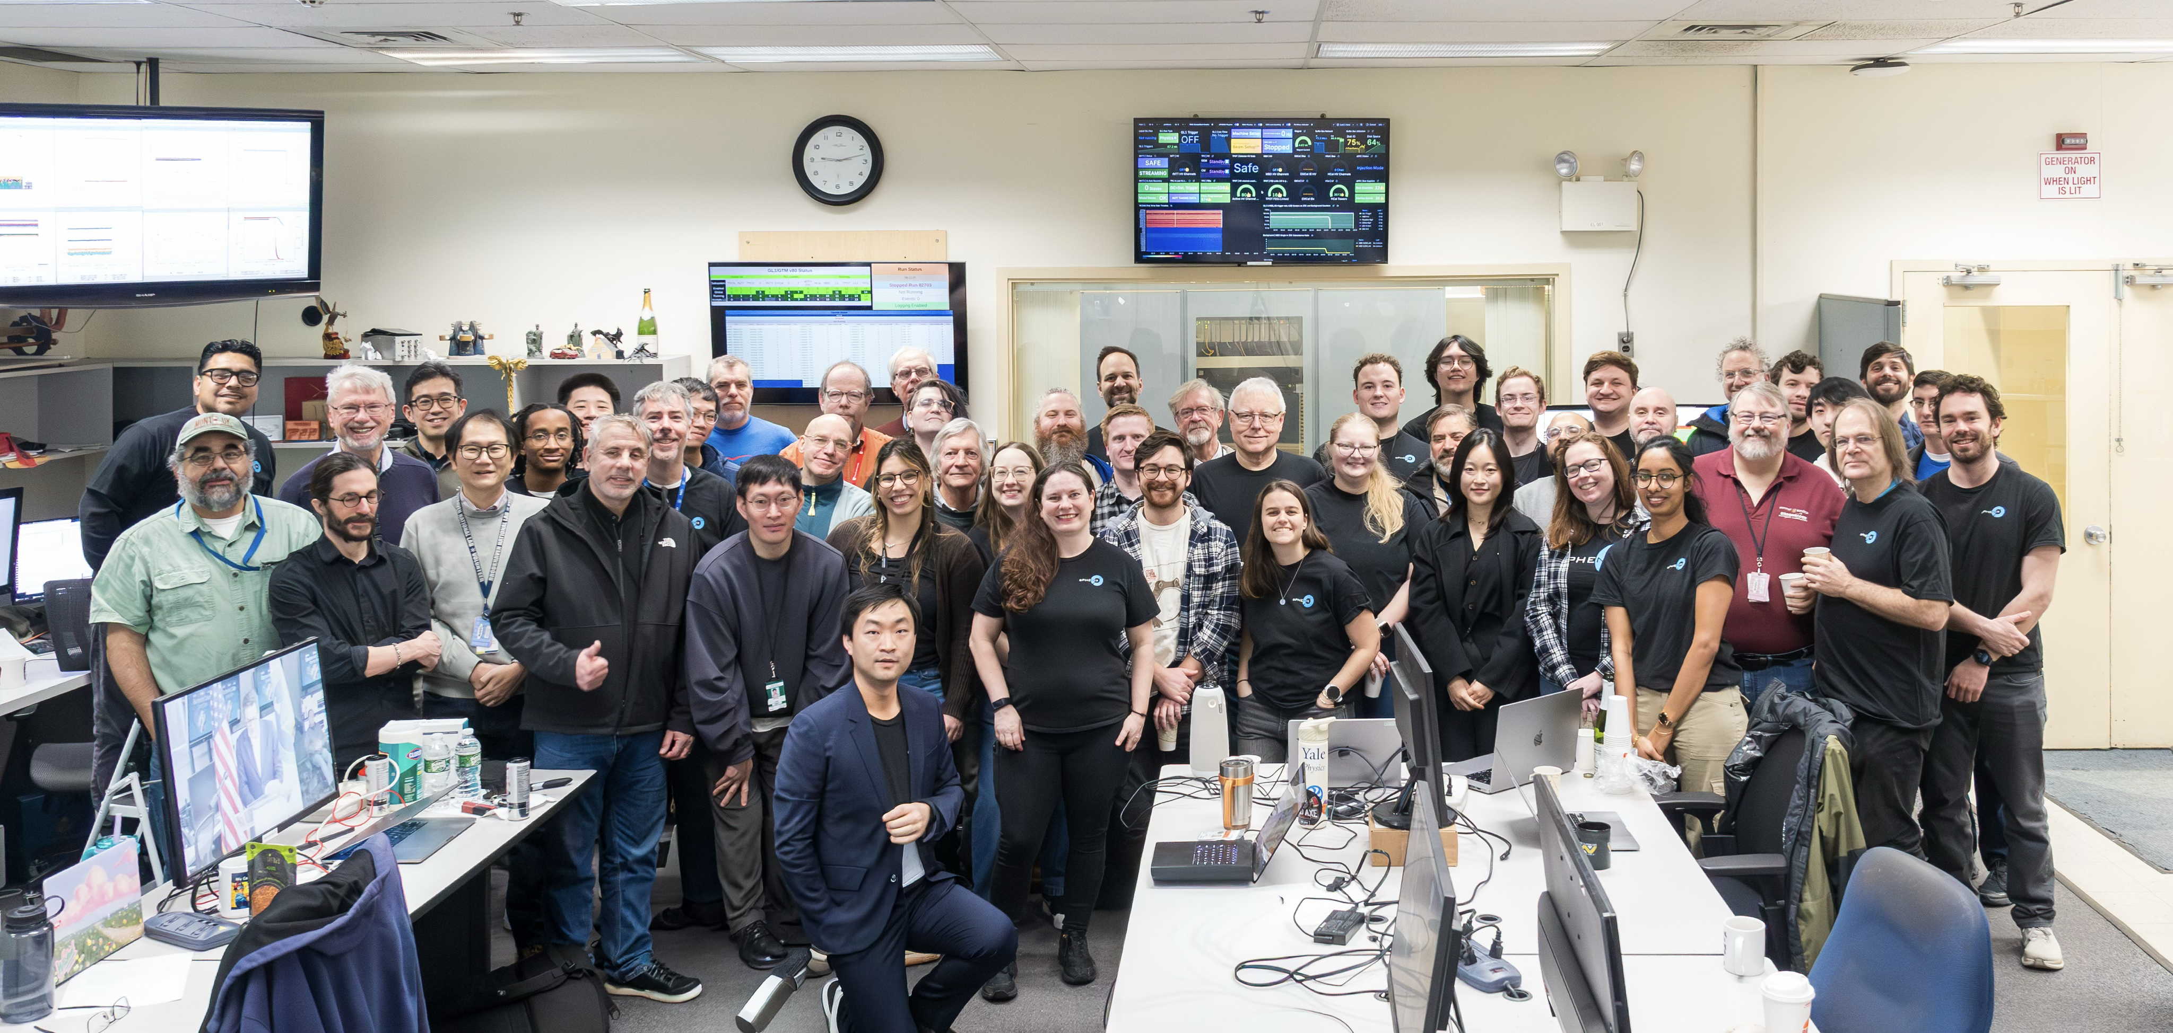
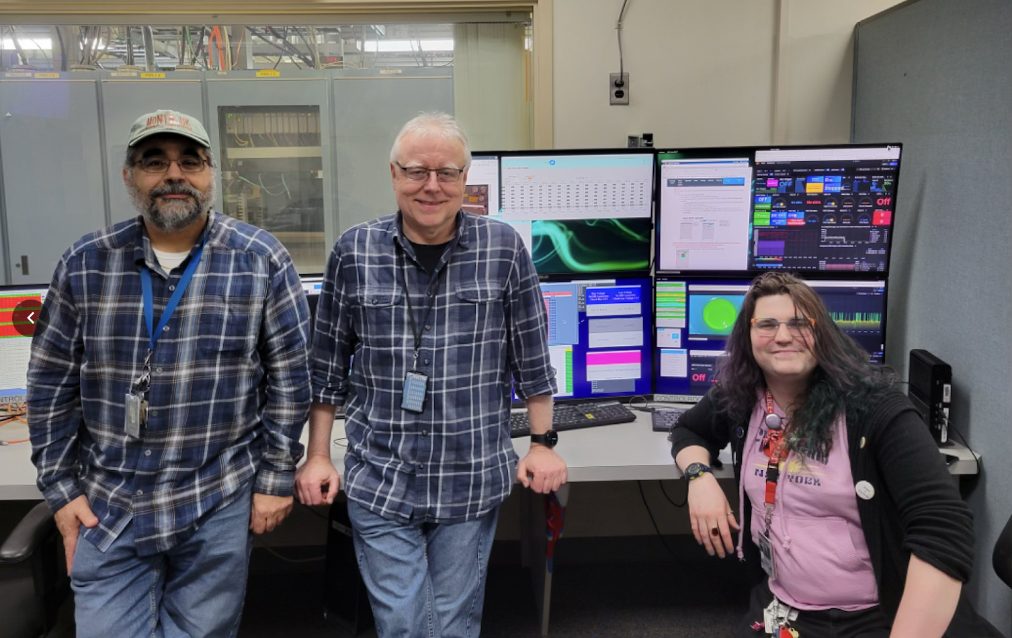
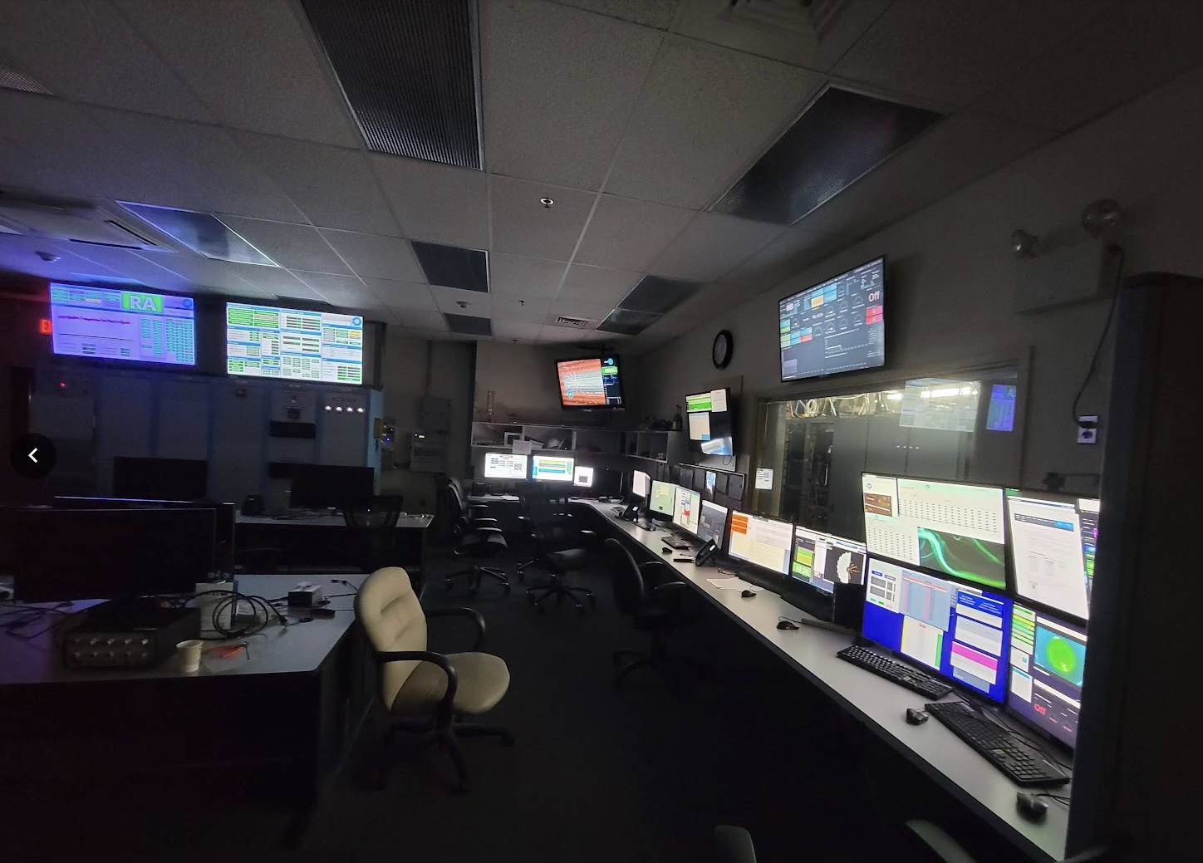
sPHENIX Approaching the End
Last collisions ever on Friday, February 6, 9:08
Post-collisions work until Feb 21 Midnight
Last shift crew
I was the one to turn the lights off…

Slide 23
Summary
We had good runs 2024 and 2025/26!
We got 300PB of data
The DAQ as designed and built can sustain 72GB/s (that’s GByte/s) of data
The Streaming Readout was a success story beyond our wildest dreams
Buying more hardware to double the DAQ bandwidth for 2025 was a great investment
I personally saw the first RHIC collisions in 2000, and was there for the last
And was the very last shift leader and turned the lights off…
A bit of melancholy, but…
Looking forward to the Electron-Ion Collider!
sPHENIX sign-off

Slide 24
The End

Slide 25
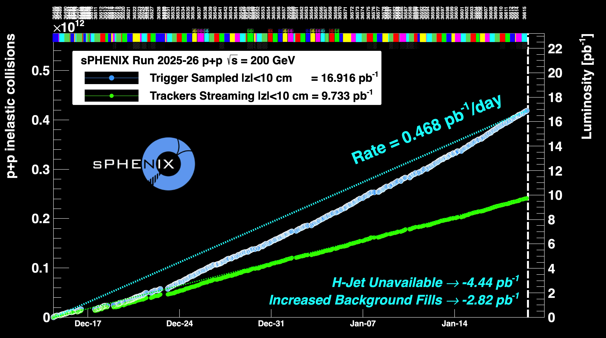
Performance p-p

Slide 26
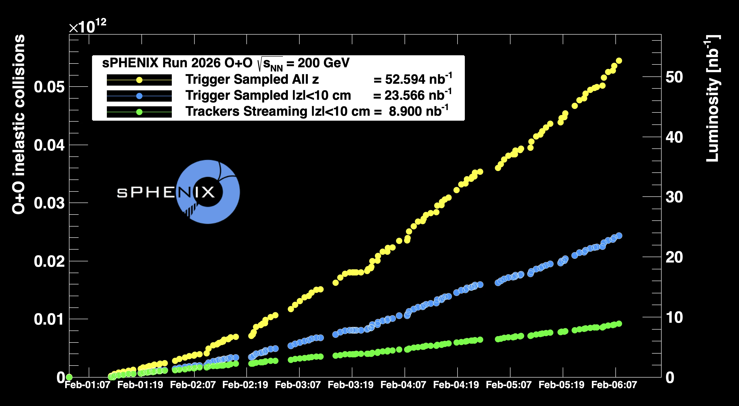
Performance O-O

Slide 27
Generic Setup script example (TPC)
This is a heavily abridged setup script for our TPC (for one of 24 sectors) read out with ann ATLAS FELIX card
Many more settings, rules to create file names, DB whereabouts, compression and file rollover setting, and more
#!/bin/bash
H=$RCDAQHOST
[ -z "$H" ] && H=$(hostname)
MYSELF=$(readlink -f $0)
rcdaq_client daq_clear_readlist
rcdaq_client daq_set_eventformat 0
# we add this very file to the begin-run event
rcdaq_client create_device device_file 9 900 "$MYSELF"
rcdaq_client load librcdaqplugin_dam.so
rcdaq_client create_device device_dam 1 4${H:4:2}0 1 $NUnit 1 /dev/dam0
rcdaq_client create_device device_dam 1 4${H:4:2}1 1 $NUnit 1 /dev/dam1

Slide 28
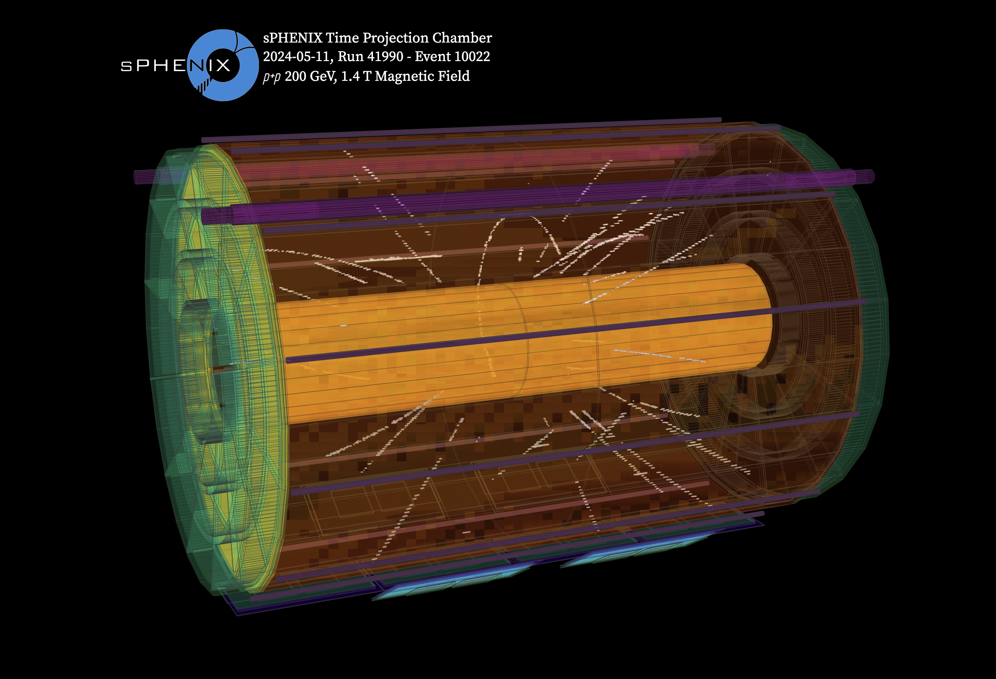
Let me show a wonderful event display…
There are many more at https://www.sphenix.bnl.gov/EventDisplays

Slide 29
Bunch number
Our Trigger/Timing system needs to be aware of the “RHIC rotation”
Each collider needs to have an ”abort gap”, empty bunches where we can flip a switch and “derail” the beam to a beam dump
The abort gap defines the “front of the bunch train” where we can flip a switch and divert the beam to the beam dump when done
Beam Dump
Abort Gap
RHIC: 9 of 120 bunches
(LHC: 756 out of 3564 bunches)

Slide 30
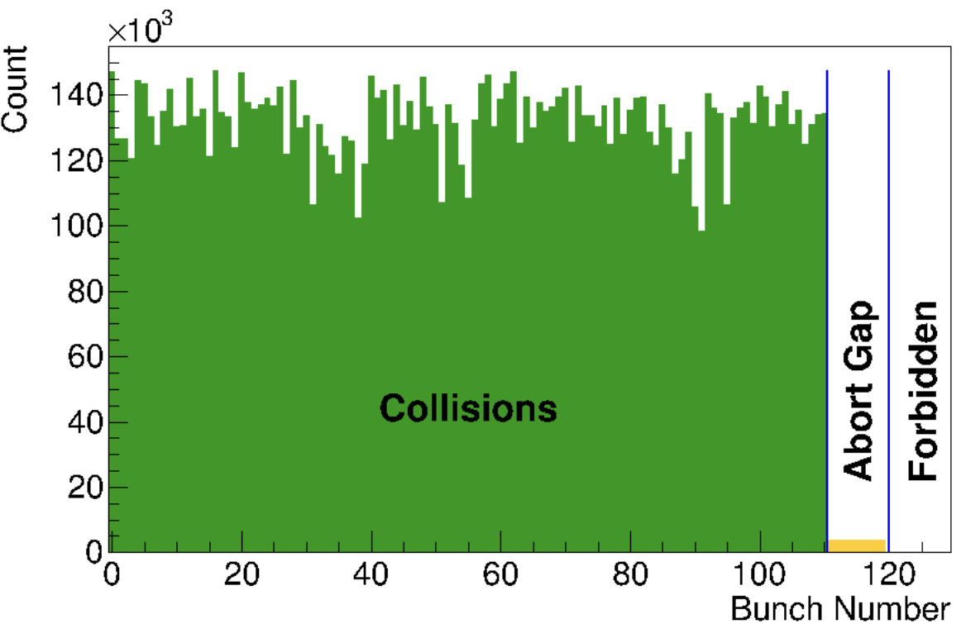
Bunch number
For us, the abort gap provides the opportunity to schedule calibration events where no collisions happen
For next year’s polarized-proton running we must have the bunch number right – each bunch is special with polarization and number of protons
This shows that we are sync’ed up with the rotation!
We meticulously check (online monitoring plot here) that the abort gap is in the right place, meaning that the accelerator interface told us the truth

Slide 31
Accelerator rotation / “modebits”
RHIC has 120 bunch “buckets” – one full rotation of about 12us
The vGTMs know (from the v124) when “bunch 0” is passing buy
Each vGTM has 32 “banks” with information for 120 individual bunch crossings each
We can store detector instructions (“modebits”) for any crossing and per vGTM
(so you can send different instructions to, say, the TPC and the EmCal)
That is the way to make a frond-end do things exactly when we need it to
They are detector-specific special instructions such as “reset all your internal counters”, “prime yourself for taking data”, “start”, etc
All modebits but a tiny handful are empty - “just the clock and nothing else”
Better explained with an example…

Slide 32
Modebits
Here is the (really simple) setup for our calorimeters using 5 such 120-slot banks
(remember each bank represents one RHIC turn, about 12us)
When we start, we issue a “run” modebit, more accurately “prime yourself”
Later we issue a “reset” modebit, clearing all internal counters - now we are ready to go
What you see here is a one-shot init section in banks 0..3, followed by sending ”nothing” indefinitely (until we say “stop”)
0 – we make 100 turns doing nothing
1 – in bucket 9 we issue “run”
2 – 100 turns / 1.2ms nothing
3 – bucket 9 sends “reset”
4 – 120,000 turns of nothing, followed by a jump to bank 4 again, going on forever
# modegrp repeat jump target values
0 100 0 0
1 0 0 0 9:RUN;
2 100 0 0
3 0 0 0 9:RESET;
4 120000 1 4

Slide 33
LED etc calibs
Now it’s easy to see how calibration events are triggered, and the readout is started.
We place the LED firing into the abort gap, where the detector is quiet
From there it’s a calibrated propagation latency until we need to trigger the ADC readout (here: 29 buckets)
… again until we say “stop”
0…3 you already know
4 – we wait 757 turns - ~10ms
5 – “PULSE” fires the LEDs in bucket 119 (last bucket in abort gap)
6 – 29 beam crossings after we start the readout (FA = “Forced Accept”)
… and we jump back to 4, so we get ~100Hz of LED events.
# modegrp repeat jump target values
0 100 0 0
1 0 0 0 9:RUN
2 100 0 0
3 0 0 0 0:RESET
# 757 is about 10ms
4 757 0 0
5 0 0 0 119:PULSE
6 0 1 4 28:FA

Slide 34
And you can see what this does
# modegrp repeat jump target values
0 100 0 0
1 0 0 0 9:RUN
2 100 0 0
3 0 0 0 0:RESET
# 757 is about 10ms
4 757 0 0
5 0 0 0
6 0 1 4 28:FA
# modegrp repeat jump target values
0 100 0 0
1 0 0 0 9:RUN
2 100 0 0
3 0 0 0 0:RESET
# 757 is about 10ms
4 757 0 0
5 0 0 0 119:PULSE
6 0 1 4 28:FA
This is the setup for a pedestal run, everything as before, just no LED firing

Slide 35
Summary
The GL1 core, and by extension the vGTMs know the “bunch number” that is currently flying by
They count bunches 0…119, 0…119, and so on
That allows us to place special actions such as the LEDs firing into the abort gap when the detector is quiet, and schedule the detector readout at the right moment after
We can do that on a per-detector basis (latency of the HCal LED->signal is different from the emcal)
Important b/c even though we take dedicated LED runs, we need to do this with beam in the machine.
We meticulously check (online monitoring plot here) that the abort gap is in the right place, meaning that the V124 told us the truth

Slide 36
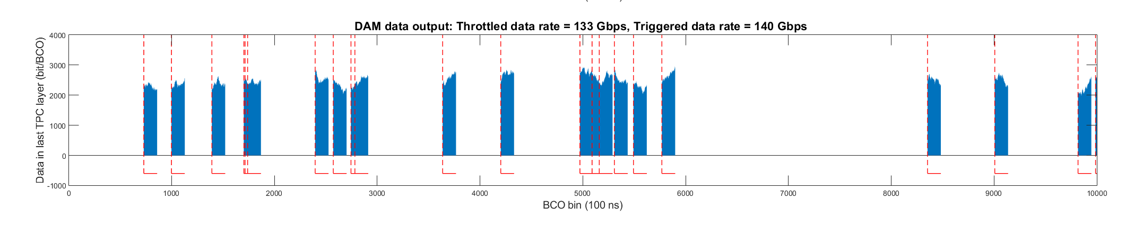
Let me show you
We initially assumed that we could add another 50-100 crossings that way
must-have (triggered-on crossings)
Additional
What we we able to do

Slide 37
Example: (older – 2021) sPHENIX TPC data
40 bits BCO
Clock values embedded in FEE data
0000000 feee ba5e 0ff1 0001 7229 f7a0 0088 0004
0000020 002f 8782 0004 ffff 0081 0000 0050 0050
…
0001020 d72c 0081 feed 0000 0088 3e2b 0004 feed
0001040 000f 0088 9f7a 0000 0000 0007 ffff 58af
…
0002100 0088 ad79 0004 feed 0017 0088 9f7a 0000
0002120 0000 000f ffff 58af 0081 0008 0000 ffff
…
0004740 0004 feed 0027 0047 0088 9f7a 0000 8782
0004760 0000 0004 001f ffff ffff 58af 0000 0000
FELIX Hdr
FEE structures
Clock values
bx 9f7a0
bx 9f7a0
bx 9f7a0
bx 9f7a0
…
In this way you can verify the integrity of the internal data structures, and sort the data by “time”
I’m showing an older version here since it’s easier to see

Slide 38
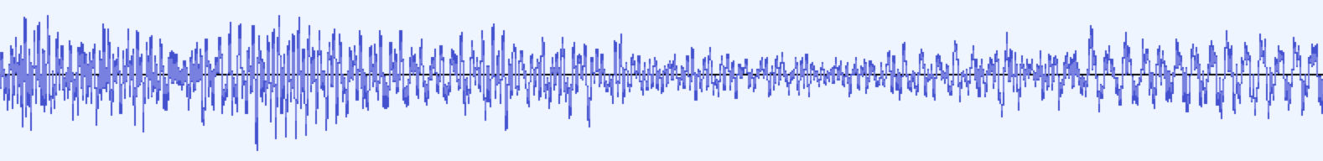
Streaming Readout and Packets
For streaming data, the “Packet” paradigm changes its meaning a bit
It becomes like a packet in the Voice-Over-IP sense - VoIP is chopping an audio waveform into conveniently-sized chunks to transfer through a network
Packet
Packet
Packet
Packet
Packet
We are chopping the streaming detector data into conveniently-sized packets for storage
Here: Streaming sPHENIX TPC data (entire sPHENIX tracking system streams!)
$ dlist rcdaq-00002343-0000.evt -i
-- Event 2 Run: 2343 length: 5242872 type: 2 (Streaming Data) 1550500750
Packet 3001 5242864 -1 (sPHENIX Packet) 99 (IDTPCFEEV2)
$
38

Slide 39
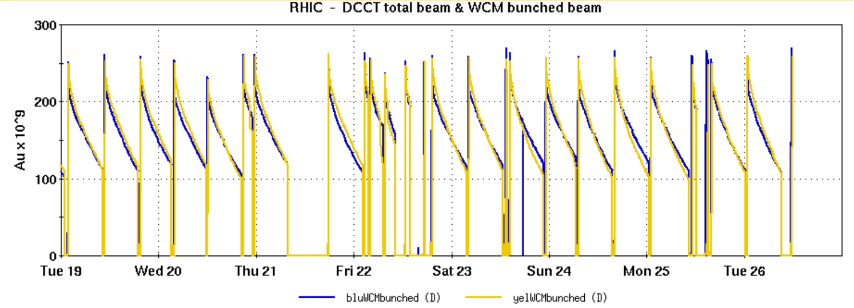
Why do we call those “BufferBoxes”?
100+ Gigabit
Crossbar
Switch
Buffer Box
The data rate at a collider is “bursty” – high luminosity at the begin of a store, then ”burning off” – change of a factor of 2
Also gaps in data flowing with collider dump/fill, access, APEX, MD
This Buffer boxes allow us to send the average, rather than the peak rate through the WAN
Buffer Box
Buffer Box
Buffer Box
Buffer Box
Buffer Box
Buffer Box
Buffer Box
Buffer Box
Buffer Box
Buffer Box
Buffer Box
39
2016 (last PHENIX run) beam intensity over a week
Average

Slide 40
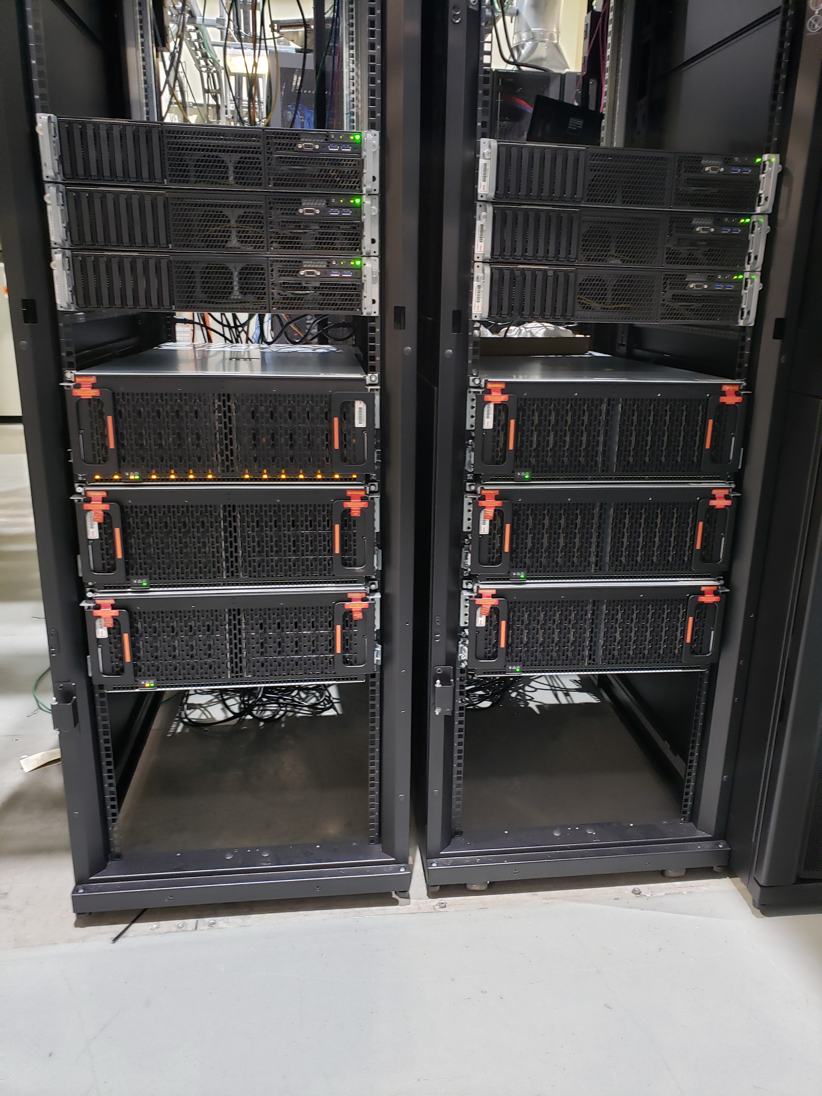
100+ Gigabit
Crossbar
Switch
Buffer Box
Buffer Box
Some Pictures
Buffer Box
Buffer Box
Buffer Box
Buffer Box
Buffer Box
Buffer Box
Buffer Box
Buffer Box
Buffer Box
Buffer Box
Disk Enclosure (102 16TB disks)
Network switch
BufferBoxes

Slide 41
Lustre ( and Zeph)
Remember, RAID allows you to “stripe” your I/O across multiple disks
You gain throughput (and data protection).
Lustre takes this same concept to multiple file servers
Same idea, distribute I/O across multiple servers, gain I/O capacity and (additionally) network capacity
Else this works pretty much like RAID, break up files into chunks, distribute across file servers.
Lustre is open-source, Zeph is fee-based from RedHat (pretty much the same concept)

Slide 42
Lustre
Disk Enclosure (102 14TB disks)
BufferBoxes
mgs00
bbox0
bbox1
bbox2
bbox3
bbox4
bbox5
…
10-disk RAID
1224 disks total, 120 10-disk ZFS raid-z1, 24 warm spares

Slide 43
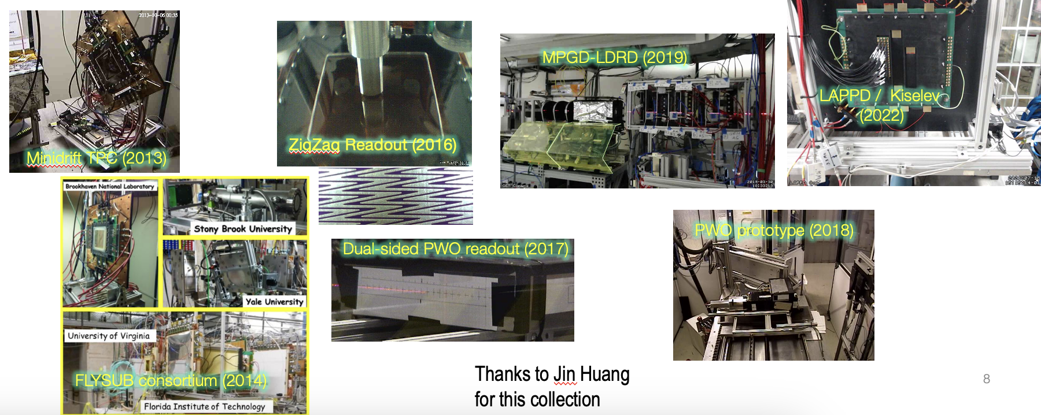
Test beams
Remember, RAID allows you to “stripe” your I/O across multiple disks
A small collage of the most important test beam setups over the years

