Slide 1
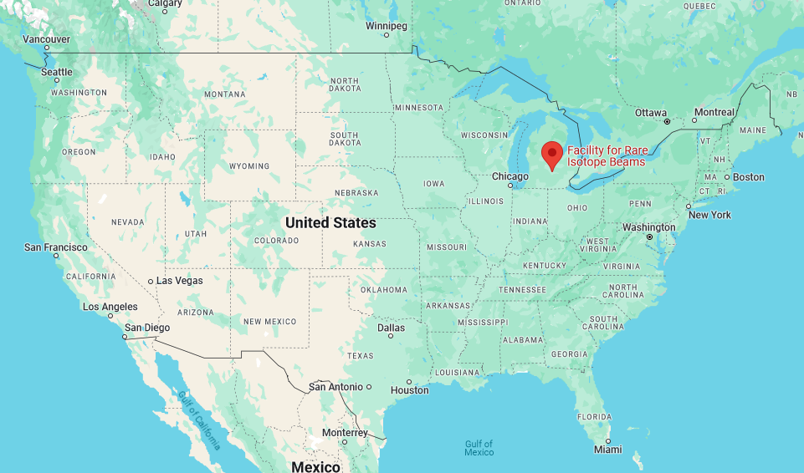
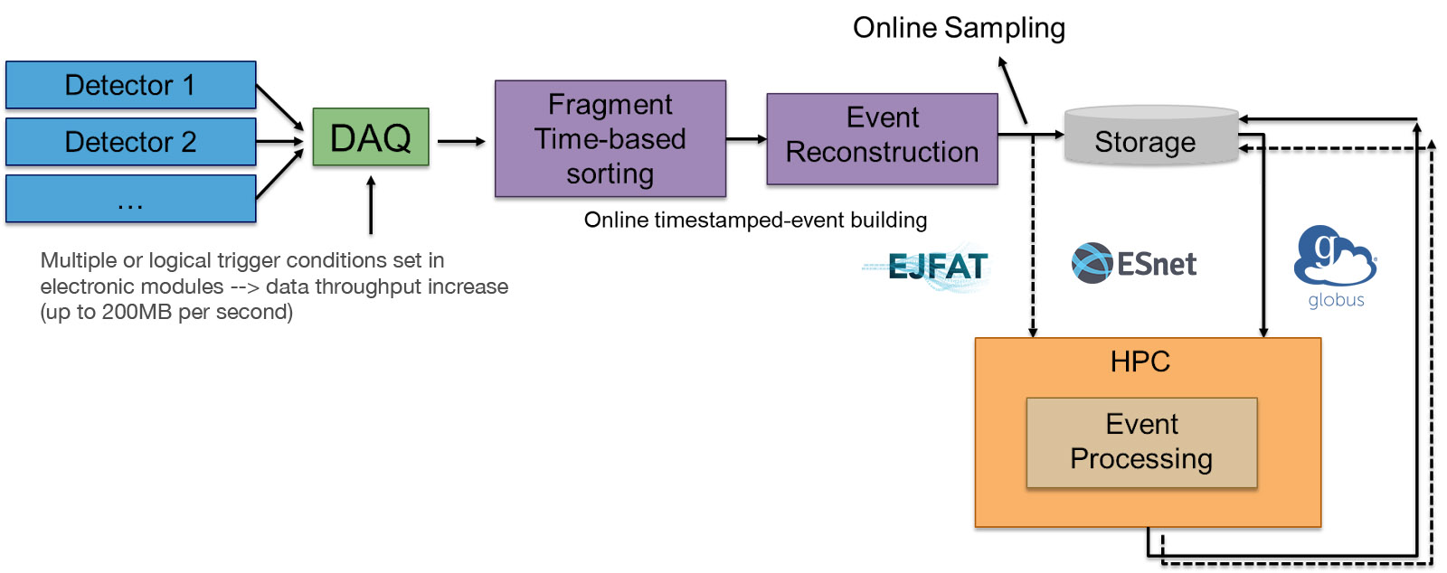
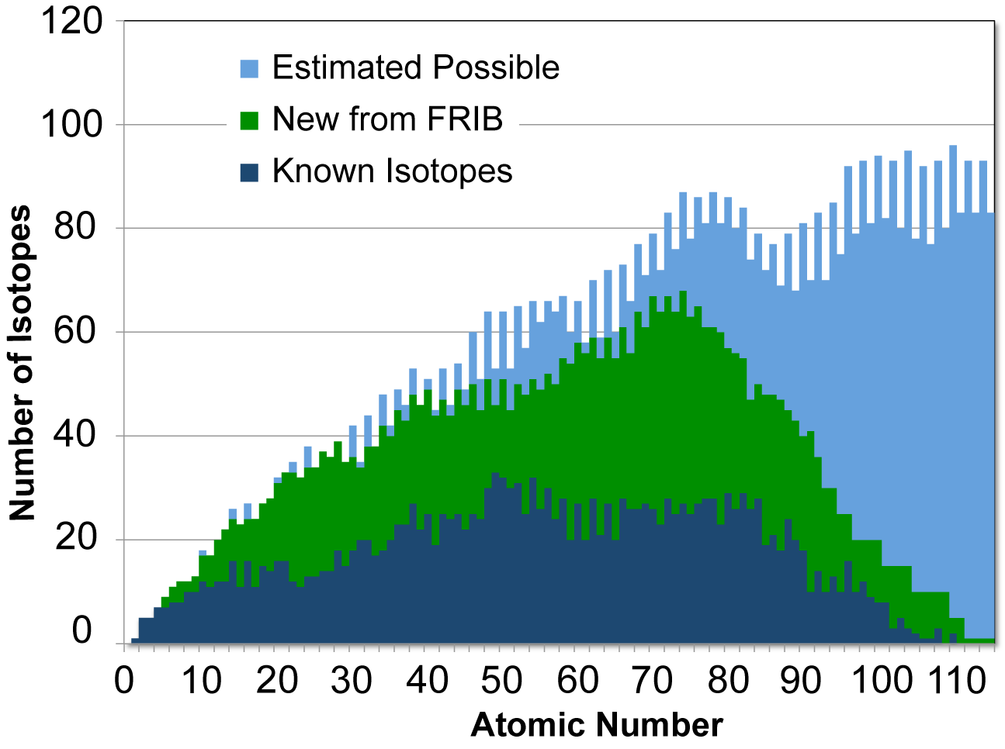
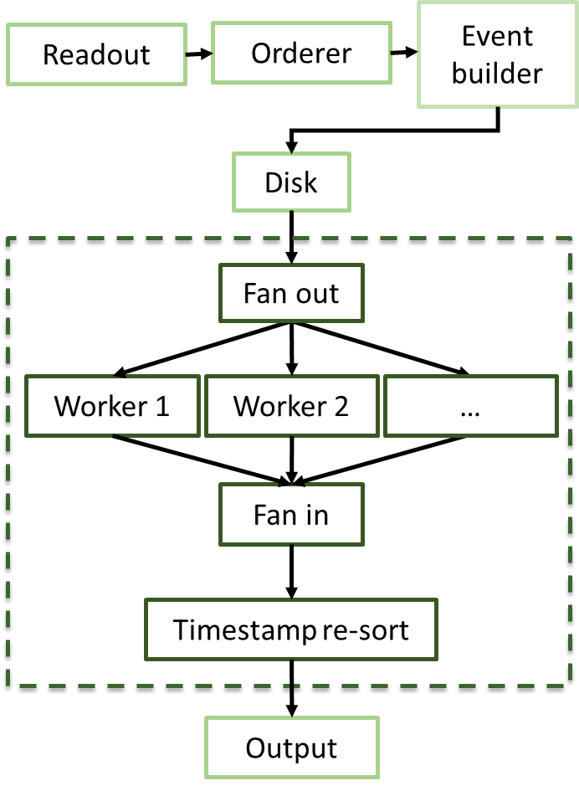
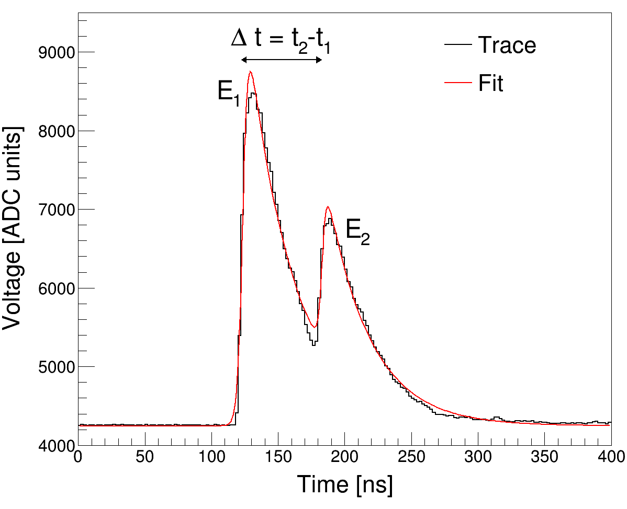
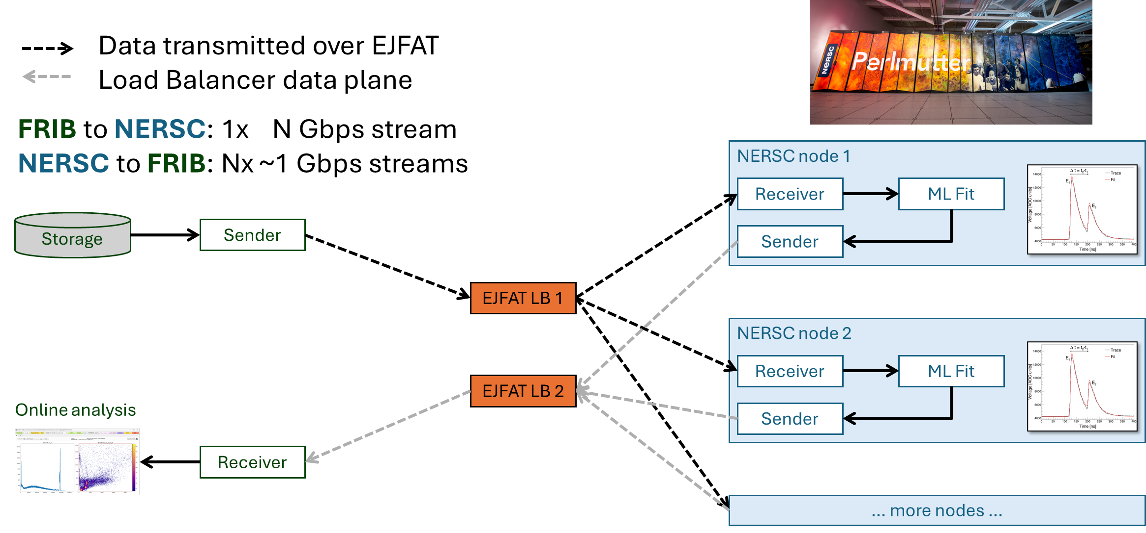
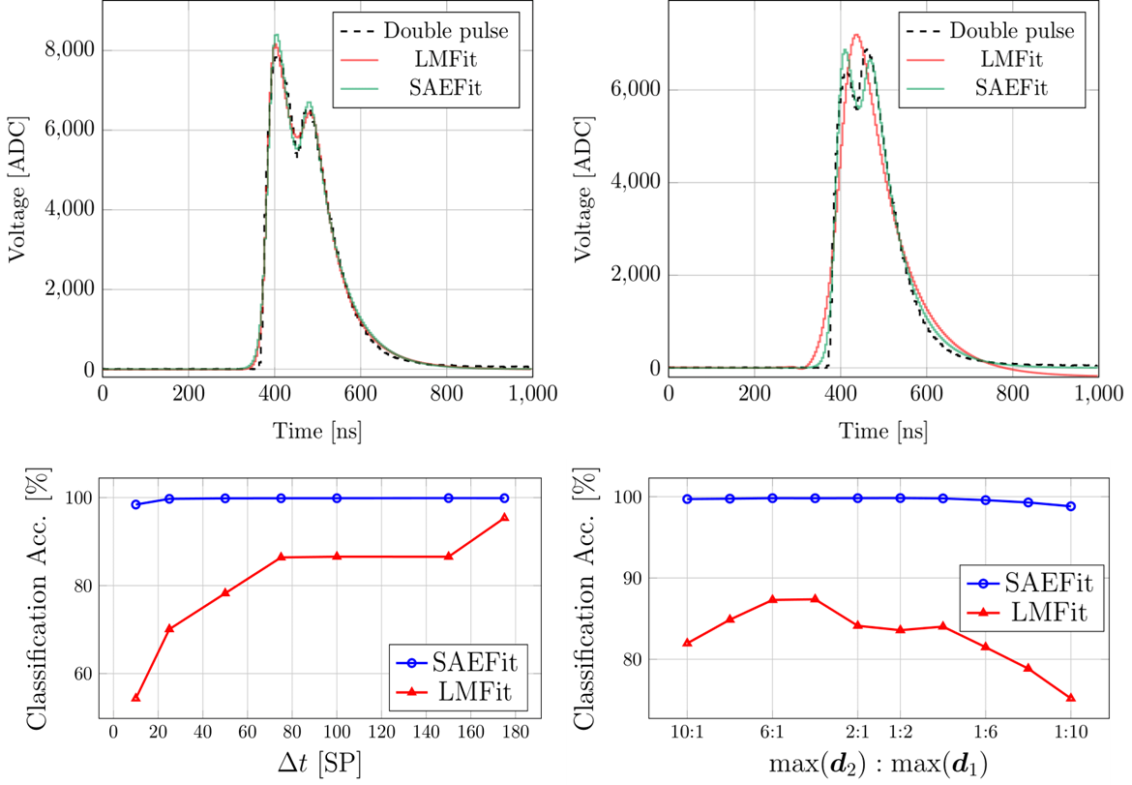
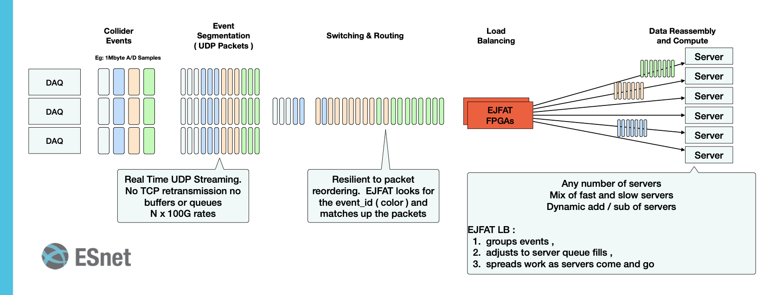
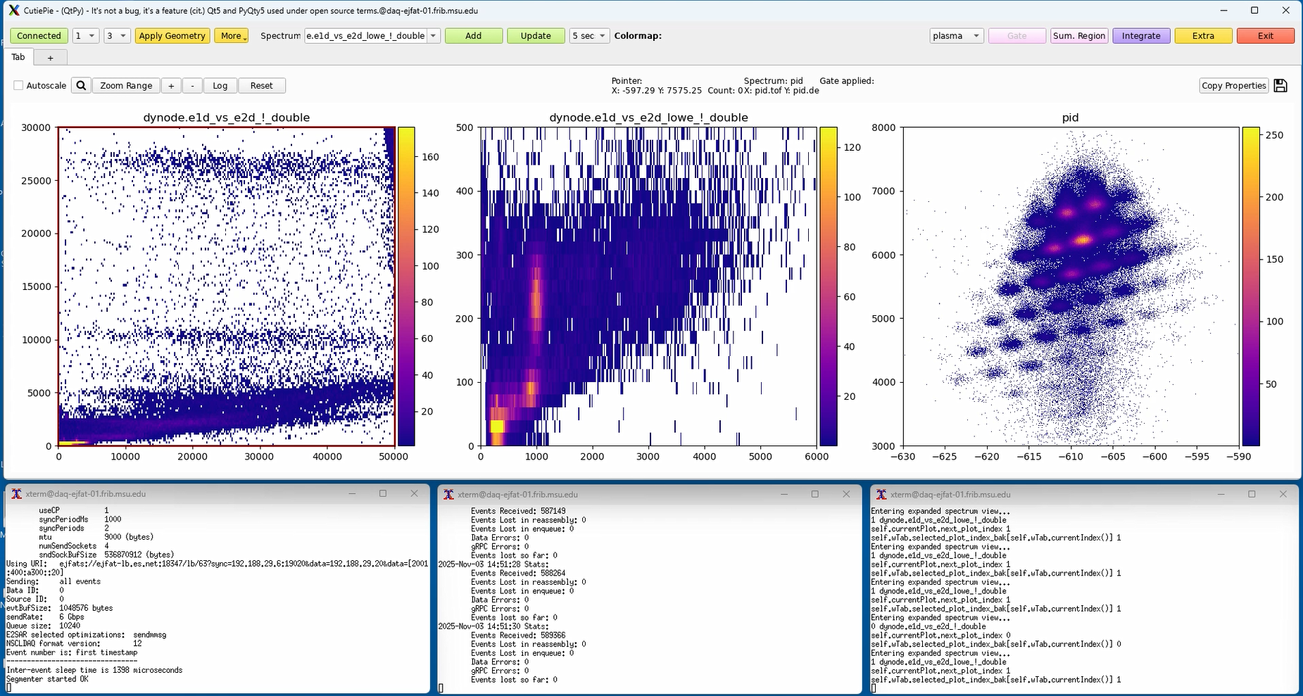
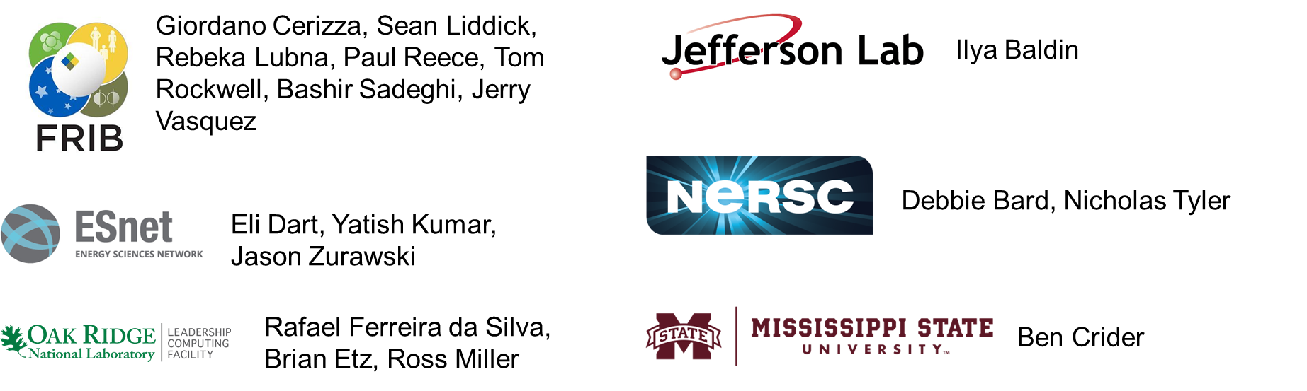
Real-Time Workflows at FRIB Using EJFAT/E2SAR and ESnet
Aaron Chester¹, Ilya Baldin², Giordano Cerizza¹, Ben Crider³, Derek Howard⁴, Yatish Kumar⁴, Sean Liddick^{1,5}, Paul Reece¹, Tom Rockwell¹, Bashir Sadeghi¹, Stacey Sheldon⁴, and Jerry Vasquez¹
¹Facility for Rare Isotope Beams, Michigan State University, East Lansing, Michigan 48824, ²Thomas Jefferson National Accelerator Facility, Newport News, Virginia 23606, ³Department of Physics and Astronomy, Mississippi State University, Mississippi State, Mississippi 38762, ⁴Energy Sciences Network, Lawrence Berkeley National Laboratory, Berkeley, California 94720, ⁵Department of Chemistry, Michigan State University, East Lansing, Michigan 48824
Overview of The Facility for Rare Isotope Beams (FRIB)
FRIB Data Acquisition Architecture
The Facility for Rare Isotope Beams (FRIB) is a scientific user facility funded by the US Department of Energy Office of Science, Michigan State University, and the State of Michigan.
The key feature of FRIB is a high-power LINAC which can operate at a maximum power of 400 kW, delivering beams from oxygen to uranium at up to 200 MeV/u to fast, stopped, and re-accelerated beam experimental areas.
Beginning operation in May 2022, FRIB has a user organization representing ~1800 users spread across 53 countries, 125 colleges universities, and 13 national labs.
The FRIB scientific program covers a broad range of nuclear science, from nuclear structure, astrophysics, fundamental symmetries, and societal applications and benefits such as isotope harvesting for nuclear medicine.
Upgradable parts of DAQ pipeline:
DAQ (streaming readout)
Event reconstruction (parallel event build)
Event processing (HPC centers)
Process-level pipeline parallelism
Separate readout and timestamp sorting
Parallel analysis framework
Plugin library for user analysis, parallel task distribution via OpenMPI or 0MQ
Event-editing software
Filters (parallel software trigger), body editors (add to or modify event data)
Rate limited by DAQ hardware backplane
80 MB/s VME64, 109 MB/s PCIe
Connecting FRIB Science to HPC Facilities: Real-time Workflows using EJFAT/E2SAR and ESnet
[Top left] A radioactive ion beam is implanted into a CeBr₃ scintillator detector. Isomeric states populated following the β decay of the implanted ion result in a characteristic double-pulse signal which is fit with a model response function to extract the isomer lifetime^{1,2}. The model response function must:
Classify events containing one or two pulses
Accurately and precisely estimate model parameters
[Middle left] Comparison of an iterative, nonlinear least squares method using the Gnu Scientific Library’s Levenburg-Marquardt solver (LMFit), and a machine-learning inference method using a Siamese autoencoder neural network architecture (SAEFit)³.
[Bottom left] The SAEFit approach offers improved classification, parameter estimation and is less computationally intensive than LMFit³.
Real-time queue, processes receive UDP traffic on the node, no batch processing of data
Can be file or TCP (ringbuffer)
Streaming workflow using E2SAR event segmentation and reassembly and EJFAT load-balancing FPGAs. E2SAR is integrated into the sender and receiver applications.
No intermediate files are written, operate exclusively on UDP and TCP streams.
¹A. Chester et al., Phys. Rev. C 104 (2021) 054314; ²A. Chester et al., Phys. Rev. C 105 (2022) 024319; ³B. Sadeghi et al., Nucl. Inst. Meth. A 1082 (2026) 170971
Online Analysis of Data Processed at Perlmutter
Summary and Conclusions
Developed a real-time workflow for distributed analysis of production FRIB experiment data offsite at NERSC.
Use of real-time queue: latency-free analysis without batch processing.
Integrated EJFAT/E2SAR data transfers and ML-inference fitting into standard FRIBDAQ online analysis tools to support real-time data processing.
Processed 615 GB of data (15 hours of run time) in 20 minutes using 8 Perlmutter nodes at an average rate of 525 MB/s (hardware limited).
Extensible framework for handling additional use cases for data streaming to HPC or between FRIB and other laboratories.
Excellent support from EJFAT team, positive user experience.
Traffic monitoring and run statistics. Note that zero events are lost through EJFAT/E2SAR.
Acknowledgements
Online analysis and monitoring of the data-processing workflow incorporating the machine-learning inference fitting. [Left] The horizontal bands are characteristic of β-delayed isomeric states depopulating via a low-energy γ ray or electron. [Middle] Circular dots are characteristic of isomer-to-isomer transitions. [Right] Particle identification plot. Each spot represents a different radioactive isotope in the beam.

