Slide 1

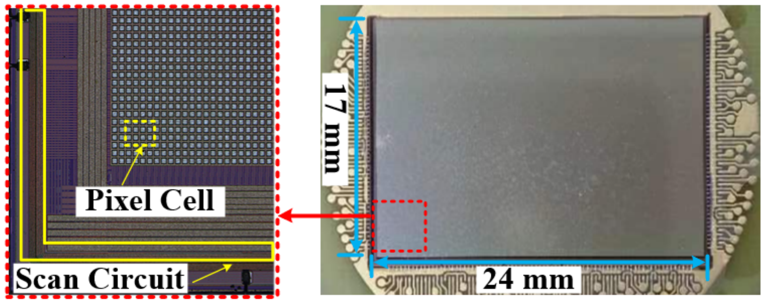
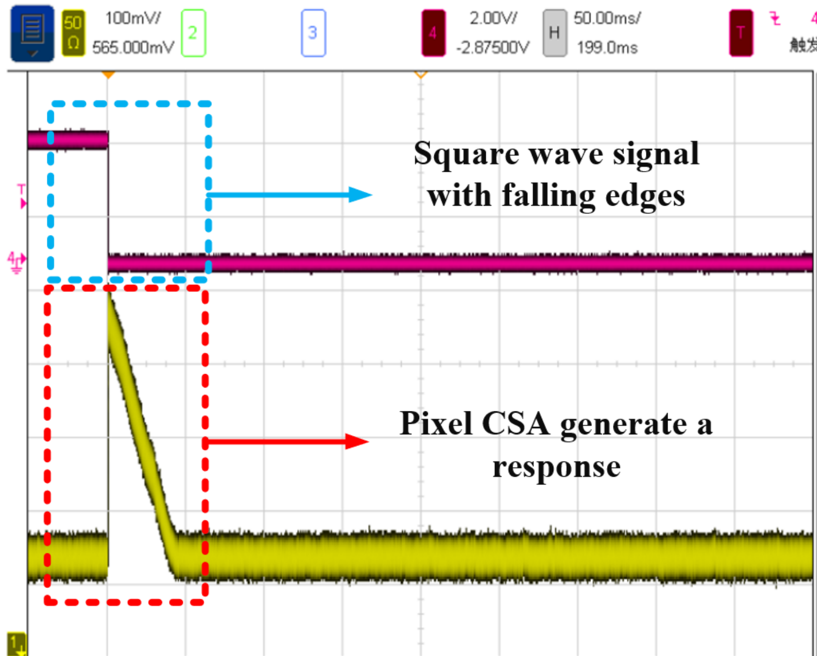
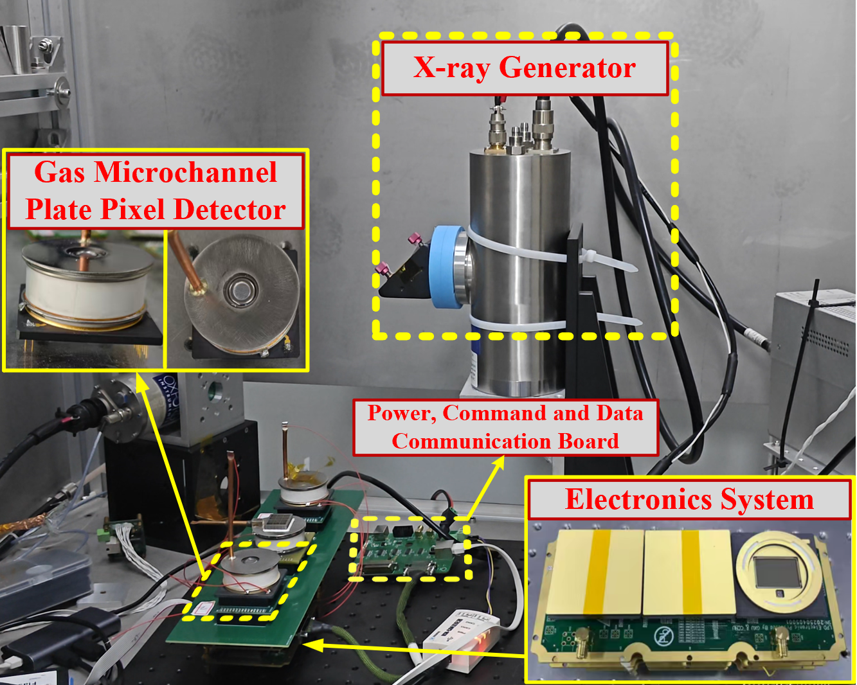
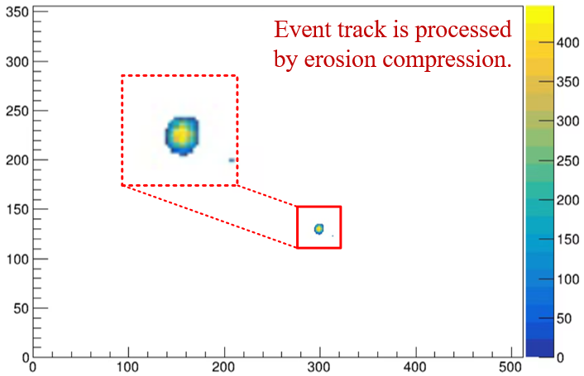
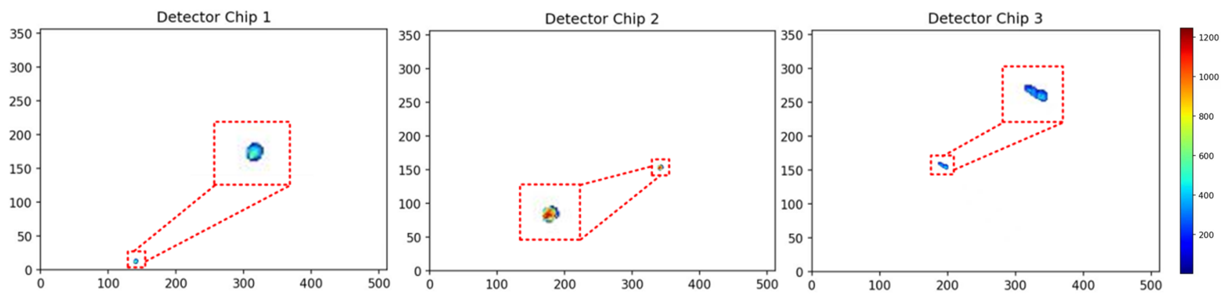
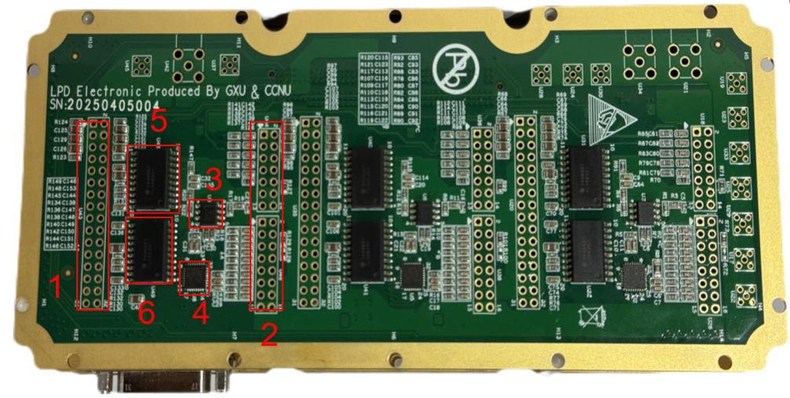
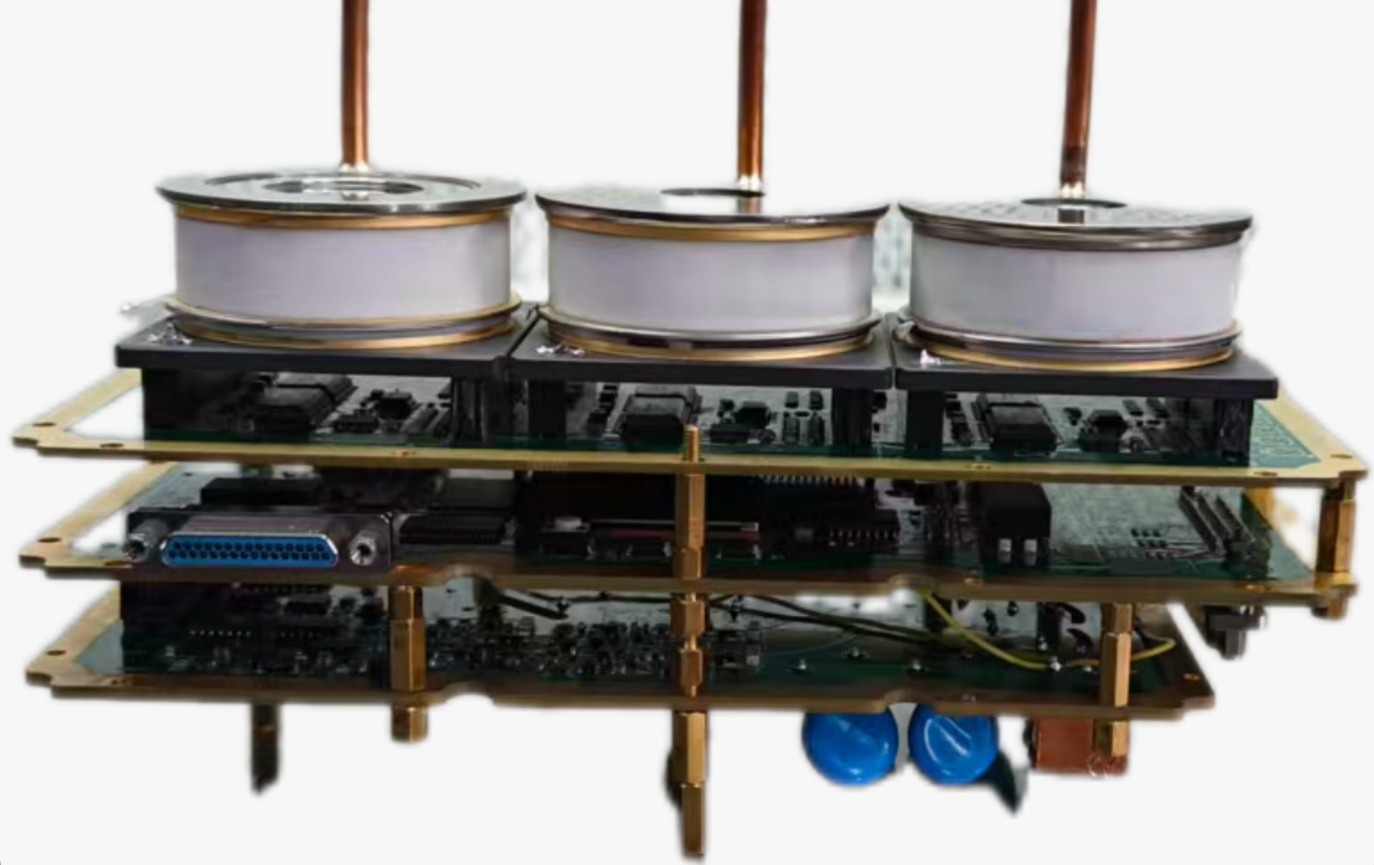
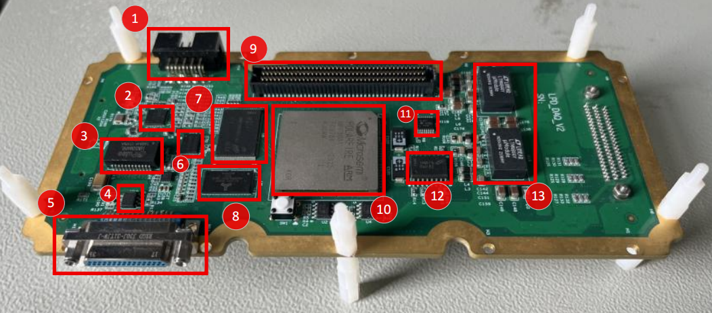
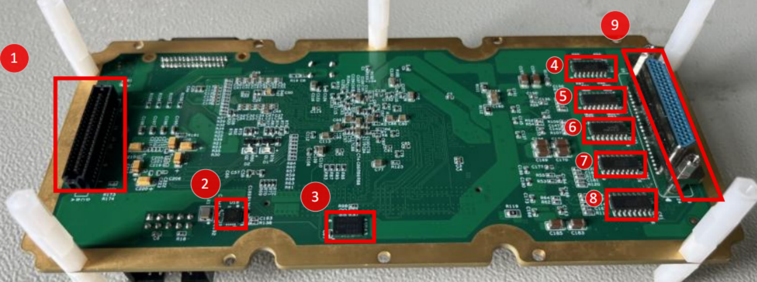
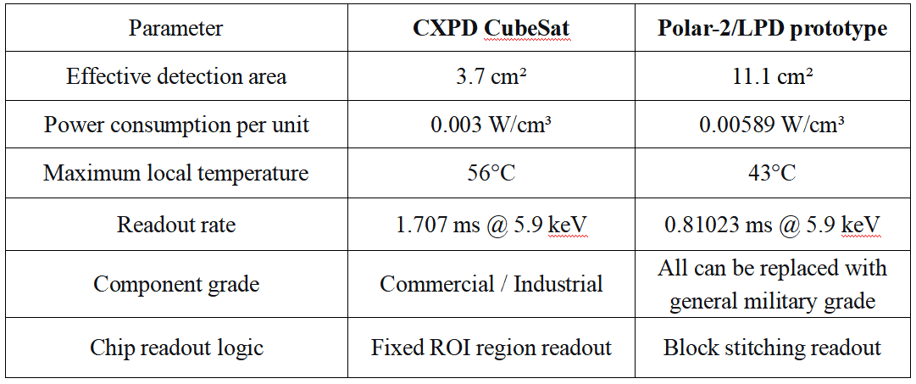

Design of a Low-Power Electronics System for Low Energy X-ray Polarization Detection Based on Multi-Detector Units
Shiqiang Zhou, Ziyi Zhang, Siying Liu, Dong Wang, Hongbang Liu, Huanbo Feng, Lirong Xie, Difan Yi, Yichen Tong, Mengping Liu, Zhuo Zhou, Yanjun Luo, Hui Wang, Kai Chen, Ni Fang, Cheng Lian
Introduction
The POLAR-2 experiment on the China Space Station aims to survey X-ray transients such as gamma-ray bursts (GRBs). As one of its three payloads, the Wide-field Low-energy X-ray Polarization Detector (LPD) uses a Gas Pixel Detector (GPD) with Topmetal-L pixel chips for charge collection. This paper presents an electronics prototype that operates three independent detection units simultaneously. The prototype adopts a three-board architecture: a Front-End Board for analog signal acquisition and ADC, a Main Control Board for data processing and satellite communication, and a High-Voltage Board for stable detector bias. Firmware optimizations reduce invalid pixel data transmission, improving efficiency. Tests show: total power consumption is 10.8 W, meeting platform constraints; thermal simulation gives a local maximum on-orbit temperature of ~44°C, much lower than existing in-orbit gas detectors; functional tests confirm stable operation of the three units, providing an effective detection area of 11.8 cm² per prototype and the ability to capture photoelectron events at fluxes up to 450 count/cm²/s.
Topmetal-L chip and ROIRC
Test results
Topmetal-L is a large-area CMOS pixel sensor developed for the LPD of the POLAR-2 mission, fabricated with a GSMC 130 nm CMOS process. It features a 356 × 512 pixel array, a total chip size of 17 mm × 24 mm, and a pixel unit of 45 × 45 μm². The chip integrates a charge-sensitive amplifier (CSA) with a folded-cascode structure and decay-based reset, providing an equivalent noise charge (ENC) of approximately 22.8 e⁻ and a pixel gain of 76.04 μV/e⁻. It employs the Region-of-Interest Readout Circuit (ROIRC) with sentinel monitoring, block-based region scanning, and dilation processing to realize fast, low-power readout. Topmetal-L can efficiently capture 2–10 keV X-ray photoelectron tracks.
Comprehensive ground tests were carried out on the LPD engineering prototype to verify the design effectiveness in four dimensions: system specifications, functional behavior, on-orbit reliability, and scientific performance. The test platform was established using ⁵⁵Fe, ²⁴¹Am radioactive sources and an X-ray generator.
A comprehensive set of verification experiments was conducted, covering noise and gain, power consumption and thermal simulation, multi-unit X-ray imaging, trigger/readout rate, wide field of view, high-voltage control, and data compression..
The LPD system exhibits low noise and excellent linearity, with a total power consumption of 10.8 W and a volume power density of 0.003 W/cm³. Its heat dissipation performance is improved compared to that of the CXPD system.
Three detector heads operate synchronously, providing a total effective detection area of approximately 33 cm².
Fig. Topmetal-L pixel chip.
LPD electronics hardware design
LThe readout electronics system of the LPD detection unit adopts a 1×3 multi-unit modular detection architecture. The hardware is based on a three-layer PCB stacking design, incorporating a total of 9 GPD detectors.
Front-End Board (FEB): Connects to the GPD detectors, provides low-noise power supply and adjustable bias. It uses a differential amplifier and ADC to digitize analog signals, with three independent parallel acquisition channels transmitting data to the DAQ.
Data Acquisition Board (DAQ): Features a Flash-based FPGA as the core, performing data aggregation, buffering, compression, and storage. It supports DDR3 and NAND Flash, enabling telecommand/telemetry and high-speed data transmission.
High-Voltage Board (HVB): Generates independent negative high voltages for three GPDs, distributing three sets of operating voltages through voltage divider circuits. It monitors voltage and current in real time, and provides creepage protection, slow rise/fall control, and discharge protection.
GPD detector: Consists of a cathode, GMCP, and Topmetal pixel chip, filled with a gas mixture. It converts X-rays into photoelectrons and multiplies them, achieving high-resolution track imaging and polarization direction determination.
Fig. Polar-2/ LPD system test platform
Fig. Event track processing
Fig. Imaging results of simultaneous track acquisition by three detector units.
Conclusions and Outlook
The LPD system, serving as the low-energy X-ray detector for POLAR-2, fills the soft X-ray observation gap in gamma-ray burst detection and supports astronomical observations on China’s space station. Upgraded from the on-orbit verified CXPD, LPD adopts a novel wide-field cooperative architecture and block-based ROI readout, realizing compact, low-power, large-area detection and significantly improving data readout efficiency.
In the future, the number of detector units driven by one FPGA can be extended to enlarge the effective area. With better performance than CXPD-01, LPD will become a key platform for MIGDAL effect experiments. Its compatible device design also supports wide applications in commercial, industrial and aerospace fields.
Fig. Engineering System Prototype of the Polar-2 / LPD
Comparison of system parameter specifications
The CXPD CubeSats have operated in orbit. As the formal prototype for Polar-2's low-energy X-ray polarization detection, the LPD system incorporates innovations in hardware, firmware, readout algorithms, component selection, and operation modes, following on-orbit standards. See table for performance comparison.
Acknowledgments and References
This study is supported by the National Key Research and Development Program of China (No. 2024YFE0110101, No. 2020YFE0202002) and in part by the Self-Determined Research Funds of Central China Normal University (CCNU) from the Colleges’ Basic Research and Operation of Ministry of Education (MOE) under Grant 30106250134, and this work is supported by the National Natural Science Foundation of China (Grant Nos.12027803,U1731239),the Natural Science Foundation of Guangxi (ZY24212021).
H. Feng, H. Li, X. Long, et al., “Redetection and possible time variation of soft X-ray polarization from Crab,” Nat. Astron., vol. 4, pp. 511–516, 2020.
H. Wang, D. Wang, R. Chen, et al., “Electronics system for the cosmic X-ray polarization detector,” Nucl. Sci. Tech., vol. 34, p. 64, 2023,.
May 24, 2026

