Slide 1

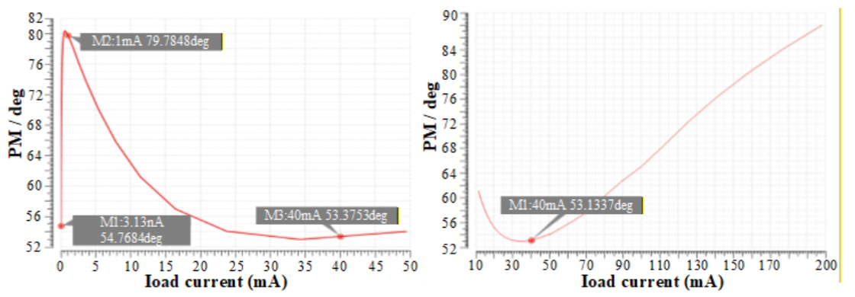
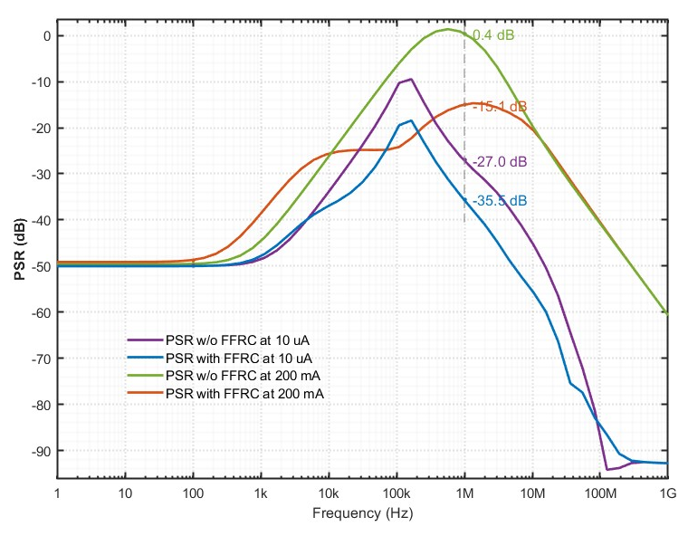
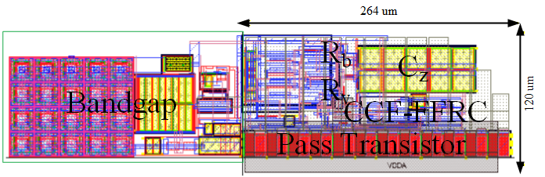
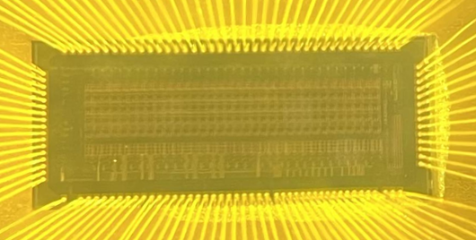
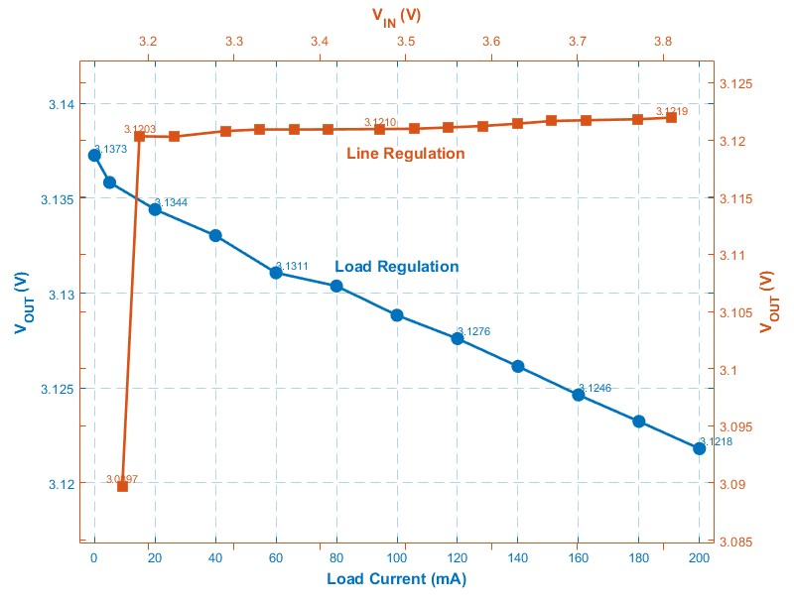
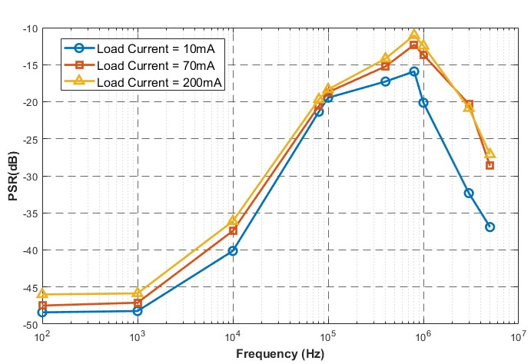
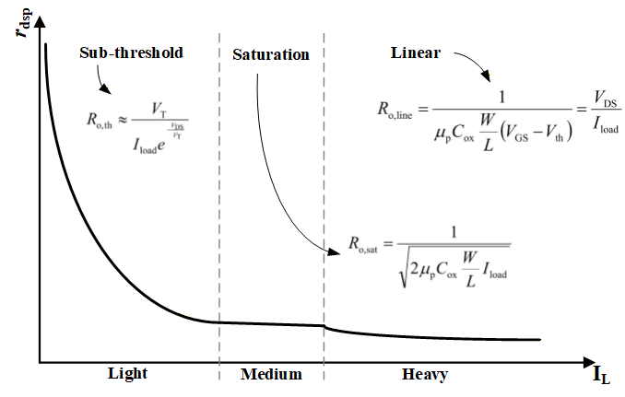
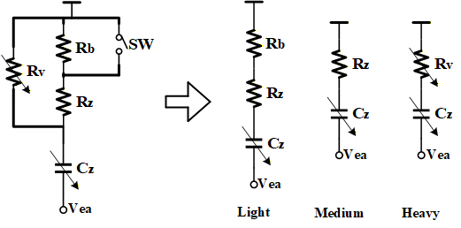
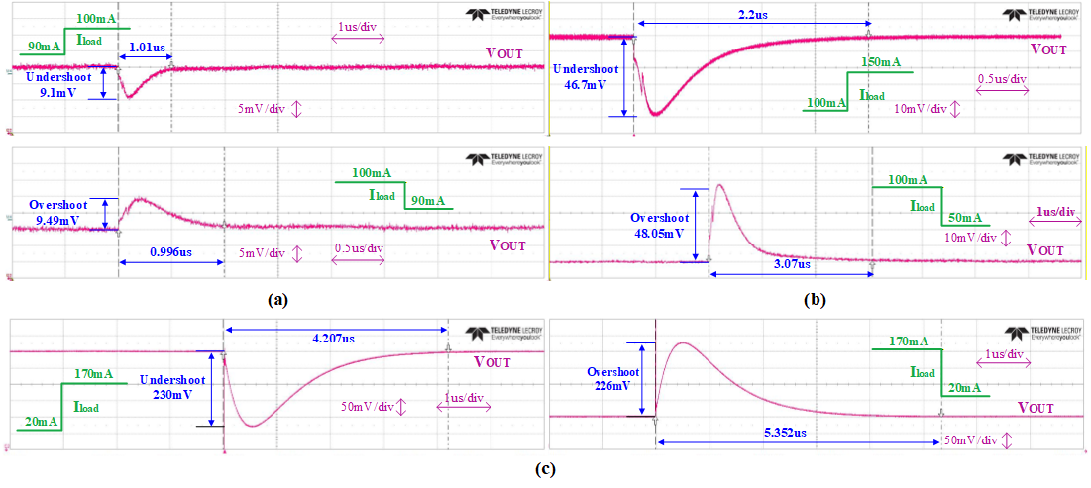


A Full on-Chip LDO Regulator with self-adapting compensation networks for Front-end Readout Circuit
Xiayu Wang¹, Jia Wang^{2*}, Yongcai Hu¹
1. School of Computer Science, Northwestern Polytechnical University, Xi’an, China
2. School of Integrated Circuit and Microelectronics, Northwestern Polytechnical University, Xi’an, China
xiayuwang@mail.nwpu.edu.cn
jwang@nwpu.edu.cn
DESIGN MOTIVATION
which remains within acceptable limits.
PSR improvement
At a light load (10 μA), the PSR at 1 MHz improves from -27 dB to -35.5 dB, while at a heavy load (200 mA), it improves from 0 dB to -15 dB.
To provide a stable and clean supply voltage for front-end readout electronics, a low-dropout (LDO) regulator must meet several key requirements:
1) Capacitor-less output, which eliminates the need for a large off-chip capacitor, is advantageous for compact size.
2) Stable operation over a wide load current (I_{L}) range.
LAYOUT AND TEST RESULTS
CIRCUIT DESIGN
Layout
Technology: 180nm CMOS Area: 120×265 um²
Structue of the proposed LDO
Four poles exist in the loop, with two located below the UGF that directly impact stability. The two main poles are given as:
Line and Load Regulation
PSR
$$P_{EA}=\frac{1}{2πR_{EA}C_{G}}$$
$$P_{OUT}=\frac{1}{2π[{({R_{1}+R_{2})r}_{o,M_{p}}||R}_{L}]C_{L}}$$
2.67 mV/V
-21dB
@1MHz
77.5 mV/A
-46dB
@100Hz
Load Transient Response
Since P_{OUT} varies widely with I_{L}, fixed zero compensation is insufficient to satisfy stability requirements across a wide I_{L} range.
Depending on the MOSFET's operating region (sub-threshld, saturation and linear), the compensation circuit is configured into three corresponding topologies to track P_{OUT} better.
Circuit Implementation
CONCLUSION AND COMPARISION
Table I. Performance summary and comparison with state-of-the-art designs.
 | [1] | [2] | [3] | [4] | This Work
Technology (nm) | 180 | 28 | 180 | 180 | 180
I_{out,max} (mA) | 200 | 10 | 50 | 200 | 200
Dropout Voltage (mV) | 30 | 200 | 268.9 | 200 | 70
Line Regulation (mV/V) | 0.346 | 1.71 | 3.484 | / | 4.09
Load Regulation (mV/A) | 9.5 | 219 | 476 | 50 | 77.3
Undershoot ΔV_{out} (mV)@ΔI_{load} (mA) | / | 50@9.8 | 152@50 | 210@190 | 230@150
Overshoot ΔV_{out} (mV)@ΔI_{load} (mA) | / | 51@9.8 | 126.9@50 | 270@190 | 226@150
PSR (dB)@Frequency (Hz) | -47@100 -37@100 k | -36@1 M | -49.4@10 k -12.6@1 M | / | -48@100 -21@ 1M
Active Area(mm²) | 0.18 | 0.012 | 0.17 | 0.148 | 0.0317
The transistor-level implementation of the proposed LDO is shown above. The inserted zero is given as:
$$Z_{z}=\frac{1}{C_{z}\{R_{M12}||[R_{z}+(R_{M13}||R_{b})]\}}$$
It varies with P_{OUT}, ensuring sufficient phase margin over the entire I_{L} range. Furthermore, a feedforward ripple cancellation path is integrated to improve the mid-to-high frequency power supply rejection (PSR) of the converter. The phase margin is 65.7°at a load current of 100 mA, and 89.8° at 200 mA. The minimum observed phase margin is 53.4°,
[1]M. Kim and S. Cho, ”An Output-Capacitorless Analog LDO Featuring Frequency Compensation of Four-Stage Amplifier,” in IEEE Transactions on Circuits and Systems I: Regular Papers, vol. 70, no. 2, pp. 642-654, Feb. 2023.
[2] J.-G. Lee and H.-S. Kim, ”A Fully Integrated, Domino-Like-Buffered LDO Regulator With High Power-Supply Rejection Across the Full Frequency Spectrum,” in IEEE Journal of Solid-State Circuits, vol. 59, no. 12, pp. 4088-4100, Dec. 2024.
[3] P. Li, X. Zhao, X. Zhang et al., ”General Performance Enhancement for Capacitor-Less Low-Dropout Regulator Using Local Positive-Feedback Technique,” in IEEE Transactions on Power Electronics, vol. 40, no. 1, pp. 1498-1507, Jan. 2025.
[4] M.-S. Kim, J.-H. Kim, S. Jeong et al., ”A Wide Load Range Output Capacitor-Less LDO With Load Tracking Zero Compensation for IoT Applications,” in IEEE Transactions on Industrial Electronics, vol. 73, no. 1, pp. 1499-1504, Jan. 2026.
25th IEEE Real Time Conference - ICISE, Elba, Italy

