Slide 1
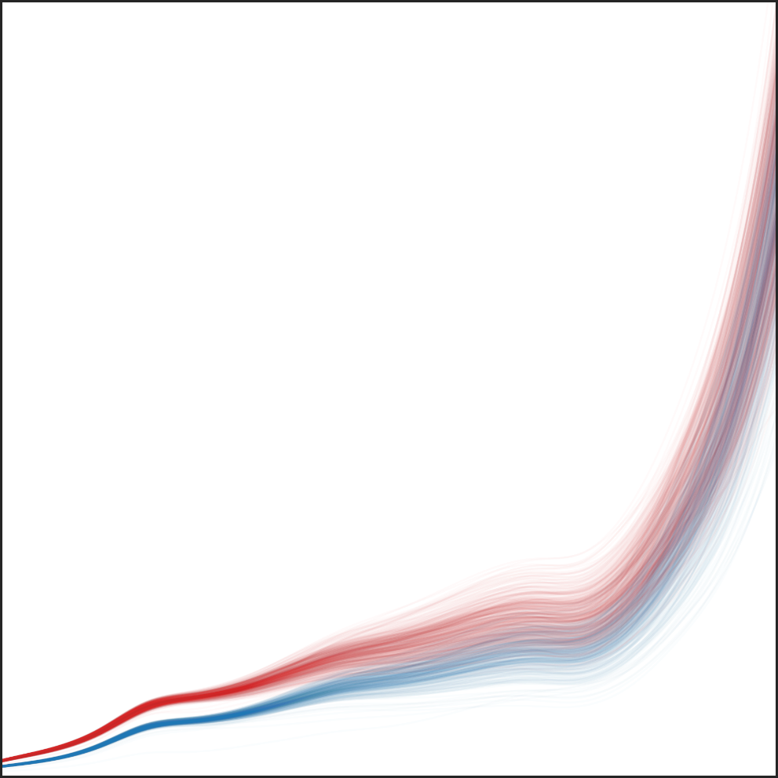
FPGA-Based Autonomous Data Logging for
Real-Time Beam Monitor Signal Processing in
Proton Therapy
Christian Groh – Michael Eichin
RealTime2026, 29 May 2026

Slide 2
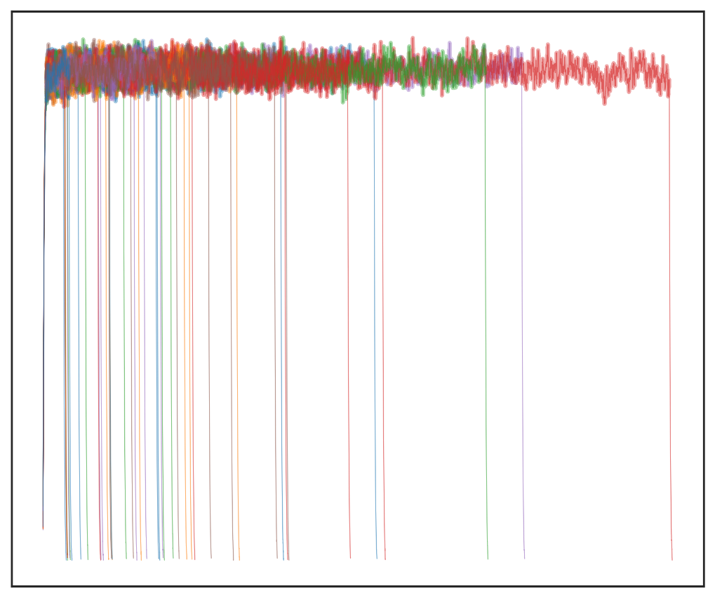
Agenda
Proton Therapy @ PSI
Introduction Pencil Beam Scanning
Beamline variations
Motivation for autonomous logging
Technical Details of autonomous logging
Results and performance

Slide 3
Proton Therapy @ PSI

Slide 4
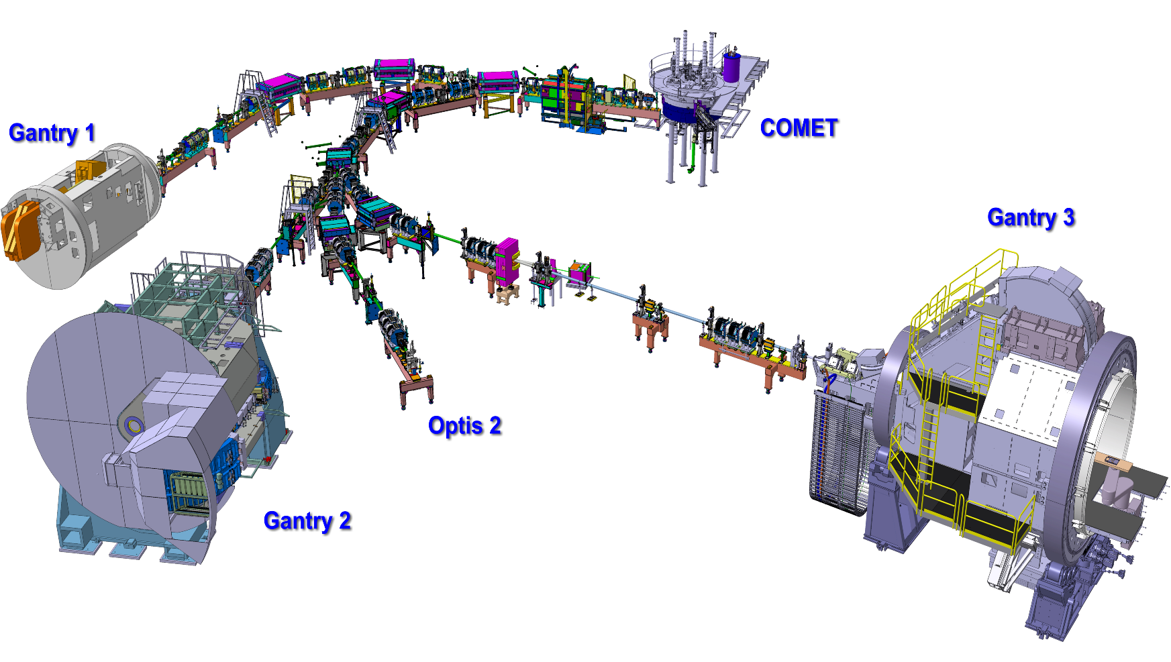
Proton Therapy @ PSI
COMET Superconducting accelerator. One accelerator for all treatment areas
Gantry1 PSI development. In operation since 1996. Worldwide 1st gantry with spot scanning pencil beam technology.
Gantry2 PSI development. Performance optimized Gantry design for continuous scanning technologies.
OPTIS2 PSI development. Horizontal fixed beamline based on scattering technology
Gantry3 Commercial gantry from VARIAN Medical Systems. Based on raster scanning technology
PSI facility to treat tumour
patients with protons
COMET Superconducting accelerator.
One accelerator for
all treatment areas
Gantry1 PSI development.
In operation since 1996.
Worldwide 1st gantry with
spot scanning pencil beam
technology.
Gantry2 PSI development. Performance optimized Gantry design for continuous scanning technologies.
OPTIS2 PSI development. Horizontal fixed beamline based on scattering technology.
Gantry3 Commercial gantry from VARIAN Medical Systems. Based on raster scanning technology

Slide 5
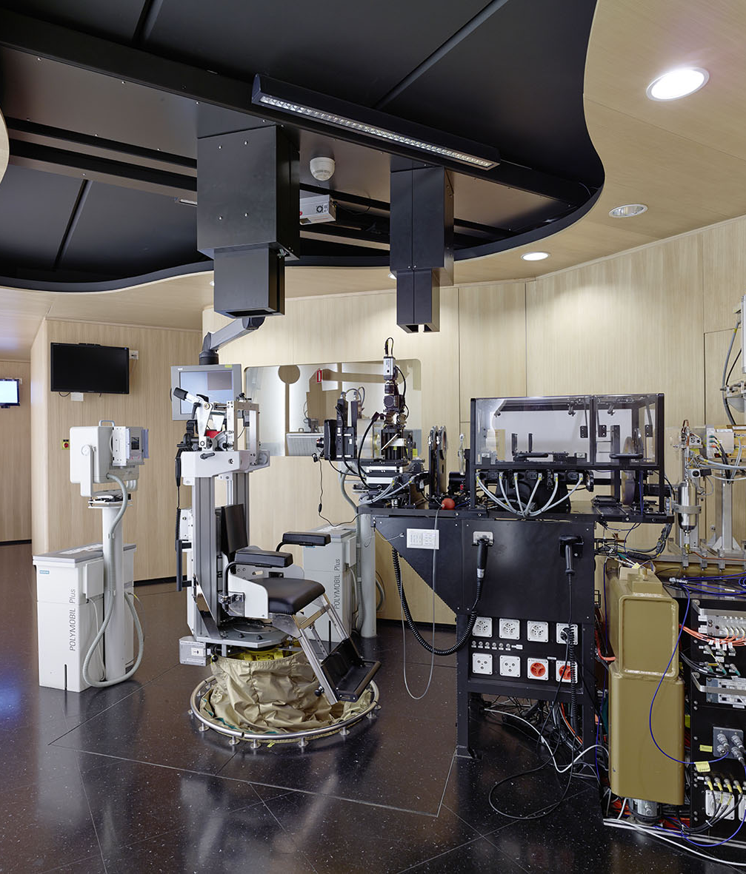
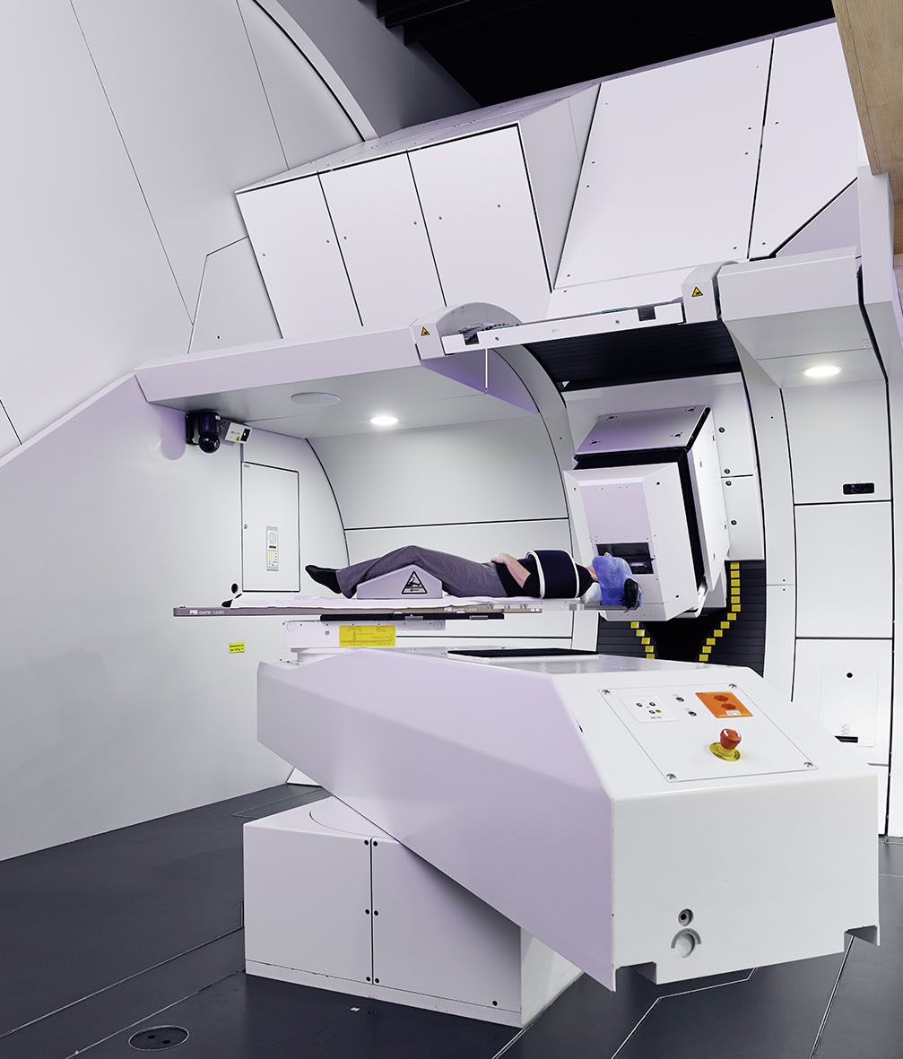
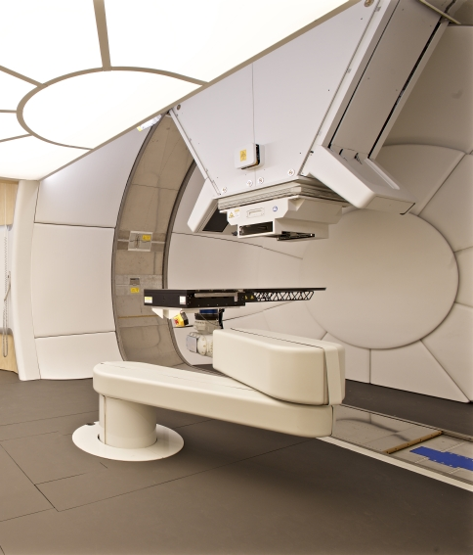
Proton Therapy @ PSI
OPTIS2 Gantry 2 Gantry 3

Slide 6
Pencil Beam Scanning

Slide 7
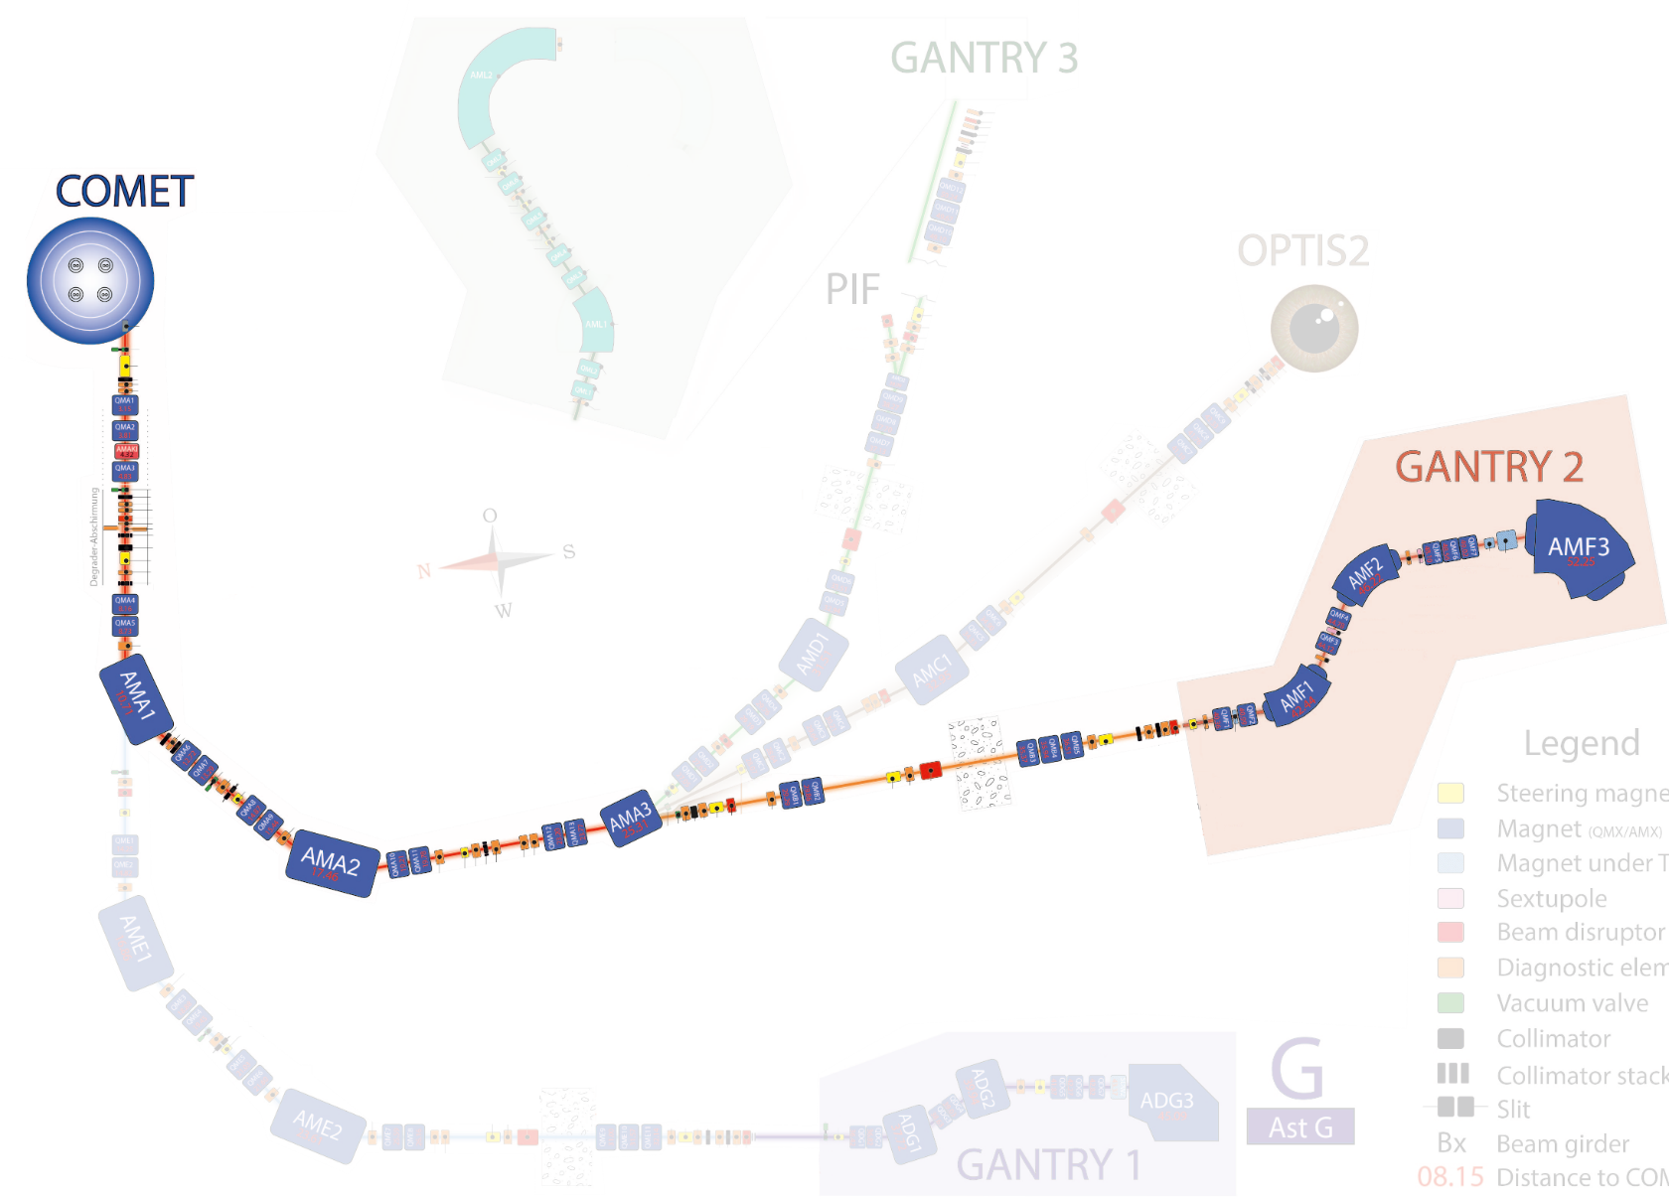
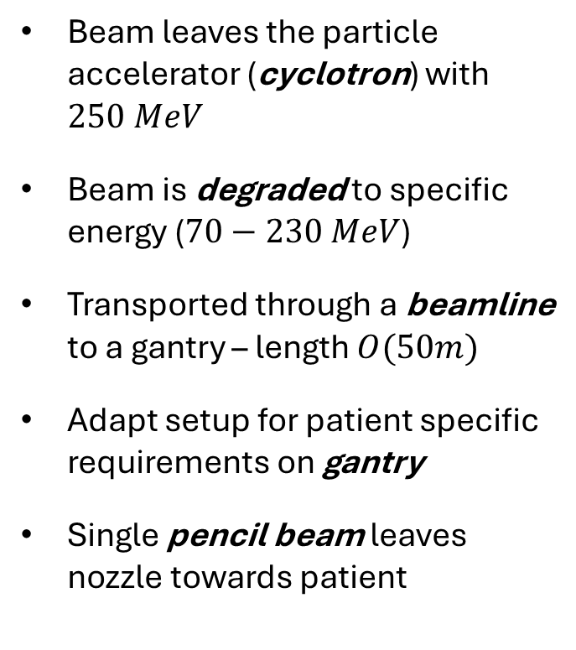
Proton Therapy – Pencil Beam Scanning – Technology
Beam leaves the particle accelerator (cyclotron) with $250 MeV$
Beam is degraded to specific energy ($70−230 MeV$)
Transported through a beamline to a gantry – length $O(50m)$
Adapt setup for patient specific requirements on gantry
Single pencil beam leaves nozzle towards patient
D. Meer
3 mm sigma

Slide 8
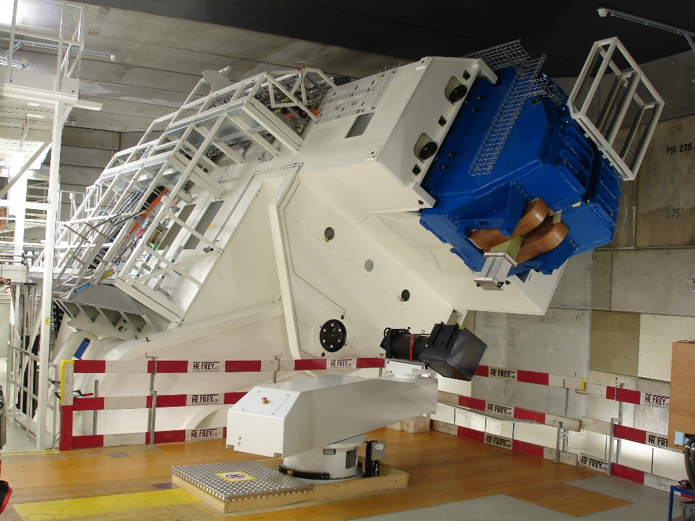
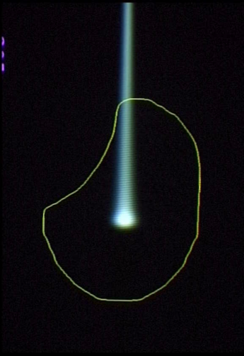
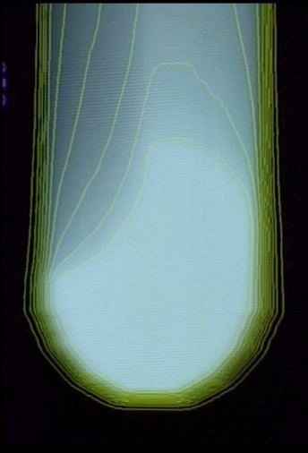



Proton Therapy – Pencil Beam Scanning – Technology
Deposit energy in a tumor by scanning its volume
Change scanning magnet currents for lateral positioning
Change beam energy for depth variations (degrader)
D. Meer
Gantry2
D. Meer
Pencil beam
Lateral scanning
Depth scanning

Slide 9
Proton Therapy – Pencil Beam Scanning – Summary
Spot scanning inside energy layer orthogonal to beam direction
Scanning depth is modulated by energy changes
Beam current has technical importance (detectors, treatment time)

Slide 10
Beamline (transmission) variations

Slide 11
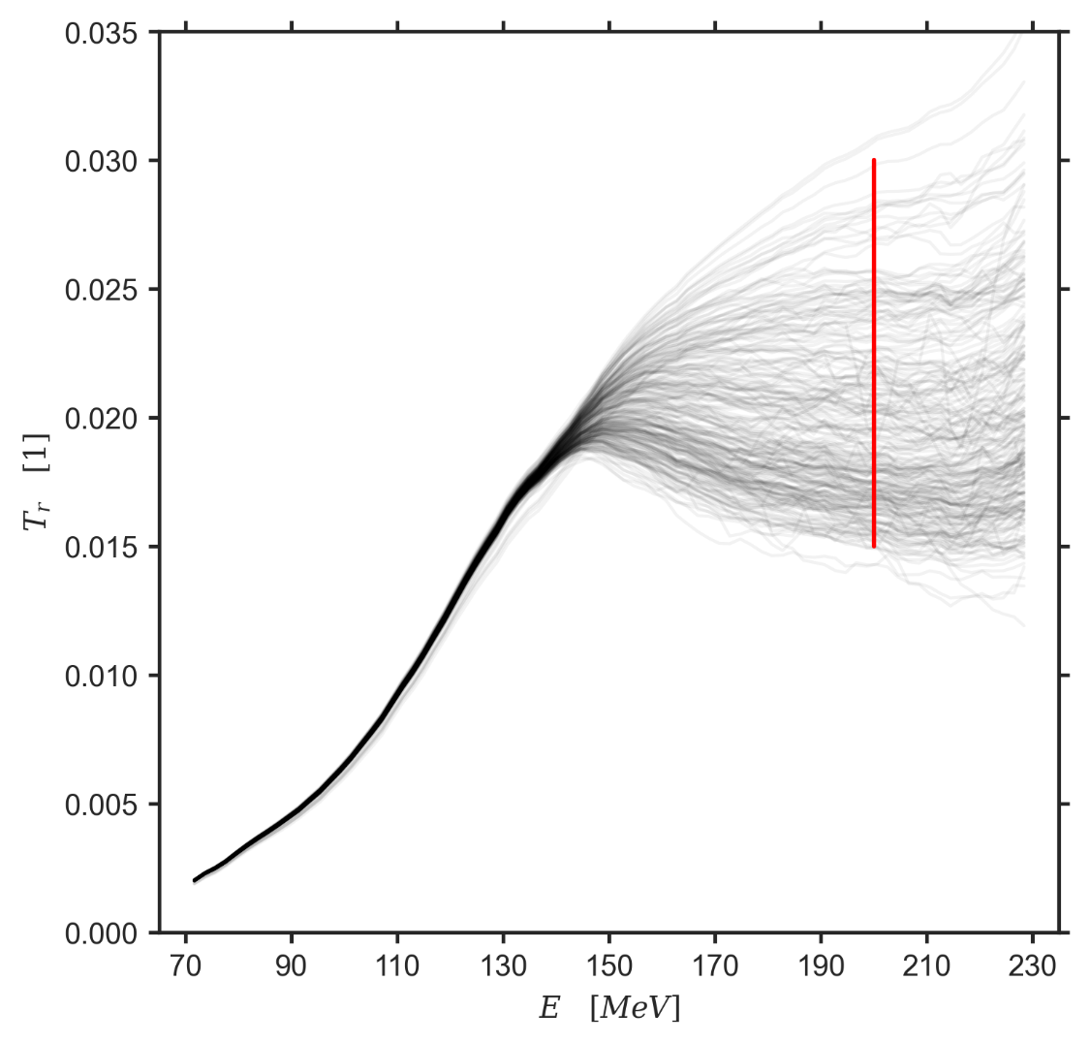
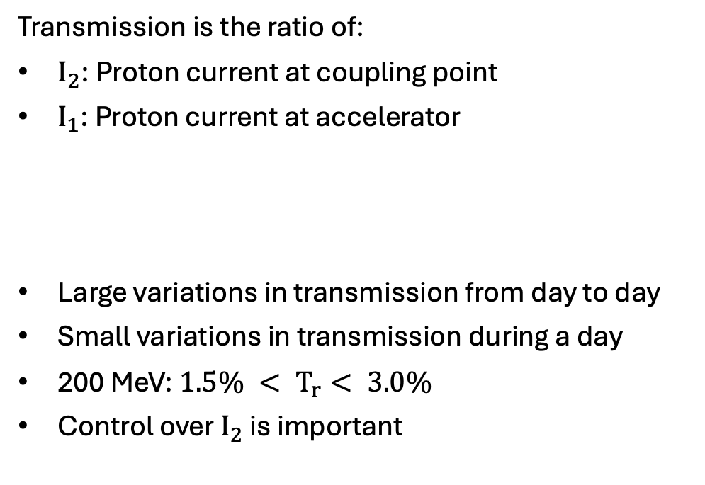

Transmission
Transmission is the ratio of:
$I_{2}$: Proton current at coupling point
$I_{1}$: Proton current at accelerator
Large variations in transmission from day to day
Small variations in transmission during a day
200 MeV: ${1.5\% < T}_{r}< 3.0\%$
Control over $I_{2}$ is important
$$T_{r}=\frac{I_{2}}{I_{1}}$$

Slide 12
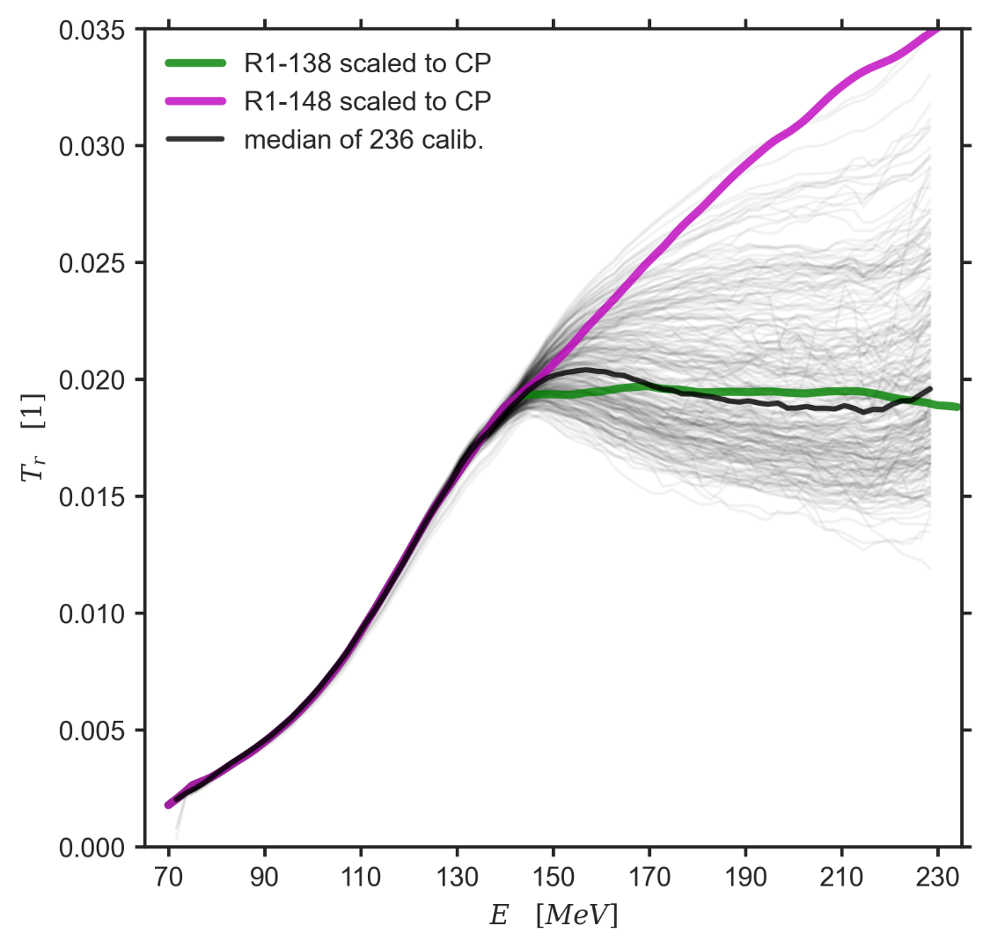


Transmission Compensation
Measure transmission $T_{r}$
Generate scaling factor $s$
Accelarator current $I_{1}$ can be freely chosen
$$I_{2} = s T_{r} I_{1}$$

Slide 13
Motivation for autonomous logging

Slide 14


PSI Site Setup
Gantry 1 and 2 are fully controlled by PSI
Energy changes
Position changes
Beam-current changes
Beam on/off
Gantry 3
Commercial system
    Responsible for treatment
    Decides on parameters (energy, current, …)
    Must verify treatment parameters
Needs access to PSI beam line
coupling point

Slide 15
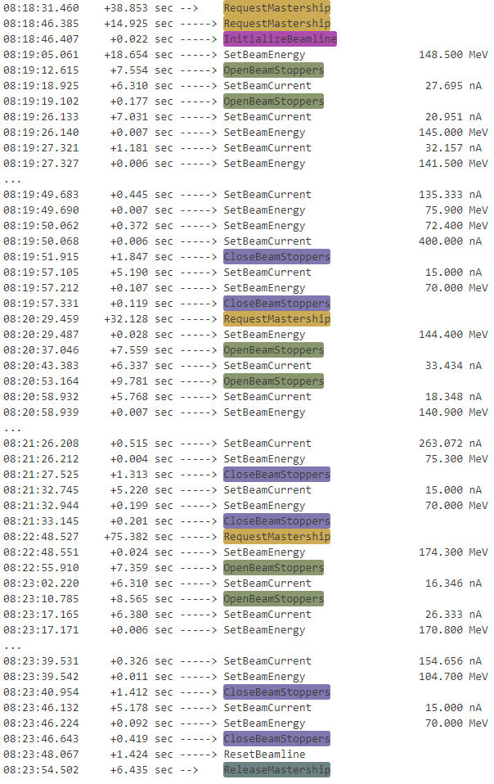
Gantry 3 Setup
G3 system delegates energy and beam-current changes to PSI IOC (TcsAdapter)
TcsAdapter is interface to beamline
TcsAdapter receives commands from G3
    Open/CloseBeamStoppers
    SetBeamEnergy
    SetBeamCurrent
Commands must be executed as fast as possible
TcsAdapter unaware of spot position changes
TcsAdapter unaware of beam on/off

Slide 16
Gantry 3 Setup
TcsAdapter must measure transmission
TcsAdapter must scale beam currents
TcsAdapter must not negatively interfere with treatment
Solution:
Autonomously log data
Process during idle times

Slide 17
Technical Details of
Autonomous Logging

Slide 18
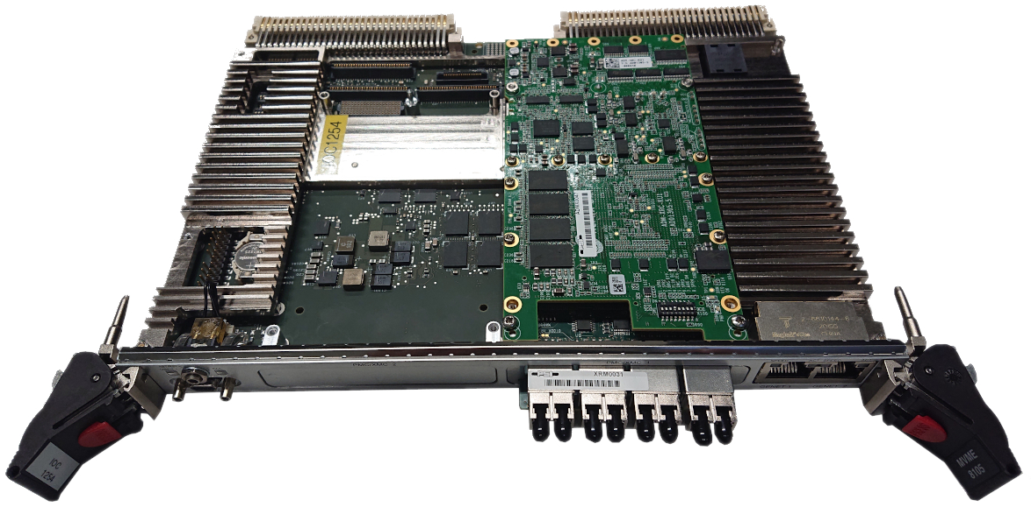
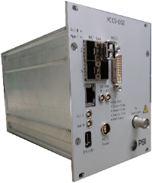


Hardware
IOC:
    VME – MVME8105 with VxWorks BSP
    hosts TcsAdapter software
FPGA:
    XMC board from Alpha Data
    AMD Kintex Ultrascale FPGA
    Sits on IOC
    implements autonomous logging
DSE: (detector specific electronics)
    PSI development
    AMD Kintex-7 FPGA
    Sits along beamline
    near detectors
    Sends detector data
    every $∆t=10μs$
CH2
CH3+4
CH1
DSEs

Slide 19
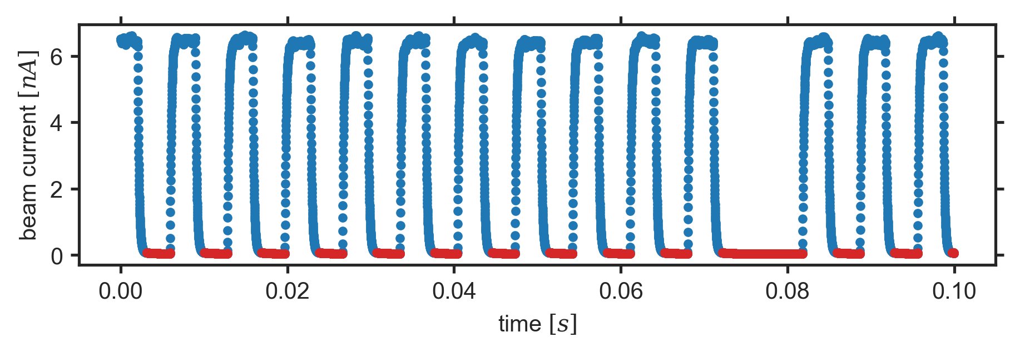

Naïve Logging
naïve: log all incoming data
Example below:
    10’000 data points recorded
    4’300 useless (beam was off)
Only 4MB available; 16 Bytes per sample
CH2
$$T_{max}=2^{18}×10μs≈2.6s$$
CH3+4
CH1
DSEs

Slide 20
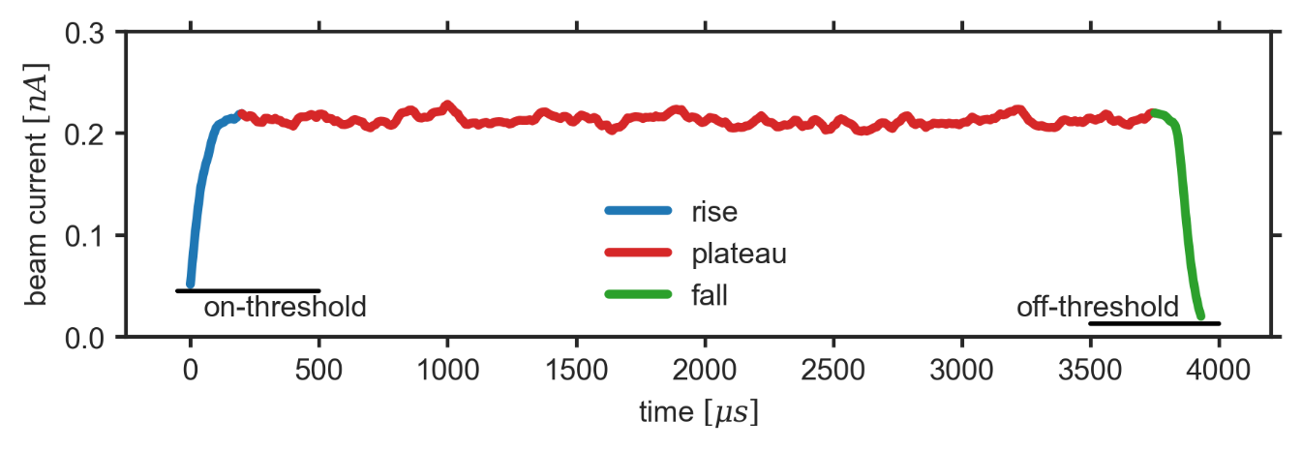
Autonomous Threshold Logging
Threshold TH1: start logging if CH1 > TH1
Threshold TH2: stop logging if CH1 < TH2
TH2 < TH1
Beam off periods are not recorded
CH2
CH3+4
CH1
DSEs

Slide 21
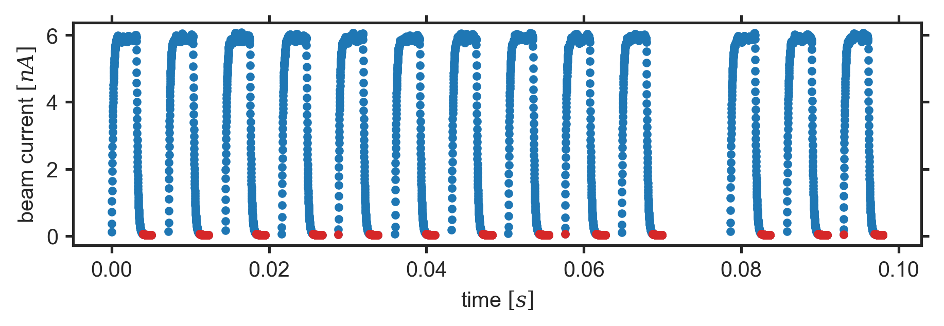




Autonomous Threshold Logging
What is logged:
    timestamp
    CH1, CH2, CH3, CH4
    var CH1, var CH2
Compression $c$:
    Average over $n=2^{c}$samples
    Variance (std. dev.) calculated for ch1 and ch2
    Longer logging$T_{max,c}≈2^{c}×2.6s$
No cost to IOC
$$∆t=10μs$$
$$T_{max}=2^{18}×10μs≈2.6s$$
$2^{18}×16$ byte

Slide 22
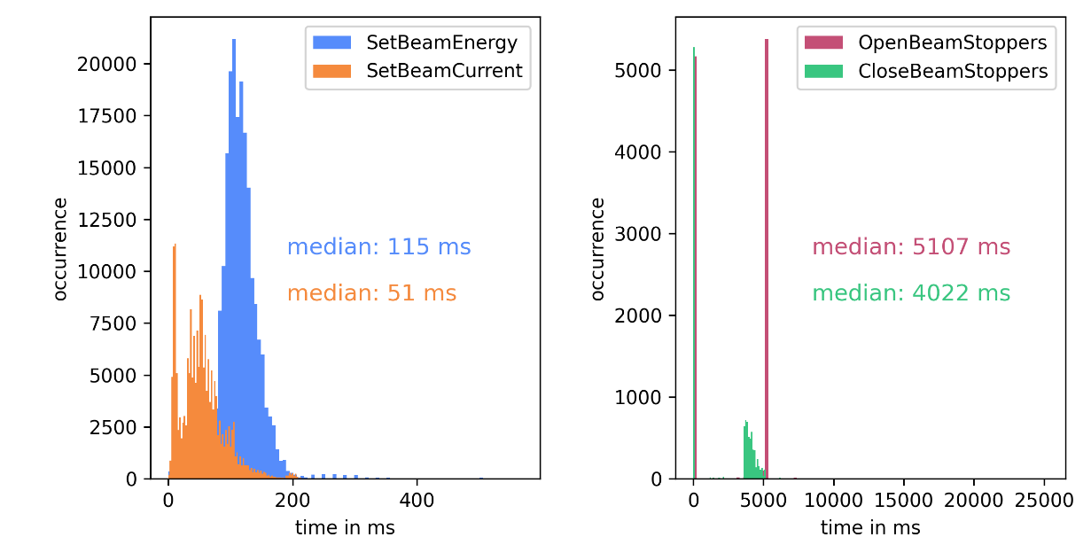
Interaction with IOC
FPGA: logs into RAM until full
IOC: access logged data on commands
    setBeamEnergy
    setBeamCurrent
    store it in IOC memory and reset FPGA logging
    Should take less than160 ms

Slide 23
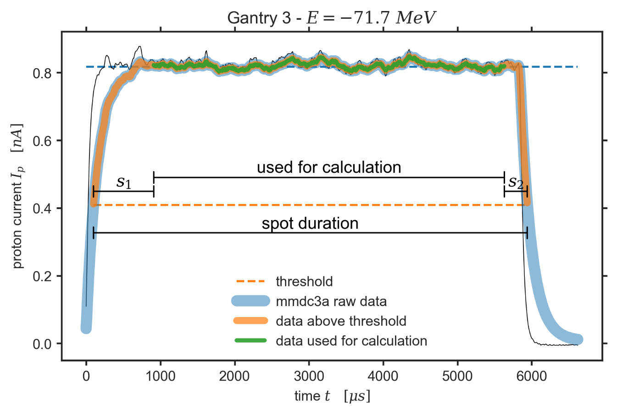
Post Processing on IOC
CloseBeamStoppers (>4seconds)
Persist logged data
Calculate statistics from data
Calculate scaling factors

Slide 24
Results and performance

Slide 25
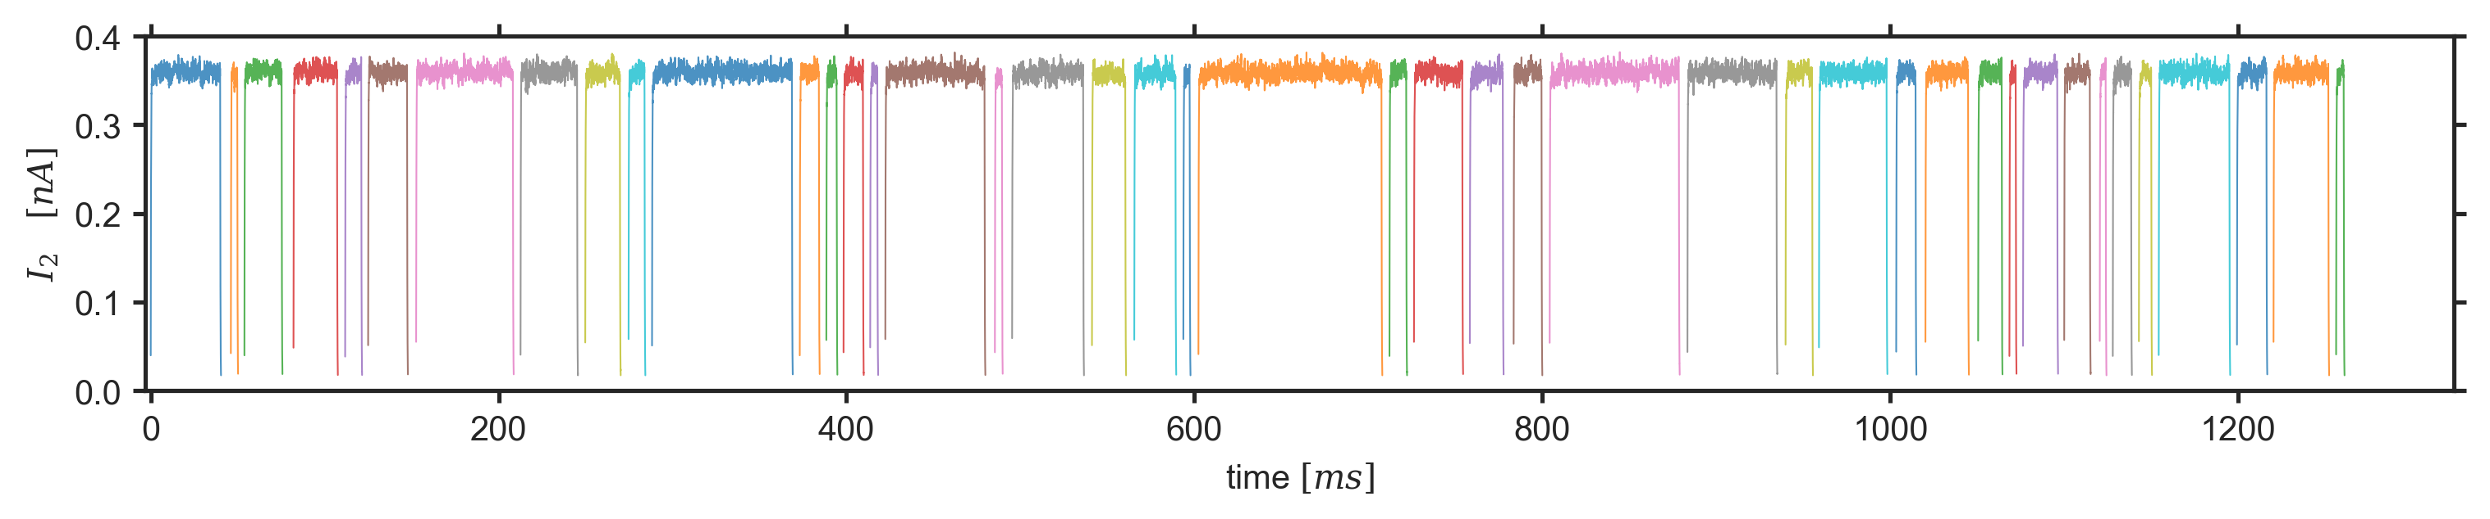
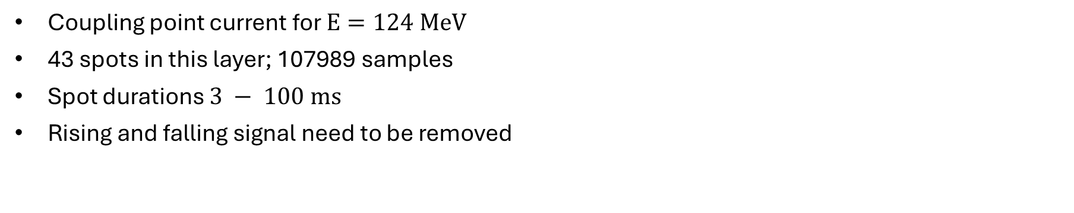
Single Energy Layer
Coupling point current for $E=124 MeV$
43 spots in this layer; 107989 samples
Spot durations $3 − 100 ms$
Rising and falling signal need to be removed

Slide 26
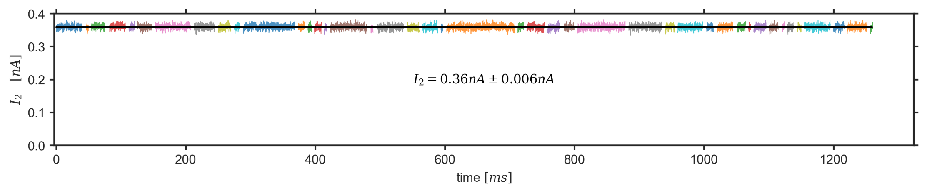
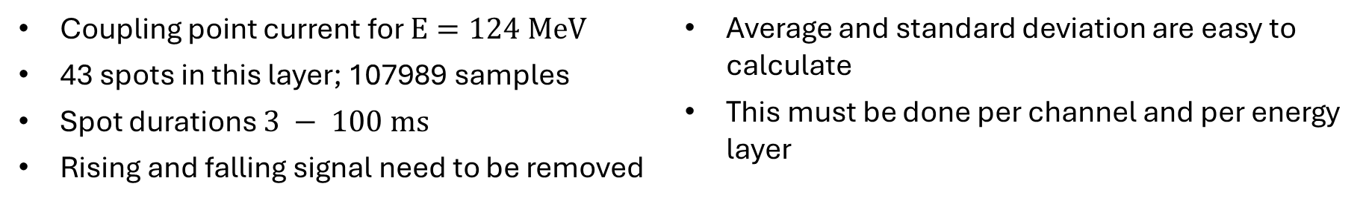
Single Energy Layer
Coupling point current for $E=124 MeV$
43 spots in this layer; 107989 samples
Spot durations $3 − 100 ms$
Rising and falling signal need to be removed
Average and standard deviation are easy to calculate
This must be done per channel and per energy layer

Slide 27
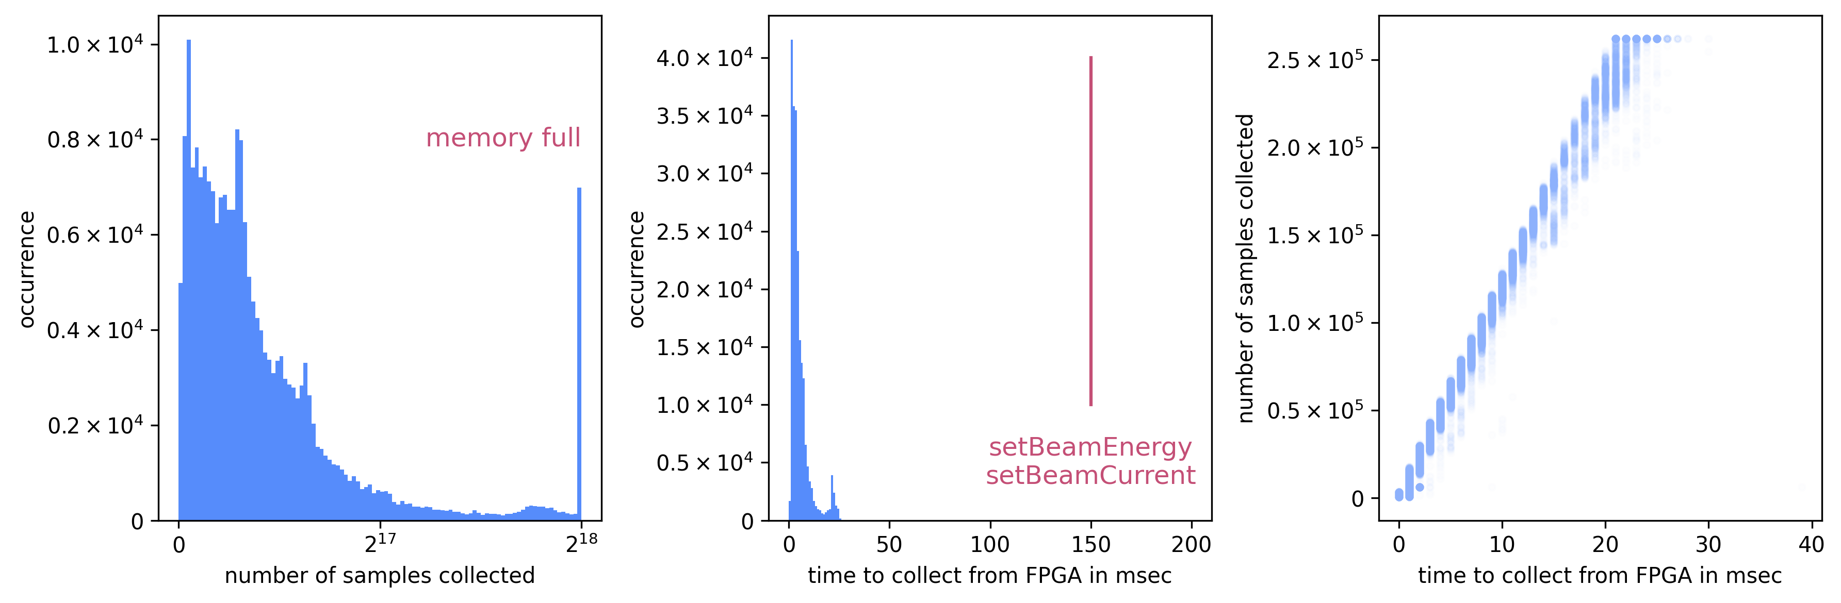
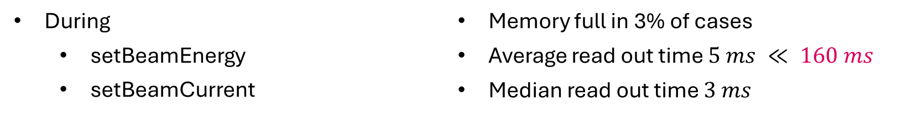
Memory Readout from FPGA
During
    setBeamEnergy
    setBeamCurrent
Memory full in 3% of cases
Average read out time $5 ms ≪ 160 ms$
Median read out time $3 ms$

Slide 28
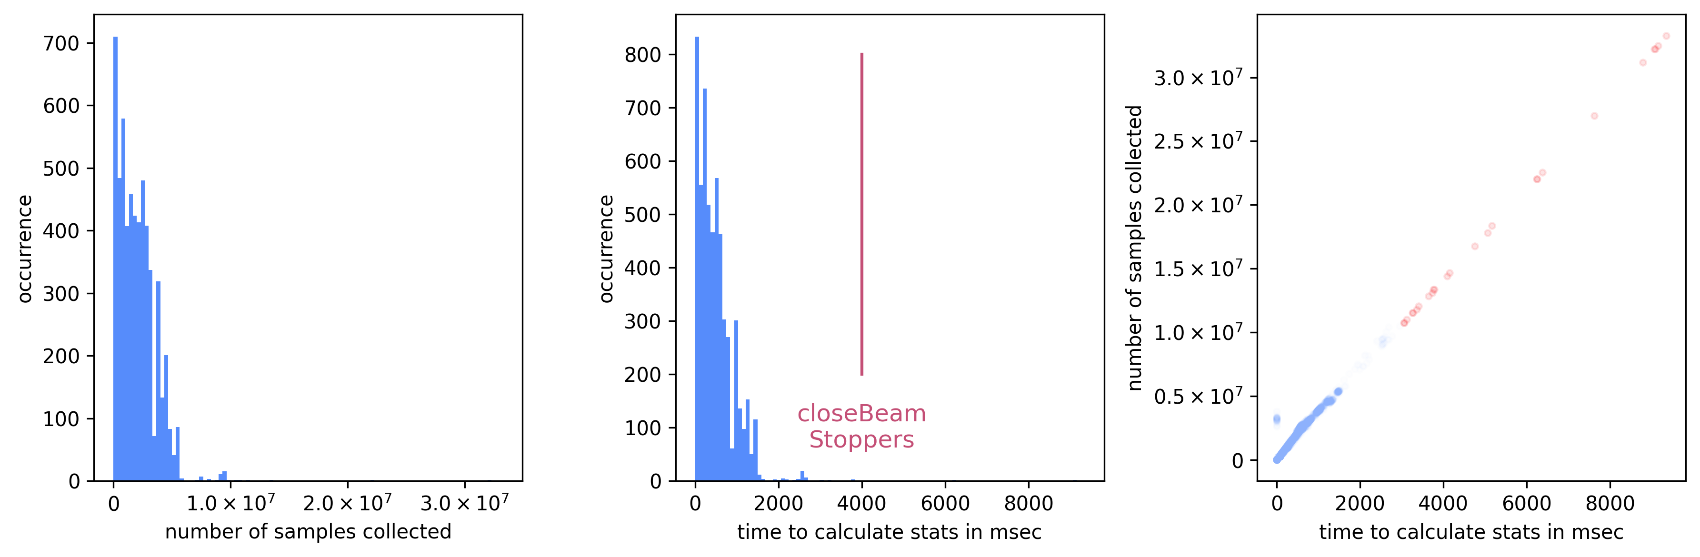
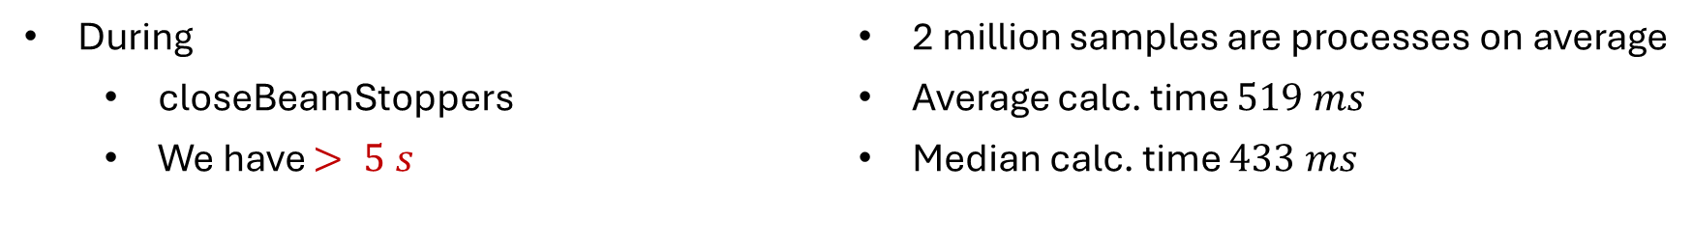

Calculate statistics on IOC
During
    closeBeamStoppers
    We have $> 5 s$
2 million samples are processes on average
Average calc. time $519 ms$
Median calc. time $433 ms$
$$≪ 5000 ms$$

Slide 29
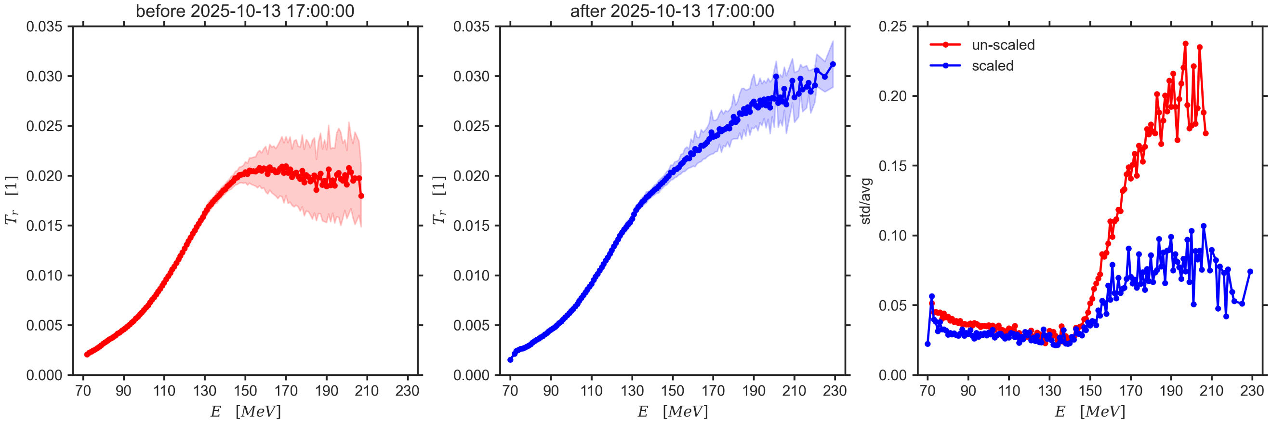

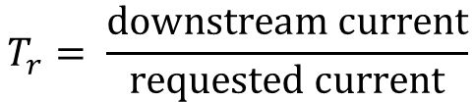



Application: Transmission Compensation
Logging active since 2025-04-29
Scaling active since 2025-10-13
$$±std$$
$$\frac{std}{avg}$$
$$avg$$
~16’500 transmission curves
$$T_{r}= \frac{downstream current}{requested current}$$
$$binned energies ∆E=1MeV$$

Slide 30
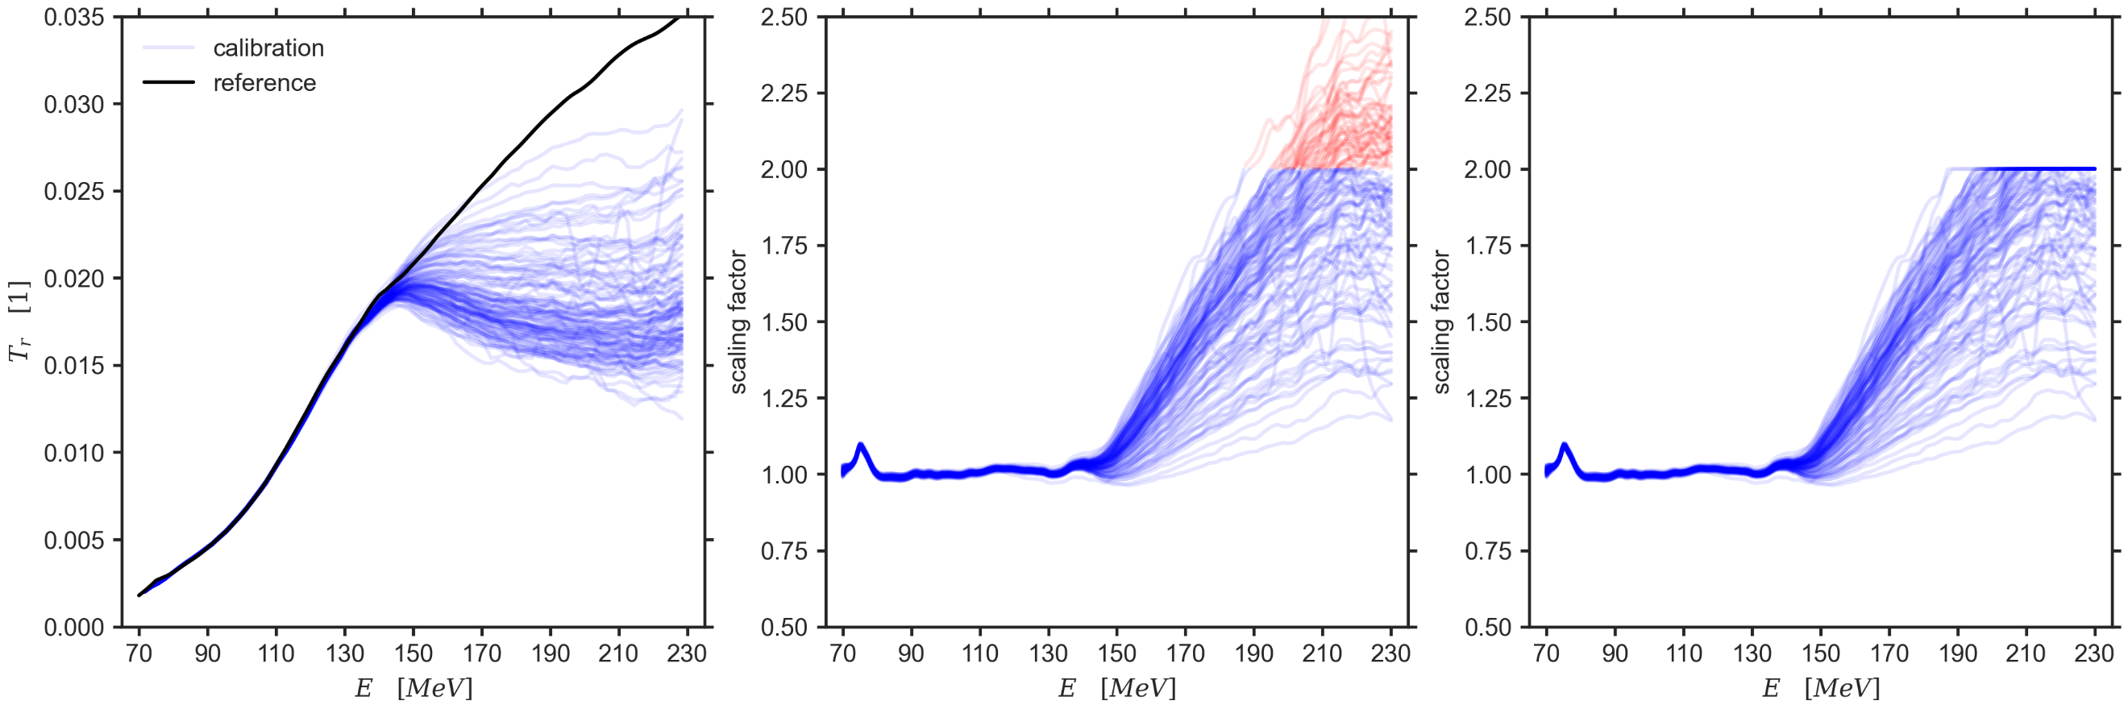
Energy Dependent Scaling
113 references between 2025-10-13 and 2026-03-19

Slide 31
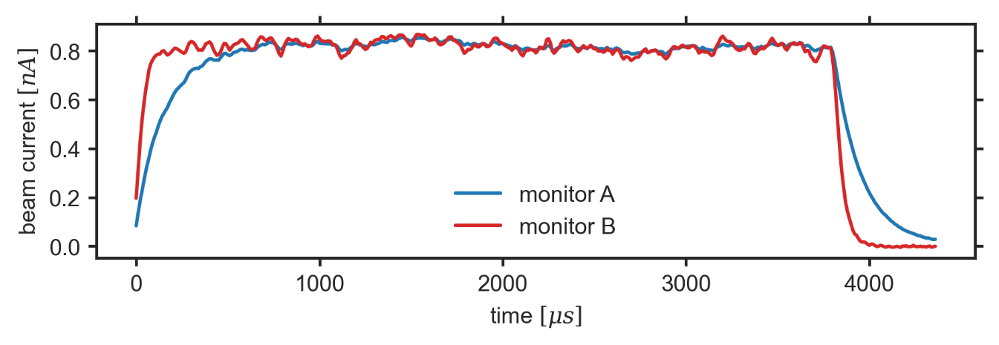
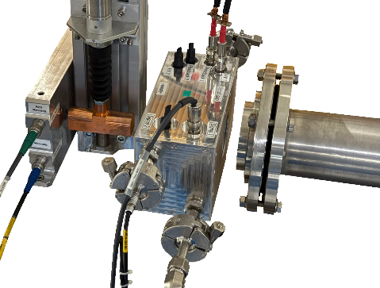
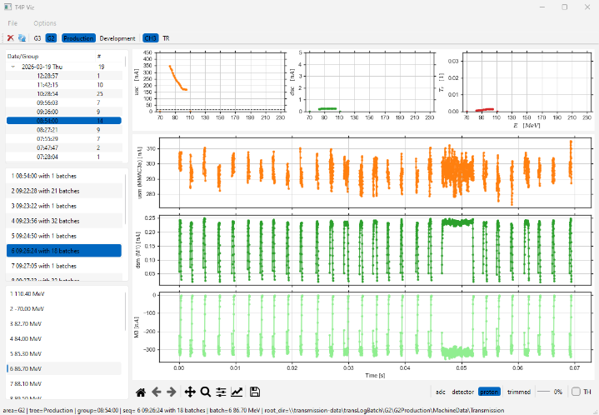
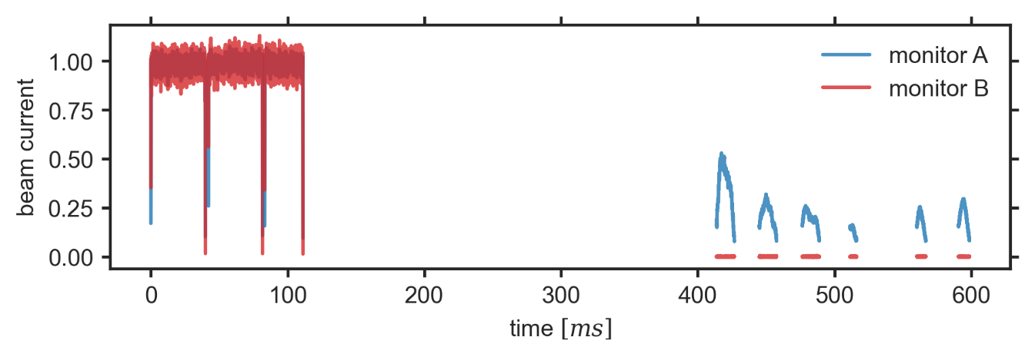
Also Useful for …
characterizing detectors
debugging detectors

Slide 32


Where to go …
Logging:
G2 and G3 working
O2 coming soon
Possible future applications:
Beam current regulation on G2
UHDR on G2

Slide 33
Thank you.
Questions?
Project Team:
Michael Eichin – FPGA
Christian Groh – Software
Machine Operation:
Vitaly Finogeshin
Advisors:
David Meer
Urs Rechsteiner
Zema Chowdhuri

