Slide 1

A Real-Time Archiving Framework from EPICS to Time-Series Databases for Fusion Plant Data
Guang Yang,
guangyang@mail.ustc.edu.cn
25th IEEE Real Time Conference - La Biodola, Elba, Italy
25-29 May, 2026
Notes:
good afternoon, everyone. My name is Yang, and I am from the Institute of Plasma Physics, Chinese Academy of Sciences.
Today, I will talk about “A Real-Time Archiving Framework from EPICS to Time-Series Databases for Fusion Plant Data.”

Slide 2
outline
1. Introduction
2. Design of the framework
3. Implementation of the system
4. Test
5. Summary and plan
Notes:
My presentation is organized into five parts: Introduction, Design of the Framework, System Implementation,Test, and Summary and Future Plan.

Slide 3
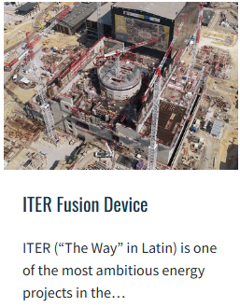
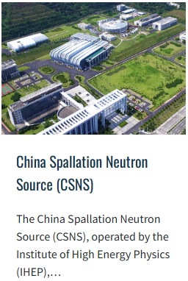
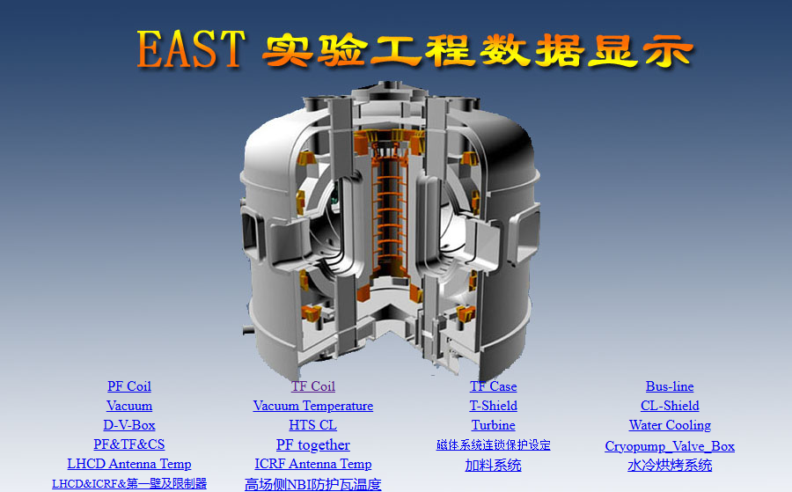
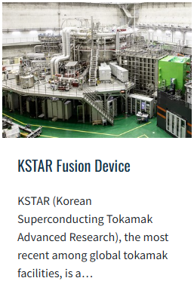
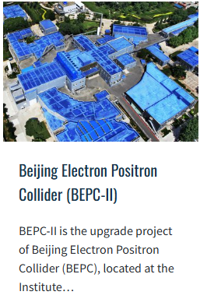
工程数据
Introduction
Background
EAST rely on large-scale distributed control systems to supervise subsystem with the continuous growth of plant data.
Image from: https://epics-controls.org
EAST Plant Data System
EPICS Widely used in: EAST, ITER, KSTAR, China Spallation Neutron Source (CSNS), Beijing Electron Positron Collider (BEPC-II).
25th IEEE Real Time Conference - La Biodola, Elba, Italy, 25-29 May, 2026
Notes:
cryogenics, power supplies, vacuum subsystems, and related engineering systems
In these environments, EPICS has become a widely adopted framework for control and monitoring because it provides a standard Process Variable model, the Channel Access communication protocol for efficient client--server data exchange, mature input/output controller support, and a rich ecosystem of client tools.
and now EPICS Widely used in:xxxx Large scientific facilities

Slide 4
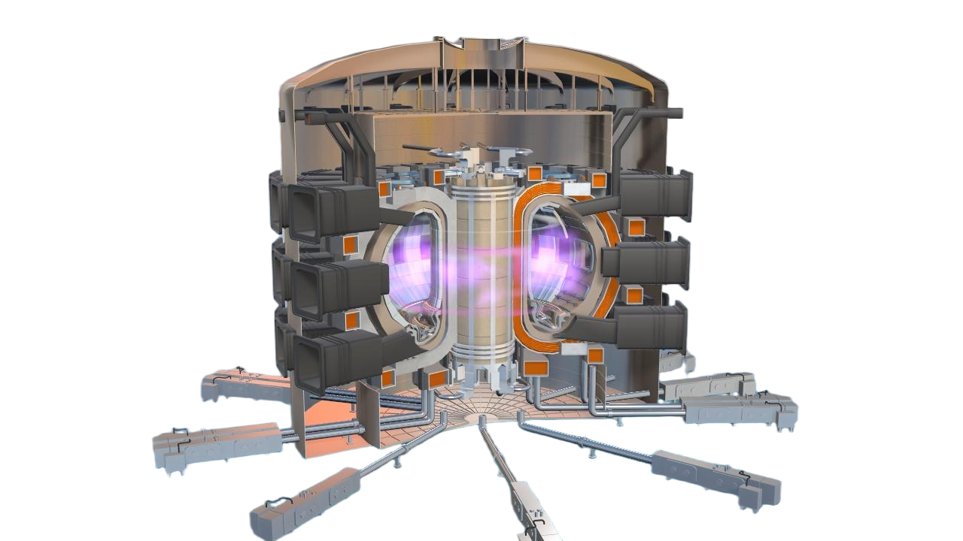
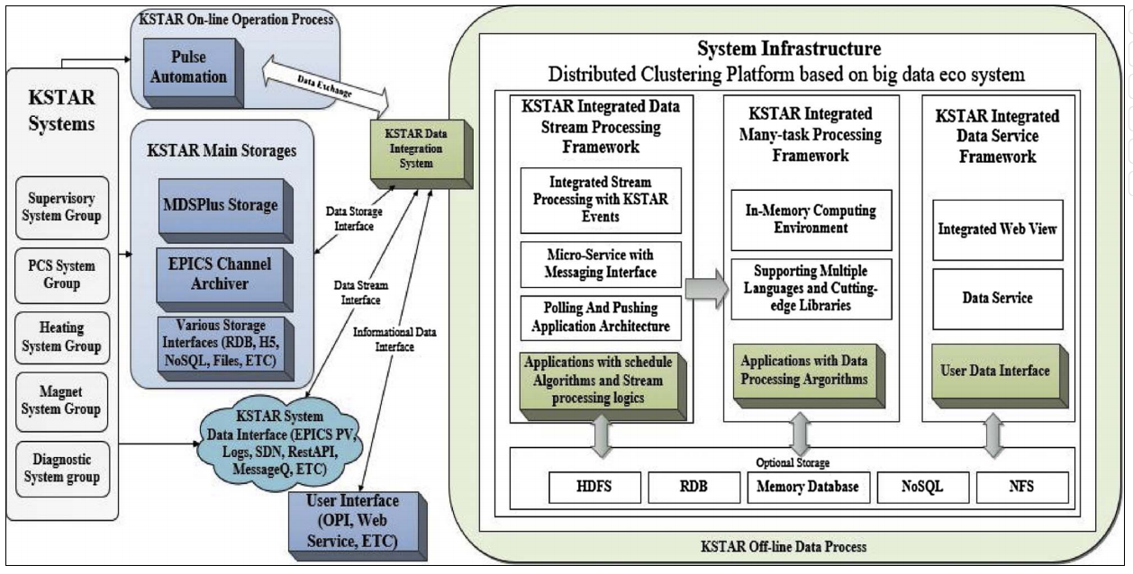
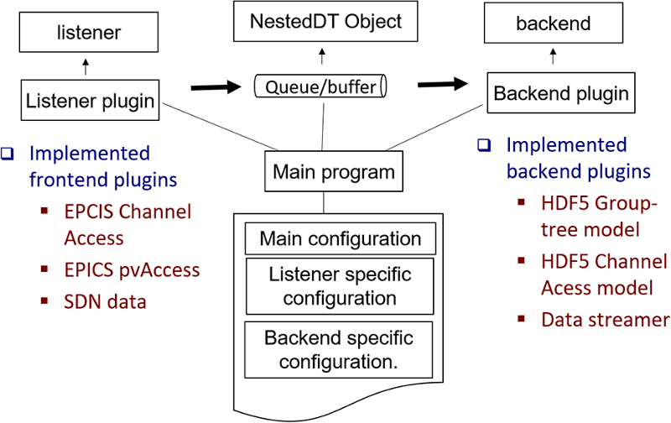
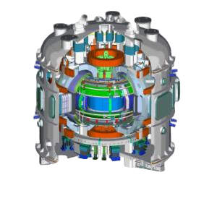
工程数据
Introduction
Work Motivation and Existing Archivers
The volume, velocity, and diversity of EAST plant data will continue to grow as more equipment is instrumented and higher sampling rates are adopted in future tokamaks.
ITER
KSTAR
ITER Data archiver service architecture
KSTAR Data System
Varying data scales, access patterns, existing ecosystems, and engineering decisions across different devices call for distinct solutions.
[1]Castro et al., 2023 R. Castro, Y. Makushok, L. Abadie, B. Bauvir, A. Neto, J. Vega, Storing EPICS process variables in HDF5 files for ITER, Fusion Engineering and Design
[2]Tak et al., 2018 T. Tak, J. Hong, K. Park, W. Lee, T. Lee, H. Han, G. Kwon, J. Park, Conceptual design of new data integration and process system for KSTAR data scheduling, Fusion Engineering and Design.
25th IEEE Real Time Conference - La Biodola, Elba, Italy, 25-29 May, 2026
Notes:
However, as more equipment is instrumented and higher sampling rates are adopted in future tokamaks, the volume, velocity, and diversity of EAST plant data will continue to grow. This also raises stronger requirements for data archiving, querying, analysis, and AI integration.
Different fusion devices have developed different solutions according to their own requirements. ITER focuses on long-term storage, archiving EPICS PV data into pulse-sliced HDF5 files for traceability and offline analysis. KSTAR, on the other hand, emphasizes online capability, combining reflective memory and MDSplus to support millisecond-level real-time data sharing for plasma control. These examples show that varying data scales, access patterns, existing ecosystems, and engineering decisions across different devices naturally call for distinct solutions.

Slide 5
工程数据
Introduction
Work Targets
  Future fusion devices
  - Stronger large-scale query performance
  - Integrated AI training platform.
- Generated by sensors and control systems
- Orderd by timestamp
  Fusion plant data
- Purpose-built for high-throughput, time-ordered data.
- Native support for: column store, compression, down-sampling, range query, distributed clusters.
- Representative systems: InfluxDB, TimescaleDB, Apache IoTDB.
TimeSeries DataBase
25th IEEE Real Time Conference - La Biodola, Elba, Italy, 25-29 May, 2026
Notes:
Therefore, we believe that future fusion devices will require two key capabilities: stronger large-scale query performance and a more integrated AI training platform.
Fusion plant data naturally has the characteristics of time-series data. It is continuously generated by sensors and control systems, ordered by timestamp, and usually queried over time ranges across many signals. For this reason, we decided to introduce a time-series database into the EPICS data archiving workflow.
They natively support column-oriented storage, compression, down-sampling, range queries, and distributed clusters. Time-series databases are purpose-built for high-throughput, time-ordered data. Representative systems include InfluxDB, TimescaleDB, and Apache IoTDB. A TSDB is a specialized database optimized for storing, indexing, compressing, and querying timestamped data at high write rates and large scale. Existing studies have demonstrated that TSDBs significantly outperform traditional relational databases in the storage and query of large-scale plant data, especially for high-frequency ingestion and time-range retrieval workloads.

Slide 6
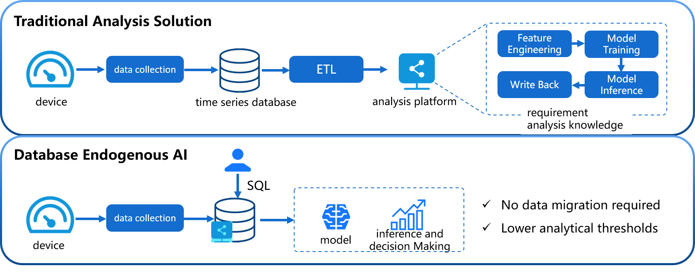
Design of the framework
From EPICS to Timeseries Database
Timeseries Database
EPICS to Timeseries
Database
Channel Access
Network Protocol
IoTDB AI Node platform
- EPICS side: PVs, distributed IOCs, Channel Access network.
- TSDB side: column-oriented, multi-device range queries, AI integration.
- Gap: Channel Access is event-driven; TSDB is batch-oriented.
- Need a bridge that converts CA monitor events into batched Tablet writes — efficiently, reliably, and at scale.
C. Wang, X. Huang, J. Qiao et al., “Apache IoTDB: Time-series database for internet of things,” Proceedings of the VLDB Endowment, vol. 13, no. 12, pp. 2901–2904, 2020
25th IEEE Real Time Conference - La Biodola, Elba, Italy, 25-29 May, 2026
Notes:
In this work, we aim to develop a real-time archiving framework from EPICS to a time-series database, enabling continuous PV ingestion, efficient historical query, and AI applications.
Among them we chose Apache IoTDB because of its tree path model, its Tablet batch insert API, and especiallyits AINode component, which lets us run forecasting and anomaly detection directly inside the database.
The image on the right shows the difference between ETRA and traditional archiving methods for AI analysis. Extraction Transformation Loading

Slide 7
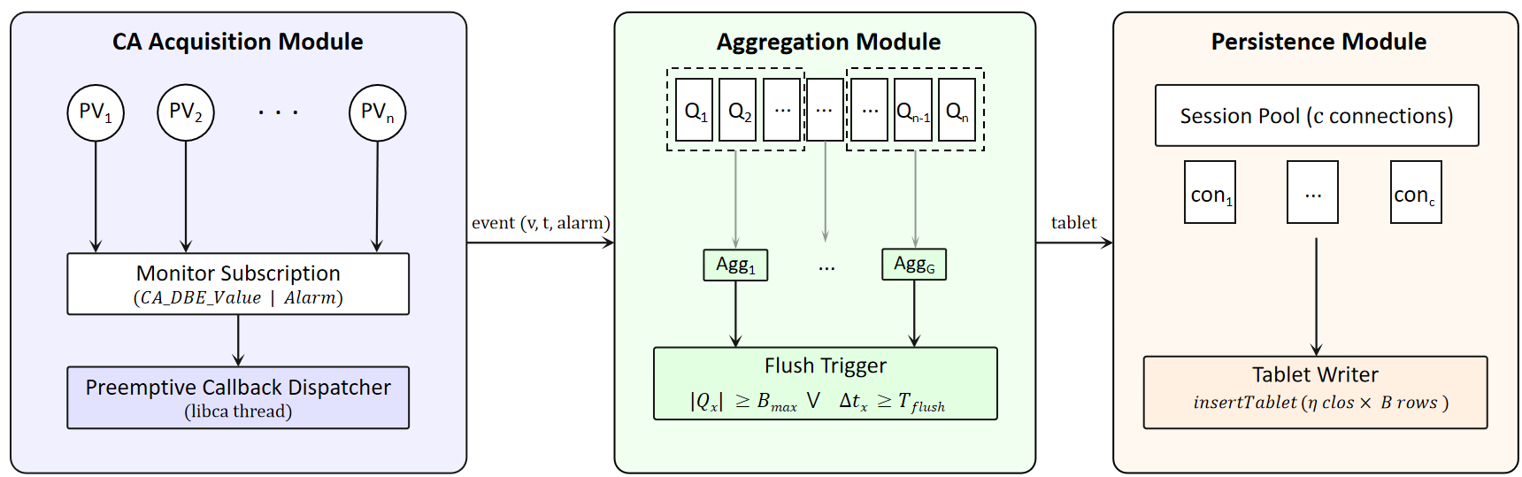
Design of the framework
EPICS To Timeseries Database Architecture (ETRA)
- CA Acquisition Module — libca preemptive callback dispatcher; one event channel per PV.
- Aggregation Module — PVs partitioned into G groups; flush trigger by size or time.
- Persistence Module — Session pool of c connections; batched Tablet write.
- Pipeline: event → channel → aggregator → Tablet → TSDB.
25th IEEE Real Time Conference - La Biodola, Elba, Italy, 25-29 May, 2026
Notes:
ETRA is designed as a three-module.
First, the CA Acquisition Module communicates with EPICS through Channel Access. It uses preemptive callbacks, so whenever an IOC publishes a monitor update, the event is immediately captured and pushed into a dedicated channel for that PV.
Second, the Aggregation Module groups multiple PV channels together. It continuously drains these channels and triggers a flush either when the buffer reaches a predefined size, or when a fixed time interval expires. In this way, many small CA events are converted into larger batches.
Finally, the Persistence Module maintains a session pool to the time-series database. Each aggregated batch is written as a Tablet, which is much more efficient than inserting points one by one.

Slide 8
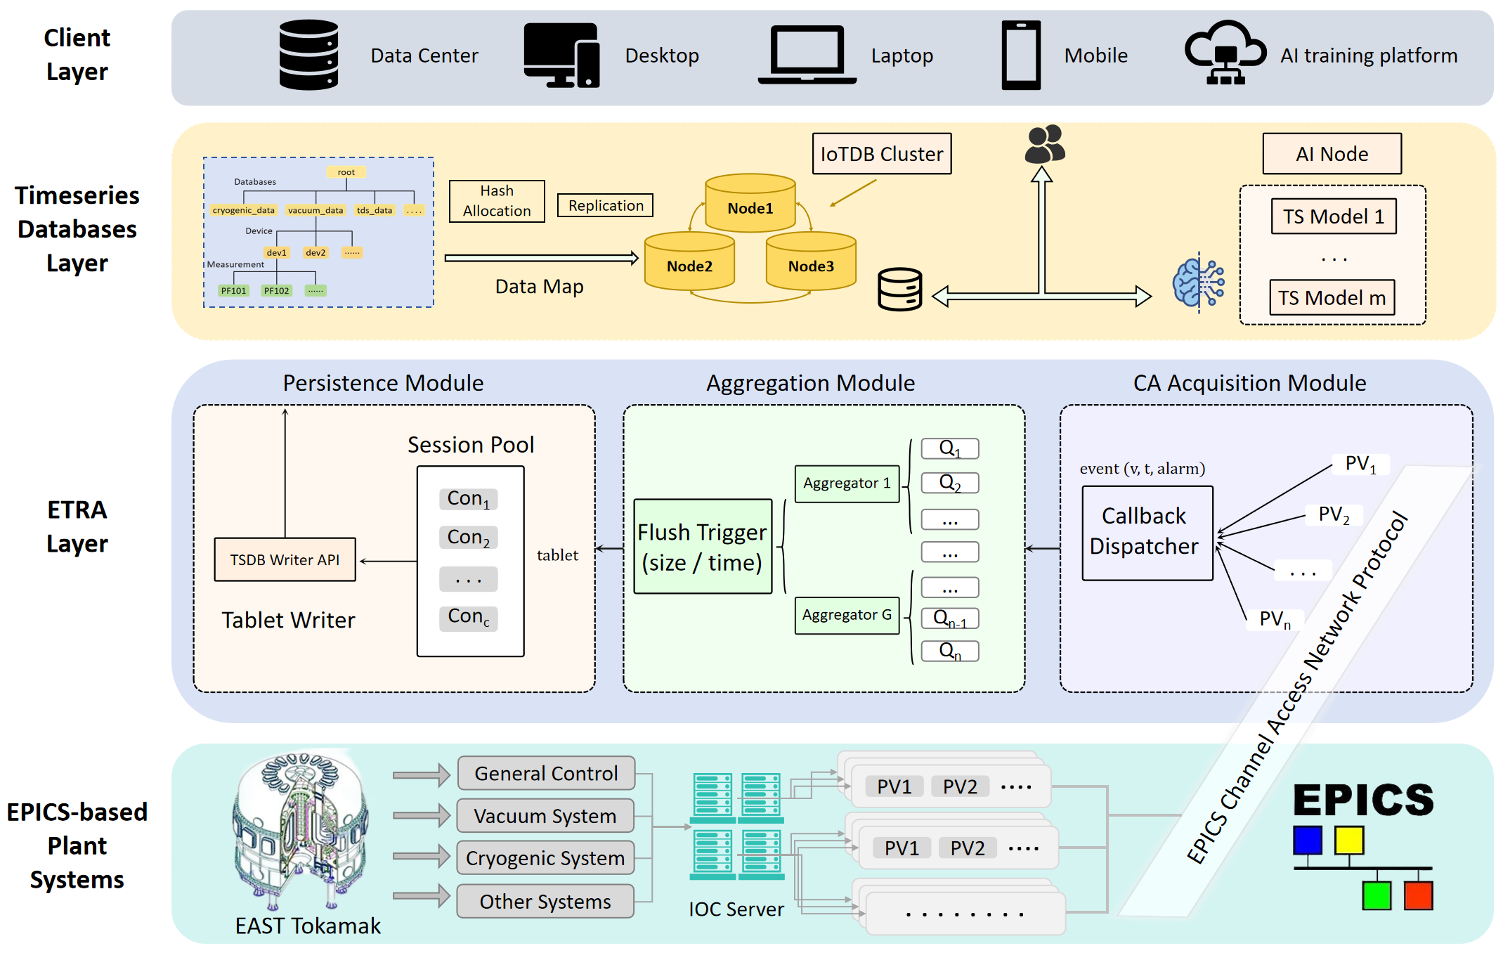
Implementation of the system
The EAST Plant system based on ETRA
- EPICS plant systems: EAST tokamak, vacuum, cryogenic, general control; IOC servers; PVs published via EPICS Channel Access Network Protocol.
- ETRA layer: CA Acquisition, Aggregation, Persistence modules.
- TSDB layer: IoTDB cluster with hash allocation and replication; AINode for ML inference.
- Client layer: data center, desktop, mobile, AI training platform.
25th IEEE Real Time Conference - La Biodola, Elba, Italy, 25-29 May, 2026
Notes:
This figure shows the end-to-end implementation of our system. At the bottom, the EPICS-based plant systems are the data source. In EAST, subsystems such as the general control system, vacuum system, cryogenic system, and other plant systems publish their signals as PVs through IOC servers. These PVs are transmitted through the EPICS Channel Access network protocol.
In the middle, the ETRA layer subscribes to these PVs and processes them through the three modules introduced before: CA Acquisition, Aggregation, and Persistence. The CA Acquisition module receives monitor events, the Aggregation module batches them, and the Persistence module writes them into the database.
Above that is the time-series database layer. We use an IoTDB cluster with hash-based data allocation and replication, so the archived data can be distributed across multiple nodes and queried efficiently. This layer also connects to AINode, which allows machine learning models to perform forecasting and anomaly detection directly on archived time-series data.
Finally, at the top is the client layer. Different clients, including data centers, desktops, laptops, mobile devices, and AI training platforms, can access the archived data for monitoring, analysis, and model training.
Overall, this architecture connects EPICS plant data with a time-series database and provides a unified path from real-time data acquisition to large-scale storage, query, and AI analysis.

Slide 9
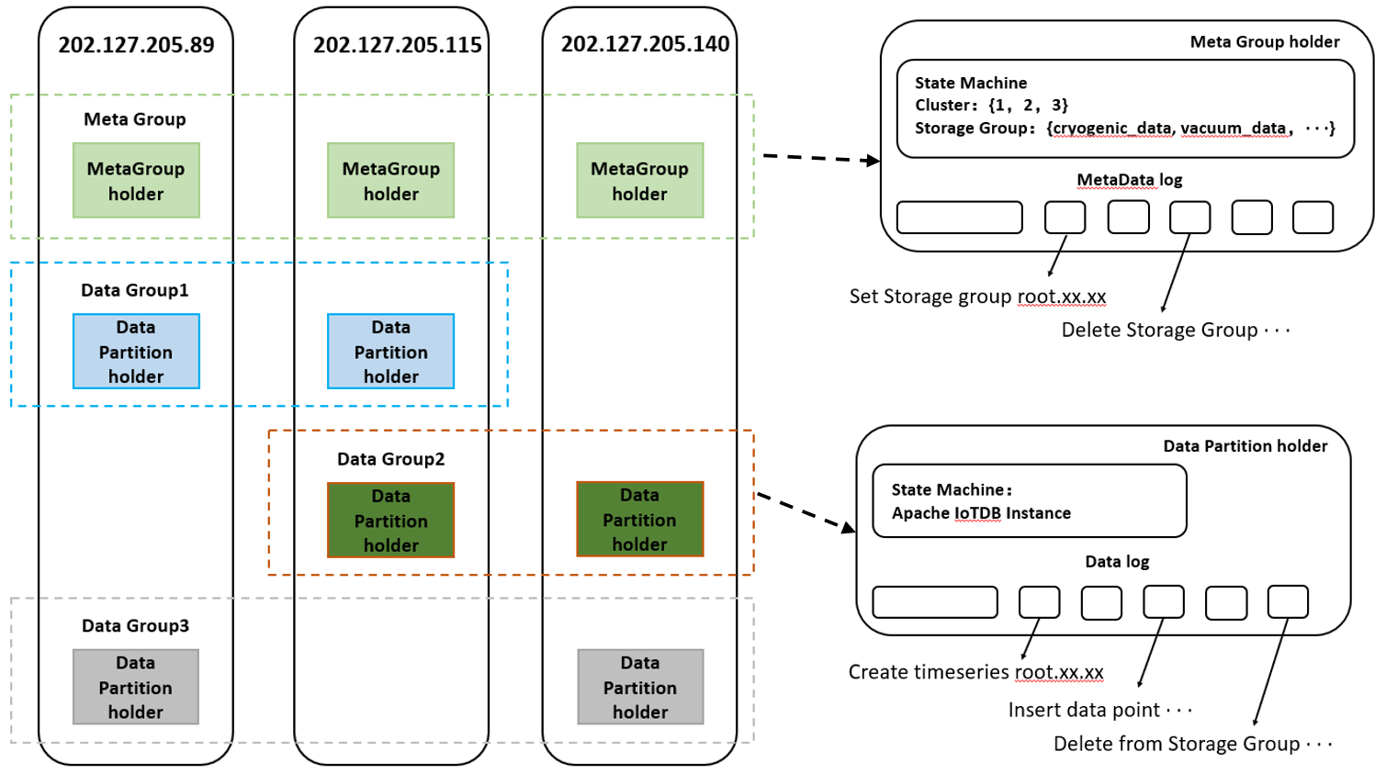
Implementation of the system
The EAST distribute data cluster based on IoTDB
- Metadata:
Each system's metadata is kept in three copies across different servers.
- Plant Data:
Split the EAST plant data into three parts and store them on different servers.
Copy the EAST plant data, store it on different servers according to the principle of hash allocation.
Timeseries Database cluster Logic Design
C. Wang, J. Qiao, X. Huang, Z. Song, X. Zhang, T. Z. J. Fu, R. Rui, J. Sun, and J. Wang, “Apache IoTDB: A time series database for IoT applications,” Proceedings of the ACM on Management of Data.
25th IEEE Real Time Conference - La Biodola, Elba, Italy, 25-29 May, 2026
Notes:
This figure shows the logical design of our time-series database cluster.
In this design, the cluster consists of three servers. For metadata, each system’s metadata is replicated three times and stored across different servers. This means that information such as storage groups, devices, and measurement definitions can still be recovered even if one server fails.
For plant data, the EAST plant data is divided into three data groups and distributed across the servers. Each data group is also copied to another server according to the hash allocation strategy. In other words, every piece of plant data has a primary partition and a replica partition on different machines.
This design provides two benefits. First, it improves data safety, because both metadata and plant data have redundant copies. Second, it improves performance, because different data partitions can be written and queried in parallel across multiple servers. Therefore, the cluster can support both reliable long-term archiving and high-throughput query workloads.

Slide 10
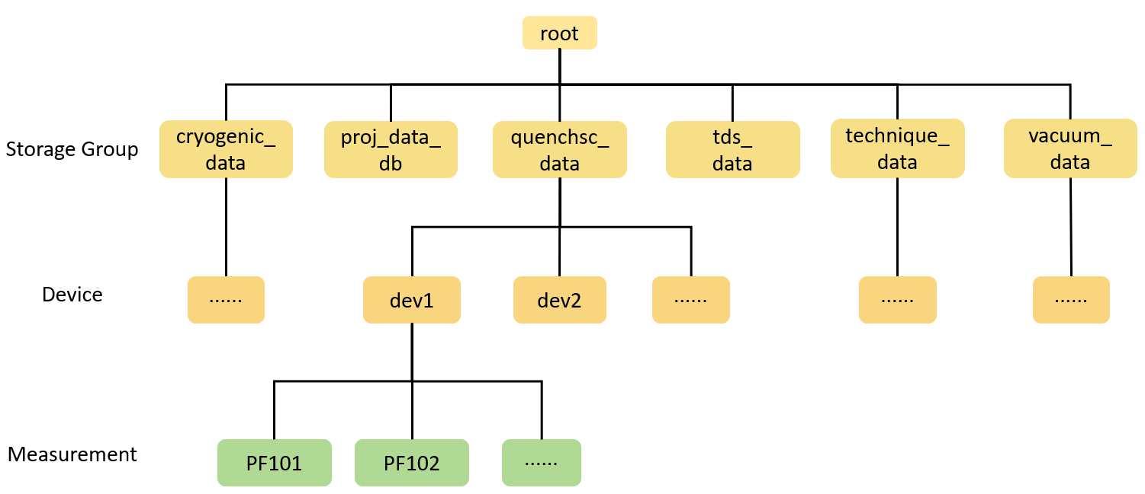
Implementation of the system
Data mapping
- System: The system in the EAST plant corresponds to the storage group level in IoTDB, which is the first level under the root node.
- Device: The devices in the EAST plant corresponds to the device level in IoTDB, each device contains 100 sensor (IoTDB measurement).
- Sersor : In the EAST plant data, sensors correspond to measurements level in IoTDB, which are the leaves of the tree structure.
Data mapping From EAST Plant data to IoTDB
25th IEEE Real Time Conference - La Biodola, Elba, Italy, 25-29 May, 2026
Notes:
In our system, EAST plant data is mapped into the treesl structure of IoTDB.
At the top level, each plant system, such as the cryogenic system, vacuum system, or quench detection system, is mapped to a storage group under the root node. At the middle level, devices in each system are mapped to IoTDB device nodes. In our current design, each device contains around 100 sensors. At the bottom level, each sensor is mapped to a measurement, which is the leaf node of the IoTDB tree structure.
This mapping preserves the physical organization of the EAST plant. More importantly, it improves efficiency: related sensors are stored under the same device, which enables more efficient Tablet writing, better compression, and faster range queries over multiple signals.

Slide 11
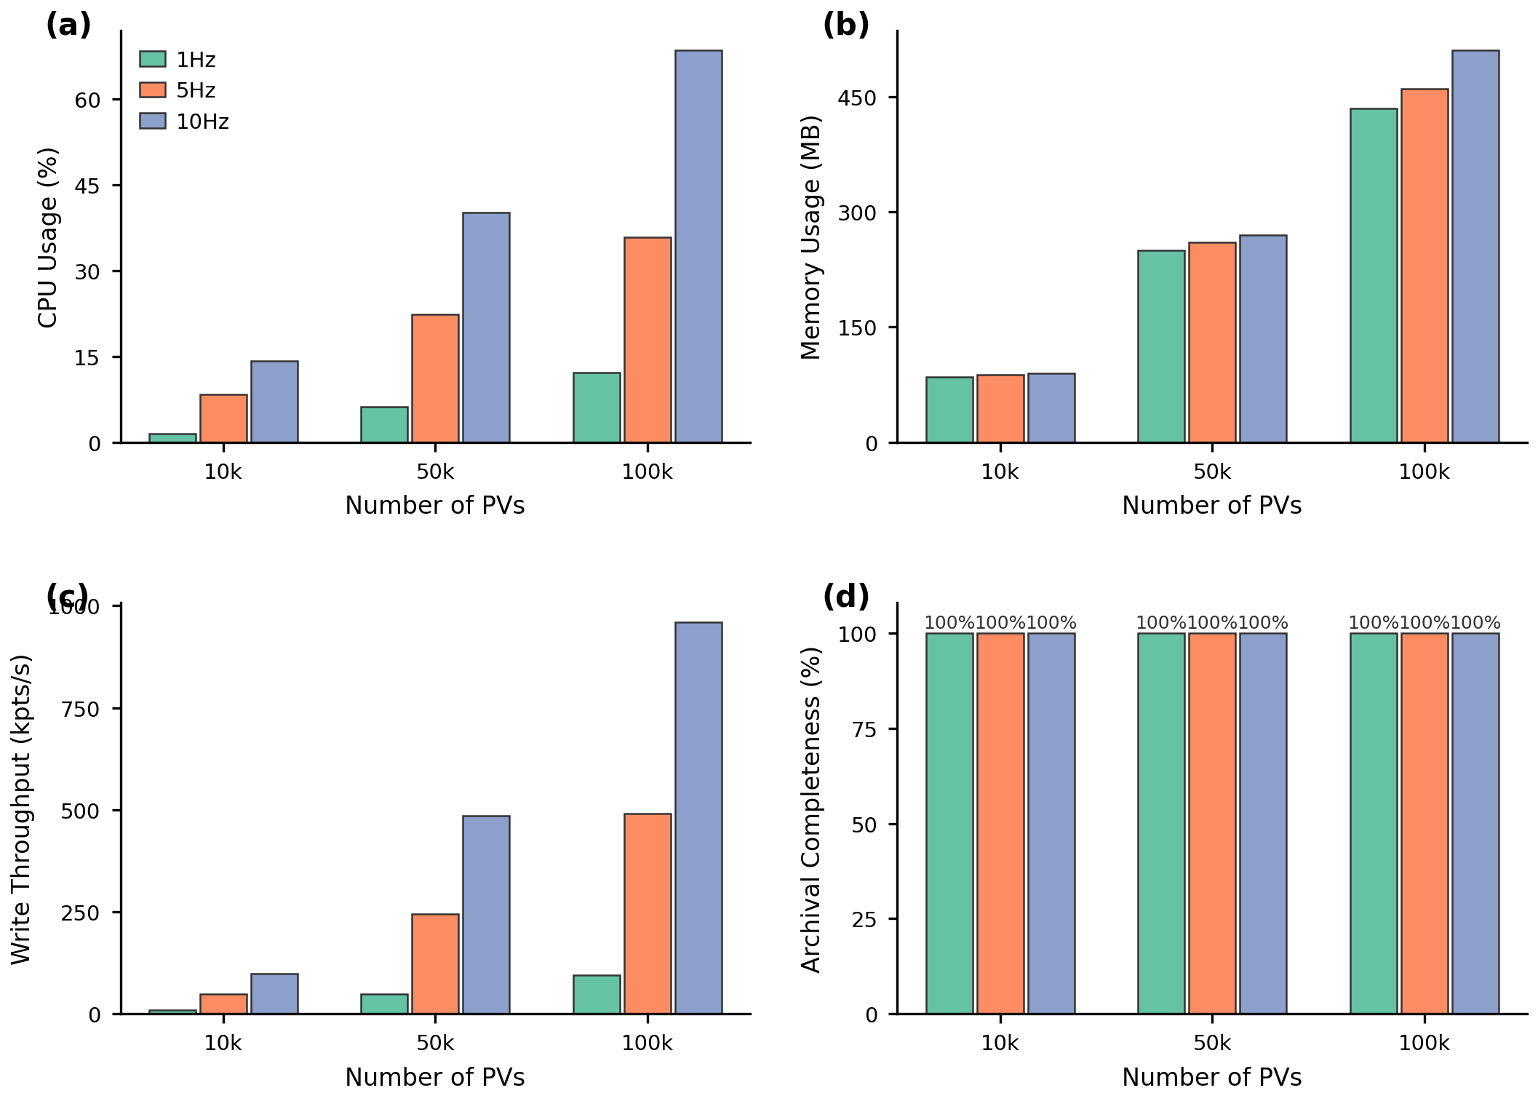
Test
ETRA Performance Test (Write Throughput, CPU, Memory, Completeness)
Test Data: EAST cryogenic system and vacuum system plant data.
- Matrix: PVs ∈ {10k, 50k, 100k} × frequency ∈ {1, 5, 10 Hz} for 300 s.
- (a) CPU usage stays under ~70% even at 100k PV × 10 Hz. - (b) Memory usage linear with PV count, ≤ ~500 MB.
- (c) Write throughput: up to ~1 M points/s at 100k × 10 Hz.
- (d) Archival completeness = 100% across all 9 cells — zero point loss.
25th IEEE Real Time Conference - La Biodola, Elba, Italy, 25-29 May, 2026
Notes:
Finally, to evaluate the system, we conducted four groups of test
First, we performed the ETRA performance test for data writing, including write throughput, CPU usage, memory usage, and archival completeness.
This is our write scalability test. We swept PV count and diferennt sampling rate, ran each cell for five minutes, and measured CPU, memory, throughput, and archival completeness.
ETRA scales smoothly: CPU stays below 70% even at one million points per second, memory stays under half a gigabyte, and crucially, no points are dropped in any cell — archival completeness is exactly 100 percent.

Slide 12
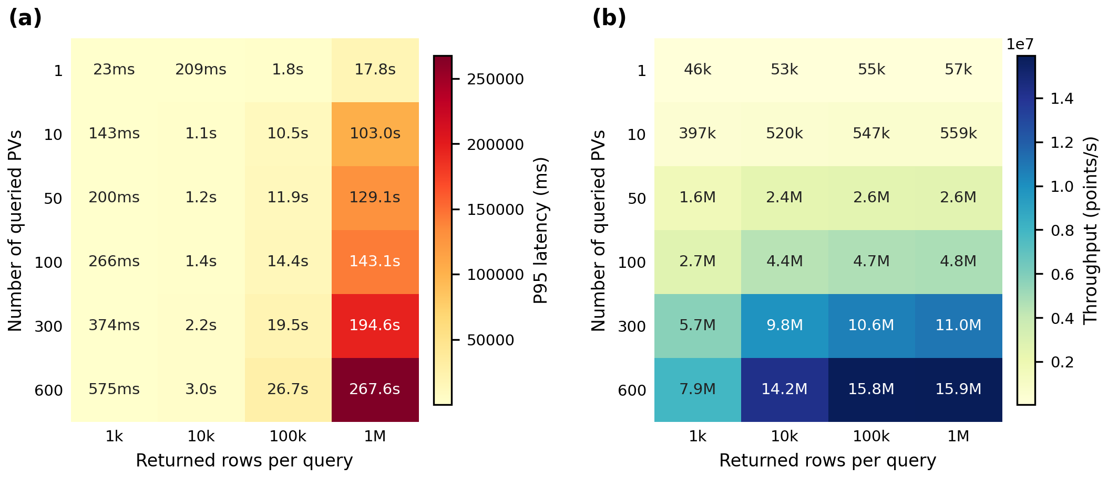
Test
ETRA Performance Test (Range Query Performance)
Test Data:
EAST cryogenic system and vacuum system plant data.
- Workload: 600 cryogenic PVs, real EAST archive.
- Matrix: returned rows per query ∈ {1k, 10k, 100k, 1M} × PV scope ∈ {1…600}.
- (a) p95 latency: scales smoothly from 23 ms (1 PV, 1k rows) to 267 s (600 PV, 1M rows).
- (b) Throughput: peaks at ~15.9 M points/s for 600 PV × 1M rows.
- Multi-PV range queries scale near-linearly without per-PV fan-out cost.
25th IEEE Real Time Conference - La Biodola, Elba, Italy, 25-29 May, 2026
Notes:
Second, we evaluated the range query performance of ETRA under different data volumes and different numbers of queried PVs.
This is our query benchmark on 600 real cryogenic PVs. The left heatmap shows p95 latency, the right shows query throughput in points per second.
ETRA delivers sub-second latency for moderate workloads and reaches up to about 16 million points per second for the largest query.
The key reason is that IoTDB serves multi-device range queries natively, so increasing the number of PVs does not multiply the per-request overhead.

Slide 13
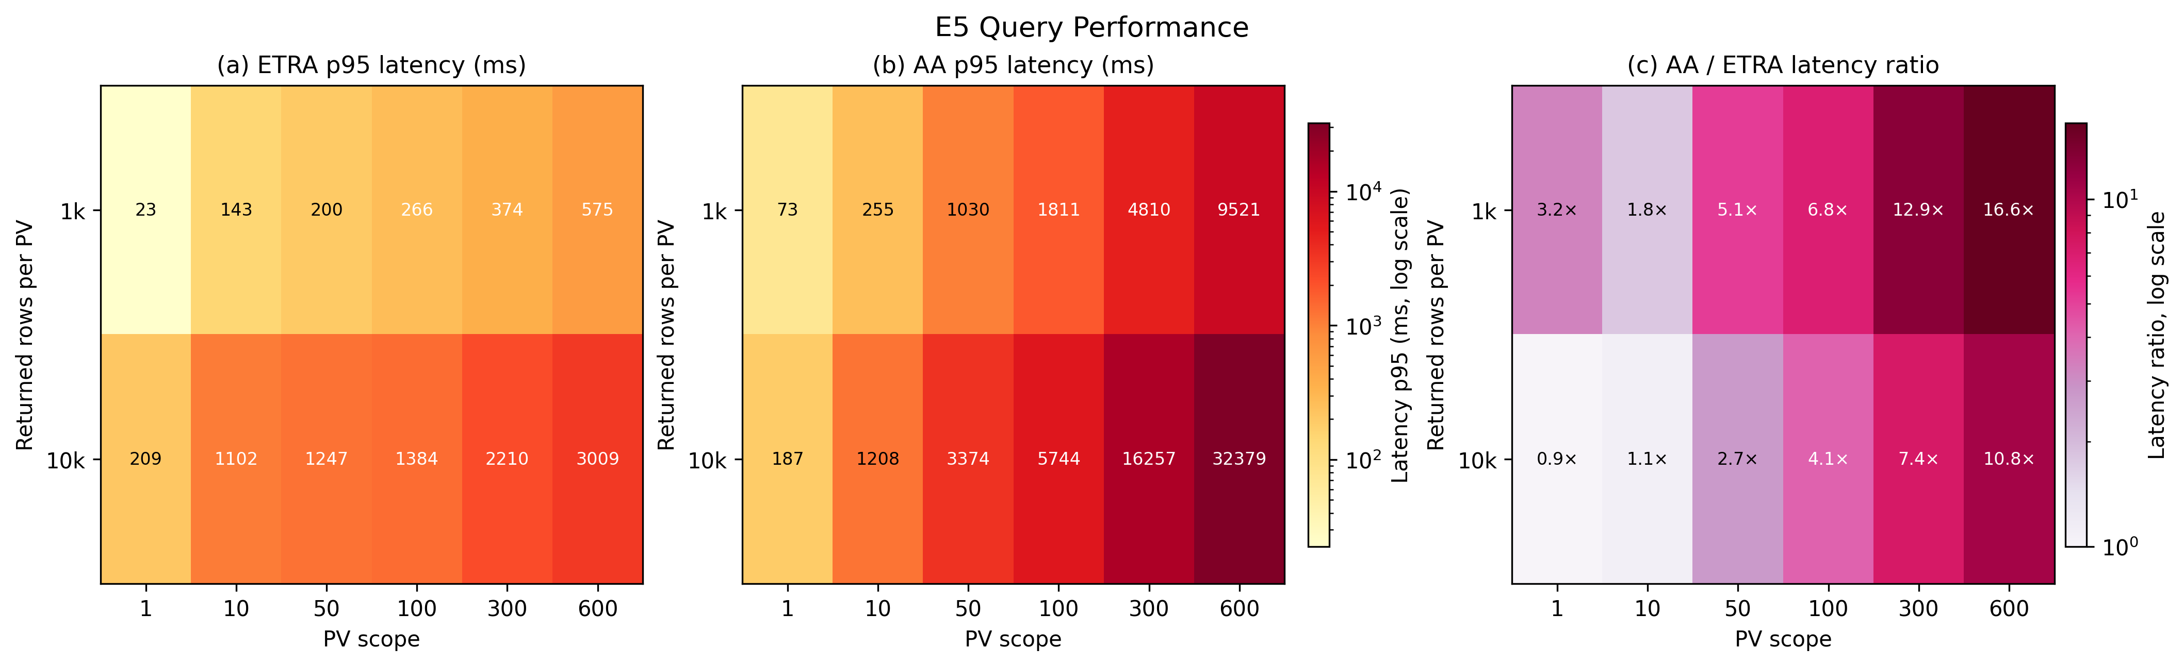
Test
Comparative Test
Query performence test compare with EPICS Archiver Appliance
- Matched returned data volume: 1k and 10k rows per PV, 1–600 PV scopes.
- (a) ETRA p95 latency: 23 ms – 3.0 s.
- (b) AA p95 latency: 73 ms – 32.4 s.
- (c) Latency ratio: AA is up to 16.6× slower at 600 PV × 1k rows; up to 10.8× slower at 600 PV × 10k rows.
25th IEEE Real Time Conference - La Biodola, Elba, Italy, 25-29 May, 2026
Notes:
Third, we conducted a comparative test between ETRA and the EPICS Archiver Appliance, focusing on query latency under matched returned data volumes.
Here we directly compare ETRA against AA on the same data volume per query. ETRA is consistently faster as soon as the query touches more than a handful of PVs. At 600 PVs, ETRA finishes in three seconds where AA takes more than thirty.
The reason is architectural: AA serves each PV through an independent HTTP retrieval, so multi-PV queries fan out and the slowest request determines the overall latency. ETRA, backed by IoTDB, executes a single distributed range query across all requested devices.

Slide 14
Test
AI Node Train Test
Multi-step forecasting: Timer-XL, Sundial.
One-step forecasting: navie_forecaster, exponential_smoothing, holtwinters, stl_forecaster
Anomaly detection: stray
Timeseries-Model
Test Data
EAST Plant Data, Cryogenic system, TI2226, 10000 Timestamp.
Method of testing
[1] Timer- Generative Pre-trained Transformers Are Large Time Series Models, Yong Liu, Haoran Zhang, Chenyu Li, Xiangdong Huang, Jianmin Wang, Mingsheng Long.
[2] TIMER-XL- LONG-CONTEXT TRANSFORMERS FOR UNIFIED TIME SERIES FORECASTING ,Yong Liu, Guo Qin, Xiangdong Huang, Jianmin Wang, Mingsheng Long.
[3] Sundial- A Family of Highly Capable Time Series Foundation Models, Yong Liu, Guo Qin, Zhiyuan Shi, Zhi Chen, Caiyin Yang, Xiangdong Huang, Jianmin Wang, Mingsheng Long, ICML 2025 spotlight.
25th IEEE Real Time Conference - La Biodola, Elba, Italy, 25-29 May, 2026
Notes:
Finally, we carried out an AINode test, using archived plant data for time-series forecasting and anomaly detection, to demonstrate the potential of integrated AI analysis on top of the archived data.
we can run AI models directly on top of it through AINode without ETL. We tested two pretrained large time-series models — Timer-XL and Sundial — for multi-step forecasting on a real cryogenic temperature signal. We also evaluated classical one-step models and an anomaly detection algorithm called Stray.

Slide 15
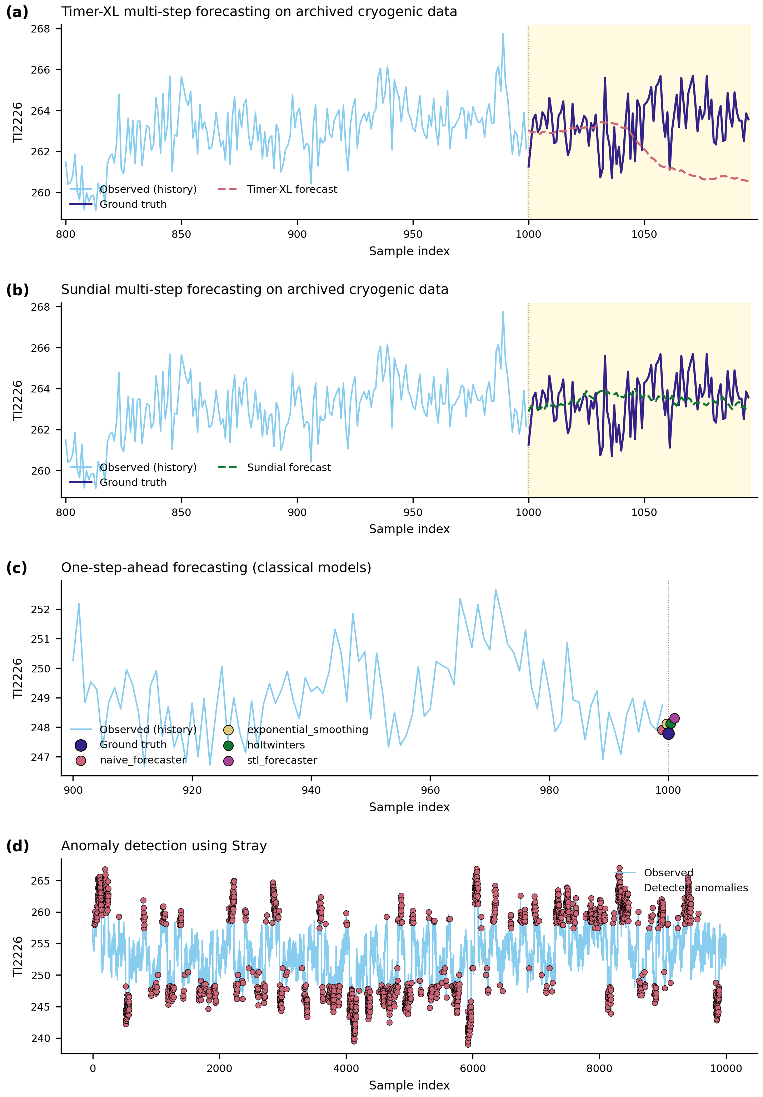
Test
AI Node Train Test
- (a) Timer-XL multi-step forecast: drifts toward mean over 80-step horizon.
- (b) Sundial multi-step forecast: tracks trend, smooths high-frequency noise.
- (c) Classical one-step models (naive, exp-smoothing, Holt-Winters, STL): all converge near ground truth.
- (d) Stray anomaly detection: identifies excursions outside normal cryogenic operating band.
25th IEEE Real Time Conference - La Biodola, Elba, Italy, 25-29 May, 2026
Notes:
For the AINode experiment, we evaluated four types of AI-based time-series analysis.
In panel (a), Timer-XL is used for multi-step forecasting. It captures the overall level of the signal, but over the 80-step prediction horizon, the forecast gradually drifts toward the mean.
In panel (b), Sundial is also used for multi-step forecasting. Compared with Timer-XL, it follows the general trend more stably, while smoothing out some high-frequency fluctuations.
In panel (c), we tested several classical one-step forecasting models, including the naive forecaster, exponential smoothing, Holt-Winters, and STL-based forecasting. Since this is a one-step-ahead task, the predictions are close to the ground truth.
In panel (d), we apply Stray for anomaly detection. The detected points highlight abnormal excursions outside the normal operating range of the cryogenic signal, showing that the archived data can support not only forecasting, but also anomaly detection.
The point of this test is not to compare model accuracy; it is to demonstrate that with ETRA, archived plant data is immediately consumable by modern AI workloads, with no additional ETL pipeline.
Extract Transform Load

Slide 16
Summary and plan
Summary and Future work
Summary:
- ETRA bridges EPICS Channel Access and a Timeseries Database.
- By leveraging the large-scale query capability of TSDBs, ETRA achieves strong performance for EAST plant data archiving and analysis.
- Native AI workloads (forecasting, anomaly detection) supported via IoTDB AINode.
Future work:
- Adaptive flush policy based on PV update statistics.
- Design time series models more suitable for EAST plant data.
- Deployment validation on full EAST production workload.
25th IEEE Real Time Conference - La Biodola, Elba, Italy, 25-29 May, 2026
Notes:
To summarize, ETRA is a lightweight and high-throughput bridge from EPICS Channel Access to a time-series database. It connects real-time EPICS PV streams with TSDB-based storage through three decoupled modules: acquisition, aggregation, and persistence.
By leveraging the write, query, and distributed storage capabilities of the TSDB, ETRA achieves strong performance for EAST plant data archiving and analysis. It also supports native AI workloads, such as forecasting and anomaly detection, through IoTDB AINode, without requiring extra data migration.
For future work, we plan to improve the system in three directions. First, we will develop an adaptive flush policy based on the update statistics of different PVs. Second, we will design time-series models that are more suitable for EAST plant data. Finally, we will validate the system on the full EAST production workload.

Slide 17
Thank you for your attention !
Guang Yang,
guangyang@mail.ustc.edu.cn
25th IEEE Real Time Conference - La Biodola, Elba, Italy
May 25-29, 2026
Notes:
Thank you for your attention.
That concludes my presentation. I would be happy to answer any questions.

