Slide 1


25th IEEE Real Time Conference | Oral presentation
Cost-effective and competitive alternative to the ITER time communication network for accurate time synchronization
From the validated MITICA TCN to a compact Kria-based all-in-one prototype
L. Trevisan, G. Manduchi, R. Cavazzana, A. Rigoni, M. Bevilacqua | Consorzio RFX
La Biodola, Isola d'Elba | May 25-29, 2026

Slide 2
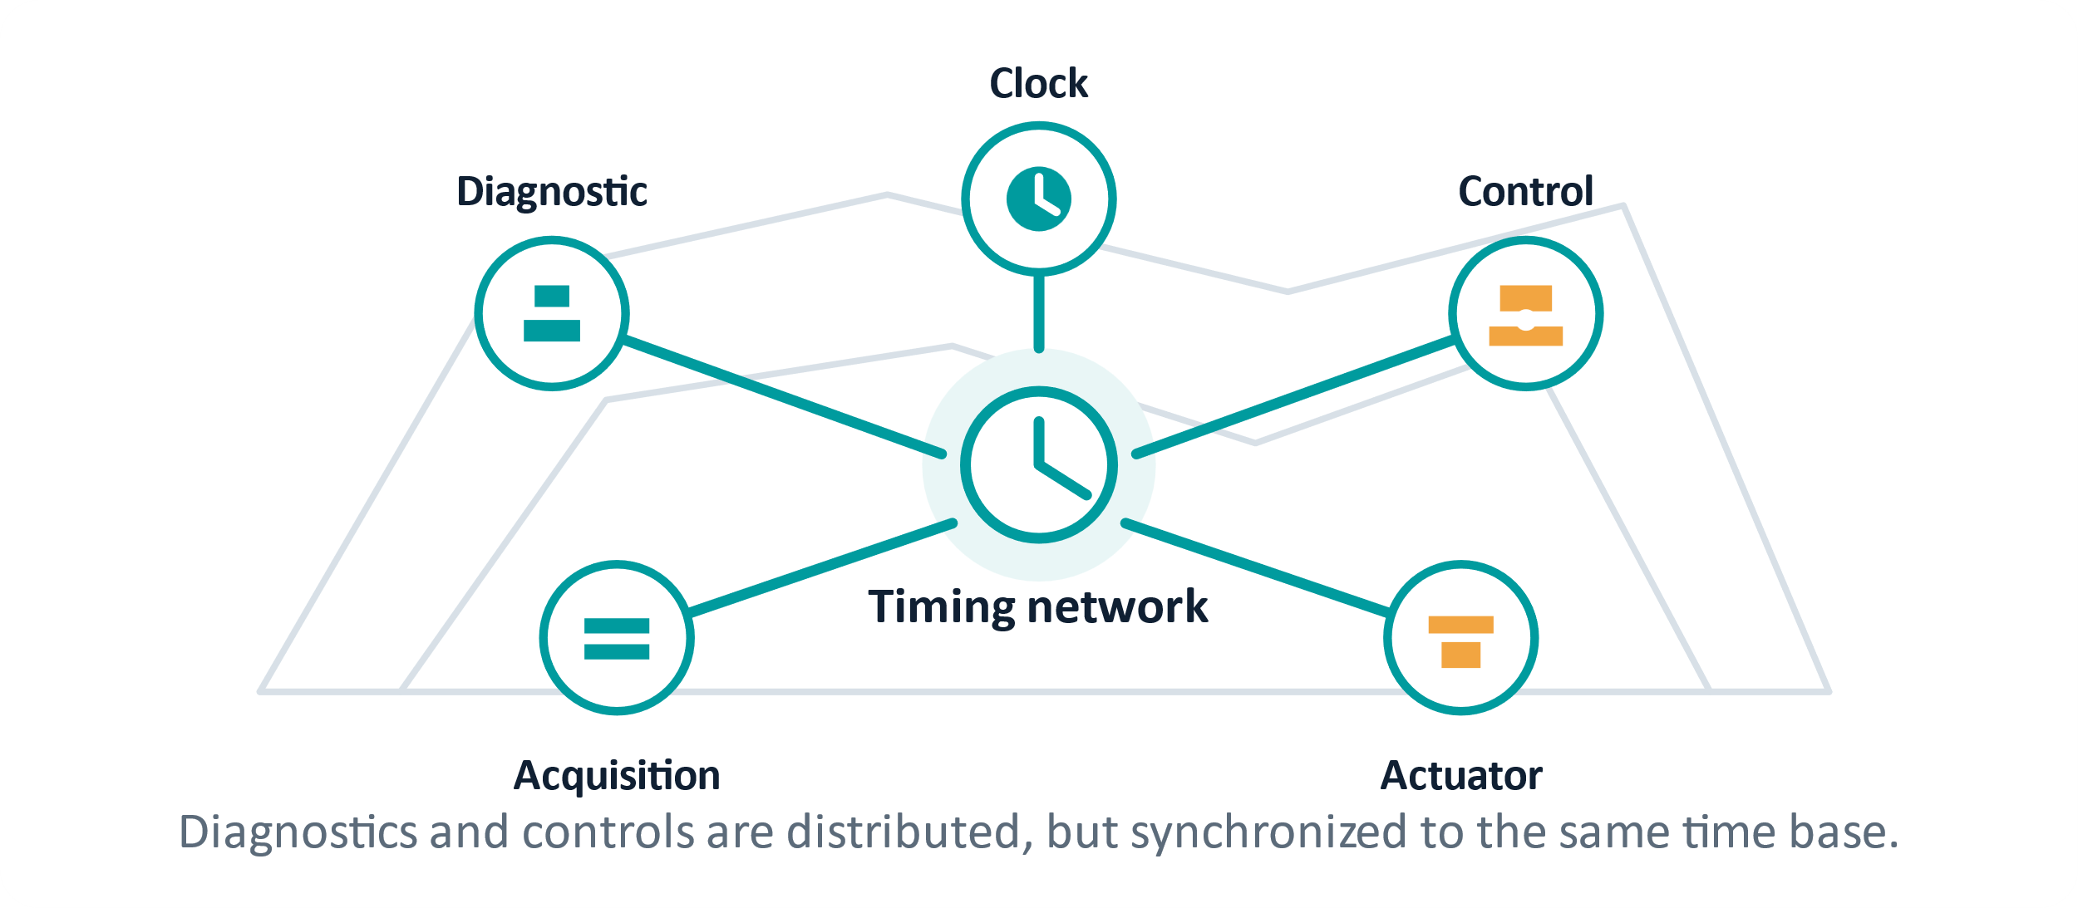
Why timing matters in ITER/NBTF
Distributed control and acquisition only work if every node agrees on time.
Diagnostics and controls are geographically distributed across the facility.
Clock and trigger coherence are required for reproducible acquisition and event timing.
IEEE 1588/PTPv2 lets timing travel through the same network class used by the control system.
The Timing Communication Network (TCN) is not infrastructure decoration, it is a crucial part of the measurement chain.
RT2026 | La Biodola, Isola d'Elba | May 25-29, 2026
02

Slide 3
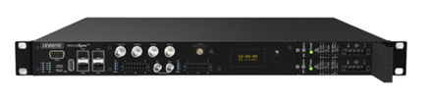
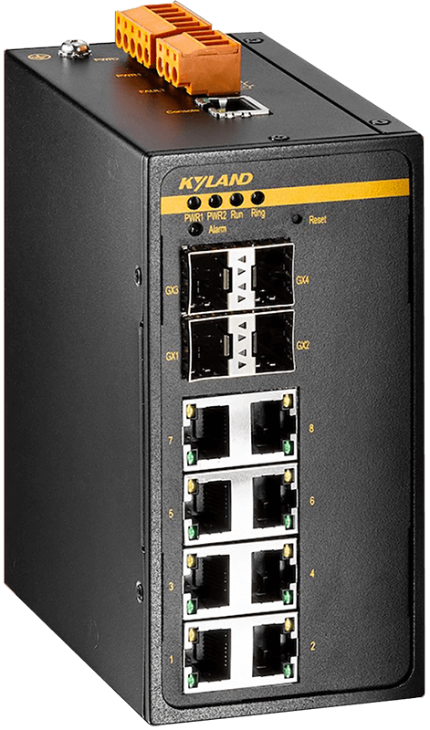
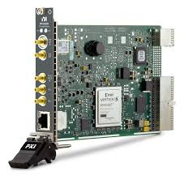
Baseline: the MITICA TCN has been already validated
The new prototype starts from a trusted reference, not from a blank page.
Kyland
PTP-aware switch
PXI-6683H node
Meinberg RX201
PTP Grandmaster
10 MHz measurement
Kyland
PTP-aware switch
PXI-6683H node
Previous MITICA campaigns showed that the ITER architecture based on PTP-aware network equipment and NI timing modules satisfies the ITER RMS requirement. (< 50ns)
https://doi.org/10.1109/TNS.2023.3237003
RT2026 | La Biodola, Isola d'Elba | May 25-29, 2026
03

Slide 4
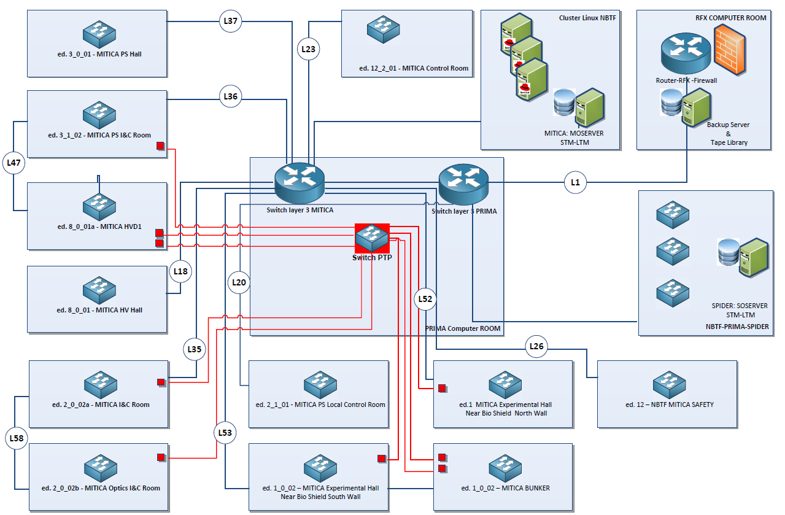
MITICA TCN Topology
Distributed over 6 different buildings
Core layer: PTP Grand Master Clock connected via Ethernet TCP to 2 PTP switches
9 PTP boundary clock switches connected va fiber optics to guarantee the synchronization to the connected leaves
Segregated traffic though different VLANs
No redundancy
RT2026 | La Biodola, Isola d'Elba | May 25-29, 2026
03

Slide 5

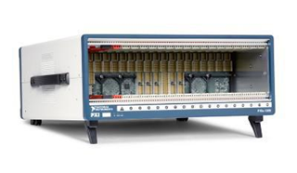
The reference node works, but it is challenging to scale
The question is whether the timing function can be compressed into one embedded platform.
Standard ITER-like node
CODAC server
Can one FPGA-based board generate synchronized clocks and triggers while staying inside ITER-like PTP constraints?
NI chassis
PXI-6683H module
This is the design target for the Kria prototype.
High-end hardware, custom integration, high per-node cost
RT2026 | La Biodola, Isola d'Elba | May 25-29, 2026
04

Slide 6
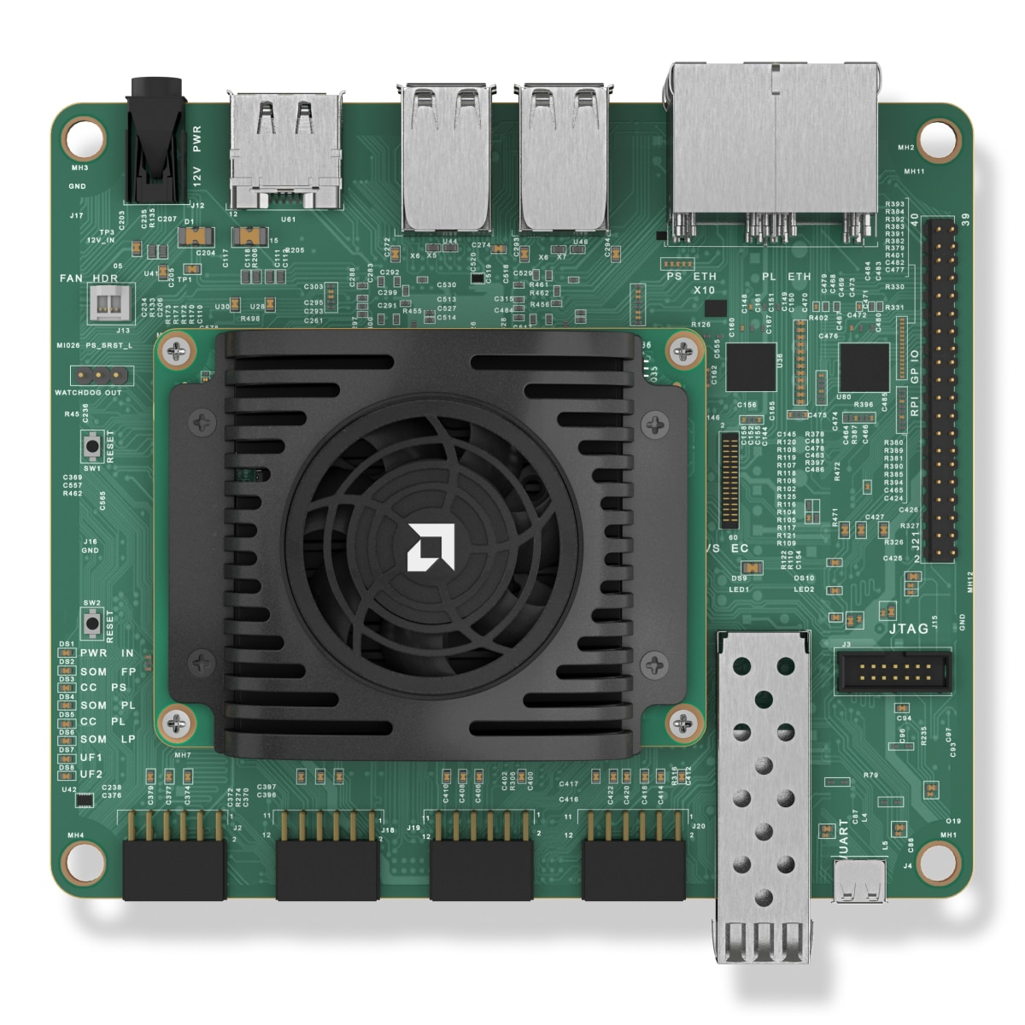
Kria KR260 all-in-one timing node
Zynq™ UltraScale+™ MPSoC EV (XCK26)
256K logic cells, 1.2K DSP slices, 144 Block RAM, 64 UltraRAM
4 GB DDR4 non-ECC + 512 Mb QSPI boot memory
4× Gigabit Ethernet + 1× 10G SFP+ for deterministic industrial networking
4× USB 3.0, DisplayPort 1.2a, SLVS-EC vision interface
RT2026 | La Biodola, Isola d'Elba | May 25-29, 2026
06

Slide 7
Kria KR260 all-in-one timing node
ARM/Linux handles PTP; FPGA fabric generates deterministic timing outputs.
ARM / Linux
LinuxPTP
FPGA fabric
Clock synchronization logic
PTP network
Synchronized clocks + triggers outputs
PetaLinux environment tailored to the board
Goal: one compact node instead of server + chassis + timing module.
External clock lock and configurable FPGA outputs
Open software stack keeps the prototype tunable
RT2026 | La Biodola, Isola d'Elba | May 25-29, 2026
05

Slide 8
Test setup: PTP synchronization, PPS acquisition
The Grandmaster Clock synchronizes both timing boards; CAEN measures their generated PPS outputs.
NI PXI-6683H
PPS output
Grandmaster
clock
PTP network
CAEN
5GHz acquisition
Kria
PPS output
TCN
PPS Output
Offset analysis
vs master channel
RT2026 | La Biodola, Isola d'Elba | May 25-29, 2026
06

Slide 9
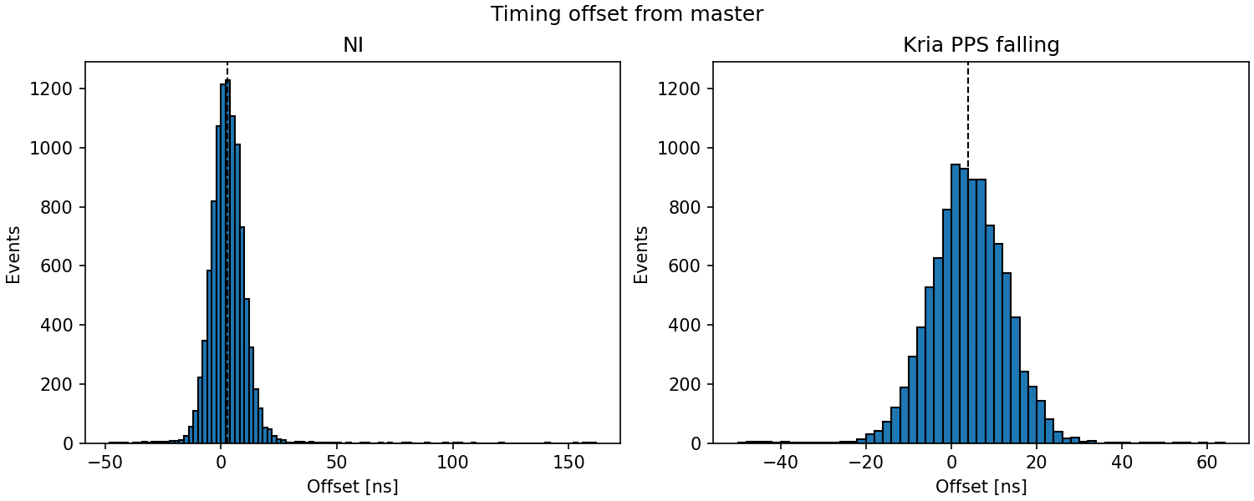
Test A: PPS from the PTP-synchronized internal clock, raw data
Kria generates the PPS directly from its clock synchronized via PTP.
9.189 ns
9.738 ns
NI Filtered RMS
Kria RMS
161 ns
62 ns
MAX delay
MAX Delay
ITER requirement: RMS < 50 ns
PXI6683H synchronization presents groups of outliers that affect the statistics
RT2026 | La Biodola, Isola d'Elba | May 25-29, 2026
07

Slide 10
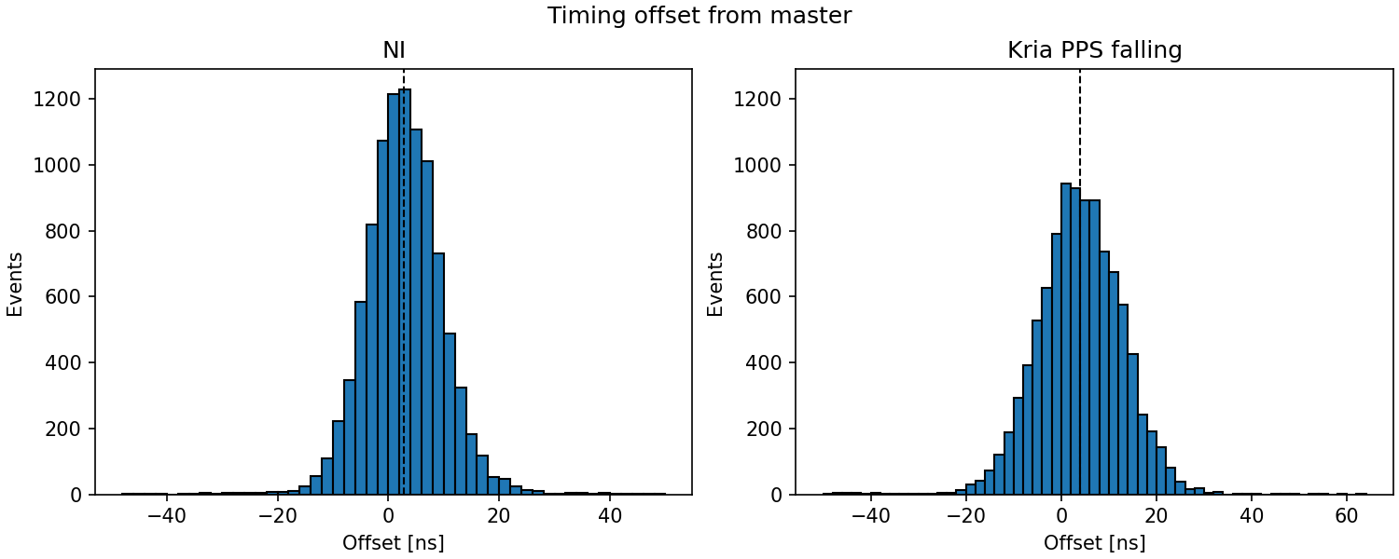
Test A: PPS from the PTP-synchronized internal clock, filtered data
Kria generates the PPS directly from its clock synchronized via PTP.
7.726 ns
9.738 ns
NI Filtered RMS
Kria RMS
ITER requirement: RMS < 50 ns
The direct PPS path is already compliant, but it leaves room for jitter reduction.
RT2026 | La Biodola, Isola d'Elba | May 25-29, 2026
07

Slide 11
Two Kria PPS generation paths
Both tests start from PTP synchronization; the difference is where the PPS is derived.
Test A: direct PPS path
Test B: 10 MHz digital PLL path
PTP-synchronized
internal clock
PPS
generator
PPS out
PTP-synchronized
clock
Digital PLL
10 MHz
PPS
generator
PPS out
The KRIA generates the PPS directly from the PTP Hardware Clock (PHC)
The KRIA links a 10MHz clock to the PTP Hardware Clock (PHC)
The PPS is generated from the 10MHz clock
The output triggers and clock are generated by the 10MHz clock
RT2026 | La Biodola, Isola d'Elba | May 25-29, 2026
07

Slide 12
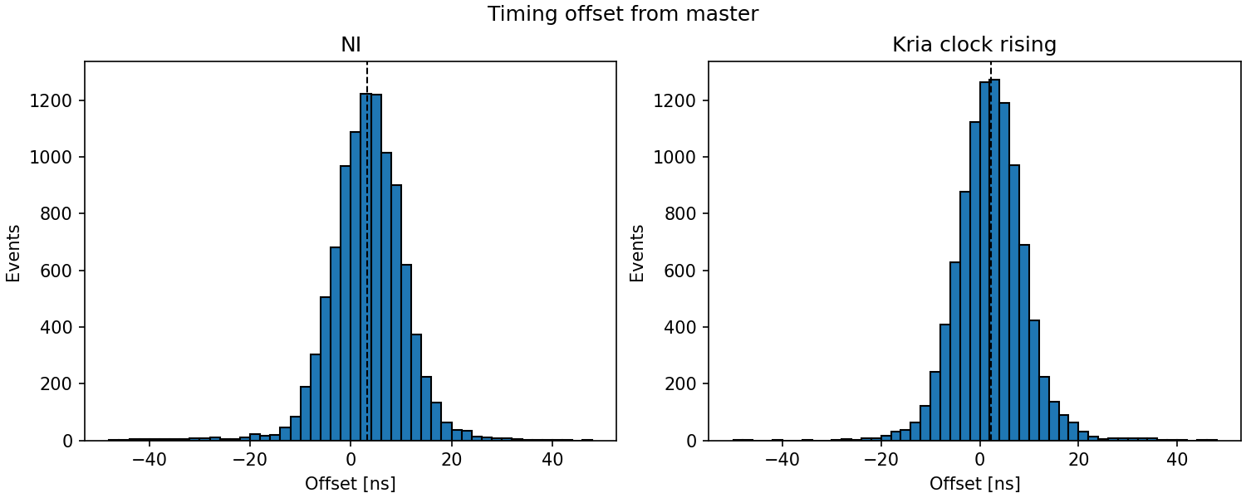
Test B: digital PLL to 10 MHz, then PPS generation
The PTP-synchronized clock feeds a digital PLL; the resulting 10 MHz clock generates the PPS.
8.167 ns
7.177 ns
NI filtered RMS
KriaRMS
ITER requirement: RMS < 50 ns
The 10 MHz digital PLL path reduces variance and gives the best Kria result.
RT2026 | La Biodola, Isola d'Elba | May 25-29, 2026
08

Slide 13
Cost and integration impact
The Kria prototype statistics are comparable with the ITER timing nodes.
Reference node
Kria prototype board
Server
ARM/Linux PTP
Simpler setup
same timing target
NI chassis
FPGA timing outputs
PXI-6683H
RT2026 | La Biodola, Isola d'Elba | May 25-29, 2026
09

Slide 14
Conclusions and next steps
MITICA validated the ITER TCN path.
7.177 ns
9.738 ns
The 10 MHz digital PLL path gives the best Kria result.
Kria PLL path RMS
Kria direct PPS RMS
The next validation is API-level compatibility.
ELAD will produce the final timing module with appropriate service contracts.
Future work: expose the prototype through behavior compatible with ITER TCN APIs and extend test duration.
RT2026 | La Biodola, Isola d'Elba | May 25-29, 2026
10

