Slide 1
Timing Distribution Method via 10-km Optical Fibers
at the J-PARC for the Hyper-K Project
Che-Sheng Lin^{A,B},
Eitaro Hamada^{A}, Ian Benjamin Heitkamp^{C}, Yota Hino^{A,B}, Ryotaro Honda^{A,B}, Ken Sakashita^{A,B}
^{A}KEK IPNS, ^{B}SOKENDAI, ^{C}Tohoku University
This work is supported by the JST K-program
(Grant No. JPMJKP24J2).
2026/05/28 25th IEEE Real Time Conference [OS_DataAcquisitionAndTriggerArchitectures_125]

Slide 2
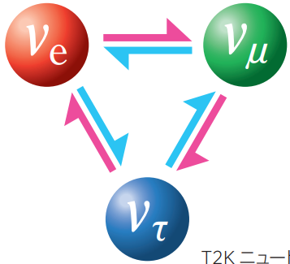
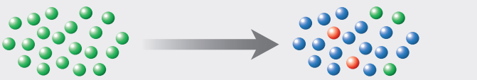
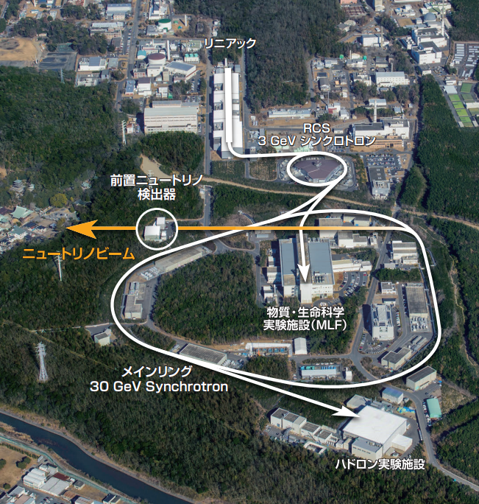
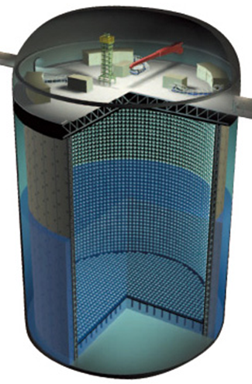
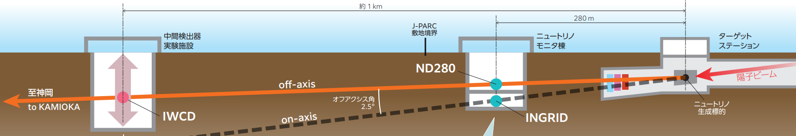
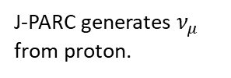



T2K (Tokai to Kamioka)/HK Experiment
Ref: Abe, K., et al., NIM A,
659.1 (2011): 106-135.
Long-baseline neutrino oscillation experiment
- Neutrino Oscillation
J-PARC generates $ν_{μ}$
from proton.
Kamiokande measures the arriving $υ$ flavor.
- Neutrino flavors change
after traveling some distance.
neutrino
flavor
pure $ν_{μ}$
most of $ν_{τ}$
with a few of $ν_{e}$, $ν_{μ}$
- T2K Experiment
- Super-Kamiokande
- J-PARC
- Near Detectors
- Muon neutrino (ν_{μ}) beam is generated
from the J-PARC main-ring (MR) proton beam.
- The neutrino flavor is measured
by Super-Kamiokande after traveling 295 km.
Notes:
https://j-parc.jp/documents/pdf/2024/T2K_202408_J-Low.pdf
https://www.mdpi.com/2673-9984/8/1/38
https://www-sk.icrr.u-tokyo.ac.jp/~berns_s/RT99/
far

Slide 3
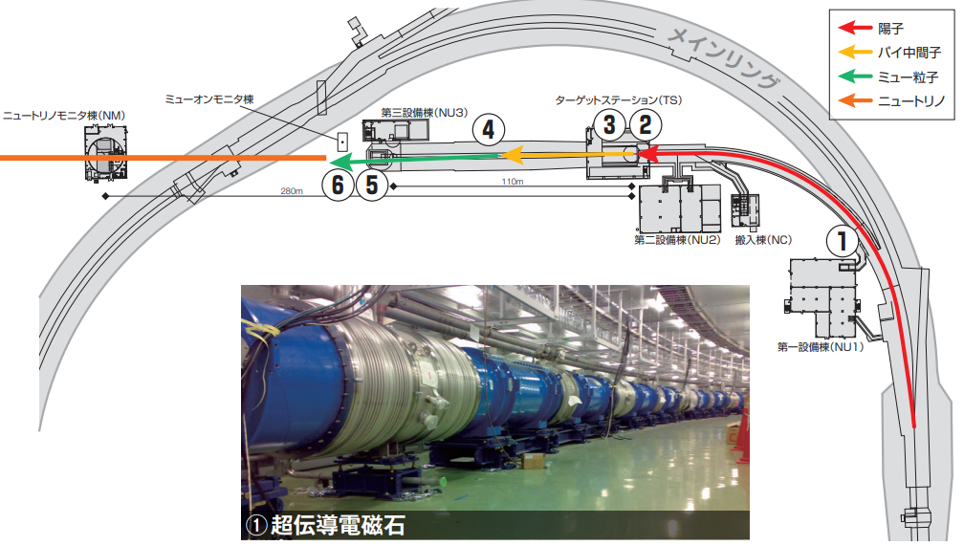
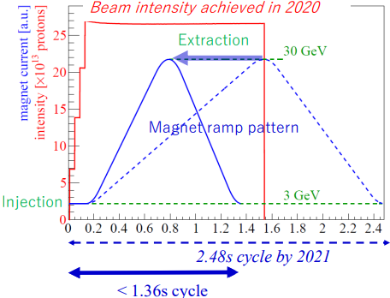
J-PARC Site of T2K Experiment
Ref: Y. Sato, J-PARC MR,
MOA2I1, HB2023
Fast-extraction (FX) and beam kicking pulse signal
- Neutrino beam
- MR fast-extraction (FX) mode
Main ring
proton
pion
muon
neutrino
beam kicker pulse signal
- The MR delivers a beam kicker timing pulse signal.
- The period of the fast-extraction (FX) mode is 1.3s.
Notes:
https://indico.cern.ch/event/1138716/contributions/5437848/attachments/2730099/4745819/MOA2I1_TALK.pdf

Slide 4
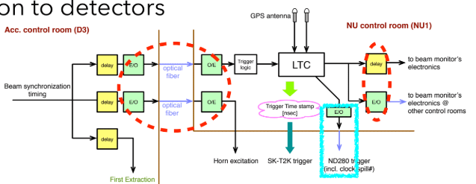
Timing Distribution System
Distribute the beam trigger and spill number
- Neutrino beam
- Local time clock (LTC) at the J-PARC site
beam kicker
pulse signal
beam trigger & spill number
beam trigger
& spill number
beam kicker pulse signal
- Developed during the K2K era over 20 years ago.
- Several modules have exceeded their production lifespan
and are no longer available.
- The system occasionally suffers from signal dropouts.
➔We aim to develop a new transmission method
to replace the current system for the future Hyper-K experiment.
- When receiving the kicker pulse signal,
the timing distribution system distributes
the beam trigger pulse signal and spill number
to each neutrino facility.
- Requirements:
beam kicker
pulse signal
- Beam trigger pulse signal
with spill number
- No trigger loss
- Timing accuracy < 1 ns
- Transmission distance > 10km
- Transmission latency < 1 ms
beam trigger
pulse signal
fixed latency
Notes:
https://indico.cern.ch/event/1138716/contributions/5437848/attachments/2730099/4745819/MOA2I1_TALK.pdf

Slide 5
1. Timing Distribution Method
2. Phase Compensation Method
3. Implementation

Slide 6
Method of Timing Distribution System
Principle: digitize analog pulse signals for transmission
clock (125MHz)
Main board
Sub board
recovered clock (125MHz)
MIKUMARI
Link TX
MIKUMARI
Link RX
Time
Counter
pulse I/F
pulse I/F
Time
Counter
data I/F
optical
fiber
data I/F
(1) Digitalize
pulse signal
(3) Generate
pulse signal
time
time
Kicker
Timing
Pulse
(2) Transmit the leading-edge timing
Beam
Trigger
Pulse
Pulse
Sampler
Data
Encode
Data
Decode
Pulse
Generator
Spill
Counter
Spill
Num.
Spill Num.
(1) Main board:
Digitalize the pulse signal.
- Principle:
Digitize analog pulse signals
for transmission
(2) MIKUMARI link protocol:
Transmit the leading-edge timing of pulse signal.
(3) Sub board:
Generate the pulse signal at the corresponding timing.
Notes:
ref: D. Calvet, IEEE TNS, vol. 67, no. 8, pp. 1912-1919, Aug. 2020
ref: R. Honda, IEEE TNS, vol. 70, no 6, pp. 1102-1109, June 2023

Slide 7
Method of Timing Distribution System (0)
Ref: R. Honda, IEEE TNS,
70.6 (2023): 1102-1109
Prepare the synchronize time counter
clock (125MHz)
Main board
Sub board
recovered clock (125MHz)
MIKUMARI
Link TX
MIKUMARI
Link RX
Time
Counter
pulse I/F
pulse I/F
Time
Counter
data I/F
optical
fiber
data I/F
time
time
Kicker
Timing
Pulse
Pulse
Sampler
Data
Encode
Data
Decode
Pulse
Generator
Beam
Trigger
Pulse
Spill
Counter
Spill
Num.
Spill Num.
(0) Prepare the synchronize time counters:
Note: interface (I/F) of MIKUMARI link protocol:
(0.1) MIKUMARI signal serves as a reference clock
to recover the synchronized clock on the Sub board.
1) clock I/F:
- synchronous clock signal of 125 MHz (8 ns).
2) pulse I/F:
- pulse signal with fixed latency and 3-bit data width.
(0.2) Periodically synchronize the time counter via pulse I/F
The time counter values have a fixed offset,
which depends on the transmission latency of the pulse I/F.
3) data I/F:
- DC-balanced data frame (a few 8-bit characters)
- transmission latency with slight uncertainty
Notes:
ref: D. Calvet, IEEE TNS, vol. 67, no. 8, pp. 1912-1919, Aug. 2020
ref: R. Honda, IEEE TNS, vol. 70, no 6, pp. 1102-1109, June 2023

Slide 8
Method of Timing Distribution System (1)
Digitalize the kicker timing pulse signal
clock (125MHz)
Main board
Sub board
recovered clock (125MHz)
MIKUMARI
Link TX
MIKUMARI
Link RX
Time
Counter
pulse I/F
pulse I/F
Time
Counter
(8ns/16bit)
data I/F
optical
fiber
data I/F
TDC (1ns/3bit)
time
time
Kicker
Timing
Pulse
Pulse
Sampler
Data
Encode
Data
Decode
Pulse
Generator
Beam
Trigger
Pulse
Spill
Counter
Spill
Num.
Spill Num. (32bit)
(1) Digitalize the kicker timing pulse signal:
Note: 1ns TDC (1-to-8 ISERDES )
(1.1) Measure the leading-edge timing of the pulse signal.
(1 ns-resolution TDC implemented by the ISERDES primitive.)
clock (8 ns)
(1.2) Measured timing = timing counter + pulse sampler
(8ns/16bit) (1ns/3bit)
pulse signal
(1.3) Spill number for identifying the beam trigger (32bit).
0
0
0
0
1
1
1
1
parallel data pattern (1 ns)
Notes:
ref: D. Calvet, IEEE TNS, vol. 67, no. 8, pp. 1912-1919, Aug. 2020
ref: R. Honda, IEEE TNS, vol. 70, no 6, pp. 1102-1109, June 2023

Slide 9
Method of Timing Distribution System (2)
Ref: R. Honda, IEEE TNS,
70.6 (2023): 1102-1109
Transmit the leading-edge timing and spill number
clock (125MHz)
Main board
Sub board
recovered clock (125MHz)
MIKUMARI
Link TX
MIKUMARI
Link RX
Time
Counter
pulse I/F
pulse I/F
Time
Counter
data I/F
optical
fiber
data I/F
time
time
Kicker
Timing
Pulse
Pulse
Sampler
Data
Encode
Data
Decode
Pulse
Generator
Beam
Trigger
Pulse
Spill
Counter
Spill
Num.
Spill Num.
(2) Transmit the leading-edge timing and spill number:
Note: interface (I/F) of MIKUMARI link protocol:
1) clock I/F:
- synchronous clock signal of 125 MHz (8 ns).
(2.1) Transmit the information of pulse signal by data I/F
leading-edge timing + spill number
(16+3 bit) (16 bits)
(spill number: 32 bits(total)/16 bits (delivered))
2) pulse I/F:
- pulse signal with fixed latency and 3-bit data width.
3) data I/F:
- DC-balanced data frame (a few 8-bit characters)
- transmission latency with slight uncertainty
Notes:
ref: D. Calvet, IEEE TNS, vol. 67, no. 8, pp. 1912-1919, Aug. 2020
ref: R. Honda, IEEE TNS, vol. 70, no 6, pp. 1102-1109, June 2023

Slide 10
Method of Timing Distribution System (3)
Generate the pulse signal at the corresponding timing
clock (125MHz)
Main board
Sub board
recovered clock (125MHz)
MIKUMARI
Link TX
MIKUMARI
Link RX
Time
Counter
pulse I/F
pulse I/F
Time
Counter
data I/F
optical
fiber
data I/F
corresponding timing
time
time
Kicker
Timing
Pulse
Pulse
Sampler
Data
Encode
Data
Decode
Pulse
Generator
Beam
Trigger
Pulse
- Parameters:
- pulse width
- extra fixed latency
OSERDES
Spill
Counter
Spill
Num.
Spill Num.
(3) Generate the pulse signal at the corresponding timing:
Time counter
(main board)
T1
T2
T3
(3.1) Generate the pulse signal at the corresponding timing.
( leading-edge timing + pulse width)
Note: transmission latency: data I/F > pulse I/F
➔ add an extra fixed latency to ensure receiving
of data from the data I/F.
Kicker timing
pulse signal
leading-edge timing
Time counter
(sub board)
T1
T2
T3
Beam trigger
pulse signal
(3.2) Use the OSERDES primitive to achieve 1ns accuracy.
width
Notes:
ref: D. Calvet, IEEE TNS, vol. 67, no. 8, pp. 1912-1919, Aug. 2020
ref: R. Honda, IEEE TNS, vol. 70, no 6, pp. 1102-1109, June 2023

Slide 11
1. Timing Distribution Method
2. Phase Compensation Method
3. Implementation

Slide 12
Phase drift of 10km Optical Fiber Link
Ref: Slavík, R., et al.,
Sci Rep 5, 15447 (2015)
Phase shift caused by temperature
Main board
Sub board
recovered
clock signal
clock signal
Note:
low thermal coefficient standard optical fiber (SMF-28)
thermal coefficient ≈ 35 ps/km/K.
PLL
(1)
MIKUMARI
Link TX
MIKUMARI
Link RX
Pulse
Generator
beam
trigger
pulse
duplex optical fiber
MIKUMARI
Link RX
MIKUMARI
Link TX
temperature-dependent
propagation-delay variation
(2)
- For a 10-km optical fiber link, temperature-dependent propagation delay variations cannot be neglected.
(1) Drift of beam trigger pulse signal:
Pulse signal generation is based
on the recovered clock signal
(2) Decoding error of MIKUMARI RX of main board:
Decoding by the MIKUMARI RX on the main board
relies on the main-board clock.
main board clock
main board clock
(DDR)
sub board clock
main board
MIKUMARI RX decode
beam trigger
pulse signal
variation
variation

Slide 13


Phase compensation of 10km Optical Fiber Link
Phase measurement and compensation
Main board
Sub board
recovered
clock signal
clock signal
PLL
Data
Encode
MIKUMARI
Link TX
MIKUMARI
Link RX
Pulse
Generator
beam
trigger
pulse
duplex optical fiber
(2)
MIKUMARI
Link RX
MIKUMARI
Link TX
temperature-dependent
propagation-delay variation
(3)
$$φ$$
Phase
Detector
(1)
(1) The temperature-dependent phase shift can be measured
by comparing the returned MIKUMARI modulated clock signal with the local main-board clock.
(2) Leading-edge timing is added to the phase compensation
to mitigate the drift of beam trigger pulse signal.
$$T_{pulse w/φ}=T_{pulse}−φ/2$$
(3) MIKUMARI RX of main board dynamically adjusts the IDELAY taps and bit slip
based on the measured phase shift to keep the sampling point centered.

Slide 14
Phase Measurement
Digital dual mixer time difference (DDMTD)
- The DDMTD down-converts a high-frequency clock signal into a low-frequency beat signal.
main board
clock signal
generate
DDMTD
beat signal
detect
leading
(deglitcher)
DDMTD reference
clock signal
(1)
(2)
(3)
(4)
return modulated
clock signal
generate
DDMTD
beat signal
detect
leading
(deglitcher)
compare
leading
timing
average &
unit conv.
accumulate
measured
phase shfit
sampling moment
(1) The DDMTD reference clock signal with slightly lower frequency is used to sample the measured clock signals,
and generate the DDMTD beat signal with lower-frequency. ( $f_{DDMTD}=f_{measured}−f_{reference}$ )
(2) The DDMTD beat signal preserves the measured clock signal phase.
➔ The phase difference can be measured from the DDMTD beat signal phase difference.
(3) Multiple phase samples are averaged to obtain a stable phase estimate.
(4) The measured phase is accumulated to track long-range phase shift.

Slide 15

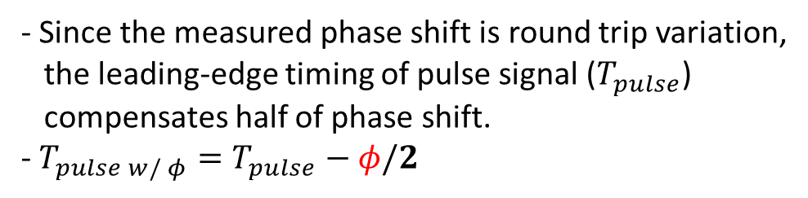

Phase compensation
For leading-edge timing of pulse signal
Main board
Phase
Detector
Sub board
10km duplex optical fiber
$$φ$$
Kicker timing
pulse signal
Pulse
Sampler
Phase
Compensation
Pulse
Generator
Beam trigger pulse signal
w/ phase compensation
- Phase detector
- Pulse sampler
- Measure the phase shift ($φ$)
- 1 ns-resolution TDC
- 8-to-1 OSERDES
- unit interval: 1 ns
- Phase compensation
- Since the measured phase shift is round trip variation,
the leading-edge timing of pulse signal ($T_{pulse}$)
compensates half of phase shift.
- $T_{pulse w/ φ}=T_{pulse}−φ/2$
- Pulse generator
- Achieve the fine compensation
- 8-to-1 OSERDES + ODELAY primitive
- unit interval: 78 ps

Slide 16
1. Timing Distribution Method
2. Phase Compensation Method
3. Implementation

Slide 17
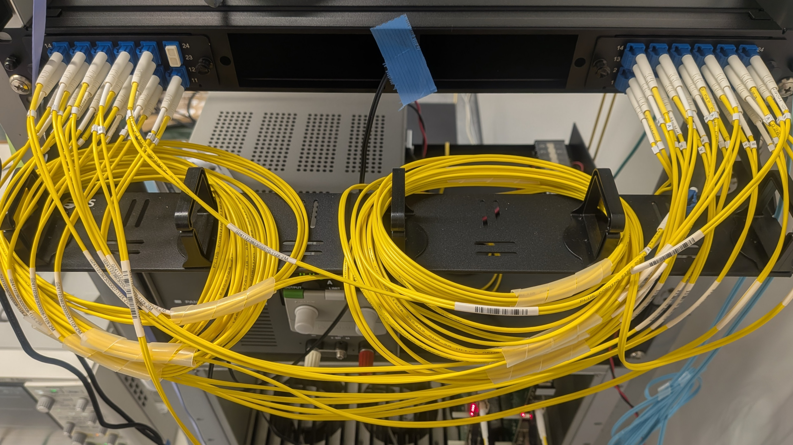
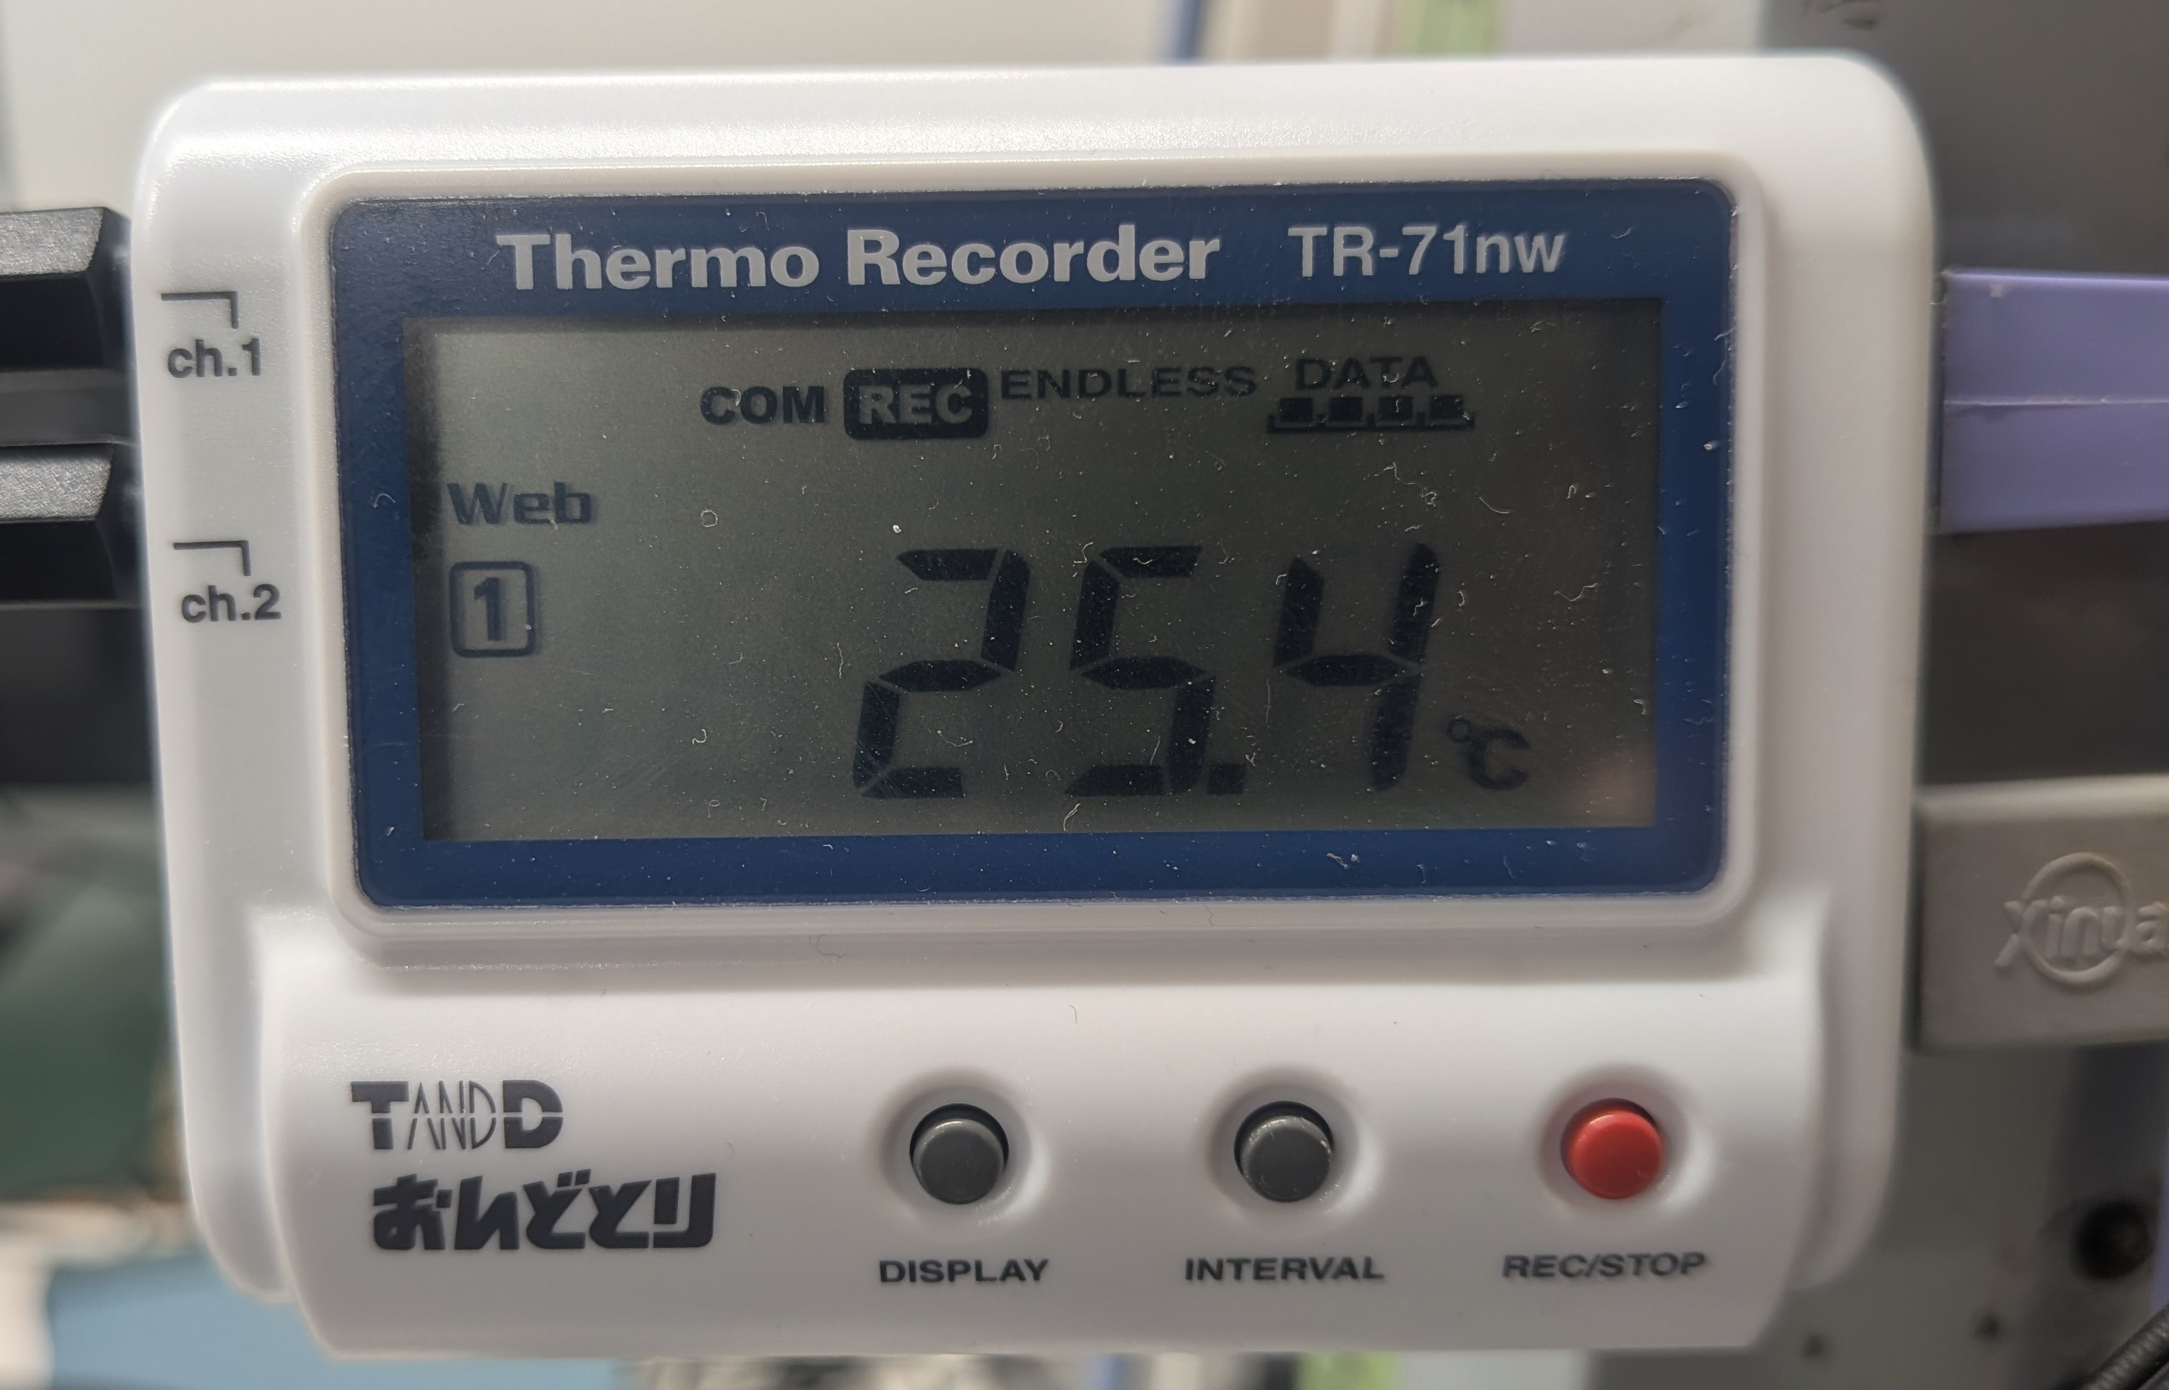
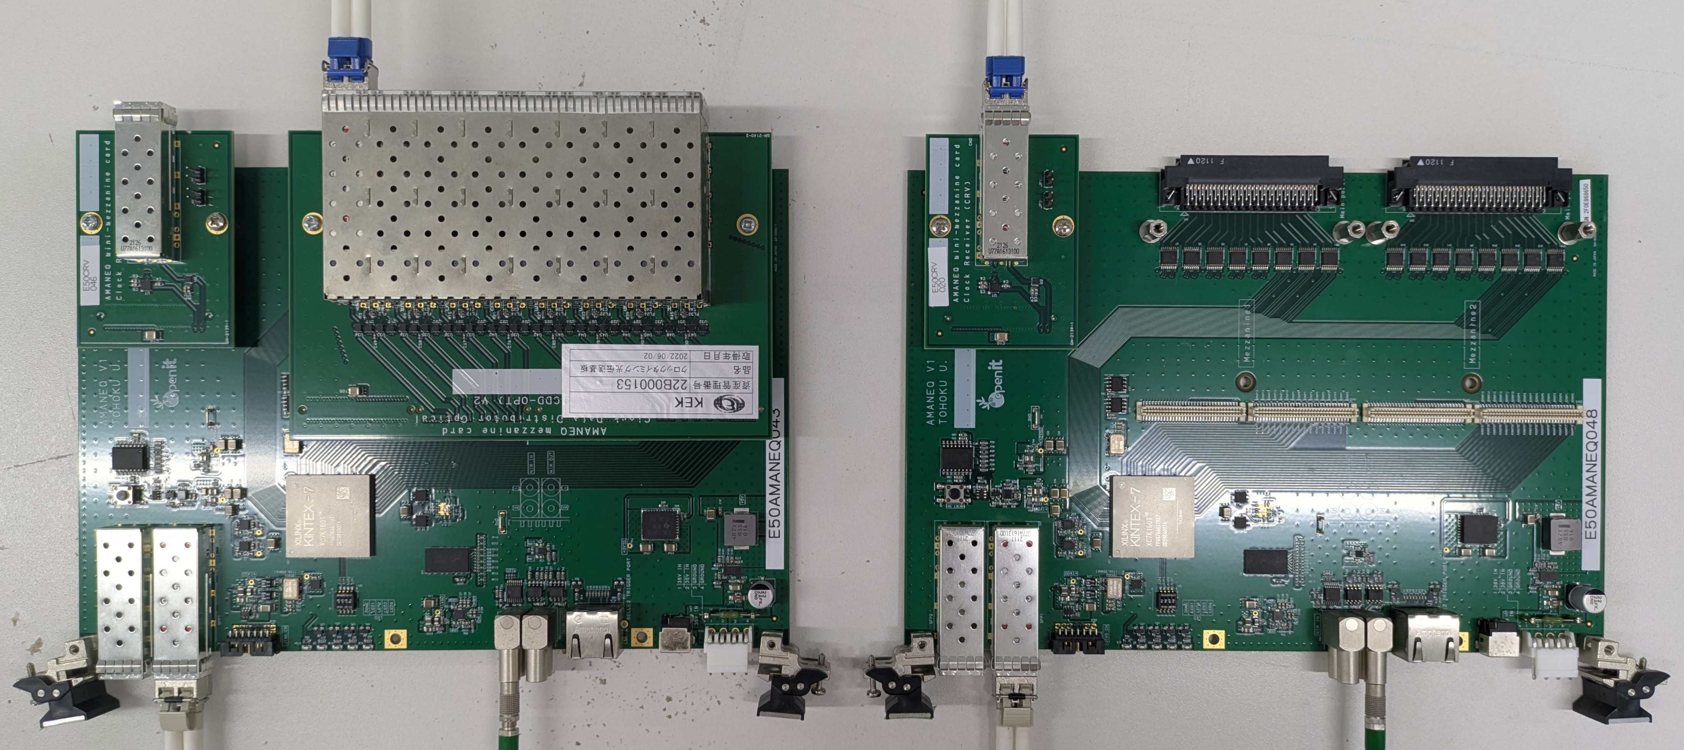
Testbench of Timing Distribution System
Tested by a 10km optical fiber
- AMANEQ: a general main electronics
for trigger-less data acquisition system
- FPGA: Kintex-7, XC7K-160T-2FFG676-2
- PLL: CDCE62002
- NIM_IN: SN65LVDS348PWR
- NIM_OUT: SN65CML100D
- SFP: SFP1G-LX-31 (1G/1310nm/20km)
- Optical fiber: 24F MTP-MTP trunk cable (1310nm/1km)
fiber patch cable (1310nm/2m)
- Fiber Optic Cassette: FHD-1MTP12LCOS2AF
- Oscilloscope: KEYSIGHT DSOS054A (2GHz Upgrade)
- Thermo recorder: TANDD TR-71nw
- Fiber Optic Cassette
- Thermo recorder
- AMANEQs
10 km optical fiber
- The testbench of timing distribution system
is implemented by AMAENQs.
- NIM input of Main board receives the pulse signal.
- NIM output of Sub board generates the pulse signal.
- Pulse information is transmitted by 10 km optical fiber
with MIKUMARI link protocol.
Main board
Sub board
- Main board measures phase shift.
- Thermo recorder records the room temperature.
Kicker timing
pulse signal
Beam trigger
pulse signal
PC
PC
Notes:
There are too many flow charts. Real photos for the test bench could be more in your slide.

Slide 18
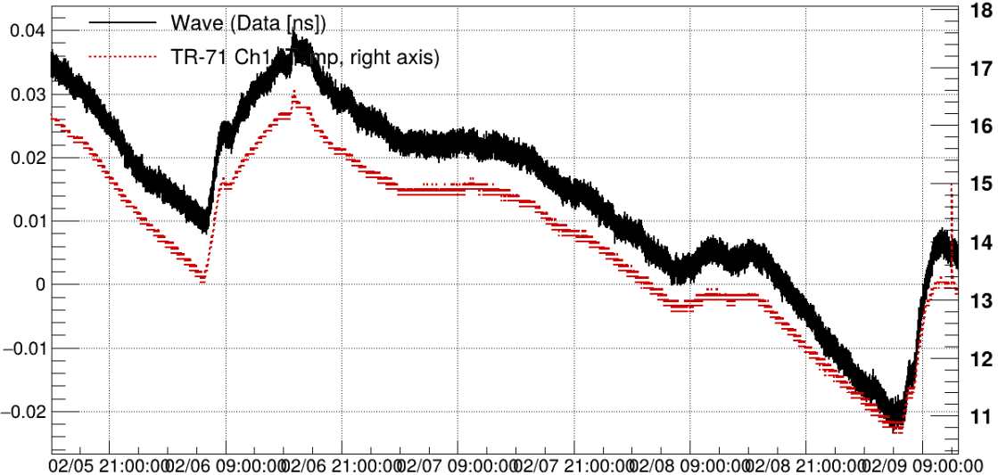
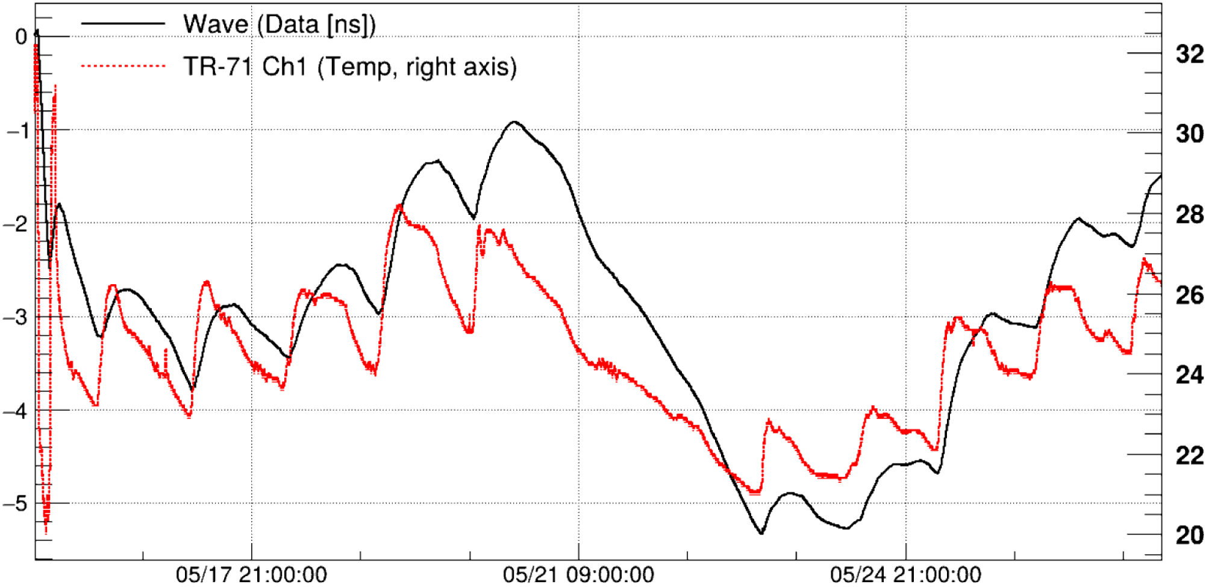
Result of Phase Shift and Room Temperature
Tested by a 10km optical fiber
2m optical fiber (1day)
Phase shift [ns]
Temperature [°C]
- Red : room temperature
- Block : measured phase shift
- The measured phase shift
clearly tracks the room temperature variation.
10km optical fiber (13day)
time
- The phase shift of the 10km optical fiber
are significantly larger than the 2m one.
Phase shift [ns]
Temperature [°C]
time

Slide 19
Measured signals on Oscilloscope
Tested by a 10km optical fiber
Phase
Detector
Main board
Sub board
10km optical fiber
Pulse
Generator
Phase
Compensation
Beam trigger pulse signal
w/ phase compensation
(1)
Kicker timing
pulse signal
Pulse
Sampler
Pulse
Generator
Beam trigger pulse signal
w/o phase compensation
Pulse
Generator
(2)
Reference
pulse signal
(1) Trigger the kicker timing pulse signal
(2) Trigger the reference pulse signal
- Evaluate the pulse signal transmission performance.
- Evaluate the phase compensation performance.
- Suppress sampling-timing uncertainty.

Slide 20
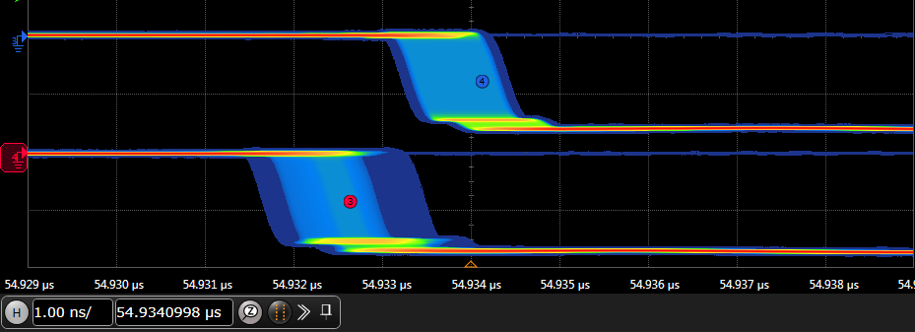
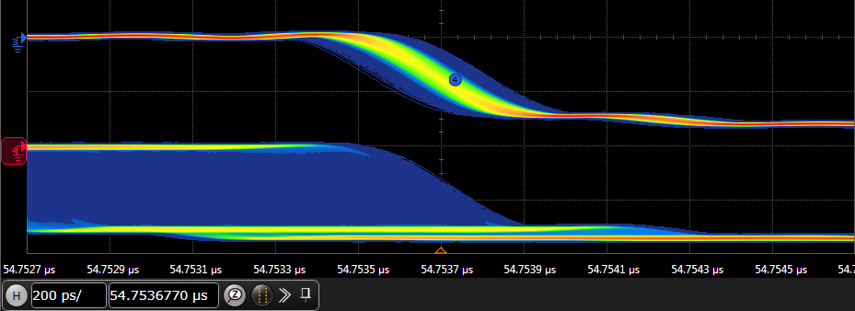
Result of Time Synchronization System
Tested by a 10km optical fiber
1) Transmission latency & Timing accuracy :
2) Phase compensation performance:
Beam trigger pulse signal
w/ phase compensation
Beam trigger pulse signal
w/o phase compensation
unit: 1 ns
unit: 200 ps
- Kicker timing pulse signal as trigger
- Transmission latency: (requirement <1 ms)
- Time interval: 54.934 μs (with extra latency of 5 μs)
- Timing accuracy:
- Range (Max-Min): 1.223 ns
- Reference pulse signal as trigger
- Phase compensation performance :
- Range (Max-Min): 287.754 ps
- Std Dev: 34.996 ps
3) Stability:
- Testing time ≈ 11 days
- Room temperature variation ≈ 12°C
- Clock phase shift ≈ 5 ns
- The MIKUMARI RX on the main board
maintains the sampling point at the center
based on the measured phase shift.
- # of transmitted pulse signal: 9,352,060,226
- No trigger loss was detected.
- Probability of trigger loss: < 3.2x10⁻¹⁰ @95%CL
The testing results
confirmed requirements.

Slide 21
Conclusion
Development of the new pulse signal transmission method
- Motivation: replace the current timing distribution system of T2K experiment at J-PARC site.
- Principle: digitize the analog pulse signal for transmission.
(1) Main board: digitalize the pulse signal.
(2) MIKUMARI link protocol: transmit the leading-edge timing of pulse signal.
(3) Sub board: generate the pulse signal at the corresponding timing.
- Advantage:
(1) Enables flexible transmission of multi-channel pulse signals or additional information
via a duplex optical fiber.
(2) Mitigates the drift of the pulse signal caused by ambient temperature variation.
- Test results using a 10-km optical fiber:
- Timing accuracy : 1.22 ns - Transmission latency: fixed 54.92 μs (with extra latency of 5 μs)
- Probability of trigger loss: < 3.2x10⁻¹⁰ @95%CL
➔ Confirmed requirements.
- Future: implement it for the timing distribution system of Hyper-K experiment.

Slide 22
Backup

Slide 23
MIKUMARI
Ref: D. Calvet, IEEE TNS, vol. 67, no. 8, pp. 1912-1919, Aug. 2020
R. Honda, IEEE TNS, vol. 70, no 6, pp. 1102-1109, June 2023
Clock distribution system based on clock-duty-cycle-modulation (CDCM)
- MIKUMARI link
user data content (variable)
PLL
clock signal
recovered
clock signal
modulated
clock signal
pulse I/F
MIKUMARI
Link TX
clock reference content (fixed)
MIKUMARI
Link RX
pulse I/F
data I/F
optical fiber
data I/F
recovered
clock signal
- MIKUMARI modulated clock signal:
- characteristic
- fixed leading-edge interval carrying clock reference.
- variable duty cycle embedding user data.
- transmitter
- modulated by OSERDES (Serializer) primitive of FPGA.
- receiver
- used as the PLL (Phase-Locked Loop) reference
to recover clock signal.
- decoded by IDELAY and ISERDES (Deserializer) primitive of FPGA.
- MIKUMARI link interface (I/F):
- pulse I/F
- 3-bit data width.
- fixed transmission latency.
- data I/F
- DC-balance data frame (a few 8-bit characters)
- transmission latency with a few uncertainty

Slide 24
Method of Time Synchronization System (2)
Sample and Generate the Kicker Timing
- Pulse Sampler (1ns TDC)
parallel
data pattern
clock
ISERDES
Timing
Encoder
leading-edge timing
pulse signal
- I/O SERDES
Inputput SERial/DESerializer
- Serial/Deserial Convertor
clock (8 ns)
- ISERDES samples the data pattern of pulse signal.
- Timing encoder converts the data pattern to leading-edge timing
pulse signal
0
0
0
0
1
1
1
1
I/O SERDES
- Pulse Generator
clock
parallel data pattern (1 ns)
encode/decode data
leading-edge timing
Timing
Decoder
OSERDES
- Converting ratio: 1-to-8
- Timing resolution: 8 ns→1ns
pulse signal
Output SERial/DESerializer
pulse width
- Only the leading-edge timing is delivered by MIKUMARI link protocol.
- Timing decoder generates the data pattern
by the leading-edge timing and pulse width parameter.
- OSERDES generates the pulse signal.
Notes:
ref: D. Calvet, IEEE TNS, vol. 67, no. 8, pp. 1912-1919, Aug. 2020
ref: R. Honda, IEEE TNS, vol. 70, no 6, pp. 1102-1109, June 2023

Slide 25
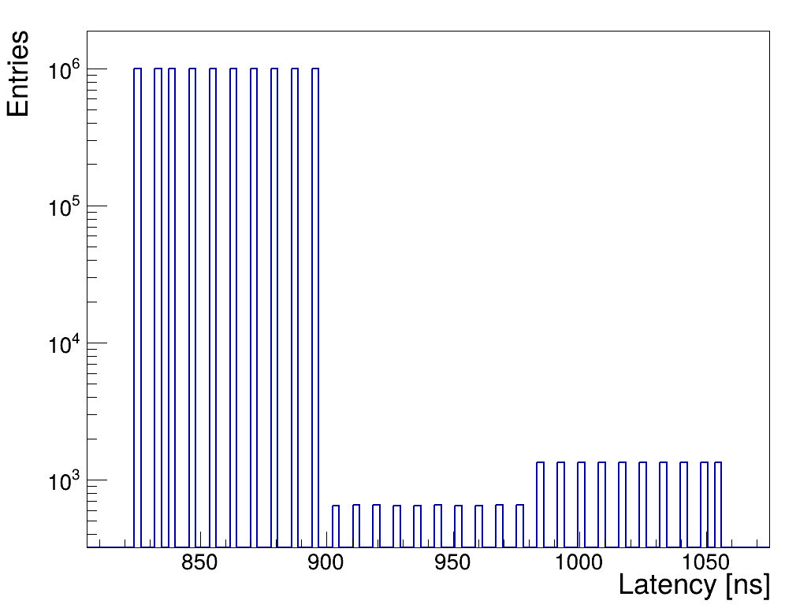
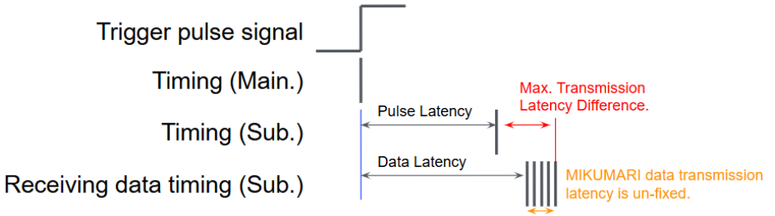
Extra Fixed Latency
To ensure timely pulse generation.
- Transmission latency difference of MIKUMARI I/F
Note:
1) The latency of the data I/F are longer than the pulse I/F,
and has a small uncertainty.
2) The pulse I/F has higher priority than the data I/F.
MIKUMARI data frame phase
Conflict with pulse I/F
- To ensure timely pulse generation,
the added extra fixed latency must be enough long.
- Larger than the maximum of transmission latency difference
between the MIKUMARI data and pulse I/F.
- The maximum of transmission latency difference
is acceptable.
- Extract fixed latency > 1060 ns
Notes:
ref: D. Calvet, IEEE TNS, vol. 67, no. 8, pp. 1912-1919, Aug. 2020
ref: R. Honda, IEEE TNS, vol. 70, no 6, pp. 1102-1109, June 2023

Slide 26
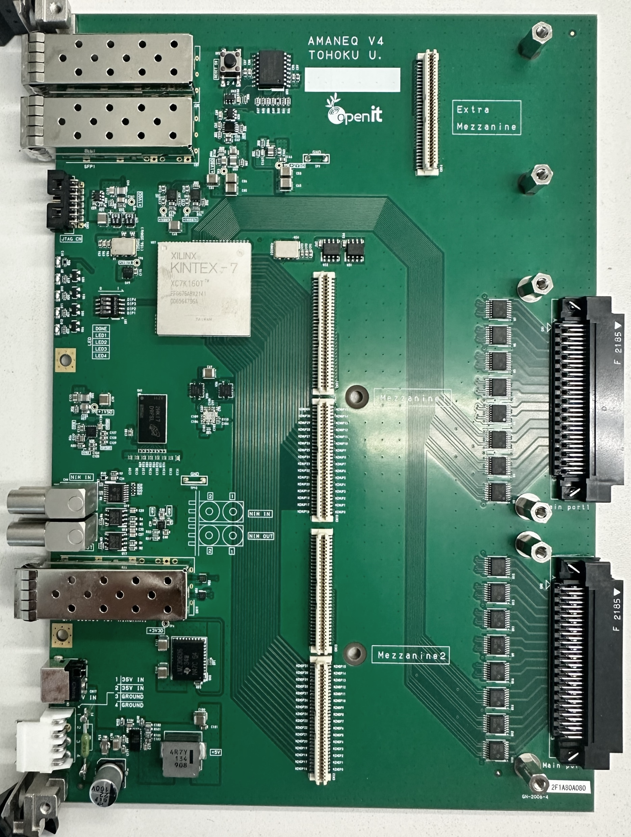

AMANEQ
ref: https://openit.kek.jp/project/StrHRTDC
A Main Electronics for Network Oriented Trigger-less Data Acquisition System
- The AMANEQ is generic electronic board for StrDAQ system.
- By modifying the FPGA firmware and exchanging the mezzanine card,
the AMANEQ can achieve various purposes.
SFP+
(Up to 10G)
Small mezzanine
for I/O extension
Clock Synchronization
FPGA
Small Mezzanine Slot
for IO Extension
XC7K160T
-2FFG
(MIKUMARI)
SFP+
CDCE62002
Jitter Clear
100 MHz
Clock Oscillator
64 (32)
Mezzanine slot
(compatible with HUL)
4 (2)
DDR3-SDRAM
(DDR3-800, 2Gb)
Main Mezzanine Slots
Compatible with HUL
SFP+
64 (32)
FPGA
Data Communication
Up to 10 Gbps
NIM I/O
SFP+
SFP+
(MIKUMARI)
Signal Receiver
Main input
part
(Diff. signals)
32
EEPROM
Power
(DC 35V)
Main Input Ports
LVDS/PECLE/ECL
Differential
to Single-end
EEPROM
Memory
32
2
2
NIM-INs
NIM-OUTs
SDRAM

Slide 27
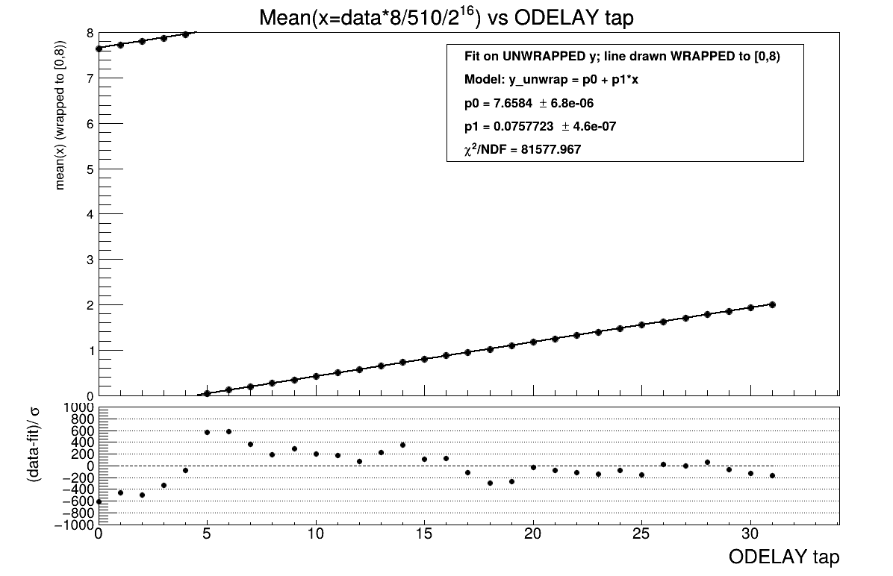
Evaluate DDMTD phase measurement
By ODELAY of MIKUMARI TX on sub board

