Slide 1





Universitat Politècnica de València
An OS-based Software Architecture for reliable front-end data readout in the Hyper-Kamiokande Experiment
  A. Gómez Gambín, F. Ameli, F.J. Mora, J.F. Toledo, F.J. Ballester
  25th IEEE Real Time Conference, Elba, Italy

Slide 2
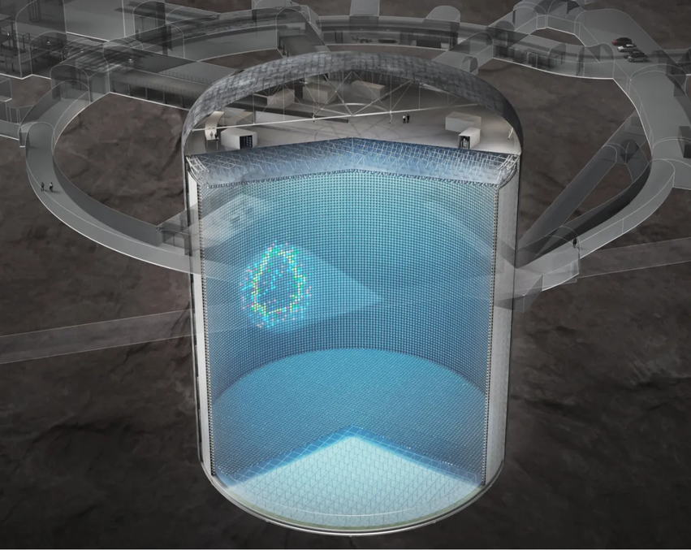

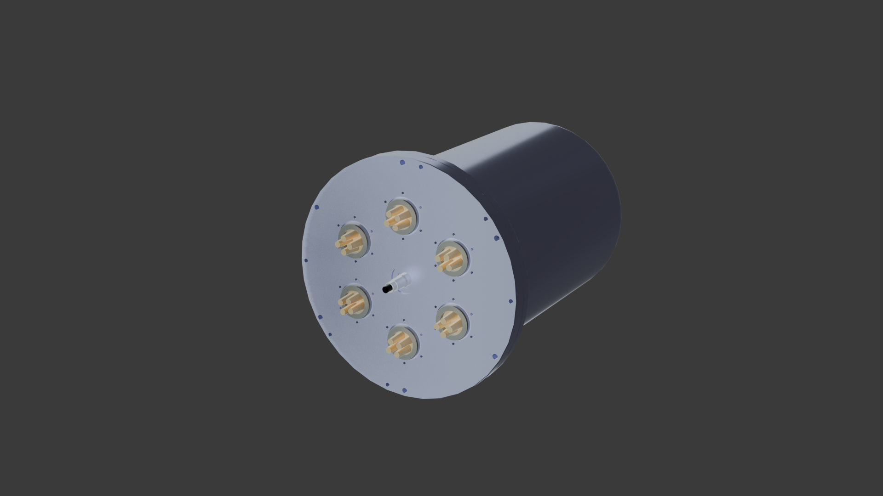
Introduction
  New challenges arise in the design of Hyper-kamiokande with respect to Super-Kamiokande
    4 times as many PMTs in a 69m diameter, 74m height detector
    Larger detector implies longer wires, twice as long
    Hammamatsu R12860, more sensitive PMTs
  Design choice: front-end electronics must be as close as possible to the PMTs
  Consequence: malfunctioning modules neither replaceable nor reparable without a significant effort!
    Design with reliability and durability as main focus
    Ability to manage and configure remotely the electronics
    Aggregate data and send it reliably through high speed-links to the dome
  Solution proposed: In-vessel Software-FPGA mixed approach
Notes:
This presentation is done as part of the efforts in Hyper-Kamiokande collaboration to build the successor to Super-Kaiokande. It focuses on one of the electronic boards of the front-end: the DPB. The reason of this board to exist is due to several challenges found due to…

Slide 3
FIRST, A CLOSER LOOK INTO A VESSEL…
Notes:
To understand the software, first we need to know what kind of CPUs we have in the front-end electronics, so let’s take a closer look into a vessel…

Slide 4
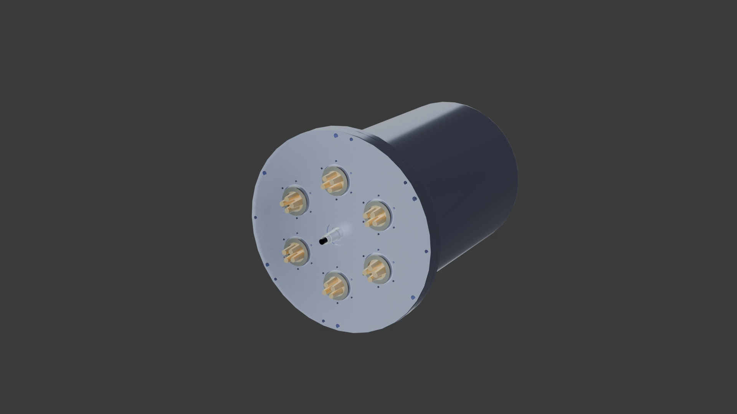

Slide 5
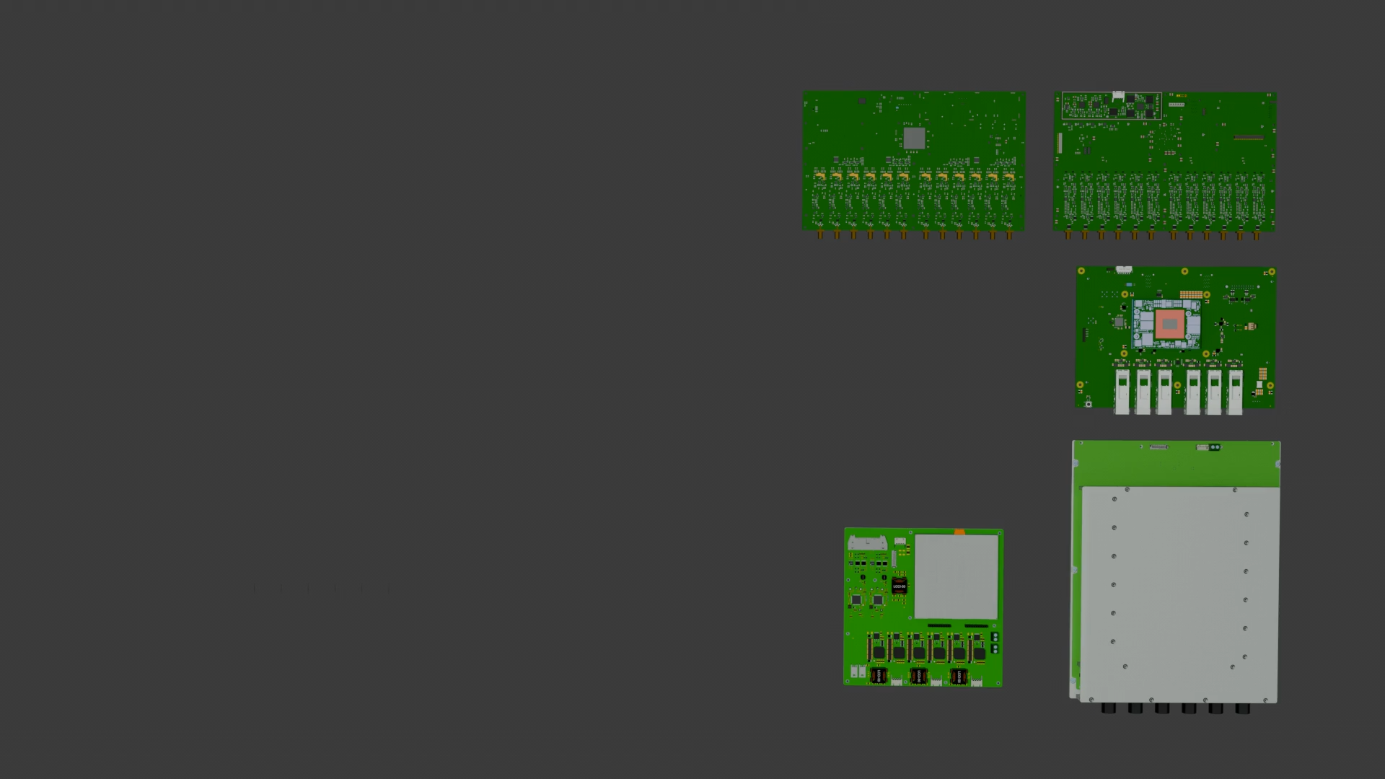

Slide 6
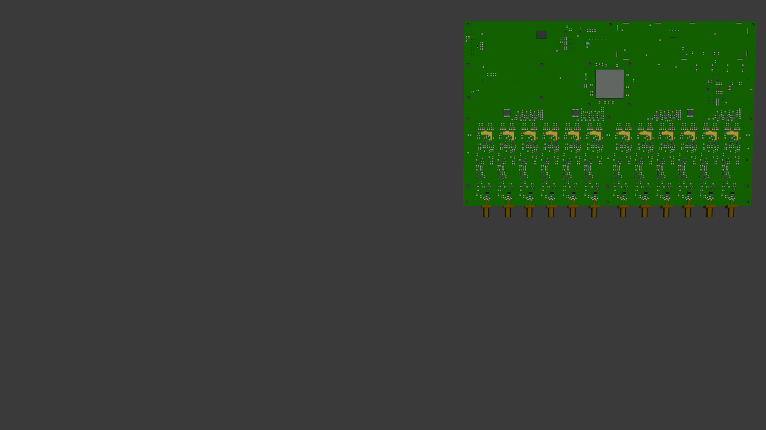
ID DIGITIZER
  Direct interface with the PMTs
    Converts charge signal into voltage signal
    Analog to digital conversion
  Kintex-7 FPGA:
    Microblaze Soft Core running slow control tasks on single thread task
    Command system to configure data taking parameters
  36-pin MiniSAS SF-8643 interface with the DPB
    Aurora 64B/66B FPGA Core @ 3.125Gbps
    JTAG programming of the Kintex-7 from the DPB
    UART Lite FPGA core: serial link for slow control commands
    Timing and synchronization differential data and clock pairs
  Digitizer for outer detector and calibrator as additional daughter boards

Slide 7
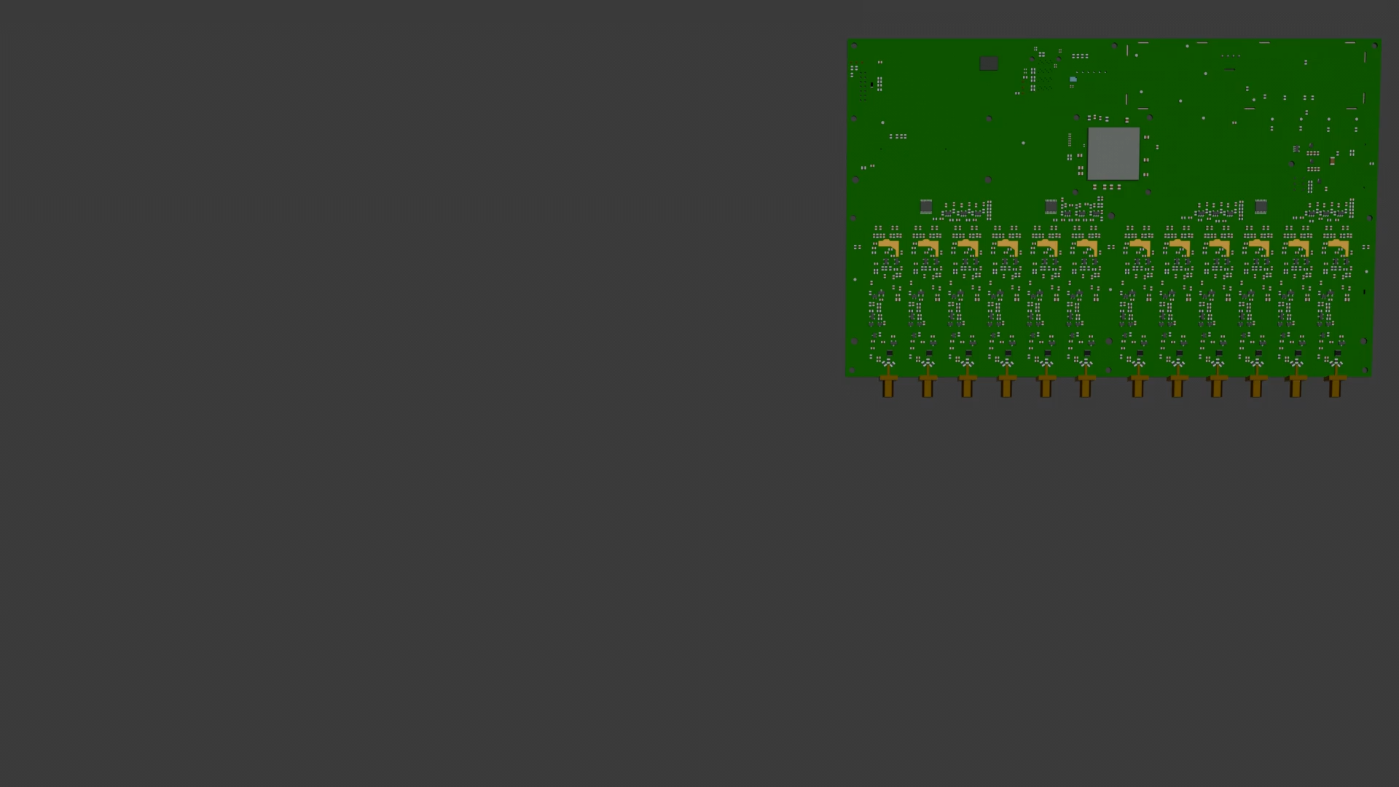

Slide 8
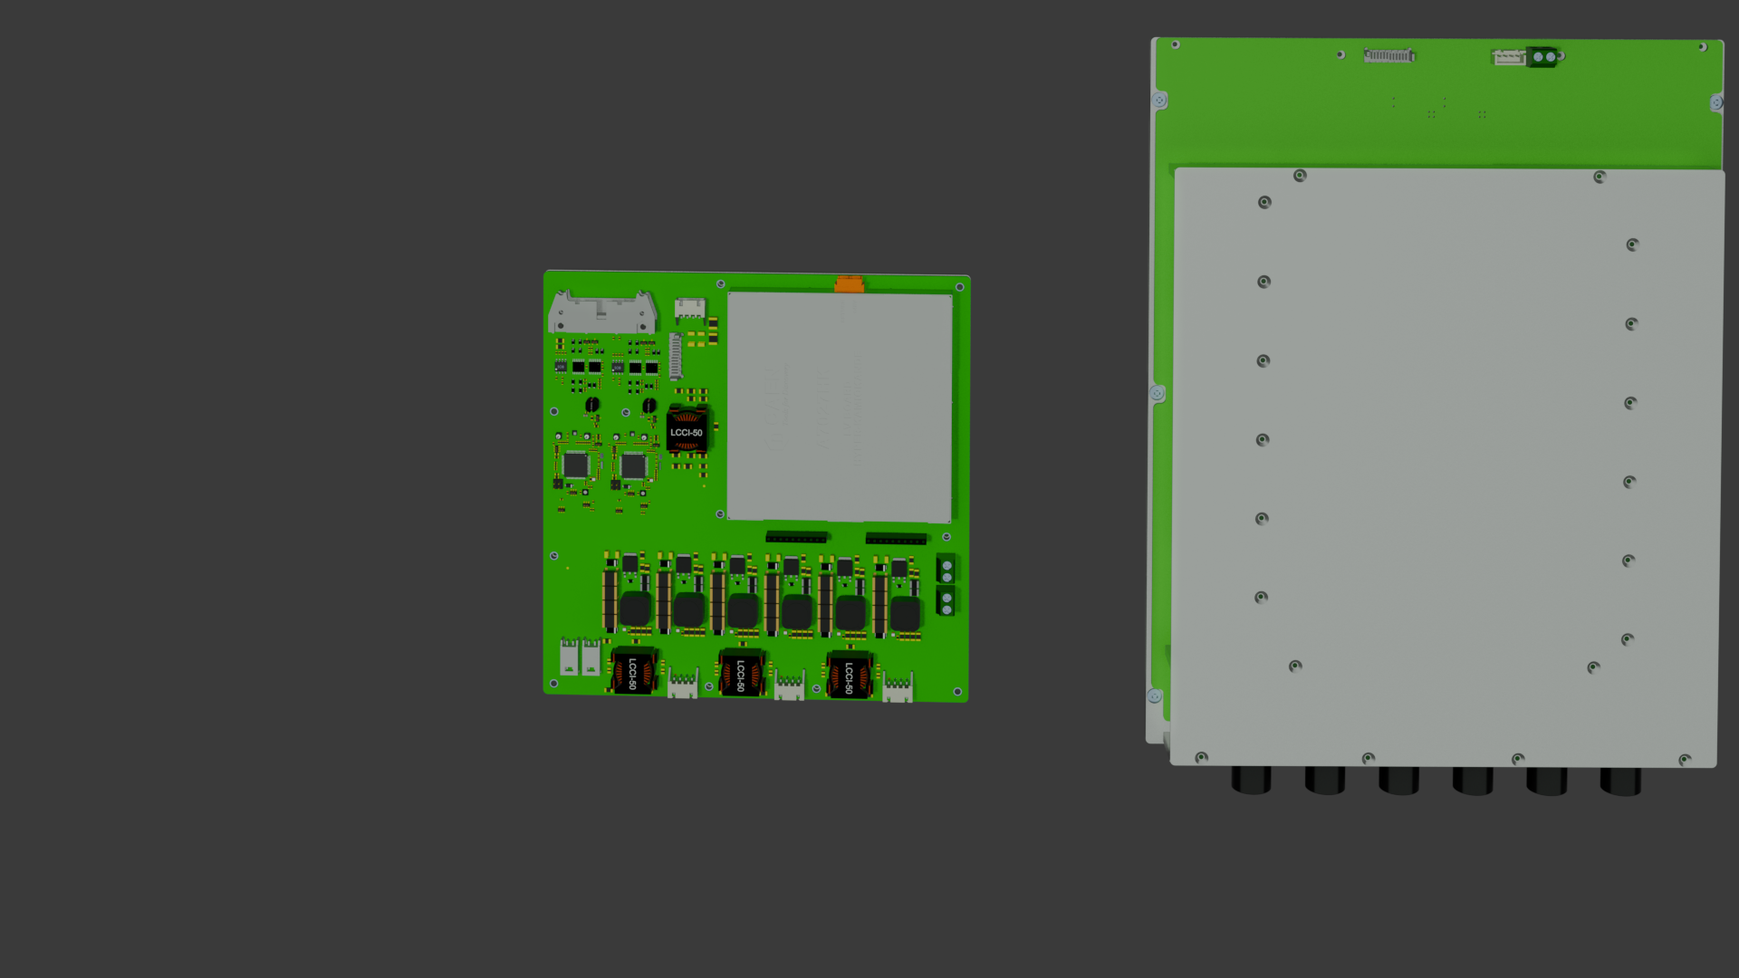

HIGH VOLTAGE AND LOW VOLTAGE BOARDS
RS485
bus
  Power supplies of the vessel elements
    HV: 2.5kV for the PMTs
    LV: 48V to 12V for DPB, Digitizers and HV
  MSP430 Texas Instruments microcontroller
    2 per board (main, redundant)
    Command system to control HV and LV
  Main and redundant RS485 shared buses
  Direct connection to RS485 drivers on the DPB
DPB

Slide 9
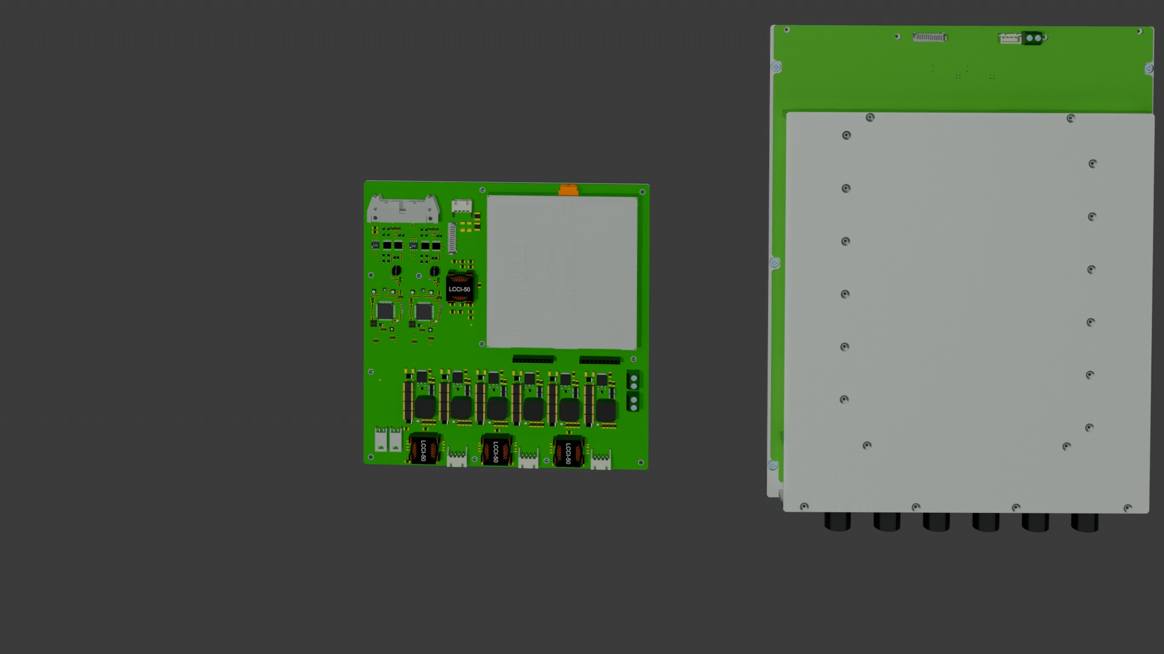

Slide 10

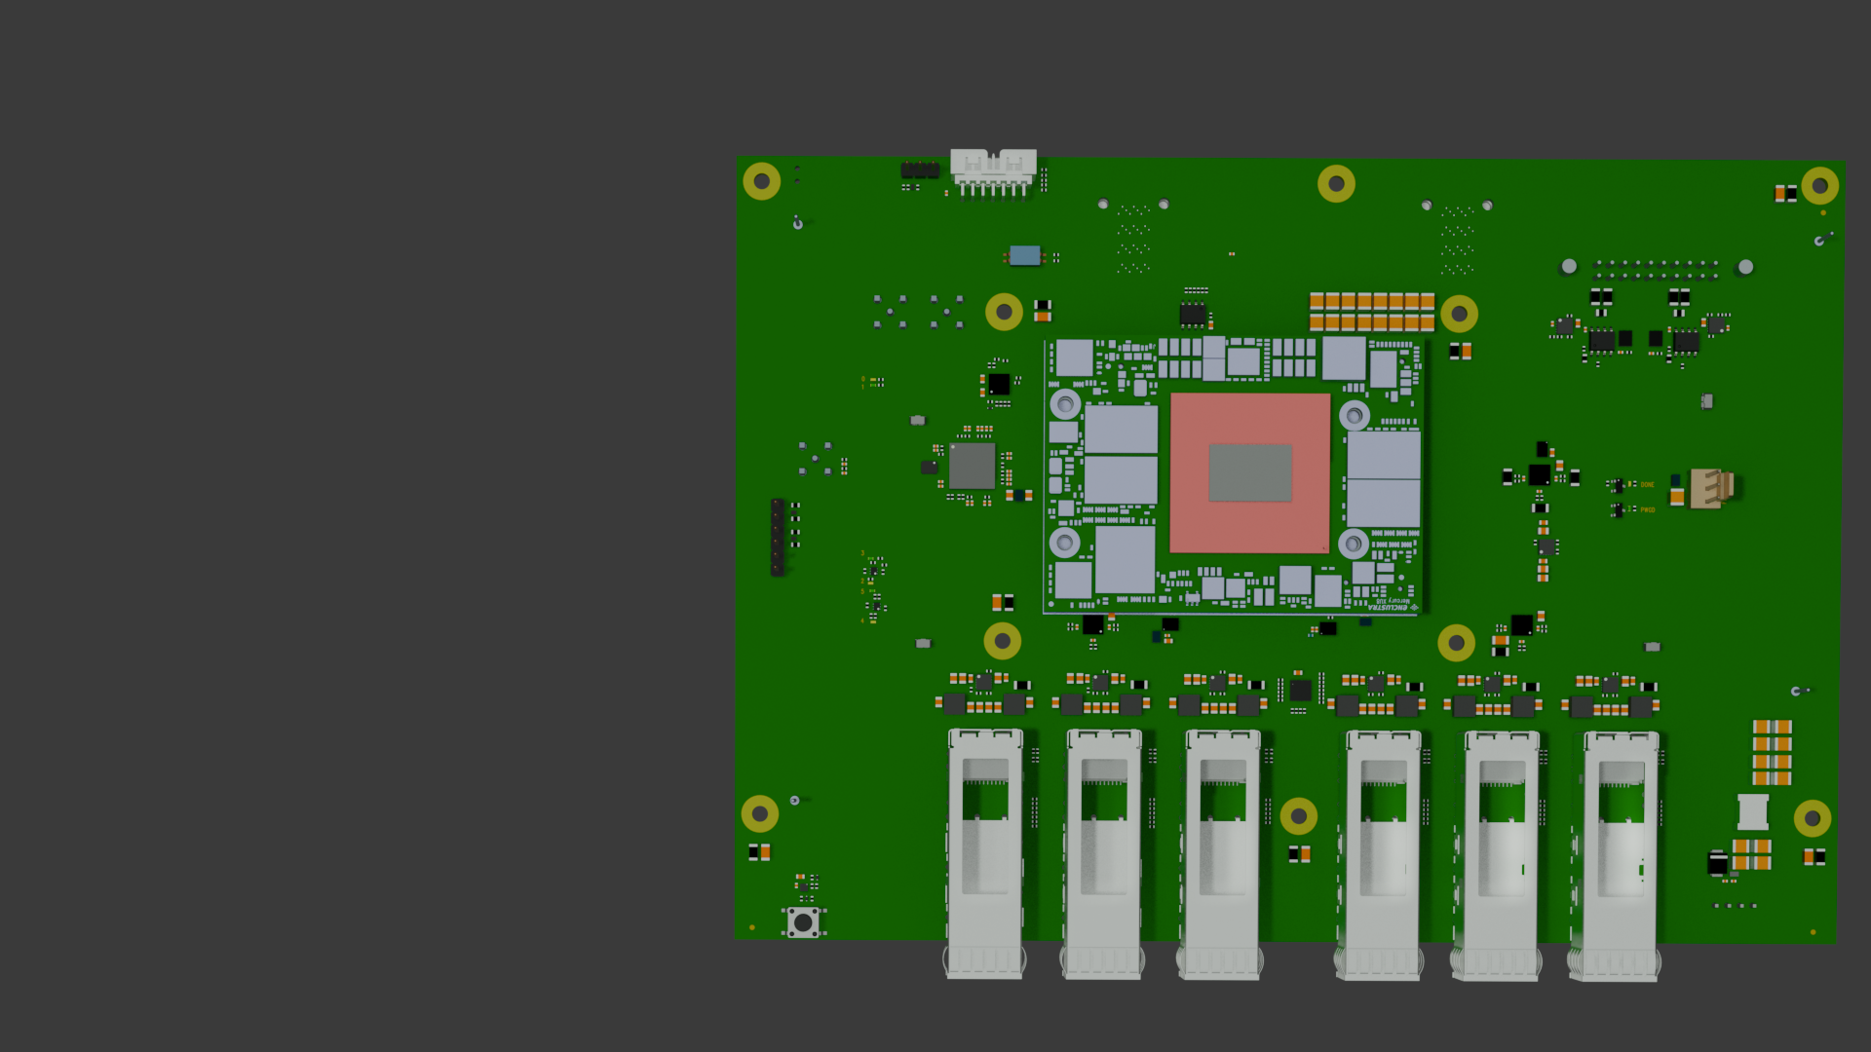

DATA PROCESSING BOARD
DIG0
DIG1
  Hub of sensor and PMT data from the front-end electronics in the vessel
    Carrier + SOM Architecture
    Zynq Ultrascale+ MPSoC
  High I/O capabilities
    2x 36-pin MiniSAS SF-8643
    6x SFP modules
    1x D3428-5202 (HV/LV conn)
    JTAG and UART (debugging)
  Reliability through redundancy
    2x PS-routed SFPs
    4x PL-routed SFPs
    HV/LV redundant RS485 drivers
    Data and Timing links redundancy in MiniSAS links
HV LV
Notes:
And finally, the DPB, the

Slide 11
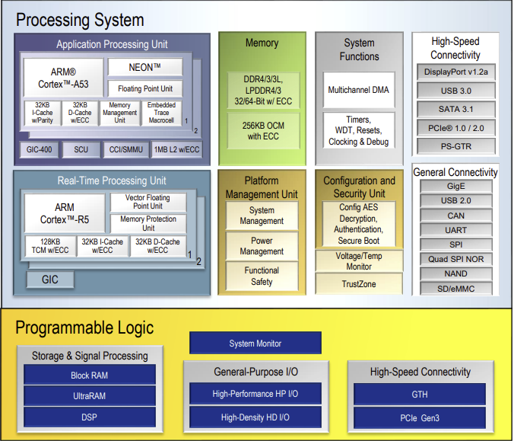
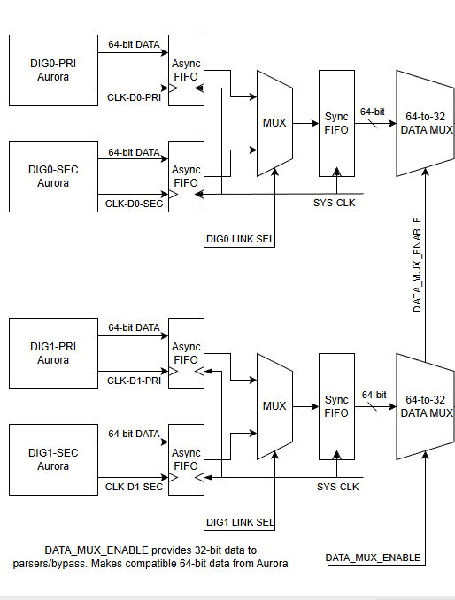
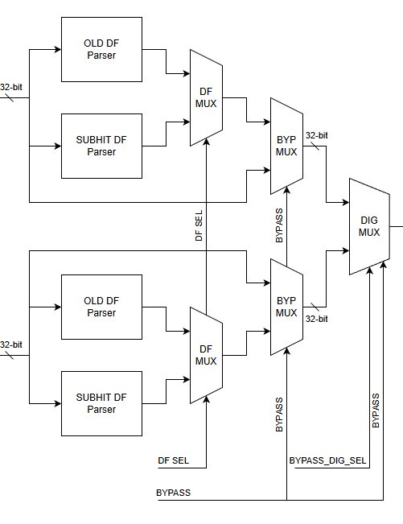
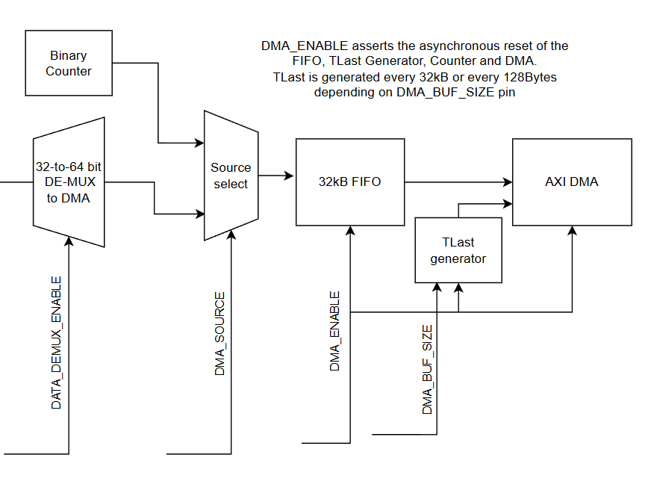
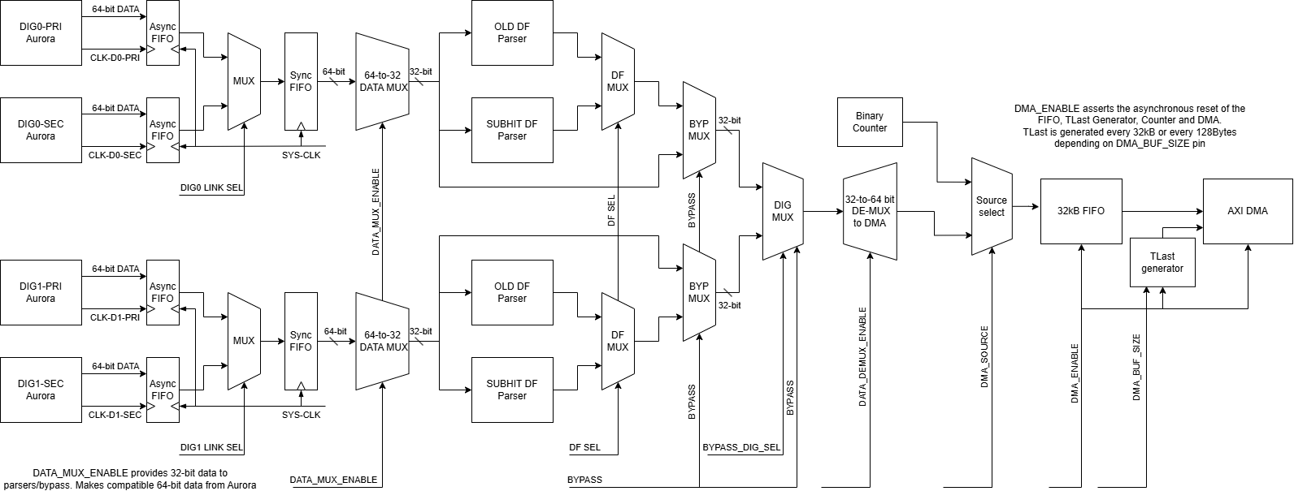
Hybrid CPU- FPGA architecture
  Zynq Ultrascale+ MPSoC (XZU4CG)
  Flexible FPGA combined with general purpose CPU
  Processing System:
    CPU Core Cluster (2x ARM A53 + 2x ARM R5)
    DDR4 Memory controller for data buffering
    Gigabit Ethernet MAC
    Multistage bootup from many sources
  Programmable Logic, for custom protocols and extended peripherals:
    Direct data readout from MiniSAS links
    Additional serial links for slow control tasks
    Software upgradeability for HV, LV and Digitizers
Copyright 2016-2022 Xilinx
Copyright 2022-2026 AMD

Slide 12
Programmable Logic Data Path:
Notes:
I Will begin explaining what is in the PL part of the DPB

Slide 13
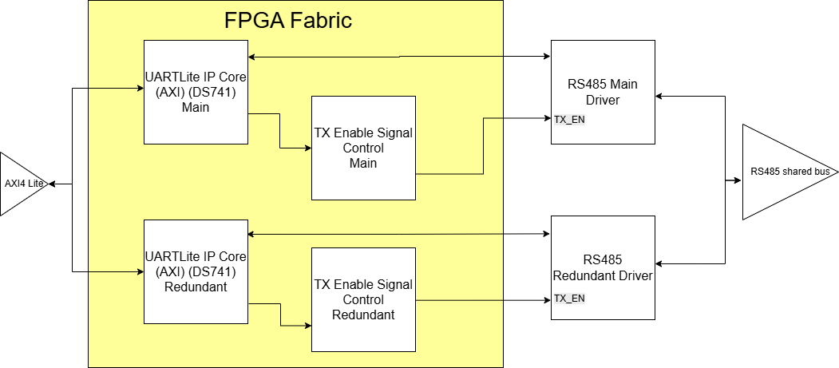
Programmable Logic HV-LV Path:
Controlling the RS485 drivers

Slide 14
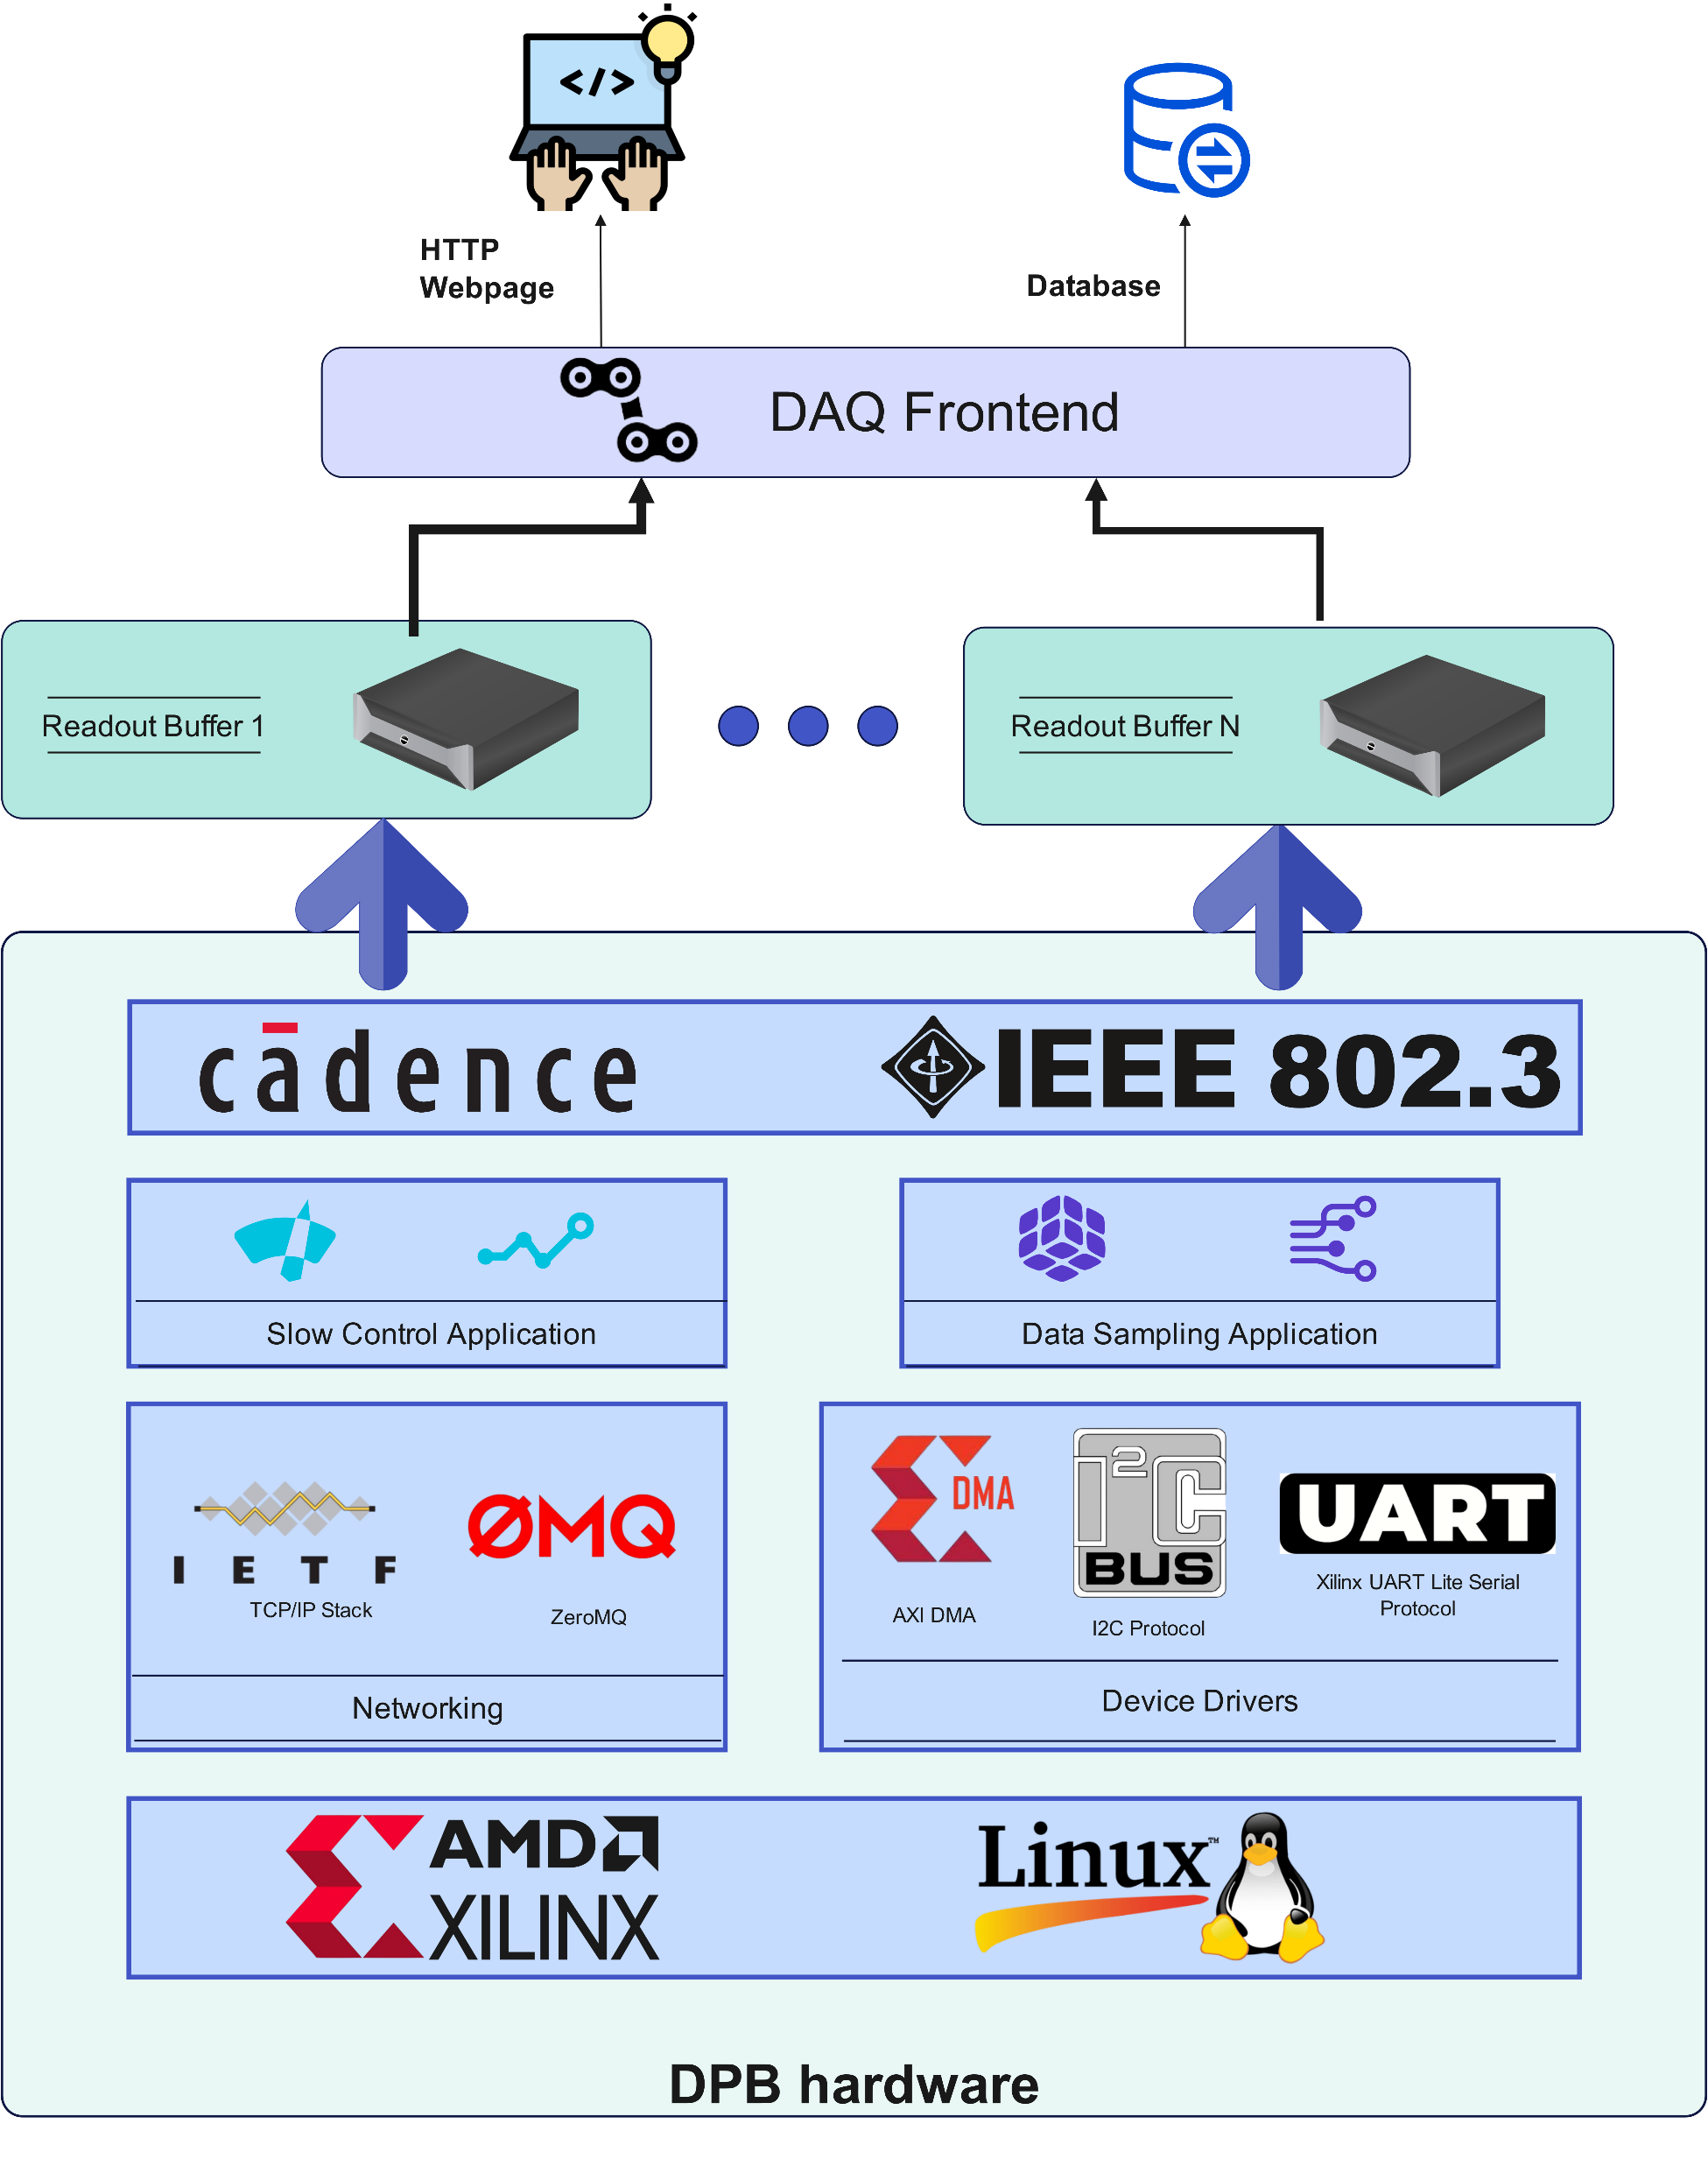
What about software ?
Copyright 2016-2022 Xilinx
Copyright 2022-2026 AMD

Slide 15


CPU OS-based software stack
  Embedded Linux OS
    Petalinux Kernel Image
    Customised Root File System
    Mounted as RamDisk, reliability advantages
  Device drivers
    Si5345 PLL kernel drivers, bootup configuration
    Xilinx AMS Driver
    QSPI Flash Protection patch
    DMA Kernel and Userspace drivers
  Ethernet stack
    ZeroMQ: high reliability message-based TCP/IP network library
    Bonding driver: virtual interface aggregating physical interfaces

Slide 16
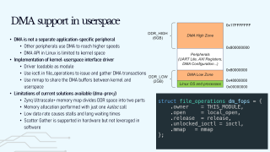
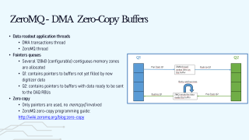
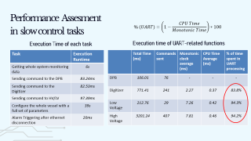
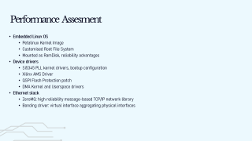

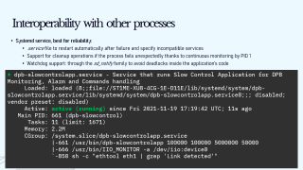
Reliability-oriented software

Slide 17
Interoperability with other processes
  Systemd service, best for reliability:
    .service file to restart automatically after failure and specify incompatible services
    Support for cleanup operations if the process fails unexpectedly thanks to continuous monitoring by PID 1
    Watchdog support: through the sd_notify family to avoid deadlocks inside the application’s code
* dpb-slowcontrolapp.service - Service that runs Slow Control Application for DPB Monitoring, Alarm and Commands handling
Loaded: loaded (8;;file://ST1ME-XU8-4CG-1E-D11E/lib/systemd/system/dpb-slowcontrolapp.service/lib/systemd/system/dpb-slowcontrolapp.service8;;; disabled; vendor preset: disabled)
Active: active (running) since Fri 2021-11-19 17:19:42 UTC; 11s ago
Main PID: 661 (dpb-slowcontrol)
Tasks: 11 (limit: 1671)
Memory: 2.2M
CGroup: /system.slice/dpb-slowcontrolapp.service
|-661 /usr/bin/dpb-slowcontrolapp 100000 100000 5000000 50000
|-666 /usr/bin/IIO_MONITOR -a /dev/iio:device0
`-850 sh -c "ethtool eth1 | grep 'Link detected'"

Slide 18
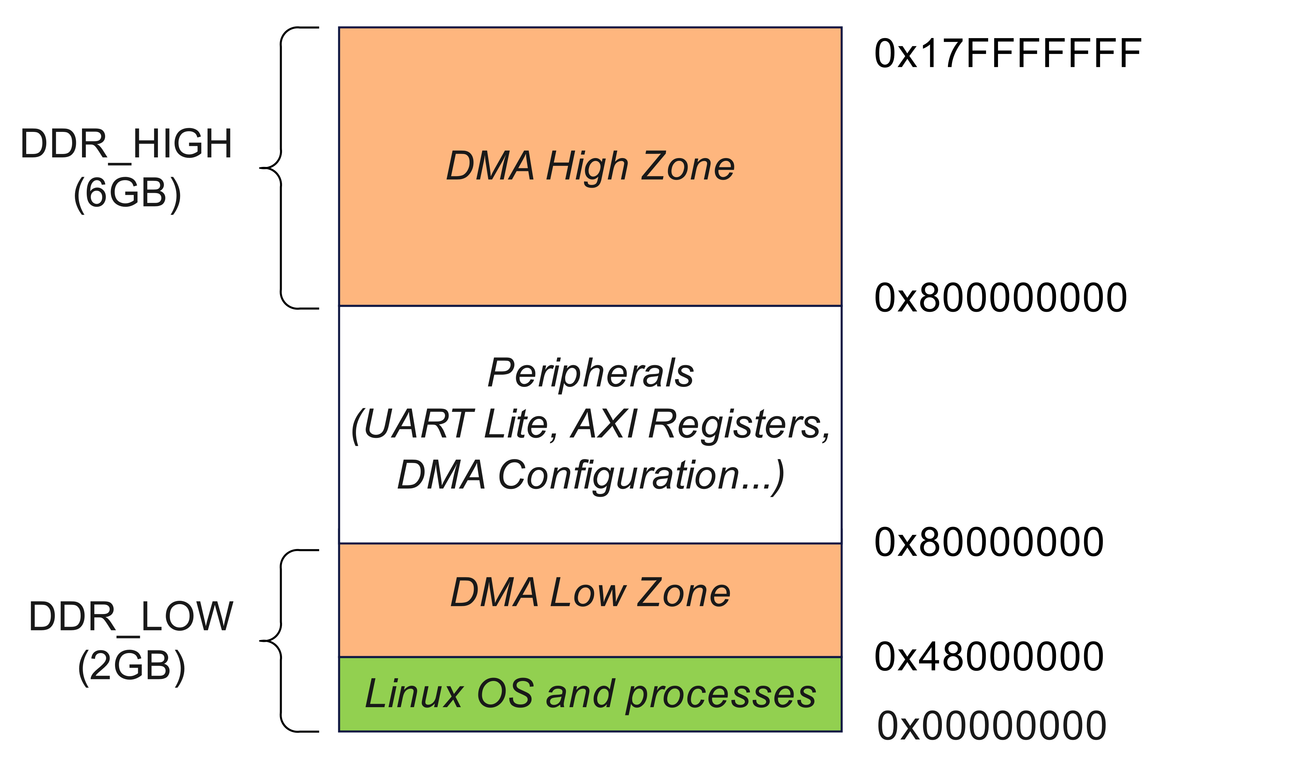
DMA support in userspace
  DMA is not a separate application-specific peripheral
    Other peripherals use DMA to reach higher speeds
    DMA API in Linux is limited to kernel space
  Implementation of kernel-userspace interface driver
    Driver loadable as module
    Use ioctl in file_operations to issue and gather DMA transactions
    Use mmap to share the DMA buffers between kernel and userspace
  Limitations of current solutions available (dma-proxy), solved:
    Zynq Ultrascale+ memory map divides DDR space into two parts
    Memory allocation performed with just one kalloc call
    Low data rate causes stalls and long waiting times
    Scatter Gather is supported in hardware but not leveraged in software
struct file_operations dm_fops = {
.owner = THIS_MODULE,
.open = local_open,
.release = release,
.unlocked_ioctl = ioctl,
.mmap = mmap
};

Slide 19
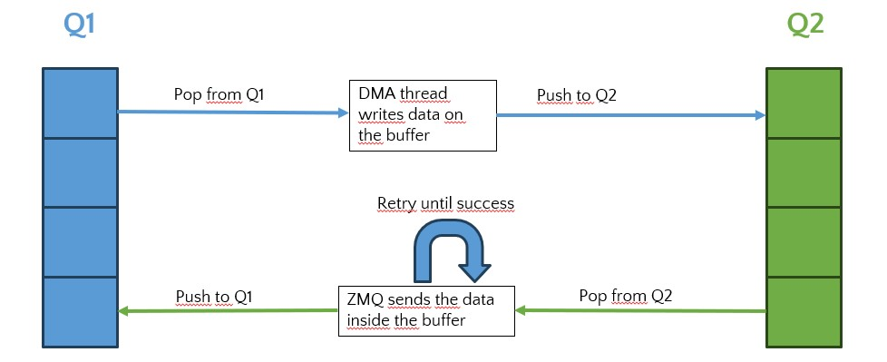
ZeroMQ - DMA Zero-Copy Buffers
  Data readout application threads
    DMA transactions thread
    ZeroMQ thread
  Pointers queues
    Several 128kB (configurable) contiguous memory zones are allocated
    Q1: contains pointers to buffers not yet filled by new digitizer data
    Q2: contains pointers to buffers with data ready to be sent to the DAQ RBUs
  Zero copy
    Only pointers are used, no memcpy() involved
    ZeroMQ zero-copy programming guide:
    http://wiki.zeromq.org/blog:zero-copy

Slide 20

Performance Assesment
in slow control tasks
$$\% (UART)=\left(1−\frac{CPU Time}{Monotonic Time}\right)∗100$$
Execution Time of each task
Execution time of UART-related functions
Task | Execution Runtime
Getting whole system monitoring data | 6s
Sending command to the DPB | 83.24ms
Sending command to the Digitizer | 82.53ms
Sending command to HV/LV | 97.39ms
Configure the whole vessel with a full set of parameters | 39s
Alarm Triggering after ethernet disconnection | 20ms
 | Total Time (ms) | Commands sent | Monotonic clock average (ms) | CPU Time Average (ms) | % of time spent in UART processing
DPB | 106.01 | 76 | - | - | -
Digitizer | 771.41 | 241 | 2.27 | 0.37 | 83.8%
Low Voltage | 212.76 | 29 | 7.26 | 0.42 | 94.3%
High Voltage | 3201.24 | 407 | 7.81 | 0.46 | 94.2%

Slide 21
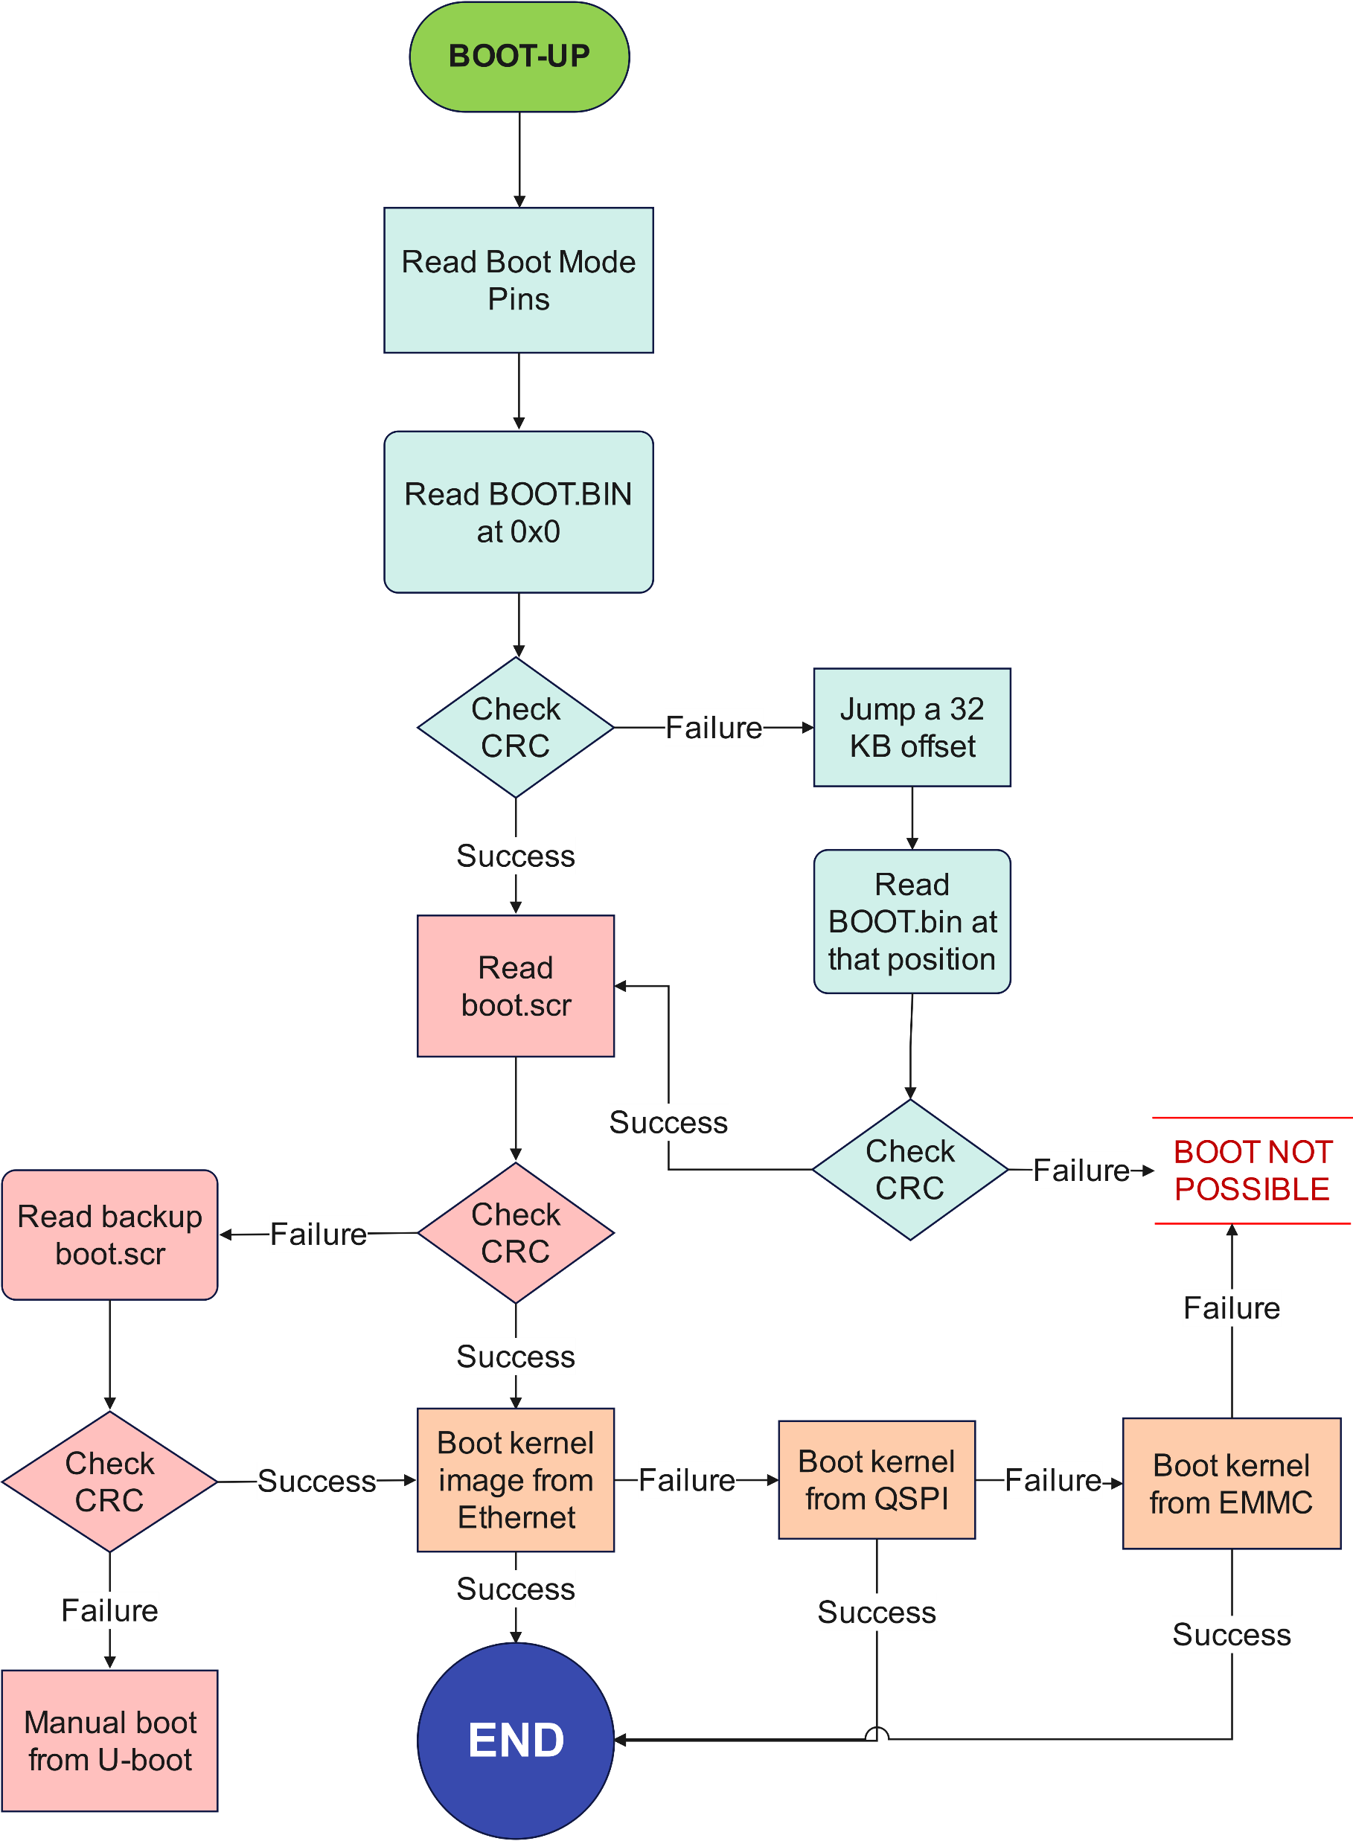
Reliable Bootup Procedure
  Multistage bootup
    Stage 1: Boot.BIN loading (FSBL, PMU, Bitstream)
    Stage 2: boot.scr execution (U-boot script)
    Stage 3: kernel and rootfs lookout
  Redundant sources to perform stage 2 and stage 3
    Boot script is copied 8 times into the QSPI
    Kernel bootup can be performed from Ethernet, QSPI and eMMC
    Bitstream load can be hot-loaded from ethernet
  Ethernet bootup logging
    U-boot normally outputs to stdout (UART serial port)
    Netconsole can be configured to output through ethernet link a logging console
    In Hyper-Kamiokande, UART is not connected to DAQ.

Slide 22
Conclusions
Reliable software stack
Custom Rootfs mounted in RAM Disk
Full control over ethernet link
Upgradeability
Update from DAQ for all electronics boards
Protected QSPI zone in case of failed update
Failover mechanisms
Automatic network interface switching
Bootup procedure from redundant sources

Slide 23
Reliable Bootup Procedure: U-boot settings
  Boot script structure
    Iterative loop to test all boot sources
    Try to copy to DDR kernel image and rootfs
    Use boot or bootm depending on the source file
  Relevant U-boot environment variables
    bootpretryperiod:
    netretry
    autoload
  Ethernet bootup
    Get IP address from DHCP server
    Download bitstream from TFTP server
    Get PXE configuration
    Boot OS using PXE configuration
if test "${boot_target}" = "pxe" ; then
setenv fdt_addr_r 0x00100000
setenv autoload no
setenv bootpretryperiod 2000
setenv netretry once
dhcp
setenv netretry no
if test "${dpb_carrier_ver}" = "4"; then
tftpboot system.bit
fpga load 0 ${loadaddr} ${filesize}
fi
if pxe get ; then
pxe boot
fi
fi

Slide 24
Programmable Logic Data Path:

Slide 26
Programmable Logic Data Path:

Slide 28
Programmable Logic Data Path:

