Slide 1
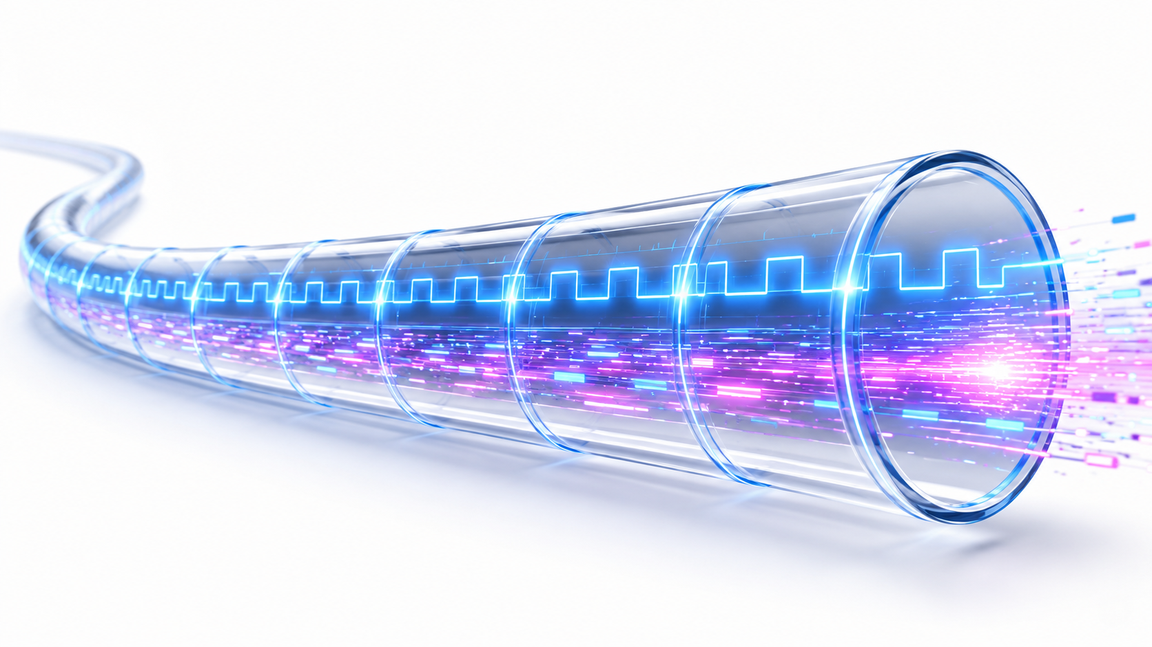


TD-link: A Deterministic Optical Daisy-Chain Link for Synchronous Data Acquisition in Large-Scale Detector Systems
A. Abba
G. Becuzzi
M. Bianchini
F. Caponio
S. Carsi
A. Cusimano
C. Maggio
A. Mati
D. Ninci
A. Picchi
C. Tintori
Notes:
Good morning, everyone. My name is Andrea, and today I'll be presenting TD-Link — a deterministic optical daisy-chain interconnect developed for large-scale particle physics detector systems. This work addresses a fundamental challenge in modern high-energy physics instrumentation: how do you synchronise thousands of front-end detector channels across a large experiment to within a few tens of picoseconds, reliably, and at a cost that makes large-scale deployment practical?

Slide 2
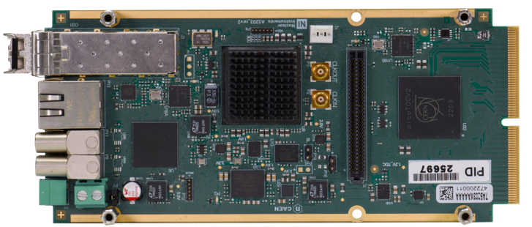
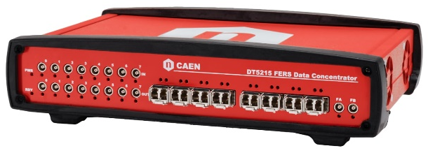
FERS: detector readout chains for every (photon) need
TDLink
3.125 Gb/s
TDLink
3.125 Gb/s
Detector array - Multichannel
64-channel
Frontend unit 1
CONCENTRATOR
Sync & Readout
DAQ Interface
Daisy-chain sync
64-channel
Frontend unit N-3
Detector array - Multichannel
optical fibers
Node 1
Node 5
Daisy chain → Up to 16 boards/node
Up to 128 total boards
Up to 8k channels
64-channel
Frontend unit 2
64-channel
Frontend unit N-2
Node 2
Node 6
1 board/node to maximize readout bandwidth
64-channel
Frontend unit 3
64-channel
Frontend unit N-1
Node 3
Node 7
64-channel
Frontend unit 4
64-channel
Frontend unit N
Node 4
Node 8
. . .
10/100MbE – USB 2.0
1/10GbE – USB 3.0
DAQ PC
Janus Software
Notes:
To set the scene, let me briefly introduce the FERS-5200 front-end readout system — this is the hardware platform that TD-Link was designed to serve. FERS stands for Front-End Readout System. It is a family of compact, low-cost acquisition boards intended for large detector arrays: silicon photomultipliers, scintillators, wire chambers, and similar detectors. The key design goals for FERS are high channel density, low power, and the ability to scale to thousands of boards in a single acquisition system. Each FERS unit provides timing, charge, and hit data with nanosecond-level timestamps. The challenge is that when you deploy hundreds or thousands of these boards, you need all of them to share a common time reference — and to share it with an accuracy that does not degrade as the system grows. That is exactly the problem TD-Link is designed to solve.

Slide 3
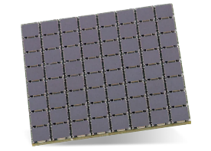
FERS: detector readout chains for every (photon) need
Direct Connection: easy but slow (~2 MB/s)
ETH 10/100T
USB 2.0
DETECTOR SPECIFIC
COMMON INFRASTRUCTURE
FE ASIC:
PREAMP
SHAPER
DISCRIM
ADC
ACQ
LOGIC
READOUT
INTERF
1/10 GbE
USB 3.0
(~80/800 MB/s)
TRIGGERS
MEM
TDC
DT5215
Concentrator
3.125 Gb/s
CONFIG
TDlink
SYNC
Ext. SYNC
HV BIAS
(if applicable)
A520x
Notes:
Here you can see the broader FERS ecosystem. FERS boards connect to concentrator units, which aggregate data from multiple front-ends and interface to the DAQ back-end. The system is modular: you start with a handful of boards for a small experiment, and you scale up to a very large installation simply by adding more concentrators and more FERS units. What I want to draw your attention to is the connectivity problem. Each concentrator manages multiple FERS boards. But in a real detector, the boards may be distributed over tens of metres, mounted inside detector volumes where you cannot easily run differential copper links. Optical fibre is attractive — it is immune to electromagnetic interference, it can run over long distances without signal degradation, and it is lightweight. TD-Link is the optical link technology we developed to connect these boards together in a way that preserves timing accuracy end-to-end.

Slide 4
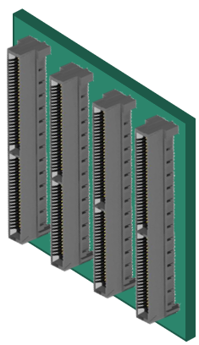


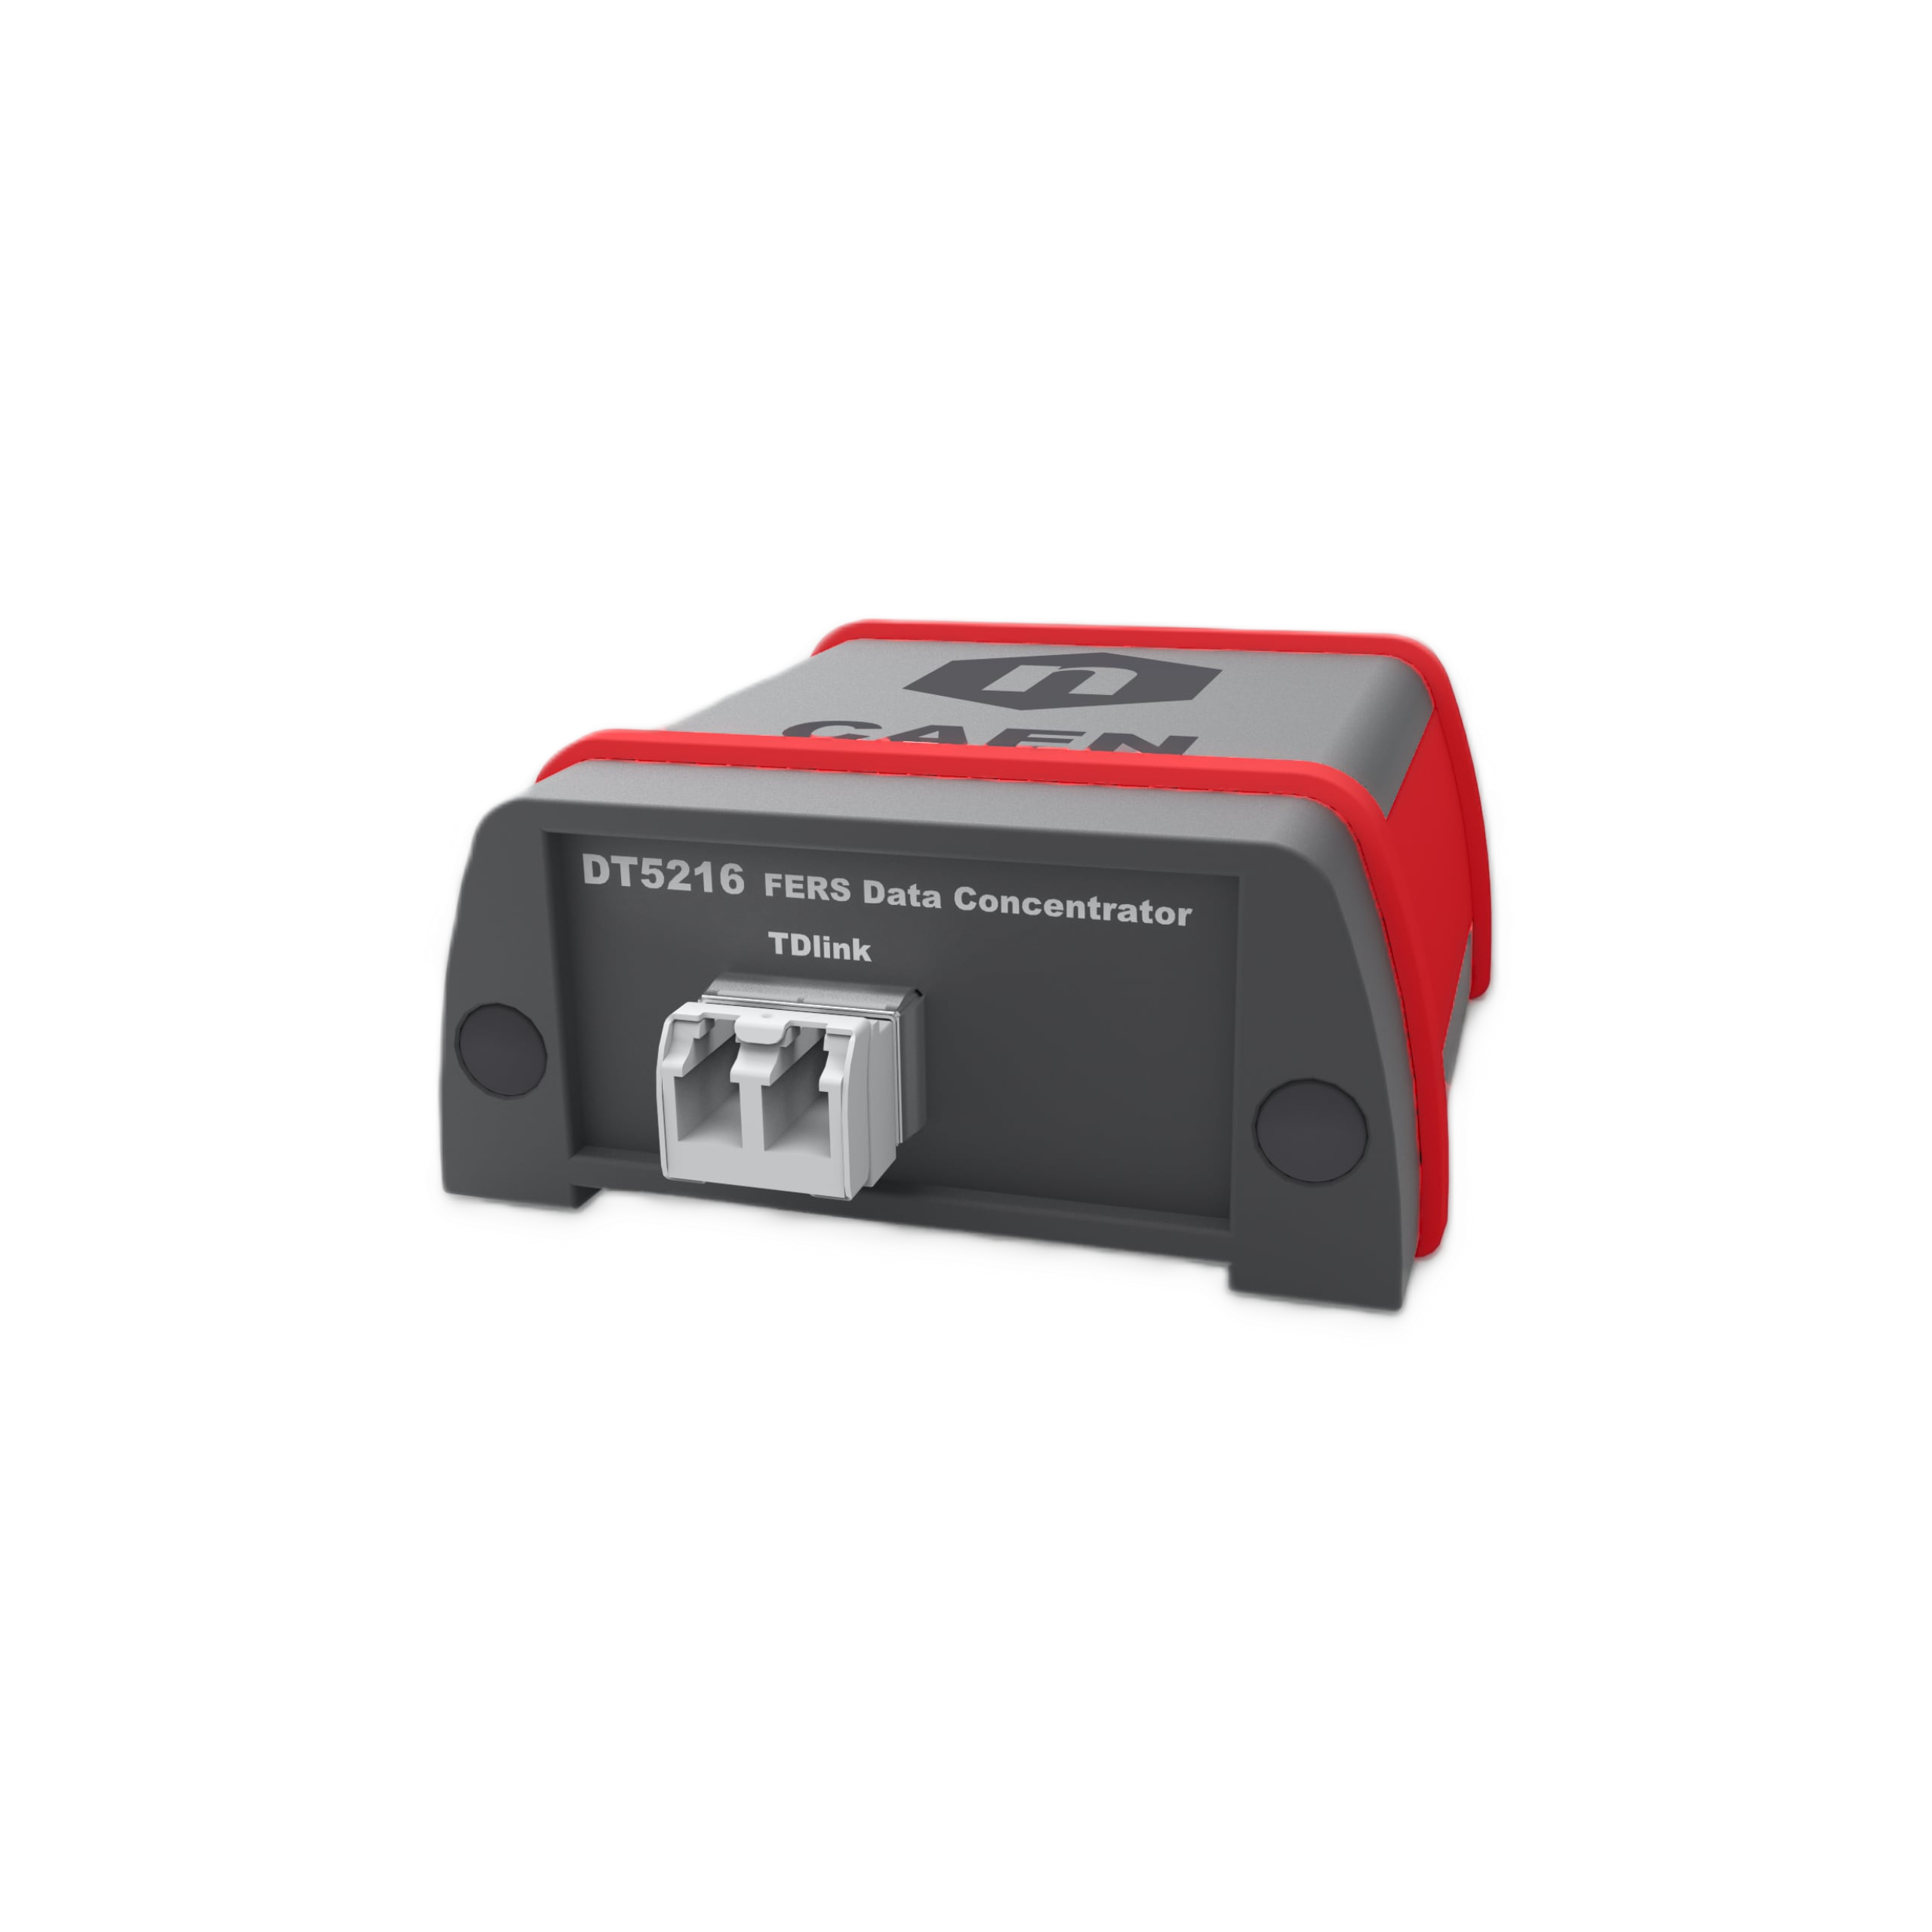
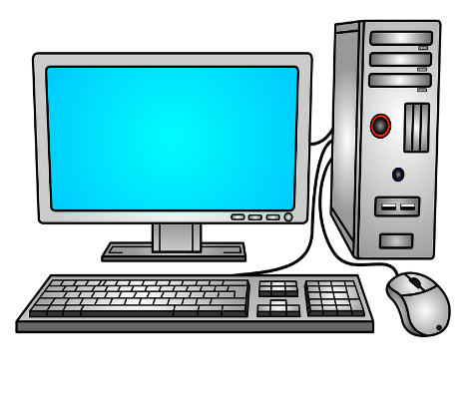

Data Readout and Multi-Unit Synchronization via TDlink
Custom Flange
or Backplane
1/10Gb Eth
USB 3.0
FERS Units
3.125 Gb/s TDlink
Readout
Slow Control
Synchronization
1 DT5215 => 16x8 FERS = 8k/16k ch
1 DT5216 => 8 FERS = 512/1024 ch
USB 3.0
DT5215/DT5216 Data Concentrators:
TDlink (duplex optical fiber connection) proprietary protocol
Possibility to sync multiple DT5215
Sync to GPS on DT5215 Concentrator Board
SW
Notes:
This slide summarises the two main functions that TD-Link must perform: data readout and multi-unit synchronisation. These two requirements pull in somewhat different directions, and that tension is at the heart of the design challenge. For data readout, we need sufficient bandwidth to move hit data, charge measurements, and housekeeping information from up to 128 FERS boards to the concentrator without bottlenecks. For synchronisation, we need to distribute a common clock and a common time reference — what we call T0 — to all boards simultaneously. The critical insight is that both functions must share the same physical link. We cannot afford a separate synchronisation network; the cost and cable count would be not acceptable. So TD-Link must perform both functions deterministically on the same optical medium. Deterministic here means that the latency from the concentrator to any given FERS board is precisely known and stable — not just approximately, but at the sub-nanosecond level. This is what makes the timing transfer accurate and, crucially, scalable.

Slide 5
What is TD-Link?
Protocol Overview
Proprietary protocol for simultaneous data transport and deterministic timing distribution over a single ring optical fiber
Operates at 3.125 Gb/s line rate, carrying both control and data traffic on the same physical link
Multidrop Daisy-Chain Ring Topology
Single fiber from Data Concentrator → up to 16 FERS front-end boards → back to Concentrator (closed loop)
Single concentrator hosts 8 independent links → readout hundreds of front-end modules
Key Advantage
Dramatically reduces cabling complexity in large-scale distributed detector systems where front-end electronics span extended volumes and long distances
Notes:
So what exactly is TD-Link? Let me give you the key parameters. TD-Link operates at 3.125 gigabits per second — a data rate chosen to be compatible with standard multi gigabit transceiver primitives available in low-cost FPGAs. It uses a ring topology: the concentrator transmits downstream to the first FERS board, that board passes the signal onward to the next, and so on, with the last board connecting back to the concentrator. Up to 16 FERS units can be chained on a single link, and a single concentrator can manage up to 8 such links in parallel — giving a maximum of 128 FERS boards per concentrator. The physical medium is standard SFP optical transceivers and multimode fibre

Slide 6
TD-Link Synchronization & Timing Architecture
Concentrator (Master) — Clock Generation
Low-jitter PLL locked to 10 MHz TCXO, generating 156.25 MHz system clocks for transceivers and FPGA fabric
Multiple clock sources: local oscillator, external digitizers, GPS (PPS + NMEA) for absolute global reference
Inter-quad phase alignment via an innovative synchronization technique (detailed later); elastic buffers remain active
External clock sync: DDMTD measures phase offset, adjusts 156.25 MHz clock phase via closed-loop correction
FERS Front-End (Slave) — Clock Recovery
Elastic buffers disabled to enforce deterministic latency
RX clock recovered from transceiver, cleaned by external jitter cleaner PLL
Cleaned clock, phase-shifted, used as TX clock — strict RX-to-TX phase lock along the daisy chain
T0 Global Synchronization
Round-trip delay measurement → per-board correction → deterministic global time reset across all nodes
Validated: ~25 ps RMS inter-board synchronization, stable across power cycles
Notes:
This slide gives an overview of the full synchronisation and timing architecture of TD-Link. There are three layers to this architecture, and it is worth understanding how they fit together before we go into the details of each one.
The first layer is clock generation at the concentrator. The master board derives a 156.25 MHz system clock from a low-jitter PLL locked to a 10 MHz TCXO. This single reference clock drives both the FPGA fabric and the high-speed serial transceivers. The system supports multiple clock sources — a local oscillator, external digitisers, or GPS
The second layer is clock recovery at the FERS front-end. Each slave board recovers the clock directly from the incoming serial data stream. This recovered clock is cleaned by an external jitter-cleaner PLL and then used as the transmit clock for the next hop in the daisy chain. This RX-to-TX phase locking is what makes the ring a timing distribution medium: the clock propagates from board to board with controlled, deterministic latency at each hop.
The third layer is global time synchronisation. Once the clock is distributed and the link latency is fixed, the concentrator performs a round-trip delay measurement to each board and applies a per-board correction. This allows all boards in the system — across all links and all concentrators — to be brought to a common time zero with a validated precision of around 25 picoseconds RMS, stable across power cycles.

Slide 7
TD-Link Data Transport: Token-Based Train Protocol
Data
Concentrator
FERS #1
FERS #2
FERS #3
①
②
③
④
◄ return path (ring closed back to concentrator)
① Empty train from Concentrator
② After FERS #1
HDR
0x8000
CRC
TRL
0xC000
LAST
COMMA
HDR
0x8000
DATA
#1
CRC'
TRL
0xC000
LAST
COMMA
③ After FERS #2
④ Full train → Concentrator
HDR
0x8000
DATA
#1
DATA
#2
CRC'
TRL
0xC000
LAST
COMMA
HDR
0x8000
DATA
#1
DATA
#2
DATA
#3
CRC'
TRL
0xC000
LAST
COMMA
Train is never stopped inside a node — header is forwarded immediately while data is appended in streaming
Each FERS board appends up to N events per train; larger payloads are fragmented across multiple trains
Max train size: 64 Mword per link (concentrator DDR4 memory); CRC recalculated at each hop
Notes:
I now explain how data actually flows across TD-Link. We use what we call a token-based train protocol. The concentrator initiates a data collection cycle by sending a token downstream — a special control word that travels from board to board around the ring. When a FERS board receives the token, it appends its buffered hit data to the stream and passes the augmented packet to the next board. The last board in the chain sends the complete assembled data frame back upstream to the concentrator

Slide 8
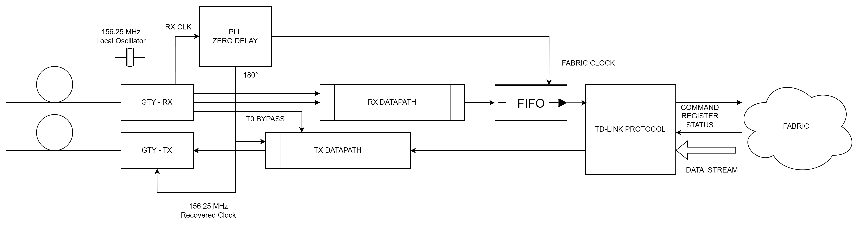
FERS Front-End Datapath Architecture
RX deserializer recovers data and clock from the upstream link
Recovered clock cleaned by jitter cleaner PLL, phase-shifted, used as TX clock
Elastic buffers disabled → deterministic, fixed latency through each node
Protocol FSM decodes header, forwards train, appends local events before trailer
Digitizer data (ADC/TDC) buffered in local FIFO, drained into passing train
Timing: Data Flow Through Node
RX Stream In
Header Detect
Pass-through
Append Local
TX Stream Out
HDR
Upstream Data
Local Events
CRC+TRL
← fixed propagation delay
Notes:
When the concentrator clock arrives at a FERS board via the TD-Link optical connection, the board must first recover the clock from the incoming serial data stream. This recovered clock then drives all the on-board timing logic — the TDC channels, the ADC sampling, and the output serialiser. The front-end datapath is therefore critically dependent on the quality of clock recovery. Any jitter added by the clock recovery process directly degrades the timestamp resolution of the detector channels. The FERS board uses the recovered clock as its sole timing reference, which means the quality of that recovered clock is the limiting factor for the system's timing performance. This is why so much of the TD-Link design effort went into minimising jitter at the clock recovery stage. The on-board TDC achieves single-channel resolution better than 10 picoseconds— but only if the recovered clock is clean enough to support it.

Slide 9
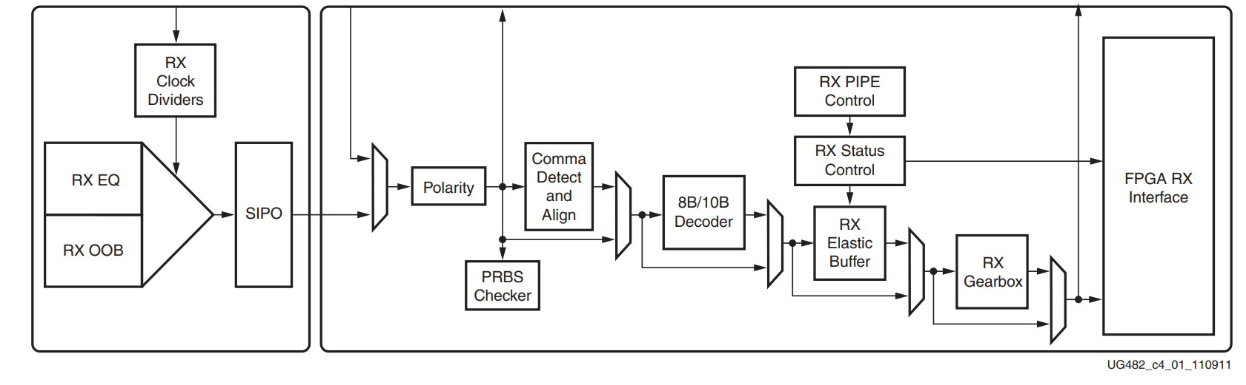
FERS Slave Clock Recovery and Distribution
Inside FPGA
~~ with jitter ~~
low jitter
RX Link
(from upstream)
Transceiver CDR
(clock recovery)
Recovered CLK
(156.25 MHz)
Jitter Cleaner
PLL (external IC)
Clean CLK
(156.25 MHz)
External IC
LOCAL
OSCILLATOR
TDC / ADC
(Digitizers)
FPGA Fabric
(all logic)
TX Serializer
(phase-shifted)
40 bit comma manual alignment
Notes:
When data arrives at a FERS board from the upstream node, it comes as a 3.125 Gb/s serial bitstream encoded using 8b/10b line coding. The board's FPGA contains a clock and data recovery circuit that uses the transitions in the incoming data to lock its internal oscillator to the transmit clock. The challenge is that each hop around the ring adds its own CDR jitter contribution, and with up to 16 hops in a chain, this jitter can accumulate. The key insight in our design is that we clean the clock with an external jitter cleaner on each FERS board before use it for retrasmitting

Slide 10
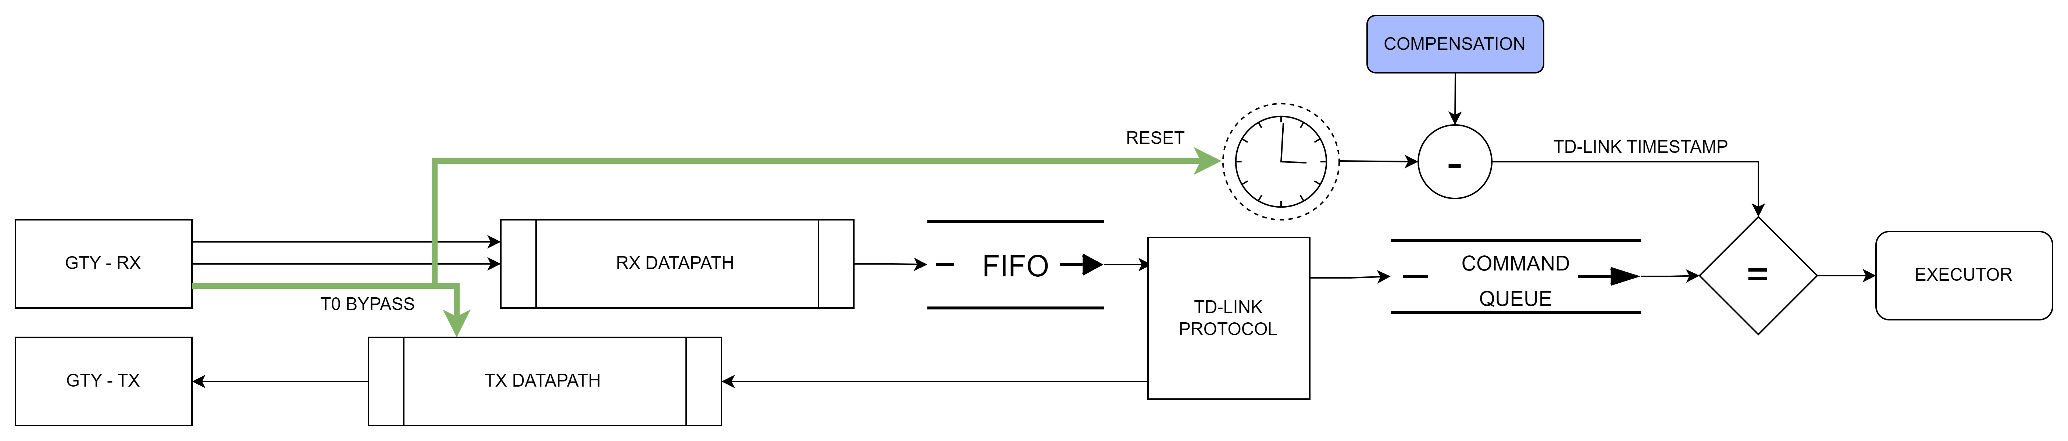
T0 Synchronization & Deterministic Command Execution
Timing: Deterministic Command Execution via Timestamp Matching
T0 Reset
All triggers
aligned
(<<< 1 clk jitter)
Master CMD TX
cmd arrival (diff delays)
FERS #1 Trigger
FERS #2 Trigger
FERS #3 Trigger
T0
CMD TX
Exec time
T0 (K-word 0xFEFE) propagates atomically RX→TX (no FIFO), resets all timestamp counters to zero
Commands carry a future execution timestamp; each FERS corrects it by CMD_ChainTimeCompensation (derived from RTT)
Execution fires when local counter matches CMD timestamp → all boards trigger simultaneously regardless of chain position
Notes:
This Slide covers one of the most important functions of TD-Link: the T0 synchronisation pulse and deterministic command execution. In a physics experiment, T0 is the reference signal — the moment that defines the time origin for all detector channels. When the DAQ system decides to record an event, it must communicate that decision to all FERS boards with a guaranteed, known latency. The concentrator broadcasts a T0 command down the TD-Link chain. Because the link latency to each board is known and the concentrator can compensate for the different propagation delays and ensure that all boards execute a command at the same absolute time in respect to the T0. The word "deterministic" is key here. It is not sufficient to say that the latency is approximately constant. It must be exactly constant.

Slide 11
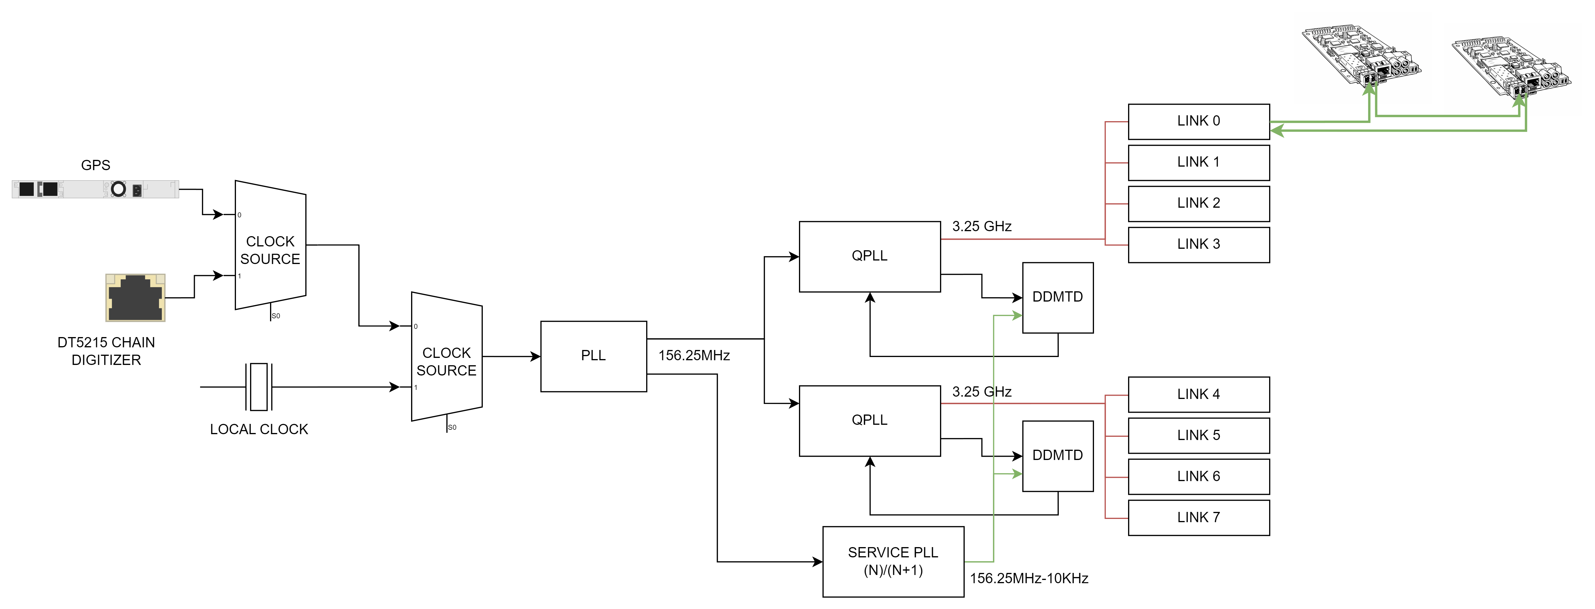
Multi link and multi-concentrator synchronization
Random phases between QPLL outputs
Zero phase delay between PLL (AD9545)
Input and output
Notes:
This slide introduces the core synchronisation challenge when you have multiple links or multiple concentrators in the same system.
The problem starts inside the FPGA. Each high-speed serial transceiver uses its own QPLL — a dedicated PLL that generates the serial bit clock for that transceiver quad. When the FPGA powers up, each QPLL locks to the reference clock, but its output phase is completely arbitrary. There is no mechanism to control or even to know, a priori, what phase the QPLL has chosen. Two QPLLs driven by the same reference will in general lock with different, unpredictable phase offsets. This means that two links coming out of two different FPGA quads — or two different concentrator boards — will have an unknown and variable phase relationship with respect to each other, and with respect to the external 10 MHz reference clock.

Slide 12
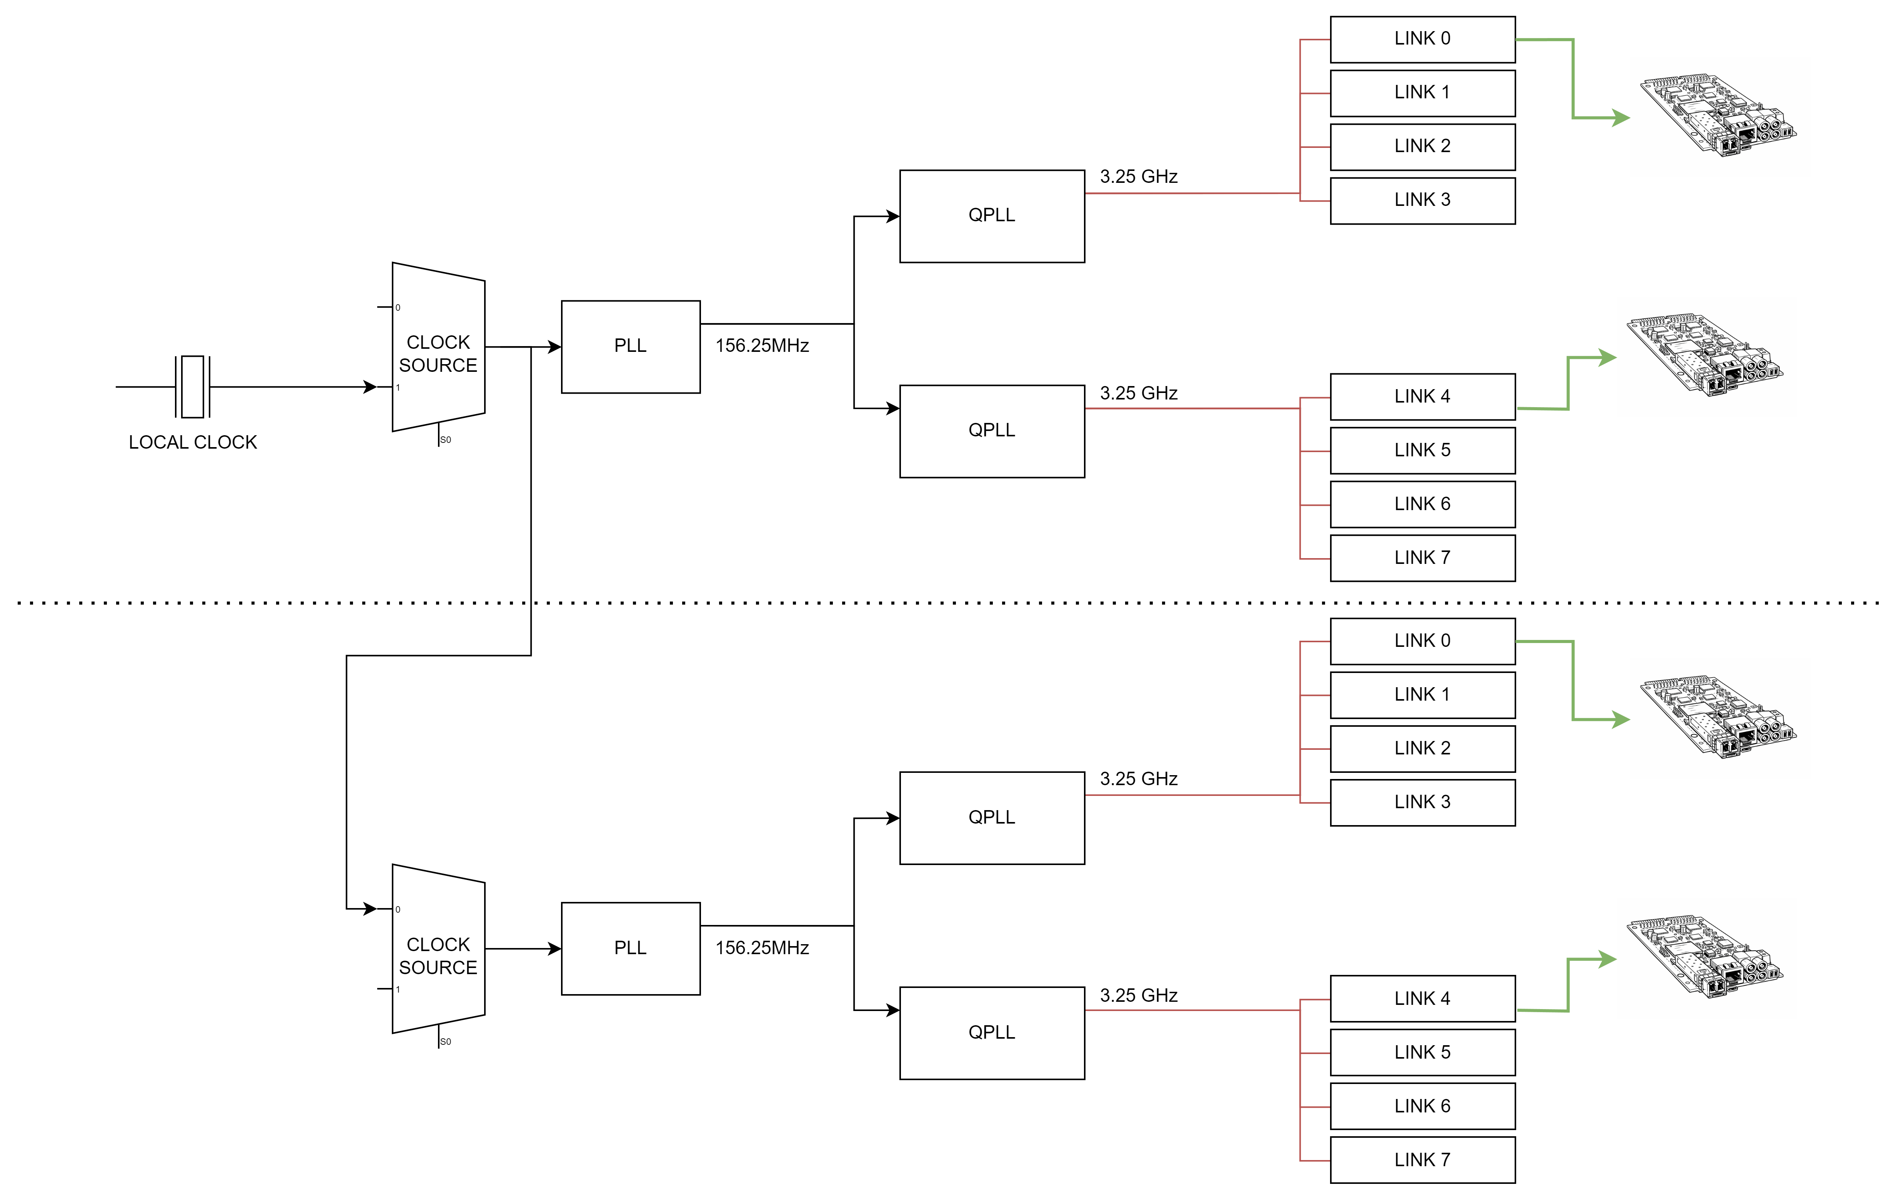
Multi link and multi-concentrator synchronization
CONCENTRATOR MASTER
①
②
③
④
CONCENTRATOR SLAVE
Notes:
For very large experiments, a single concentrator with 128 FERS boards is not enough. You might need thousands of channels, requiring many concentrators. The concentrators themselves must be synchronised to each other. The concentrators are synchronised to the master, and the FERS boards are synchronised to their local concentrator. The absolute timing uncertainty at the FERS level is the quadrature sum of the concentrator synchronisation error and the TD-Link synchronisation error — both of which are below 30 picoseconds in our measurements.

Slide 13
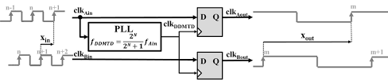
DDMTD Phase Detector: Sub-ps Clock Phase Measurement
beat_A
Deglitcher
Interval
Counter
ΔΦ (phase
measurement)
beat_B
f_in + Δf (Δf ≪ f_in)
Phase Magnification Principle
Beat frequency: f_beat = f_in − f_DDMTD = Δf
Phase resolution: T_in / (f_in / Δf) = T_in × (Δf / f_in)
e.g. f_in=156.25 MHz, Δf=15.625 kHz → N=10000× magnification → ~0.6 ps resolution
clk_A
clk_D
beat_A
↑ Slow beat period = f_in/Δf × T_in (time-magnified phase info)
How It Works
Two input clocks (clk_A, clk_B) are sampled by D flip-flops clocked with clk_DDMTD
clk_DDMTD has frequency very close to clk_A/B but offset by a small Δf
Each FF output (beat) is a slow square wave at frequency Δf — phase info is time-magnified
Time difference between beat_A and beat_B rising edges = ΔΦ × (f_in / Δf)
Deglitcher removes metastable glitches at beat transitions
A simple counter measures the interval → sub-picosecond resolution
Notes:
To synchronise two concentrators, we therefore need to do two things. First, we must measure the phase of each link — that is, the phase of the recovered serial clock at the FERS receiver side — relative to the external reference clock. This is exactly what the DDMTD phase detector does: it gives us a precise measurement of how far the link clock is offset from the external reference.
DDMTD stands for Dual Digital Mixer Time Difference. The idea comes from the field of metrology and was adopted by the White Rabbit project at CERN. Here is the principle: instead of measuring the phase difference between two clocks at their native frequency — which requires very fast, precise analog circuitry — we mix both clocks with a third frequency that is very close to, but slightly different from, the clock frequency. The result is two low-frequency beat signals. The phase difference between these beat signals is proportional to the original clock phase difference, but scaled by a factor equal to the ratio of the beat frequency to the clock frequency. A typical scaling factor might be 2,000 or more — meaning that a 1-nanosecond phase difference at the clock frequency appears as a 2-microsecond difference in the beat signals, which is trivially measurable with a digital counter. In our implementation, the DDMTD achieves sub-picosecond resolution — around 700 femtoseconds — using entirely digital logic running in a standard FPGA.

Slide 14
DDMTD Training Loop: PI Controller Phase-Locks PLL to Reference
10 MHz
External Ref
VCXO + PLL
156.25 MHz
QPLL
GTY TX
Quad 0, Link 0
Serial data
3.25 GHz
156.25 MHz Fabric clock (from TX serializer)
156.25 MHz recovered
DDMTD Phase Detector
clk_B
D Flip-Flop
(samples clk_B)
ΔΦ
(phase)
clk_A
phase error
PI Controller
(Kp + Ki/s, D=0)
Training Goal
ΔΦ(clk_A, clk_B) → 0
PLL output phase-locked to
external 10 MHz reference
D Flip-Flop
(samples clk_A)
clk_DDMTD (f + Δf)
156.25 MHz PLL output
156.25 MHz recovered (Quad 0)
PI feedback path
Phase measurement
Notes:
Second, once we know this phase offset, we must compensate for it. The way we do this is by shifting the external reference clock itself, using a programmable clock conditioner — in our case the AD9545 — which is configured in zero-delay mode. By adjusting the AD9545's phase offset, we can align the clock that the concentrator distributes to the FERS boards so that it is phase-coherent with the reference, regardless of what random phase the QPLL chose at startup.
The result, shown on this slide, is that even though the QPLL outputs have random phases, the synchronisation layer on top brings the distributed clock into alignment. Two concentrators, each with their own QPLL and their own AD9545, end up distributing clocks that are phase-aligned to the common external reference — and therefore to each other.

Slide 15
TX Buffer & Deterministic-Latency Link Design
Start-up — Random Phase:
With TX Phase Aligner — Aligned:
Lane 0
TX Data
Random inter-lane
skew each reset
Lane 0
TX Data
Lane 1
TX Data
Lane 1
TX Data
All lanes aligned
deterministic
Lane 2
TX Data
Lane 2
TX Data
Lane 3
TX Data
Lane 3
TX Data
What is the TX Elastic Buffer?
A FIFO between two clock domains: TXUSRCLK (fabric) writes, XCLK (PMA serializer) reads
Safely handles CDC (Clock Domain Crossing) between mesochronous clocks Default mode (enabled) adds variable latency (FIFO fill level changes at each reset)
Bypassing it removes latency variation but breaks CDC safety and creates the dual-PI conflict
TX BUFFER
156.25M
REF CLOCK
QPLL0
LANE0
…
LANE3
TX BUFFER
LANE4
TX BUFFER
QPLL1
…
LANE7
TX BUFFER
Why Deterministic Latency Matters
PCS DATA
TX BUFFER
USER DATA
TDlink synchronizes multiple FERS units — each link must add a known, fixed latency
Random FIFO fill → RTT measurement changes per reset → timestamp compensation breaks
T0 propagation and command scheduling depend on stable, repeatable link latency
PCSCLK
TXUSRCLK
Notes:
One of the less obvious but critical design challenges is what we call the TX elastic buffer. When the FPGA's transmit clock and the reference clock are not perfectly phase-aligned, the transmit FIFO — the small buffer between the logic clock domain and the serialiser clock domain — will be at an arbitrary fill level. If this fill level drifts, you can get either FIFO overflow or FIFO underflow, both of which corrupt data. More importantly for our purposes: the fill level directly affects the transmit latency. If the FIFO is three words deep instead of two words deep, the data leaves the transmitter one clock cycle later — and in a timing-critical system, one clock cycle at 156 MHz is about 6.4 nanoseconds. That is an unacceptably large timing error. The solution is to bypass the tx buffer or having a tx buffer with deterministic latency control.

Slide 16
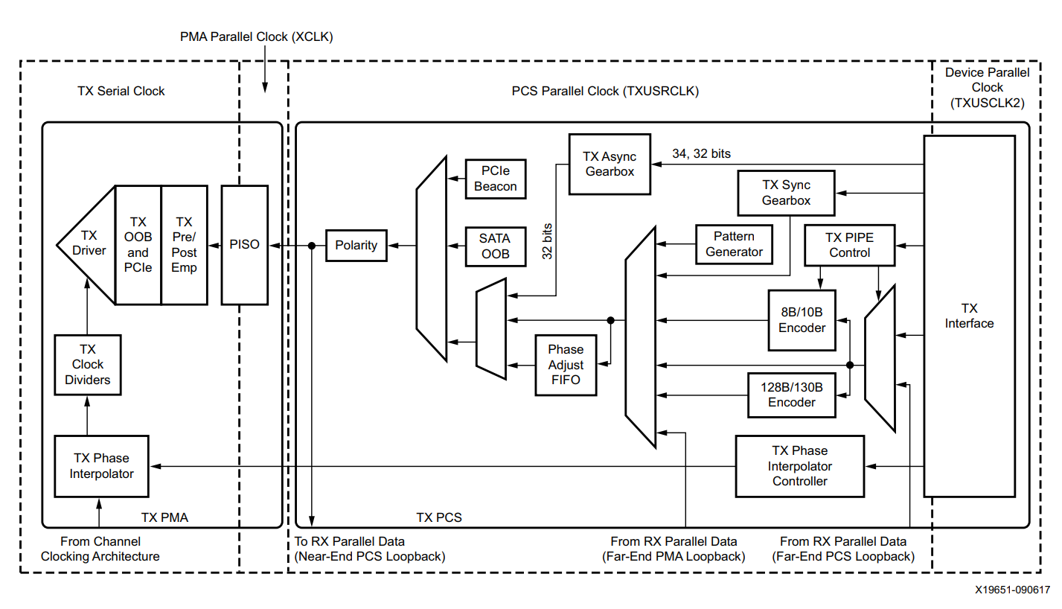
TX Phase Interpolator — Buffer Bypass
Buffer Bypass Mode
Elastic buffer (FIFO) is bypassed. The PCS logic runs directly from TXUSRCLK.
The CDC Problem
Two clock domains exist in the TX path:
TXUSRCLK (fabric BUFG, user logic)
TXOUTPCSCLK (from PISO divider of TXCLK, PMA-side)
These are mesochronous: same frequency but unknown phase offset after each reset.
Phase Interpolator Role
Without the FIFO, there is no hardware CDC. The TX Phase Interpolator shifts TXUSRCLK in fine steps until the phase offset between the two domains is within the safe setup/hold window of the PISO flip-flops.
TXOUTPCSCLK
TXUSRCLK
DATA PATH
TXCLK
Notes:
The phase interpolator is a circuit that allows the transmit clock phase to be adjusted in fine steps — in our case, approximately 18.6 picoseconds per step. This is used during the training loop to bring the transmit phase into alignment with the reference. But the phase interpolator serves a second purpose: it can be used to bypass the elastic buffer entirely. In bypass mode, data passes from the logic domain directly to the serialiser without going through the FIFO. This eliminates the FIFO-induced latency uncertainty at the cost of requiring the logic clock and the serialiser clock to be phase-coherent. The bypass mode is only used after the phase interpolator has been set to align the two clock domains — at which point the FIFO is no longer needed for rate matching, and bypassing it removes a source of latency variability. The result is a transmit path with a precisely known, fixed latency that is independent of FIFO fill level dynamics.

Slide 17
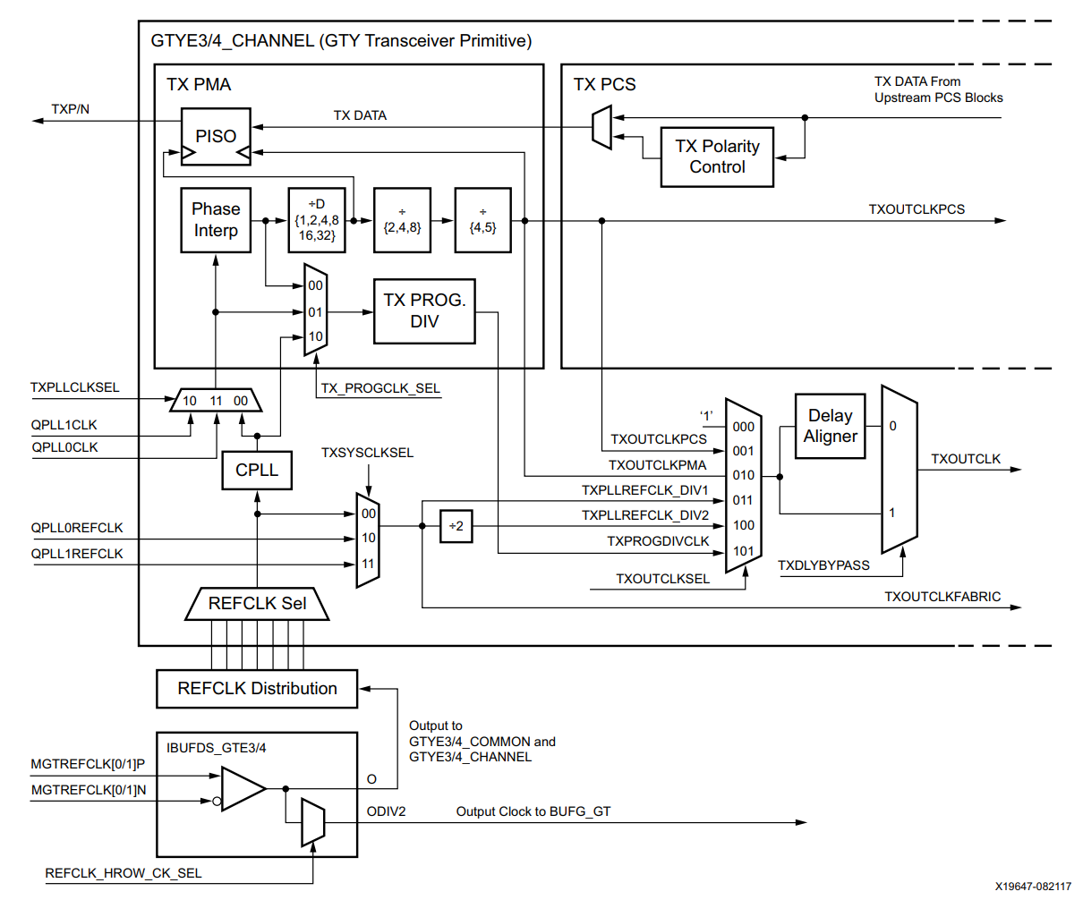
TX Phase Interpolator — Multi Lane synchronization
TXOUTCLKPCS (phase shifted clock) ≠ TXUSRCLK2 (fabric data clock) — they are mesochronous: same frequency, mutually random phase after each reset.
φ₀≠0 and different for every lane
Used to compensate
random phase of the QPLL
What is the Phase Interpolator (PI)?
The TX Phase Interpolator is a mixed-signal circuit inside each GTP transceiver that can shift the phase of the internal PMA clock (TXOUTCLKPCS) in fine steps.
How it works
The PMA serializer runs on its own clock domain (TXOUTCLKPCS), derived from the PLL
Resolution: typically ~18.6 ps per step
Why it matters for TDlink
Without alignment, the serializer clock phase φ₀ is random after each reset and different per lane
The multi-lane PI alignment forces all lanes to the same phase, eliminating lane-to-lane skew
Common to all lanes
Notes:
A practical complication arises when you have multiple links — remember, we have up to 8 links per concentrator. The FPGA organises its high-speed serial transceivers into groups of four, called quads. Each quad shares a common PLL. When all four links in a quad use the same clock, they are naturally phase-coherent. But when links from different quads need to be synchronised, you have a harder problem: the two quad PLLs are independent and can have different phases.

Slide 18
Buffer Bypass — TX PI Dual-Purpose Conflict
The TX Phase Interpolator has two jobs:
156.25M
REF CLOCK
QPLL0
φ₀
PISO
LANE 0
DATA LANE 0
φ₀
TD LINK
FABRIC
IP CORE
XCLK ₀
÷D
CLKPCS0
φ₀
Job 1 — CDC Phase Margin
Shift TXUSRCLK vs XCLK (PISO clock) to guarantee setup/hold for the data→serializer clock domain crossing.
Job 2 — Inter-Lane TX Alignment
Shift each TX serializer clock so the 156.25 MHz recovered at the FERS receivers are phase-aligned across all lanes.
The Conflict:
Each QPLL starts with a random phase (φ₀ ≠ φ₁ after reset).
If you use the PI to align φ₀ to φ₁ (Job 2), the resulting Δφ on Lane 4 violates the setup/hold timing between XCLK_PCS₁ and TXUSRCLK₂ — the PI cannot satisfy both constraints simultaneously.
PRG DIV
φ₀
TXUSRCLK2
φ₁
XCLK ₁
÷D
CLKPCS1
QPLL1
PISO
LANE 4
DATA LANE 4
φ₁
φ₀ !!
Notes:
I want to flag a design tension that appears when the buffer bypass mode and the TX phase interpolator are both in play. The phase interpolator has a dual role: on one hand it is used to align the transmit phase to the reference during calibration; on the other hand, maintaining the bypass mode requires that the transmit and logic clock phases remain aligned during normal operation. The conflict arises because both functions want to control the same resource — the interpolator setting. If the DDMTD feedback loop tries to adjust the interpolator to track the phase of the reference clock, this could inadvertently pull the logic and serialiser clocks out of alignment, breaking the bypass mode.

Slide 19
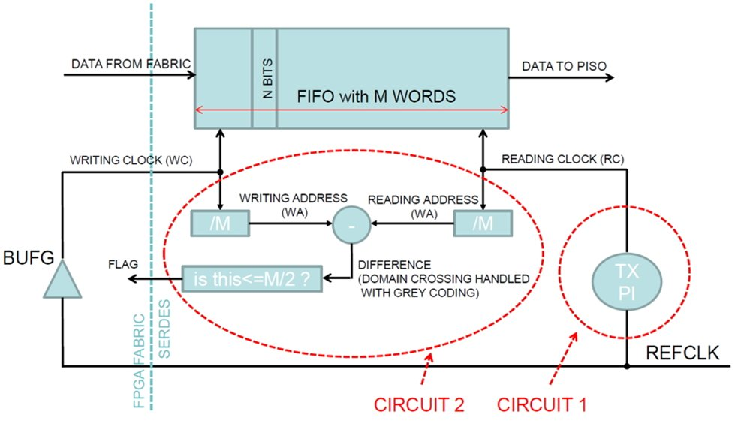
Deterministic TX Buffer
Solution: keep the elastic buffer enabled. The FIFO handles CDC (Job 1) for each lane independently. The TX PI is then free to perform Job 2 — shift each serializer clock to align recovered 156.25 MHz across all lanes.
Circuit 1 — TX PI
Shifts REFCLK phase before the CPLL/QPLL. Each step moves the XCLK (FIFO read clock) by ≈1.5 ps → 18.6 ps @ 156.25 MHz.
Total range ≈ 1 REFCLK period (6.4 ns at 156.25 MHz).
Circuit 2 — Fill level feedback
The FIFO maintains WA and RA pointers (both divided by M for comparison). The difference WA−RA (using Gray coding for CDC) is compared to M/2:
txbufstatus[0] = 1 → FIFO ≥ half-full
txbufstatus[0] = 0 → FIFO < half-full
This flag is the 1-bit phase detector driving the alignment FSM.
Notes:
This slide presents the solution to the multi-link phase alignment problem using Deterministic TX buffer. The key idea is to re-enable the elastic buffer — and exploit it actively as a phase measurement device rather than bypassing it.
The fill level of the TX elastic buffer FIFO is a direct function of the phase difference between the write and read clock domains. If the read clock runs slightly faster than the write clock, the FIFO drains; if it runs slower, the FIFO fills up. The txbufstatus[0] flag — which signals whether the FIFO is at least half-full — is therefore a one-bit phase detector: it tells us on which side of the half-period boundary the relative phase currently sits.
This flag drives the TX phase interpolator. The TX PI shifts the serialiser clock phase step by step, chasing the half-full condition. Once the FIFO stabilises around its midpoint, the traversal latency is deterministic.
The elastic buffer simultaneously serves two roles: it eliminates metastability at the clock-domain crossing between the CDR-recovered clock and the FPGA fabric — its classical CDC function — and it provides the phase measurement that closes the control loop around the TX PI, at no additional hardware cost.

Slide 20
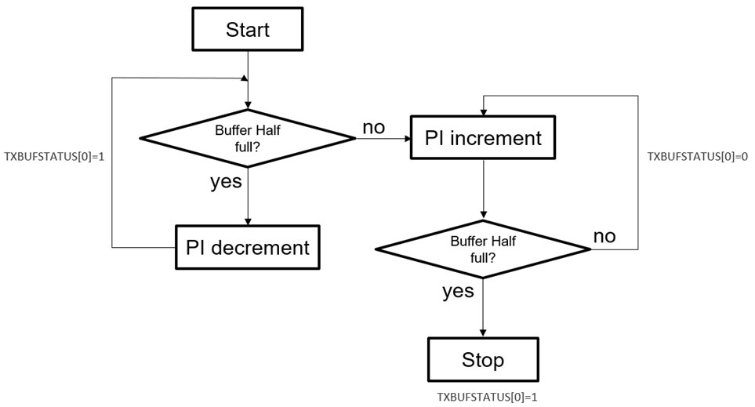
Deterministic TX Buffer
Phase 1 — Initial Sweep (find edge)
On start: if buffer is already half-full (i_half_full=1), decrement PI step-by-step to exit the half-full zone. Then increment PI until the buffer becomes half-full again (0→1 transition).
Phase 2 — Lock on Transition (0→1)
The 0→1 transition of txbufstatus[0] marks the half-fill point. The FSM stops: the PI is locked on this code. The phase between WR and RD pointers is now deterministic.
Result
Repeatable inter-lane skew after each reset ≈ few PI steps (≈10 ps). PI is fixed post-alignment → no additional jitter.
Notes:
This slide shows how the phase alignment loop is implemented as a finite state machine — the PI sweep FSM.
The algorithm runs in two phases. In Phase 1 — the initial sweep — the FSM checks the starting state of the txbufstatus[0] flag. If the buffer is already half-full at reset, the FSM first decrements the TX PI step by step until the flag drops to zero, ensuring we exit the half-full zone and establish a known starting point. It then reverses direction and increments the PI until the flag rises from zero to one.
Phase 2 triggers on that 0-to-1 transition of txbufstatus[0]. This rising edge is the precise half-fill point: it marks the PI code at which the write and read pointers are exactly half a FIFO depth apart, meaning the phase between the two clock domains is centred in the elastic buffer's range. The FSM freezes the PI at this code and the alignment is complete.
Once locked, the PI value is held fixed. Because it no longer dithers, it contributes zero additional jitter to the link. The result is a repeatable inter-lane phase alignment after every reset, with a residual skew of only a few PI steps — on the order of 10 picoseconds —

Slide 21
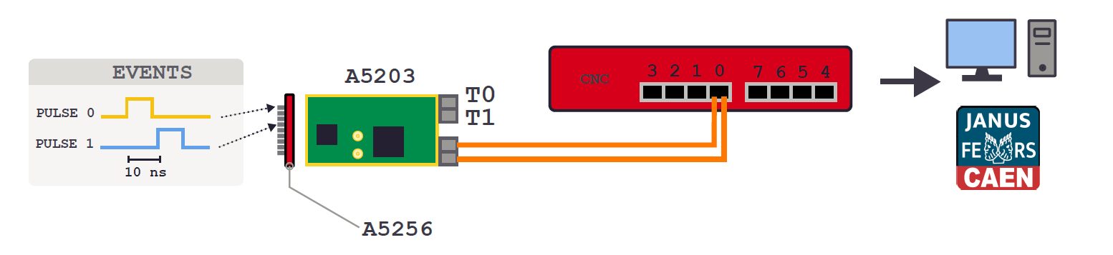
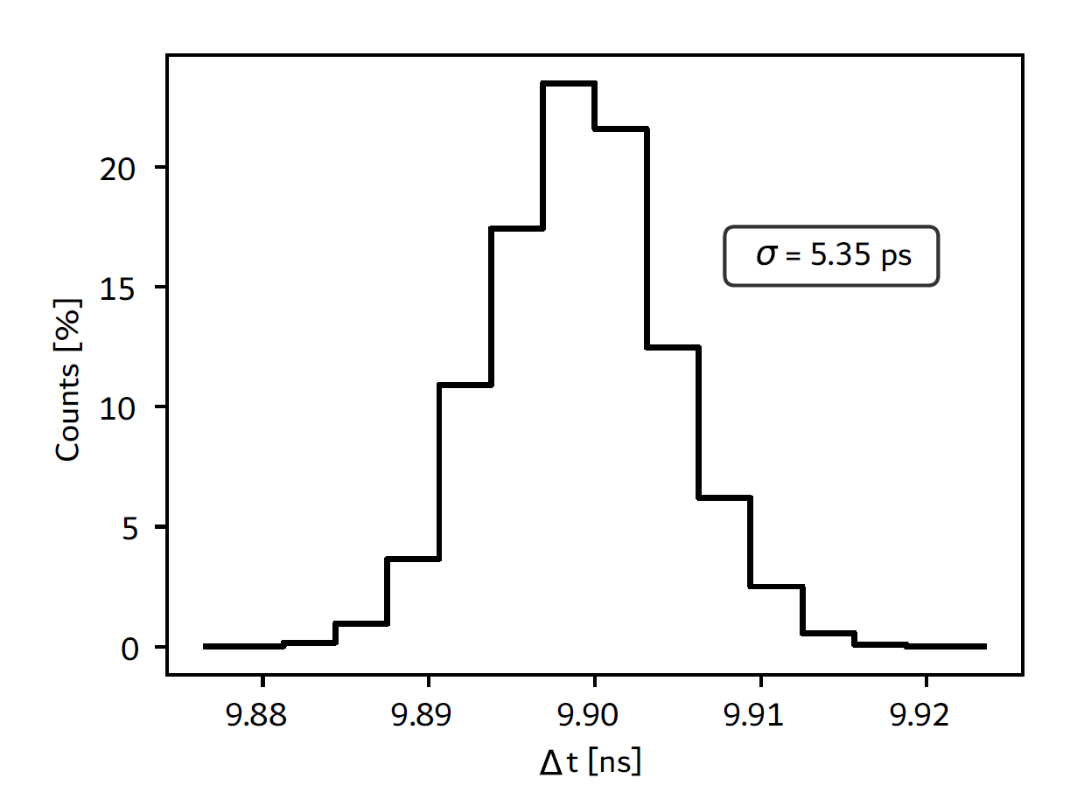
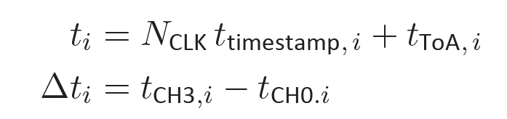
Link timing jitter measurement: TDC Performance
CERN PicoTDC
Notes:
Now I will move to the measurement results — this is where the design is validated. We begin with slide 22, which introduces our measurement methodology. To measure the timing jitter between two FERS boards, we use the on-board TDC — time-to-digital converter. Both boards are fed a common external pulse signal; each board timestamps the pulse arrival using its local clock. The difference between the two timestamps is the timing jitter between the two boards. This is the RMS timing jitter between the two channels. The key benchmark is to compare the TD-Link-connected result against a reference measurement where both boards are connected by a single short copper cable directly This cable reference gives us the best-case timing that the FERS hardware can achieve.

Slide 22
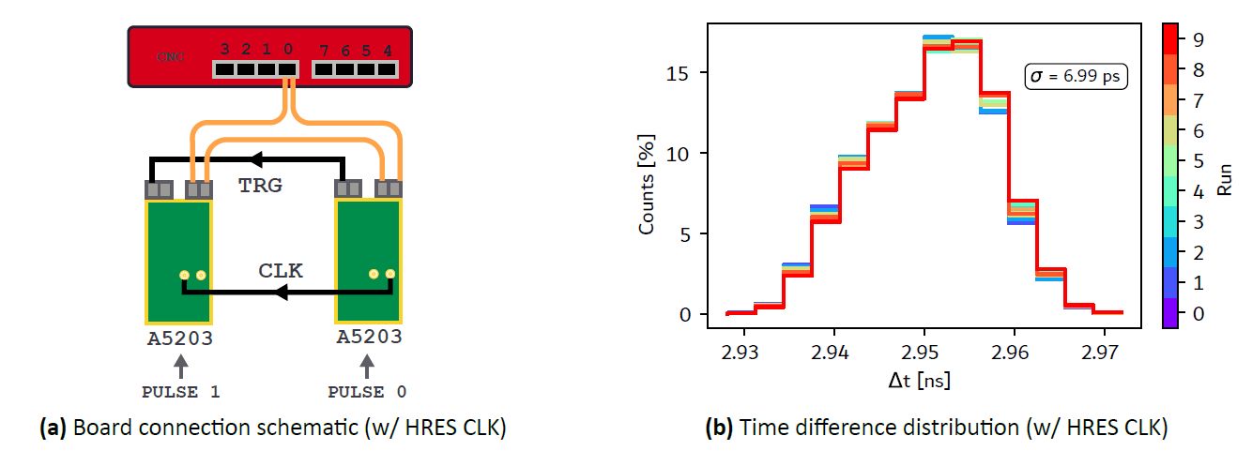
Link timing jitter measurement: Clock distributed via cable
Notes:
In the cable reference, both boards share the same timing clock via short copper cables. The measured RMS jitter between the two boards is our baseline — this is the intrinsic jitter floor of the FERS hardware.

Slide 23
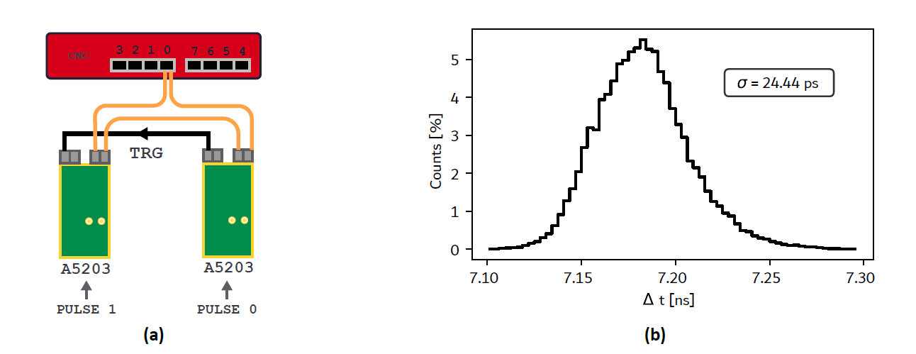
Link timing jitter measurement: Clock distributed via TD-LINK
Same Link – Daisy Chain Board
Notes:
The next question is: how does timing performance scale with the number of boards in the daisy chain? This slide shows measurements from a chain with multiple boards. The key result is that the timing jitter between any two boards in the chain remains approximately constant regardless of how many boards separate them.

Slide 24
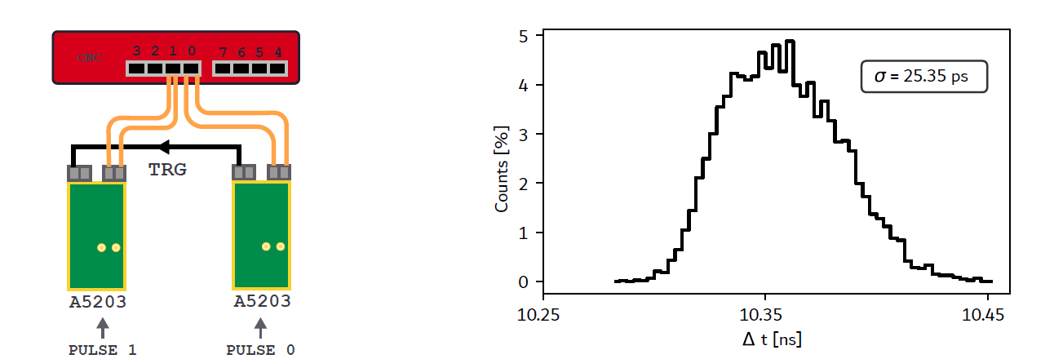
Link timing jitter measurement: Clock distributed via TD-LINK
Link 0 and 1 – Same Quad
Notes:
[~60 seconds] This slide examines the timing between two boards on the two link but same quad, specifically looking at links 0 and 1 which are on the same FPGA transceiver quad. Within a quad, the four lanes share a common PLL, so their output clocks are naturally phase-coherent.

Slide 25
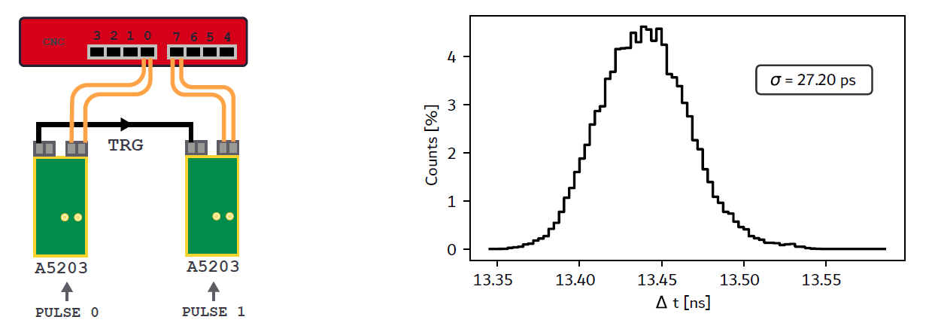
Link timing jitter measurement: Clock distributed via TD-LINK
Link 0 and 7 – Quad 0 and 1, same data concetrator
Notes:
Now we go one step further — two different qaud, each distributing the clock via TD-Link to their own ring of FERS boards. We are comparing the timing of a FERS on link 0 and link 7

Slide 26
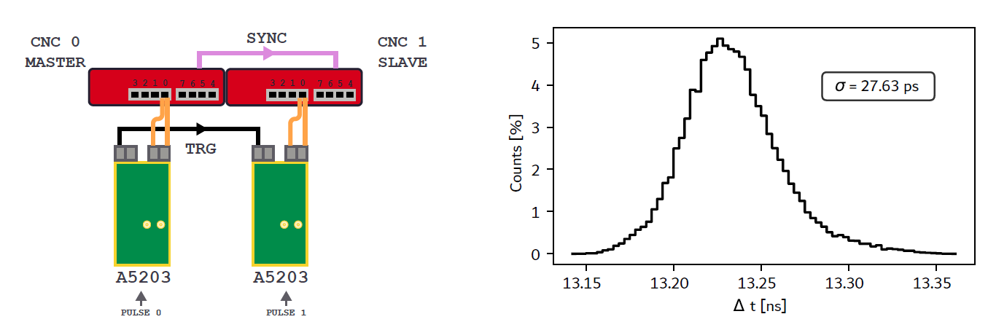
Link timing jitter measurement: Clock distributed via TD-LINK
Link 0 and 0 – Two different data concentrators

Slide 27
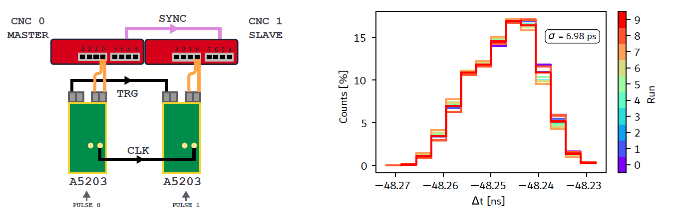
Link timing jitter measurement: Clock distributed via cable
Link 0 and 0 – Two different data concentrators
Notes:
This is the cable-distributed baseline for the two-concentrator scenario. Instead of distributing the clock through the TD-Link daisy chain, we now connect both concentrators to a common 10 MHz reference via a coaxial cable splitter.
This is the gold standard reference: both concentrators see exactly the same physical clock signal, with no digital reconstruction, no DDMTD loop, and no phase interpolator in the path. The residual jitter comes only from the cable propagation, the TCXO's own phase noise, and the TDC quantisation in the FERS boards themselves.
Comparing this slide to the previous one — TD-Link across two concentrators — you will notice that the cable reference gives perhaps 5 to 10 picoseconds less jitter. That difference is the overhead introduced by the digital clock distribution chain: the DDMTD tracking loop adds a small amount of residual noise. But the gap is small, and given the practical advantages of an all-digital, optical clock distribution — no cable plant, no impedance matching, no physical routing constraints — this is a very acceptable trade-off.
This comparison is really the key result of the whole jitter study: TD-Link performs within a few tens of picoseconds of a hard-wired reference, which validates the architecture for physics-grade timing applications.

Slide 28
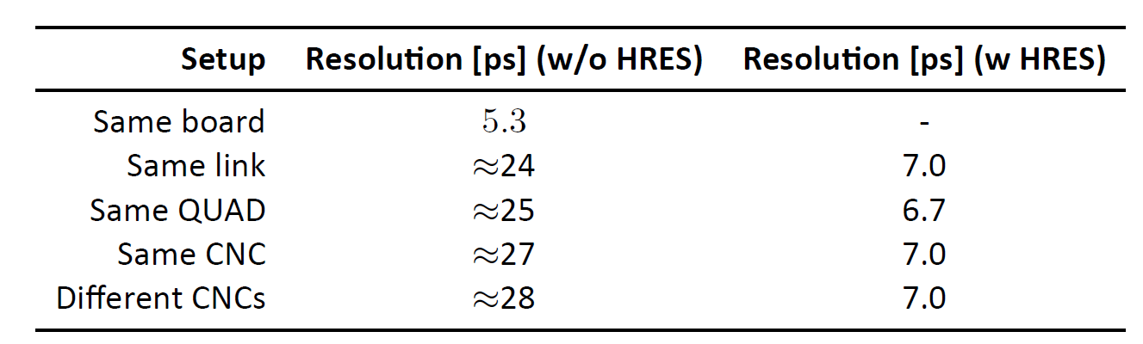
Link timing jitter measurement: Summary
Feature | TD-Link | White Rabbit
Timing precision | ~25–30 ps RMS | 1ns/100 ps
Clock distribution | Embedded in serial data | SyncE + PTP (IEEE 1588)
Topology | Daisy-chain ring | Star / tree (switches)
Link speed | 3.125 Gb/s per ring | 1 Gb/s (GbE)
Max nodes / link | 16 per ring unlimited number of rings | ~1000 (network)
Max distance | SFP 300 m per hop | Up to 10 km fiber (SMF)
Data + clock on same link | Yes | Yes
Dedicated switch needed | No | Yes (WR Switch)
Target application | Detector front-end DAQ | General lab / accelerator timing
Notes:
This slide brings together the performance summary and positions TD-Link against White Rabbit — the most established sub-nanosecond timing protocol in the HEP world.
White Rabbit is an impressive system. It achieves sub-nanosecond accuracy over multi-kilometre fibres, supports thousands of nodes, and is already deployed at facilities like CERN and GSI. It is essentially IEEE 1588 PTP combined with Synchronous Ethernet and a DDMTD phase detector — a mature, well-supported standard.
So why did we design TD-Link instead of using White Rabbit?
The fundamental reason is topology. White Rabbit is built for a star or tree network: a central switch fans out timing to many nodes. That is ideal for a large facility to distribute timing to the DAQ back-end rather then directly to the front end boards. But our detector systems use a daisy-chain ring — FERS boards connected in sequence, one after the other, with no switch. The two systems are therefore not really competing — they address different deployment constraints. If you have a large facility with a star topology and can dedicate a WR switch, White Rabbit is excellent. If your front-end boards are chained together in a ring inside a detector volume, TD-Link is the natural fit.

Slide 29
BACK-UP
Notes:
[Brief transition — use to catch breath]
Before moving to the packet format slides, let me recap the key message from the jitter measurements: across all configurations tested — same quad, different quads, and different concentrators — TD-Link distributes the clock with a timing precision comparable to a direct cable reference. The dominant contribution to the measured jitter is the TDC quantisation in the FERS front-end itself, not the link. That is the validation we needed.
The next two slides explain how data is framed and transmitted on the link, which underpins the deterministic latency we have been discussing throughout the talk.

Slide 30
Physical Layer: CDR, 40-bit Comma Alignment & Link Lock
40-bit Comma Alignment
GTP transceiver outputs 20-bit raw data per clock (no internal 8b/10b decoder)
CDR checks current + previous 20-bit words (40 bits total) for a dual K28.5 comma pair
A single K28.5 (20-bit) has a symmetric 10-bit pattern → shifted by 10 bits it can still match
Two consecutive K28.5 with forced alternating disparity (RD+, RD−) break the symmetry
Master forces disparity control: commas are sent with a deterministic RD+/RD− sequence
Searching before 8b/10b decoding on the raw 10b stream: only one alignment out of 20 matches → no 180° phase ambiguity
CDR State Machine
STARTUP
Wait ~64 us
(10k cycles)
CHECK_COMMA
Look for 40-bit
dual K28.5 pattern
rxslide (bit-slip) + 50 cyc wait
errors
25 matches
LINKCHECK
Monitor 156.25M clk
(1s), count errors
errors < 2
timeout
LOCKED
Keep-alive: dual
comma every ~10ms
Expected raw 40-bit pattern:
10100000 11100 11110 0
K28.5 (RD+)
01100000 11010 11110 0
K28.5 (RD−)
Word [N-1] (20 bits)
Word [N] (20 bits)
LINKCHECK: after comma lock, monitors 156.25 M clock cycles (1 second). If error count ≤ 1 → LOCKED. Otherwise → full GTP soft reset + STARTUP.
Keep-alive: once LOCKED, master periodically sends dual commas. If no comma received within ~9.6 ms → STARTUP (link loss detection).
Notes:
At the physical layer, clock and data recovery relies on what the FPGA vendor calls a CDR — a clock data recovery block embedded in the high-speed serial transceiver. An important detail is the comma alignment mechanism. In 8b/10b encoding, certain 10-bit patterns called commas are reserved as synchronisation markers. We use 40-bit comma alignment — meaning the receiver aligns to a 40-bit boundary rather than a 10-bit boundary. This gives us a larger synchronisation frame, which is important for the deterministic latency guarantee. When the receiver locks to a comma boundary, the latency from transmitter to receiver is quantised in 40-bit increments at the line rate — a well-defined and stable value that we can calibrate out. Without this alignment, the latency would be non-deterministic, changing each time the link re-synchronises.

Slide 31
TD-Link Data Packet Structure (0x81 Response)
Header
0x81 | BRD_ADDR
Board address (8-bit)
Metadata
QTY | SIZE[23:16]
SIZE[15:0]
Data quality + payload size (24-bit, in 32-bit words)
Timestamp
TS[55:48]
TS[47:32]
TS[31:16]
TS[15:0]
56-bit timestamp (4 words)
Trigger ID
TRG[55:48]
TRG[47:32]
TRG[31:16]
TRG[15:0]
56-bit trigger ID (4 words)
Packet ID
PKT[55:48]
PKT[47:32]
PKT[31:16]
PKT[15:0]
56-bit packet ID (4 words)
Payload
DATA[31:16]
DATA[15:0]
× N
32-bit event data words (2 words each, repeated SIZE times)
... repeated for SIZE words ...
CRC
CRC-16
Verified by master on reception; error counter incremented on mismatch
Each FERS board appends one 0x81 response per train pass; packet is forwarded immediately (streaming, never stopped)
SOP (Start of Packet) and EOP (End of Packet) signals generated for upstream data handling
Train terminated by 0xC000 (EOB — End of Block); master releases pending token
Notes:
This slide shows the structure of the TD-Link data packet — specifically the 0x81 response packet that each FERS board appends as the token passes through it during a train.
The packet starts with a header word — this is a 16-bit control word that identifies the packet type and the board address. Then comes the metadata section: a 32-bit timestamp giving the precise time of the trigger relative to the local clock, a trigger ID for event matching, and board-specific status bits.
After the metadata comes the payload, which is where the actual physics data lives — charge, energy, hit position, or whatever the FERS board is configured to measure. The payload length is variable because different FERS boards may have different numbers of channels and different acquisition modes.
The packet ends with a 16-bit CRC. This is computed at each hop: when a slave forwards the token to the next board in the ring, it has already checked the CRC of the incoming packets and appended its own new packet with a fresh CRC. Any corruption in transit is detected at the concentrator before the data reaches the DDR4 buffer.
The key point about this structure is that it is entirely streaming — the token never stops moving through the ring. The FERS board receives the incoming token stream, appends its own packet on the fly, and immediately forwards the extended stream. This is what makes the latency deterministic: the transit time through each hop is fixed regardless of payload size.

Slide 32
TD-Link Control Packet Formats
Register Write
0x01 | BRD
ADDR[15:0]
ADDR[31:16]
DATA[15:0]
DATA[31:16]
CRC
Header
6 words × 16-bit | Writes a 32-bit value to a 32-bit addressed register on target board
Address
Data
Register Read Req
0x02 | BRD
ADDR[15:0]
ADDR[31:16]
CRC
Command
4 words × 16-bit | Requests a register read from target board
Enumeration
Register Read Resp
0x03 | BRD
ADDR[15:0]
ADDR[31:16]
DATA[15:0]
DATA[31:16]
CRC
CRC
6 words × 16-bit | Board responds with register value; CRC verified by master
Command
0x03 | BRD
ARG[15:0]
ARG[31:16]
ARG[47:32]
CRC
5 words × 16-bit | ARG[47:16] offset by LinkTimeCode for deterministic execution
Enumeration TX
0xFF00
0xABCD
CRC
0xFFFF
Enumeration RX
0xFF | CNT
0xABCD
CRC
0xFFFF
Each board increments CNT as packet traverses the chain; round-trip time measured
All fields are 16-bit words on the link (8b/10b encoded)
Address and data are 32-bit values split across two consecutive 16-bit words
Notes:
This slide shows the control packet formats — the packets that flow from the master concentrator downstream to the FERS boards, as opposed to the data packets that flow back upstream.
There are several packet types. A register write packet carries a 32-bit target address and a 32-bit data value, split across two consecutive 16-bit link words. This is how the concentrator configures the FERS boards at startup — setting thresholds, acquisition modes, trigger windows, and so on.
A register read request is similar but carries no data word — it just specifies the address. The addressed FERS board will then include the register value in its next upstream response packet.
The trigger or T0 command is a compact packet that carries only the timing information: the 64-bit T0 timestamp that was discussed earlier in the synchronisation section. Because this packet is small and its transmission is timed precisely, it is the mechanism by which all FERS boards are told to start a new acquisition window at exactly the same moment.
Finally, there is the train initiation packet that starts the token-passing sequence. This packet carries the train identifier and, importantly, the next expected fill level target for the TX elastic buffer — which is how the feedback loop we discussed earlier communicates the required phase correction to each FERS board.
All fields, as noted on the slide, are 16-bit words on the link, 8b/10b encoded. 32-bit values are split across two consecutive 16-bit words. This keeps the link word width consistent and the decoder simple.

Slide 33
TD-Link Packet Structure
HEADER
0x8000
PAYLOAD (32-bit words)
Event data from FERS boards
CRC
TRAILER
0xC000
LAST COMMA
16-bit
32-bit (encoded as 16-bit via 8b/10b)
16-bit
16-bit
16-bit
Encoding Scheme
Payload carries 32-bit data words
8b/10b encodes them on 16-bit symbols
Header, CRC, Trailer, LAST COMMA are 16-bit control words
Streaming Behavior
Each FERS appends up to N events per train pass
CRC appended at the end of each hop
Payloads stored in concentrator DDR4 (64 Mword/link)
Notes:
This final slide summarises the encoding and streaming behaviour of TD-Link packets.
On the encoding side: the link operates at 3.125 gigabits per second using 8b/10b encoding. The basic data unit on the link is a 16-bit symbol. Physics data words are 32 bits wide and are mapped onto two consecutive 16-bit symbols. Control words — the header, CRC, trailer, and the special LAST COMMA delimiter — are also 16-bit symbols, which keeps the framing logic simple and efficient.
The 8b/10b encoding serves two purposes. First, it maintains DC balance on the optical link. Second, it reserves a set of special characters — the K characters — for control purposes, which is how the LAST COMMA and other framing markers are recognised by the receiver without any ambiguity.
On the streaming side: the architecture is non-blocking. Each FERS board receives the incoming stream and immediately begins forwarding it, appending its own data packet at the appropriate point in the sequence. There is no store-and-forward buffering at the FERS level — the token flows through the ring at line rate.
At the concentrator end, each incoming data stream is written to a 64-megaword DDR4 buffer. With 8 links per concentrator and 16 boards per link, this gives substantial buffering capacity for high-rate physics runs.
Let me now close with a brief summary of the whole presentation. TD-Link is a complete solution — one optical cable per ring, carrying clock, trigger, commands, and data simultaneously. It achieves sub-50-picosecond coincidence timing across all tested configurations, including multi-concentrator scenarios. The architecture scales to 128 FERS boards per concentrator and supports daisy chains of arbitrary depth within the link rate budget.
We are currently using TD-Link in detector systems at multiple test beam installations, and the results I have shown today come from real hardware running in production conditions. Thank you very much for your attention. I am happy to take questions.

