Slide 1
FPGA-Deployed VAE for real-time SXR electron temperature reconstruction in RFX-mod2
How to reconstruct in real time the electron temperature of a fusion experiment in case of diagnostic failure
Luca Orlandi, A. Rigoni Garola, L. Saccaro, P. Franz, M. Gobbin, L. Piron, R. Cavazzana · Consorzio RFX – Universita di Padova
25th IEEE Real Time Conference · La Biodola · 27.05.2026

Slide 2
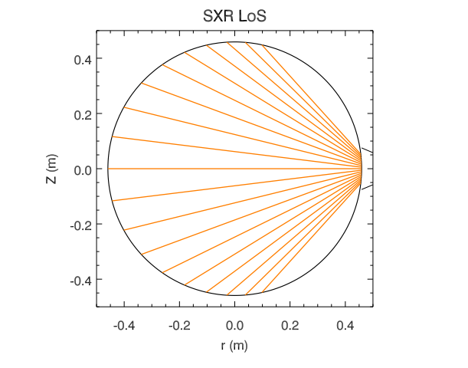
Electron Temperature measurements
Electron temperature (Te) is a key parameter in fusion experiments.
Diagnostic system: data is acquired through the Soft X-ray diagnostic
Problem: the acquired data is noisy and sometimes the electron temperature computation explodes leading to missing data
Solution: a Neural Network deployed on FPGA can reconstruct the temperature profile, also supplying the missing data points
Lines of sight of the Soft X-Ray diagnostic in the RFX-mod experiment.

Slide 3
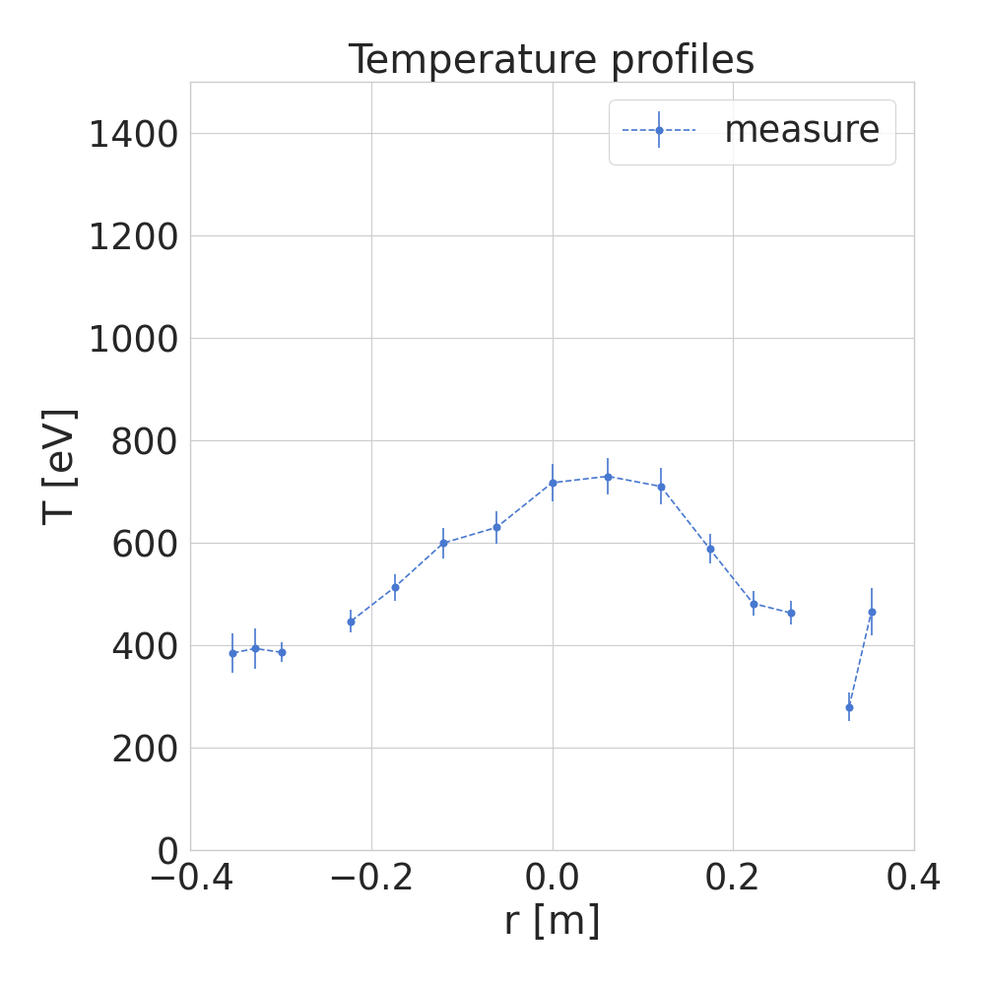
Problems with the Diagnostic
Electron temperature (Te) is a key parameter in fusion experiments.
Diagnostic system: data is acquired through the Soft X-ray diagnostic
Problem: the acquired data is noisy and sometimes the electron temperature computation explodes leading to missing data
Solution: a Neural Network deployed on FPGA can reconstruct the temperature profile, also supplying the missing data points
Missing points
Example of missing points in the temperature profile

Slide 4
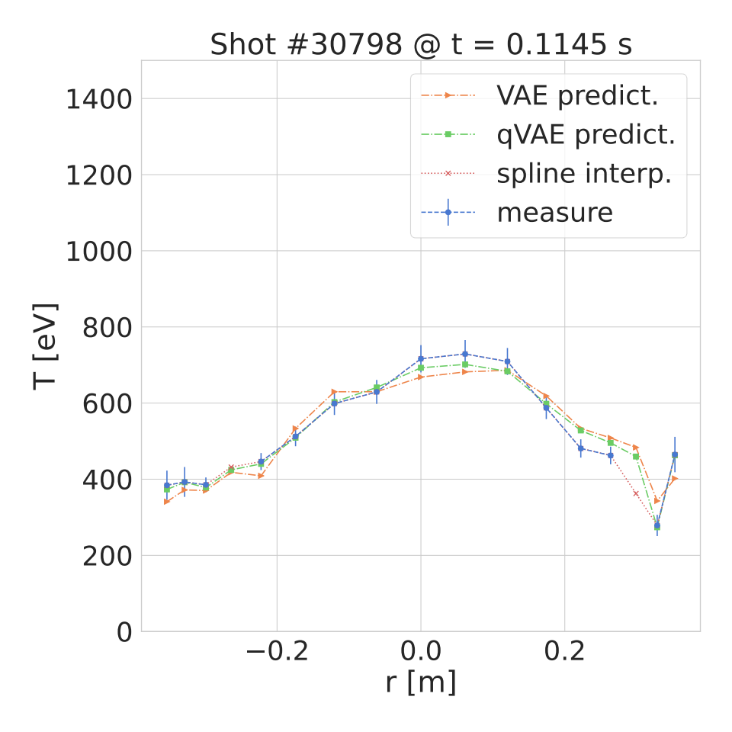
Reconstructing Electron Temperature Profiles
Electron temperature (Te) is a key parameter in fusion experiments.
Diagnostic system: data is acquired through the Soft X-ray diagnostic
Problem: the acquired data is noisy and sometimes the electron temperature computation explodes leading to missing data
Solution: a Neural Network deployed on FPGA can reconstruct the temperature profile, also supplying the missing data points
Metti immagine dell’architettura
Reconstruction of a temperature profile with float32 model, quantized model, Bspline and raw measure.

Slide 5
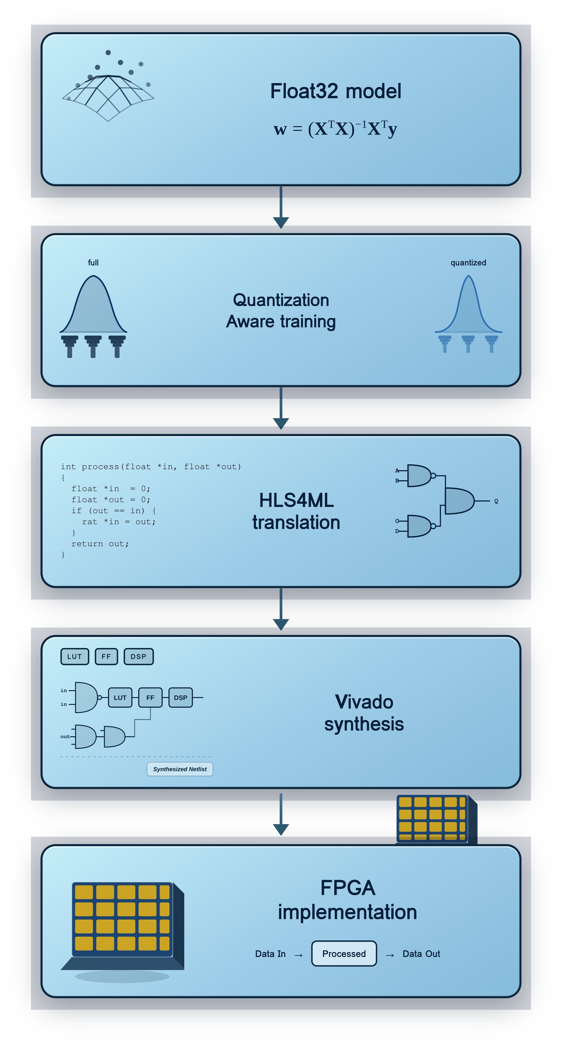
Work Flow
1) Start from training a float32 model
2) Apply quantization aware training with HGQ
3) Translate the model to HLS with HLS4ML
4) Synthesize it using Vivado
5) Deploy it on your FPGA of choice

Slide 6
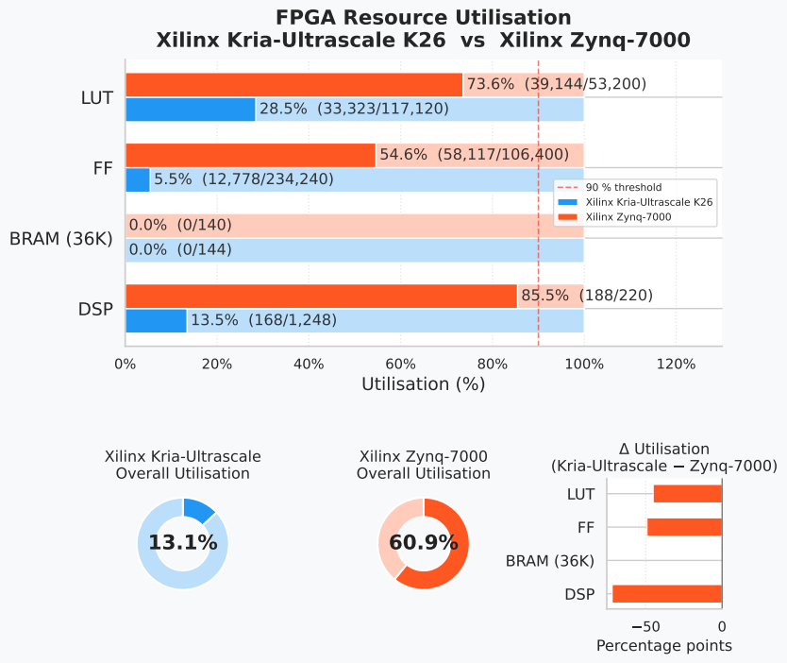
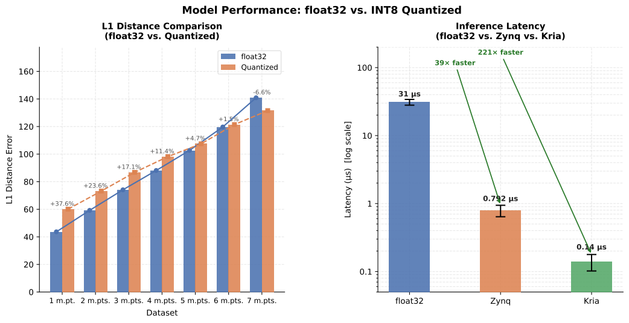
Accuracy and Resource utilization on FPGA

Slide 7
Thank you!
Also many thanks to the co-authors:
A. Rigoni Garola, L. Saccaro, P. Franz, M. Gobbin, L. Piron, R. Cavazzana
Luca.orlandi@igi.cnr.it

