Slide 1
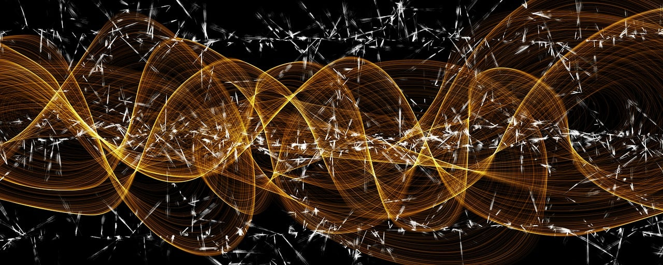

Real-Time FPGA-Based SiPM Detector Emulation using
Temporally Quantized Model
S. Carsi^{1,2,*}, E. Proserpio^{1,2}, A. Abba¹, F. Caponio¹, V. Arosio¹
  *Speaker: s. carsi@nuclearinstruments.eu
  1. Nuclear Instruments SRL
  2. Università degli Studi dell’Insubria
IEEE Realtime 2026 – La Biodola, Isola d’Elba (Italy)
May 27th, 2026
Notes:
Good morning Everyone and thanks for having me here today. I’m Stefano Carsi and I am a firmware developer at Nuclear Instruments.
Today I present you our work on a Real-Time FPGA-Based SiPM Detector Emulation using Temporally Quantized Model

Slide 2
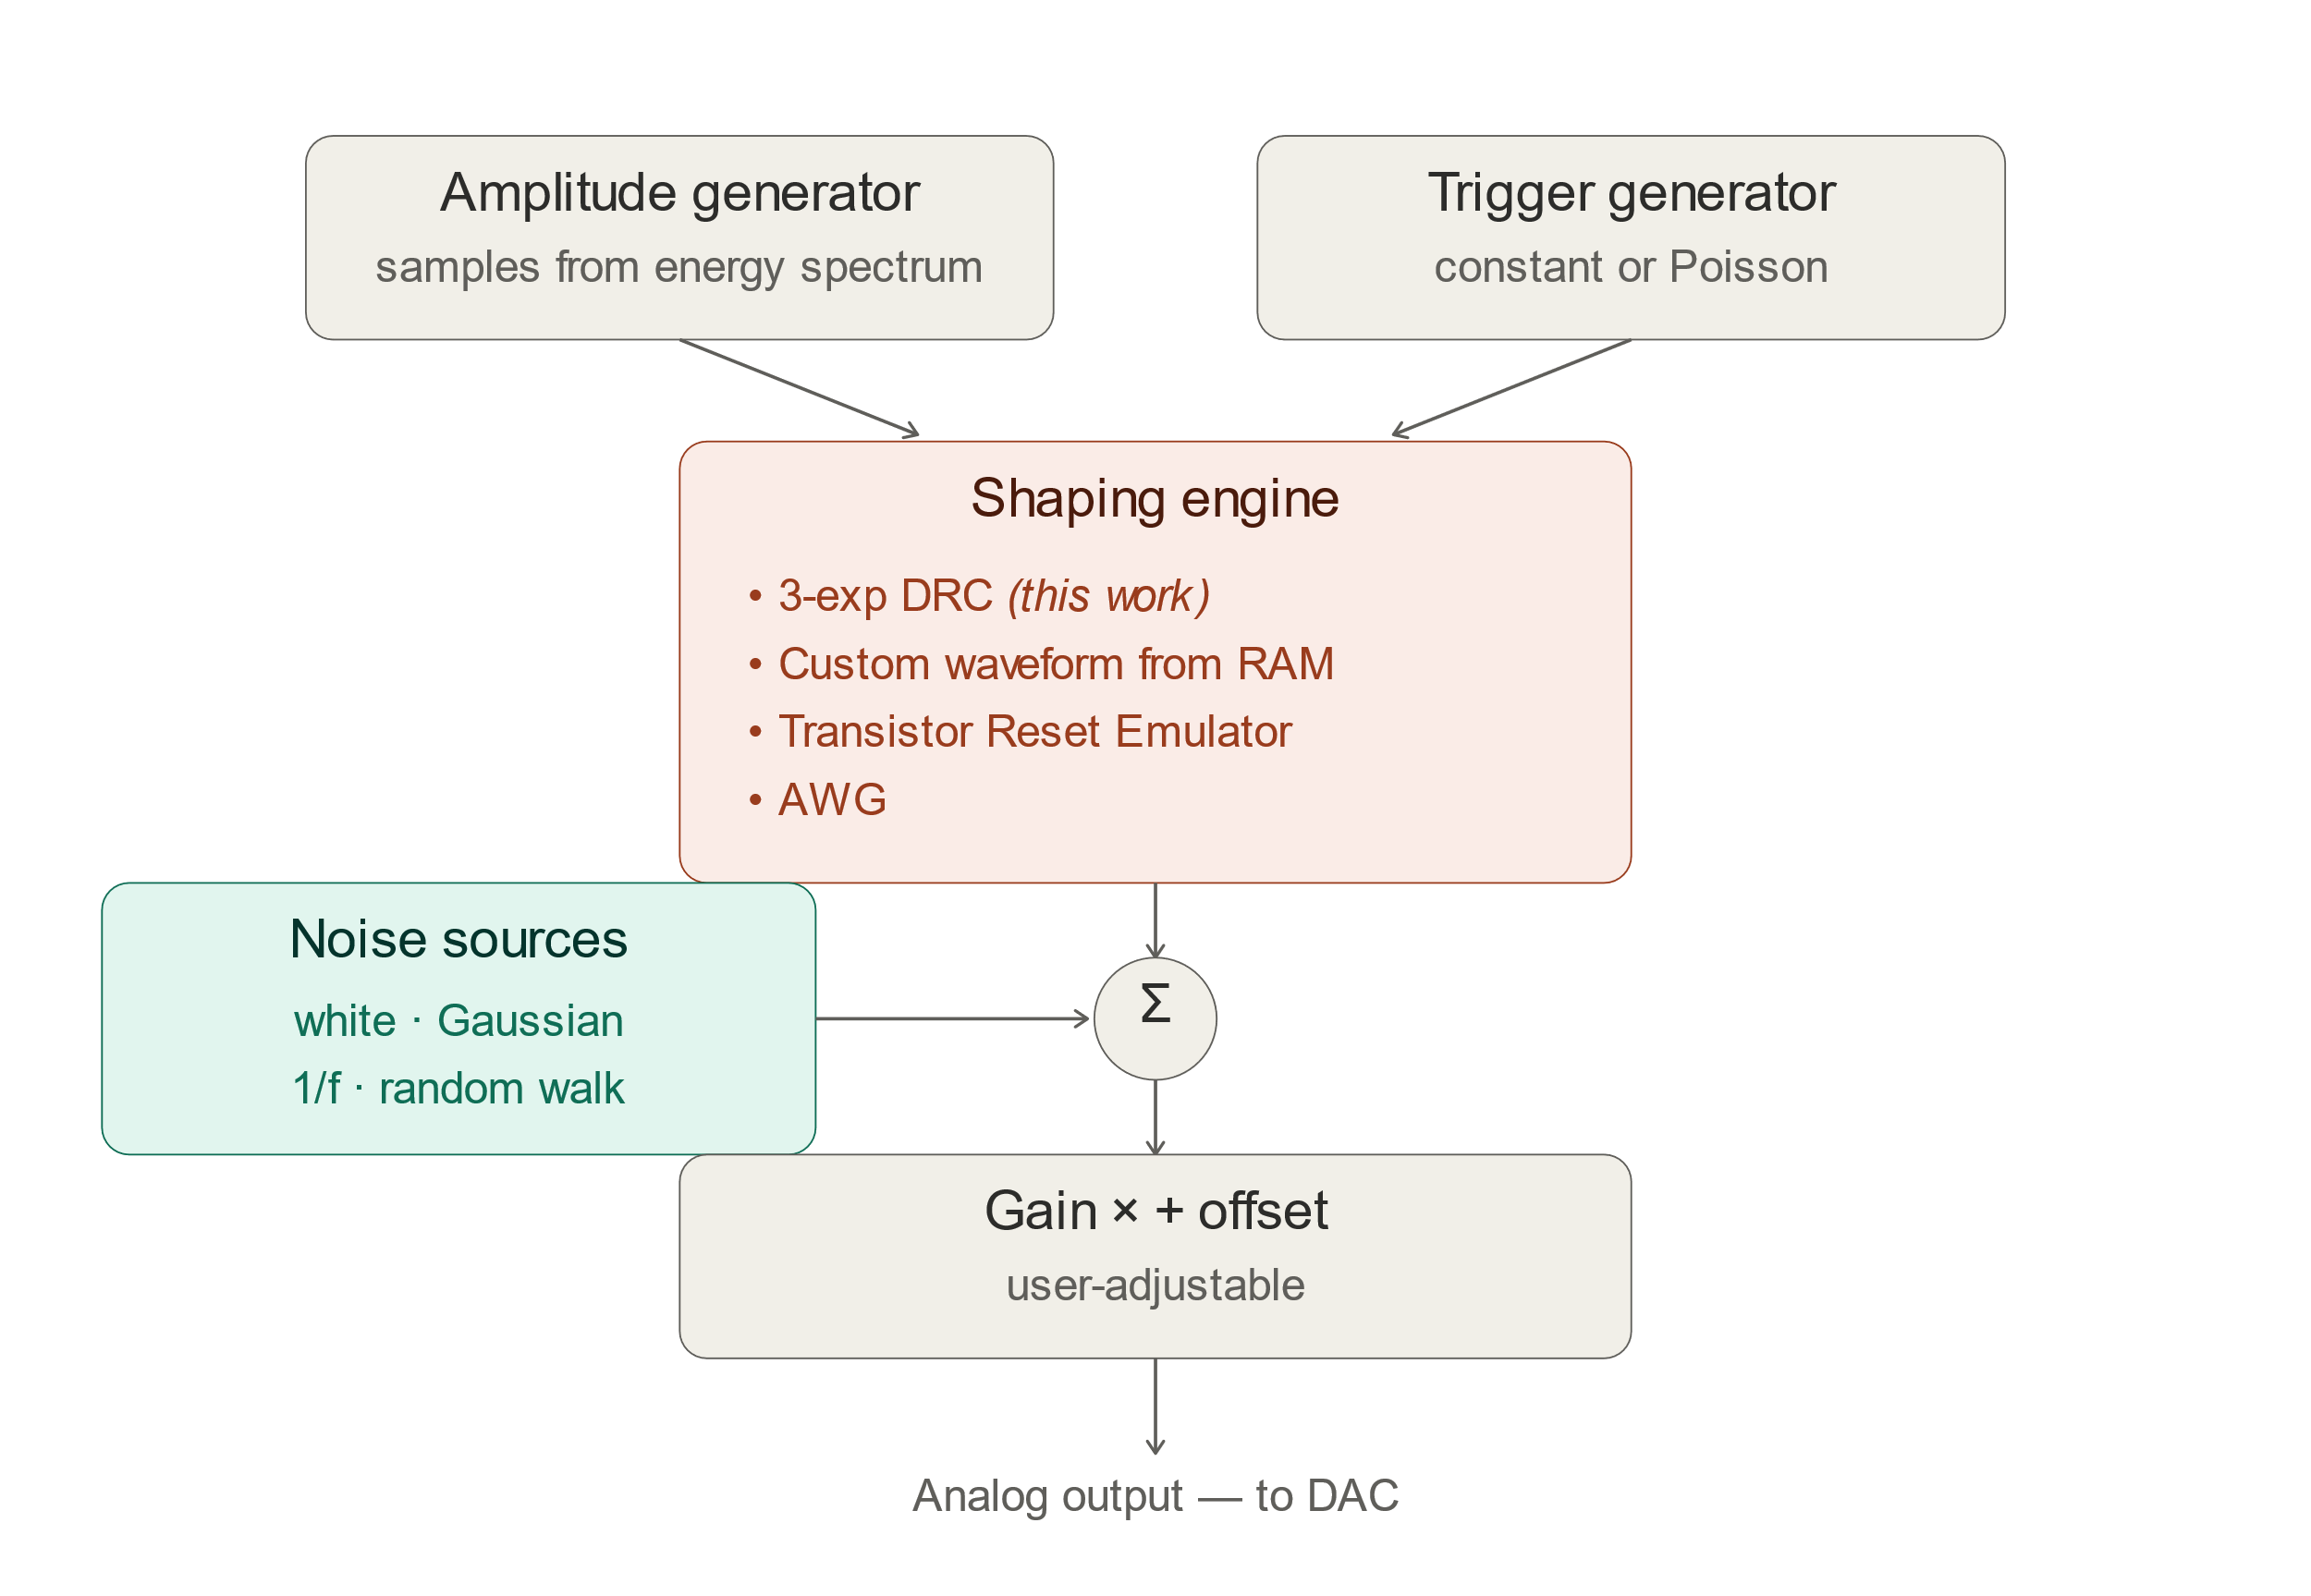
What is a detector emulator?
What it is
An instrument that generates analog signals indistinguishable from a real detector
Use cases:
Front-end characterization (preamp, shaper, ADC, trigger) without physical detector
Hardware-in-the-loop validation of firmware/DAQ
Stress testing under controlled rate, pile-up, background
Perfect ground truth for reconstruction-algorithm validation
Key differentiator vs AWGs
Reproduces detector physics, not just a fixed waveform → runtime-controlled response
2
Notes:
Let me start with some background. A detector emulator is an instrument that generates analog signals identical to indistinguishable from the one coming from a real particle detector.
You can use it to characterize frontend electronics without a physical detector or radiation source. It also lets you stress-test your DAQ under controlled, fully reproducible conditions
The diagram on the right shows our layout. An amplitude generator — constant or sampled from a spectrum — and a trigger generator — constant periodic or Poisson — feed the shaping engine, which produces the analog waveform. After that, you can add noise, gain, and offset, and send everything to the DAC.
The key difference from an Arbitrary Waveform Generator is that we reproduce detector physics, not a fixed waveform

Slide 3
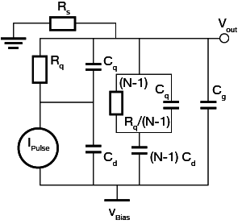
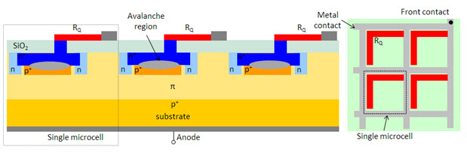
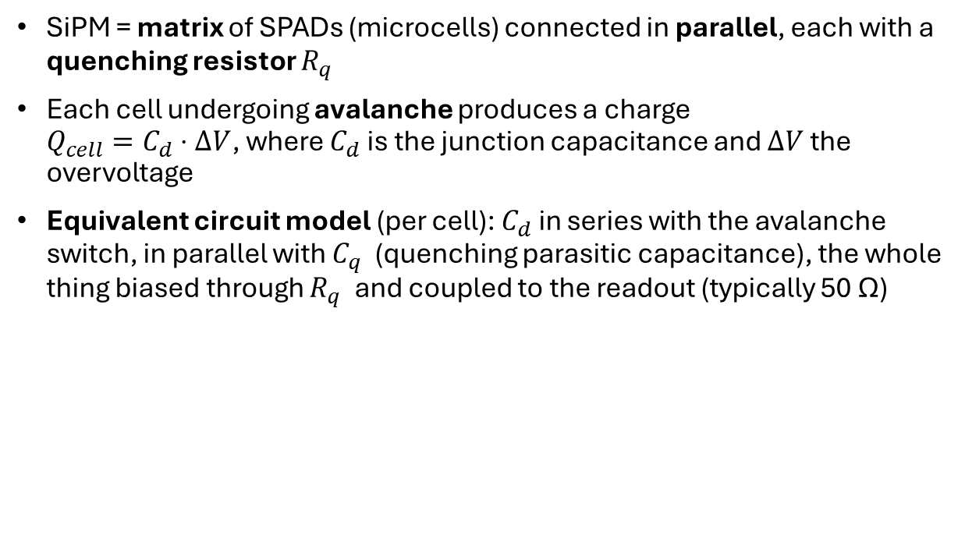
Silicon Photomultipliers (SiPM) basics
SiPM = matrix of SPADs (microcells) connected in parallel, each with a quenching resistor $R_{q}$
Each cell undergoing avalanche produces a charge
$Q_{cell}=C_{d}⋅ΔV$, where $C_{d}$is the junction capacitance and $ΔV$ the overvoltage
Equivalent circuit model (per cell): $C_{d}$​ in series with the avalanche switch, in parallel with $C_{q}$​ (quenching parasitic capacitance), the whole thing biased through $R_{q}$​ and coupled to the readout (typically 50 Ω)
3
Notes:
Quick reminder on Silicon Photomultipliers — most of you know these detectors already.
A SiPM is an array of avalanche photodiodes operated in Geiger mode, with all outputs in parallel. When a photon hits a cell, it triggers an avalanche, and a quenching resistor shuts it down.
On the right you see the equivalent circuit per cell with Rs the readout impedance — that's what we solve to get the waveform.

Slide 4
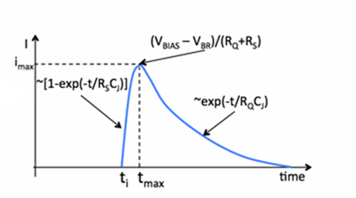
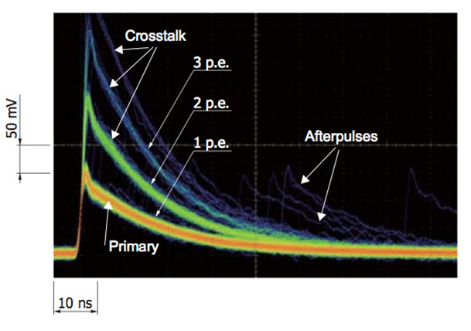
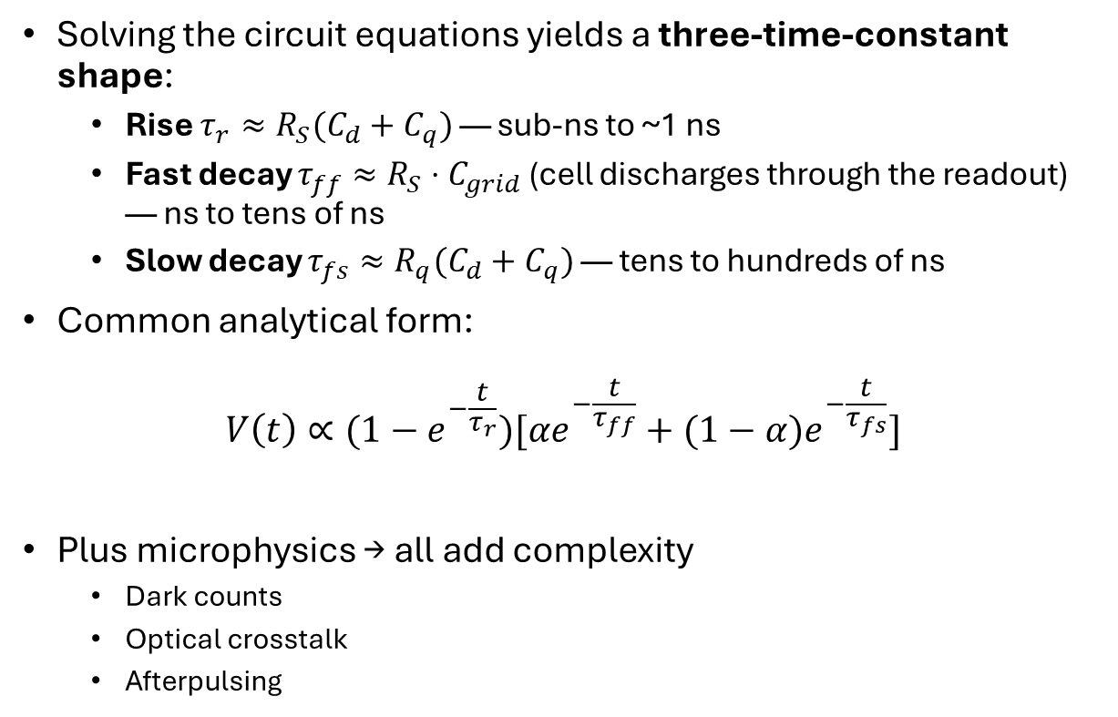
SiPM Signal Shape
Solving the circuit equations yields a three-time-constant shape:
  Rise $τ_{r}≈R_{S}(C_{d}+C_{q})$ — sub-ns to ~1 ns
  Fast decay $τ_{ff}≈R_{S}⋅C_{grid}$ (cell discharges through the readout) — ns to tens of ns
  Slow decay $τ_{fs}≈R_{q}(C_{d}+C_{q})$ — tens to hundreds of ns
Common analytical form:
$$V\left(t\right)∝(1−e^{−\frac{t}{τ_{r}}})[αe^{−\frac{t}{τ_{ff}}}+(1−α{)e}^{−\frac{t}{τ_{fs}}}]$$
Plus microphysics → all add complexity
  Dark counts
  Optical crosstalk
  Afterpulsing
4
Notes:
If we solve the circuit, the response comes out as three contributions: a rising exponential and two decaying ones, the fast decay and the slow decay. The slide shows the analytical form, where α is the fast-component fraction.
This is just the response of one cell, regardless of what triggered the avalanche. And in real SiPMs there are extra effects we have to account for: – dark counts, when a cell fires on its own due to thermal excitation – optical crosstalk, when a photon emitted during one avalanche reaches a neighboring cell and triggers a second one – afterpulsing, when a carrier trapped during the avalanche is released later and triggers a delayed pulse

Slide 5
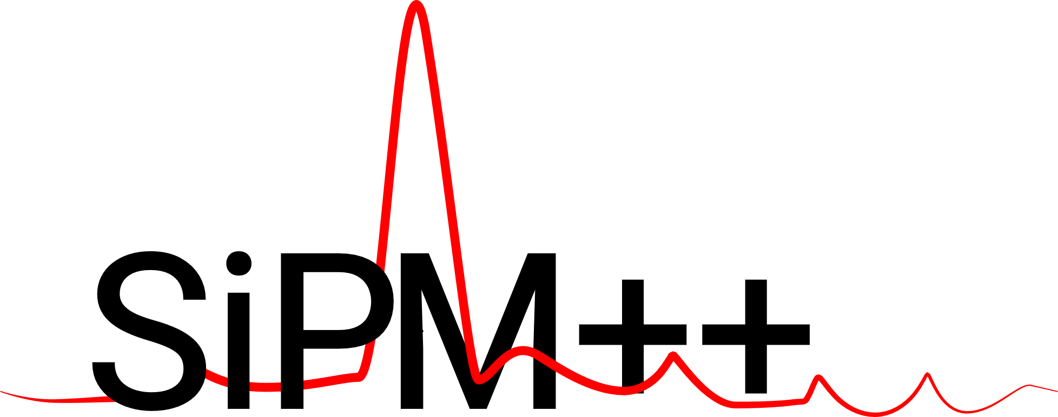

SimSIPM
Open-source framework for cell-by-cell simulation of the SiPM response
Models PDE, optical crosstalk, afterpulsing, and dark counts at the microscopic level
Output:
List of "photon hits" with timestamp and amplitude, at arbitrary temporal and amplitude resolution (idealized)
Fixing the timing constants, you can build the waveform
Limitation:
Runs on CPU, not real-time, produces abstract high-resolution waveforms
Good for offline studies
Not designed to drive an analog output in real time
https://github.com/edopro98/simsipm
5
Notes:
One last piece of background — SimSiPM. It's an open-source framework that simulates SiPM response cell by cell: it models PDE, optical crosstalk, afterpulsing, and dark counts at the microscopic level.
The output is a list of photon hits — timestamp and amplitude — at arbitrary time and amplitude precision. From those hits, you can build a waveform once you fix the time constants.
The catch: SimSiPM runs on a CPU. Great for offline studies, not designed to drive an analog output in real time.

Slide 6
Motivation: from "PC simulator" to real-time emulator
Goal:
Real-time SiPM channel for our next-gen detector emulator
Targets:
No precomputed waveforms — fully in-hardware shaping
Physical accuracy: 3-exp shape + microphysics
16-bit @ 2.5 GS/s analog output (DAC)
Low CPU overhead, low and deterministic latency
Challenge
Stream photon-hit sequences
Shape in real time on FPGA
6
Notes:
Our goal is to design a real-time SiPM channel for the next-gen detector emulator.
The targets is that all the shaping has to happen on the FPGA, because the DACs run at 2.5 GS/s, 16-bit. So we want the FPGA to receive just a few high-level event parameters and compute the waveform itself.
We also want to keep physical accuracy of the full three-exponential model.
The challenge is to stream photon-hit sequences and shape in real time on the FPGA.

Slide 7
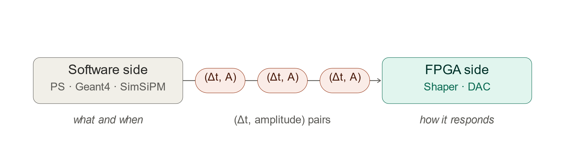
Core idea: decouple event generation from signal shaping
Software side (PS / Geant4 / SimSiPM): produces event lists — what and when
FPGA side: shapes events into analog waveforms — how the detector responds
Wire format: lists of (Δt, amplitude) pairs — Δt = inter-arrival time
Implications:
Drastic bandwidth reduction vs streaming raw waveforms
Detector model parameters reconfigurable at runtime — no re-synthesis
Single shaping core ↔ many physics models
7
Notes:
The core idea is to decouple event generation from signal shaping.
The software side produces a list of interarrival time-amplitude pairs, it handles the what and the when.
The FPGA side takes those events and shapes them into the analog waveform, it generates the response of the detector.
The payoff is a drastic drop in bandwidth compared to streaming raw waveforms

Slide 8
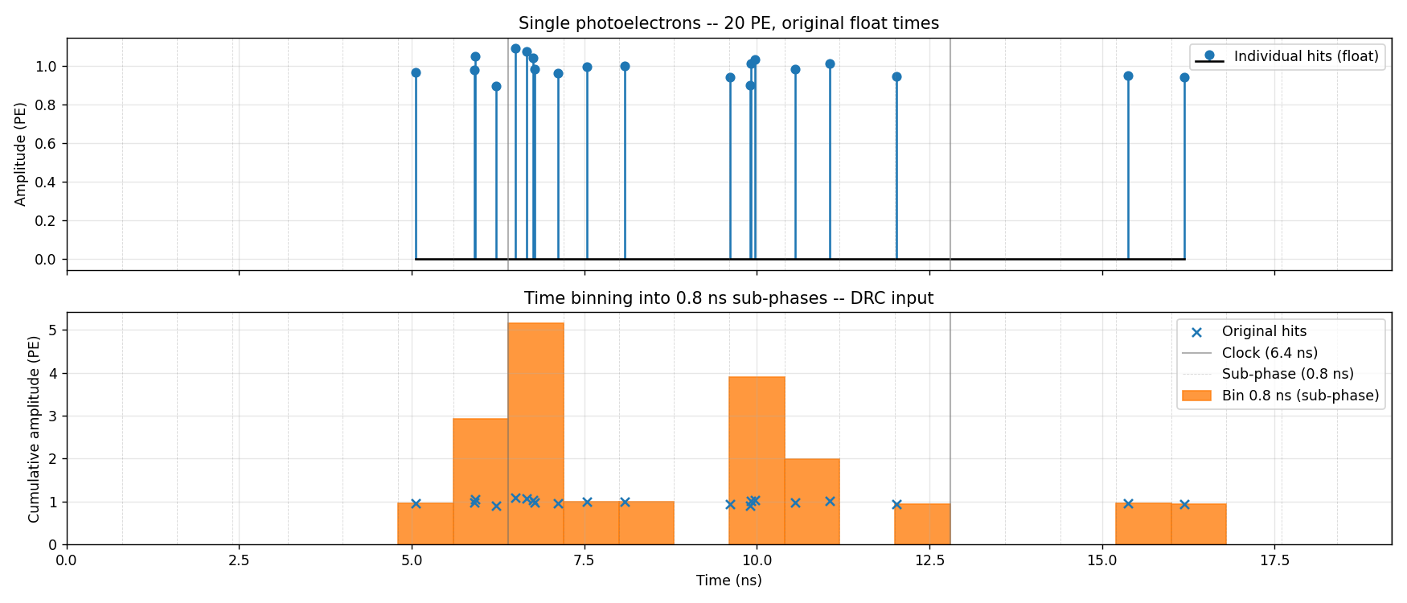
Three-stage temporal hierarchy
Coarse — fabric clock @ 156.25 MHz → 6.4 ns cycle
Fine — 8 sub-phases per cycle → 0.8 ns spacing
8-bit trigger vector + 8 parallel amplitudes
Pile-up natively absorbed (multiple sub-phase hits in same cycle = superposition)
Output — 2× linear interpolation → 16 DAC samples/cycle @ 0.4 ns = 2.5 GS/s
Effective trigger time resolution: 0.8 ns at 156 MHz fabric clock
Transmit only non-empty bins
8
Notes:
Now let's look at the algorithm in detail. On a CPU you have arbitrary-precision timestamps. In digital hardware, time is discrete — everything moves on the clock beat. Our firmware runs at 156.25 MHz, and inside each cycle we handle 8 sub-phases
To bridge the gap, the software bins the simulation events: one bin per sub-phase, and any hits that fall in the same bin are summed.
We transmit only the non-empty bins, as (sub-phase index, summed amplitude) pairs.

Slide 9
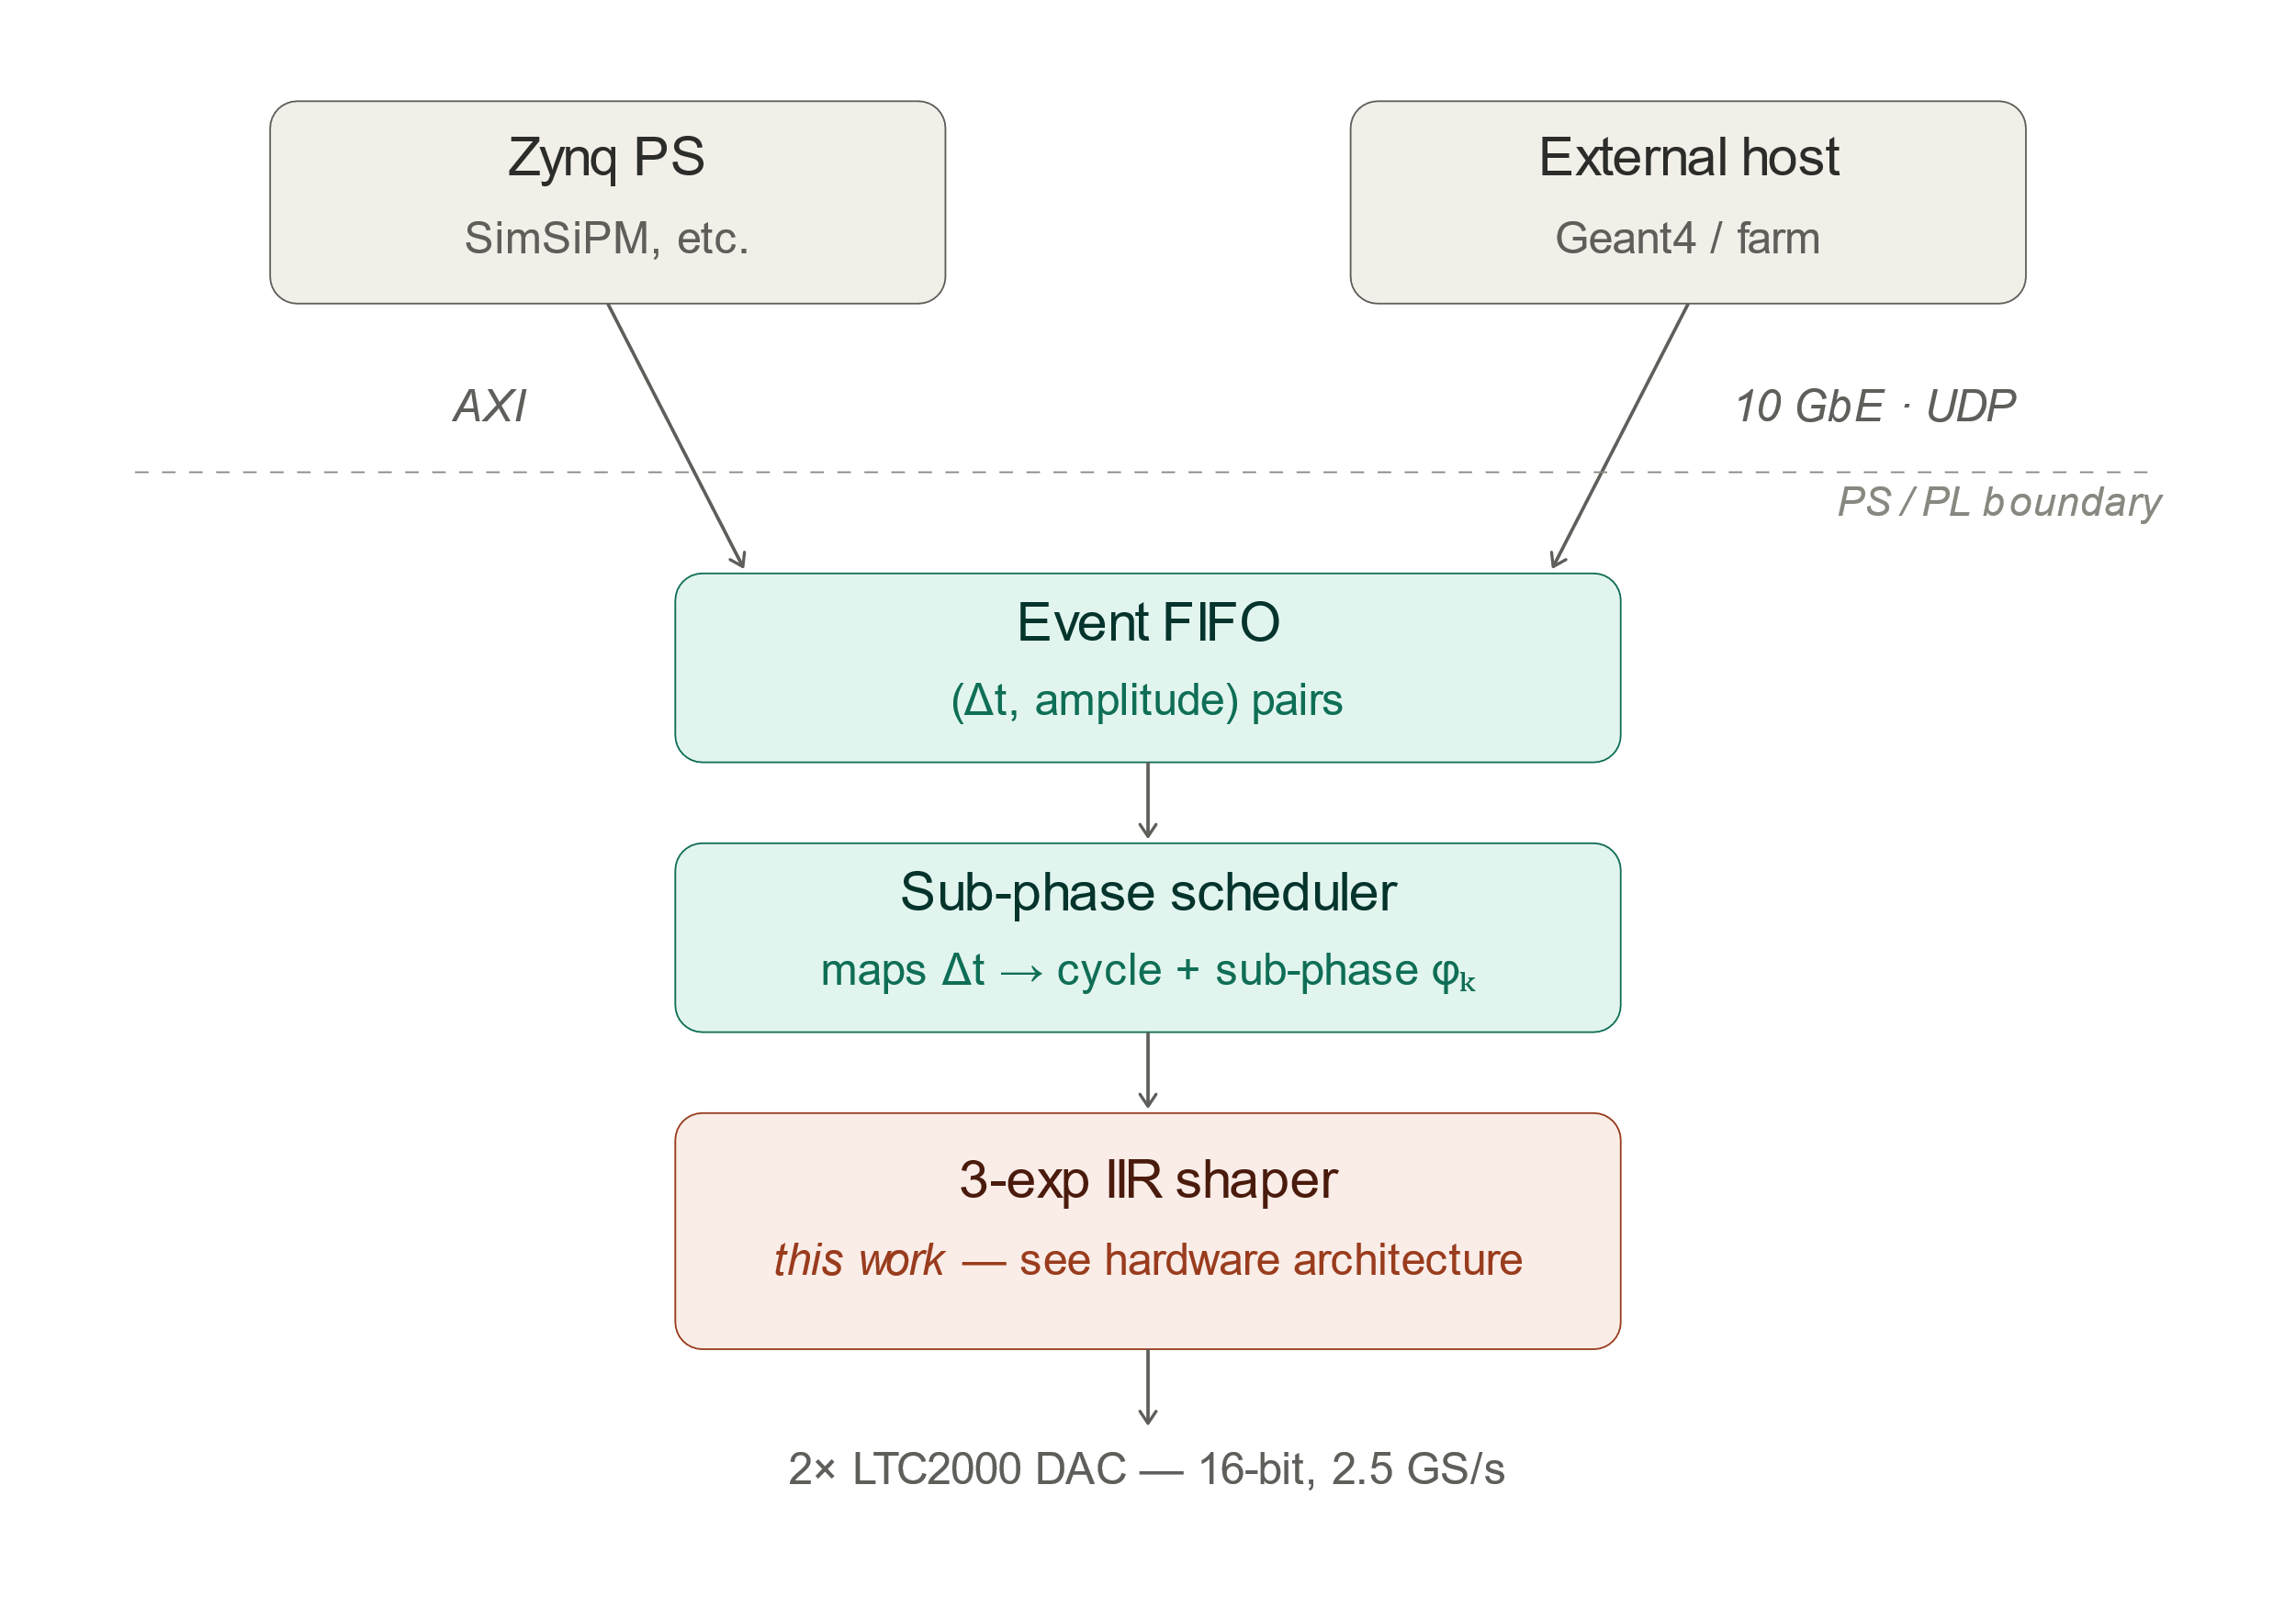
System architecture + data path
Event format: (Δt, amplitude) pairs
Δt = inter-arrival time vs previous event
Temporal quantization done upstream (PS or UDP sender) — keeps the PL lean
10 GbE connects directly to the PL — bypasses the PS for high-throughput streaming
Two input paths share the same downstream pipeline
9
Notes:
Here's the system architecture. The quantized events come in from one of two paths: either from the Zynq processing system over AXI, or streamed from an external host via 10-gigabit UDP. The 10G link goes directly into the PL, bypassing the PS, so we don't bottleneck on software when the rate goes up.
Both paths feed the same Event FIFO. A sub-phase scheduler then groups all events that belong to a given clock cycle and hands them to the shaping core — which I'll cover next.

Slide 10
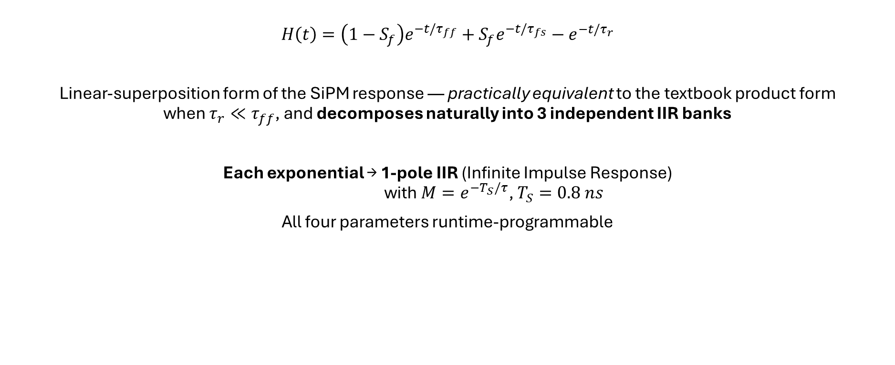
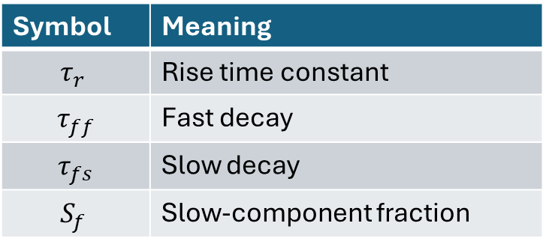
Emulated signal equation + shaping implementation
$$H\left(t\right)=\left(1−S_{f}\right)e^{−t/τ_{ff}}+S_{f}e^{−t/τ_{fs}}−e^{−t/τ_{r}}$$
Linear-superposition form of the SiPM response — practically equivalent to the textbook product form
when $τ_{r}≪τ_{ff}$, and decomposes naturally into 3 independent IIR banks
Each exponential → 1-pole IIR (Infinite Impulse Response)
with $M=e^{−T_{S}/τ}$, $T_{S}=0.8 ns$
All four parameters runtime-programmable
Symbol | Meaning
$$τ_{r}$$ | Rise time constant
$τ_{ff}$ | Fast decay
$τ_{fs}$ | Slow decay
$$S_{f}$$ | Slow-component fraction
10
Notes:
This is the response we implement in the core. It's mathematically equivalent to the more general form I showed earlier, when the rise time is much shorter than the decays — which holds for any realistic SiPM.
The key point is that this form is a linear superposition of three exponentials, so it decomposes naturally into three independent IIR banks. Each pole becomes a one-pole IIR with M = exp(−Ts/τ)

Slide 11
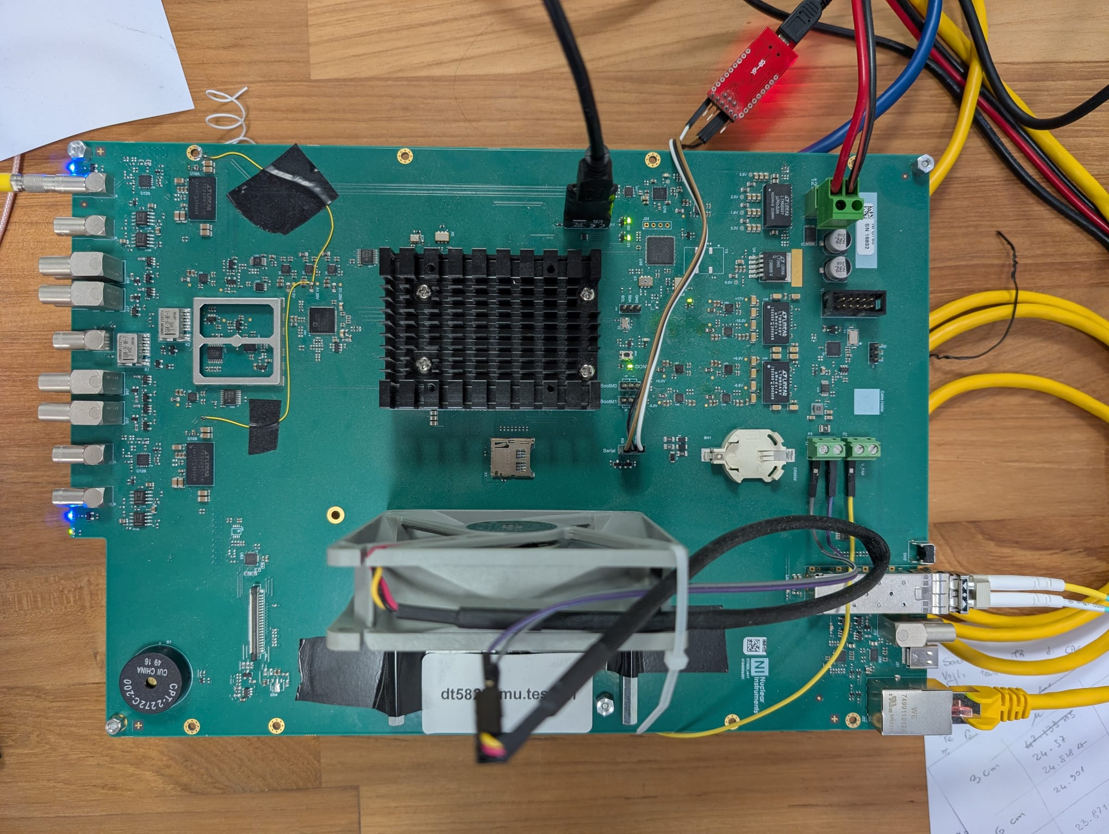
Hardware platform
2x LTC2000 DAC
16 bit - 2.5 GS/s
Zynq™ UltraScale+™ MPSoC
Chan 1 Analog output (Fast+HD)
Chan 2 Analog output (Fast+HD)
10G SFP
Transceiver
11
Notes:
This is the prototype board, with the main components labeled. At the center, the Zynq UltraScale+ MPSoC — that gives us both the ARM processing system and the FPGA fabric. On the right, the 10-gigabit SFP transceiver for the UDP path. And on the left, the two LTC2000 DACs — 16-bit, 2.5 GS/s — driving the two analog channels.

Slide 12
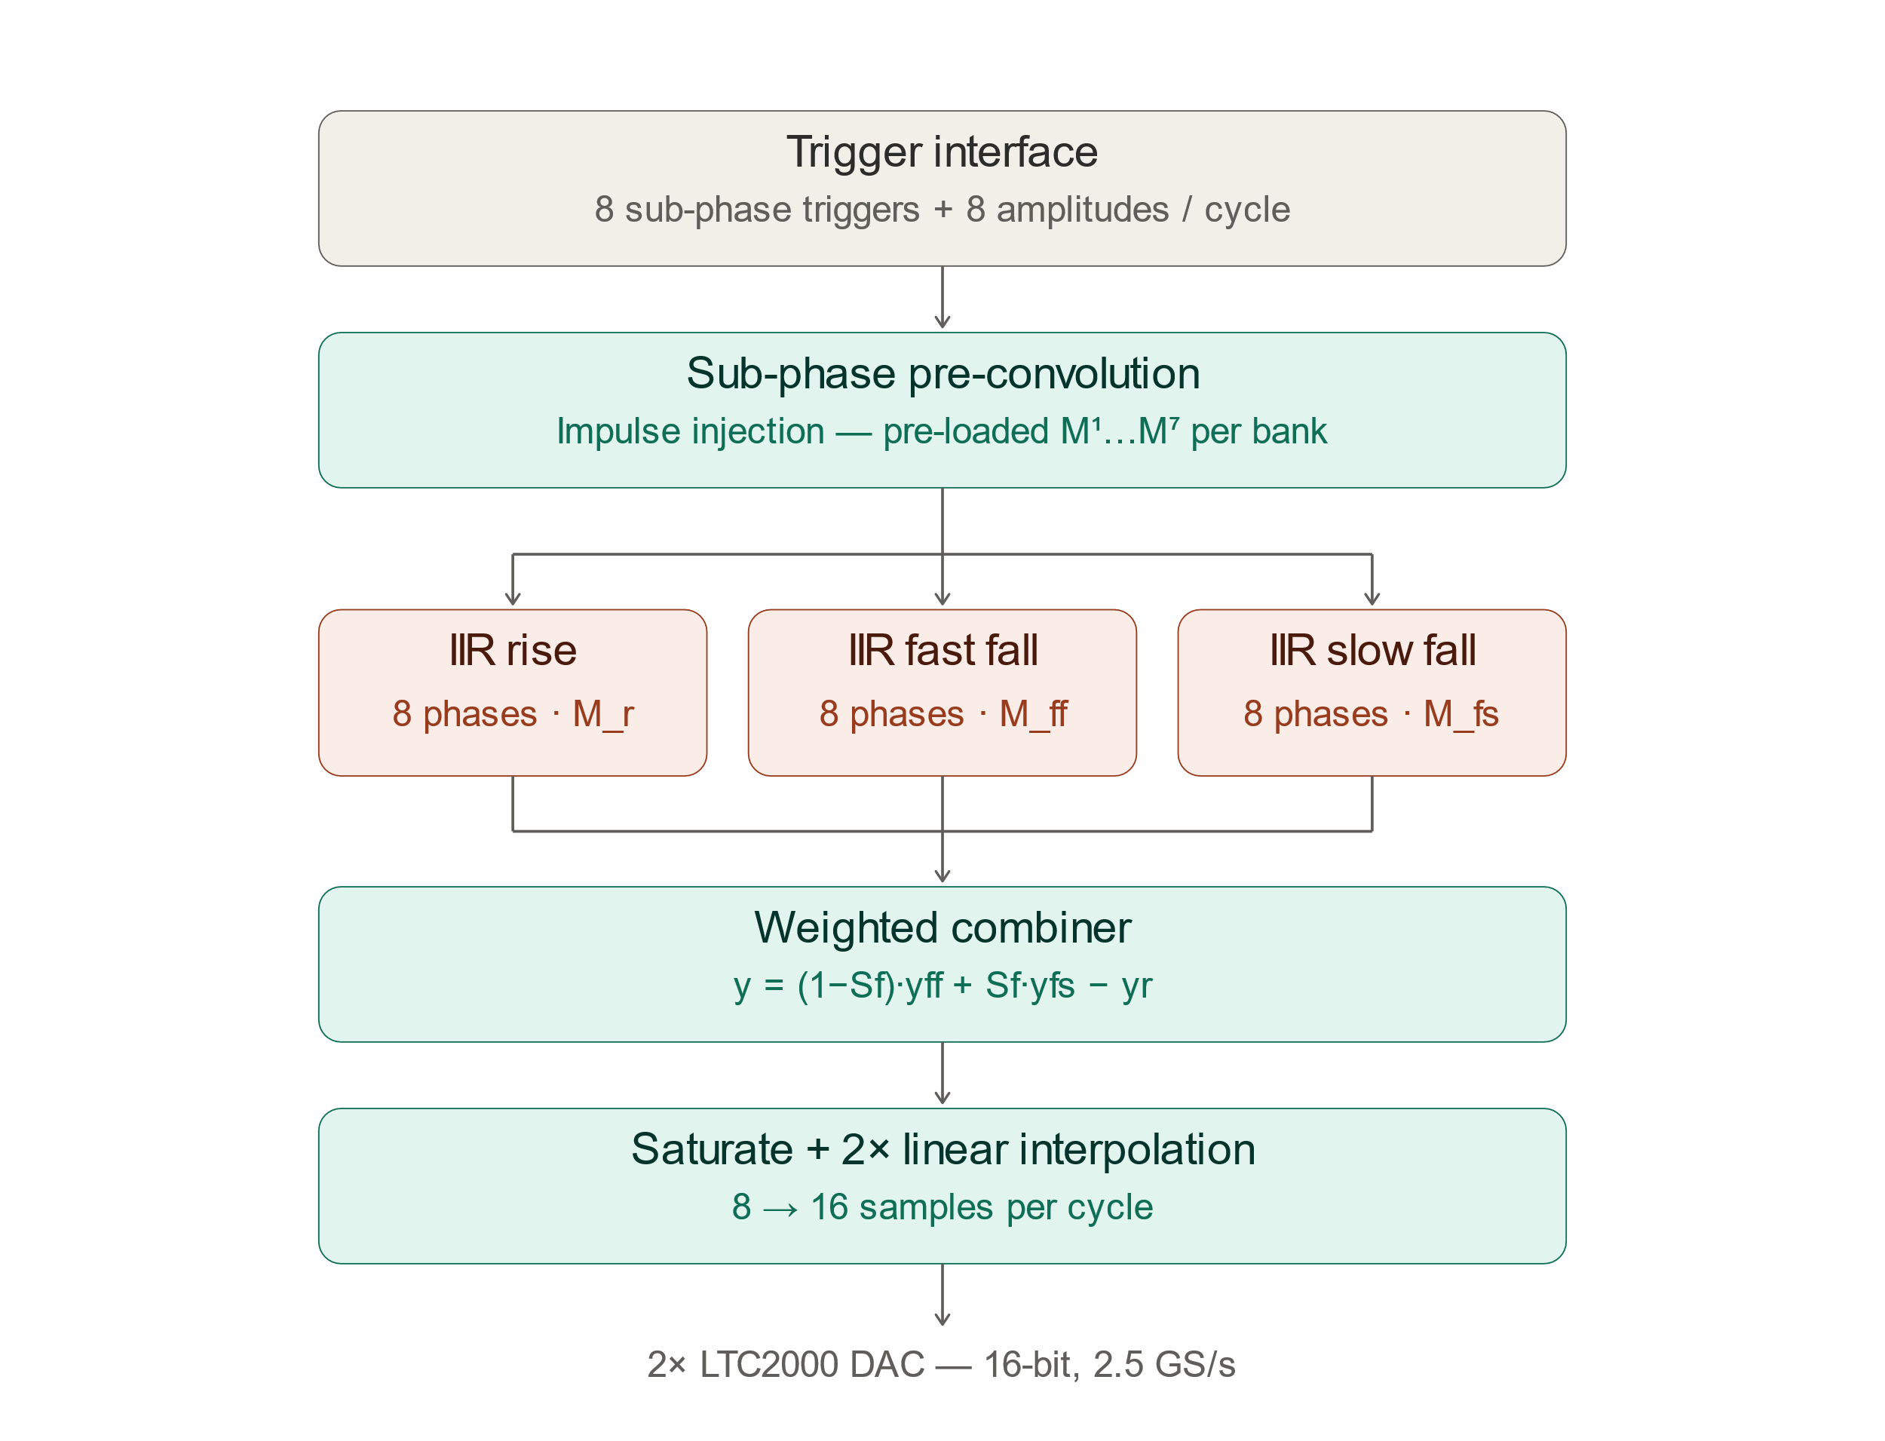
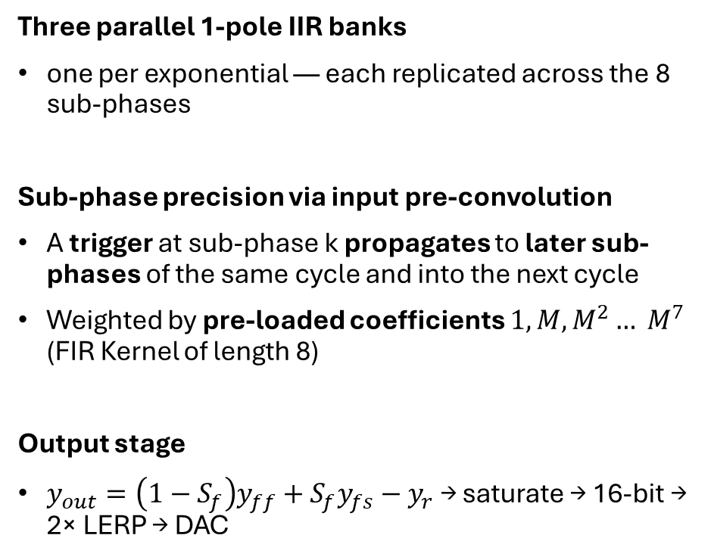
Hardware architecture
Three parallel 1-pole IIR banks
one per exponential — each replicated across the 8 sub-phases
Sub-phase precision via input pre-convolution
A trigger at sub-phase k propagates to later sub-phases of the same cycle and into the next cycle
Weighted by pre-loaded coefficients ${1, M,M}^{2}… M^{7}$ (FIR Kernel of length 8)
Output stage
$y_{out}=\left(1−S_{f}\right)y_{ff}+S_{f}y_{fs}−y_{r}$ → saturate → 16-bit → 2× LERP → DAC
12
Notes:
Here's the hardware architecture. The trigger interface receives, every cycle, 8 sub-phase triggers and 8 corresponding amplitudes.
Three parallel IIR banks process the signal, one per exponential — rise, fast fall, slow fall. They run in parallel, not in cascade, thanks to the linear-superposition form we saw before. Each bank is replicated across the 8 sub-phases.
To get sub-phase precision, we use a pre-convolution stage: a trigger arriving at sub-phase k propagates to the later sub-phases of the same cycle and into the next cycle, weighted by pre-loaded coefficients M¹ through M⁷.
At the output, a weighted combiner forms y = (1−Sf)·y_ff + Sf·y_fs − y_r, to yield the form we saw before.

Slide 13
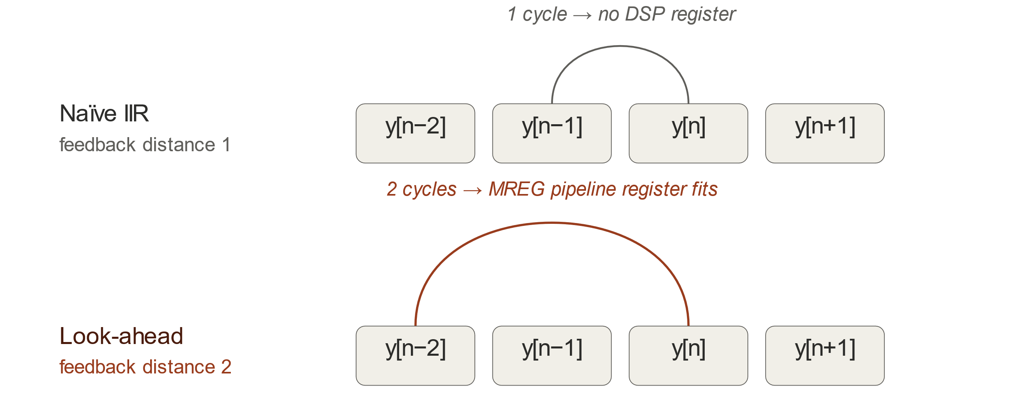
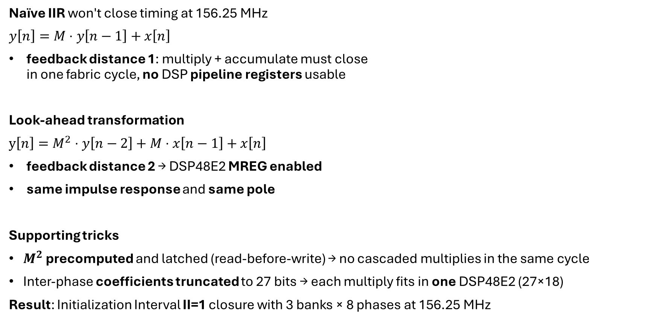
Timing closure: the look-ahead trick
Naïve IIR won't close timing at 156.25 MHz
$y\left[n\right]=M⋅y\left[n−1\right]+x\left[n\right]$
feedback distance 1: multiply + accumulate must close
in one fabric cycle, no DSP pipeline registers usable
Look-ahead transformation
$y\left[n\right]=M^{2}⋅y\left[n−2\right]+M⋅x\left[n−1\right]+x\left[n\right]$
feedback distance 2 → DSP48E2 MREG enabled
same impulse response and same pole
Supporting tricks
$M^{2}$ precomputed and latched (read-before-write) → no cascaded multiplies in the same cycle
Inter-phase coefficients truncated to 27 bits → each multiply fits in one DSP48E2 (27×18)
Result: Initialization Interval II=1 closure with 3 banks × 8 phases at 156.25 MHz
13
Notes:
The last technical piece is about the timing closure.
The naïve IIR equation y[n] = M·y[n−1] + x[n] has feedback distance 1: in one cycle you have to multiply, accumulate, and feed back.
You can't use the DSP pipeline registers because the result has to be ready in the same cycle it's used.
The look-ahead transformation rewrites the recursion as y[n] = M²·y[n−2] + M·x[n−1] + x[n] — feedback distance 2. Now you have two cycles to close the loop, which is exactly what you need to enable the MREG pipeline register inside the DSP48E2.
Same impulse response, same pole — just a different recursion structure.
This idea, along with some other tricks that I mentioned here, allowed us to close the timing reaching an II=1, meaning we can accept 8 triggers each clock cycle.

Slide 14
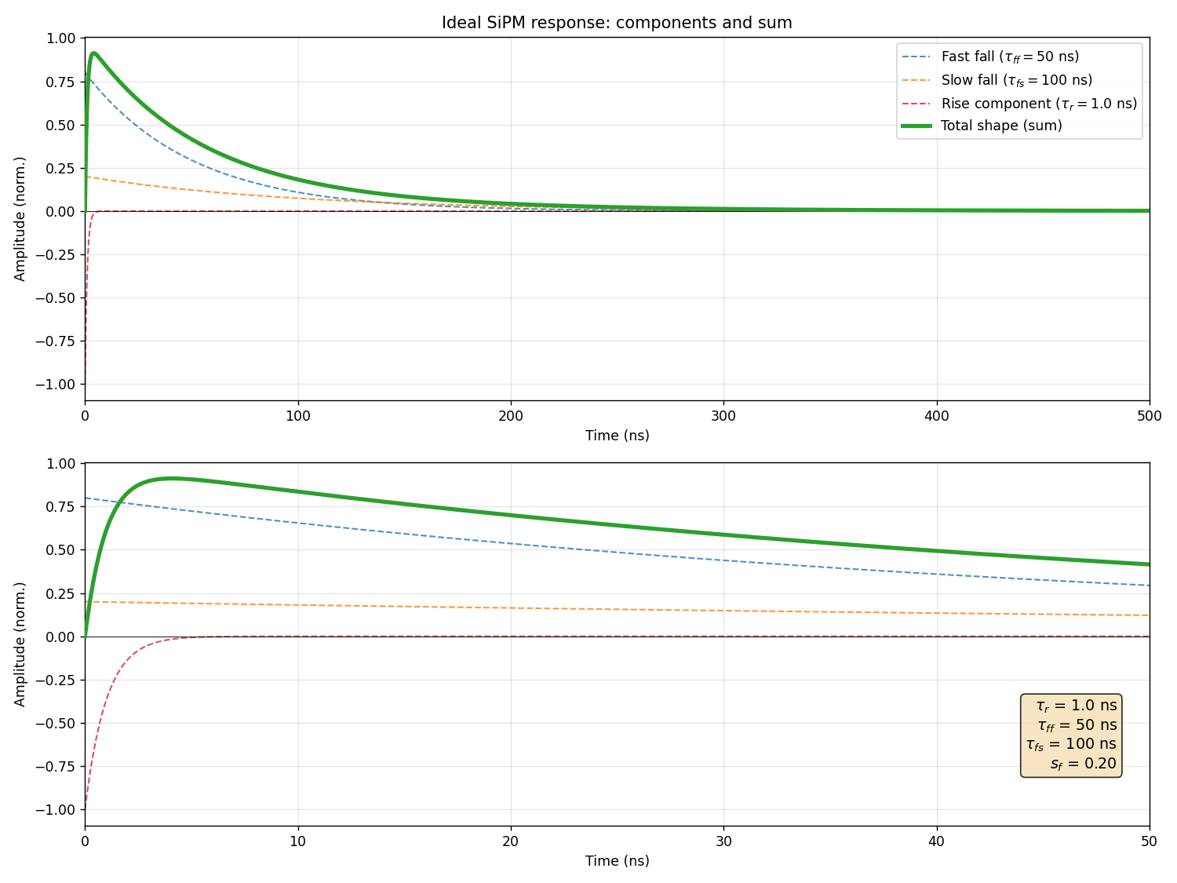
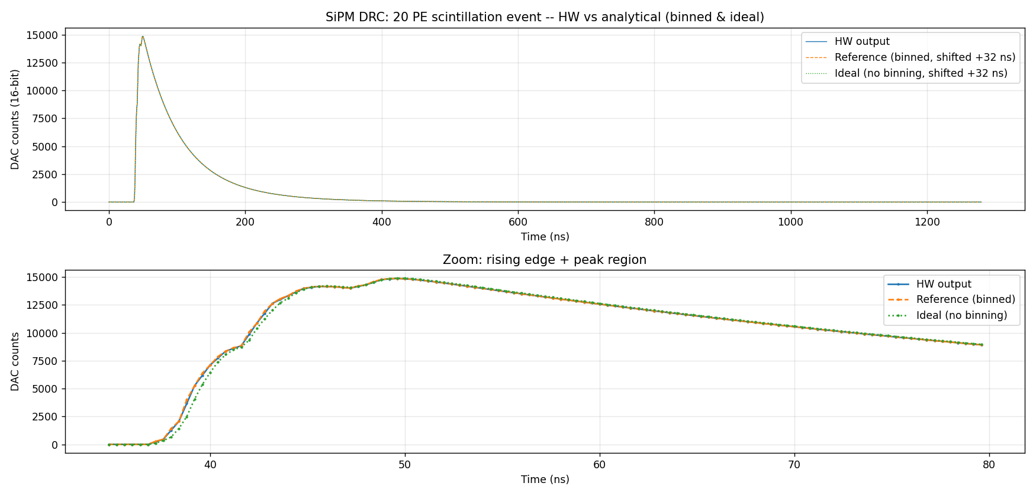
Resulting waveform – Comparison with SimSIPM
Validation: HW output vs analytical reference
(20 photo-electron event)
Blue dots: HW output of the core
Orange: simulation of the filter response
Good agreement, the filter is doing the job
Green: ideal 3 exponential response
The 0.8 ns quantization does not degrade the shape
14
Notes:
Now some results. We simulated a 20-photoelectron event — the same one I showed earlier on the quantization slide. The parameters I used are typical SiPM values — 1 ns rise, 50 ns fast decay, 100 ns slow decay, 20% slow fraction.
The plot on the left shows the full waveform on top, and a zoom on the peak region at the bottom. Blue dots are the hardware analog output. The orange curve is a software simulation of the same core. The green solid line is the reference computed from the three-exponential formula.
All three overlap to within DAC noise: the agreement with the binned simulation says the filter does its job, the agreement with the ideal curve says the 0.8 ns quantization doesn't degrade the shape.
The plot on the right shows the individual contributions of the three exponentials (dashed lines) and their sum — which is the analog output.

Slide 15
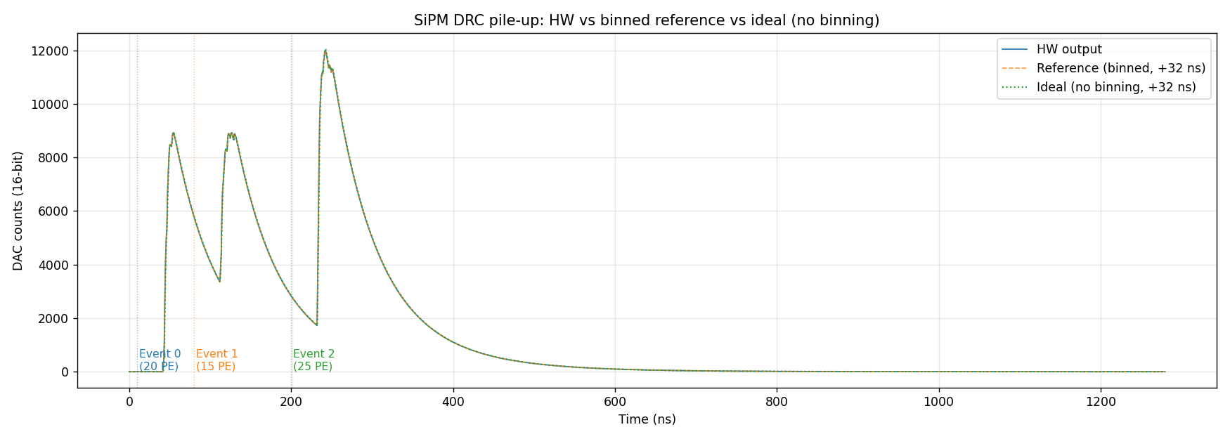
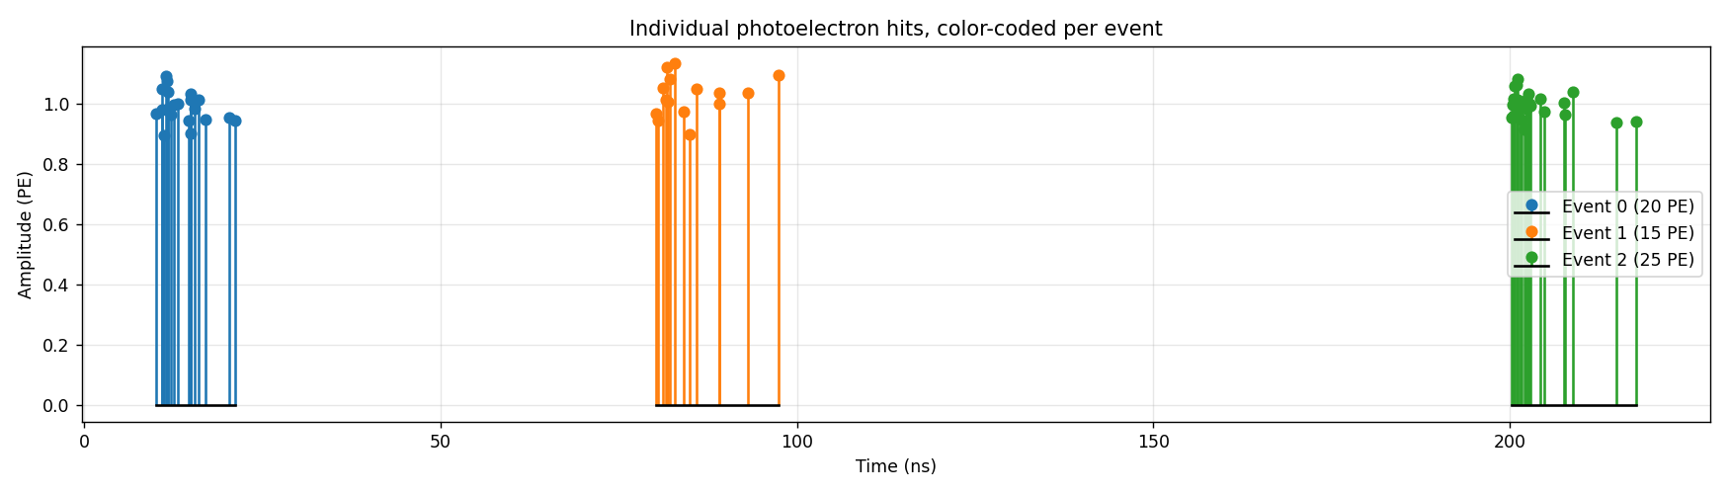
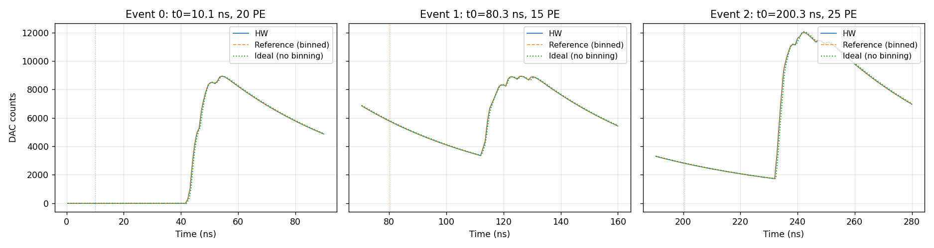
Pile-up validation: three overlapping scintillation events
3 events at t = 10, 80, 200 ns
HW output matches binned reference and ideal sum within DAC noise
15
Notes:
Here we show how the shaping core handles pileup. We generated three events close to each other with 20, 15, and 25 photoelectrons so that each event lands on the decay tail of the previous one.
The plot on the right shows the simulated photons before the temporal quantization, one color for each event, with their temporal and amplitude distribution.
The left other plots are the same as before: it presents the hardware output, the simulation of the shaping core and the reference curve computed from the response formula. Below and, a zoom on each peak region
The shape stays clean even when an event sits on top of a long decay tail. This is linear superposition working as expected — the IIR is a linear operator, so pile-up just adds.

Slide 16

Implementation status and FPGA resources
Status
working prototype
validation ongoing
Implementation
written in Vitis HLS (High Level Synthesis):
C++ code compiled into RTL
math-heavy DSP described at the algorithmic level
recursion and pre-convolution
DSP48E2: 235 used (≈ 65 IIR + ≈ 170 pre-convolution)
~10% of available DSP resources
Initializazion Interval II=1
16
Notes:
Quick word on the implementation.
The core is written in Vitis HLS — C++ code compiled into either VHDL or Verilog. High-level synthesis fits well here because the algorithm is math-heavy: you describe the recursion and the pre-convolution at the algorithmic level, and the timing tricks we just saw boil down to a handful of pragmas in the code.
Below is the HLS resource report. DSP usage is about 200 — roughly 65 for the IIR banks, 170 for the pre-convolution. That's around 10% of the available UltraScale+ DSP resources.
The key number is II = 1 — meaning the core accepts 8 sub-phase triggers and 8 amplitudes every fabric cycle

Slide 17
Generalization and use cases
Primary use case:
Front-end testbench Drives any analog-input front-end with realistic signals — no physical detector required
Beyond SiPMs:
Coupled with Geant4 Particle-level interactions → analog detector output, in real time
Pulse Shape Discrimination Tuning Sf + decay constants reproduces gamma vs neutron pulses in organic scintillators — same firmware, software-only switch
The shaping core is a primitive — any detector with a 3-time-constant response fits, no re-synthesis
17
Notes:
First the primary use case: front-end testbench. You connect the emulator output directly to the input of the front-end you're developing — preamp, shaper, ADC, whatever. The front-end sees signals indistinguishable from a real SiPM, with perfect ground truth and full reproducibility. No detector, no radioactive source.
Beyond SiPMs, two more things.
Coupled with Geant4: particle-level interactions go straight to the analog output, in real time.
Pulse Shape Discrimination: tuning Sf and the decay constants reproduces gamma versus neutron pulses in organic scintillators — same firmware, software-only switch.
Bottom line: the shaping core is a primitive. Any detector with a three-time-constant response fits, no re-synthesis.

Slide 18
Conclusions
Demonstrated
Real-time, physically-accurate SiPM emulation on FPGA
2.5 GS/s @ 16-bit output, 83 ns end-to-end shaping latency, II=1
Sub-phase trigger precision (0.8 ns) at modest 156.25 MHz fabric clock
Validated against analytical reference and SimSiPM, both single-event and pile-up
Architecture is general
Reusable shaping core for arbitrary 3-time-constant detectors
Next steps
End-to-end validation with real front-end electronics
PSD demonstration
Direct Geant4 → DAC pipeline
18
Notes:
To wrap up. We demonstrated real-time, physically accurate SiPM emulation on FPGA — 2.5 GS/s, 16-bit output, 83 ns end-to-end shaping latency, II = 1. Sub-phase trigger precision of 0.8 nanoseconds at a modest 156 MHz fabric clock. Validated against the analytical reference and SimSiPM, both at single-event and pile-up level.
The architecture is general — the same core works for any detector with a three-time-constant response.
Next steps: end-to-end validation with real front-end electronics, a PSD demonstration, and a direct Geant4-to-DAC pipeline.
Thank you for your attention.

Slide 19
Thanks for your attention!
Stefano Carsi
Nuclear Instruments SRL
s.carsi@nuclearinstruments.eu
19

Slide 20
Backup slides

Slide 21
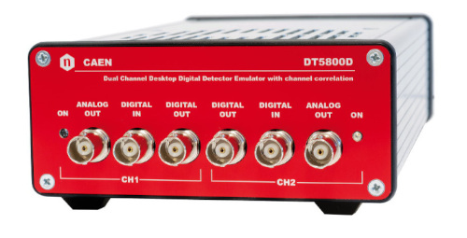
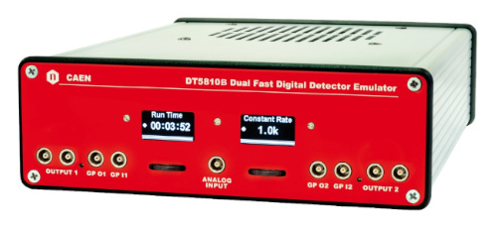
What is a detector emulator?
Detector emulator = an instrument that generates realistic analog signals "indistinguishable" from those of a real detector
What it's used for:
  Testing, debugging, and characterization of front-end electronics (preamp, shaper, ADC, trigger) without a physical detector
  Hardware-in-the-loop: validation of firmware/DAQ with reproducible, controlled scenarios
  Stress testing: rate, pile-up, backgrounds, anomalous conditions generated on demand
  Perfect ground truth: energy, timing, and multiplicity are known exactly → useful for validating reconstruction algorithms
Key advantage over arbitrary waveform generators: it reproduces the physics of the detector, not just a waveform
Caen DT5800
Caen DT5810

