Slide 1
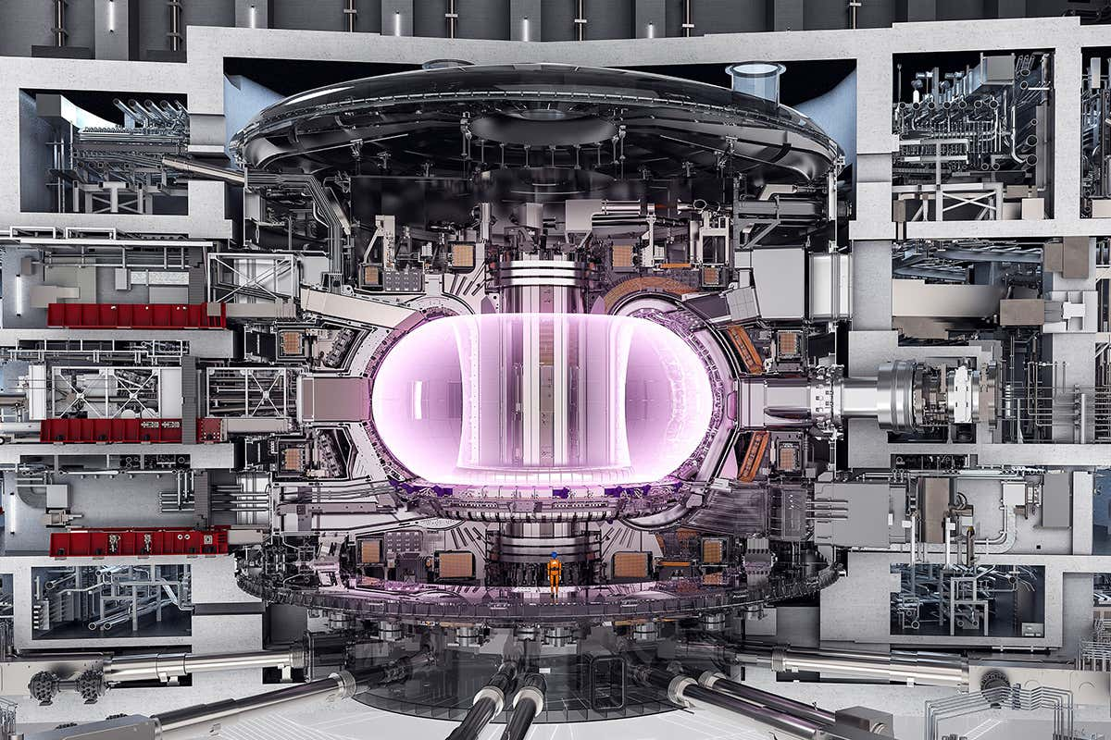
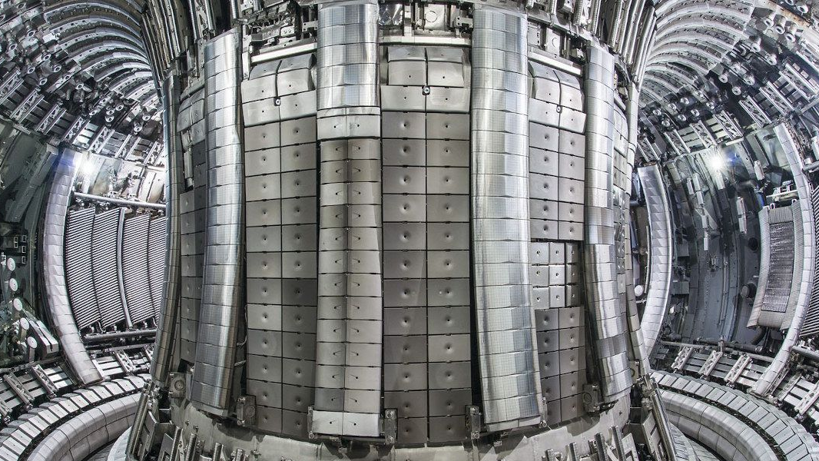



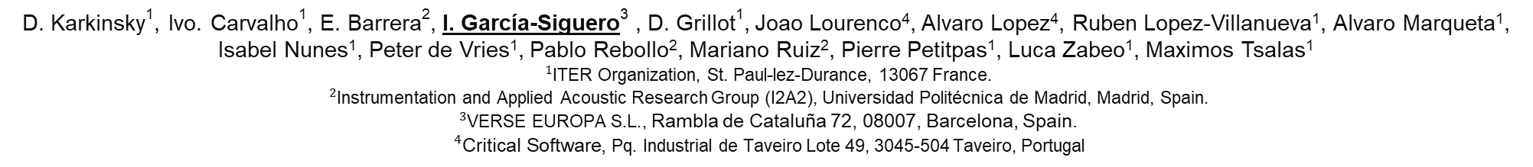
Configurable real-time emergency pulse termination system for investment protection in ITER’s interlock architecture
D. Karkinsky¹, Ivo. Carvalho¹, E. Barrera², I. García-Siguero³ , D. Grillot¹, Joao Lourenco⁴, Alvaro Lopez⁴, Ruben Lopez-Villanueva¹, Alvaro Marqueta¹, Isabel Nunes¹, Peter de Vries¹, Pablo Rebollo², Mariano Ruiz², Pierre Petitpas¹, Luca Zabeo¹, Maximos Tsalas¹
${}_{}^{1}{\text{ITER}}$ Organization, St. Paul-lez-Durance, 13067 France.
${}_{}^{2}{\text{Instrumentation}}$ and Applied Acoustic Research Group (I2A2), Universidad Politécnica de Madrid, Madrid, Spain.
${}_{}^{3}{\text{VERSE} \text{EUROPA} \text{S}\text{.}\text{L}\text{.}}$, Rambla de Cataluña 72, 08007, Barcelona, Spain.
${}_{}^{4}{\text{Critical} \text{Software}}$, Pq. Industrial de Taveiro Lote 49, 3045-504 Taveiro, Portugal
ACKNOWLEDGEMENTS
This work was supported under grant PID2022-137680OB-C33 funded by MCIN/AEI/10.13039/501100011033
- The views and opinions expressed herein do not necessarily reflect those of the ITER Organization -

Slide 2
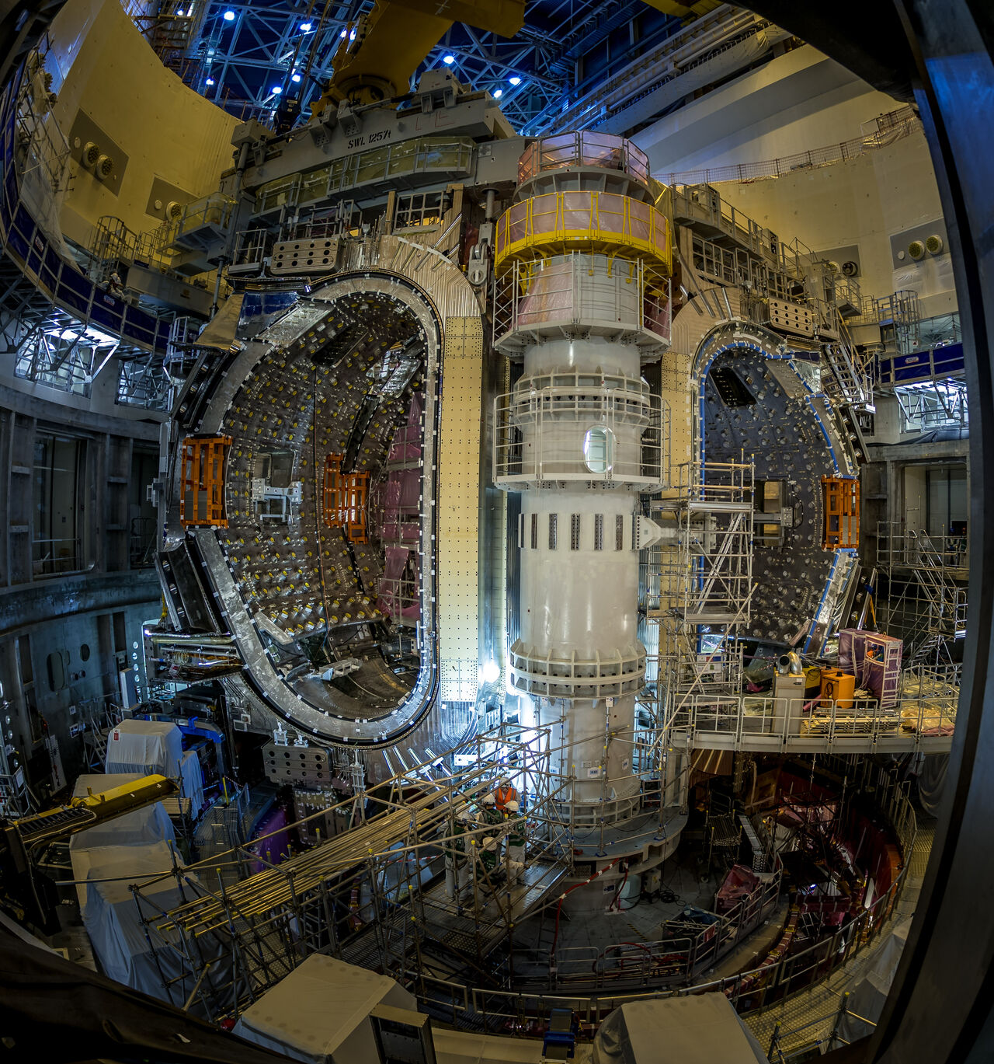
text
OUTLINE
Background
Motivation
Emergency Pulse Termination at ITER
CIS Critical Gateway
CIS Critical Gateway Prototype
Results & Conclusions
text
text
text

Slide 3
Background I
ITER is a super-conducting tokamak capable of 15MA of plasma current – more than 350MJ of thermal energy alone.
Control of ITER is divided into three layers based on the impact of events
  Plasma Control System (PCS): This is the conventional control system in charge of operating ITER under normal conditions. It is responsible for controlling and maintaining the plasma in the ITER tokamak.
  Interlock Control System (ICS) ¹ : is the ITER system that implements the Investment Protection Functions and is responsible for protecting the integrity of the machine against any possible failure.
  Central Safety System: layer that implements nuclear and personal protection functions.
The ICS is structured as:
  Central Interlock System (CIS): Modules in charge of implementing the Central Protection Functions coordinating the events and actions between plants.
  Plant Interlock System (PIS): Modules implementing protection event/actions for individual plants.
  Advanced Protection System (APS): Modules that implement plasma-related protection functions.
J.L. Fernández-Hernando, D. Carrillo, G. Ciusa, Y. Liu, I. Prieto-Díaz, R. Pedica, S. Sayas, J. Soni, A. Vergara, The ITER interlock system, Fusion Engineering and Design, Volume 129, 2018, Pages 104-108, ISSN 0920-3796,

Slide 4
Background II
The ICS implements three different architectures depending the response time required: hardwired, slow (PLC) and fast (FPGA).
The CIS Fast Architecure¹ (CIS-FA) is based on the use of two redundant NI9159 CompactRIO chassis in 1oo2D mode, each with its own Fast Controller connected.
  Firmware development through the LabVIEW FPGA tool
  Host software use MARTe2 framework on Linux RT kernel
  Following the IEC 61508 standard guidelines²
  Platform customized to meet hard real-time requirements³
MARTe2 application & host with TCN connection
E. Barrera et al., "Implementation of ITER Fast Plant Interlock System Using FPGAs With CompactRIO," IEEE Transactions on Nuclear Science, vol. 65, no. 2, pp. 796-804, Feb. 2018, doi: 10.1109/TNS.2017.2783243.
I. García-Siguero et al., "Verification and Validation of ITER Interlock System Fast Architecture According to IEC 61508 Standard" IEEE Transactions on Nuclear Science, vol. 70, no. 6, pp. 1164-1170, June 2023, doi: 10.1109/TNS.2022.3224780
D. Karkinsky et al., "Assessing NI FPGA-Based Platform With MXIe Interface for Use in ITER Hard Real-Time Investment Protection Applications," in IEEE Transactions on Nuclear Science, vol. 72, no. 3, pp. 530-537, March 2025, doi: 10.1109/TNS.2024.3474749.

Slide 5
Motivation
Tokamak interlocks can terminate a pulse very fast through immediate actions of hardwired logic.
This induces large mechanical and thermal loads on the tokamak’s structures. Availability is seriously reduced.
Allows time for conventional systems (e.g. Plasma Control System PCS) to lower tokamak stored energy in a controlled manner.
There are some interlock events where interlock actions can be scheduled rather than triggered immediately
Within CIS, the central function that coordinates with PCS to terminate a pulse is called Emergency Pulse Termination (EPT)
EPT offers a period of time before interlock actions must trigger to GUARANTEE pulse termination
EPT functional specification must cater for evolving tokamak plant requirements & design.
Interlocks trigger immediate termination only if the events ESCALLATE to conditions that requires it.
It must be general enough for scalable, cost-efficient integration and configurable enough for specific kinds of operation.

Slide 6
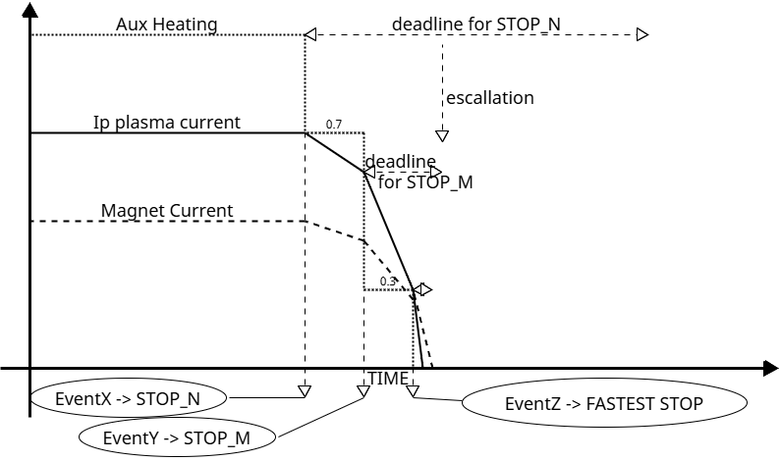
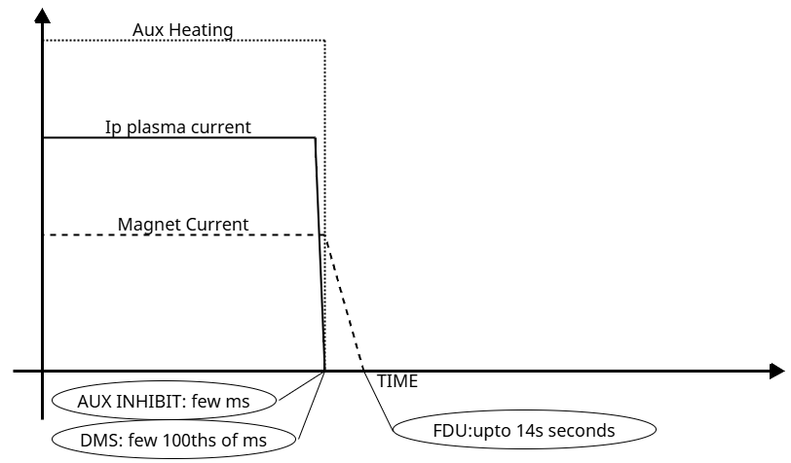
Emergency Pulse Termination at ITER I
During a pulse, interlock events trigger in some sequence. There can be no limit on the length of the sequence or any assumptions on the order in which events occur.
All events have an associated deadline to achieve pulse termination. Pulse termination is defined as; no plasma current, Poloidal Field (PF), Central Solenoid (CS) and Correction Coils (CC) magnets fully discharged, auxiliary heating switched off and inhibited.
Deadlines either remain in force until the end of the pulse or escalate towards immediate pulse termination.
Immediate pulse termination is where PF/CS is discharged at the fastest possible rate through a bank of resistors and plasma needs to be shut down within a few 100ths of ms with disruption mitigation – PCS no longer in control.

Slide 7
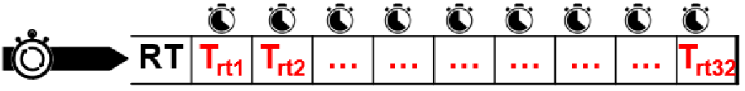
Emergency Pulse Termination at ITER II
EPT has 32 interlock action requests governed by 32 counters updated in hard real-time.
  This number is oversized to ensure future-proofing.
When a counter reaches 0s, a corresponding interlock action is requested.
Interlock events are mapped to a set of stop-codes, with associated deadlines specified in a table.
  Deadlines are specified relative to event triggering time.
Priority Evaluation - If an interlock event requests a stop-code with a shorter deadline than the counter’s current time, the counter is advanced to the shorter deadline. Stop-codes latch until termination is achieved.
Countdown – below 4000s, counters are updated with elapsed time with 500us precision.
  Maximum ITER pulse time is 3000s. 4000s is the threshold for enabling the countdown.
Initial state of the function - counters are initialized before start of pulse to 5000s.
PF/CS Fast Discharge
PF1/PF6 CS Voltage=0
Disruption Mitigation
AUX-heating inhibit requests

Slide 8
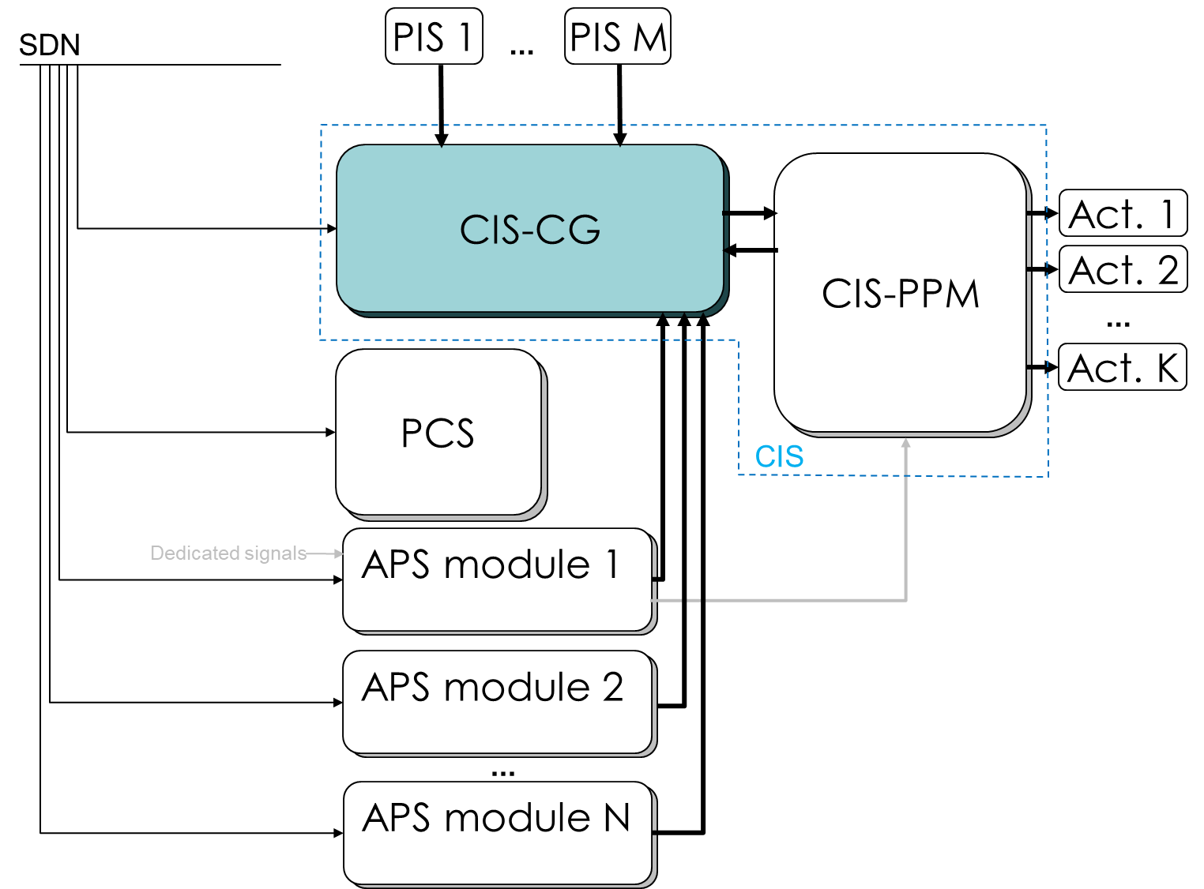
CIS Critical Gateway I – System Design
At ITER ETP is implement in the CIS Fast Architecture – CIS Critical Gateway (CIS-CG)
  One CIS-CG node is in the Main Server Room and the other is in Backup Server Room.
Each node receives a fixed set of stop codes (42) through a hardwired 5Mbps Manchester Code link with error detection mechanism (CRC8, Sequence Number).
Each node is time synchronized to ITER’s central time coordination network TCN (PTP) with less than 1us jitter.
Each node monitors the PCS through a heartbeat on the real-time network SDN.
PCS receives the active stop codes via SDN from each node separately, performs exception handling and conventional control of the plasma.
Nodes monitor their TCN synchronization and coordinate counter updates in lockstep so as to be correct even if one node is de-synchronized.

Slide 9
CIS Critical Gateway II – System Details
  Logic implemented entirely in FPGA firmware which operates 100usec control loop carrying out:
    essential checks,
    voting stops,
    prioritizing deadlines and triggering a 500usec counter update process,
    voting interlock action requests.
  MARTe2 receives PCS heartbeat from SDN, sends PCS heartbeat to the FPGA at 1kHz and reports the status of interlocks back to PCS and CODAC at same rate.
  RHEL 8.5 RT kernel with CODAC Core System distribution and running MARTe2 host application.
  Host interfaces with the other actors (CODAC/SUPervisor, CIS HMI) via OPC UA.

Slide 10
CIS Critical Gateway III – System Configuration
CIS-CG configuration must be coordinated with ITER pulse schedule.
Configuration is achieved through an IEC61508 compliant approach with ITER’s CIS High Integrity Operator Commands (HIOC) protocol and the pulse schedule managed by CODAC-SUP’s Chain Data Processing (CDP) & Configuration Validation & Verification Framework (CVVF) ¹
The critical parameters are the 42×32 stop-code table (~6kB) holding the deadlines for each stop-code.
  The table is stored on the FPGA in dual redundant Error Correcting Code (ECC) BlockRAMs that implement a custom secure access protocol.
Karkinsky, D., Van Herck, W., Diaz, I. P., Soni, J., & Marqueta, A. “Integrated supervision for conventional and machine-protection configuration parameters at ITER.”, ICALEPCS2021, Shanghai, China, doi:10.18429/JACoW-ICALEPCS2021-WEBR05.

Slide 11
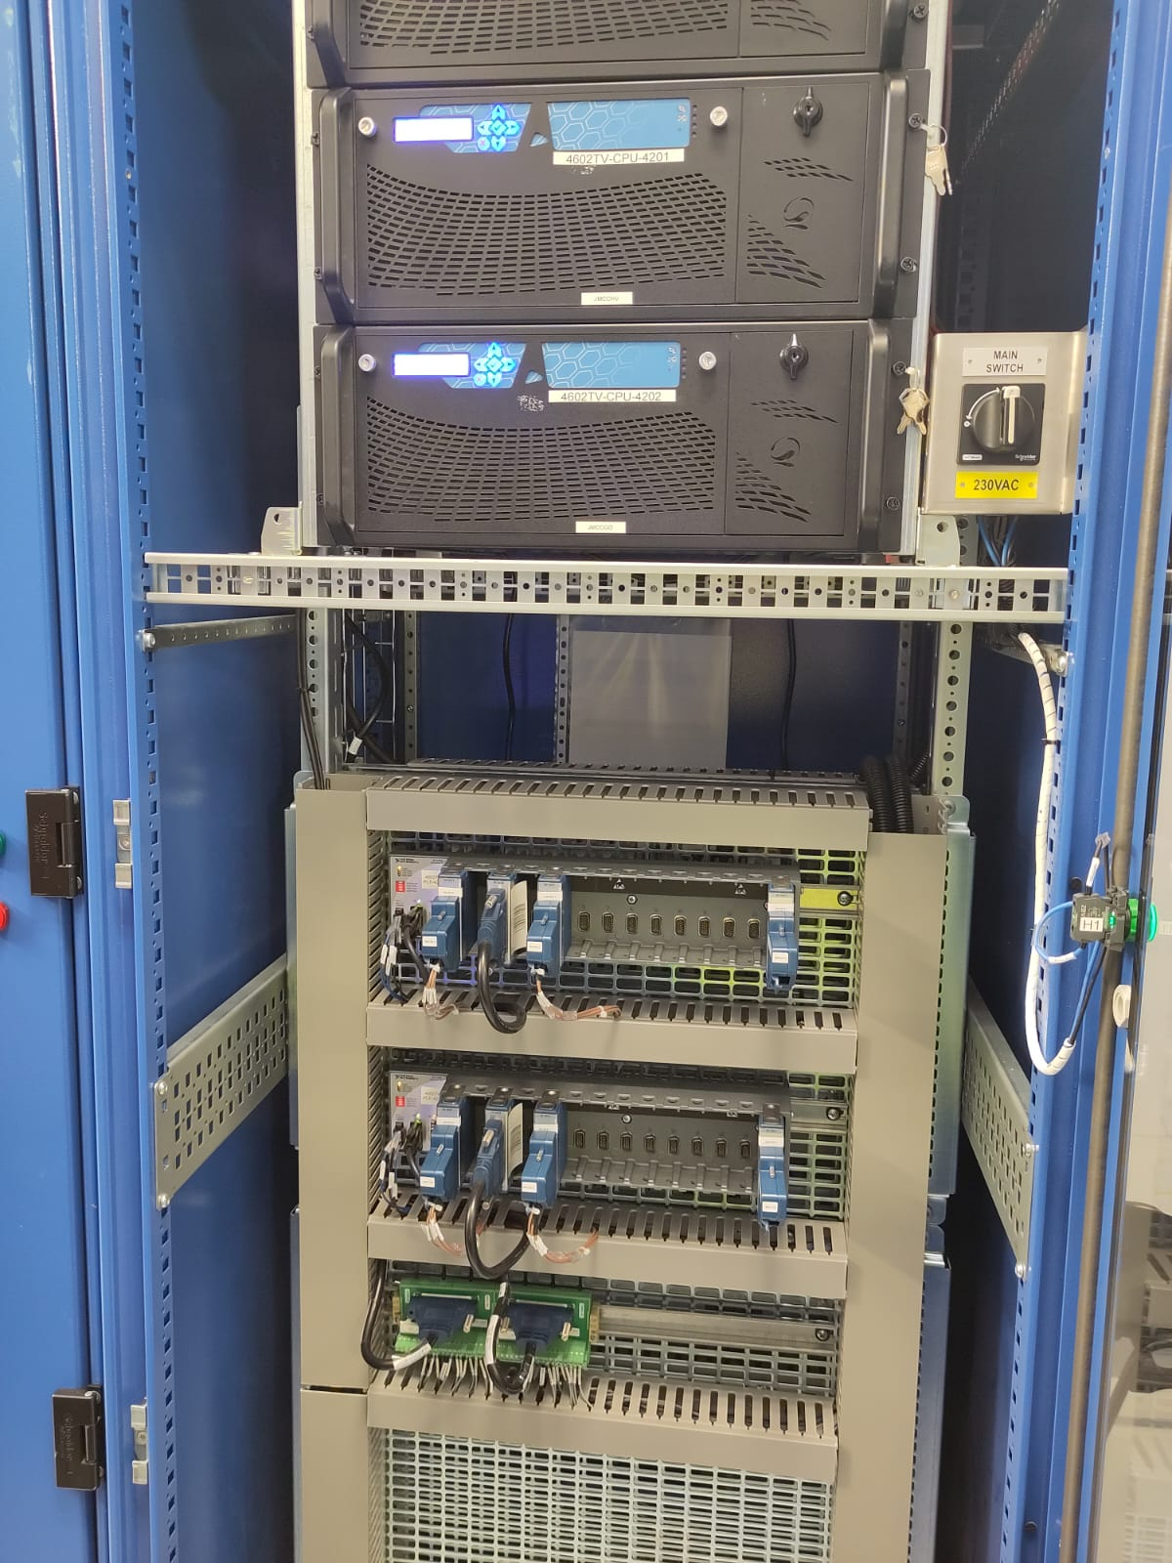
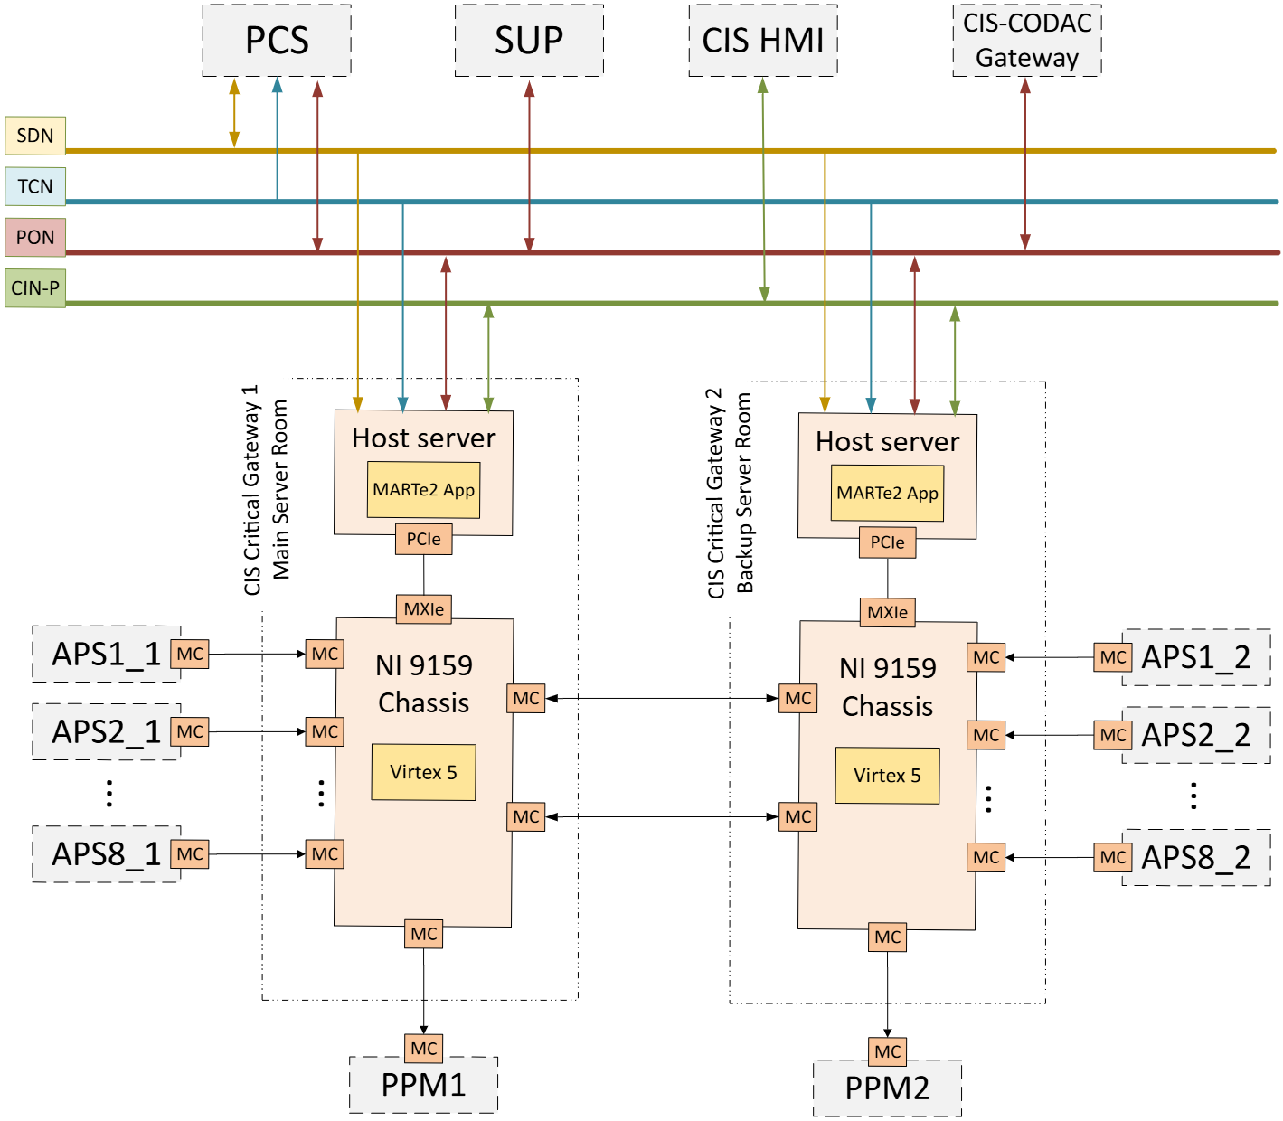
CIS Critical Gateway Prototype
  Prototype developed with requirements close to the final system.
  Includes full implementation of the most critical requirements required for the start of ITER integrated commissioning.
  Includes all defined interfaces at this moment covering the Advanced Protection System (APS)
  The system has been deployed and validated on a test platform that maximally replicates real operation.

Slide 12
Results & Conclusions
Explained and motivated a concrete definition of Emergency Pulse Termination for ITER.
First hard real-time system implemented on CIS Fast Architecture → thus validating the CIS-FA platform capabilities.
  A system that provides guaranteed pulse termination in a fault-tolerant manner coordinated with the PCS.
The system will be required during the start of ITER integrated commissioning when PCS is expected to attempt magnet operation.
Meanwhile we will carry out extensive verification of the fault-tolerance properties.
Define plant guidelines for interfacing the CIS-CG in a scalable manner – plants map their events to stop codes which can be combined upstream. This offers a scalable solution that can be rolled out client systems who have diverse event requirements.
We plan to define operational procedures for stop-code table configuration, based on hazard analyses.
The first likely client will be ITER’s Coil Power Supply System (CPSS) which has many events that must be precipitated by EPT so-as to prevent long term delays in operation.
EPT generality and configurability facilitates its adaptation to other tokamak environments (or even other kinds of physics experiments).

Slide 13
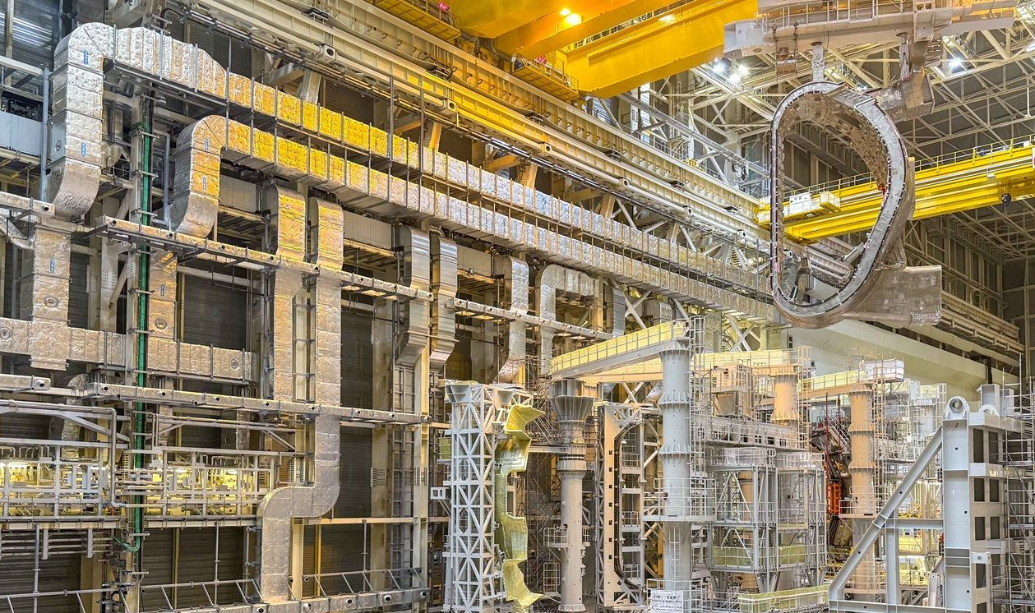
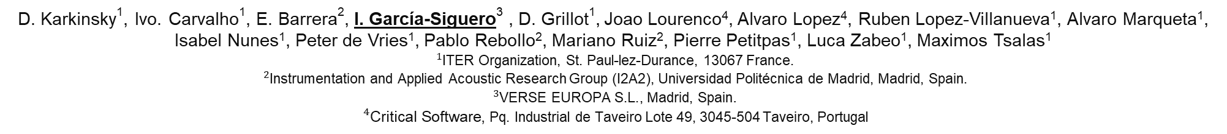
Thank you!
Configurable real-time emergency pulse termination system for investment protection in ITER’s interlock architecture
D. Karkinsky¹, Ivo. Carvalho¹, E. Barrera², I. García-Siguero³ , D. Grillot¹, Joao Lourenco⁴, Alvaro Lopez⁴, Ruben Lopez-Villanueva¹, Alvaro Marqueta¹, Isabel Nunes¹, Peter de Vries¹, Pablo Rebollo², Mariano Ruiz², Pierre Petitpas¹, Luca Zabeo¹, Maximos Tsalas¹
${}_{}^{1}{\text{ITER}}$ Organization, St. Paul-lez-Durance, 13067 France.
${}_{}^{2}{\text{Instrumentation}}$ and Applied Acoustic Research Group (I2A2), Universidad Politécnica de Madrid, Madrid, Spain.
${}_{}^{3}{\text{VERSE} \text{EUROPA} \text{S}\text{.}\text{L}\text{.}}$, Madrid, Spain.
${}_{}^{4}{\text{Critical} \text{Software}}$, Pq. Industrial de Taveiro Lote 49, 3045-504 Taveiro, Portugal
Responsible: Damien.karkinsky@iter.org
Presenter: ignacio.garcia@verse-europa.com

