Slide 1

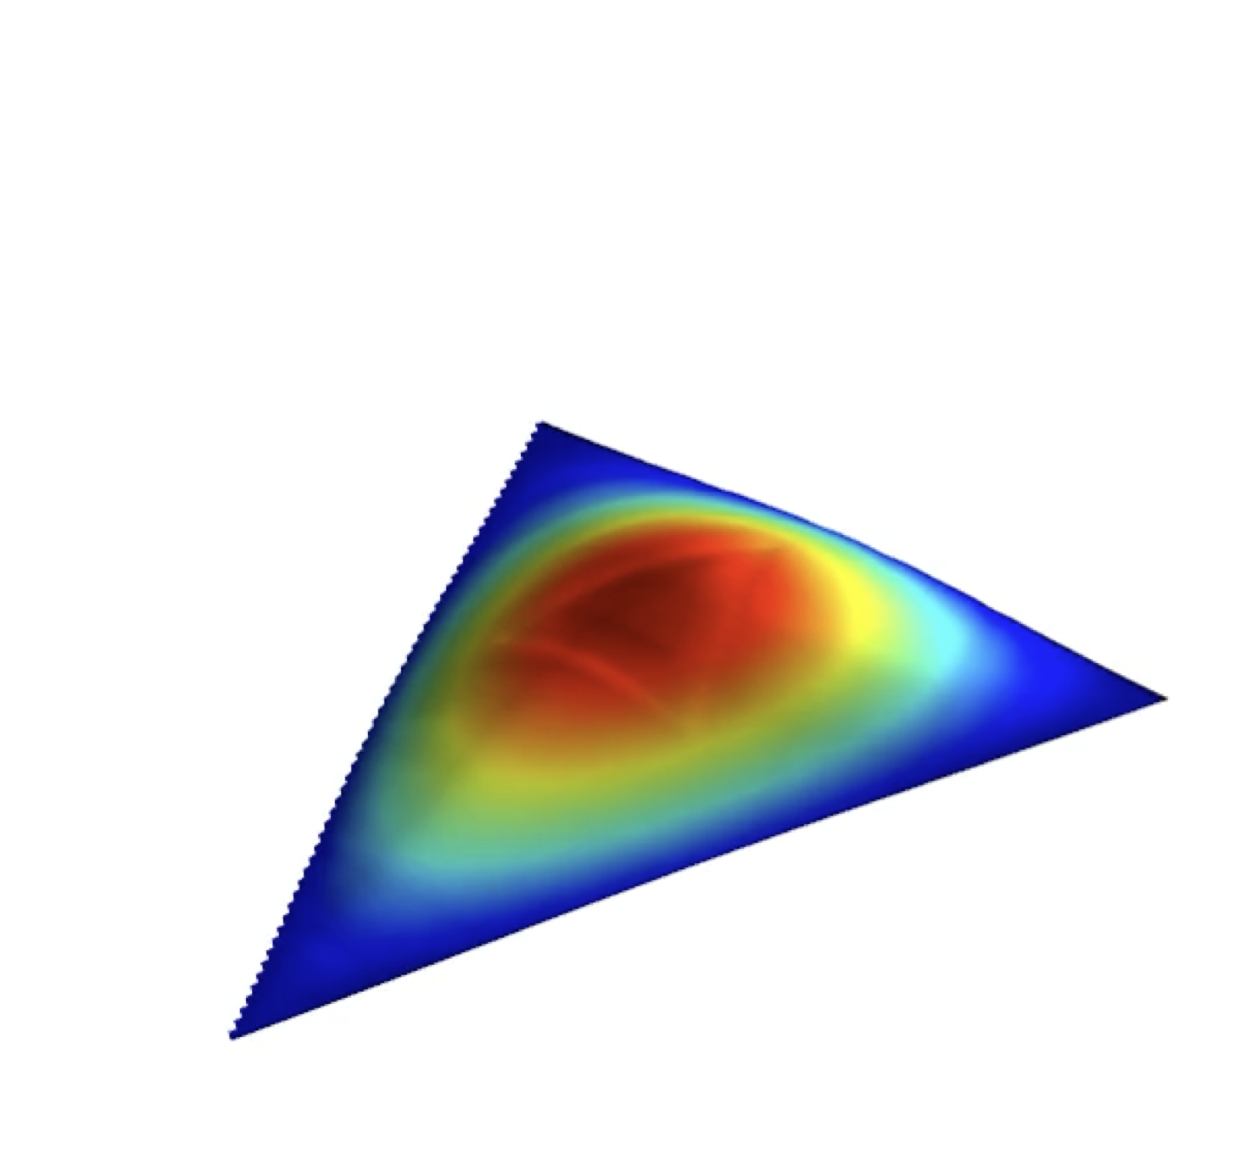
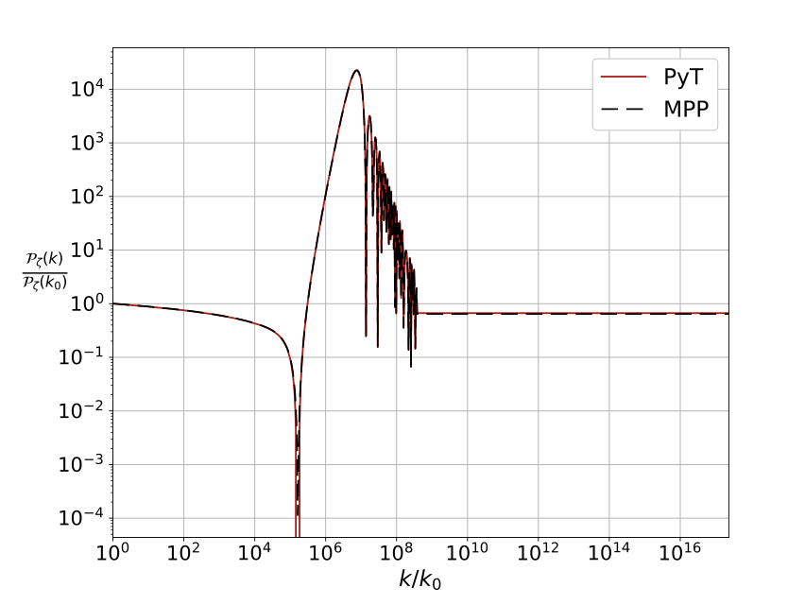
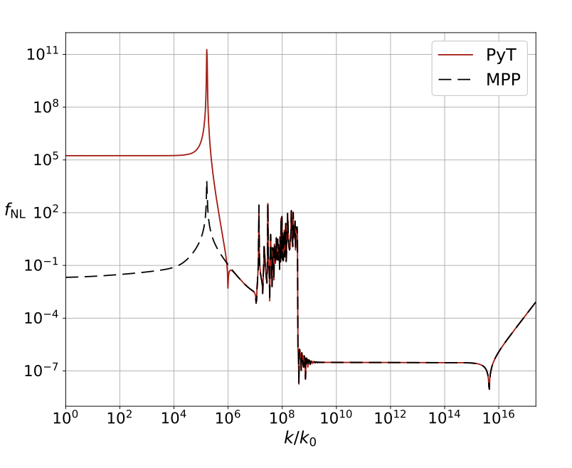
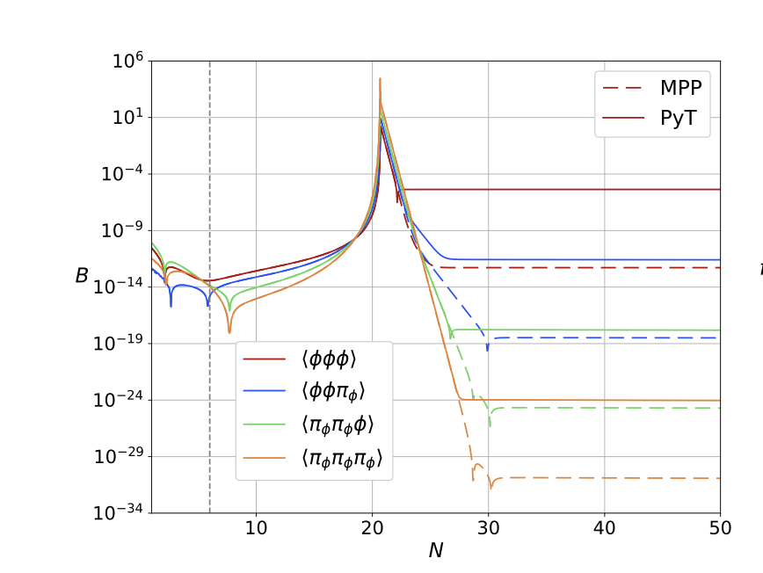
Taylor expansion methods for inflation, loops, and the decoupling of scales
David Mulryne
2601.14229 , with Laura Iacconi, David Seery; and 2503.15194 with Laura Iacconi, Andrea Constanti; ++
PACOS 2026, Sheffield

Slide 2
Plan
Inflation, and the observational signatures of inflation
Inflationary dynamics for short scale signatures (c.f. Oksana Iarygina talk)
Why might loops be important and a recent debate: the coupling of large and short scales at loop level (c.f. quantum correction talk from Lucien Heurtier)
A segway into “Taylor expansion” methods (and a numerical implementation)
Addressing the debate and the decoupling of scales

Slide 3
Context
To test models of inflation we want to calculate the statistics of the fluctuations they produce
To do so reliably having different tools is useful, both analytic and numerical
Numerical tools are needed for precision predictions, but can be challenging or slow for some models (c.f. Guillermo Fernando Quispe Peña talk )
Sometimes different tools are very efficient for analytic calculations, or reveal different analytic structures (e.g. )
Recently strong focus on very short scales, PBHs, and SIGWs

Slide 4
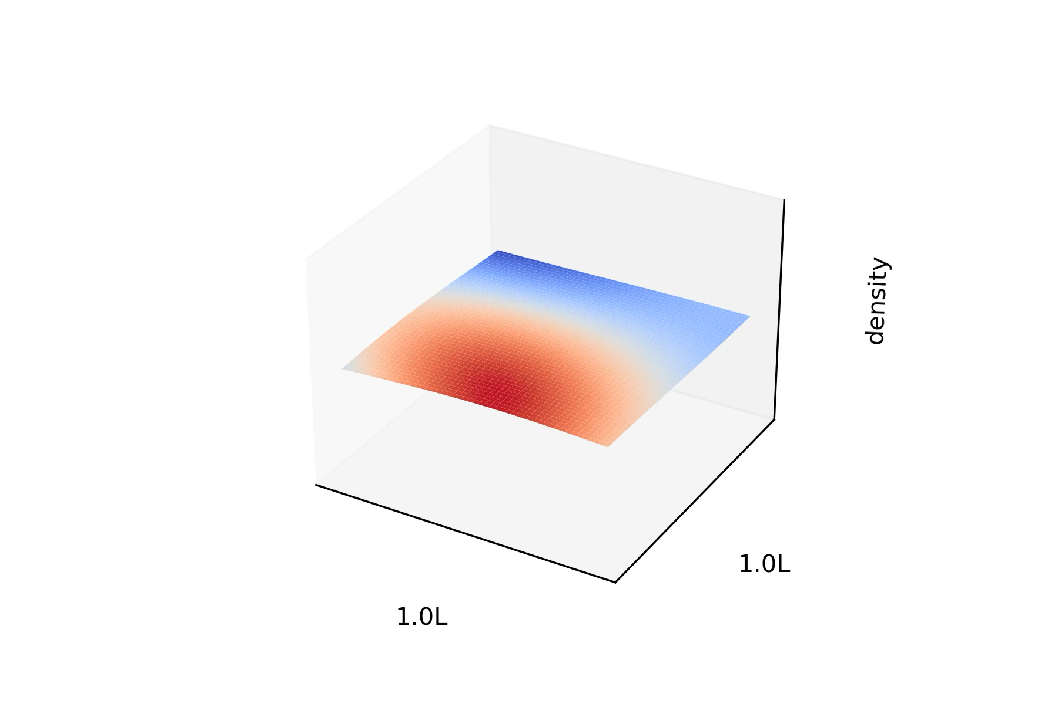
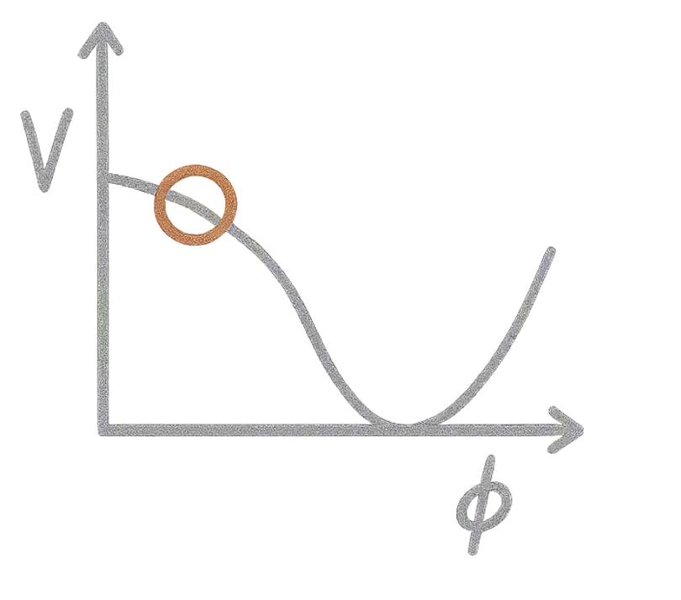
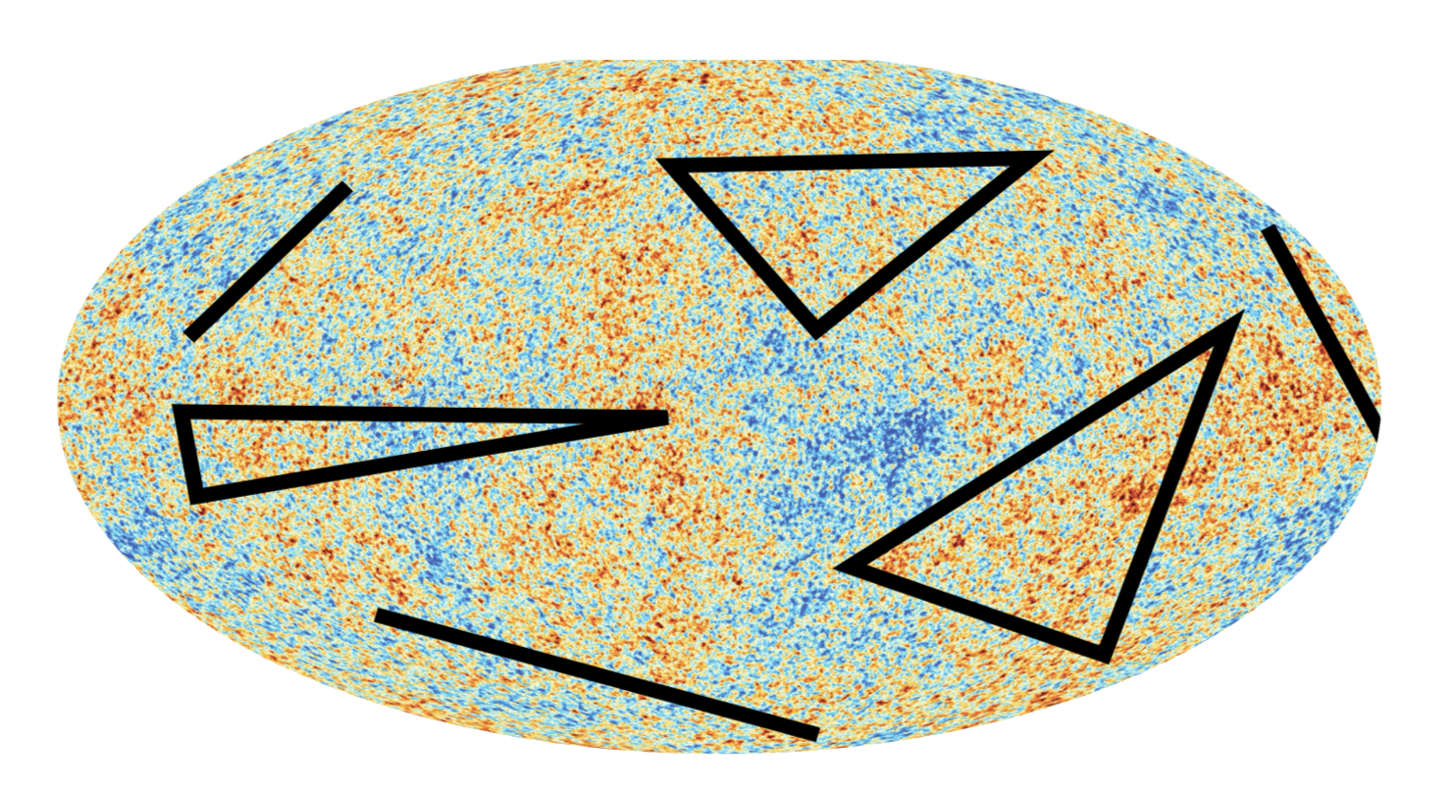
Inflation
Postulate new field (fields), , field can mimic a cosmological constant
Quantum mechanics implies
Inflation makes “long lived”, and retains information about fields present during inflation, a “cosmological collider”

Slide 5
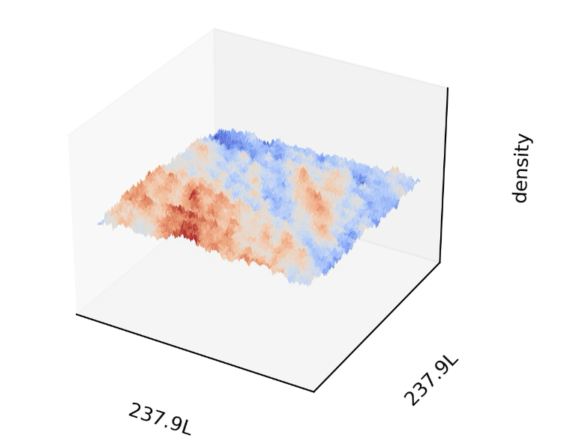
Inflation
Postulate new field (fields), , field can mimic a cosmological constant
Quantum mechanics implies
Inflation makes “long lived”, and retains information about fields present during inflation, a “cosmological collider”

Slide 6
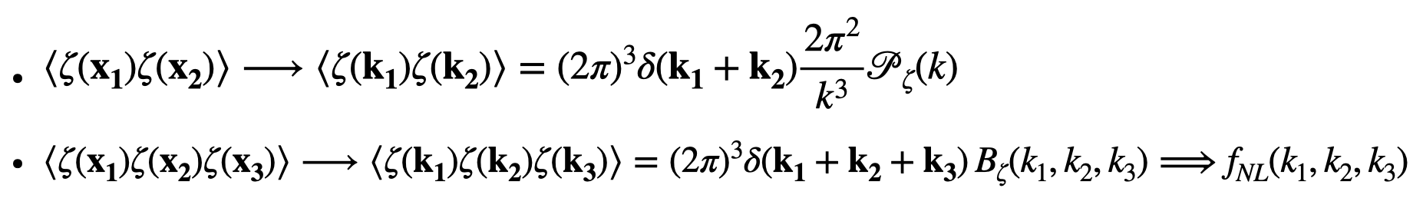
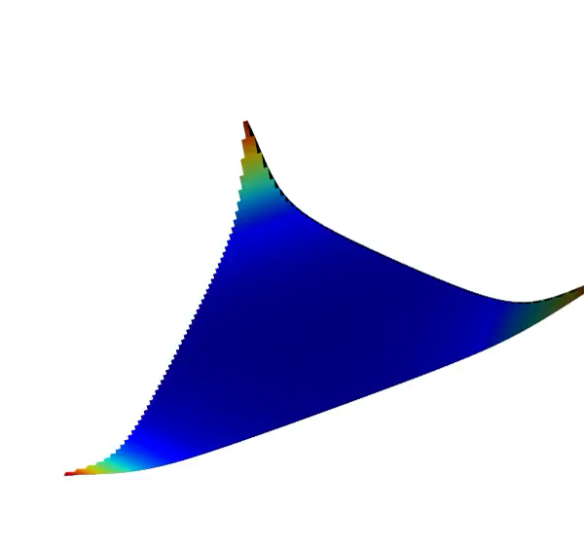
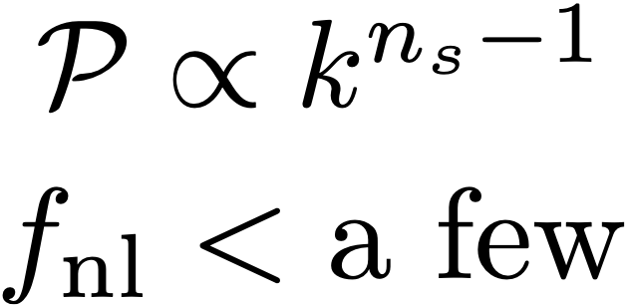
Calculating statistics
We have a code for that! (PyTransport, 2016 onwards, DJM, Ronayne, Constantini, Iacconi, Seery; Dias, Frazer; also other code e.g. CppTransport, Seery 2016; CosmoFlow, Werth, Pinol, Renaux-Petel, 2024)
1807.6211
Planck collaboration

Slide 7
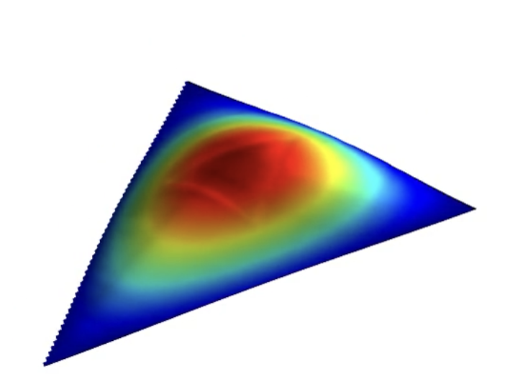
Calculating statistics
We have a code for that! (PyTransport, 2016 onwards, DJM, Ronayne, Constantini, Iacconi, Seery; Dias, Frazer; also other code e.g. CppTransport, Seery 2016; CosmoFlow, Werth, Pinol, Renaux-Petel, 2024)
1807.6211
Planck collaboration

Slide 8
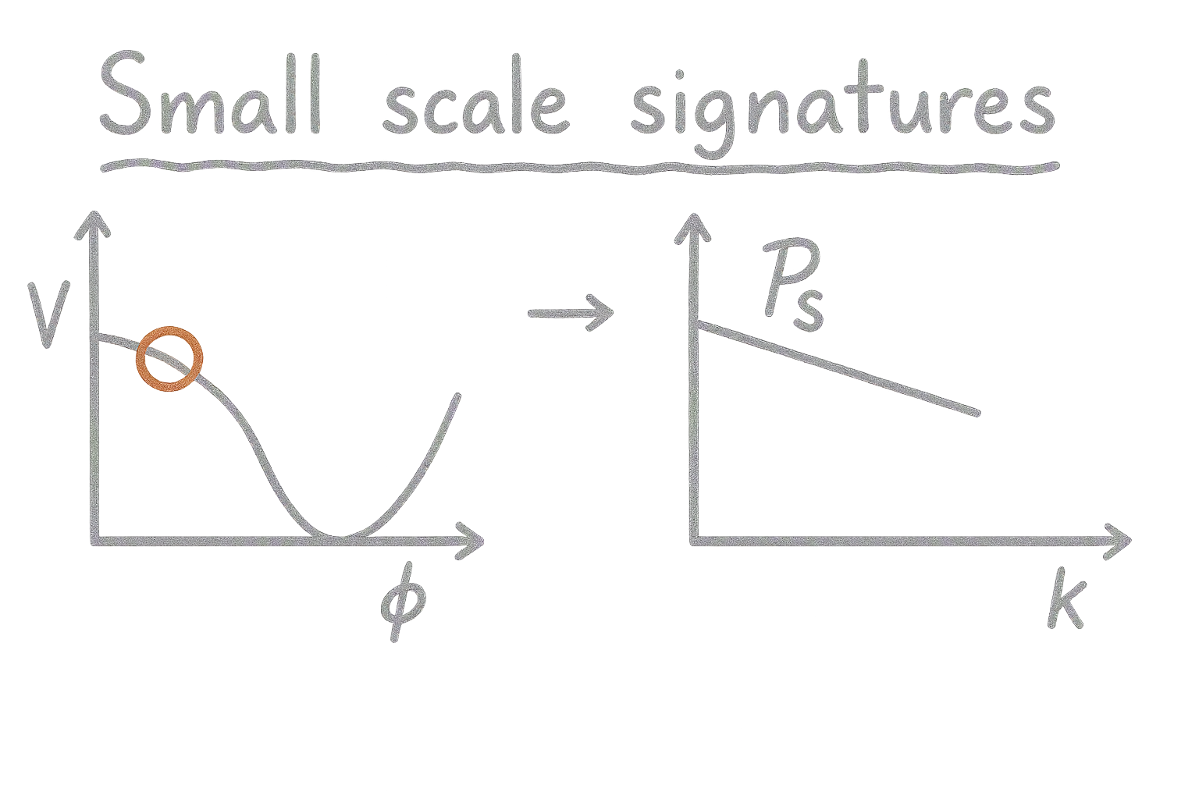
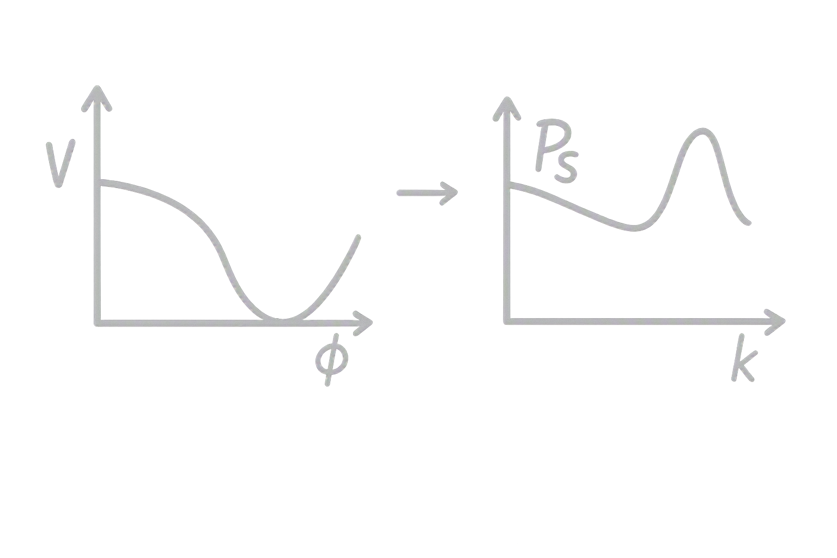

From large to short scales (PBHs, SIGWs)
Large Scales
Short Scales
  Features, or multiple field dynamics?
  PBHs
  Induced Gravitational Waves
Non-Gaussian
Loop corrections?
7 orders
Loop corrections?

Slide 9
From large to short scales (PBHs, SIGWs)
Large Scales
Short Scales
  Features, or multiple field dynamics?
  PBHs
  Induced Gravitational Waves
Non-Gaussian
Loop corrections?
7 orders
Loop corrections?

Slide 10
From large to short scales (PBHs, SIGWs)
Large Scales
Short Scales
  Features, or multiple field dynamics?
  PBHs
  Induced Gravitational Waves
Non-Gaussian
Loop corrections?
7 orders
Loop corrections?

Slide 11
From large to short scales (PBHs, SIGWs)
Large Scales
Short Scales
  Features, or multiple field dynamics?
  PBHs
  Induced Gravitational Waves
7 orders

Slide 12
From large to short scales (PBHs, SIGWs)
Large Scales
Short Scales
  Features, or multiple field dynamics?
  PBHs
  Induced Gravitational Waves
Non-Gaussian
7 orders

Slide 13
From large to short scales (PBHs, SIGWs)
Large Scales
Short Scales
  Features, or multiple field dynamics?
  PBHs
  Induced Gravitational Waves
Loop corrections?
7 orders
Loop corrections?

Slide 14
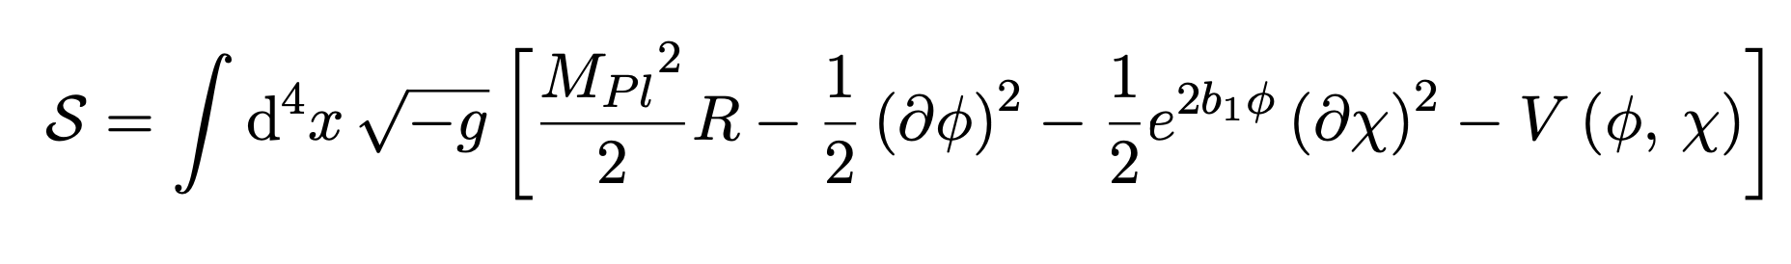
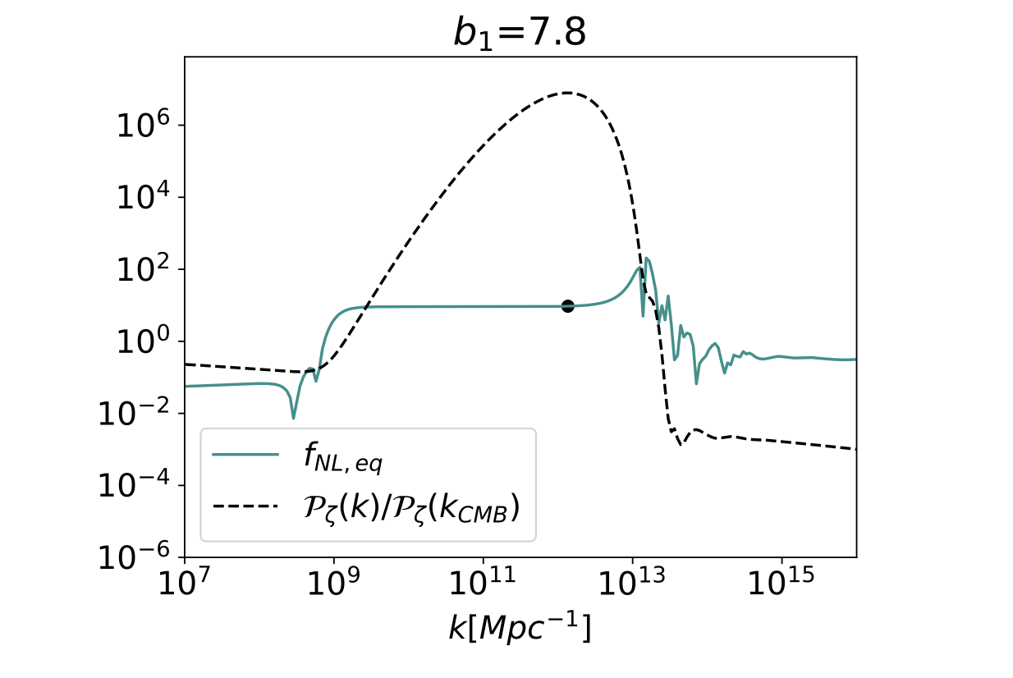
A concrete example
Palma+, Fumagalli+, Braglia+, Iacconi+, …+++
Iacconi, DJM, 2023, c.f. others e.g. Fumagalli et al 2023, Caravano et al. 2024 + , Garcia-Saenz et al. 2025, ++

Slide 15
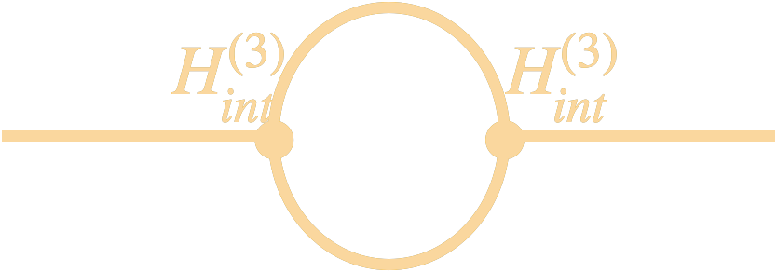

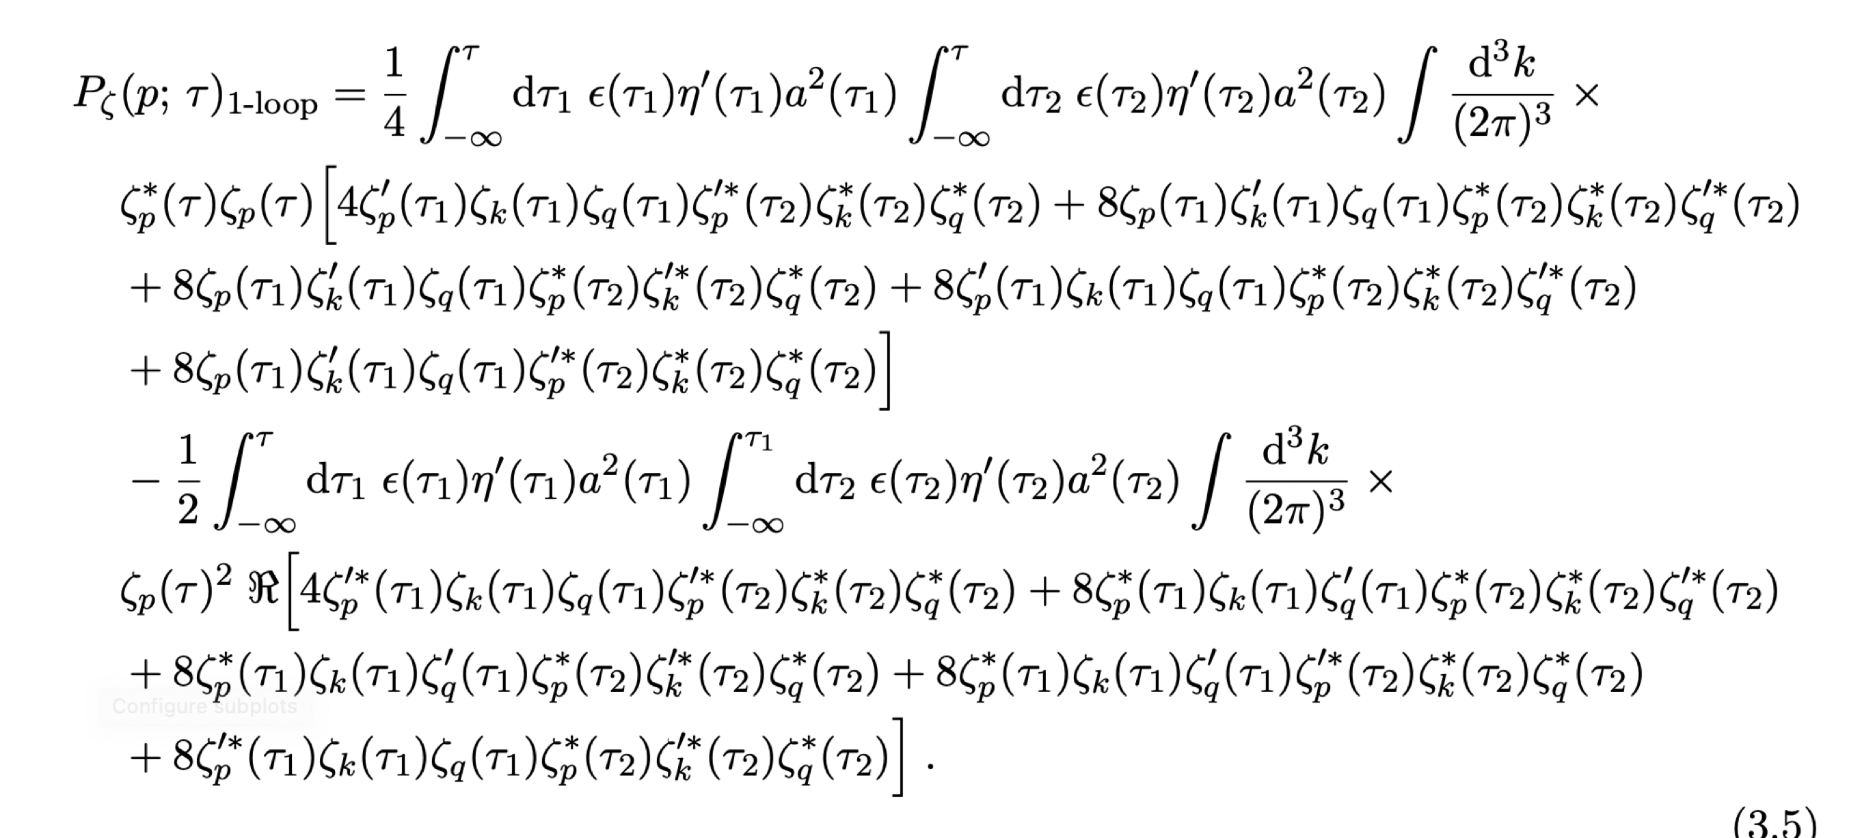
Loops on separated scales (a recent debate)
7 orders
Loop corrections?
Original claim: backreaction is so strong, that peak can never be high enough for PBHs Kristiano & Yokoyama, 2022, then many many others challenging or supporting, e.g. Riotto, Firouzjahi, Kawaguchi, Fumagalli, Tada et al.

Slide 16
Alternative approach
Is there a more intuitive approach? (Iacconi, DJM, Seery, 2023)

Slide 17
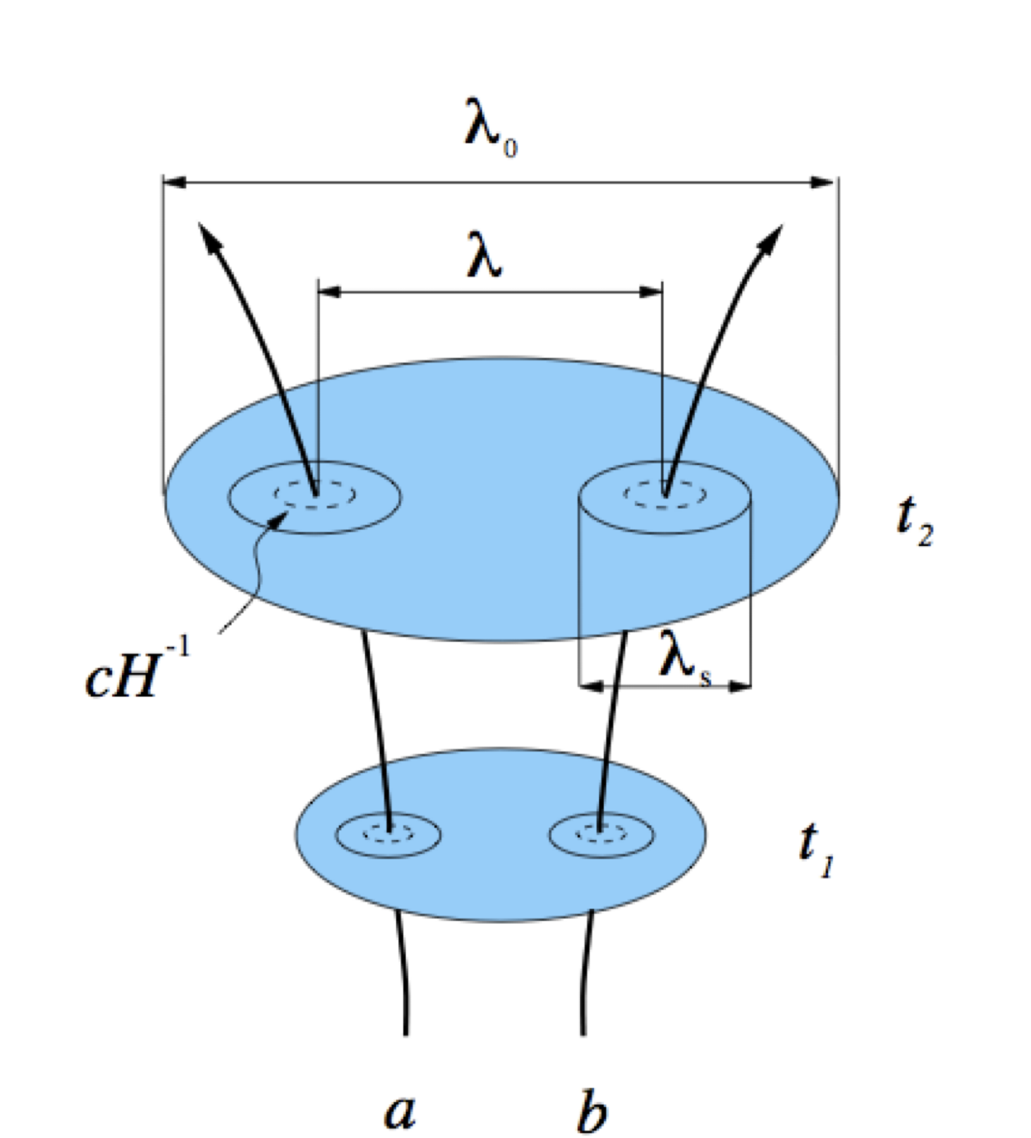
Taylor expansion methods: and MPPs (1)
In cosmological perturbation theory (on super-horizon scales) becomes a Taylor expansion in the number of e-folds (equivalent to the curvature) in terms of field fluctuations, schematically:
Moreover, soft limits are a Taylor expansion, schematically:
Liddle, Lyth, Malik Wands, Sasaki, +++, Bynes and Wands,
Seery and Lidsey

Slide 18
Taylor expansion methods: and MPPs (2)
It is also possible to make a like Taylor expansion in field space, and even for it to be valid at the quantum (operator) level
This is known as a Multi-point propagator (MPP) schematically: (Constantini, Iacconi, DJM, 2025; c.f. Seery, DJM, Frazer Ribeiro, 2010; Bernardeau et al. 2008)

Slide 19
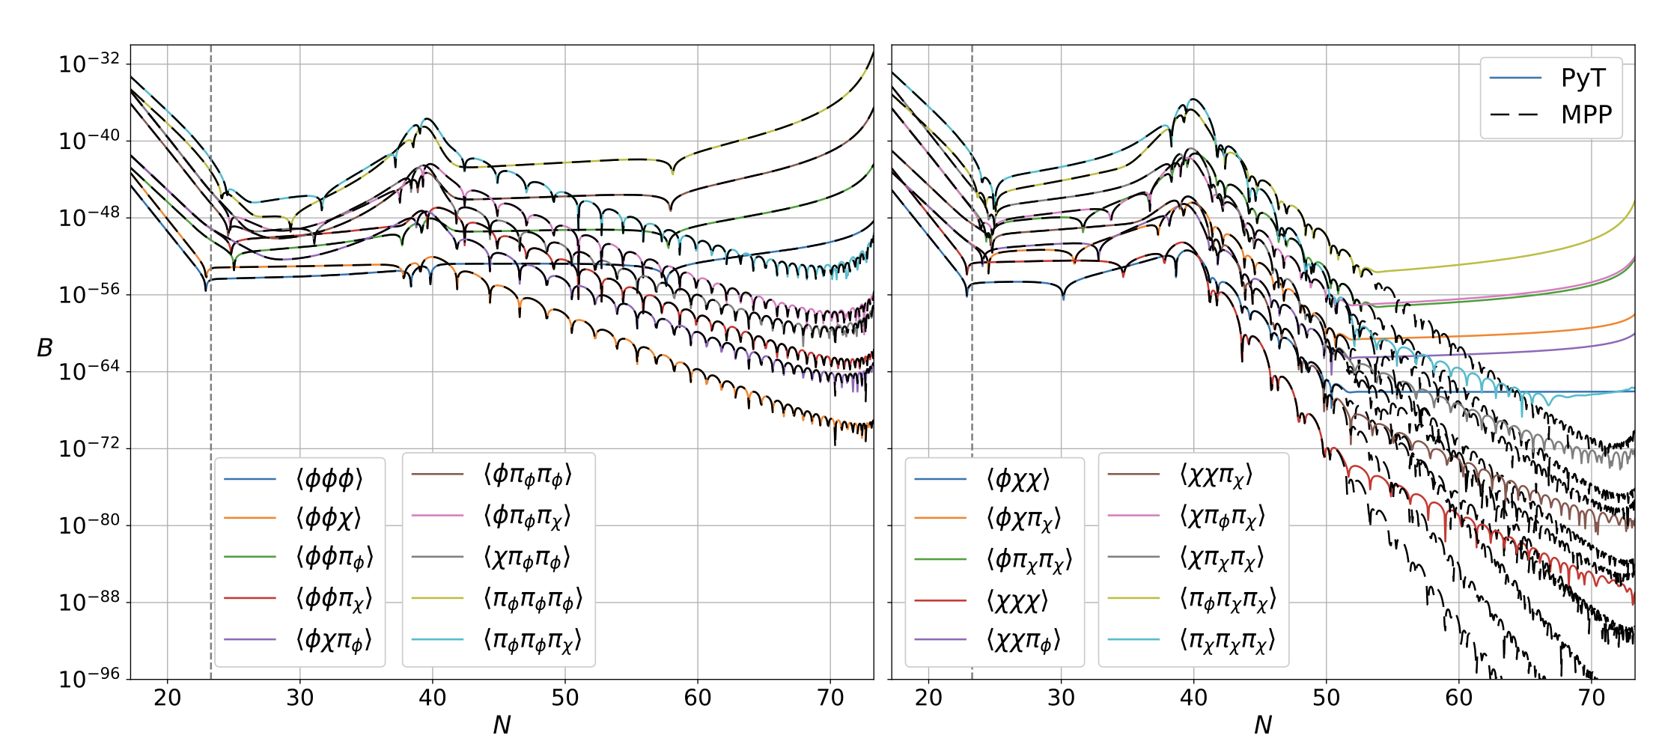
MPPs work: An MPP code
The MPP coefficients satisfy ordinary differential equations
We can evolve them numerically, and, use them to calculate the statistics of field perturbation (or of zeta) starting deep inside the horizon, with some advantages! (Constantini, Iaconni, DJM, 2025)

Slide 20
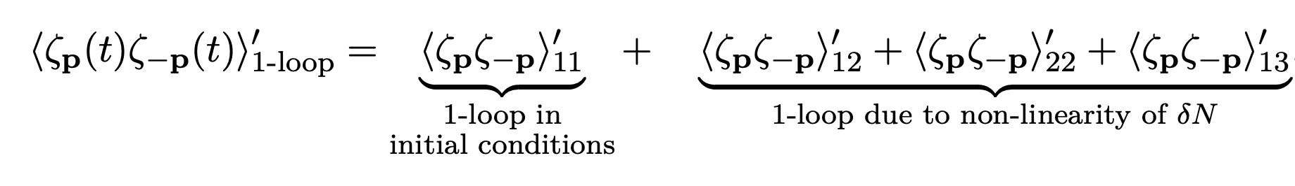
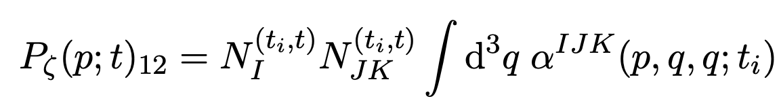
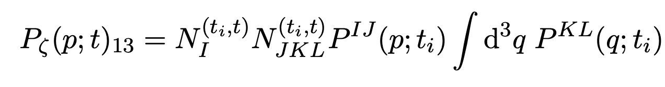
loops (1) Iacconi, DJM, Seery, 2023, 2026
Mathematically we can study our intuitive picture using using or related methods by forming loops (for earlier loop work see e.g. Byrnes et al. 2007)

Slide 21
loops (1) Iacconi, DJM, Seery, 2023, 2026
Mathematically we can study our intuitive picture using using or related methods by forming loops (for earlier loop work see e.g. Byrnes et al. 2007)
Field space 3pt function
Field space 2pt function

Slide 22
loops (1) Iaconi, DJM, Seery, 2023, 2026
Mathematically we can study our intuitive picture using using or related methods by forming loops (for earlier loop work see e.g. Byrnes et al. 2007)
Field space 3pt function
Field space 2pt function

Slide 23
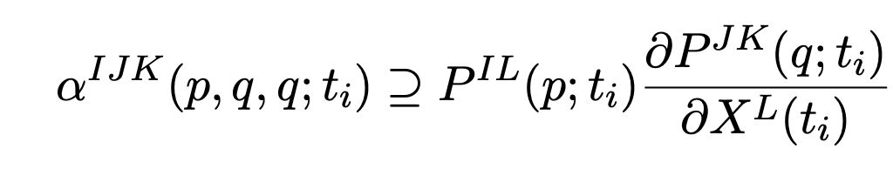
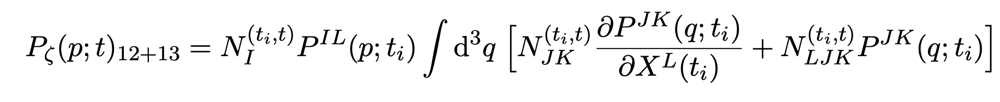
loops (2)
We can use soft limit expression: (c.f. single field consistency, Maldacena, 2002)
Then
X represents field and field momentum

Slide 24
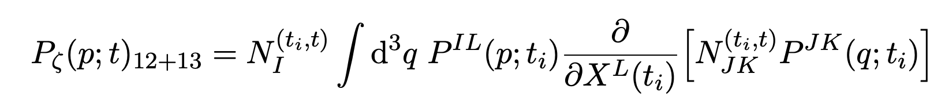
loops (2)
We can use soft limit expression: (c.f. single field consistency, Maldacena, 2002)
Then
X represents field and field momentum

Slide 25
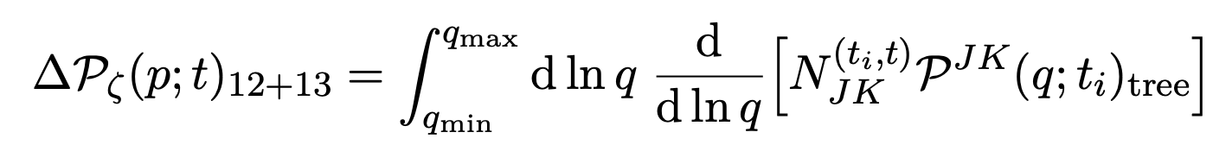
loops (2)
We can use soft limit expression: (c.f. single field consistency, Maldacena, 2002)
Then
X represents field and field momentum
For single field, p mode adiabatic

Slide 26
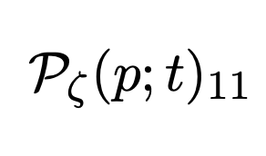
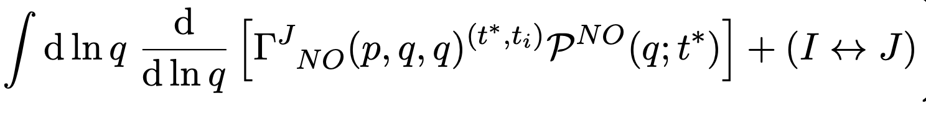
loops (2)
We can use soft limit expression: (c.f. single field consistency, Maldacena, 2002)
Then
X represents field and field momentum
For single field, p mode adiabatic
Also MPP loop:

Slide 27
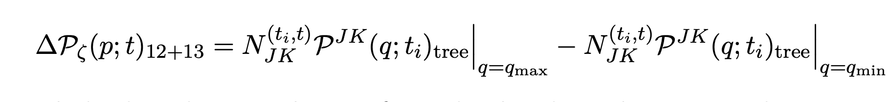
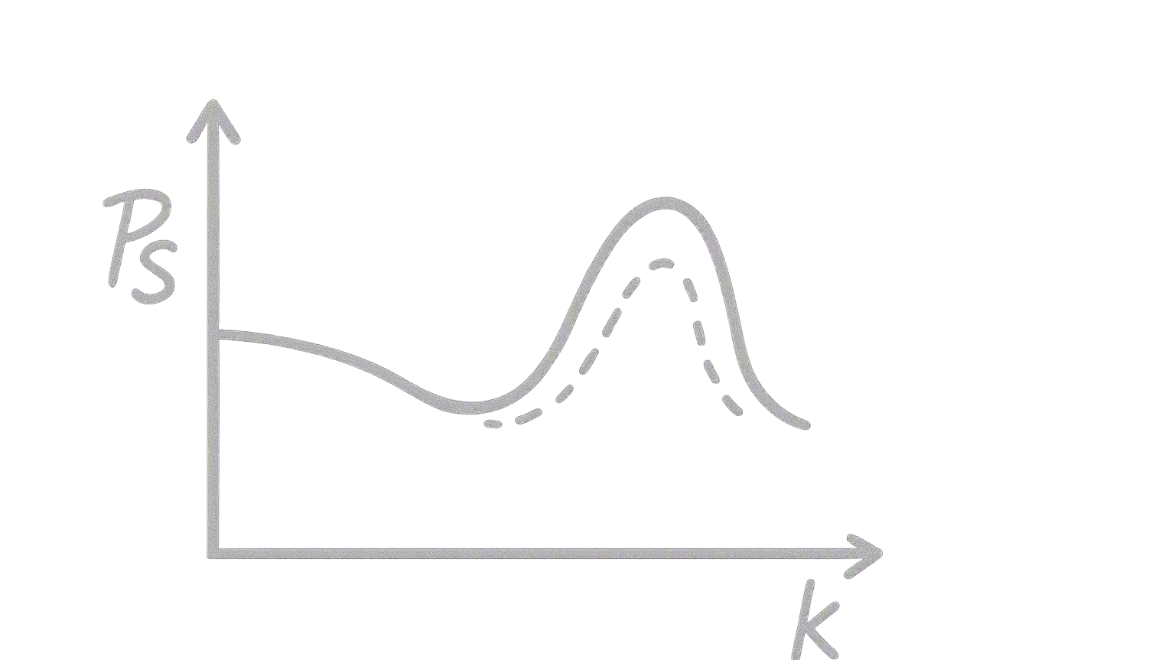

Decoupling of scales
We have
Hence, only boundary terms, and not the peak structure, enters the answer (similar conclusions found by other authors, Tada et al 2024, Fumagalli 2025, Kawaguchi et al. 2024)

Slide 28
Conclusions
Taylor expansions, such as MPP methods, can be numerically advantageous, as well analytically simpler for some problems or limits
We have, for example, a new version of our numerical multi-field inflation code that uses them
Loop order contributions to correlators can be built using or MPPs –equivalent to In-In loops
This provides insight into the structure of loop terms in the limit of separated scales
Could we also calculate loops using numerical MPP codes?

