Slide 1
Quantum Field Theory
in the Age of Data
Miranda C. N. Cheng
University of Amsterdam · Academia Sinica Taiwan
PASCOS 2026 · Sheffield · 22–26 June 2026

Slide 2
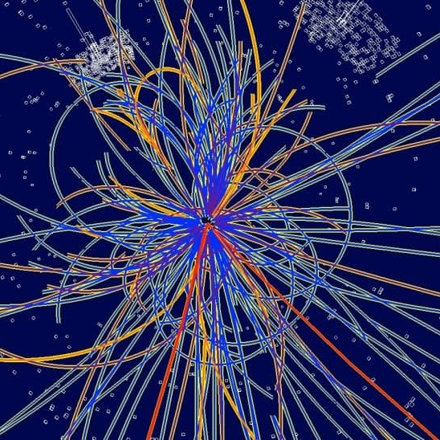
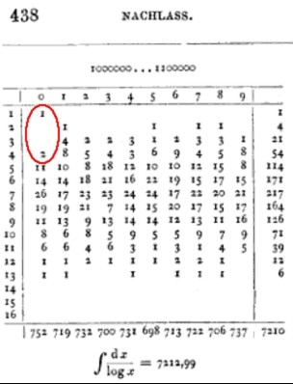
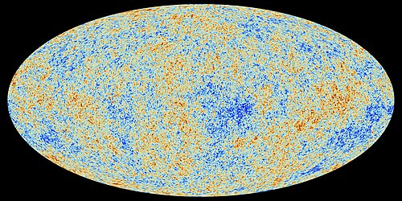
Data has long helped drive physical sciences.
The LHC
particle-collision data informs the most fundamental physics
Cosmic Microwave Background
thermal radiation data informs the origin of universe
Gauss’ Count of Prime Numbers
the birth of analytic number theory
Today, we discuss some new AI-enabled ways of treating and learning from scientific data.

Slide 3
AI Models as Data:
Use AI to simulate physics — and study the trained models as new physical observables.
AI to simulate physics
AI models as physics observables

Slide 4
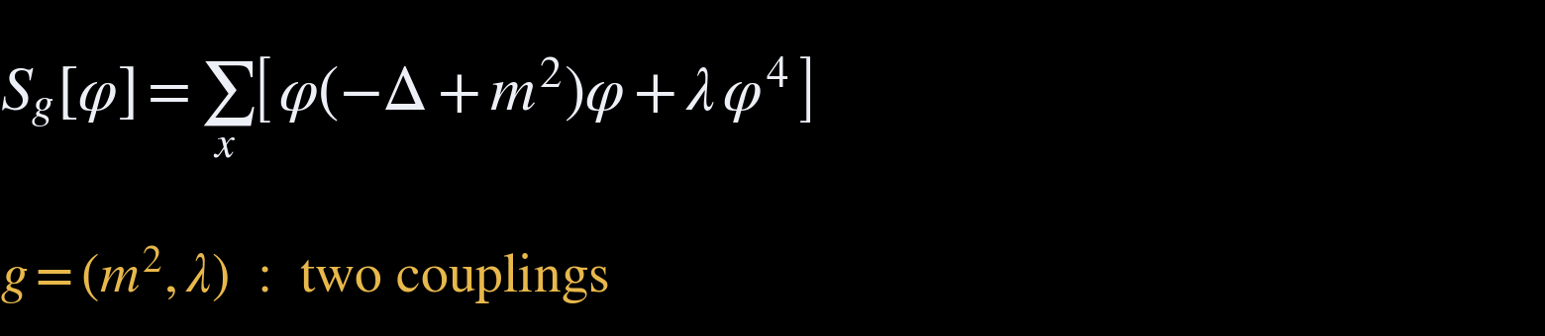
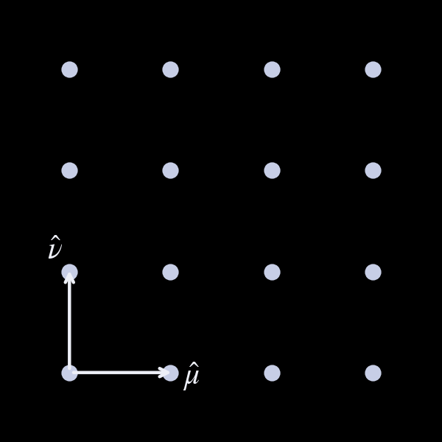
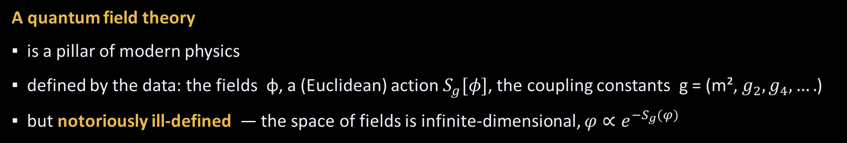
How do we study a quantum field theory?
A quantum field theory
▪ is a pillar of modern physics
▪ defined by the data: the fields φ, a (Euclidean) action $S_{g}[φ]$, the coupling constants g = (m², $g_{2},g_{4}, ….$)
▪ but notoriously ill-defined — the space of fields is infinite-dimensional, $φ∝e^{−S_{g}(φ)}$
A lattice field theory
▪ the main first-principle method for non-perturbative QFT (e.g. QCD)

Slide 5
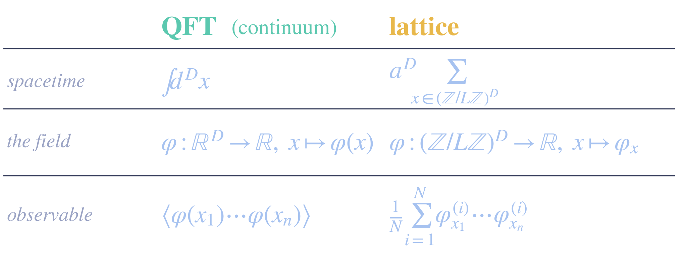

Lattice Field Theories
Workhorse for non-perturbative physics: from the strong force to phases in materials.
↑ N samples (of field configurations)
$φ∼e^{−S_{g}\left(φ\right)}/Z$

Slide 6
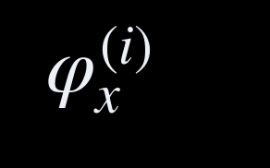
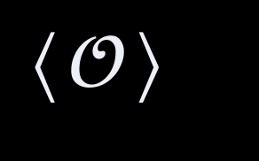

The lattice field theory workflow
from couplings to physics, in four steps
The action
Samples
Observables
Physics
$$S_{g}[φ]$$
e.g. the phase diagram
Monte-Carlo sampling of field configurations turns the action into measurable physics.

Slide 7
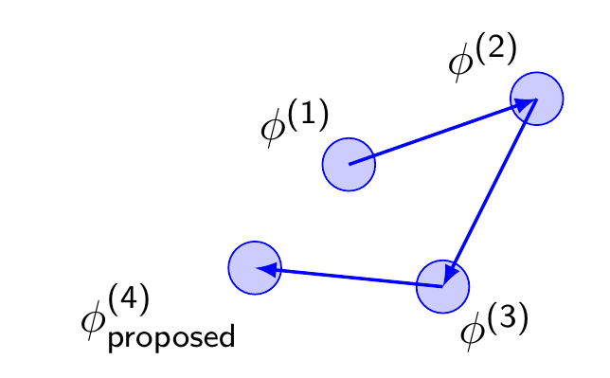
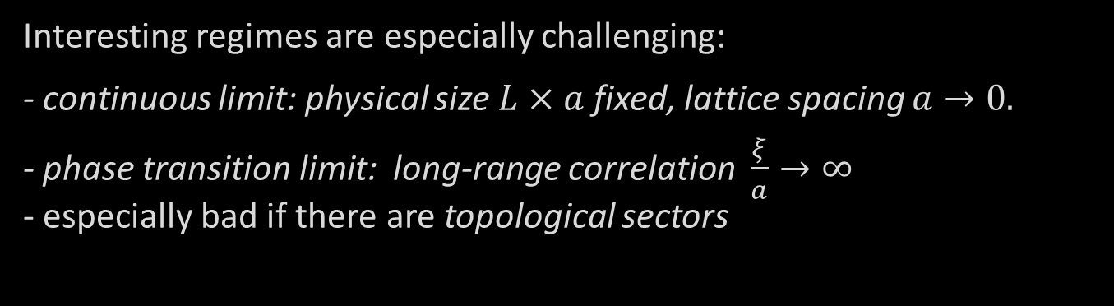
Challenges: Critical Slowing Down
Slow exploration of the high-dimensional configuration space, particularly when using local updates, is a problem.
Interesting regimes are especially challenging:
- continuous limit: physical size $L×a$ fixed, lattice spacing $a→0.$
- phase transition limit: long-range correlation $\frac{ξ}{a}→∞$
- especially bad if there are topological sectors

Slide 8


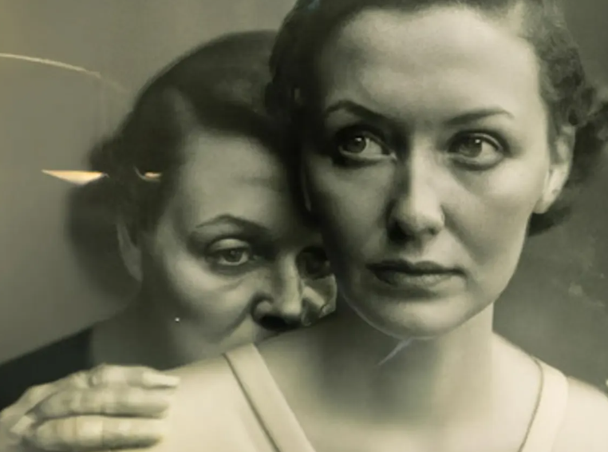
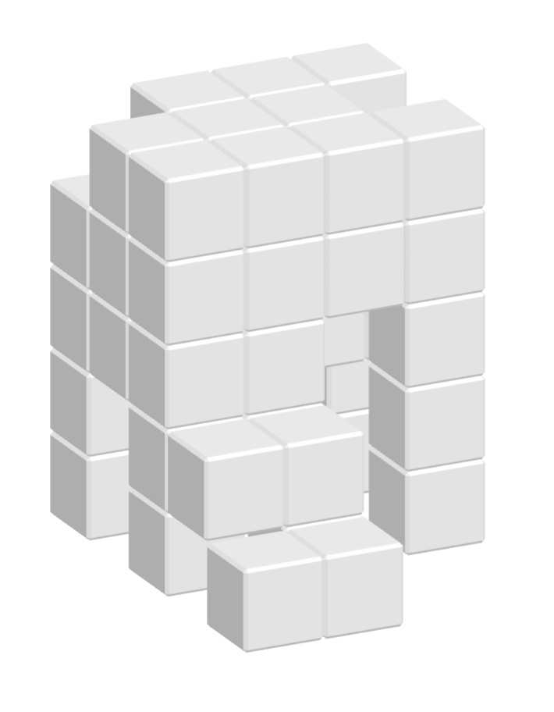
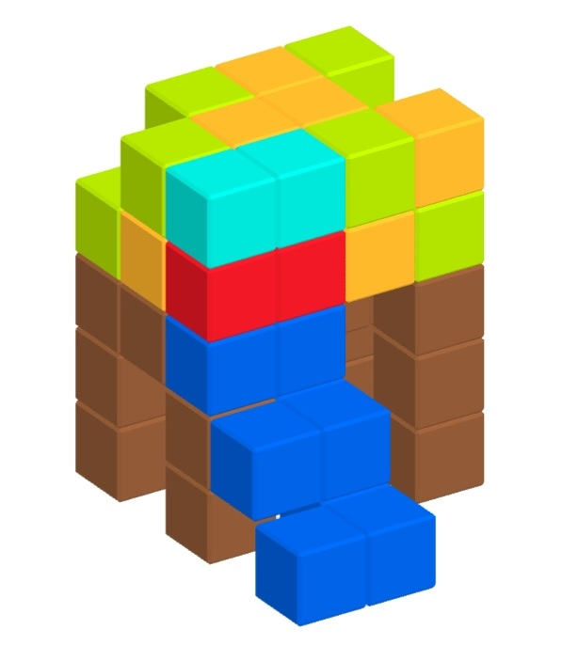
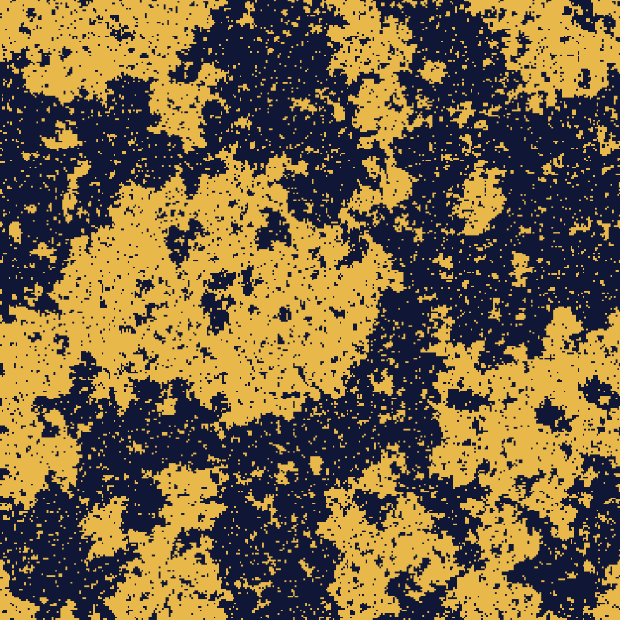



Generative AI
$$f_{θ^{ini}}$$
$$f_{θ^{∗}}:input↦output$$
train
generate
$$θ^{ini}→θ^{∗}$$
Ising model
configurations

Slide 9
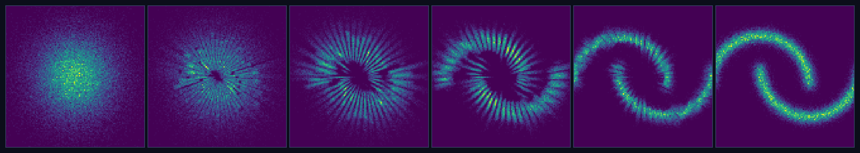
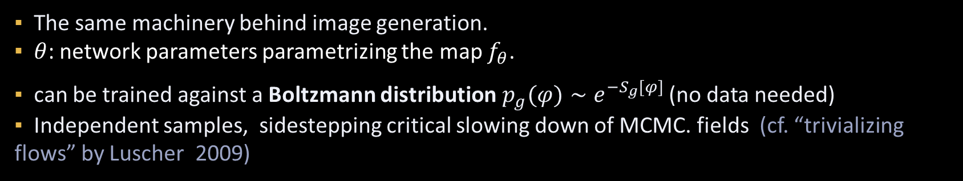
The 30-second “flow” (generative) model
▪ The same machinery behind image generation.
▪ $θ$: network parameters parametrizing the map $f_{θ}$.
▪ can be trained against a Boltzmann distribution$p_{g}(φ)∼e^{−S_{g}[φ]}$ (no data needed)
▪ Independent samples, sidestepping critical slowing down of MCMC. fields (cf. “trivializing flows” by Luscher 2009)
16

Slide 10
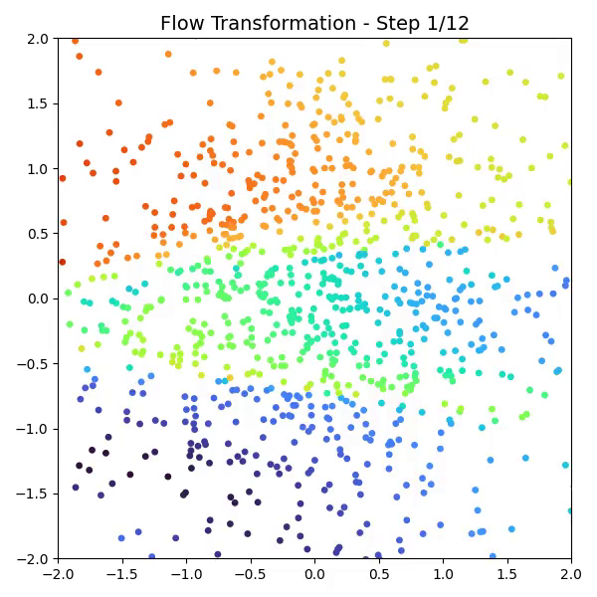
Normalizing flows, illustrated
an invertible map carries simple noise to the target, layer by layer
[M Gerdes, MC, Analytic Bijections for Smooth and Interpretable Normalizing Flows, ICML 2026]

Slide 11
A fast-moving field: generative samplers for the lattice
Coupling / gauge-equivariant flows — RealNVP for φ⁴; U(1) & SU(N) gauge [Albergo–Kanwar–Shanahan ’19; Kanwar+ ’20; Boyda+ ’21, …]
Continuous & trivializing flows — neural-ODE flows; trivializing maps [Lüscher ’09; de Haan+ ’21; Del Debbio+ ’21; Gerdes+ ’23,…]
Stochastic normalizing flows — flows + non-equilibrium MCMC [Caselle+ ’22, …. ]
Diffusion models — diffusion ≈ stochastic quantization; transferable across couplings [Wang–Aarts+ ’24,…]
………
Reviews: [Cranmer+ ’23, Nat. Rev. Phys.; Cheng–Stratikopoulou ’26 (lecture notes)]
Flows do more than sample: variance reduction of observables
[Kanwar+ ’26; Bacchio ’23, ….]

Slide 12
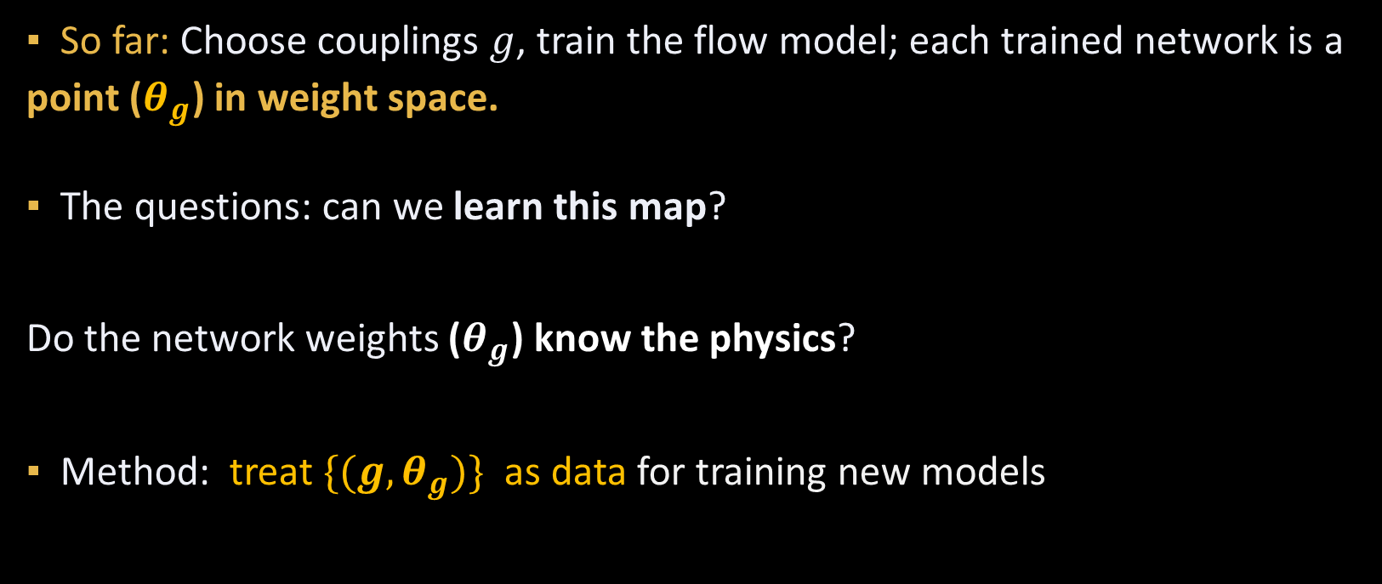
Then we asked: what did the network learn?
▪ So far: Choose couplings $g$, train the flow model; each trained network is a point ($θ_{g}$) in weight space.
▪ The questions: can we learn this map?
Do the network weights ($θ_{g}$) know the physics?
▪ Method: treat ${\{(g,θ}_{g})\}$ as data for training new models
JEPAWG (JEPA-based Weight Generator)
— treating trained networks as data
(Göbel, Ebelt, Mensch, Gerdes, MC, 2026 ICML AI4Phys Workshop)

Slide 13


The hypernetwork: a network that outputs networks
g
two numbers:
(m², λ)
HYPERNETWORK
a neural network
trained once
a flow $f_{θ_{g}}$ to sample from
$$p_{g}\left(φ\right)∝ e^{{−S}_{g}(φ)}$$
$$θ_{g}∈ℝ^{∼100,000}$$
network parameters
▪ The hypernetwork learns the whole map g ↦ θ(g) — a network whose output layer is another network's weight vector.
▪ Physics analogy: learning the map from couplings to an observable— but a hyper-observable allowing to simulate the theory.
▪ Before: one coupling g → one training run → one flow θ_{g}. Starts anew for each g, no knowledge between couplings learned or retained.
▪ w. hypernet: exploit the fact that the physics, hence θ(g) , to vary smoothly with g (except at criticality).
Next: make this robust and interpretable with a representation space in the middle.

Slide 14
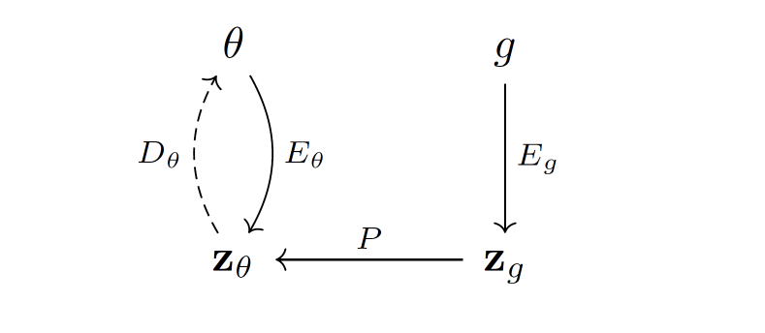
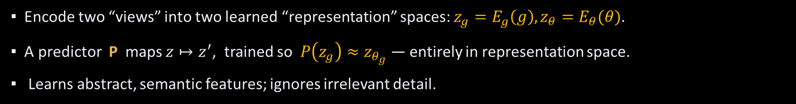
JEPA: Joint-Embedding Predictive Architecture
predict in representation space, not input space (LeCun 2022)
: target view
: context view
: representation
spaces
▪ Encode two “views” into two learned “representation” spaces: $z_{g}=E_{g}\left(g\right), z_{θ}=E_{θ}(θ)$.
▪ A predictor P maps $z↦z^{′}$, trained so $P\left(z_{g}\right)≈z_{θ_{g}}$ — entirely in representation space.
▪ Learns abstract, semantic features; ignores irrelevant detail.

Slide 15
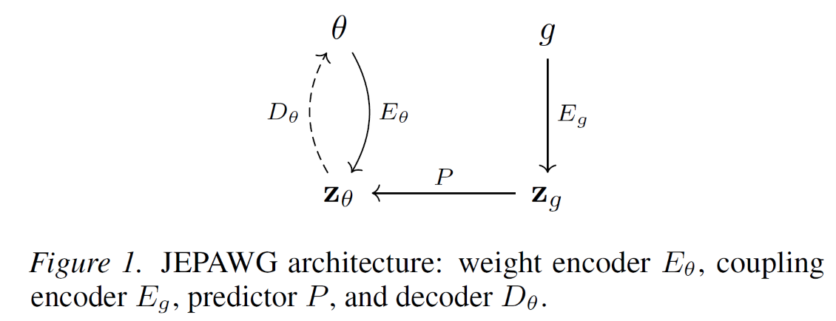
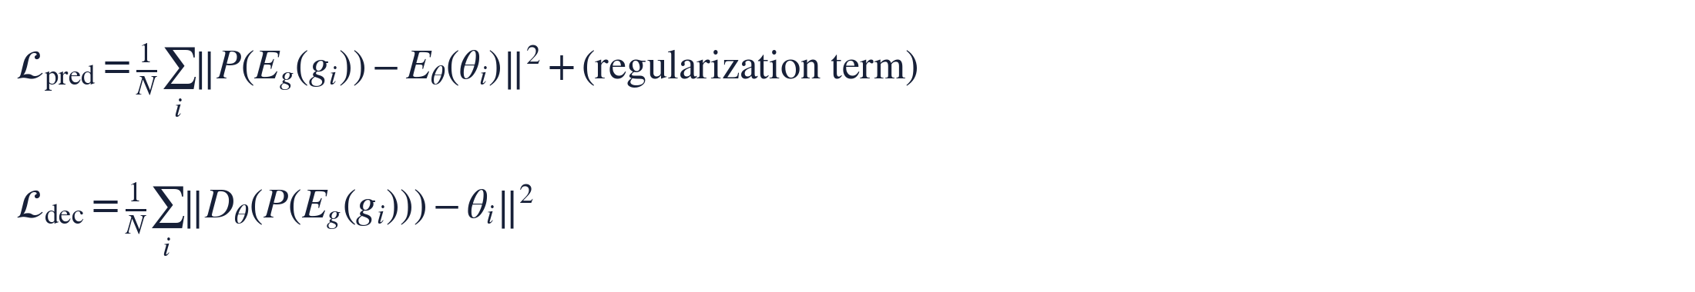

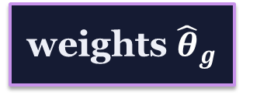



JEPAWG: a hypernetwork with a feature window
JEPA+ Decoder $D_{θ}$
$$∈ℝ^{\sim 100,000}$$
$$∈ℝ^{2}$$
coupling g
encoder E₉
z_{g} → z_{θ}
decoder Dθ
weights ${\hat{θ}}_{g}$
predict in feature space (JEPA) — trained against encoded true weights E_{θ}(θ_{g})
$$∈ℝ^{16}$$
$$∈ℝ^{16}$$
▪ Diagnostic: does feature geometry recover the physics?
▪ Generator: produce flow weights for couplings never trained on (amortized training)
joint-embedding predictive architecture for weight generation

Slide 16

JEPAWG: how well does it work?
$$∈ℝ^{\sim 100,000}$$
$$∈ℝ^{2}$$
coupling g
encoder E₉
z_{g} → z_{θ}
decoder Dθ
weights ${\hat{θ}}_{g}$
predict in feature space (JEPA) — trained against encoded true weights E_{θ}(θ_{g})
$$∈ℝ^{16}$$
$$∈ℝ^{16}$$
▪ Diagnostic: does feature geometry recover the physics?
▪ Generator: produce flow weights for couplings never trained on (amortized training)
joint-embedding predictive architecture for weight generation
Quality: Are the generated weights fitting the reality (here: physics) ? ✓😊
Interpretability: Does the feature space capture the relevant structure (here: physics) ?
20

Slide 17
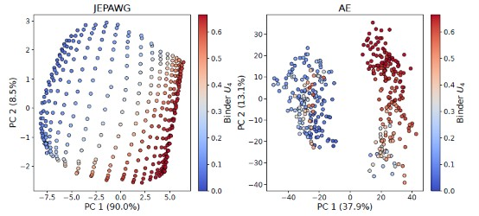
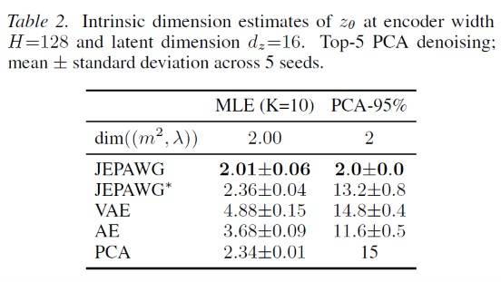
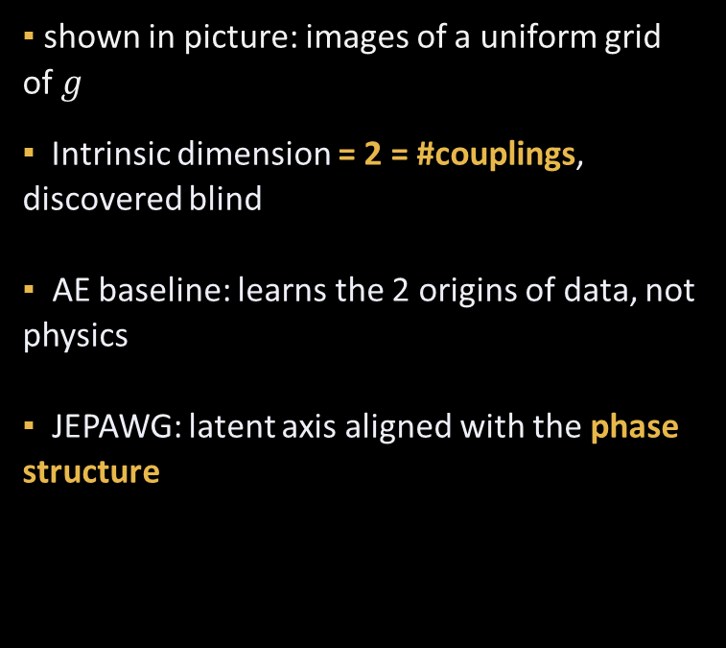
Interpretability : The feature space captures the physics
▪ shown in picture: images of a uniform grid of $g$
▪ Intrinsic dimension = 2 = #couplings, discovered blind
▪ AE baseline: learns the 2 origins of data, not physics
▪ JEPAWG: feature axis aligned with the phase structure
feature PCA, colored by Binder cumulant U₄ — JEPAWG vs autoencoder
21

Slide 18
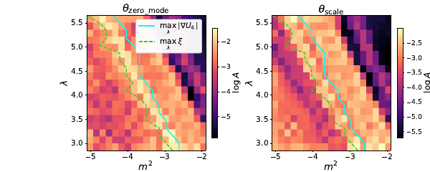
The critical line, from weights alone
▪ Sensitivity spikes along the critical line
▪ Matches max |∇U₄| and ξ proxies
▪ No correlators computed — weights only
sensitivity of weight components to couplings; overlaid: standard critical-line proxies
22

Slide 19
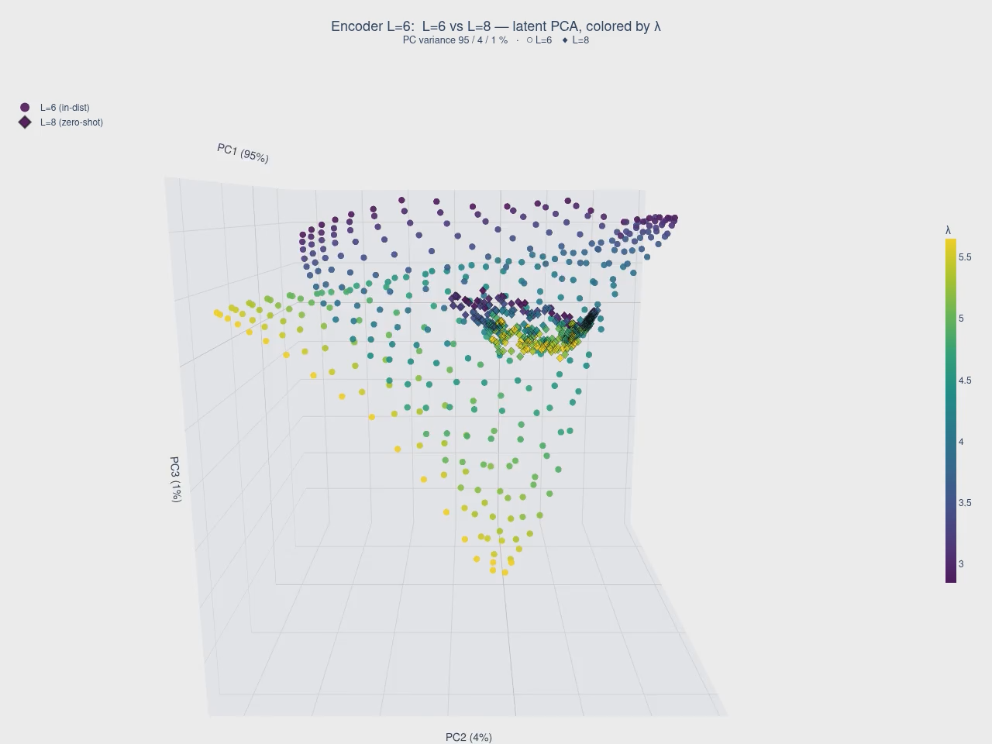
Finite-size scaling in weight space: ν ≈ 1
Idea: look at networks for lattice sizes L and L + δL, and ask how to pair points such that they are closest in feature space.
23

Slide 20
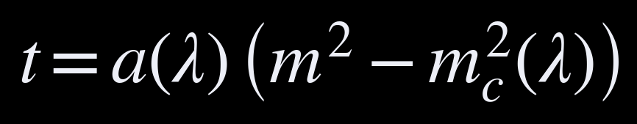
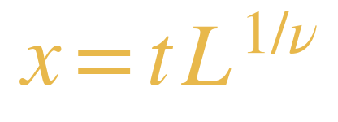
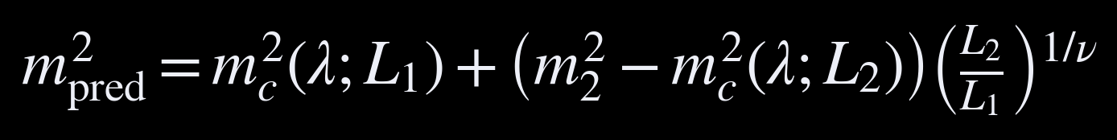
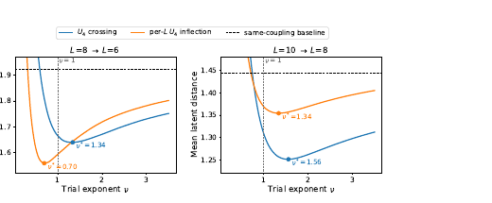
Finite-size scaling in weight space: ν ≈ 1
FSS — the workhorse of numerical criticality — reveals itself in network parameters.
▪ Pair couplings across L = 6, 8, 10 by the FSS map with trial exponent ν̂
▪ Feature distance minimized near ν = 1 — the 2D Ising value
▪ Weights as a brand new type of (hyper)-observable
24

Slide 21
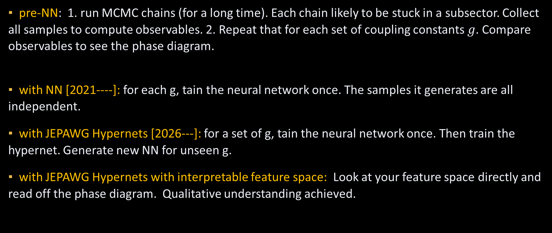
A data-driven new paradigm for studying unknown physics
▪ pre-NN: 1. run MCMC chains (for a long time). Each chain likely to be stuck in a subsector. Collect all samples to compute observables. 2. Repeat that for each set of coupling constants $g$. Compare observables to see the phase diagram.
▪ with NN [2021----]: for each g, tain the neural network once. The samples it generates are all independent.
▪ with JEPAWG Hypernets [2026---]: for a set of g, tain the neural network once. Then train the hypernet. Generate new NN for unseen g.
▪ with JEPAWG Hypernets with interpretable feature space: Look at your feature space directly and read off the phase diagram. Qualitative understanding achieved.
Disclaimer: Currently, this paradigm can still be computationally heavy. But this can change soon (WIP).
25

Slide 22
What’s Next?
More types of fields and Larger system sizes.
AI to simulate physics
AI models as physics observables
Goal: a new standard tool for theoretical physicists in the age of AI.
Thank you!
with M. Gerdes, T. Göbel, J. R. Ebelt, Z. Mensch, R. Bondesan, P. de Haan, C. Rainone.

