Slide 1
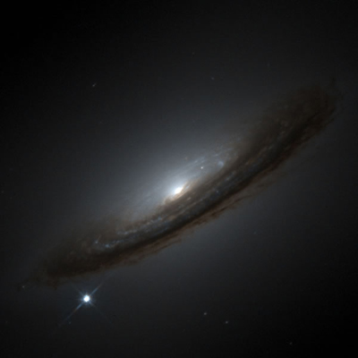

Are SN Ia safe?
Paul Shah

Slide 2
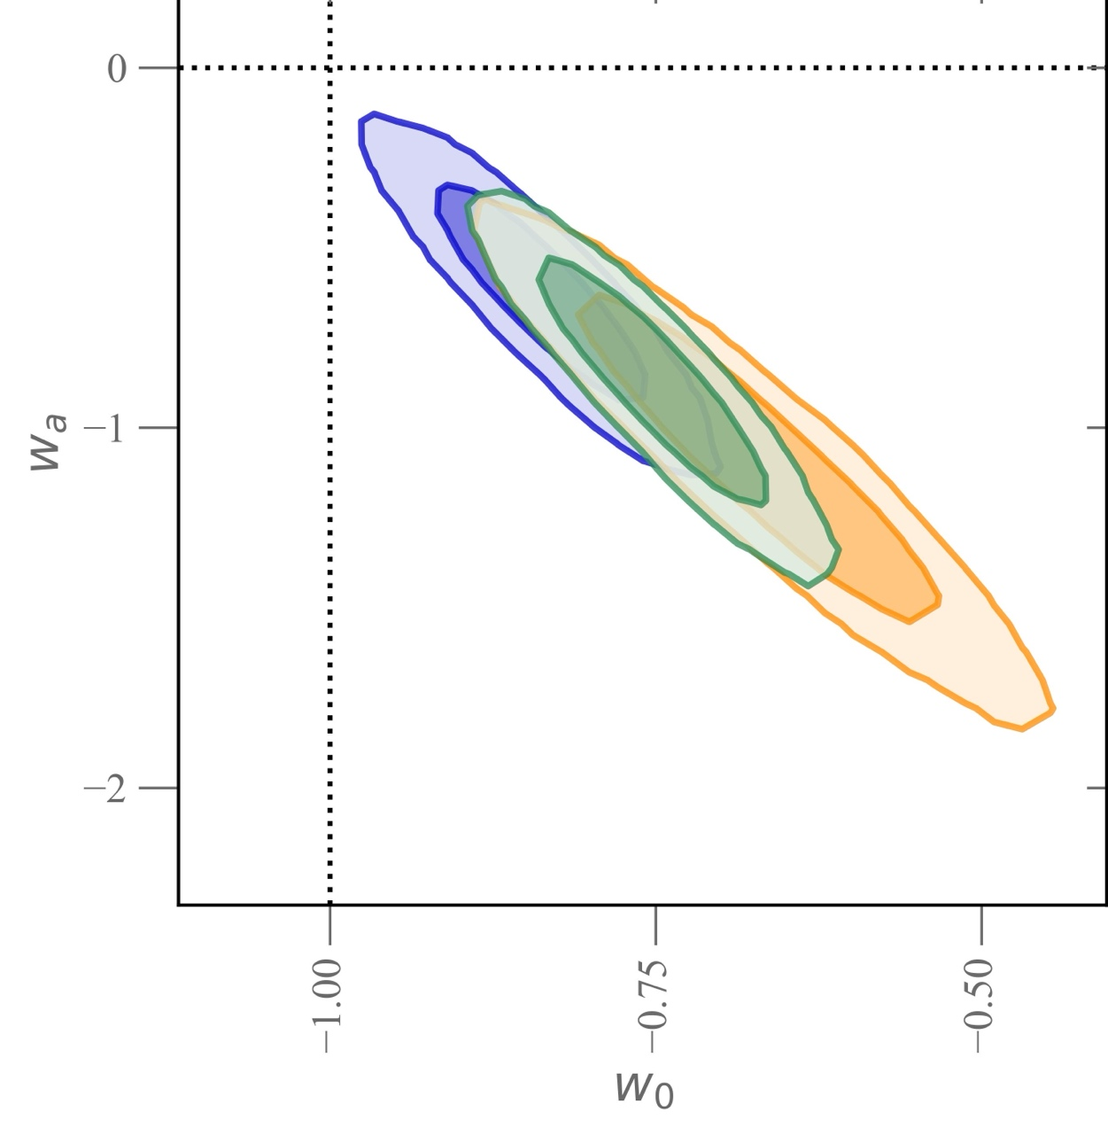



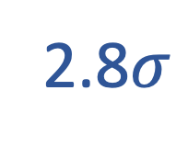
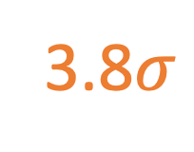
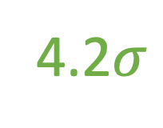
SN in early 2025
2.8$σ$
4.2$σ$
3.8$σ$
CMB+DESI DR2+Pantheon+
CMB+DESI DR2+Union3
CMB+DESI DR2+DES-5Y

Slide 3


SN in early 2025
2.8$σ$
4.2$σ$
3.8$σ$
CMB+DESI DR2+Pantheon+
CMB+DESI DR2+Union3
CMB+DESI DR2+DES-5Y
Strong evidence for $w_{0}w_{a}$ requires sub 1% accuracy

Slide 4
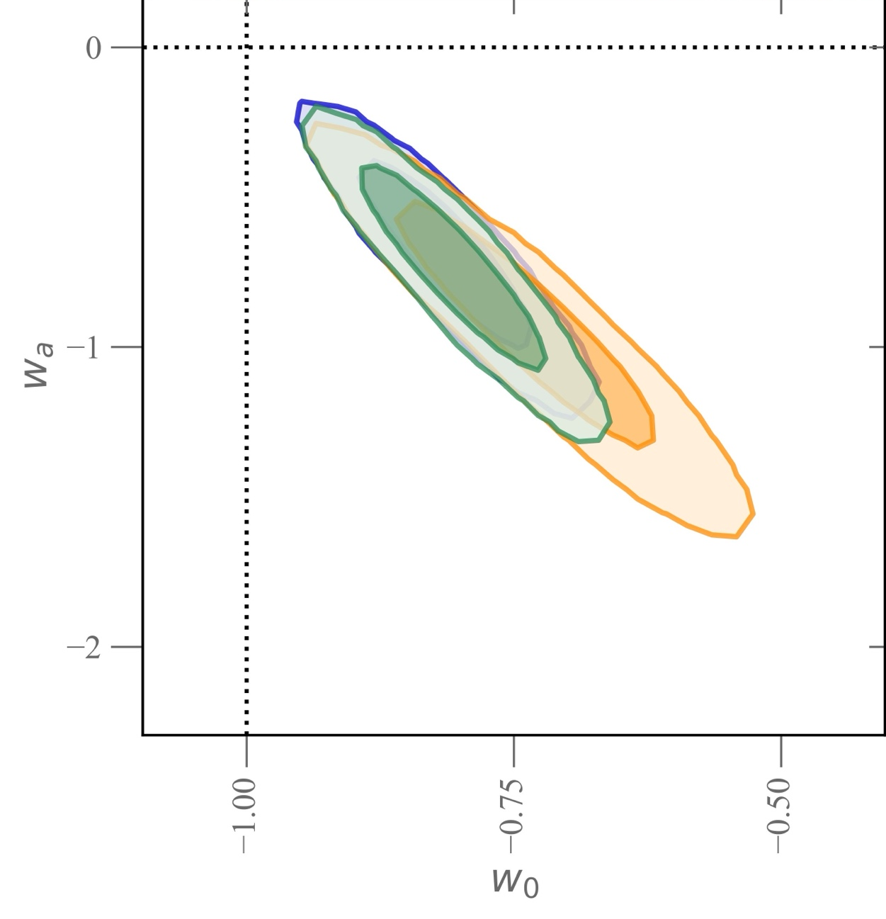
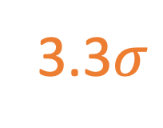
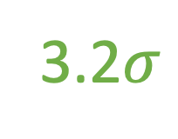
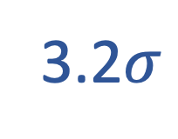
SN today
3.2$σ$
Same data !
3.2$σ$
3.3$σ$
CMB+DESI DR2+Pantheon+ (new hostmass)
CMB+DESI DR2+Union3.1 (two population)
CMB+DESI DR2+DES-Dovekie (photometry)

Slide 5
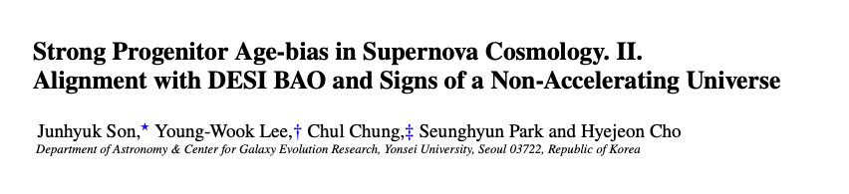
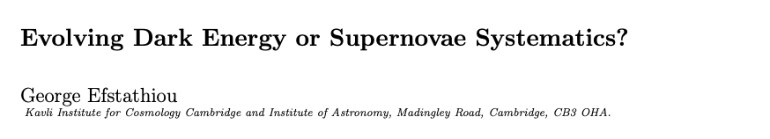
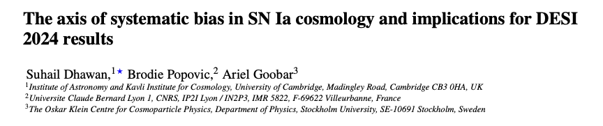
SN today
3.2$σ$
Same data !
3.2$σ$
3.3$σ$
CMB+DESI DR2+Pantheon+ (new hostmass)
CMB+DESI DR2+Union3.1 (two population)
CMB+DESI DR2+DES-Dovekie (photometry)

Slide 6
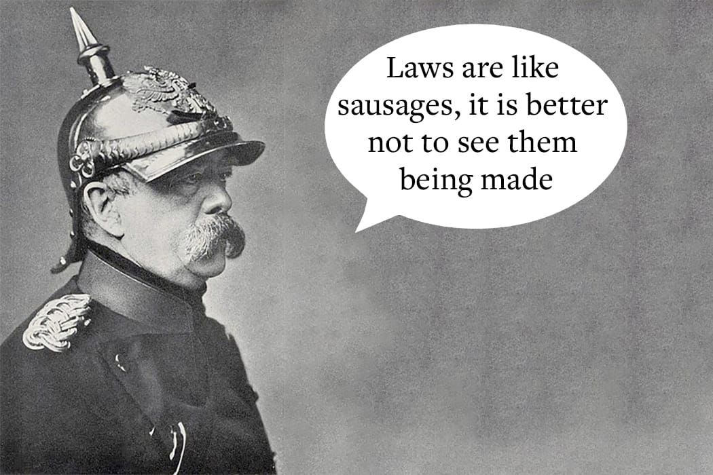

What’s in the sausage?
SN

Slide 7
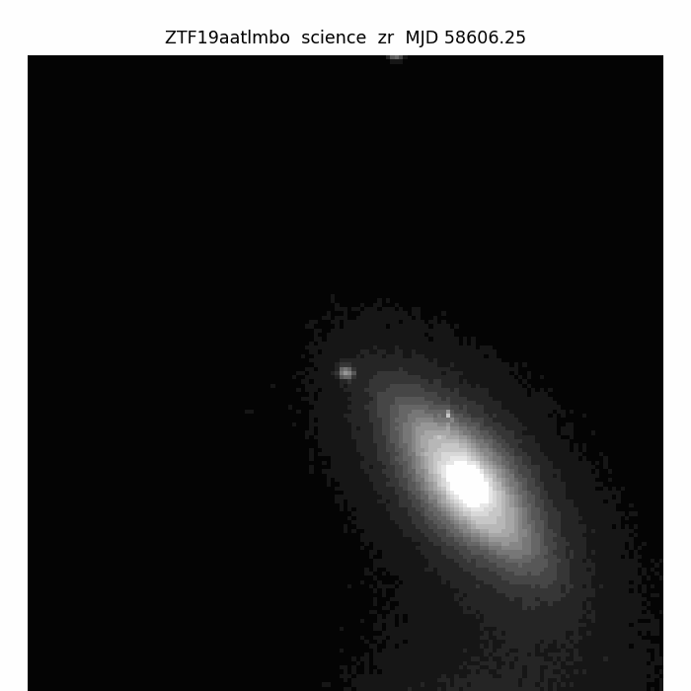
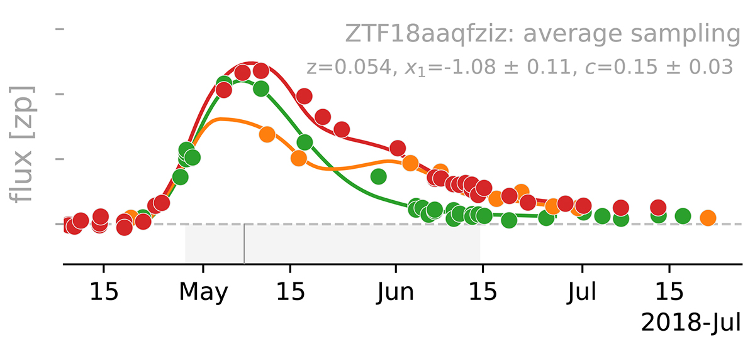
SN light curves and environment
Rigault++2025
Light curves
Environment (host galaxy, foreground)

Slide 8
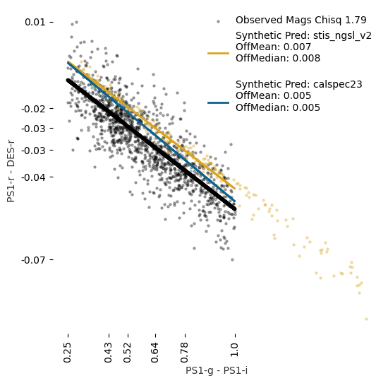
SN are rare : merge multiple surveys
Each filter system
+ standard stars
Adjust passbands to match observations
Common photometric system
Popovic++2024
DES-5Y used the same model as Pantheon+

Slide 9
DES-Dovekie improves the calibration
Each filter system
+ standard stars
Adjust passbands to match observations
Dovekie :
More data,
more flexible model!
Common photometric system
Popovic++2024
Or : use the same telescope (DEBASS)!

Slide 10
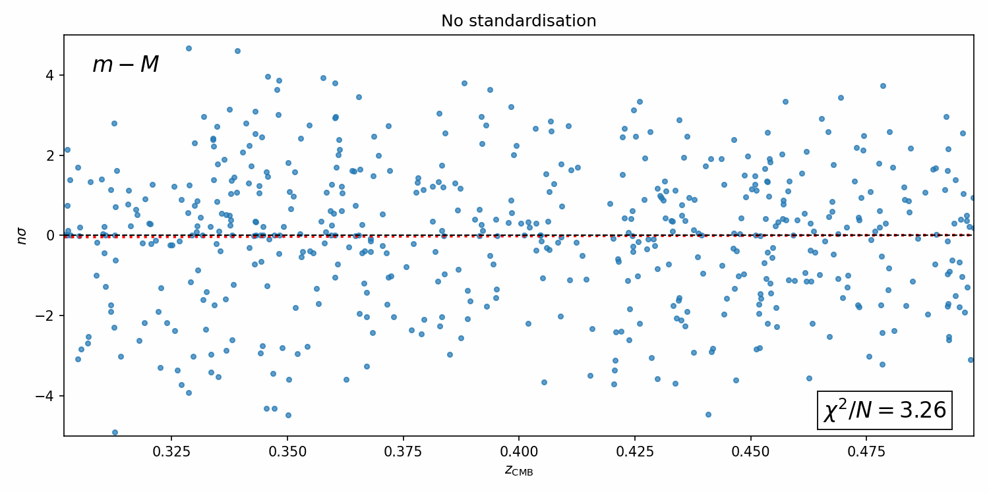

SN are standardisable candles
$$μ_{obs}=m−M+αx_{1}−βc+Δ_{B}+Δ_{M}$$

Slide 11
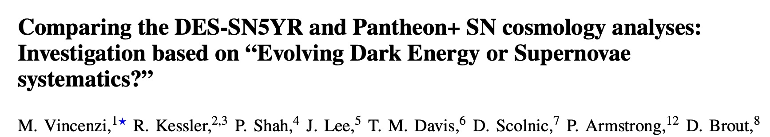

Same SN, different distance…?
$$μ_{obs}=m−M+αx_{1}−βc+Δ_{B}+Δ_{M}$$
Distances are corrected for selection effects
Pantheon+ used a brighter subset of DES
This accounts for the difference
Vincenzi++ 2025

Slide 12

Do SN evolve with distance?
$$μ_{obs}=m−M+αx_{1}−βc+Δ_{B}+Δ_{M}$$
Fit population model to data
  Intrinsic variation
  Host dust extinction
  Evolution
Vincenzi++ 2024

Slide 13
Do SN evolve with distance?
$$μ_{obs}=m−M+αx_{1}−βc+Δ_{B}+Δ_{M}$$
Fit population model to data
  Intrinsic variation
  Host dust extinction
  Evolution
systematics
Vincenzi++ 2024

Slide 14
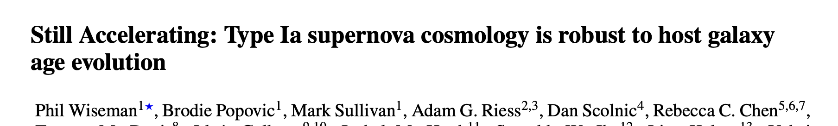
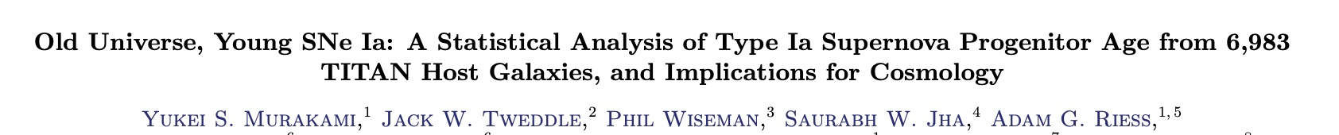
Do SN evolve with distance?
$$μ_{obs}=m−M+αx_{1}−βc+Δ_{B}+Δ_{M}$$
SN in high mass galaxies are brighter
  But age and host mass are correlated !
After host mass correction, minimal age correlation
Wiseman++ 2026

Slide 15
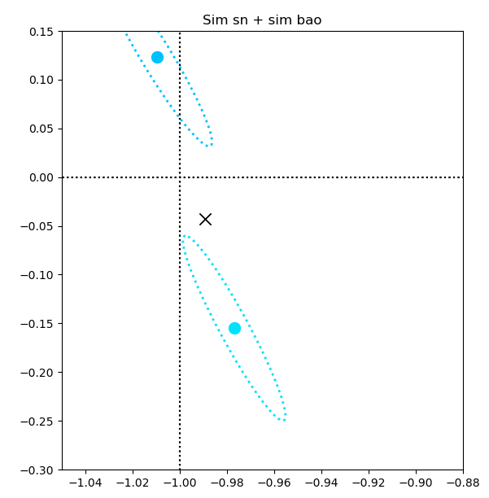



What I worry about #1
$$μ_{obs}=m−M+αx_{1}−βc+Δ_{B}+Δ_{M}$$
Distances depend on population models
  The fit is better with latest models but…
Ongoing debate
  Host dust?
  Intergalactic dust?
  Progenitor?
$$Δw_{a}\sim 0.25$$
  More data better systematic control
Changing SN host mean $R_{V }$by +1.5, -1.0
(but doesn’t seem preferred by data)

Slide 16
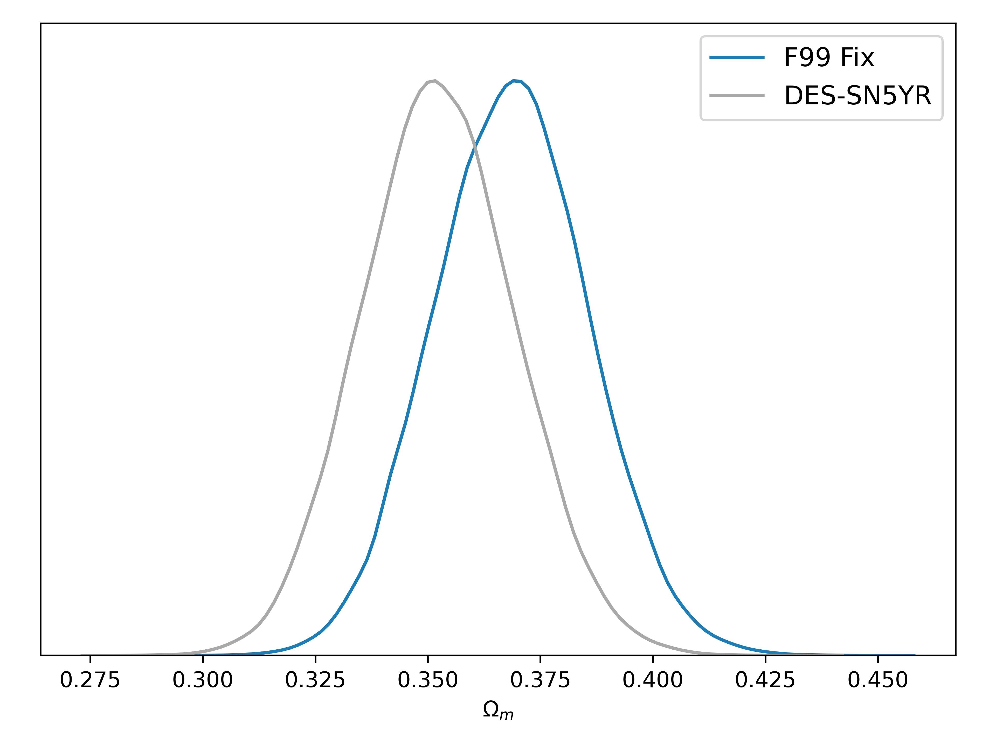

What I worry about #2
Inaccurate colour law was used in DES-5Y
Was used to simulate data
…and analyse the simulated data
DES-5Y would have been >5$σ$ evidence for $w_{0}w_{a}$!
Popovic++ 2025
  Data challenge? Regression testing?
  Independent code/teams

Slide 17
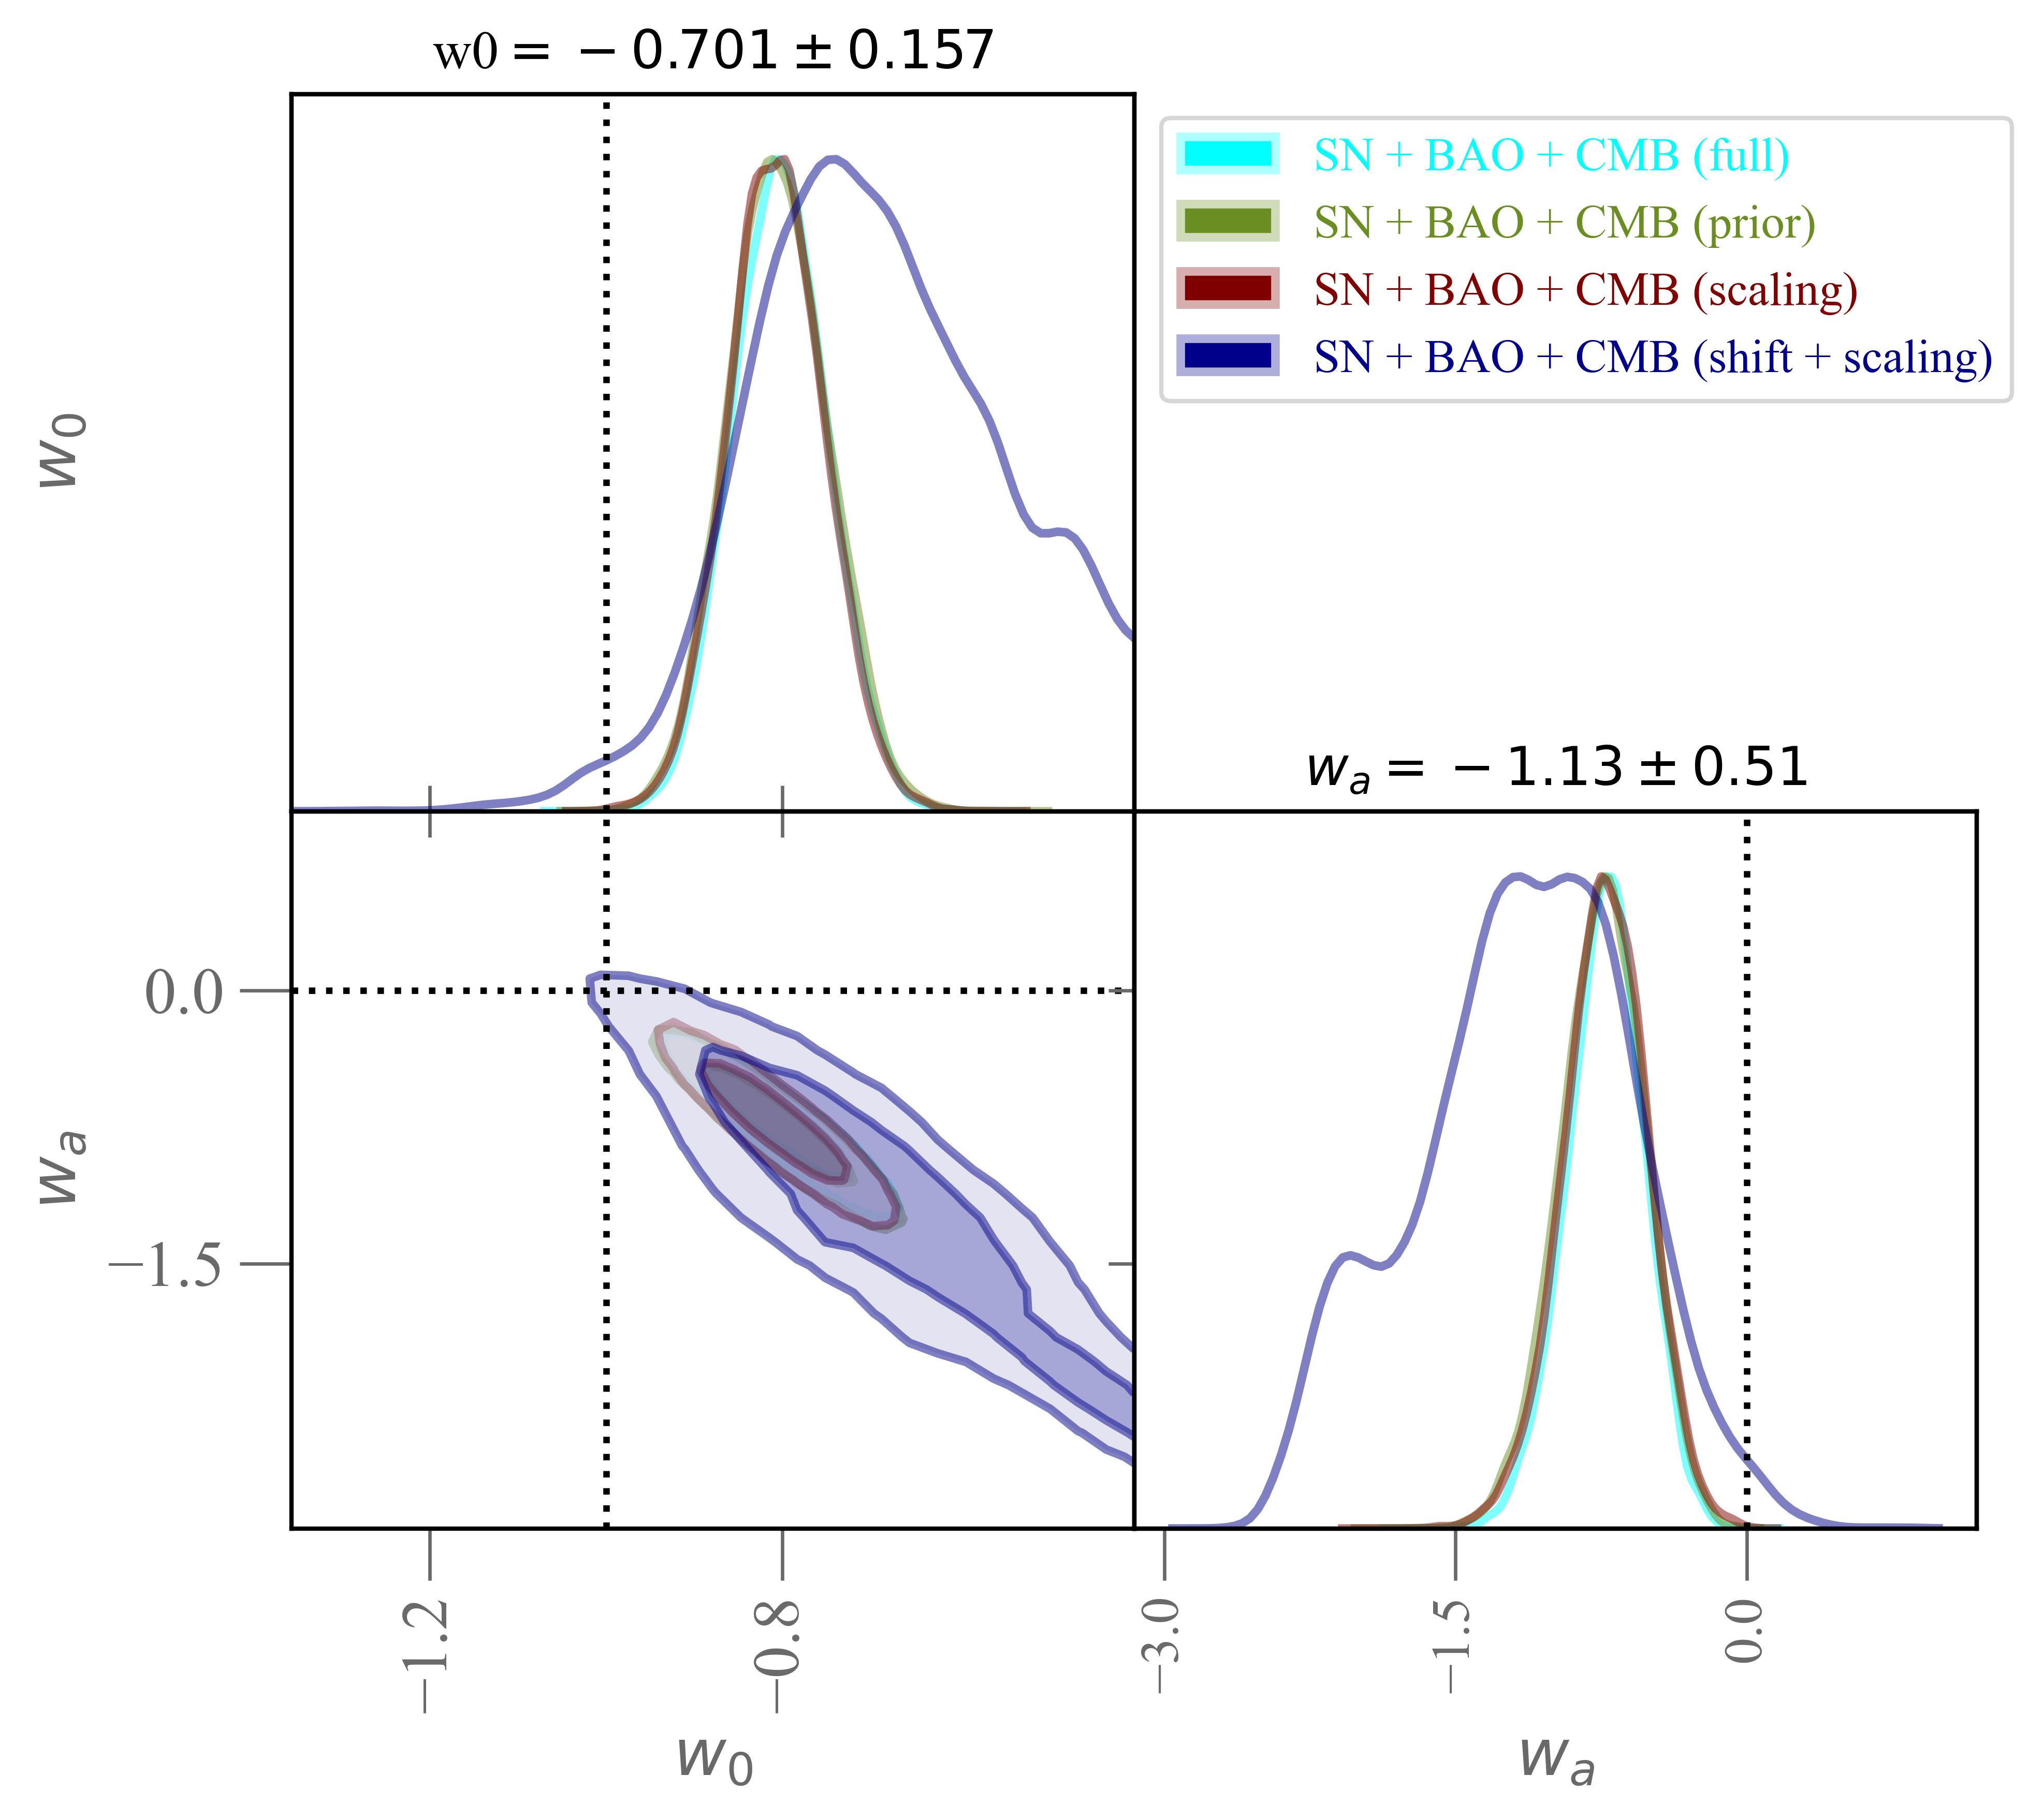

A Bayesian test for systematics
Hyper-parameters
  $Ω_{m, SN }= Ω_{m , true}+Δ_{SN}$, etc.
  $Cov_{SN}=S∗Cov_{SN}$
  …also for BAO, CMB
No evidence that SN have larger systematics
$Λ$+Systematics is an even bet to $w_{0}w_{a}$
Preliminary
Lahav 2000, Lahav 2005, Bernal & Peacock 2017 (BACCUS)

Slide 18
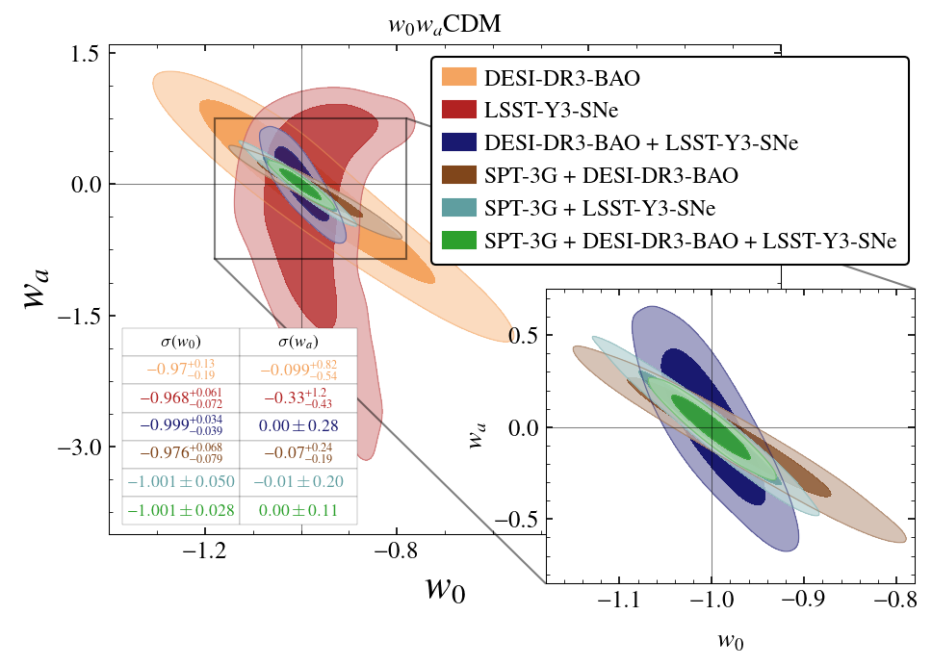
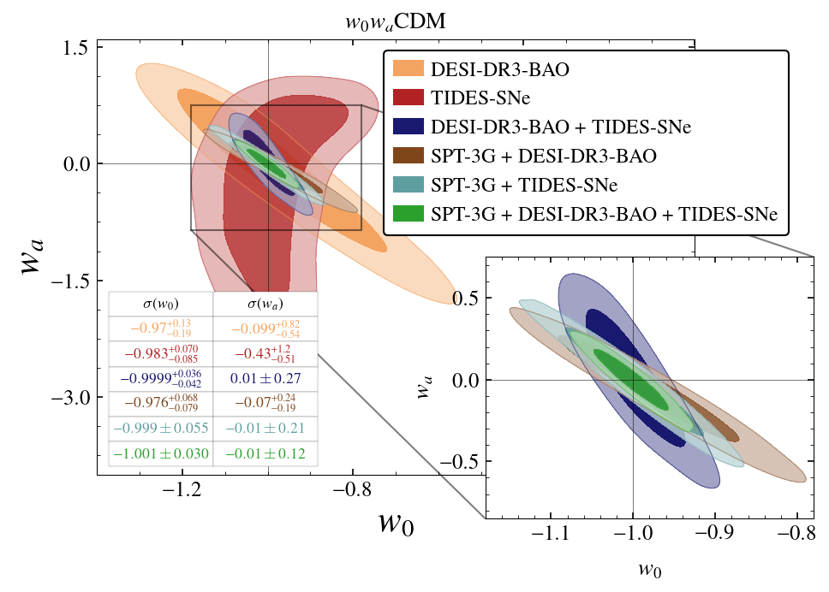

Forecasting is difficult, especially about the future…
Figure of merit for $w_{0}w_{a}$
  Best = 227 (Popovic++ 25)
TIDES-SN (LSST + 4MOST)
  150k SN + DESI DR3 + CMB + SPT-10k
  Figure of merit $\sim 800$
  but ‘Pessimistic’ systematics …
Also : ATLAS, ZTF, …
Figure courtesy of Srini Raghunathan

Slide 19
Which SN dataset should I use?
 | Pantheon+ | DES-Dovekie | Union3.1
Number of SN | 1701 | 1820 | ~2000
Classification | Spec | Photo | Spec
Number of surveys | 20 | 7 | 24
Oldest photometry | 1980 | 2001 | 1992
Light curve fitter | Salt2 | Salt3 | Salt3
Bias correction | Frequentist | Frequentist | Bayesian
DES-Dovekie and Union3.1 are current state-of-the-art
  (Mostly) different data
  (Mostly) different pipeline
  Different teams

Slide 20
Conclusions
  SN distances consistent
    (mostly) independent data from independent teams
  Systematics under control at the current precision of data
    We can be optimistic for the (SBI) future!

