Slide 1


Probing gluon saturation in a DIS process via nonconformal soft-wall holography
ADRITA CHAKRABORTY
AGH UNIVERSITY OF SCIENCE AND TECHNOLOGY
KRAKOW, POLAND
In collaboration with : Piotr Kotko
Arxiv: 2607.xxxxx
Contributed talk at PASCOS 2026, University of Sheffield, UK

Slide 2
Deep Inelastic Scattering process and gluon saturation

Slide 3
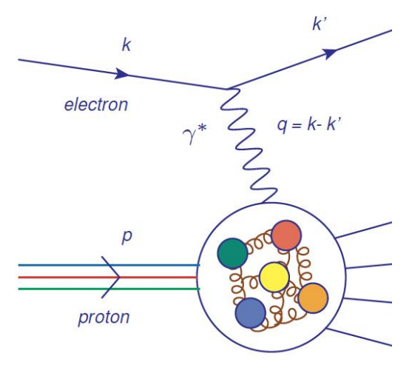
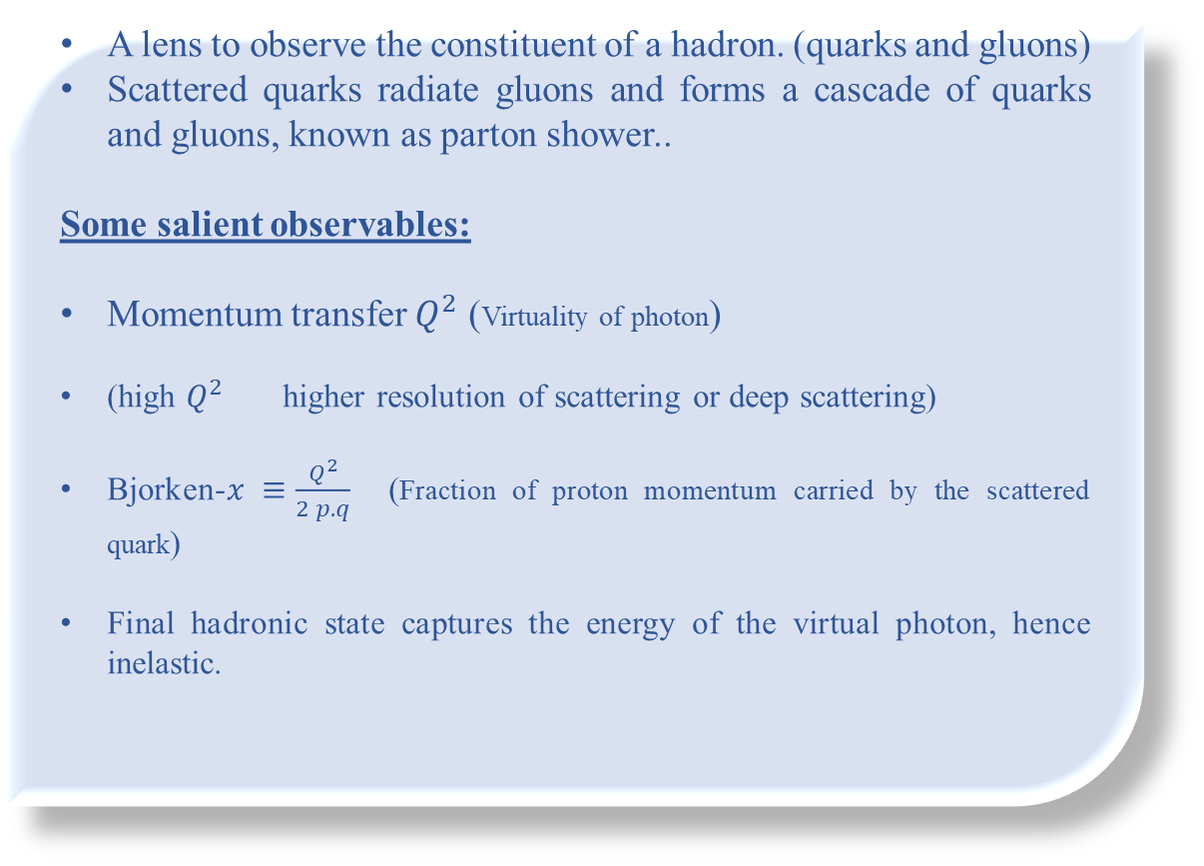
Deep Inelastic Scattering process
Picture credit: Rojae Mighty’s talk, CFNS 2025
A lens to observe the constituent of a hadron. (quarks and gluons)
Scattered quarks radiate gluons and forms a cascade of quarks and gluons, known as parton shower..
Some salient observables:
Momentum transfer $Q^{2}$ (Virtuality of photon)
(high $Q^{2}$ higher resolution of scattering or deep scattering)
Bjorken-$x ≡\frac{Q^{2}}{2 p.q}$ (Fraction of proton momentum carried by the scattered quark)
Final hadronic state captures the energy of the virtual photon, hence inelastic.

Slide 4
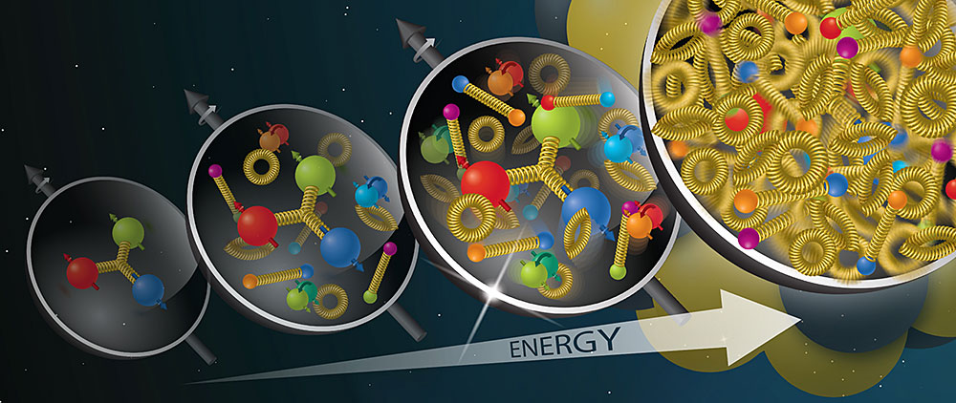

High energy gluon saturation in DIS
Gluon density grows rapidly for higher energy and smaller Bjorken-$x$.
For even higher energy, gluons start to interact and recombine, slowing down the growth.
Eventually, gluon density reaches a saturation at sufficiently high energy of the projectile.
Saturation is characterized by saturation scale $Q_{s}$($x$), in general, as a function of Bjorken-$x.$
*We will extract a gluon saturation scale in a soft-wall holographic prescription of DIS
*For a sufficiently IR boundary theory, the saturation scale is expected to be a function of the
soft-wall effect of the holographic bulk.

Slide 5
Holographic understanding of DIS process and gluon saturation

Slide 6
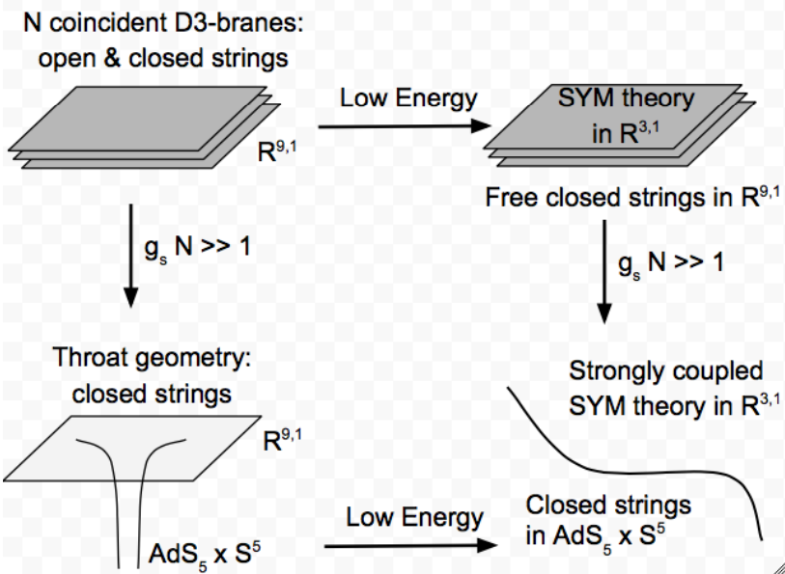
Gauge/Gravity holographic correspondence
( AdS/CFT )
Maldacena, 1998

Slide 7





DIS and gluon saturation from AdS/CFT
Target hadron or nucleus Gravitational Shockwave in AdS (Highly boosted in one light-cone direction)
(in the form of a slice of plasma)
Holographically dual to an excitation in boundary correlators
Associated current correlators in CFT :
In bulk:
Gluon structure function: ,
Gluon saturation momentum scale : $Q_{s}^{2}\sim \frac{1}{x}$ ,
From AdS/CFT holography, , $Λ$ is the IR cutoff defining the confinement scale.
Maldacena 2008; Kovchegov 2010; Avsar, Iancu, McLerran, Triantafyllopoulos, 2009

Slide 8
Nonconformal gauge/gravity holography
Gravity in deformed 5D AdS
dual
4D Nonconformal pure Yang-Mills theory
Relaxation in conformal symmetry by introducing either running dilaton or modified vector field components.
Extra dimensionful parameter appears to deform the AdS metric with dominating effect in the IR regime.
Running effective coupling of the boundary QCD-like theory can capture the physics of confinement.
Deformed metric merges to conformal AdS when the extra parameter vanishes.
Mimics the effects of IR cutoff in hard-wall scenario and is known as soft-wall AdS/QCD model.
Witten, 1998; Maldacena, Aharony, Gubser, Oz, Ooguri, 1999

Slide 9
Probing gluon saturation using shockwave in nonconformal holography

Slide 10


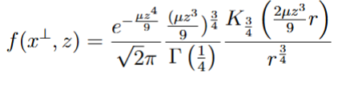
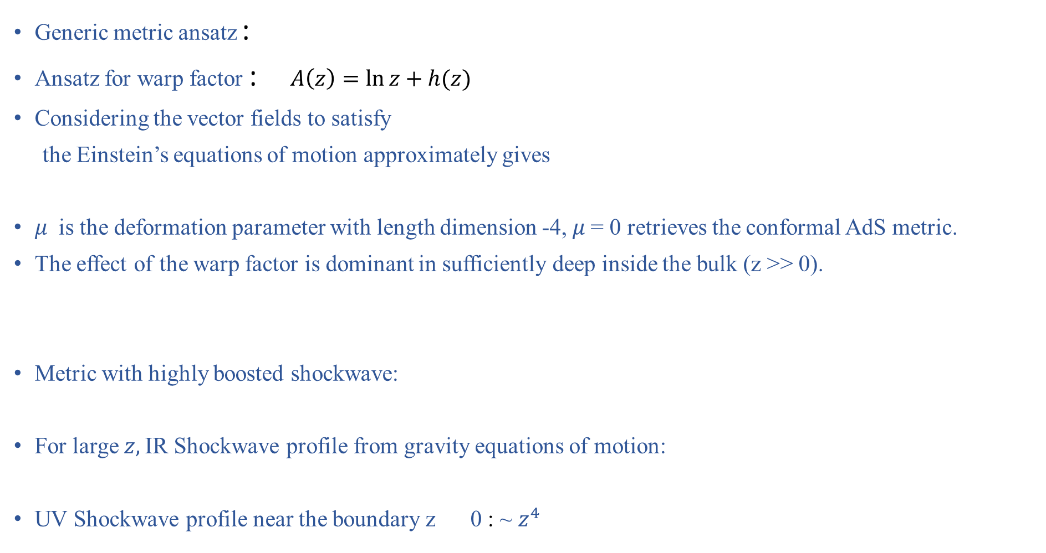
Nonconformal warped bulk and shockwave
Generic metric ansatz :
Ansatz for warp factor : $A\left(z\right)=\ln{z}+h(z)$
Considering the vector fields to satisfy
the Einstein’s equations of motion approximately gives
$μ$ is the deformation parameter with length dimension -4, $μ$= 0 retrieves the conformal AdS metric.
The effect of the warp factor is dominant in sufficiently deep inside the bulk (z >> 0).
Metric with highly boosted shockwave:
For large $z,$IR Shockwave profile from gravity equations of motion:
UV Shockwave profile near the boundary z 0 : ~ $z^{4}$
Shockwave in nonconformal bulk
Chakraborty, Kotko, 2026

Slide 11
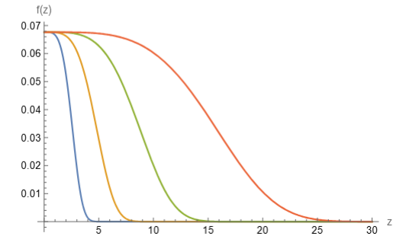

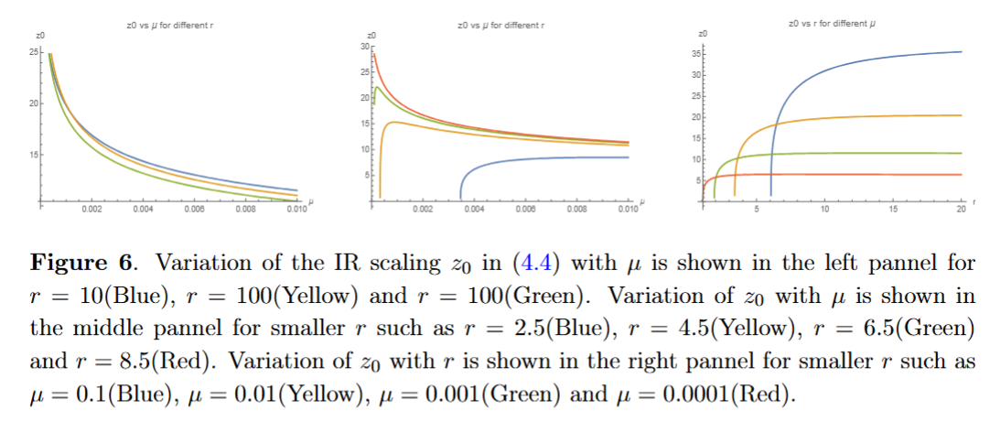


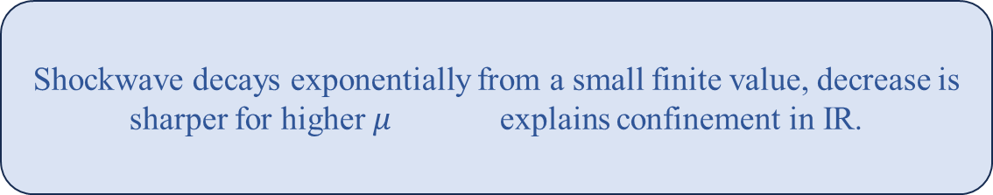
Confinement scale from the IR shockwave profile
Shockwave decays exponentially from a small finite value, decrease is sharper for higher $μ$ explains confinement in IR.
Confinement scale:
Ranges of r and μ:
Chakraborty, Kotko, 2026

Slide 12

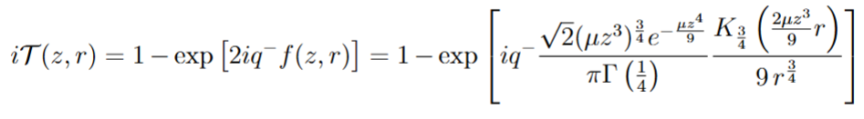
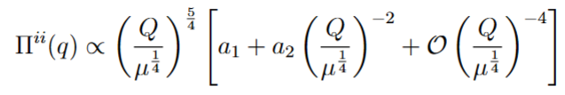

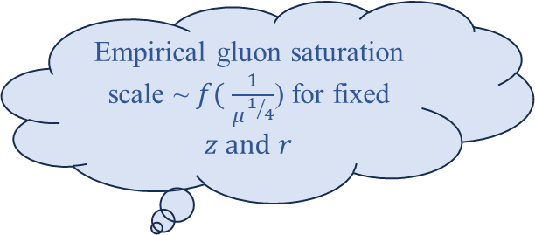
Current correlators and structure functions
IR boundary theory at large $z$ is nonconformal unlike AdS/CFT.
As a gauge condition, we choose all Maxwell’s field components to be finite except
Iterative solutions of Maxwell’s equations gives eikonal scattering amplitude
in IR limit.
Current correlator:
Empirical gluon saturation
scale ~$f($ $\frac{1}{μ^{1/4}}$) for fixed $z and r$
Chakraborty, Kotko, 2026

Slide 13

Summary
Preparation of shockwave in soft-wall warped holographic set-up.
Decaying shockwave profile suggests confinement in IR regime.
Dimensionful deformation parameter causes a confinement scale.
Eikonal scattering amplitude and gluon structure functions in IR boundary theory yield a saturation scale which is a nontrivial function of the deformation of the bulk geometry.
Gluon saturation is observed in IR boundary theory of a nonconformal holographic framework without introducing IR cutoff.
However !
Saturation scale is still empirical, needs more study.
For now, we just have $f($ $\frac{1}{μ^{1/4}}$) $∝\frac{1}{x}.$ We are working on a more explicit expression of$f($ $\frac{1}{μ^{1/4}}$) and its relation with Bjorken$−$ $x$.
Studying other existing current correlator
will yield the whole information on the effect of $μ$on gluon saturation.
We will soon come back addressing these issues in our arXiv submission. Stay tuned!

Slide 14
Thanks all!
Questions and comments are welcome

