Slide 1


Primordial Black Hole Formation from Inflationary Higgs Instability
Ethan Milligan and Dr. David Mulryne

Slide 2
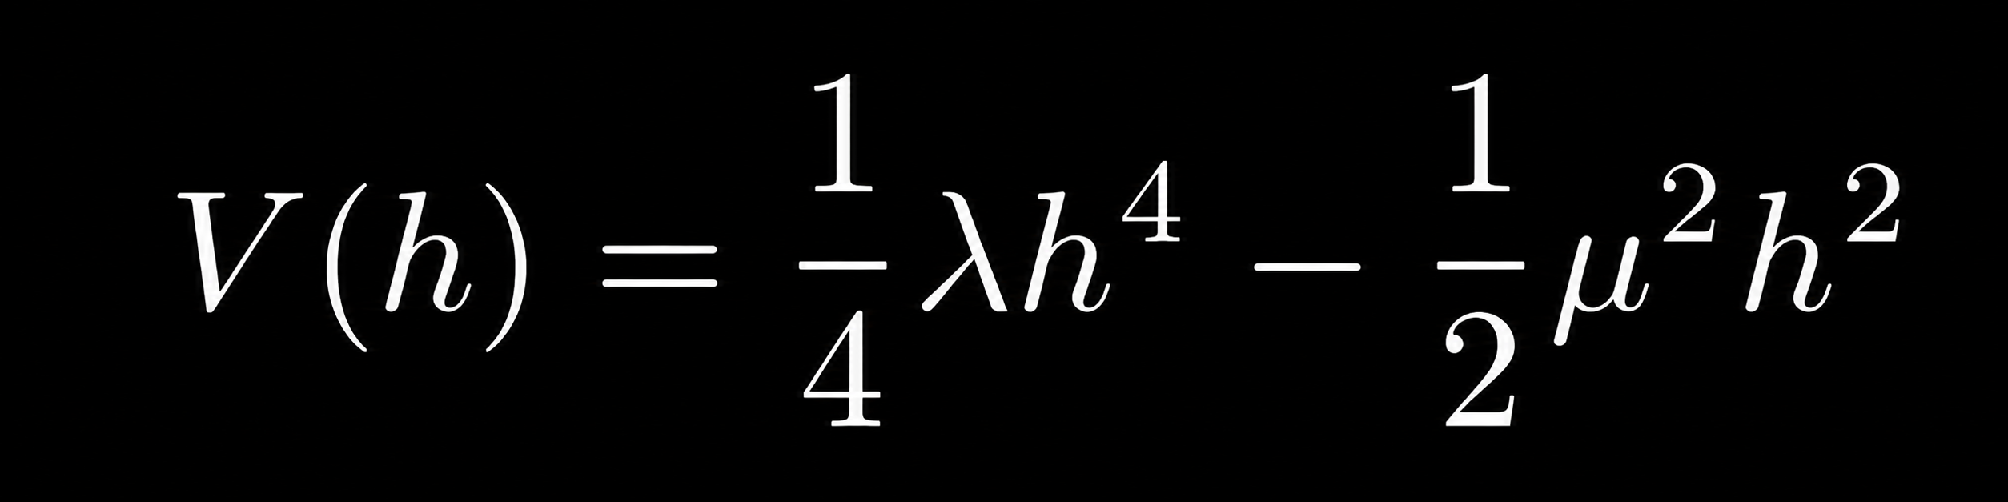
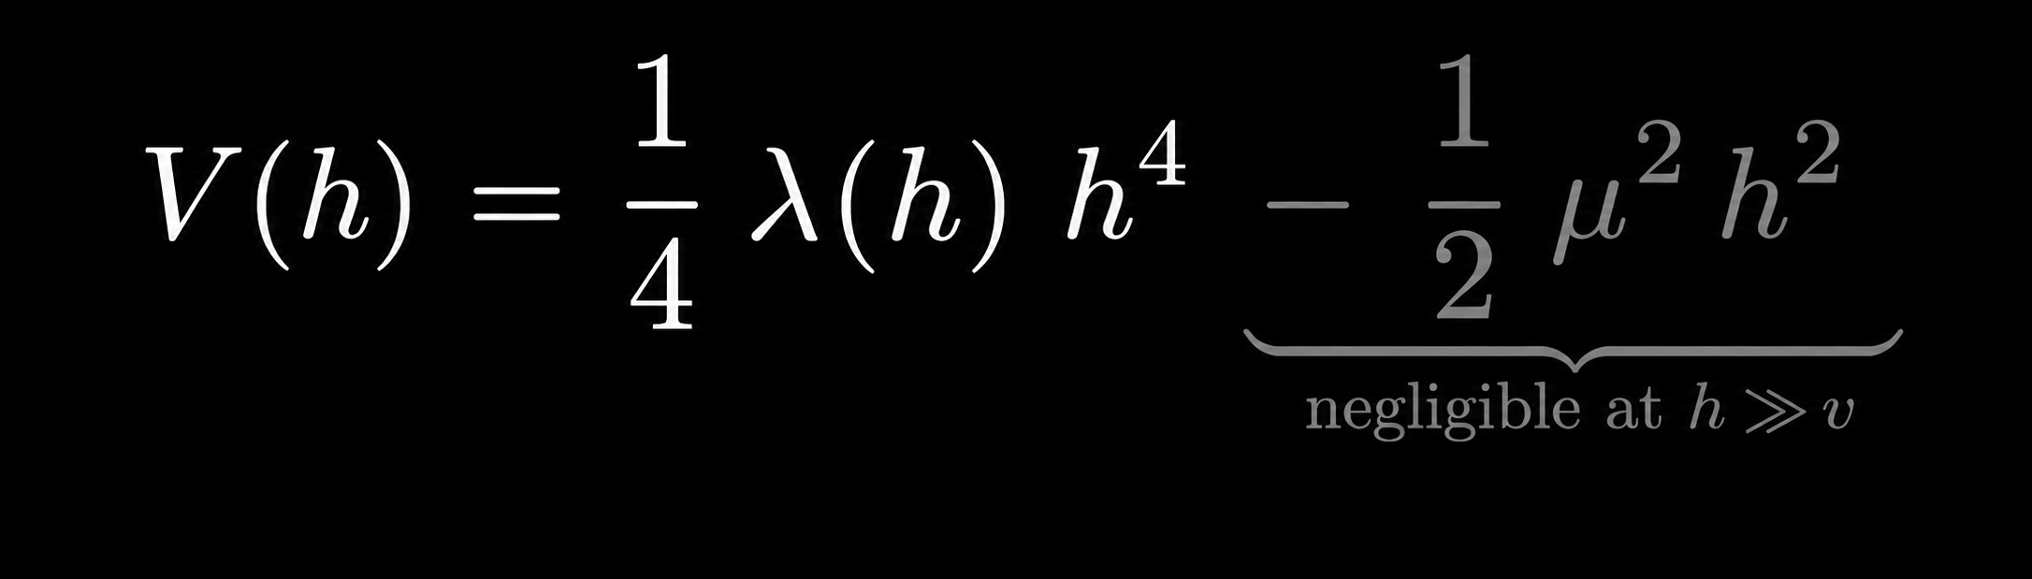
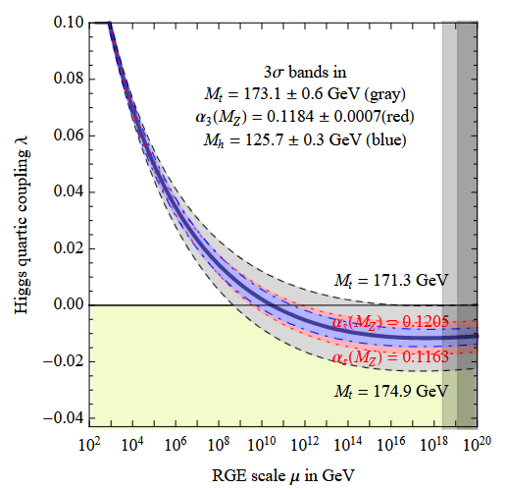
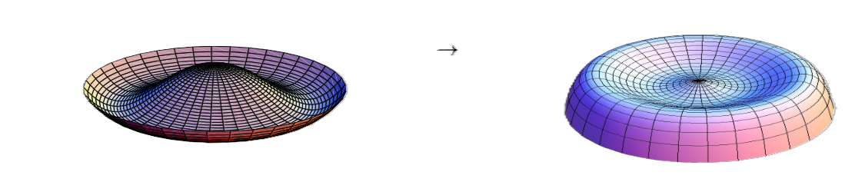
Higgs vacuum instability
Tree level potential
RG improved potential
Degrassi, G. et al [arXiv:1205.6497], Strumia, A. talk at GGI 2017

Slide 3
The higgs metastability is not just a particle physics question…
… it is a nonlinear spacetime question.

Slide 4

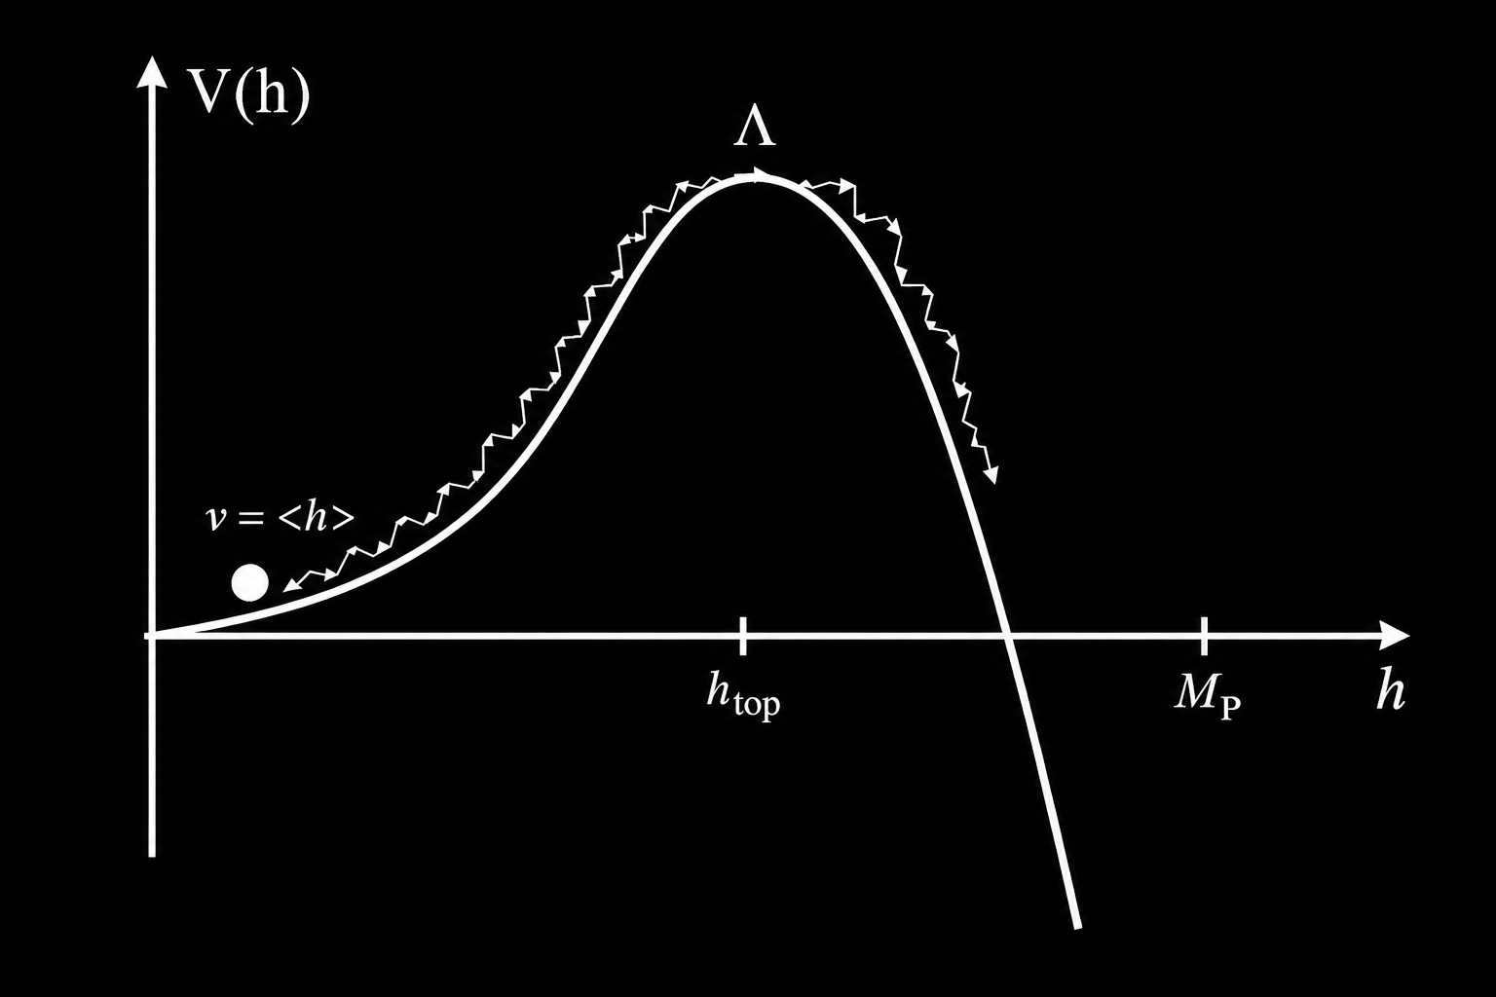
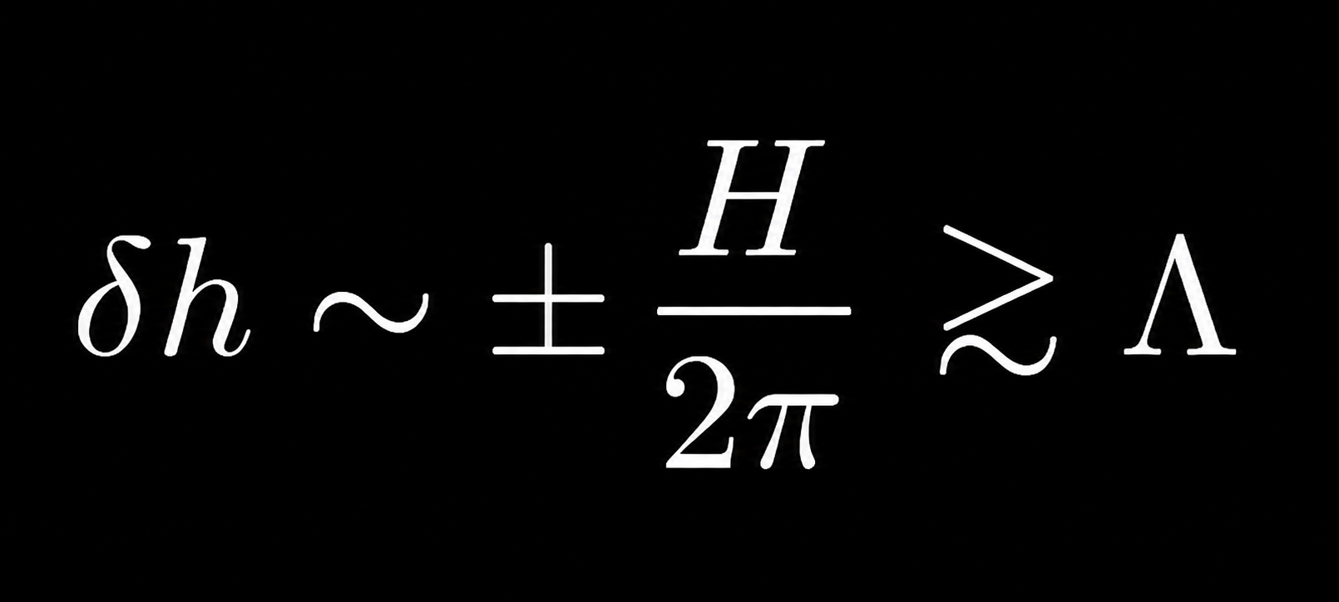
Cosmological implications & stochastic kicks
If the Higgs field is a light spectator during inflation, stochastic fluctuations δh may push the Higgs field over the top of the hilltop
Being over the hilltop is not enough. The field must reach the regime where the classical drift dominates the quantum diffusion

Slide 5
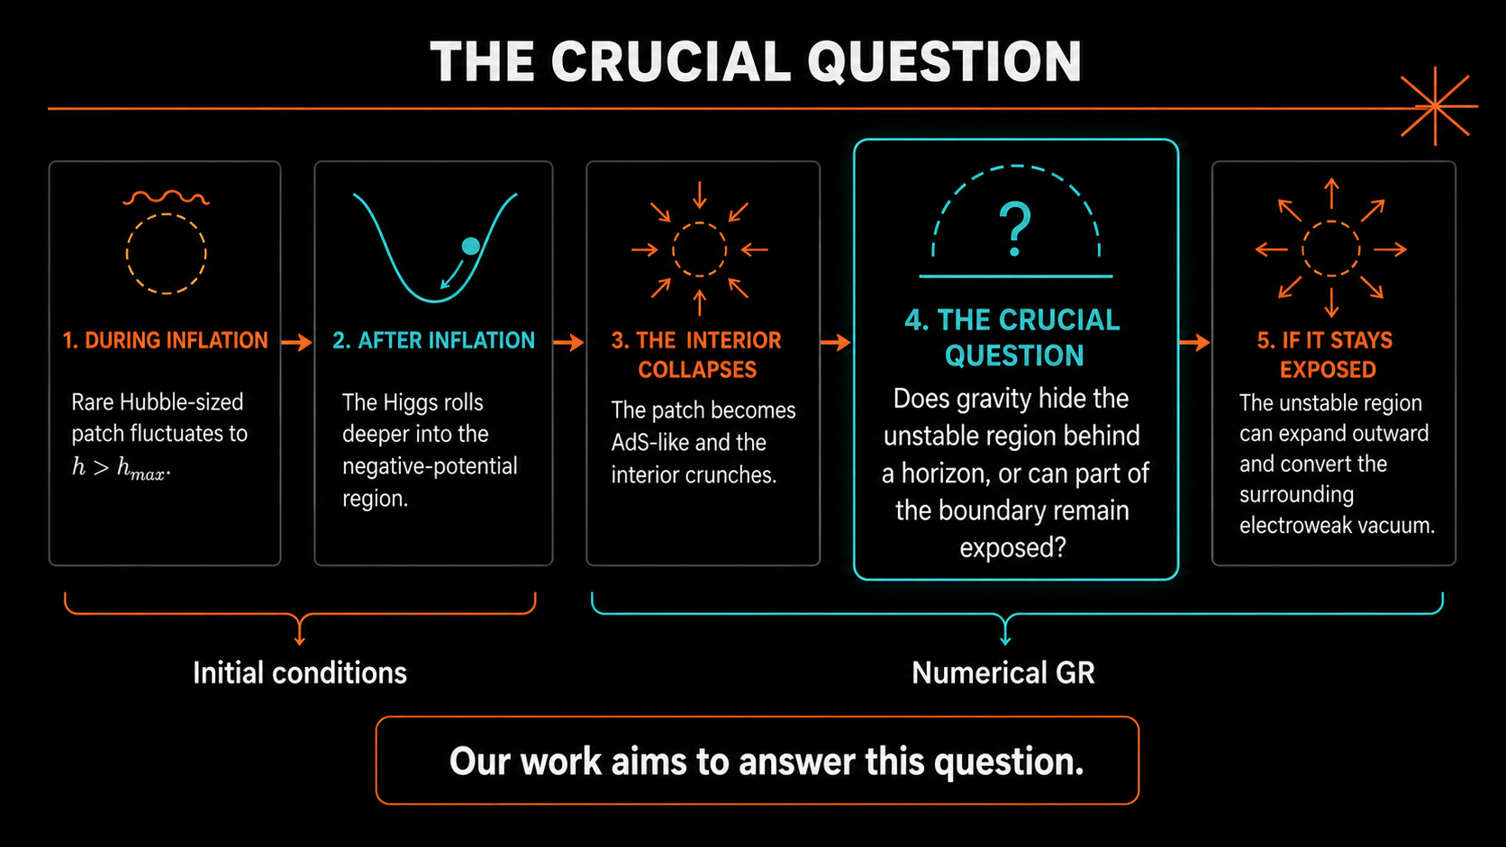
HOW CAN ONE PATCH THREATEN THE UNIVERSE?
arXiv:2205.10240, arXiv:2207.00299, arXiv:1505.04825, arXiv:1607.00381, arXiv:1612.03753, arXiv:1710.02865, and many more..

Slide 6
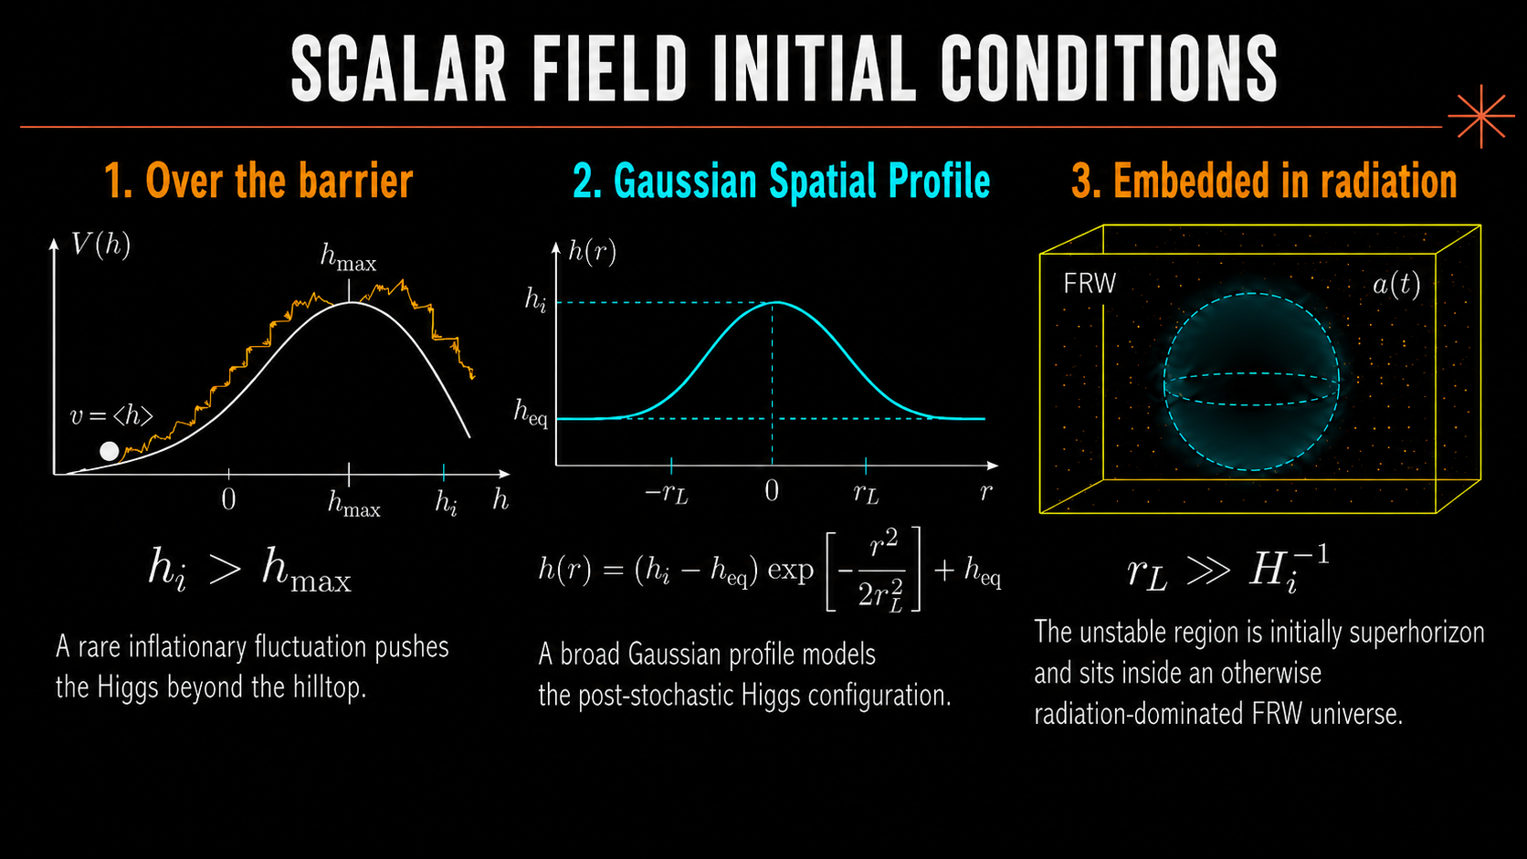
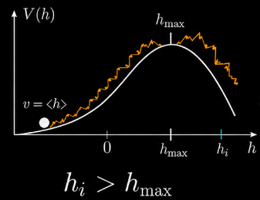
Scalar field initial conditions
Initial Conditions
1. Over the hilltop
A rare inflationary fluctuation pushes the Higgs beyond the hilltop
The unstable region is initially superhorizon and sits inside a radiation dominated FRW universe
A rare inflationary fluctuations pushes the Higgs over the hilltop
A Gaussian spatial profile models the post stochastic Higgs configuration

Slide 7
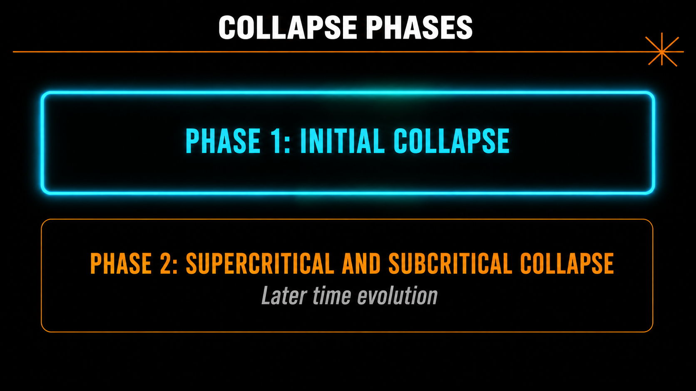

Slide 8
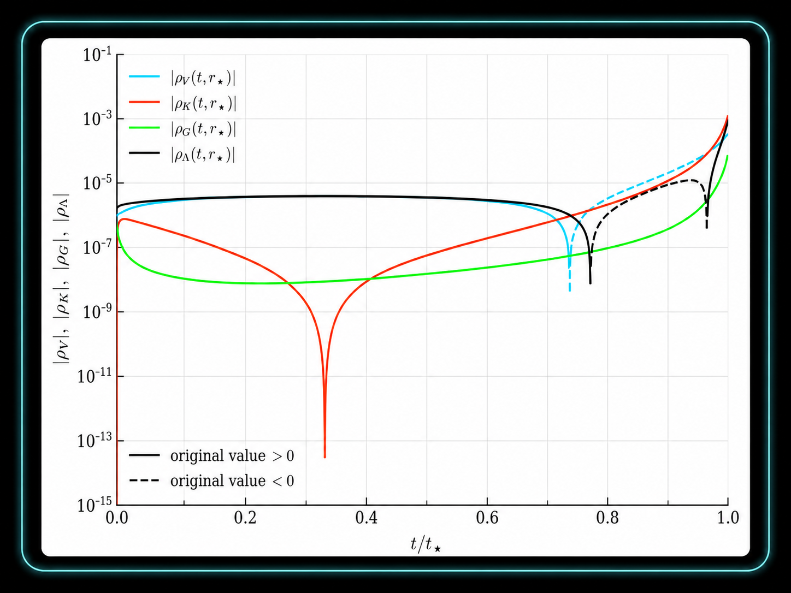
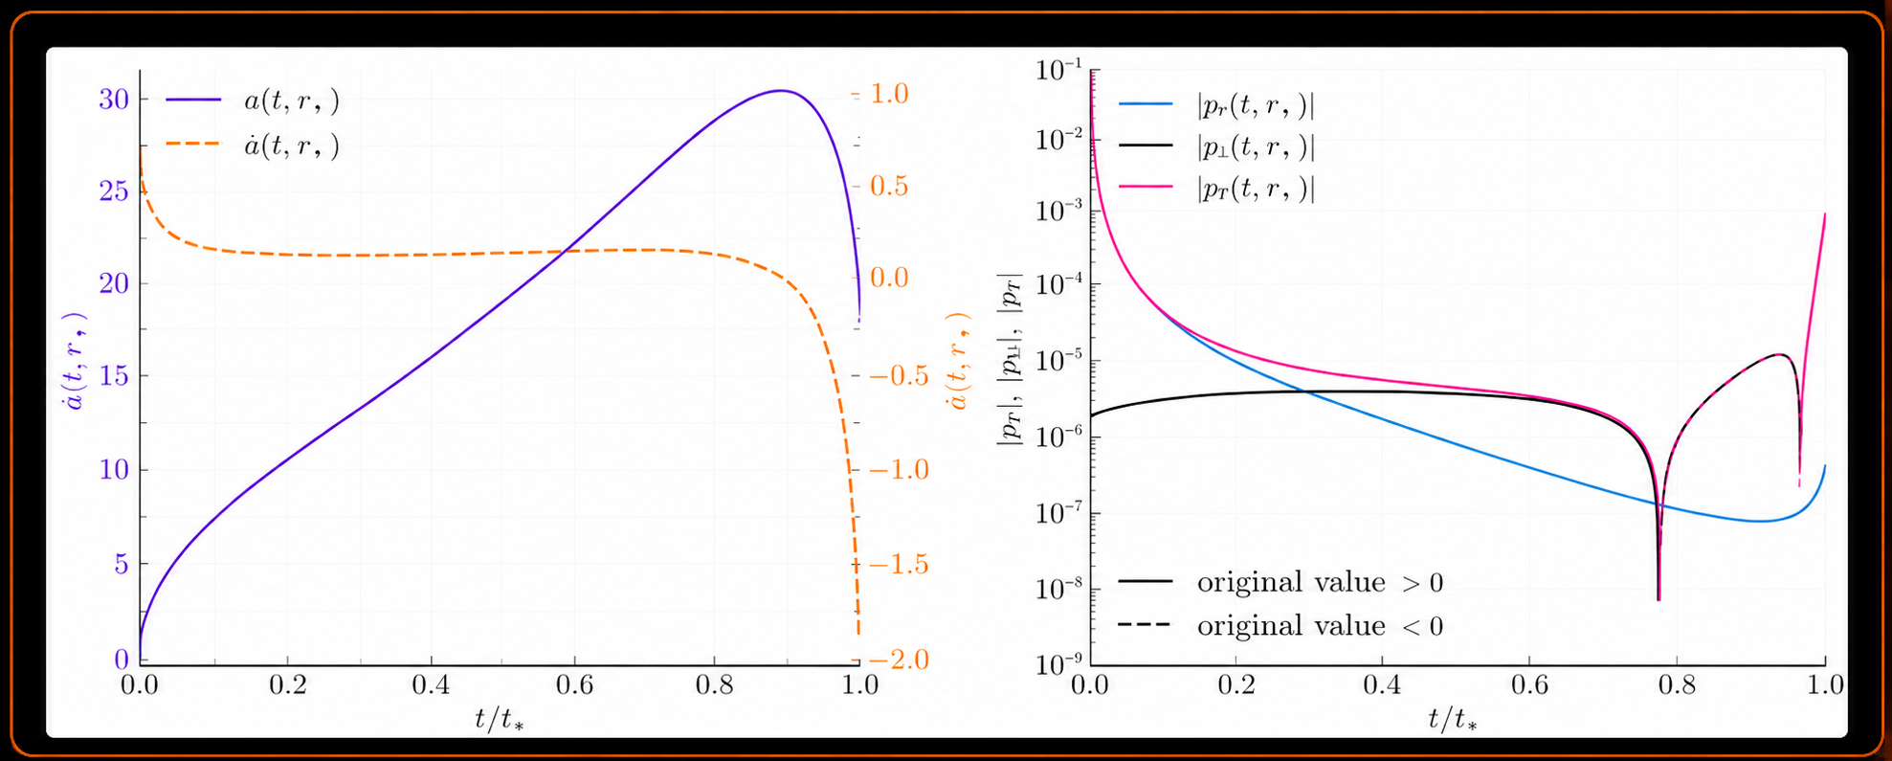
Phase 1: Initial Collapse
Expansion: Kinetic energy is Hubble redshifted and gradient energy is subdominant
Turnaround: Negative Higgs potential locally overcomes the radiation density
Contraction: Kinetic energy blueshifts and collapse proceeds toward horizon formation

Slide 9
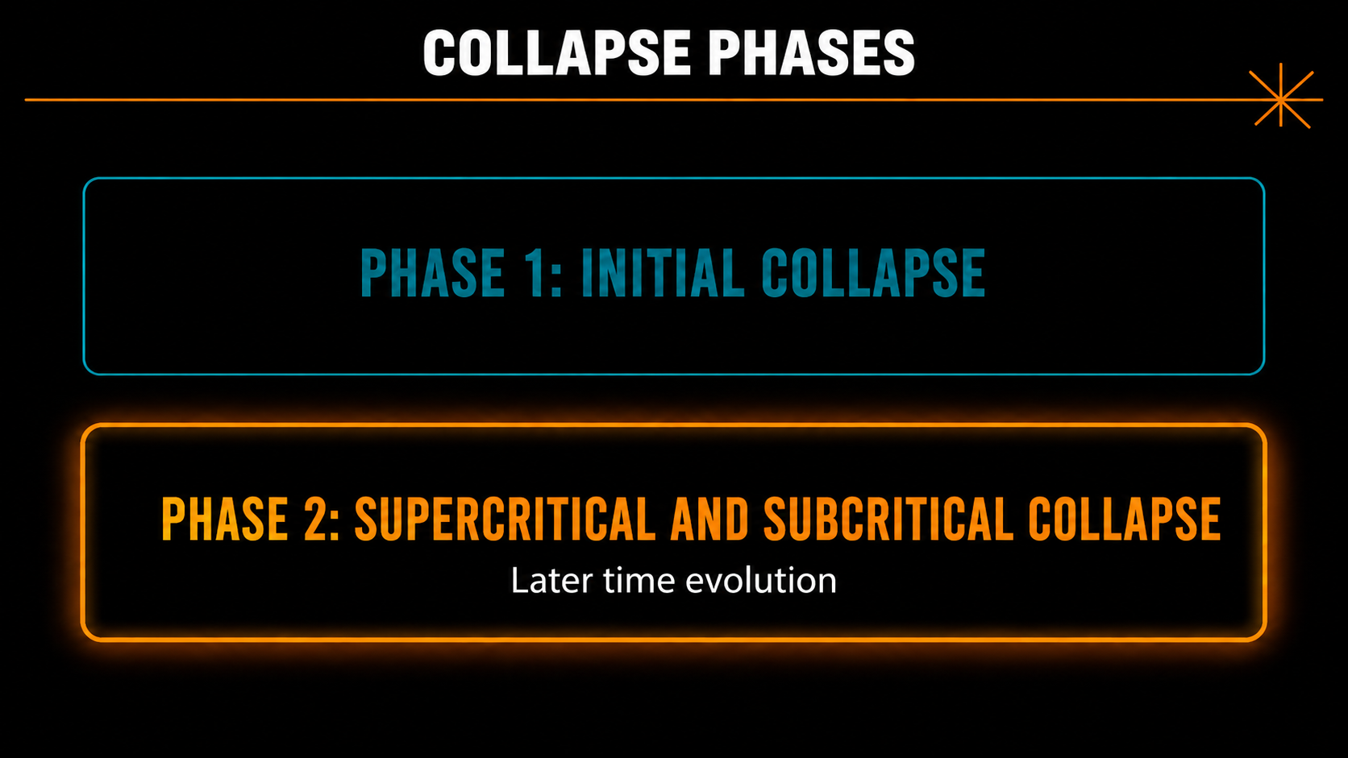

Slide 10
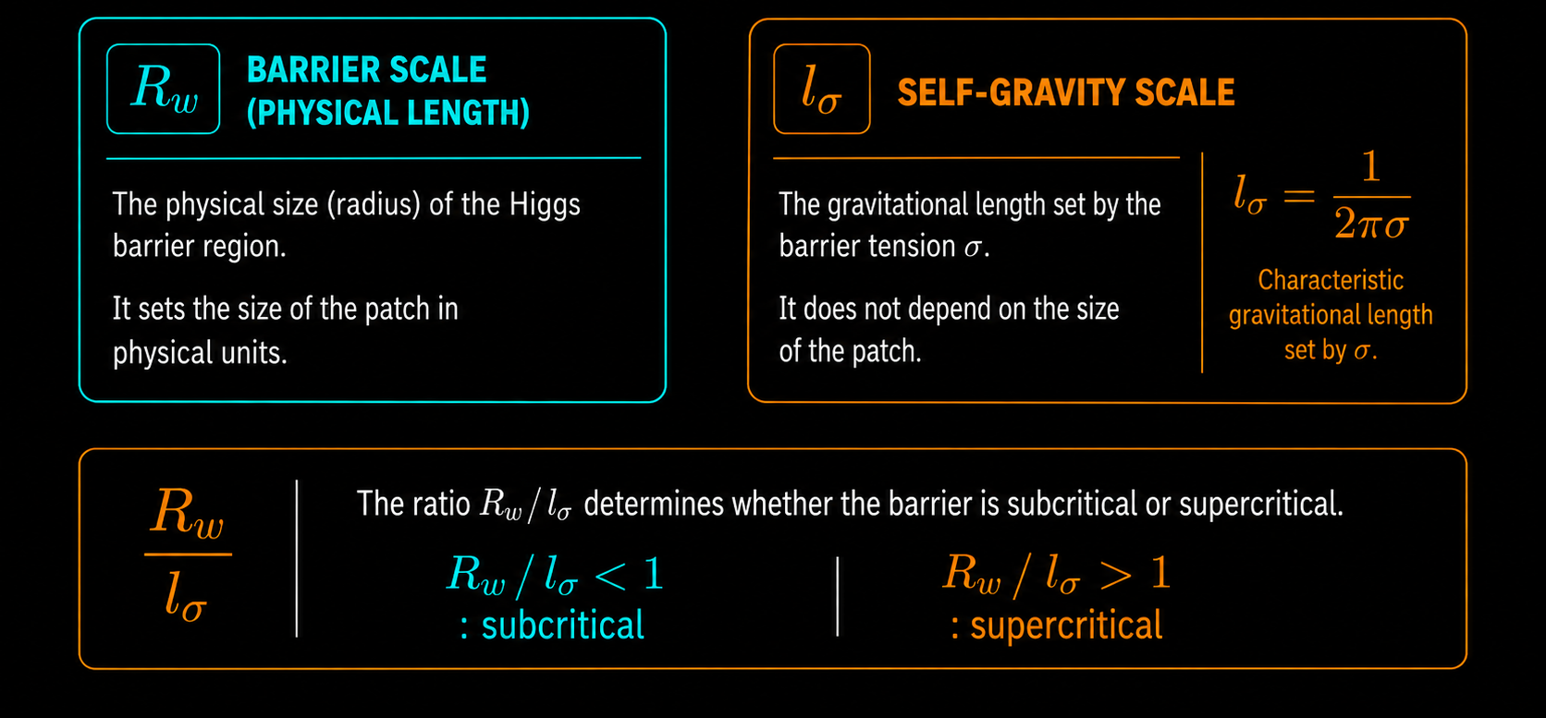
Phase 2: The role of the higgs barrier

Slide 11
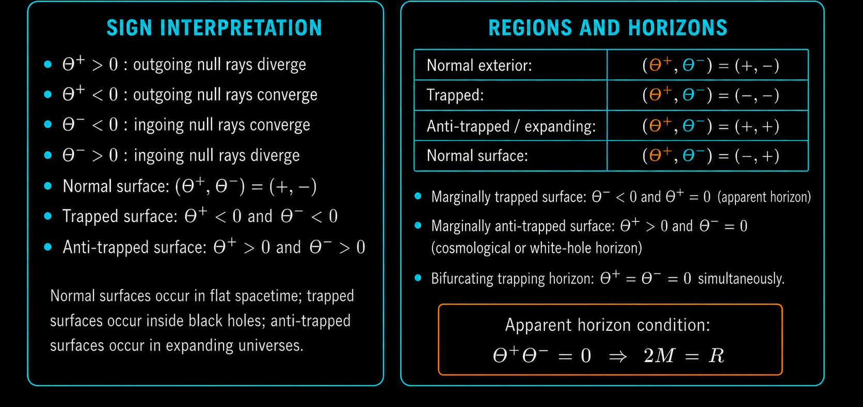
Phase 2: Null geodesic expansions

Slide 12
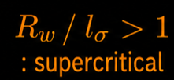
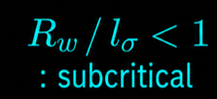
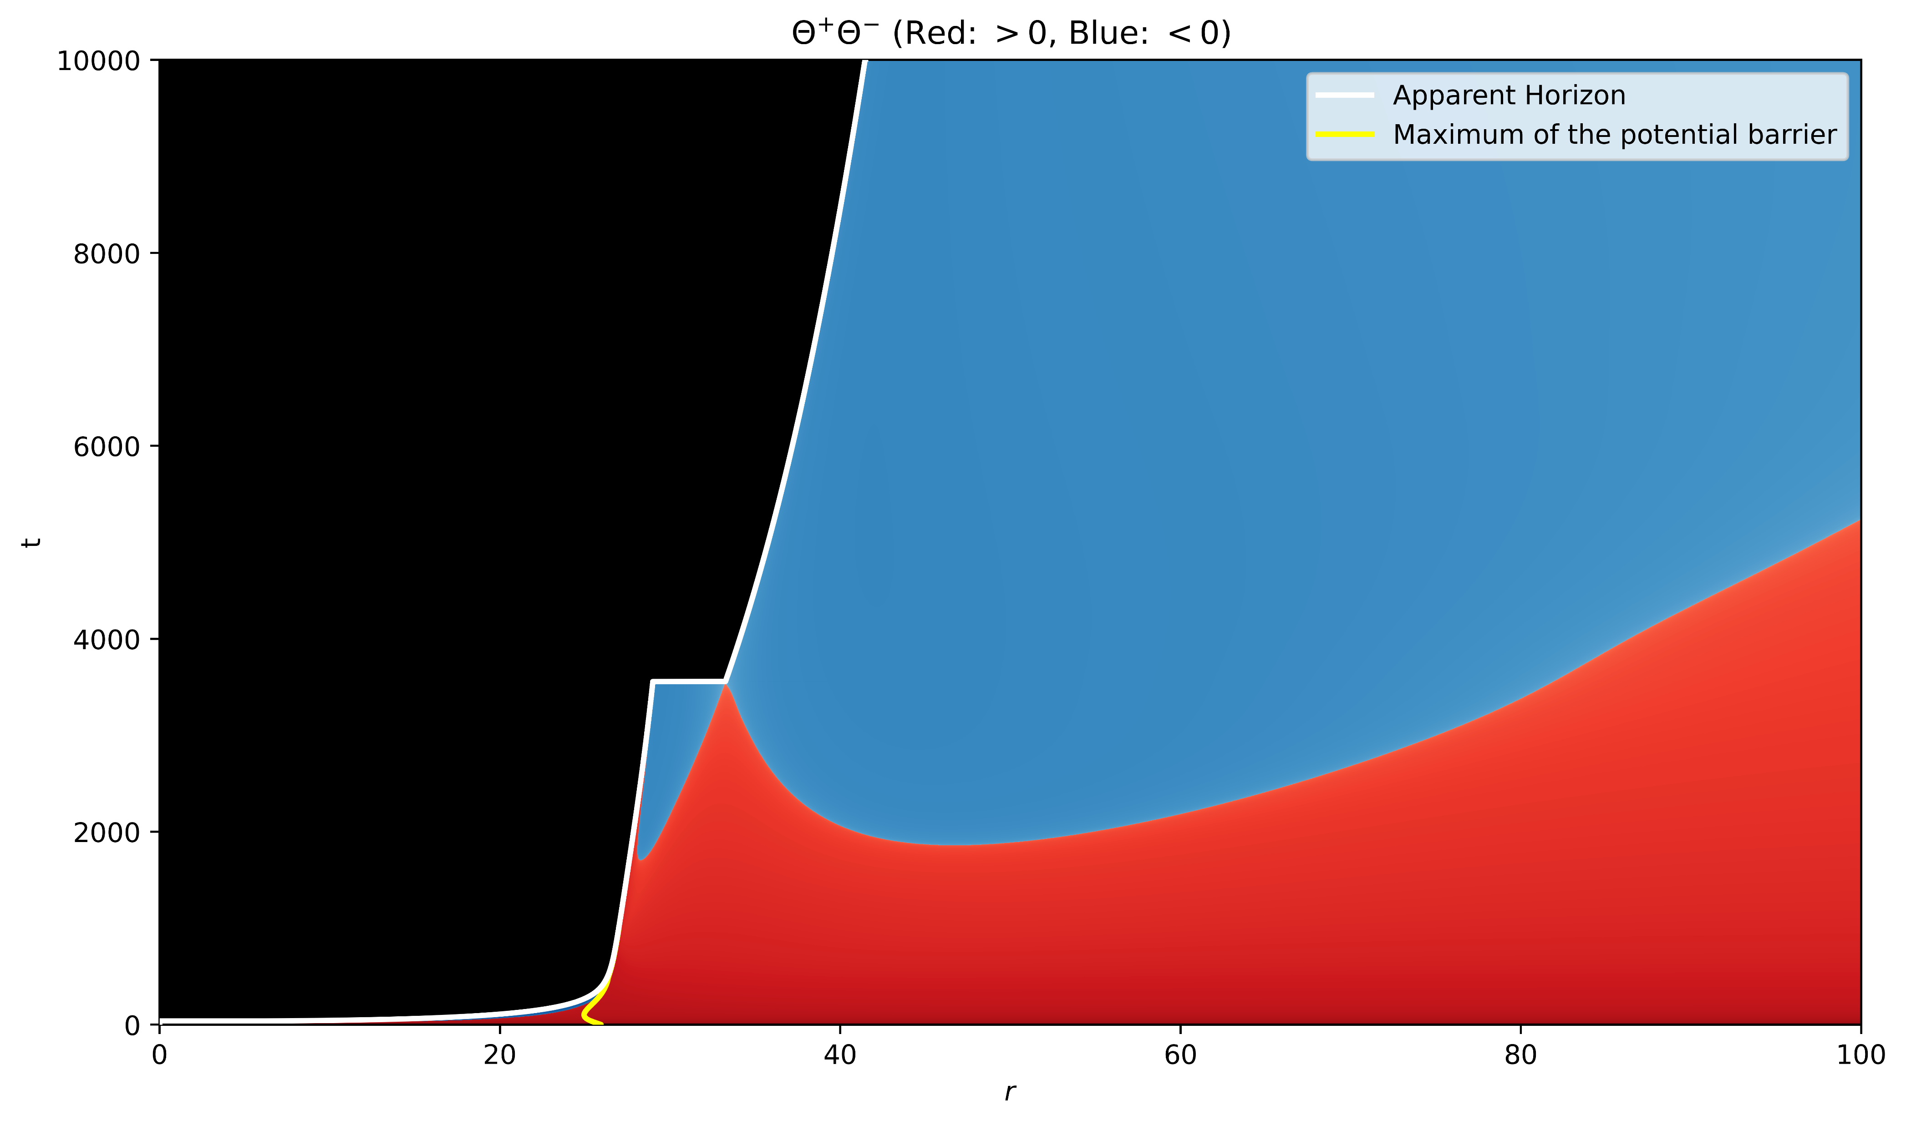
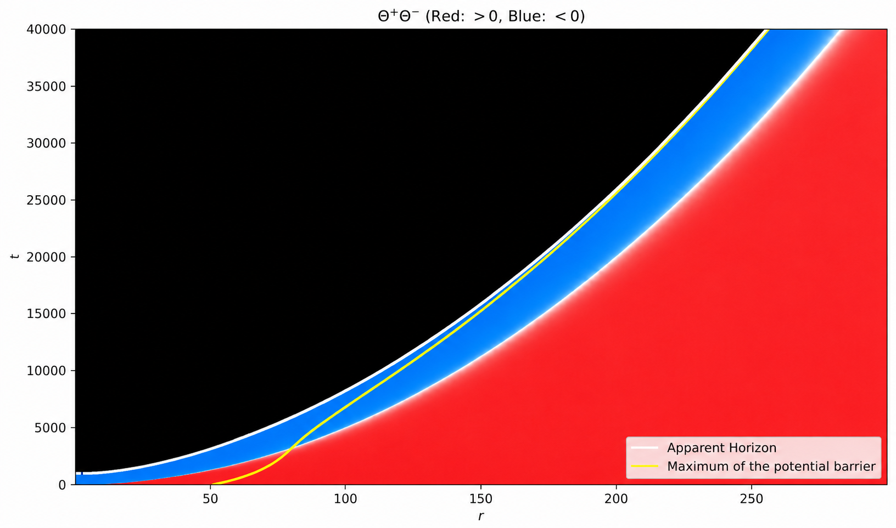
Phase 2: Late time causal structure
Large radial excursion signifies secondary apparent horizon formation.
Single apparent horizon, gradual growth of the initial PBH.
Black Hole
Black Hole
Normal Surface
Normal Surface
FRW Cosmology
FRW Cosmology

Slide 13
Phase 2: Late time causal structure
Large radial excursion signifies secondary apparent horizon formation.
Single apparent horizon, gradual growth of the initial PBH.
Black Hole
Black Hole
Normal Surface
Normal Surface
FRW Cosmology
FRW Cosmology

Slide 14
Phase 2: Late time causal structure
Large radial excursion signifies secondary apparent horizon formation.
Single apparent horizon, gradual growth of the initial PBH.
Black Hole
Black Hole
Normal Surface
Normal Surface
FRW Cosmology
FRW Cosmology
Both supercritical and subcritical configurations result in the over-the-barrier region hidden behind horizons.

Slide 15
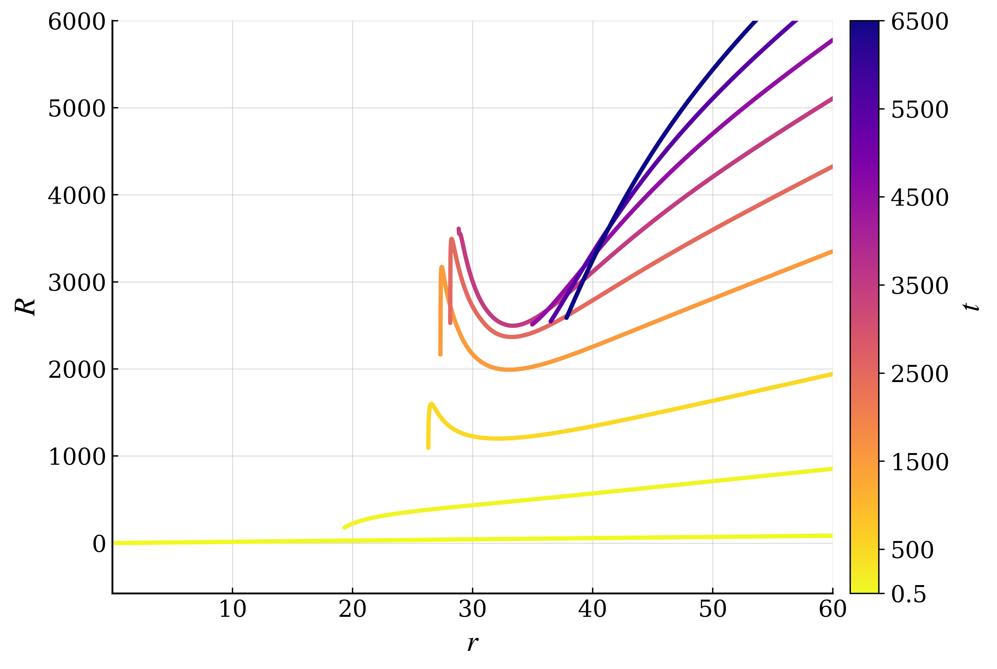

Phase 2: Throat structure
supercritical branch
A spatial slice passing through this region experiences the 3-geometry curves back on itself.
The minima of $R$ ($∂R/∂r=0$) corresponds to the throat connecting the black hole interior to the exterior FRW.
The throat pinches of at the bifurcating horizon.

Slide 16
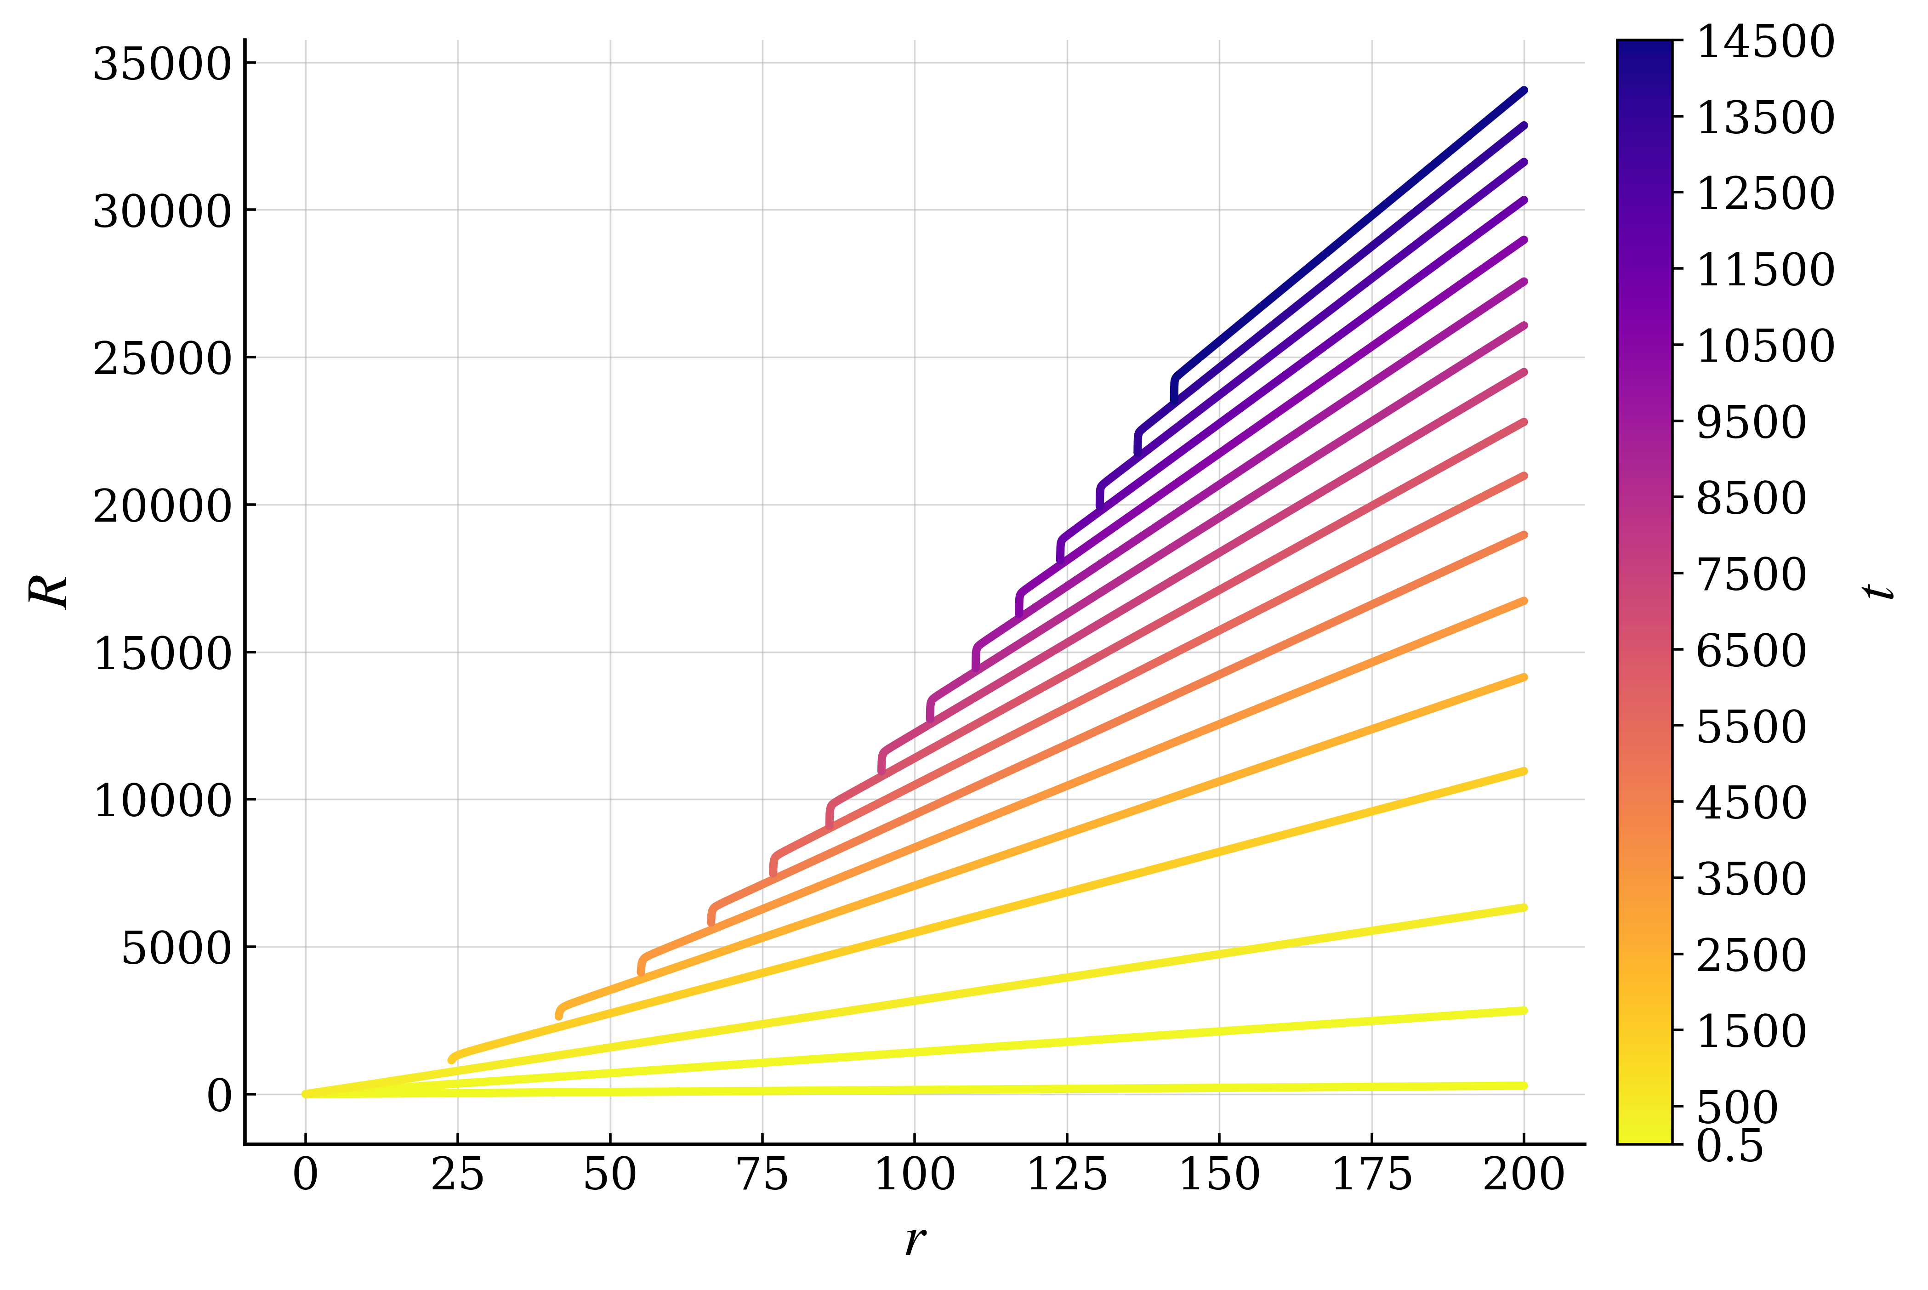
Phase 2: absence of throat formation
subcritical branch
The areal radius remains monotonic
The initial true vacuum black hole deforms the areal radius away from FRW near the horizon
The areal radius continues to always label a single connected exterior
Subcritical collapse remains a single horizon spacetime

Slide 17
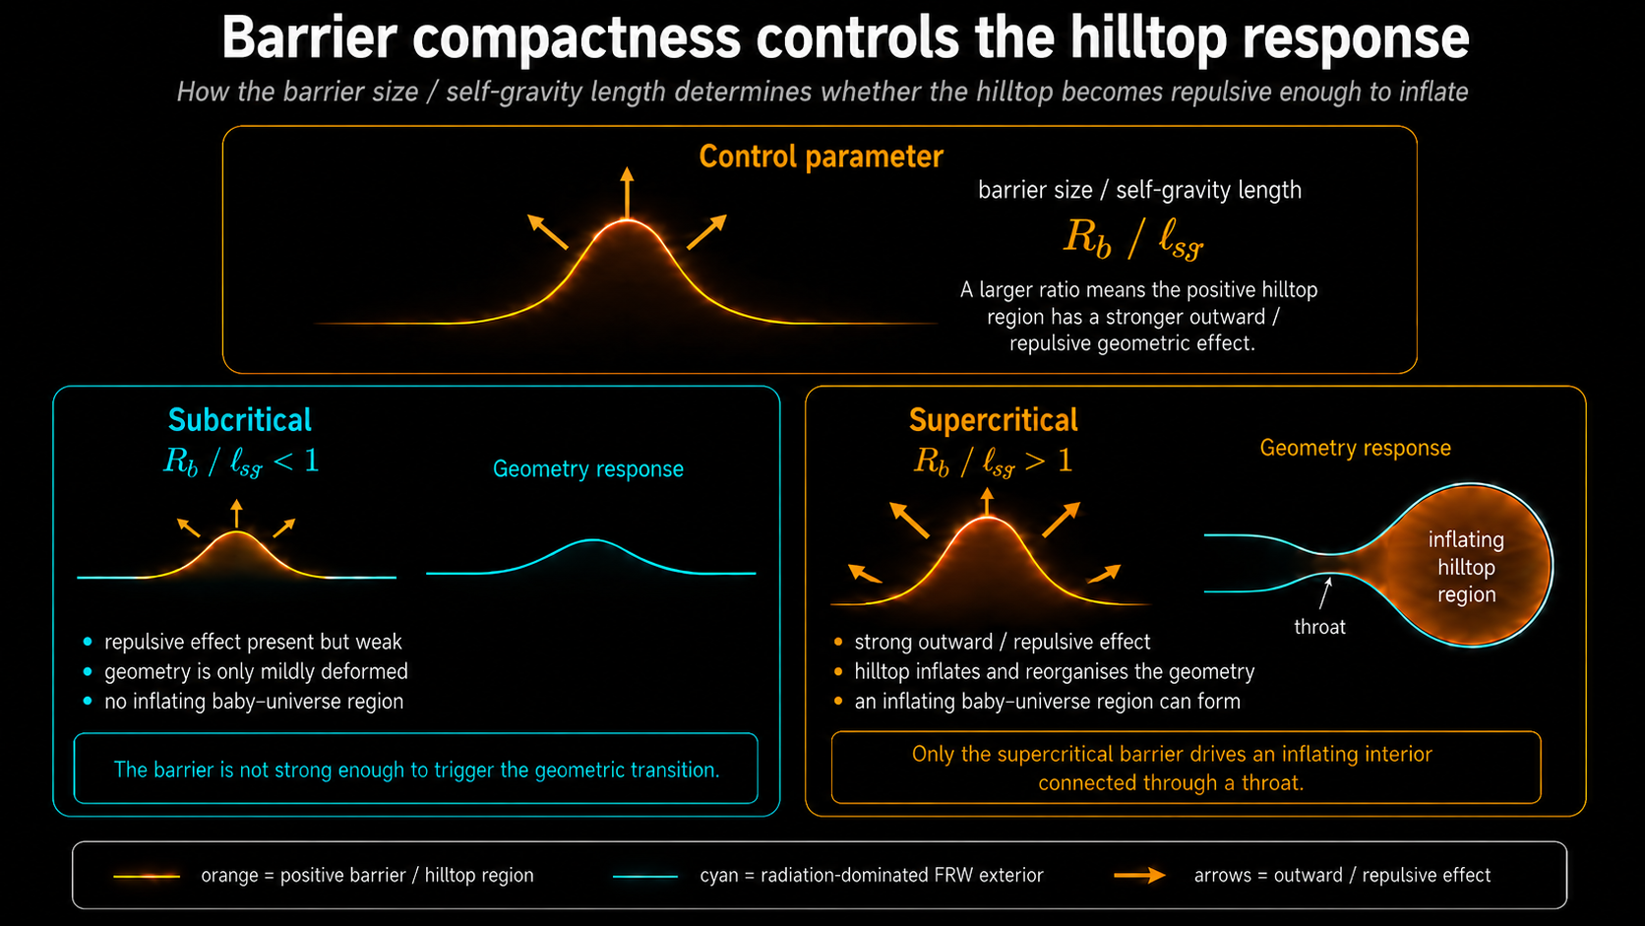

Slide 18
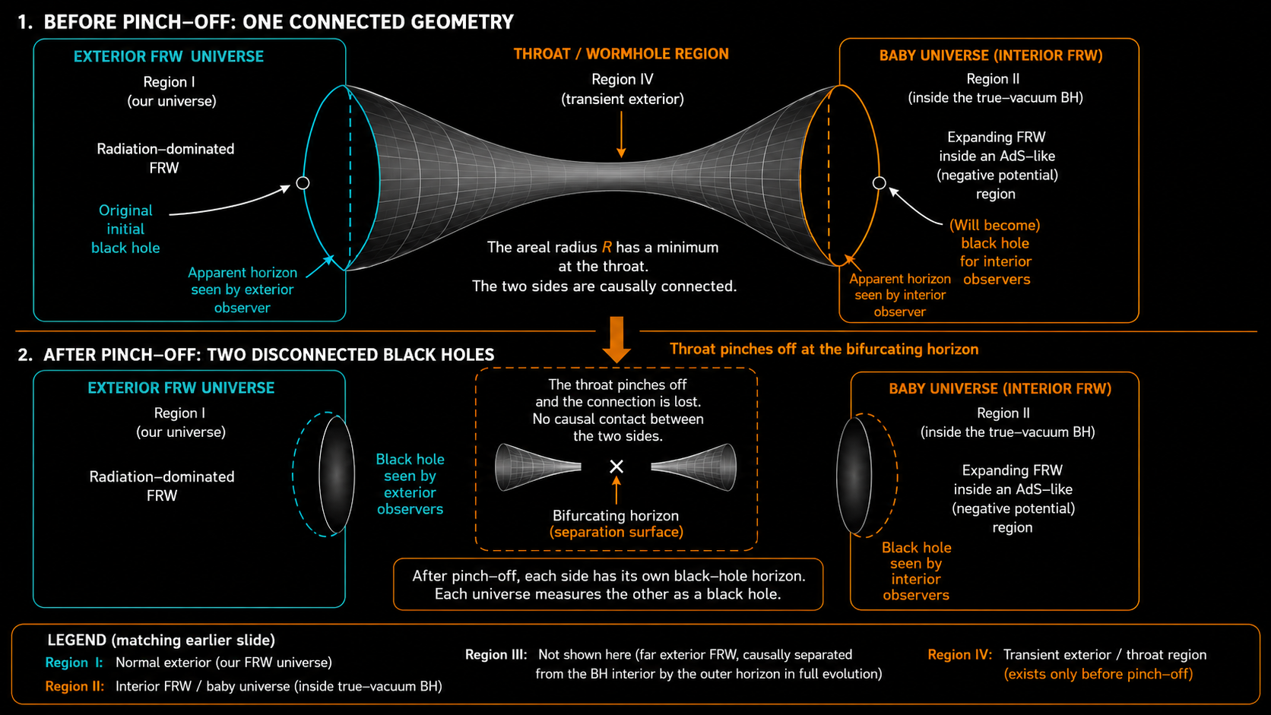

Slide 19
Conclusions
The final state is always a standard black hole embedded in a radiation dominated FRW background, with any unstable over the barrier region entirely hidden behind horizons
The early evolution is controlled by the true vacuum
The late time evolution is controlled by the potential barrier
The question of whether inflation produces fluctuations that probe negative regions of field space through stochastic fluctuations is not only relevant to the Standard Model Higgs field but is a question of relevance to many multi-field models.
THANK YOU!

Slide 20
Back up slides

Slide 21
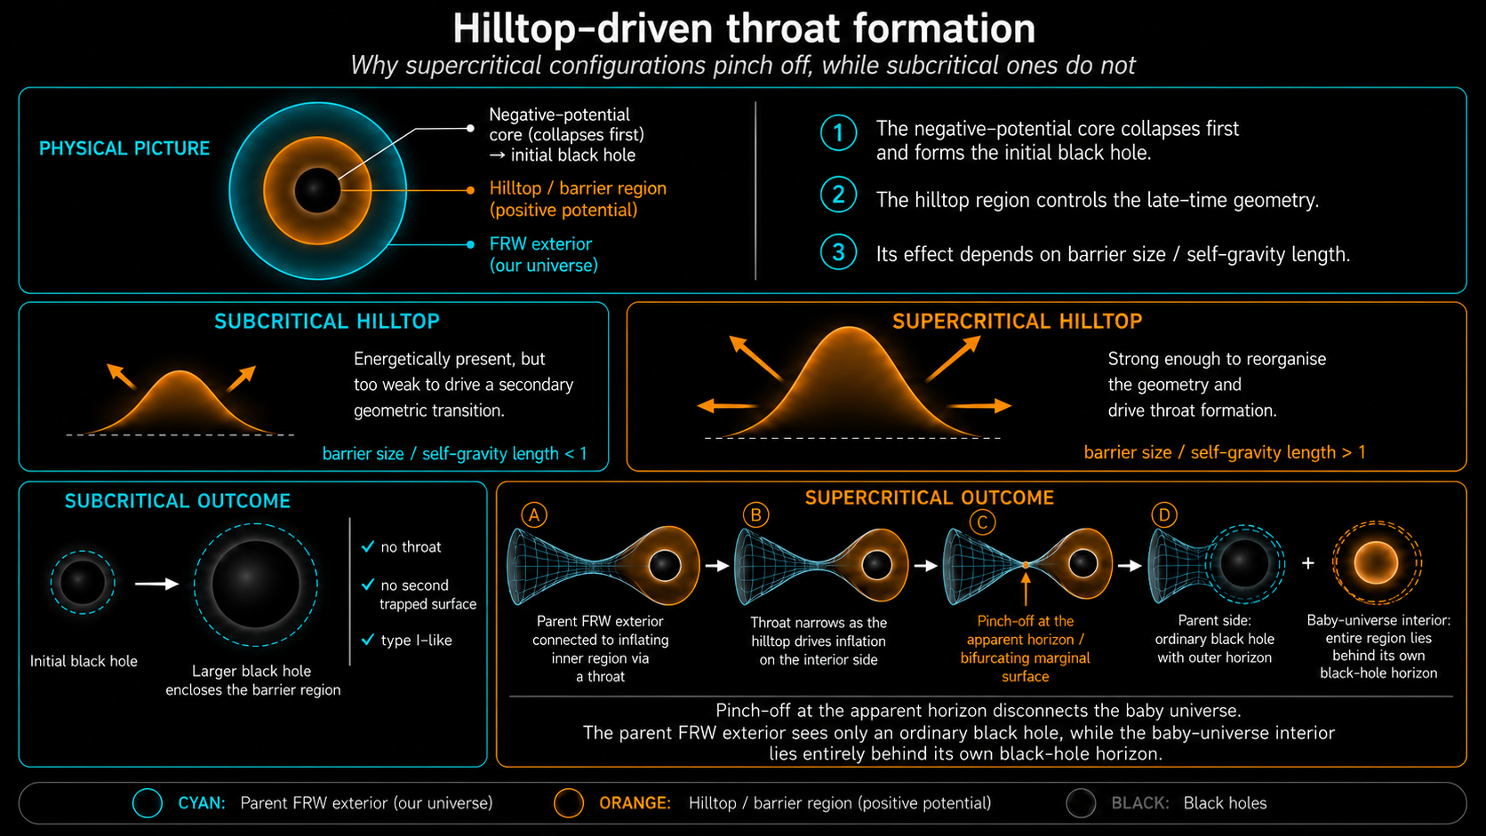

Slide 22
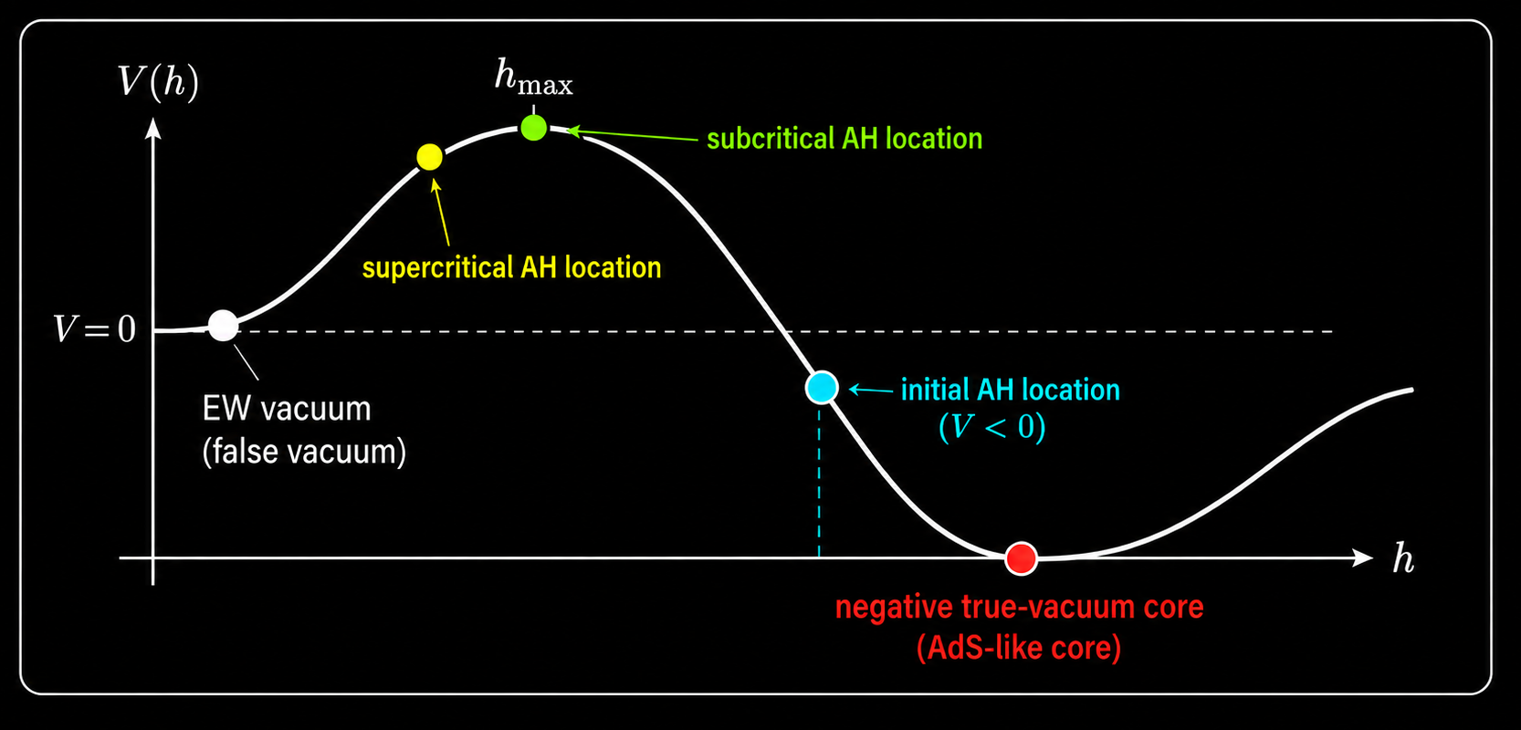

Slide 23
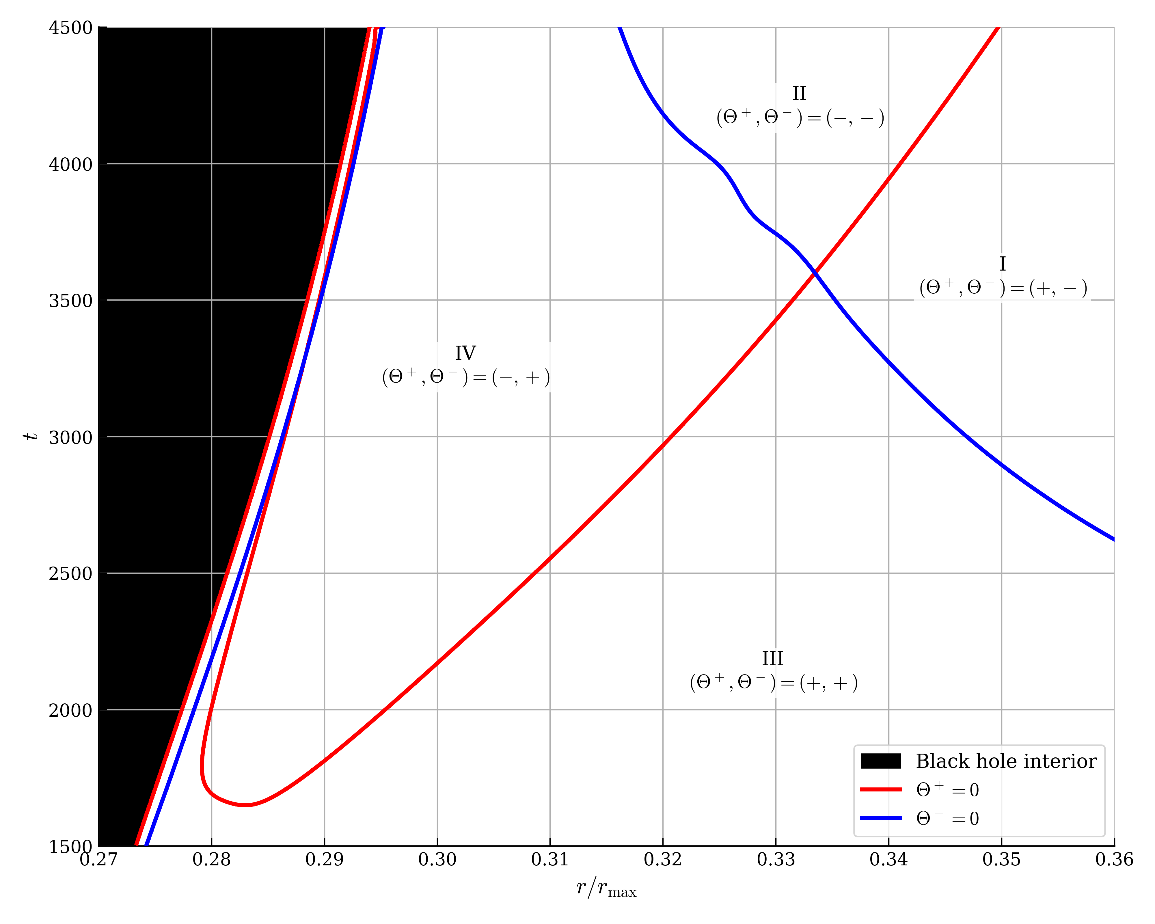
Phase 2: Throat/wormhole structure
Region I: Normal causal exterior.
Region II: Fully trapped black hole interior with a baby universe inside.
Region III: FRW cosmology, causally separated from the black hole and accessible to an external FRW observer.
Region IV: Transient causal exterior to the true vacuum black hole and the supercritical black hole.
The location where the expansions intersect corresponds to a bifurcating horizon.

Slide 24

Phase 2: Throat structure
The minima of $R$ ($∂R/∂r=0$) corresponds to the throat connecting the black hole interior to the exterior FRW.

Slide 25
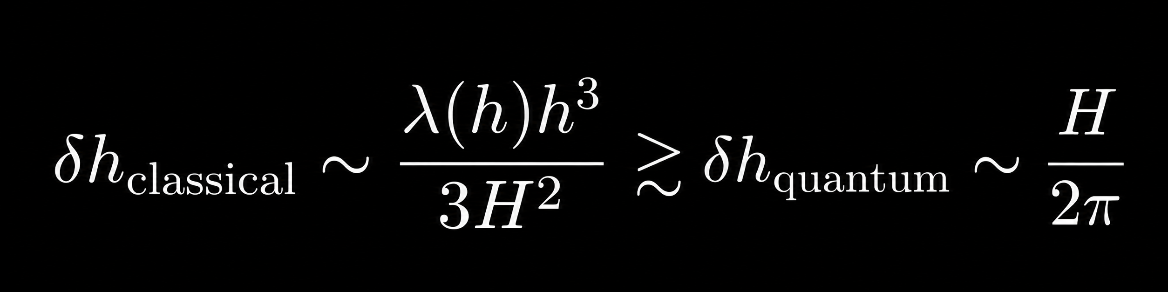
Cosmological implications & stochastic kicks
The classical motion will beat the quantum motion if:
e.g. when the slow-roll evolution due to the potential exceeds the stochastic evolution due to the inflationary fluctuations.
Then, only after the fluctuation becomes very large, that the SR approximation breaks down, the fluctuation rapidly diverges to the true vacuum.
What is the fate of these resulting rare patches?

Slide 26
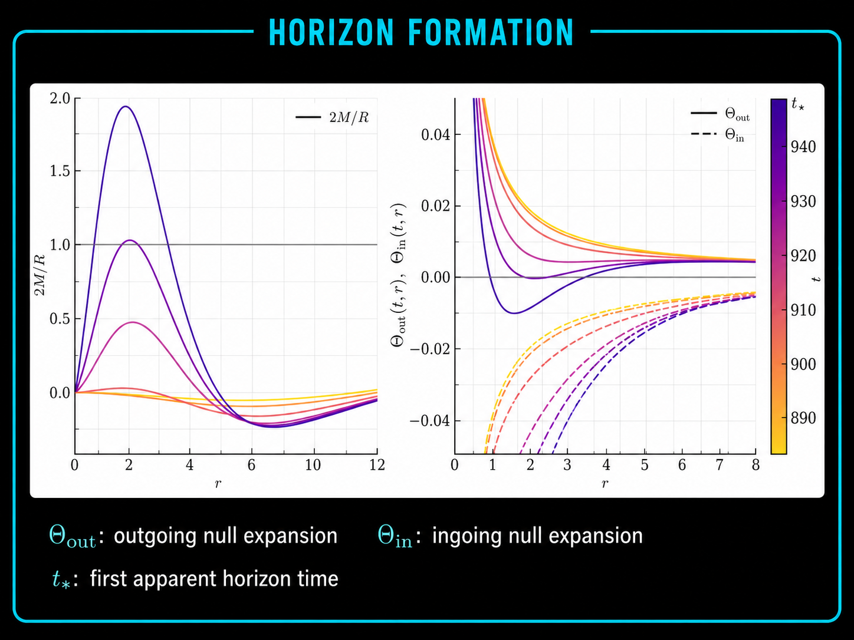
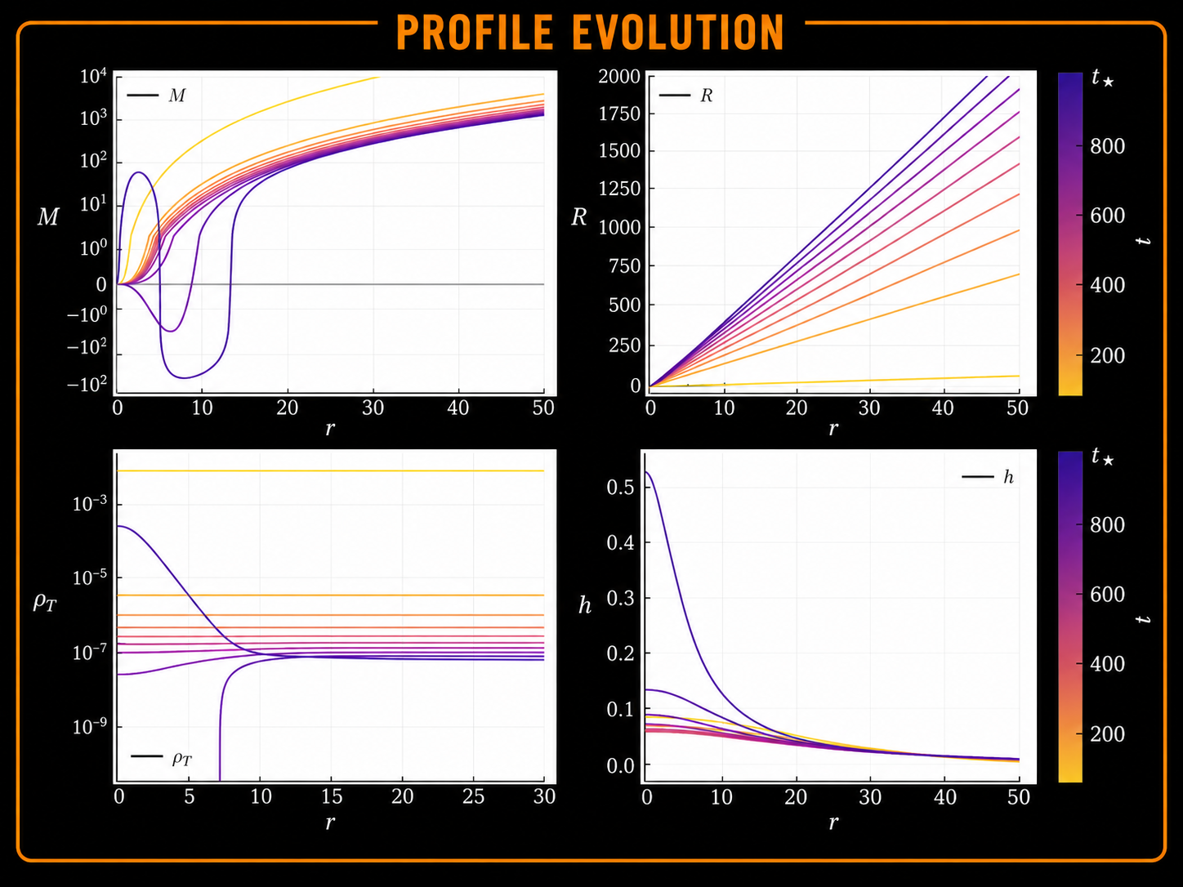
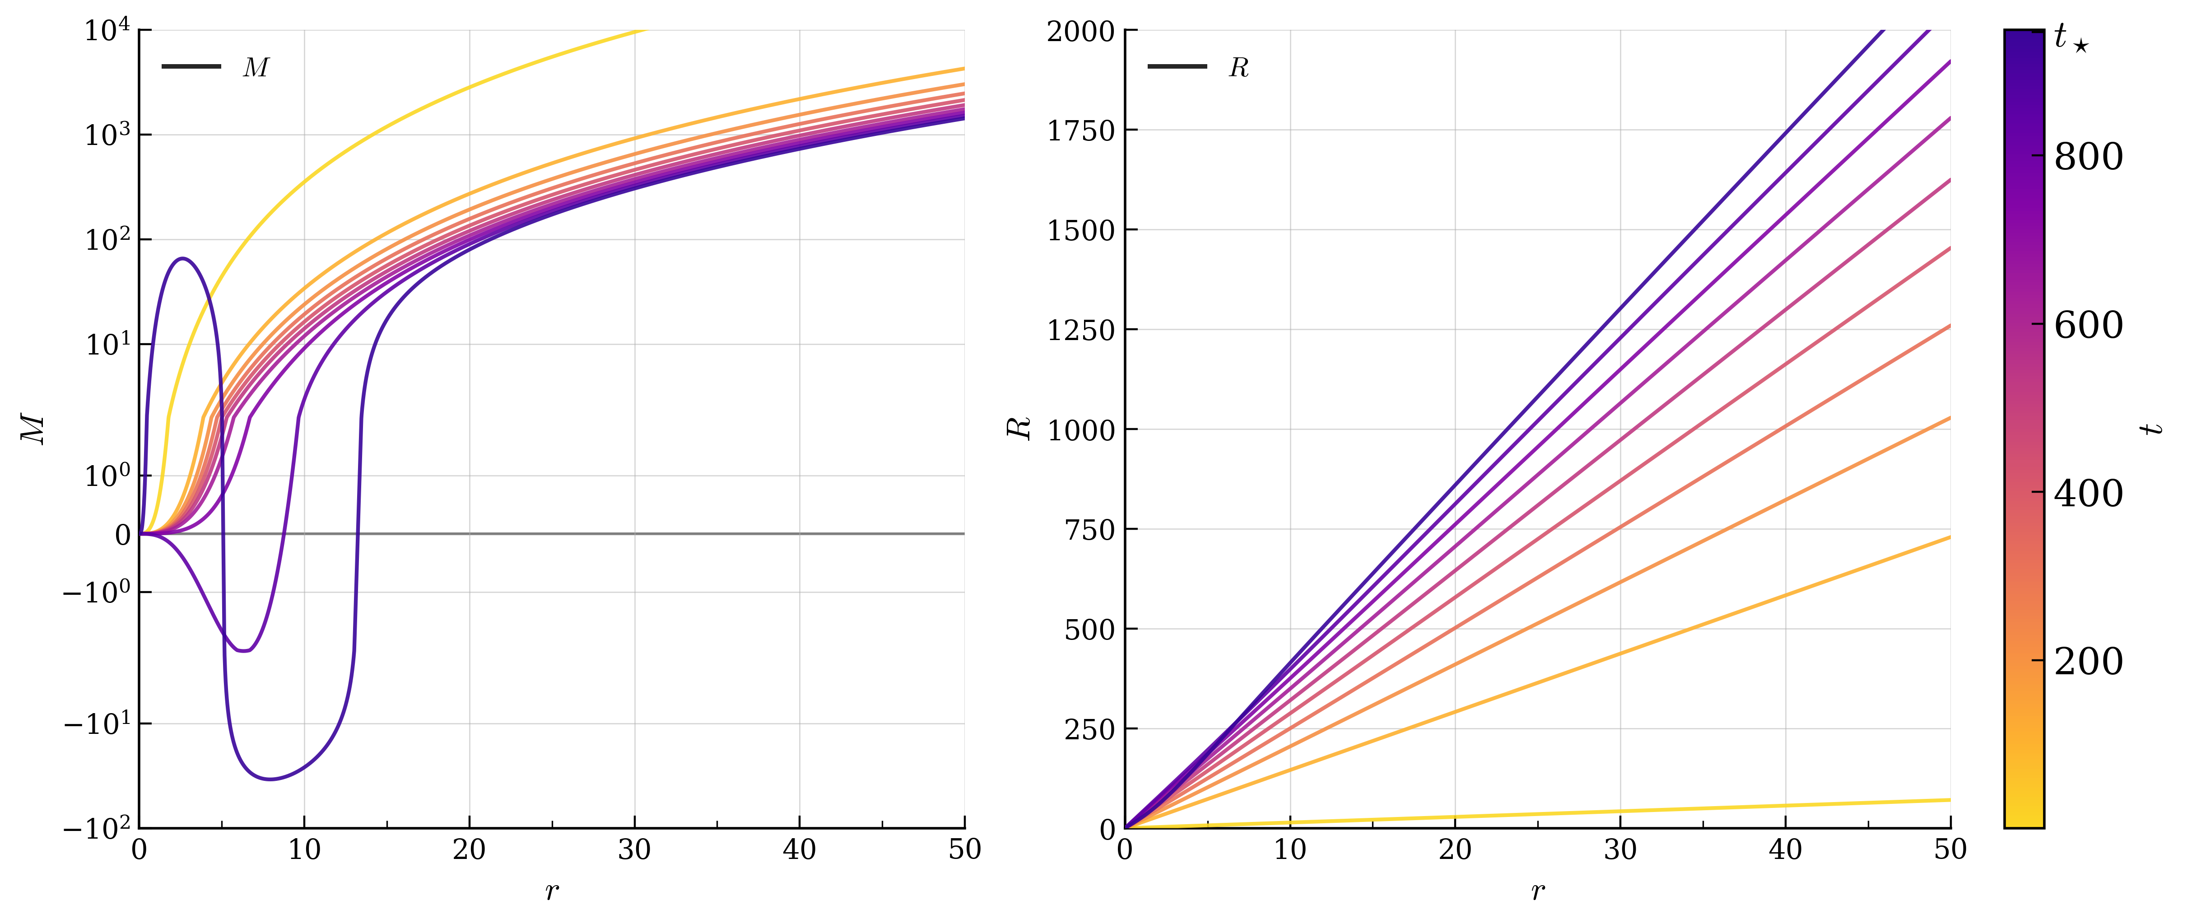
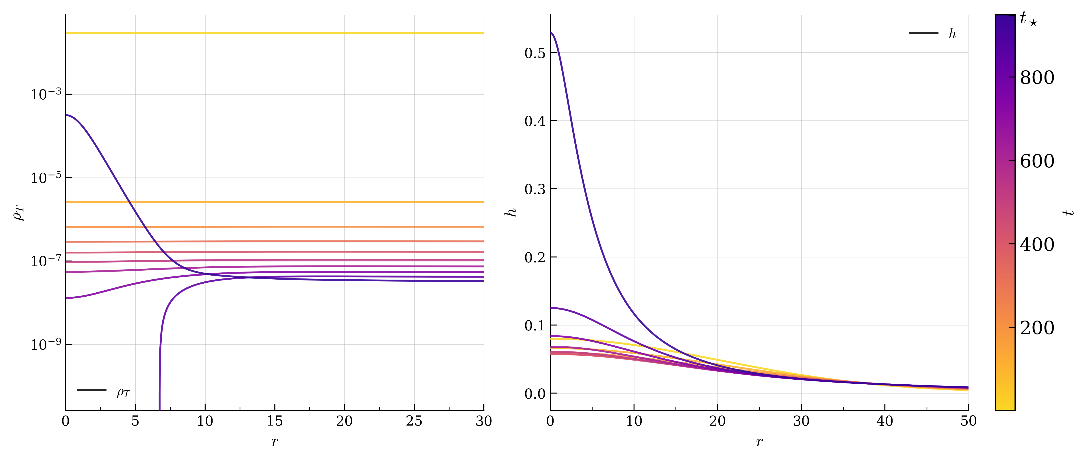
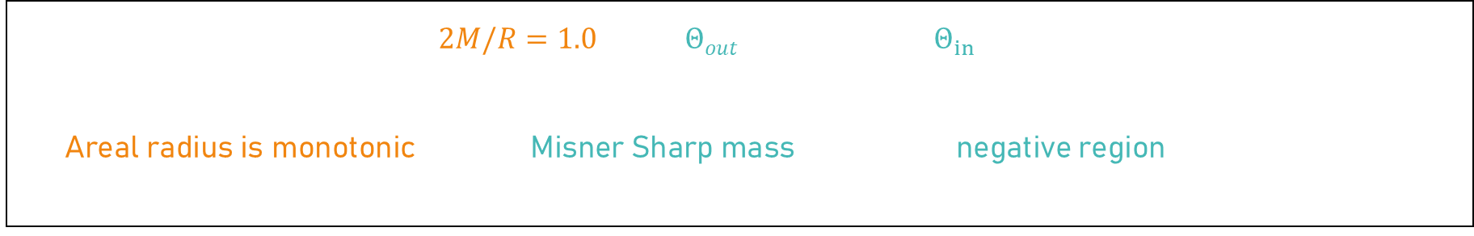
Phase 1: True Vacuum PBH
Compactness rises through $2M/R=1.0$while $Θ_{out}$ vanishes and $Θ_{in}$ remains negative, indicating an apparent horizon has formed
Areal radius is monotonic and the Misner Sharp mass develops a negative region

Slide 27
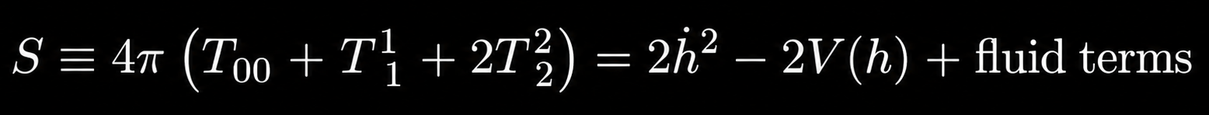
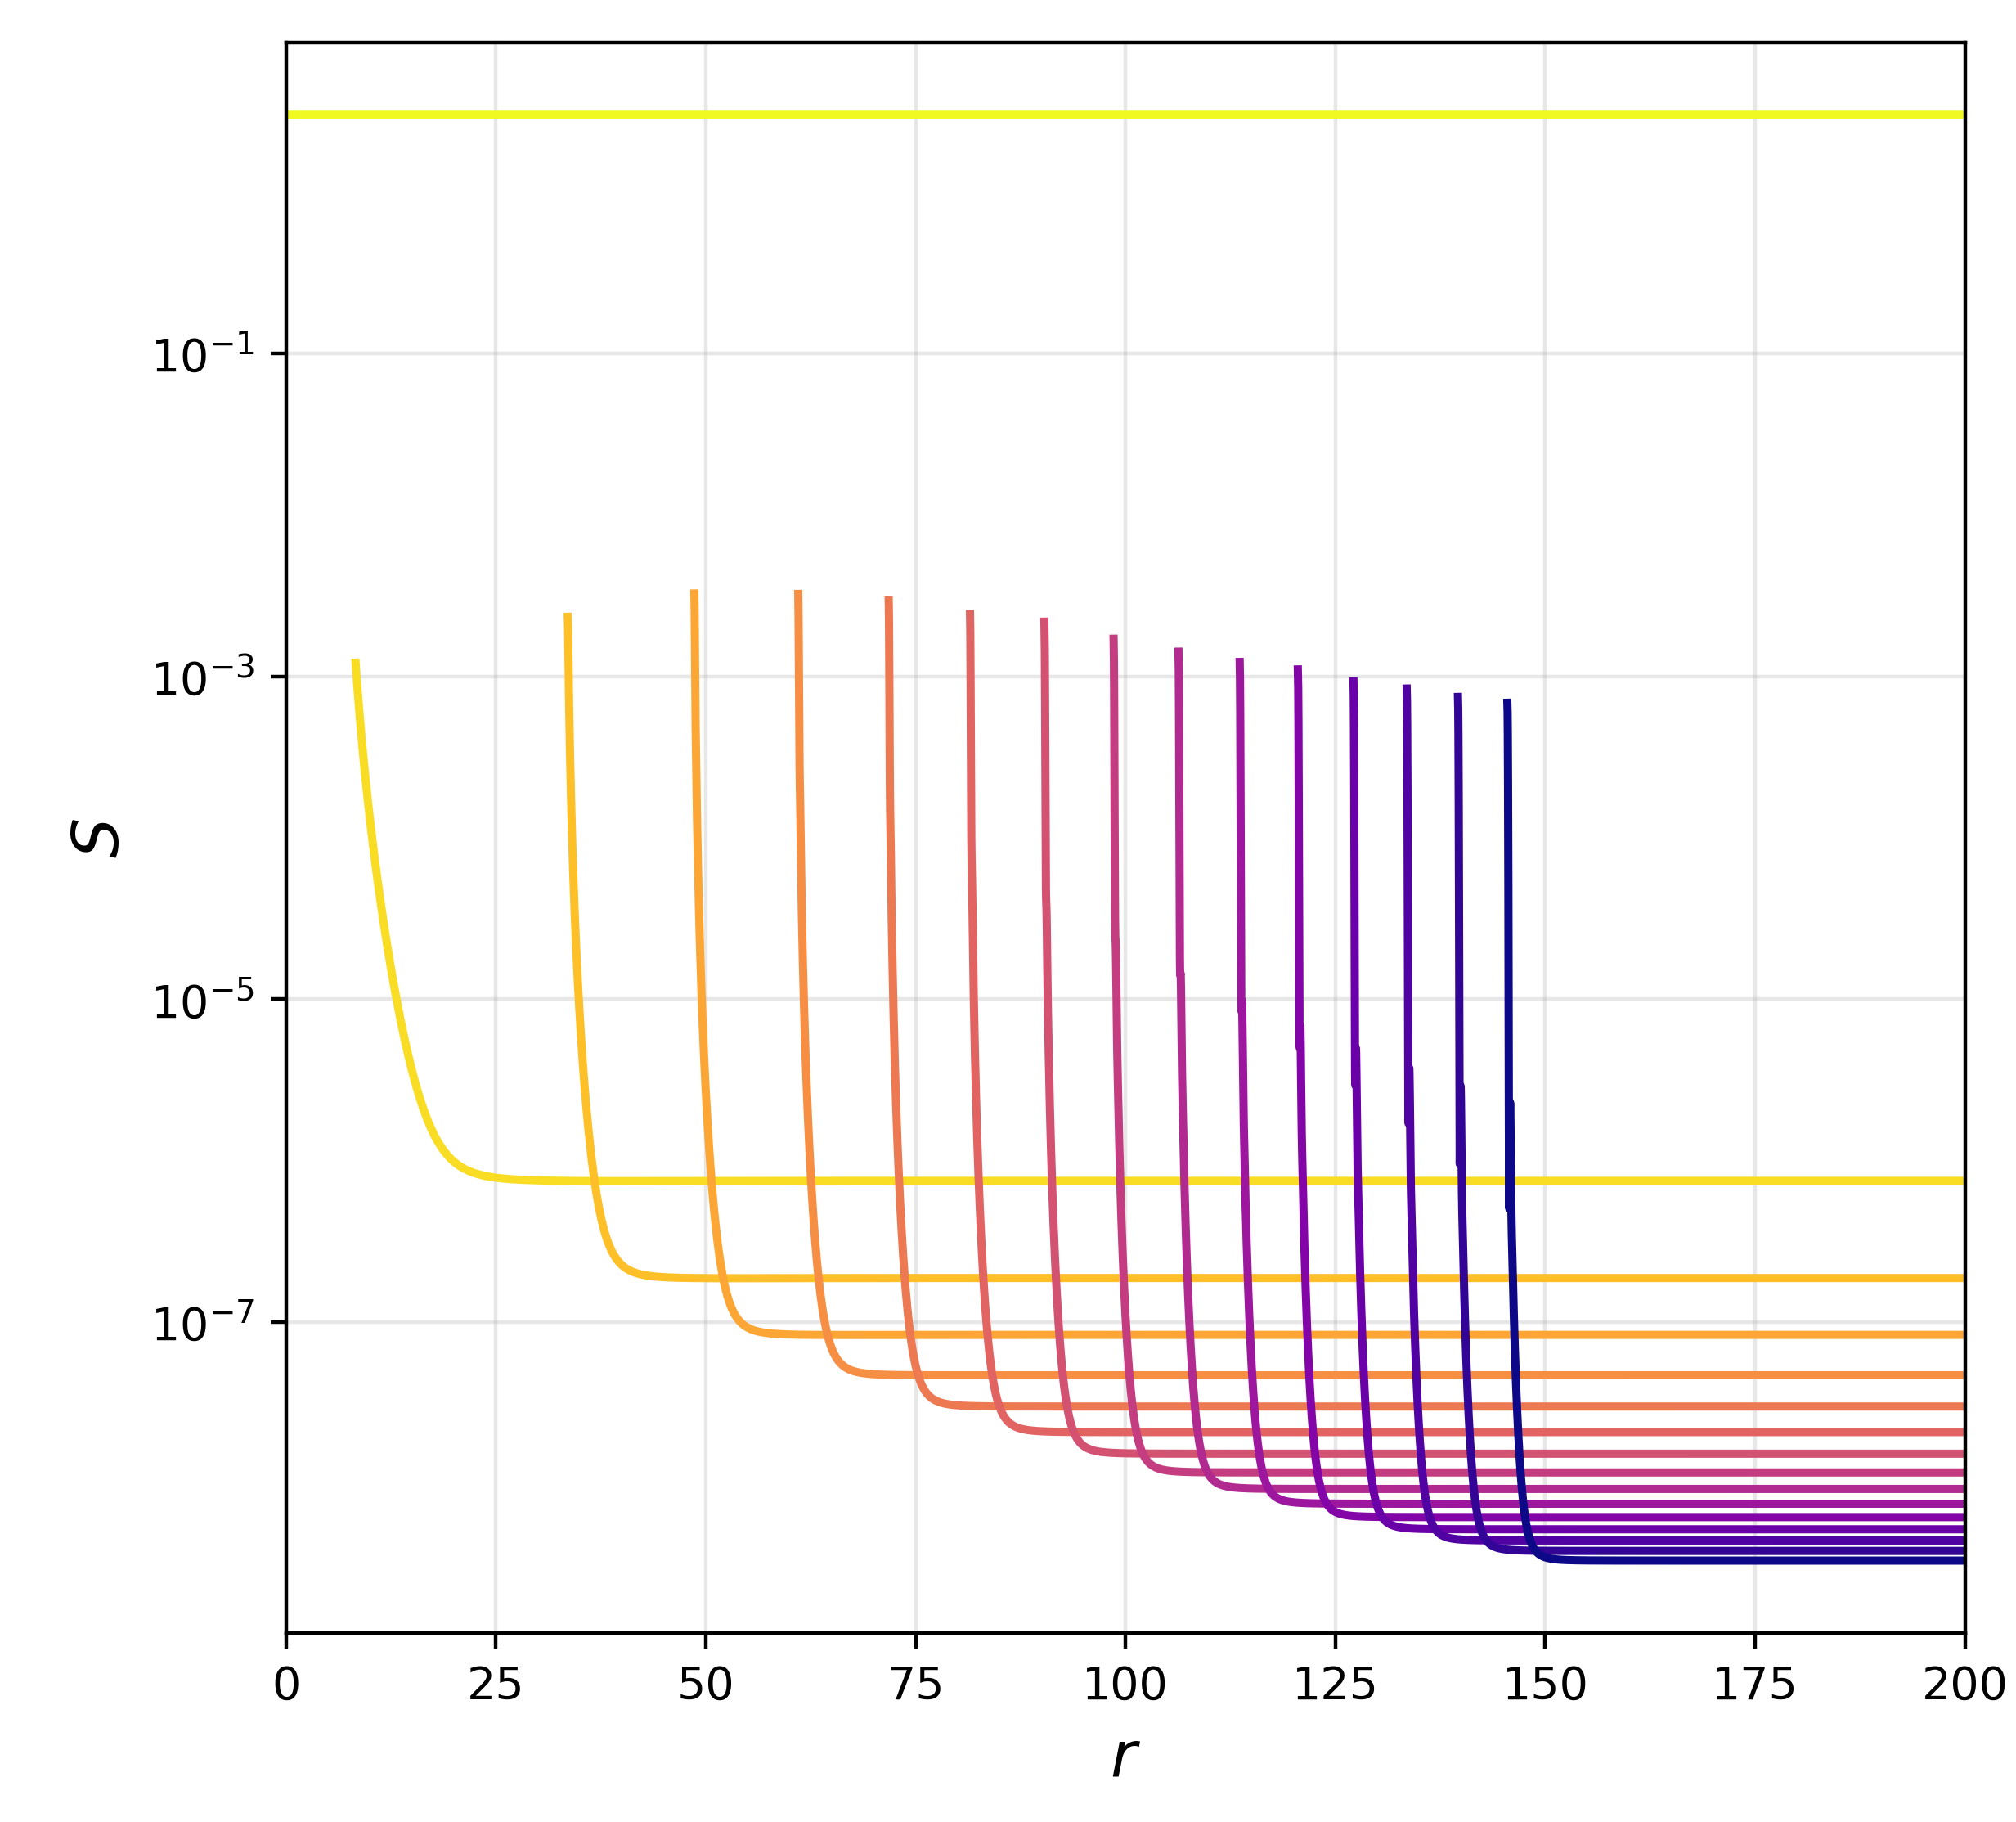
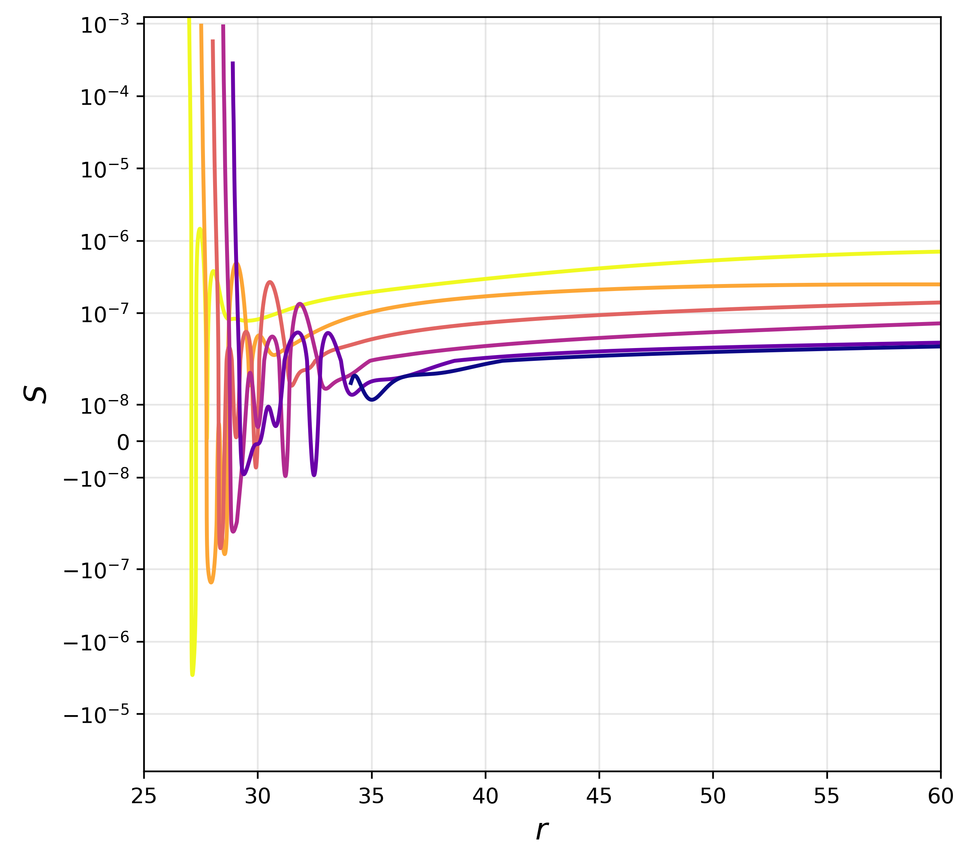
Phase 2: energy driving late time evolution
Negative potential (True Vacuum) contributes a “focusing”
Positive potential (Higgs Hilltop) contributes a “repulsion”
The gravitational source is related to the trace of the extrinsic curvature
If the positive potential barrier dominates, it reorganises the exterior geometry and dictates the supercritical or subcritical evolution

Slide 28
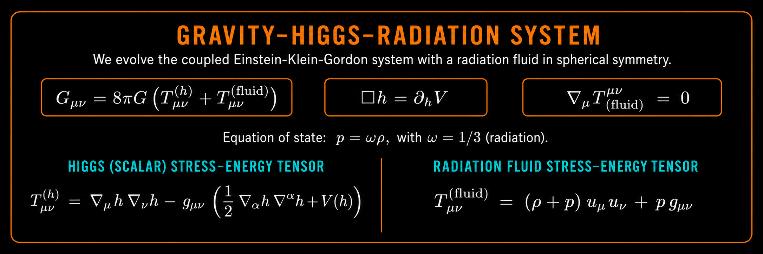
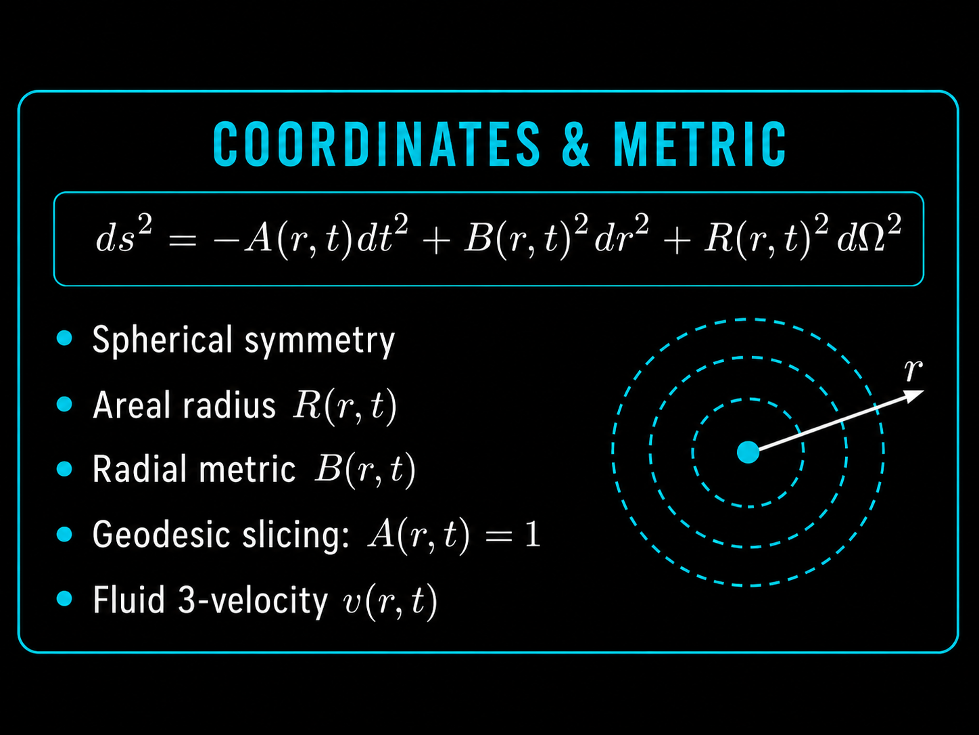
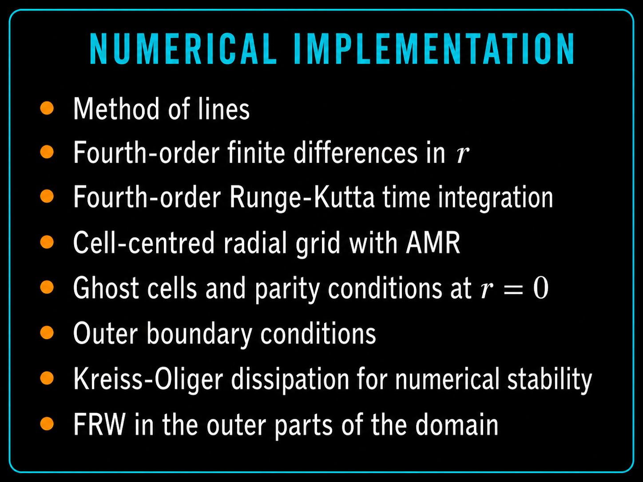
Numerical GR SETup

Slide 29
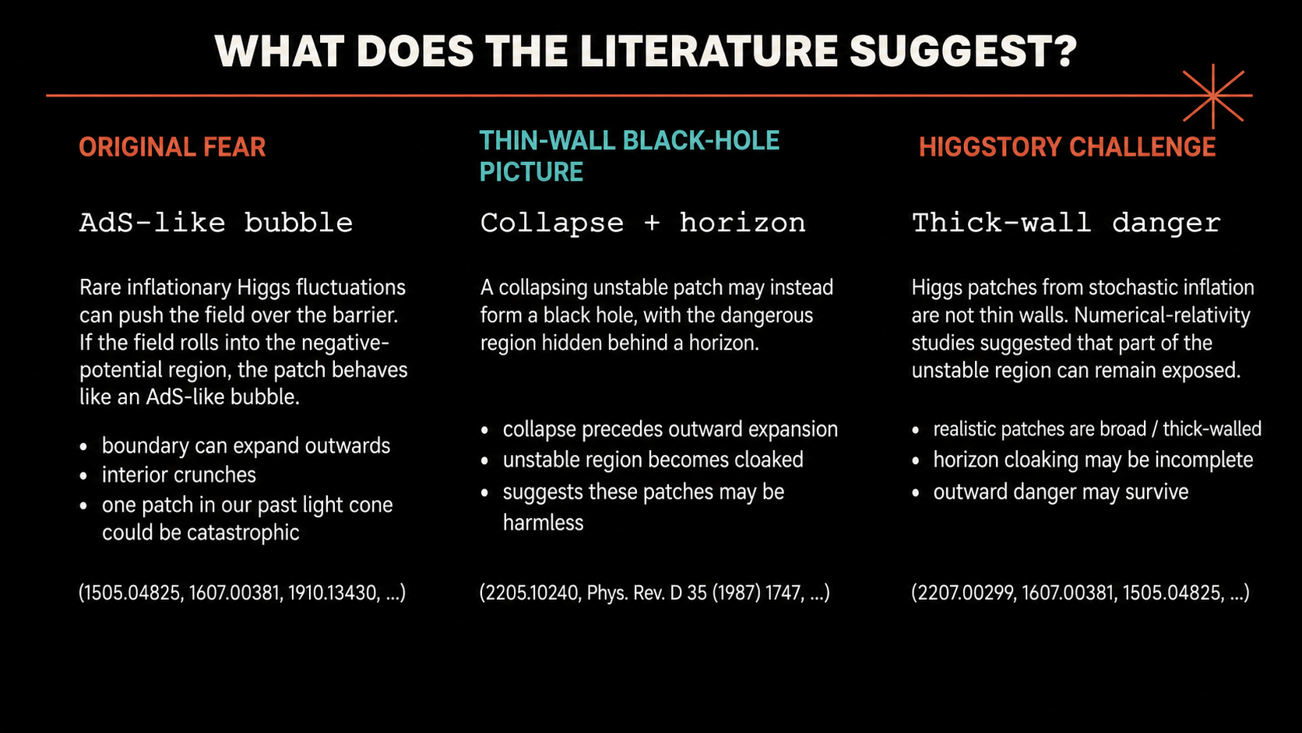

Slide 30
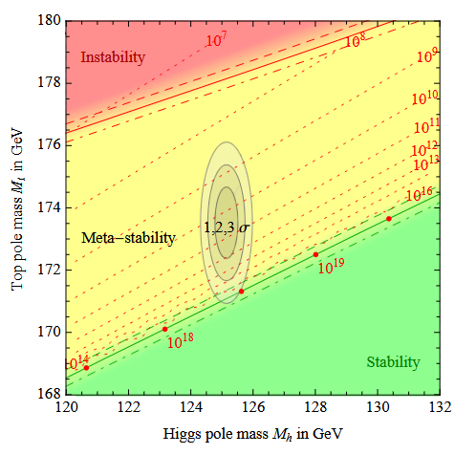
Higgs vacuum instability
The Higgs quartic term receives the largest corrections at large energies from the top quark
Metastability favoured at about 2σ

Slide 31
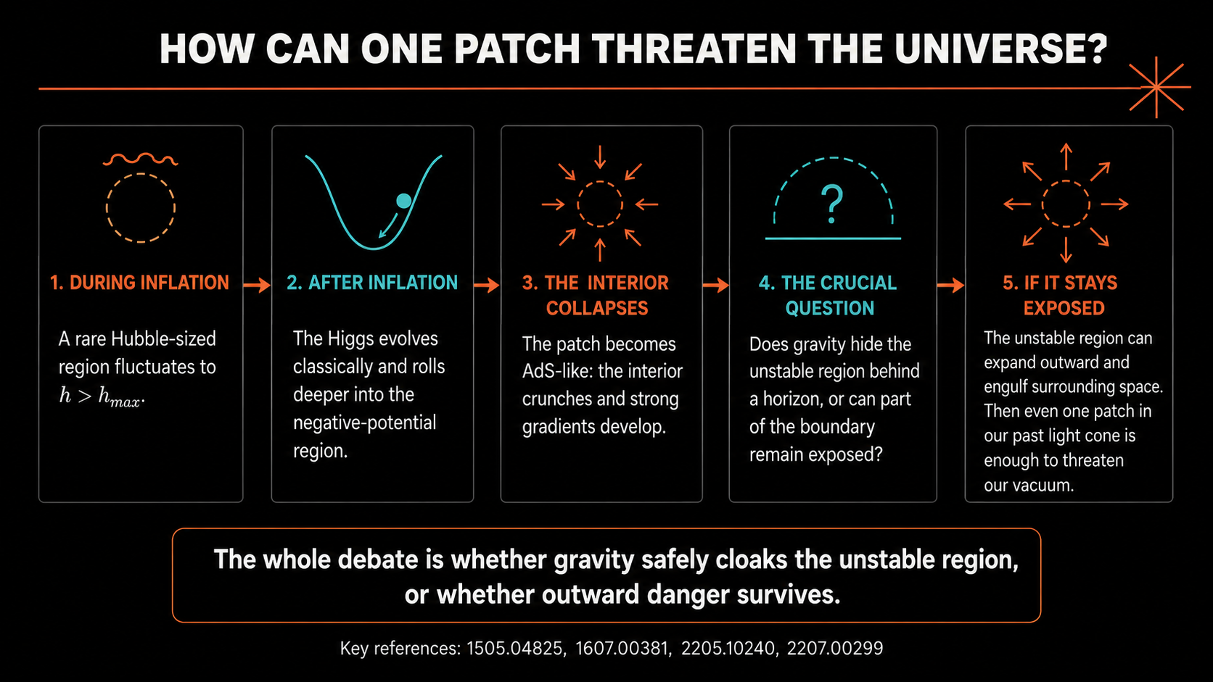
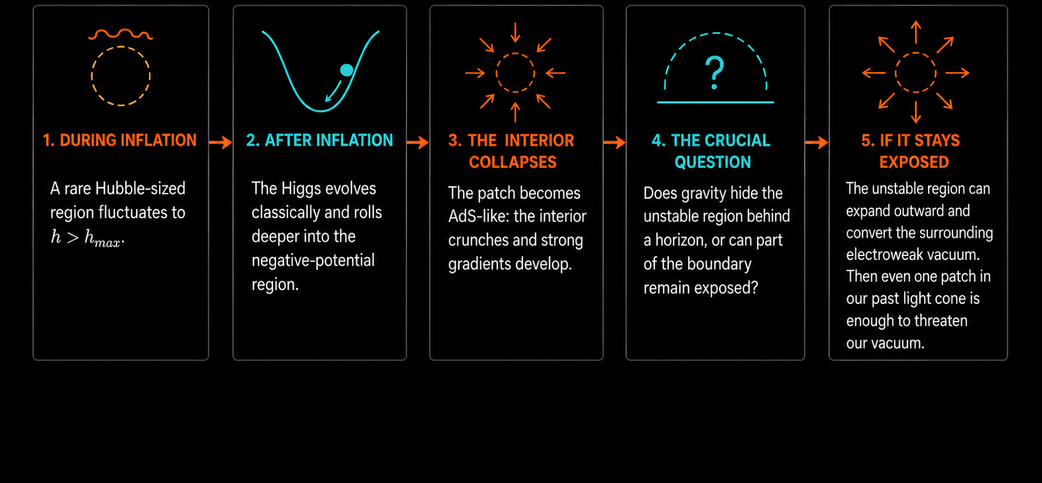
HOW CAN ONE PATCH THREATEN THE UNIVERSE?

Slide 32
Presentation contents
Higgs vacuum instability
Cosmology implications and stochastic kicks
Previous Higgstory
Primordial Black Holes

