Slide 1
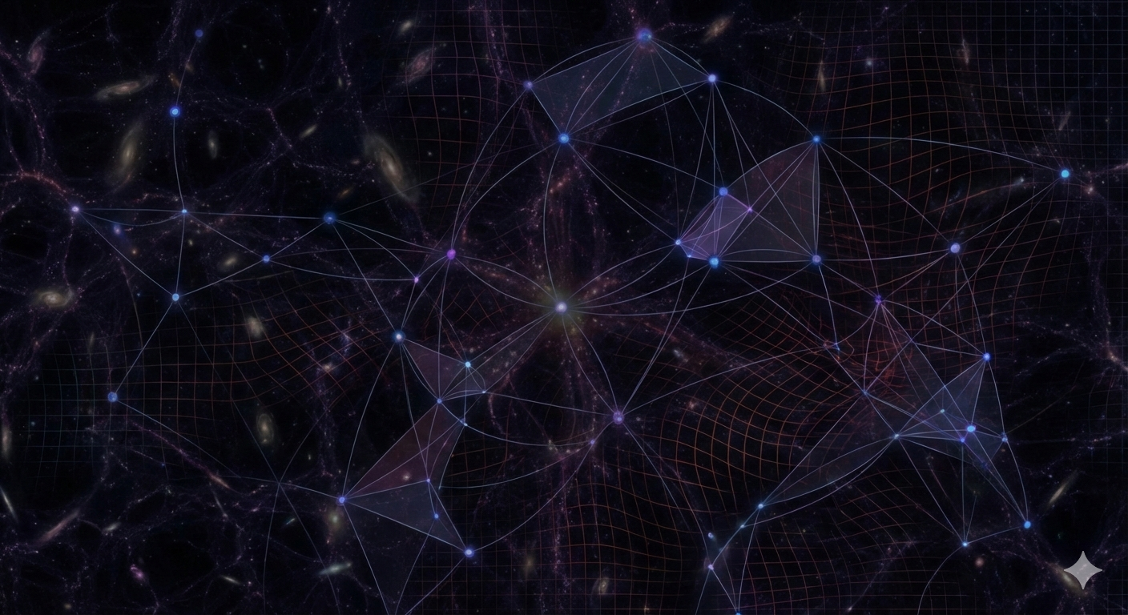



Non-Gaussian statistics to break degeneracies in Modified Gravity
Alessandro Vadalà
3rd yr. PhD
Joint program INAF-OAR – Sapienza U. – Tor Vergata U.
PhD advisors:
Dr. Vincenzo F. Cardone
Prof. Roberto Maoli
Collaborators:
Simone Vinciguerra, Filippo Bouchè, Carlo Giocoli, Marco Baldi
alessandro.vadala@inaf.it
Alessandro Vadalà – PASCOS 2026 U. Sheffield , 25.06.26

Slide 2
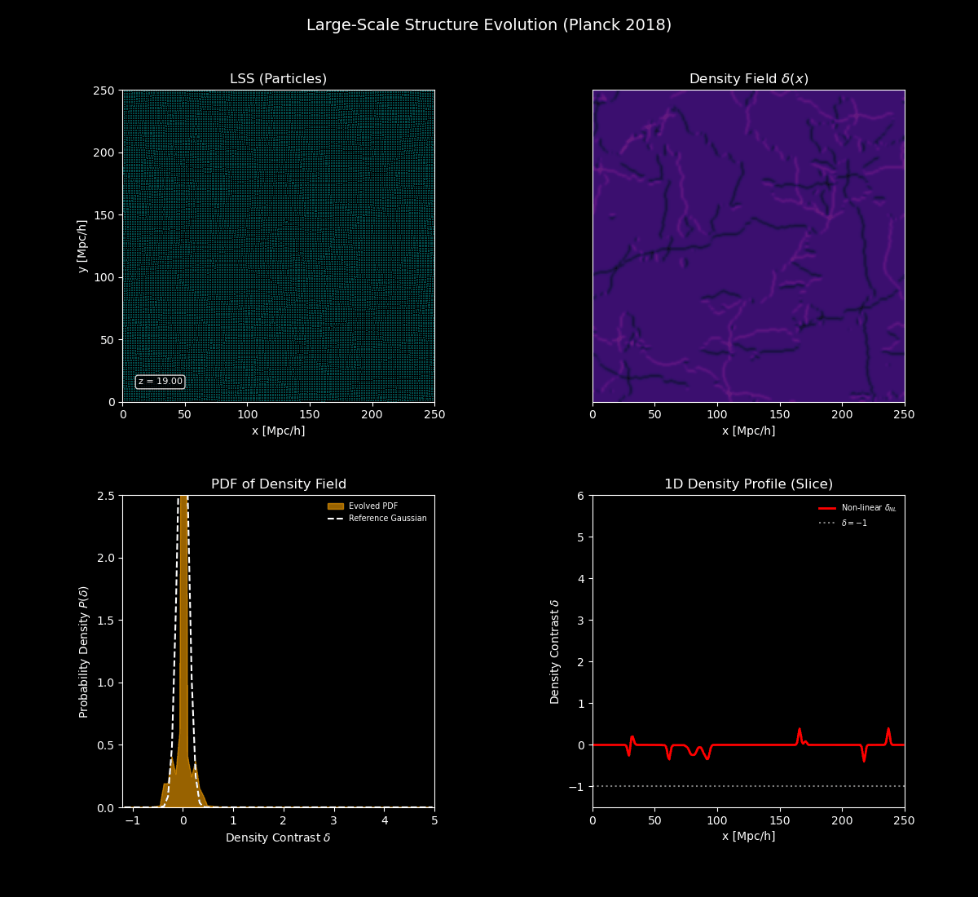
Non-Gaussianities
in LSS
Gravitational evolution
→ non-Gaussian features
Tight high-density peaks
Larger underdensities (voids)
Notes:
First, what are NG? We are talking about late-time NG induced by gravitational collapse, so we don’t mean primoradial NG, we assume G or QG IC and the gravitational pull leads to the formation of the filamentary structure of the cosmic web, with.. Due to mode coupling

Slide 3
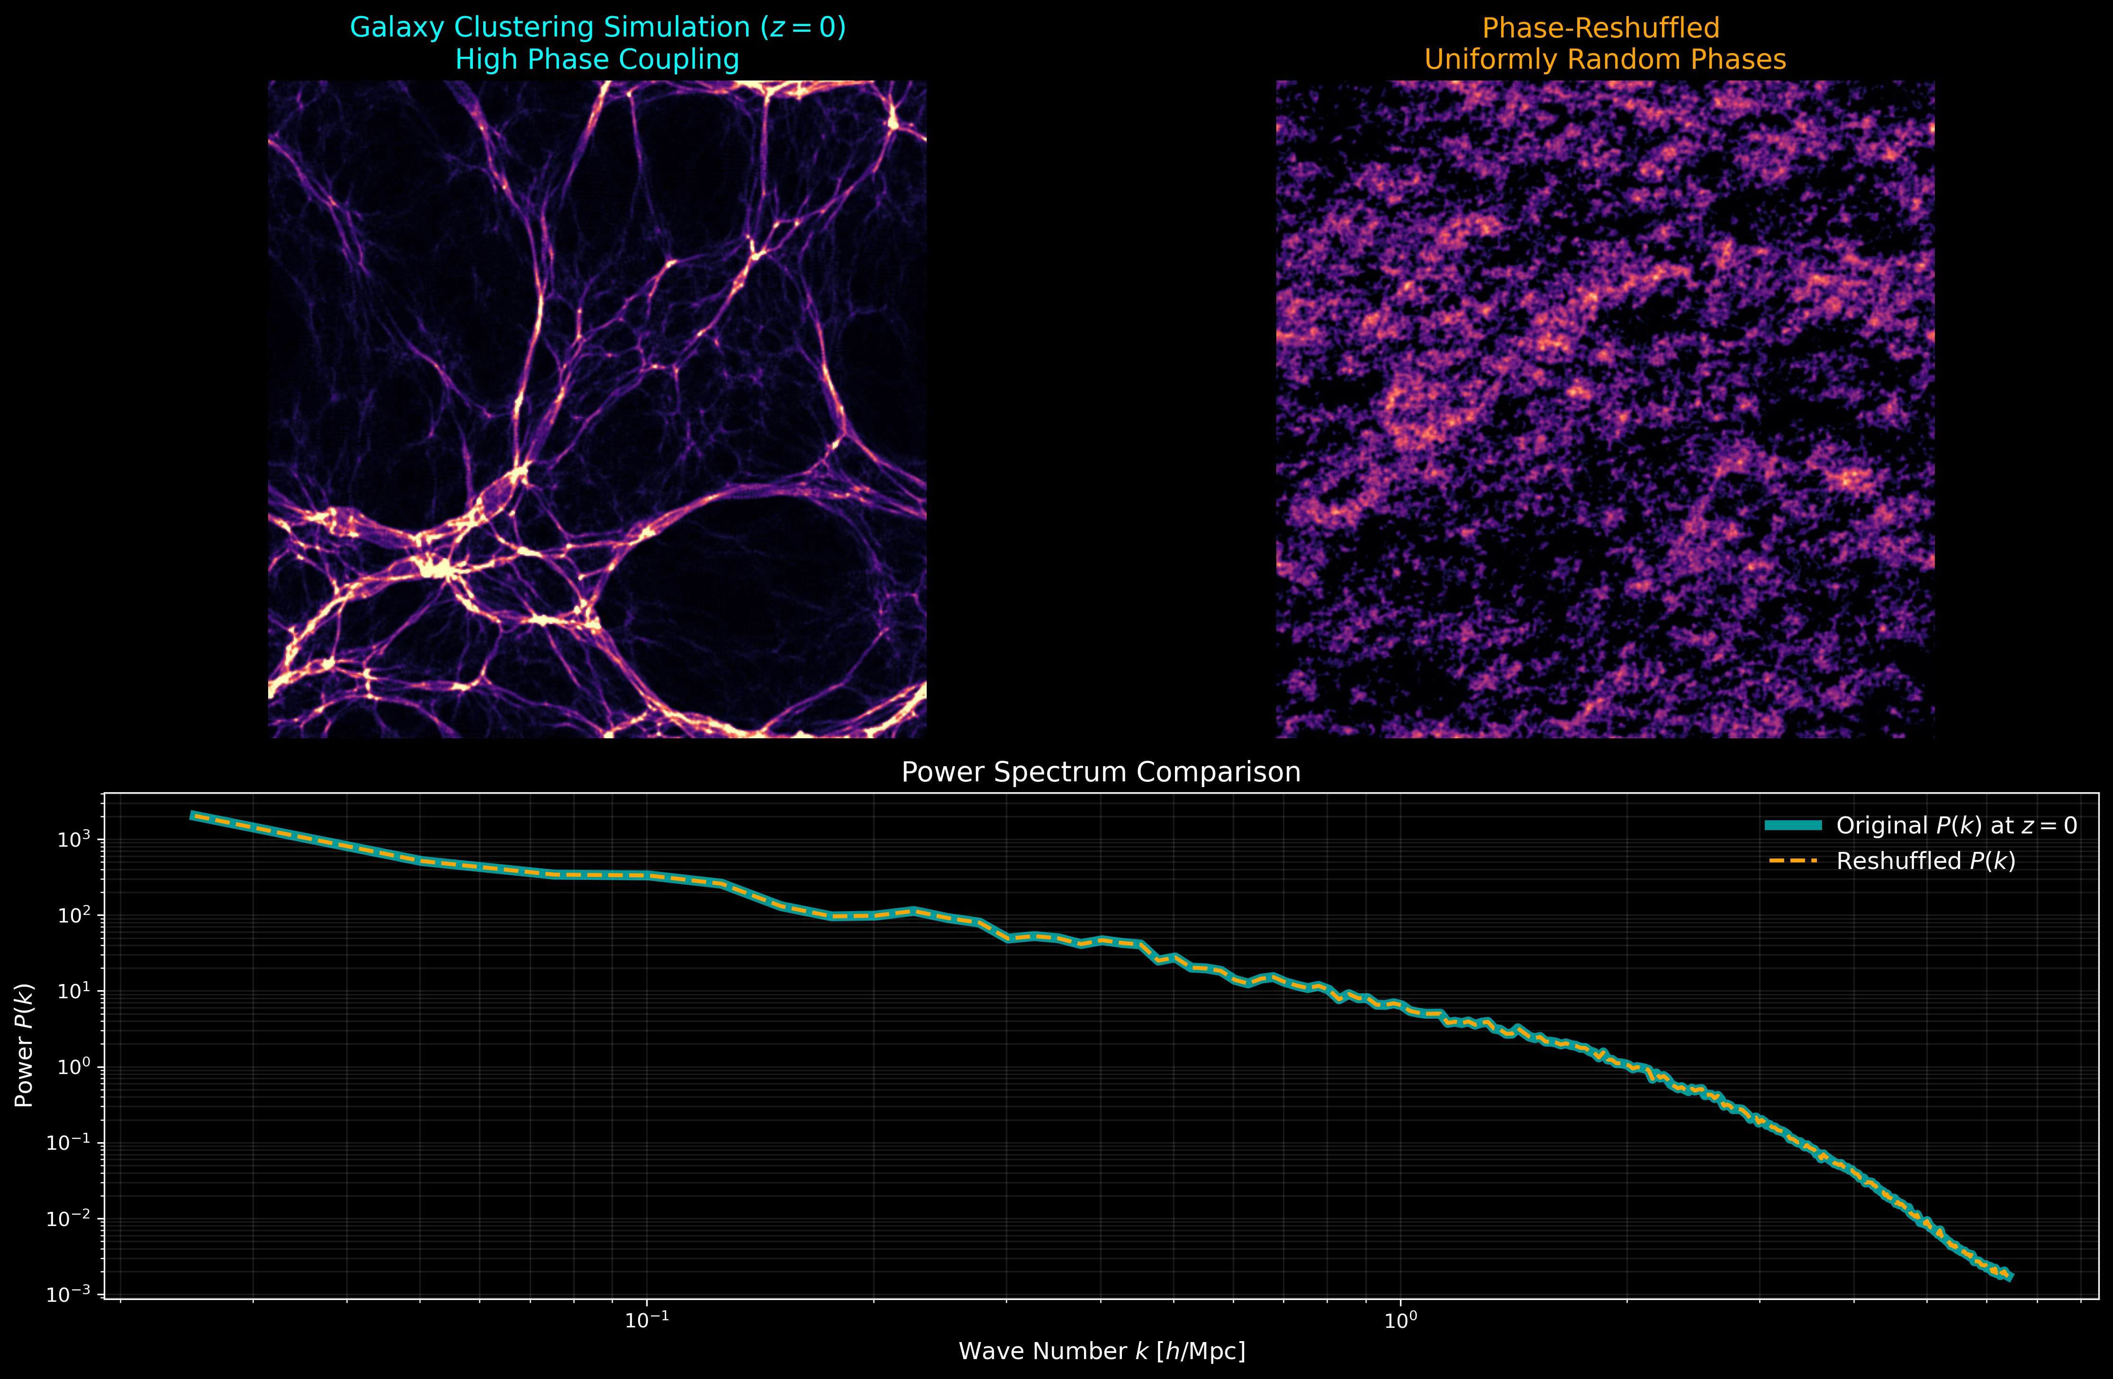
See “Coles, Lucchin” 2nd ed, chap. 16
Fourier transform of δ
complex
→ amplitude and phase
Phase reshuffling
→ Same amplitude
Notes:
Now that we have a definition of PS and, in this slide I tried to reproduce an illustration from a cosmology textbook.. I don’t claim it to be scientifically accurate, but at least visually reproduces the LSS with strong mode coupling. If we take the FT of the density field, since in general is complex.. We can randomly rotate the phases destroying the correlation, leading to the second image in which the phases are randomly distributed. However ..

Slide 4
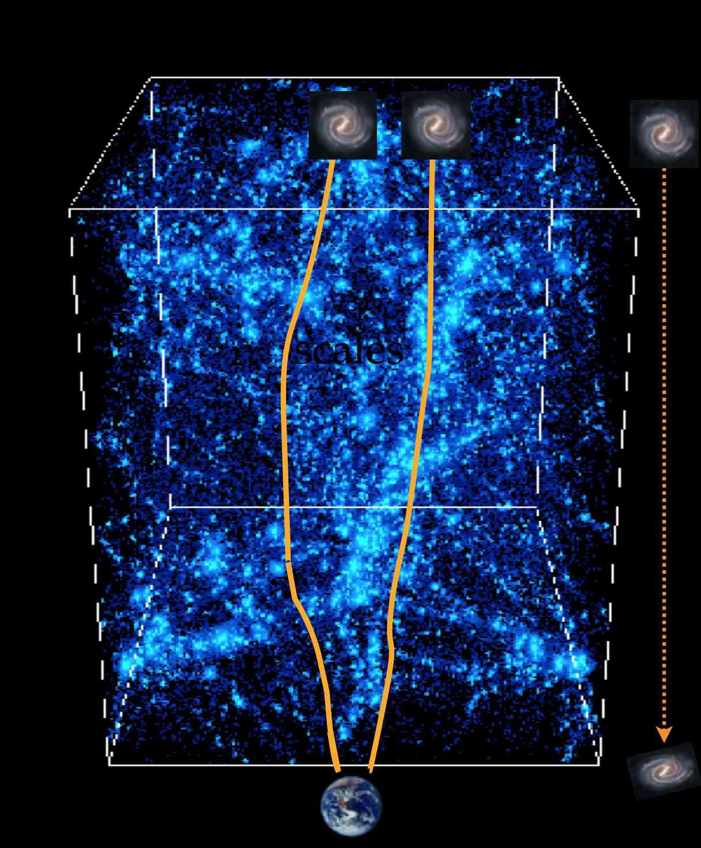
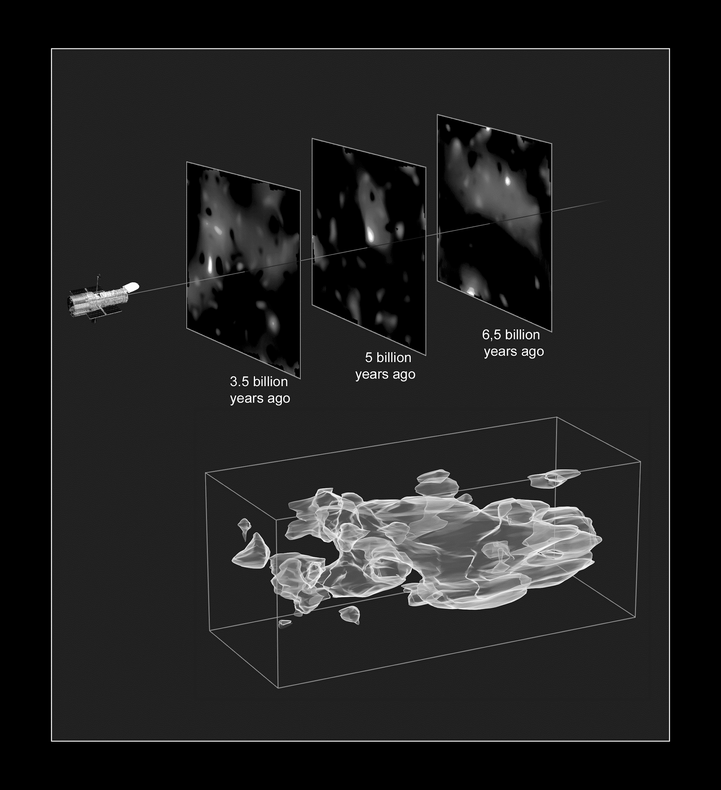



From shear to convergence
Mass-mapping
[CEA]
[Euclid/Weak lensing]
Cosmic shear
(coherent deformation)
Convergence maps (projected mass)
Notes:
Although from sims we can directly obtain k-maps, from real surveys we measure the elliptization, so the shear..

Slide 5
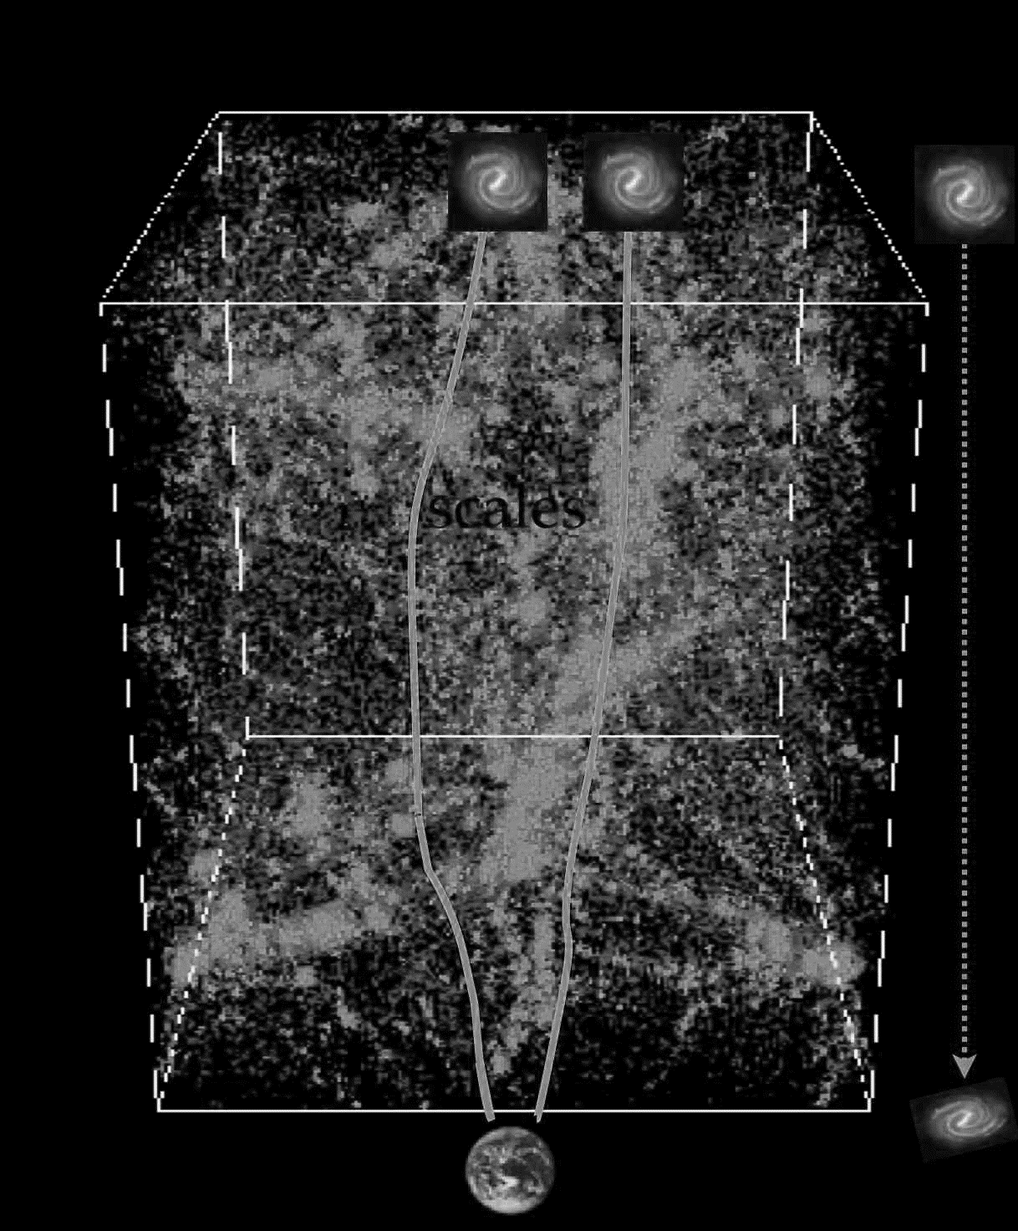
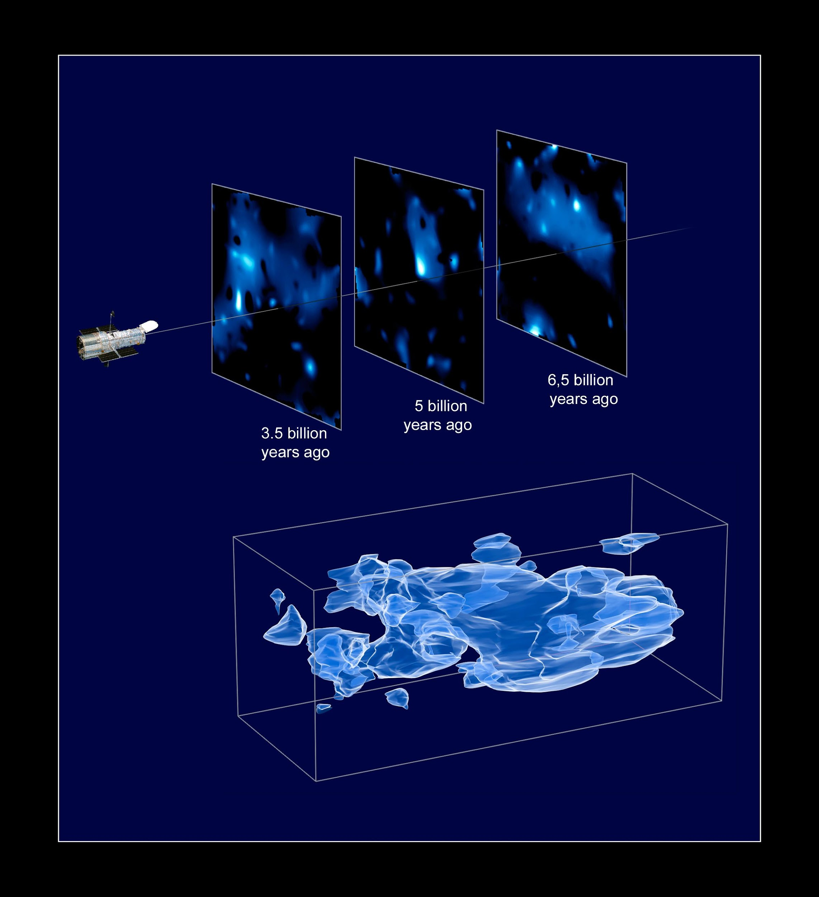
From shear to convergence
Mass-mapping
[CEA]
[Euclid/Weak lensing]
Cosmic shear
(coherent deformation)
Convergence maps (projected mass)

Slide 6
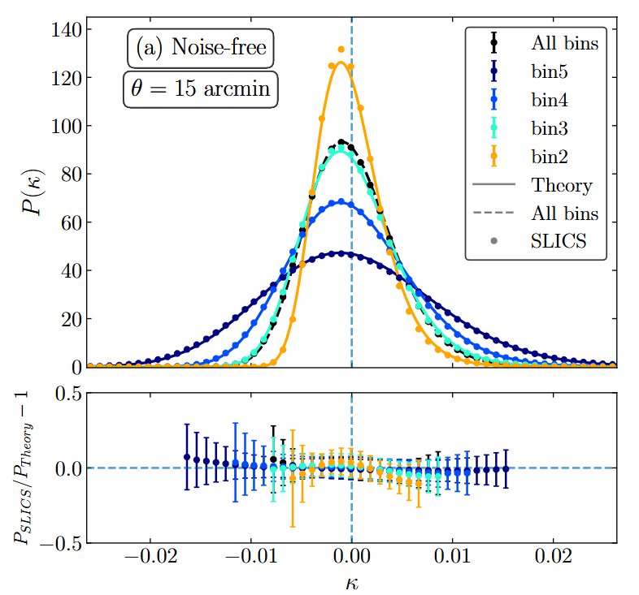
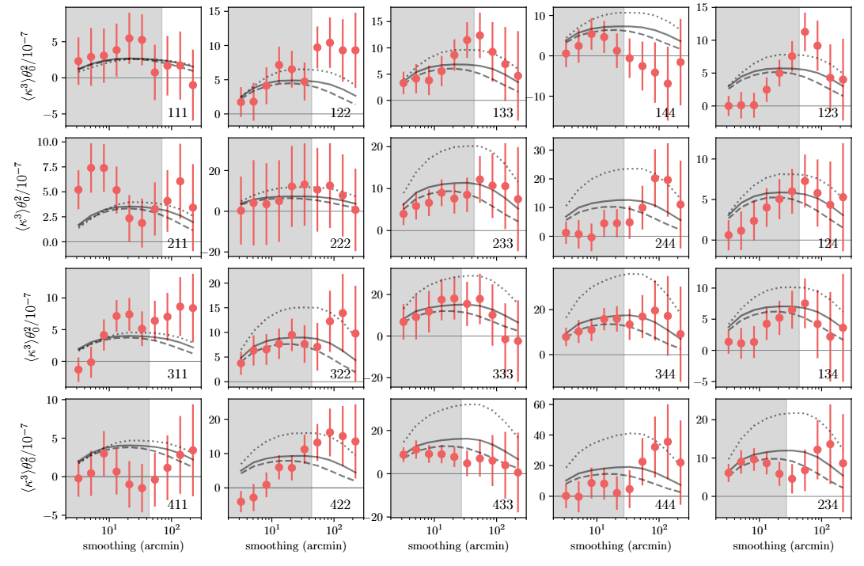
Higher-order statistics – one-point
1pt 𝛋 - PDF
𝛋 - higher-order moments
[2405.09651]
[2110.10141]
Notes:
1PDF: it is a 1pt statistic but, encompassing different scales it can provide the whole information about the convergence field, and it has been proved in literature that it is sensitive to non-gaussian features
HOMs: the higher-order moments of the convergence, although being integrated quantities of the PDF [weighted average], depend on higher-order correlators like the bi- and tri-spectrum and provide information about non-gaussianities
L1-norm: normalized sum of absolute values of wavelet coefficients, obtained from k-maps. Sensitive to multi-scales analysis.

Slide 7
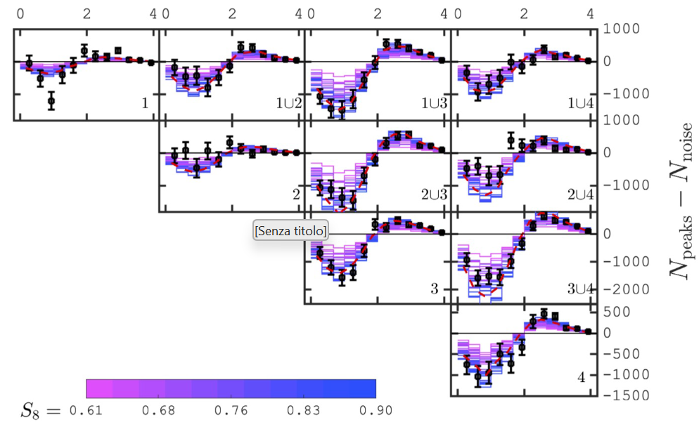
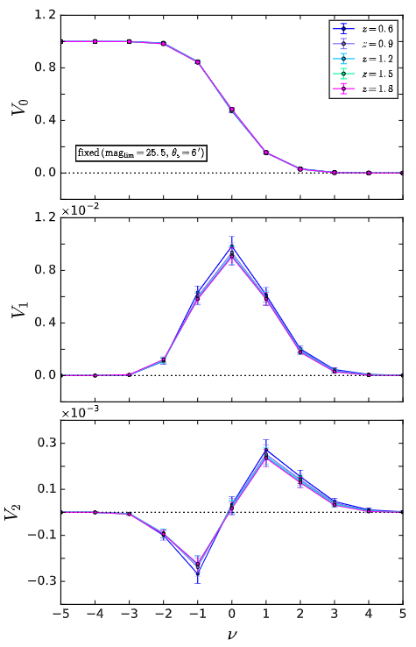
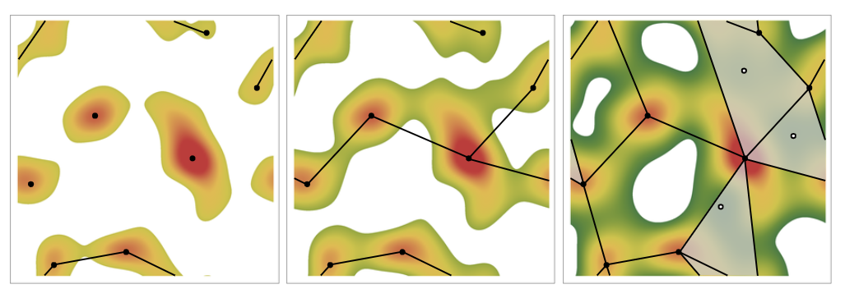
Higher-order statistics – topological
𝛋 – Minkowski functionals
𝛋 - peak counts
[2012.02777]
[1908.01619]
𝛋 - Betti numbers
[1911.06243]
Notes:
Peaks: we counted the peaks on the convergence field and the Map, the field convoluted with a compensated filter function. The peak statistic comes from the projection of LSS overdensities and provides additional information about matter inhomogeneities
Betti nrs: topological invariants that give information about the connectivity of critical points of the field; b0 counts nr disjoint components, b1 the non equivalent loops (particularly interesting in MG)
Minkowski functionals: scalar functionals giving information about the area, perimeter of excursion sets (regions with value of the field above a given threshold) and Euler characteristic (difference between nr disconnected regions above and below threshold)

Slide 8
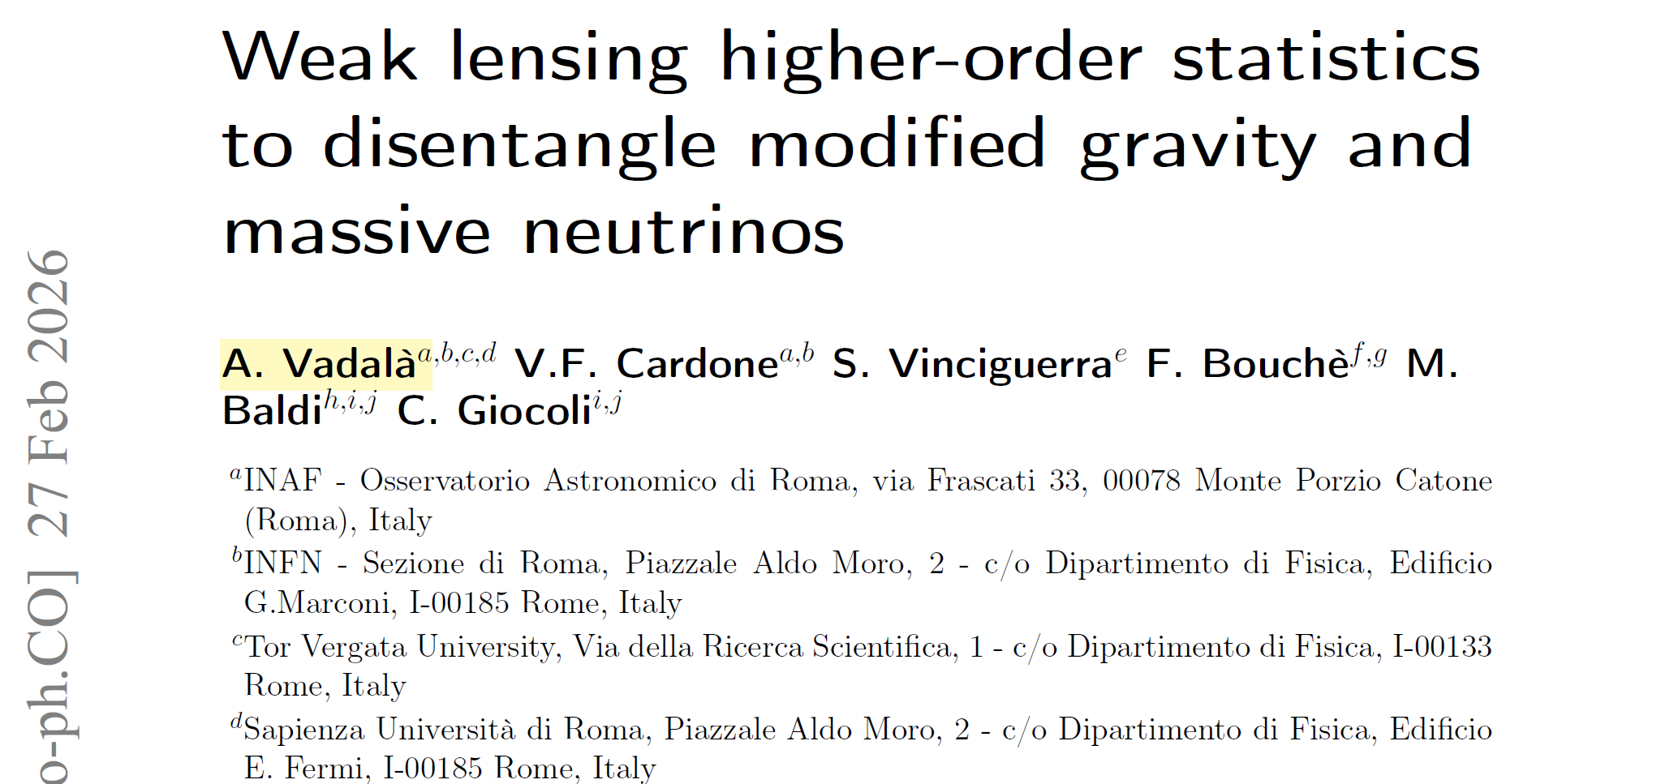

Break modified gravity degeneracy
Notes:
What I presented so far was in GR, however HOS can also be used in a beyond LCDM scenario..

Slide 9
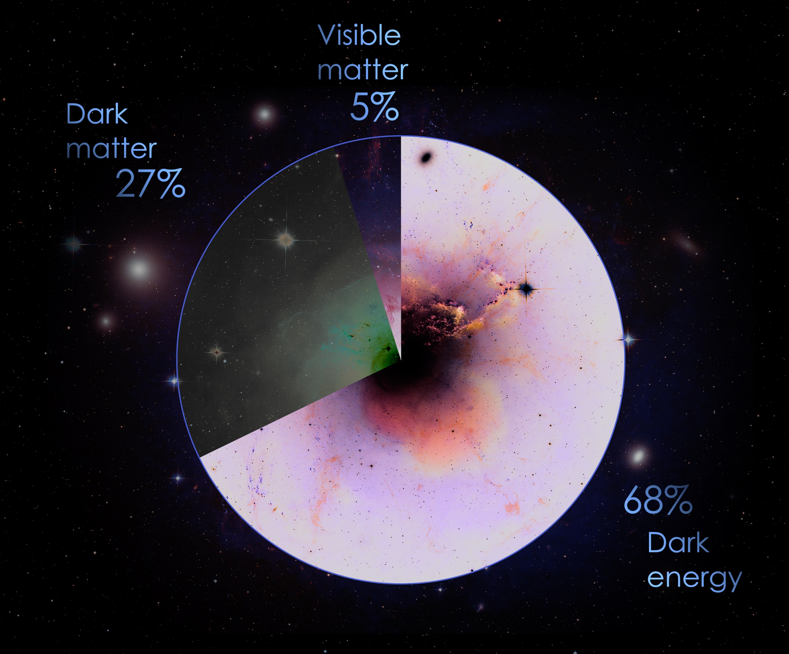
Standard cosmological model - ΛCDM
Phenomenological model
General Relativity (GR)
Λ: Dark Energy–CDM: Cold Dark Matter
Cosmological tensions (H₀, S₈)
[Image credits: NASA]
Notes:
Proper introduction to LCDM.. Unknown dark components and cosmological tensions..

Slide 10


gravity
[arXiv:0705.1158]
Notes:
Those reasons encouraged the search for alternatives, questioning one assumption that is the validity of GR, leading to MG. We used a model known as..

Slide 11



gravity
Hu & Sawicki
~ ΛCDM at background
different at perturbations
[0705.1158]
Notes:
In this work, we used a specific form for f(R) introduced by HS.. It has the advantage.. Moreover, in f(R) models, the effects..

Slide 12

gravity
Hu & Sawicki
~ ΛCDM at background
different at perturbations
enhanced
suppressed
[0705.1158]
Notes:
However, this parameter is highly degenerate with total neutrino mass..

Slide 13
gravity
Hu & Sawicki
~ ΛCDM at background
different at perturbations
HOS?
enhanced
suppressed
[0705.1158]
Notes:
The question was..

Slide 14
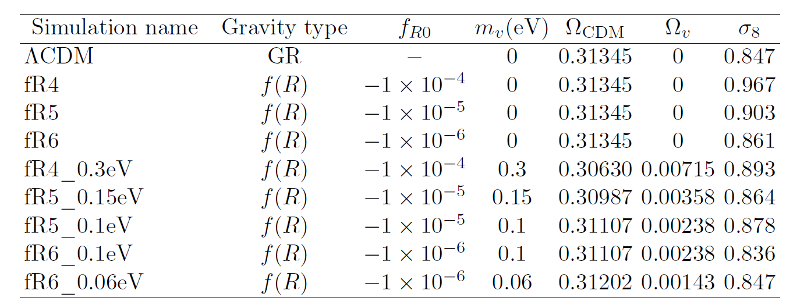
Simulations setup
DUSTGRAIN-pathfinder simulations
Run in GR and f(R) gravity
Different combinations of f_{R0} and m_{ν}
Fixed redshift planes - z ∊ [0.0, 1.0, 2.0, 4.0]
|f_{R0}|= 10⁻⁴ strongest
|f_{R0}|= 10⁻⁶ weakest
+ Shape noise

Slide 15
Discriminate ΛCDM - f(R) gravity with HOS
Distance metrics
SMAPE
Hellinger
Mahalanobis
Wasserstein
Nonparametric hypothesis testing
Kolmogorov-Smirnov
Cramér-von Mises
Ansari-Bradley
Mann-Whitney U
Gaussianity requirements
Point-like differences in samples
Notes:
So, we knew what we wanted to do but we didn’t know how.. We had to come up with something.. We landed on two methods..

Slide 16
Metrics-based method
M_{GR} - σM_{GR}, M_{MG} - σM_{MG}
median - 68% confidence range, from 500 random realizations
sampled from multivariate Gaussian
Must verify HOS Gaussian distributed
Gaussianity test (SMAPE-test) [2510.04953]
No HOM

Slide 17
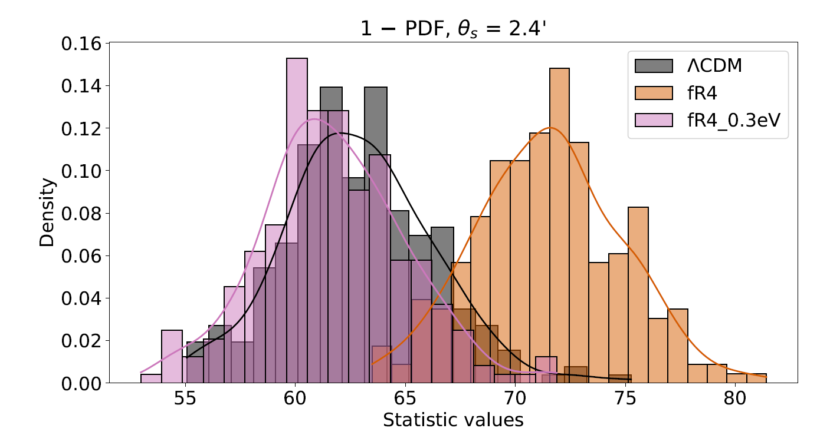
Hypothesis rejection-based method
For probe and configuration (i.e., smoothing, range, redshift), split range in 20 bins.
For bin, histogram of the 256 realizations of that bin → 20 different histograms
Gaussian smoothing with kernel density estimation (KDE)
h0 : same distribution
α = 0.001
p < α → reject h0, different
p > α → fail to reject h0

Slide 18
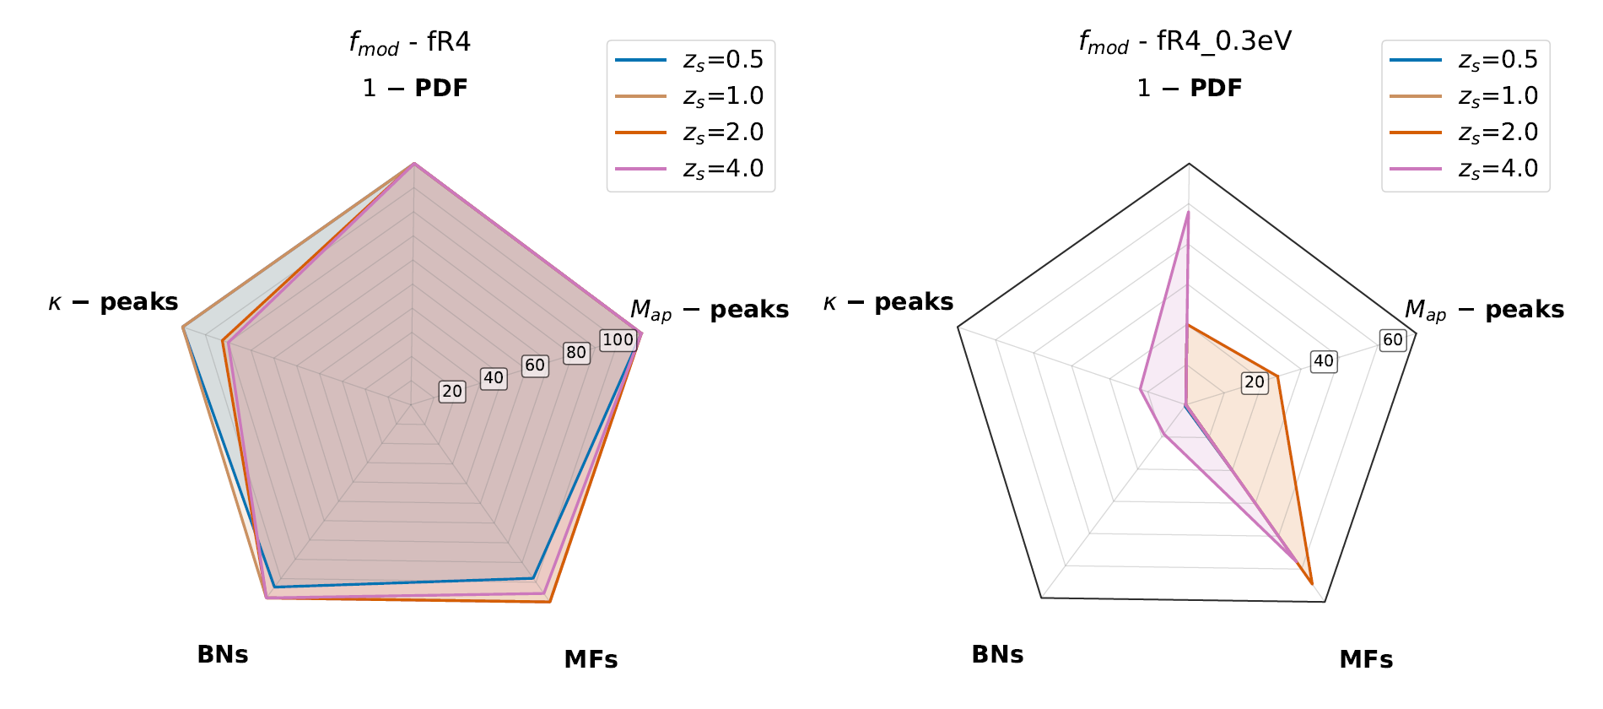


Metric-based method - Results
Combinations range+binning+smoothing → large number of cases
Selected cases with higher S/N → 100 cases per configuration
Notes:
Saturates without neutrinos.. The effect of neutrinos is dramatic, most contours falls back to zero, just..

Slide 19
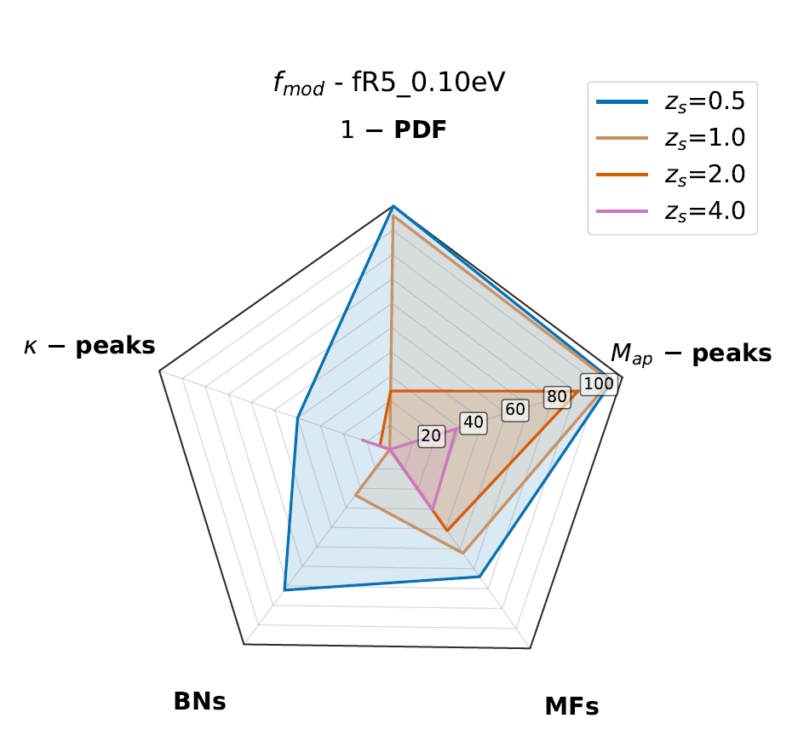
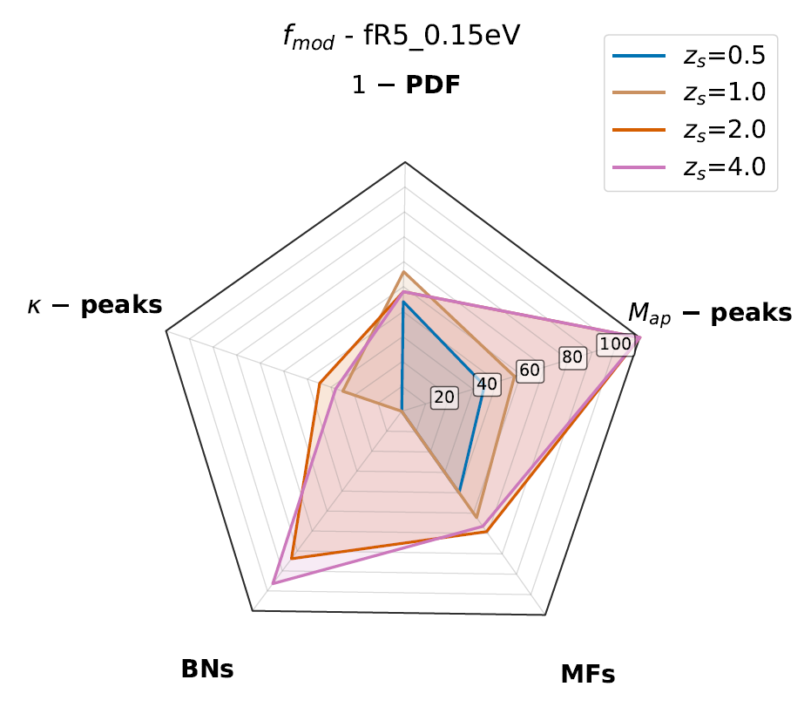
Metric-based method - Results
Notes:
This is an intermediate and more realistic case.. On right MG, on left MV

Slide 20
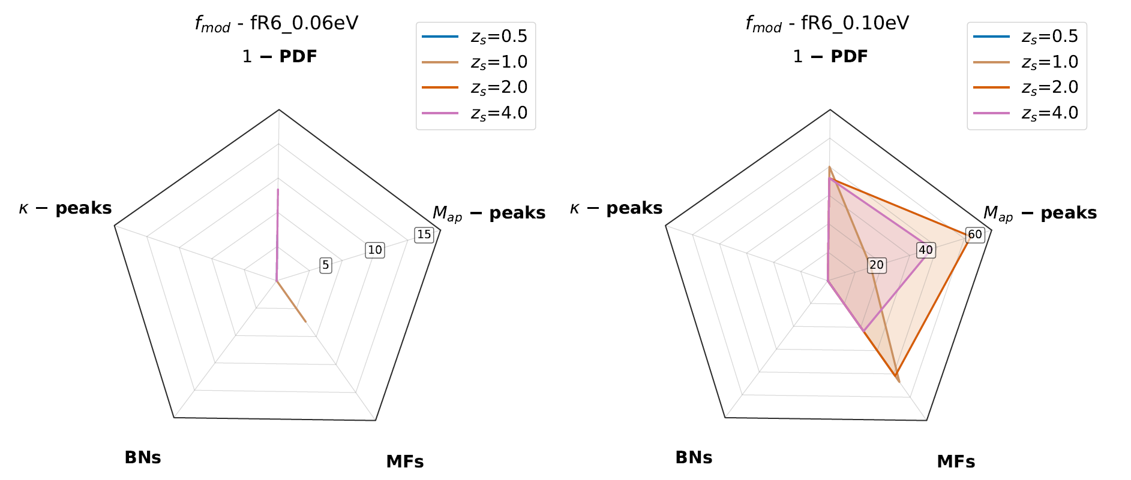
Metric-based method - Results
Notes:
The hard case, the left almost perfectly mimics LCDM..

Slide 21
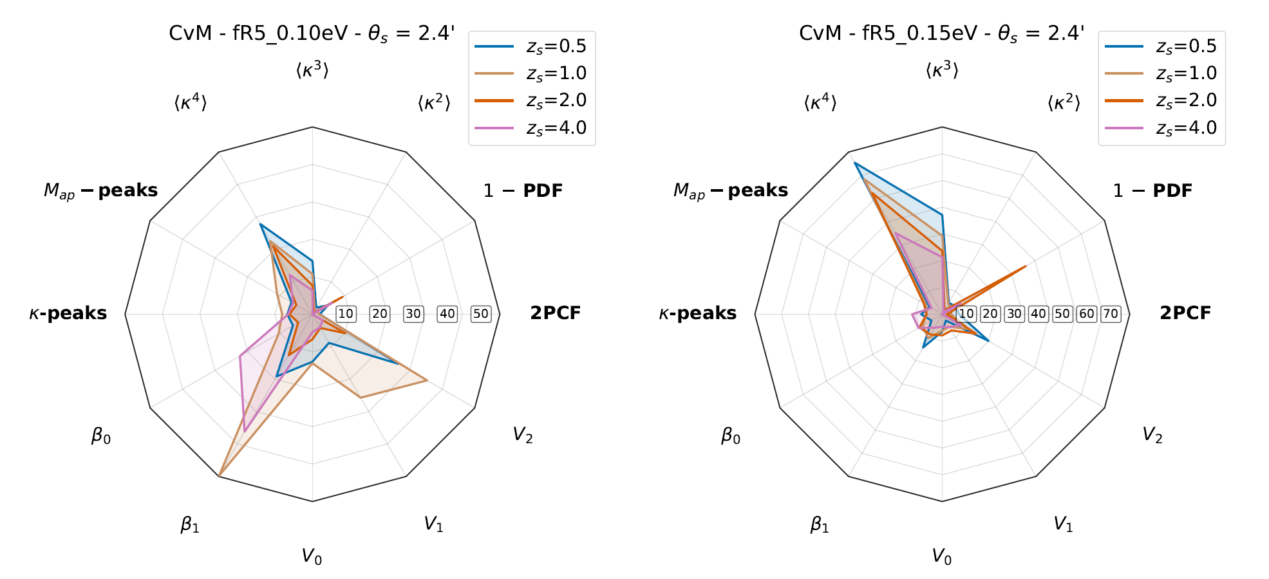
Hypothesis-rejection method - Results
Notes:
HRM are complementary, tailored for the inclusion of HOMs, although they provide a different kind of information.. Not concatenated DV but specific for configuration.. We see the effect of kurtosis.. Sensitive to the tail of the distribution, where we have the extrema, more massive structures, enhanced by MG..

Slide 22
Conclusions
2PCF systematically outperformed
No clear winner! Different configuration → different optimal probe
For future analyses → risky choosing single HOS on average performance
Correct strategy → full toolkit, let data tell where to head
2PCF still backbone of cosmological analysis → maybe insufficient for beyond GR
Realistic survey → tomography, systematics: IA, source clustering, baryonic feedback
Excellent timing: Euclid, LSST, Nancy Roman Space Telescope
→ high-precision data from LSS

Slide 23
Extra
Slides

Slide 24
Higher-order statistics
𝛋 - peak counts
(M_{ap} -)
𝛋 – Minkowski functionals
𝛋 - Betti numbers
1pt 𝛋 – PDF
𝛋 - higher-order moments
+
Vs.
𝛋 – 2PCF

Slide 25



Higher-order statistics – one-point
1pt 𝛋 - PDF
𝛋 - higher-order moments
𝛋 - ℓ1 norm
Notes:
1PDF: it is a 1pt statistic but, encompassing different scales it can provide the whole information about the convergence field, and it has been proved in literature that it is sensitive to non-gaussian features
HOMs: the higher-order moments of the convergence, although being integrated quantities of the PDF [weighted average], depend on higher-order correlators like the bi- and tri-spectrum and provide information about non-gaussianities
L1-norm: normalized sum of absolute values of wavelet coefficients, obtained from k-maps. Sensitive to multi-scales analysis.

Slide 26



Higher-order statistics – topological
𝛋 - peak counts
(Map -)
𝛋 – Minkowski functionals
𝛋 - Betti numbers
Notes:
Peaks: we counted the peaks on the convergence field and the Map, the field convoluted with a compensated filter function. The peak statistic comes from the projection of LSS overdensities and provides additional information about matter inhomogeneities
Betti nrs: topological invariants that give information about the connectivity of critical points of the field; b0 counts nr disjoint components, b1 the non equivalent loops (particularly interesting in MG)
Minkowski functionals: scalar functionals giving information about the area, perimeter of excursion sets (regions with value of the field above a given threshold) and Euler characteristic (difference between nr disconnected regions above and below threshold)

Slide 27
Gaussianity test
Assuming Gaussian distributed HOS
SMAPE-test (Symmetrized Mean Absolute Percentage Error)
If N_{d} ~ N_{f}, y_{i} no more follows χ² distribution
500 realizations from multivariate Gaussian, with mean and variance as SLICS
mean P_{gauss}(y_{i}) as new target realization
S_{mean} and S_{sd} from mean from 500 realizations
Notes:
Error Lower Limits: provides a lower limit on the marginalized errors of model parameters.
Degeneracy Mapping: It is instrumental in identifying degeneracy directions—the specific combinations of parameters that the data cannot easily distinguis.
Quantifiable Information Content: It allows for the calculation of the Figure of Merit (FoM), a numerical value inversely proportional to the area of the confidence ellipse
Gaussian Likelihood Assumption: The standard Fisher formalism assumes the likelihood follows a Gaussian distribution. The authors found that both HOS and traditional two-point statistics often violate this assumption, requiring "tail cuts" to ensure the results remain valid.
Ill-Conditioning: The matrix can become "nearly singular" (ill-conditioned), where small numerical noises from simulations are amplified during matrix inversion. This leads to unstable and unreliable parameter constraints, particularly when dealing with many parameters or long data vectors.
Numerical Sensitivity: The accuracy of the Fisher matrix is highly dependent on the quality of the model derivatives and the data covariance matrix, both of which must be estimated numerically from a large but finite number of expensive N-body simulations
we compute the
observed SMAPE value, Sobs, by comparing the yi computed
from the SLICS dataset to the target distribution. The Gaussianity threshold, Slim, is then computed as

Slide 28
Metrics-based method
For metric M and observable O, compute fiducial DV in GR/MG from 256 DUSTGRAIN maps.
Generate 256 DVs (D_{rnd}) for GR/MG from Gaussian centered on fiducial values and with covariance from GR.
For each realization, compute M for either D_{rnd} GR or D_{rnd} MG → M_{rnd} GR, M_{rnd} MG
Repeat steps i. - iii. 500 times. From set (M_{rnd} GR, M_{rnd} MG) estimate (M_{GR}, M_{MG}) and errors: median and symmetrized 68% confidence ranges of distributions.

Slide 29
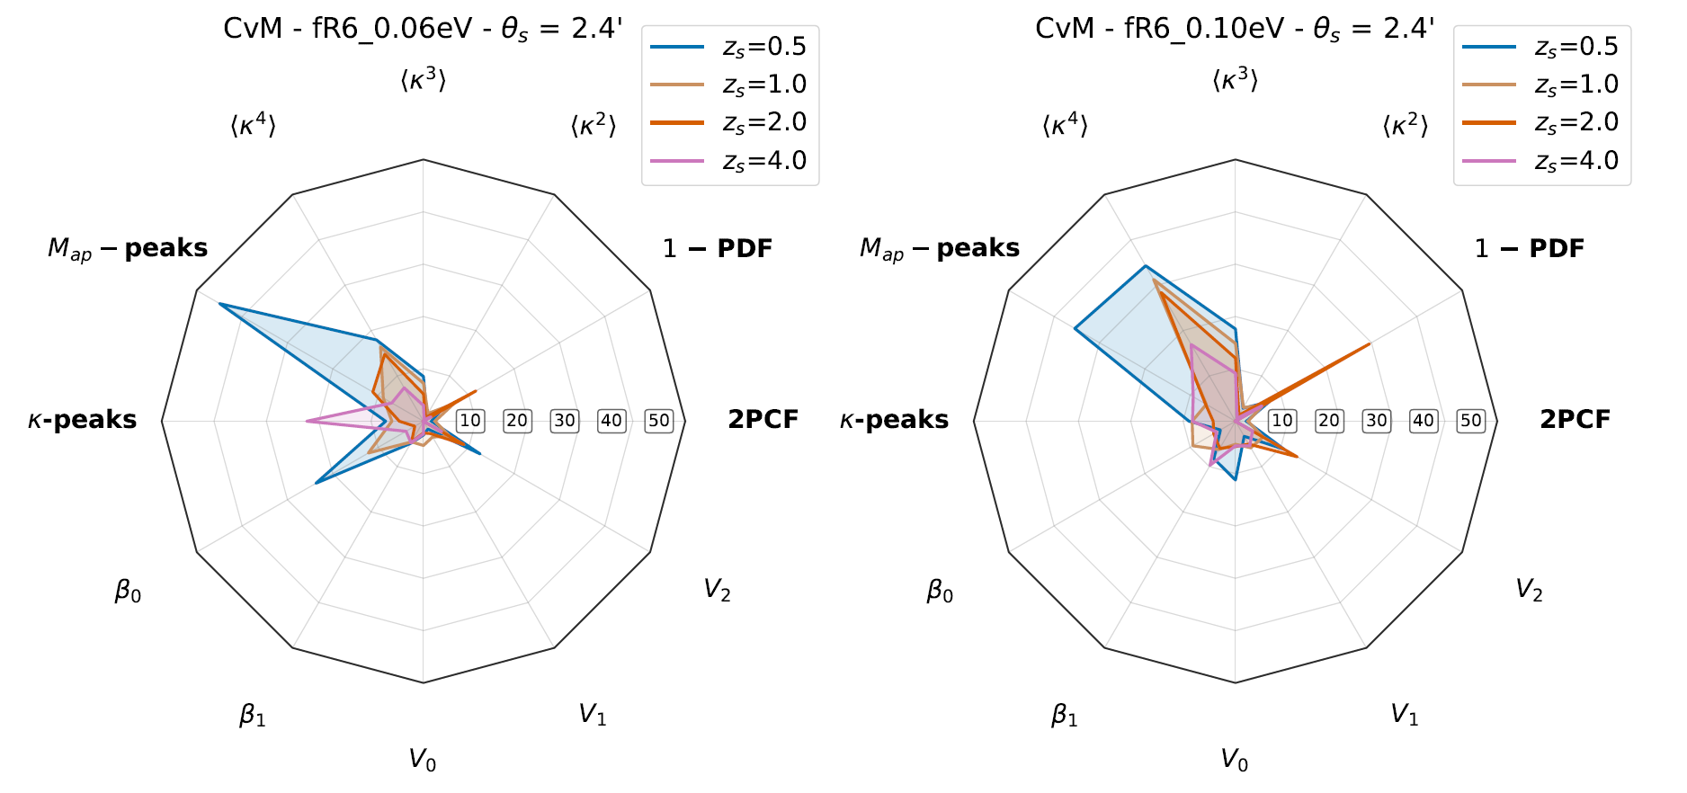
Hypothesis-rejection method - Results

