Slide 1



Constraining dark matter with high-redshift Lyman-α forest data
Olga Garcia Gallego
og313@cam.ac.uk
Institute of Astronomy, University of Cambridge
Kavli Institute for Cosmology, Cambridge
With Vid Irsic, Matteo Viel, Martin Haehnelt, Matteo Viel & James Bolton
Based on the work:
arXiv:2504.06367
arXiv:2510.00107
arXiv:2603.04401
og313@cam.ac.uk
PASCOS 2026 (Sheffield) – 26/06
Notes:
og313@cam.ac.uk

Slide 2
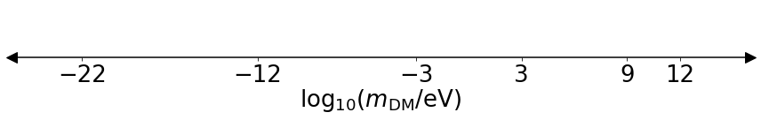
ΛCDM and Dark Matter
1
Tests of ΛCDM model successful on large scales: CMB (WMAP + Planck + ACT). Galaxy clustering (e.g. SDSS, DESI, DES). Difficult on $≤$1Mpc: baryonic physics, nature of dark matter.
Dark matter mass scale:
Ultralight DM
WDM
Bosonic fields, non-thermal
Thermal & non-thermal
QCD axion
(sterile) ν
WIMPs
ALPs
Dark photon
HDM
Recall talk by
Andreas Ringwald
Introduction
Background
Method
Results
Summary
Notes:
On small scales, however, the physics become non-linear, baryonic physics processes that are still not well understood take place, and that means that the observed galaxy clustering does no longer trace the underlying dark matter distribution. These scales can be used to probe dark matter. Since even thought it makes up around 26% of the energy density content of the Univese we still don’t have a viable candidate within the Standard Model.
The candidates that I am showing here as a function of the mass of the dark matter particle, which in this case expands almost 40 order of magnitude, with more candidates that I am not showing here in the higher mass regime.
On the higher end of this diagram we have weakly interacting massive particles, which historically have received the most attention. If thermal, they decouple deep in RD while being non-relativistic and are cold dark matter candidates, strong experimental effort to detect it in the laboratory, such as the LHC or Fermi-LAT, but no success so far.
From keV range and above, the next regime would correspond to Light DM or Warm dark matter candidates, with main effect of suppressing structures below the Mpc scale. The preferred candidate for WDM are heavier neutrinos that the SM neutrinos, also known as sterile (right-handed) neutrinos.
Then we enter in the ultralight DM regime, with two well motivated candidates, the dark photons and the axion. The first involves the idea of a dark sector with the dark photon being the new force carrier, and theorised to be detected via its mixing with ordinary photons. It is a new gauge boson and arises in hypothetical dark sector.
Axions were first introduced to sole the strong CP problem and then it was later realized that they are a good DM candidate. Theta can take a value between -pi and pi but it takes a value very close to 0 and this is what we mean by a fine-tuning problem.
Proposing a dynamical explanation: promote theta to a dynamical field - the axion, and when the angular variable can relax to 0: then in that configuration there is no electric dipole moment.
Another way of posing this problem is having this term that could appear in the QCD Lagrangian: that is proportional to theta, that would give a noin-zero neutron EDM.
Now we have said that we promote theta to be a dynamical field.
Experimental efforts to detect axions like ADMX, , but the mass range probed does not cover the entire range aallowed for the QCD axion (10^-11 to 10^-2) with ALPHA being next-generation experiment: ALPHA have found nothing

Slide 3
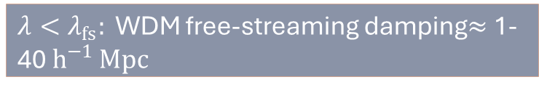

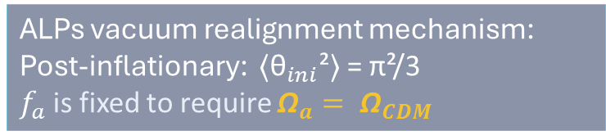



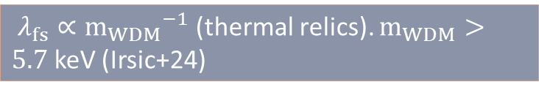
Dark Matter models
2
Recall talk by
Martin Bauer
Ultralight DM
WDM (light)
Axion-like particles
(sterile) ν -like
Strong CP problem; axion field: $θ= φ/f_{a}$
Non-zero velocity dispersion at decoupling.
θini varies from patch to patch. Effective initial angle is then : ⟨${\text{θ}}_{ini}$²⟩ = π²/3
PQ-like symmetry breaking scale $f_{a}$
$λ<λ_{fs}:$ WDM free-streaming damping$≈$ 1-40 $h^{−1 }Mpc$
ALPs vacuum realignment mechanism:
Post-inflationary: ⟨${\text{θ}}_{ini}$²⟩ = π²/3
$f_{a}$is fixed to require ${\text{Ω}}_{a}= {\text{Ω}}_{CDM}$
$λ_{fs}∝{m_{WDM}}^{−1}$ (thermal relics). $m_{WDM}>5.7$ keV (Irsic+24)
ISOCURVATURE PERTURBATIONS
Cold+Warm Dark Matter (CWDM): ${Ω_{WDM}= Ω}_{DM} f_{WDM}$
Results
Motivation
Results
Motivation
Introduction
Background
Background
Method
Method
Method
Summary
Results
Summary
Background
Summary
1
Notes:
When the PQ-symmetry is broken the axion chooses a random initial point theta (that is a point in the circular valley of the potential)
The initial vacuum misalignment angle after symmetry breaking
Many initial misalignment angles so you can average over all possible angles

Slide 4
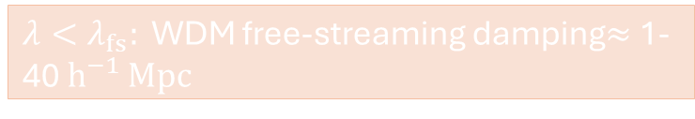

Dark Matter models
2
Ultralight DM
WDM (light)
Axion-like particles
(sterile) ν -like
Strong CP problem; axion field: $θ= φ/f_{a}$
Non-zero velocity dispersion at decoupling.
θini varies from patch to patch. Effective initial angle is then : ⟨${\text{θ}}_{ini}$²⟩ = π²/3
PQ-like symmetry breaking scale $f_{a}$
$λ<λ_{fs}:$ WDM free-streaming damping$≈$ 1-40 $h^{−1 }Mpc$
ALPs vacuum realignment mechanism:
Post-inflationary: ⟨${\text{θ}}_{ini}$²⟩ = π²/3
${\text{f}}_{a}$ is fixed to require ${\text{Ω}}_{a}= {\text{Ω}}_{CDM}$
$λ_{fs}∝{m_{WDM}}^{−1}$ (thermal relics). $m_{WDM}>5.7$ keV (Irsic+24)
ISOCURVATURE PERTURBATIONS
Cold+Warm Dark Matter (CWDM): ${Ω_{WDM}= Ω}_{DM} f_{WDM}$
Motivation
Method
Results
Introduction
Background
Results
Summary
Background
Method
Summary
1
Notes:
When talking about particle dark matter, the mass of established DM candidates can expand a wide range of scales.

Slide 5
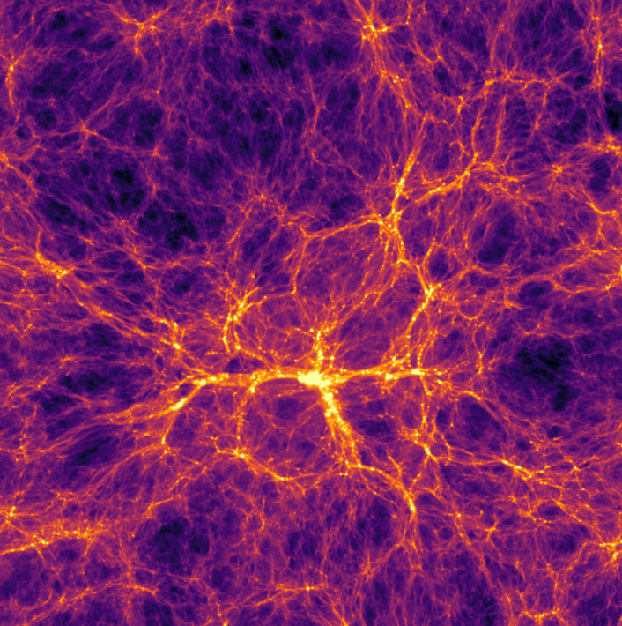

Key signature
3
Cold Dark Matter
20 $h^{−1 }Mpc$
Results
Motivation
Results
Motivation
Introduction
Background
Background
Method
Method
Method
Method
Summary
Results
Summary
Results
Summary
Background
Summary
Motivation
Background
1
Notes:
Slide through a cosmological box of size 20 MPc at z=4.2 using the Sherwood Relics simulations.

Slide 6
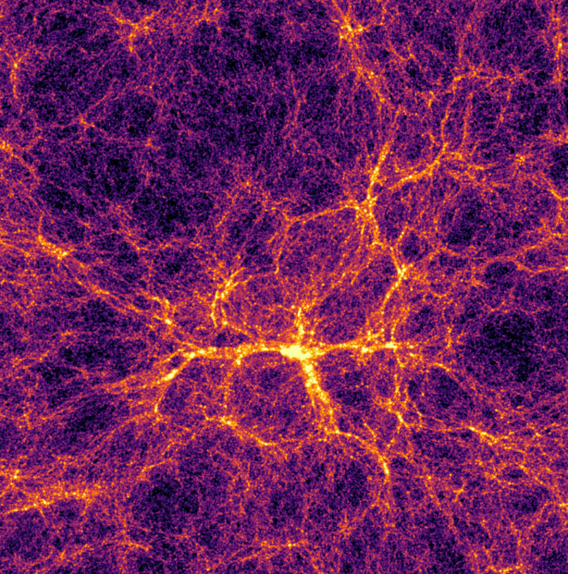
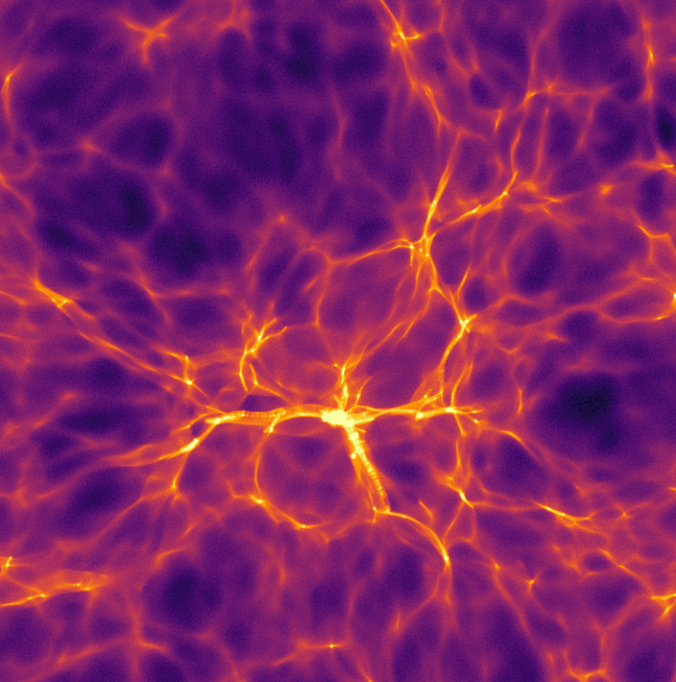
Key signature
3
Axion-like-particles
Cold Dark Matter
Warm Dark Matter
20 $h^{−1 }Mpc$
Results
Motivation
Results
Motivation
Introduction
Background
Background
Method
Method
Method
Method
Summary
Results
Summary
Results
Summary
Background
Summary
Motivation
Background
1

Slide 7
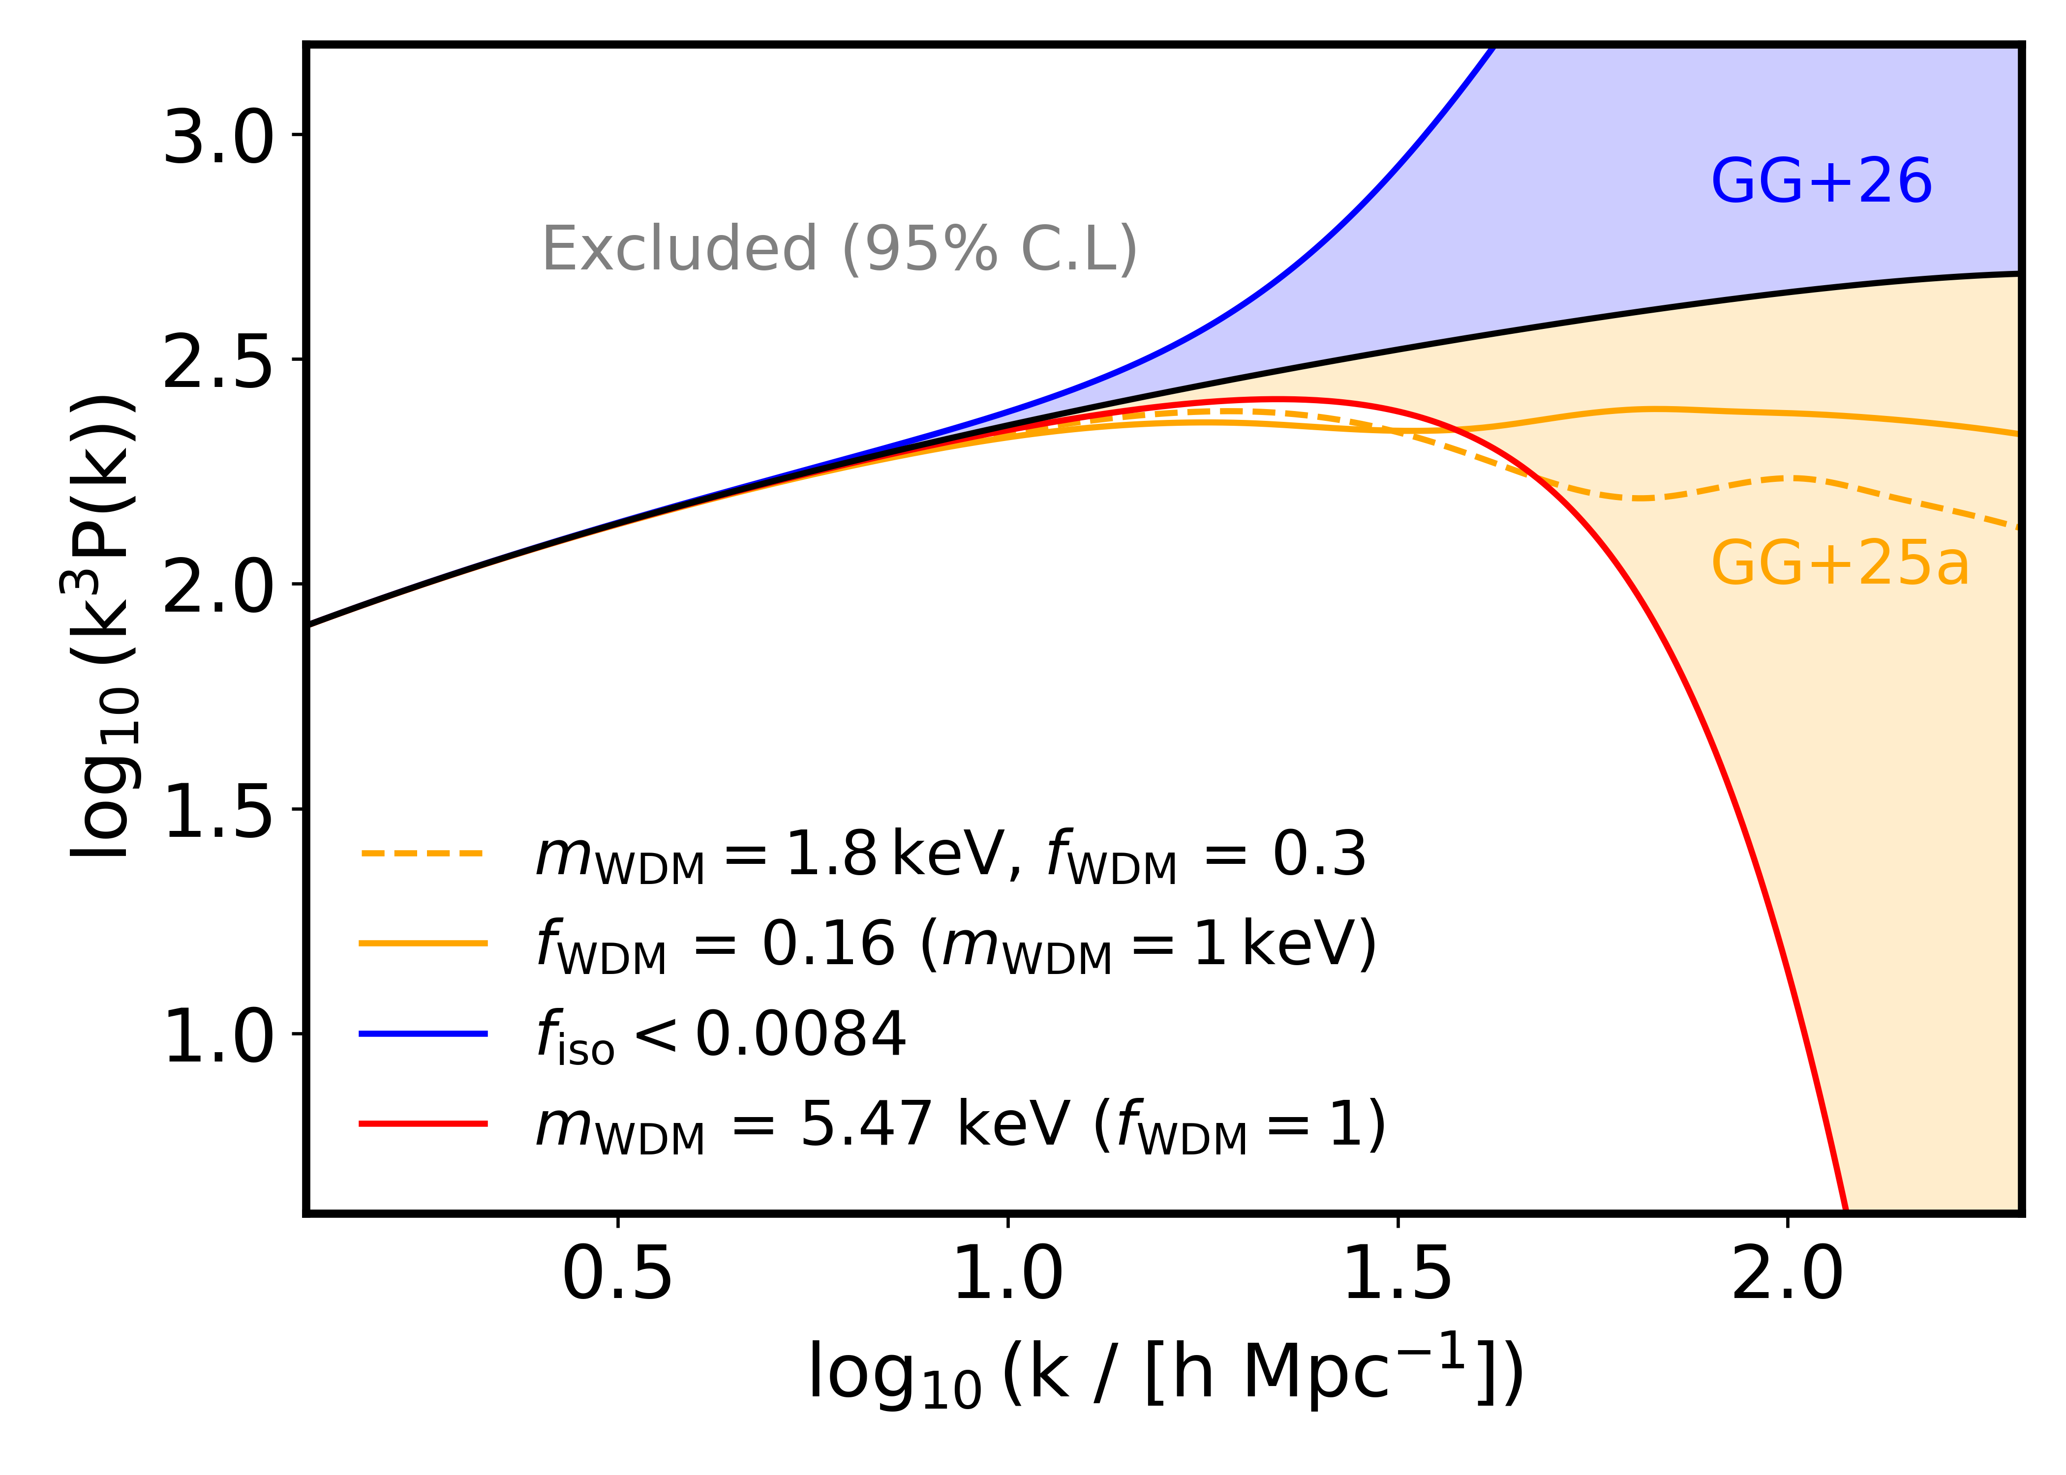
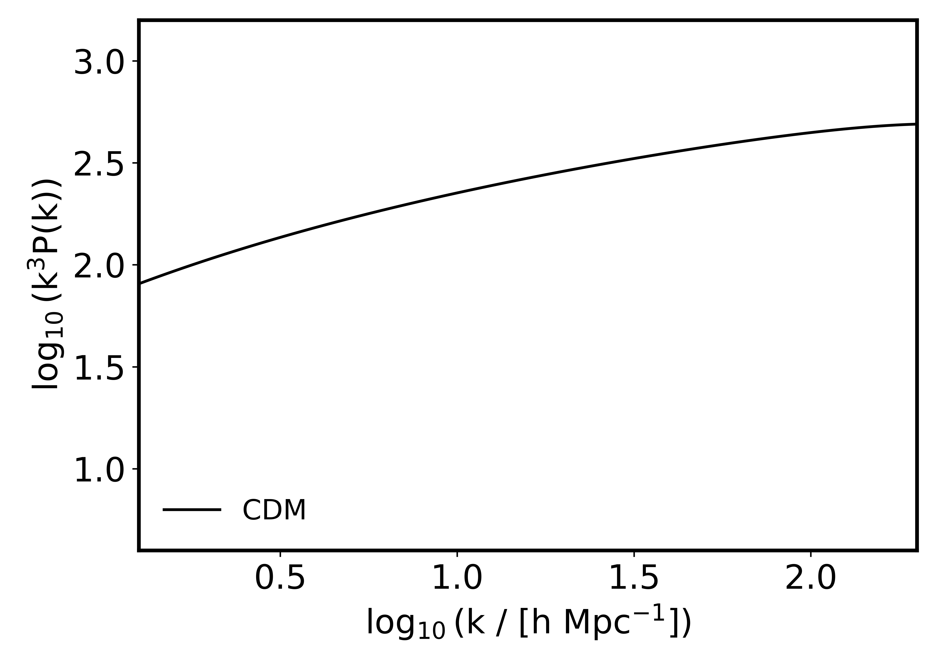
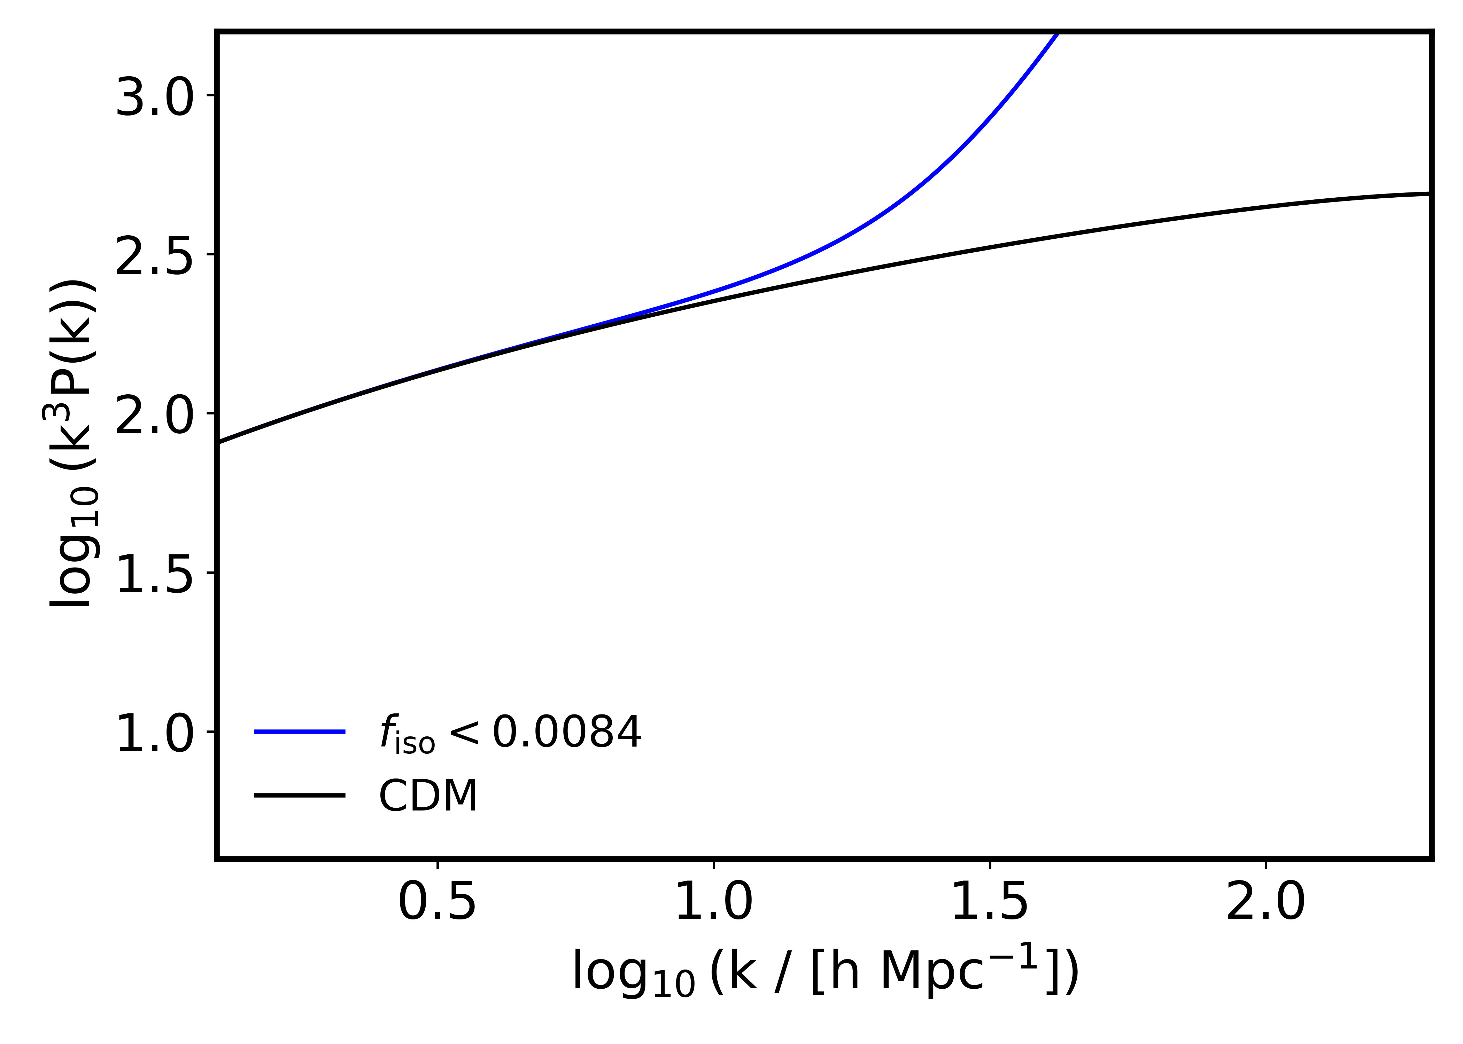
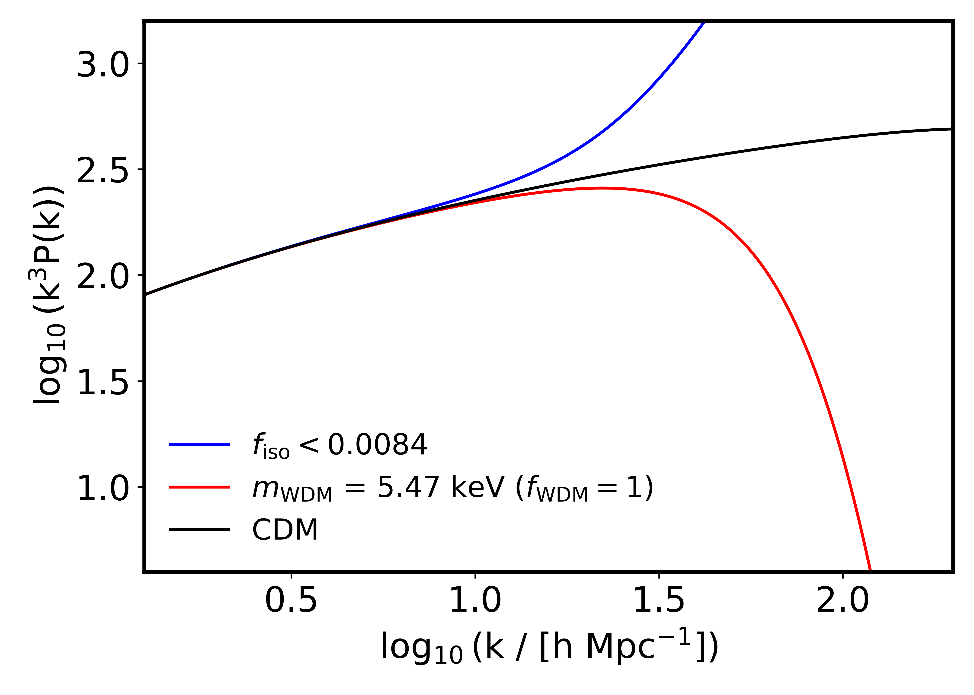
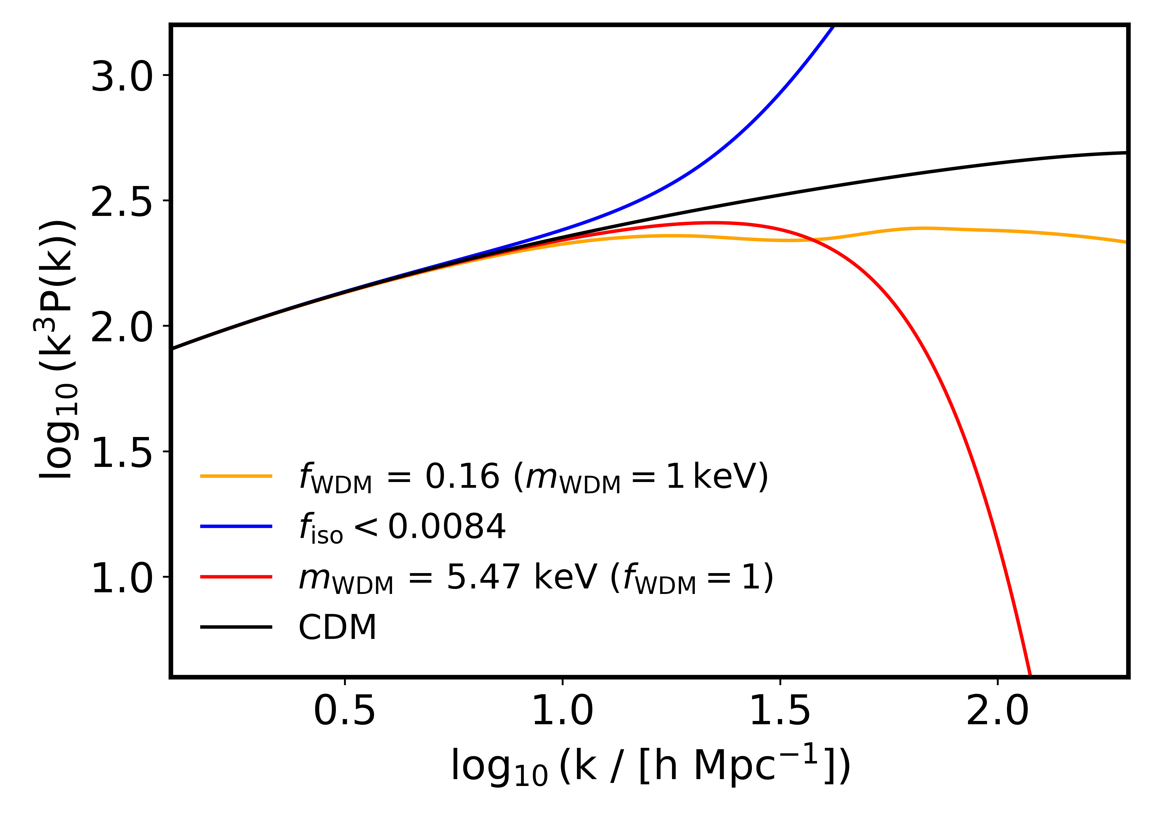
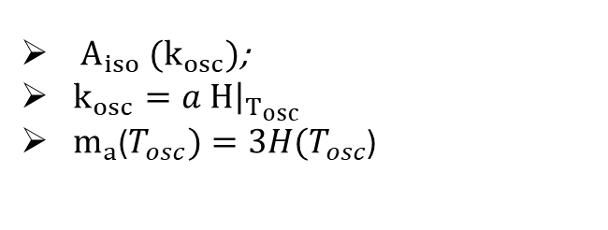
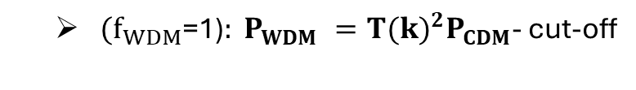
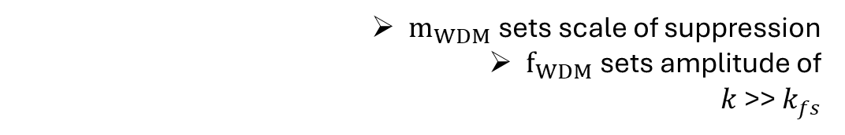

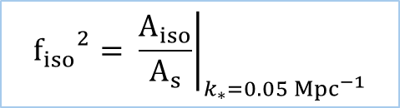
The matter power spectrum
4
$P_{iso} =\frac{2π^{2}}{k^{3}}A_{iso}{\left(\frac{k}{k_{∗}}\right)}^{n_{iso}−1}$; $n_{iso}=4$ ⟶ white noise
Axion-like particles
$A_{iso} (k_{osc})$;
$k_{osc}=a {\left.H\right|}_{T_{osc}}$
$m_{a}$($T_{osc})=3H(T_{osc}$)
$${f_{iso}}^{2}= {\left.\frac{A_{iso}}{A_{s}}\right|}_{k_{∗}=0.05 {Mpc}^{−1}}$$
CWDM
$(f_{WDM}$=1)$: P_{WDM} ={T(k)}^{2}P_{CDM}$- cut-off
$m_{WDM}$sets scale of suppression
$f_{WDM}$sets amplitude of
$k$>> $k_{fs}$
Results
Motivation
Results
Motivation
Introduction
Background
Background
Method
Method
Method
Method
Summary
Results
Summary
Results
Summary
Background
Summary
Motivation
Background
1
Notes:
Matter power spectrum at z=0, multiplied by k^3 to yield the variance per lnk bin.
In the post-inflationary case that we study, the misalingment angle has uncorrelated values in casually disconnected regions, leading to a white noise power pectrum
ALP density scales with theta and therere
T(k) fit to Boltzmann code

Slide 8
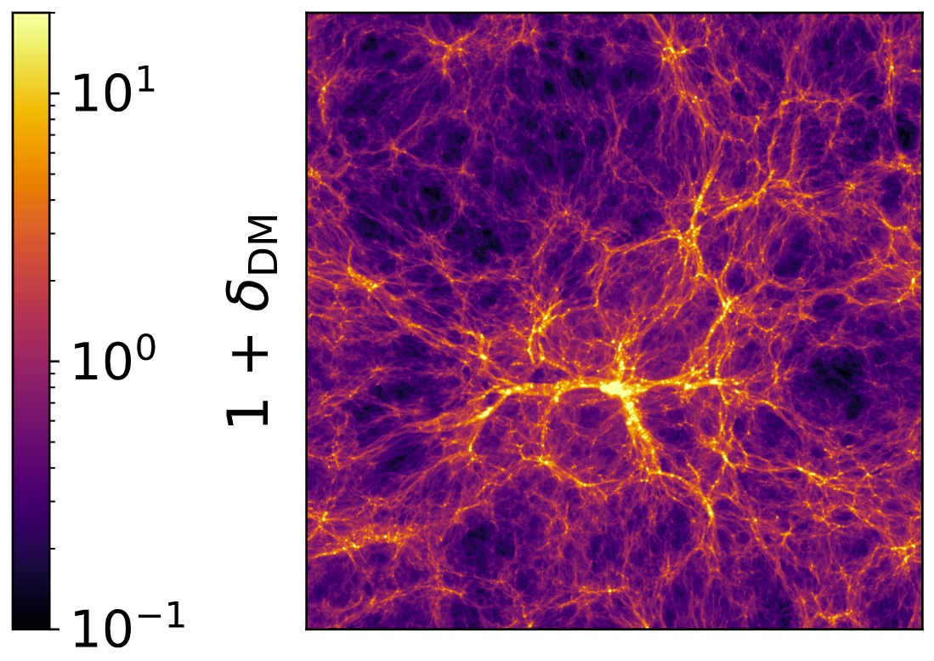
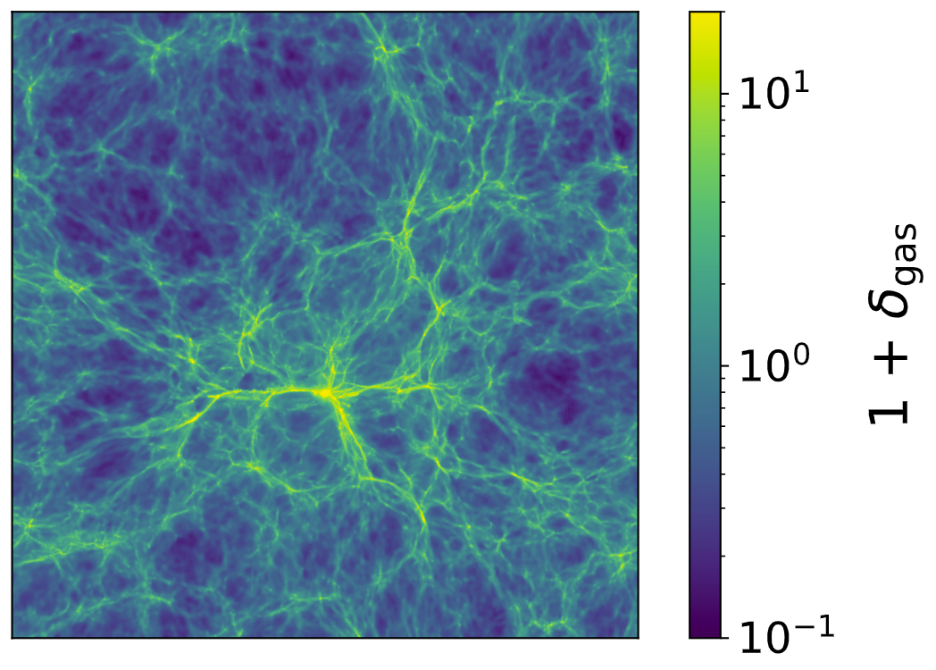
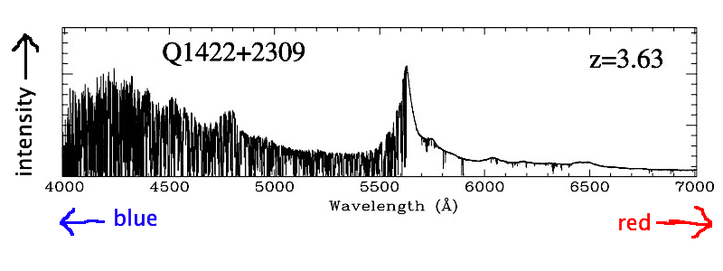


Gas as a proxy of dark matter
5
20 $h^{−1 }Mpc$
Lyman-α flux $F= e^{−τ}$
Optical depth $τ(ρ_{gas},T_{gas},v_{gas})$
Results
Motivation
Results
Motivation
Introduction
Background
Background
Method
Method
Method
Method
Summary
Results
Summary
Results
Summary
Background
Summary
Motivation
Background
1
Notes:
The same two dimensional slide is now shown for the projected gas density field
We can use the Most of this gas is made up of neutral hydrogen, and that contained in voids and filaments so overdensities of order 1 gives rise to the Lyman-alpha forest, a series of lines observed in quasar spectra that appear when the light from distant quasar intersects this neutral hydrogen along the LOS. This is how the Lyman-alpha fores tan be used as a tracer of dark matter.
What we observe if the flux from these quasars and we characterize it through the optical depth tau, which are related through a non-linear transformation.
Tau therefore provides a nonlinear map of the gas overdensity but it also depends on the temperature of the gas (through thermla broadening) and on the velocity of the gas.
The baryon distribution is slightly more diffused due to the smoothing effect of the gas pressure

Slide 9
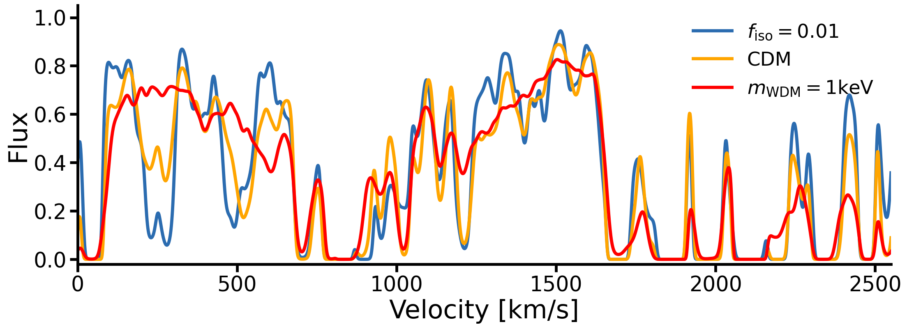
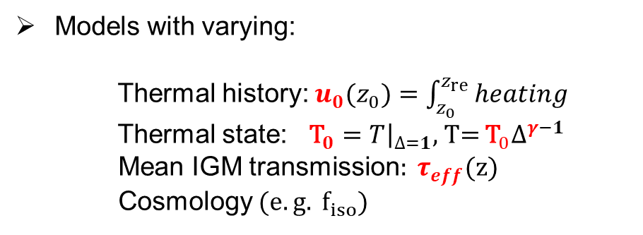

Simulations: Sherwood-Relics suite
6
$λ_{obs}=$ 1215.67$(1+z_{α})Å$
Hydrodynamical simulations of the IGM with the P-Gadget3 code (uniform UV background + patchy reionization).
Puchwein+2019
Puchwein+2023
Output: Lyman-α forest skewers ⟶ Flux distribution:
Models with varying:
Thermal history: $u_{0}(z_{0})=\int_{z_{0}}^{z_{re}}{heating}$
Thermal state: ${\text{T}}_{0}={\left.T\right|}_{∆=1}$, T= ${\text{T}}_{0}∆^{γ−1}$
Mean IGM transmission$: τ_{eff}(z)$
Cosmology ($e.g. f_{iso}$)
Results
Motivation
Results
Motivation
Introduction
Background
Background
Method
Method
Method
Method
Method
Summary
Results
Summary
Results
Results
Summary
Summary
Background
Summary
Background
Motivation
Background
Motivation

Slide 10
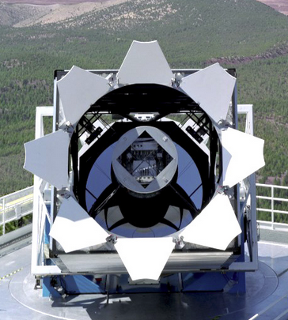
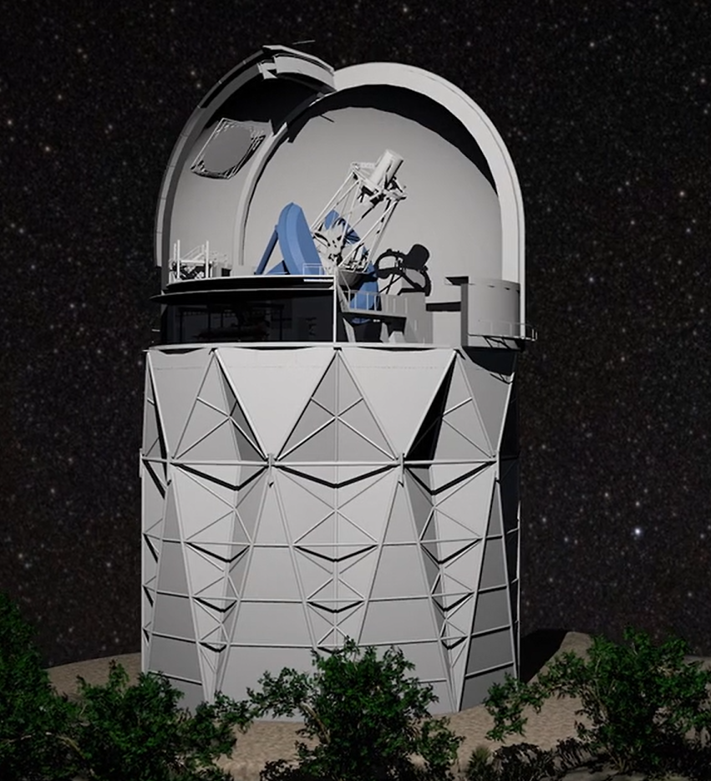
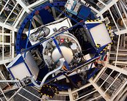
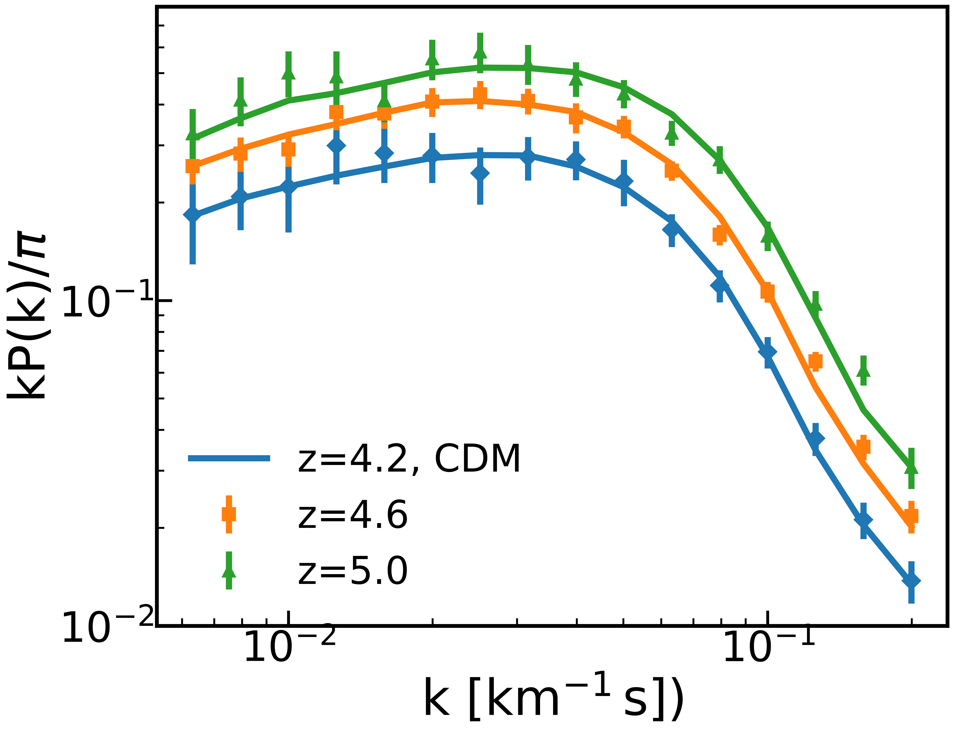
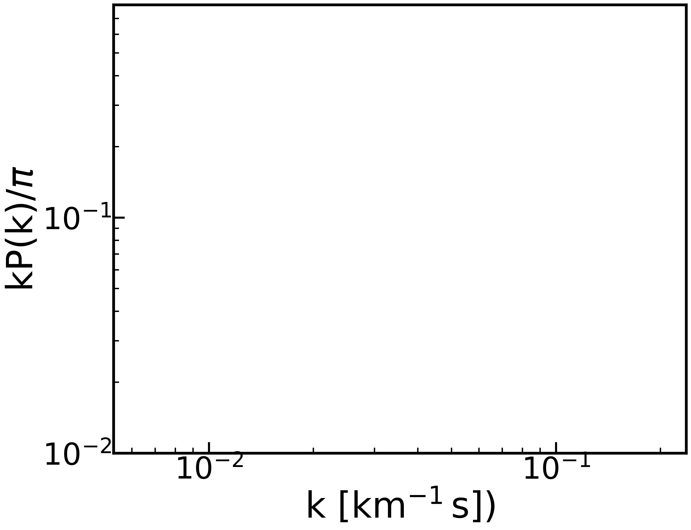
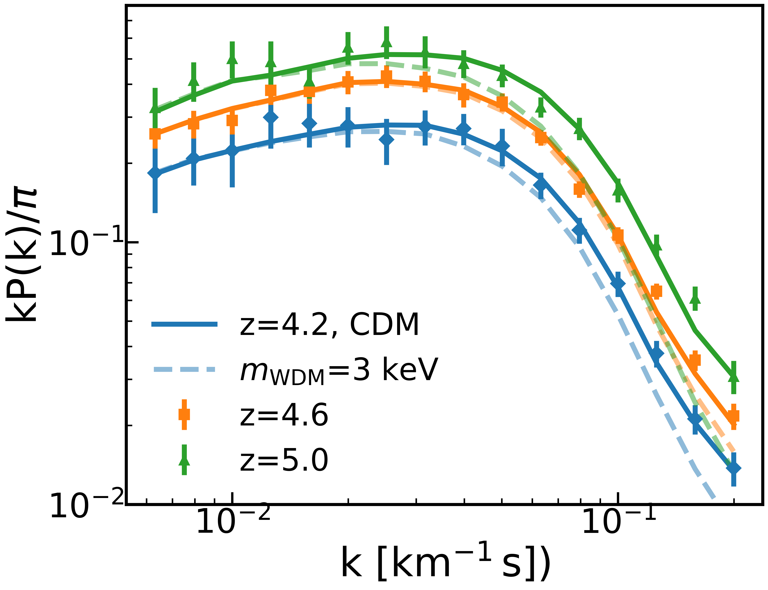
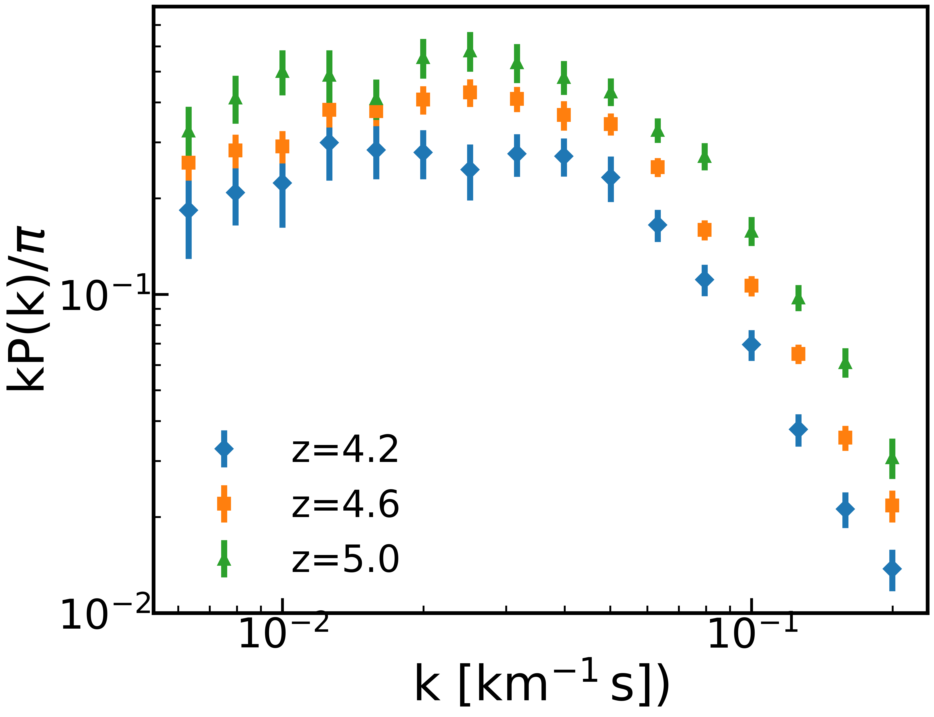
The 1D Lyman-α forest flux power spectrum
7
Fourier transform along skewers to get synthetic Lyman-α 1D flux power spectrum: $<δ_{F}δ_{F}∗>{\text{=}\text{P}}_{F }$
Compare against data from HIRES (Keck) and UVES (VLT) spectrographs:
Boera+2019
$k_{max}=0.2 s/km$ (or 20 $h/Mpc)$
Results
Motivation
Results
Motivation
Introduction
Background
Background
Method
Method
Method
Method
Method
Summary
Results
Summary
Results
Results
Summary
Summary
Background
Summary
Background
Motivation
Background
Motivation

Slide 11
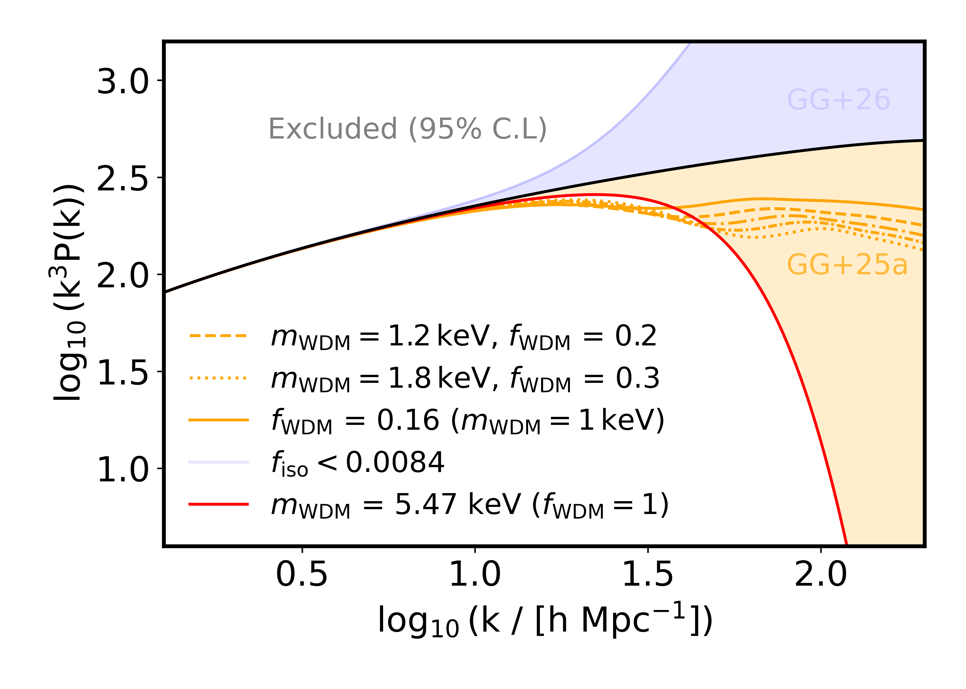
Results – CWDM constraints
8
Results
Motivation
Results
Motivation
Introduction
Background
Background
Method
Method
Method
Method
Method
Summary
Results
Summary
Results
Results
Summary
Summary
Background
Summary
Background
Motivation
Background
Motivation

Slide 12
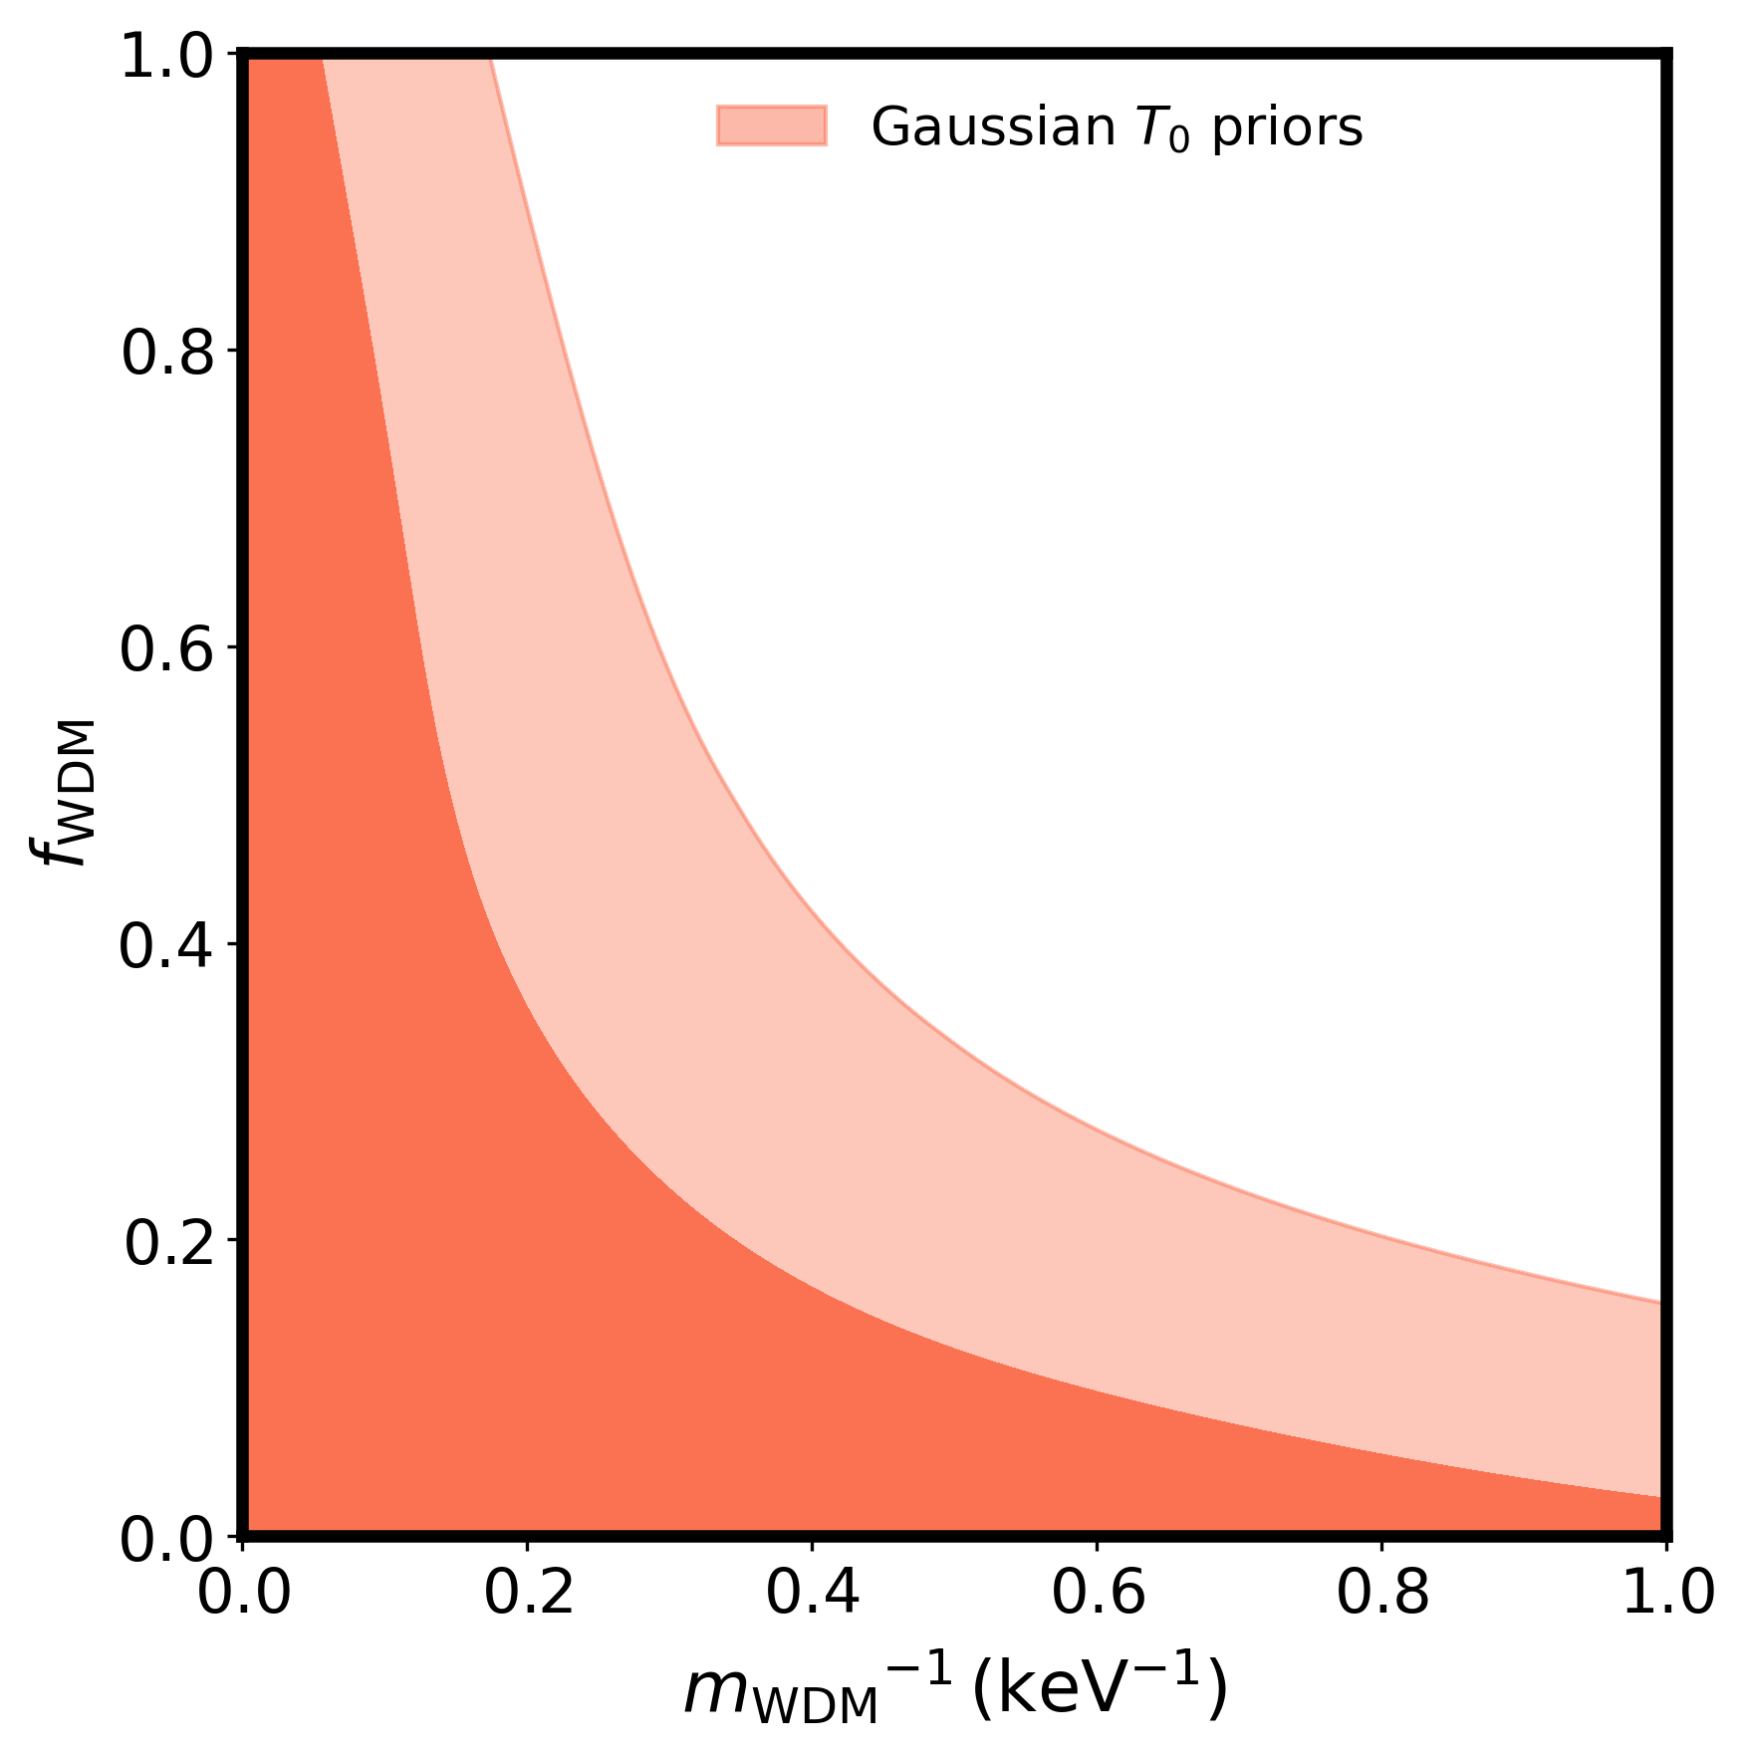
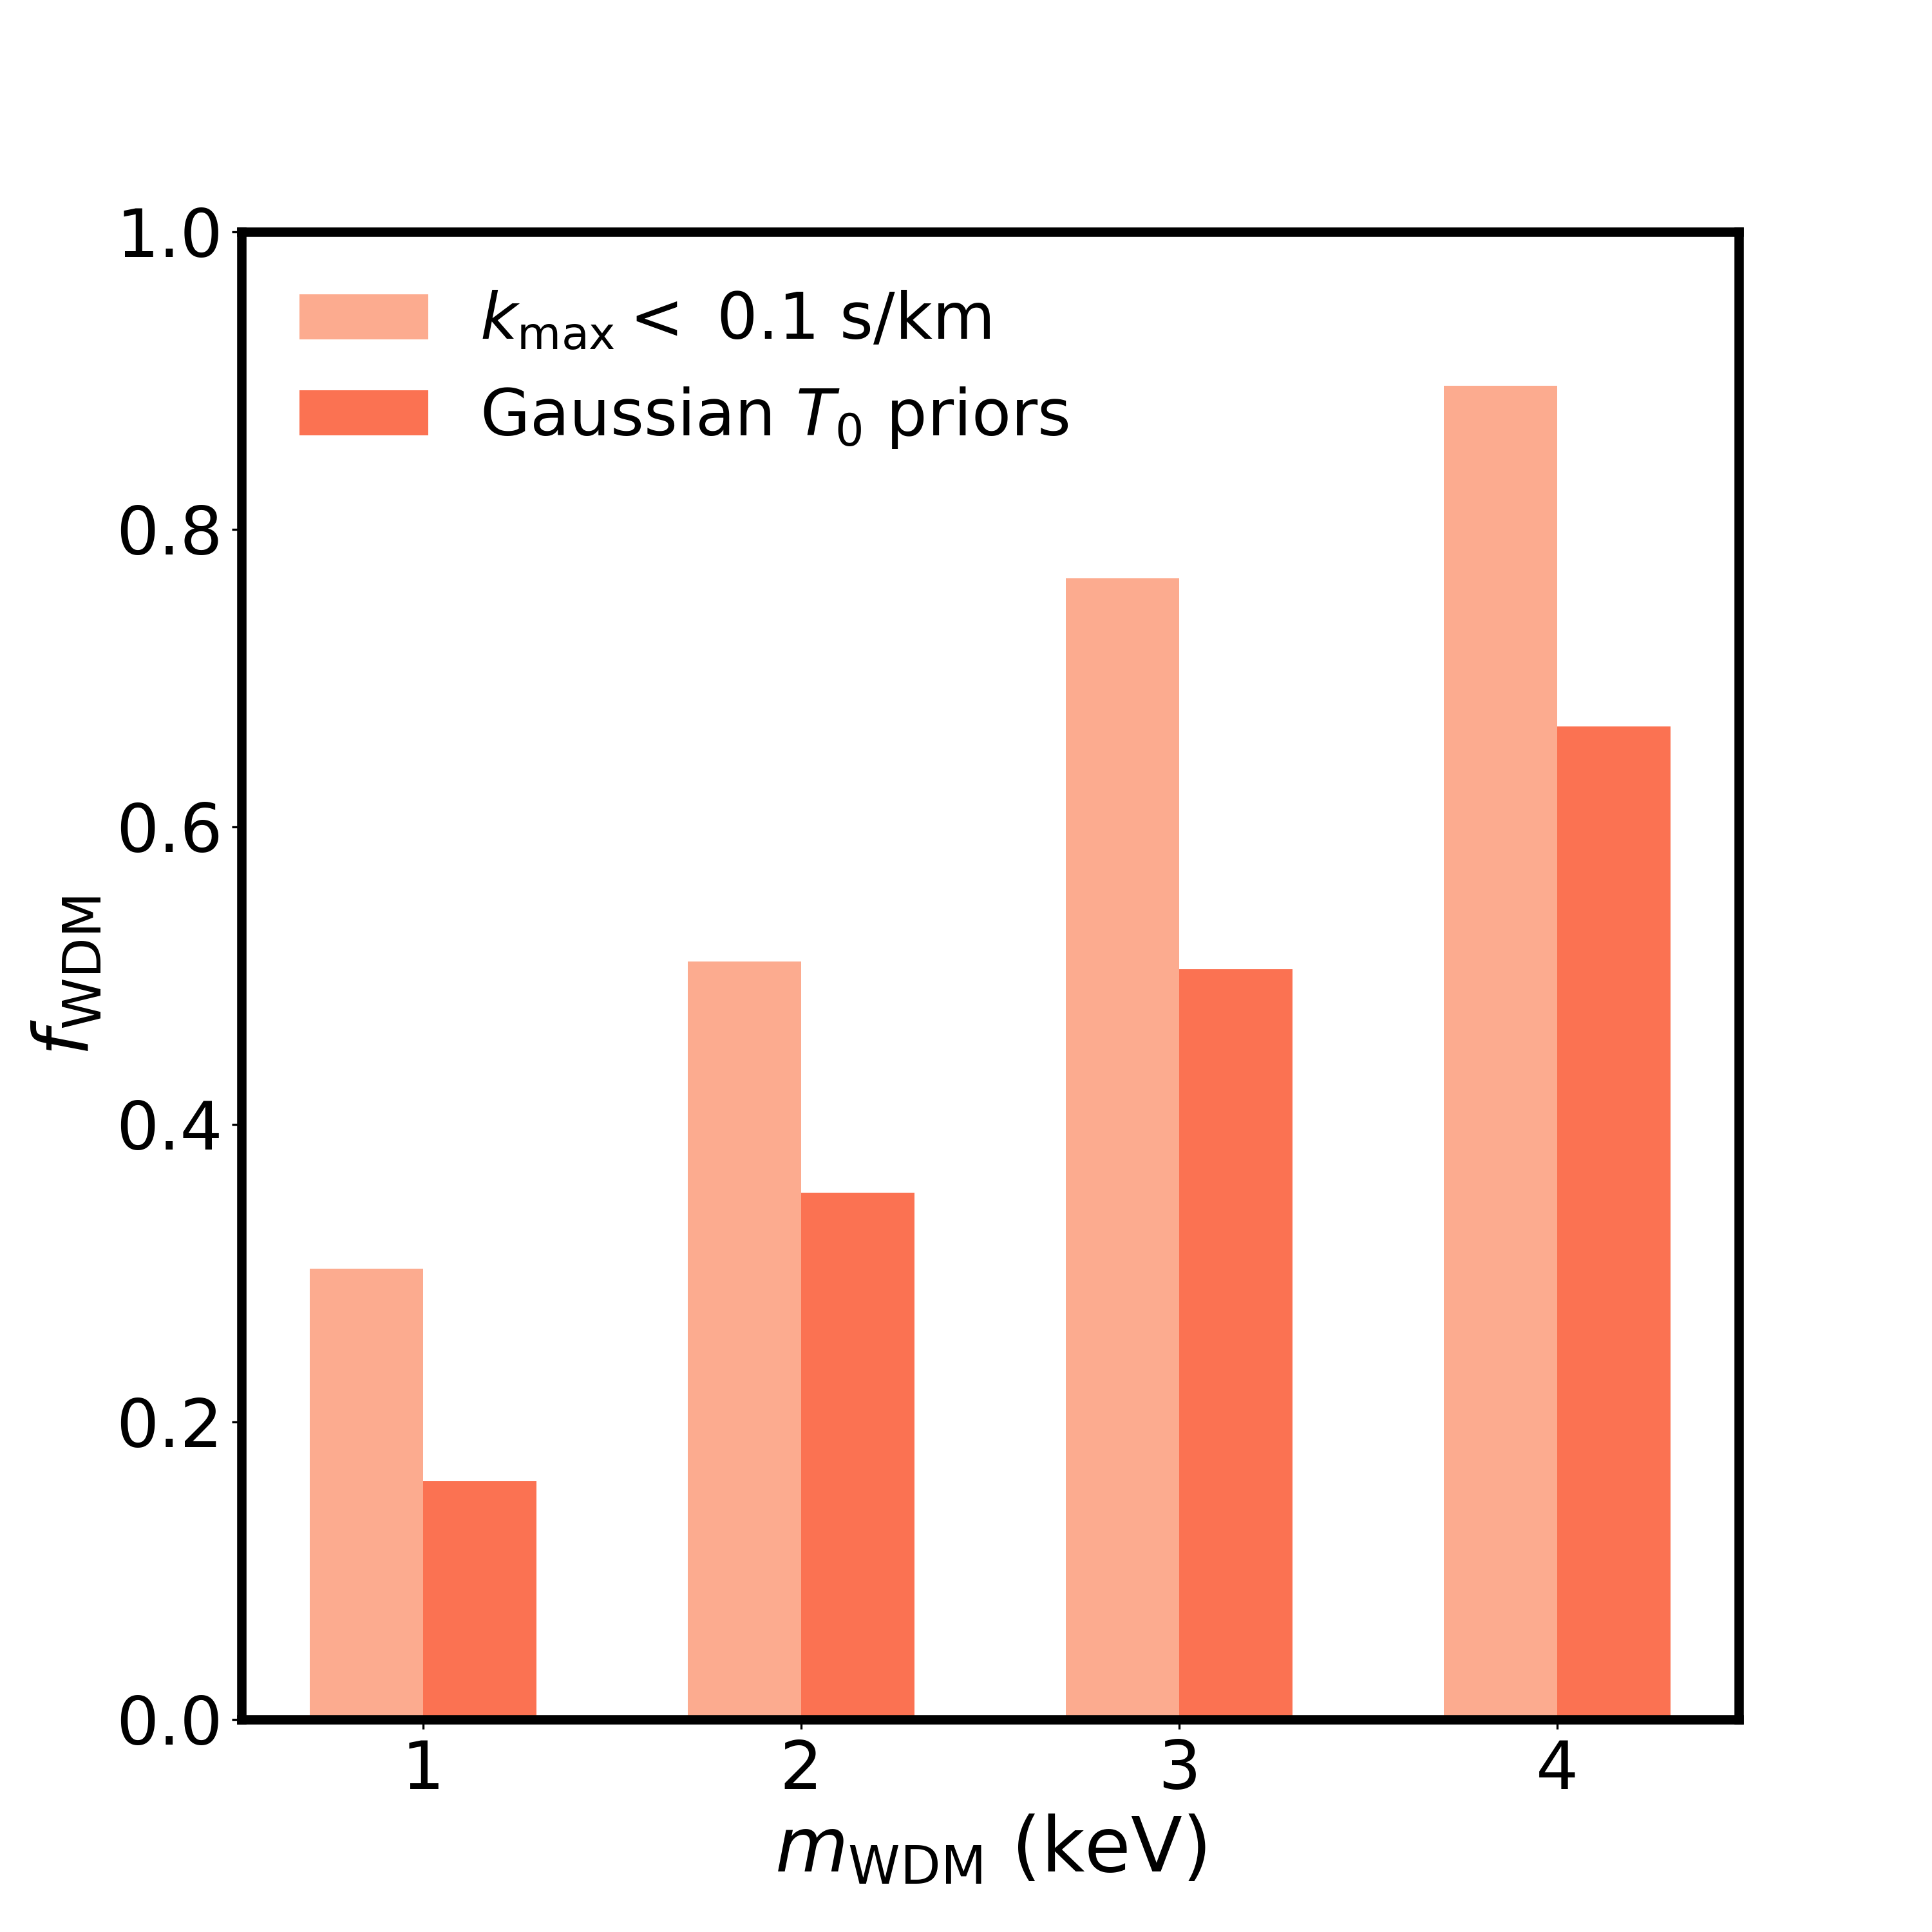
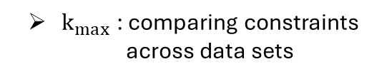
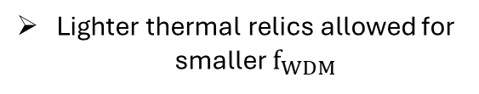
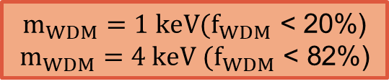


Results – CWDM constraints
9
IGM thermal state: ${\text{T}}_{0}={\left.T\right|}_{\text{ρ}\text{/}\overline{\text{ρ}}\text{ =1}}$
Gaikwad+2020
Gaikwad+2022
Thermal priors informed by independent $T_{0}(z)$
95% C.L.
$$m_{WDM}=1 keV(f_{WDM}\text{ < 20\%}\text{)}$$
$$m_{WDM}=4 keV (f_{WDM}\text{ < }\text{82}\text{\%)}$$
CDM
Lighter thermal relics allowed for smaller $f_{WDM}$
$k_{max}$ : comparing constraints across data sets
$m_{WDM}<3.67 keV \left(f_{WDM}=1\right)$ HIRES/UVES
c.f. $m_{WDM}<2.1 keV$ (Irsic+17, MIKE/HIRES)
Summary
Summary
Results
Motivation
Results
Motivation
Introduction
Background
Background
Method
Method
Method
Method
Method
Summary
Results
Summary
Results
Background
Results
Summary
Background
Motivation
Background
Motivation

Slide 13
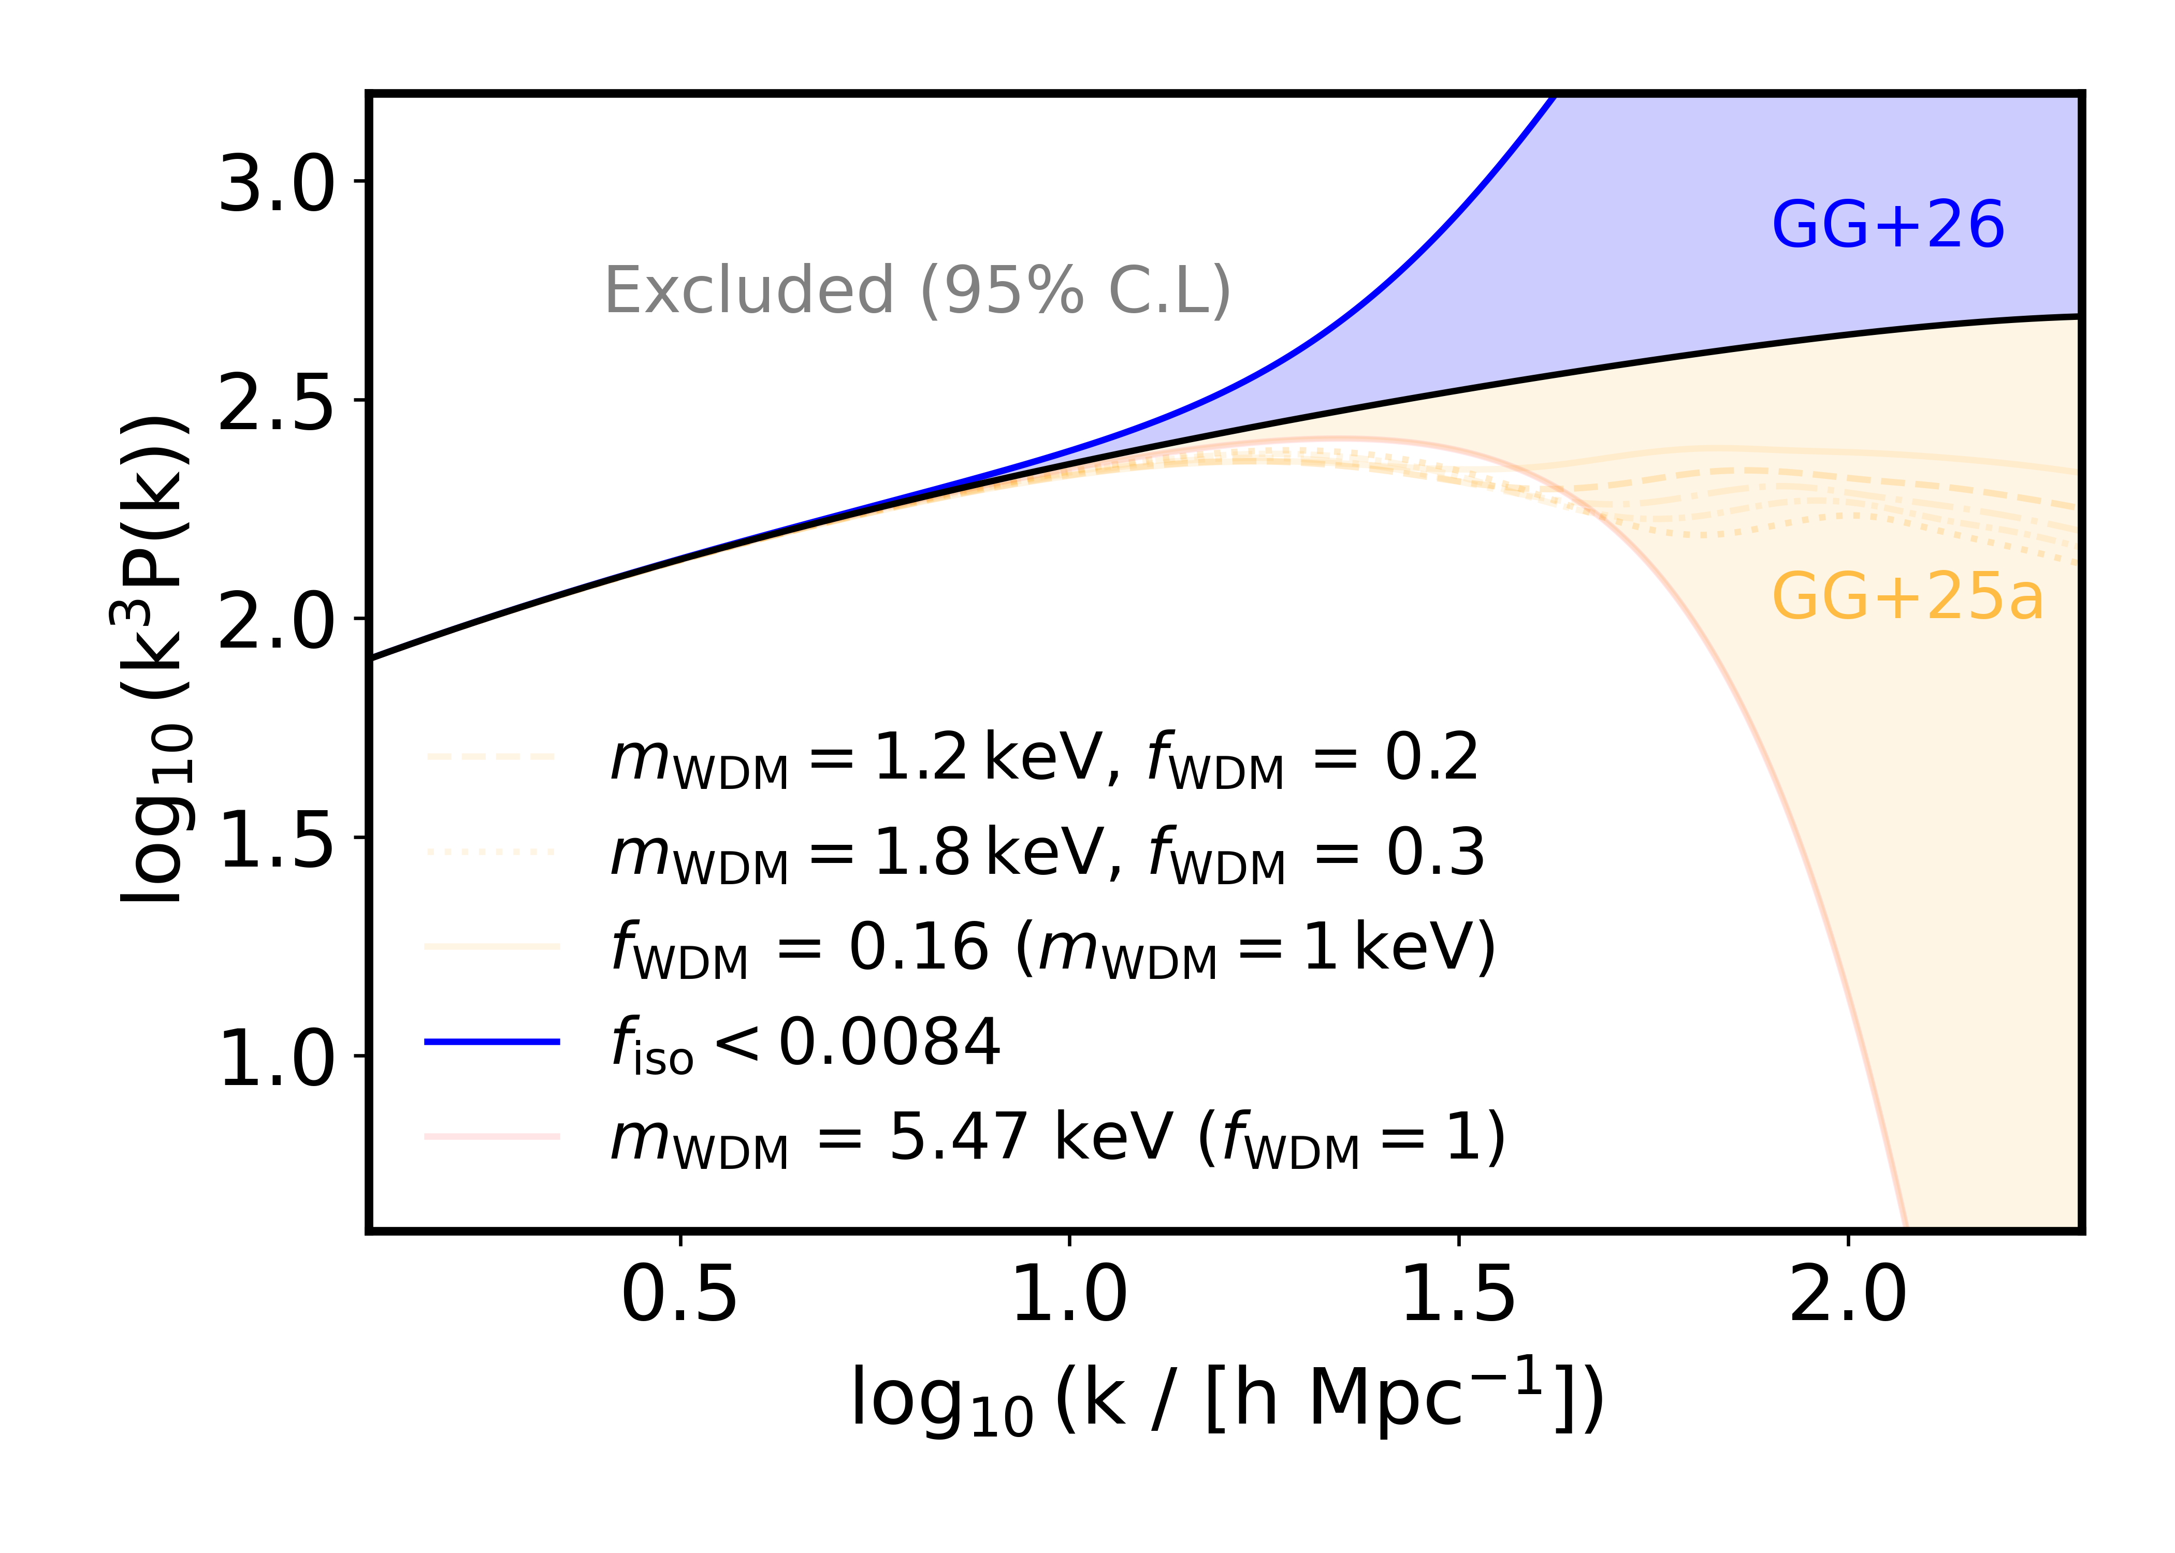
Results – Isocurvature constraints
10
Results
Motivation
Results
Motivation
Introduction
Background
Background
Method
Method
Method
Method
Method
Summary
Results
Summary
Results
Results
Summary
Summary
Background
Summary
Background
Motivation
Background
Motivation

Slide 14
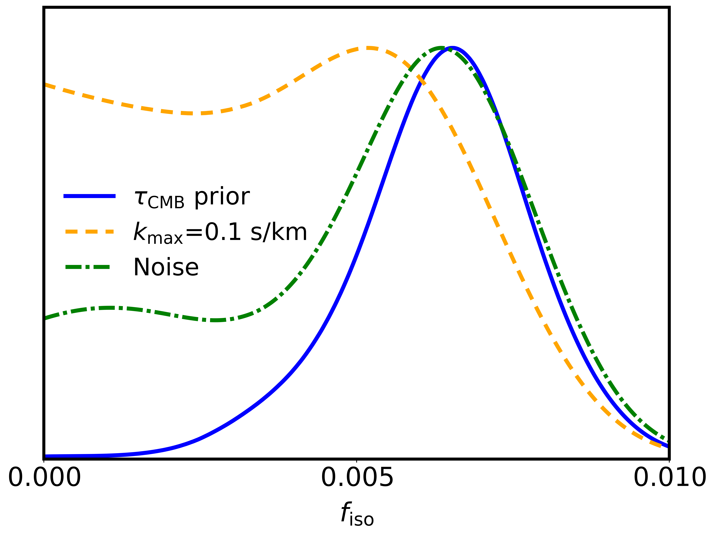
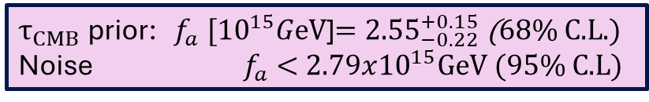

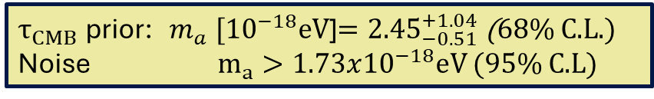
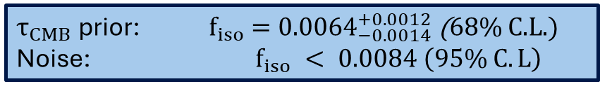
Results – Isocurvature constraints
11
Informative thermal priors from $τ_{CMB}$on a combination of ionization and thermal histories.
$${f_{iso}}^{2}= {\left.\frac{A_{iso}}{A_{s}}\right|}_{k_{∗}=0.05 {Mpc}^{−1}}$$
$τ_{CMB}$ prior: ${ f}_{iso} ={0.0064}_{−0.0014}^{+0.0012}$ (68% C.L.)
Noise: $f_{iso} < 0.0084 \left(95\% C.L\right)$
Default analysis excludes CDM at 3.6σ
Map constraints to $m_{a}: f_{iso}⟵(m_{a},f_{a})$
Temperature-independent mass
$τ_{CMB}$ prior: ${ m}_{a} [{10}^{−18}\text{eV}$]$={2.45}_{−0.51}^{+1.04}$ (68% C.L.)
Noise $m_{a}>1.73x{10}^{−18}eV$(95% C.L)
$τ_{CMB}$ prior: ${ f}_{a} [{10}^{15}G\text{eV}$]$={2.55}_{−0.22}^{+0.15}$ (68% C.L.)
Noise ${ f}_{a} <2.79x{10}^{15}GeV$(95% C.L)
CDM
Summary
Summary
Results
Motivation
Results
Motivation
Introduction
Background
Background
Method
Method
Method
Method
Method
Method
Summary
Results
Summary
Results
Results
Results
Summary
Background
Summary
Background
Background
Motivation
Background
Motivation
Motivation

Slide 15
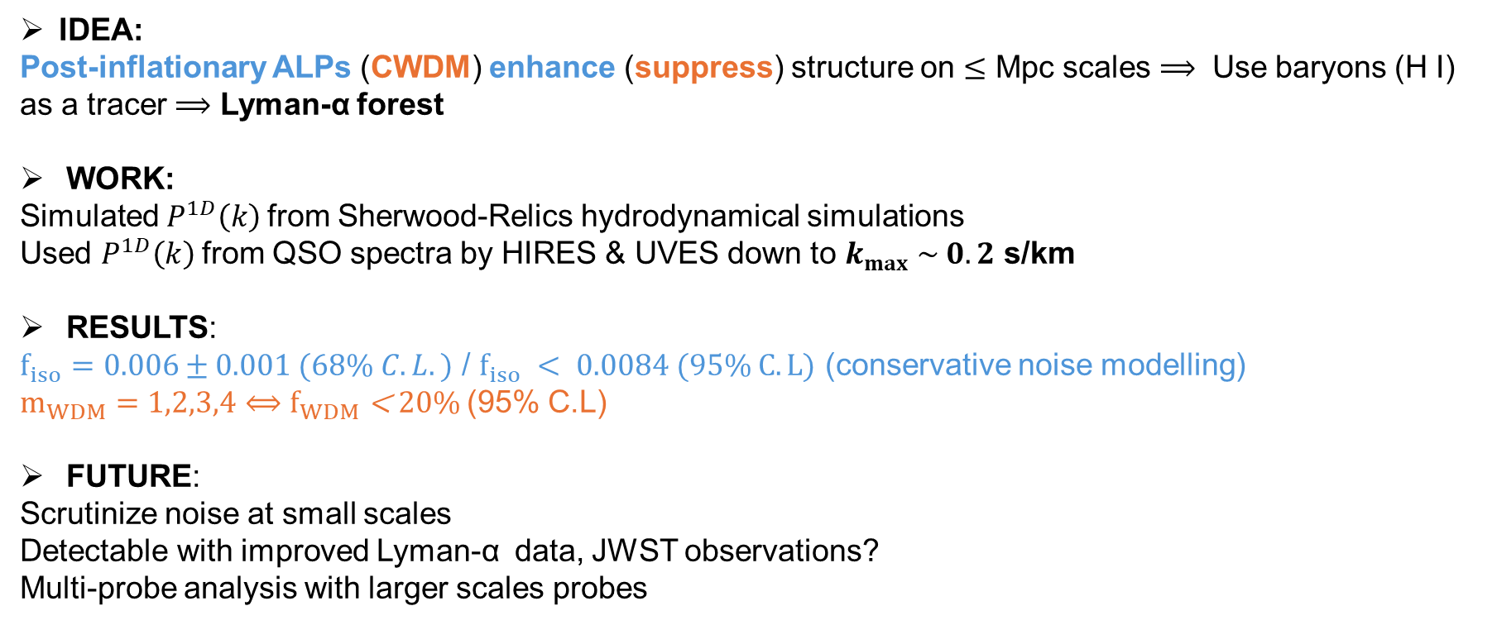
Summary
12
IDEA:
Post-inflationary ALPs (CWDM) enhance (suppress) structure on $≤$ Mpc scales $⟹$ Use baryons (H I) as a tracer $⟹$ Lyman-α forest
WORK:
Simulated $P^{1D}\left(k\right)$from Sherwood-Relics hydrodynamical simulations
Used $P^{1D}\left(k\right)$from QSO spectra by HIRES & UVES down to $k_{max} \sim 0.2$ s/km
RESULTS:
$f_{iso}=0.006±0.001 (68\% C.L.)$ / $f_{iso} < 0.0084 (95\% C.L)$ (conservative noise modelling)
$m_{WDM}=1,2,3,4⟺f_{WDM}\text{ < }\text{20\%}$ (95% C.L)
FUTURE:
Scrutinize noise at small scales
Detectable with improved Lyman-α data, JWST observations?
Multi-probe analysis with larger scales probes
Summary
Summary
Results
Motivation
Results
Motivation
Introduction
Background
Background
Method
Method
Method
Method
Method
Method
Summary
Results
Summary
Results
Results
Results
Summary
Background
Summary
Background
Background
Motivation
Background
Motivation
Motivation

Slide 16
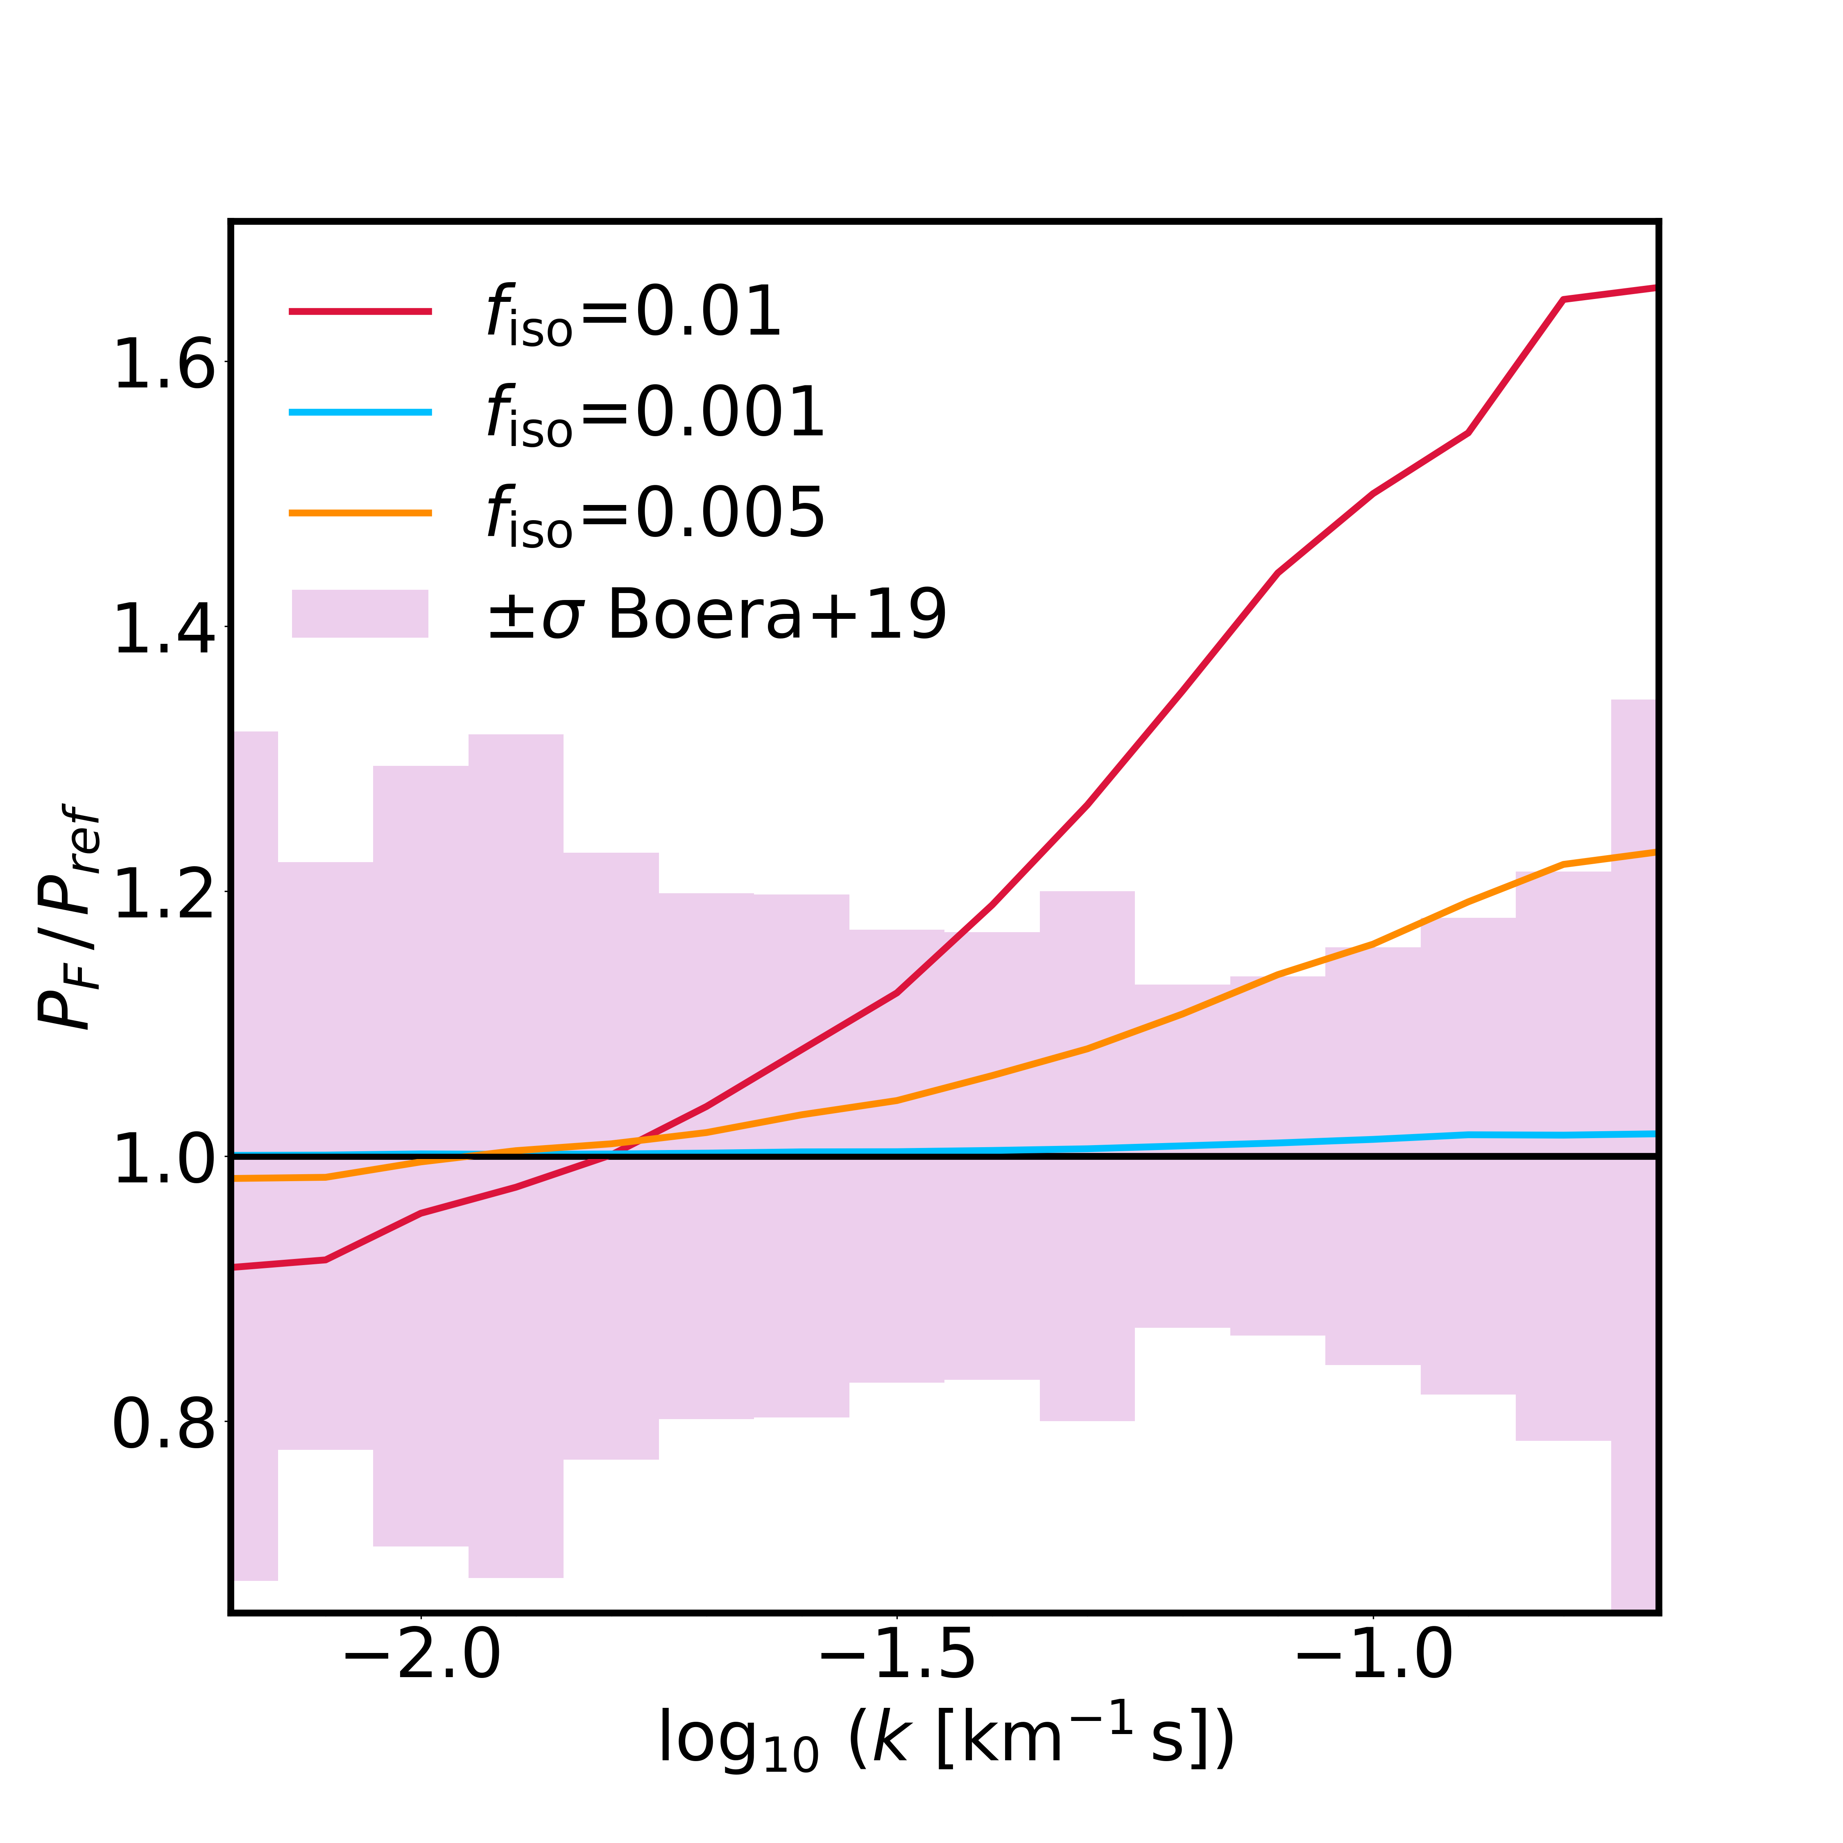
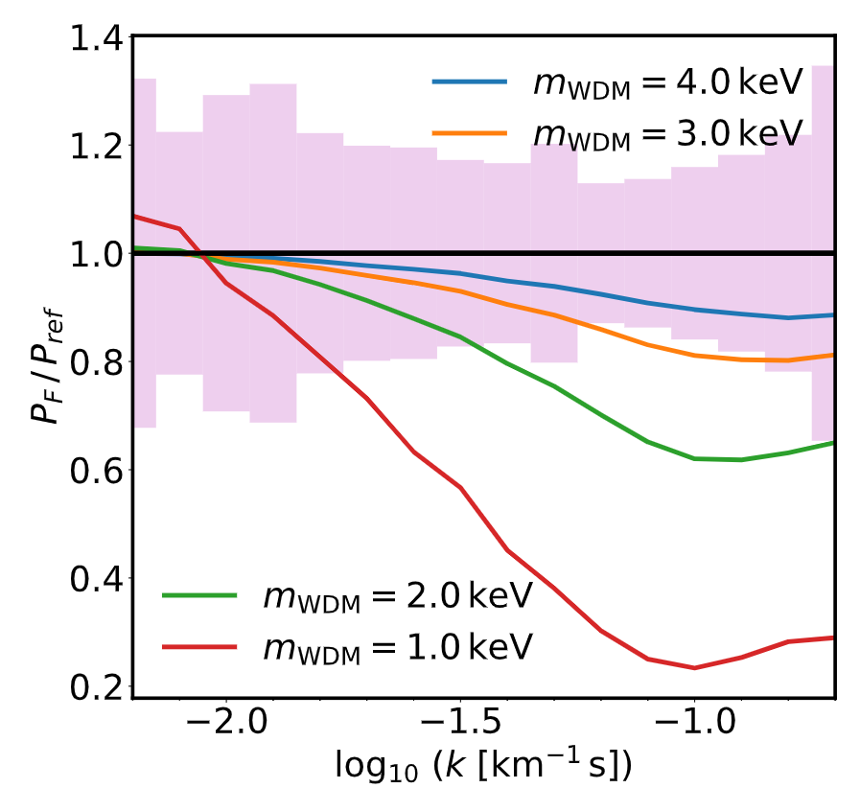


The 1D Lyman-α forest flux power spectrum
Models defined over a 14D grid: ($T_{0}$(z), $u_{0}$(z), $γ$(z), $τ_{eff}(z)$) x 3 z-bins
+ cosmological parameters ${(e.g. m}_{WDM})$
z=4.2
$${f_{iso}}^{2}= {\left.\frac{A_{iso}}{A_{s}}\right|}_{k_{∗}=0.05 {Mpc}^{−1}}$$
$λ_{fs}∝{m_{WDM}}^{−1}$
Results
Motivation
Results
Motivation
Introduction
Background
Background
Method
Method
Method
Method
Method
Summary
Results
Summary
Results
Results
Summary
Summary
Background
Summary
Background
Motivation
Background
Motivation

Slide 17
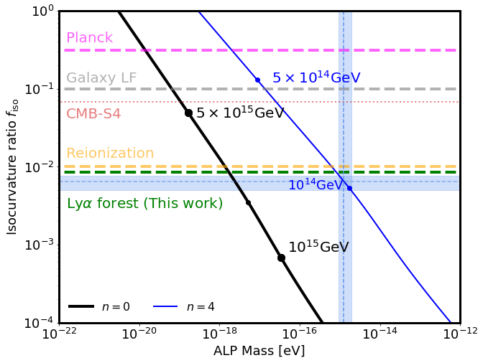

Equations
$$f_{iso}⟵k_{osc}⟵(f_{a},T_{osc})⟵(m_{a}, n)$$
Axion field: $θ= φ/f_{a}$
Early axion mass evolution ⟶temperature dependence ⟹ $m_{a}∝ T^{−n}$
$m_{a}\left(T\right)$= $m_{a}$ ${\left(\frac{\text{Λ}}{T}\right)}^{n}$T > $\text{Λ}$
$m_{a}\left(T\right)$= $m_{a}$ T < $\text{Λ}\text{,}$ where $m_{a}$ =${\text{Λ}}^{2}/f_{a}$
H(T) ~ $\frac{T^{2}}{M_{P}}$
$ρ_{a}$ ~ $f_{a}^{2}$ ⟨${\text{θ}}_{ini}$²⟩ $m_{a}\left(T\right)m_{a}\left({\text{T}}_{osc}\right)$ $T_{osc}^{−3}$
Fixing DM abundance + oscillation condition:
⟹ $T_{osc}\sim f_{a}^{2}$ ⟨${\text{θ}}_{ini}$²⟩ $m_{a}$
$k_{osc}=a {\left.H\right|}_{T_{osc}}$ = $\frac{T_{CMB,0}}{T_{osc}}$ $\frac{m_{a}(T_{osc})}{3}$ ~ $T_{osc}$
$$A_{iso} =A_{osc}{\left(\frac{k_{∗}}{k_{osc}}\right)}^{3}$$
$${f_{iso}}^{2}= {\left.\frac{A_{iso}}{A_{s}}\right|}_{k_{∗}=0.05 {Mpc}^{−1}}$$
Summary
Summary
Results
Motivation
Results
Motivation
Introduction
Background
Background
Method
Method
Method
Method
Method
Method
Summary
Results
Summary
Results
Results
Background
Results
Summary
Background
Background
Motivation
Background
Motivation
Motivation
Notes:
Eliminate Lambda dependence in favour of ma and fa

Slide 18
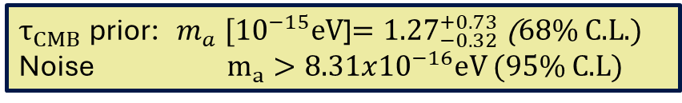
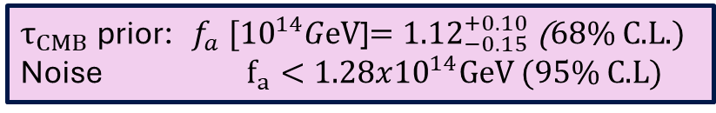
Results – Isocurvature constraints
Informative thermal priors from $τ_{CMB}$on a combination of ionization and thermal histories.
$${f_{iso}}^{2}= {\left.\frac{A_{iso}}{A_{s}}\right|}_{k_{∗}=0.05 {Mpc}^{−1}}$$
$τ_{CMB}$ prior: ${ f}_{iso} ={0.0064}_{−0.0014}^{+0.0012}$ (68% C.L.)
Noise: $f_{iso} < 0.0084 \left(95\% C.L\right)$
Default analysis excludes CDM at 3.6σ
Map constraints to $m_{a}: f_{iso}⟵(m_{a},f_{a})$
Ealy axion mass evolution: $m_{a}∝ T^{−4}$
$τ_{CMB}$ prior: ${ m}_{a} [{10}^{−15}\text{eV}$]$={1.27}_{−0.32}^{+0.73}$ (68% C.L.)
Noise $m_{a}>8.31x{10}^{−16}eV$(95% C.L)
$τ_{CMB}$ prior: ${ f}_{a} [{10}^{14}G\text{eV}$]$={1.12}_{−0.15}^{+0.10}$ (68% C.L.)
Noise $f_{a}<1.28x{10}^{14}GeV$(95% C.L)
CDM
Summary
Summary
Results
Motivation
Results
Motivation
Introduction
Background
Background
Method
Method
Method
Method
Method
Method
Summary
Results
Summary
Results
Results
Results
Summary
Background
Summary
Background
Background
Motivation
Background
Motivation
Motivation

Slide 19
Results – Isocurvature constraints
Priors on thermal history: $u_{0}−T_{0}$ informed by $τ_{CMB}$ from Planck
Summary
Summary
Results
Motivation
Results
Motivation
Introduction
Background
Background
Method
Method
Method
Method
Method
Method
Summary
Results
Summary
Results
Results
Results
Summary
Background
Summary
Background
Background
Motivation
Background
Motivation
Motivation

Slide 20
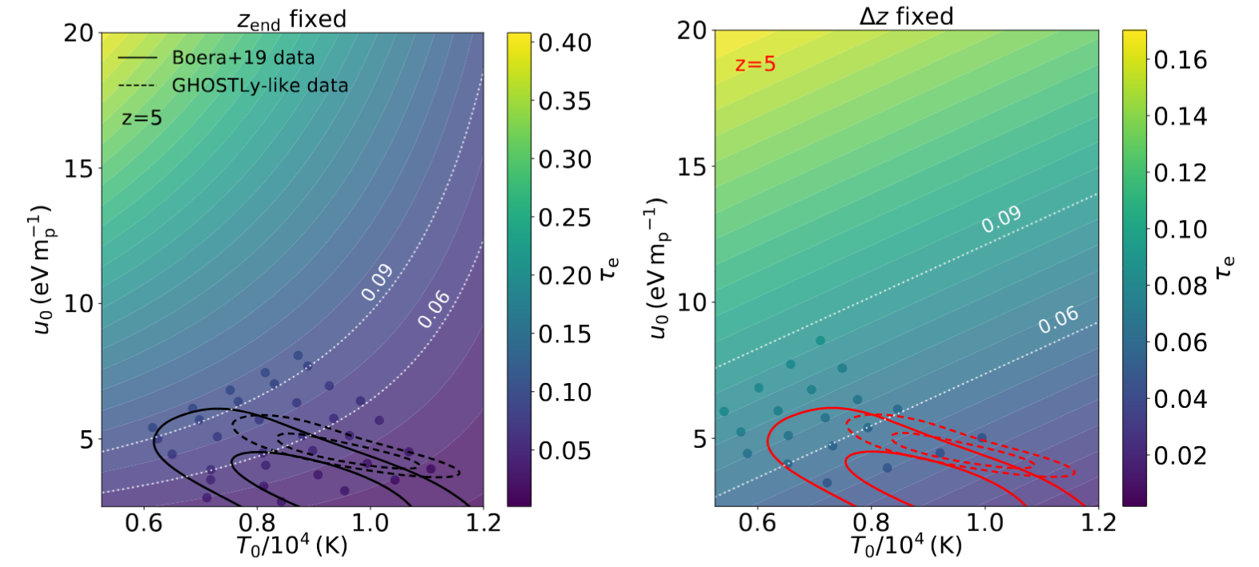


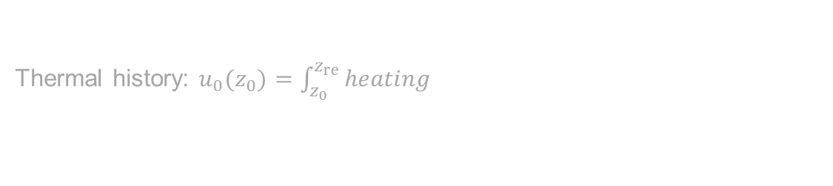


Priors on $u_{0}−T_{0}$ informed by $τ_{CMB}$
Thermal history: $u_{0}(z_{0})=\int_{z_{0}}^{z_{re}}{heating}$
IGM thermal state: ${\text{T}}_{0}={\left.T\right|}_{\text{ρ}\text{/}\overline{\text{ρ}}\text{ =1}}$
$$z_{start}$$
$Δz$
Results
Motivation
Results
Motivation
Introduction
Background
Background
Method
Method
Method
Method
Method
Summary
Results
Summary
Results
Results
Summary
Summary
Background
Summary
Background
Motivation
Background
Motivation

Slide 21
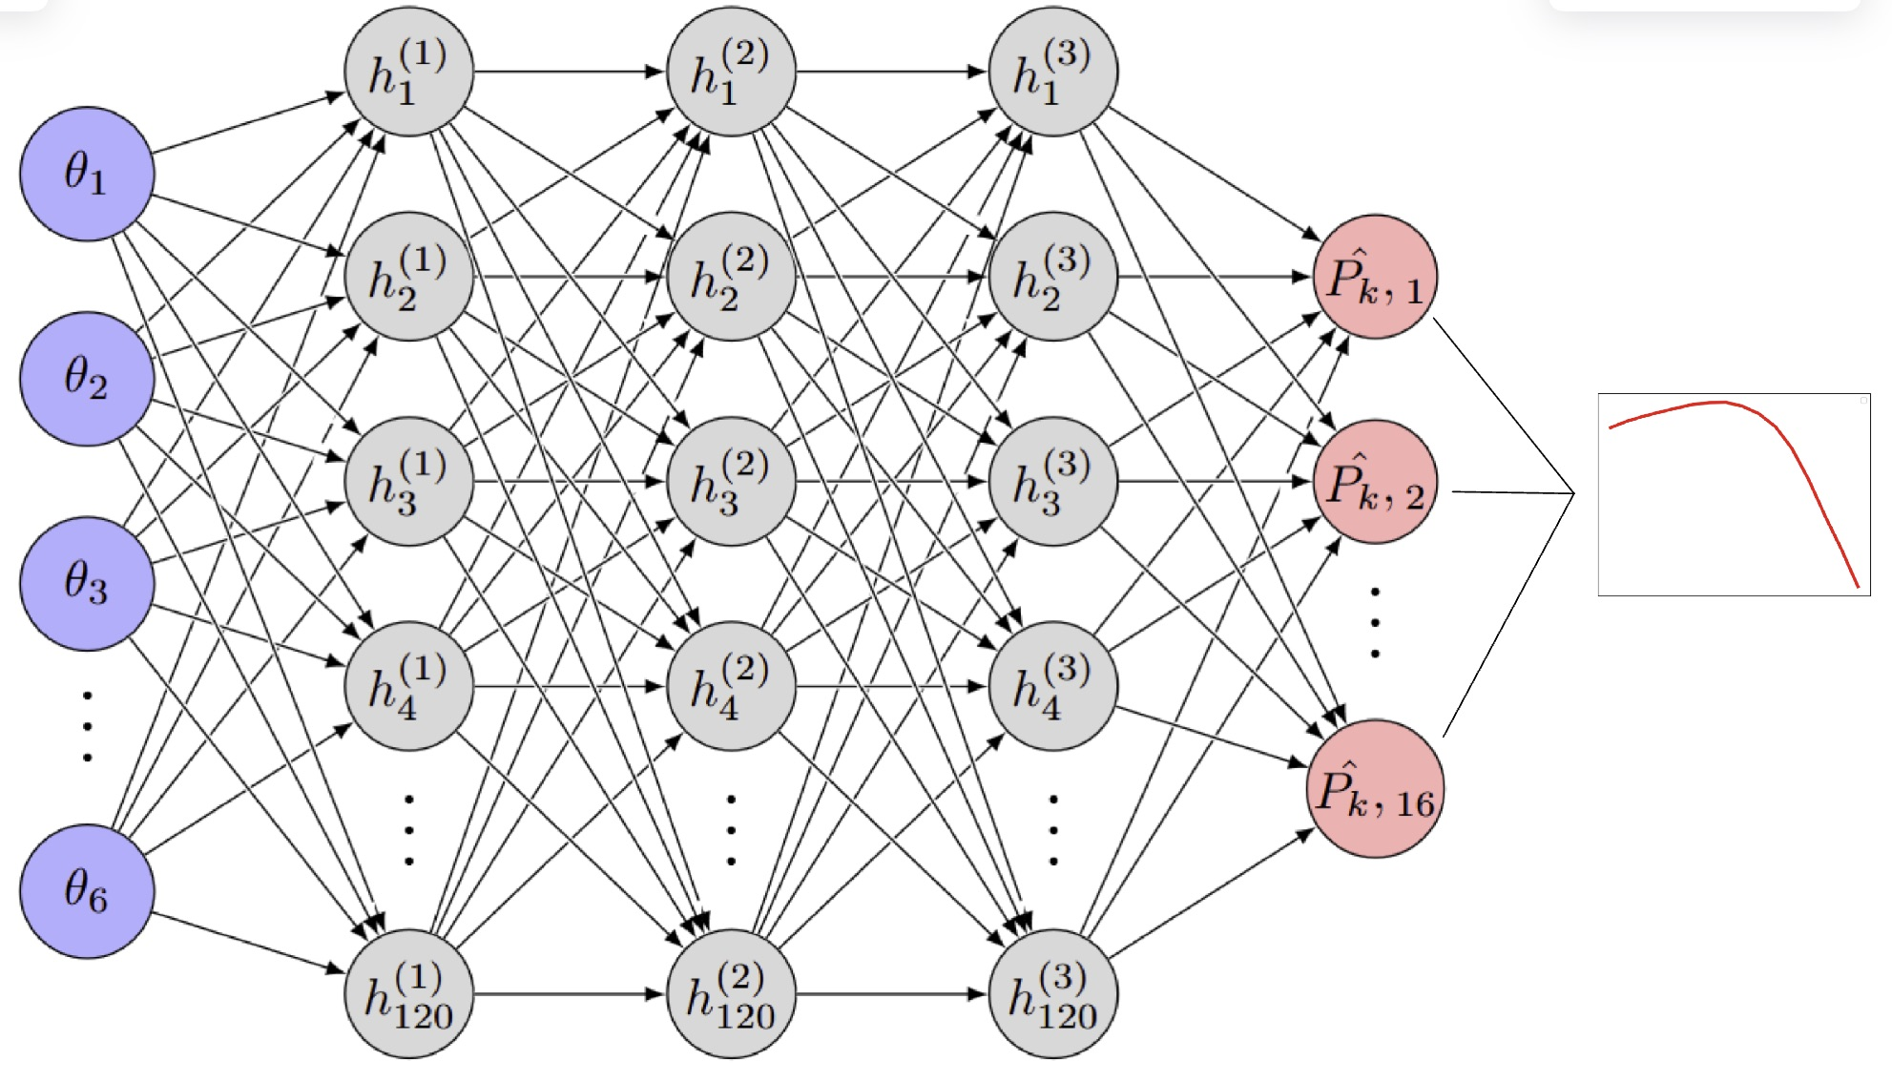

Neural network emulator
Performance on test set (z=4.2)
10 emulators per redshift bin
Summary
Summary
Results
Motivation
Results
Motivation
Introduction
Background
Background
Method
Method
Method
Method
Method
Method
Summary
Results
Summary
Results
Results
Background
Results
Summary
Background
Background
Motivation
Background
Motivation
Motivation
Notes:
Eliminate Lambda dependence in favour of ma and fa

