Slide 1

Cosmologists are often in error, but seldom in doubt. Attributed to Lev Landau.

Slide 2
Cosmologists are often in error, but seldom in doubt. Attributed to Lev Landau.
We are at the cusp of a paradigm change in Cosmology [in reference to ΛCDM]. Heard at a recent cosmology meeting.

Slide 3
Cosmologists are often in error, but seldom in doubt. Attributed to Lev Landau.
We are at the cusp of a paradigm change in Cosmology [in reference to ΛCDM]. Heard at a recent cosmology meeting.
Wow, the data NAILS ΛCDM!. Heard at the same meeting.
Notes:
I want to share with you the excitement.

Slide 4
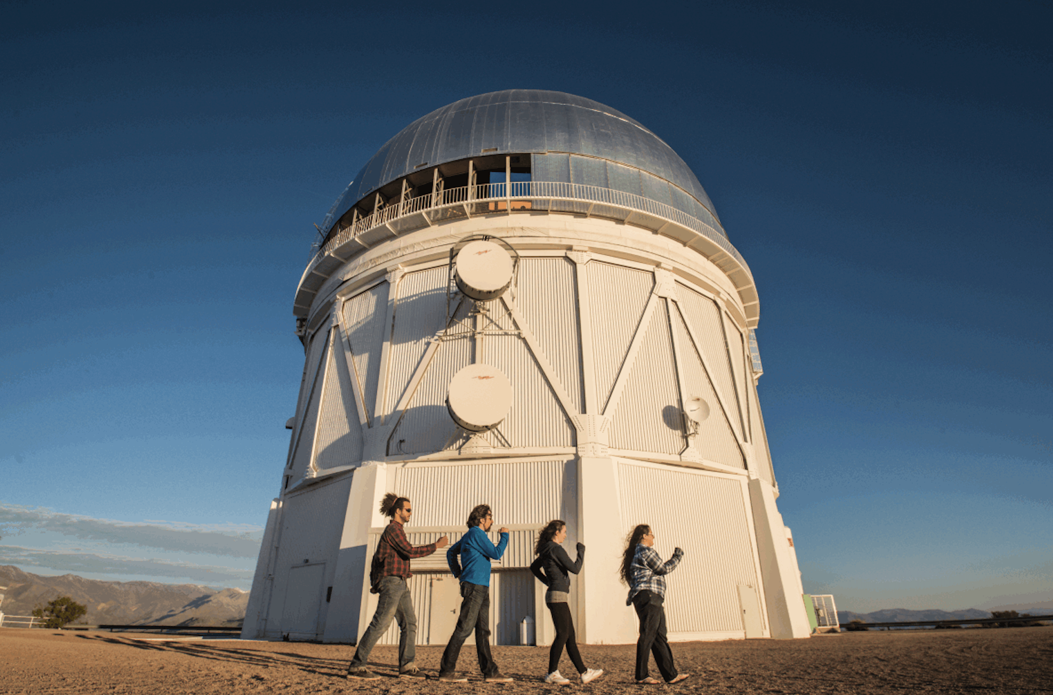
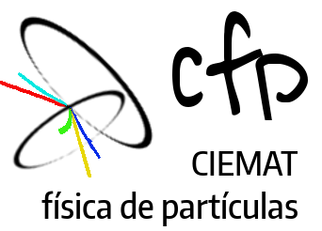


Marching towards a concordance model: a biased view of cosmology in 2025
Nacho Sevilla Noarbe (CIEMAT)
LII International Meeting of Fundamental Cosmology 2025
Credit: Brian Nord

Slide 5
Marching towards a concordance model: a biased view of cosmology in 2025
Nacho Sevilla Noarbe (CIEMAT)
Former LSST-DESC Computing and Simulations Coordinator
Former DES Cosmic Magnification Convenor
Former PAU Verification and Validation Lead
LII International Meeting of Fundamental Cosmology 2025
Credit: Brian Nord

Slide 6
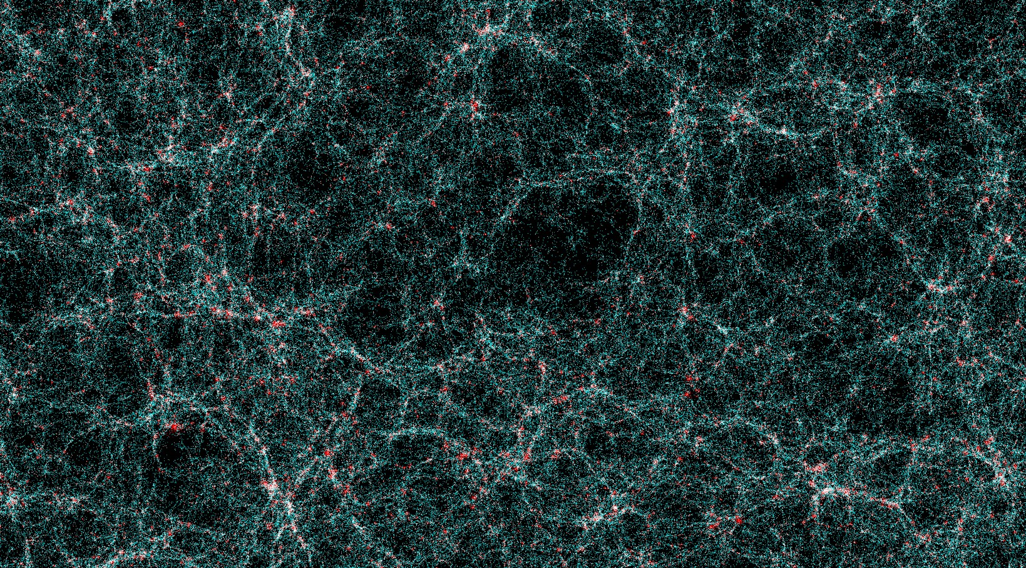
Outline
Reminder of the standard model of cosmology
Probes for cosmology
A-tension!: Some recent highlights
Cosmology’s thrilling future in the next decade
Notes:
Rubin Observatory picture from Paulo

Slide 7
Observing the cosmos has allowed us to make essential progress in fundamental physics
A source of discoveries of physics beyond the Standard Model
Multichannel searches (lab experiments/observations) are crucial to confirm and understand new findings.
Nowadays, data leads discovery in cosmology.

Slide 8
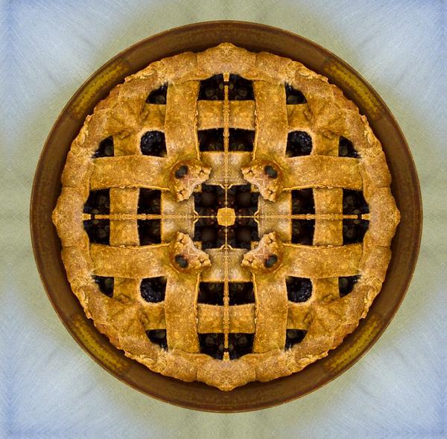
Our current cosmological model fits all observations to date (but it is weird)
The ΛCDM model describes the observable Universe and its large scale dynamics.
Assumes homogeneity and isotropy.
Initial conditions: hot Big-Bang (+ inflation —> origin of matter)
Origin of structure:
Quantum fluctuations —> Large scale structure
Cold dark matter acts as ‘seeds’ for that structure
Evolution:
General Relativity
Recent time acceleration (cosmological constant)
Only six parameters!! (Ω_{b},Ω_{m},τ, H₀,n_{S}, Δ —> S₈)
Cosmic pie
Atoms 5%
Dark Matter 27%
Dark Energy 68%
Planck Collaboration 2020
Notes:
El conjunto de observaciones que tenemos ha permitido ir construyendo un modelo empírico de nuestro universo, muy robusto a las observaciones pero que esencialmente parametriza estos componentes desconocidos, eso sí, proporcionando predicciones y acotando algunas de sus características.

Slide 9
Our current cosmological model fits all observations to date (but it is weird)
The ΛCDM model describes the observable Universe and its large scale dynamics.
Assumes homogeneity and isotropy.
Initial conditions: hot Big-Bang (+ inflation —> origin of matter)
Origin of structure:
Quantum fluctuations —> Large scale structure
Cold dark matter acts as ‘seeds’ for that structure
Evolution:
General Relativity
Recent time acceleration (cosmological constant)
Only six parameters!! (Ω_{b},Ω_{m},τ, H₀,n_{S}, Δ —> S₈)
“Si hubiera estado presente en la Creación, habría dado algunas indicaciones útiles XD” @ElSabioAX
Notes:
El conjunto de observaciones que tenemos ha permitido ir construyendo un modelo empírico de nuestro universo, muy robusto a las observaciones pero que esencialmente parametriza estos componentes desconocidos, eso sí, proporcionando predicciones y acotando algunas de sus características.

Slide 10

The triple consistency question
ΛCDM
Study of the characteristics and robustness of the concordance model allows probing fundamental physics.
Consistency with ΛCDM (is it a good fit?)
Consistency between different observational techniques.
Consistency between low and high redshift measurements.
Notes:
Y esto constituyen hoy en día los temas candentes. LCDM funciona tan bien que se trata de un ejercicio en la “demolicion” de este edificio (repasar los bullet points)

Slide 11
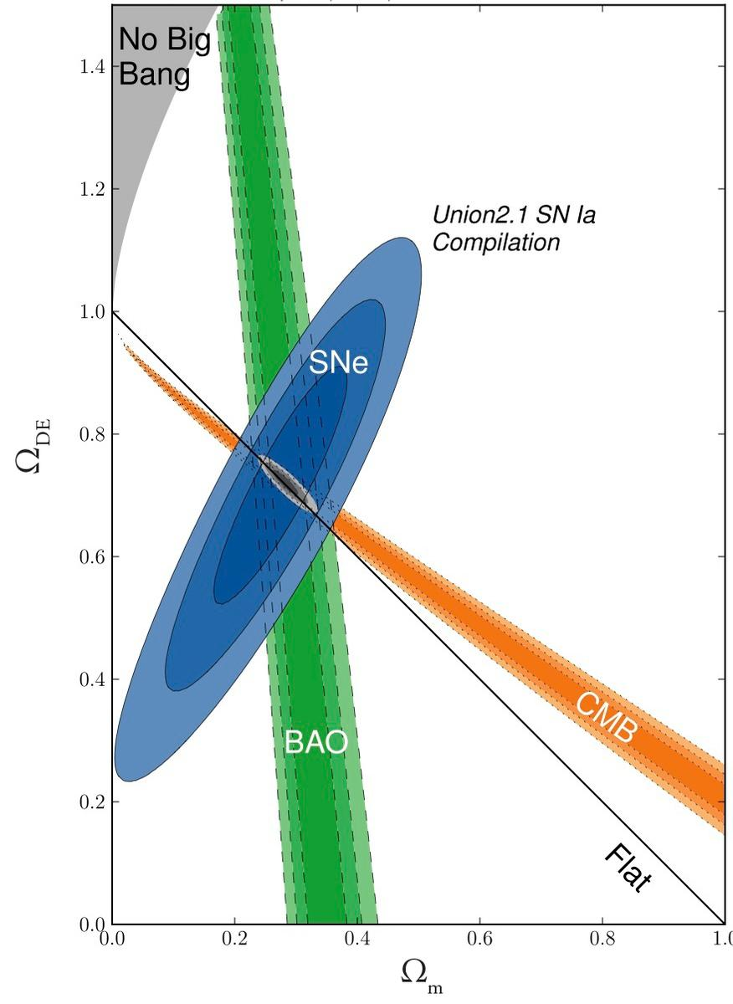
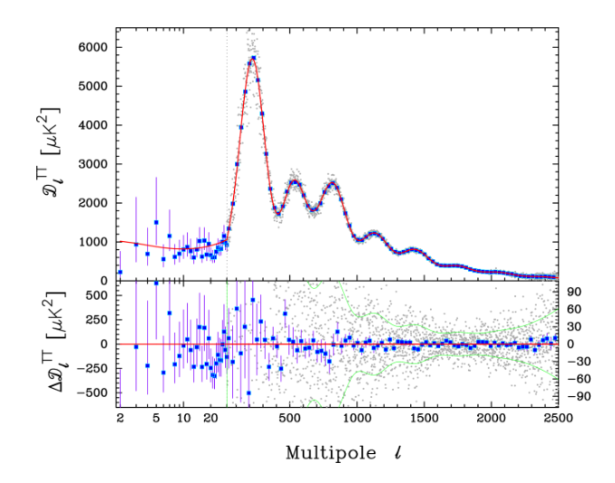
ΛCDM is in extraordinary agreement with data!
Suzuki et al. 2012
Planck Collaboration 2020
Notes:
But before I dive into a world of tensions, crisis and cracks, let me remind you that the cosmological model has been working very well!
0.1% errors

Slide 12
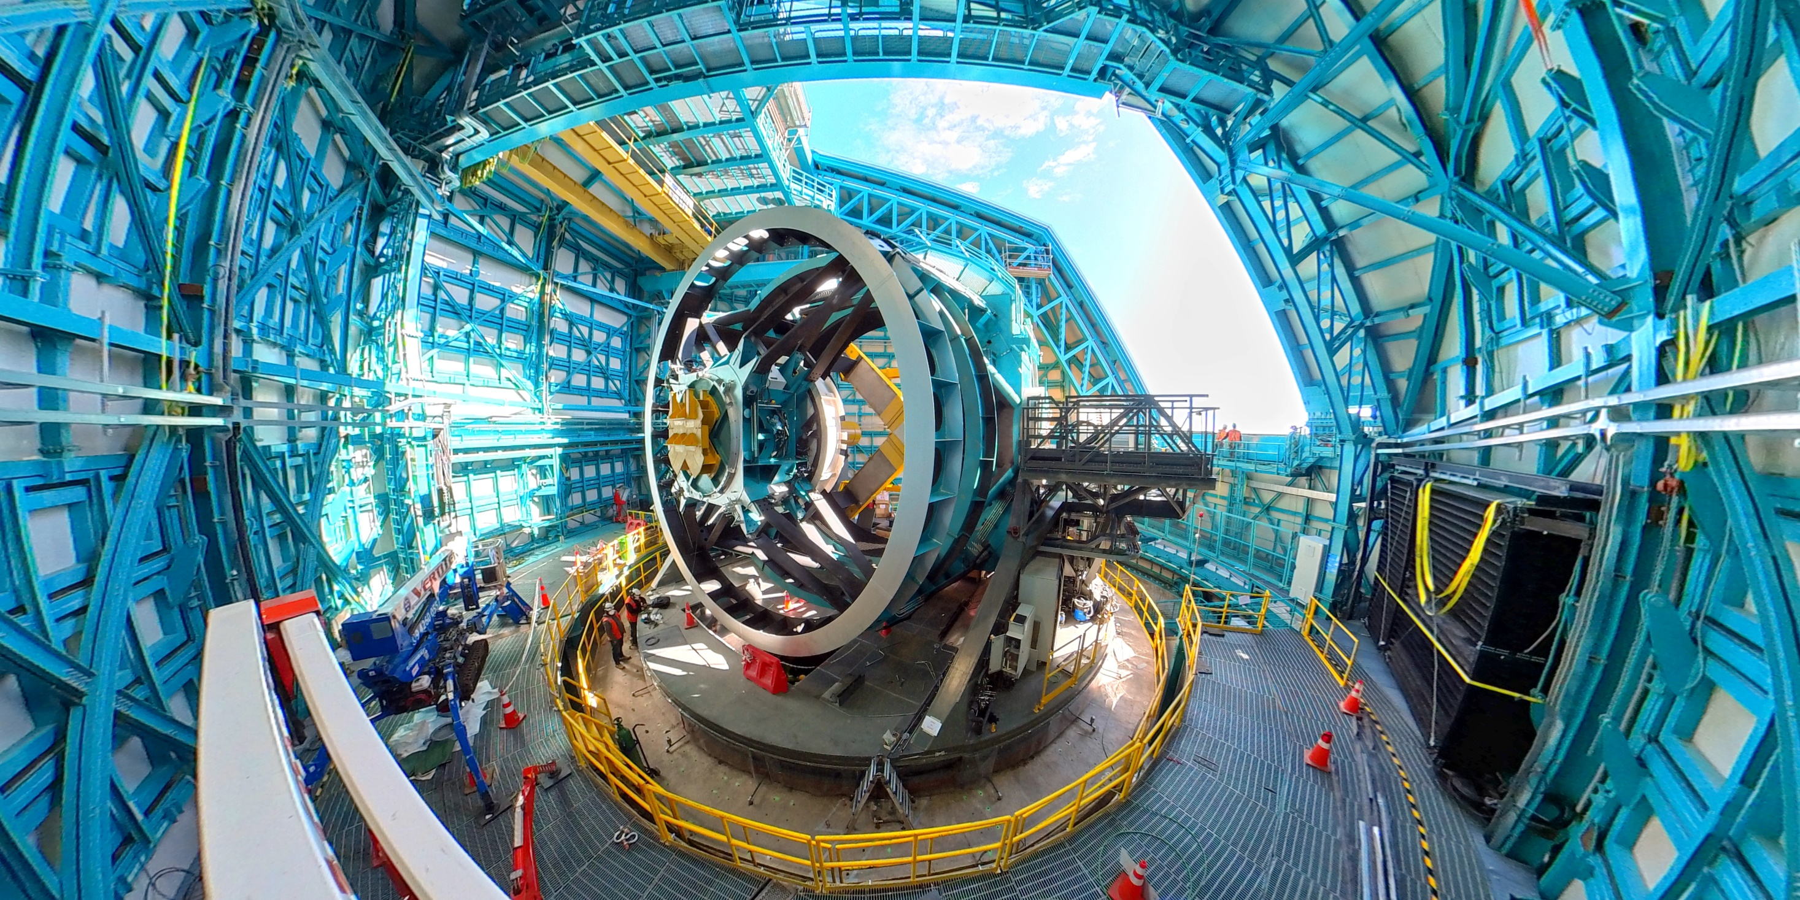
PROBES FOR COSMOLOGY
Credit: The Rubin Observatory
Notes:
What are the probes that we have used to test this model?

Slide 13
PROBES FOR COSMOLOGY
Cosmic Microwave Background
Galaxy surveys
Credit: The Rubin Observatory
Notes:
What are the probes that we have used to test this model?

Slide 14
The observation of the Universe can be done through a variety of probes
Gravitational waves and neutrinos
CMB
Gamma and cosmic rays
Dark matter
IR and optical
Radio
Notes:
As we heard today the exploration of the universe has become more and more varied, sophisticated and precise. And this I would say only in the last couple of decades. Thanks to advances in instrumentation and computing, stimulated by theoretical interpretation. Differente probes allow to explore different eras of the history of the cosmos

Slide 15

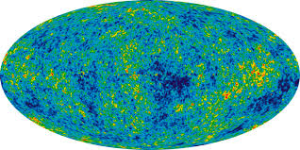
The Cosmic Microwave Background is leftover radiation from the early Universe with an imprint of its conditions
Quantum fluctuations of inflaton field lead to over and under densities of matter
Gravity makes them deeper, photon pressure pushes back → baryon acoustic oscillations
Universe becomes transparent, photons emitted capture these features
Theorist paradise: we can model and predict from first principles
Observer paradise: high sensitivity of observables to predictions
2.7 K black body all-sky uniform emission
Projected sky: from ‘raw’ to 10**5 contrast enhancement. Credit: WMAP
Notes:
The Early Universe was hot and dense plasma, quantum fluctuations led to macroscopic over and underdensities after inflation. Gravity is a driving force leading to deeper inhomogeneities. At the same time photon pressure tries to restore or erase the inhomogeneities by pushing baryons around. This tug of war lead to the Baryon Acoustic Oscillations. The largest distance these waves have travelled since the BB is the sound horizon scale.
This was imprinted on the light that escaped once the universe became transparent. The microwave sky is constant (exc Galactic plane) at first sight, at 2.7K. We want to look at the tiny fluctuations that contain very rich information. We decompose the sky into a set of contributing waves with different wavelengths. Each wavelength has a specific strength.
Solving the fluid equations for all major components of the universe (Boltzmann equations, a few specialized codes do this), gives your prediction for this power spectrum.
We can measure the angular size of this horizon scale, and relate it to the physical size and the distance. The distance contains cosmological information

Slide 16
The Cosmic Microwave Background is leftover radiation from the early Universe with an imprint of its conditions
Quantum fluctuations of inflaton field lead to over and under densities of matter
Gravity makes them deeper, photon pressure pushes back → baryon acoustic oscillations
Universe becomes transparent, photons emitted capture these features
Theorist paradise: we can model and predict from first principles
Observer paradise: high sensitivity of observables to predictions
2.7 K black body all-sky uniform emission
Projected sky: from ‘raw’ to 10**5 contrast enhancement. Credit: WMAP
Notes:
The Early Universe was hot and dense plasma, quantum fluctuations led to macroscopic over and underdensities after inflation. Gravity is a driving force leading to deeper inhomogeneities. At the same time photon pressure tries to restore or erase the inhomogeneities by pushing baryons around. This tug of war lead to the Baryon Acoustic Oscillations. The largest distance these waves have travelled since the BB is the sound horizon scale.
This was imprinted on the light that escaped once the universe became transparent. The microwave sky is constant (exc Galactic plane) at first sight, at 2.7K. We want to look at the tiny fluctuations that contain very rich information. We decompose the sky into a set of contributing waves with different wavelengths. Each wavelength has a specific strength.
Solving the fluid equations for all major components of the universe (Boltzmann equations, a few specialized codes do this), gives your prediction for this power spectrum.
We can measure the angular size of this horizon scale, and relate it to the physical size and the distance. The distance contains cosmological information

Slide 17
The Cosmic Microwave Background is leftover radiation from the early Universe with an imprint of its conditions
Quantum fluctuations of inflaton field lead to over and under densities of matter
Gravity makes them deeper, photon pressure pushes back → baryon acoustic oscillations
Universe becomes transparent, photons emitted capture these features
Theorist paradise: we can model and predict from first principles
Observer paradise: high sensitivity of observables to predictions
2.7 K black body all-sky uniform emission
Projected sky: from ‘raw’ to 10**5 contrast enhancement. Credit: WMAP
Notes:
The Early Universe was hot and dense plasma, quantum fluctuations led to macroscopic over and underdensities after inflation. Gravity is a driving force leading to deeper inhomogeneities. At the same time photon pressure tries to restore or erase the inhomogeneities by pushing baryons around. This tug of war lead to the Baryon Acoustic Oscillations. The largest distance these waves have travelled since the BB is the sound horizon scale.
This was imprinted on the light that escaped once the universe became transparent. The microwave sky is constant (exc Galactic plane) at first sight, at 2.7K. We want to look at the tiny fluctuations that contain very rich information. We decompose the sky into a set of contributing waves with different wavelengths. Each wavelength has a specific strength.
Solving the fluid equations for all major components of the universe (Boltzmann equations, a few specialized codes do this), gives your prediction for this power spectrum.
We can measure the angular size of this horizon scale, and relate it to the physical size and the distance. The distance contains cosmological information

Slide 18
The Cosmic Microwave Background is leftover radiation from the early Universe with an imprint of its conditions
Quantum fluctuations of inflaton field lead to over and under densities of matter
Gravity makes them deeper, photon pressure pushes back → baryon acoustic oscillations
Universe becomes transparent, photons emitted capture these features
Theorist paradise: we can model and predict from first principles
Observer paradise: high sensitivity of observables to predictions
2.7 K black body all-sky uniform emission
Projected sky: from ‘raw’ to 10**5 contrast enhancement. Credit: WMAP
Notes:
The Early Universe was hot and dense plasma, quantum fluctuations led to macroscopic over and underdensities after inflation. Gravity is a driving force leading to deeper inhomogeneities. At the same time photon pressure tries to restore or erase the inhomogeneities by pushing baryons around. This tug of war lead to the Baryon Acoustic Oscillations. The largest distance these waves have travelled since the BB is the sound horizon scale.
This was imprinted on the light that escaped once the universe became transparent. The microwave sky is constant (exc Galactic plane) at first sight, at 2.7K. We want to look at the tiny fluctuations that contain very rich information. We decompose the sky into a set of contributing waves with different wavelengths. Each wavelength has a specific strength.
Solving the fluid equations for all major components of the universe (Boltzmann equations, a few specialized codes do this), gives your prediction for this power spectrum.
We can measure the angular size of this horizon scale, and relate it to the physical size and the distance. The distance contains cosmological information

Slide 19
The Cosmic Microwave Background is leftover radiation from the early Universe with an imprint of its conditions
Quantum fluctuations of inflaton field lead to over and under densities of matter
Gravity makes them deeper, photon pressure pushes back → baryon acoustic oscillations
Universe becomes transparent, photons emitted capture these features
Theorist paradise: we can model and predict from first principles
Observer paradise: high sensitivity of observables to predictions
2.7 K black body all-sky uniform emission
Projected sky: from ‘raw’ to 10**5 contrast enhancement. Credit: WMAP
Notes:
The Early Universe was hot and dense plasma, quantum fluctuations led to macroscopic over and underdensities after inflation. Gravity is a driving force leading to deeper inhomogeneities. At the same time photon pressure tries to restore or erase the inhomogeneities by pushing baryons around. This tug of war lead to the Baryon Acoustic Oscillations. The largest distance these waves have travelled since the BB is the sound horizon scale.
This was imprinted on the light that escaped once the universe became transparent. The microwave sky is constant (exc Galactic plane) at first sight, at 2.7K. We want to look at the tiny fluctuations that contain very rich information. We decompose the sky into a set of contributing waves with different wavelengths. Each wavelength has a specific strength.
Solving the fluid equations for all major components of the universe (Boltzmann equations, a few specialized codes do this), gives your prediction for this power spectrum.
We can measure the angular size of this horizon scale, and relate it to the physical size and the distance. The distance contains cosmological information

Slide 20
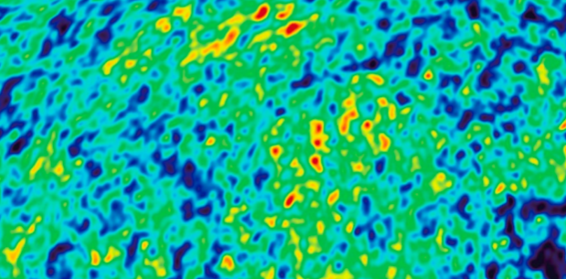
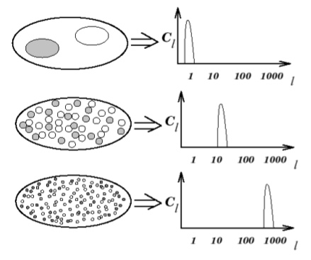


The Cosmic Microwave Background is the most important tool to understand the basic picture of the universe
We observe intensity and polarization maps:
Notes:
In fact it can be argued that …
Temperature fluctuations can be expressed in terms of their spherical harmonics decomposition. There is a natural lmax which depends on the observatory, at some point it becomes damped by other physical processes in the way.

Slide 21
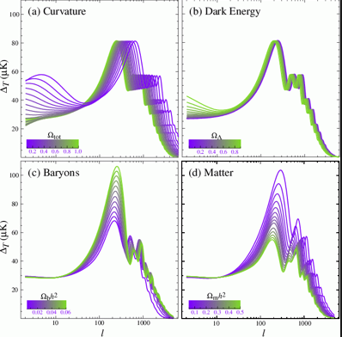
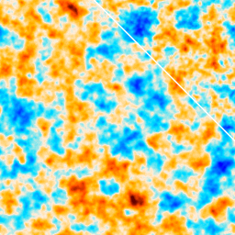
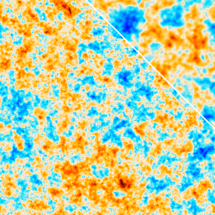
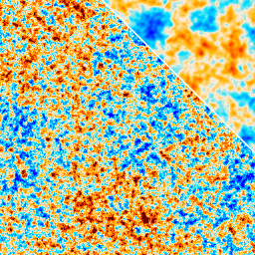
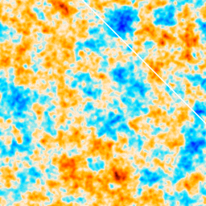
Peaks in the CMB power spectrum encode valuable information about the cosmological model parameters
Our universe
Our universe
Ω_{b}= 0.2
Ω_{c}= 1.0
Ω_{Λ}= 0
Ω_{b}= 0.05
Ω_{c}= 0.275
Ω_{Λ}= 0
Our universe
Ω_{b}= 0.05
Ω_{c}= 0.275
Ω_{Λ}= 0.675
Ω_{b}= 0.05
Ω_{c}= 0
Ω_{Λ}= 0
https://chrisnorth.github.io/planckapps/Simulator

Slide 22
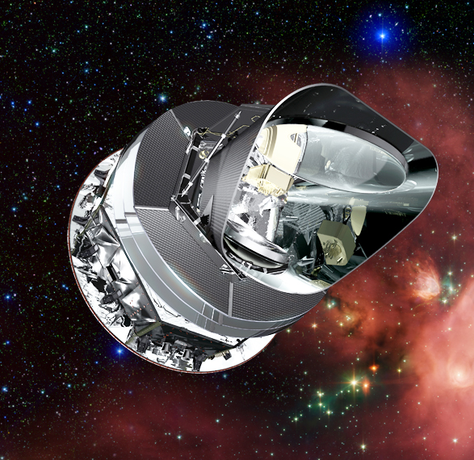
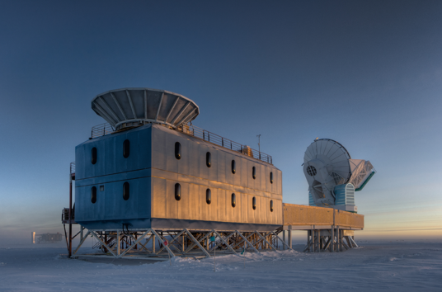
Credit: Planck Collaboration
Credit: South Pole Telescope Collaboration

Slide 23
Feature | Planck (L2 orbit) | ACT (Chile) | SPT (South Pole)
Operating | 2009-2013 | 2007-2022 | 2007-
Sky Coverage | Full sky | ~40% (Southern Hemisphere focus) | ~6% (fixed sky patch)
Resolution | 5–10 arcminutes | ~1 arcminute | ~1 arcminute
Frequency Bands | 30–857 GHz (9 bands) | 90, 150, 220 GHz | 90, 150, 220 GHz
Strengths | - Best for large scales (whole-sky map)- Precise cosmological parameters- Foreground separation | - High-resolution small-scale structure- CMB lensing and SZ effect- Independent cosmology check - Polarization | - Ultra-stable, clean atmosphere- Small-scale anisotropies- Excellent for long-term lensing & SZ studies - Polarization
Limitations | Coarser resolution than ACT/SPT | Partial sky coverage | Very limited sky coverage
Best For | Global cosmology, large-scale CMB | Fine-scale CMB, galaxy clusters, cross-checking Planck | Ultra-precise small-patch studies, secondary anisotropies
Notes:
Simplify and highlight, add dates of operation

Slide 24
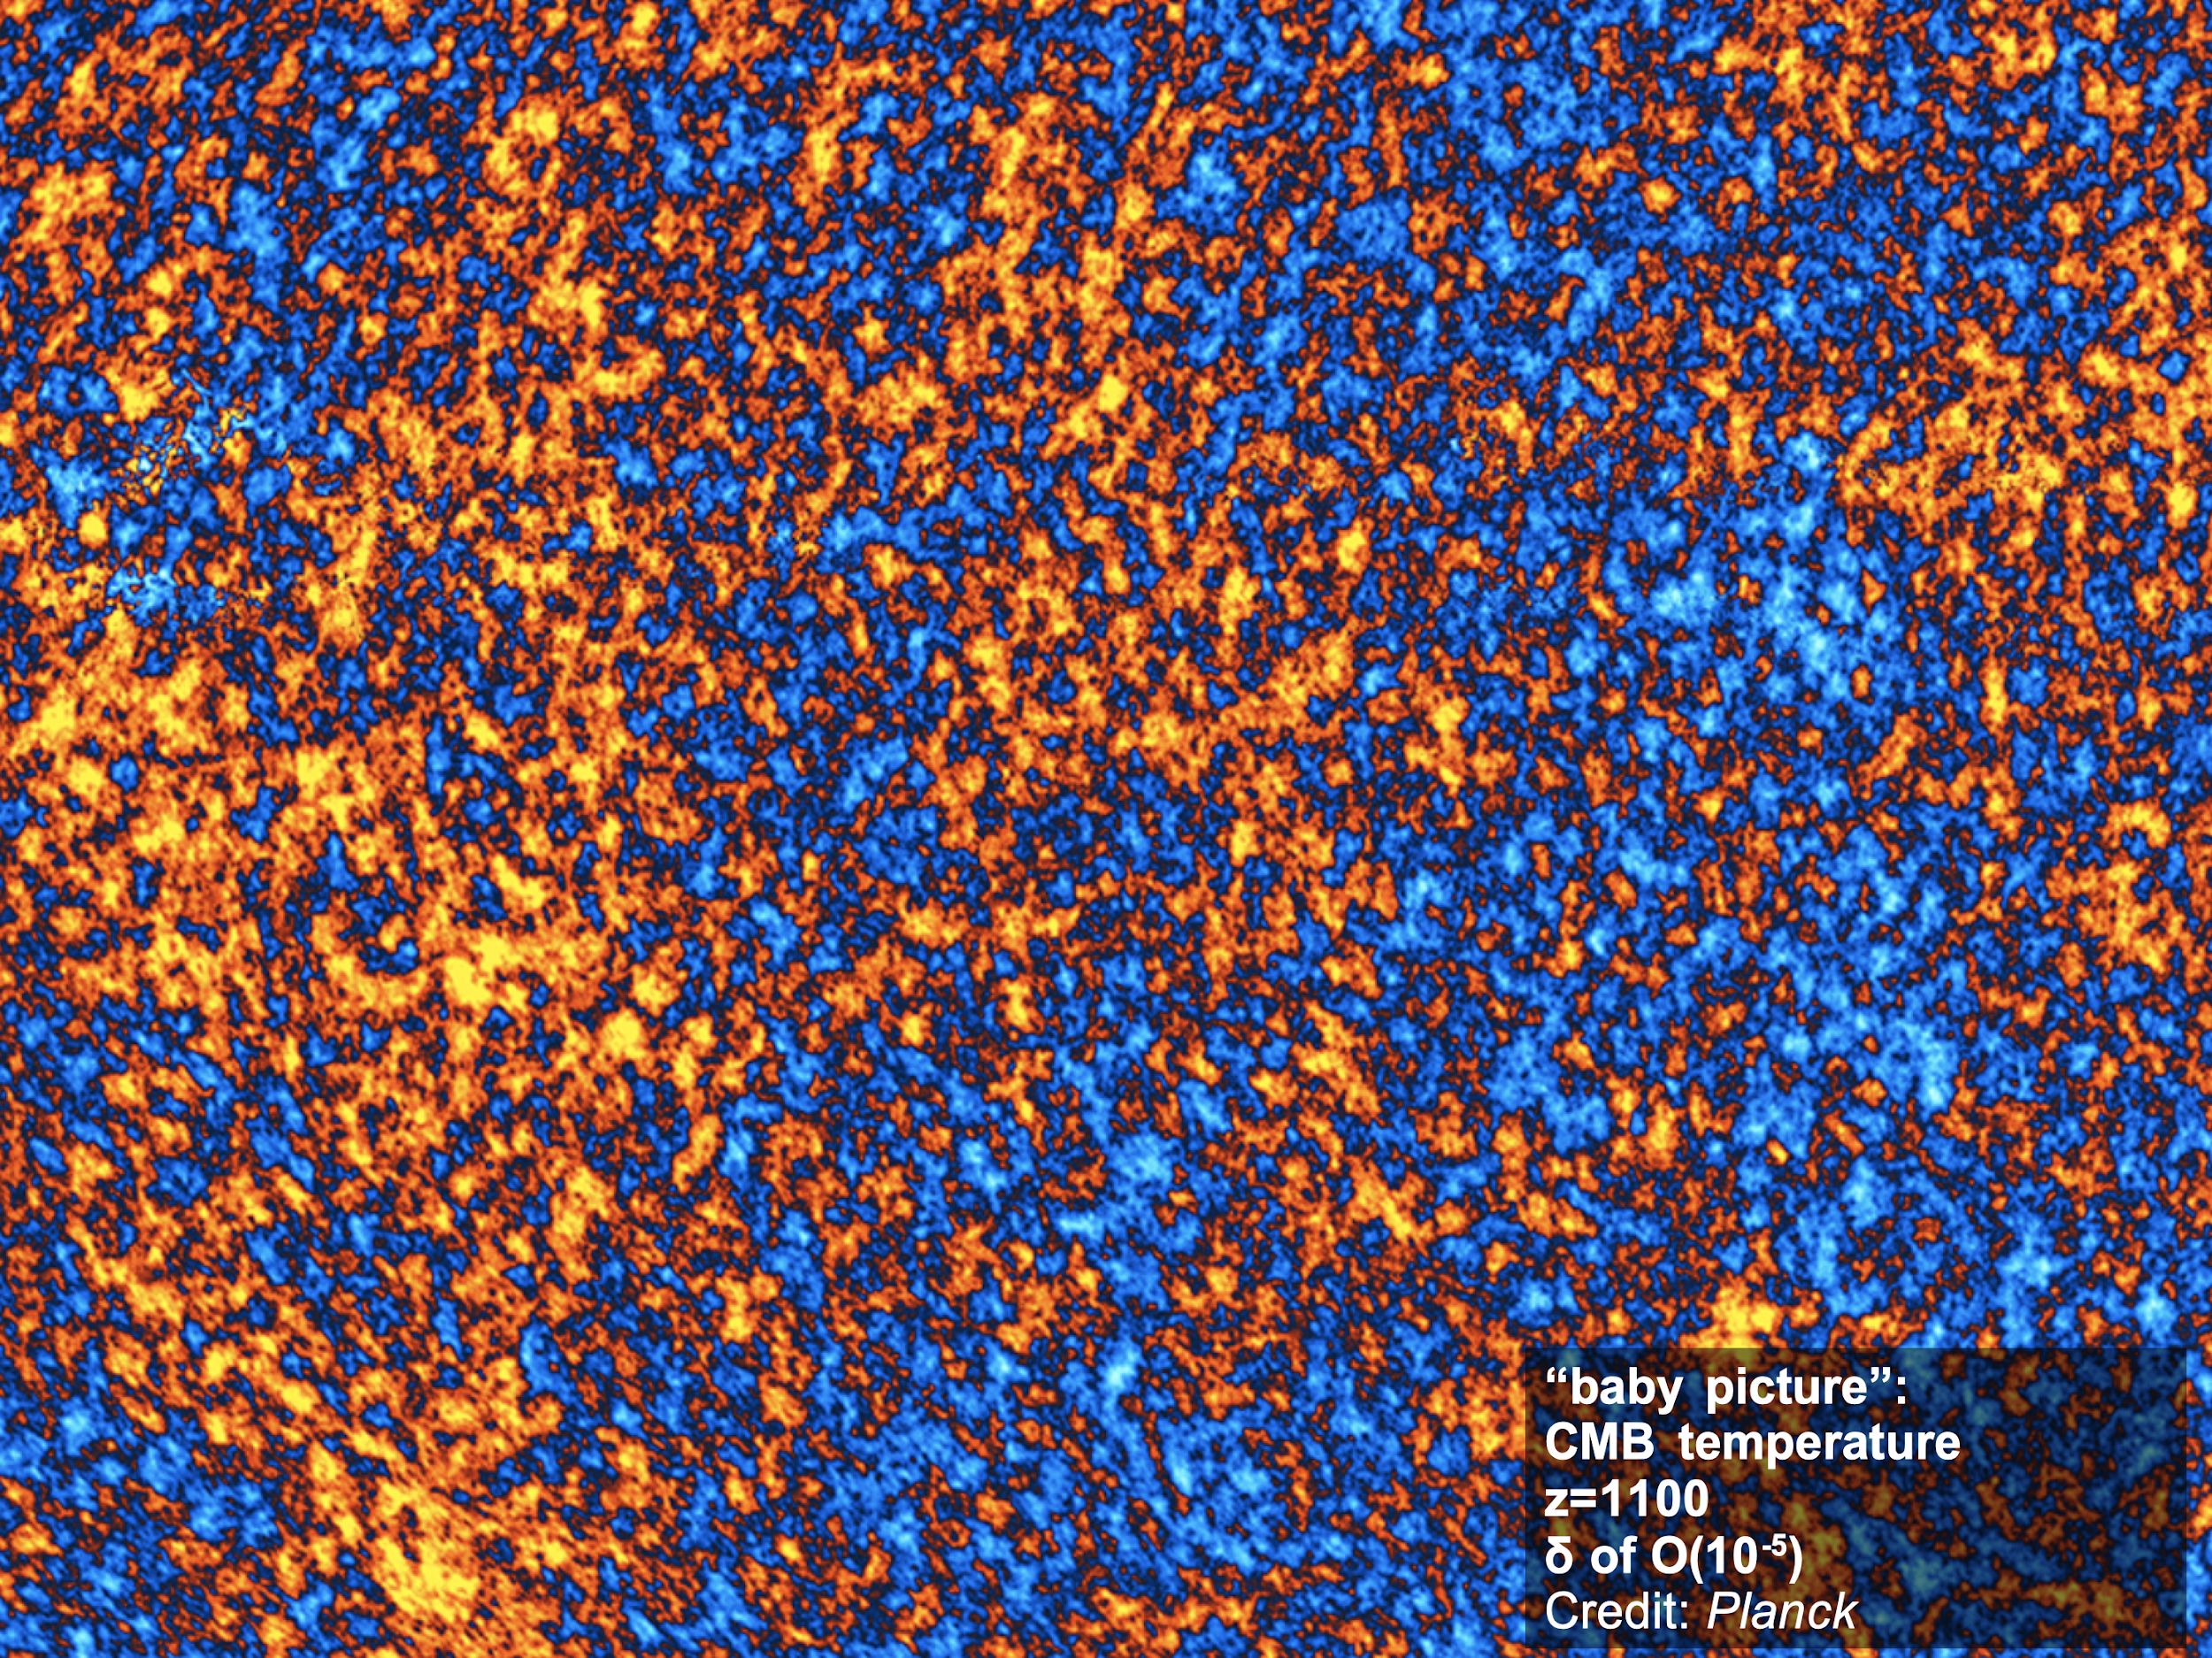
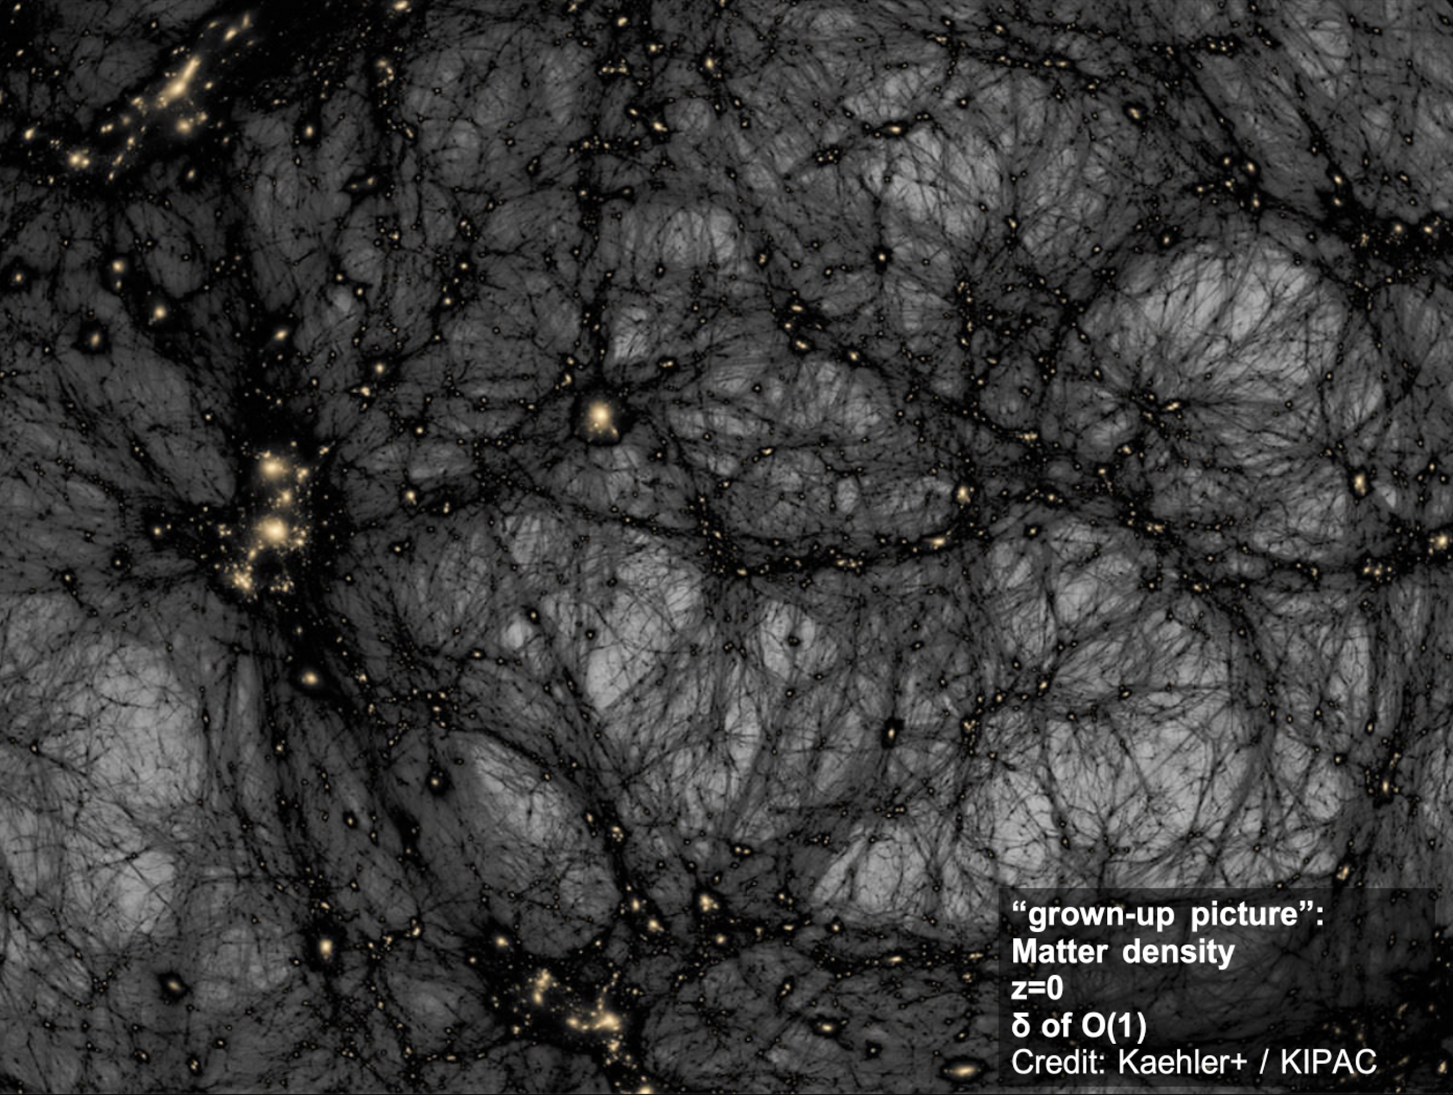
Credit: Euclid Flagship simulation

Slide 25
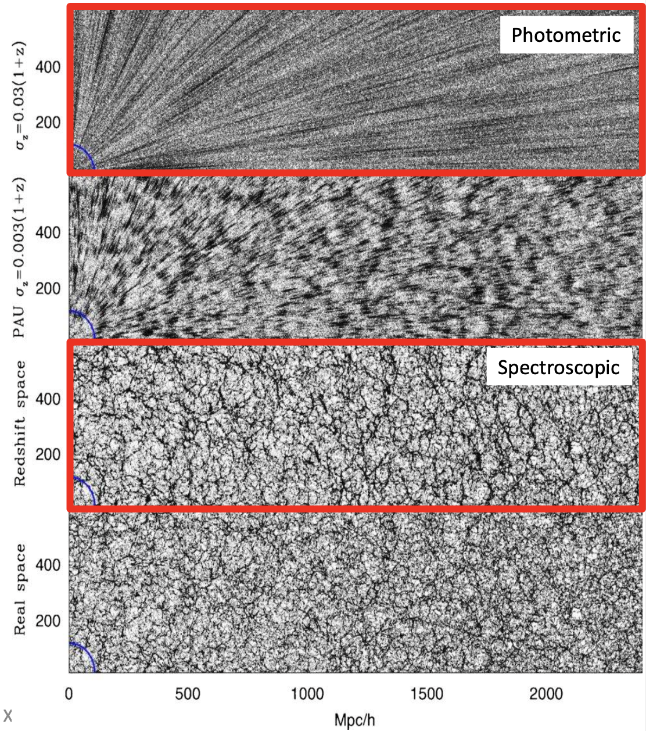
Galaxy surveys* have become a core ingredient for understanding the Universe at low redshifts
Spectroscopic and photometric surveys provide different advantages.
Spectroscopic: precise redshifts → distances.
Photometric: redshifts imprecise, but much more statistics. Shapes (weak lensing) and transient events (supernova cosmology).
(*) Will focus on optical and near-infrared.
Benítez+ 2008

Slide 26
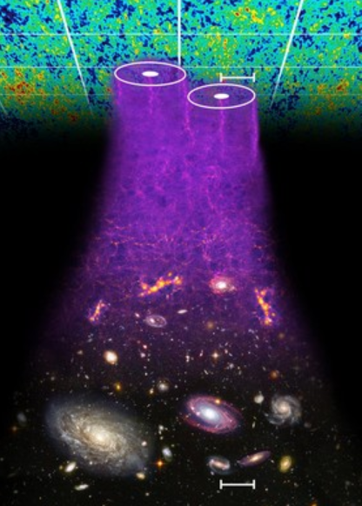
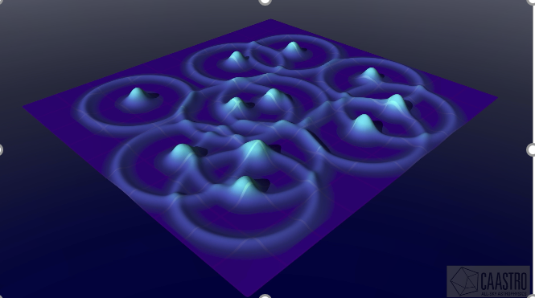
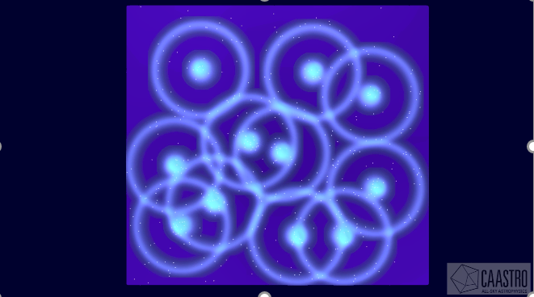
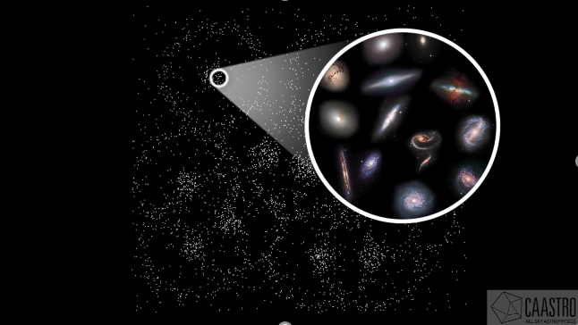
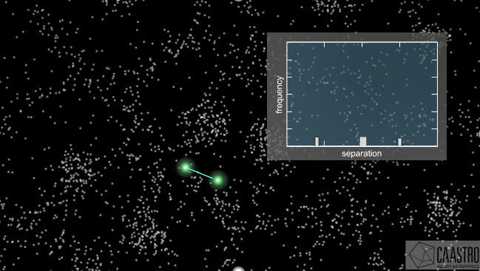
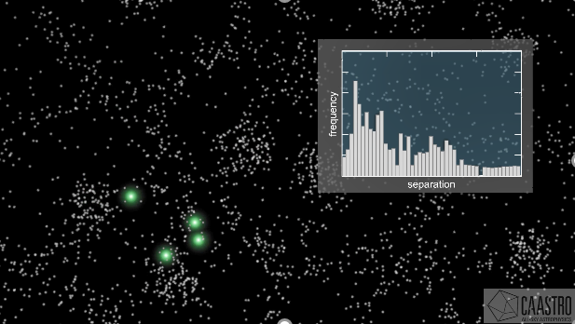
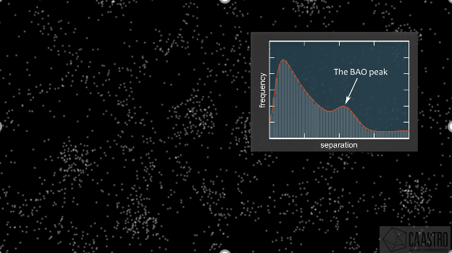

Baryon Acoustic Oscillations are the same imprint of the early Universe conditions as CMB, on matter distribution
You can measure this known scale radially and angularly, and determine distances to the redshift the data is in.
Distance (look back time) vs redshift = expansion history

Slide 27
This equation is very important
Distance measurements, clustering measurements, modifications to standard model, all enter here:

Slide 28
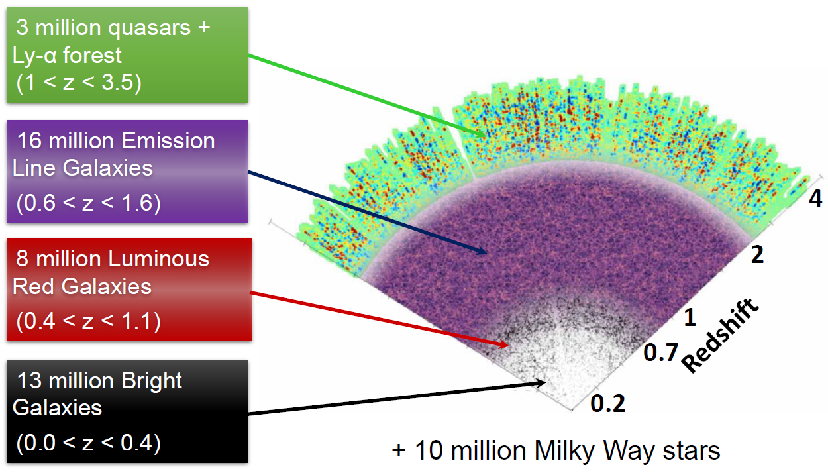
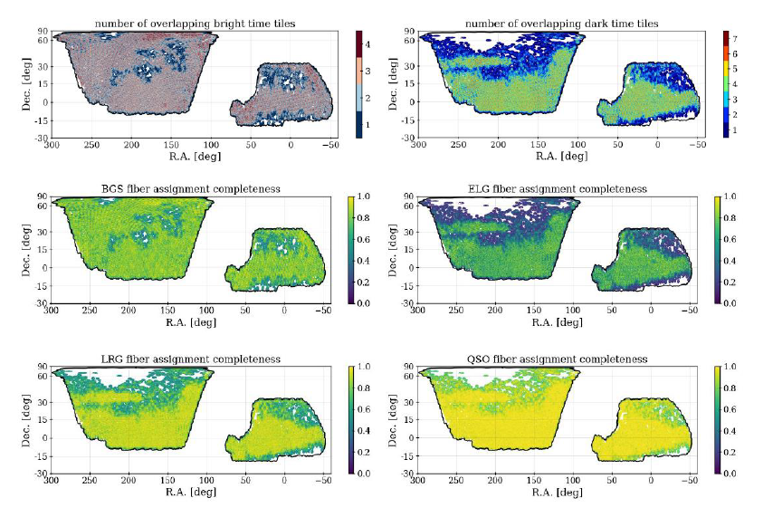
DESI measures the BAO scale at many redshifts, providing the time evolution of the size of the Universe
Extraordinary precision (statistical floor, very low systematics) for BAO measurements.
DESI Collaboration 2025

Slide 29

Notes:
Spectroscopic (DESI – LRG, DESI-Ly alpha, 21 cm)
Photometric (DES, LSST)
Low redshift (DESI-LRG, DES, LSST)
High redshift (DESI-Ly alpha, 21 cm)

Slide 30
High redshift
21cm exp.
DESI QSOs. Lyα
Photometric
Spectroscopic
DESI – ELG
LSST
DES
DESI – LRG
DESI – BGS, SDSS
Low redshift
Notes:
Spectroscopic (DESI – LRG, DESI-Ly alpha, 21 cm)
Photometric (DES, LSST)
Low redshift (DESI-LRG, DES, LSST)
High redshift (DESI-Ly alpha, 21 cm)

Slide 31
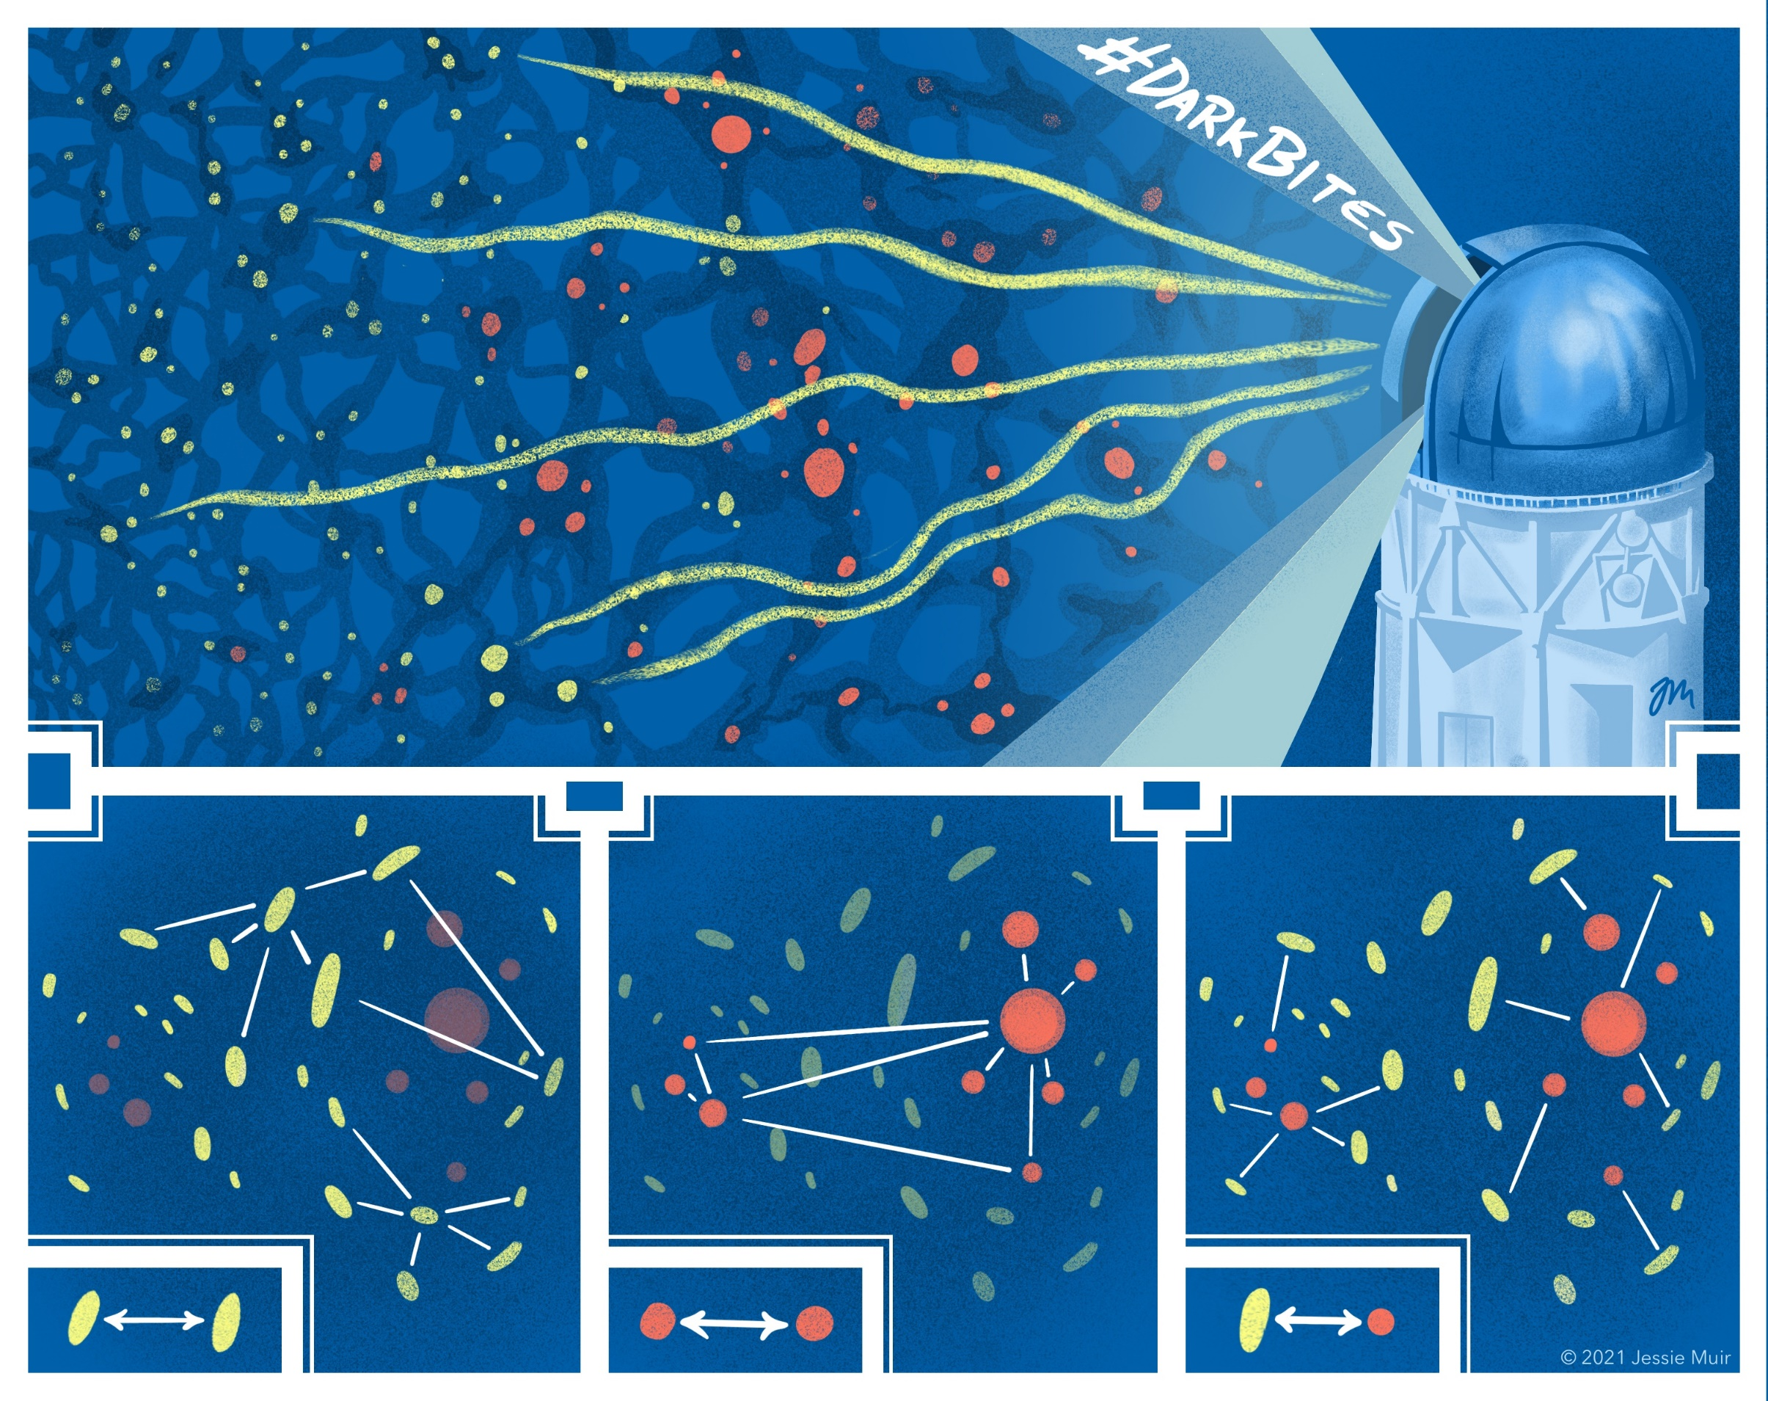
Photometric galaxy surveys can measure the *matter* power spectrum through the relationships of positions and shapes of galaxies
Galaxy positions trace underlying matter distribution.
Galaxy shapes encode information of matter distribution ‘in front’ of them.
We can combine this information, as a function of redshift, to determine ΩM, S8.
Jessie Muir
Notes:
But there are other ways to study the structure

Slide 32
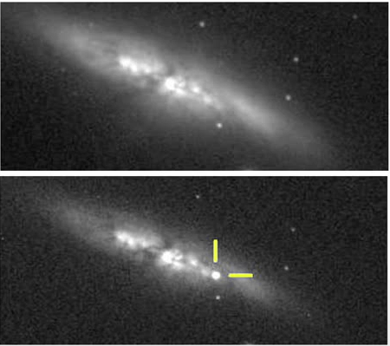
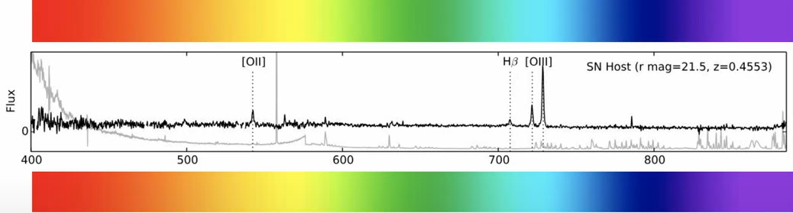
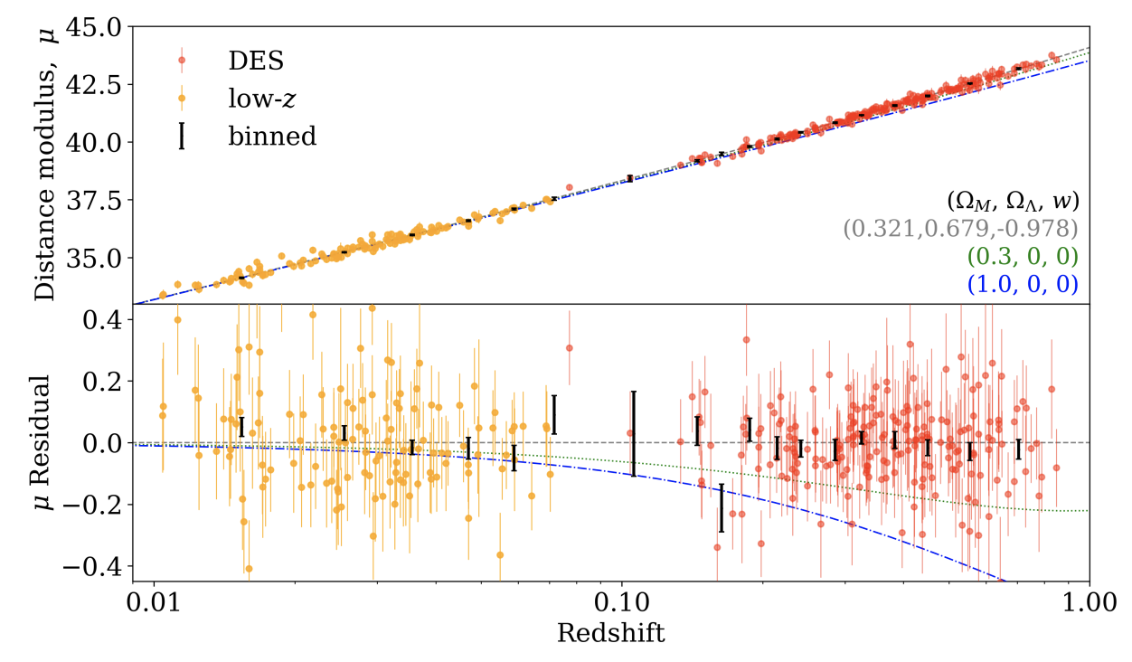
Measuring type Ia supernovae provides an independent handle of the expansion history
Peak flux → distance
Follow-up spectroscopic observation → redshift
Combine both for Hubble diagram (distance vs redshift)
Ω_{M}, expansion history

Slide 33
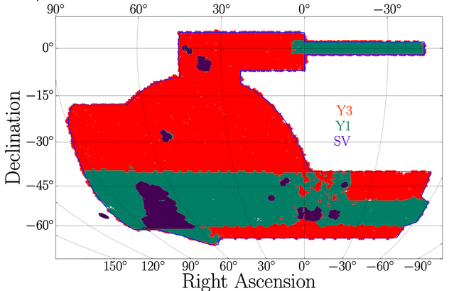
DES performed an extensive photometric galaxy survey, using a variety of probes that measure expansion and clustering across time
Jessie Muir
Multiprobe:
Weak lensing x Clustering
Supernovae
Baryon Acoustic Oscillations
Clusters of galaxies
ISN et al. 2021
Notes:
But there are other ways to study the structure

Slide 34
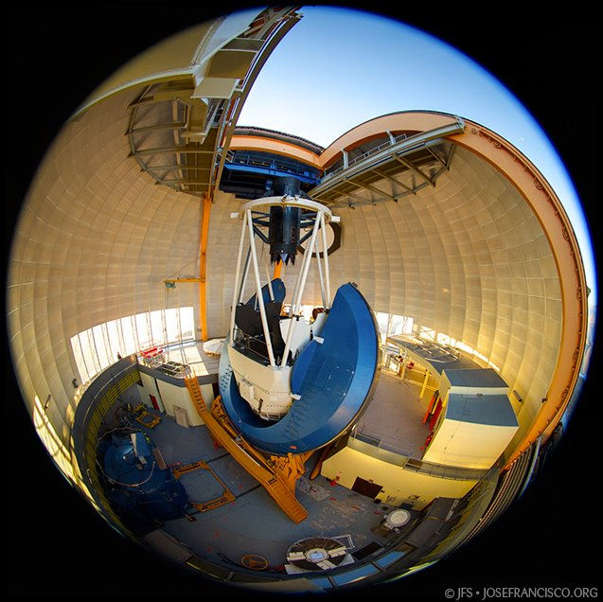
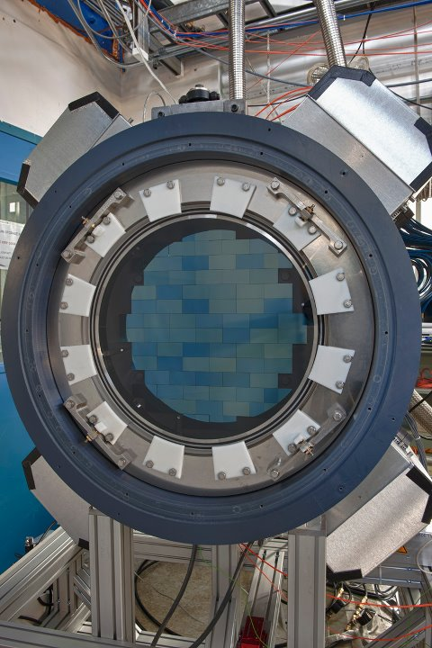
DES focal plane (Fermilab)
DESI focal plane (Berkeley)
Credit: Fermilab

Slide 35
Feature | Dark Energy Survey (DES, Chile) | Dark Energy Spectroscopic Instrument (DESI, US)
Type | Photometric | Spectroscopic
Sky Coverage | ~12% (Southern hemisphere) | ~33% (Northern Hemisphere)
Frequency Bands | 5 broad bands (400-1100 nm) | λ/Δλ = 2000+ (360-980 nm)
Strengths | Images for weak lensing, strong lensing, time domain supernova survey | Very precise distance determination, BAO at several redshifts, redshift space distortions
Limitations | Coarse redshift determination | Narrower focus on a few probes
Best For | Multi-probe measurement, combining weak lensing and clustering, supernovae | BAO, growth of structure

Slide 36
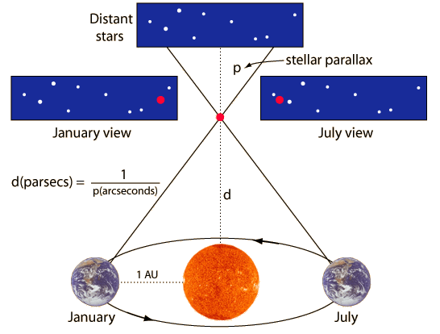
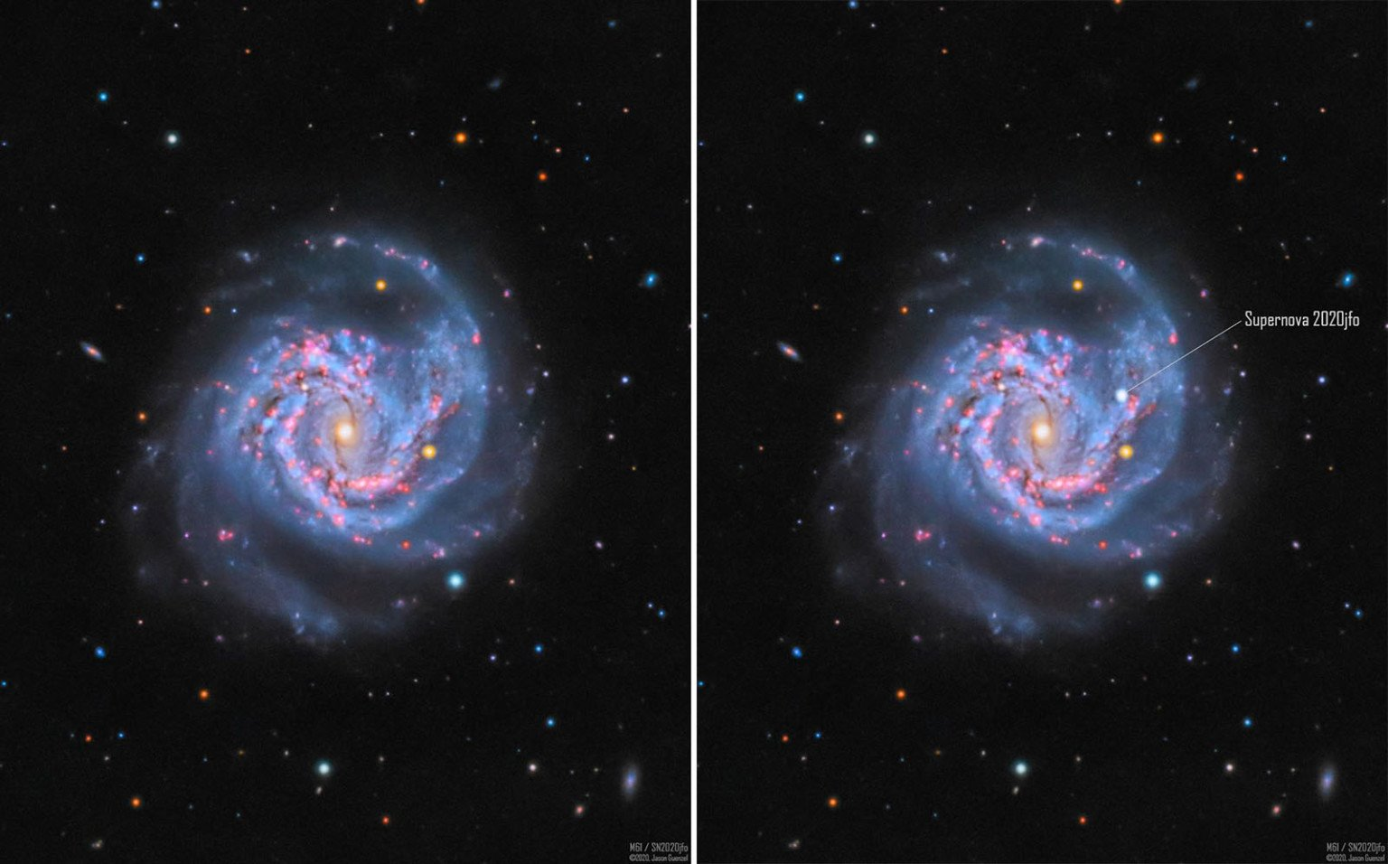
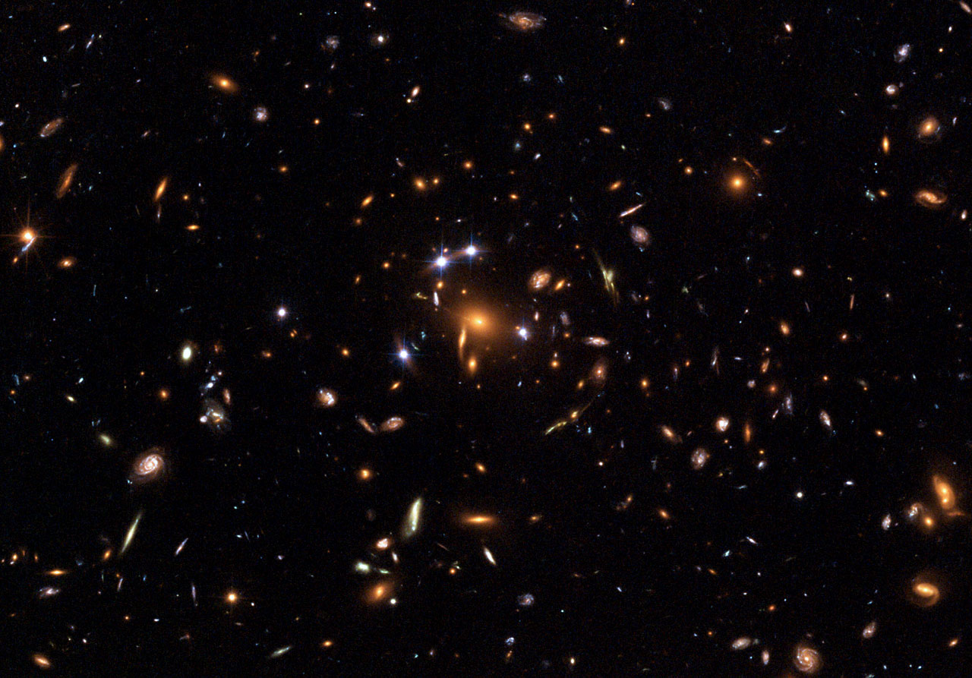
We can measure distances locally to obtain the Hubble constant independently
But many other methods:
Tip of the red giant branch
Time delay cosmography
Neutron star mergers
…
Use the ‘cosmic distance ladder to get to a determination of H₀.
These methods are cosmological model independent.
Determine geometric distance to Cepheids
(distance < 10 Mpc)
2. Look for SNIa in galaxies with Cepheids
(10 Mpc < distance 60 Mpc)
3. Measure H₀ from cz = H₀·d to SNIa at larger distances
0.02 < redshift < 0.2
Notes:
Geometric distances: Gaia parallaxes (single Cepheids and open clusters), detached eclipsing binaries (photometry + spectroscopy + modelling → radius, temperature → luminosity → distance), megamasers (NGC4258). Measure distances to systems that contain Cepheids and treat systematics for Cepheid variability (metallicity, reddening). Also independent non-Cepheid measurements with larger errors.
https://www.youtube.com/watch?v=EBkPMXooZbc (Riess talk at Lisbon)
https://www.youtube.com/watch?v=MfruQ5-4GAw (Breval talk in CosmoVerse seminar series)

Slide 37
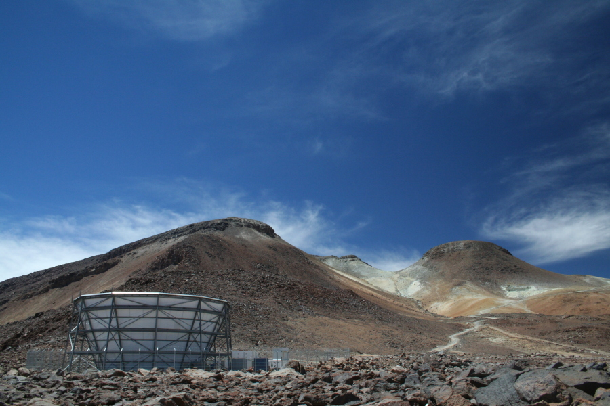
PROBES FOR COSMOLOGY – RECAP
We use electromagnetic waves to study the primitive and late Universe.
CMB is an extraordinarily precise tool, with a phenomenal fit to ΛCDM.
We can study the late universe through galaxy surveys and observations in the optical, and compare predictions of CMB.
Credit: Atacama Cosmology Telescope Collaboration

Slide 38
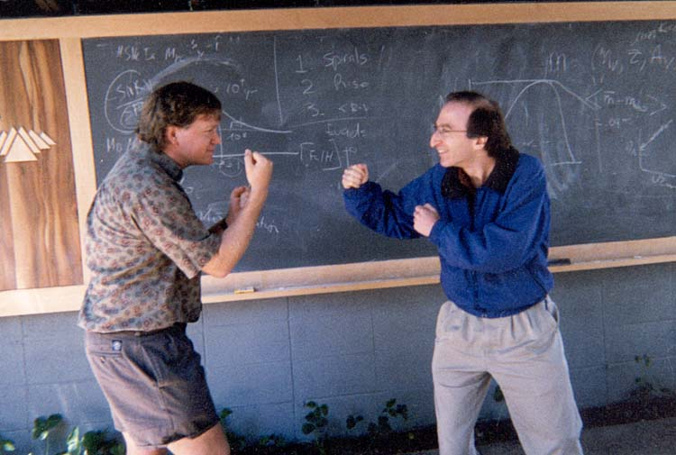


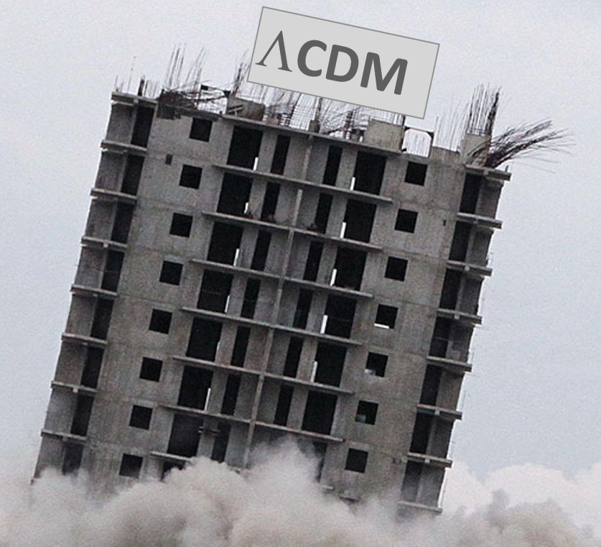


2025 COSMOLOGY: TENSIONS AHOY!
Cosmo parameter 2
Cosmo parameter 1

Slide 39
2025 COSMOLOGY: TENSIONS AHOY!
Cosmo parameter 2
Cosmo parameter 1
Hubble tension
Dynamical Dark Energy hints
Miscellanea and other curiosities

Slide 40
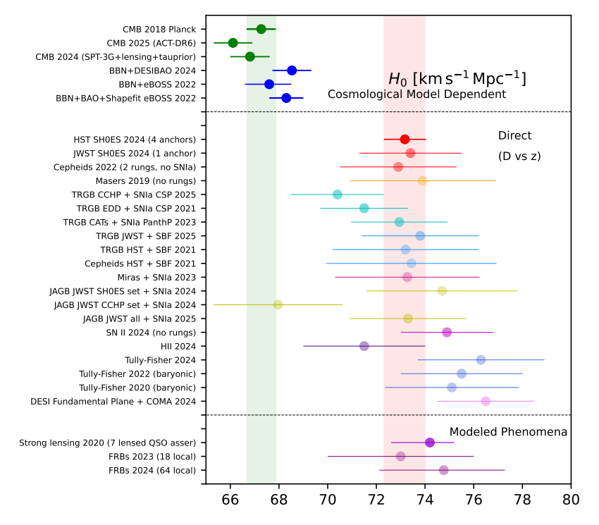
There is a >5σ discrepancy between H0 values determined from distance ladder and other methods
This is the so-called Hubble tension and has been a centerpiece for theoretical and observational research for a decade.
CMB measurements are consistent across experiments. BAO measurements independent of CMB are also consistent.
H₀ ≈ 68 ± 0.5 km/s/Mpc
Distance ladder (local measurements) are varied, independent, and contain many astrophysical/empirical details and fits.
H₀ ≈ 73 ± 1 km/s/Mpc
Cosmoverse White Paper 2025
Notes:
Scolnic (Istambul 2025): https://www.youtube.com/watch?v=JkOdOn7nJEU&t=2046s

Slide 41
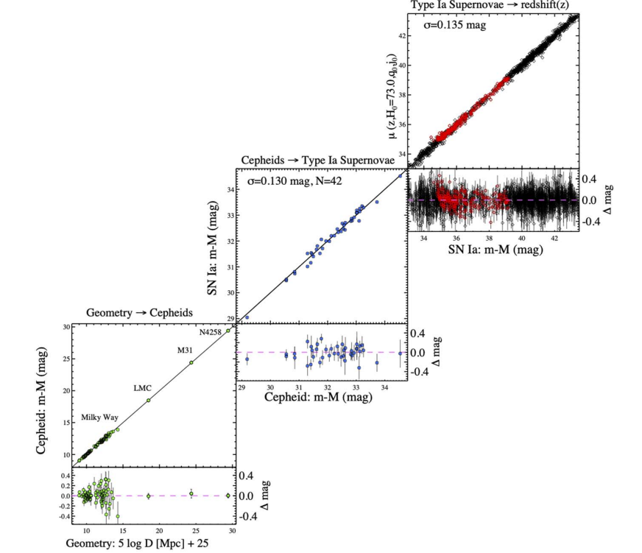

The SH0ES collaboration obtains the tightest constraint using a Cepheid based distance ladder
Method: Obtain H₀ from cz = H₀·d.
Find q that minimizes the χ² of a large system of linear equations
Riess et al. 2022
(SH0ES collaboration)
Distances
SN and Cepheid parameters
H₀
Caveats: various sources of systematic errors
Advantages: many cross-checks, cosmo model independent
H₀ = 73.17 ± 0.86 km/s/Mpc
Breuval et al. 2024 (SH0ES)

Slide 42
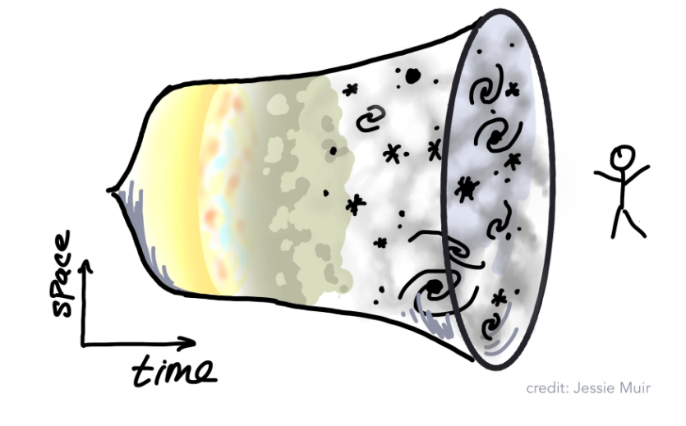

The CMB constrains very much the other cosmological parameters, so we can compute H₀
Method:
Assume a cosmological model (ΛCDM)
Measure angular size in CMB of sound horizon (θ_{S})
Compute comoving sound horizon at z* using precise CMB measurements (r_{S})
Relate the ratio of these quantities (D_{A}) to the evolution of H(z). In this case H(z) only depends on Ω_{m} and H₀.
Markov Chain Montecarlo to obtain Ω_{m} , H_{0.}
r_{S}(z*)
D_{A}(z*)
θ_{S}
z = z*
z = 0

Slide 43
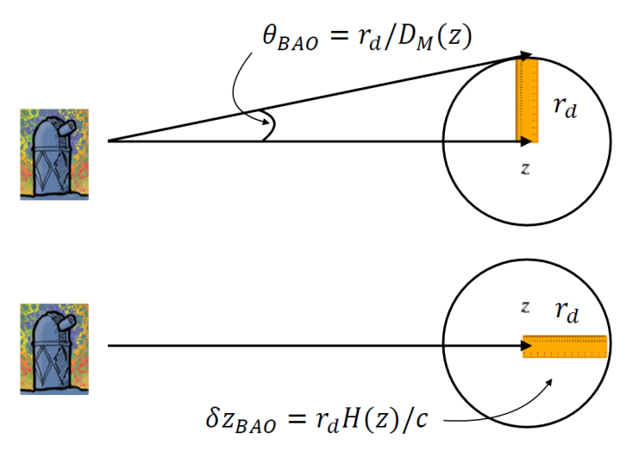
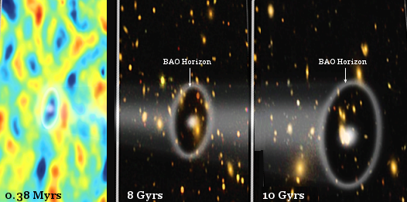
We can use a an absolute distance measured at early times and BAO, to build an inverse distance ladder to H0
Method:
Use the sound horizon scale as absolute distance scale. This depends on Ω_{b}h², Ω_{m}h²
Use deuterium abundances and Big Bang Nucleosynthesis theory to determine Ω_{b.}
BAO transverse and radial measurements depends on Ω_{m} and H₀ independently.
Markov Chain Montecarlo to obtain H_{0.}
Notes:
Also for SN, see refs 236-238 of White Paper

Slide 44
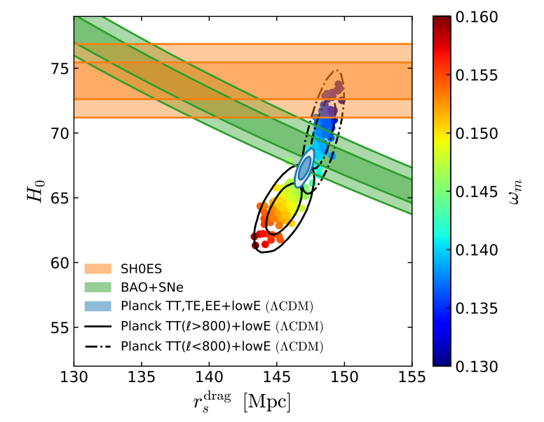
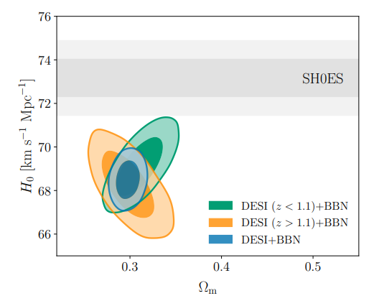
The discrepancy is evident between SH0ES and CMB/BAO based on early Universe measurements
Knox & Millea 2019
DESI Collaboration 2025

Slide 45
Proposed theoretical solutions create tensions elsewhere
Early Dark Energy
Interacting DE-DM
Proposal: introduce a transient dark energy component in the early Universe, thus allowing for a higher inferred H₀ from CMB.
Drawbacks: some fine tuning requirement; creates tensions in S₈ and Ω_{M}, recent measurements constrain them very much.
Proposal: introduce a non-trivial coupling between dark energy and dark matter.
Drawbacks: CMB and BAO constrain very much the parameter space, some fine tuning required.
Modified gravity
Proposal: extend general relativity with additional degrees of freedom
Drawbacks: (again) extra parameters, increases tension with CMB and LSS measurements
Also: Late Dark Energy, Local Void Hypothesis, extra relativistic species (see Di Valentino et al. 2021 for a review)
Notes:
Solutions to H0 need to leave θ_{S} measurements unaffected fall under two categories:
1 -- Reduce sound horizon scale (new relativistic species, EDE). Constrained by CMB.
2 – Change expansion history after recombination (LDE, MG, phantom DE, IDE). Constrained by late time measurements.

Slide 46
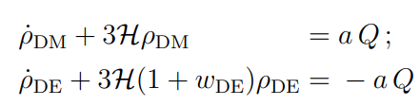
Proposed theoretical solutions create tensions elsewhere
Early Dark Energy
Interacting DE-DM
Proposal: introduce a transient dark energy component in the early Universe, thus allowing for a higher inferred H₀ from CMB.
Drawbacks: some fine tuning requirement; creates tensions in S₈ and Ω_{M}, recent measurements constrain them very much.
Proposal: introduce a non-trivial coupling between dark energy and dark matter, modifying late time H(z)
Drawbacks: CMB and BAO constrain very much the parameter space, some fine tuning required.
Modified gravity
Proposal: extend general relativity with additional degrees of freedom
Drawbacks: (again) extra parameters, increases tension with CMB and LSS measurements
Also: Late Dark Energy, Local Void Hypothesis, extra relativistic species (see Di Valentino et al. 2021 for a review)
Notes:
Solutions to H0 need to leave θ_{S} measurements unaffected fall under two categories:
1 -- Reduce sound horizon scale (new relativistic species, EDE). Constrained by CMB.
2 – Change expansion history after recombination (LDE, MG, phantom DE, IDE). Constrained by late time measurements.

Slide 47
Proposed theoretical solutions create tensions elsewhere
Early Dark Energy
Interacting DE-DM
Proposal: introduce a transient dark energy component in the early Universe, thus allowing for a higher inferred H₀ from CMB.
Drawbacks: some fine tuning requirement; creates tensions in S₈ and Ω_{M}, recent measurements constrain them very much.
Proposal: introduce a non-trivial coupling between dark energy and dark matter, modifying late time H(z)
Drawbacks: CMB and BAO constrain very much the parameter space, some fine tuning required.
Modified gravity
Proposal: extend general relativity with additional degrees of freedom
Drawbacks: (again) extra parameters, increases tension with CMB and LSS measurements
Also: Late Dark Energy, Local Void Hypothesis, extra relativistic species (see Di Valentino et al. 2021 for a review)
Notes:
Solutions to H0 need to leave θ_{S} measurements unaffected fall under two categories:
1 -- Reduce sound horizon scale (new relativistic species, EDE). Constrained by CMB.
2 – Change expansion history after recombination (LDE, MG, phantom DE, IDE). Constrained by late time measurements.

Slide 48


There was even H₀ Olympics!
Schöneberg et al. 2021
“…no model does exceptionally well…
“… all models are left with a residual tension…”
Notes:
Solutions to H0 need to leave θ_{S} measurements unaffected fall under two categories:
1 -- Reduce sound horizon scale (new relativistic species, EDE). Constrained by CMB.
2 – Change expansion history after recombination (LDE, MG, phantom DE, IDE). Constrained by late time measurements.

Slide 49


The combination of recent late time Universe measurements show a moderate preference for dynamical Dark Energy
ΛCDM
Dark energy parametrization:
This is robust against:
Different supernova analyses
Different CMB analyses
Substituting CMB by 3x2 pt measurements
𝒘_{𝟎}=−𝟎.𝟕𝟓𝟐±𝟎.𝟎𝟓𝟕
𝒘_{𝒂}=−𝟎.𝟖𝟔_{−𝟎.𝟐𝟎}^{+𝟎.𝟐𝟑}
DESI Collaboration 2025

Slide 50

The combination of recent late time Universe measurements show a moderate preference for dynamical Dark Energy
ΛCDM
Dark energy parametrization:
This is robust against:
Different supernova analyses
Different CMB analyses
Substituting CMB by 3x2 pt measurements
w₀=-0.76 ± 0.11
w_{a}=-0.79_{-0.67}^{+0.87}
DES Collaboration 2025

Slide 51


DESI measures the BAO scale at many redshifts, providing the time evolution of the size of the Universe
Find the peak position in the correlation function or oscillations in power spectrum.
Sharpen the peak by removing the local redshift features.
Obtain cosmology as deviations from a fiducial or default one.
CosmoVerse White Paper 2025
Credit: E.Sánchez

Slide 52


Type Ia supernovae can also constrain dark energy characteristics measuring expansion history
Compile SNe events.
Downselect to a ‘golden sample’
Exhausting control of systematics
Fit light curve and obtain μ_{obs}
Obtain cosmology through luminosity distance (cosmo parameters) and minimize χ²
DES Collaboration 2024
Notes:
“Finally, the absolute magnitude of SNe Ia (M) and the H0 parameter (which appears in the luminosity distance) are completely degenerate and therefore they are combined in the single parameter M = M + 5 log10(c/H0). All of our cosmology results are marginalized over this term. Therefore, the value of H0 has no impact on the fitting of our cosmological results, and we do not constrain H0. While M has no impact on cosmology fitting, a precise value is needed to simulate bias corrections. The M uncertainty is below 0.01, resulting in a negligible impact on bias corrections (Brout et al. 2022a; Camilleri et al. in prep. 2024).”

Slide 53

Theoretical support has to deal with a ‘phantom’ crossing
Thawing Dark Energy
Proposal: a scalar field that only started to roll down its potential recently (unfreeze, eg. Frieman et al. 1995)
Current data favors an era of ‘phantom’ dark energy, which is difficult to accomodate in most models.
Modified gravity
Proposal: extend general relativity with additional degrees of freedom
Current results with evolving DE do not point to deviations of GR in a generic parametrization (Ishak et al. 2024)
Non-minimal coupling of DE with gravity opens up compatibility, at the cost of extra parameters.
Notes:
Interacting DE-DM in the light of DESI: https://arxiv.org/pdf/2404.15232
Evolving DE: https://arxiv.org/html/2502.06929v1

Slide 54
Theoretical support has to deal with a ‘phantom’ crossing
Interacting DE-DM
Thawing Dark Energy
Proposal: introduce a non-trivial coupling between dark energy and dark matter.
The data very mildly favors a positive flow of energy momentum from DM to DE (similar to w_{a} ≠ 0 finding). Solves partially H₀ tension.
Proposal: a varying equation state that fits the expansion rate better in the late universe (w₀w_{a}, w_{φ})
Current data favors an era of ‘phantom’ dark energy, which is difficult to accomodate in most models
Modified gravity
Proposal: extend general relativity with additional degrees of freedom
Current results with evolving DE do not point to deviations of GR.
In general: Dark Energy models fit to recent data don’t solve the H₀ tension
Notes:
Interacting DE-DM in the light of DESI: https://arxiv.org/pdf/2404.15232
Evolving DE: https://arxiv.org/html/2502.06929v1

Slide 55


There are other interesting results: S₈ and neutrino mass
Wright et al. 2025, KiDS Collaboration
Tension in clustering amplitude could be explained by systematic effects.
Neutrino mass cosmological constraint is relaxed with w₀w_{a} parametrization.
DESI Collaboration 2025

Slide 56

There are other interesting results: S₈ and neutrino mass
DES + KiDS Collaboration 2023
Tension in clustering amplitude could be explained by systematic effects.
Neutrino mass cosmological constraint is relaxed with w₀w_{a} parametrization.
DESI Collaboration 2025

Slide 57


There are other interesting results: Alens, JWST galaxies
CosmoVerse White Paper 2025
Boylan-Kolchin 2023
Notes:
JWST talk: https://www.youtube.com/watch?v=ApB4Jv3P9Gs&t=611s

Slide 58
2025 COSMOLOGY – RECAP
In the last five years, we have seen the first serious challenges to the ΛCDM paradigm (>3-5σ tensions)
Contrary to Dark Energy and Dark Matter discovery, they are a hard fit to proposed theories. No solution fits all.
Makes more theoretical work, systematics control with alternative measurements and new observations very compelling!
Notes:
Int

Slide 59

COSMOLOGY’S THRILLING FUTURE!

Slide 60
A timeline for future projects
What is dark energy and dark matter? What is the sum of neutrino masses?
How was the primordial Universe?
What is the Hubble tension telling us?
Galaxy surveys
CMB, radio
2025
SH0ES
TDCOSMO
DESI
Resolving current stress on LCDM
Euclid
2030
LVK, ET…
LSST
Roman
Simons Observatory
21 cm
DESI-II
DEBASS,ZTF
LiteBIRD
Mapping the full expansion history of the Universe. What is driving DE.
2035
Spec-S5
Notes:
Surveys: Rubin, Roman, Euclid, DESI-II, Spec-S5
CMB: BICEP3, Simons Obs, SPT-3G+ and QUIJOTE will pin down systematics
SH0ES, DEBASS, TD-COSMO follow up?
Radio: HII surveys
CRs (incl. gammas) and GW, other talks

Slide 61

What can we expect to gain by the 2030s?
H₀ tension: Cepheid method is mature, add new distance anchors (30m telescopes); improve errors in other non-Cepheid methods; improve statistics of dark sirens
Dynamical Dark Energy: more nearby supernovae (soon!); map out all expansion history in detail to high redshift.
Other interesting cosmology: neutrino mass constraints and new tension with lab results; inflation probes with CMB polarization experiments.
Gray et al. 2020
Notes:
H0:
More precise parallaxes from Gaia DR4, distance measurements to new anchors M31, M33 (w/ ELT >2030)
More studies on systematic errors from alternative methods to Cepheids

Slide 62
What can we expect to gain by the 2030s?
H₀ tension: Cepheid method is mature, add new distance anchors (30m telescopes); improve errors in other non-Cepheid methods; improve statistics of dark sirens
Dynamical Dark Energy: more nearby supernovae (soon!); map out all expansion history in detail to high redshift.
Other interesting cosmology: neutrino mass constraints and new tension with lab results; inflation probes with CMB polarization experiments.
DESI Collaboration 2025
Notes:
H0:
More precise parallaxes from Gaia DR4, distance measurements to new anchors M31, M33 (w/ ELT >2030)
More studies on systematic errors from alternative methods to Cepheids

Slide 63

What can we expect to gain by the 2030s?
H₀ tension: Cepheid method is mature, add new distance anchors (30m telescopes); improve errors in other non-Cepheid methods; improve statistics of dark sirens
Dynamical Dark Energy: more nearby supernovae (soon!); map out all expansion history in detail to high redshift.
Other interesting cosmology: neutrino mass constraints and new tension with lab results; inflation probes with CMB polarization experiments.
Ivezić et al. 2019
Notes:
H0:
More precise parallaxes from Gaia DR4, distance measurements to new anchors M31, M33 (w/ ELT >2030)
More studies on systematic errors from alternative methods to Cepheids

Slide 64

What can we expect to gain by the 2030s?
H₀ tension: Cepheid method is mature, add new distance anchors (30m telescopes); improve errors in other non-Cepheid methods; improve statistics of dark sirens
Dynamical Dark Energy: more nearby supernovae (soon!); map out all expansion history in detail to high redshift.
Other interesting cosmology: neutrino mass constraints and new tension with lab results; inflation probes with CMB polarization experiments.
LiteBIRD Collaboration 2023
Notes:
H0:
More precise parallaxes from Gaia DR4, distance measurements to new anchors M31, M33 (w/ ELT >2030)
More studies on systematic errors from alternative methods to Cepheids

Slide 65

Challenges of future projects
Ultimately limited by statistical effects at low redshift, but plenty of work on systematics still. At higher redshifts, diminishing returns. In time domain probes, events are scarce.
Systematics are difficult to model: complex systems often crunched into one or two numbers, simulations need to expand orders of magnitude. At higher redshifts, even more challenging to measure and model.
Satellite constellations, astrophysical foregrounds
Harnessing artificial intelligence in a useful and impactful way
Constraints in building new facilities
International politics in the last decade
Vincenzi et al. DES Collaboration 2024
Notes:
Constraints to new facilities → diminishing returns (use https://arxiv.org/pdf/1606.06273)
International politics → difficulties in the last decade ()
Satellite constellations (optical, radio)
Statistical floor (large scales, near universe)
Systematics floor (astrophysical modelling) → compare stat and syst for supernovae, S8
Algún plot enseñando lo que se espera de las tensiones en H0 y w0wa

Slide 66
Challenges in theory
Mechanisms that explain dark energy, dark matter and inflation are still uncertain.
Whether ΛCDM is valid or not, the value of the cosmological constant (zero or small) is not explained.
Where does that leave the ‘prediction’ from the Standard Model for vacuum energy? Decades-old problem!
Tensions: no solution fits all tensions (including dark energy) and all cosmological probes.
Dark Energy (?) behavior is puzzling (phantom crossing)
DESI Collaboration 2025

Slide 67

Cosmology has an exciting future!
In the last five years, we have seen the first serious challenges to the ΛCDM paradigm (>3-5σ tensions)
Contrary to the original Dark Energy and Dark Matter discoveries, they are a hard fit to proposed theories. No solution fits all.
Galaxy surveys and ‘nearby’ cosmology are opening new avenues for fundamental physics in the coming 10 years!
Notes:
cosmology is crucial for fundamental physics;
cosmology is living through exciting times;
challenge from systematic effects across probes

