Slide 1
Outline
Instrumentation challenges in the PBB:
The three “Eras” of experiments.
The answer to the chanllenges in the PBB:
DRD collaborations
Detector concepts for the second Era.
The technological R&D Landscape from the PBB
Final remark:
PBB vs the first Spanish Input for the ESPP

Slide 2


Update of the Spanish input for the ESPP: A review of the Physics Briefing Book inputs
Final community meeting on the ESPP update
Santiago de Compostela, Octubre 7
I. Vila Álvarez
IFCA (CSIC-UC)

Slide 3
Three Eras of Future Particle Physics Experiments
Era 1 – Present Upgrades (2020s):
HL-LHC (CERN), SuperKEKB (Belle II, Japan) and EIC (BNL, US). Key detector projects: ATLAS/CMS Phase-2, ALICE 3, LHCb Upgrade II, ePIC.
Era 2 – Higgs/Electroweak/Top Factories (2030s):
Electron-positron colliders: FCC-ee, ILC/LCF, CLIC. Additional options: LEP3 and LHeC reusing LHC infrastructure. Detector concepts guide R&D for next-generation precision.
Era 3 – Multi-TeV Frontier (Beyond 2040):
High-energy colliders up to 10 TeV partonic energy: Muon Collider, FCC-hh.

Slide 4
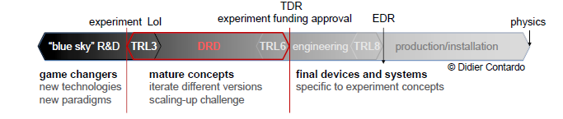
The Detector R&D Collaborations (DRDs)
Purpose: Created by ECFA to implement the Detector R&D Roadmap, ensuring long-term, strategic coordination of detector research across Europe.
Structure: Nine DRDs (DRD1–DRD9) grouped by technology families — gaseous, solid-state, calorimetry, photon detection, quantum sensors, system integration, electronics, mechanics, and simulation.
Other Missions: • Foster synergies among collider and non-collider experiments. • Provide shared infrastructures and promote open access to test facilities. • Link academia, national labs, and industry to bridge fundamental R&D to applications.
Governance: Managed under ECFA with strong links to CERN Detector R&D office and national networks.
Strategic role: Acts as the backbone of Europe’s detector innovation ecosystem — preparing technologies for future colliders

Slide 5

An Alternative vision of the DRDs
Three Sensors for the Silicon realms beneath the beam,
Seven for the Gas-lords in their chambers deep,
Nine for the Scintillators where the photons gleam,
One for the Quantum mind their secrets to keep,
In the Labs of Europe where the magnets lie.
One Ring^{(*)} to rule them all,
One Roadmap to find them,
One Strategy to bring them all,
and in the DRDs bind them
(*) A straight line can be viewed as the limit of a circle whose radius tends to infinity.

Slide 6
Detector concepts for HET factories
Included detector concepts:
ILD – particle-flow-optimized concept with large-volume TPC tracker and highly granular calorimetry.
CLD – compact adaptation of CLICdet tailored to FCC-ee beam conditions.
IDEA – lightweight, cost-efficient design featuring a drift-chamber tracker, dual-readout calorimeter, and thin solenoid.
ALLEGRO – advanced concept exploring monolithic silicon tracking and precision timing in an ultra-compact layout.
FCC-ee challenges: larger luminosity (≈ 10³⁶ cm⁻² s⁻¹) and beamstrahlung create intense backgrounds:
TPCs suffer from space-charge distortions, ion backflow, and event pile-up under continuous collisions (20–100 kHz).
TDAQ systems must manage enormous data rates while maintaining precise time separation and synchronization.
Message: From an instrumentation perspective, FCC-ee poses a significantly greater technical challenge than any linear-collider option.

Slide 7
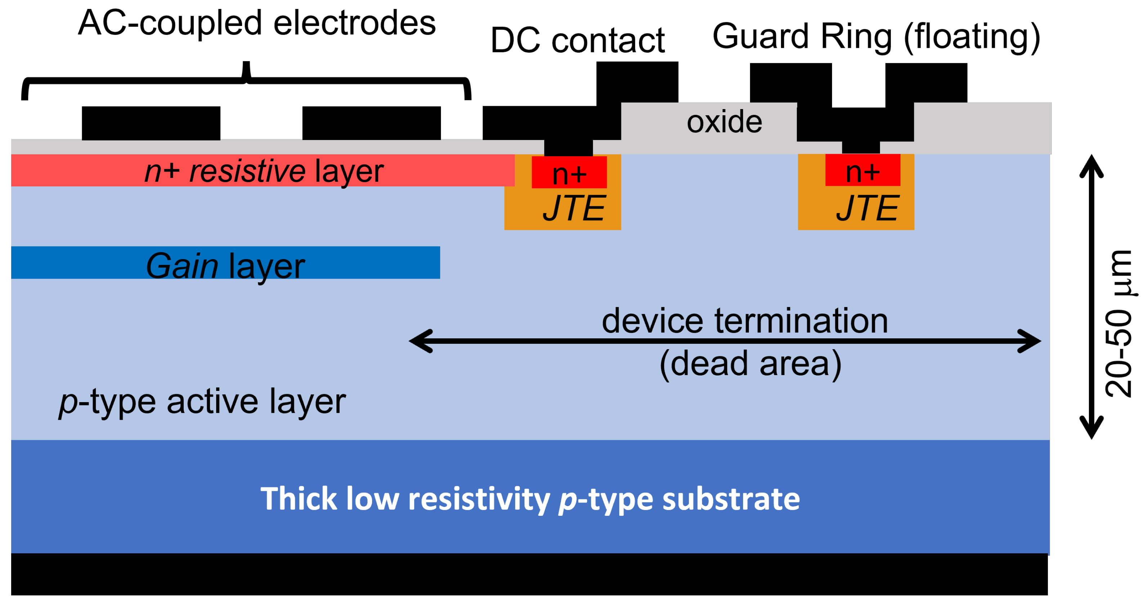
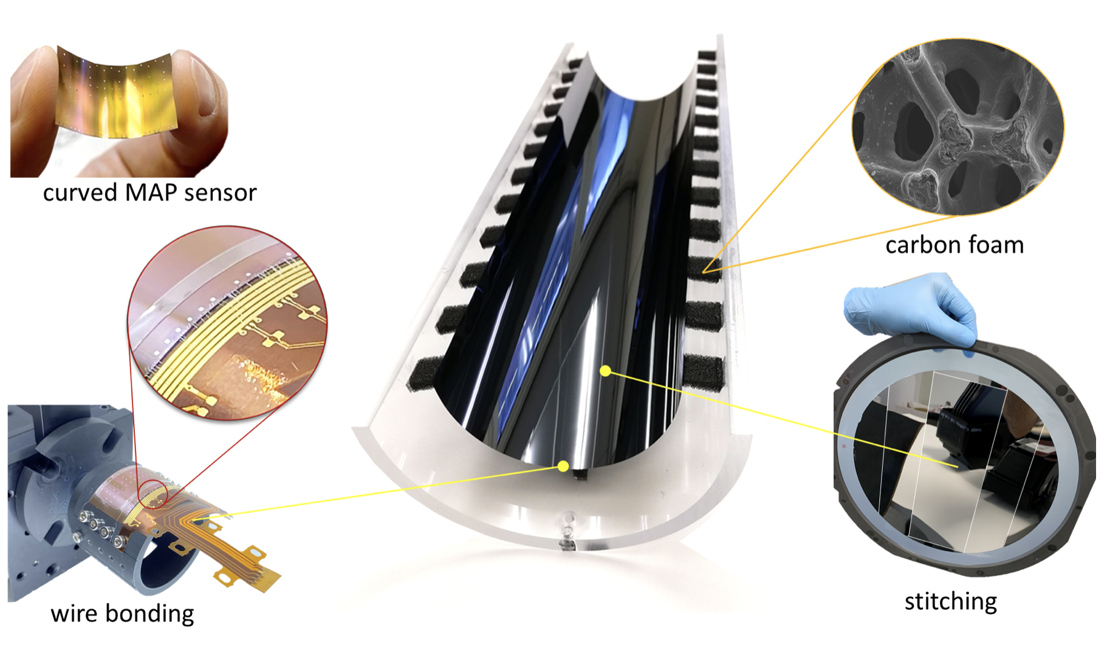
Semiconductor Detector Technology (DRD3)
Semiconductors remain the foundation for future tracking, vertexing, and timing systems.
Era‑2 (HET factory) and Era‑3 (FCC‑hh, Muon Collider) require fine segmentation, low mass, and extreme radiation tolerance.
R&D focuses on CMOS DMAPS, LGADs, 3D and trench sensors, and new materials (SiC, diamond, GaN).
Integration and hybridisation for ultra‑light, high‑density modules are crucial for scalability.
Microelectronics advances must drive the next leaps in precision and rate capability.

Slide 8
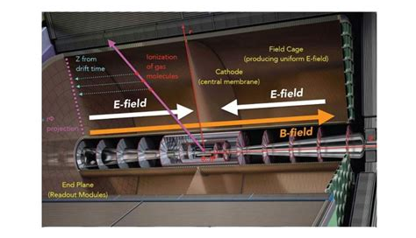
Gaseous Detector Technology (DRD1)
Gaseous detectors evolve toward higher rate capability, finer granularity, and picosecond timing.
Future trackers must sustain rates up to 10 MHz/cm² with long‑term stability and eco‑friendly gases.
DRD1 unifies R&D on MPGDs, RPCs, drift chambers, and TPCs with shared tools and facilities.
Ion backflow suppression, low‑GWP gas mixtures, and recirculation systems are key sustainability goals.

Slide 9
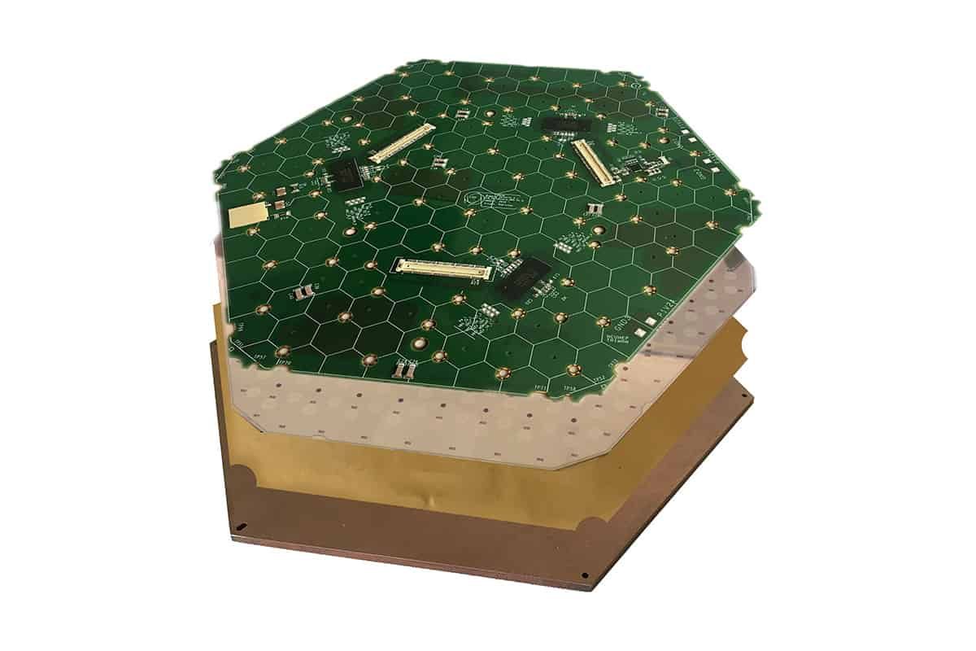
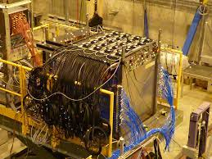
11.6 Calorimeter Technology (DRD6)
Calorimetry transitions to five‑dimensional detectors: energy, position, time, and shower composition.
R&D (DRD6) develops particle‑flow, dual‑readout, and optical calorimetry with embedded electronics.
Integration with tracking and electronics (DRD3, DRD7) is essential for system‑level optimisation.
System demonstrators must validate scalability, power management, and industrialisation early on.

Slide 10
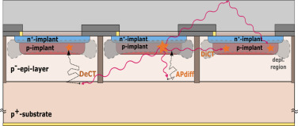
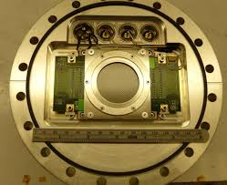
RICH and Photon Detector Technology (DRD4)
Photon detection underpins particle identification across collider and non‑collider experiments.
SiPMs, MCP‑PMTs, and hybrid devices are advancing toward < 100 ps timing and high radiation tolerance.
R&D targets compact, low‑mass, and integrated RICH systems with eco‑friendly radiators.
System‑level co‑design of sensors and readout electronics is needed for high‑rate operation.

Slide 11
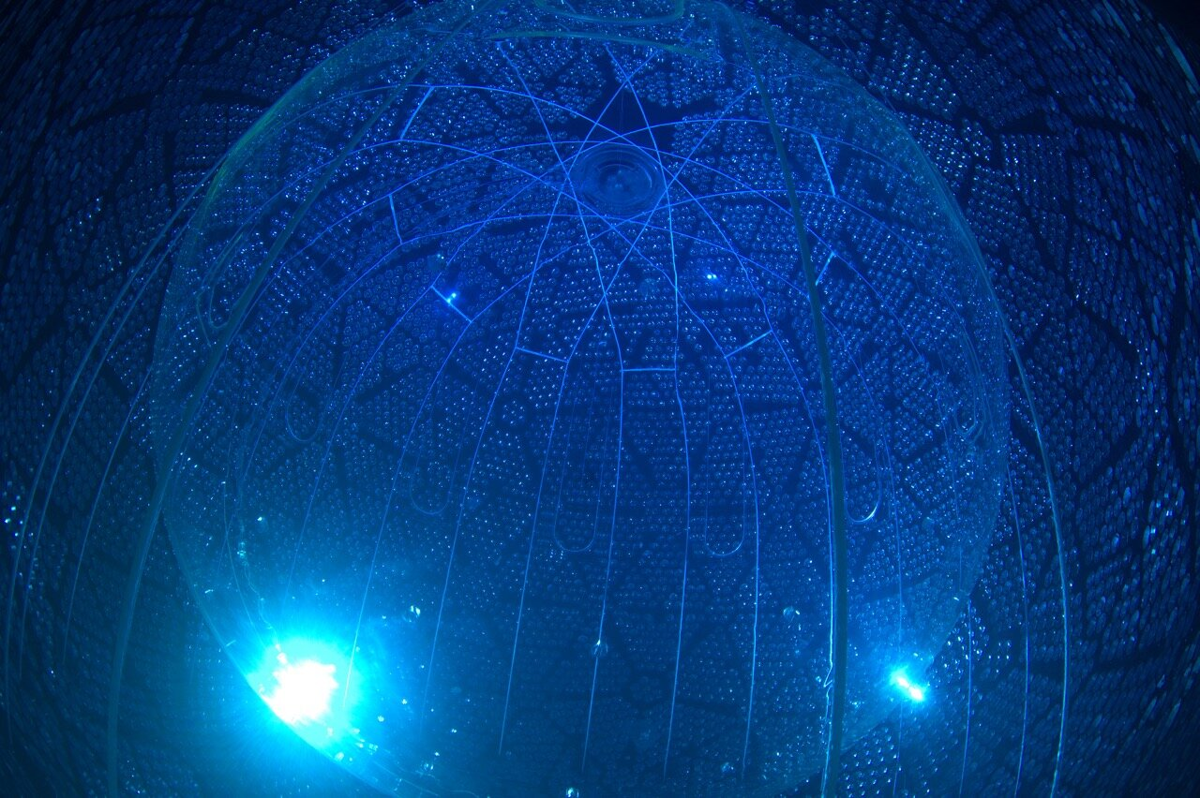
Technologies for Neutrino Experiments (DRD2)
Next‑generation neutrino detectors require scalable, low‑background, high‑resolution technologies.
Liquid detectors (water Cherenkov, scintillator, LAr TPCs) remain dominant, driven by DRD2.
Solid‑state, gaseous, and hybrid detectors address ββ0ν, CEνNS, and neutrino‑mass measurements.
Sustained support for the CERN Neutrino Platform is essential to enable R&D and prototyping.

Slide 12
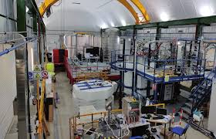
Dark Matter and Rare Event Searches
Dark‑matter instrumentation spans noble liquids, cryogenics, RF, and quantum sensors.
European facilities (LNGS, LSM, Canfranc) provide world‑leading underground R&D infrastructure.
Synergies with DRD1‑6 enable advances in noble‑liquid TPCs, bolometers, and quantum detectors.
Coordination through initiatives like DMInfraNet is key to maximise impact and efficiency.

Slide 13
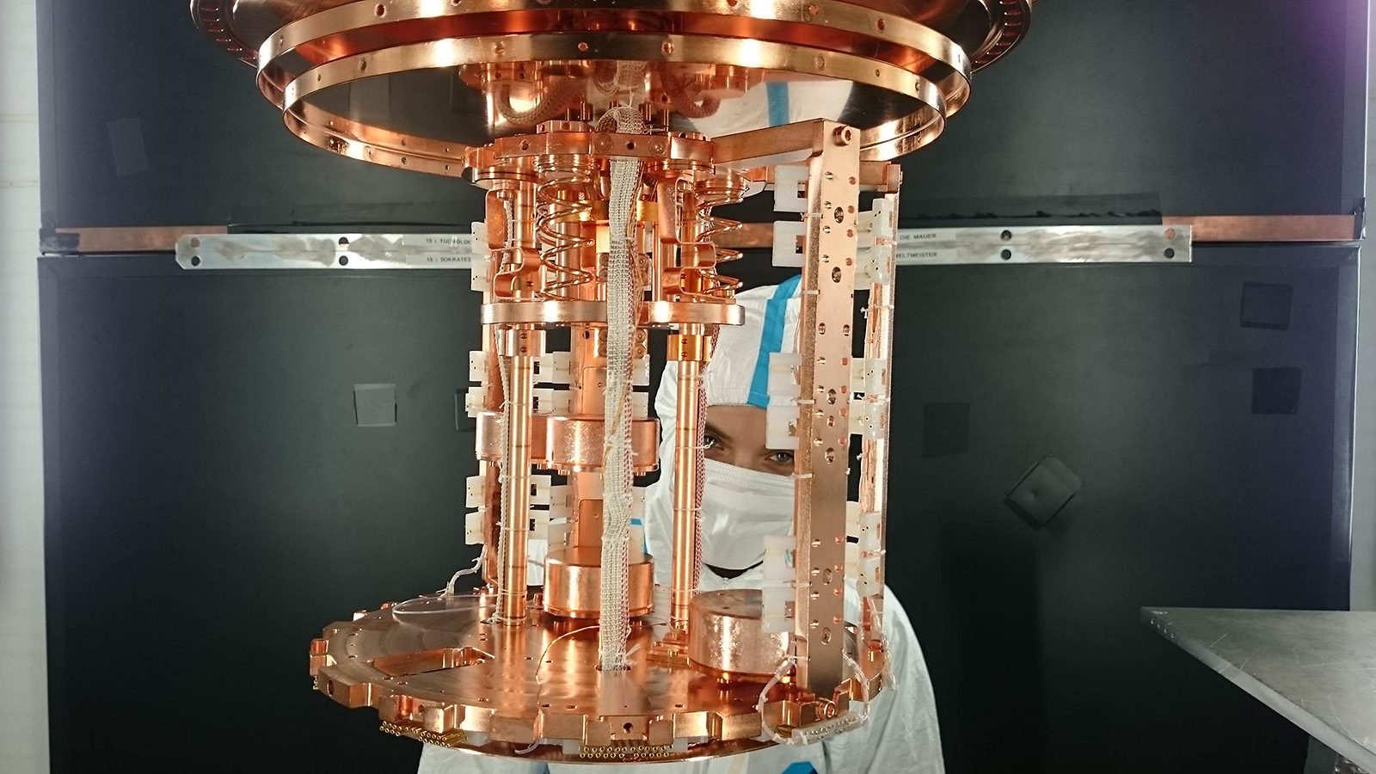
Quantum Sensors (DRD5)
Quantum sensors offer transformative sensitivity for both low‑ and high‑energy experiments.
DRD5 coordinates R&D on spin‑based, superconducting, atomic, and low‑dimensional systems.
Applications range from axion searches and neutrino mass to timing and calorimetry at colliders.
Pilot implementations in particle‑physics detectors should be supported at EU and national levels.

Slide 14
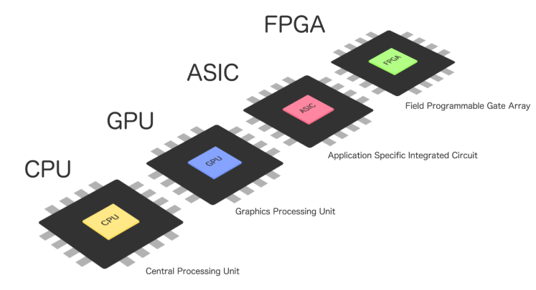
Trigger and Data Acquisition (DRD7)
Future detectors move toward trigger‑less, full‑readout architectures handling extreme data rates.
Intelligent ASICs and real‑time reconstruction are needed to compress, filter, and process data.
FCC‑hh and FCC‑ee front‑ends will demand throughput beyond HL‑LHC; radiation‑hard links are critical.
Joint hardware‑software R&D across DRDs must ensure scalable, power‑efficient DAQ systems.

Slide 15
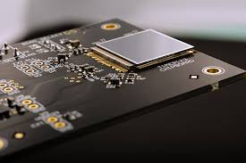
Electronics (DRD7)
Electronics remain the backbone of detector innovation
The HL-LHC ASIC experience exposed limits of small,
dispersed design teams.
The CERN-HEP IC Design Platform (CHIPS) proved
the value of shared tools, professional verification,
and coordinated design.
DRD7 establishes a hub-based collaborative model for ASIC development with shared infrastructure, risk mitigation, and access to advanced foundries.
Future steps: Key message: A coordinated, professional electronics R&D ecosystem is essential to sustain Europe’s leadership in detector technology.

Slide 16
Final remarks: possible update of the Spanish Input to the ESPP?
Key recomendation from the Physics briefbook:
“First priority must be the success of the Era-1 projects at the HL-LHC, at SuperKEKB and at the EIC”
“The Detector R&D (DRD) collaboration structure, created to implement the Roadmap, must be fully exploited”
An incremental update of the Detector R&D Roadmap should be organised by ECFA once a flagship project is approved and its scope and timeline established, to support further focussing of the activities
Key recommedations from the Spanish national input to the European Strategy for Particle Physics:
“The highest priority should now be to ensure the full implementation of the ECFA Detector R&D Roadmap”
“For the future collider experiments identified as top priorities in this ESPP update, it is recommended that ECFA fosters the creation of detector-concept collaborations.”

Slide 17
Final remarks: possible update of the Spanish Input to the ESPP? (2)
Additional (transversal) recommendations from the PBB:
Training should be strengthened by establishing new instrumentation schools that provide early-career researchers and experts with first-hand exposure to state-of-the-art technologies, ensuring their attraction and retention within particle-physics instrumentation.
A supportive R&D ecosystem must be ensured through well-equipped and continuously upgraded beam-test and irradiation facilities, access to generic test platforms, and an environment that fosters creativity, agility, and innovation in developing novel detector technologies.

Slide 18
Discussion slide - Instrumention
Key recomendation from the Physics briefbook:
“First priority must be the success of the Era-1 projects at the HL-LHC, at SuperKEKB and at the EIC”
“The Detector R&D (DRD) collaboration structure, created to implement the Roadmap, must be fully exploited”
An incremental update of the Detector R&D Roadmap should be organised by ECFA once a flagship project is approved and its scope and timeline established, to support further focussing of the activities
Key recommedations from the Spanish national input to the European Strategy for Particle Physics:
“The highest priority should now be to ensure the full implementation of the ECFA Detector R&D Roadmap”
“For the future collider experiments identified as top priorities in this ESPP update, it is recommended that ECFA fosters the creation of detector-concept collaborations.”
Additional (transversal) recommendations from the Physics briefbook:
Training should be strengthened by establishing new instrumentation schools that provide early-career researchers and experts with first-hand exposure to state-of-the-art technologies, ensuring their attraction and retention within particle-physics instrumentation.
A supportive R&D ecosystem must be ensured through well-equipped and continuously upgraded beam-test and irradiation facilities, access to generic test platforms, and an environment that fosters creativity, agility, and innovation in developing novel detector technologies.

