Slide 1
Summary of the Future Colliders Comparative Evaluation Working Group Report
FCCE WG: G. Arduini (chair), M. Benedikt, F. Gianotti, K. Jakobs, M. Lamont, R. Losito, M. Meddahi, J. Mnich, N. Mounet, D. Schulte, F. Sonnemann, S. Stapnes, F. Zimmermann
LII International Meeting on Fundamental Physics, IGFAE, 07/10/2025

Slide 2
Future Colliders Comparative Evaluation
Working group established by CERN Directorate in June 2023, involving Project Leaders of main projects, and other experts.
Membership: G. Arduini (chair), M. Benedikt, F. Gianotti, K. Jakobs, M. Lamont, R. Losito, M. Meddahi, J. Mnich, N. Mounet, D. Schulte, F. Sonnemann, S. Stapnes, F. Zimmermann.
Goal: compare FCC and alternative scenarios in a consistent way, using common assumptions and methodology, in view of the ESPP Update in 2026.
Deliverables:
Summaries of FCC-ee and alternative options for implementation at CERN
Metrics for comparison
Comparative evaluation of the potential options for realization at CERN
Credible and consistent timelines for implementation and time to first physics
Summary of options considered elsewhere in the world that could be realized within the given time frame
Working Group report submitted as input to ESPP2026 on 26/5/2025
https://indico.cern.ch/event/1439855/contributions/6542430/

Slide 3
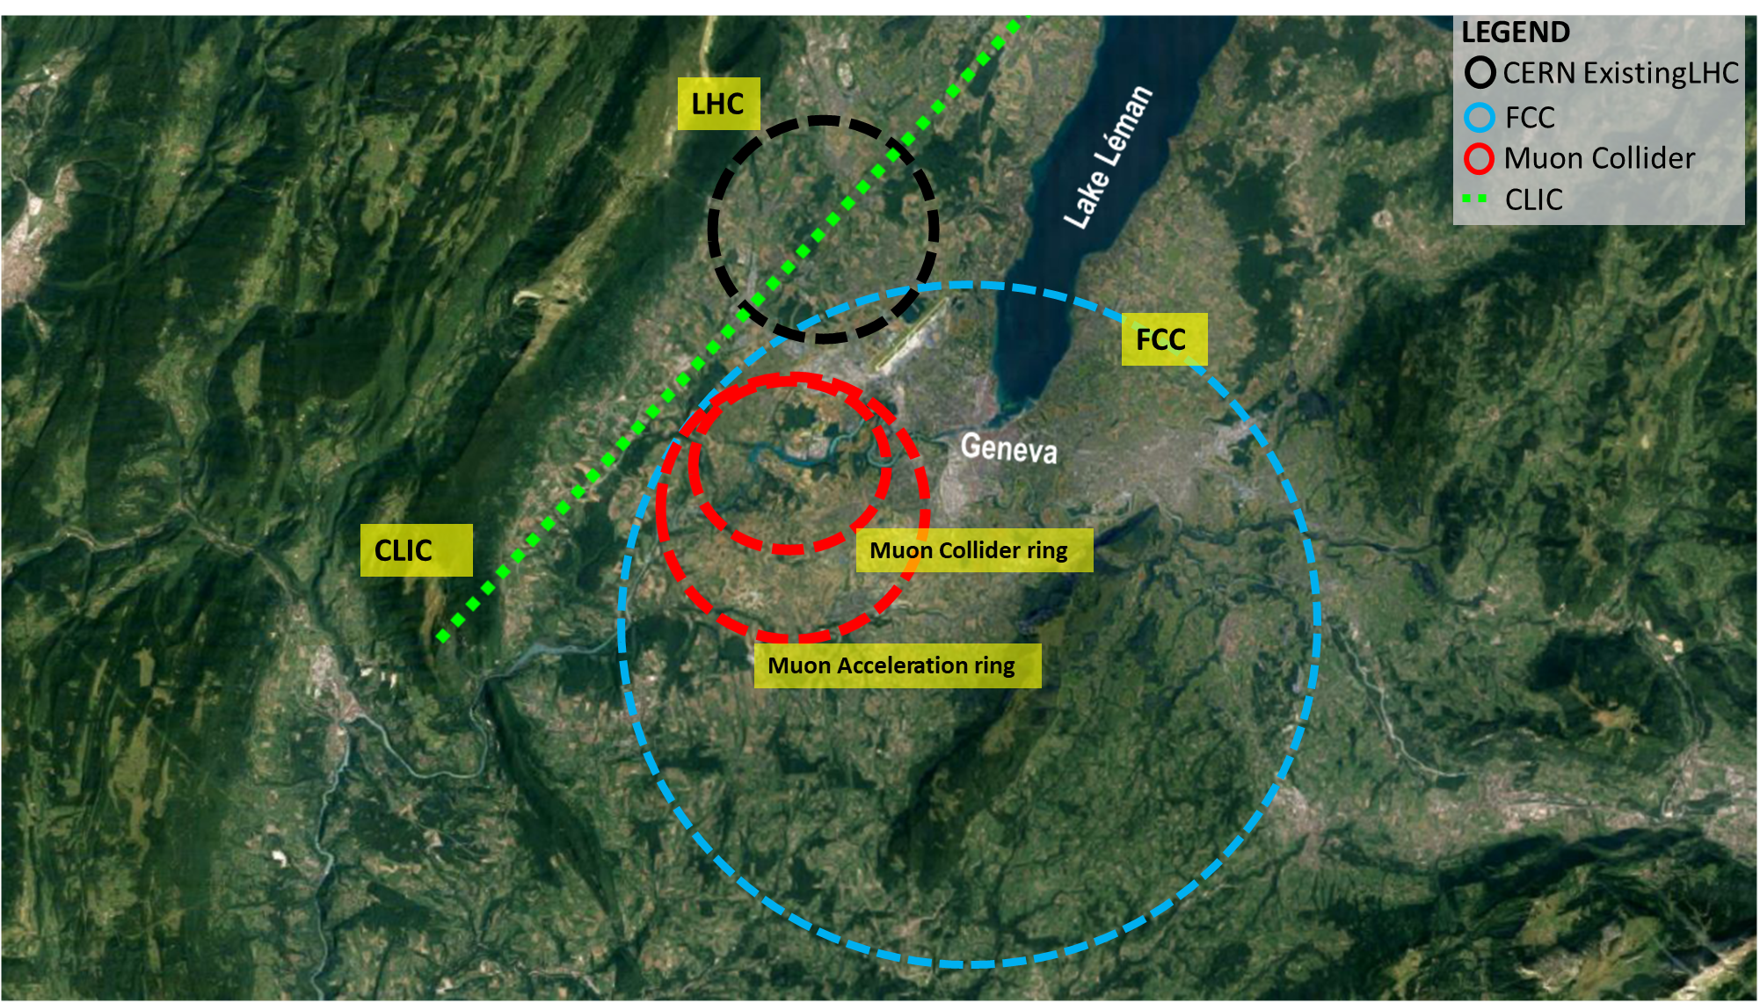
Options considered for the comparison study
Two timeframes considered:
e⁺e⁻ colliders operating in the mid-2040s:
Future Circular e⁺e⁻ Collider (FCC-ee)
Compact LInear Collider (CLIC)
Linear Collider Facility (LCF)
Future colliders operating beyond 2050:
Future Circular hadron-hadron Collider (FCC-hh)
CLIC and LCF upgrades
Muon collider
International landscape:
Circular Electron Positron Collider (CEPC) - China
International Linear Collider (ILC) – Japan
And some considerations about
re-using the LHC tunnel:
High-Energy Large Hadron Collider (HE-LHC)
Large Electron Positron (collider) 3 (LEP3)
Large Hadron-electron Collider (LHeC)
wakefield accelerators, for example
Hybrid Asymmetric Linear Higgs Factory (HALHF)
Advanced Linear collider for Very high Energy (ALiVE)

Slide 4
Methodology
Key performance parameters / topics analysed:
main parameters and performance (luminosity)
environmental aspects (carbon footprint)
technical readiness level (TRL)
material costs for accelerator and experiments construction and installation
human resources for accelerator construction and installation
project timeline
material and personnel costs for operation
Contributed to the standardisation / normalisation of the input provided by the projects to the ESPP2026.
only for e⁺e⁻ colliders starting in the mid 2040s

Slide 5
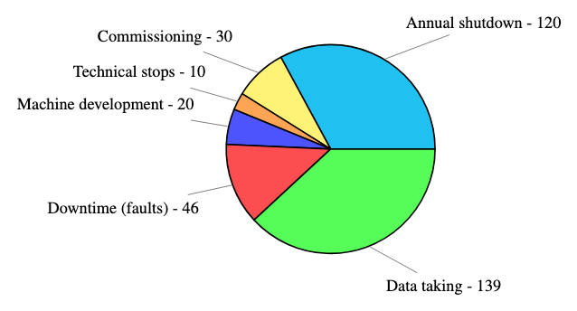
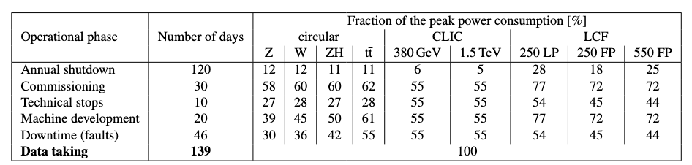
Performance comparison – assumptions
Common assumptions used for operational scenarios for e+/e- colliders [1] to compute
integrated luminosity estimate per year (summed over all IPs)
electricity consumption per year, from the peak wall plug power and the fraction used during each operation phase, provided by the projects.
[1] F. Bordry et al., Machine Parameters and Projected Luminosity Performance of Proposed Future Colliders at CERN, 2018, arXiv: 1810.13022.

Slide 6
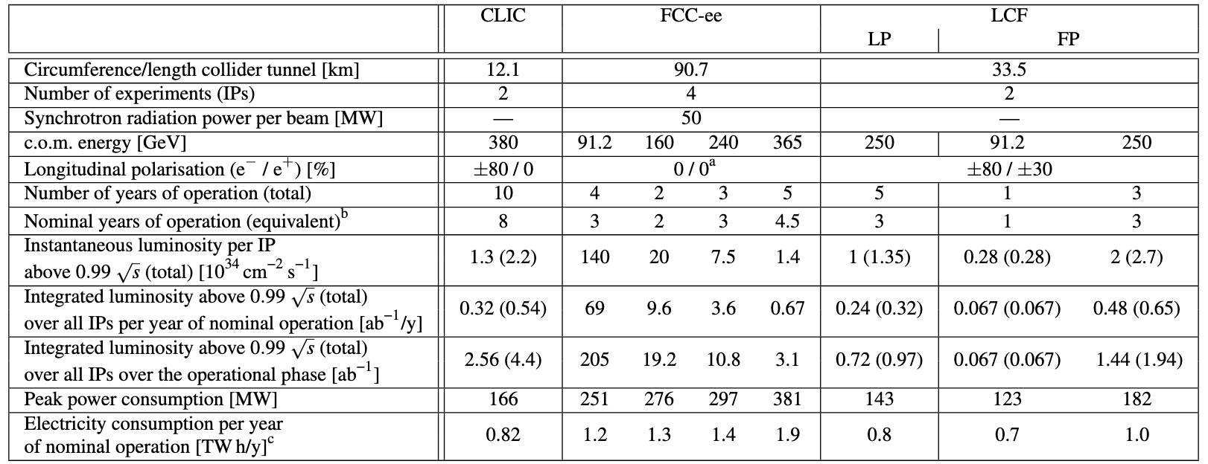
Performance comparison – tables
LP: low power
FP: full power
Comparison table for e⁺e⁻ colliders starting in the mid 2040s:

Slide 7
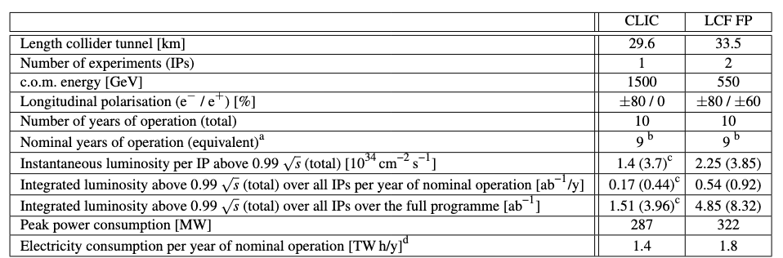
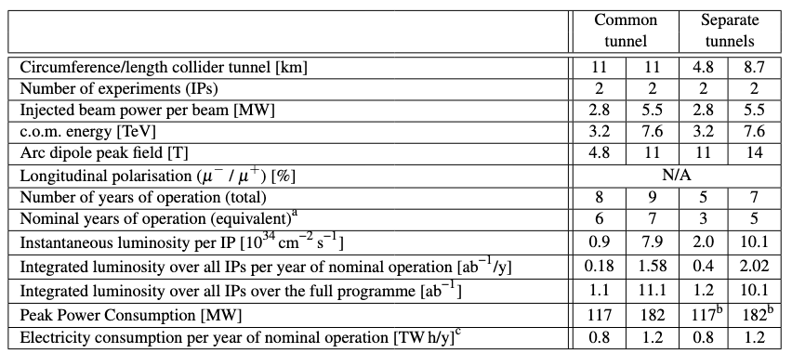
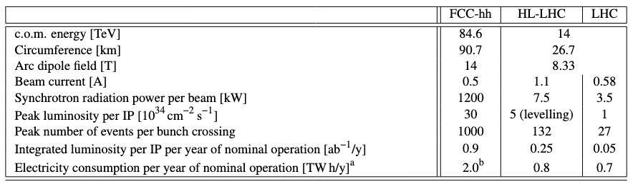
Performance comparison – tables
Comparison table for e⁺e⁻ colliders starting beyond 2050:
Muon collider @ CERN
FCC-hh

Slide 8
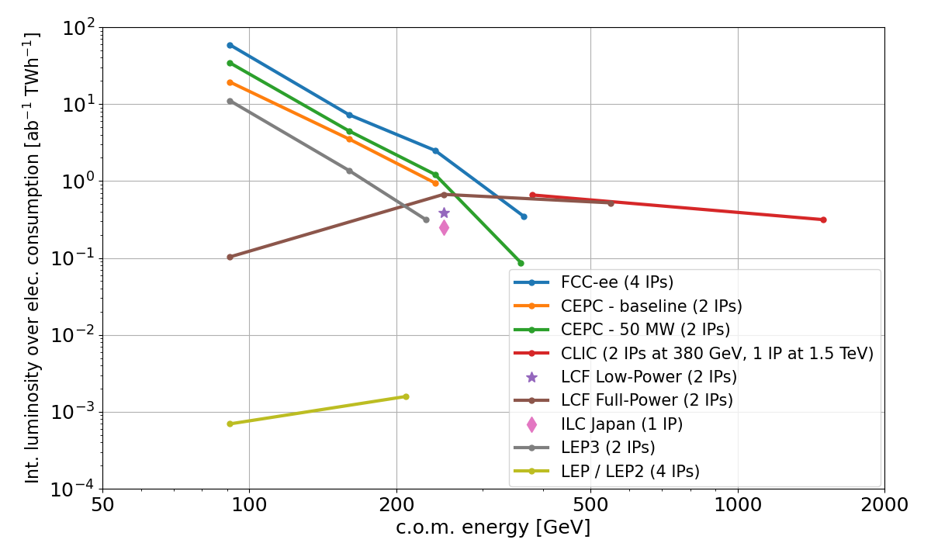
Performance comparison – one figure of merit
Integrated luminosity per unit of electricity consumption, vs. centre-of-mass energy:
Circular colliders are the most efficient at low energy, and can accommodate more experiments and energy levels.
Linear colliders can achieve higher energy, and include polarized e⁻ beam.
LEP3 is still at pre-conceptual design level: larger uncertainty on luminosity & power consumption.
All proposals are several orders of magnitude more efficient than LEP/LEP2.

Slide 9

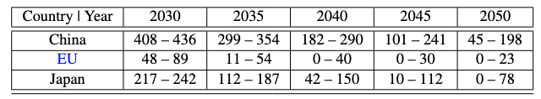
Environmental aspects & sustainability
Environmental aspects are crucial at all levels: in general for the member states, and more specifically in the host states and local area. Life Cycle Assessment (LCA) is an internationally standardised method to assess environmental impact.
Focus on Greenhouse Gas (GHG) emissions:
Construction: civil engineering, hardware (when available)
Operation: electricity consumption, using conversion factor (in g CO₂ eq. per kWh):
For France, the factor includes the full life-cycle (from power plant construction to its end of life).
Thanks to N. Bellegarde and N. Sapountzoglou

Slide 10
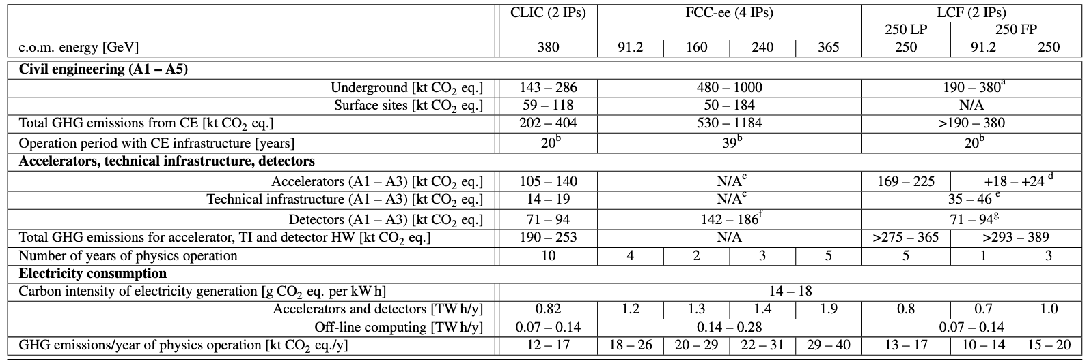
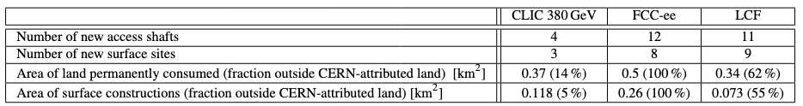
Environmental aspects & sustainability – results
Greenhouse gas footprint comparison for e⁺e⁻ colliders (starting in the mid 2040s):
Area of occupied land also compared:

Slide 11
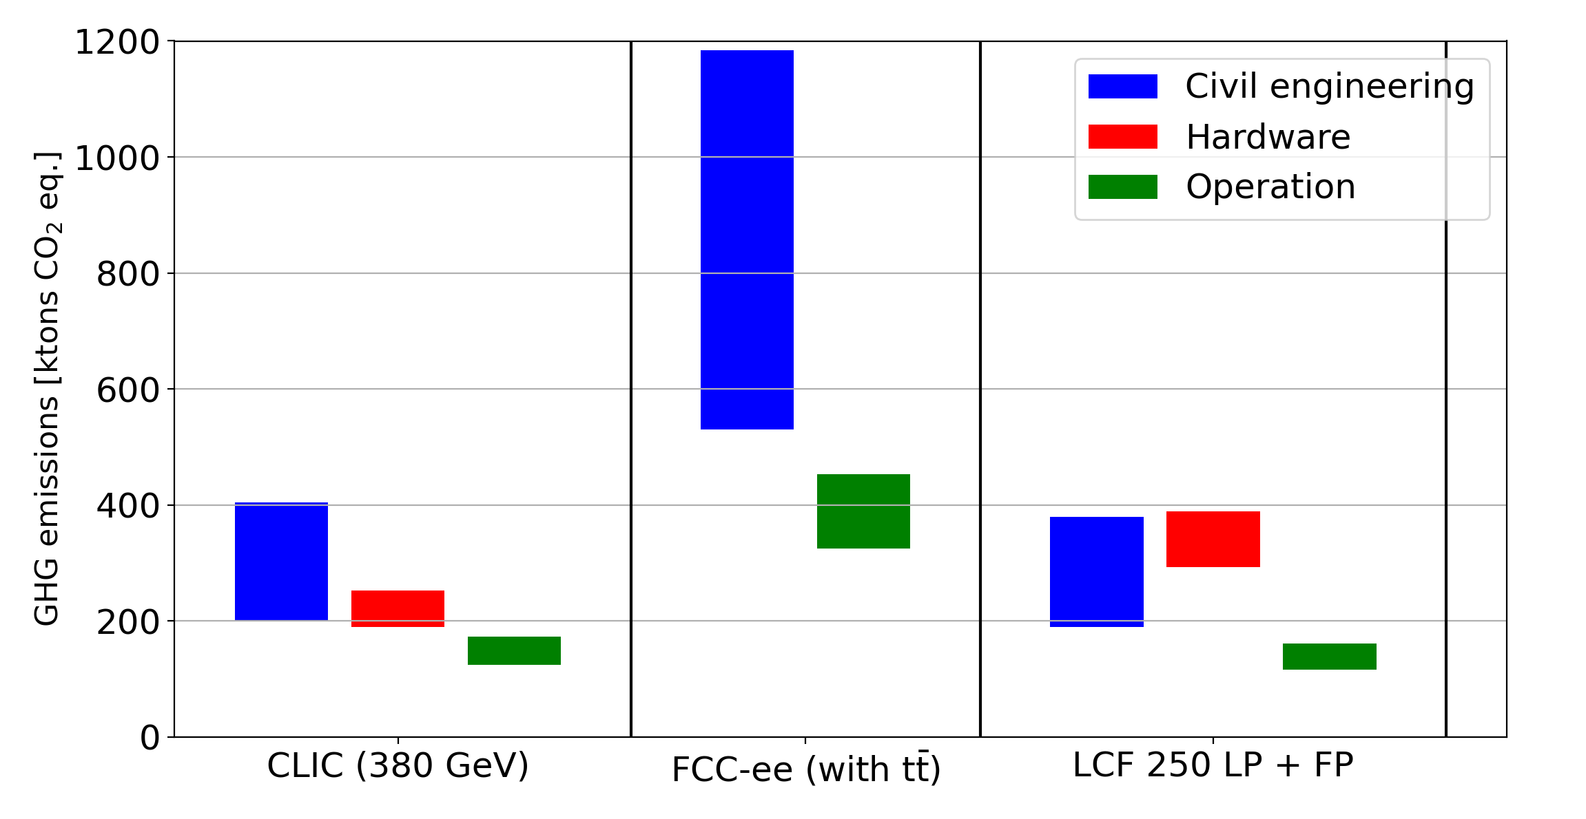
Environmental aspects & sustainability – results
Greenhouse gas footprint comparison for e⁺e⁻ colliders (range of values – higher bound based on available technology, lower one on potential reductions, e.g. improvement in cement):
Reuse of infrastructure (e.g. CE) for future upgrades will benefit the sustainability of projects.

Slide 12
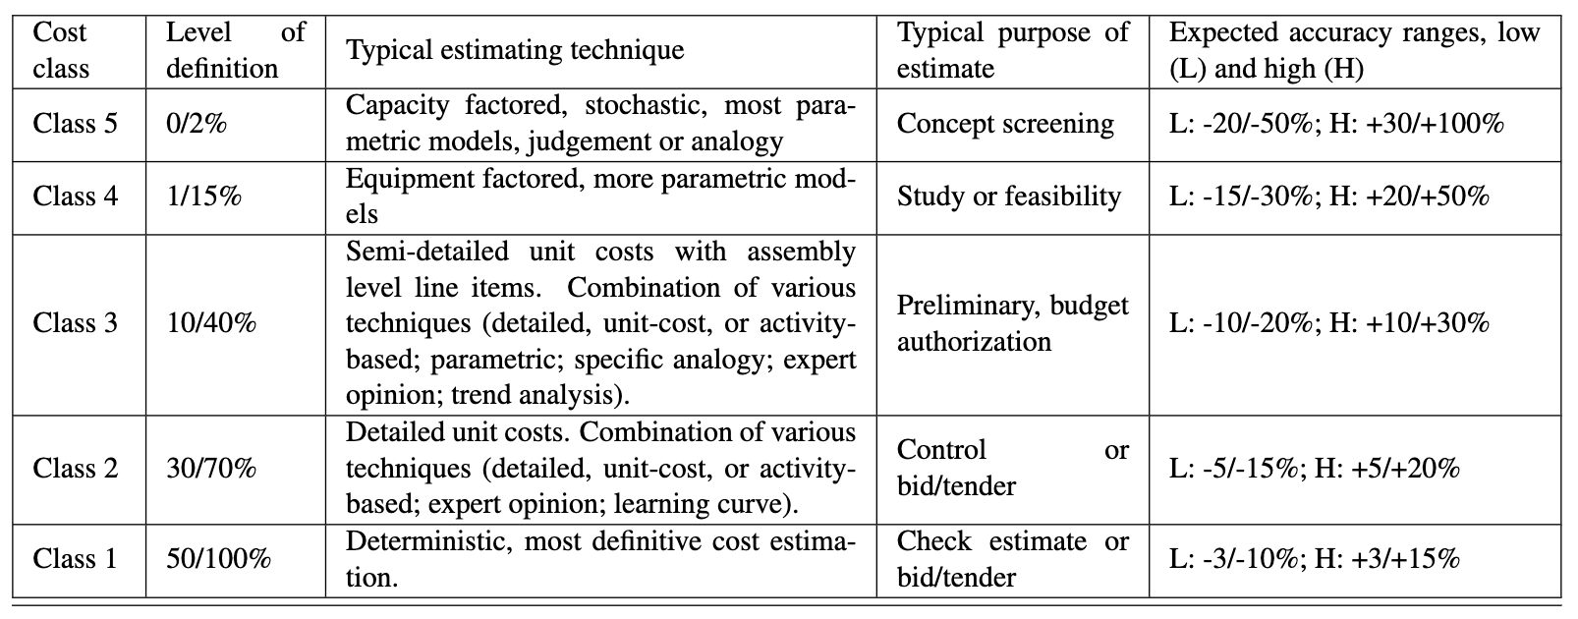
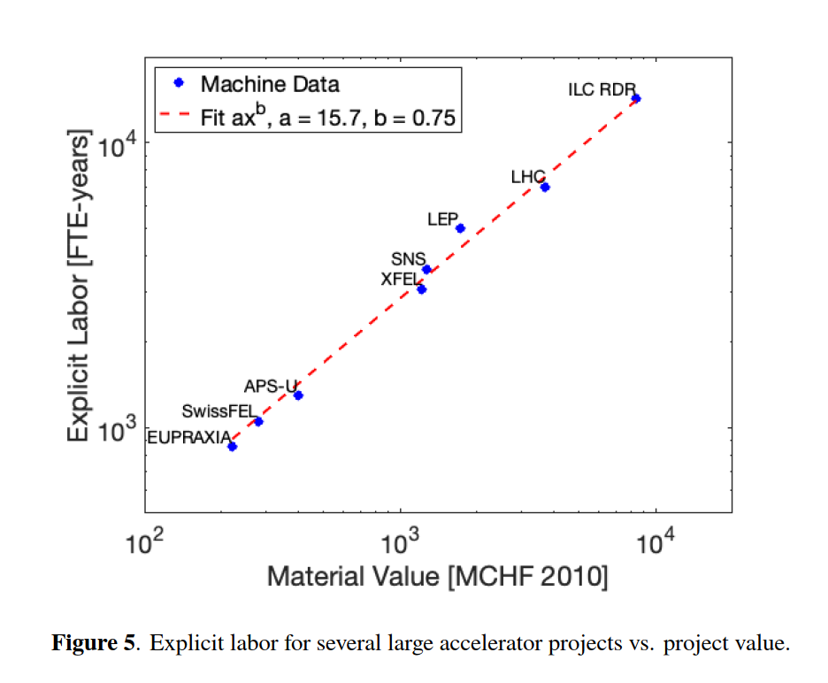
Construction and Installation Costs: Material and Personnel
From AACE® International, AACE International Recommended Practice No. 18R-97 – Cost Estimate Classification System
Detailed costing for CLIC, FCC-ee, LCF (the latter considering ILC cost update, 2 IPs, CERN implementation):
Main tunnel accelerators, (pre-)Injectors & transfer lines, Civil Engineering, Technical infrastructures, Experiments.
with cost uncertainty class.
Have different level of uncertainty and scrutiny:
FCC-ee has generally the most accurate cost estimate: CE highest contributor but with good accuracy as the placement scenario has been fully defined. Cost has been reviewed by expert committees, CERN Council and its subordinate bodies.
Personnel for the construction of the accelerators ranges between 10 and 15 kFTEy. Consistent with scaling law proposed by Snowmass’21 [1].
[1] T. Roser et al.,” On the feasibility of future colliders: report of the Snowmass'21 Implementation Task Force”, JINST 18 P05018 (2023)
Notes:
Cost excludes: explicit labour / contingency / costs prior to project approval / off-line computing / spares & maintenance / beam commissioning

Slide 13
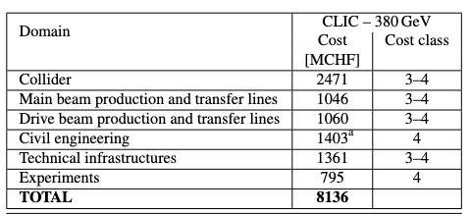
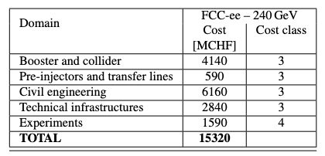
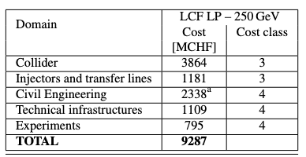
Construction costs summary – CLIC / FCC-ee / LCF
Breakdown of construction costs:
Costs include construction, tooling, reception tests, pre-conditioning, hardware commissioning, total detector costs (CERN contribution will actually be 10% of the total), and land-related and administrative costs.

Slide 14
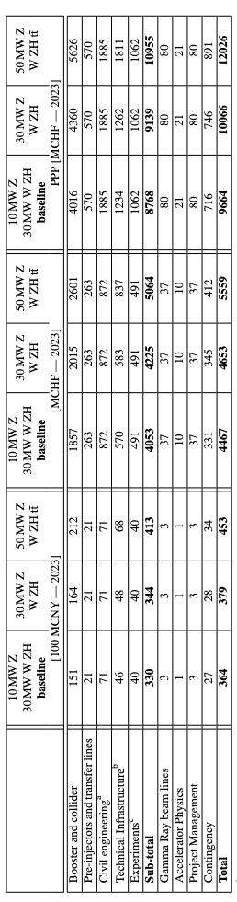
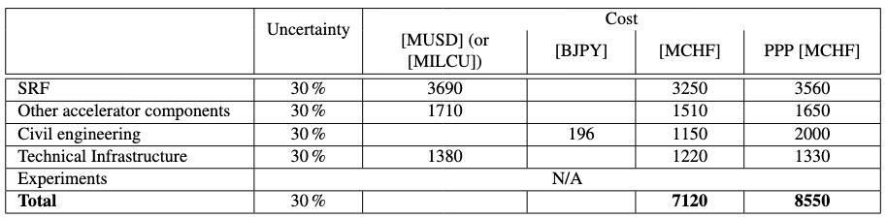
Construction costs & lumi – comparison with projects outside CERN
CEPC (China) & ILC (Japan) construction costs:
CEPC
ILC
These are the costs that can be compared to CERN projects, after conversion using the Purchasing Power Parity (PPP)

Slide 15
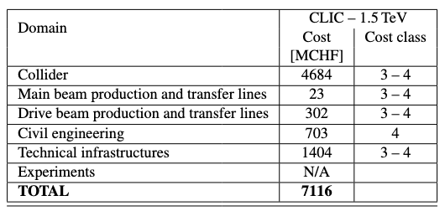
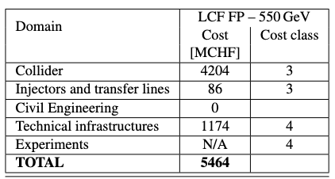
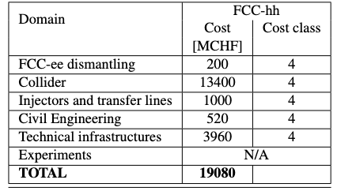
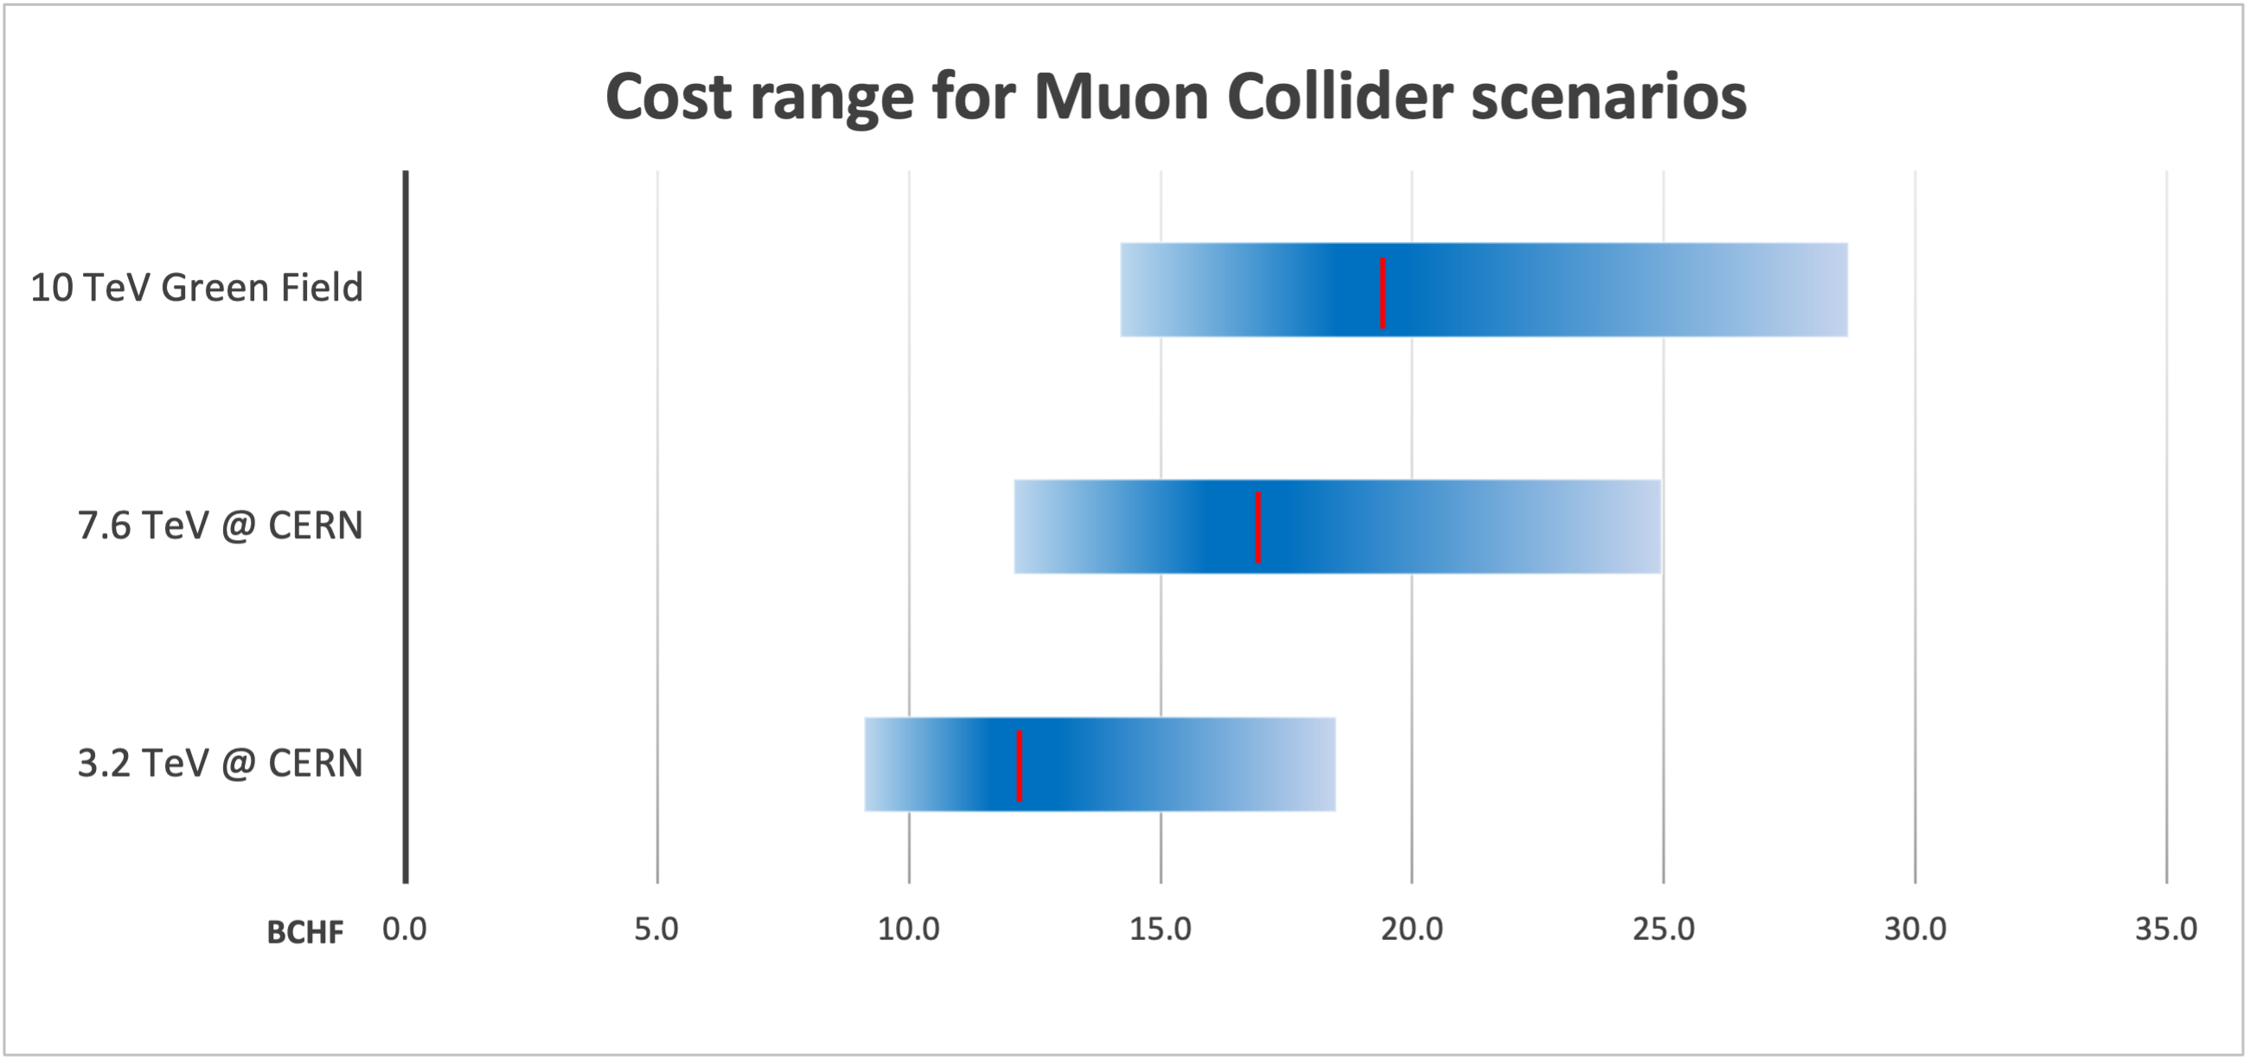
Construction costs summary – beyond 2050
Breakdown of construction costs:

Slide 16
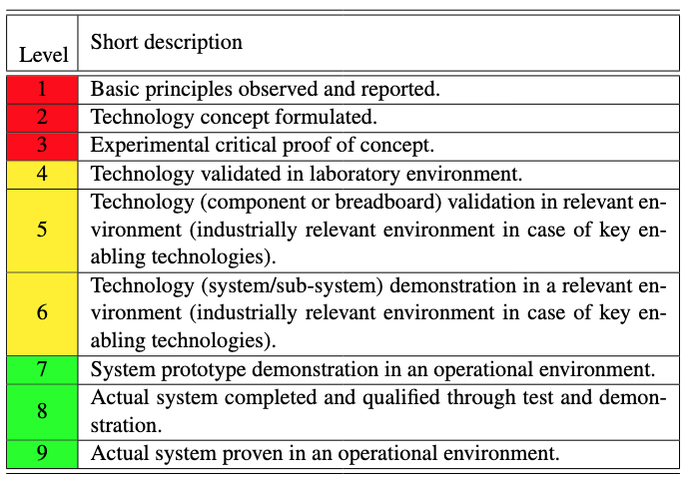
Technical readiness – methodology
Evaluated via the concept of Technical Readiness Level (TRL) of selected, critical components:
Improvement factor on critical components, and the R&D effort needed to reach it, is also compared between the options.
From N. Holtkamp et al., Input
to the European Strategy for Particle Physics — 2026 Update — ID 154

Slide 17
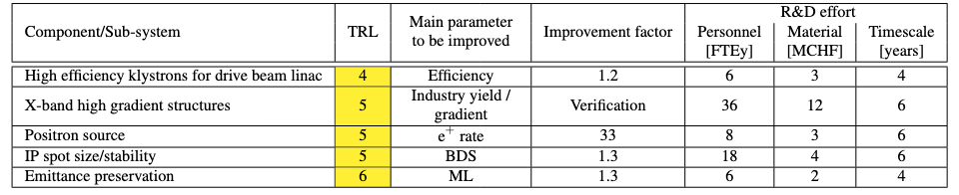
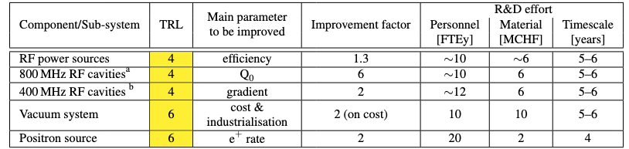
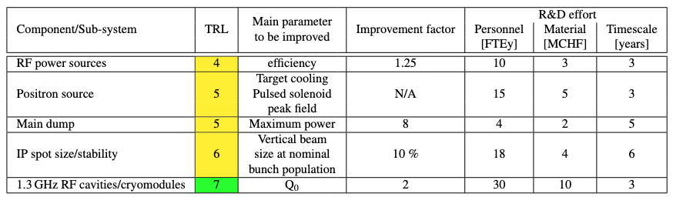
Technical readiness – CLIC / FCC-ee / LCF
TRL / improvement factor / R&D for key selected components:
Building on Snowmass’21 Implementation Task Force [1] and on the LDG accelerator R&D review held in February 2025 [2]
CLIC
FCC-ee
[1] T. Roser et al., JINST 18 P05018 (2023)
[2] N. Holtkamp et al., Input
to the ESPP - 2026 Update - ID 154.
LCF
⟹ TRLs are comparable for the major Higgs factory studies.

Slide 18
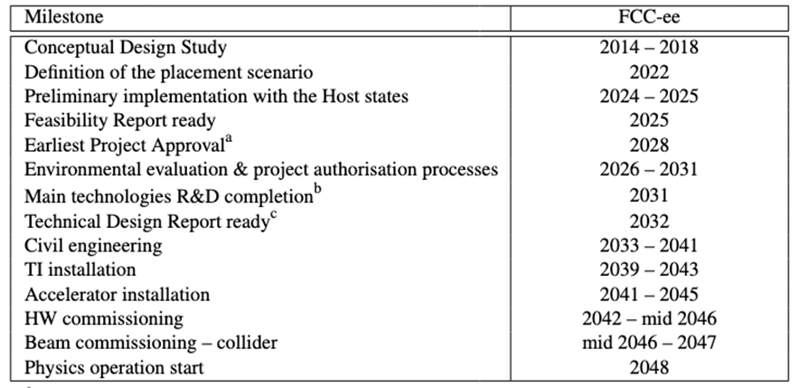
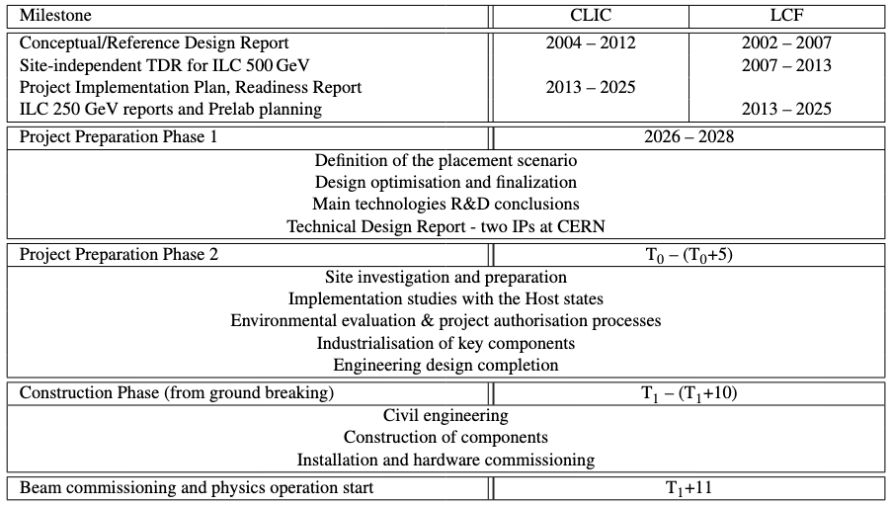
Project timeline
Financial and personnel commitments for HL-LHC operations imply that a future collider cannot realistically start operation before mid 40s.
FCC feasibility study (FS) completed and detailed timeline established considering the above constraints.
CLIC, and particularly LCF@CERN, would require a preparation phase (with corresponding resources) to reach a level of detail comparable to the FCC FS. ⟹ Difficult to conduct two territorial implementation studies in parallel in the Host States. ⟹ Relative timelines provided, with respect to decision points (and considering the above constraint).
Notes:
For CLIC & LCF, timeline depends on several dates which will be defined later:
T₀ is determined by a process in 2028-29 to validate the progress and promise of the project for a further development towards implementation.
T₁ for Preparation Phase 2 will be determined by the processes needed, by the CERN Council and with host-states, for project approval and to start construction.

Slide 19
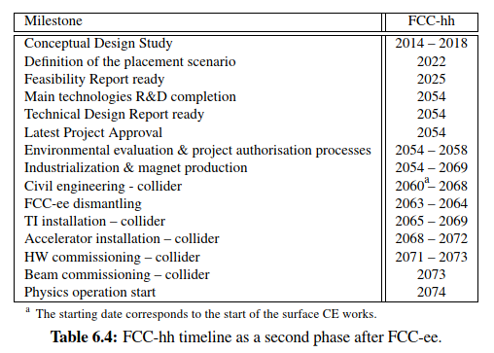
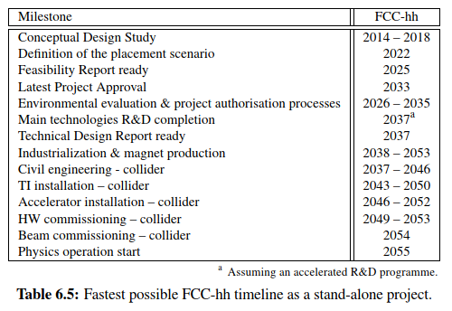
Project timeline
As a 2nd phase after FCC-ee, FCC-hh could start operation in mid 2070s.
On a technically-limited timescale (assuming accelerated R&D) a stand-alone FCC-hh with 14 T Nb₃Sn dipoles could start operation in the mid 2050s.

Slide 20
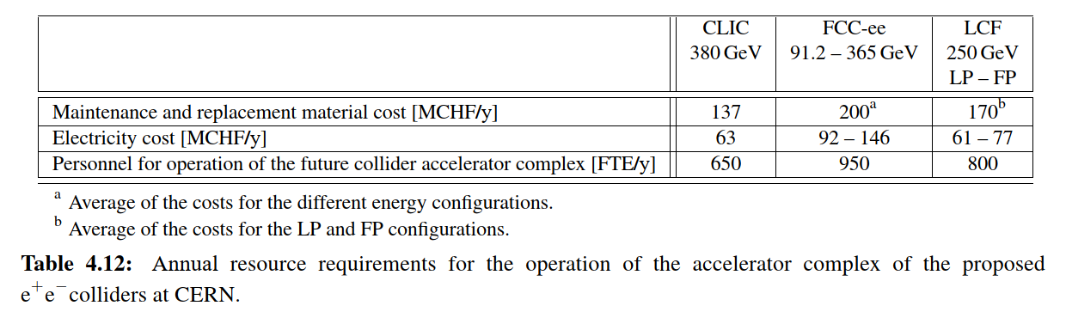
Operation: resources (annual requirements)
Material:
Maintenance and replacement costs:
3% of powering systems (e.g. klystrons, RF and magnet power converters) CAPEX, considering the limited lifetime of these parts;
1% of remaining accelerator HW (RF cavities/structures, magnets) CAPEX for replacements
5% of technical infrastructure (e.g. cooling, ventilation, electronics and electrical infrastructures, access and safety systems, cryogenics, computer and network infrastructure, control systems, robotics, lifts and transport system) CAPEX. It includes the cost of contractors;
Electricity cost (assumed 80 €/MWh)
Personnel:
Based on LHC experience
Notes:
These estimates might be pessimistic and represent an upper limit considering the expected impact
of modern controls, Artificial Intelligence (AI) and robotics by the time of the operation of the future
colliders.

Slide 21
Other alternatives – re-use of LHC tunnel
Three main possibilities for a new collider within LHC tunnel:
LEP3 [1] (earliest start: second half of 2040s):
Cost: ~3850 MCHF (FCC-ee: 15200 MCHF)
c.o.m. energy: 91.2 / 230 GeV (FCC-ee: 91.2 / 240 GeV)
Integrated luminosity per year: 10.6 / 0.43 ab⁻¹/y (FCC-ee: 69 / 3.6 ab⁻¹/y)
Peak power (assuming HTS magnets): NA / 250 MW (FCC-ee: 251 / 297 MW)
HE-LHC [2] (earliest start: beginning of 2070s):
Cost: ~7200 MCHF (FCC-hh: 19080 MCHF + FCC-ee)
c.o.m. energy: 27 / 34 TeV (FCC-hh: 84.6 TeV)
Arc dipole field: 16 / 20 T (FCC-hh: 14 T)
Integrated luminosity per year: 0.5 ab⁻¹/y (FCC-hh: 0.9 ab⁻¹/y)
LHeC [3] (earliest start: 2 years after the end of HL-LHC):
Cost: ~2400 MCHF
c.o.m. energy: 1.18 TeV
Integrated luminosity per year: 180 fb⁻¹/y
[1] T. Virdee et al, ESPP 2026, ID 188, back-up document
[2] L. Bottura and F. Zimmermann, p. 367, in “The future of the Large Hadron Collider : a super-accelerator with multiple possible lives”, O. Brüning (editor), Word Scientific, 2023
[3] F. Ahmadova et al., ESPP 2026, ID 56

Slide 22
Summary
Comparative evaluation of main future collider options
Taking the same criteria & assumptions for all options
Information collected through the projects (leaders directly involved in the WG), in collaboration with CERN sustainability panel and LDG sustainability WG
Report was an input to ESPP (ID 281). It will be on arXiv soon, then hopefully published as yellow report.
Next steps: within the European Strategy Group (WG2a).
Acknowledgements: Erik Adli, Bernhard Auchmann, Nicolas Bellegarde, Caterina Bloise, Oliver Brüning, Liam Bromiley, Xavier Buffat, Simone Campana, John Farmer, Gerardo Ganis, Jie Gao, Frank Gerigk, Edda Gschwendtner, Philippe Lebrun, Benno List, Jenny List, Ed Mactavish, Peter McIntosh, Shinichiro Michizono, Tatsuya Nakada, Mauro Nonis, John Osborne, Vittorio Parma, Thomas Roser, Nikolaos Sapountzoglou, John Seeman, Thomas Schörner, Markus Schulz, Maxim Titov, Ezio Todesco, Marlene Turner, Anders Unnervik, Jim Virdee, Tim Watson, and Akira Yamamoto. From LDG: Dave Newbold, Mike Seidel, Norbert Holtkamp, Mei Bai, Frederick Bordry, Nuria Catalan-Lasheras, Barbara Dalena, Massimo Ferrario, Andreas Jankowiak, Robert Rimmer, Herman ten Kate, Peter Williams.

Slide 23
Backup

Slide 24
Context
HL-LHC will be operating until 2041.
CERN is positioning itself to be able to start operating a new major facility in the mid-2040s, and to ensure bright future for CERN for the second half of the century.
From the 2020 update of the European Strategy for Particle Physics (ESPP) [1]:
An electron-positron Higgs factory is the highest-priority next collider. For the longer term, the European particle physics community has the ambition to operate a proton-proton collider at the highest achievable energy.
⟹ New facility should be an e⁺e⁻ Higgs factory.
⟹ Need down-selection, a decision, and project resource commitment in the 2028 – 2030 time frame.
[1] European Strategy Group, 2020 Update of the European Strategy for Particle Physics, CERN-ESU-015

Slide 25
General considerations & CERN constraints
HL-LHC will be operating until 2041:
Finance & personnel do not allow commissioning of any major new facility at CERN before 2041.
A transitional period is required to redeploy resources / complete installation & commissioning / ramp up infrastructures
⟹ no matter how mature it is, a future collider at CERN cannot realistically start operation before the mid-2040s.
FCC has invested a lot in territorial implementation studies with the Host State authorities and local communities
These cannot support implementation studies for two big infrastructures
⟹ Siting analysis for alternative options should be limited to conceptual studies, using existing information.
The Muon Collider:
is an exciting long-term possibility with excellent physics potential
but still at an early stage of development, with much R&D required, so cannot be considered as an option for implementation in the timeframe discussed here.
⟹ Should be pursued through a sustained R&D effort, independent of the decision on the next major collider.
Alternative options re-using the LHC tunnel, such as LEP3 or LHeC, would require infrastructure investments and operating costs, and delay the implementation of a next-generation collider by at least one to two decades.
⟹ cannot be considered as “bridges” but rather as alternatives to other proposed colliders.
A linear collider at CERN would preclude FCC-hh construction (infrastructure and other constraints in the local region).

Slide 26
New acceleration techniques – wakefield accelerators (WFAs)
Many outstanding issues remain unsolved for WFAs (e.g. positron acceleration in PWFA / LWFA, staging, emittance preservation, repetition rate) ⟶ ~15 years of R&D needed (see ESSP submission 154, 2025)
For Higgs factories, the WFAs studies submitted to ESPP have not reached the maturity of projects like FCC-ee / CLIC / LCF. In particular:
HALHF avoids the positron acceleration problem but does not solve the basic R&D requirements to address the existing parameter gap. From B. Foster et al., New J. Phys. 25 (2023) 093037: "[...] there must be progress toward the use of multiple stages, self-correction mechanisms, higher accelerated charge (by a factor ∼ 10), higher repetition rate (by a factor ∼ 1000), plasma-cell design required to cope with large power dissipation (by a factor ∼ 1000) and reduction of beam jitter to an acceptable level (by a factor ∼ 10 − 100)”
The proton-driven ALiVE (Advanced Linear collider for Very high Energy – ESPP submission 210, 2025) avoids the staging issue, but is still without any solution for the positron acceleration, nor any detailed design for the fast-cycling, FFAG proton complex.

