Slide 1
Superconducting RF for Higgs factories
September 4, 2025
Kellen McGee
FNAL

Slide 2
Outline
Introduction to superconducting RF
Special SRF considerations for Higgs factories
SRF for FCC
SRF for ILC/LCF
Muon collider

Slide 3
Introduction to superconducting RF

Slide 4
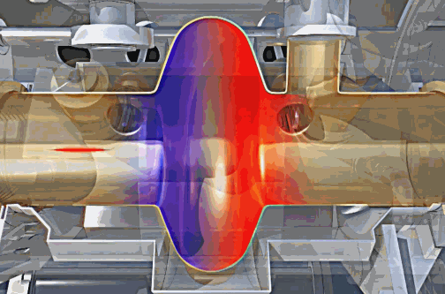
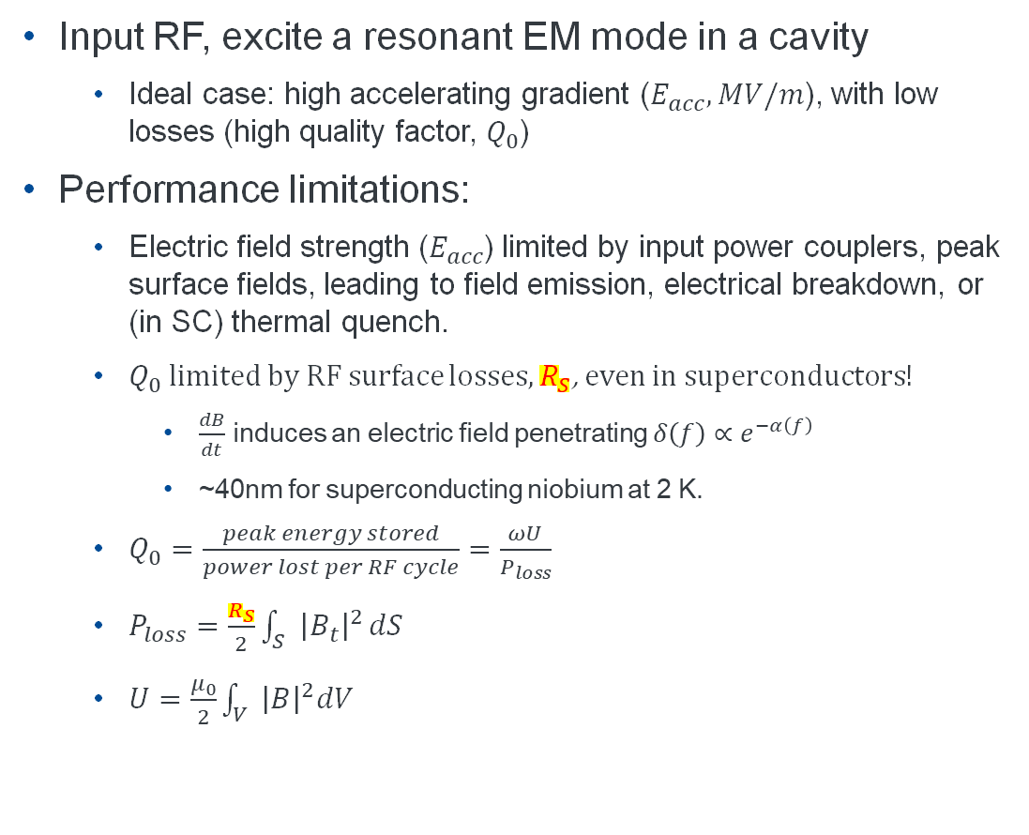
Introduction to SRF: theory
(...and practice)
Input RF, excite a resonant EM mode in a cavity
Ideal case: high accelerating gradient ($E_{acc}, MV/m$), with low losses (high quality factor, $Q_{0}$)
Performance limitations:
Electric field strength ($E_{acc}$) limited by input power couplers, peak surface fields, leading to field emission, electrical breakdown, or (in SC) thermal quench.
$Q_{0}$ limited by RF surface losses, $R_{S}$, even in superconductors!
$\frac{dB}{dt}$ induces an electric field penetrating $δ\left(f\right)∝e^{−α\left(f\right)}$
~40nm for superconducting niobium at 2 K.
$Q_{0}=\frac{peak energy stored}{power lost per RF cycle}=\frac{ωU}{P_{loss}}$
$P_{loss}=\frac{R_{S}}{2}\int_{S}{{\left|B_{t}\right|}^{2}}dS$
$U=\frac{μ_{0}}{2}\int_{V}{{\left|B\right|}^{2}dV}$
© 2014 CERN: Daniel Dominguez, Arzur Catel Torres

Slide 5
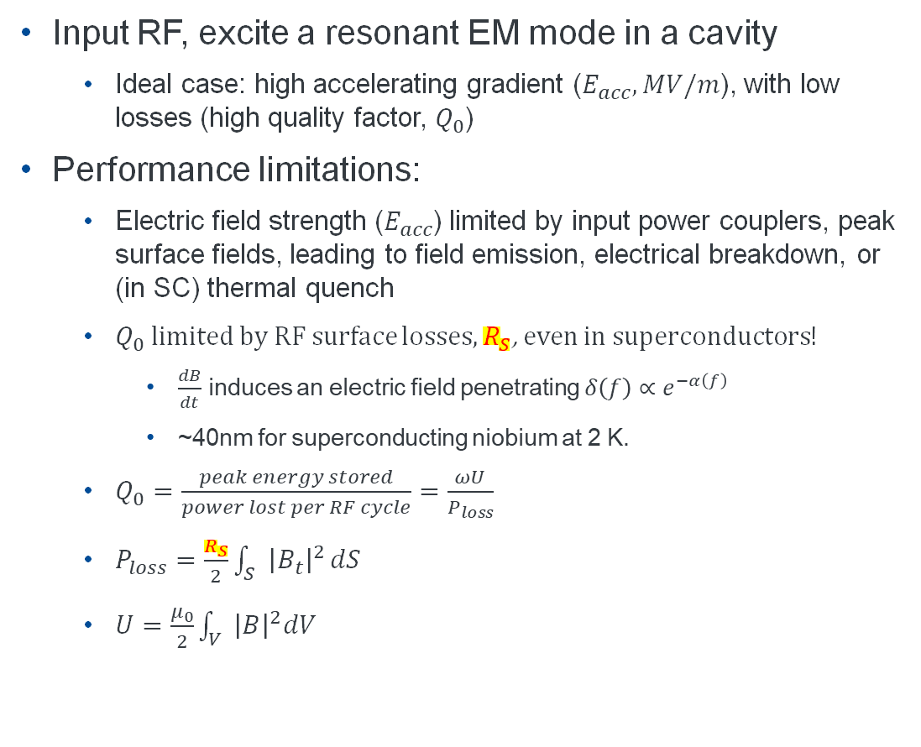
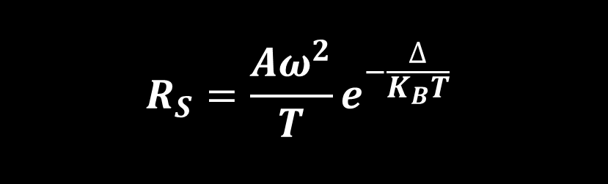
Introduction to SRF: theory
(...and practice)
Input RF, excite a resonant EM mode in a cavity
Ideal case: high accelerating gradient ($E_{acc}, MV/m$), with low losses (high quality factor, $Q_{0}$)
Performance limitations:
Electric field strength ($E_{acc}$) limited by input power couplers, peak surface fields, leading to field emission, electrical breakdown, or (in SC) thermal quench
$Q_{0}$ limited by RF surface losses, $R_{S}$, even in superconductors!
$\frac{dB}{dt}$ induces an electric field penetrating $δ\left(f\right)∝e^{−α\left(f\right)}$
~40nm for superconducting niobium at 2 K.
$Q_{0}=\frac{peak energy stored}{power lost per RF cycle}=\frac{ωU}{P_{loss}}$
$P_{loss}=\frac{R_{S}}{2}\int_{S}{{\left|B_{t}\right|}^{2}}dS$
$U=\frac{μ_{0}}{2}\int_{V}{{\left|B\right|}^{2}dV}$
© 2014 CERN: Daniel Dominguez, Arzur Catel Torres
$$R_{S}=\frac{Aω^{2}}{T}e^{−\frac{∆}{K_{B}T}}$$

Slide 6
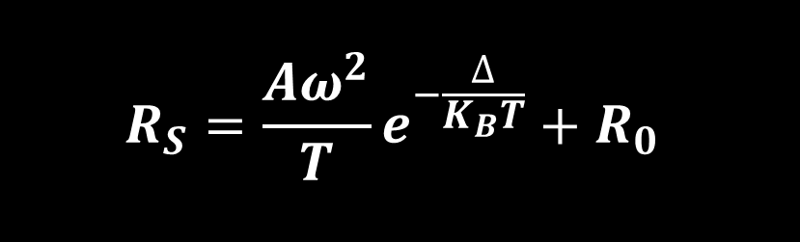
Introduction to SRF: theory
(...and practice)
Input RF, excite a resonant EM mode in a cavity
Ideal case: high accelerating gradient ($E_{acc}, MV/m$), with low losses (high quality factor, $Q_{0}$)
Performance limitations:
Electric field strength ($E_{acc}$) limited by input power couplers, peak surface fields, leading to field emission, electrical breakdown, or (in SC) thermal quench
$Q_{0}$ limited by RF surface losses, $R_{S}$, even in superconductors!
$\frac{dB}{dt}$ induces an electric field penetrating $δ\left(f\right)∝e^{−α\left(f\right)}$
~40nm for superconducting niobium at 2 K.
$Q_{0}=\frac{peak energy stored}{power lost per RF cycle}=\frac{ωU}{P_{loss}}$
$P_{loss}=\frac{R_{S}}{2}\int_{S}{{\left|B_{t}\right|}^{2}}dS$
$U=\frac{μ_{0}}{2}\int_{V}{{\left|B\right|}^{2}dV}$
© 2014 CERN: Daniel Dominguez, Arzur Catel Torres
$$R_{S}=\frac{Aω^{2}}{T}e^{−\frac{∆}{K_{B}T}}+R_{0}$$

Slide 7
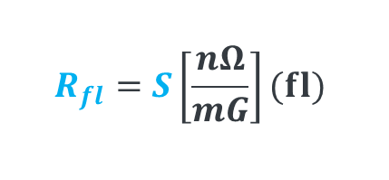
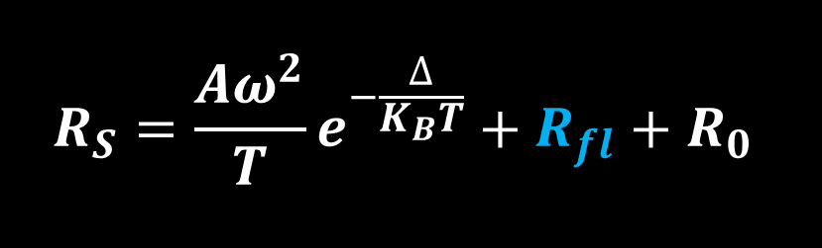
Introduction to SRF: theory
(...and practice)
Input RF, excite a resonant EM mode in a cavity
Ideal case: high accelerating gradient ($E_{acc}, MV/m$), with low losses (high quality factor, $Q_{0}$)
Performance limitations:
Electric field strength ($E_{acc}$) limited by input power couplers, peak surface fields, leading to field emission, electrical breakdown, or (in SC) thermal quench
$Q_{0}$ limited by RF surface losses, $R_{S}$, even in superconductors!
$\frac{dB}{dt}$ induces an electric field penetrating $δ\left(f\right)∝e^{−α\left(f\right)}$
~40nm for superconducting niobium at 2 K.
$Q_{0}=\frac{peak energy stored}{power lost per RF cycle}=\frac{ωU}{P_{loss}}$
$P_{loss}=\frac{R_{S}}{2}\int_{S}{{\left|B_{t}\right|}^{2}}dS$
$U=\frac{μ_{0}}{2}\int_{V}{{\left|B\right|}^{2}dV}$
© 2014 CERN: Daniel Dominguez, Arzur Catel Torres
Flux “sensitivity,” is an unknown function of some Nb material properties, changes with surface treatment
$$R_{fl}=S\left[\frac{nΩ}{mG}\right](fl)$$
$$R_{S}=\frac{Aω^{2}}{T}e^{−\frac{∆}{K_{B}T}}+R_{fl}+R_{0}$$

Slide 8
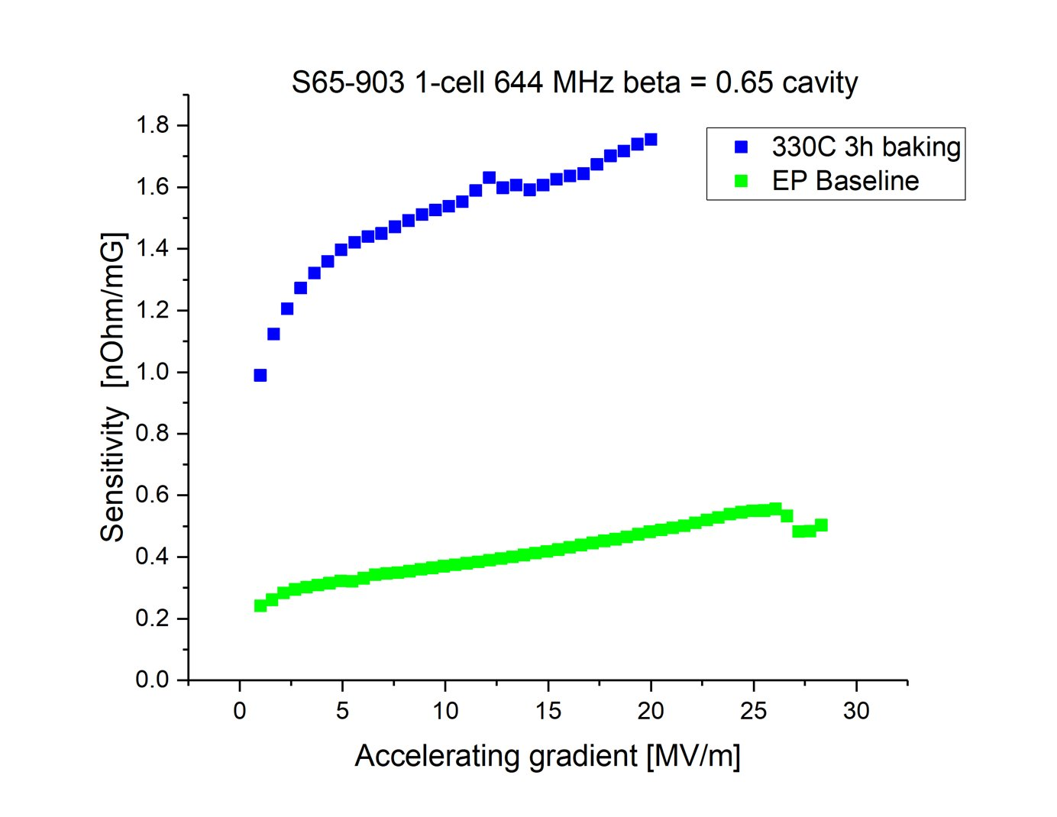
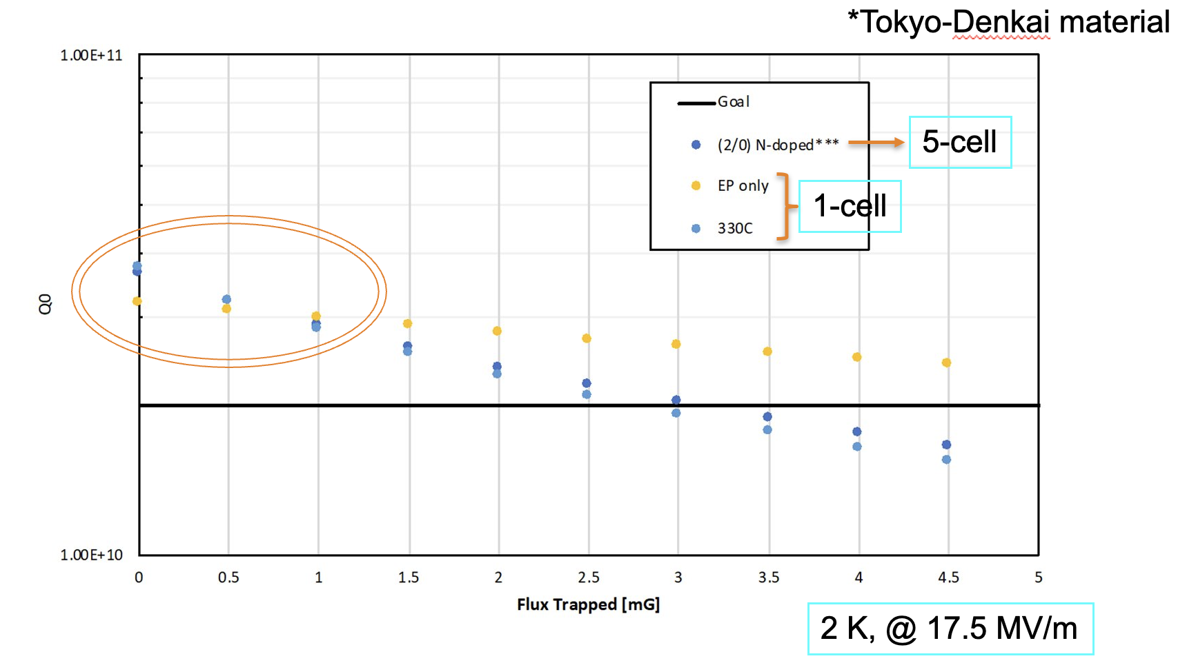
Production challenges
S
...and implications
~4x
Cleanliness: Clean RF surfaces for zero-FE cavities not a well-controlled process at scale
10-20%, or higher rework rate possible
Some high-Q treatments increase sensitivity to trapped flux...
Flux trapping degrades Q!
Varies within Nb batches
Highly correlated with Nb texture
Difficult/impossible to control at the Nb vendor level
Mid-T baking

Slide 9
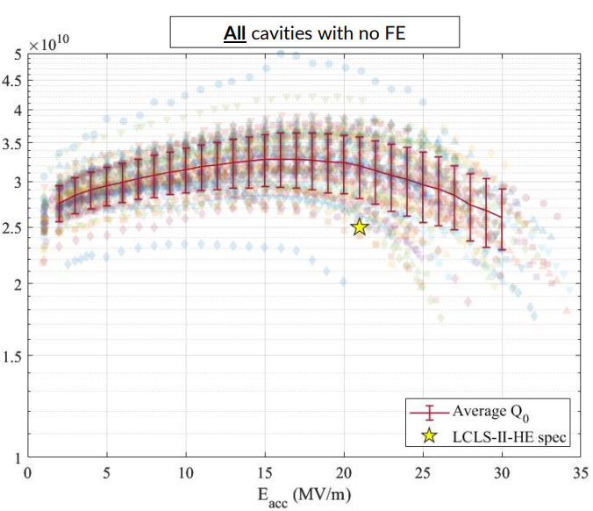
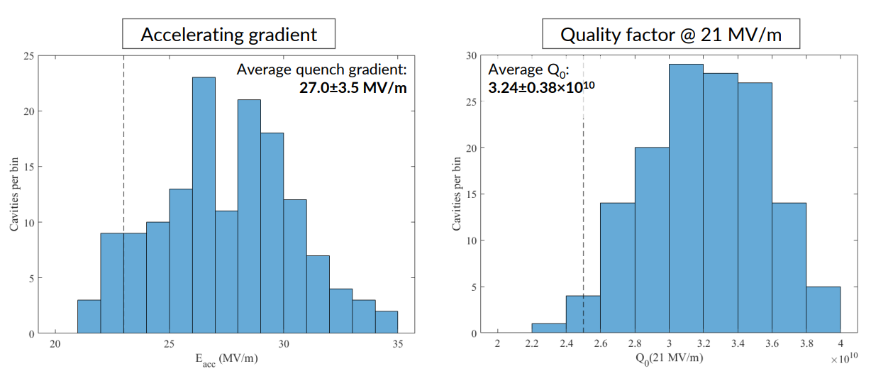
Cavity production statistics
…to keep in mind
LCLS-II-HE 1.3 GHz cavities (ILC-like)
N-doped cavities
Discovered magnetic flux sensitivity
Mitigated with high-temperature heat treatment
All cavities FE-free (clean)
PIP-II 650 MHz cavities (FCC-like)
Mid-T and N-doped cavities
Spec is for FE-free up to gradient
In prototype and pre-production 650 cavities, FE-free performance is still inconsistent
Clean-room and HPR techniques need more research and development to achieve production consistency
PIP-II production will provide more insight into large sub-GHz cavity cleaning(FE)/performance statistics
167 9-cell 1.3 GHz
~20% rework rate
Q0 2.5-4x10¹⁰
LCLS-II-HE Cavity and Cryomodule Test Progress, J. Maniscalco, TTC 2023

Slide 10
Superconducting RF for FCC-ee
02

Slide 11
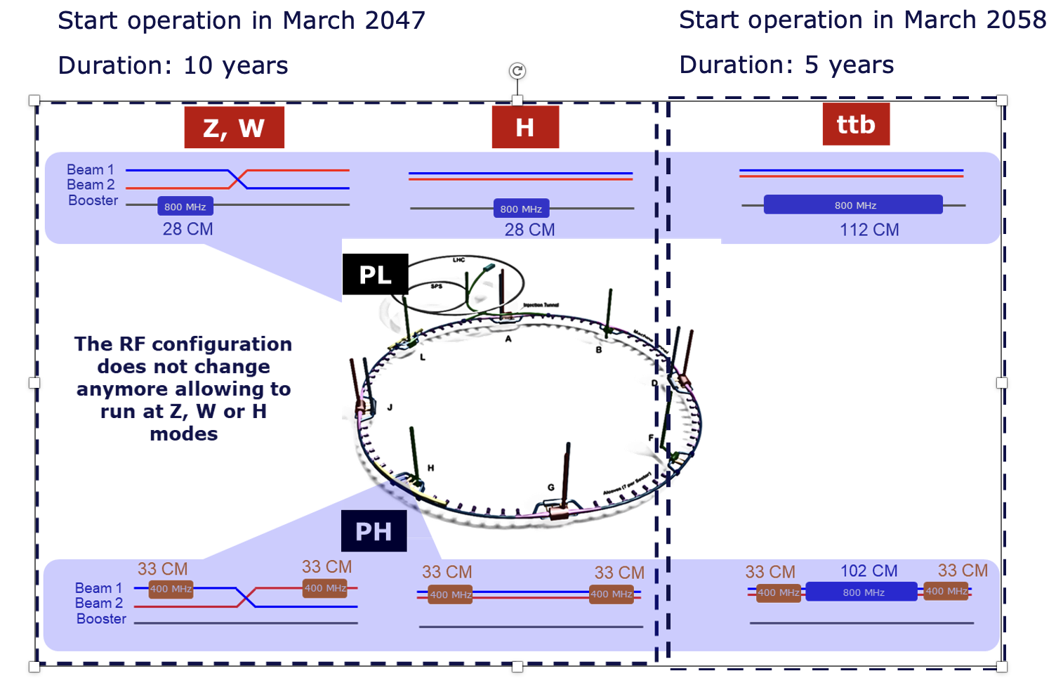
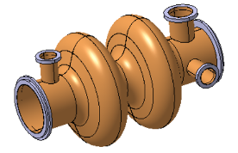
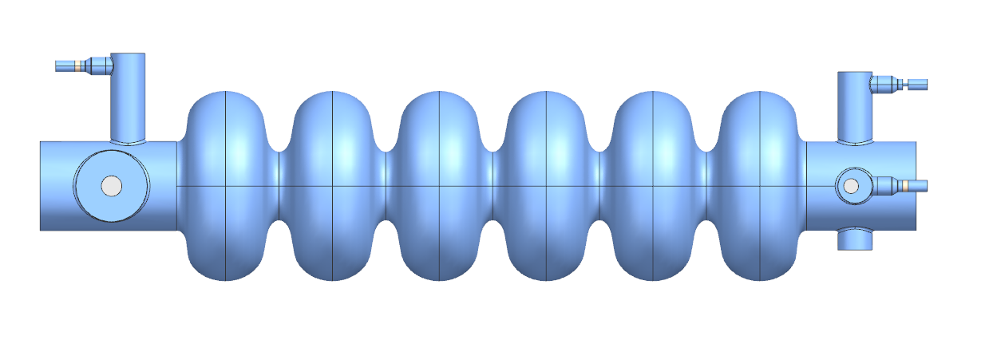
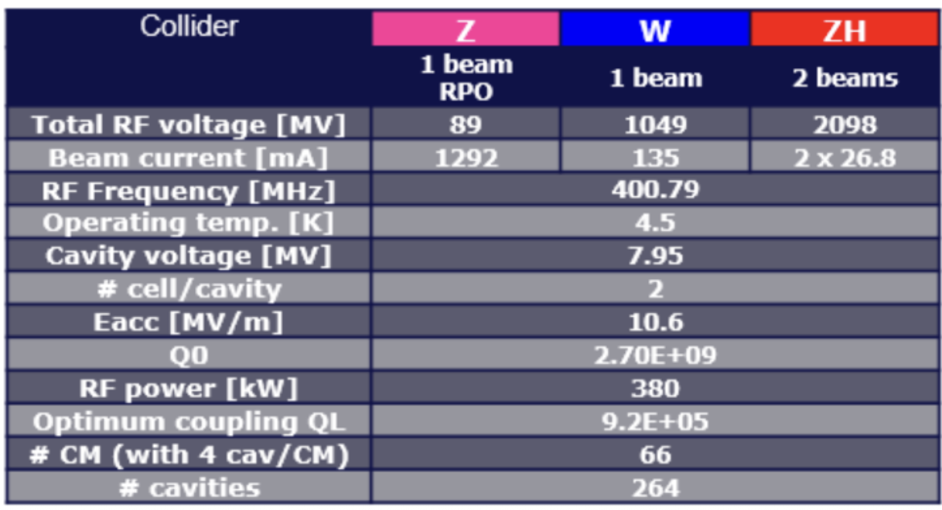
800 MHz SRF for FCC-ee
Introduction
400 MHz Nb/Cu, 66 CM (collider)
800 MHz bulk Nb, 214 CM (collider+booster)
Phase 1: Z,W, and H operating points
High-current machine: higher-order mode excitation
Reverse phase operation enables Z,W, and H OPs
Phase 2: TTb operating point
High-gradient machine
448 booster + 408 collider
= 856 800 MHz cavities/214 CM
400 MHz Collider: 264 cavities/66 CM
800 MHz Booster: 112 cavities/28 CM
Booster | Z | W | ZH
 | RPO | RPO
Total RF voltage [MV] | 80 | 401.9 | 1961
Beam current [mA] | 16.2 | 6.2 | 2
RF Frequency [MHz] | 801.58
Operating temp. [K] | 2
Cavity voltage at extraction [MV] | 5.6 | 13.5 | 17.5
# cell/cavity | 6
Eacc [MV/m] | 4.9 | 12 | 15.6
Q0 | 3E+10
Max RF power [kW] | 42
Coupling QL | 1E+07
# CM (with 4 cav/CM) | 28
# cavities | 112

Slide 12
800 MHz SRF for FCC-ee
Introduction
400 MHz Nb/Cu, 66 CM (collider)
800 MHz bulk Nb, 214 CM (collider+booster)
Phase 1: Z,W, and H operating points
High-current machine: higher-order mode excitation
Reverse phase operation enables Z,W, and H OPs
Phase 2: TTb operating point
High-gradient machine
448 booster + 408 collider
= 856 800 MHz cavities/214 CM
400 MHz Collider: 264 cavities/66 CM
800 MHz Booster: 112 cavities/28 CM
Booster | Z | W | ZH
 | RPO | RPO
Total RF voltage [MV] | 80 | 401.9 | 1961
Beam current [mA] | 16.2 | 6.2 | 2
RF Frequency [MHz] | 801.58
Operating temp. [K] | 2
Cavity voltage at extraction [MV] | 5.6 | 13.5 | 17.5
# cell/cavity | 6
Eacc [MV/m] | 4.9 | 12 | 15.6
Q0 | 3E+10
Max RF power [kW] | 42
Coupling QL | 1E+07
# CM (with 4 cav/CM) | 28
# cavities | 112
370 CM, ~1,500 cavities

Slide 13
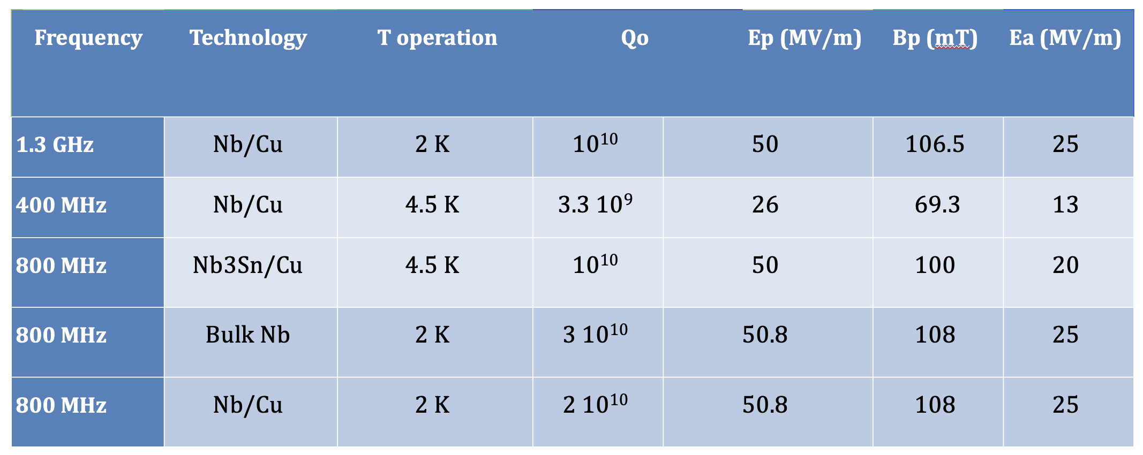
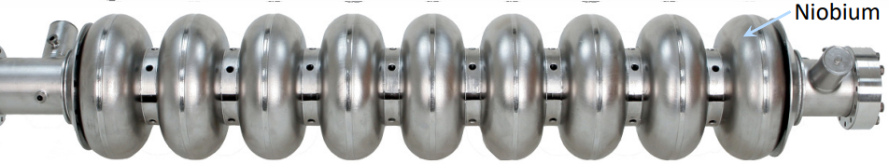
FCC performance goals
ˆ

Slide 14
Reaching high Q0
Recent advances in high-Q high-gradient SRF cavities
“2/0” N-doping: Bulk EP, High T (degassing+stress release) bake, light EP, N-Doping (2min doping/0min annealing), Post-doping+cold EP, HPR+VT assembly, RF test.
N-doping¹
2012-13 FNAL: Doubled Q, reversed R_{BCS} dependence on E_{acc}
Industrialized at 1.3 GHz to deliver LCLS-II
Medium temperature baking^{2,3}
Simple one-step chemical processing (FNAL)
300C, 3-hour bake dissolves the native oxide layer and diffuses oxygen into the niobium bulk
Mechanism not fully understood, but seems to have traits in common with N-doping, despite differences in diffusion depth: See H. Hu, Hu, Hannah. "Decoupling of Nitrogen and Oxygen Impurities in Nitrogen Doped SRF Cavities." , Jun. 2024.
Sensitivity to trapped magnetic flux increases in both cases
“Sensitivity” measures the amount of residual resistance generated per unit of trapped magnetic flux
“Increased sensitivity” means your accelerator is more vulnerable to the effects of trapped flux
Mitigation strategies include fast cooldown, improved magnetic hygiene
¹ A. Grassellino et al, Supercond. Sci. Technol. 26, 102001 (2013).
Bulk EP, High T (degassing+stress release) 800-950C 3h, light EP, mid-T furnace bake 300C 3h, HPR, VT assembly, RF test.
² S. Posen, et al., Phys.Rev.Applied., Volume 13, Issue 1, Jan 2020 (FNAL)
³ H. Ito, et al., Prog of Theor. and Exp. Phys., Volume 2021, Issue 7, July 2021

Slide 15
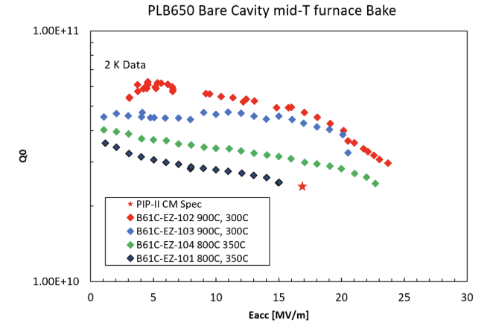
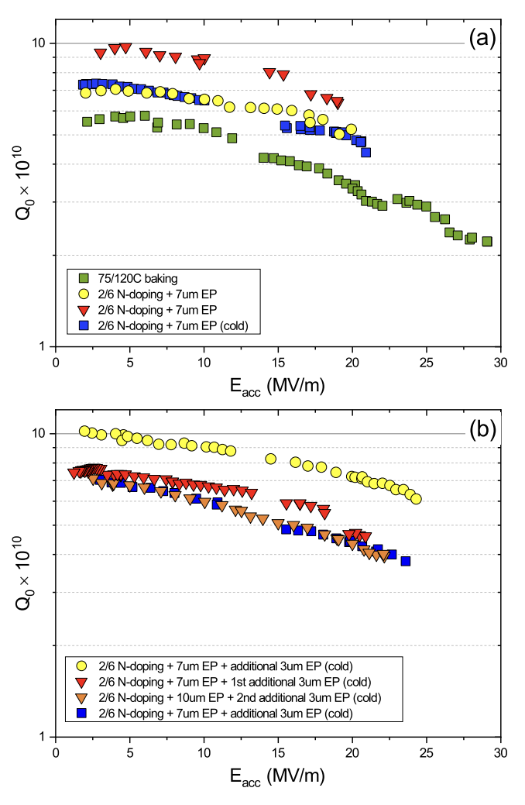
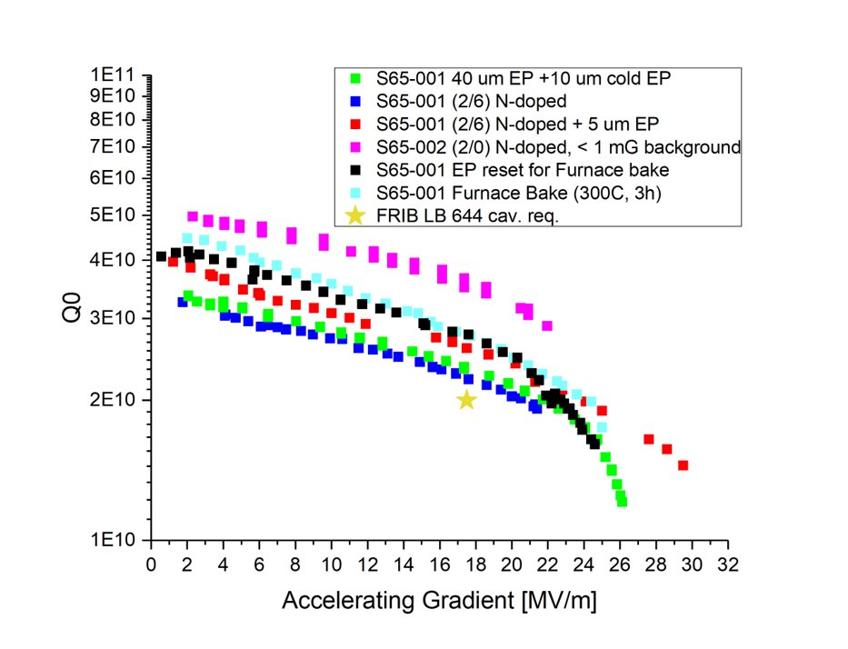
Technical perspective: SRF
PIP-II HB650: N-doping
PIP-II LB650: Mid-T
FRIB 644 MHz: various

Slide 16
Technical perspective: SRF
PIP-II HB650: N-doping
PIP-II LB650: Mid-T
FRIB 644 MHz: various

Slide 17
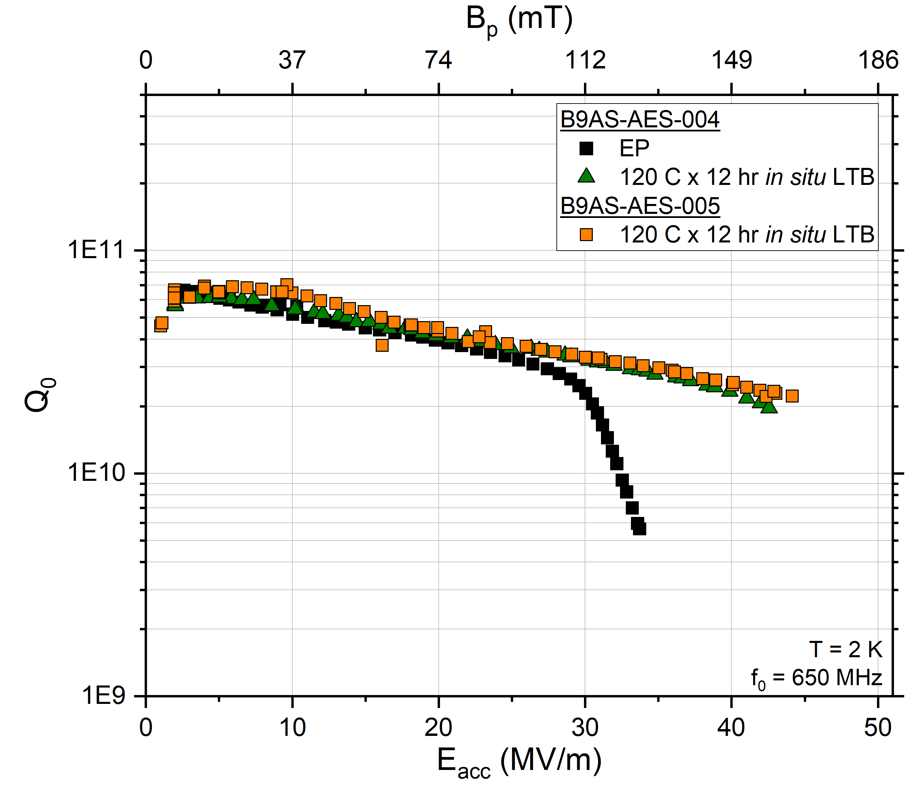
Technical perspective: SRF
PIP-II HB650: N-doping
PIP-II LB650: Mid-T
1-cell 650 MHz
FRIB 644 MHz: various
“Optimized EP”

Slide 18
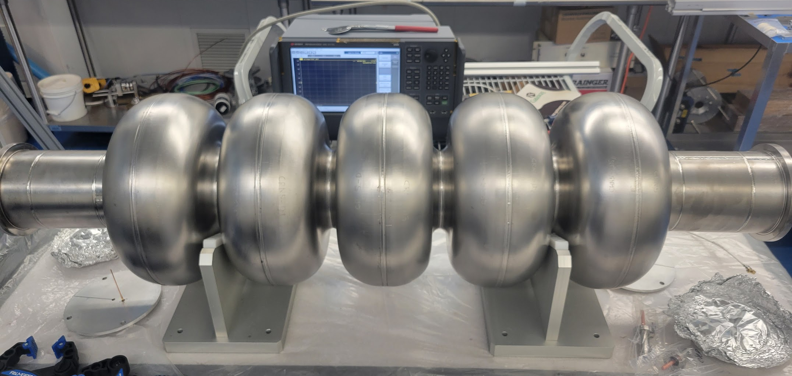
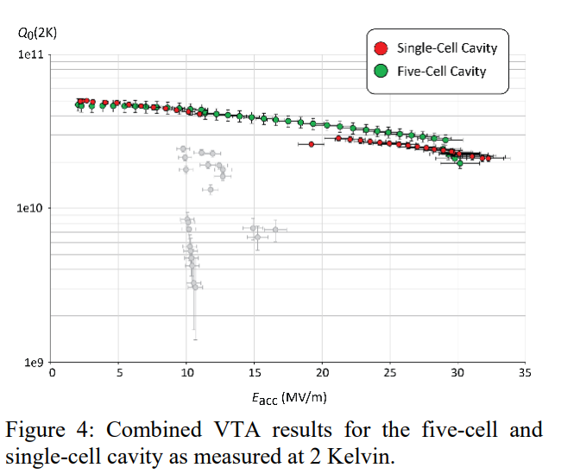
800 MHz 5-cell cavity
First experiments
Cavity fabricated at JLab, currently at FNAL
High-power RF cold-test baseline electropolish
Q₀~3x10¹⁰ at 25 MV/m
Quench at 27 MV/m
Explore advanced techniques for >26% improvement in Q₀
Mid-T baking complete 7/2025!
Cold-test expected Fall 2025
N-doping?
Nb3Sn (future)
1-cell 800 MHz (rapid iteration) tests underway in collaboration with CERN
F. Marhauser et al. 802 MHz ERL Cavity Design and Development (cern.ch) IPAC 2018 THPAL146

Slide 19
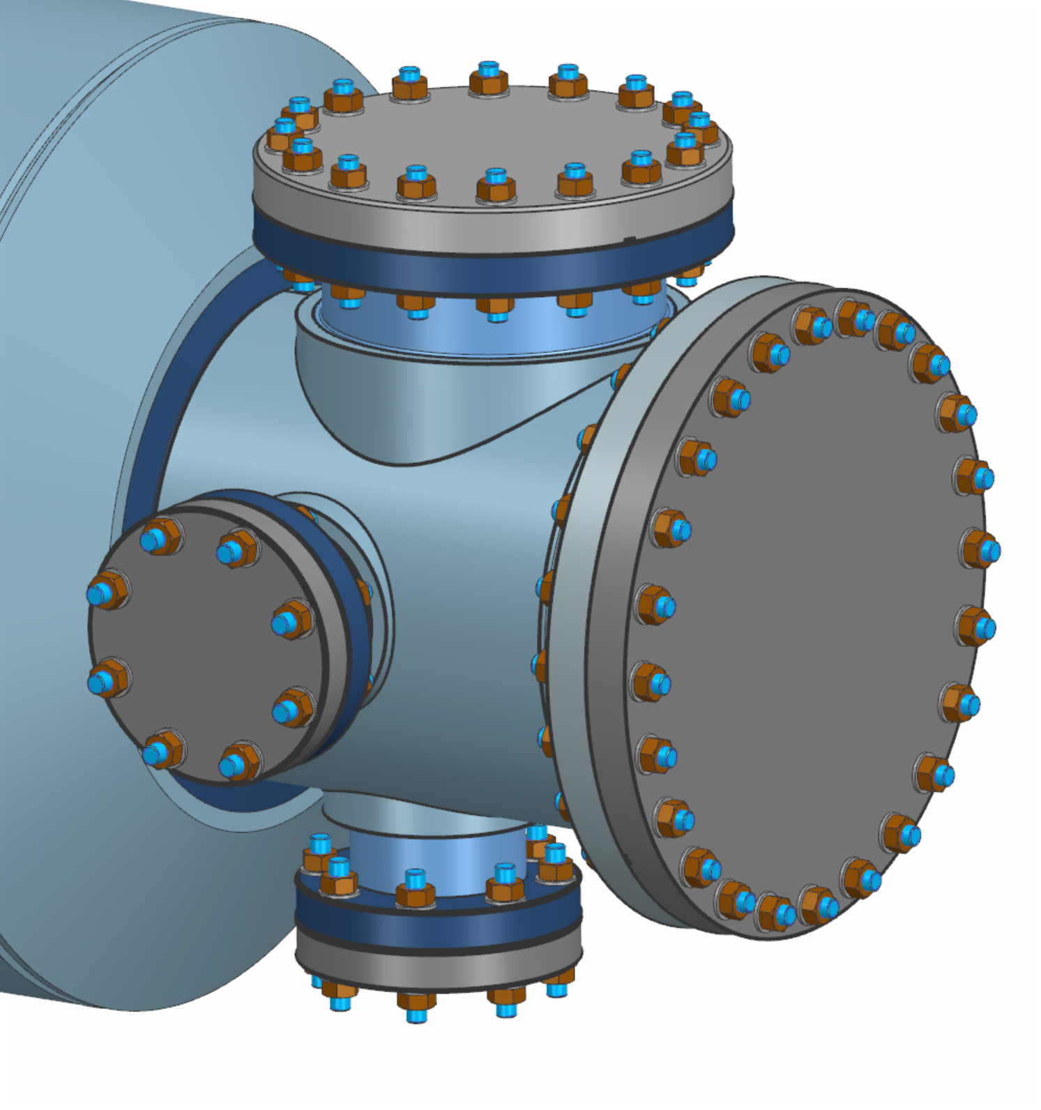
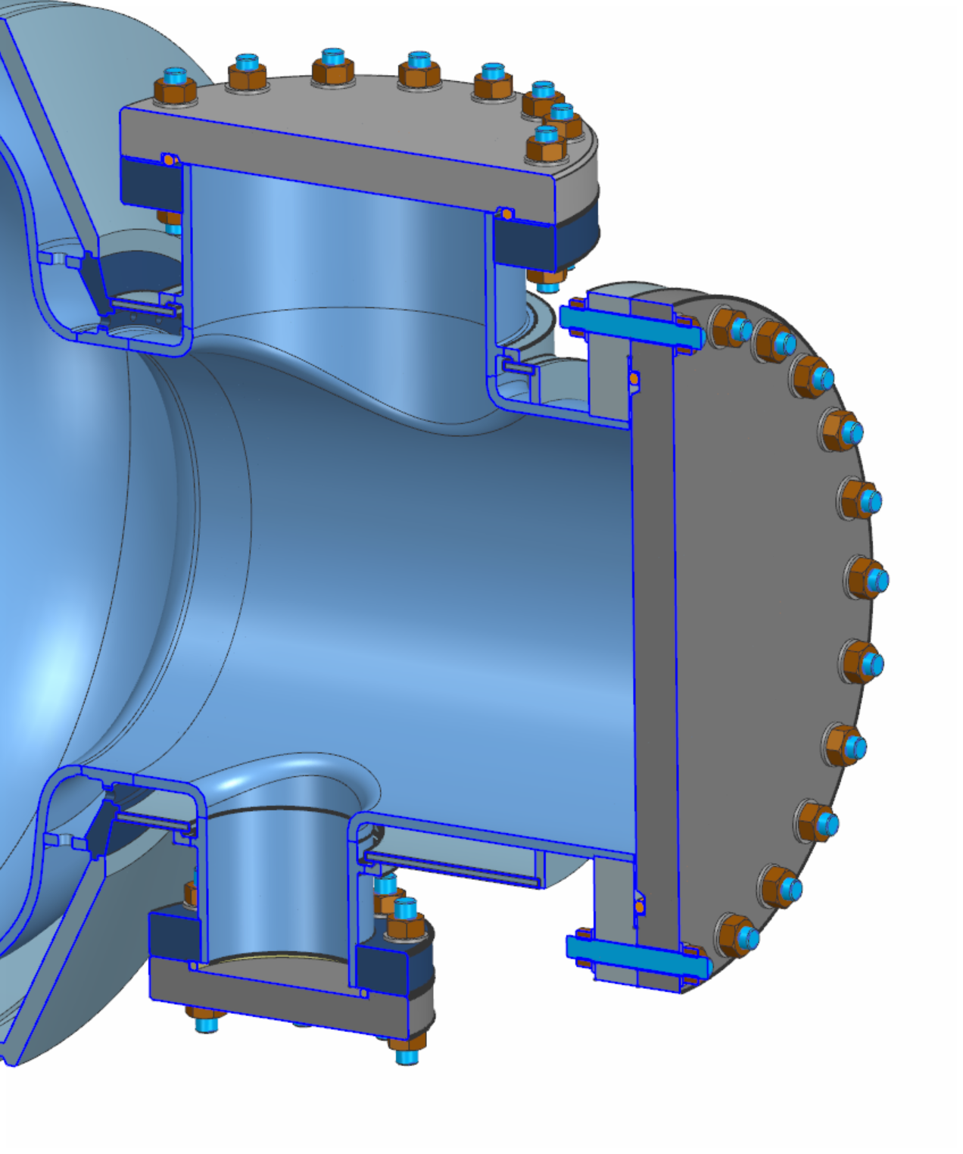
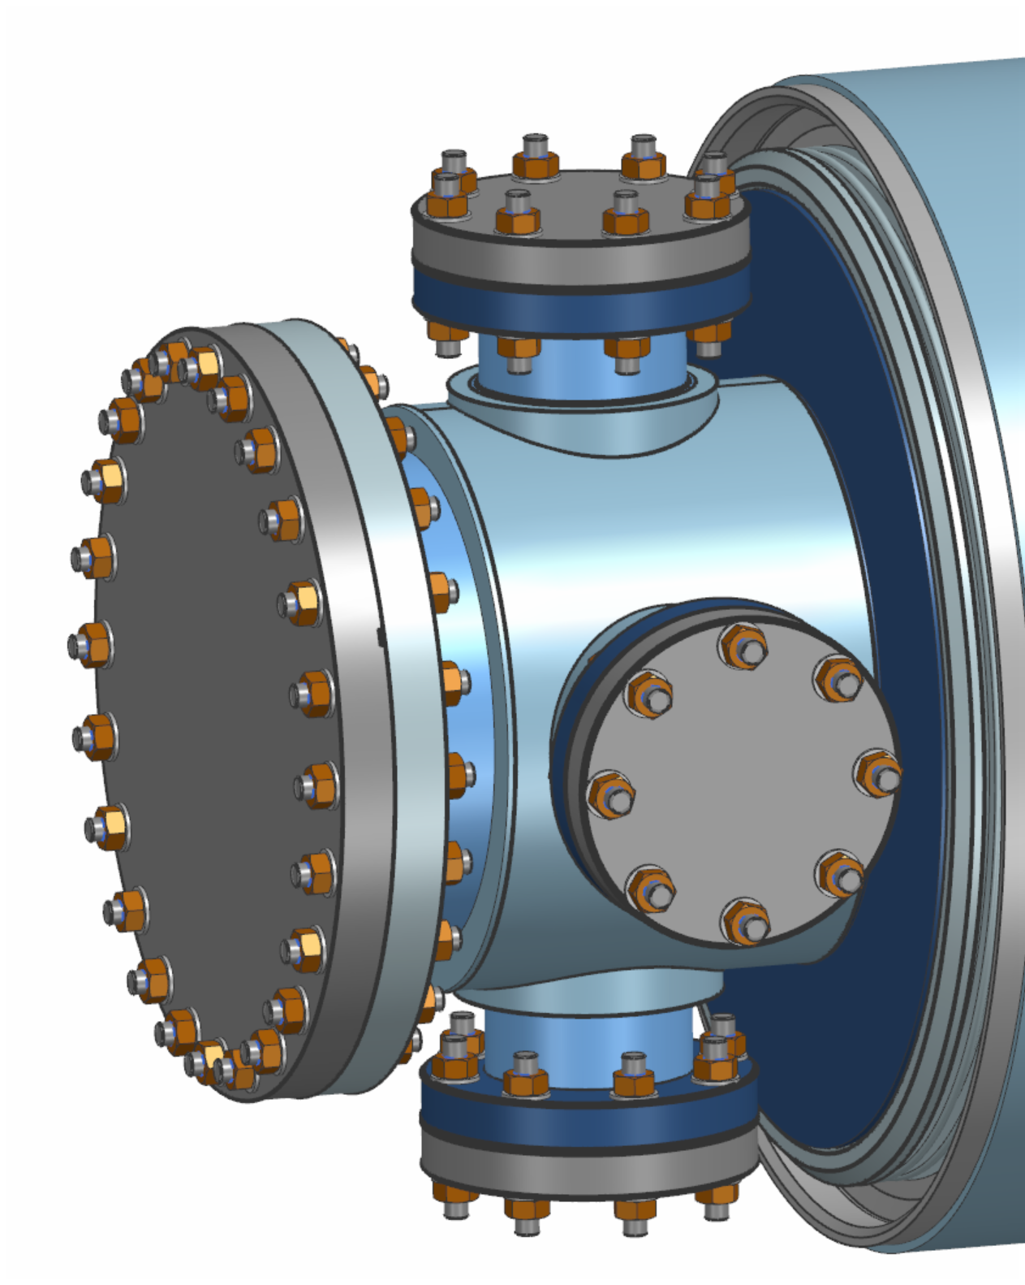
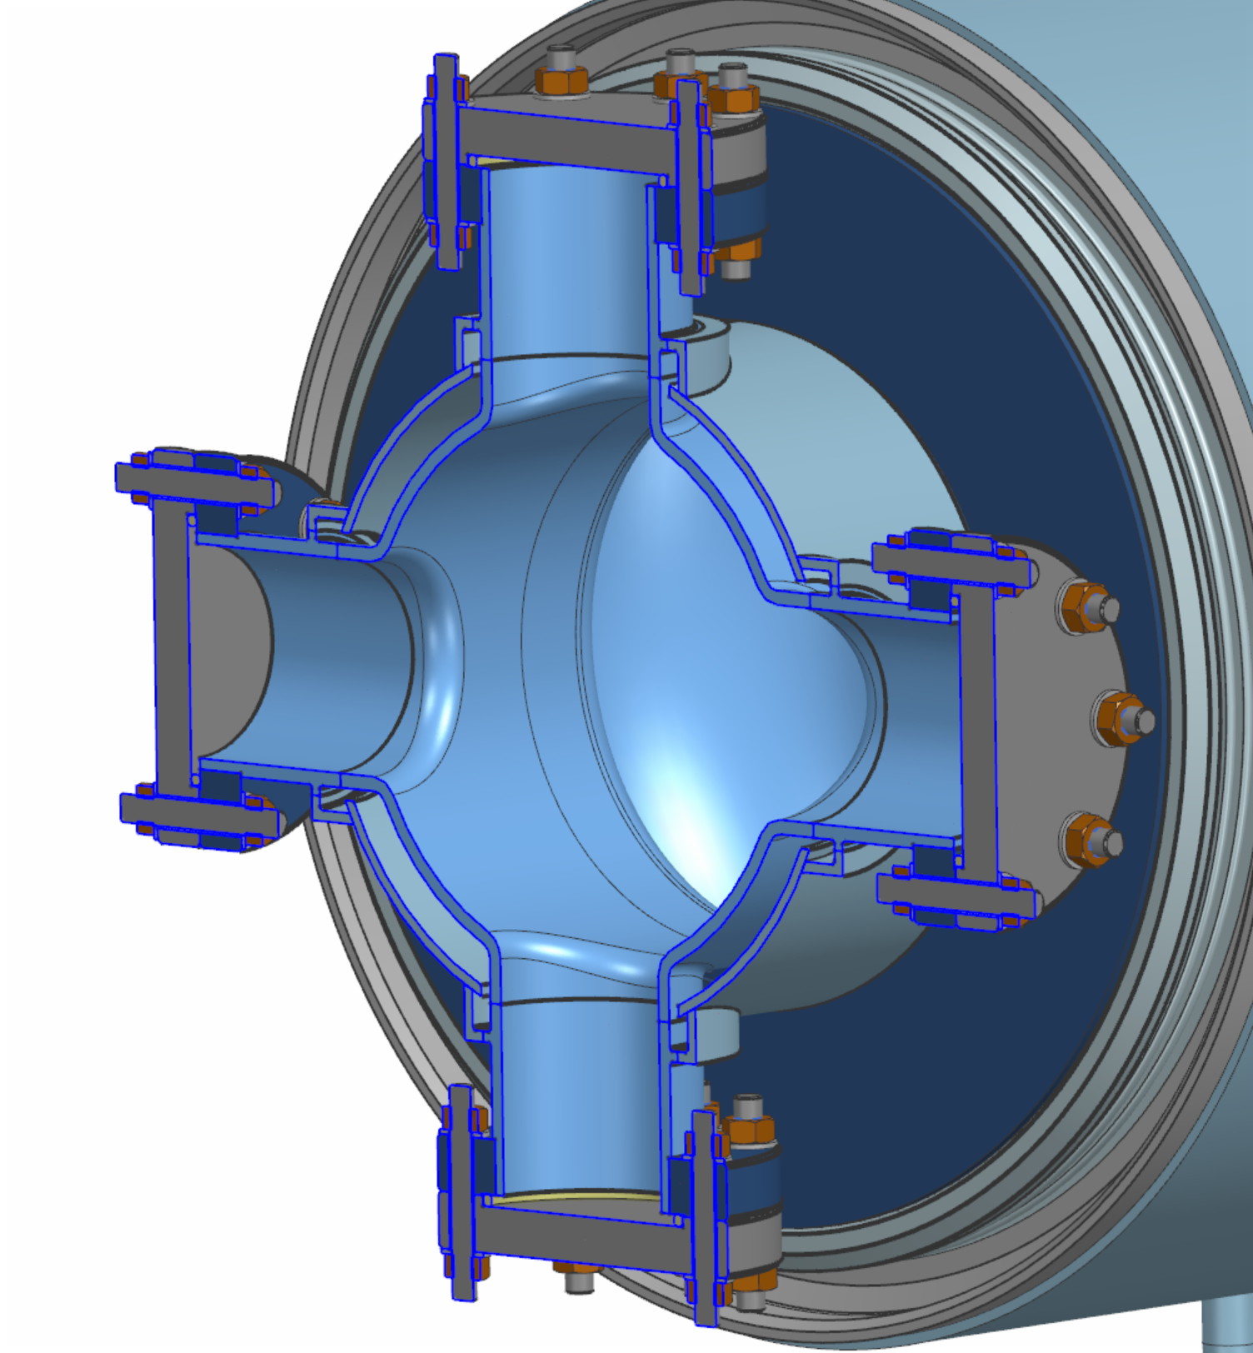
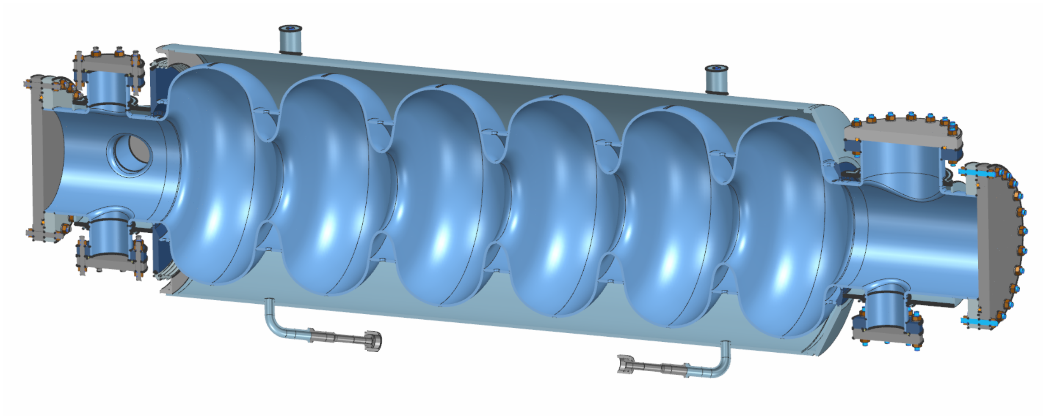
3D Model and planned analysis
Mattia Parise, FNAL
Progress on conceptual mechanical designs
Complex higher order mode (HOM) port design
Single cavity design for booster and collider
Potential need for active cooling on the HOM ports, studies ongoing
Detailed weldmap, fabrication plans to be optimized

Slide 20
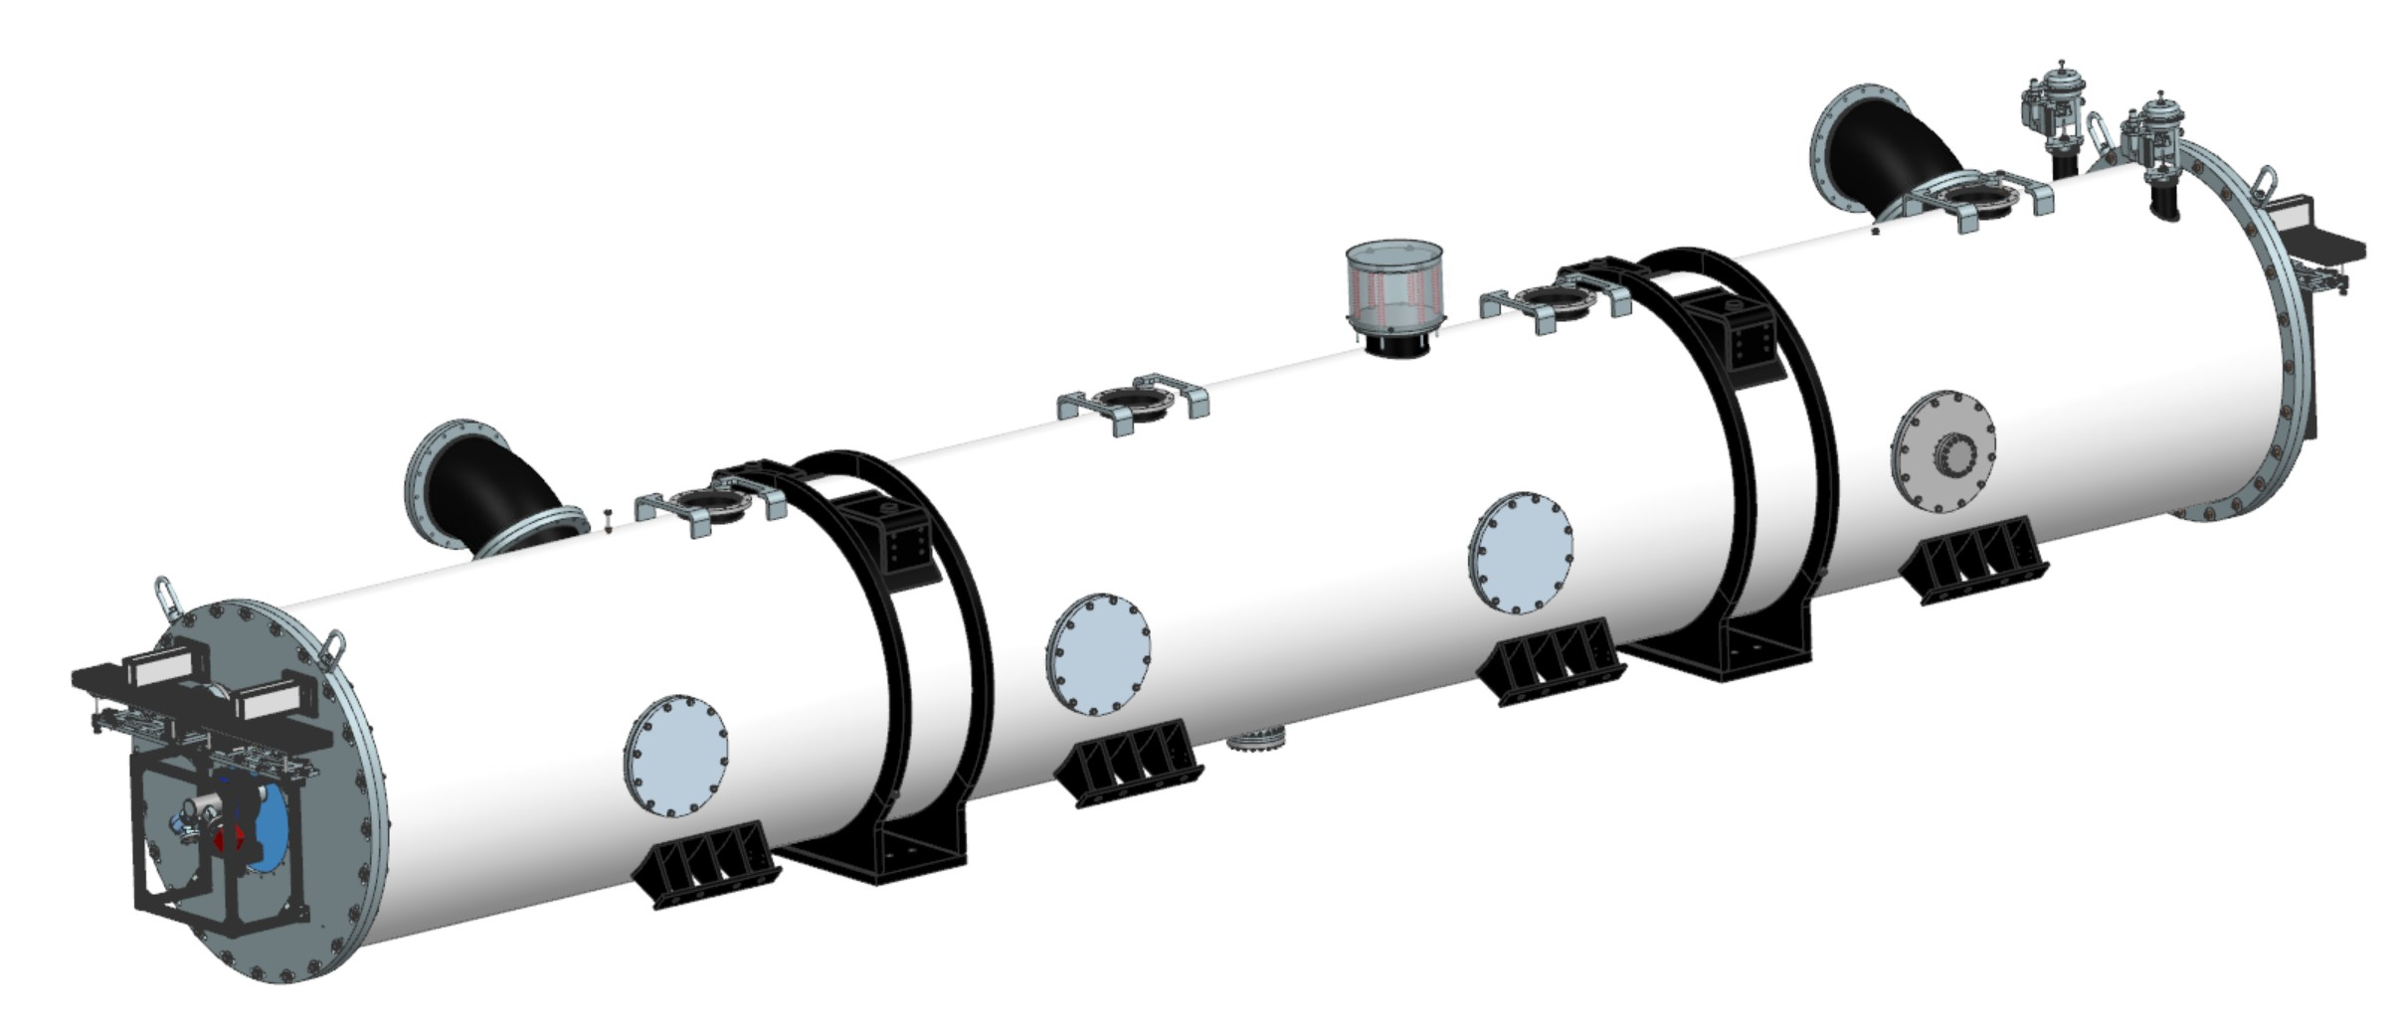
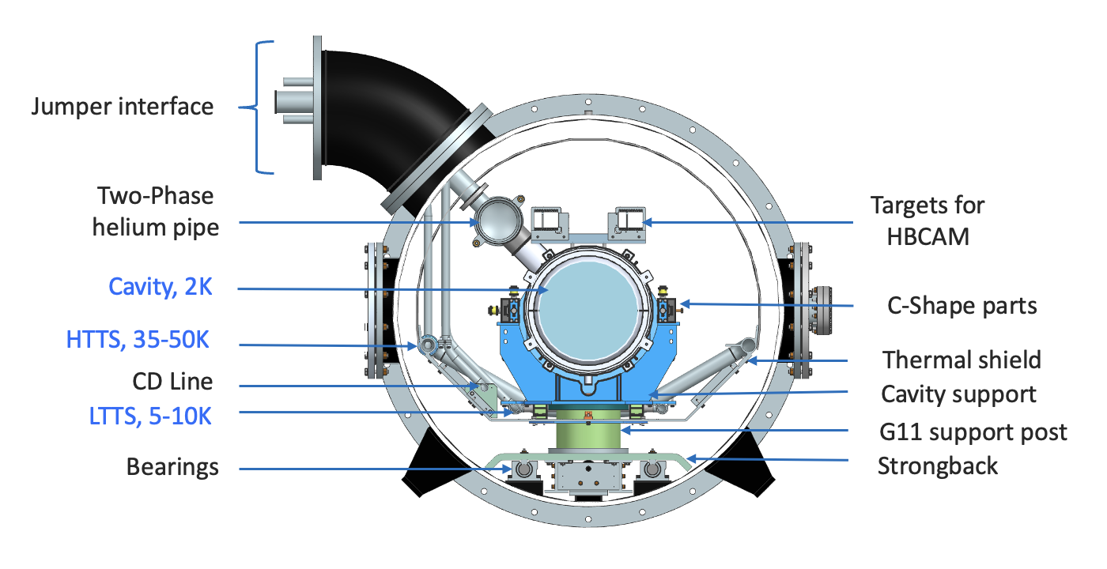
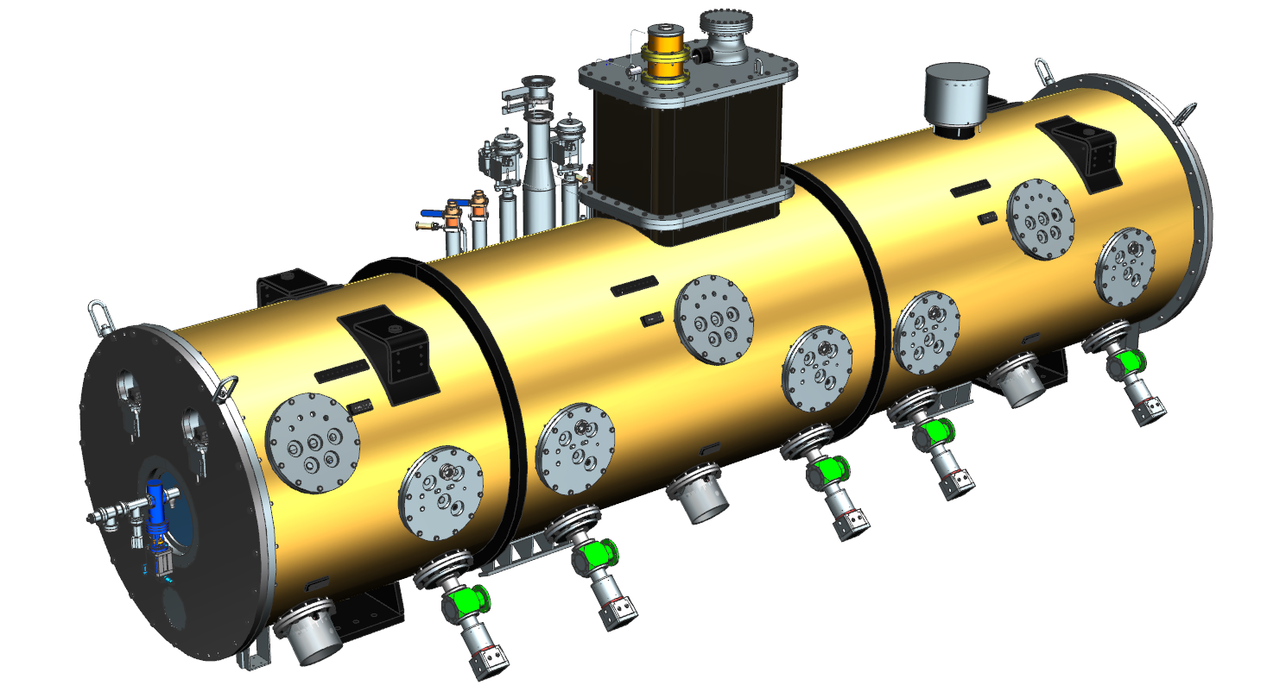
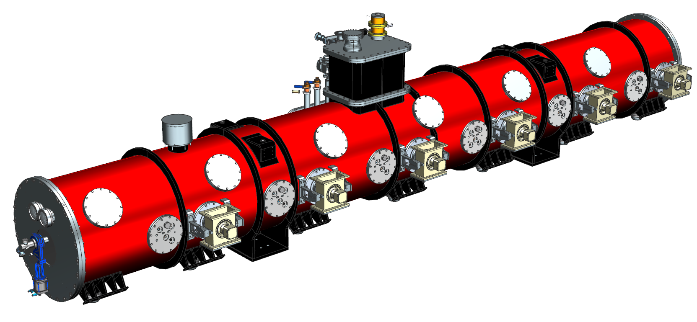
Preliminary design of FCC 800MHz Cryomodule
Vincent Roger, FNAL
The FCC 800 MHz CM design is based on SSR2 and HB650 PIP-II CMs with the following main differences:
Heat exchangers and valves are integrated into the Cryogenic Distribution System (CDS).
A “Jumper” will be used to interface with CDS through welded connection into the tunnel (no u-tubes).
Couplers are actively cooled with helium.
FCC 800 MHz cryomodule
PIP-II HB650 cryomodule
PIP-II SSR2 cryomodule
“Final Design of the Pre-Production SSR2 Cryomodule for PIP-II Project at Fermilab”, V. Roger et al., Proceedings of LINAC 2022
“Design of the 650 MHz High Beta Prototype Cryomodule for PIP-II at Fermilab”, V. Roger et al., Proceedings of SRF 2021

Slide 21
Superconducting RF for ILC/LC
02

Slide 22
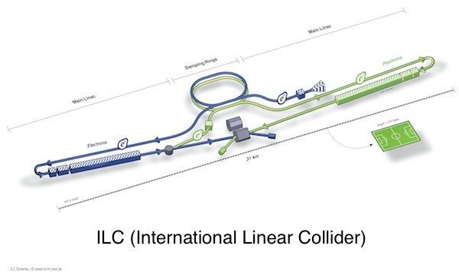
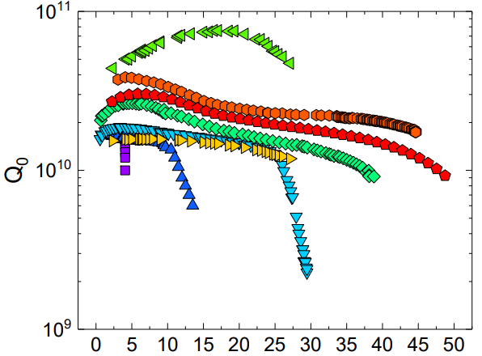
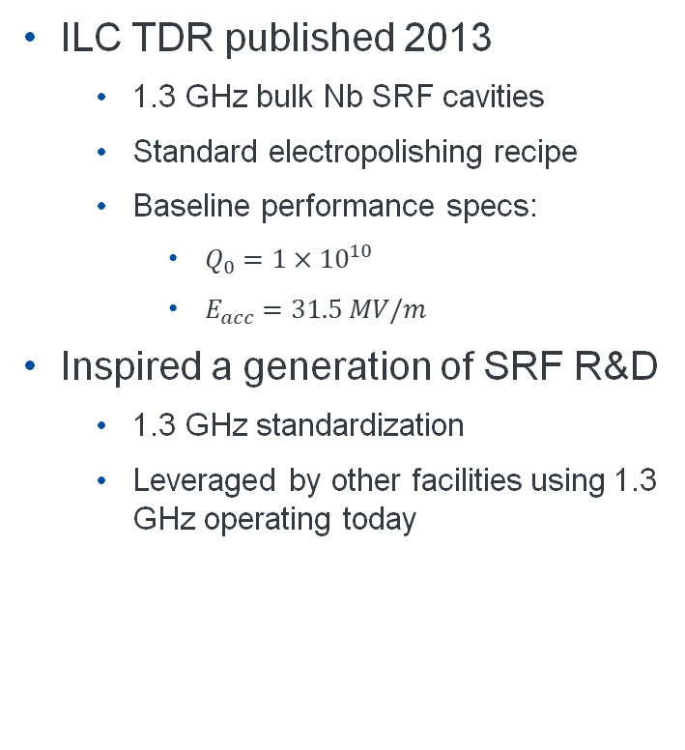
International Linear Collider
Casting a long shadow in SRF…
ILC TDR published 2013
1.3 GHz bulk Nb SRF cavities
Standard electropolishing recipe
Baseline performance specs:
$Q_{0}=1×{10}^{10}$
$E_{acc}=31.5 MV/m$
Inspired a generation of SRF R&D
1.3 GHz standardization
Leveraged by other facilities using 1.3 GHz operating today
Nitrogen doping!
2-step baking/N infusion
Cavity shape+High RRR Nb
High pressure water rinse
EP+low-temperature baking

Slide 23
International Linear Collider
Casting a long shadow in SRF…
ILC TDR published 2013
1.3 GHz bulk Nb SRF cavities
Standard electropolishing recipe
Baseline performance specs:
$Q_{0}=1×{10}^{10}$
$E_{acc}=31.5 MV/m$
Inspired a generation of SRF R&D
1.3 GHz standardization
Leveraged by other facilities using 1.3 GHz operating today
Nitrogen doping!
2-step baking/N infusion
Cavity shape+High RRR Nb
High pressure water rinse
EP+low-temperature baking

Slide 24
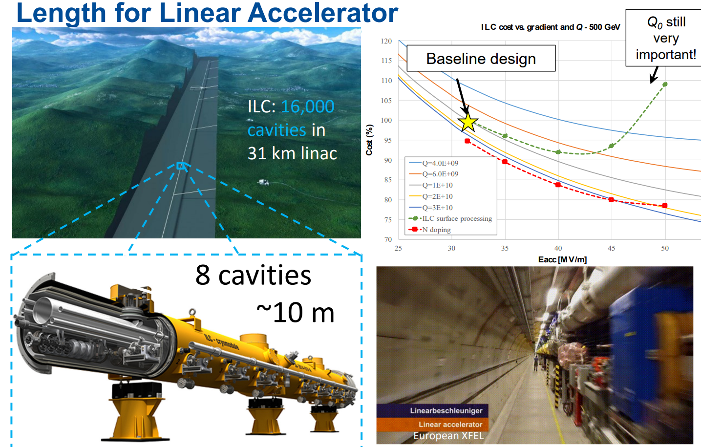
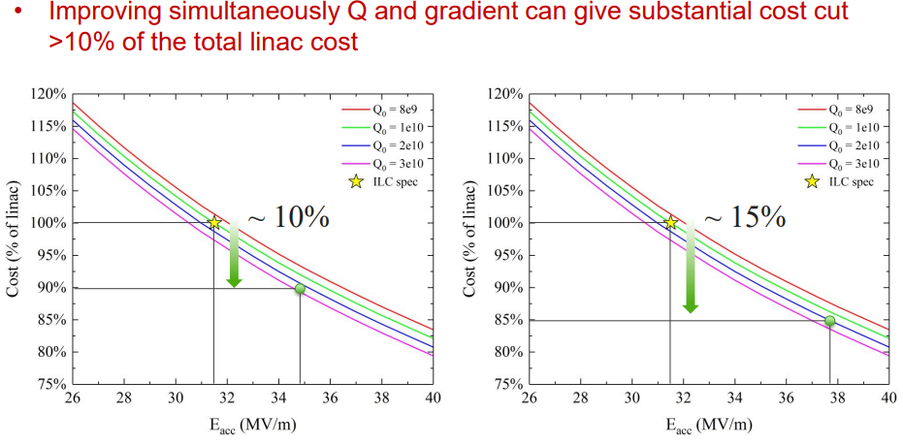
ILC and cost
ILC as a unit of cost

Slide 25

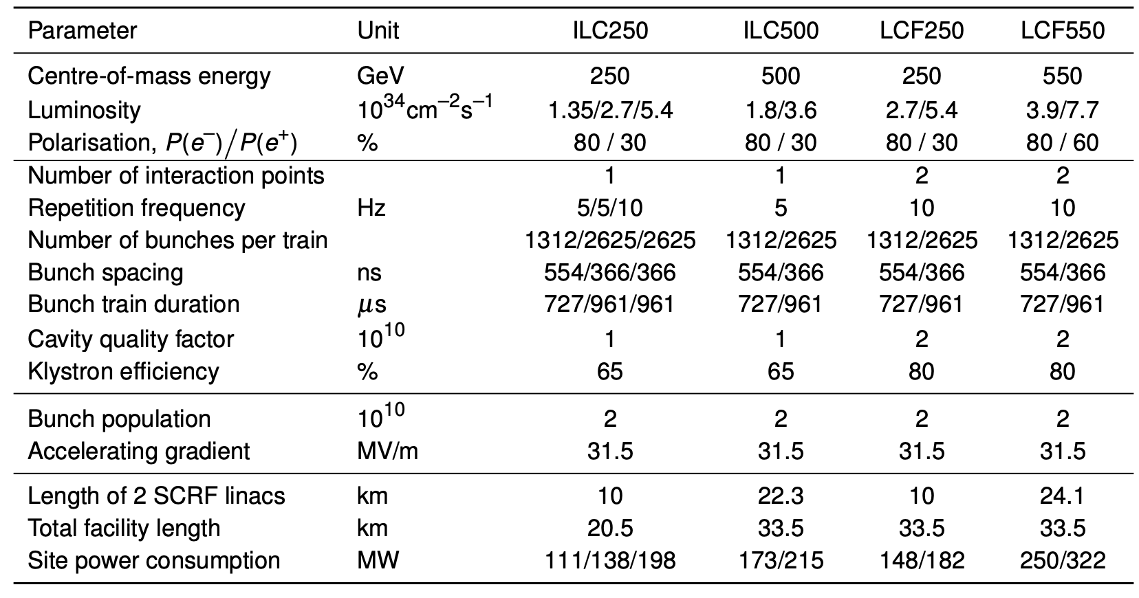
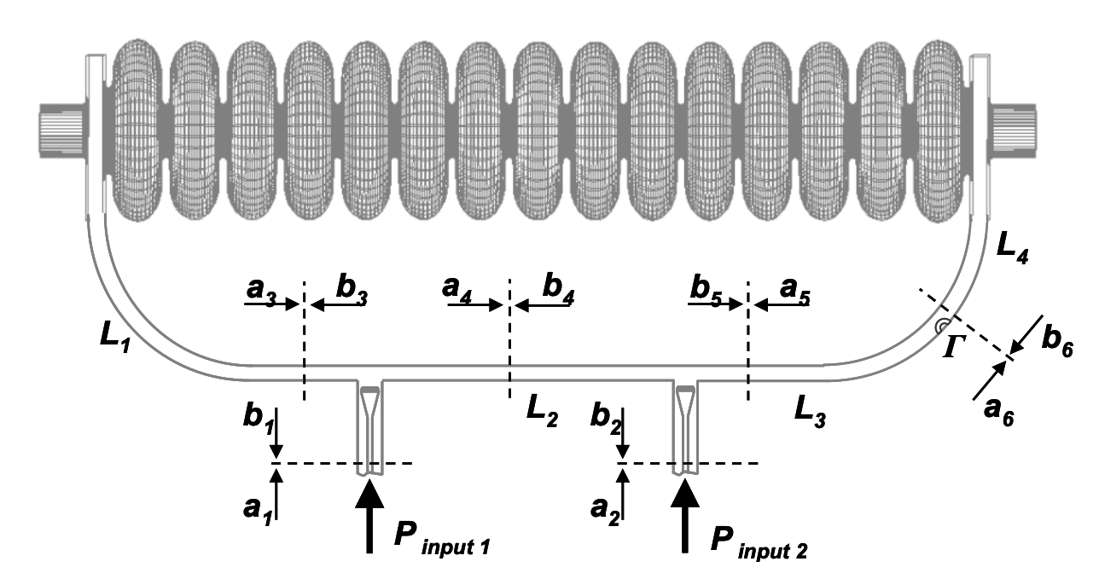
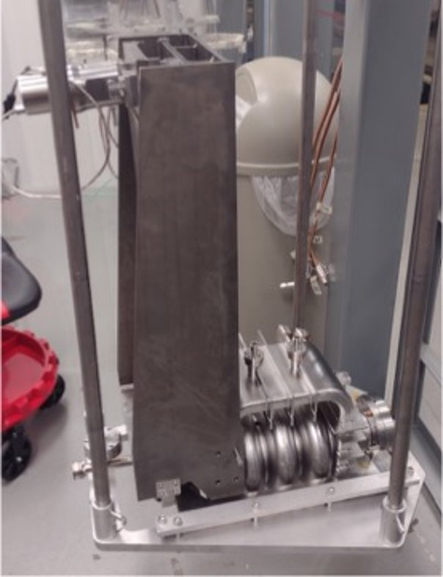
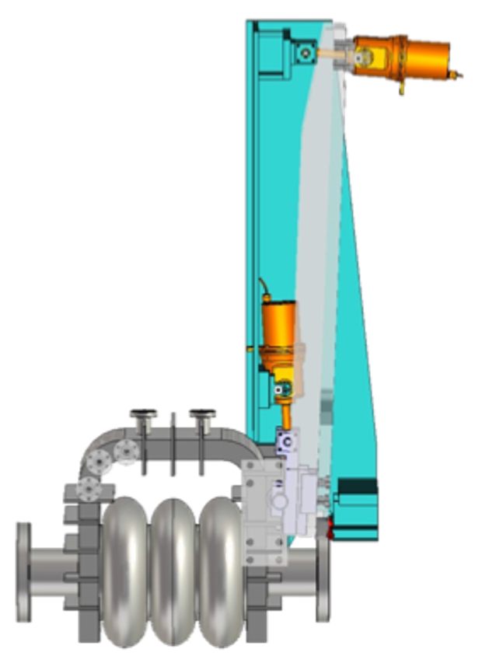
LC facility at CERN
Updated ILC…
2025 study
Maintains ILC baseline, updates Q0 specification to 2x10¹⁰
Mid-T baking/Oxygen doping
Not yet at scale
Cites XFEL and other stats
3.9 GHz cavities
Future R&D: travelling-wave
HELEN

Slide 26
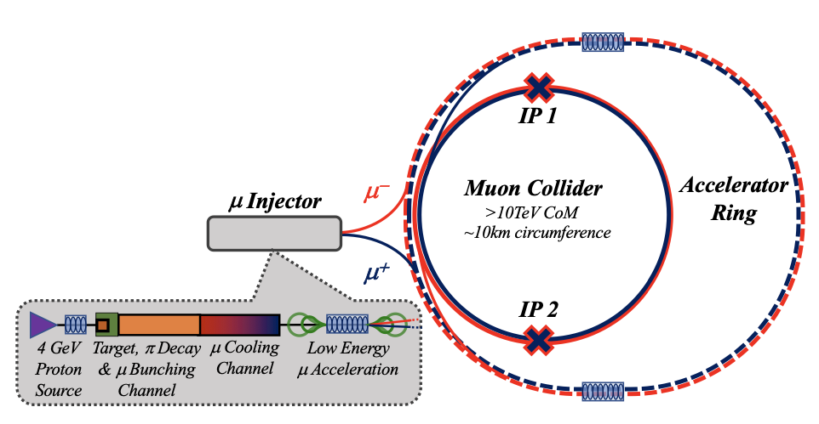
SRF for Muon collider
c/o R. Rimmer, JLab. Muon Cmte meeting
Proton driver e.g. SNS, ESS, PIP-II
SRF challenges
Fast acceleration - high gradient, large transverse beam size
Low frequency – Depends on 6D cooling – 200 MHz,325 MHz, 20 MV/m, 650 MHz 25 MV/m, 975 MHz?
Proximity to high field magnets (solenoids or quads)
Effect of decay products (~15% muons lost in acceleration)?
LFD, microphonics – High stored energy?
Efficient cryomodules – High packing factor (how close can the magnets be to SRF?)
High power RF sources, modulators, components
Muon acceleration using SRF looks feasible
Frequency choice strongly depends on 6D cooling
Bulk Nb, Nb on Cu or other materials viable
R&D needed (more on cost reduction than viability), test/demonstrator facilities needed

Slide 27
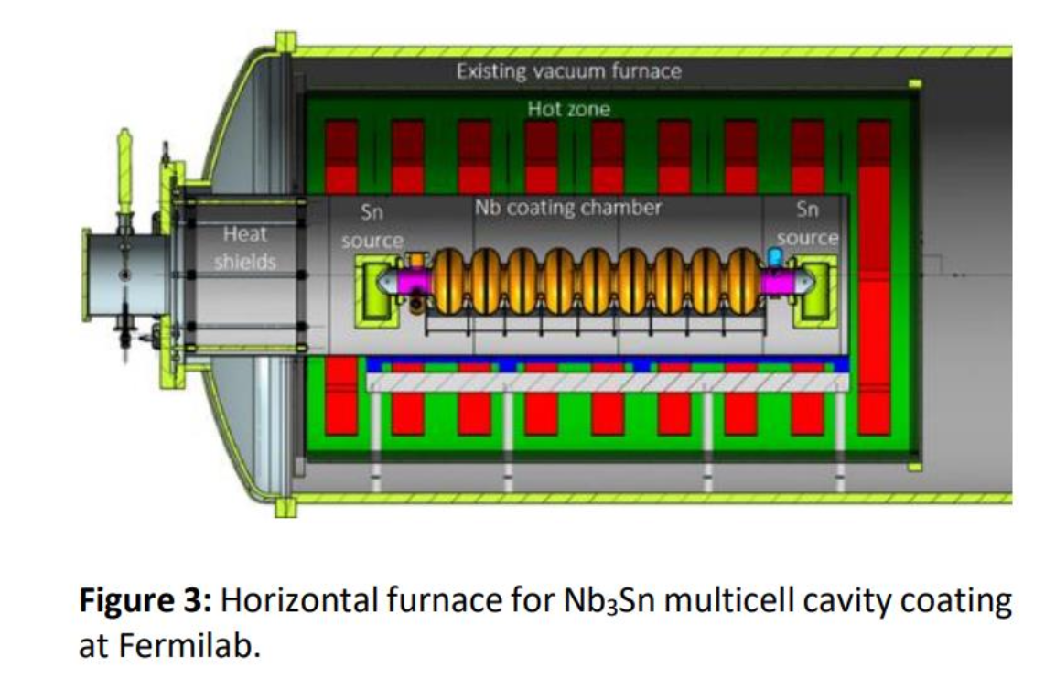
FCC/LC Synergies in SRF R&D
Linear...circular...
Bulk Nb R&D
High-Q/High-gradient advancements to reduce overall cost of construction (length of ILC) or cooling (both for LC concepts and for FCC)
Moving away from complex N-doping process and exploring simpler and less costly low-(~120℃) and mid-(~300℃) temperature baking benefit FCC and LC concepts
Modest R&D needed to bring sub-GHz bulk cavity performance to FCC 800 MHz spec
R&D in low-temperature baking and two-step baking shows potential to significantly increase 1.3 GHz cavity gradient, but more development needed to reach 50 MV/m+
Current status of Nb3Sn at FNAL
> 20 MV/m demonstrated in 1-cell, 15 MV/m demonstrated in multicell
FCC gradient demonstrated in Nb3Sn sub-GHz cavities
R&D needed to realize this performance in multicell cavities and the cryomodule context
Significant further R&D is needed to reach high gradients in 1.3 GHz Nb3Sn cavities for potential use in ILC
Nb3Sn cavity processing and handling techniques also require R&D to enable consistent quality in ~16,000 cavities for ILC.

Slide 28
Summary
SRF has a large role to play in many promising future Higgs factory options!
Technical drivers:
Circular machines benefit most from high-Q R&D, high current iterations suffer from higher-order mode damping concerns that must be thoroughly understood and mitigated at scale
Linear machines benefit greatly from high-Gradient R&D, reducing the length of the machine
SRF has experienced a bright period of innovation
N-doping, O-doping, Nb3Sn, other high-Q treatments have the potential to deliver a lot to Higgs factory applications IF SUFFICIENT R&D IS SUPPORTED CONSISTENTLY OVER TIME
In Praise of Boredom! In the technical/production context, you cannot afford to overlook “boring” challenges
Cavity cleaning, processing, handling, shipping, tuning….

