Slide 1
HFCC News
4 Sep 2025

Slide 2
Welcome
Agenda:
  1. Update from OHEP
  2. News
  3. Featured presentation: “Superconducting RF” - Kellen McGee (FNAL)
For next meeting (2 Oct), featured talk will be: Opportunities in physics/software/simulation: Lothar Bauerdick and Mike Hance

Slide 3
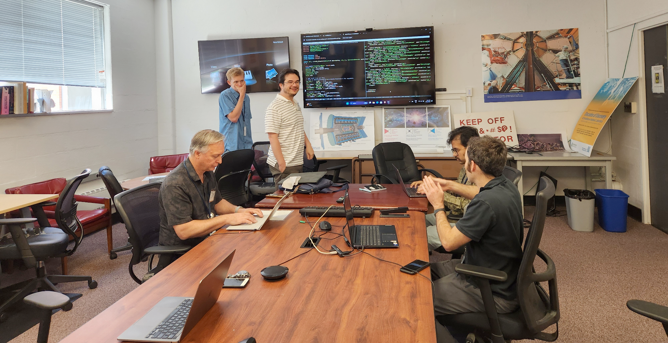
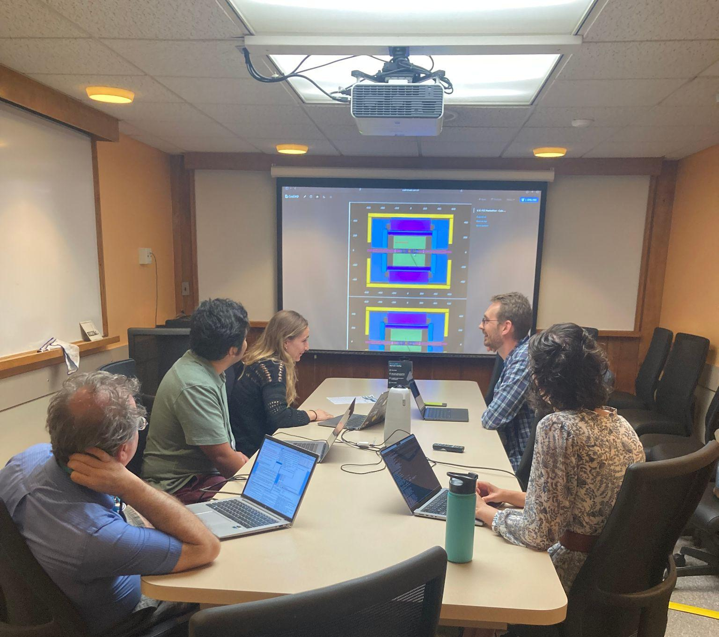
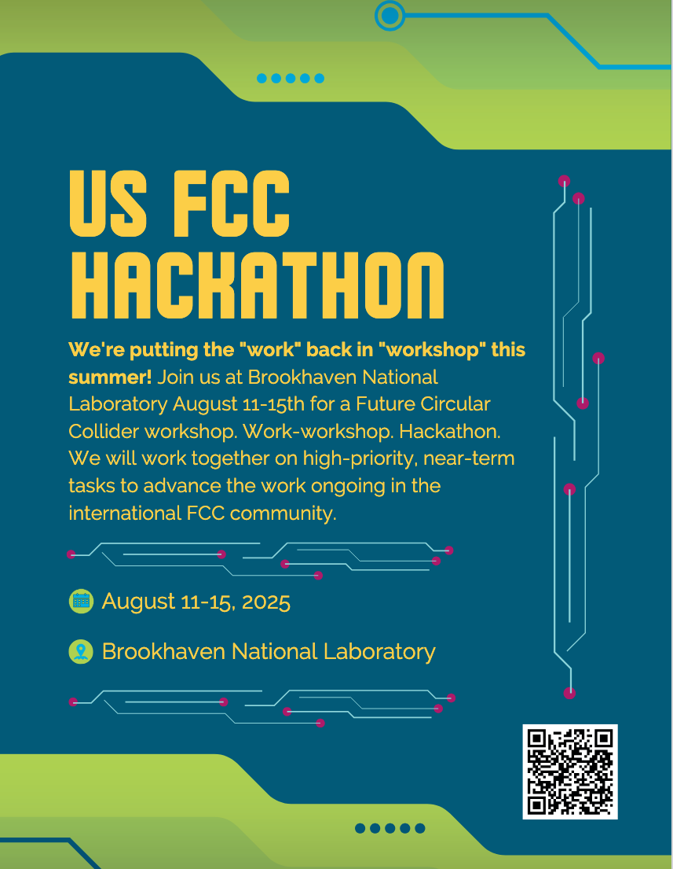
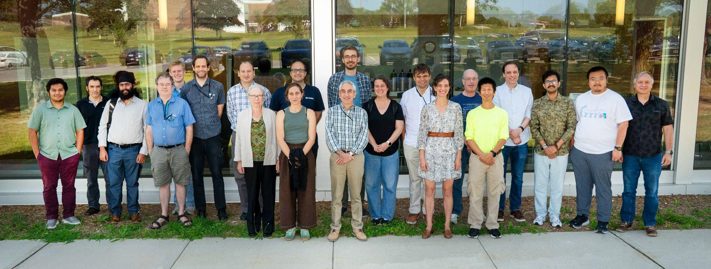
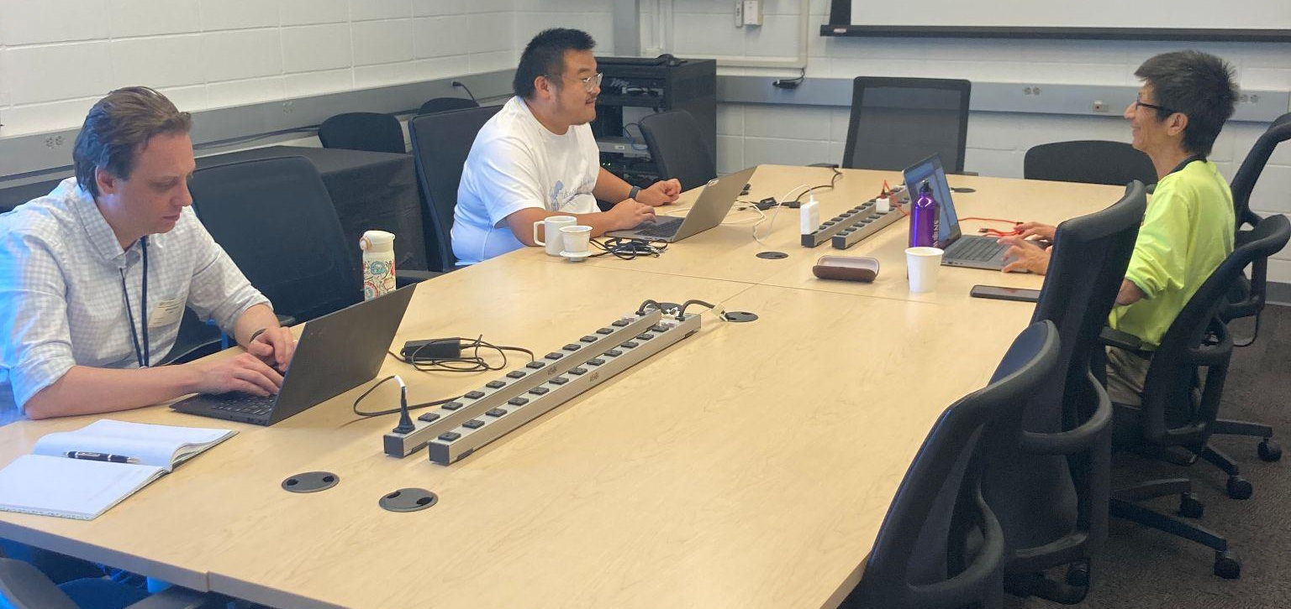
US FCC Hackathon 2025
We put the "work" back in "workshop"! August 11-15th Future Circular Collider workshop. Work-workshop. Hackathon.
Work-workshop by the numbers:
39 registered participants (30 in-person at BNL)
6 work packages,15 hours of dedicated time
  Summarized in 15 final presentations by participants
Two motivational talks and one tutorial
16 feet of hero sandwiches and 8 pizzas consumed
1 workshop playlist

Slide 4
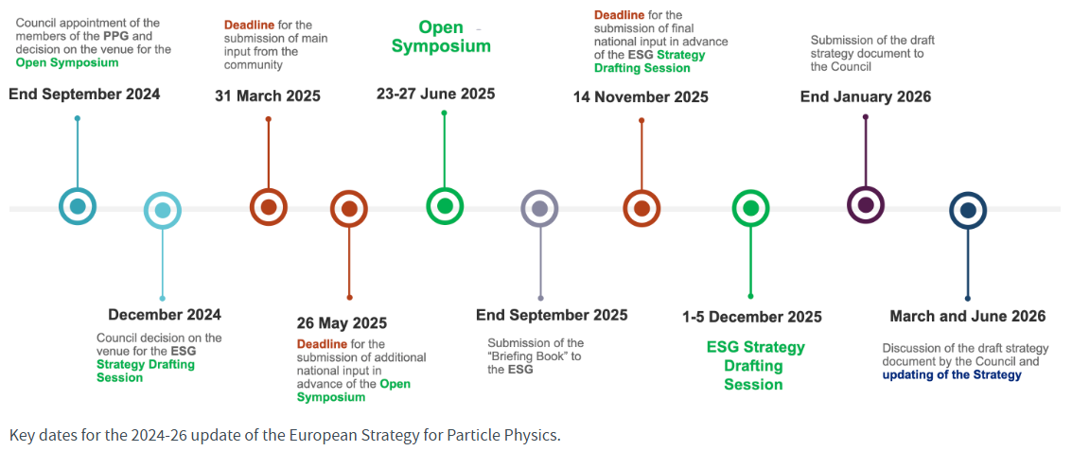
Upcoming FCC activities
TDAQ workshop at CERN 6 Nov

Slide 5
HEP S&C “Blueprint” Workshop
Goal: bring together current/future HEP experiments to coordinate R&D efforts on software and computing
Broad scope:
  US-LHC Ops programs
  IRIS-HEP, HEP-CCE
  CPSC
  EIC, DUNE
  HFCC, Key4Hep, FCC, Linear Colliders, Muon Collider
Dec 3-5, at Notre Dame's Keough School of Global Affairs in Washington, DC
  Virtual pre-meetings in Oct/Nov will provide technical context for in-person discussions
Contact Lothar and Mike (PS&C coordinators) if you’re interested in participating in the process

Slide 6
2026 HFCC Meeting
After the successful Third Annual US Higgs Factory Future Circular Collider meeting at FNAL/ANL, there is a desire to maintain the momentum, especially given that the recommendations from the ESG will have been released.
We are asking for bids to host the next Higgs Factory Workshop, most likely for the August – October 2026 timeframe. See https://docs.google.com/spreadsheets/d/1ThFBH3P-Zsw1dZNp-MVKZ4OY-177Q1PO28HXvxnxvQg/edit?usp=sharing for a schedule to think about dates
Please send your bids to - or discuss with – one of the HFSC members.

Slide 7
Upcoming events
DRD6-calo
Ancona Spain 16-19 Sep https://indico.cern.ch/event/1551941/overview
International Workshop on new photodetectors
Bologna, Italy 3-4 Oct https://agenda.infn.it/event/47073/abstracts/
CPAD
Philadelphia PA 7-10 Oct https://indico.global/event/14966/registrations/3525/
Linear Collider Workshop (LCWS 2025)
Valencia, Spain October 20-24 https://agenda.linearcollider.org/event/10594/.
Vertex Detector R&D for FCC-ee
Pisa, 30-31 Oct https://agenda.infn.it/event/47923/
TIPP International Conference on Technology & Instrumentation in Particle Physics
Mumbai, 2-6 Feb https://www.tifr.res.in/tipp2026/
Calor26
Santa Fe NM, May 31 - June 5, 2026 https://indico.cern.ch/event/1572594/

Slide 8
On the arxiv
https://arxiv.org/abs/2508.04191 Optimisation of the vertex detector and measurement of Higgs decays to second-generation quarks at the CEPC
https://arxiv.org/abs/2508.04471 Prospects of searches for invisible $B$-meson decays at FCC-ee
https://arxiv.org/abs/2508.04656 Charged Higgs Signatures at Future Electron-Proton Colliders
https://arxiv.org/abs/2508.06954 Bounding exotic top decays inclusively at the FCC-ee
https://arxiv.org/abs/2508.08893 Optimal estimation of Higgs-Gauge Boson couplings at the future colliders
https://arxiv.org/abs/2508.06954 Bounding exotic top decays inclusively at the FCC-ee
https://arxiv.org/abs/2508.14700 Jets at electron-positron colliders
https://arxiv.org/abs/2508.14282 Precise Predictions for Event Shapes in Hadronic Higgs Decays
https://arxiv.org/abs/2508.18087 Forward neutrino production and event rates at the Future Circular Collider for hadron collisions

Slide 9
Grey Book reminder
Institutes are encouraged to register to the Grey book.
See slide 10 of https://indico.fnal.gov/event/67484/contributions/310851/attachments/187132/257993/ifnc-USfcc-COLLAB-building-2025.pdf

Slide 10
Join HFCC
Web page: https://higgsfactory.slac.stanford.edu/
US Higgs Factory Accelerator (ACC) Working Groups
Beam Physics
Infrastructure Engineering
Integration & Sustainability
Magnet Systems
Machine-detector Interface
RF Systems
Diagnostics & Instrumentation .
US Higgs Factory Physics, Experiments & Detectors (PED) Working Groups
AI, Integration and Microelectronics (AIM)
Calorimetry
Muon detectors
Physics, Software and Computing (PSC)
Trigger and Data Acquisition (TDAQ)
Trackers
Agendas: https://indico.cern.ch/category/19010/.

Slide 11
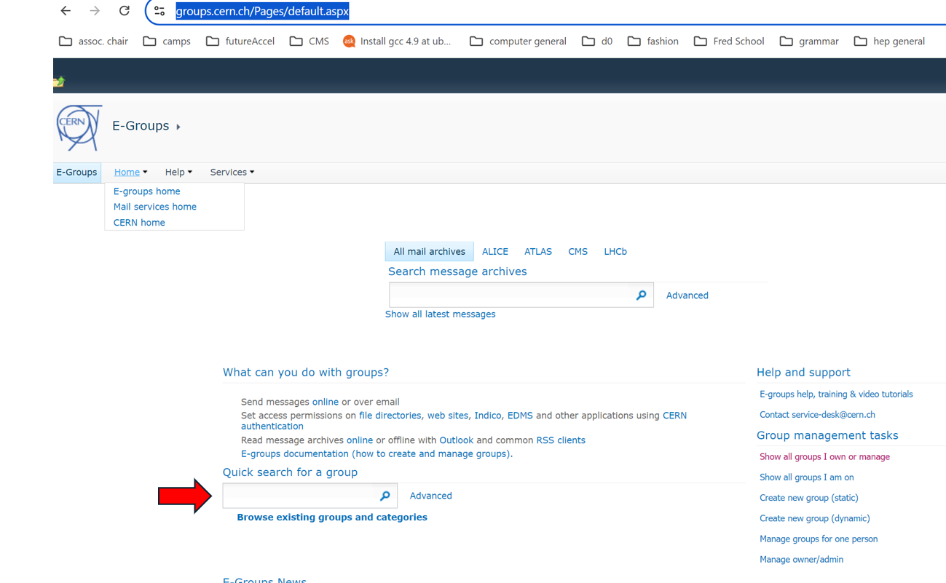
Email lists
Working group mailing list sign-up:
Go to https://groups.cern.ch/Pages/default.aspx
In the box with the red arrow pointing towards it, type us-hfcc or us-hfcc-acc
Sign up for FCC mailing lists: https://fcc-ped.web.cern.ch/##
Sign up for the US-LC and US-FCC mailing lists: https://groups-portal.web.cern.ch/
Need help?
Contact jlvay@lbl.gov or
jrp3@cornell.edu

