Slide 1
HFCC News
3 July 2025

Slide 2
Welcome
Agenda:
  1. News
  2. Featured presentation: “Blow-by-blow description of e+e- collisions
  using cartoons” - Arianna Formenti (LBNL)
For next meeting (7 August), featured talk will be:
“Summary of FCC tracker workshop at BNL” - Christoph Paus (MIT)

Slide 3

Report of the National Academies
The report
“Elementary Particle Physics:
The Higgs and Beyond (2025)”
was presented at a public briefing on
11 June, 2025 and presented a 40-year
vision for elementary particle physics.
Report contains 8 recommendations; the
first two are most pertinent to this audience
https://nap.nationalacademies.org/catalog/28839/elementary-particle-physics-the-higgs-and-beyond

Slide 4
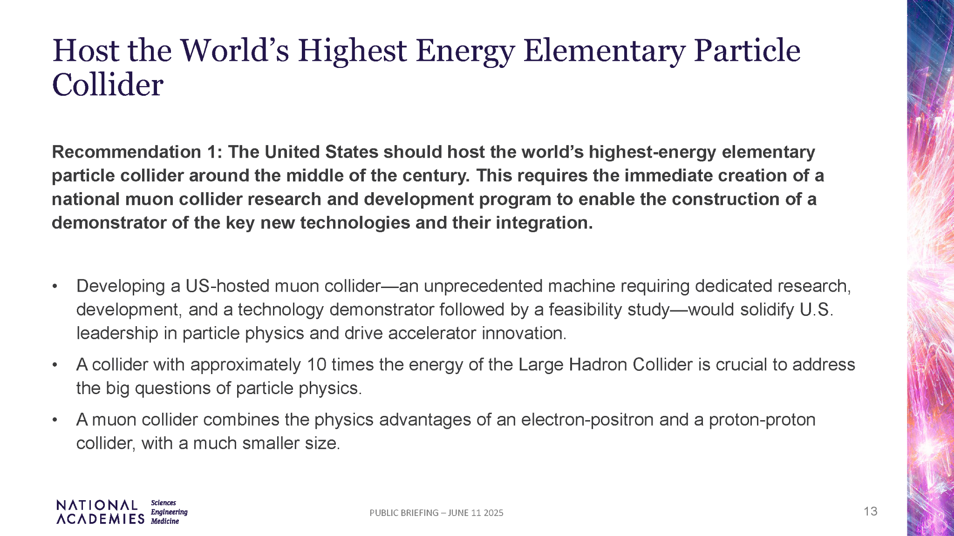

Slide 5
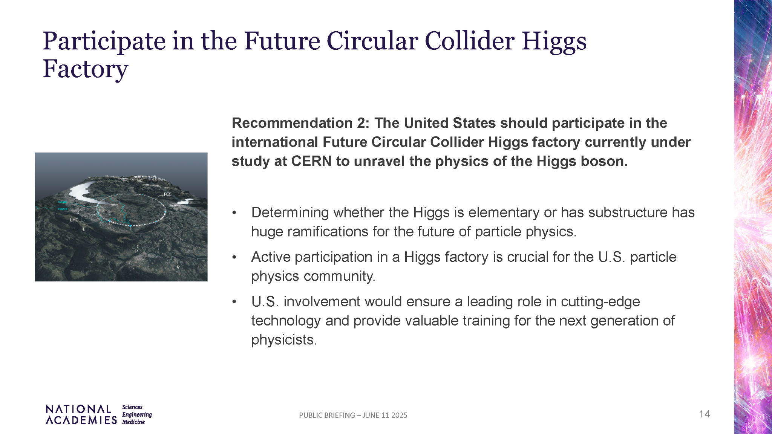

Slide 6
National academy report
Strong support for the muon collider community.
Surprising break of symmetry between possible Higgs factories.
Surprising break of integrated FCC project ?
If accepted by the agencies, funding will very limited.
Any thoughts from the audience?

Slide 7
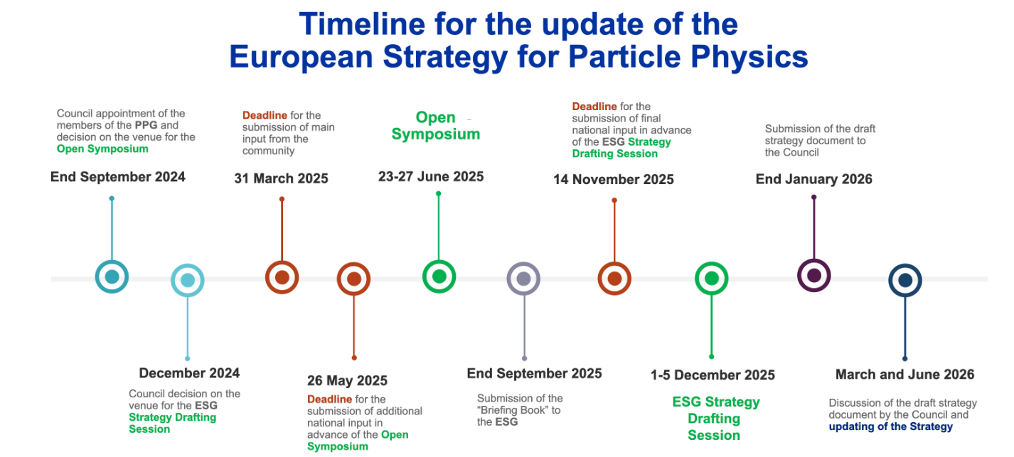
ESU update

Slide 8

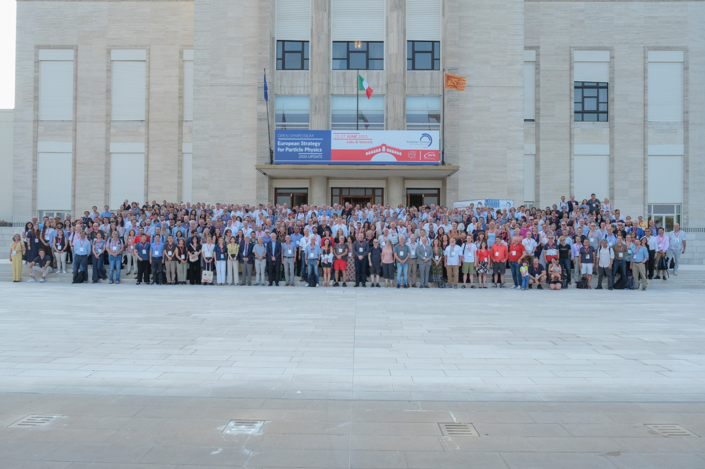

Slide 9
ESPP Open Symposium, Venice, June 23-28
~ 630 in-person participants and
~ 720 remote participants per day

Slide 10
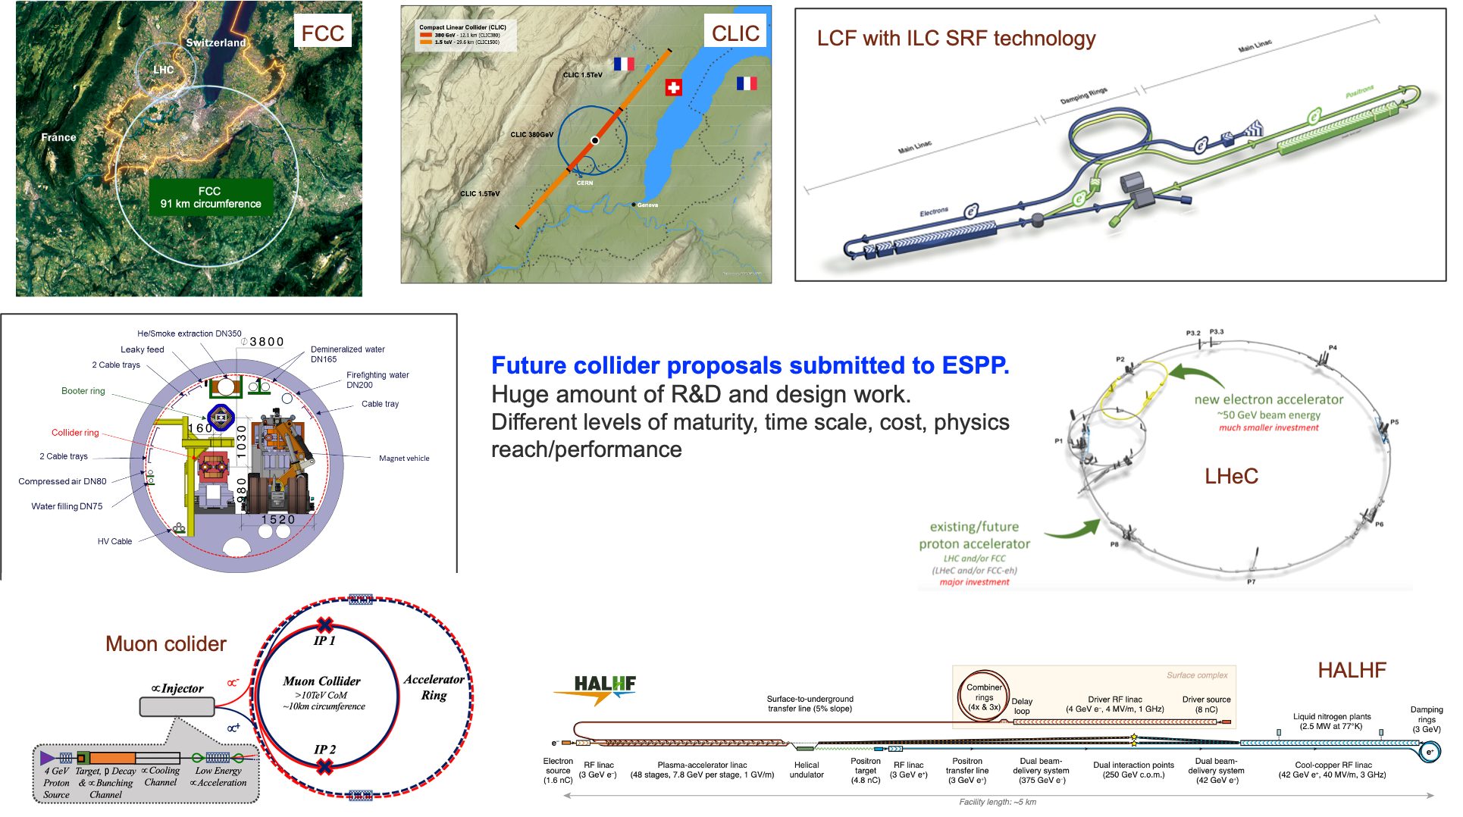
Projects Proposed

Slide 11
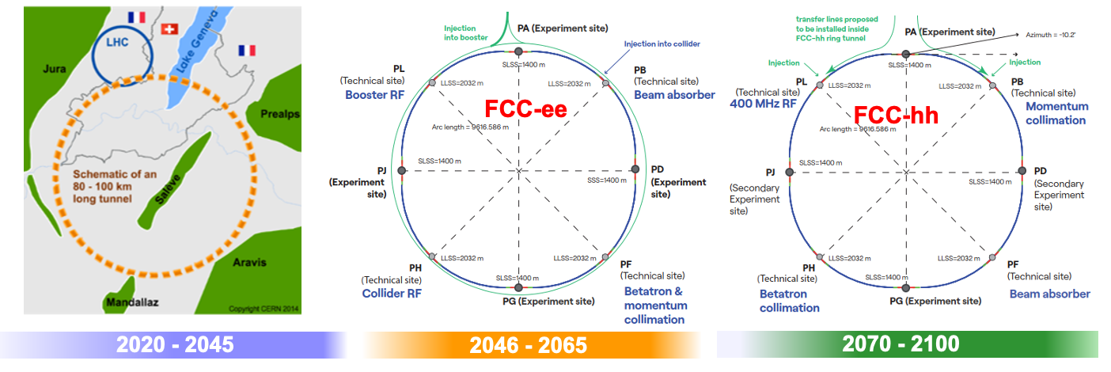
FCC-ee/hh

Slide 12
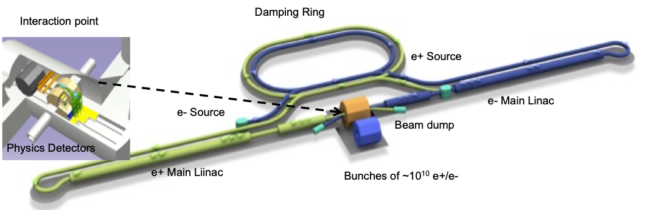
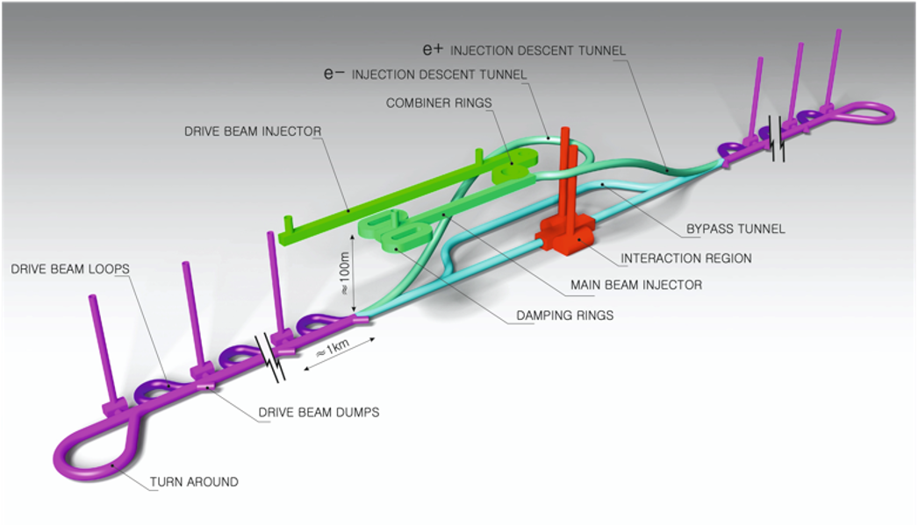
CLIC and LCF
HALHF, C3, PWA plus ERL,
gamma-gamma, …

Slide 13
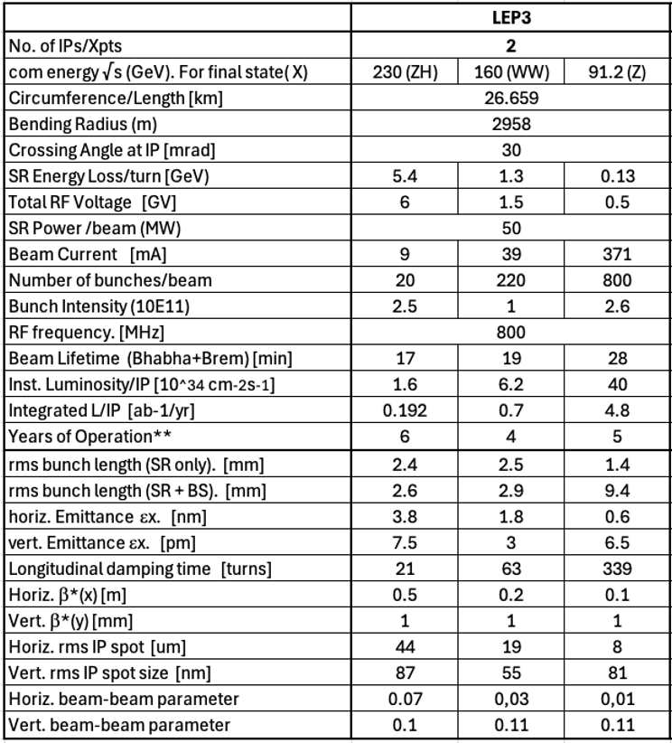
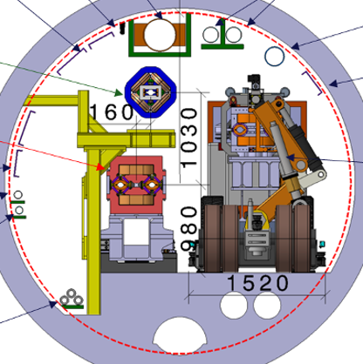
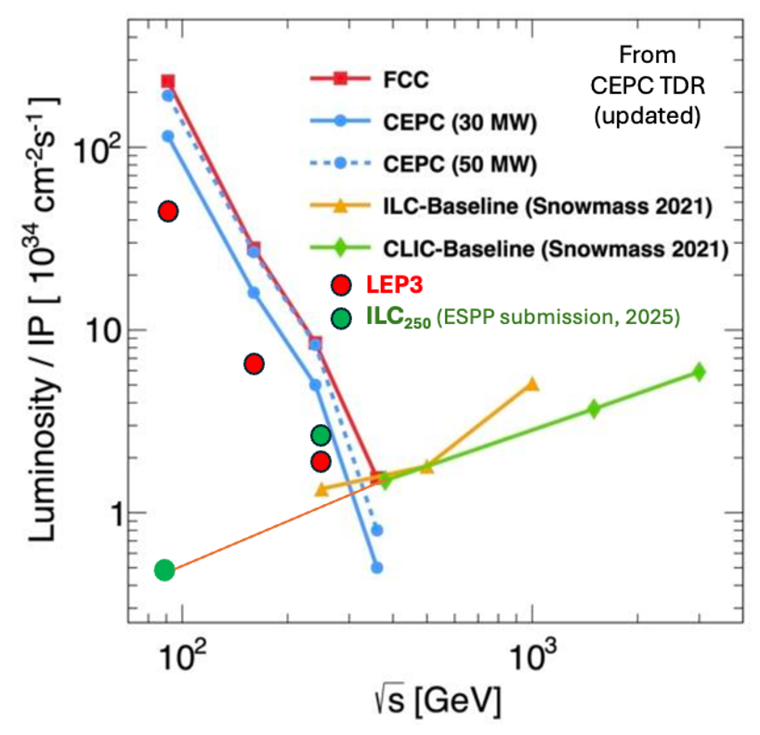
LEP3

Slide 14
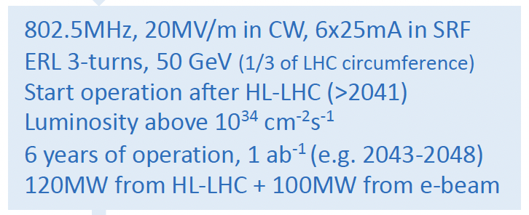
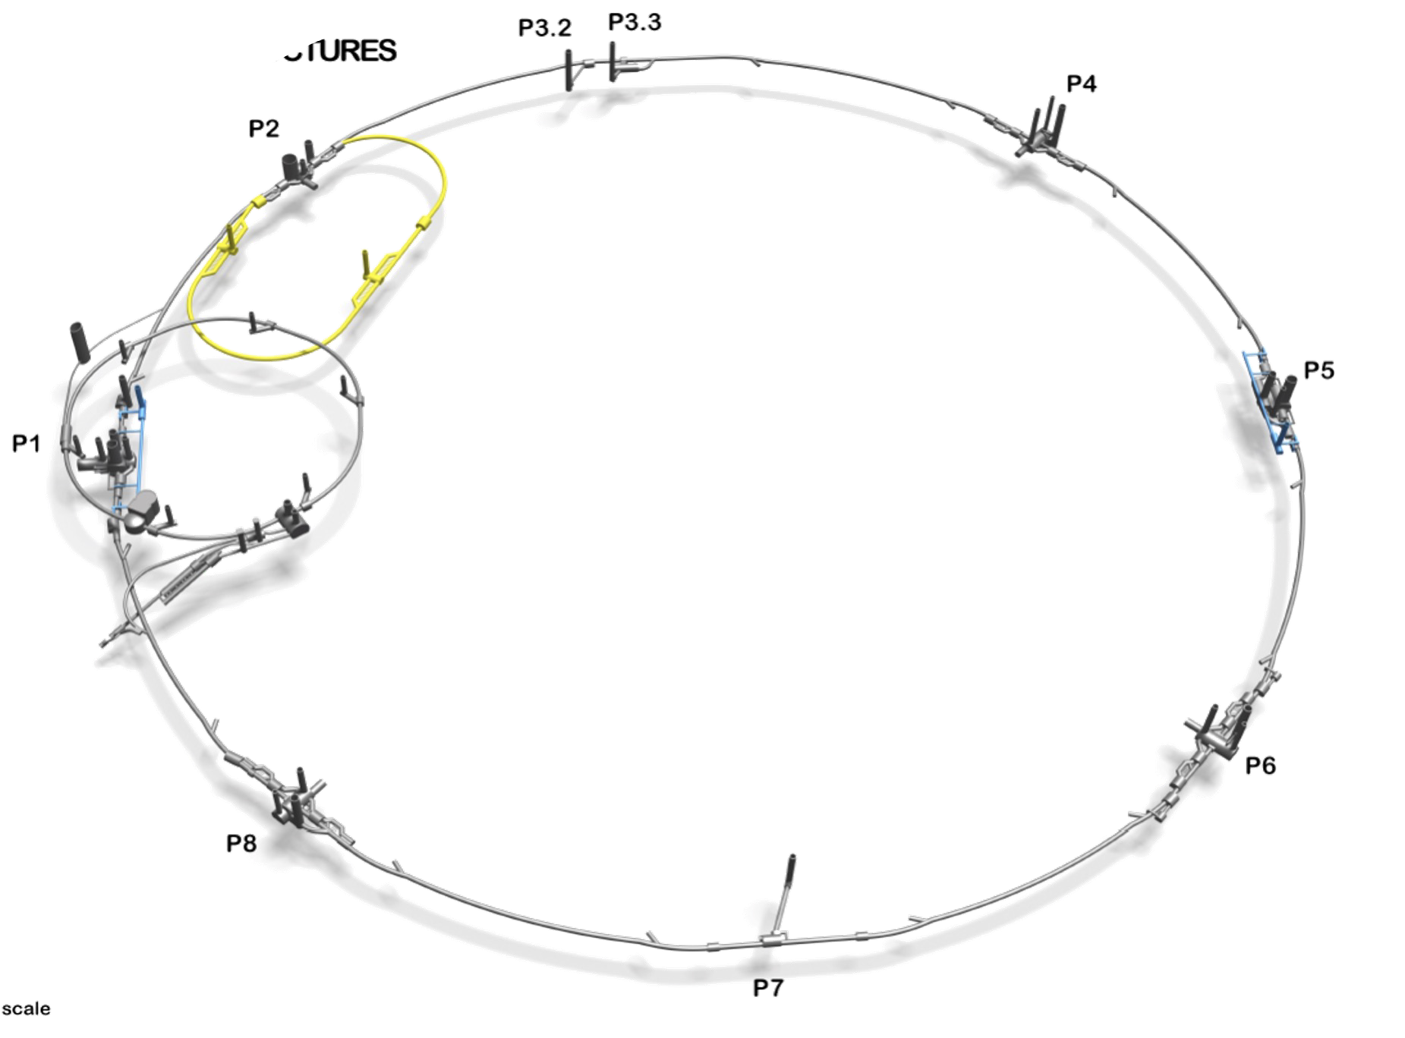
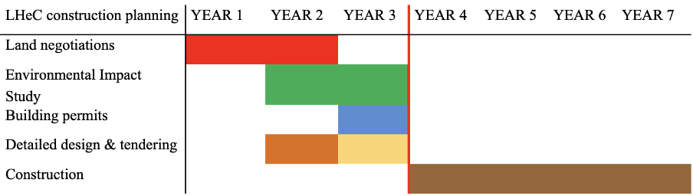
LHeC

Slide 15
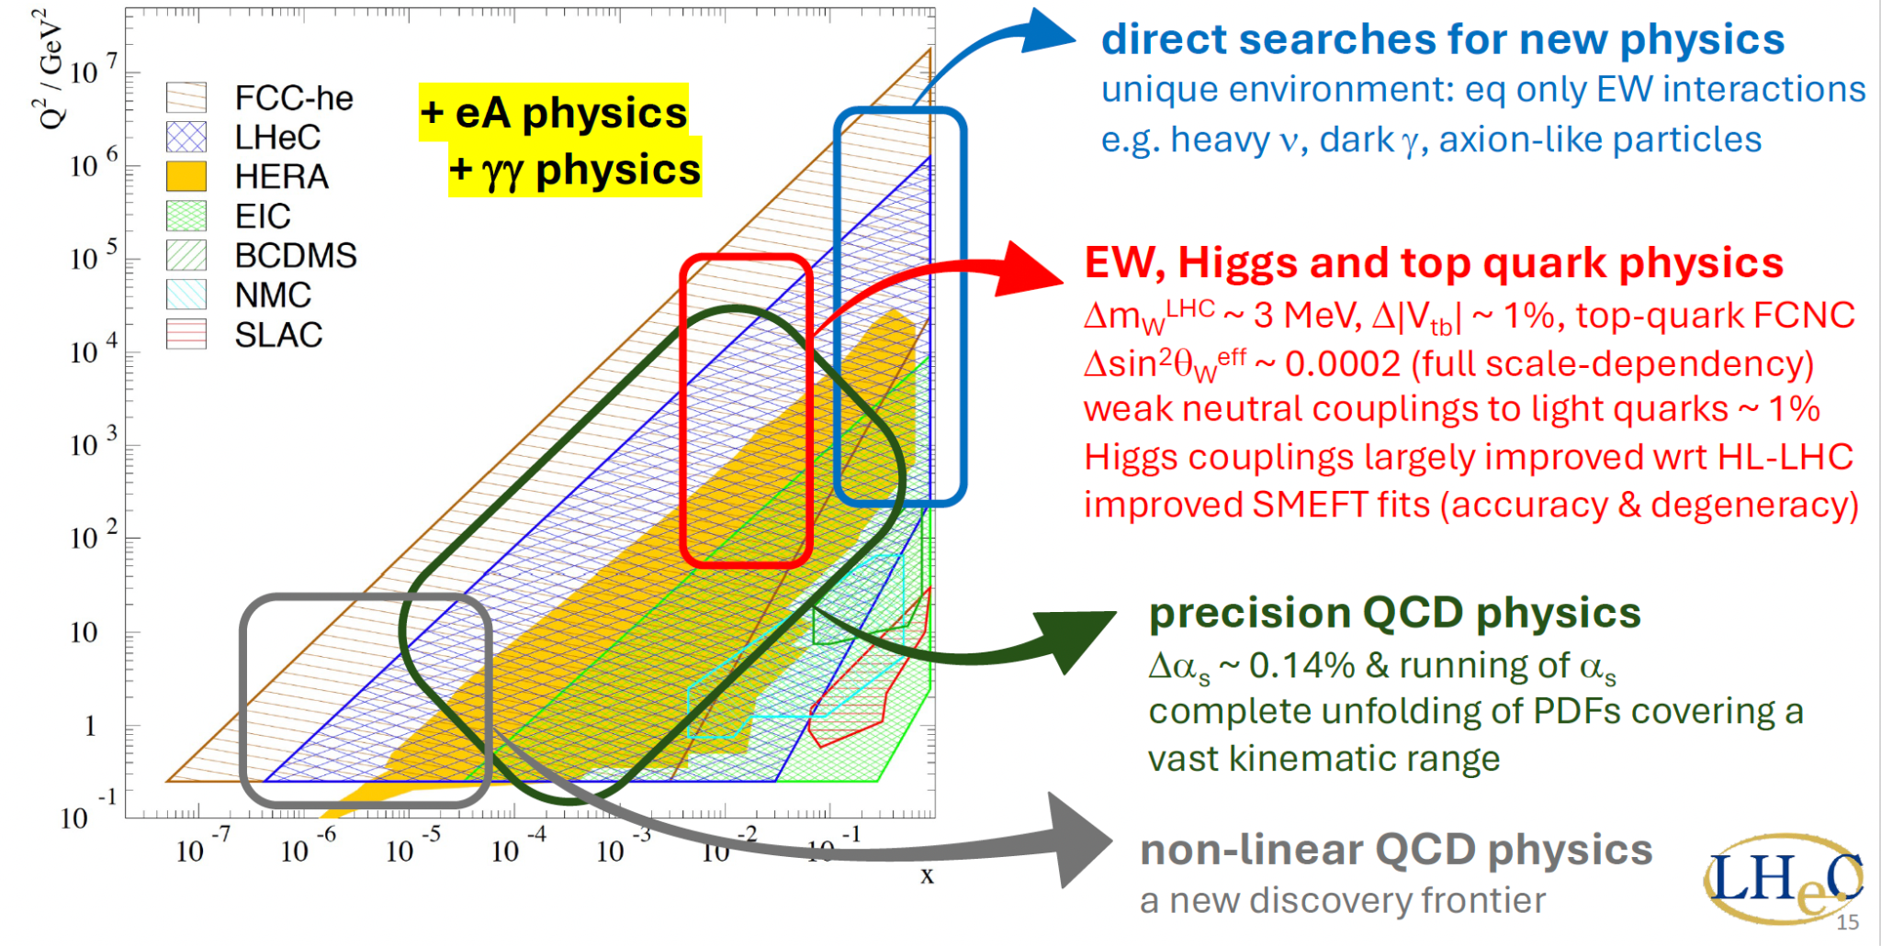
LHeC

Slide 16
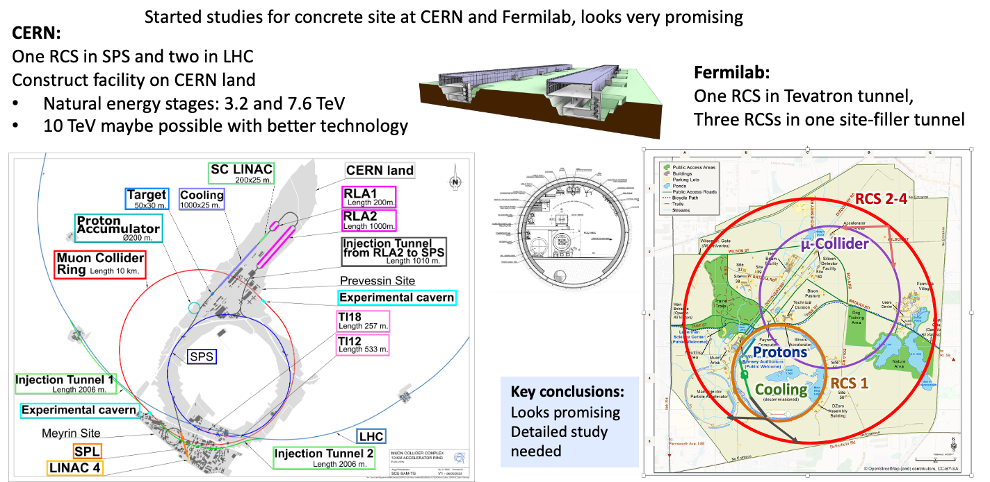
Muon Collider

Slide 17
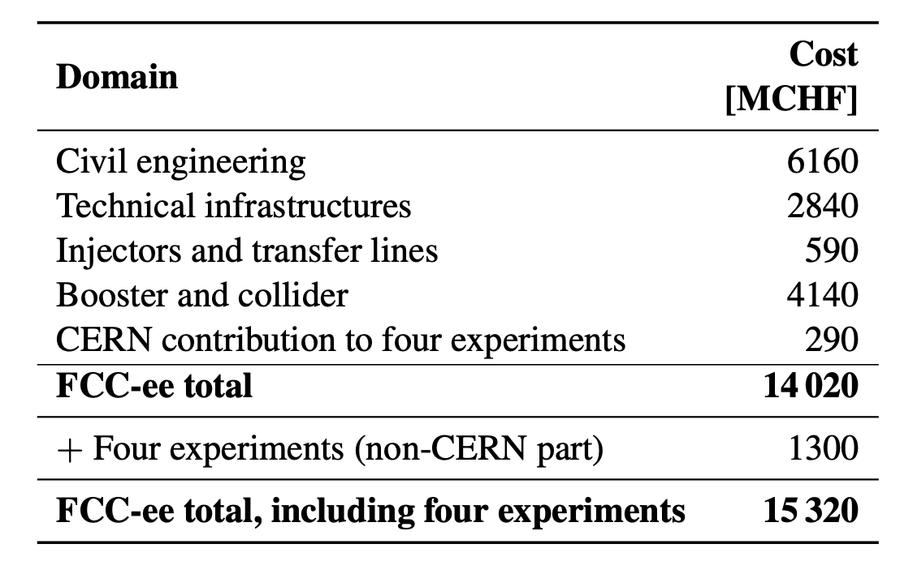
Financing FCC
Updated project cost for FCC-ee up to and including
operation at ZH and 4 experiments
t-tbar upgrade requires additional 1.3 BCHF
Funding of FCC (or any other major future collider project) expected to come from two main sources:
CERN Budget (i.e. revenues from Member and Associate Member States): would cover more than 50% of FCC investment cost
External contributions:
- additional voluntary contributions (in-cash or in-kind) from Member and Associate Member States
- contributions from non-Member States
- exploring possible contributions from the European Union in the next Multiannual Financial Framework (MFF 2028-2034)
- exploring possible contributions of private donors (→ in Dec 2024, Council approved “Policy for fundraising from private donors
for scientific activities at CERN ”)
→ good progress over the past months
Several funding scenarios developed, based on different assumptions (e.g. constant or slightly increased CERN Budget)
→ ongoing discussions in Council
From F. Gianotti, CERN 2 July, 2025

Slide 18
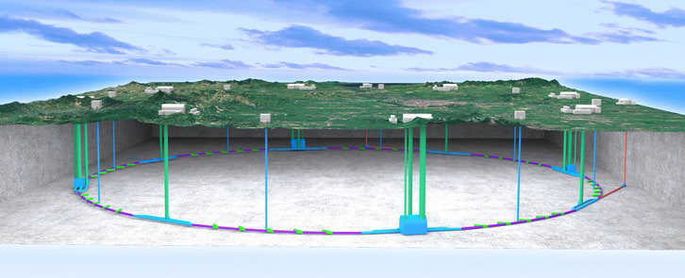
CepC

Slide 19
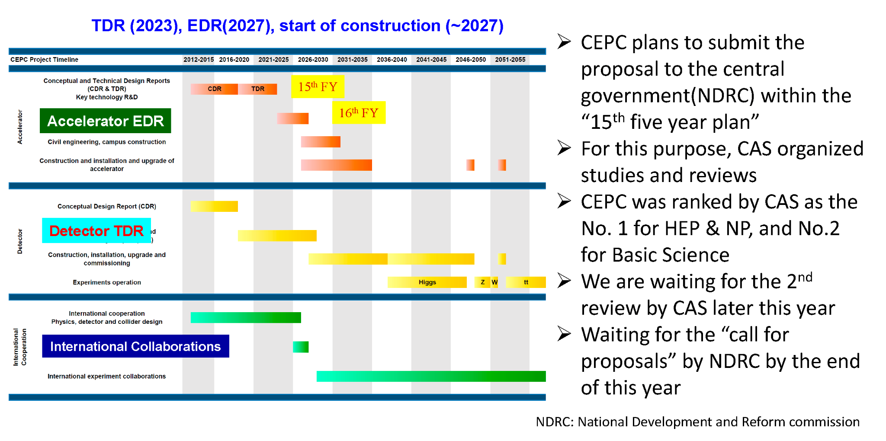
CepC

Slide 20
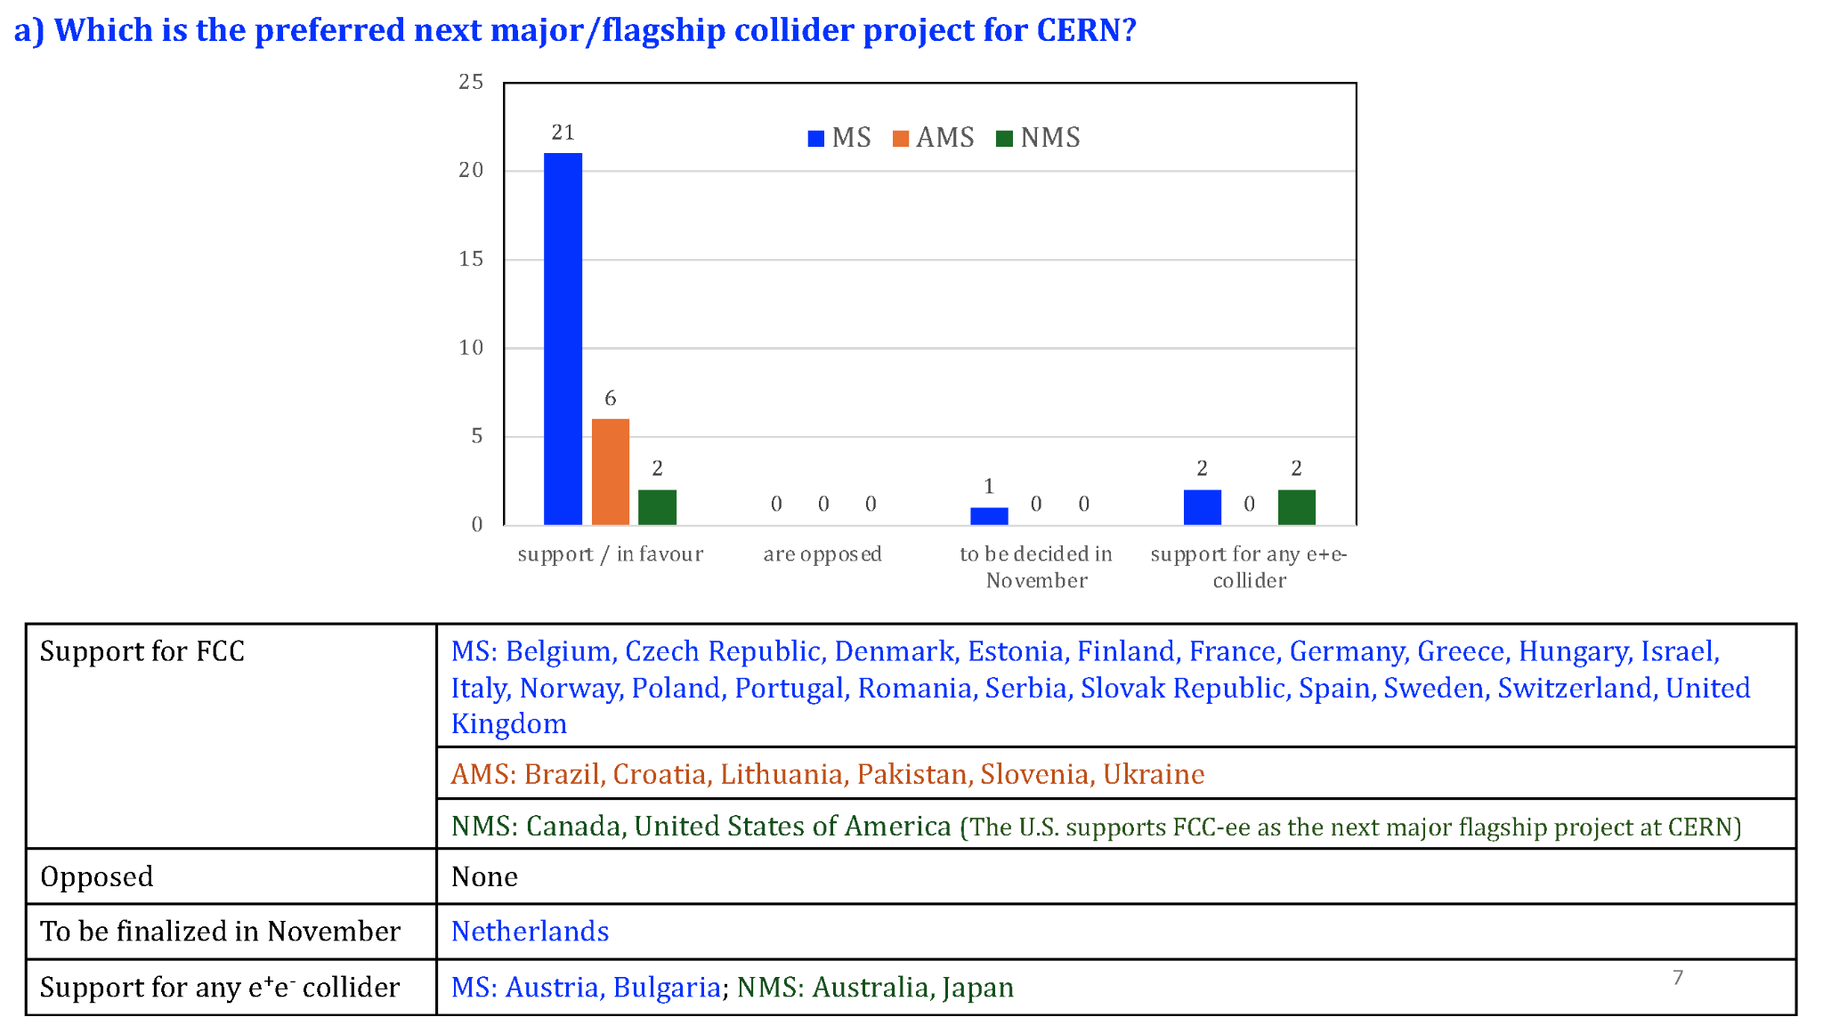
National Inputs

Slide 21
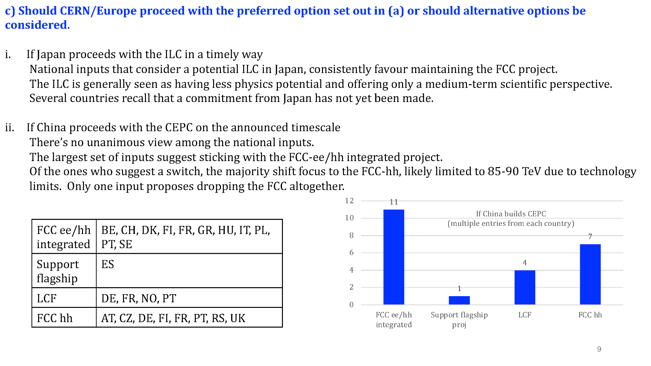
National Inputs

Slide 22
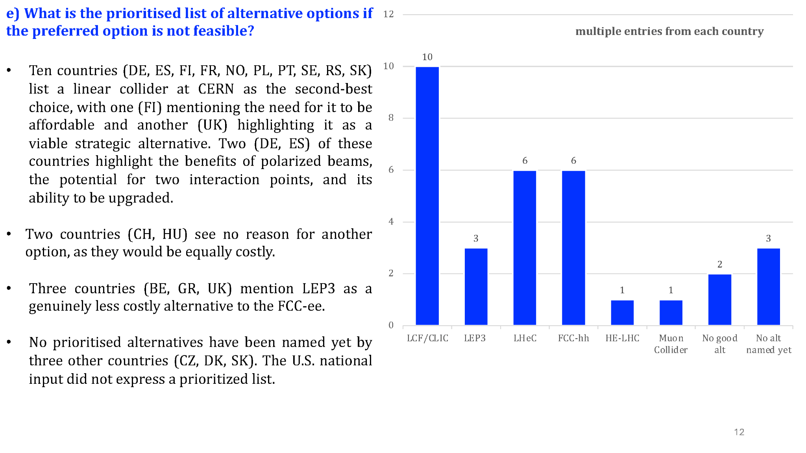
National Inputs

Slide 23
ACC news
Higgs Factory Contacts
FCC
Beam Physics: Katsunobu Oide katsunobu.oide@cern.ch, optics, Xavier Buffat xavier.buffat@cern.ch, beam-beam, Mauro Migliorati mauro.migliorati@uniroma1.it for impedances
Diagnostics: Robert Kieffer
RF: Olivier Brunner Olivier.Brunner@cern.ch and Franck Peauger Franck.Peauger@cern.ch
Magnet Systems: Bernhard Auchmann bernhard.auchmann@psi.ch SC, (also HTS and low field), Daniel Schoerling Daniel.Schoerling@cern.ch warm magnets
MDI : Manuela Boscolo Manuela.Boscolo@lnf.infn.it manuela.boscolo@lnf.infn.it and Fabrizio Palla fabrizio.palla@cern.ch
Infrastructure & engineering : Jean-Paul Burnet Jean-Paul.Burnet@cern.ch
Integration & Sustainability: Johannes Gutleber Johannes.Gutleber@cern.ch
ILC/LC Vision
Beam Physics: Daniel Schulte Daniel.Schulte@cern.ch
Diagnostics: Angeles Faus-Golfe Angeles.Faus.Golfe@cern.ch
RF: Sergey Belomestnykh (sbelomes@fnal.gov) and Benno List benno.list@desy.de
Magnet Systems: maybe Akira Yamamoto akira.yamamoto@kek.jp
MDI : Rogelio Tomas Garcia rogelio.tomas@cern.ch and Vera Cilento vera.cilento@cern.ch
Infrastructure & engineering : Steinar Stapnes Steinar.Stapnes@cern.ch and Thomas Schoerner thomas.schoerner@desy.de
Integration & Sustainability : Steinar Stapnes Steinar.Stapnes@cern.ch and Thomas Schoerner thomas.schoerner@desy.de
Positrons : Gudrid Moortgat-Pick gudrid.moortgat-pick@desy.de and Steffen Doebert Steffen.Doebert@cern.ch

Slide 24
Upcoming events
MAPS Academy 2025
A summer school July 23-30 at KEK, Japan, for people who have started or would like to start to develop Monolithic Active Pixel Sensor (MAPS) with CMOS technology. See https://wiki.kek.jp/display/mapschool/MAPS+Academy .
53rd SLAC Summer Institute (SSI 2025)
The SSI will take place on July 28 - August 8 with the theme "Pathways to New Physics”. For information and to register, see https://indico.slac.stanford.edu/event/9605/overview.
Muon collider accelerator school
will take place on Aug 3 - Aug 6For information and to register, see https://indico.uchicago.edu/event/478/
Muon collider annual meeting
will take place on Aug 7- Aug 8For information and to register, see https://indico.uchicago.edu/event/479/
SUSY 2025 Conference
the 32nd International Conference on Supersymmetry and Unification of Fundamental Interactions--will be hosted at the University of California, Santa Cruz, California from August 18 - 23, 2025. The conference webpage is located at https://indico.cern.ch/event/1446820/ and early bird registration is open until June 26th.
Lepton Photon Symposium
32nd International Symposium on Lepton Photon Interactions at High Energies, August 25-29 in Madison Wisconsin. See https://agenda.hep.wisc.edu/event/2188/
Vertex 2025
33rd International Workshop on Vertex Detectors August 25-29 in Knoxville, TN. See https://indico.phy.ornl.gov/event/677/
Linear Collider Workshop (LCWS 2025)
The next Linear Collider workshop will take place October 20-24, 2025 in Valencia, Spain. Mark your calendars and stay tuned for details at https://agenda.linearcollider.org/event/10594/.
HFCC Working groups and mailing lists
As always, we invite your participation in the working groups of the US Higgs Factory Coordination Consortium. You may subscribe by going to https://groups-portal.web.cern.ch/ and searching for "US-HFCC” or by contacting Ritchie Patterson (jrp3@cornell.edu).

Slide 25
Join HFCC
Web page: https://higgsfactory.slac.stanford.edu/
US Higgs Factory Accelerator (ACC) Working Groups
Beam Physics
Infrastructure Engineering
Integration & Sustainability
Magnet Systems
Machine-detector Interface
RF Systems
Diagnostics & Instrumentation .
US Higgs Factory Physics, Experiments & Detectors (PED) Working Groups
AI, Integration and Microelectronics (AIM)
Calorimetry
Muon detectors
Physics, Software and Computing (PSC)
Trigger and Data Acquisition (TDAQ)
Trackers
Agendas: https://indico.cern.ch/category/19010/.

Slide 26
Grey Book reminder
Institutes are encouraged to register to the Grey book.
See slide 10 of https://indico.fnal.gov/event/67484/contributions/310851/attachments/187132/257993/ifnc-USfcc-COLLAB-building-2025.pdf

Slide 27
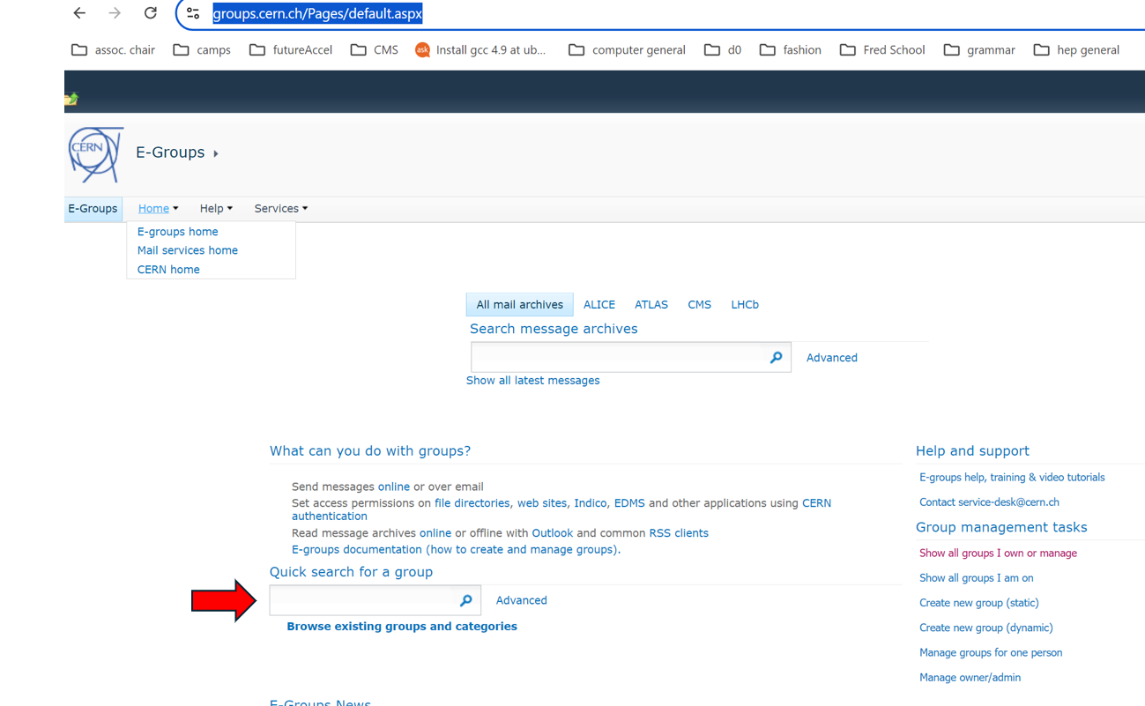
Email lists
Working group mailing list sign-up:
Go to https://groups.cern.ch/Pages/default.aspx
In the box with the red arrow pointing towards it, type us-hfcc or us-hfcc-acc
Sign up for FCC mailing lists: https://fcc-ped.web.cern.ch/##
Sign up for the US-LC and US-FCC mailing lists: https://groups-portal.web.cern.ch/
Need help?
Contact jlvay@lbl.gov or
jrp3@cornell.edu

Slide 28

Suggestion Box
Suggest technical talks for future meetings in this series
Send to: Ritchie Patterson jrp3@cornell.edu,
Steve Gourlay sgourlay@fnal.gov
or Sarah Eno eno@umd.edu

