Slide 1


Slide 3

Black hole X-ray binaries (BH XRBs)
(Credit: NASA and Steve Prabu who had this in one of his presentations)

Slide 4

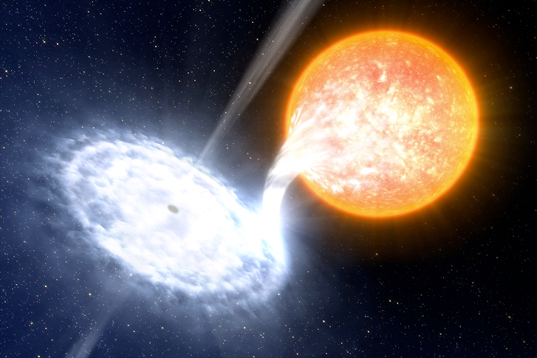





Black hole X-ray binaries (BH XRBs)
(Credit: ESO/L. Calçada)

Slide 5
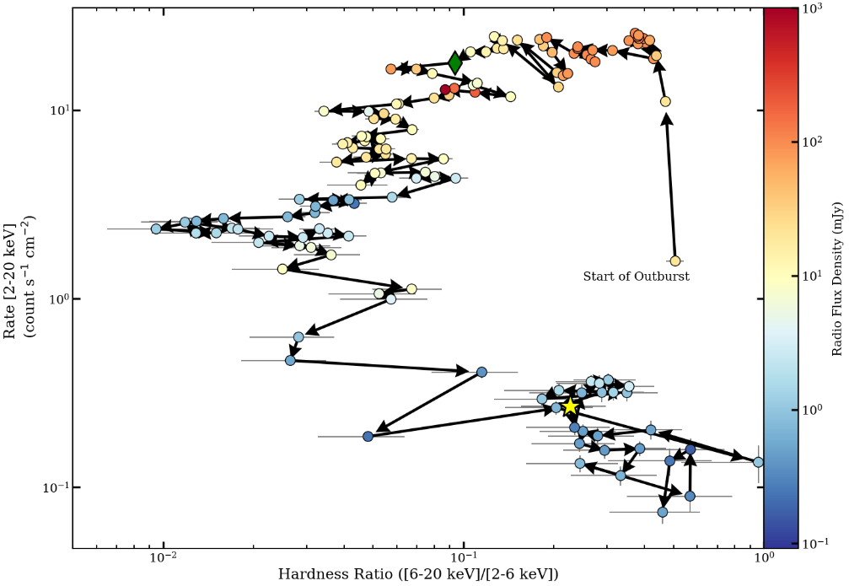
BH LMXB outbursts: An oversimplification
Hardness intensity diagram
X-ray Luminosity
X-ray Spectral ‘hardness’

Slide 6
BH LMXB outbursts: An oversimplification
Hard state:
  Steady, coupled jet
  Self-absorbed
  𝜶 ~ 0 (for Flux density ~ 𝛎^{𝜶})
Hardness intensity diagram schematic (attempt)
Soft State
Hard State
X-ray Luminosity
start
X-ray Spectral ‘hardness’

Slide 7
BH LMXB outbursts: An oversimplification
Hard state:
  Steady, coupled jet
  Self-absorbed
  𝜶 ~ 0 (for Flux density ~ 𝛎^{𝜶})
Hard→Soft transition:
  Decoupled ‘blobs’
  Transition to optically thin
  e.g., 𝜶 ~ -0.7 (or lower)
Hardness intensity diagram schematic (attempt)
Soft State
Hard State
X-ray Luminosity
start
X-ray Spectral ‘hardness’

Slide 8
BH LMXB outbursts: An oversimplification
Hard state:
  Steady, coupled jet
  Self-absorbed
  𝜶 ~ 0 (for Flux density ~ 𝛎^{𝜶})
Hard→Soft transition:
  Decoupled ‘blobs’
  Transition to optically thin
  e.g., 𝜶 ~ -0.7 (or lower)
Soft state:
  Cessation of BH jet activity
Hardness intensity diagram schematic (attempt)
Soft State
Hard State
X-ray Luminosity
start
X-ray Spectral ‘hardness’

Slide 9
BH LMXB outbursts: An oversimplification
Hard state:
  Steady, coupled jet
  Self-absorbed
  𝜶 ~ 0 (for Flux density ~ 𝛎^{𝜶})
Hard→Soft transition:
  Decoupled ‘blobs’
  Transition to optically thin
  e.g., 𝜶 ~ -0.7 (or lower)
Soft state:
  Cessation of BH jet activity
Soft→Hard transition:
  Reformation of steady jet
Hardness intensity diagram schematic (attempt)
Soft State
Hard State
X-ray Luminosity
start
X-ray Spectral ‘hardness’

Slide 10
BH LMXB outbursts: An oversimplification
Hard state:
  Steady, coupled jet
  Self-absorbed
  𝜶 ~ 0 (for Flux density ~ 𝛎^{𝜶})
Hard→Soft transition:
  Decoupled ‘blobs’
  Transition to optically thin
  e.g., 𝜶 ~ -0.7 (or lower)
Soft state:
  Cessation of BH jet activity
Soft→Hard transition:
  Reformation of steady jet
Hardness intensity diagram schematic (attempt)
Soft State
Hard State
X-ray Luminosity
start
AGN
XRBs
X-ray Spectral ‘hardness’

Slide 11
BH LMXB outbursts: An oversimplification
Hard state:
  Steady, coupled jet
  Self-absorbed
  𝜶 ~ 0 (for Flux density ~ 𝛎^{𝜶})
Hard→Soft transition:
  Decoupled ‘blobs’
  Transition to optically thin
  e.g., 𝜶 ~ -0.7 (or lower)
Soft state:
  Cessation of BH jet activity
Soft→Hard transition:
  Reformation of steady jet
Hardness intensity diagram schematic (attempt)
Soft State
Hard State
X-ray Luminosity
start
Why Jets?
X-ray Spectral ‘hardness’

Slide 12
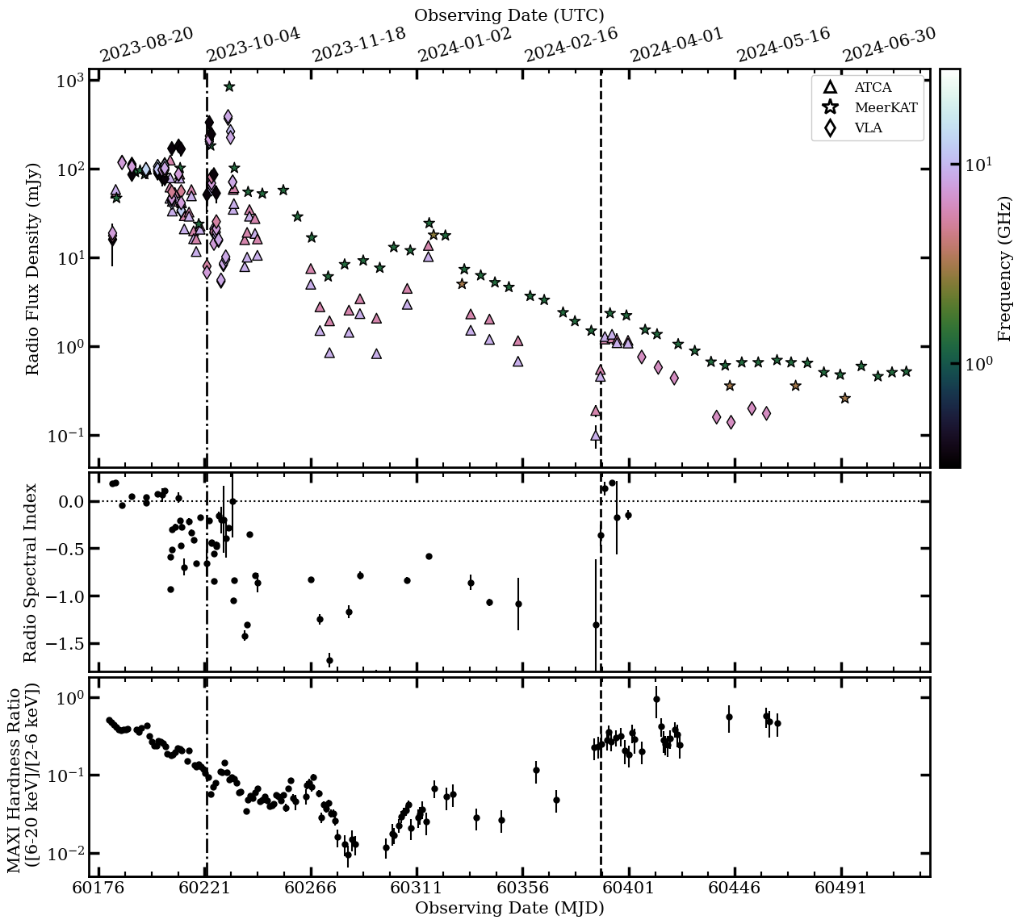
The 2023–2024+ outburst of Swift J1727.8–1613
Swift J1727.8–1613 the BH XRB:
  Activity near BH lasted ~year (Aug 2023 – July 2024)
  Figure highlights extensive radio campaign(s):
    ~200 epochs
    ~0.3–300 GHz
    7 facilities (and growing)
    https://github.com/AKHughes1994/SwJ1727_2023_Outburst
System parameters:
  Mata-Sánchez et al. 2024, 2025:
    M_{BH} > 3 M_{sun}
    Inclination < 74 deg (90 deg is ‘edge-on’)
  Mata-Sánchez + Burridge et al. 2025:
    Distance ‘in-flux’
    Somewhere between ~2–7 kpc
~1 Jy
~1e-4 Jy
(Hughes et al. 2025a, accepted)

Slide 13
The hard states
Swift J1727.8–1613 the BH XRB:
  Activity near BH lasted ~year (Aug 2023 – July 2024)
  Figure highlights extensive radio campaign(s):
    ~200 epochs
    ~0.3–300 GHz
    7 facilities (and growing)
    https://github.com/AKHughes1994/SwJ1727_2023_Outburst
System parameters:
  Mata-Sánchez et al. 2024, 2025:
    M_{BH} > 3 M_{sun}
    Inclination < 74 deg (90 deg is ‘edge-on’)
  Mata-Sánchez + Burridge et al. 2025:
    Distance ‘in-flux’
    Somewhere between ~2–7 kpc
(Hughes et al. 2025a, accepted)

Slide 14
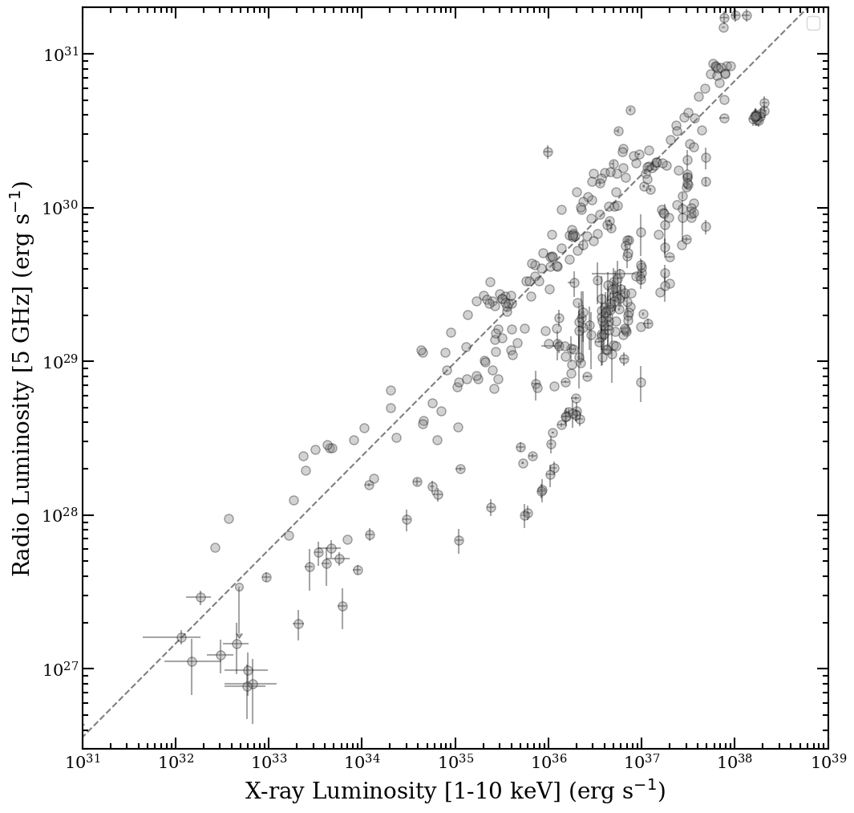
The hard states
The L_{R}– L_{X} relation from hard state jets:
(Hughes et al. 2025a, accepted)
(Hughes et al. 2025b, submitted)

Slide 15
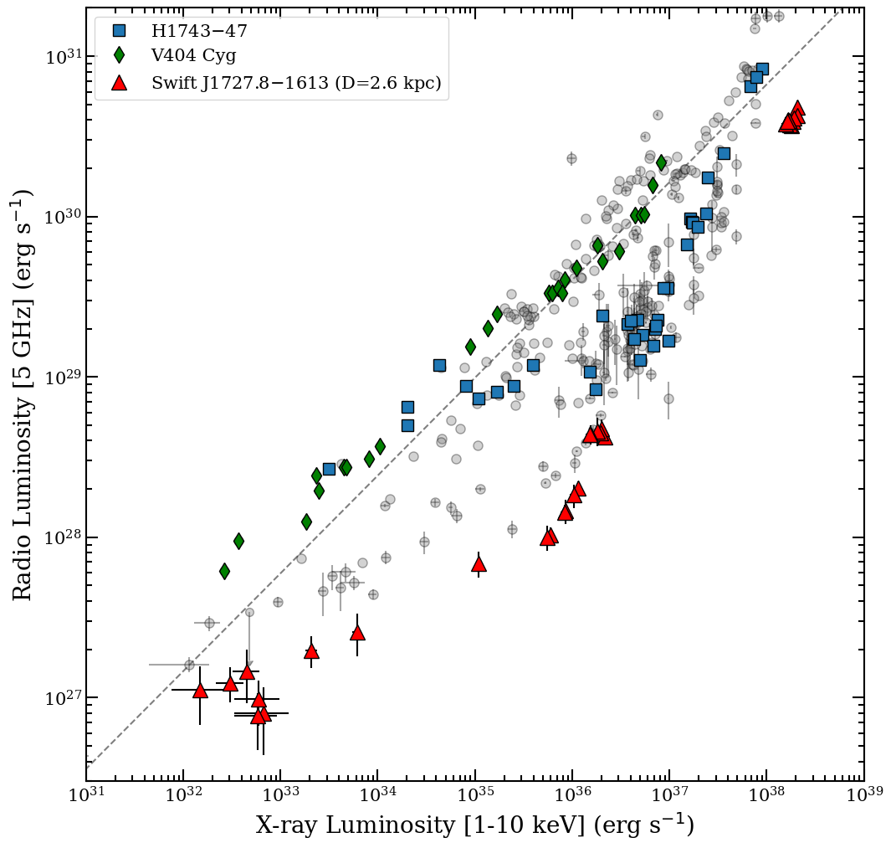
The hard states
The L_{R}– L_{X} relation from hard state jets:
J1727
(Hughes et al. 2025a, accepted)
(Hughes et al. 2025b, submitted)

Slide 16
The hard states
The L_{R}– L_{X} relation from hard state jets:
~100x
???
(Hughes et al. 2025a, accepted)
(Hughes et al. 2025b, submitted)

Slide 17
The (bright) transition
(Hughes et al. 2025a, accepted)

Slide 18
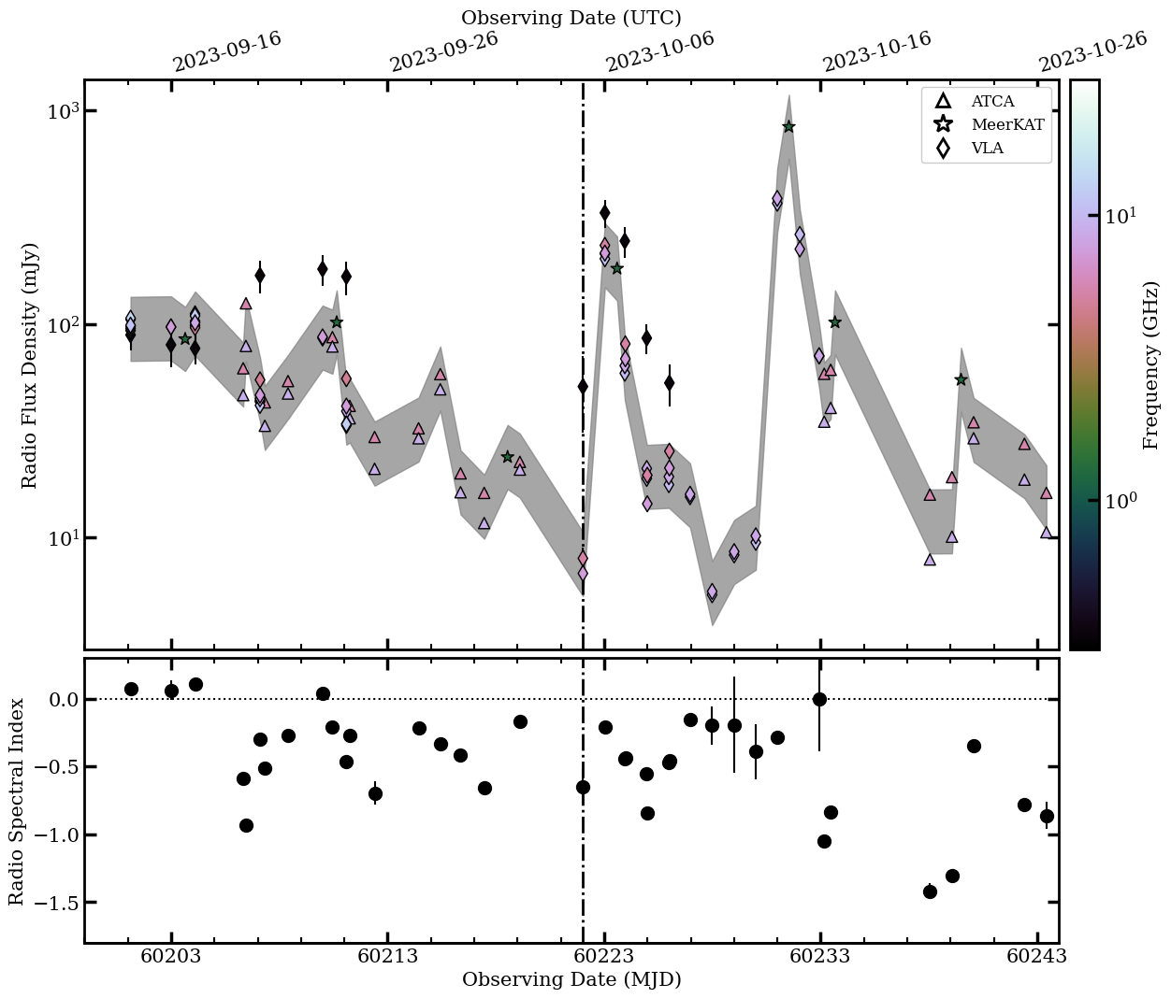
The (bright) transition
Flaring + spectral index evolution from discrete plasma ‘blobs’ with evolving optical depths
Observables can be used to estimate minimum energy within blobs (e.g., Fender & Bright 2019): E > E_{min}(D, F_{𝛎},𝛎)
(Hughes et al. 2025a, accepted)

Slide 19
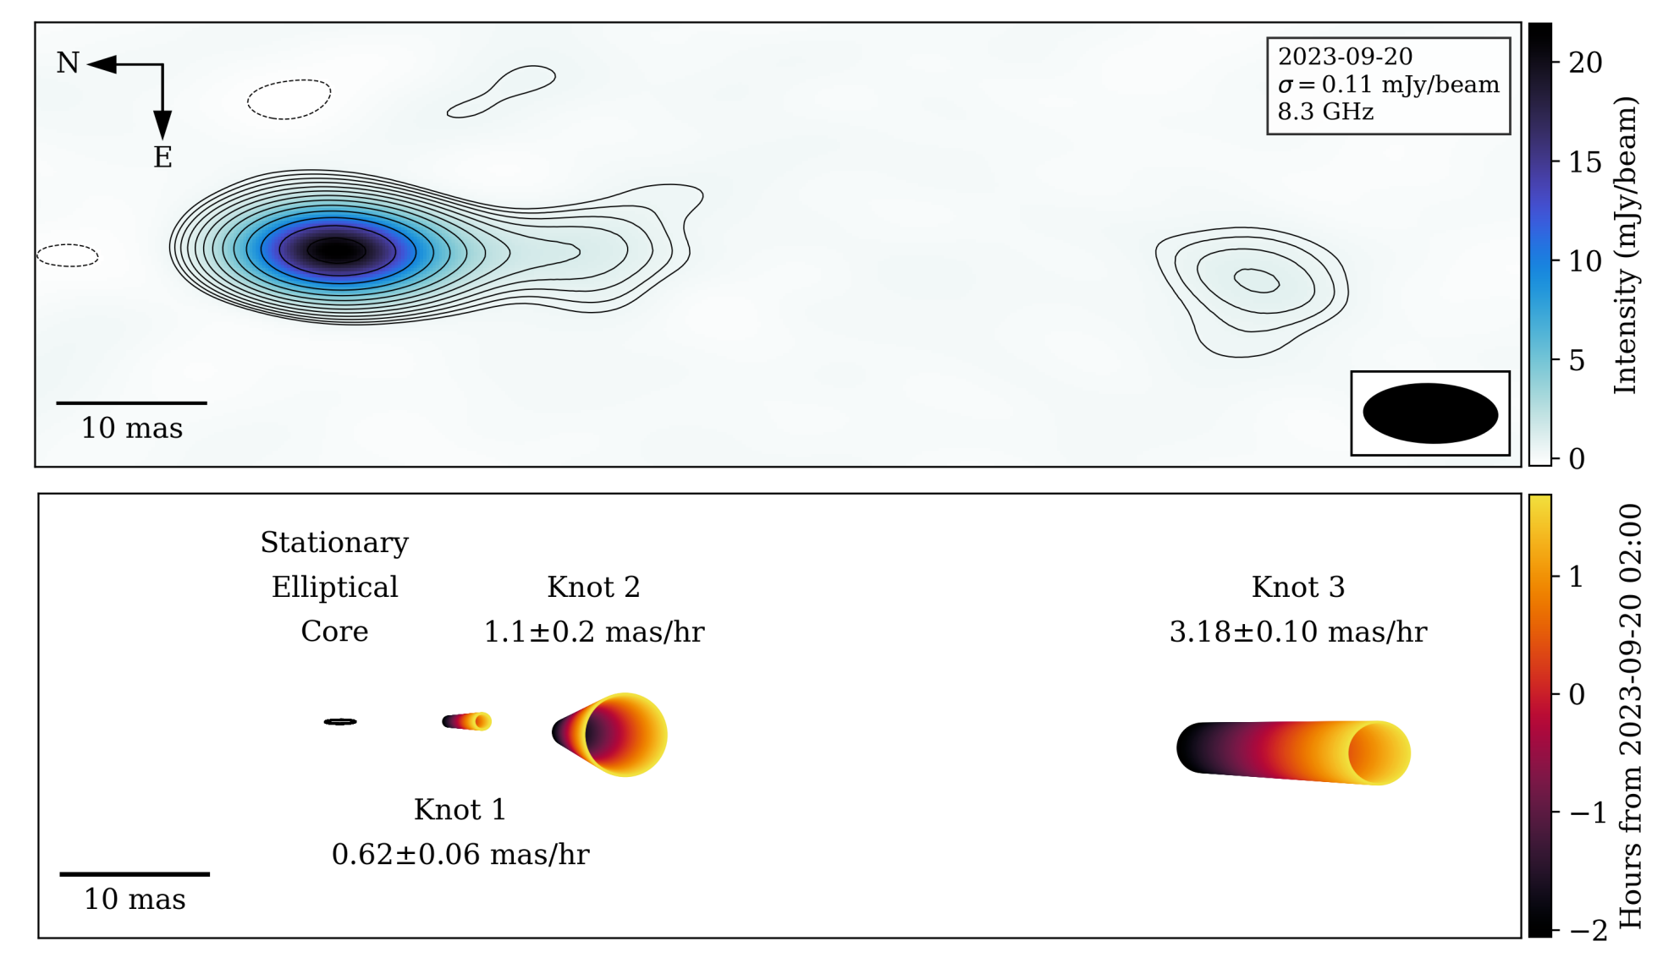
The (bright) transition
Flaring + spectral index evolution from discrete plasma ‘blobs’ with evolving optical depths
Observables can be used to estimate minimum energy within blobs (e.g., Fender & Bright 2019): E > E_{min}(D, F_{𝛎},𝛎)
(Wood et al. 2025)

Slide 20
The (bright) transition
Flaring + spectral index evolution from discrete plasma ‘blobs’ with evolving optical depths
Observables can be used to estimate minimum energy within blobs (e.g., Fender & Bright 2019): E > E_{min}(D, F_{𝛎},𝛎)
(Wood et al. 2025)

Slide 21
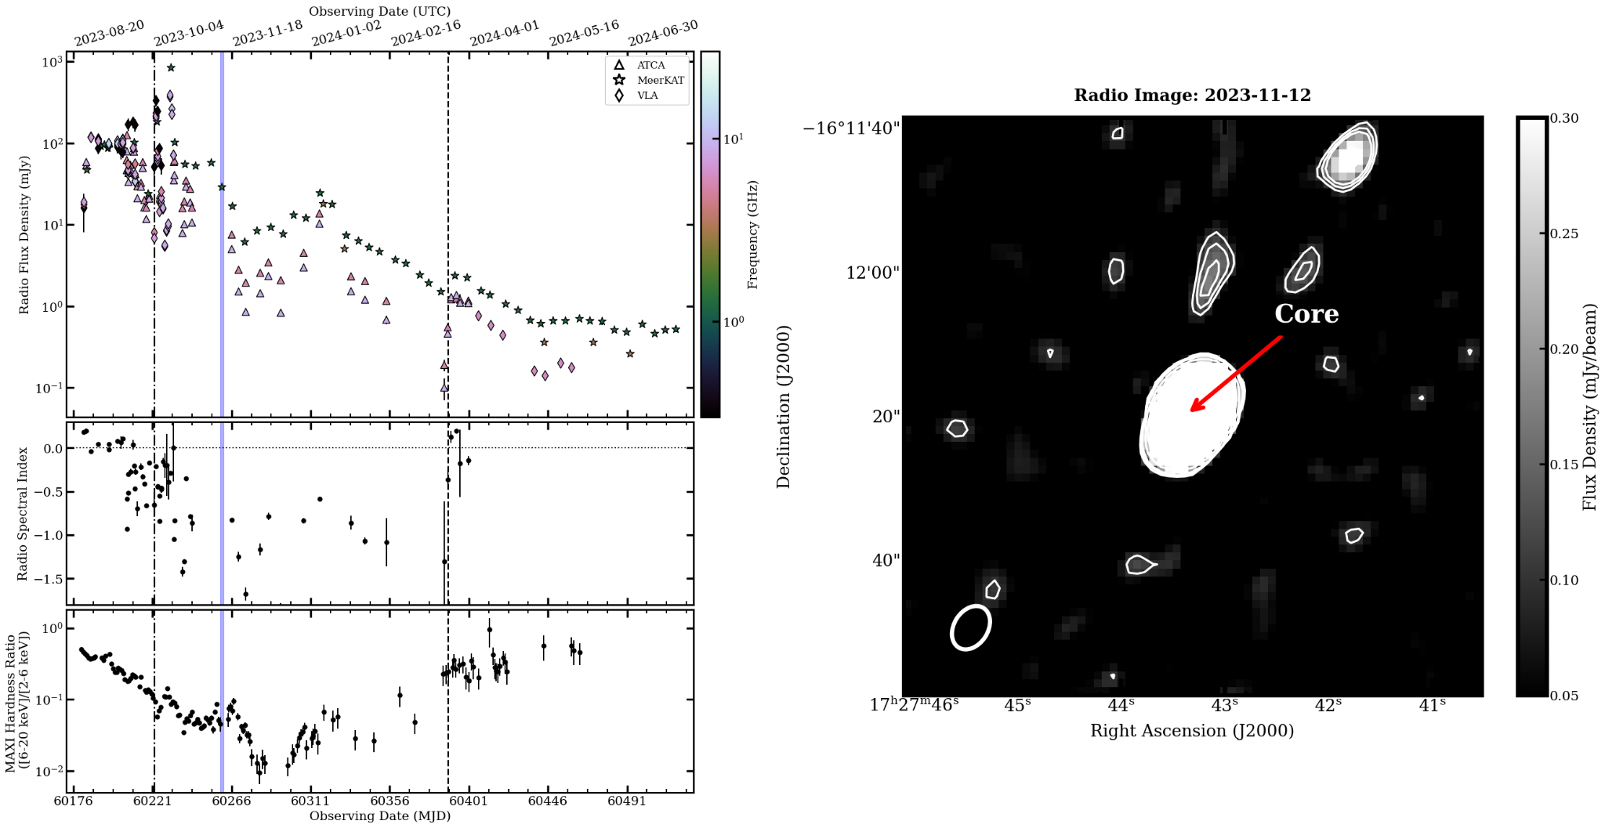
(Observing) The soft state
(Hughes et al. 2025a, accepted)

Slide 22
(Observing) The soft state
(Hughes et al. 2025a, accepted)

Slide 23
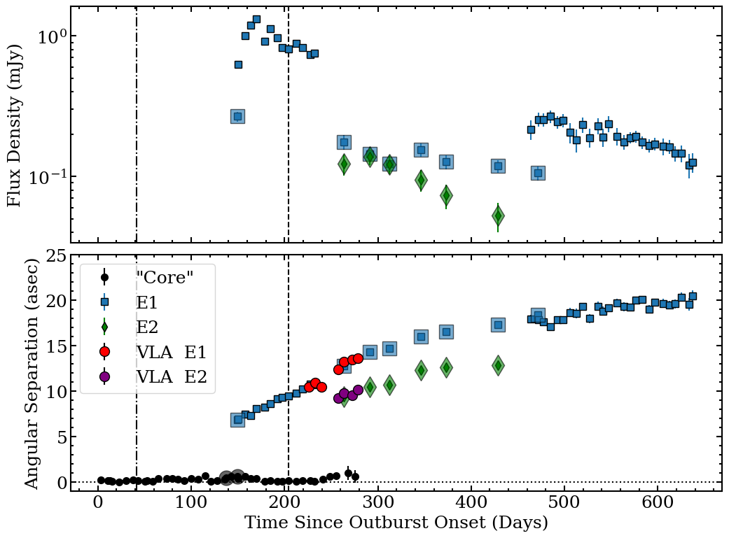

(Observing) The soft state
Deceleration through ISM interactions:
  Behaves like a kinematic-calorimeter
  Energy estimates from ‘blob matter’, not just radiating particles
Group at oxford has done loads of work on these large scale jets (e.g., Katie’s talk)
Highlight: Degeneracies, but not a strict lower limit on energy (Carotenuto 2024, Cooper 2025, Matthews 2025, based on Wang et al. 2003, Steiner & McClintock 2012)

Slide 24
Radio polarimetry of Swift J1727.8–1613
Stokes I, Q, U, V
(Hughes et al. 2025a, accepted)

Slide 25
Radio polarimetry of Swift J1727.8–1613
Stokes I, Q, U, V
(Hughes et al. 2025a, accepted)

Slide 26
Radio polarimetry of Swift J1727.8–1613
Stokes I, Q, U, V
Lin. Pol. Angle - Probes magnetic field orientation**
Lin. Pol. Frac - Probes magnetic field coherence**
Faraday effects - Probes magnetic field/composition
Asterisks are due to oversimplification: these quantities are also affected by absorption conditions, relativistic motion, resolution effects…
But high quality monitoring may be able to ‘disentangle’
(Hughes et al. 2025a, accepted)

Slide 27
Radio polarimetry of Swift J1727.8–1613
Stokes I, Q, U, V
Lin. Pol. Angle - Probes magnetic field orientation**
Lin. Pol. Frac - Probes magnetic field coherence**
Faraday effects - Probes magnetic field/composition
Asterisks are due to oversimplification: these quantities are also affected by absorption conditions, relativistic motion, resolution effects…
But high quality monitoring may be able to ‘disentangle’
(Hughes et al. 2025a, accepted)

Slide 28
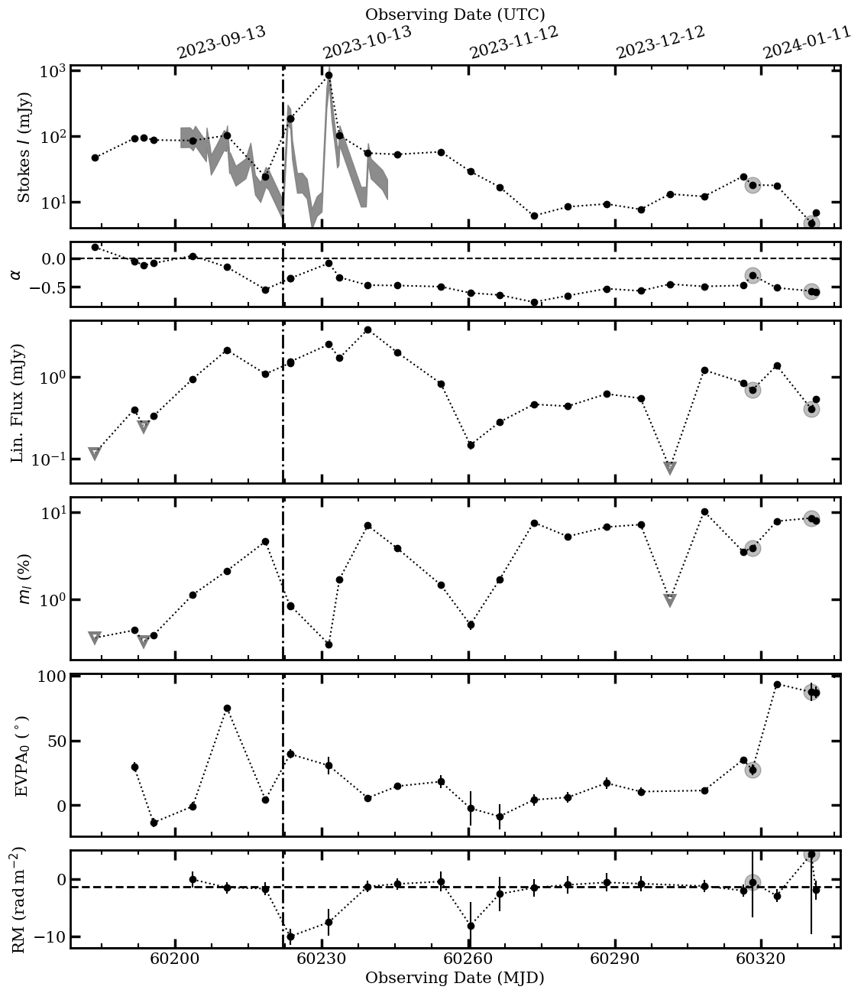
Preliminary look at the pol. evolution of J1727
Core-only
Stokes I
Currently only have MeerKAT polarisation:
  Add VLA + ATCA
MeerKAT alone shows rich phenomenology:
  Polarisation varies from ~0.1 to ~10%
  Angle varies from ~0 deg (parallel to jet axis) to ~90 deg (perpendicular to jet axis)
  The bright flaring shows transient increase in the RM of ~10 rad m⁻²
If you have to describe any idea for any of this, come find me, email me, send a raven,...
Spec. Index
Lin. Pol. Flux
Lin. Pol. Frac
Lin. Pol. Angle
Rotation Measure

Slide 29
Preliminary look at the pol. evolution of J1727
Core-only
Stokes I
Currently only have MeerKAT polarisation:
  Add VLA + ATCA
MeerKAT alone shows rich phenomenology:
  Polarisation varies from ~0.1 to ~10%
  Angle varies from ~0 deg (parallel to jet axis) to ~90 deg (perpendicular to jet axis)
  The bright flaring shows transient increase in the RM of ~10 rad m⁻²
If you have to describe any idea for any of this, come find me, email me, send a raven,...
Spec. Index
Lin. Pol. Flux
Lin. Pol. Frac
Lin. Pol. Angle
Rotation Measure

Slide 30
Preliminary look at the pol. evolution of J1727
Core-only
Stokes I
Currently only have MeerKAT polarisation:
  Add VLA + ATCA
MeerKAT alone shows rich phenomenology:
  Polarisation varies from ~0.1 to ~10%
  Angle varies from ~0 deg (parallel to jet axis) to ~90 deg (perpendicular to jet axis)
  The bright flaring shows transient increase in the RM of ~10 rad m⁻²
If you have to describe any idea for any of this, come find me, email me, send a raven,...
Spec. Index
Lin. Pol. Flux
Lin. Pol. Frac
Lin. Pol. Angle
Rotation Measure

Slide 31
Preliminary look at the pol. evolution of J1727
Core-only
Stokes I
Currently only have MeerKAT polarisation:
  Add VLA + ATCA
MeerKAT alone shows rich phenomenology:
  Polarisation varies from ~0.1 to ~10%
  Angle varies from ~0 deg (parallel to jet axis) to ~90 deg (perpendicular to jet axis)
  The bright flaring shows transient increase in the RM of ~10 rad m⁻²
If you have to describe any idea for any of this, come find me, email me, send a raven,...
Spec. Index
Lin. Pol. Flux
Lin. Pol. Frac
Lin. Pol. Angle
Rotation Measure

Slide 32
Preliminary look at the pol. evolution of J1727
Core-only
Stokes I
Currently only have MeerKAT polarisation:
  Add VLA + ATCA
MeerKAT alone shows rich phenomenology:
  Polarisation varies from ~0.1 to ~10%
  Angle varies from ~0 deg (parallel to jet axis) to ~90 deg (perpendicular to jet axis)
  The bright flaring shows transient increase in the RM of ~10 rad m⁻²
If you have to describe any idea for any of this, come find me, email me, send a raven,...
Spec. Index
Lin. Pol. Flux
Lin. Pol. Frac
Lin. Pol. Angle
Rotation Measure

Slide 33
Preliminary look at the pol. evolution of J1727
Core-only
Stokes I
Currently only have MeerKAT polarisation:
  Add VLA + ATCA
MeerKAT alone shows rich phenomenology:
  Polarisation varies from ~0.1 to ~10%
  Angle varies from ~0 deg (parallel to jet axis) to ~90 deg (perpendicular to jet axis)
  The bright flaring shows transient increase in the RM of ~10 rad m⁻²
If you have to describe any idea for any of this, come find me, email me, send a raven,...
Spec. Index
Lin. Pol. Flux
Lin. Pol. Frac
Lin. Pol. Angle
Rotation Measure

Slide 34
Summary
X-ray binaries offer a natural laboratory for studying accretion–jet coupling in the time domain.
Swift J1727.8–1613 is a newly discovered black hole X-ray binary that underwent a luminous, year-long outburst in 2023–2024, characterized by:
  An extreme location on the hard-state radio–X-ray luminosity track
  Rapid, short-timescale flaring with radio peaks spanning a factor of ~100 in luminosity
  Evidence for both short-lived or slow-moving ejecta, and
  Long-lived, decelerating ejecta—offering a rare view into jet–ISM interaction dynamics
  Rich, time-variable polarimetric evolution in linear polarization angle, polarization fraction, and rotation measure

Slide 35
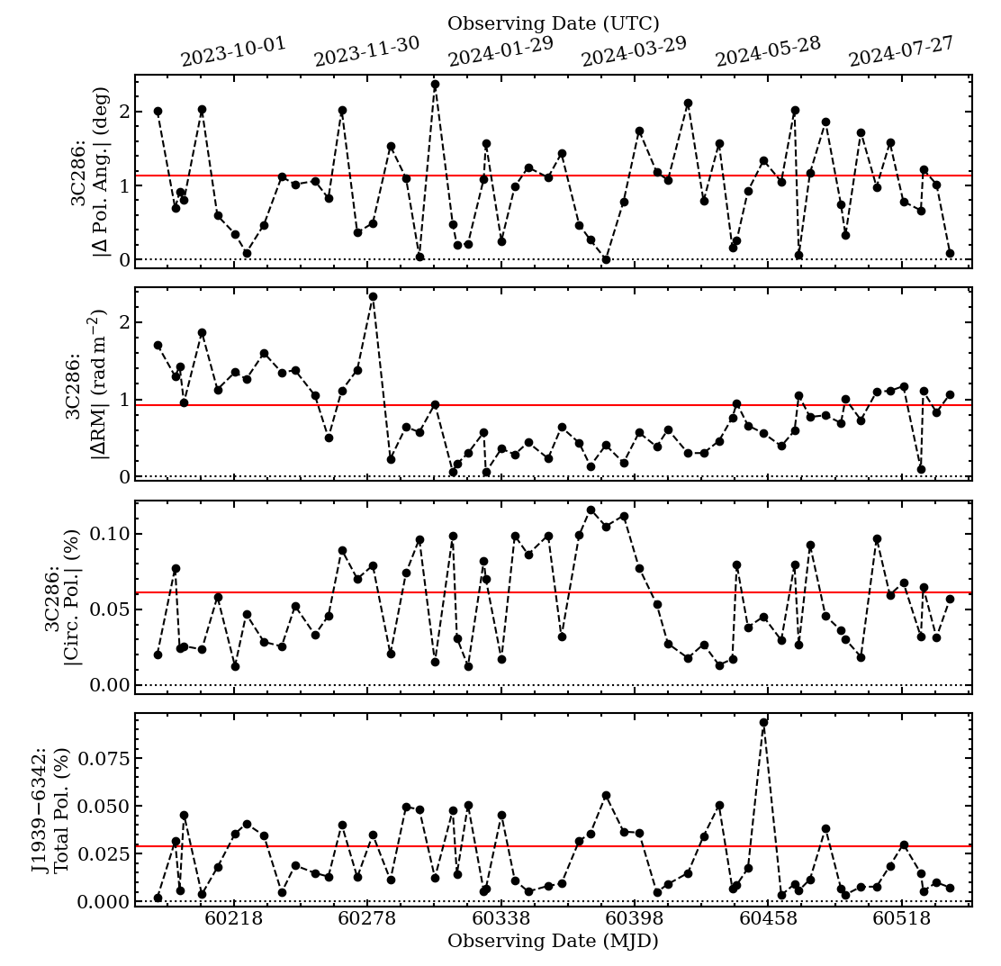
Bonus

Slide 36
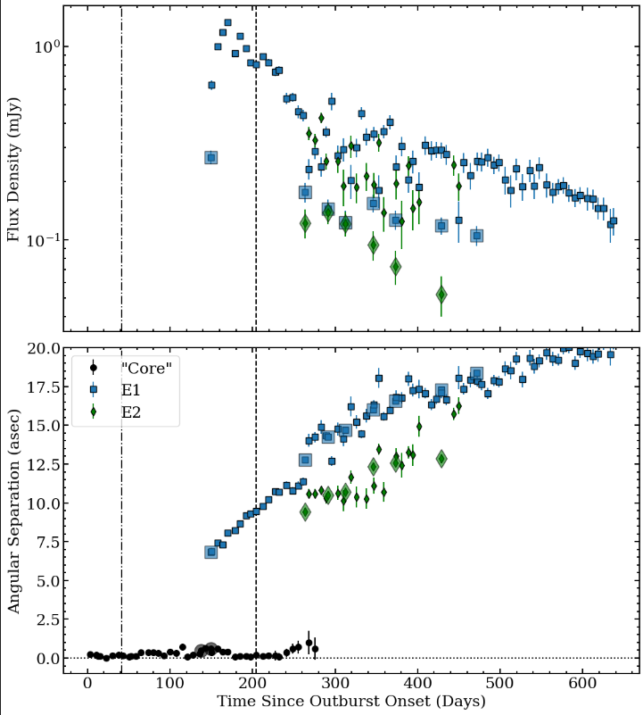
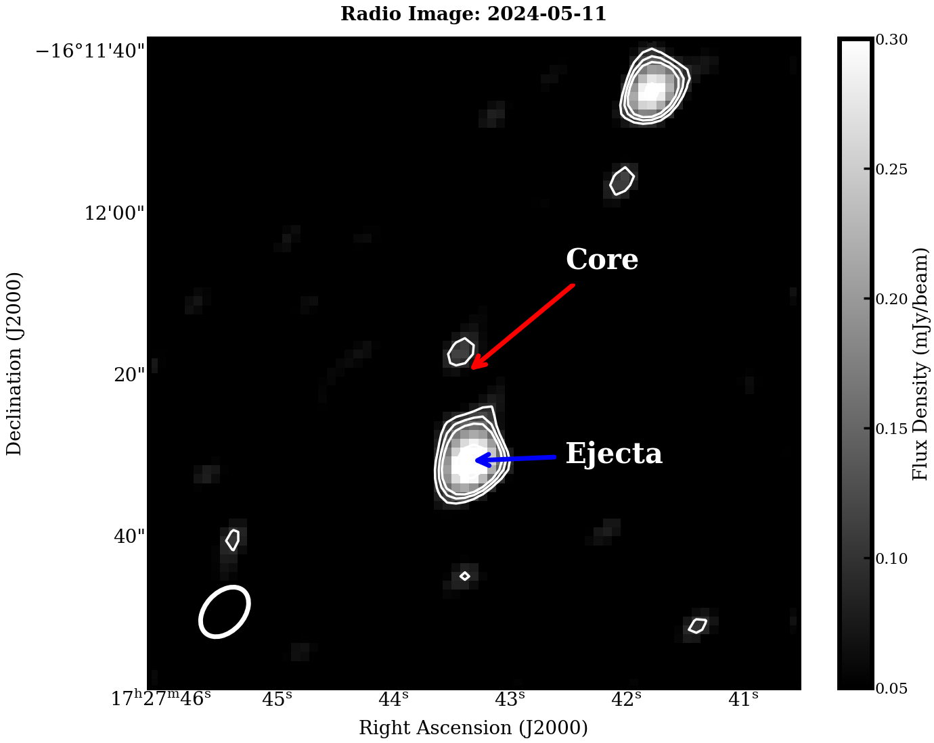
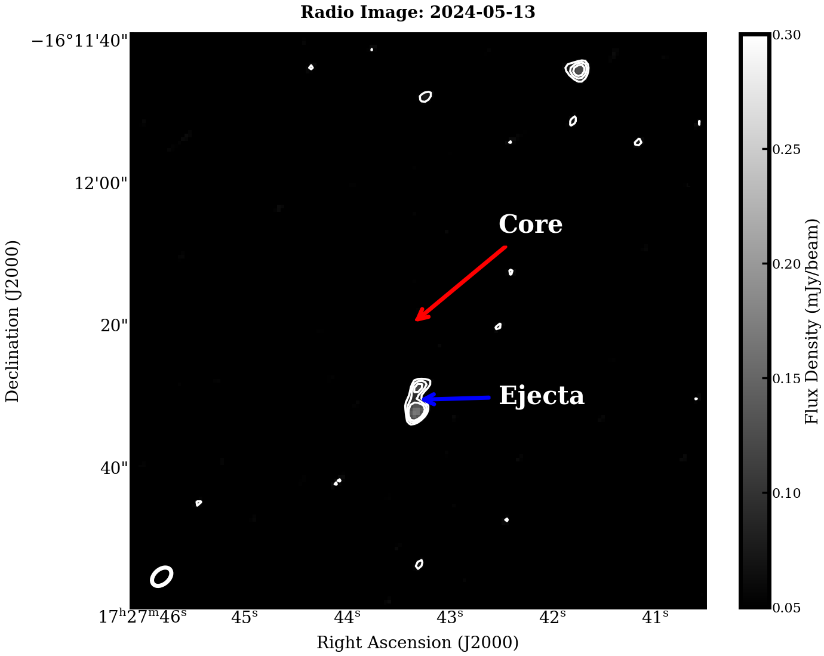
Extra slides – Confusion issues

Slide 37
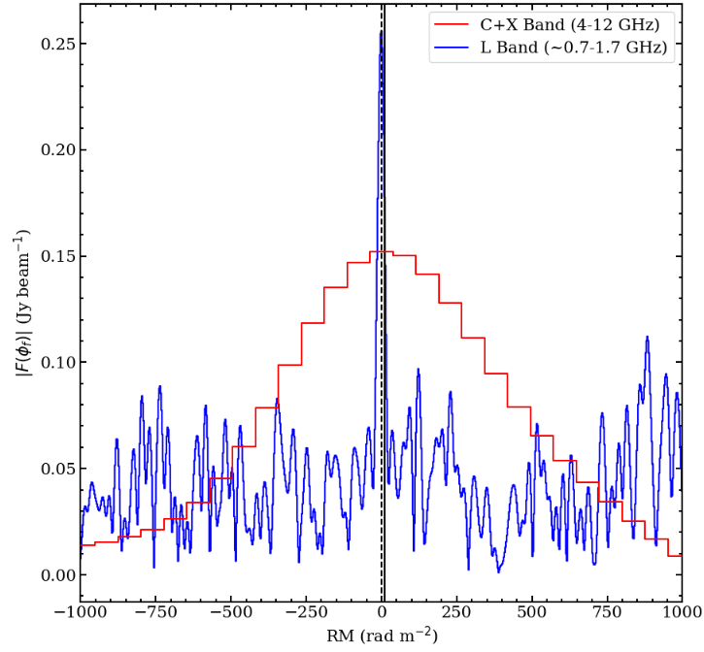
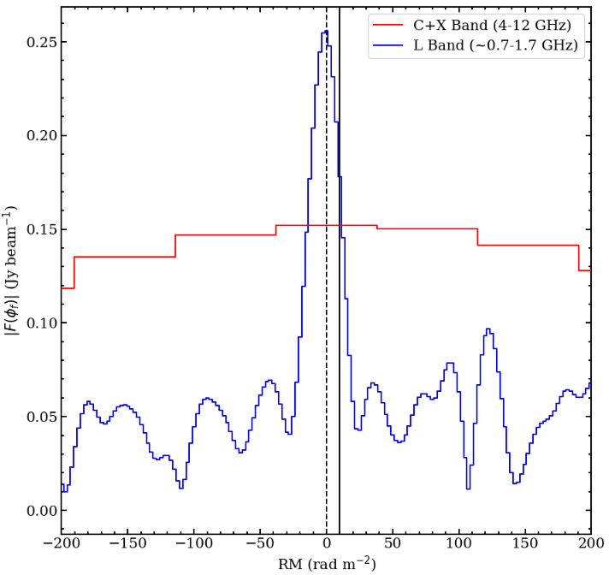

Extra slides – L-band

Slide 38
The (bright) transition
NOT SWIFT J1727
(Miller-Jones et al. 2019)

Slide 39
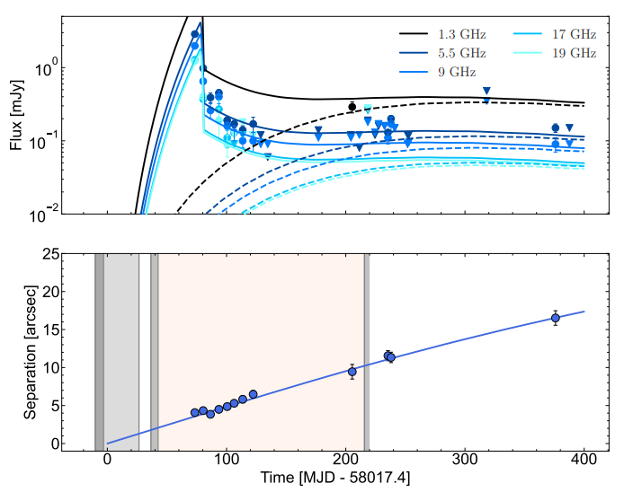
The (bright) transition
(Miller-Jones et al. 2019)

