Slide 1
Long-term radio variability of AGN
S. Kankkunen, M. Tornikoski, T. Hovatta, A. Lähteenmäki

Slide 2
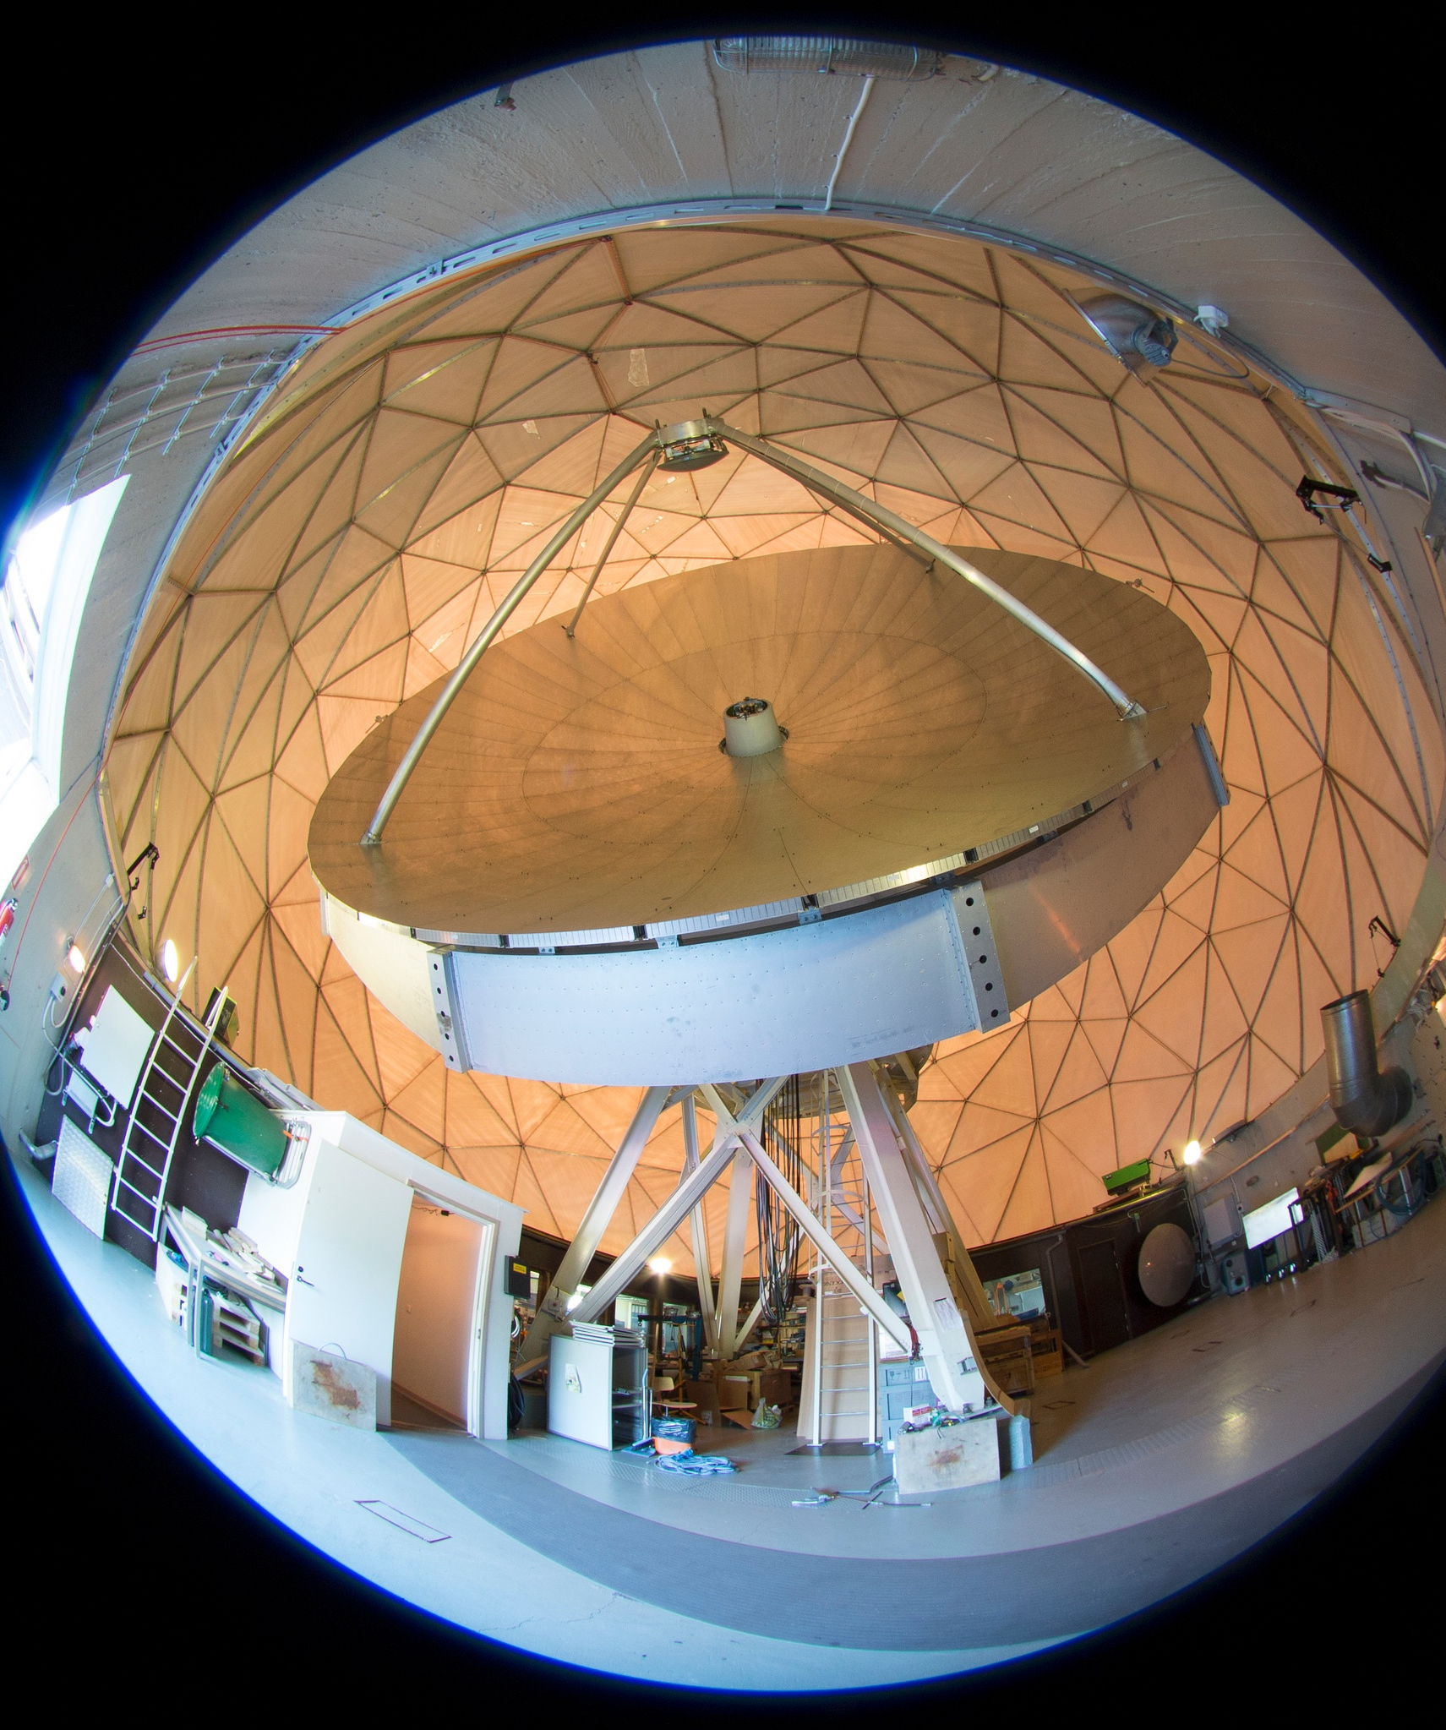
Metsähovi Radio Observatory
Observatory main instrument D = 14 m dish
  AGN observations mostly in 37 GHz (& 22 GHz)
  Part of different VLBI networks
Light curves since 1980s
  Over 1000 sources observed
Study: Are 42 years of observations enough for characterizing AGN variability timescales in the radio domain?
  Longest monitoring periods used to date!
  123 sources with average 34.5 years of observations
Photo by Merja Tornikoski

Slide 3

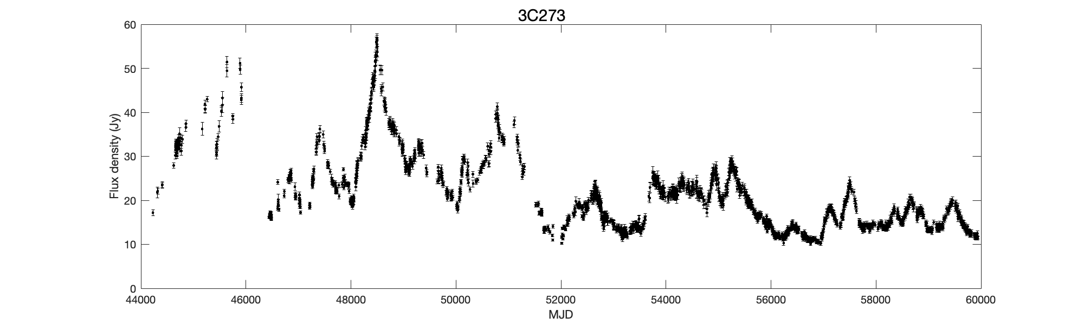
Characteristic timescale
Multiple definitions for ‘timescale’
‘Typical timescale of variability’
Distance between flares
Duration of flares
Quasiperiodicity

Slide 4
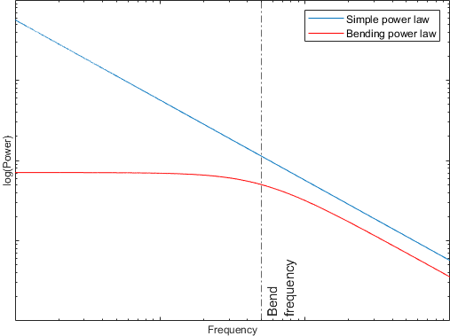
Methods
This study: Characteristic timescale = inverse of bend frequency
Power spectral density (PSD) distribution of power over ‘temporal’ frequencies
Both the bending power law and the simple power law fitted
Consensus that a bend/break frequency must eventually be present

Slide 5
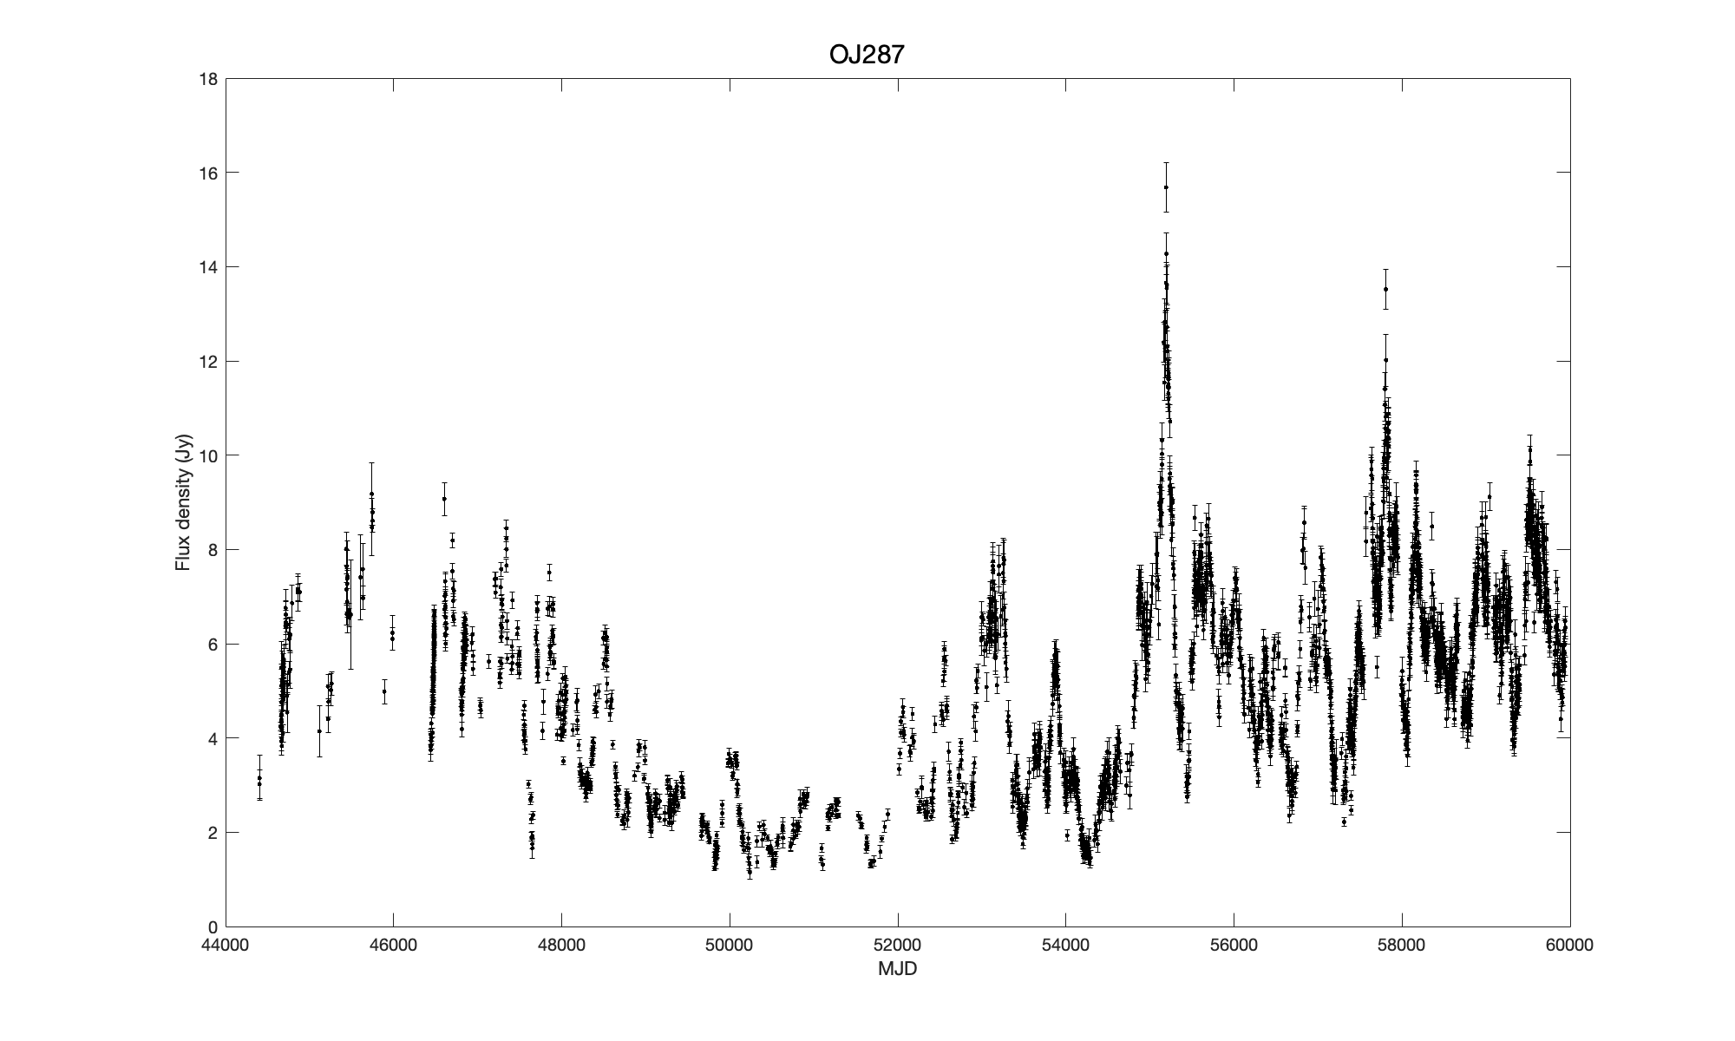
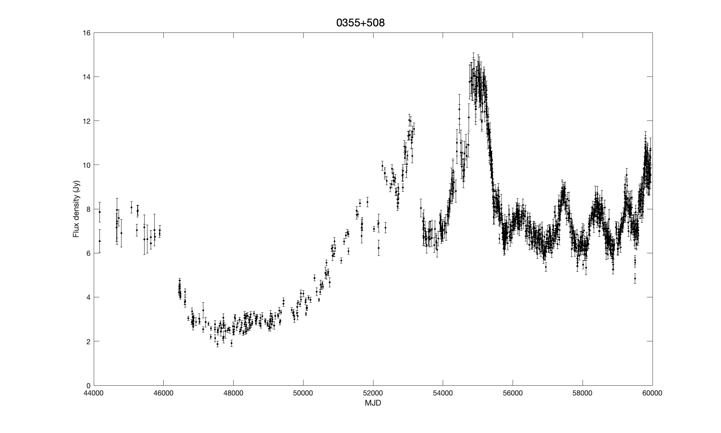
Bend frequency vs slope
Visually, slope β ≈ ‘smoothness of variations’
Bend frequency likely related to flare duration
  Halford (1968), Press (1978)
  Characteristic timescale related to maximum time a prominent flare influences a light curve?

Slide 6
Methods
Simulated light curves with matching cadence (to the observed light curve)
Fit determined through the power spectral response method (PSRESP) (Uttley et al. 2002)
Probed for slopes β = 1.0:0.1:3.5
Probed for timescales 500:500:7000 days, with additional high-frequency coverage 100, 200, 400, and 800 days

Slide 7

Results
Timescale $T_{c}$ constrained (inverse of bend frequency) for 11 out of 123 sources
  $\overline{β}$ = 2.3, $\overline{T_{c}}$= 1300 days
  Some borderline cases
Requirement: Clear ‘hot spot’ in heat map, simple power-law fit worse (with a flatter slope estimate)

Slide 8
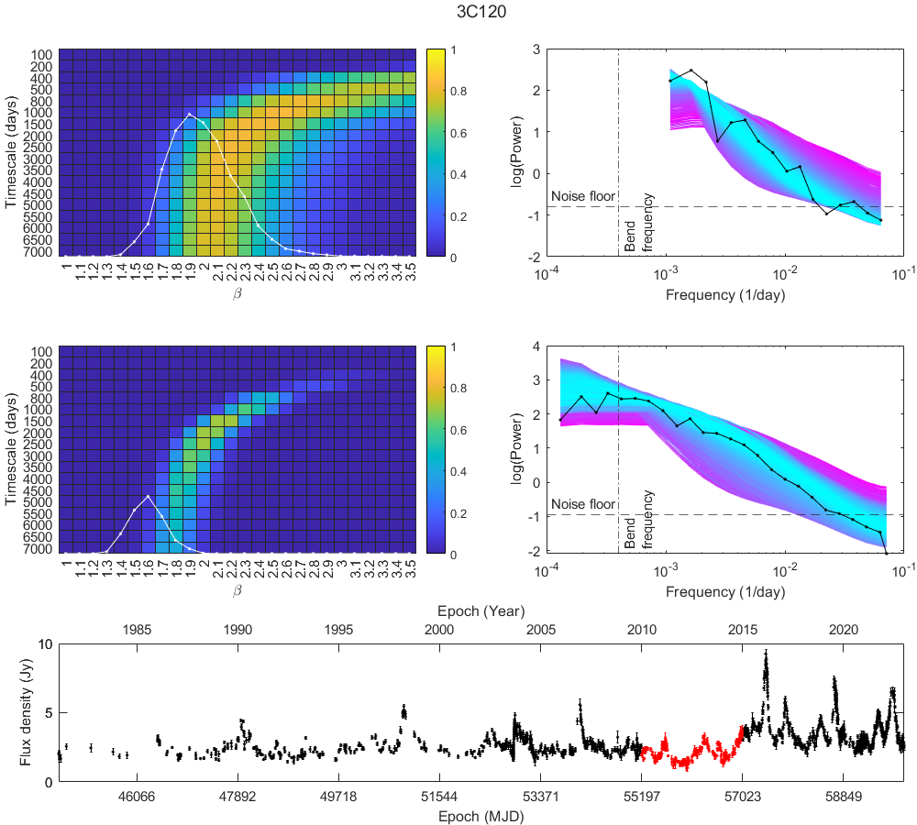
5 years of data vs 40 years of data

Slide 9
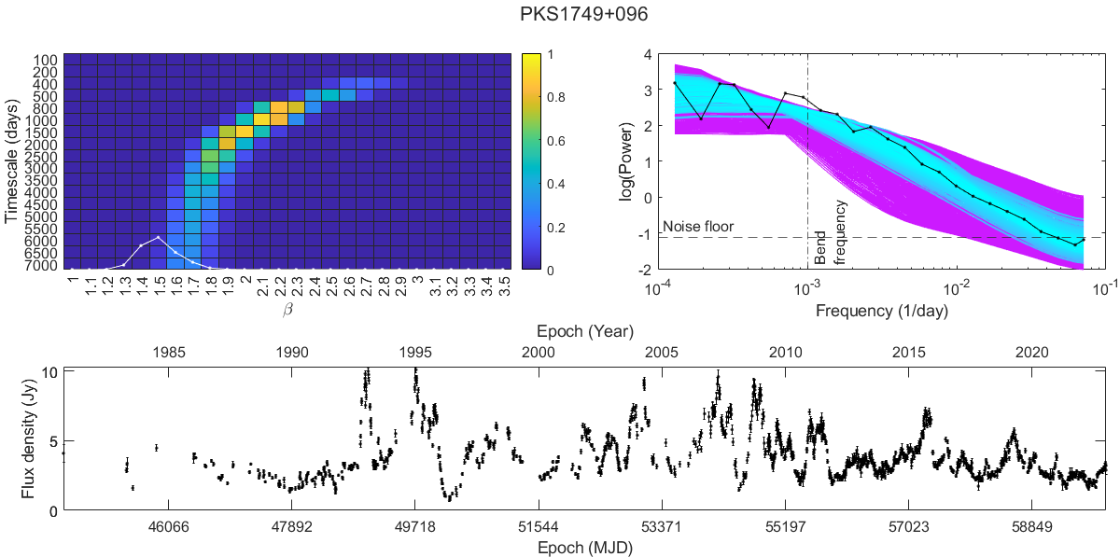
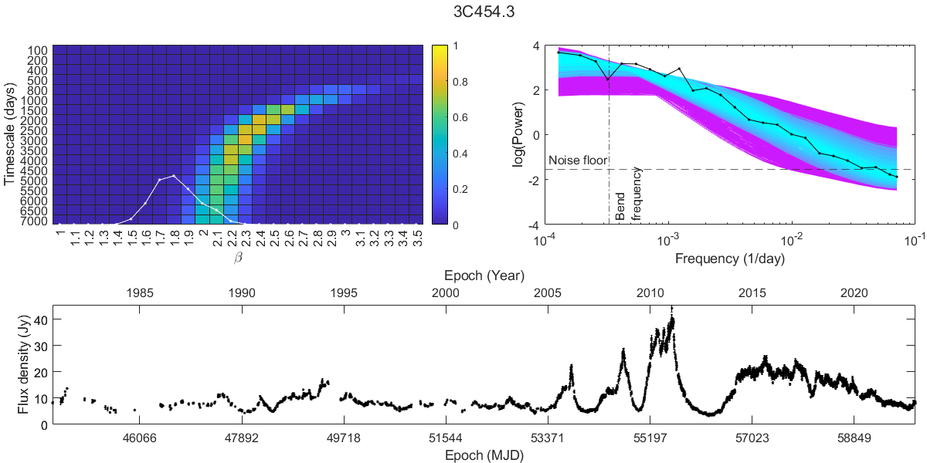
Results
Timescales of constrained sources:
  0716+714, 500 days
  2144+092, 800 days
  PG0007+106, 1000 days
  0235+164, 1000 days
  0736+017, 1000 days
  PKS1749+096, 1000 days
  2230+114, 1000 days
  0415+379, 1500 days
  4C29.45, 1500 days
  3C120, 2500 days
  3C454.3, 3000 days

Slide 10

Test with non-zero low-frequency slope
What if ${\text{β}}_{low}$ non-zero?
Correlation between slope and bend frequency
  Obtained high-frequency slopes usually close to each other
  (~) Always a shorter timescale estimate compared to ${\text{β}}_{low}$= 0
Differentiating between the two PSD shapes was not possible reliably
With ${\text{β}}_{low}$= 0, we obtain the most conservative bend frequency estimate

Slide 11
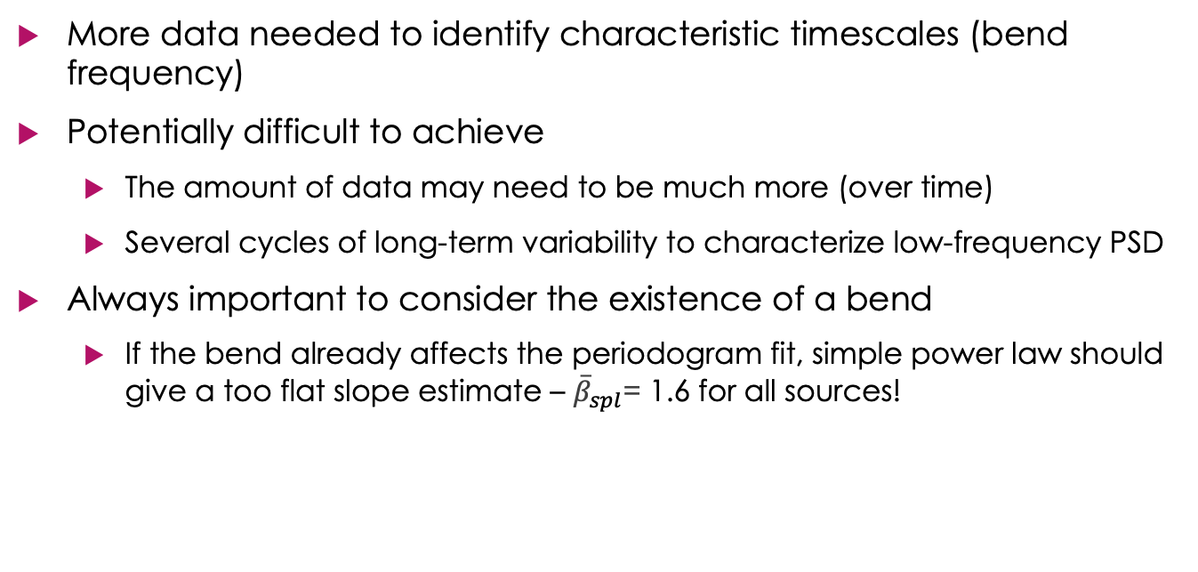
Implications
More data needed to identify characteristic timescales (bend frequency)
Potentially difficult to achieve
  The amount of data may need to be much more (over time)
  Several cycles of long-term variability to characterize low-frequency PSD
Always important to consider the existence of a bend
  If the bend already affects the periodogram fit, simple power law should give a too flat slope estimate – ${\overline{β}}_{spl}$= 1.6 for all sources!

Slide 12
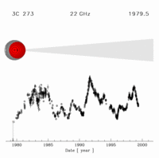
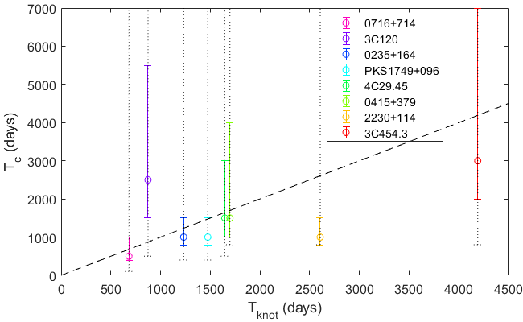
VLBI connection
Animation by Türler et al. 1999
Knots temporally related to flares (e.g. Turler et al. 2000; Savolainen et al. 2002; Lindfors et al. 2006)
Comparison to 43 GHz VLBI data from Weaver et al. (2022)
Longest time a knot was observed = estimate for the minimum time a knot or flare could affect the light curve
Knot times minimums (linear fits to VLBI observations)
Clearly, large error bars when considering all potential slopes, need a better method for constraining the values
  Plot shows only error bars for timescales considering best-fit slope
More sources needed to establish connection

Slide 13
Current analysis
Decomposition of light curves to individual flares
  Preliminary results: Flare durations match the PSD break well in superpositioned light curves (such as radio)
  Simulations of light curves with bending power-law PSDs confirm the connection
  Can the flare onset time be a dominant characteristic timescale for some sources in the PSD?
AGN physical conditions vs flare onset times
  Can a known accretion timescale be directly connected to flare onsets?
What determines the distribution in the characteristic timescales
  E.g. influence of black hole mass

Slide 14
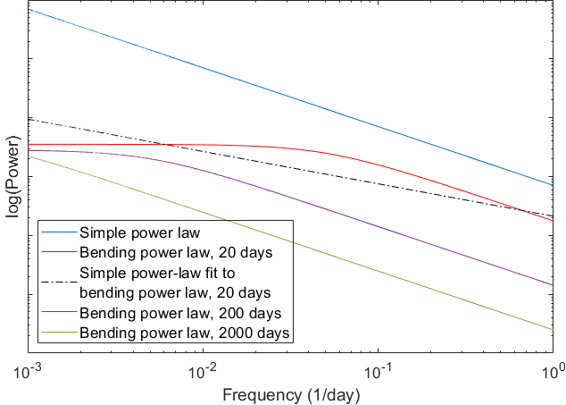

Apparent flattening of simple power-law slope
If the bend already affects the periodogram fit, simple power law should give a too flat slope estimate
If ${\overline{β}}_{spl}$≈ ${\overline{β}}_{bpl}$the bend at a sufficiently low frequency to not affect the fit

