Slide 1
Particle Accelerator Lattice Standard (PALS)
David Sagan

Slide 2

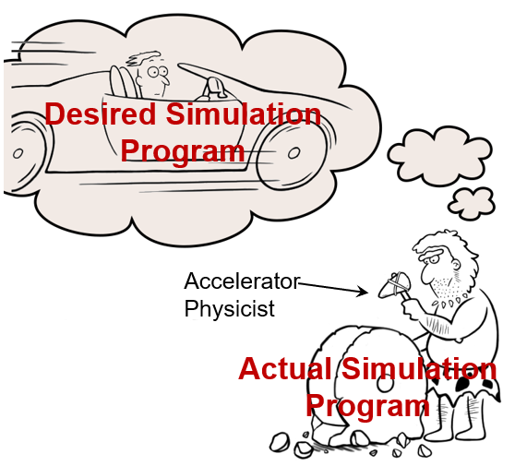
The Problem
The disorganized state of accelerator physics simulation development has been recognized by the 2021 US High-Energy Physics community Snowmass white paper:
“The development of beam and accelerator physics codes has often been largely uncoordinated. This comes at a great cost, is not desirable and may not be tenable. Due to developers retiring or moving on to other projects, numerous simulation programs have been completely abandoned or are seldom used. This has resulted in a collection of codes that are not interoperable, use different I/O formats and quite often duplicate some physics functionalities using the exact same underlying algorithms.”

Slide 3

The Vision
Cornell is helping to lead two projects:
A new software ecosystem for modern, differentiable accelerator physics simulations.
PALS: A particle accelerator lattice standard that can be used within a program to read/write lattice files and also can be used to exchange lattices between programs.

Slide 4
SciBmad
SciBmad is a multi-laboratory collaboration to create an open source, modern Julia based accelerator physics ecosystem which will provide:
Modularity!!
  Maximal code re-use, minimal reinventing the wheel
  Plug-and-play different optimizers, symplectic integrators, tracking methods, etc. with ease
Runs optimally on all architectures, with CPU & GPU parallelization
Easy to use and integrate with other programs/tools
Fully differentiable using automatic differentiation
  Fast, accurate calculation of gradients for optimizations and machine learning using forward and backward differentiation
Full featured accelerator software toolkit
  Linear and nonlinear tracking, nonlinear parametric normal forms including spin, etc.
Goal: first accelerator simulations by end of year.

Slide 5
What is PALS?
PALS is for describing lattices. The PALS schema standardizes things like:
The names of various kinds of lattice elements.
The names of the parameters a lattice element can have as well as defining what these parameters mean.
How to organize lattice elements into lines which beams of charged particles or photons can move through.
etc., etc.
Additionally, there will be PALS associated code that can be used by a program to read and write PALS lattices.

Slide 6
What PALS is Not
PALS does not concern itself with how particles are tracked.

Slide 7
PALS Vision
PALS aims to :
  Promote portability between various applications and differing algorithms.
  Standardize a unified open access description for scientific data (publishing and archiving).
  Create a unified description for post-processing, visualization and analysis.
  Create code for lattice parsing that can be used within a simulation program saving programming time and cuts down on bugs.

Slide 8
Who is PALS?
Pals is a multi-laboratory collaboration.
Anyone who is interested is invited to join.
https://github.com/campa-consortium/pals
Meetings are held approximately bi-weekly.
Primary developers are:
  David Sagan (Cornell)
  Jean-Luc Vey (LBL)
  Edwardo Zoni (LBL)
  Chad Mitchell (LBL)

Slide 9
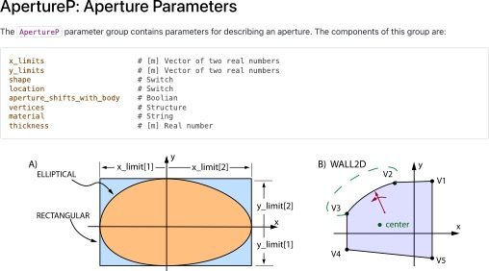
PALS Components: Schema
A standard (schema) defining things like the names of element types (Quadrupole, etc), element parameters (K1, etc.), beamlines, etc., in a format neutral way.

Slide 10
PALS Components: Language Specific Formats
PALS will define how to implement the schema in various formats:
YAML:
BeamLine:
name: position_line
line:
- thingA
- lineitem:
inherit: subline
placement:
offset: 37.5
Python:
"BeamLine":[
"name": "position_line",
"line": [
"lineitem": "thingA",
"lineitem": [
"inherit": "subline",
"placement": [
"offset": 37.5
]
]
]
JSON:
... etc...

Slide 11
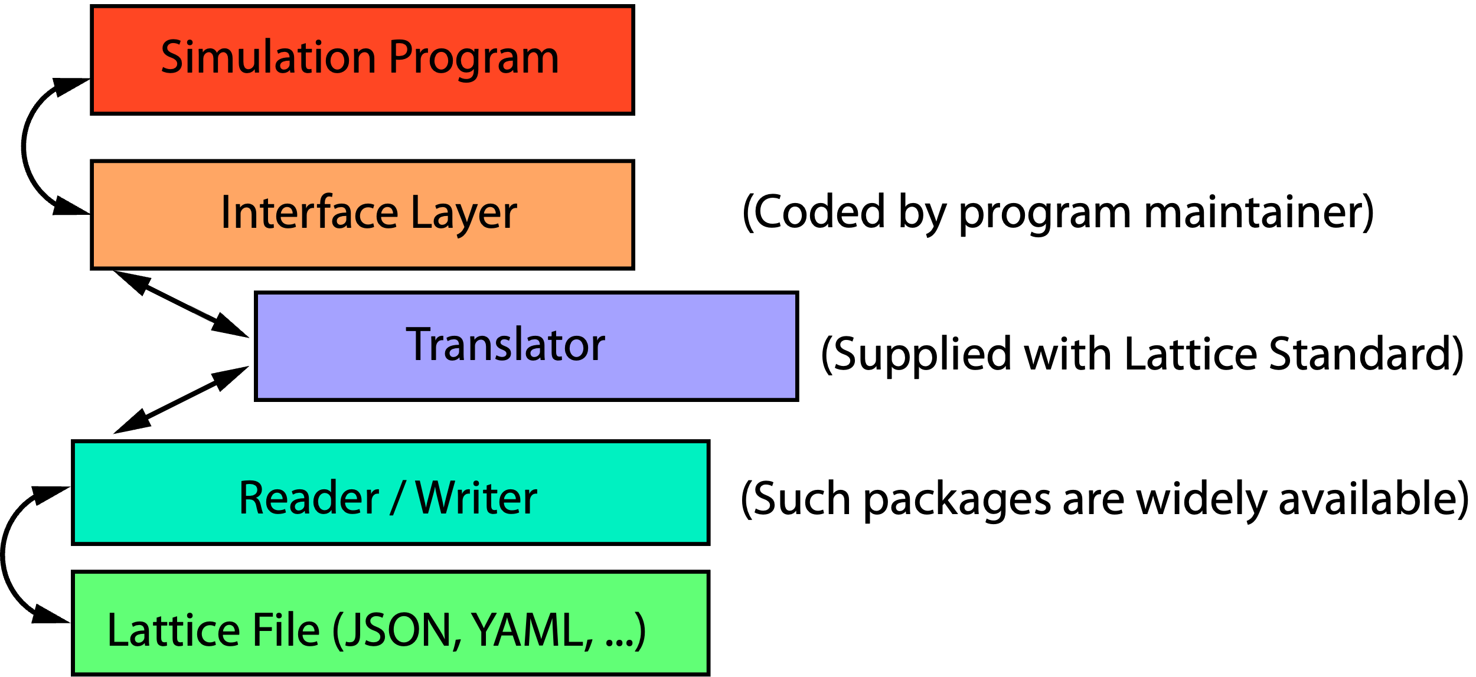
PALS Components: Parsing Code
The Translator will have modules to do common tasks like:
  Compute floor coordinate.
  Expand beamlines to give an ordered list of elements to track through.
  Evaluate expressions.

Slide 12
Conclusions
PALS is being developed to help solve a long- standing problem of incompatible lattice formats.
PALS is not a complete solution since different simulation programs will use differing parameter sets but PALS will greatly help.
PALS is being developed as part of an ecosystem of standards and code libraries (toolkits) to help programmers avoid “reinventing the wheel”.
Everyone is welcome to join the effort!
Nicholas Walker, ~2004

Slide 14



Graveyard of Accelerator Simulation Programs
programs that are no longer or seldom used:
TRACE-3D
ALIGN
BETA
COMFORT
DESIGN
DIMAD
GUINEA-PIG
HARMON
LEGO
LIAR
Etc. Etc...
MAGIC
MARYLIE
PATRICIA
PETROS
RACETRACK
SYNCH
TRACY
TRANSPORT
TURTLE
UAL
How many man-years of effort went into these programs?

Slide 15
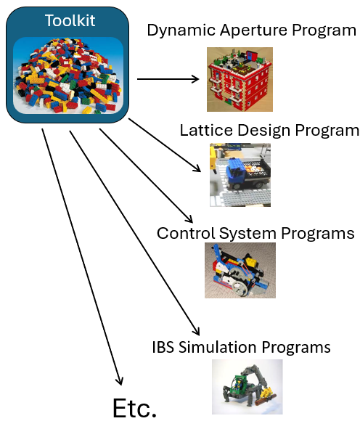
SciBmad Vision
The goal of SciBmad is to create an ecosystem of packages for accelerator simulation which is interoperable with the wider Julia package ecosystem and has connections to useful non-Julia packages.
Python Ecosystem
PyTorch
Xopt
Xsuite
Cheetah
... Etc...
Julia Ecosystem
SciBmad Ecosystem
AcceleratorLattice.jl
NonlinearNormalForm.jl
BeamTracking.jl
GTPSA.jl
AtomicAndPhysicalConstants.jl
... Etc...
Other accelerator simulation packages
Autodiff libraries
Optimizers
Integrators
Plotting
Machine Learning
... Etc...
Other
MAD-NG
... Etc...

