Slide 1
Observation of light-by-light scattering in ultraperipheral Pb+Pb collisions with the ATLAS detector
Journal Club Paper Review Slides

Slide 2
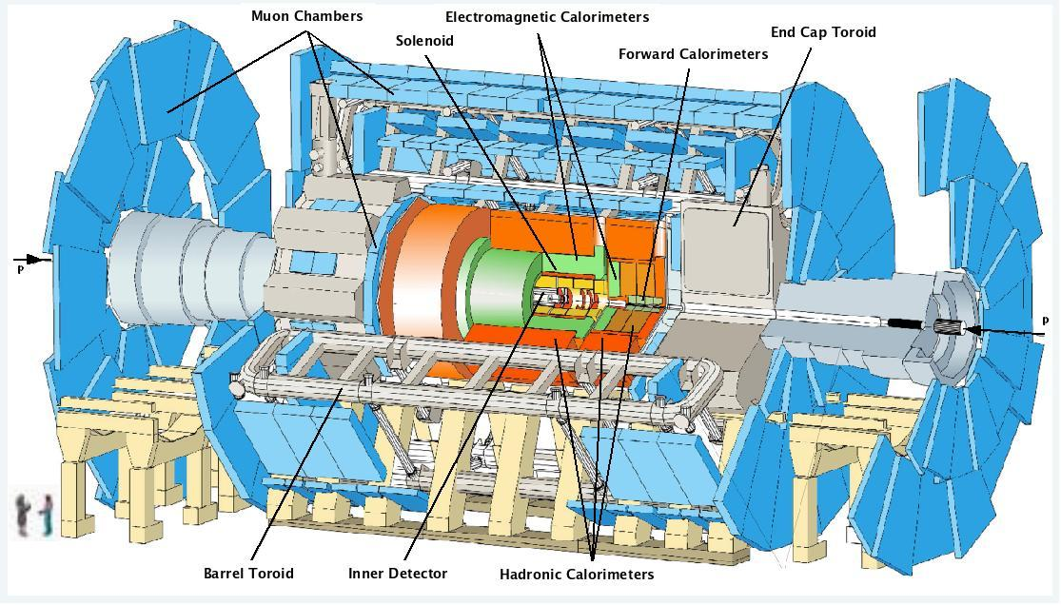
ATLAS detector

Slide 3
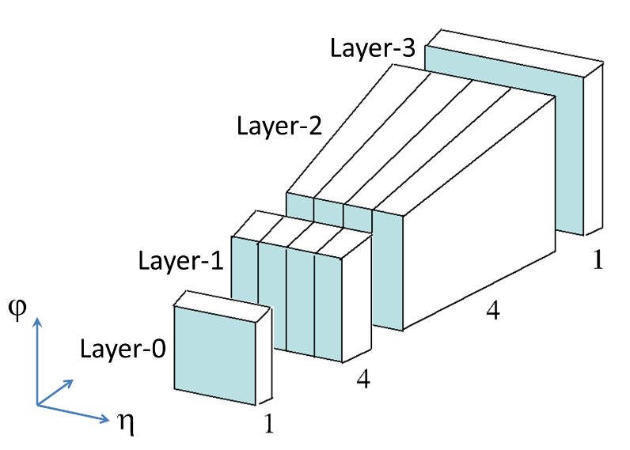
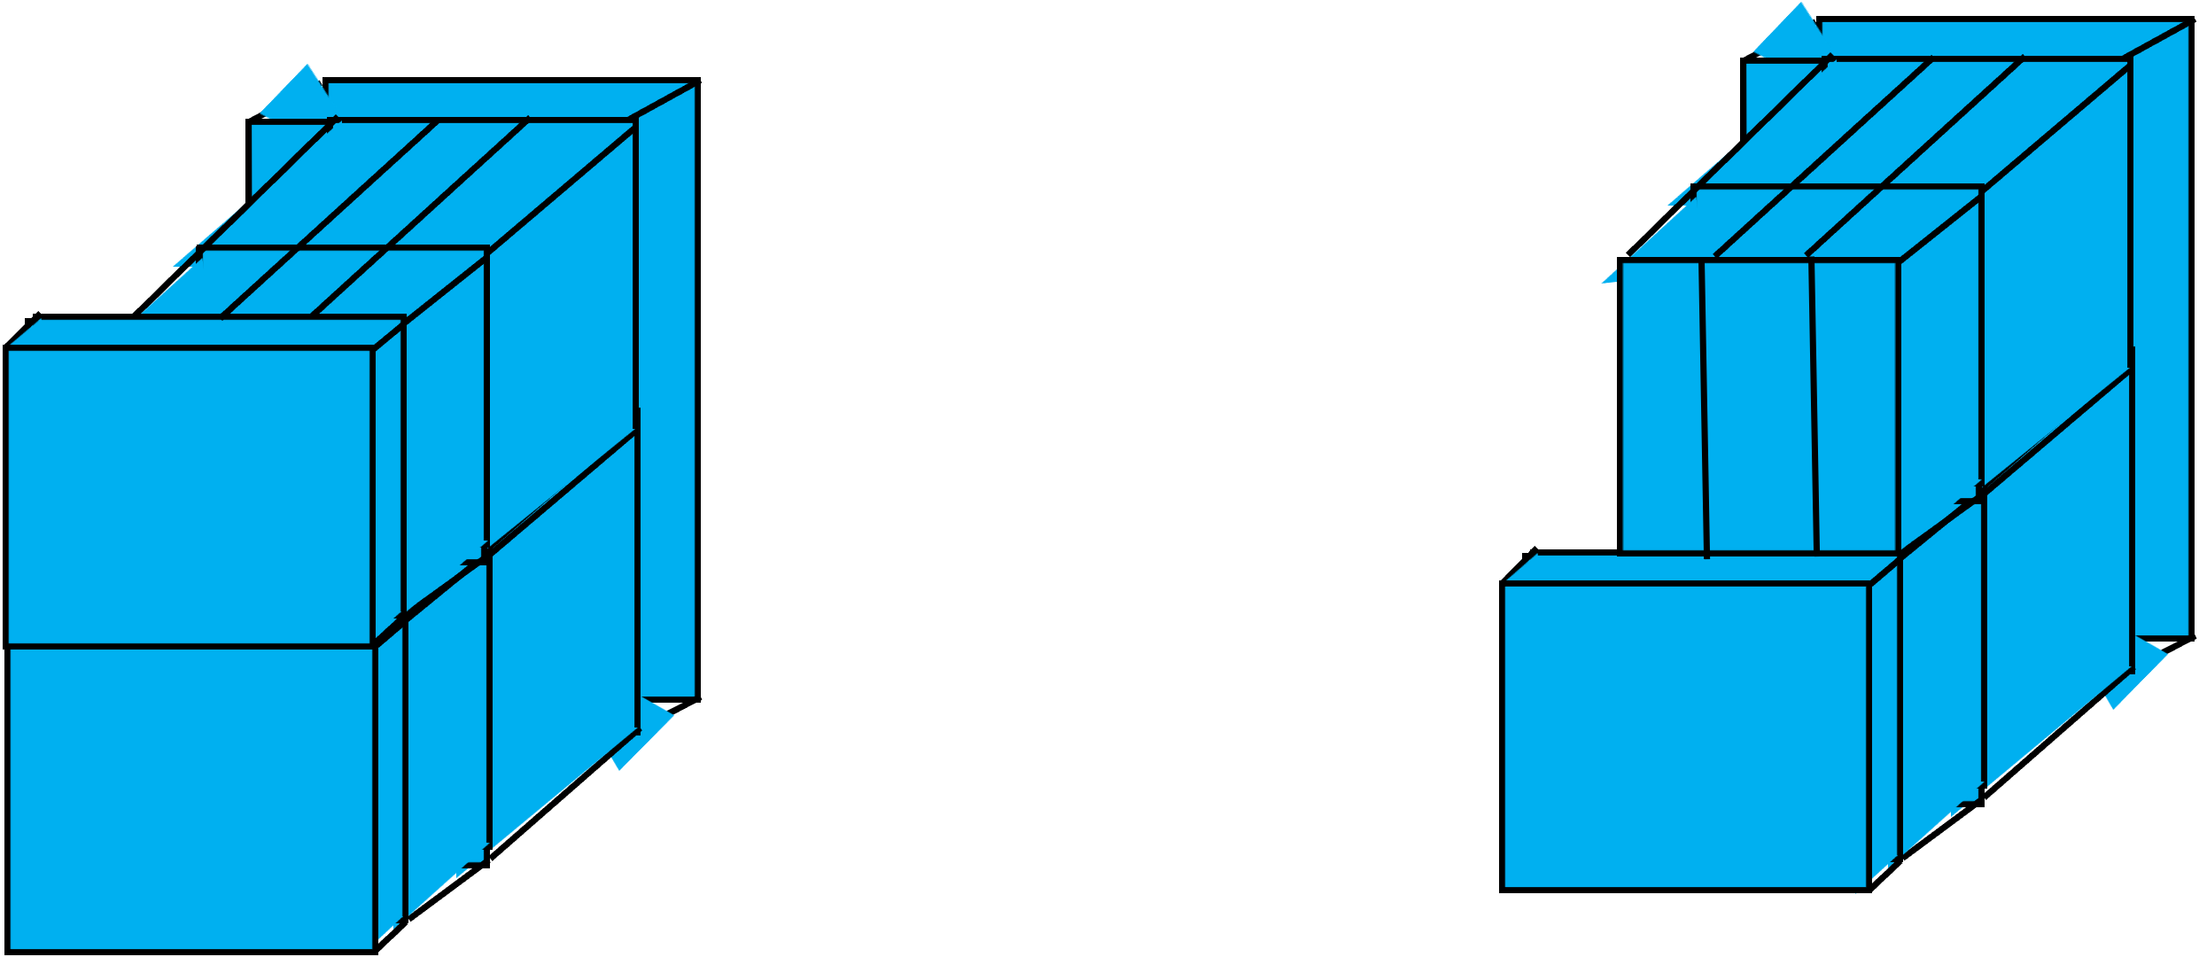
EM Cluster Et
Above is one trigger tower.
Made in the Ecal with sums of Supercells (one unit 0.1 eta*0.1 phi).
One “unit” is called TOB (Trigger object made of 3*3 trigger towers) .
Layer 3
L0 (Pre-Sampler)
Layer 2
Layer 1

Slide 4
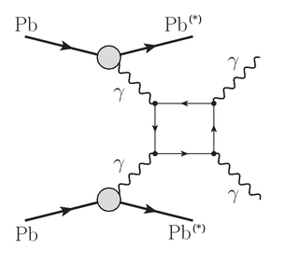
Light by Light Scattering
Forbidden in classical EM
Can proceed via box diagrams like that shown here.
Useful as cross-section sensitive to BSM effects.
These are ultra-peripheral-collisions (UPC).
Higher cross-section in Pb-Pb collisions, photon flux scales with square of number of protons.

Slide 5
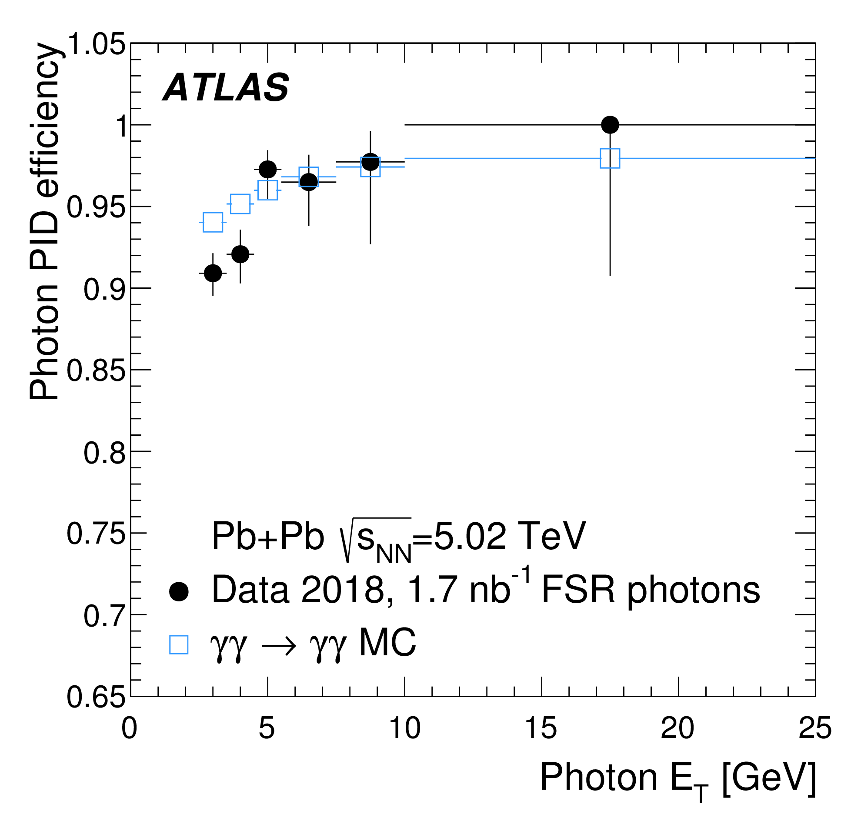
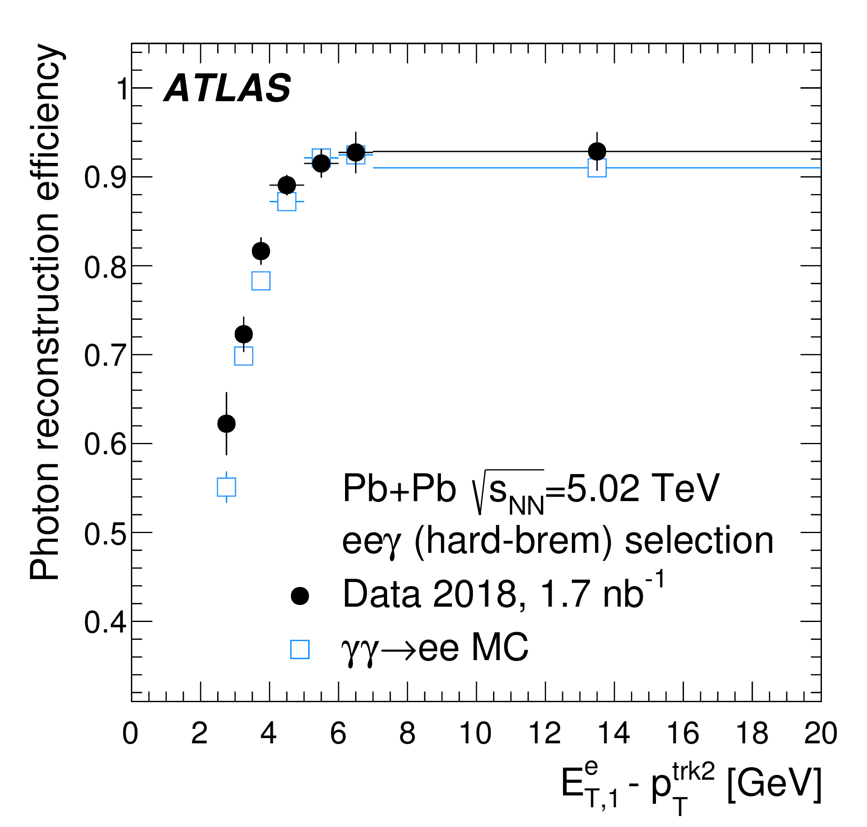
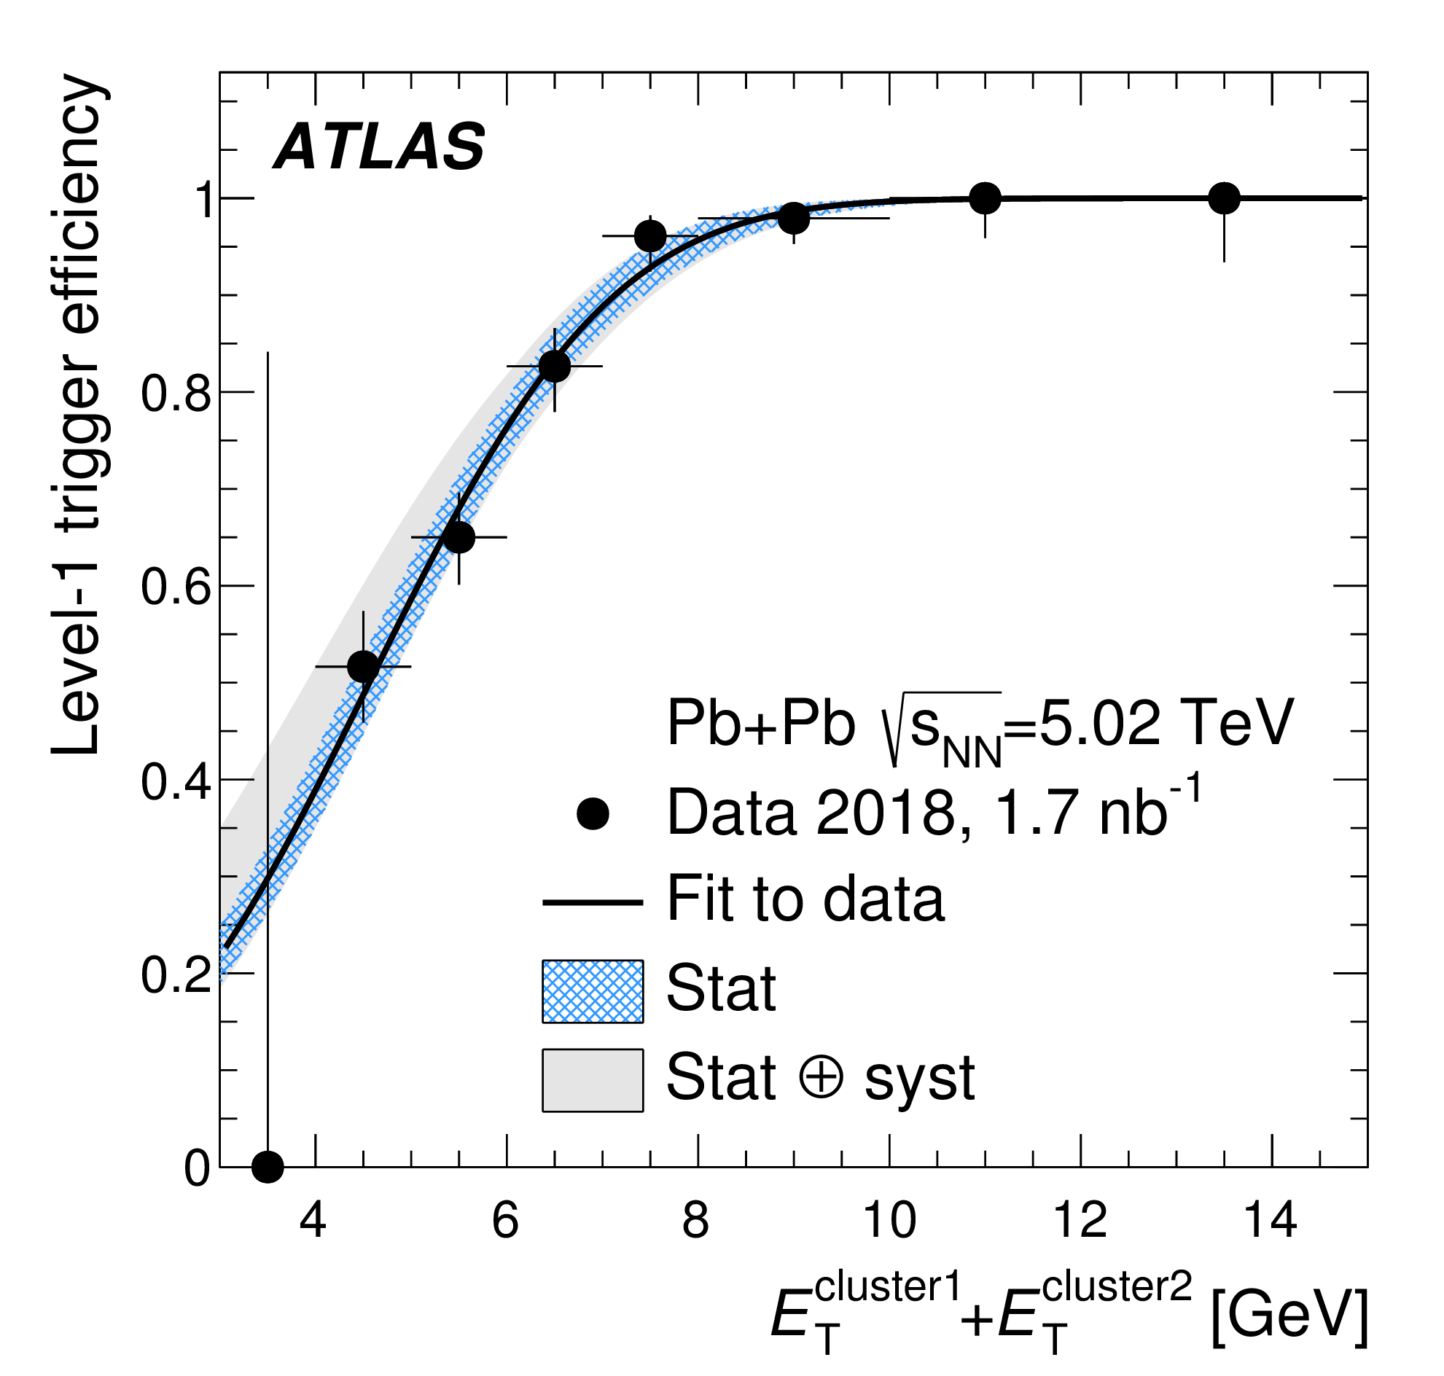
Fig 1
a
b
c

Slide 6
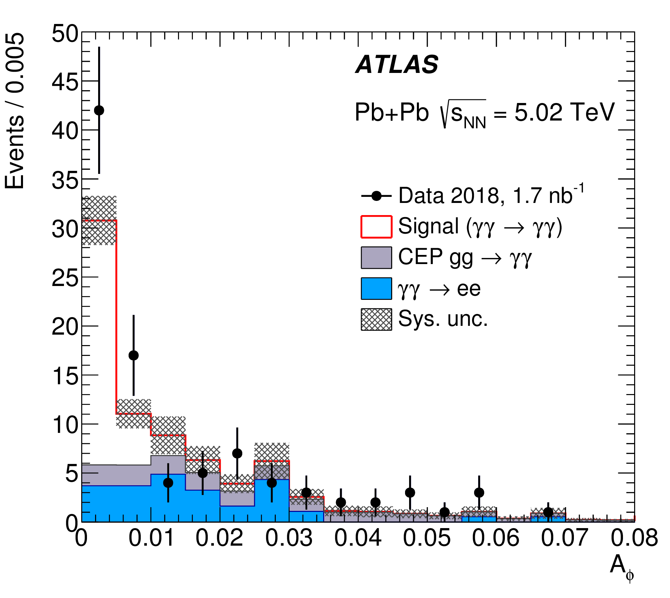
Fig 2

Slide 7
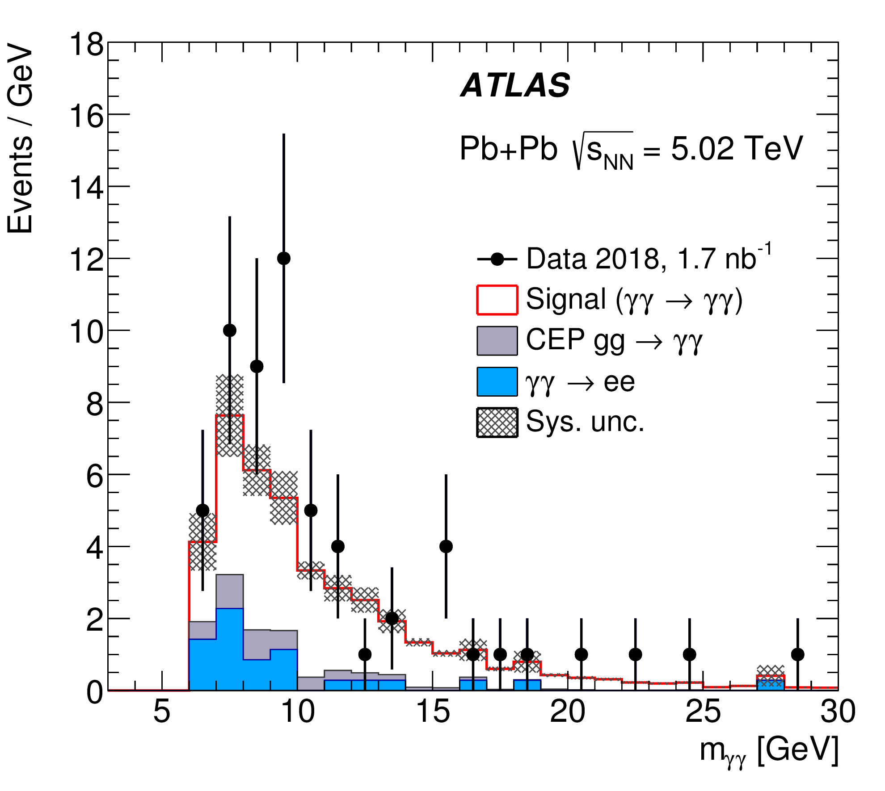
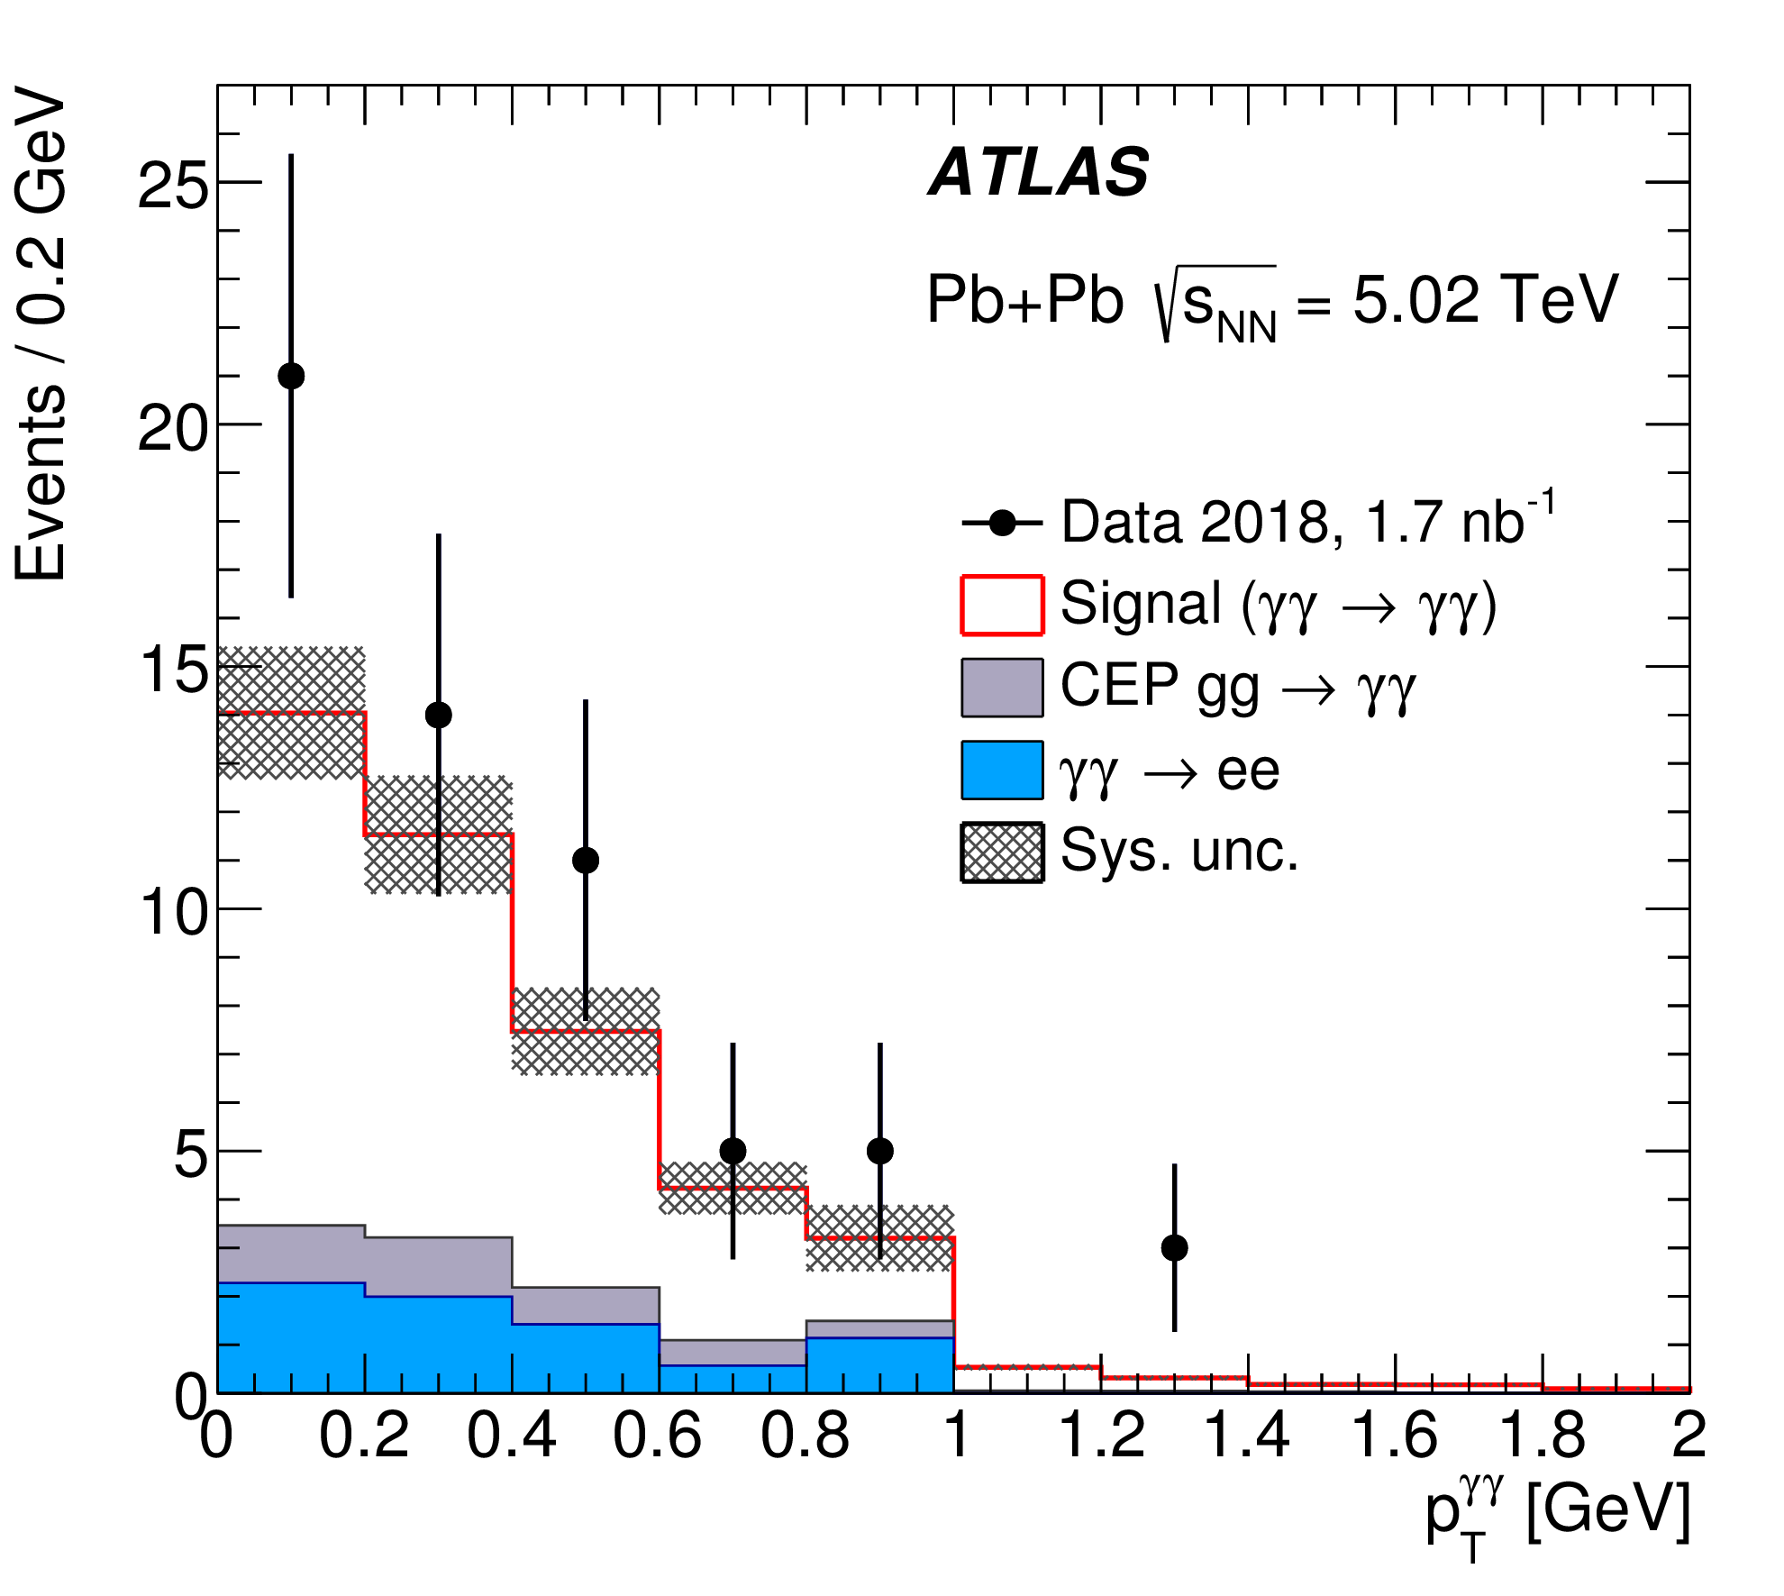
Fig 3
a
b

