Slide 1
Stochastic thermodynamics of biological systems
Hyeong-Tark Han
Department of Physics, POSTECH
H.-T Han, J. S. Lee and J.-H. Jeon, Thermodynamic uncertainty relation for systems with active Ornstein-Uhlenbeck particles, PNAS nexus, (2025)
Notes:
Hello everyone, my name is Hyeong-Tark Han from POSTECH. Today, I will present my research on **"Thermodynamic Uncertainty Relation for Nonequilibrium Systems Driven by Active Ornstein-Uhlenbeck Noise."**

Slide 2
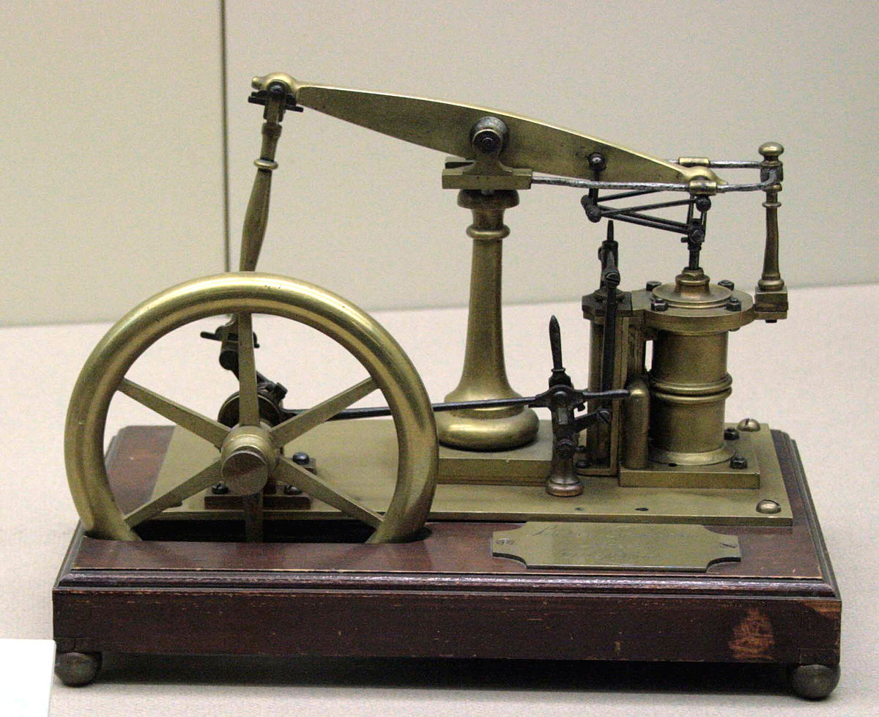


Classical thermodynamics
Macroscopic
Deterministic
Equilibrium
Laws
Steam engine
Heat
Work
U. Seifert Rep. Prog. Phys. (2012)
Notes:
Let's start with the classical thermodynamics. Classical thermodynamics deals with macroscopic systems in equilibrium, describing relationships between deterministic physical quantities such as energy, work, heat, and entropy. A well-known example is the heat engine.

Slide 3
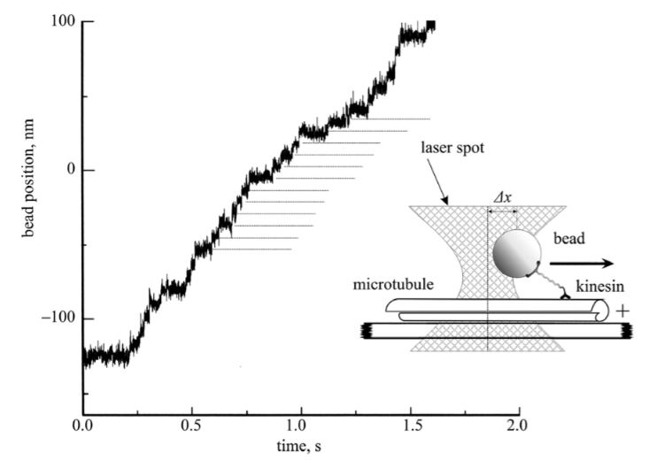
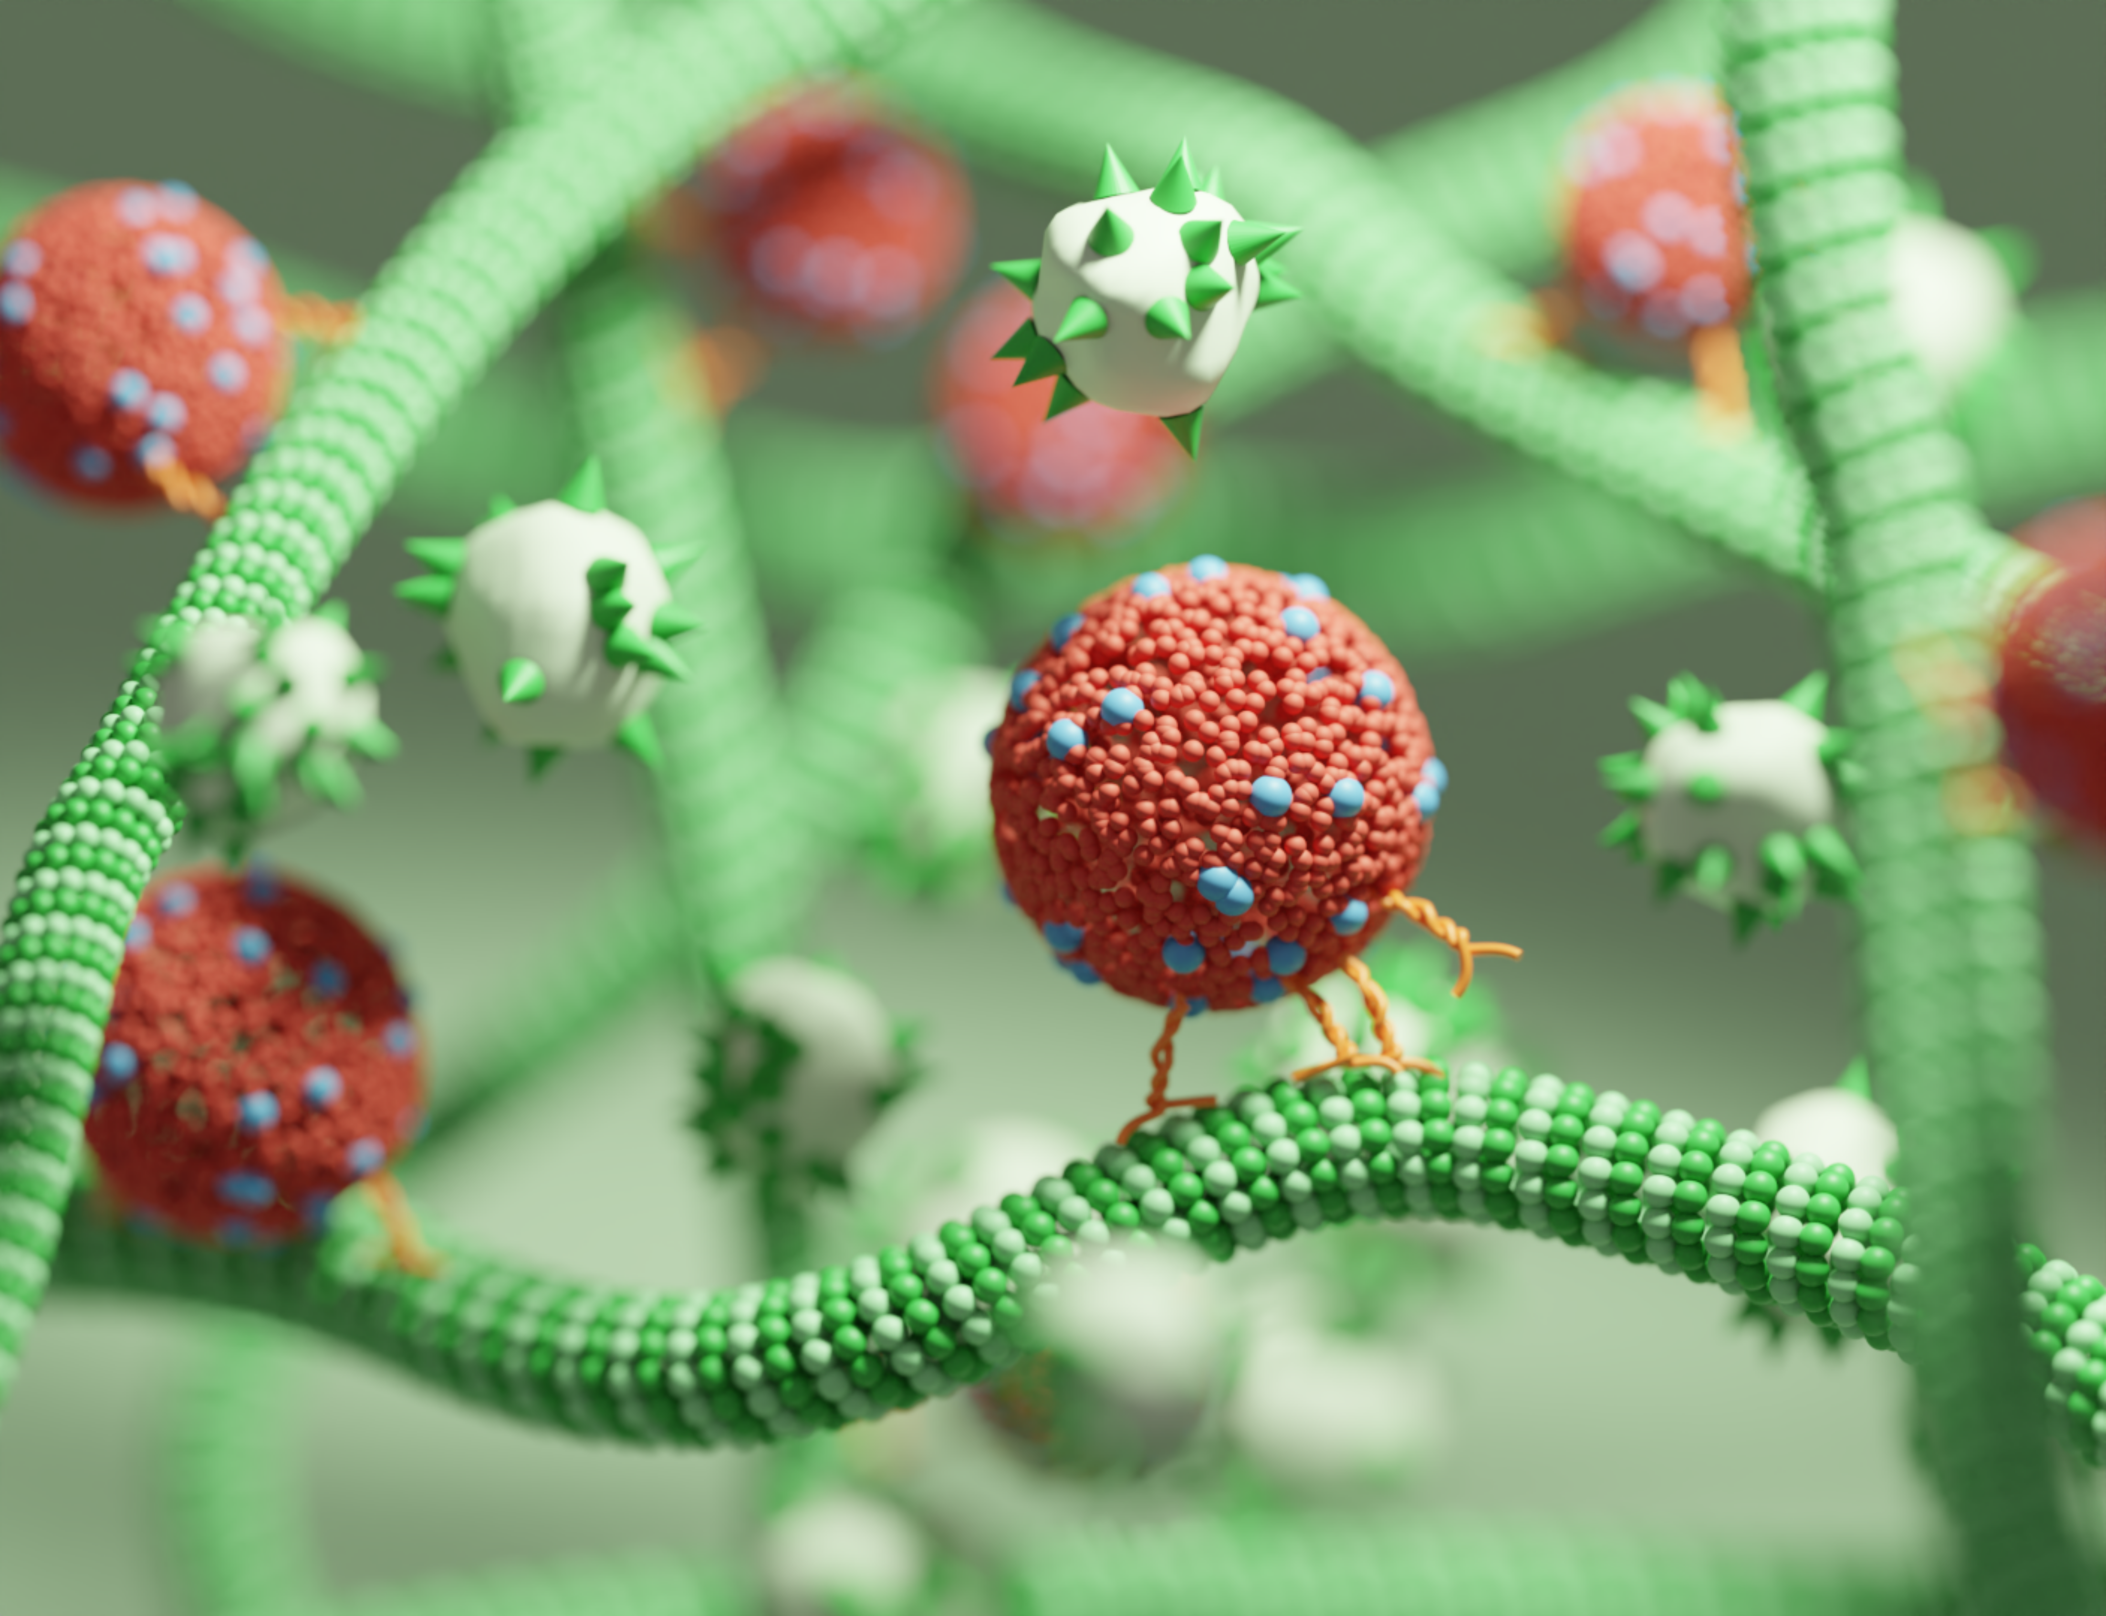
Non-equilibrium thermodynamics
Over the last 30 years, new approaches push the boundary into the non-equilibrium region
Entropy 𝑠 , heat 𝑞 , work 𝑤 , and energy 𝑢 are defined from single trajectory
Kinesin
Non-equilibrium
Notes:
Let's start with the classical thermodynamics. Classical thermodynamics deals with macroscopic systems in equilibrium, describing relationships between deterministic physical quantities such as energy, work, heat, and entropy. A well-known example is the heat engine.

Slide 4



Novel discoveries
Fluctuation theorem
Jarzynski relation
Crooks relation
Stochastic energetic
Entropy 𝑠
Heat 𝑞
Work 𝑤
Energy 𝑢
D. Evans et al., PRL (1993)
C. Jarzynski, PRL (1997)
G. Crooks, PRE (1999)
Jensen’s inequality
K. Sekimoto, J. Phys. Soc. Jpn. (1997)
Beyond thermodynamic second law
Notes:
Let's start with the classical thermodynamics. Classical thermodynamics deals with macroscopic systems in equilibrium, describing relationships between deterministic physical quantities such as energy, work, heat, and entropy. A well-known example is the heat engine.

Slide 5

Stochastic thermodynamics
U. Seifert, PRL (2005)
U. Seifert, Eur. Phys. J. B (2008)
1. The 𝑥 is observable slow and Markovian degree of freedom
2. The thermal bath consist of unobservable fast degree of freedom
3. The system entropy is defined as
Langevin equation
Principle laws of stochastic thermodynamics
Friction
coefficient γ
External
force F
Thermal
noise ξ
Notes:
Let's start with the classical thermodynamics. Classical thermodynamics deals with macroscopic systems in equilibrium, describing relationships between deterministic physical quantities such as energy, work, heat, and entropy. A well-known example is the heat engine.

Slide 6



Thermodynamic uncertainty relation (TUR)
cf.
~ uncertainty
~ energy
Lower bound of entropy production
Thermodynamic cost and efficiency of a molecular motor
S. Manikandan et al., PRL (2020)
P. Pietzonka et al J. Stat. Mech. (2016)
A. Barato, et al., PRL (2015)
Notes:
is the **Thermodynamic Uncertainty Relation (TUR)**, which expresses a trade-off between the uncertainty of an observable and energy dissipation, as shown in the equation below. The TUR can be used to determine a lower bound on entropy production or the minimum thermodynamic cost required to meet specific criteria.
2015…

Slide 7


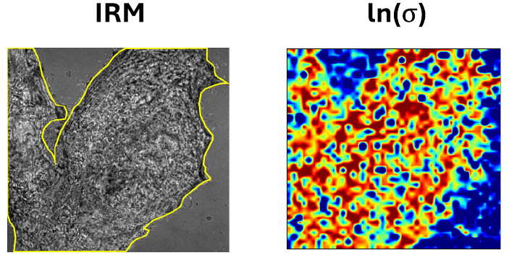
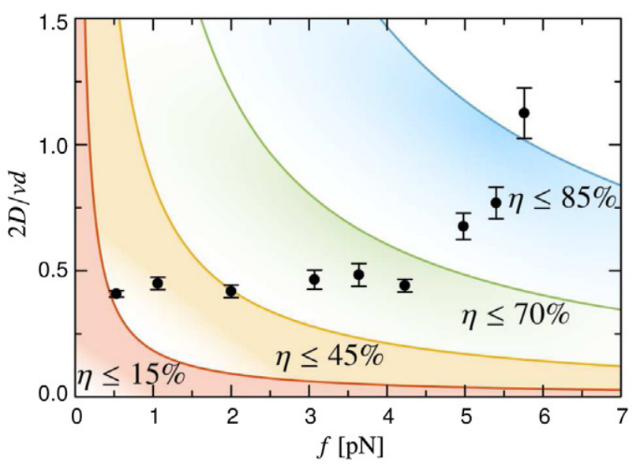
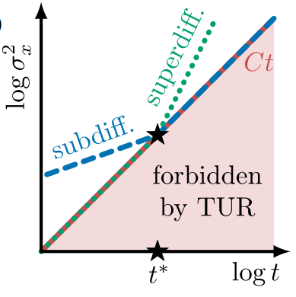
Thermodynamic uncertainty relation (TUR)
cf.
~ uncertainty
~ energy
A. Barato, et al., PRL (2015)
Lower bound of entropy production
Inference of the efficiency of motor proteins
Limit the extent of anomalous diffusion
S. Manikandan et al, PRR (2024)
U. Seifert, Phys. A (2018)
D. Hartich, et al., PRL (2021)
Notes:
is the **Thermodynamic Uncertainty Relation (TUR)**, which expresses a trade-off between the uncertainty of an observable and energy dissipation, as shown in the equation below. The TUR can be used to determine a lower bound on entropy production or the minimum thermodynamic cost required to meet specific criteria.
2015…

Slide 8
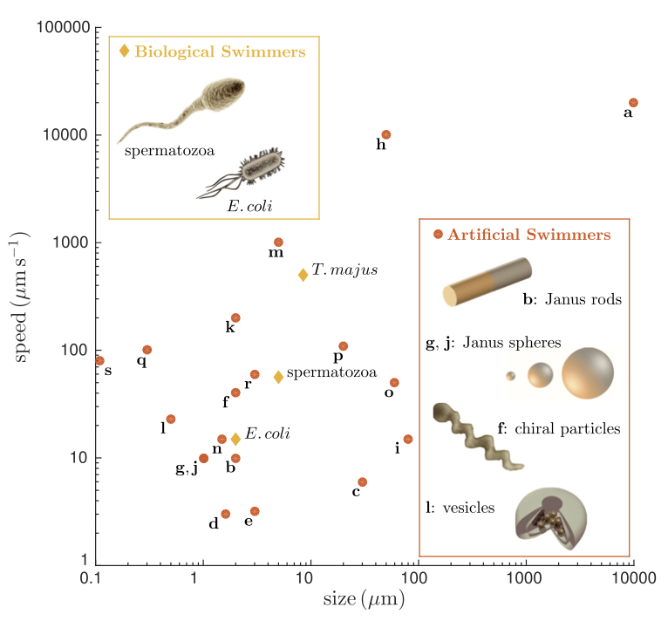
Beyond the Markovian systems
The TUR is validated in
                Overdamped Langevin dynamics
          Underdamped Langevin dynamics
          Countinous time Markov jump process
        Descrete time Markov jump process
      There is little research on TUR for systems with non-Markovianity
      Non-Markovianity is crucial in small biological systems
Y. Hasegawa et al, PRE (2019)
J. Lee et al., PRE (2021)
T. Gingrich et al., PRL (2016)
K. Proesmans et al., EPL (2017)
B. Clemens et al., Rev. Mod. Phys. (2016)
Notes:
Our research extends this result beyond Markovian systems, particularly to systems influenced by **activeness**. Activeness introduces correlations that allow a particle to propel in a certain direction. This type of noise plays a crucial role in small **biological systems** and is **ubiquitous in nature**.

Slide 9
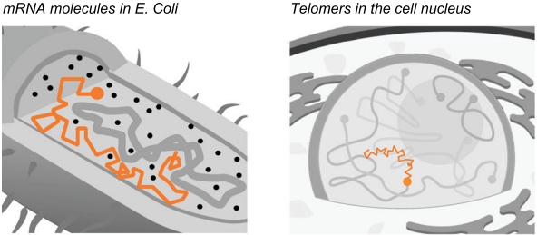
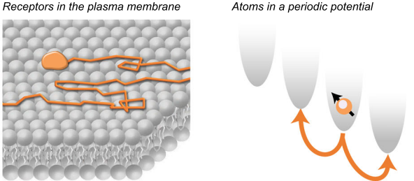
Non-Markovian biological systems
Bio-activeness
Memory effect
(aging, non-ergodicity)
B. Clemens et al., Rev. Mod. Phys. (2016)
B. Clemens et al., Rev. Mod. Phys. (2016)
G. Muñoz-Gil et al., Nat. Commun. (2021)
Notes:
Our research extends this result beyond Markovian systems, particularly to systems influenced by **activeness**. Activeness introduces correlations that allow a particle to propel in a certain direction. This type of noise plays a crucial role in small **biological systems** and is **ubiquitous in nature**.

Slide 10
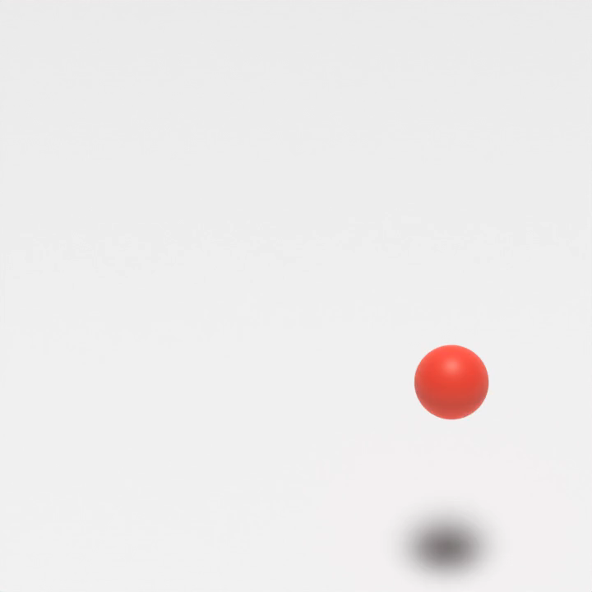

Systems with active OU particle
Active OU particle (AOUP)
Non-equilibrium active systems
Self-propulsion velocity
Directional correlation time
B. Clemens et al., Rev. Mod. Phys. (2016)
Notes:
To study the effect of active noise, I considered a system where a single **active particle** interacts with multiple **Brownian particles** while experiencing a **external force**. The active particle is described by an **Active Ornstein-Uhlenbeck Particle (AOUP)**, which experience the active Ornstein-Uhlenbeck noise that follows this Langevin equation with two key parameters: **self-propulsion velocity v_p** and **directional correlation time tau_A**.

Slide 11






Derivation of modified TUR
TUR can be driven from the Cramér-Rao inequality:
How much does the mean of observable change under perturbation
Y. Hasegawa et al., PRE (2019)
Conventional
Modified
Random variable
Observable
Perturbation parameter
PDF
Notes:
Through a rigorous derivation from Cramer-Rao inequality, we obtained a **modified TUR** that includes an **additional entropy term**. However, two key challenges arise. The first challenge is **interpreting the modified entropy** because its physical meaning is not immediately clear. The second challenge is **computing system entropy**, which is very difficult to calculate directly.

Slide 12
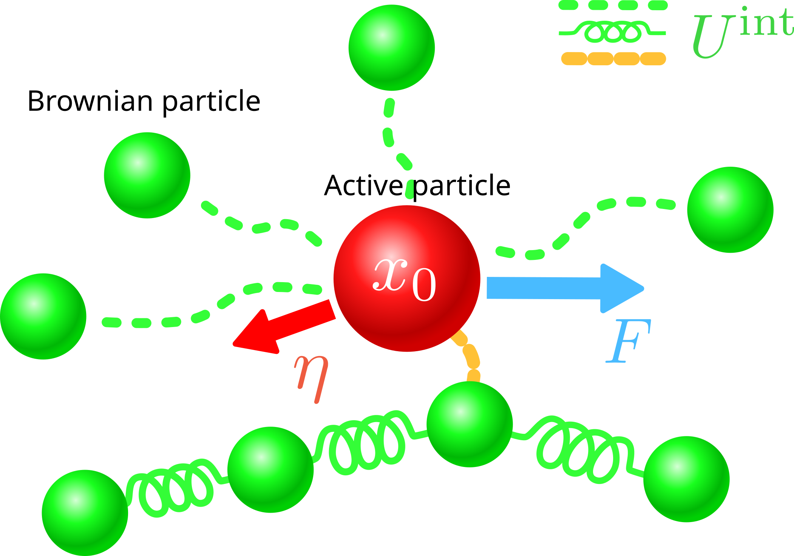

Application to the bound on MSD
Non-equilibrium active systems like kinesin
Kinesin
AOUP
Notes:
To study the effect of active noise, I considered a system where a single **active particle** interacts with multiple **Brownian particles** while experiencing a constant **drift**. The active particle is described by an **Active Ornstein-Uhlenbeck Particle (AOUP)**, which experience the active Ornstein-Uhlenbeck noise that follows this Langevin equation with two key parameters: **self-propulsion velocity v_p** and **directional correlation time tau_A**.

Slide 13

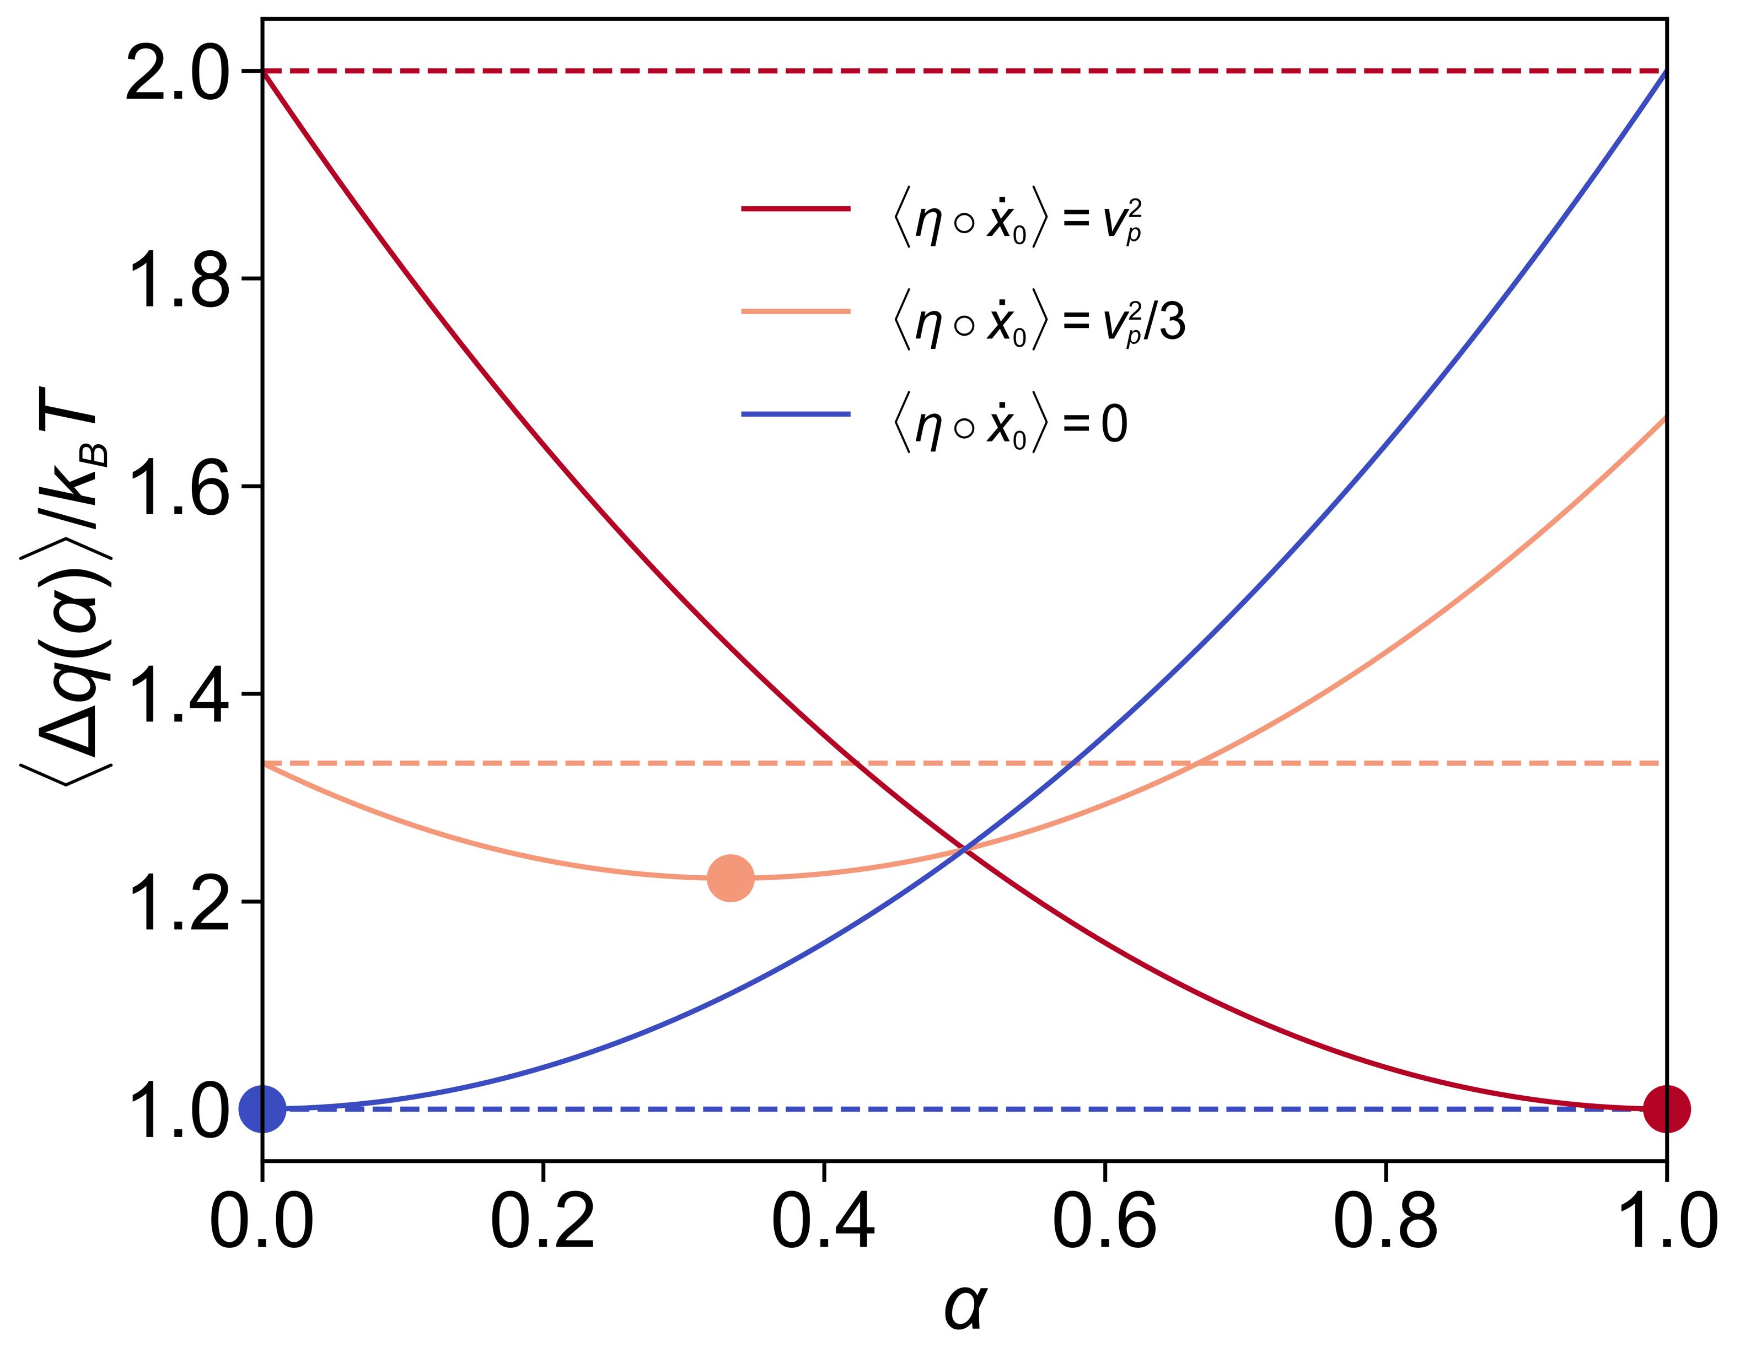

Optimized TUR bound
We can optimize the TUR bound by taking optimized parameter
in the absence of in priori information of values
independent of
Notes:
Furthermore, since **Mean Squared Displacement (MSD) is independent of the parity of the active noise α**, we can derive **optimized tur bound** by arbitrary taking **optimize α (alpha star)**, even without knowing its exact value. The alpha star can be calculated from the trajectory data.

Slide 14
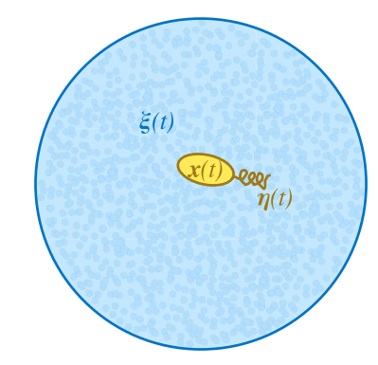
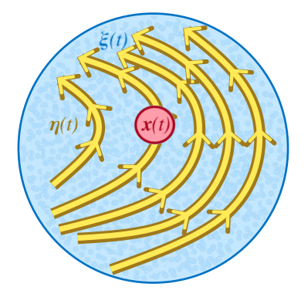
Physical interpretation of
The modified entropy is a heat dissipated by the active noise
with generalized parity under time reversal symmetry (TRS)
: heat dissipated with even parity under TRS
: heat dissipated with odd parity under TRS
e.g. Self-propelling particle
e.g. Active bath
L. Dabelow et al., PRX (2019)
Notes:
We addressed the first issue by considering the **time-reversal symmetry (TRS)** of active noise. We found that the entropy producted in the bath is equal to the total heat dissipation in the system when active noise with both even-parity and odd-parity under TRS coexist. To describe this, we introduced a generalized parity parameter, α, which characterizes the symmetry of the active noise. When α is zero, it corresponds to even parity and **self-propelling particles**, such as Janus particle. When α is one, it represents odd parity and **active baths**, where the surrounding medium itself mimics active flow.
Q(alpha=0)
Q(alpha=1)

Slide 15
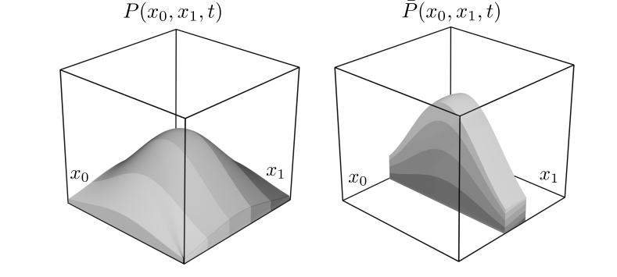
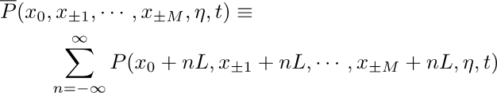


Mapping to a steady-state system
Contracted PDF
Contracted PDF will converge to the steady-state
Observable is equivalent with that of free-space by the translational symmetry
Notes:
To address the second challenge, we developed a **general mapping method** to transform our system into a steady-state system. This method, called the **contracted PDF**, works by slicing the probability density function (PDF) along one axis and stacking them into one sections. This transformation guarantees that the system reaches a steady state while simultaneously preserving the statistical properties of the observables due to **translational symmetry**. As a result, we were able to apply the **standard steady-state TUR**, allowing us to establish bounds on the observables in the original system.

Slide 16
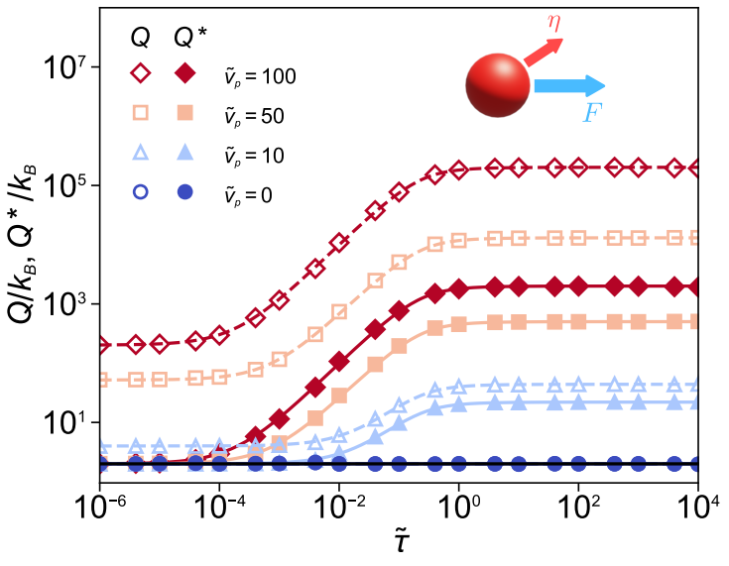
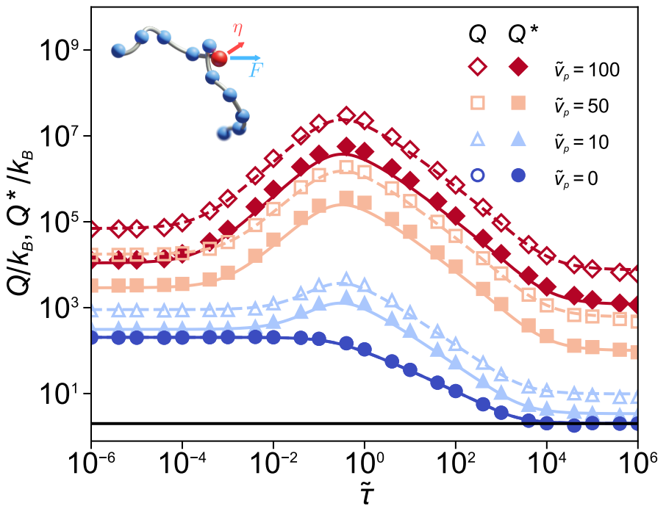

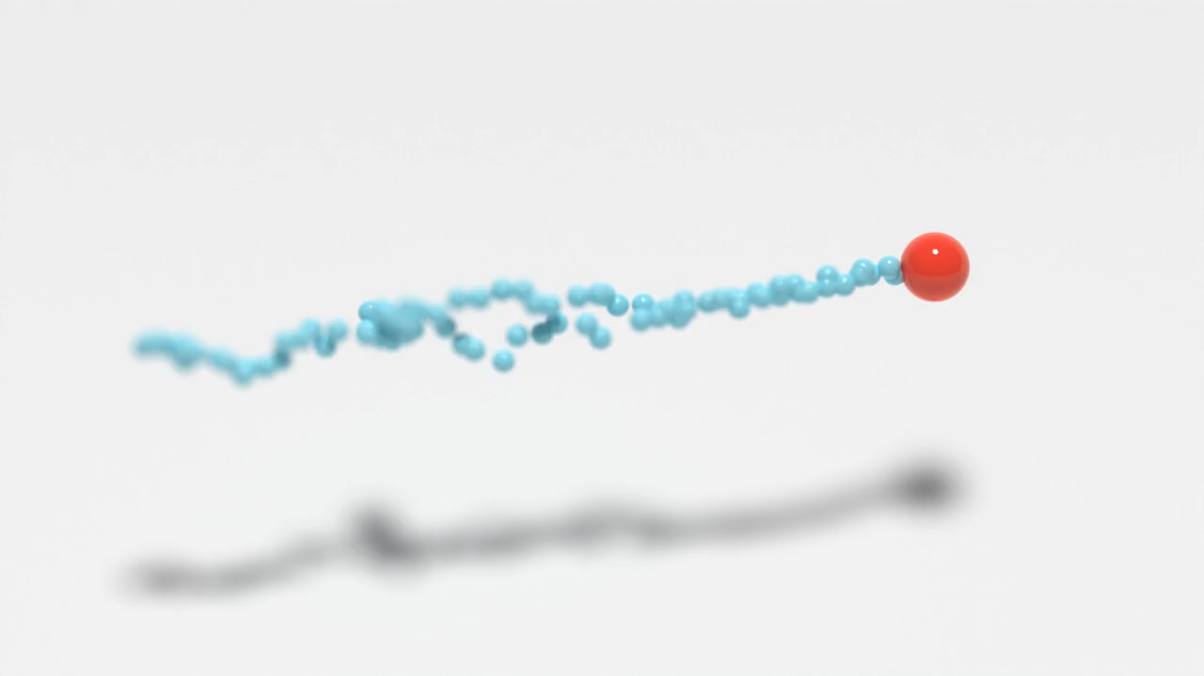
Simulation results
The tight bound is reproduced in the absence of active noise, but we get a loose bound in the present of active noise
Notes:
To verify our theoretical results, we conducted **simulations** on two cases: a **single AOUP** and a **AOUP attached to Rouse chain**. The simulations showed that the **TUR was satisfied at all time scales** in both cases. Without active noise, we successfully reproduced the **tight TUR bound**. However, with active noise, we observed a **looser bound**

Slide 17

Simulation results
Strong activity breaks down the energy-precision trade-off
Notes:
This is because that **strong active noise breaks down the energy-precision trade-off** since the strong active noise generally increases the energy dissipation as well as reduce the precision.

Slide 18

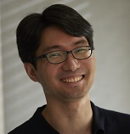

Active-TUR
Hyeong-Tark Han
POSTECH
Prof. Jae Sung Lee
KIAS
Prof. Jae-Hyung Jeon
POSTECH
We established the TUR for the active system where the thermal and active noises are present.
We can interpret entropy as a generalization of two heat contributions, each corresponding to a component with either even or odd parity.
We demonstrate that the system entropy can be disregarded in the case of free space diffusion with the translational symmetry.
We also simulated various active systems to test our TUR.
We found that in the presence of active noise the TUR does not give a tight bound for the anomalous diffusion.
H.-T Han, J. S. Lee and J.-H. Jeon, Thermodynamic uncertainty relation for systems with active Ornstein-Uhlenbeck particles, arXiv
Notes:
To summarize, we extended the **TUR to active systems** by incorporating modified entropy terms. We provided a **physical interpretation** of these entropy terms using **generalized parity α**. We introduced a **contracted pdf** to address the computational challenges of system entropy calculation. Our **simulations validated the theoretical predictions**, showing how strong active noise affects the TUR bound.
You can check our paper on arXiv and the paper is currently under **peer review**.
Thank you for your attention!

Slide 19
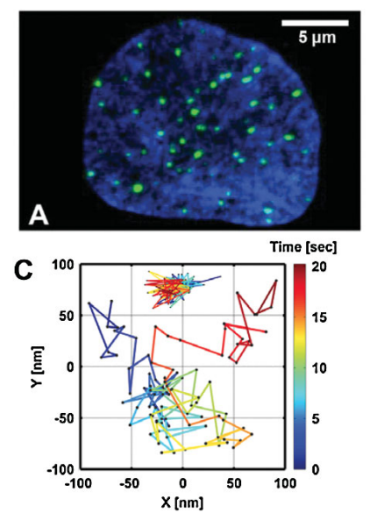
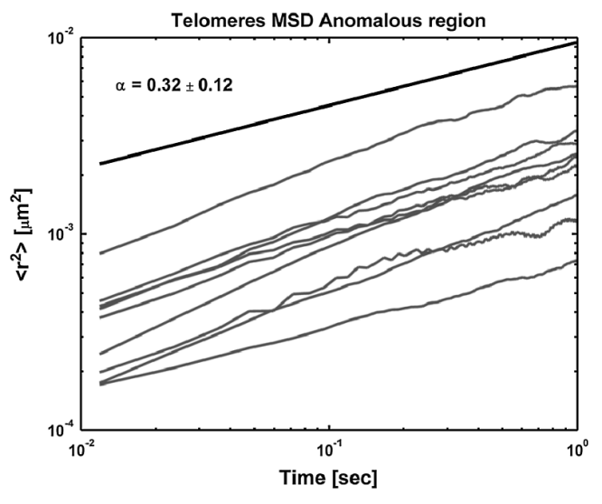
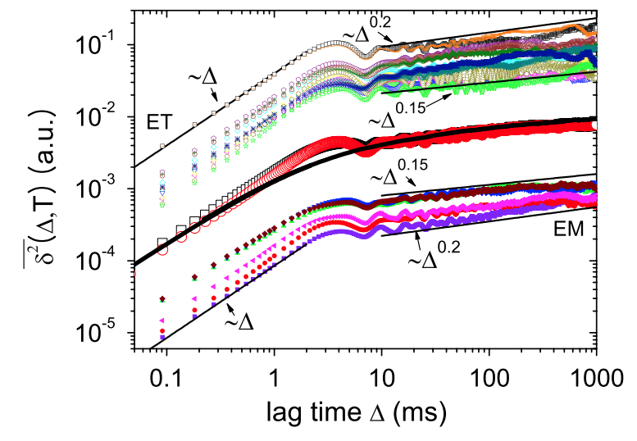

Memory effect and aging
DNA and Chromatin Dynamics
DNA and Chromatin Dynamics
Intracellular Transport
I. Bronstein et al., PRL (2009)
G. Muñoz-Gil et al., Nat. Commun. (2021)
I. Bronstein et al., PRL (2009)
J.-H. Jeon et al., PRL (2011)
(renewal)
(non-renewal)
Notes:
Our research extends this result beyond Markovian systems, particularly to systems influenced by **activeness**. Activeness introduces correlations that allow a particle to propel in a certain direction. This type of noise plays a crucial role in small **biological systems** and is **ubiquitous in nature**.

Slide 20
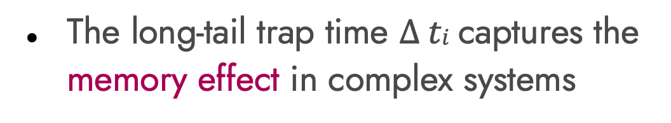
Trap model
DNA and Chromatin Dynamics
The long-tail trap time $∆ ti$captures the memory effect in complex systems
I. Sokolov, Soft Matter (2012)
I. Bronstein et al., PRL (2009)
Non-Markov process
Non-ergodicity
Memory effect
Aging effect
G. Muñoz-Gil et al., Nat. Commun. (2021)
(renewal)
(non-renewal)
Notes:
Our research extends this result beyond Markovian systems, particularly to systems influenced by **activeness**. Activeness introduces correlations that allow a particle to propel in a certain direction. This type of noise plays a crucial role in small **biological systems** and is **ubiquitous in nature**.

Slide 21

Continuous Time Random Walk (CTRW)

Slide 22
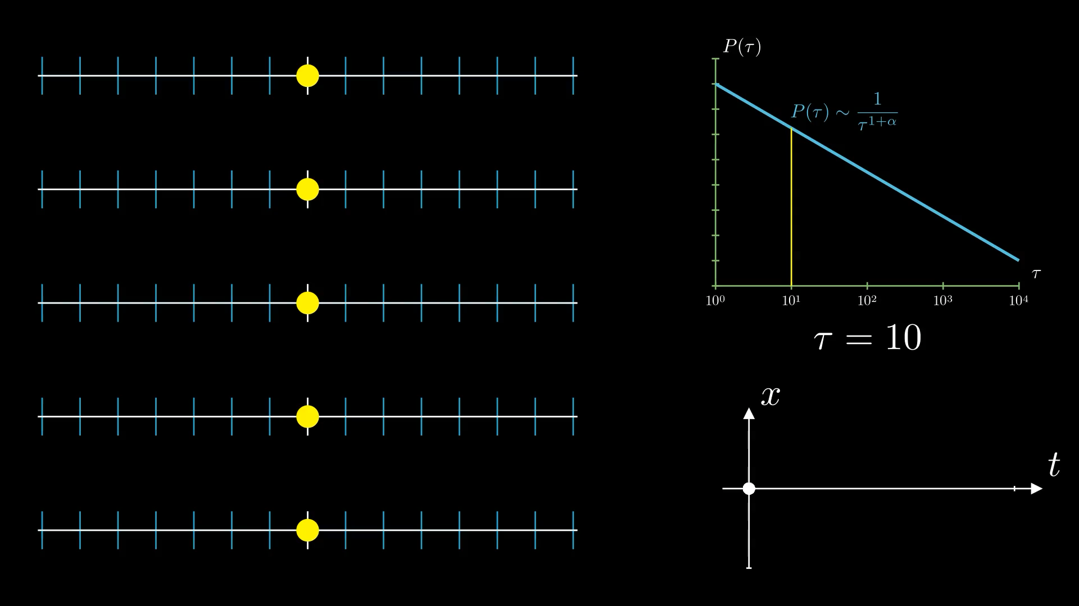
Quenched Trap Model (QTM)

Slide 23





Subordinated process
A stochastic process governed by a stochastic time (subordinator)
The probability density function is represented as weighted sum of pdfs
Law of total probability
Notes:
Our research extends this result beyond Markovian systems, particularly to systems influenced by **activeness**. Activeness introduces correlations that allow a particle to propel in a certain direction. This type of noise plays a crucial role in small **biological systems** and is **ubiquitous in nature**.

Slide 24
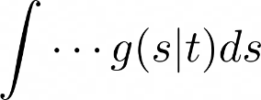


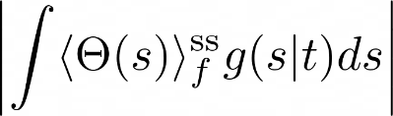
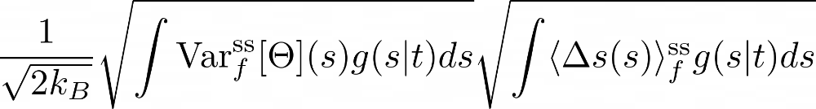

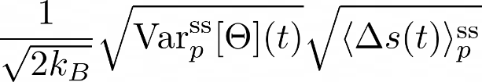




Derivation of TUR for the subordinated process
Triangle inequality
Cauchy-Schwarz inequality
Concavity of variance
TUR for the subordinated process:
Notes:
Through a rigorous derivation from Cramer-Rao inequality, we obtained a **modified TUR** that includes an **additional entropy term**. However, two key challenges arise. The first challenge is **interpreting the modified entropy** because its physical meaning is not immediately clear. The second challenge is **computing system entropy**, which is very difficult to calculate directly.

Slide 25
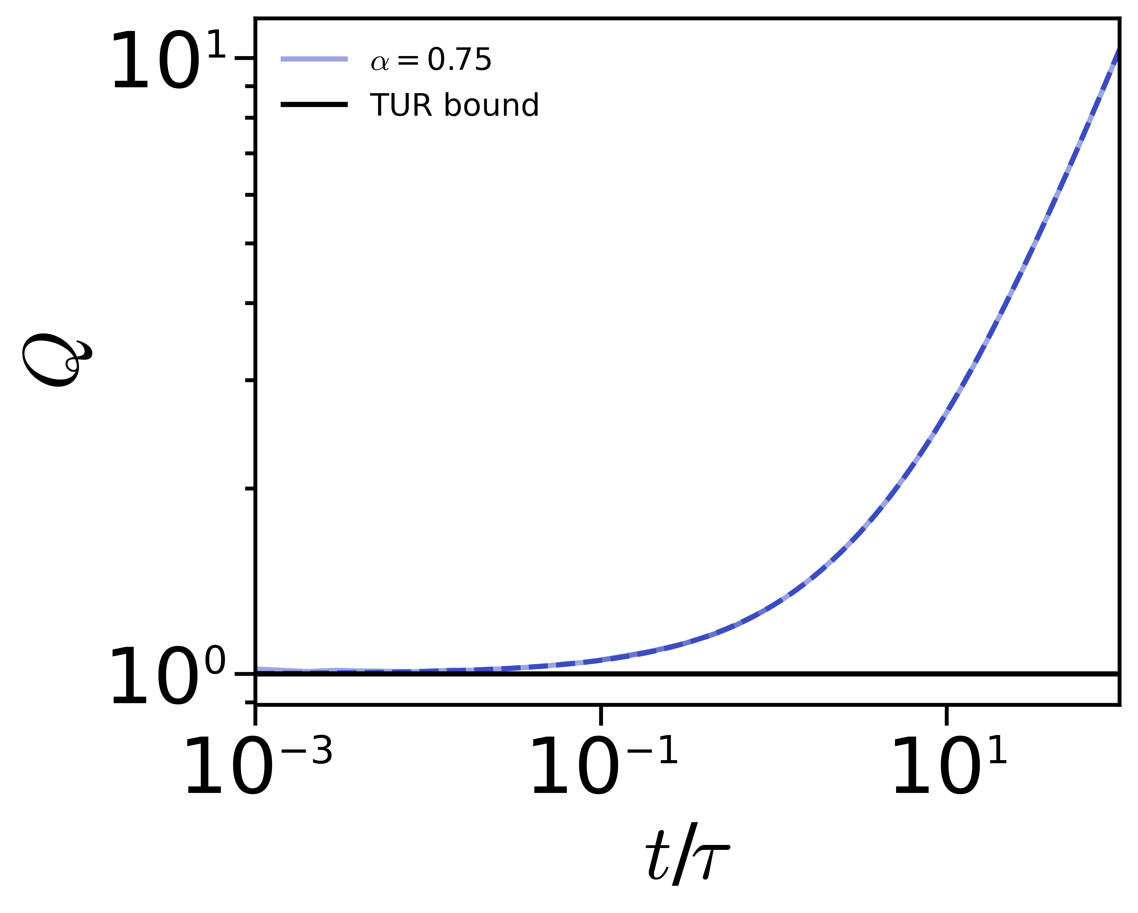

Example 1) Biased Continuous Time Random Walk
Force-induced dispersion
TUR validated through simulations
TUR provides a tight bound in the short-time limit
Tight bound
Generalized Einstein relation
Notes:
Furthermore, since **Mean Squared Displacement (MSD) is independent of the parity of the active noise α**, we can derive **optimized tur bound** by arbitrary taking **optimize α (alpha star)**, even without knowing its exact value. The alpha star can be calculated from the trajectory data.

Slide 26
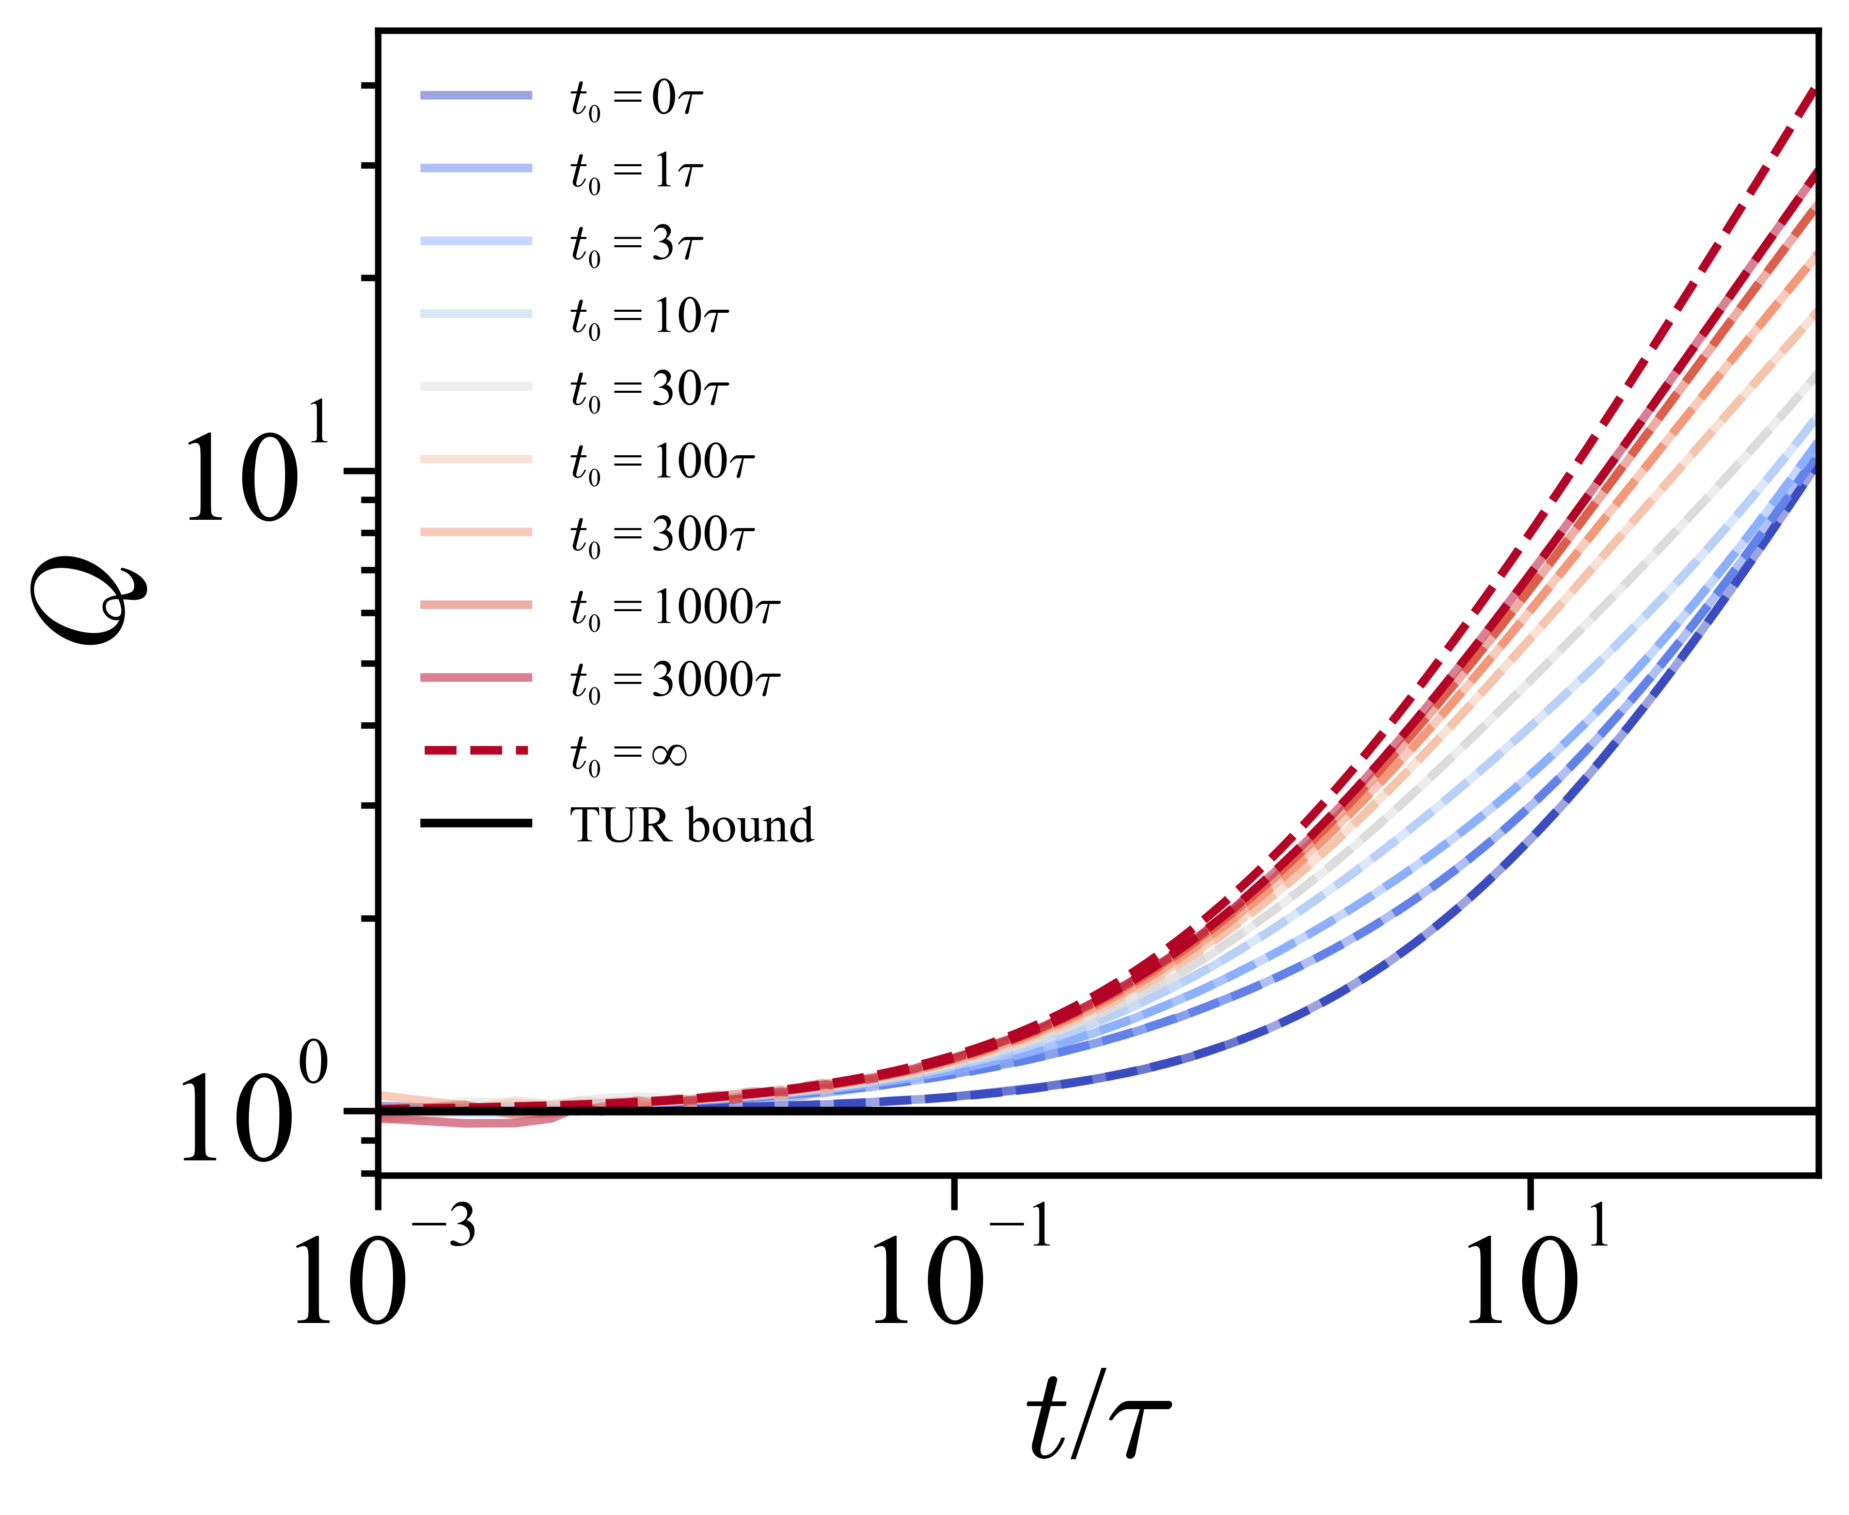



Aging effects on TUR bound
PDF with aging time also follows subordination
Q curve converges as $ta→∞$
E. Barkai et al., J. Chem. Phys. (2003)
Tight bound
Notes:
We addressed the first issue by considering the **time-reversal symmetry (TRS)** of active noise. We found that the entropy producted in the bath is equal to the total heat dissipation in the system when active noise with both even-parity and odd-parity under TRS coexist. To describe this, we introduced a generalized parity parameter, α, which characterizes the symmetry of the active noise. When α is zero, it corresponds to even parity and **self-propelling particles**, such as Janus particle. When α is one, it represents odd parity and **active baths**, where the surrounding medium itself mimics active flow.
Q(alpha=0)
Q(alpha=1)

Slide 27
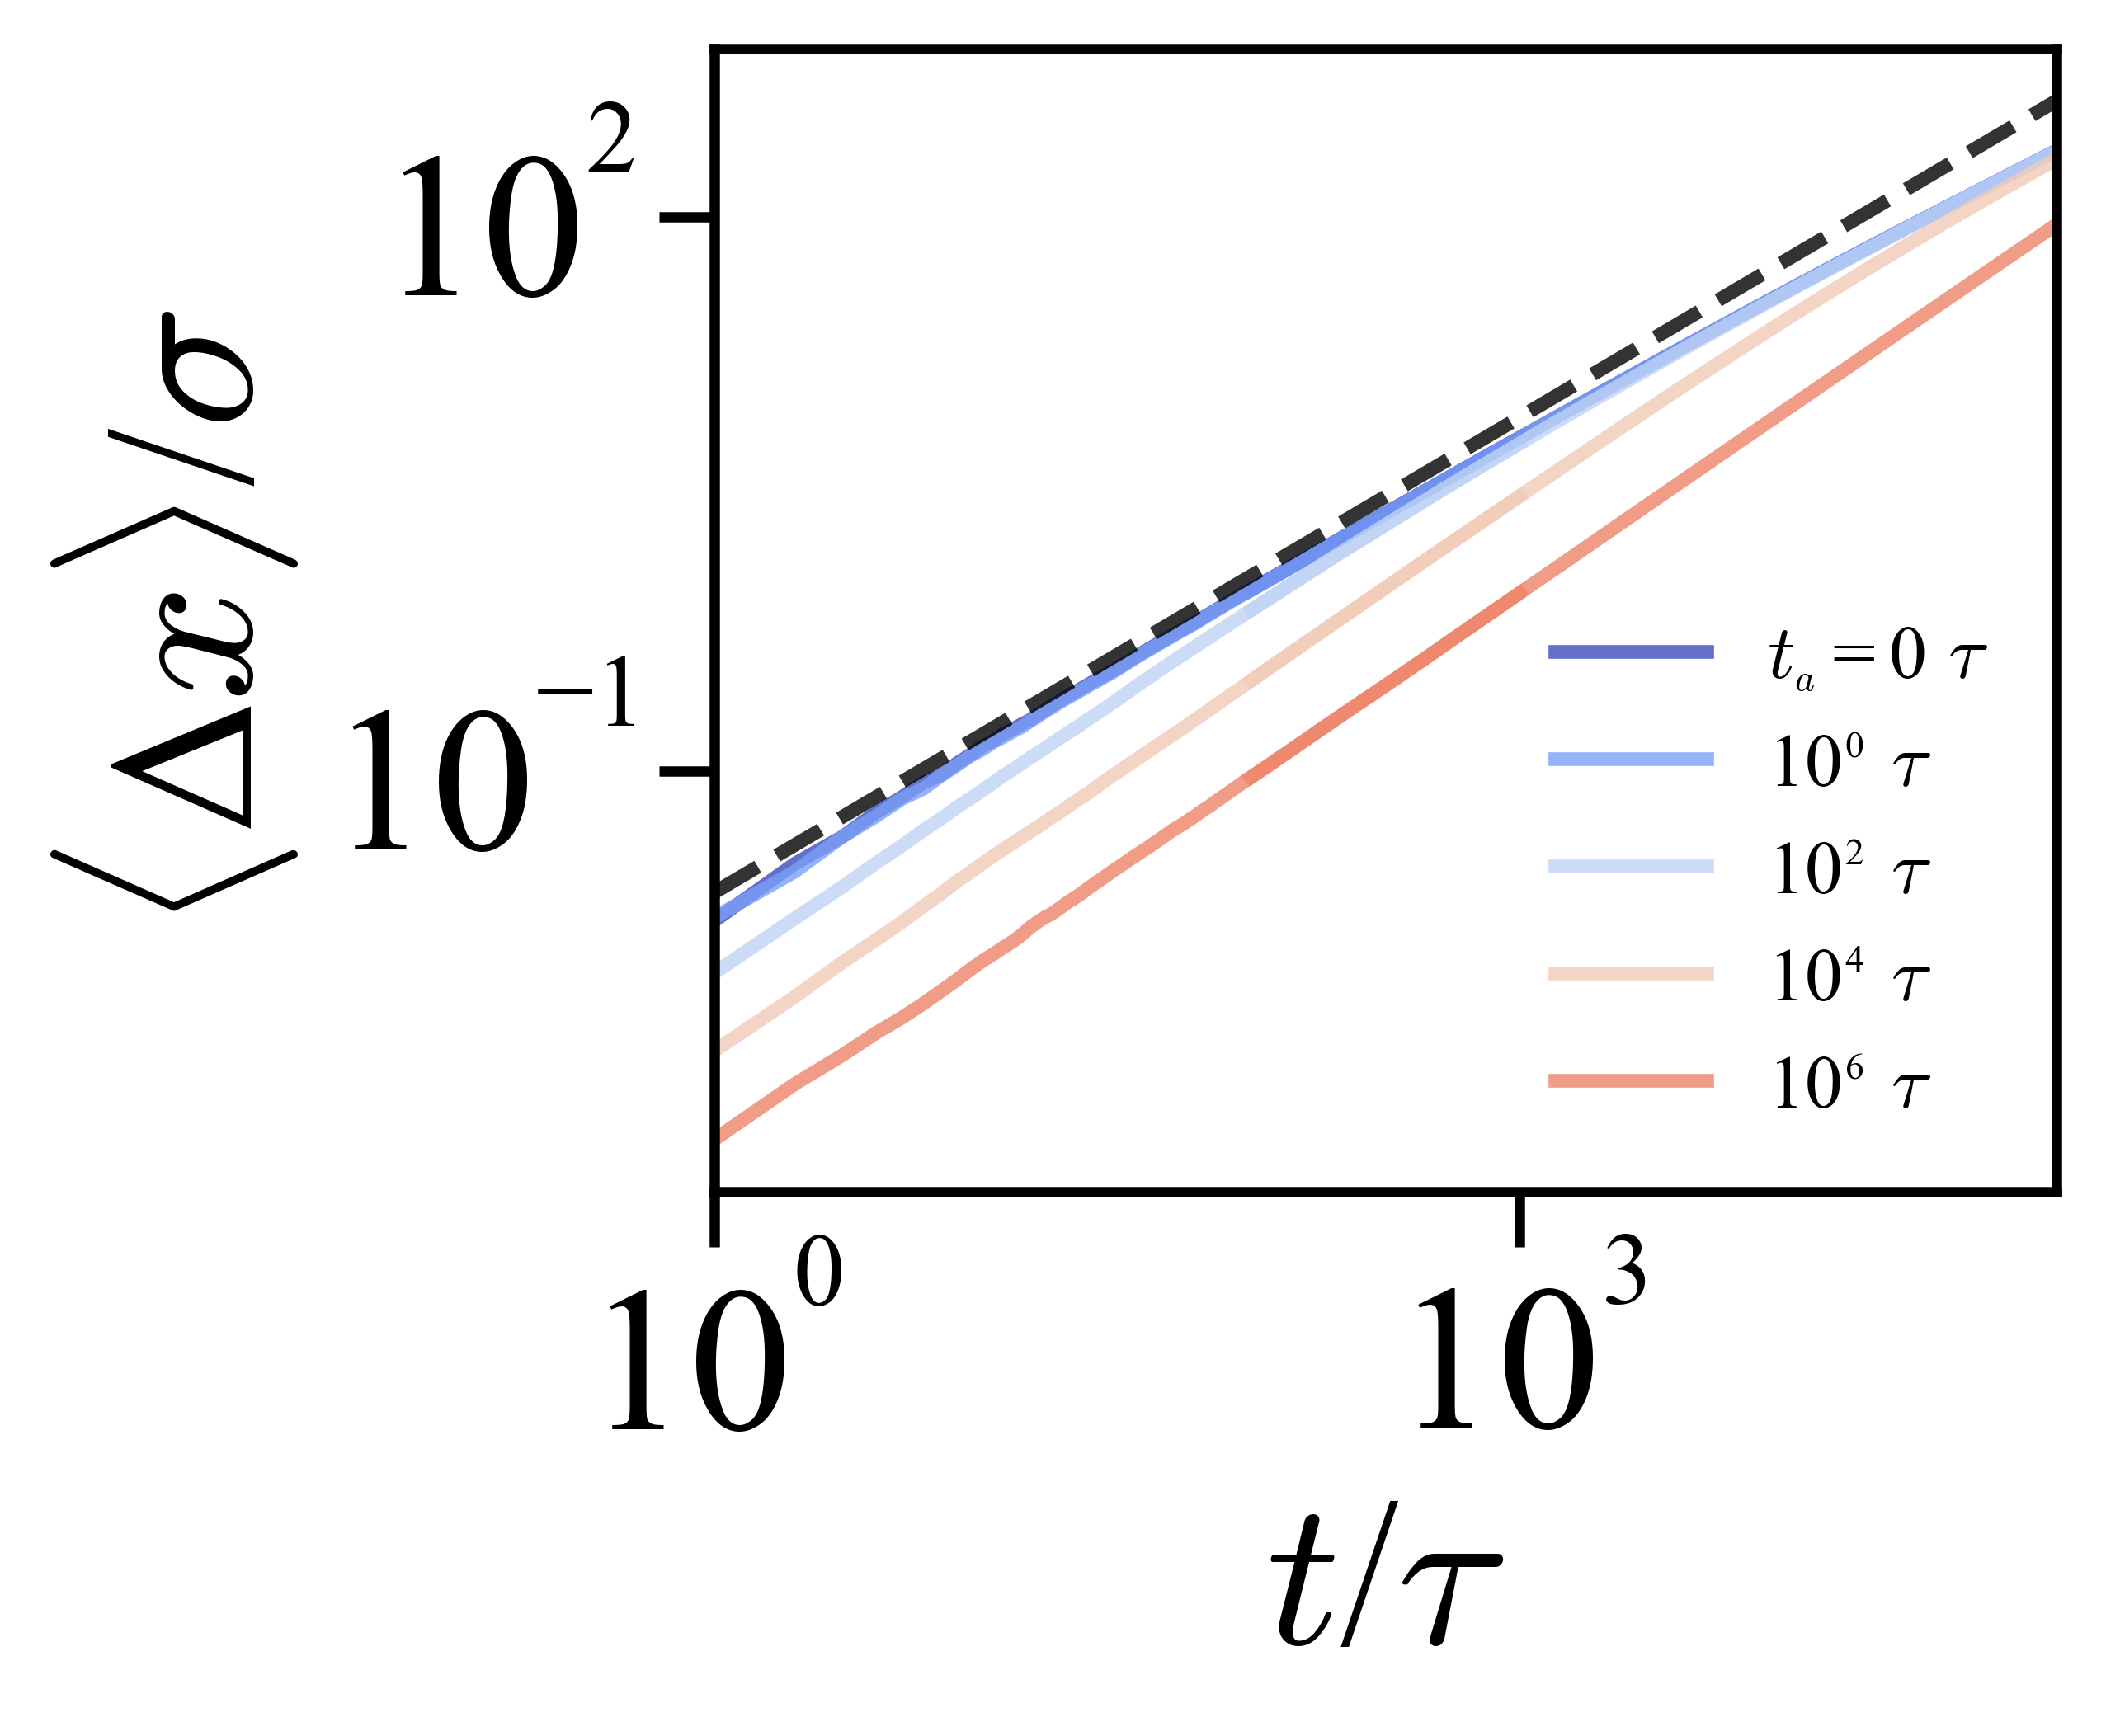
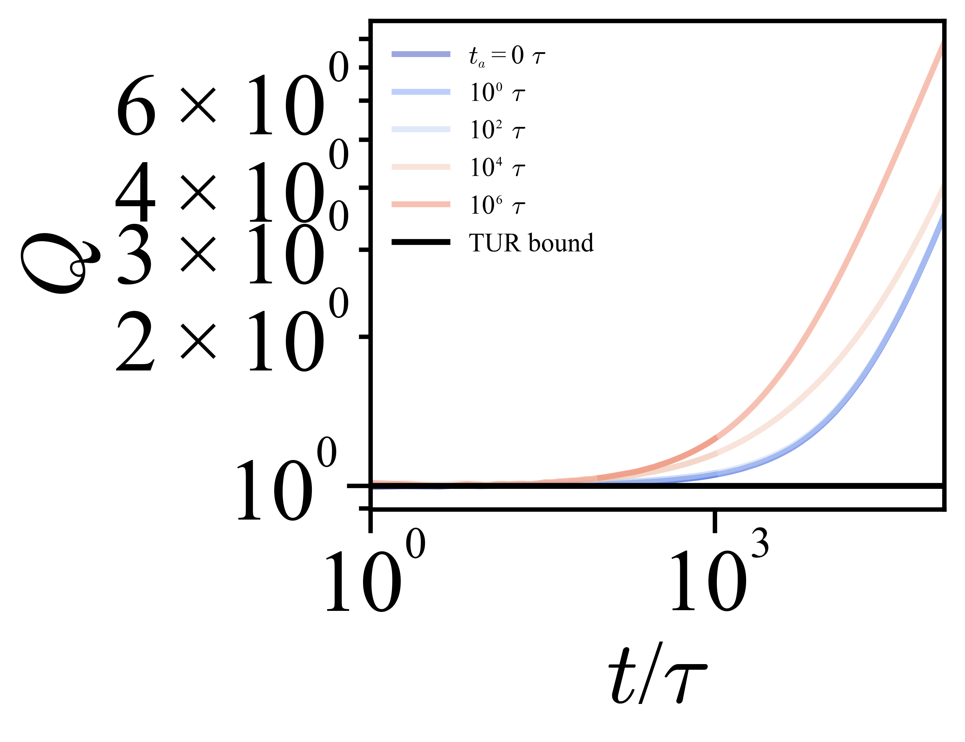

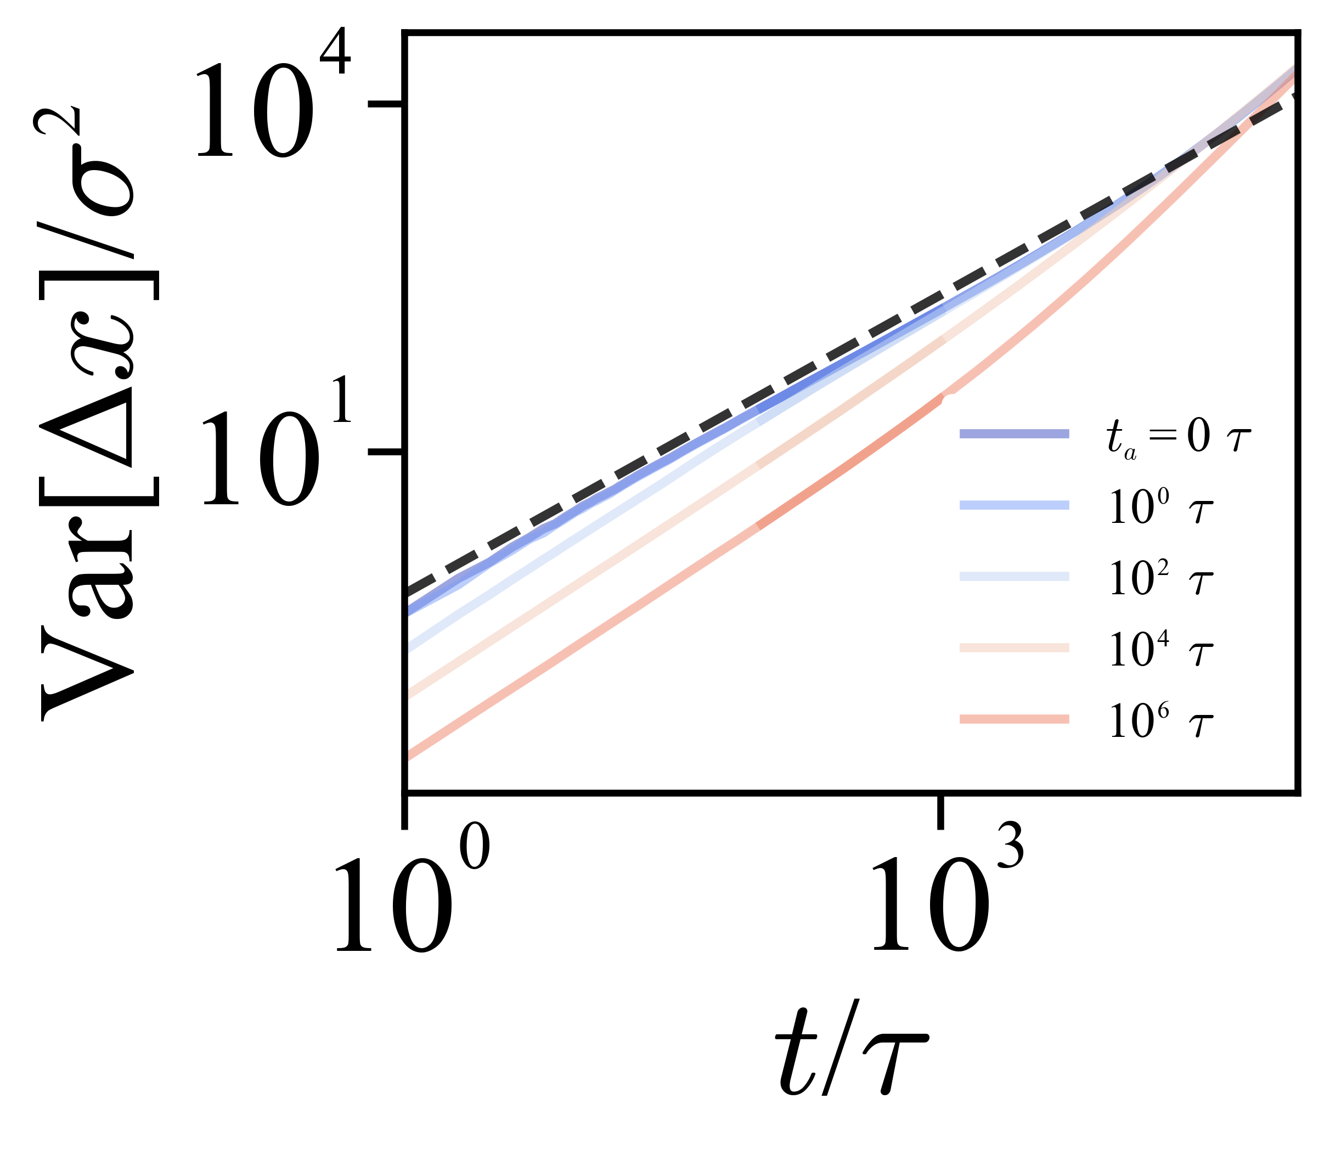

Example 2) Biased Quenched Trap Model
J. Bouchaud et al., Phys. Rep. (1990)
Trap time distribution
PDF of the quenched trap model follows the subordinated framework
S. Burov et al., PRL (2011)
Notes:
We addressed the first issue by considering the **time-reversal symmetry (TRS)** of active noise. We found that the entropy producted in the bath is equal to the total heat dissipation in the system when active noise with both even-parity and odd-parity under TRS coexist. To describe this, we introduced a generalized parity parameter, α, which characterizes the symmetry of the active noise. When α is zero, it corresponds to even parity and **self-propelling particles**, such as Janus particle. When α is one, it represents odd parity and **active baths**, where the surrounding medium itself mimics active flow.
Q(alpha=0)
Q(alpha=1)

Slide 28
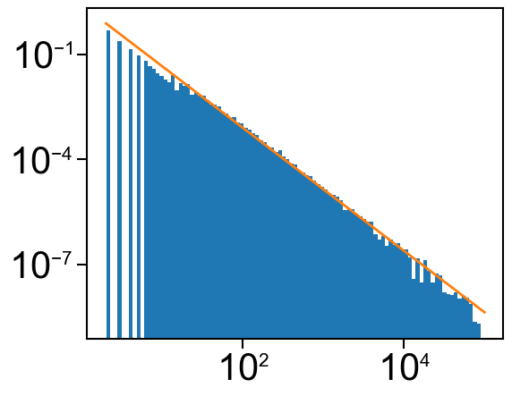

Markovian approximation of CTRW
We use the Markovian embedding for power law waiting time
S. Park et al., J. Phys. A:Math. Theor. 2021
Notes:
We addressed the first issue by considering the **time-reversal symmetry (TRS)** of active noise. We found that the entropy producted in the bath is equal to the total heat dissipation in the system when active noise with both even-parity and odd-parity under TRS coexist. To describe this, we introduced a generalized parity parameter, α, which characterizes the symmetry of the active noise. When α is zero, it corresponds to even parity and **self-propelling particles**, such as Janus particle. When α is one, it represents odd parity and **active baths**, where the surrounding medium itself mimics active flow.
Q(alpha=0)
Q(alpha=1)

Slide 29
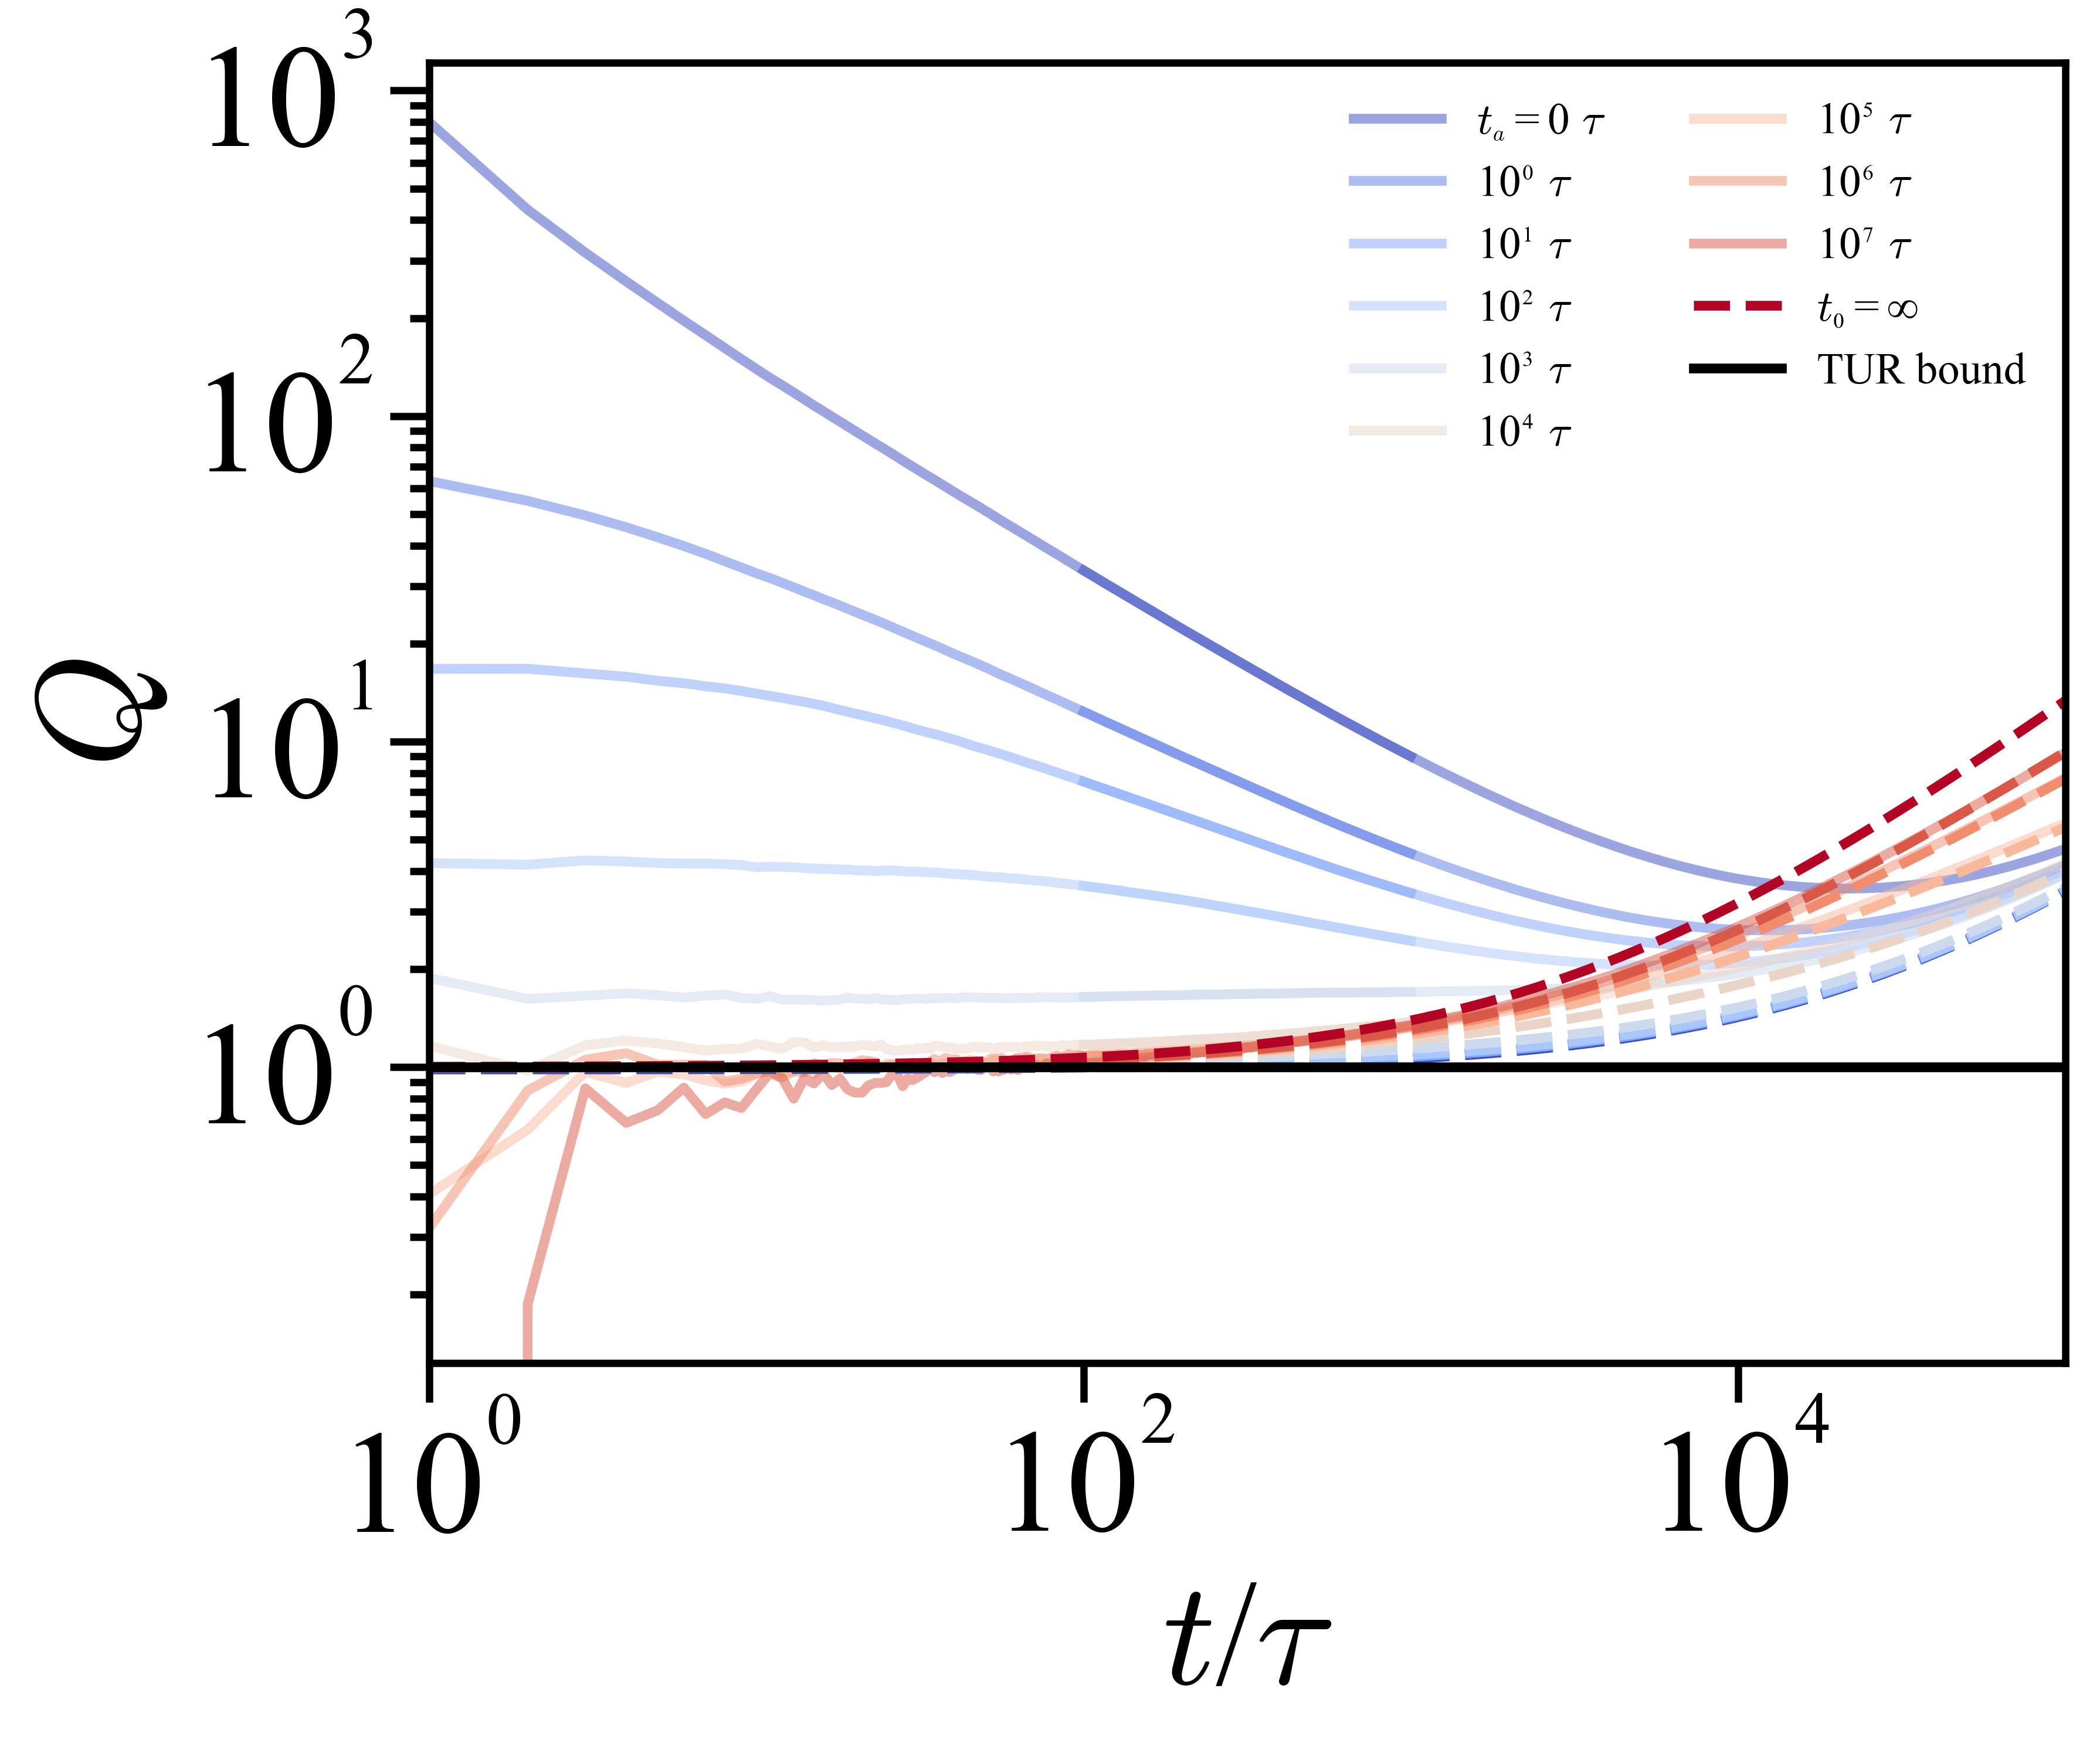
Markovian approximation of CTRW
The aging helps to find the tightest bound.
Notes:
We addressed the first issue by considering the **time-reversal symmetry (TRS)** of active noise. We found that the entropy producted in the bath is equal to the total heat dissipation in the system when active noise with both even-parity and odd-parity under TRS coexist. To describe this, we introduced a generalized parity parameter, α, which characterizes the symmetry of the active noise. When α is zero, it corresponds to even parity and **self-propelling particles**, such as Janus particle. When α is one, it represents odd parity and **active baths**, where the surrounding medium itself mimics active flow.
Q(alpha=0)
Q(alpha=1)

Slide 30

Subordinated-TUR
Hyeong-Tark Han
POSTECH
Prof. Jong-Min Park
APCTP
Prof. Jae-Hyung Jeon
POSTECH
Trap model, common in biological systems, exhibit strongly non-Markovian behavior including aging effects.
We developed the TUR for trap model.
Various trap models were simulated to test our TUR.
The TUR shows a tight bound in the short-time limit even for large ta→∞. Our TUR framework can be applied to biological systems to estimate entropy production without prior knowledge of aging time ta.
Notes:
To summarize, we extended the **TUR to active systems** by incorporating modified entropy terms. We provided a **physical interpretation** of these entropy terms using **generalized parity α**. We introduced a **contracted pdf** to address the computational challenges of system entropy calculation. Our **simulations validated the theoretical predictions**, showing how strong active noise affects the TUR bound.
You can check our paper on arXiv and the paper is currently under **peer review**.
Thank you for your attention!

