Slide 1
Miura Operators as R-matrices from M-brane Intersections
Saebyeok Jeong
Department of Theoretical Physics, CERN
Center for Geometry and Physics, IBS
APCTP-INPP Demokritos meeting
Aug 29th, 2025
Based on arXiv:2407.15990 w/ N. Haouzi,

Slide 2
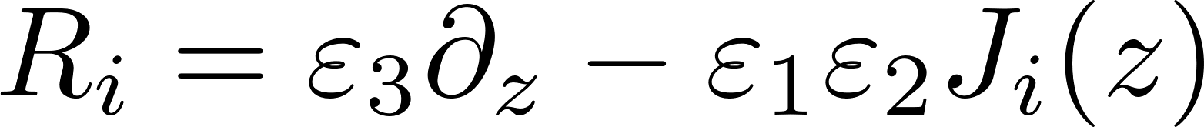
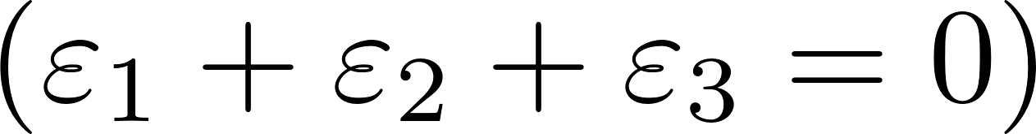
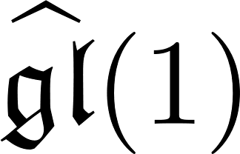
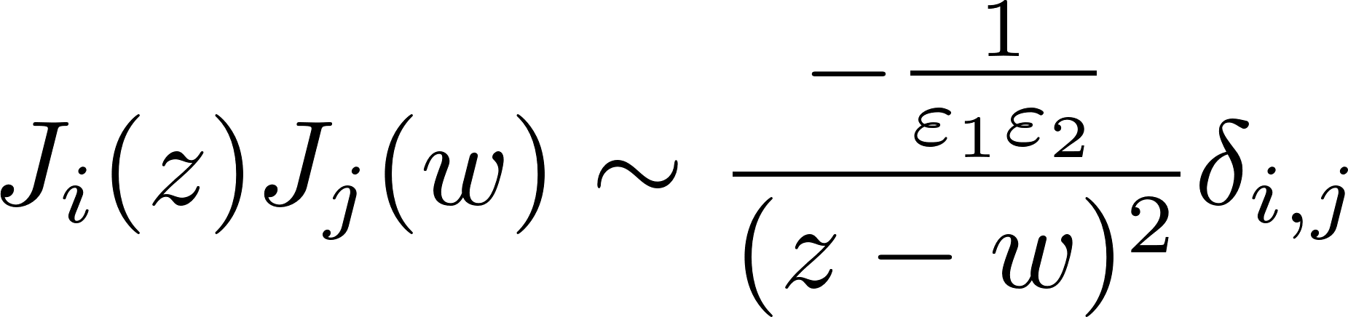
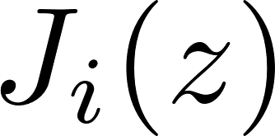
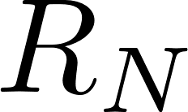
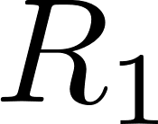
Miura transformations for W-algebras
The W-algebras of type gl(N) admit free-field realization, by Miura transformation.
Basic building block: Miura operator
The Miura transformation is obtained by taking the product of Miura operators. The coefficients of the differentials generate the W-algebra.
: i-th current
Product of R-matrices under coproduct operations?

Slide 3
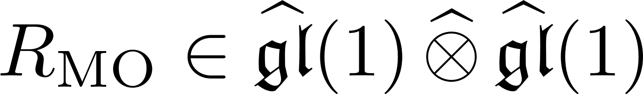
Maulik-Okounkov R-matrix
[Maulik, Okounkov 12]
The Miura transformation does not depend on the ordering; a change of ordering results in isomorphic W-algebra.
This is because of the Maulik-Okounkov R-matrix , satisfying
Yang-Baxter equation?

Slide 4
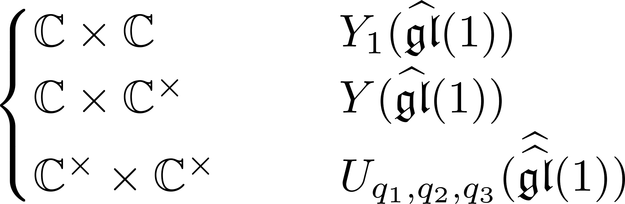
There is some amount of understanding on the case just introduced,
but let me focus on a “q-deformation” of the problem for which I have better understanding at the moment.
In the twisted M-theory setup , the change amounts to:
[SJ, N. Ishtiaque, Y. Zhou 24]
cf. [Harada, Matsuo, Noshita, Watanabe 21]
[Costello 16]
cf. [Costello 17], [Gaiotto, Oh 19],
[Gaiotto, Abajian 20], [Gaiotto, Rapčák 20]

Slide 5
Outline
Twisted M-theory
M2- and M5-branes; algebra of local operators
Intersections between M2- and M5-branes; R-matrices and Miura operators
Intersections with ends; Intertwiners, screening charges, Miura transformation

Slide 6
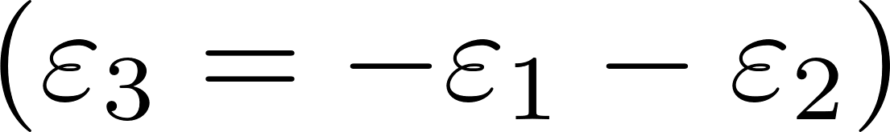
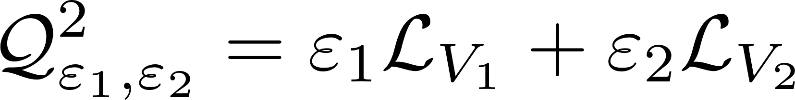
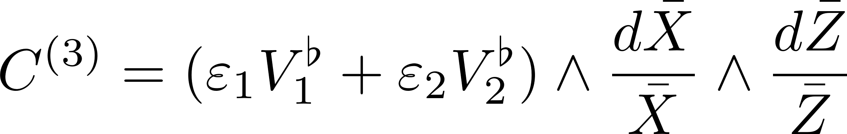
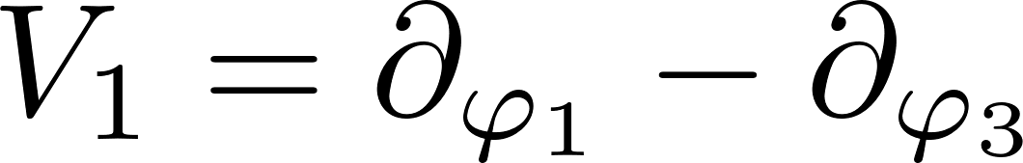
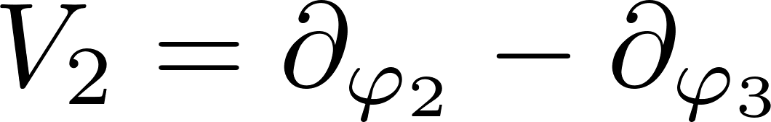
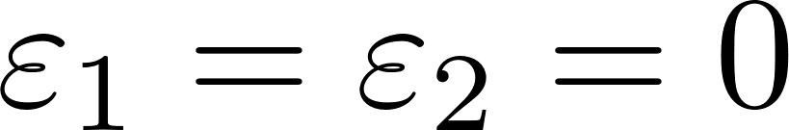
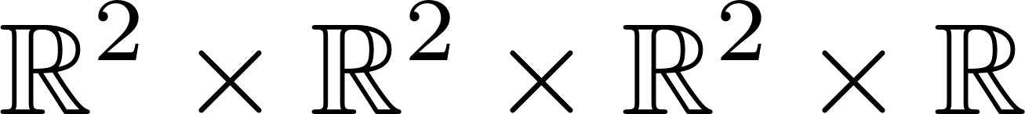
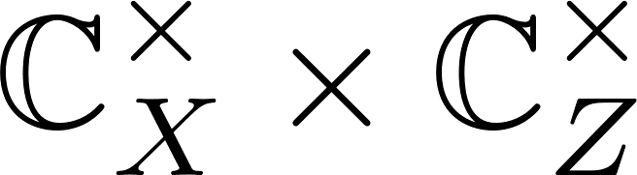
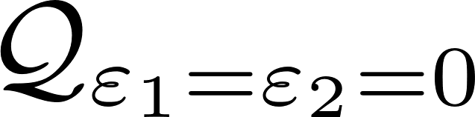
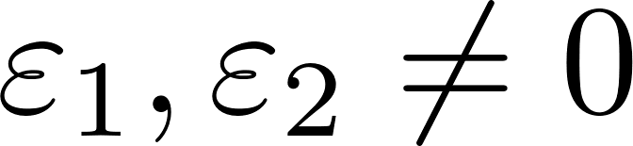
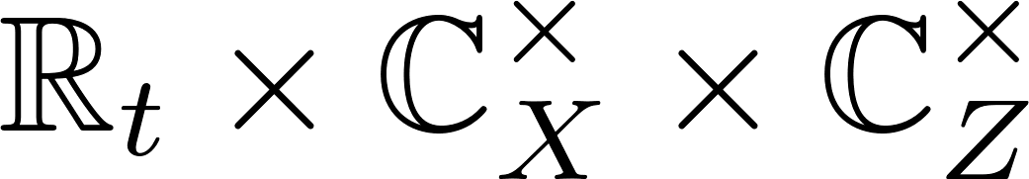
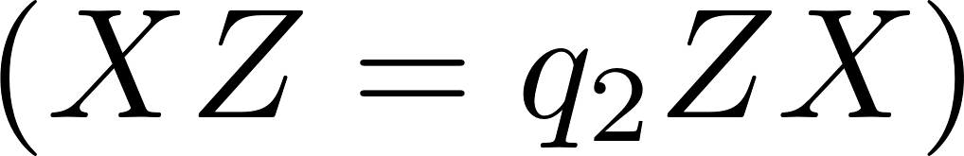
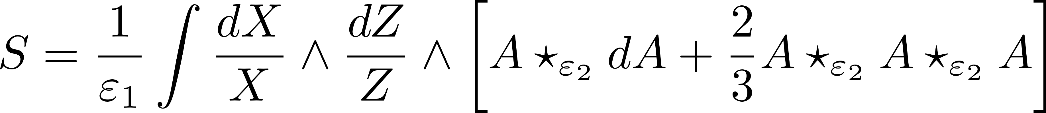
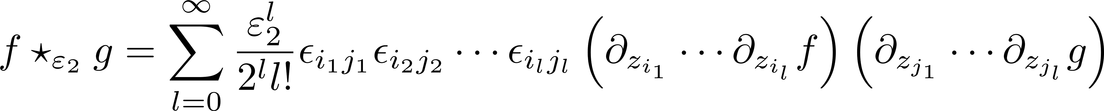
Twisted M-theory
[Costello 16]
Consider the M-theory on the 11-dimensional worldvolume with
Flat metric
Ω-background
When , is topological and is holomorphic in the cohomology of
Turning on , the 11-dimensional supergravity localizes to the fixed point of the isometry, yielding the 5d Chern-Simons theory on as the effective theory.
Triality of exchanging topological planes, seemingly broken in the 5d CS

Slide 7
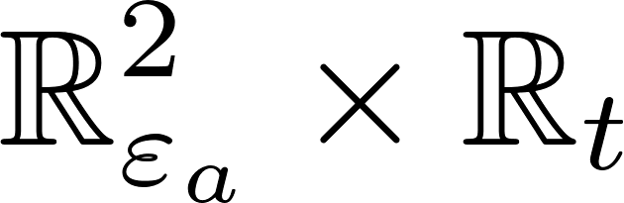
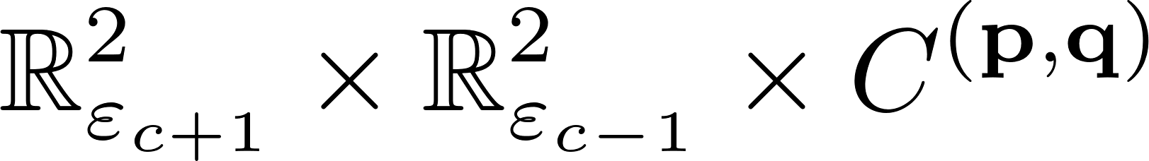
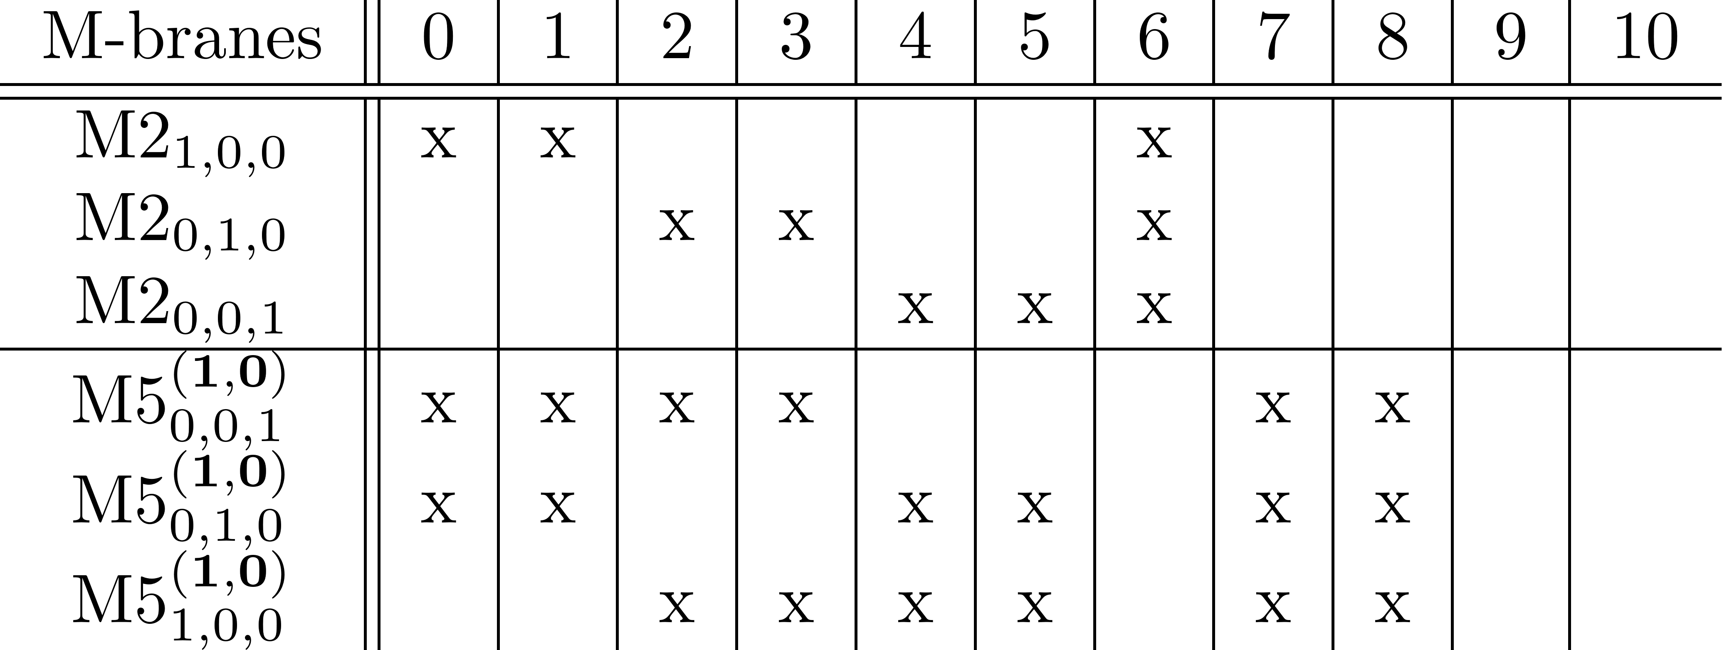
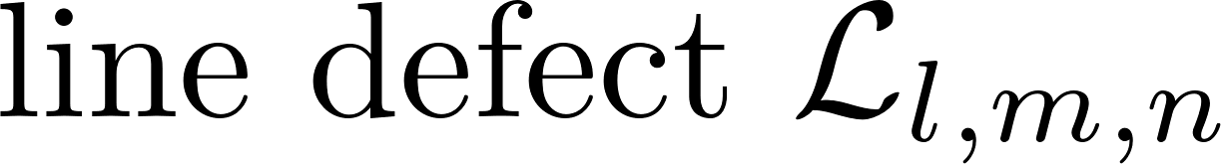
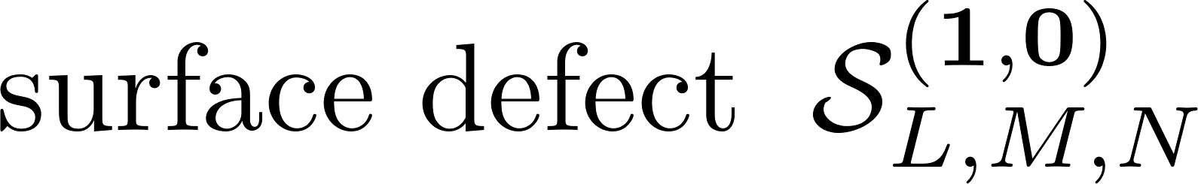
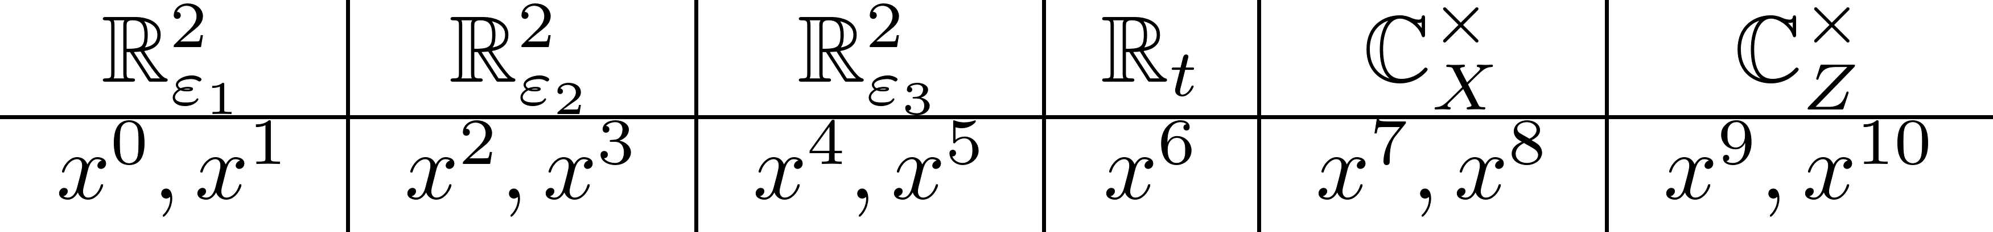
M-branes and line/surface defects
M2-branes can be supported on
M5-branes can be supported on
5d CS

Slide 8
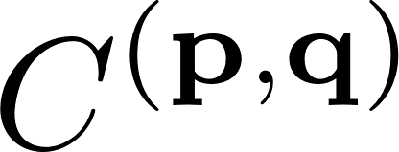
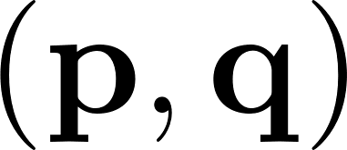
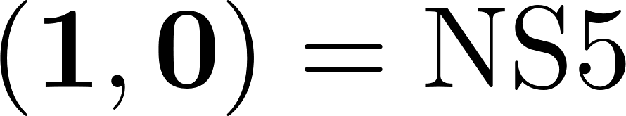
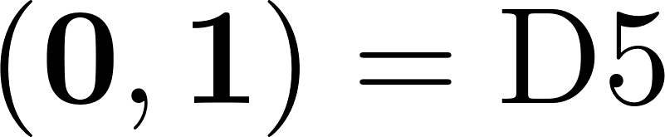
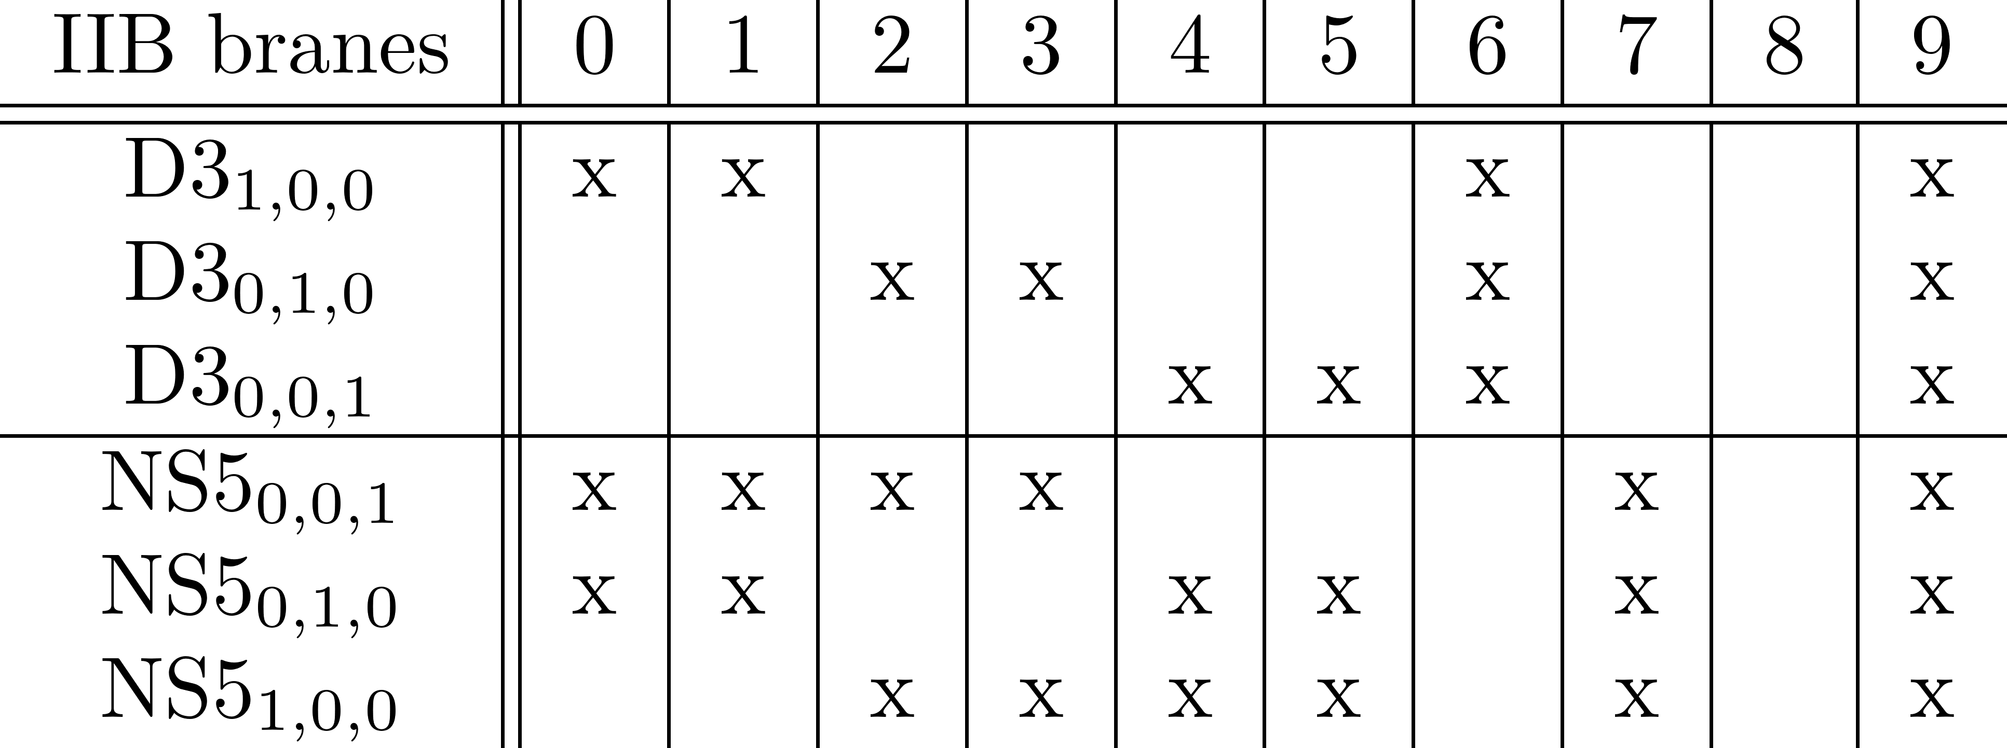
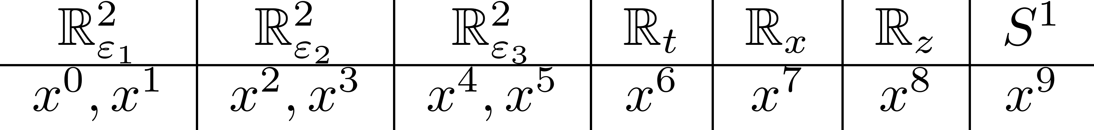
In a dual IIB frame,
M2-branes become D3-branes
M5-branes on become -fivebranes
cf. [Awata, Feigin, Shiraishi 11]
[Mironov, Morozov, Zenkevich 16],
[Bourgine, Fukuda, Harada, Matsuo, Zhu 17],
and many others

Slide 9
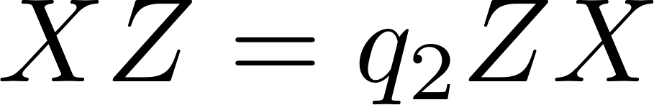
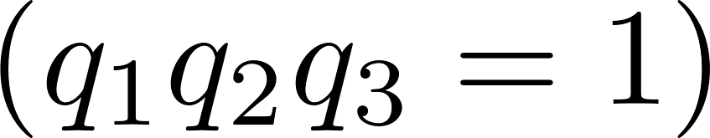
The gauge-invariance of the coupling requires the algebra of local operators on the line/surface defects to be a representation of some universal associative algebra (Koszul duality).
(for the surface defects, we only consider the mode algebra, not the (quantum) vertex algebra)
The suggestion is that, in our case, this universal associative algebra is the quantum toroidal algebra of gl(1):
Quantum torus algebra:
The demonstration requires perturbative analysis of the 5d CS. I will provide evidences.
cf. [Costello, Witten, Yamazaki 17]
[Costello 17]
[SJ, N. Ishtiaque, Y. Zhou 24]

Slide 10
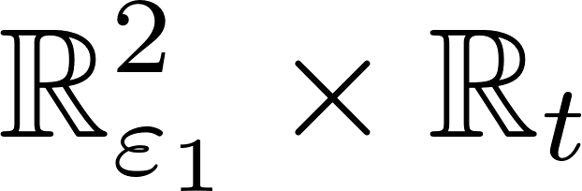


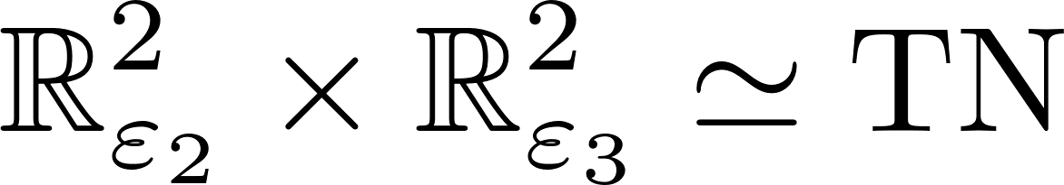
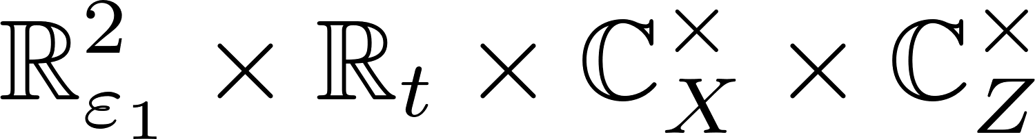
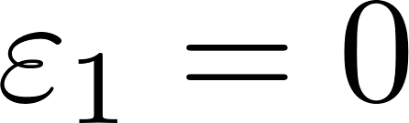
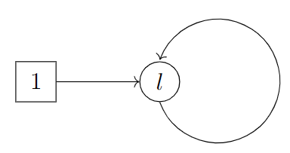
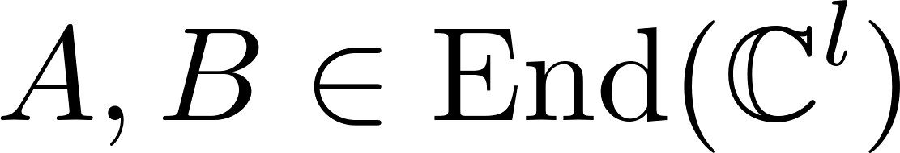
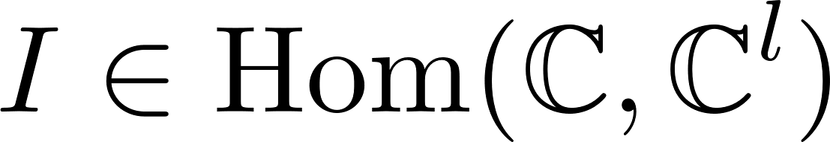
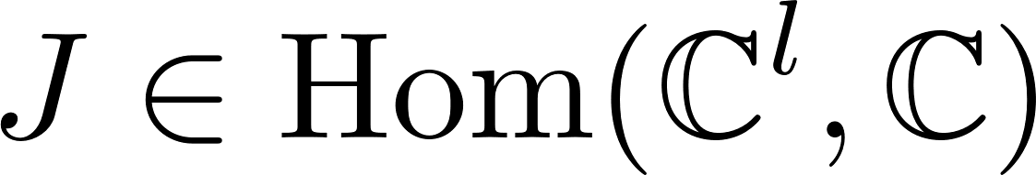
Line defects
D2 on
1 D6 on
parallel M2-brane supported on
At , the effective 3d N=4 theory on the D2-branes flows to the topological sigma model with the target space being the Higgs branch.

Slide 11
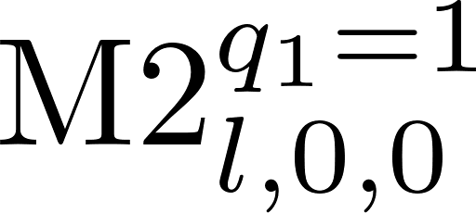
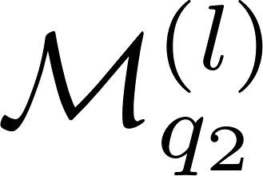
The Higgs branch is the multiplicative quiver variety associated to the Jordan quiver:
This is the phase space of the classical trigonometric Ruijsenaars-Schneider model of type gl(l)
Thus, the algebra of local operators is the commutative algebra of holomorphic functions on

Slide 12
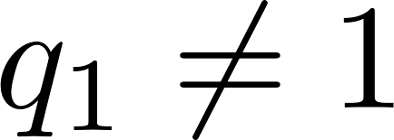
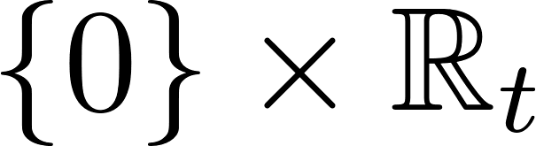
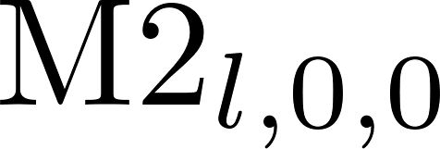


By turning on , the 3d theory localizes to the fixed locus . The algebra of local operators gets non-commutative deformation.
[Yagi 14]
This quantized algebra is called spherical DAHA of type gl(l) , generated by the difference operators (Macdonald representation),
[Jordan 14], [Wen 23]

Slide 13


Quantum toroidal algebra of gl(1)
At each , there is a surjective algebra homomorphism
[Schiffmann, Vasserot 11]
In this sense, the quantum toroidal algebra of gl(1) is the “large-N” limit of the M2-brane algebra, i.e., spherical DAHA.
Moreover, it is explicitly triality-invariant. The natural guess is therefore it is the universal associative algebra.

Slide 14






Quantum toroidal algebra of gl(1)
Generating currents:
Relations:
Triality of exchanging

Slide 15


Coproduct
Bi-grading:

Slide 16

At each , there is a surjective algebra homomorphism
[Schiffmann, Vasserot 11]

Slide 17
















Defect fusion and coproduct
Two line defects can be fused together to become single line defect:

Slide 18






In the most generic case, we have non-parallel M2-branes:
M2-branes supported on
M2-branes supported on
producing the line defect
M2-branes supported on
We can reconstruct the algebra by fusing three line defects:
generalized Ruijsenaars-Schneider representation
generalized Macdonald representation

Slide 19


Slide 20








Surface defects
Single M5-brane supported on : a free q-boson

Slide 21






Multiple parallel surface defects can be fused together into single surface defect.
q-deformed W-algebra

Slide 22




Multiple non-parallel surface defects can be fused together into single surface defect.
q-deformed Y-algebra

Slide 23







M2-M5 intersections and R-matrices
Classically,
Quantum mechanically,

Slide 24





From universal R-matrix to Miura operators
The quantum toroidal algebra of gl(1) has the universal R-matrix:
Using the Drinfeld double construction, it can be expressed as a product
[Garbali, Neguţ 21]
The generic expressions for the higher terms are not available as of now, due to the lack of
understanding of the Poincaré-Birkhoff-Witt (PBW) basis of

Slide 25


However, we do not need the generic expression of the universal R-matrix for our purpose. We only need the ones mapped to the representations associated to M2- and M5-branes.
Namely, we consider
The constraints can be solved recursively, yielding

Slide 26


Importantly, in the transverse case ,

Slide 27






R-matrices concatenate under the coproduct operations:
The relation implies:
Expanding it in the generators of gives the generators of

Slide 28








M2-M5 intersections and Intertwiners
Trivial line defect
counit

Slide 29




M2-M5 intersections and Intertwiners
Trivial line defect

Slide 30



This constraint can be solved:
[Feigin, Hashizume, Hoshino, Shiraishi, Yanagida 09]

Slide 31




Non-transverse R-matrices from intertwiners

Slide 32







Screening charges from finite M2-branes
There are only two cases for any two adjacent M5-branes:

Slide 33


The screening charges can be exactly specified:

Slide 34
Ordering-independence by Yang-Baxter equation
Consider the R-matrices between q-boson representations:
We may call them q-deformed Maulik-Okounkov R-matrices.
cf. [Fukuda, Harada, Matsuo, Zhu 17], [Garbali, de Gier 20],
[Negut 20], [Garbali, Negut 21]
The universal Yang-Baxter directly implies the change of ordering of Miura operators yields equivalent Miura transformation up to the conjugation of this R-matrix:

Slide 35





Multiple M2s and single M5
The relation implies:

Slide 36
Also…
Web of transversally intersecting M5-branes, and M2-branes (namely, the Miura operators) on this web: qq-characters.
[Nekrasov 15]
In a IIB dual frame, the M5s are mapped to (p,q)-fivebranes and M2-branes are mapped to D3-branes. In the talk, we had NS5-branes only and D3-branes passing through them. This is the brane engineering of 3d quiver gauge theory with some 1d defects. Its half-index is shown to reproduce the Miura transformation.

Slide 37
Thank you!

